Slide 1
Searching for Dark Photon Dark Matter with Cosmic Ray Antideuterons
Lisa Randall
(w/Linda Xu)
Mary K Fest Sept, 2019

Slide 2
Why Antideuteron Searches
“Indirect detection” one of three pillars of WIMP searches
Antiparticle and distinctive photon signatures have potential to find unusual cosmological processes
What to look for?
Positrons, photons, antiprotons
However, few DM models favor first two
More importantly, background difficult to calculate
“Discoveries” have taught us some interesting unanticpated astronphysics
Antiproton searches promising, but background big there too
Antideuteron searches for same type of dark matter as antiprotons
But background low at small kinetic energy (astro background higher KE)
Makes it a potentially essentially background free measurement
Only a few detections suffice for discovery

Slide 3
Why So Little Background?
Assuming proton collides with X in ISM,
To make an antiproton, at least four nucleons in final state
To make an antideuteron, you need at least six
Threshold energy
First case 7 mp
Antideuteron 17 mp
Binding energy is 2.2 MeV
Hard to slow down without dissociating
Low background targets are good places to search
DM annihilations usually close to at rest
Possibility antiproton and antineutron produced with relatively small momentum difference
In which case can coalesce
Rare process
But background calculable and essentially nonexistent (for low T)

Slide 4
Is anyone looking? Yes!!
In principle AMS II
General AntiParticle Spectrometer (GAPS)
Antarctic balloon mission
Looks for antideuteron <0.25 GeV/n
Uses an exotic atom technique
Slow low energy antiparticles so they get captured by a nucleus
Exotic atom decays emitting X-ray
Correlated pion, proton from subsequent nuclear annihilation

Slide 5
GAPS
Long duration balloon experiment
Antideuterons captured and result in exotic atom in final state
Decays into X-rays at well-defined energies
Plus a correlated pion signature
Time of flight detection to tag events and particle velocities
Distinguish from eg antiprotons
Si/Li detctors for X-ray resolution and particle tracking
Schedule
2011 prototype
2014 full experiment from Antarctica

Slide 6
That was then. This is now.
Last slide from talk in 2010
Even then struggling to see which direct dark matter models permitted in light of direct detection
But…
GAPs now planned for 2020/21
What can it do?

Slide 7
WIMP status?
Dark Matter searches important but so far negative results
WIMPs based on thermal relic density compelling
But constrained if directly interacting with SM
Viable option: Hidden Sector Dark Matter
DM annihilates to other dark particles
They in turn annihilate to SM
Dark gauge fields most promising

Slide 8
Dark Matter/Dark Photon
Dark photons mix with SM photon
Permits Cascade annihilation if kinematically allowed
Energy injected into radiation, leptons, baryons
Provide constraints and detection prospectsas we will see
We will argue antideuterons probe an as-yet unexplored mass range
Tens of GeV

Slide 9
Dark Photon Dark Matter

Slide 10
Relevant Feynman Diagrams

Slide 11
Constraints from Previous Measurements
Indirect detection provides bulk of constraints
Mass vs cross section
Limits on CMB energy injection
Limits from photon searches
Limits from antipositrons
Limits from antiprotons

Slide 12
Current Bounds

Slide 13
Constraints on Mixing ϵ
Indirect detection essentially independent of mixing
Upper bounds mostly from Direct Detection
Production essentially insensitive to ϵ
Lower bounds to avoid BBN interference
Also bound for observability
Don’t escape halo before froming antideuterons

Slide 14
Indirect Detection Constraints

Slide 15
Other light dark photon dark matter searches

Slide 16
Antideuteron
We will show can probe tens of GeV range through antideuteron searches
Challenge to theorist is correctly predicting
Lots of uncertainties as we will discuss
Still very promising

Slide 17
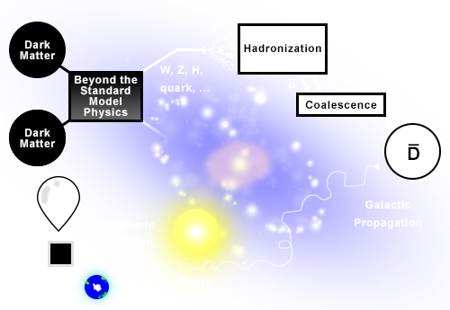
Theory Challenges

Slide 18
Theory Steps
Need to compute injection
Compute antideuteron formation
Coalescence model
Background: pp->pppbar, ppnbar
Monte Carlo
Annihilation to quarks, gauge bosons
Subseqeuent hadronization and fragmentation
K_{n}- k_{p}<(2m_{p}B)^{1/2}~70MeV,~p_{coal} most likely form antideuteron
Use data from Z decay
p_{coal}~150MeV
Diffusion and convection of cosmic ray density
Transport in solar environment: modulation and structure of magnetic field

Slide 19
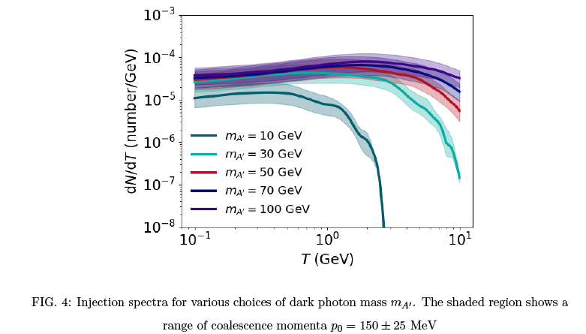

Slide 20
Also Need Halo Profile
These results we use Einasto
Less important than sensitivity to transport parameters

Slide 21
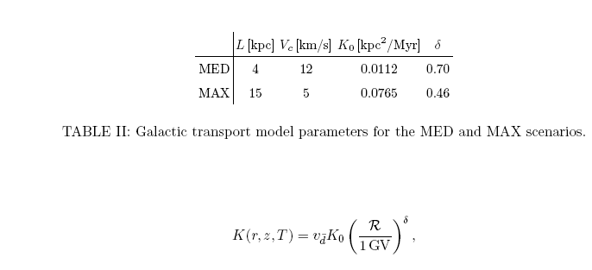
Propagation Through Galaxy and Heliosphere
Need transport through
ISM and
Heliosphere (ToA; top of atmosphere)
Again phenomenological parameter choices
Use diffusion model

Slide 22
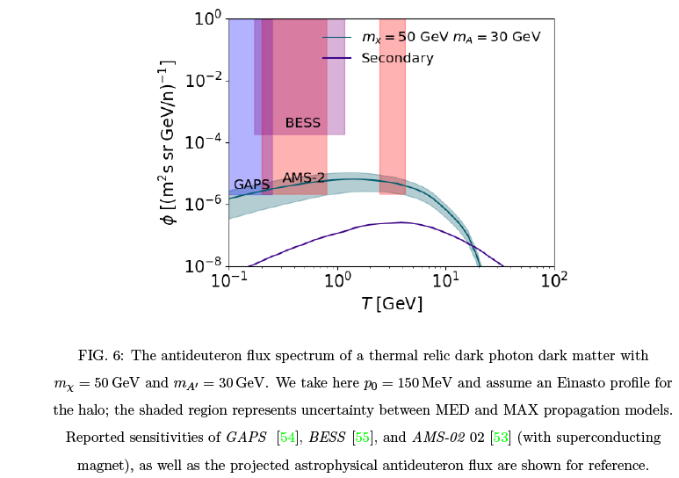
Results

Slide 23
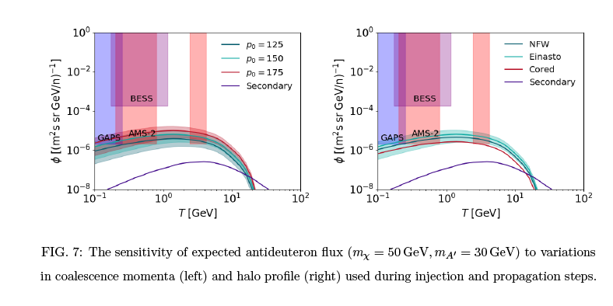
Variation with Parameters

Slide 24
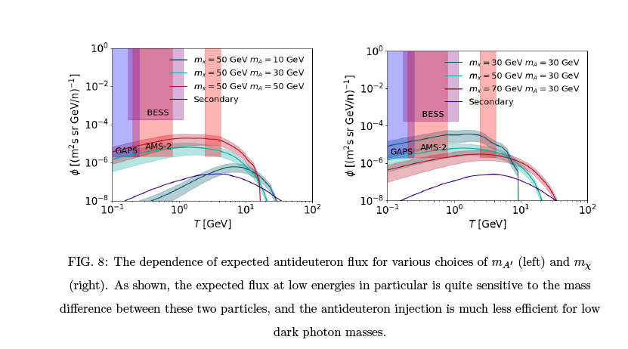
More Results

Slide 25
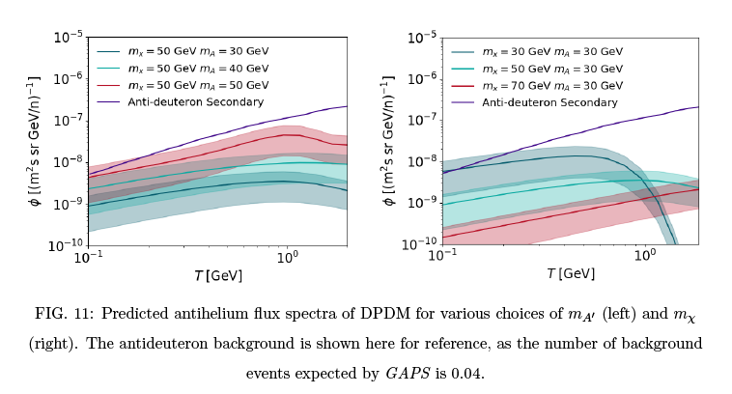
Antihelium? Who knows…

Slide 26
Conclusion
Dark matter (by definition) elusive
We should look in all ways possible
Models play a big role—suggest new searches
Dark photon dark matter receives a lot of attention
WIMP still possible
But hard to find
Antideuteron promising for interesting tens of GeV range
Not necessarily all parameters but sizable reach
Discovery possible!
Hopefully launch successfully soon!

Slide 27
Extra Slides

Slide 28
Results

Slide 29
Injection Spectra

Slide 30
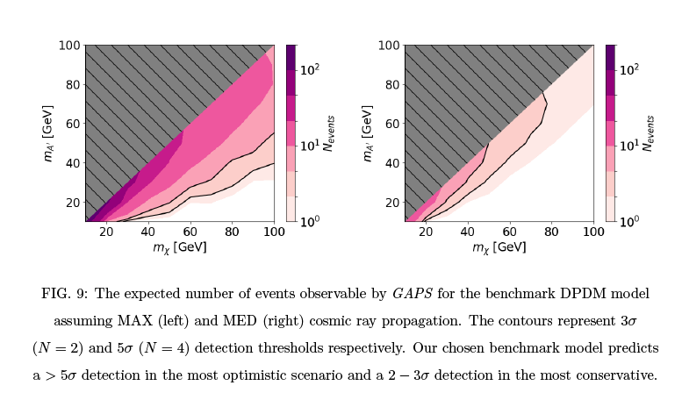
How Many Events?

