Slide 1
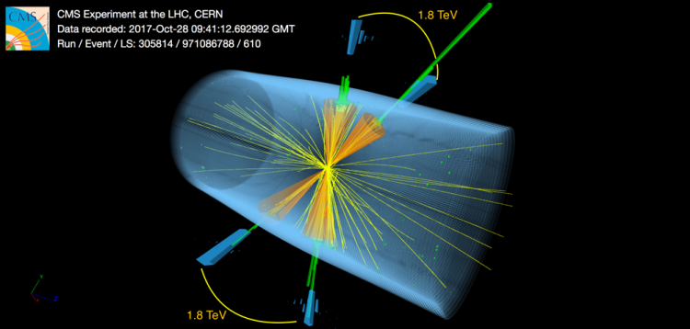
Techniques for hadronic decays of ultra-heavy resonances decaying to vector-like quark pairs
Ethan Cannaert & John Conway
University of California Davis
On behalf of the CMS Collaboration
BOOST Conference 2023
image source

Slide 2
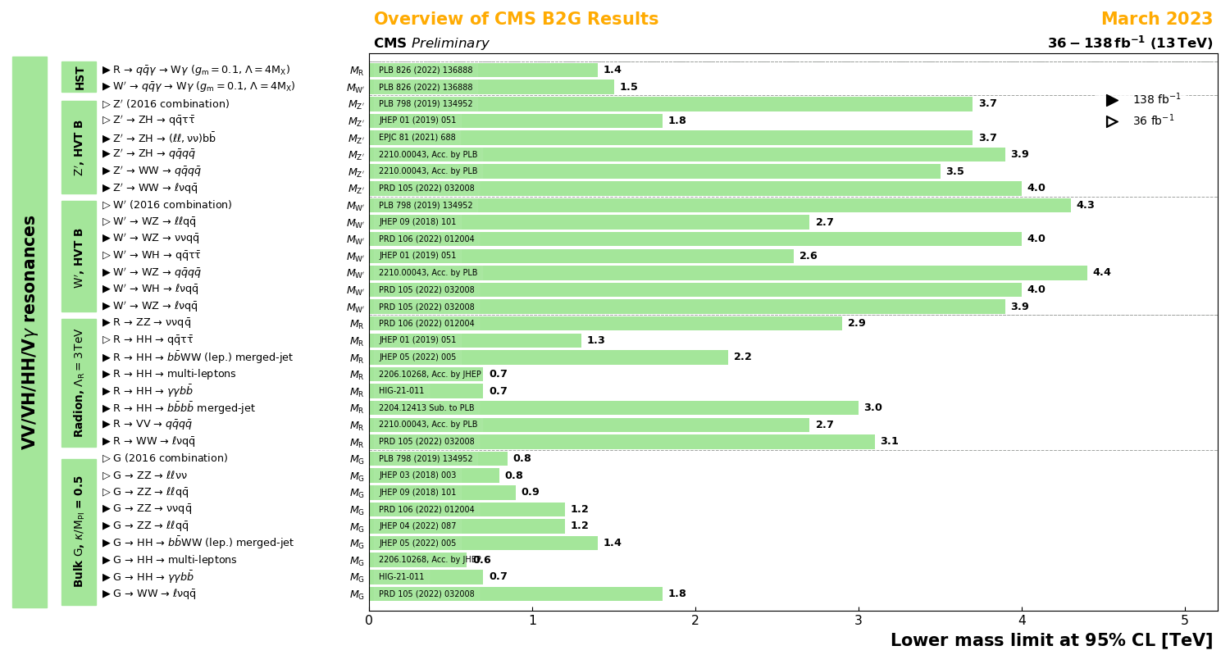
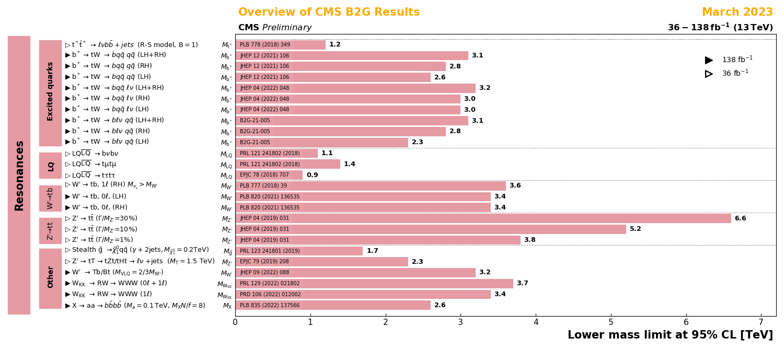
Resonance Searches in Run 2
Run 2 CMS analyses extended our limits on many resonance searches up to several TeV and beyond
Much of the possible phase space has been covered
Check out more CMS B2G analyses!
Is new physics hiding in plain sight or on the horizon?
What is the limit of what can be discovered at the LHC?
Run 2? Run 3?

Slide 3
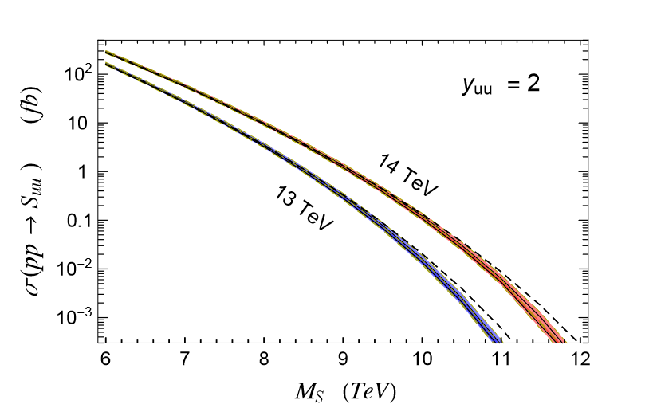
Resonances in Run 3
With Run 3 underway, it’s an exciting time to be studying ultra-heavy resonances!
Increased luminosity and ~4.5% increase in energy that significantly enhances many of these processes
Exploring the laws of nature with CMS, Dobrescu 2020

Slide 4
Resonances in Run 3
With Run 3 underway, it’s an exciting time to be studying ultra-heavy resonances!
Increased luminosity and ~4.5% increase in energy that significantly enhances many of these processes
Exploring the laws of nature with CMS, Dobrescu 2020

Slide 5
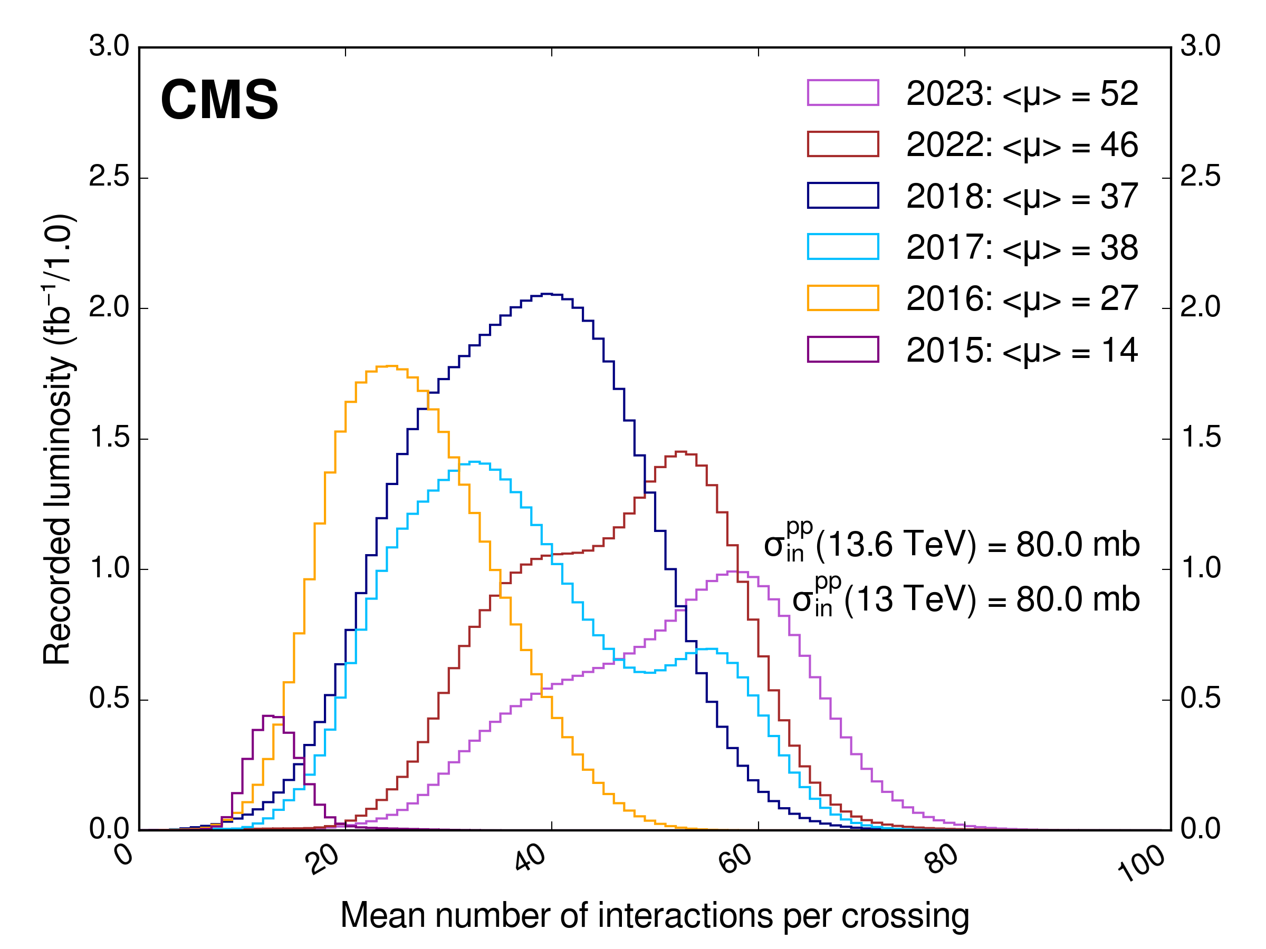
Challenges in Run 3
Increased pileup $→$ increased jet multiplicity that complicates jet sorting
Increased energy $→$ more highly boosted events with many overlapping jets
Conventional techniques often break down at high energies
e.g. b-jet identification loses efficiency at high $p_{T}$
If you are looking at fully hadronic channels, these are all challenges that need to be considered
On top of this, there is often a large phase space to cover
New techniques must be flexible to various kinematics yet robust enough to function at high energy
Above: Distribution of the average number of interactions per crossing (pileup) for pp collisions at the LHC for years 2011-2012, 2015-2018 and 2022-2023. Source: Public CMS Luminosity Results, The CMS Collaboration, 2023, link to luminosity results

Slide 6
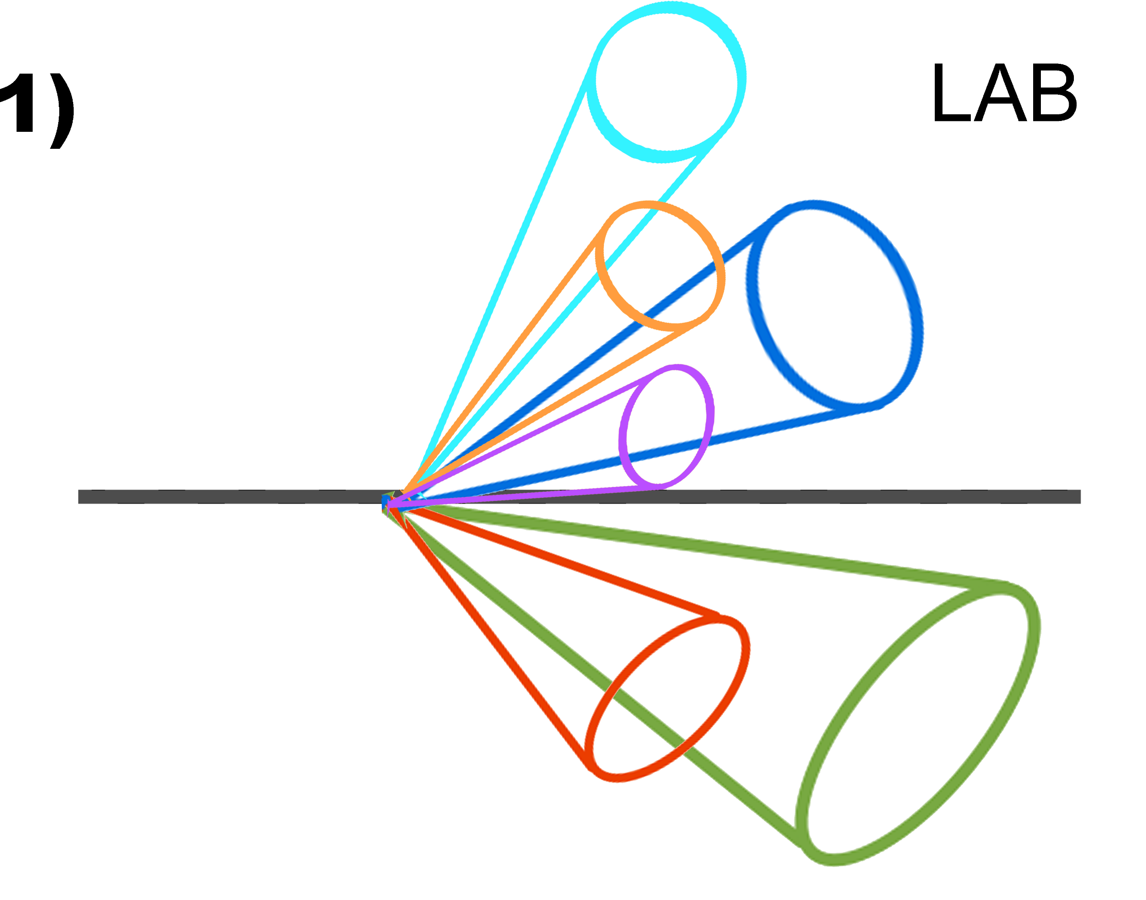
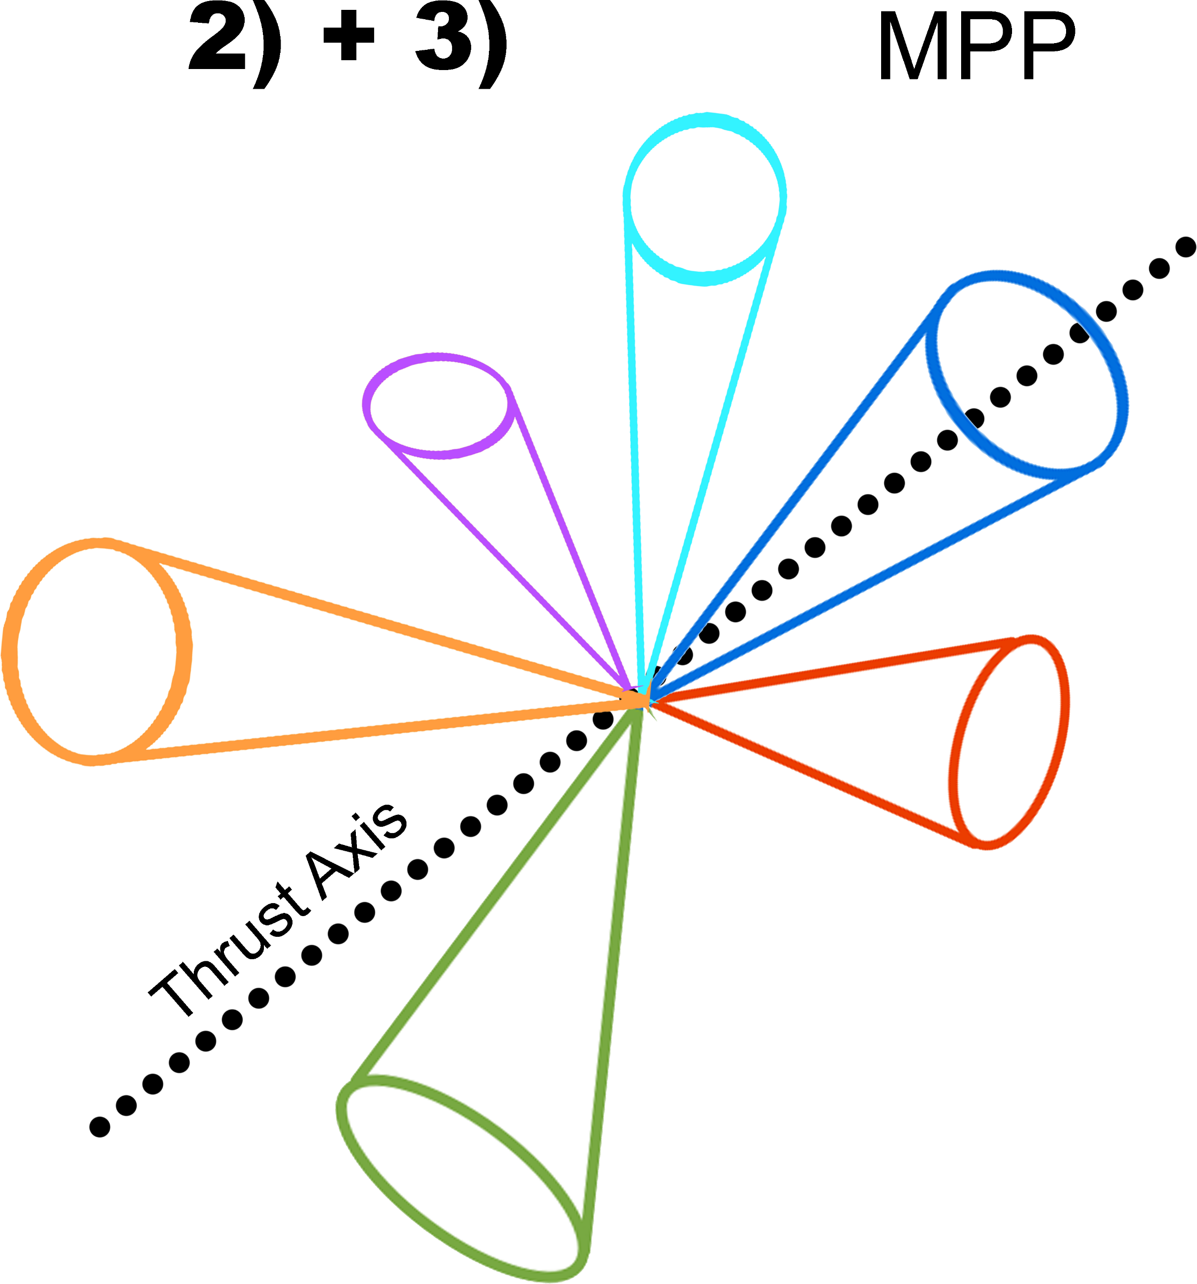
A New Geometric Jet Sorting Technique!
We have been working on a new technique to study complex, pair-produced processes in Run 2
Goal
Use event geometry to reconstruct hadronic decays of heavy pair produced signals
Maintain maximum flexibility to account for many models and levels of jet merging
Applicable to any pair-production process
Algorithm Steps
Select high $H_{T}$ (> 1.5 TeV) events with many jets
How loosely will jets be selected?
Boost all jet particles along their axis to the frame that minimizes parallel momentum (MPP frame)
Recluster particles into new AK8 or CA8 MPP jets
This resolves jets that were merged in the lab frame and gives the opportunity to shed soft radiation that gets clustered into the original jets
New jets!
(continued)

Slide 7
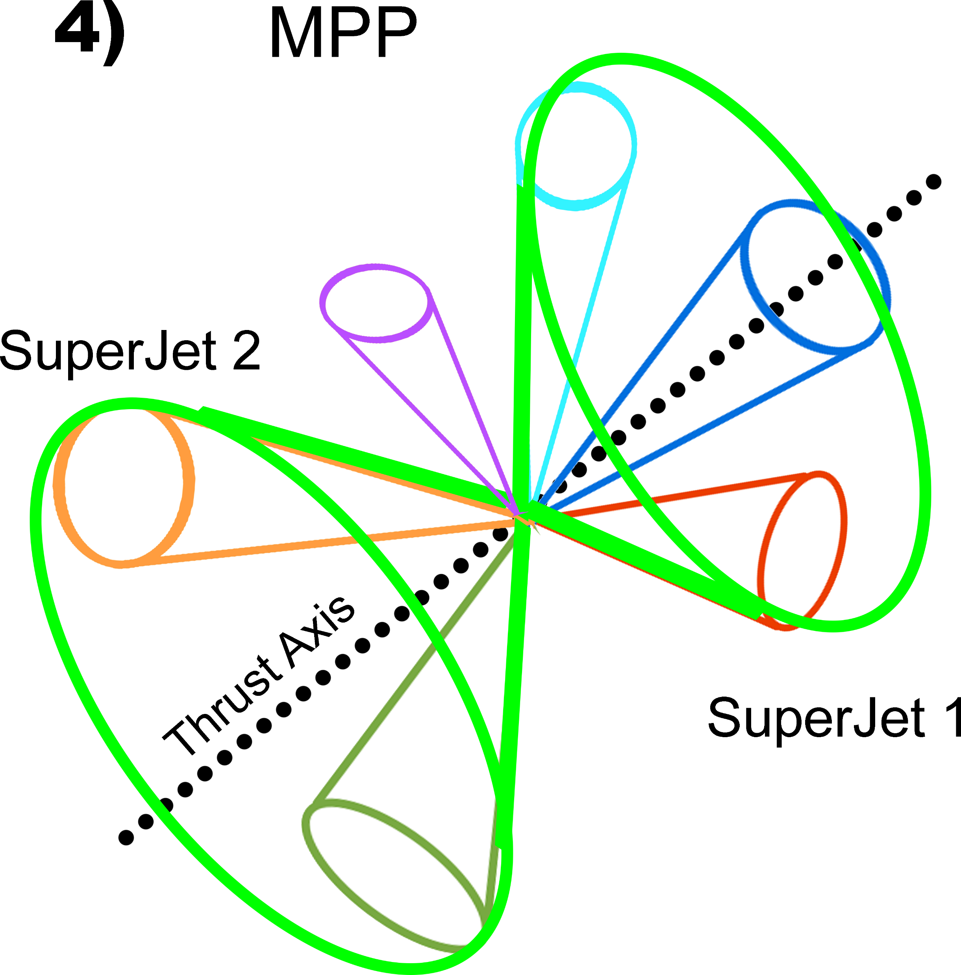
Sorting Technique Continued
*Thrust $=\max_{\left|n\right|=1}\frac{\sum_{i}{|n• p_{i}|}}{\sum_{i}{| p_{i}|}}$, [9]
Calculate the MPP thrust* axis.
This should split the event into hemispheres
Sort jets into two “superjets” from their angles relative to the thrust axis.
Nearly perpendicular jets sorted to balance superjet mass
Boost superjets to their COM & recluster particles into smaller (AK4 or CA4) jets
4) & 5)
superjet 1 COM
superjet 2 COM
6)
superjet COM
If everything went well, you’ll have two sorted superjets representing your daughter pair
Looking at substructure is a powerful tool for discriminating against backgrounds
MPP frame event shape
superjet COM event shapes
Stray particle

Slide 8
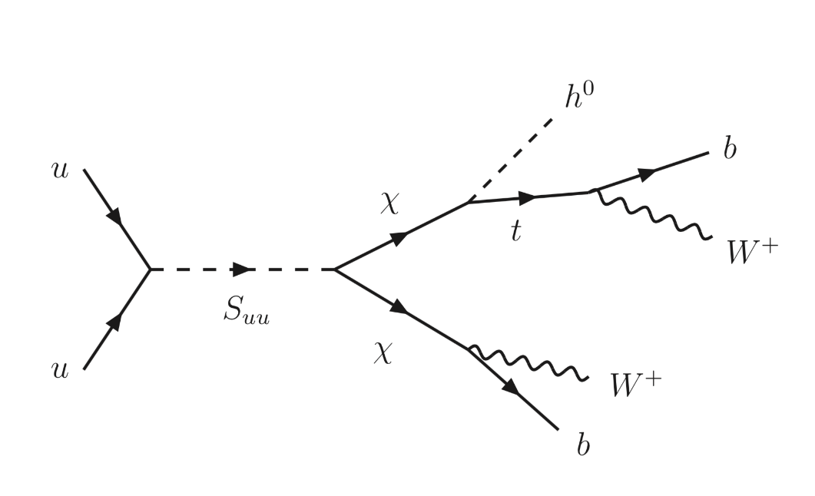
Our Pet Process - $S_{uu}→χ$ $χ$
The $S_{uu}→χ$ $χ$process provides a fantastic opportunity to put this technique into practice
$S_{uu}$ - diquark, ultra-heavy resonance, couples to up quarks
χ – vector-like quark
decays to $W^{+}$b, Z t, h t
Relatively large σ at LHC means there is potential for Run 2 discoveries up to $M_{S_{uu}}$= 8 TeV
Many complex hadronic final states with different levels of jet merging
Main backgrounds – QCD multijet & top pair production
* $S_{uu}→χ$ $χ$ model source: Bogdan Dobrescu, Robert Harris and Joshua Isaacson, FNAL

Slide 9
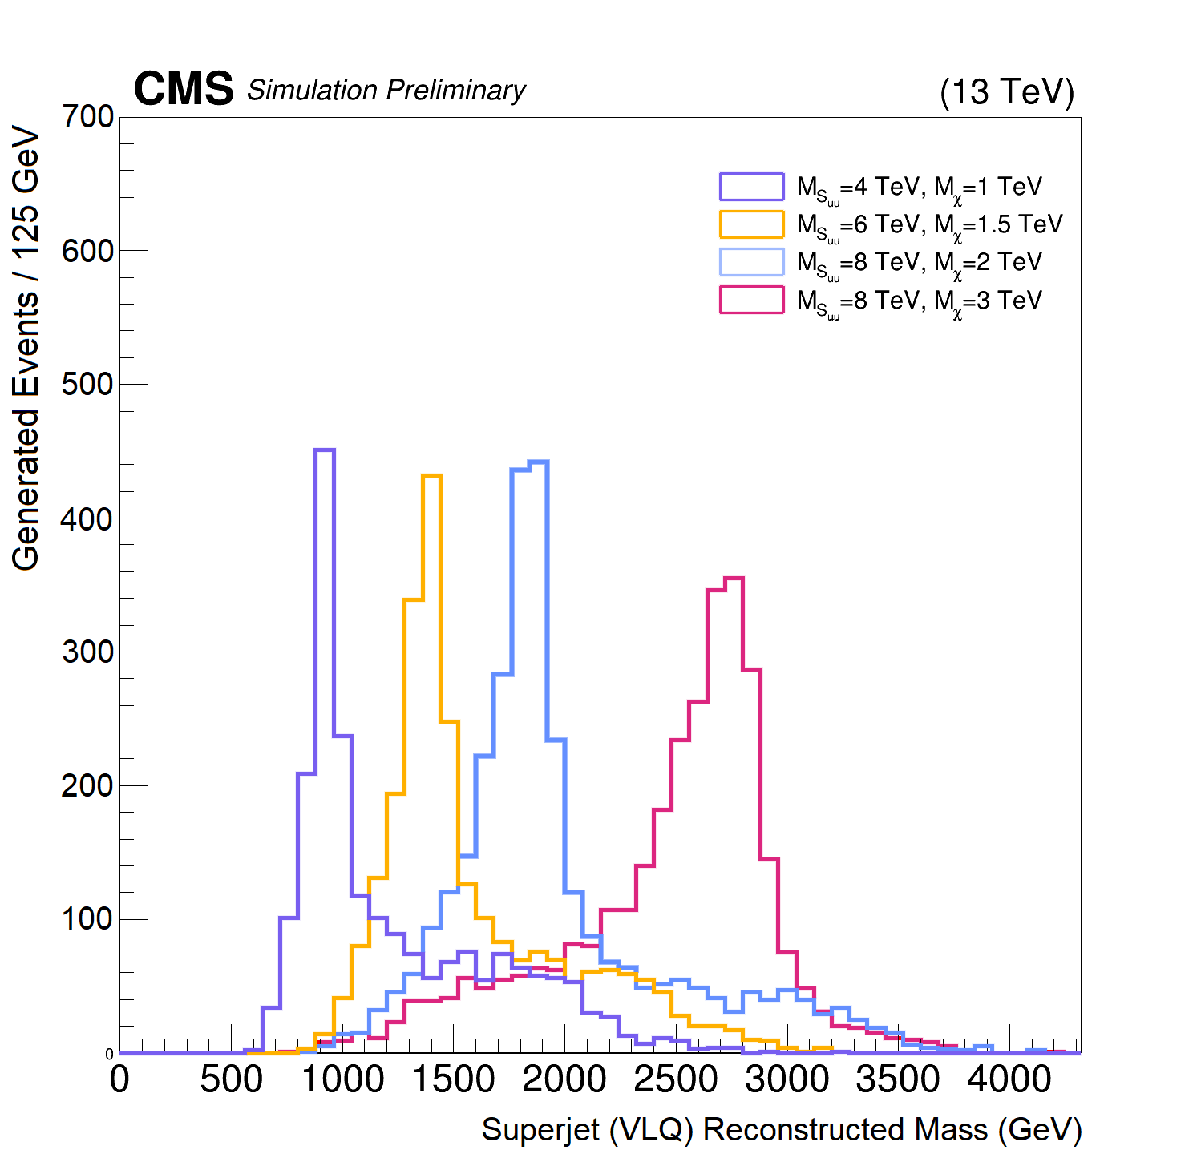
Sorting Algorithm on MC
How well does this work with reconstructed jets?
Define some baseline cuts to target the hadronic channel
Initial Selection
Lepton veto
Event $H_{T}$ > 1500 GeV
3+ AK8 jets
2+ heavy AK8 jets ($M_{PUPPI, SoftDrop}$> 45 GeV) or two dijet pairs w/ $M_{dijet}$ > 1 TeV
1+ tight b-tagged AK4 jet
Tests on $S_{uu}→χ$ $χ$ simulation samples for various${ M}_{S_{uu}}$ and${ M}_{χ}$ combinations show high resolution in${ M}_{χ}$ reconstruction
${ M}_{S_{uu}}$: 4-8 TeV, ${ M}_{χ}$: 1-3 TeV
Backgrounds are not resonant, so superjet mass vs diSuperjet distribution can give extra signal sensitivity
Above: the average reconstructed superjet mass from this technique obtained from tests on various simulated $S_{uu}/$ $χ$ mass combinations.

Slide 10
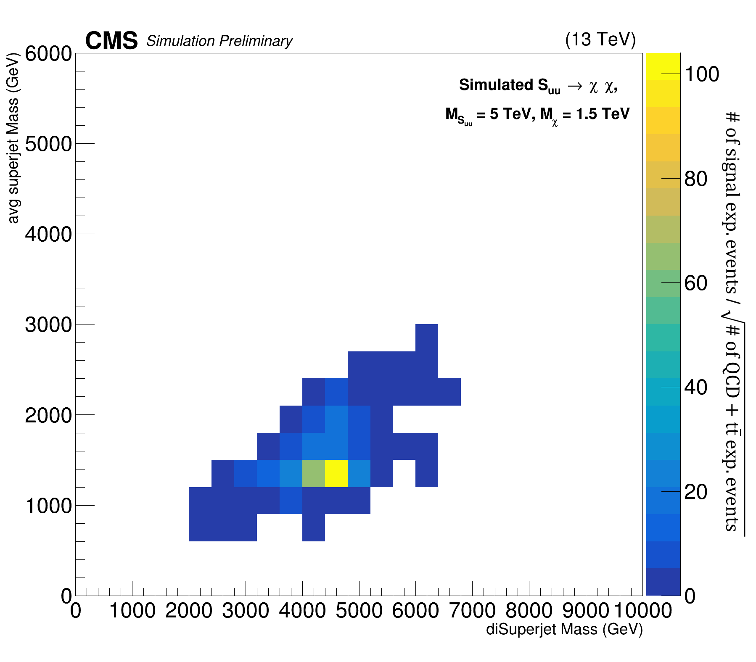
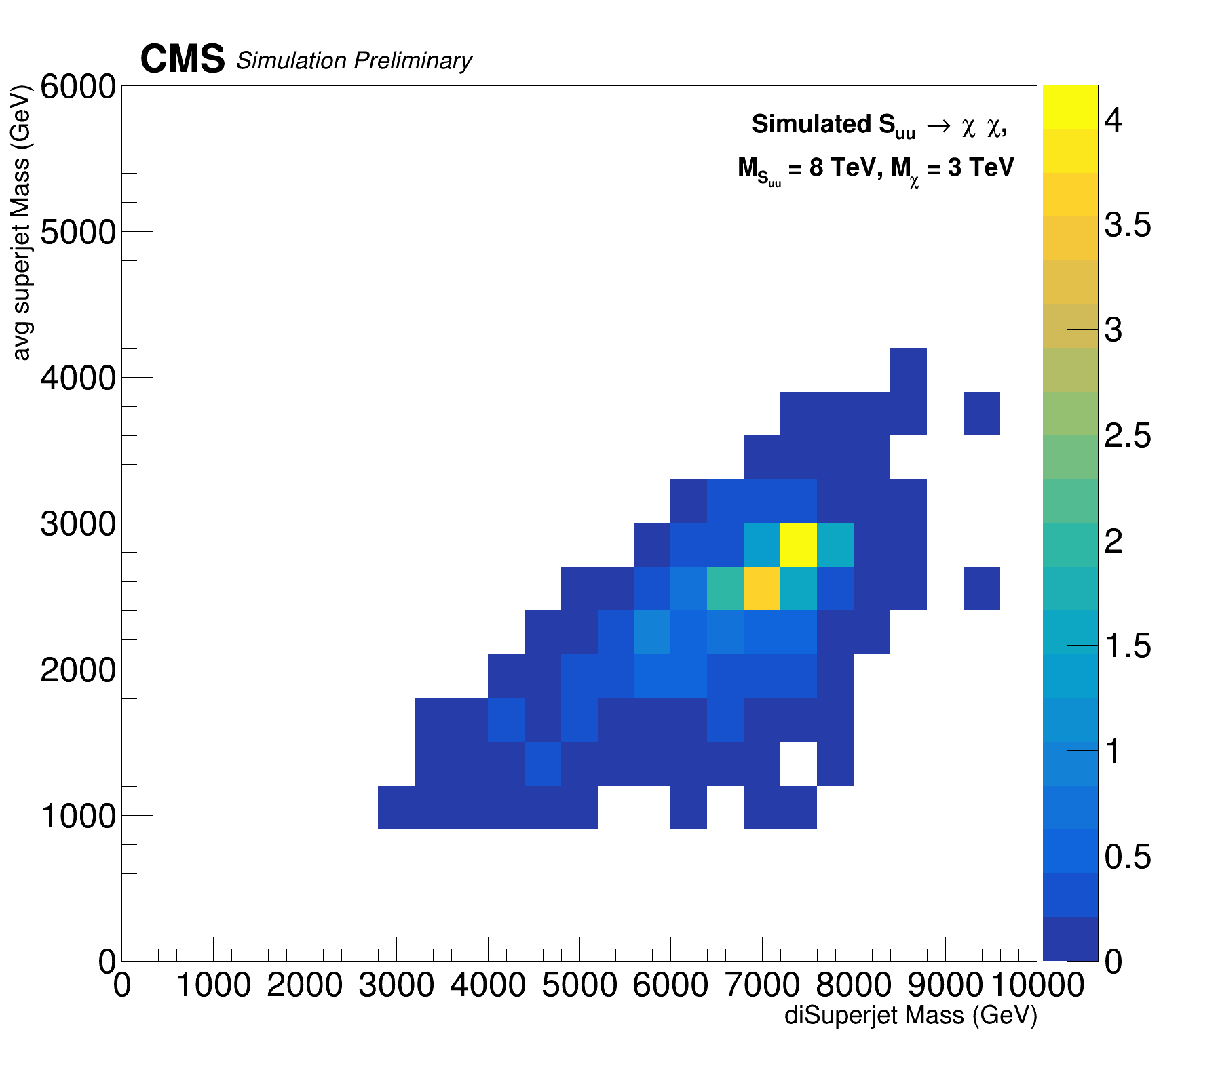
Sorting Algorithm on MC
Above: Expected signal sensitivity, given by $\frac{N_{signal events}}{\sqrt{N_{QCD+t\overline{t} events}}}$, from simulation for this technique as a function of the average superjet mass and diSuperjet mass. The distributions are shown for two different $S_{uu}/$ $χ$ mass combinations
Comparison of scaled signal to backgrounds (QCD &$t\overline{t}$) shows sensitivity greater than 4 in signal region up to 8 TeV in average SJ vs diSJ masses
$σ_{S_{uu}→χ χ}$ is only an estimate, but this gives us a lot of breathing room to float

Slide 11
Sorting Algorithm on MC
Above: Expected signal sensitivity, given by $\frac{N_{signal events}}{\sqrt{N_{QCD+t\overline{t} events}}}$, from simulation for this technique as a function of the average superjet mass and diSuperjet mass. The distributions are shown for two different $S_{uu}/$ $χ$ mass combinations
Comparison of scaled signal to backgrounds (QCD &$t\overline{t}$) shows sensitivity greater than 4 in signal region up to 8 TeV in average SJ vs diSJ masses
$σ_{S_{uu}→χ χ}$ is only an estimate, but this gives us a lot of breathing room to float

Slide 12
Future Additions & Summary
This technique has been designed with maximum adaptability in mind to accommodate any pair-produced model
Any number of jets are accepted as inputs
Steps are in place to counteract the effects of highly-boosted topologies
A new class of superjet substructure variables become available for study
Results on $S_{uu}→χ χ$ simulation show the ability to consistently reconstruct VLQ masses with reasonable resolution
The resulting signal sensitivities in the superjet vs diSuperjet plane and expected $S_{uu}$ cross-section facilitate Run 2 studies up to $M_{S_{uu}}$ = 8 TeV
Room remains to add sophistication
Iterative rounds of jet reclustering to remove unwanted particles
Machine learning for sorting jets and recognizing superjet substructure
Optimization of initial boost value of all jets
We hope the ideas we have worked on will be expanded and carried over to Run 3
In the meantime, keep an eye out for our $S_{uu}→χ$ $χ \text{Run}\text{ 2}$ analysis!

Slide 13
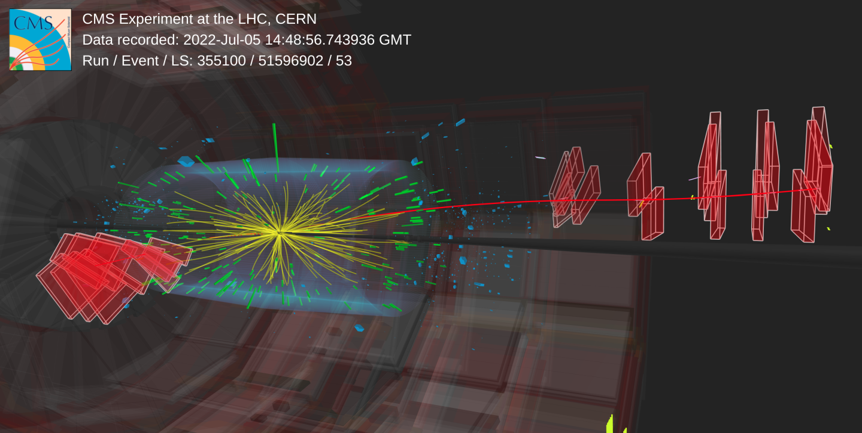
Good hunting in Run 3!
Image source

Slide 14
Thanks!

Slide 15
Glossary
η: pseudorapidity, defined as $η=−ln\left[tan\left(\frac{θ}{2}\right)\right]$ for polar coordinate $θ$.
AK8/AK4 jets: jets clustered using the anti-$k_{T}$ algorithm [1] with R parameters 0.8 and 0.4 respectively. All jet reclustering in this technique is done using the FastJet package [2].
$H_{T}$: the scalar sum of $p_{T}$ of AK4 jets with $p_{T}$>30 GeV and |η| < 2.5.
Vector-like quarks (VLQ): hypothetical particles that appear in many extensions of the Standard Model.
$S_{uu}$/diquark: a spin-0, ultra-heavy resonance coupling to up quarks [3].
$χ:$ a vector-like quark with decays to $W^{+}$b, h t, and Z t with branching fractions 0.5, 0.25, 0.25 respectively [3].
Jet energy corrections (JECs): corrections applied to jets to account for the detector effects.
Jet energy resolution (JER) corrections: corrections applied simulation jet energy distributions to account for lower energy resolutions in simulation than data.
pileup (PU): residual physics objects from events that are not of interest.
PUPPI: PileUp Per Particle Identification, a method for lessening the effect of pileup in the interactions of interest by scaling out particles that are likely from pileup [4],[5].
Softdrop (SD): a method of pileup mitigation that involves dropping soft, wide-angle radiation from jets [6].
$M_{PUPPI, SoftDrop}$: the invariant mass of a jet with PUPPI weights scaling each particle’s 4-vector and the Softdrop algorithm applied.
b-tagging: the process of identifying jets that came from b quarks. DeepJet/DeepFlavour is the b-tagging algorithm used in this note [7].
DeepTau: a deep neural network trained to identify tau leptons from other physics objects [8].

Slide 16
References
[1] M. Cacciari, G. P. Salam and G. Soyez, “The anti-kt jet clustering algorithm”, 2008, arXiv:0802.1189
[2] Matteo Cacciari, Gavin P. Salam, Gregory Soyez, "FastJet user manual", 2011, arXiv:1111.6097
[3] Bogdan A. Dobrescu, Robert M. Harris, Joshua Isaacson, “Ultraheavy resonances at the LHC: beyond the QCD background”, arXiv:1810.09429
[4] Daniele Bertolini, Philip Harris, Matthew Low, Nhan Tran, “Pileup Per Particle Identification”, 2014, arXiv:1407.6013
[5] CMS Collaboration, “Pileup-per-particle identification: optimisation for Run 2 Legacy and beyond”, 2020, CMS-DP-2021-001
[6] A. J. Larkoski, S. Marzani, G. Soyez, and J. Thaler, “Soft drop”, 2014, arXiv:1402.2657
[7] Emil Bols, Jan Kieseler, Mauro Verzetti, Markus Stoye, Anna Stakia, “Jet Flavour Classification Using DeepJet”, 2020, arXiv:2008.10519
[8] CMS Collaboration, “Identification of hadronic tau lepton decays using a deep neural network”, 2022, arXiv:2201.08458
[9] V. D. Barger, R. J. N. Phillips, “Collider Physics” Frontier in Physics, p. 284, 1997, Addison-Wesley Publishing Company, Inc.

Slide 17
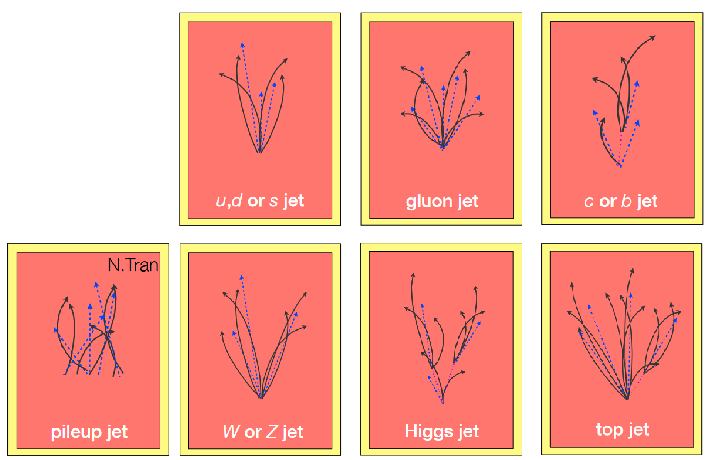
Challenges in Run 3
Increased energy $→$ busier, more highly boosted events with many overlapping jets
More pileup means increased jet multiplicity
Jet substructure, The CMS Collaboration, 2022
Imagine these jets all superimposed, overlapping, etc.

Slide 18
Analysis Regions
Signal Region
Lepton veto (medium IDs + isolations)
PFHT_1050 trigger pass + further 1500 HT cut
3+ AK8 jets (pT > 300 GeV, medium ID)
2+ heavy AK8 jets (M > 45 GeV) or two dijet pairs w/ $M_{dijet}$ > 1 TeV
1+ tight b-tagged AK4 jet
Require each SJ have 2+ recluster AK4 jets with E>300 GeV or be tagged by NN
QCD Control Region
Lepton veto (medium IDs + isolations)
PFHT_1050 trigger pass + further 1500 HT cut
3+ AK8 jets (pT > 300 GeV, medium ID)
2+ heavy AK8 jets (M > 45 GeV) or two dijet pairs w/ $M_{dijet}$ > 1 TeV
0+ tight b-tagged AK4 jet
Require each SJ have 2+ recluster AK4 jets with E>300 GeV or be tagged by NN
Anti-tag Region
Lepton veto (medium IDs + isolations)
PFHT_1050 trigger pass + further 1500 HT cut
3+ AK8 jets (pT > 300 GeV, medium ID)
2+ heavy AK8 jets (M > 45 GeV) or two dijet pairs w/ $M_{dijet}$ > 1 TeV
0+ tight b-tagged AK4 jet
One (randomly selected) SJ does not pass substructure cuts or is not tagged by NN
TTbar Control region - pending

