Slide 1
Probing the parton shower with multi-differential jet substructure measurements in pp collisions at STAR
Youqi Song (youqi.song@yale.edu)
for the STAR Collaboration
BOOST 2023, Berkeley, CA
8/2/2023

Slide 2
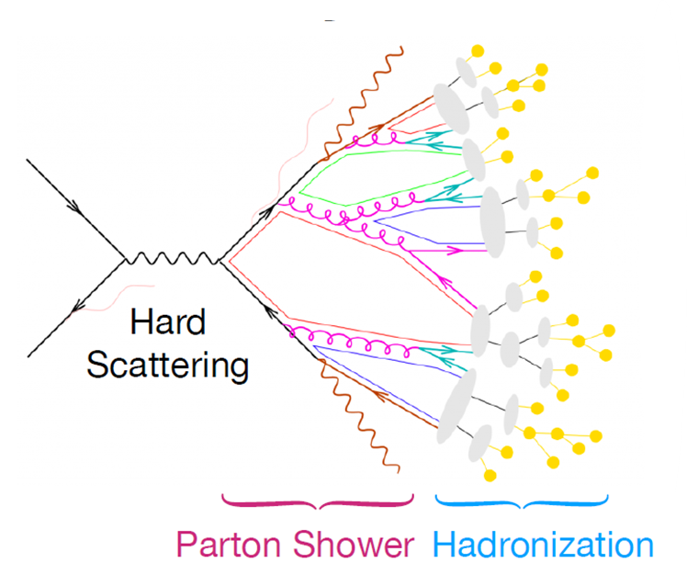
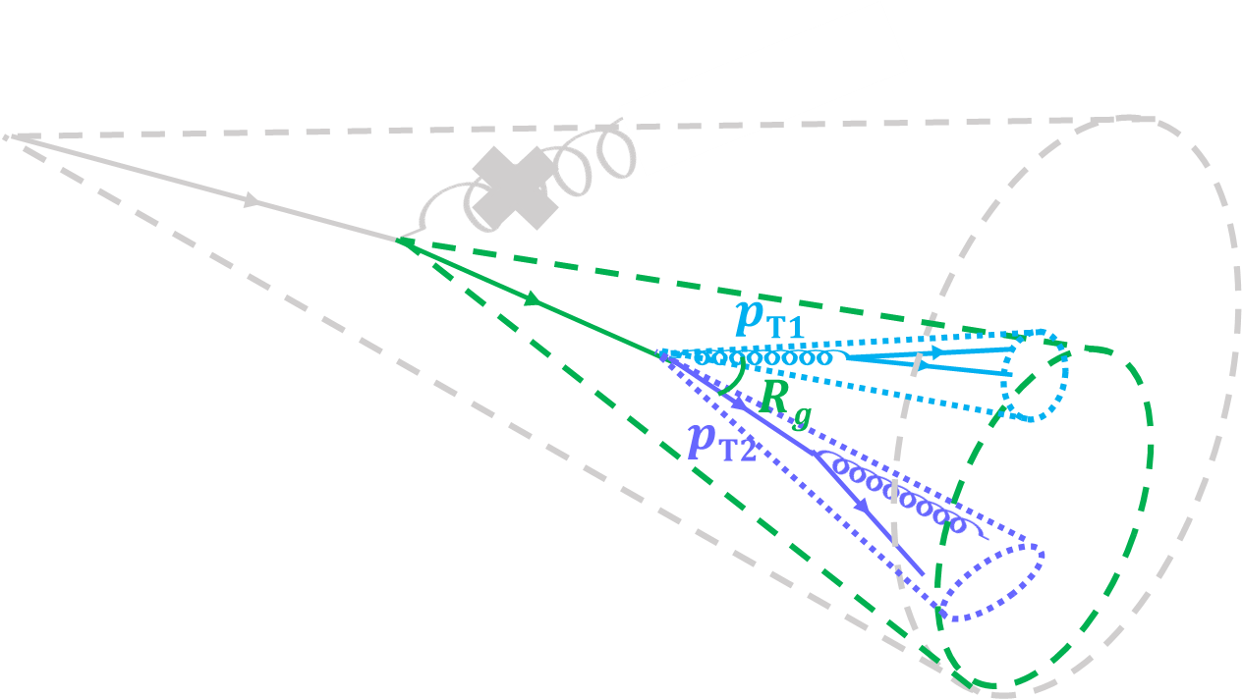
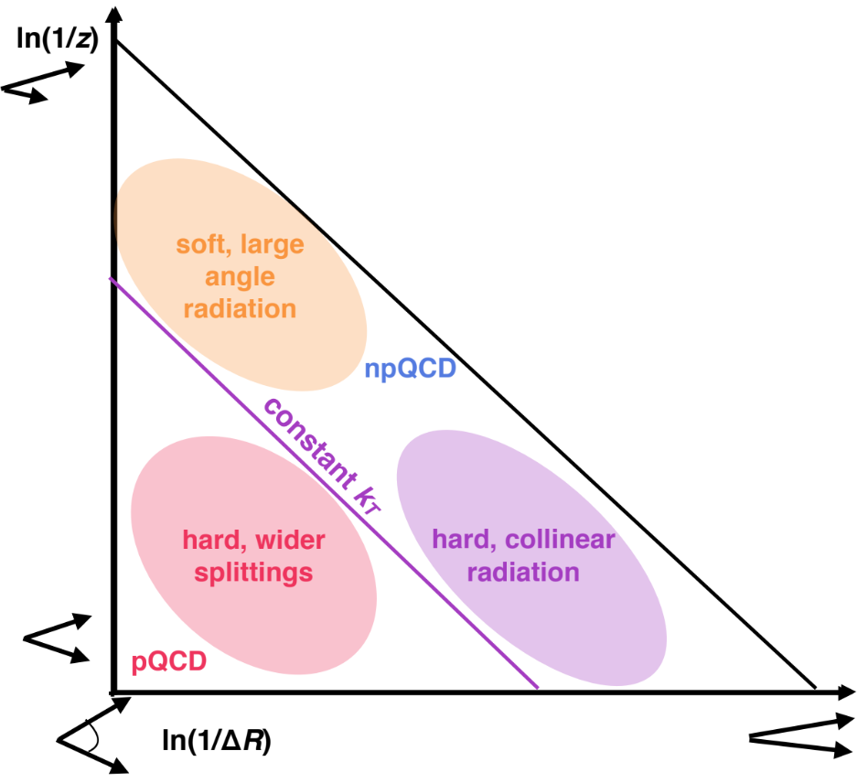
Jets and SoftDrop grooming
Jet is a multi-scale object
To enhance perturbative contributions, SoftDrop grooming is often used to remove soft wide-angle radiation
Larkoski, et al. JHEP 05 (2014) 146.
Dasgupta et al. JHEP 09 (2012) 29.
Image credit: Stefan Gieseke
Image credit:
Laura Havener
The Lund Plane
2

Slide 3
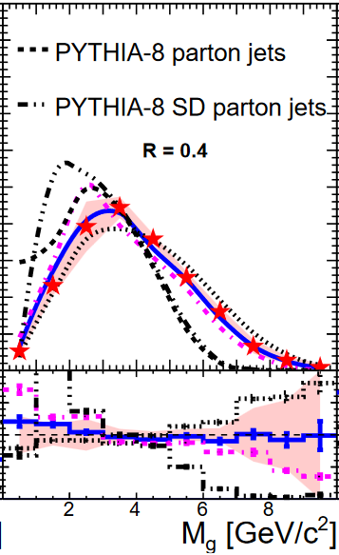
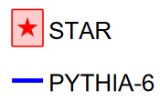
Jets and SoftDrop grooming
STAR has measured SoftDrop jet substructures
$$Rg$$
$$zg$$
$$Mg$$
Image credit:
Laura Havener
STAR. PLB 811 (2020) 135846, STAR. PRD 104, 052007(2021)

Slide 4
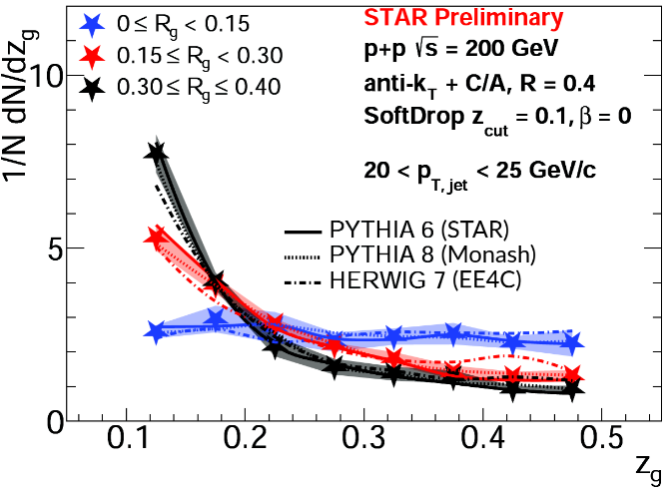
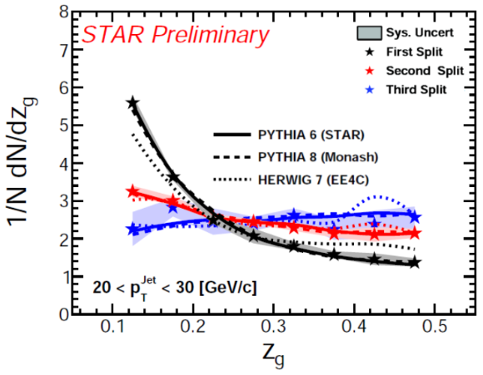
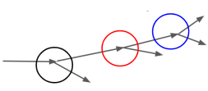
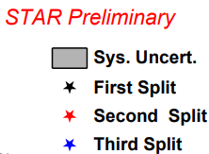
Jets and SoftDrop grooming
STAR has measured SoftDrop jet substructures
… and in a multi-dimensional fashion!
→ study dynamics of the parton shower!
Image credit:
Laura Havener
Notes:
https://indico.bnl.gov/event/9726/contributions/46219/
https://indico.bnl.gov/event/9726/contributions/46218/attachments/33725/54282/jet_splitting_substructure_STAR_raghav_DIS_14April2021.pdf

Slide 5
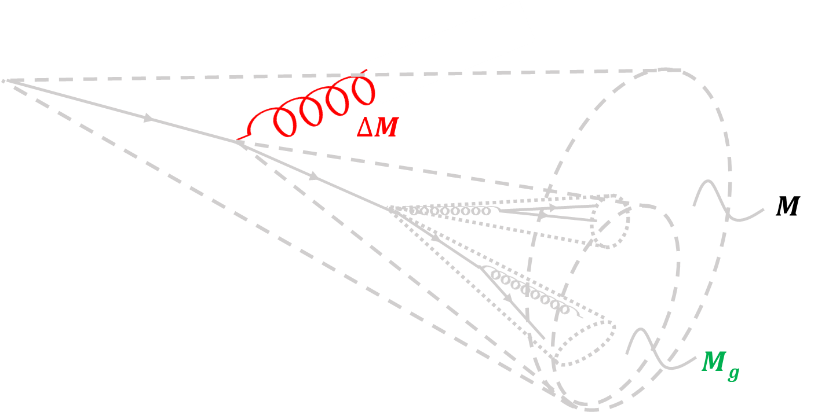
CollinearDrop grooming: probes the soft component Chien and Stewart JHEP 06 (2020) 64.
General case: difference of an observable with two different SoftDrop selections ($zcut 1, β$₁) and ($zcut 2, β$₂)
For this analysis, ($zcut 1, β\text{1}\text{)}$ = (0,0) and ($zcut 2, β$₂$\text{)}$ = (0.1,0): difference in the original and SoftDrop groomed observable
Observables: e.g.,
where
Image credit:
Laura Havener
soft and wide-angle radiation: interesting region of phase space that deserves more study!
Notes:
mention that this (trivial softer SD cut) is justifiable because of the small contribution of UE to jets at RHIC in pp

Slide 6
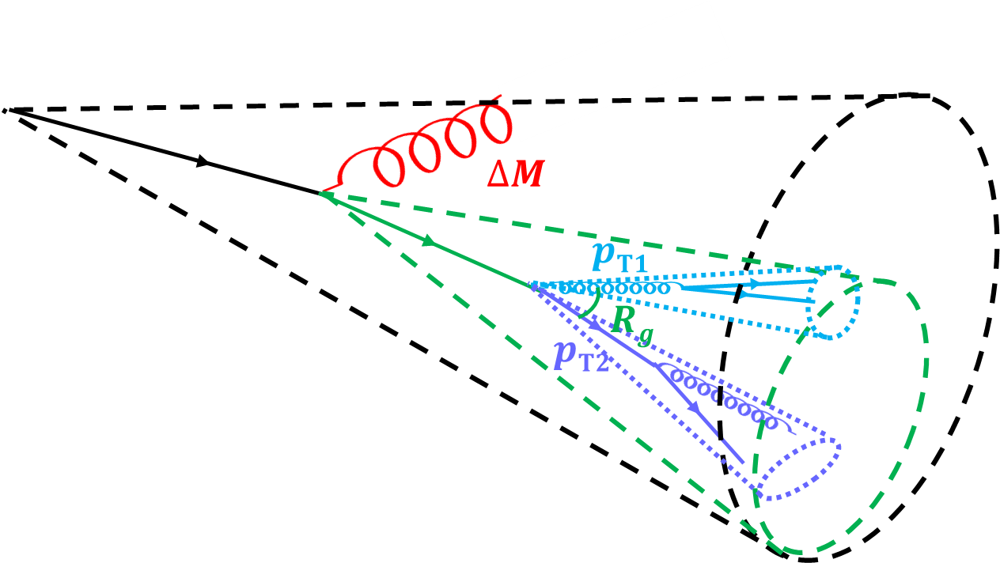
CollinearDrop vs SoftDrop correlation: probes the soft-hard correlation
How does the amount of soft radiation correlate with the angular and momentum scale of a hard splitting? → how an early emission affects a later splitting
Image credit:
Laura Havener
Note: Hadronization effects smear the distribution but don’t affect the correlations (see backup)

Slide 7
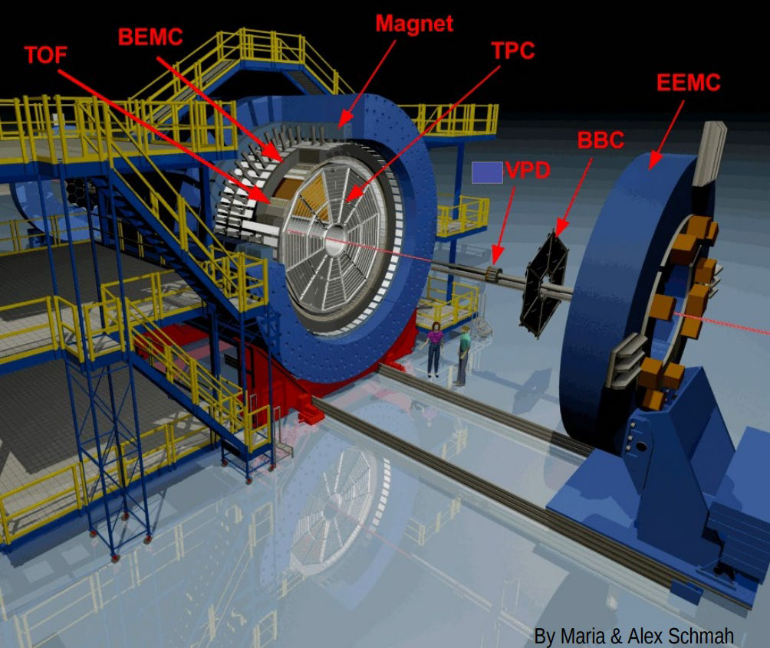
Jet reconstruction at STAR
Important subdetectors for 200 GeV pp collisions data-taking during 2012 RHIC run
TPC (Time Projection Chamber)
For charged particle track reconstruction
|η| < 1, full azimuthal coverage
BEMC (Barrel ElectroMagnetic Calorimeter)
For neutral energy measurement and triggering
|η| < 1, full azimuthal coverage
Reconstruct anti-$k_{T}$ full jets
Jet resolution parameter R=0.4
|η_{jet}| < 0.6
Additional selections
Tracks (Towers): 0.2 < $p_{T}$($E_{T}$) < 30 GeV/c
Jets
$p_{T}$ > 15 GeV/$c$, $M$ > 1 GeV/$c^{2}$
Passes SoftDrop with $z_{cut}$= 0.1 and β = 0
Notes:
pT fraction cut: it’s to reduce beam background / cosmics (https://arxiv.org/pdf/1405.5134.pdf, pg. 4)
No need to describe additional selections

Slide 8
Unfolding method
Jet measurements need to be corrected for detector effects for comparison with theory/model
Jet observables
$p_{T}$: transverse momentum
$R_{g}$: groomed jet radius
$z_{g}$: shared momentum fraction
$M_{g}$: groomed jet mass
Unfolding methods:
Iterative Bayesian unfolding (D'Agostini. arXiv:1010.0632(2010))
MultiFold (Andreassen et al. PRL 124, 182001 (2020))
Machine learning driven
Unbinned
Simultaneously unfolds many observables → Correlation information is retained!
First application of MultiFold on RHIC data!
All 6 observables are simultaneously unfolded in an unbinned way!
Uncertainties due to prior choice accounted for through 6D reweighting based on PYTHIA8 or HERWIG (see backup)
Notes:
highlight that this is the first application of multifold at RHIC more

Slide 9
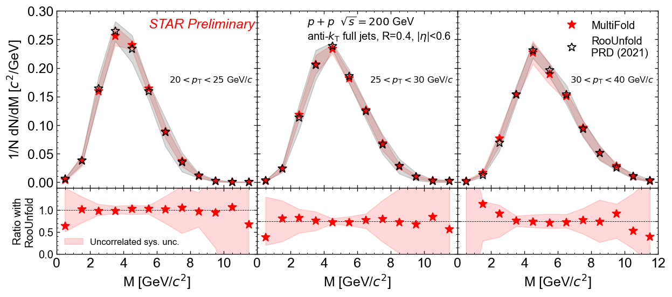
Does MultiFold work on our data?
MultiFolded result agrees with RooUnfolded result (STAR Collaboration. PRD 104, 052007(2021))
HEPData
*
… but MultiFold also gives us high-dimensional correlation between observables!
* 2D reweighting used for prior variation, to be consistent with RooUnfolded measurement
Notes:
Say result using RooUnfold/MultiFold

Slide 10
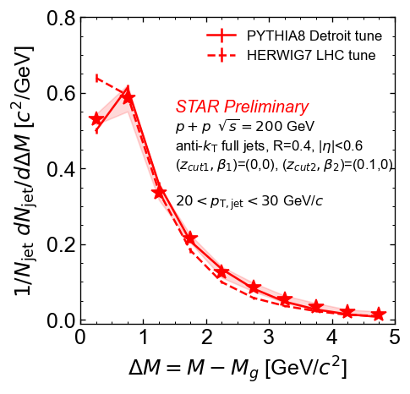
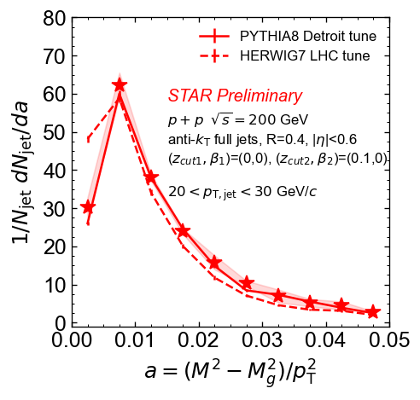
CollinearDrop groomed jet mass
PYTHIA6 Perugia + STAR tune: Skands. PRD 82, 074018 (2010)
J. K. Adkins, PhD thesis (Kentucky U., 2015)
PYTHIA8 Detroit tune: Aguilar et al. PRD 105, 016011(2022)
HERWIG7: Bellm, et al. PRC 76, 1-8 (2016)
Fully corrected data
Sys. uncertainty
Measurement excludes jets with $ΔM$ = 0 (45.5% of jets in this jet $pT$ range)
First CollinearDrop groomed jet measurement, sensitive to soft radiation within jets
MC predictions qualitatively consistent with data; some tension from HERWIG7 in small $ΔM$ region
MultiFold allows us to correlate (combinations of) unfolded quantities
Notes:
Feels like you reintroduced it? Maybe say the point about the combined observables first, then introduce dM and a?

Slide 11
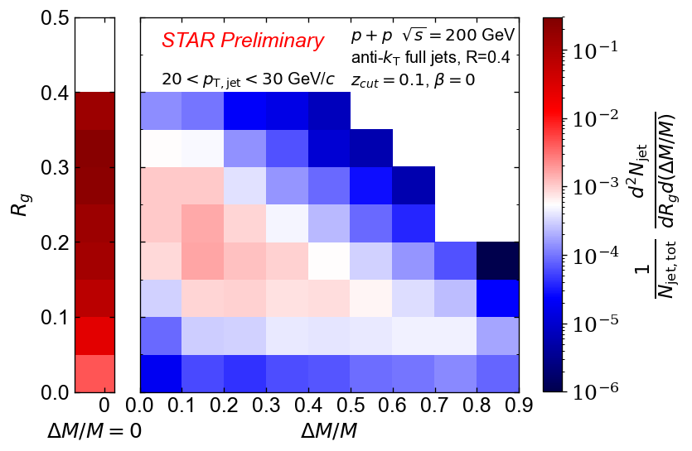
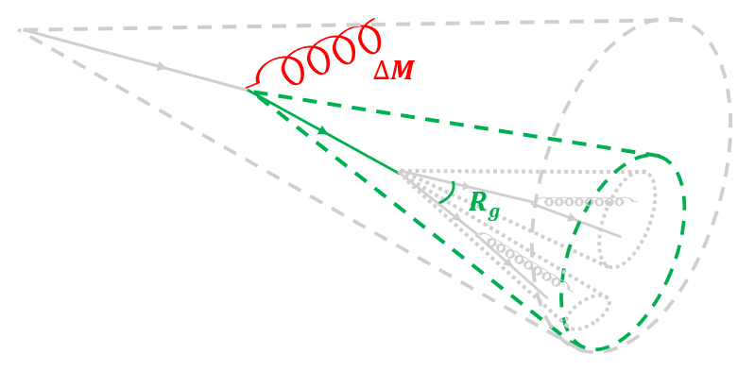
Soft radiation vs hard splitting angle
$ΔM/M$= 0
$ΔM/M$> 0
The mean of $ΔM/M$distribution is anti-correlated with mean of $Rg$ → consistent with angular ordered parton showers

Slide 12
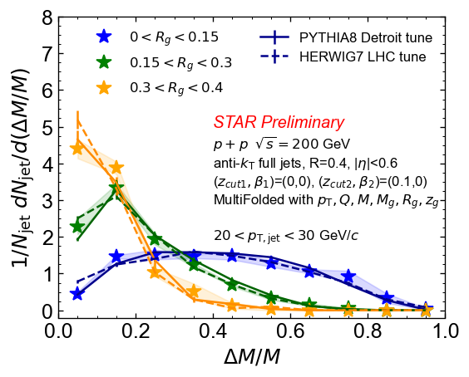
Soft radiation vs hard splitting angle
$ΔM/M$= 0
$ΔM/M$> 0
The mean of $ΔM/M$distribution is anti-correlated with mean of $Rg$ → consistent with angular ordered parton showers
Early soft wide-angle radiation constrains the angular phase space of later splittings
MC models describe the trend of data

Slide 13
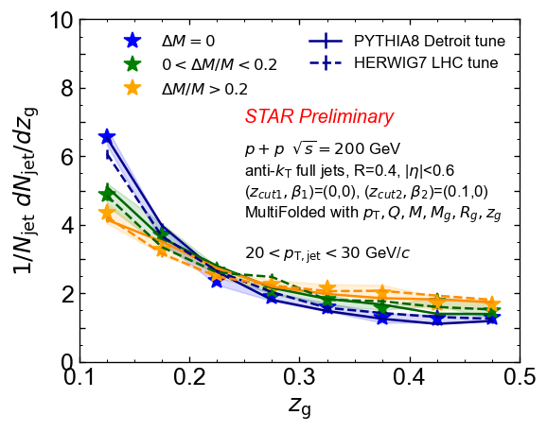
Soft radiation vs hard splitting momentum imbalance
The more mass that is groomed away relative to the original mass, the flatter the $zg$ distribution is
Demonstrates that early soft wide angle radiation constrains the momentum imbalance of later splittings
MC models describe the trend of data
$Rg$ and $zg$ are correlated, $ΔM/M$affects $Rg$
→ correlation between $ΔM/M$and $zg$

Slide 14
Summary
Probing soft wide-angle radiation within jets
Fully corrected CollinearDrop jet measurement is presented
Probing soft-hard correlation within jets
MultiFold allows for access of multi-dimensional correlations on a jet-by-jet basis. First application to RHIC data!
Jets with a more asymmetric splitting are more likely to have small early-stage radiation
Anti-correlation between the amount of early-stage radiation and the angular scale of a later-stage splitting is observed
Improve understanding of jet substructure and the correlations between different substructure observables!

Slide 15
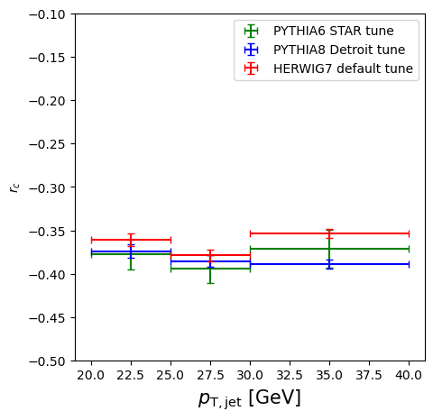
What’s next?
Study hadronization with jet substructure by measuring $rc$
Chien et al. PRD 105 051502 (2022)
$h1h2$: same charge tracks, $h1\overline{h2}$: opposite charge tracks
Mondal DIS 2022
To be validated with STAR data!
Notes:
Be careful not to make misleading statements of rc when defining it

Slide 16
What’s next?
Correct for detector effects for $rc$?
Problem: pi0s (and other neutral hadrons) decay at the detector-level
Example: jet at truth level jet at detector level
pi+ 6 GeV
pi0 4 GeV
pi- 3 GeV
pi- 1 GeV
track(+) 6 GeV
track(-) 3 GeV
neutral 2 GeV
neutral 2 GeV
track(-) 1 GeV
leading/subleading is neutral → don’t consider this jet
leading/subleading are both charged → include this jet for analysis
→ mistagged jet (shouldn’t include this jet for analysis, but cannot identify it from data)
How should we account for the neutral background?
Is a “charged jet” measurement meaningful?
Discussions are welcomed!
Notes:
smaller effect: Jet patch trigger biases towards upward fluctuation of neutral energy measurement for jet below 20 GeV

Slide 17
Jets at RHIC are great for the study of parton shower
… and have an enhanced sensitivity for non-perturbative effects like hadronization!

Slide 18
Backup

Slide 19
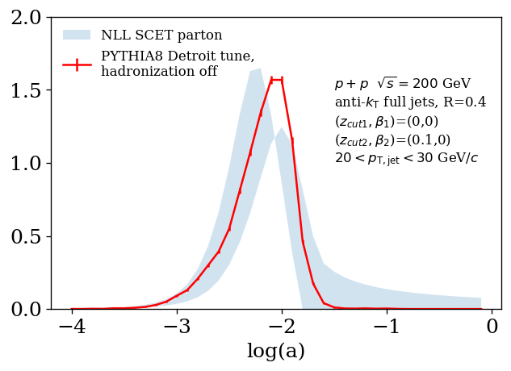
CollinearDrop groomed jet mass
Theoretical calculation (next-to-leading log precision, using SCET calculational framework, and not including hadronization) agrees with PYTHIA8

Slide 20
Method: machine learning
Detector-level
E.g., Iteration 1, step 1:
Data
Weights:
Ok for 1D
1/N dN/dx
(Andreassen and Nachman PRD 101, 091901 (2020))
where f(x) is a neural network and trained with the binary cross-entropy loss function
x
Simulation: PYTHIA+GEANT
to distinguish jets coming from data vs from simulation
1/N dN/dx
x
Unfolding → Reweighting histograms → Classification → Neural network
Where does the machine learning part come in?
Notes:
Reweighting: create weights w(x) so that when data is weighted by w, it is statistically identical to sim.
Likelihood-free inference
Neural networks learn to estimate likelihood ratio: f(x)/[1-f(x)]=p(x|class 1)/p(x|class 2)
different network for different observable structure

Slide 21
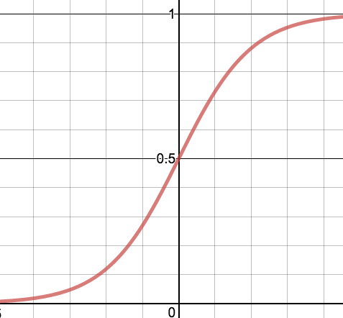
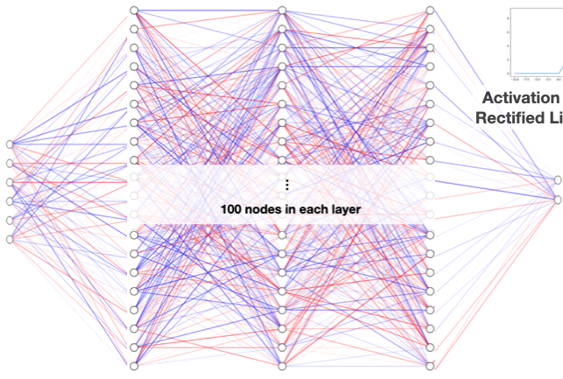
Method: machine learning
Activation function for dense layers: Rectified linear unit
Architechture: Dense neural network Activation function for dense layers: Rectified linear unit
Activation function for output layer: Sigmoid
Loss function: Binary cross entropy
Optimization algorithm: Adam https://arxiv.org/pdf/1412.6980.pdf
Nodes per dense layer: [100,100,100]
Output dimension: 2
Input dimension: 6
All hyperparameters are default: https://energyflow.network/docs/archs/#dnn
for ou
Activation function for output: Sigmoid
Sigmoid

Slide 22
Closure test for unfolding
PYTHIA+GEANT sample 1
1/N dN/dx
Step 1: Separate matched jets from PYTHIA and PYTHIA+GEANT into 2 samples
Step 2: Unfold
x
Detector-level
Particle-level
PYTHIA+GEANT sample 2
PYTHIA+GEANT sample 1
PYTHIA sample 1
1/N dN/dx
1/N dN/dx
MultiFold
1/N dN/dx
x
x
x
PYTHIA sample 2
PYTHIA+GEANT sample 2
PYTHIA sample 2
1/N dN/dx
1/N dN/dx
1/N dN/dx
1/N dN/dx
Unfolded
x
x
x
x

Slide 23
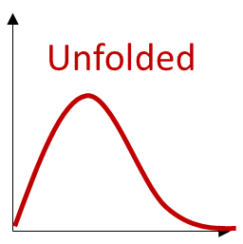
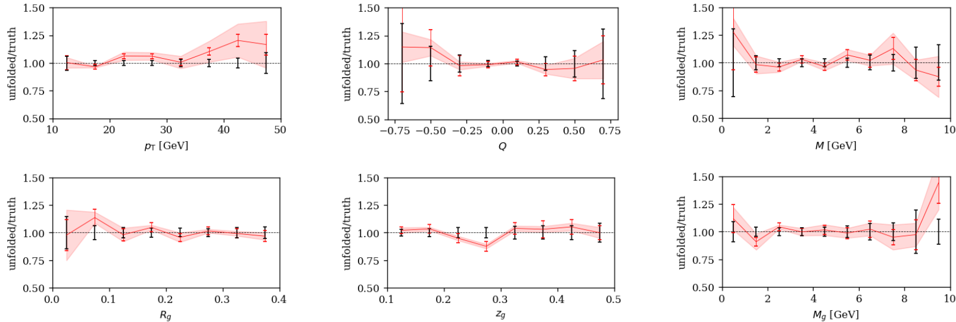
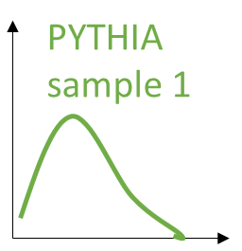
Closure test for unfolding
Unfolding unc. on data (not including misses)
Stat. unc. on sample 1
Stat. unc. on sample 2
Decent closure for all substructure observables
=

Slide 24
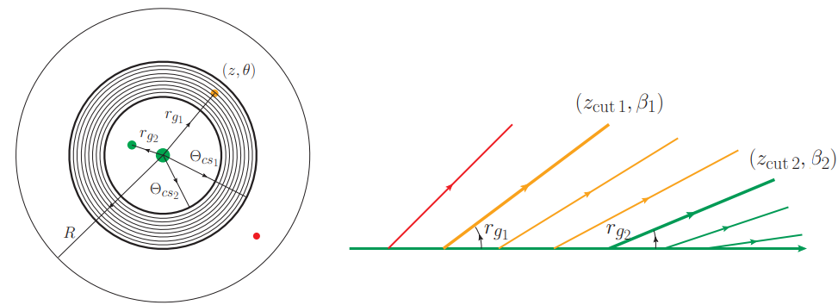
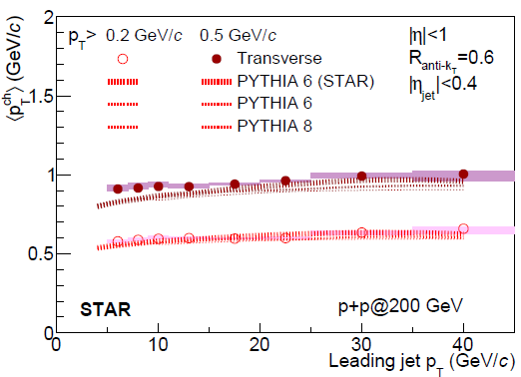
Underlying event
STAR Collaboration. PRD 101, 052004(2020)
Remove underlying effects and pileup, not necessary for 200 GeV collisions

Slide 25
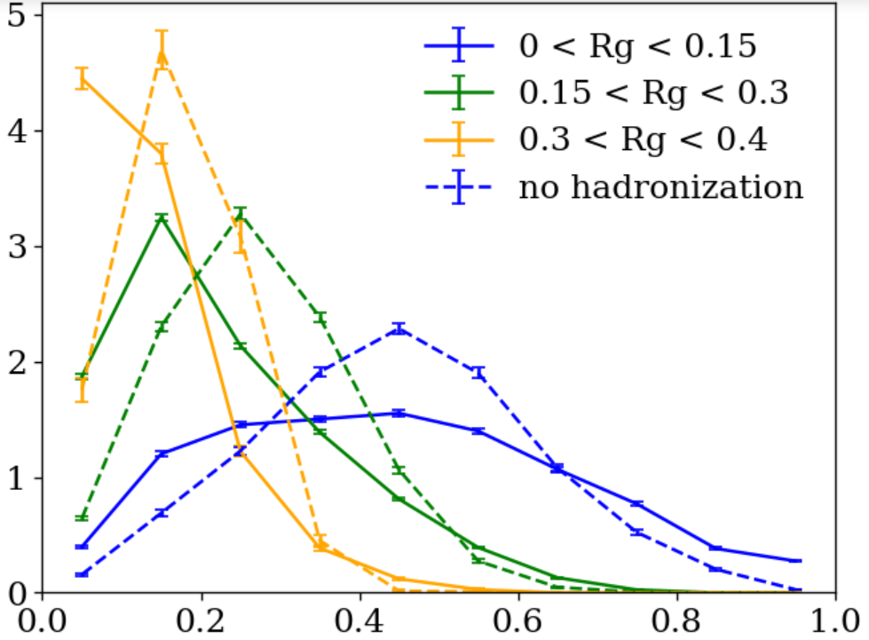
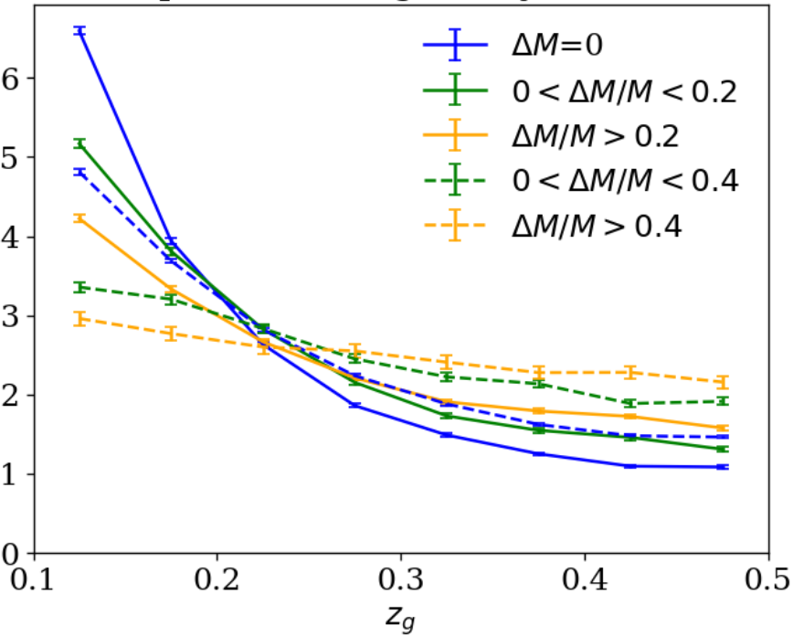
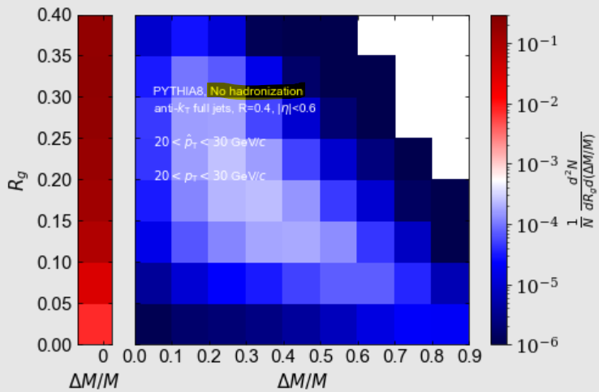
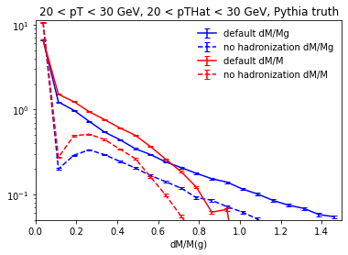
Excluding ΔM=0
PYTHIA8 Detroit tune
20 < pT,jet < 30 GeV
ΔM/M
Hadronization effects study:
Hadronization smears/shifts the distributions, but the correlation with and without hadronization is the same.
default large dM/M cut: > 0.2
no had. large dM/M cut: > 0.4

Slide 26
Among truth jets with 20 < pT < 30 GeV, 44% of PYTHIA6 jets, 48% of PYTHIA8 jets, and 43% of HERWIG jets have dM=0.
Among reco jets with 20 < pT < 30 GeV, 36% of PYTHIA6 embedding jets and 37% of data jets have dM=0. (Higher pT jets have a smaller fraction of dM=0).

Slide 27
Soft radiation vs hard splitting momentum imbalance
The more mass that is groomed away relative to the original mass, the flatter the Zg distribution is
Demonstrates that early soft wide angle radiation constrains the momentum imbalance of & the amount of npQCD contributions to later splittings
MC models describe the trend of data
Steeply falling ~ DGLAP 1/z: pQCD
→ The first splitting that passes SoftDrop can still be non-perturbative, but if we apply the $ΔM=0$ selection, we can filter out some npQCD contribution due to the parton splitting

Slide 28
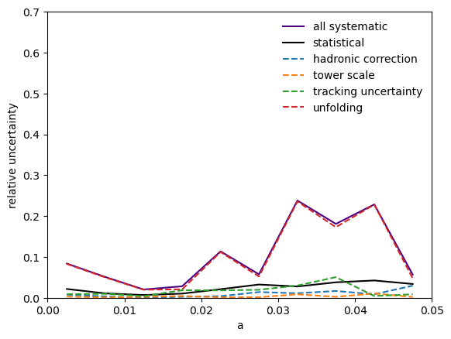
Systematic uncertainties
Detector systematics
Hadronic correction 100% → 50%
Tower scale +3.8%
Tracking uncertainty -4%
Unfolding systematics
Unfolding seed
Iteration number variation
Prior shape variation to HERWIG7 and PYTHIA8
Nominal: prior = (generation, simulation)
= (PYTHIA6, PYTHIA6 + GEANT3 + embedding)
Varied to: ,
with

Slide 29
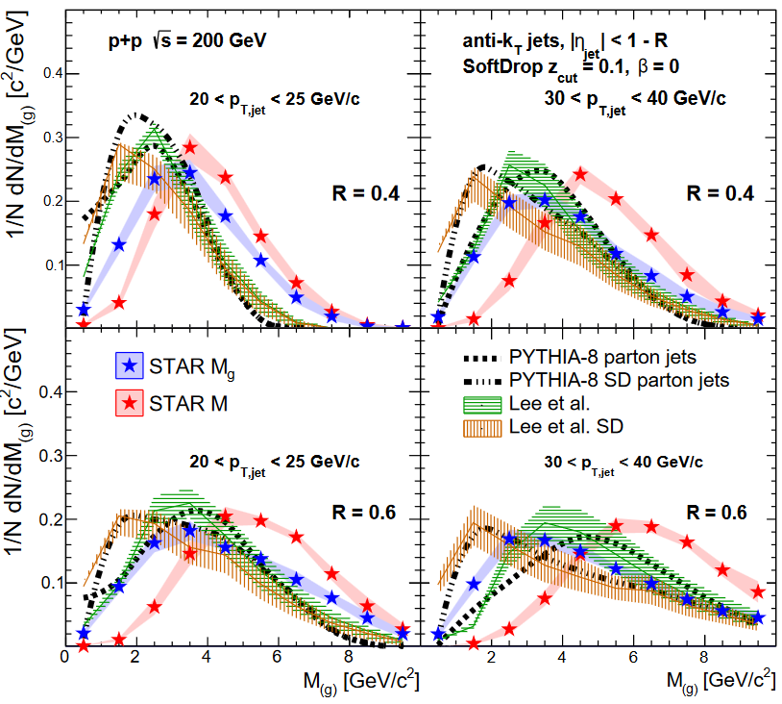
Jet mass: Comparison with models and calcaulations
STAR Collaboration. PRD 104, 052007(2021)

Slide 30
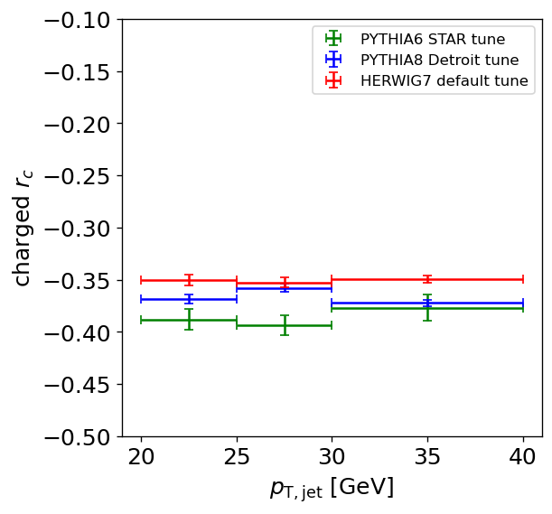
Charged jet $rc$

Slide 31
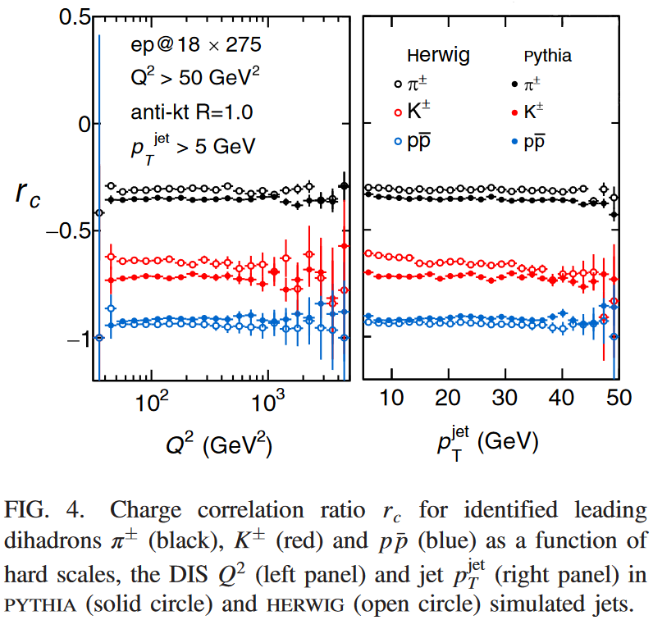
$rc$ comparison between HERWIG and PYTHIA
Chien et al. PRD 105 051502 (2022)

