Slide 1
Radiation tolerant timing generators
Jeffrey Prinzie
Valentijn De Smedt
30 August 2019

Slide 2




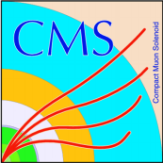


Slide 3
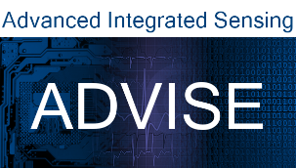


Department of Electrical Engineering (ESAT)

Slide 4
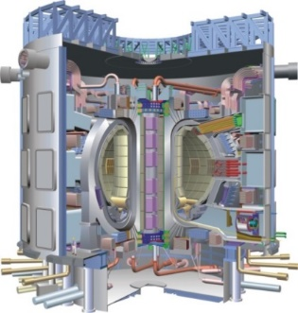
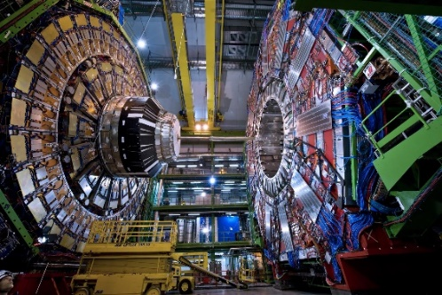
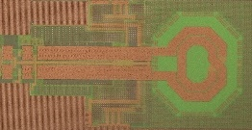
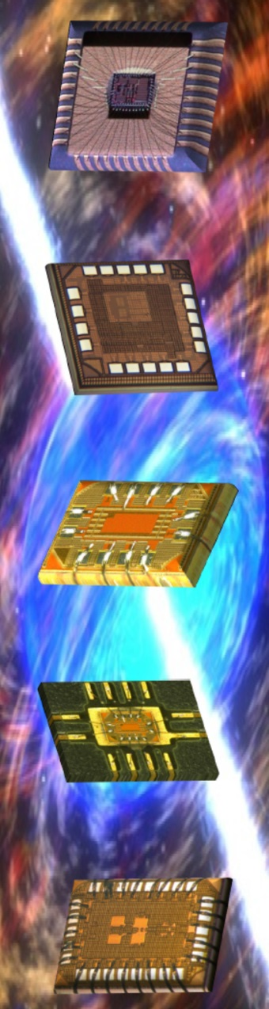
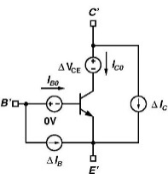
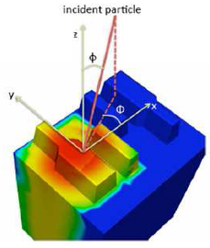
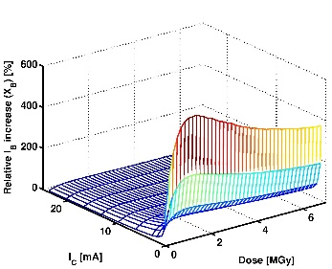
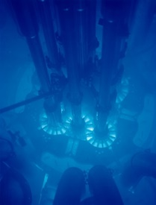
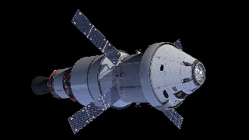
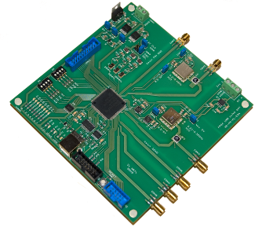
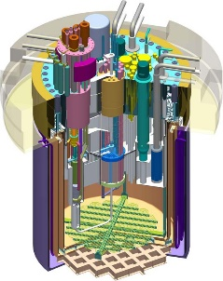
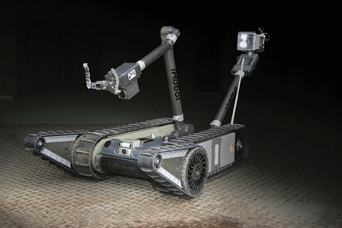
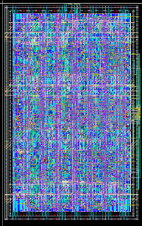
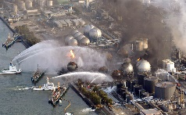
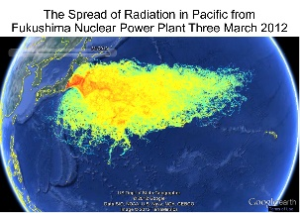
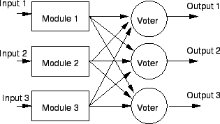
Harsh radiation environment electronics
Application fields
Expertise
RF, analog and mixed-signal radhard IC design
Modelling radiation effects
FPGA
and board level
prototyping
Radiation hardened
digital IC design & synthesis
ITER: Nuclear fusion
CERN: CMS experiment
Space
missions
Reactor safety
SCK-CEN: MYRRHA
Robotic
decommissioning
Accident
intervention

Slide 5
Data interfaces &
Conversion
Power
All-digital PLL/CDRs
Radhard RF wireless links
High resolution TDCs
HS Digital radhard circuits
Time-based sensor interfaces
Radhard HV power converters (1kV, 1kW)
Smart, resonant Power converters
Radhard Motor drivers
Hybrid Power converters for space applications
Radhard GaN and SiC drivers
Detectors
Time-precision front-ends
SRAM radiation monitor
IoT platform
Adv. Tech & Testing
Algortihms
Aging – TID – SEU
SEE laser testing
28 nm CMOS & SOI
Commercial device testing
Digitally assisted analog/RF
Algorithms for TMR placement
Integrated machine learning

Slide 6
Why do we need a PLL?

Slide 7
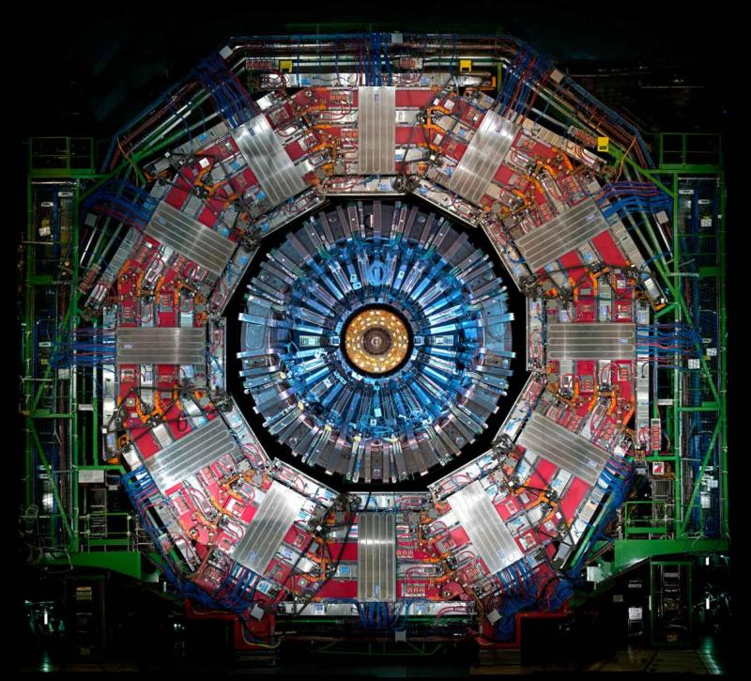
Why do we need a PLL?
> 10k Channels
+Gb speed
Low power
Radiation hard
CMS Detector @ CERN

Slide 8
Why do we need a PLL?
Frequency synthesis
Clock recovery
Jitter filter
LJPLL/LJCDR
ADPLL in development now

Slide 9
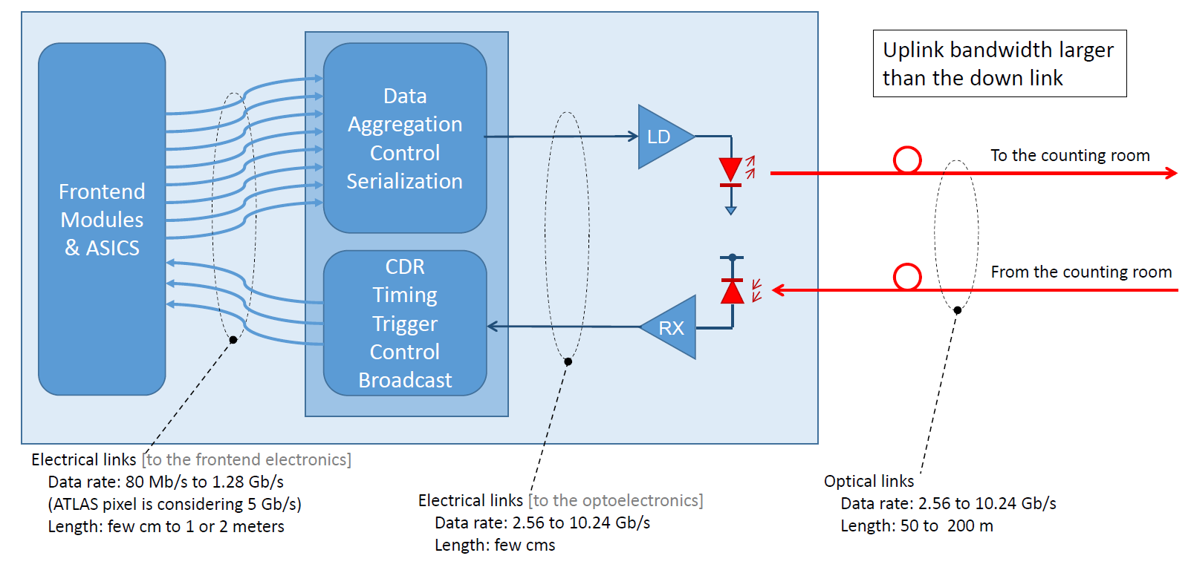
Why do we need a PLL?
CERN lpGBT
Lpgbt – GBT team

Slide 10
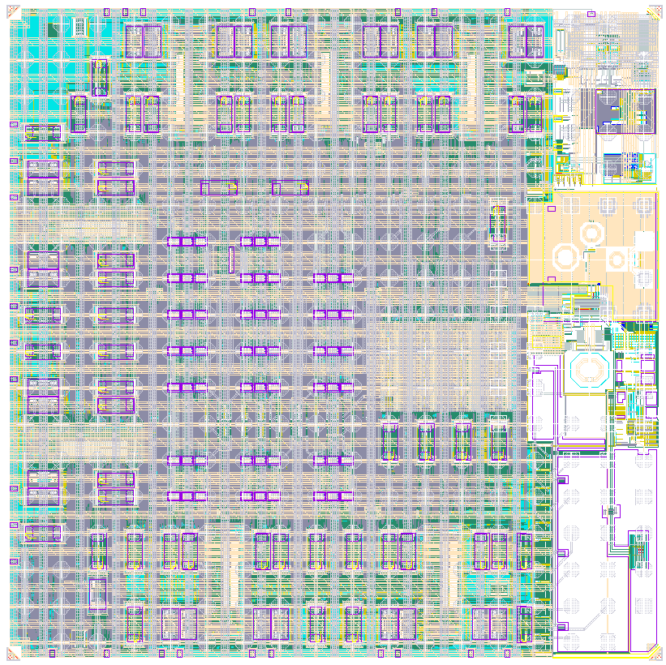
Why do we need a PLL?
CERN lpGBT
PLL
CDR
Lpgbt – GBT team

Slide 11
Content
Introduction
Basic PLL concepts
Radiation effects and hardening methods

Slide 12
Content
Introduction
Basic PLL concepts
Radiation effects and hardening methods

Slide 13
Components
Phase detector: Detects phase difference between reference clock and feedback clock.
Loop filter: Filters (and usually integrates) the phase detector signal and applies it to the VCO
VCO: Voltage controlled oscillator generates a (high frequency) clock.
Divider: Divides the output frequency to the reference frequency

Slide 14
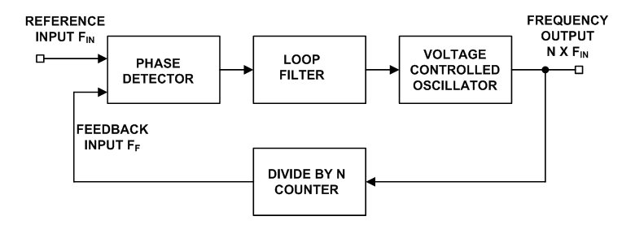
Linear operation of a PLL
voltage
Phase
phase

Slide 15
Content
Introduction
Basic PLL concepts
Radiation effects and hardening methods

Slide 16
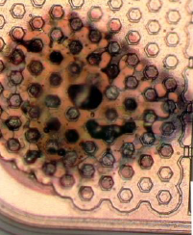
Radiation effects in CMOS
Cumulative radiation effects
Single-event effects (SEEs)
SEGR
… Gate Rupture
Total ionizing dose (TID) effects
SEL
… Latchup
SET
… Transient
SEB
… Burnout
Displacement damage
SESB
… Snapback
SEU
… Upsets
SEFI
… Functional Interrupts

Slide 17
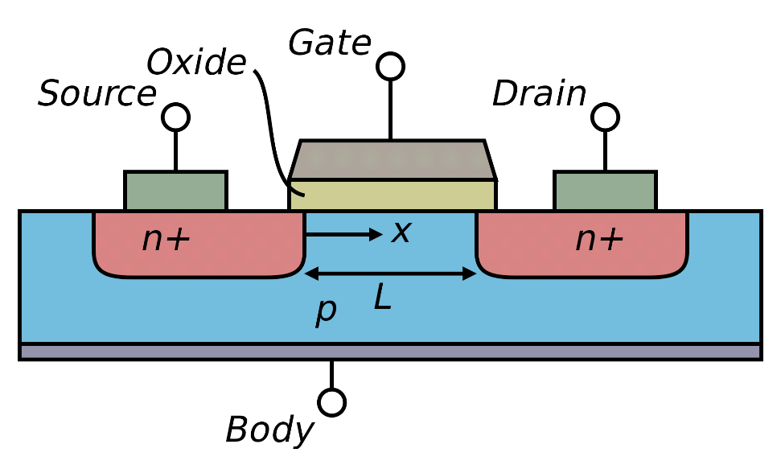
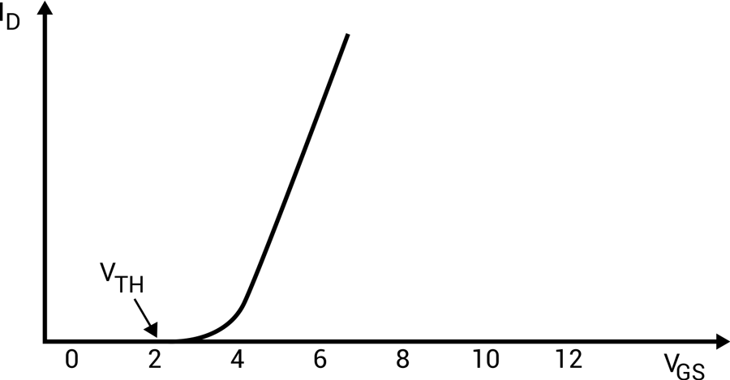
The MOS field-effect transistor
Oxide capacitance
Width of the device
Charge carrier
mobility
Threshold voltage
Length of the device
OLD CMOS transistor

Slide 18
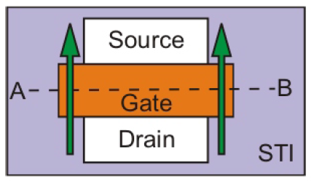
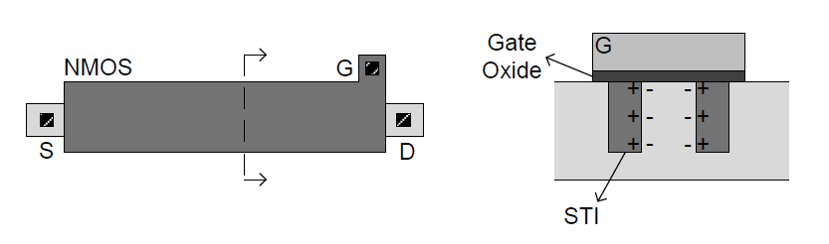
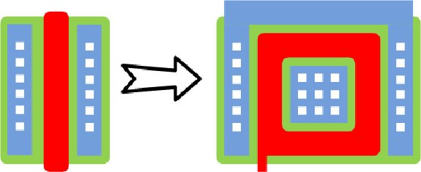
The MOS field-effect transistor
Narrow channel
STI collects positive traps
Leakage current (nmos)
Vt shift
Effect more dominant for
narrow devices
Wide devices or ELT
65nm CMOS transistor

Slide 19
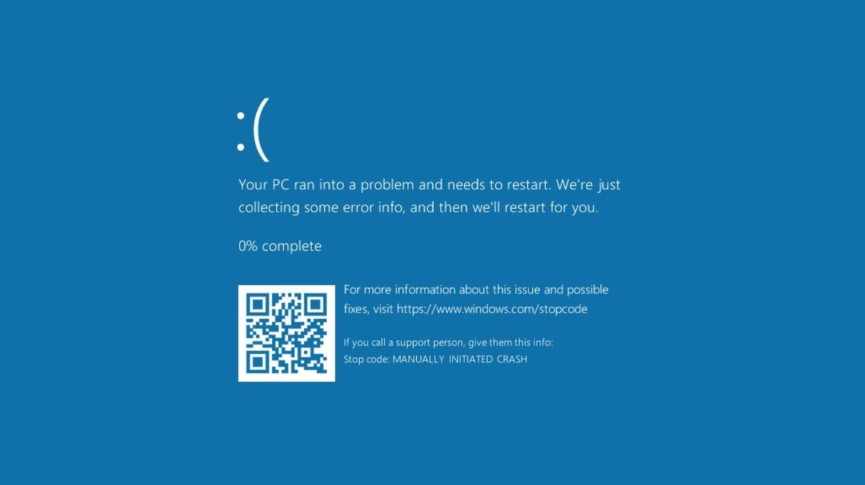

Slide 20
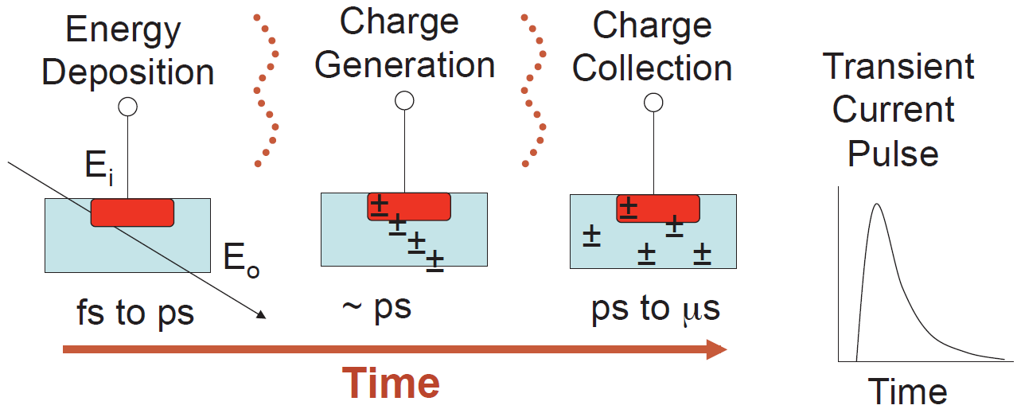
Single-event effects

Slide 21
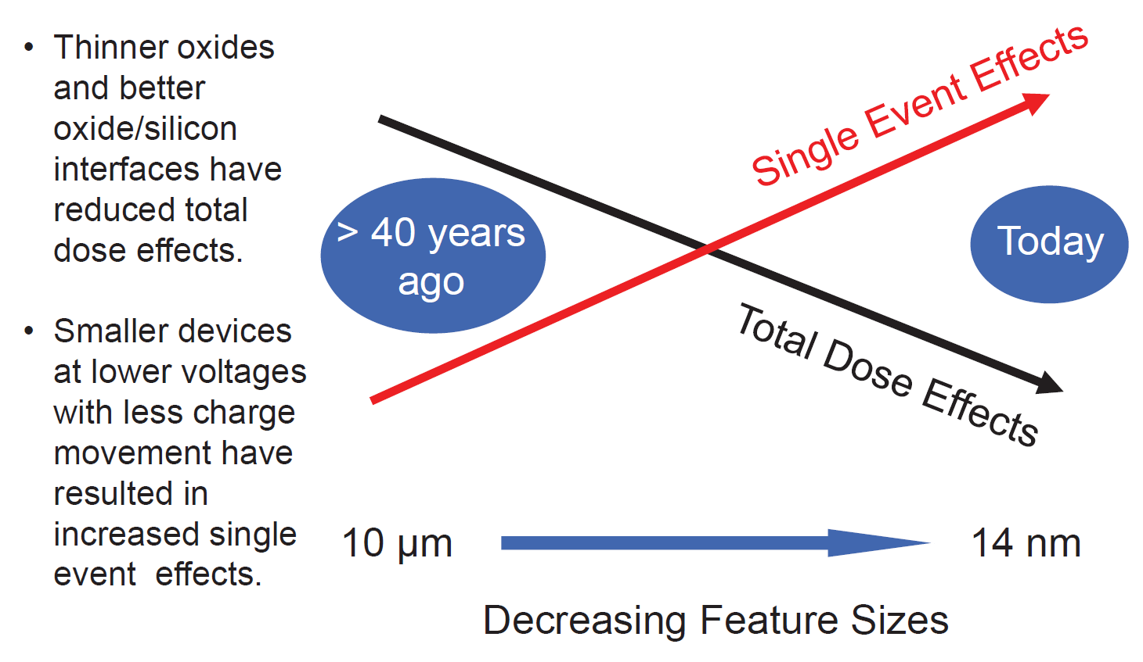
Radiation effects and IC technology scaling

Slide 22
Radiation hard PLLs
Feedback divider + Phase detector: Digital
Loop-filter / VCO: Analog

Slide 23
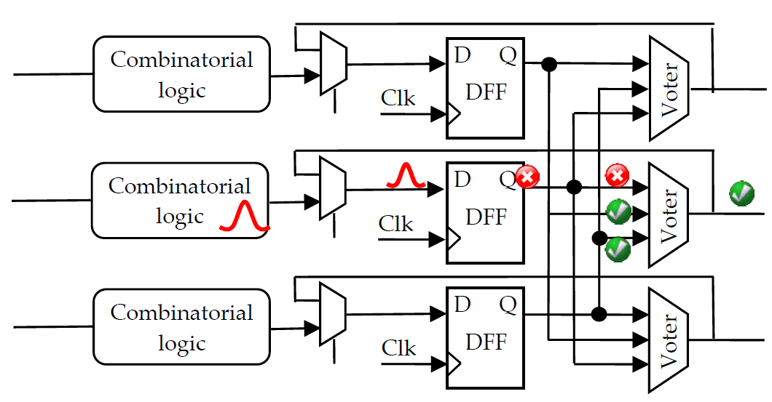
Radiation hardened digital circuits
Triple Modular Redundancy (TMR)
Feedback divider
PFD

Slide 24
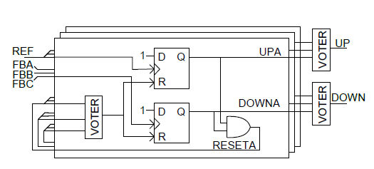
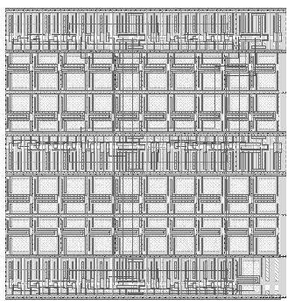
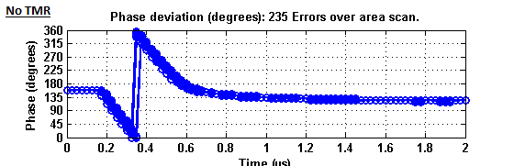
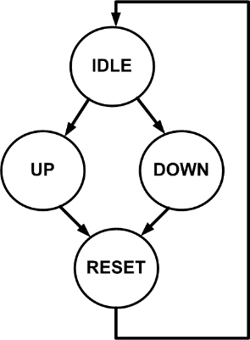
Radiation hardened digital circuits
Triple Modular Redundancy (TMR)
spacing
Worst slack reduces
Power consumption increases!
>3x Area compared to single approach, but very safe
Feedback divider
PFD

Slide 25
Radiation hardened digital circuits
Triple Modular Redundancy (TMR)
Verilog coding
Synthesis
Place and route
TMR insertion
Automatic
SEU error injection testbench
Constraint generation
Spacing between TMR cells
Optimal placement methods
Digital radiation hardening is based on a TMR digital flow

Slide 26
Radiation hardened digital circuits
Triple Modular Redundancy (TMR)
Old
New
A
A
B
C
A
B
B
C
A
B
C
C
A
B
C

Slide 27
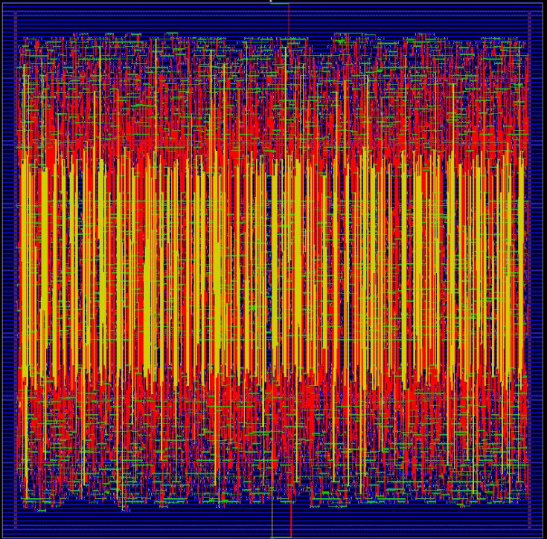
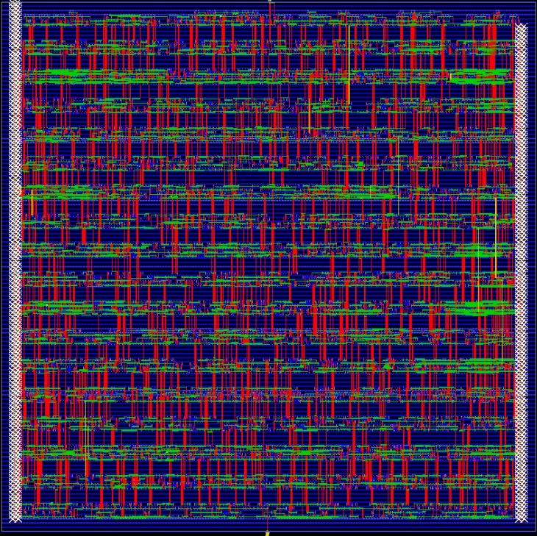
Radiation hardened digital circuits
Triple Modular Redundancy (TMR)
16 * 8Bit Counter

Slide 28
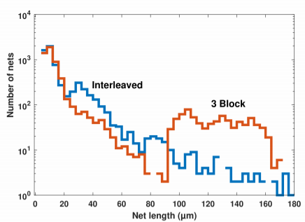
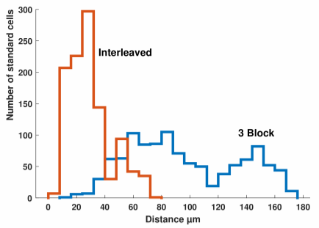
Net lengths
Radiation hardened digital circuits
Triple Modular Redundancy (TMR)
Net length
32*8Bit Counter : Interleaved FP
 | 3Blocks | Interleaved | Difference
Internal power | 55.17 mW | 51.96 mW | -5.82%
Switching power | 34.82 mW | 18.26 mW | -47.55%
Total Power | 89.99 mW | 70.22 mW | -21.96%
Total capacitance | 108 pF | 60 pF | -44.28%
Total net length | 368,032 µm | 128,320 µm | -65.13%
Cell spacing
J. Prinzie, K. Appels, S. Kulis, Optimal Physical Implementation of Radiation Tolerant High-Speed Digital Integrated Circuits in Deep-Submicron Technologies, J. Electronics 2019.

Slide 29
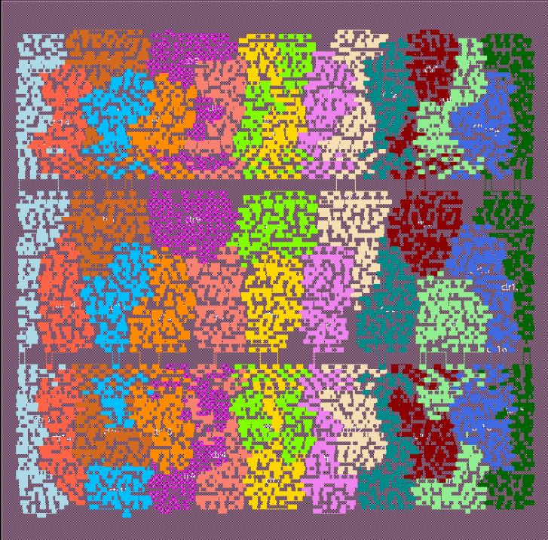
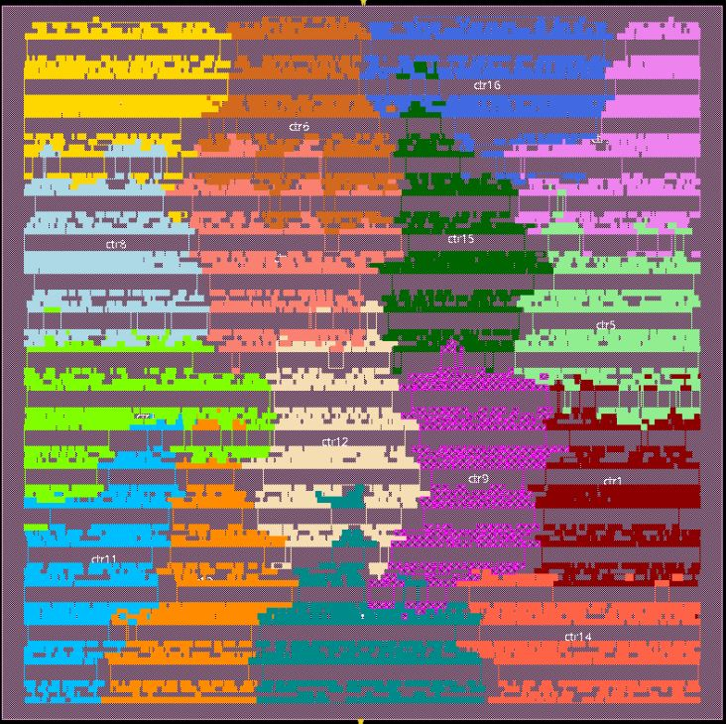
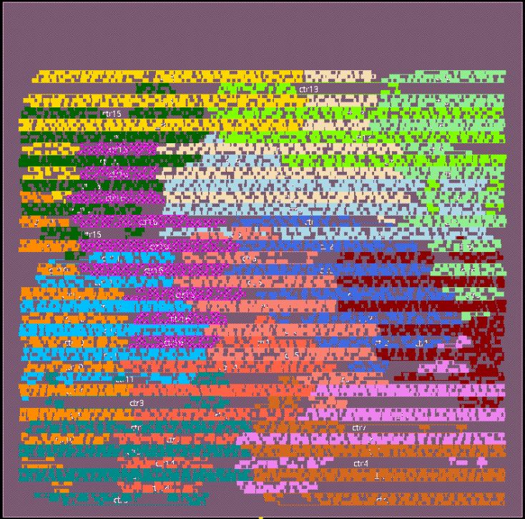
Radiation hardened digital circuits
Triple Modular Redundancy (TMR)
3Blocks
Interleaved
Interleaved 2.0

Slide 30
Radiation hard PLLs
Oscillator?

Slide 31
VCO
10x noise difference
4.8ps
0.4ps
LC
RING
Jitter
PVT
SEU
TID
Area
Power
*equal power consumption

Slide 32
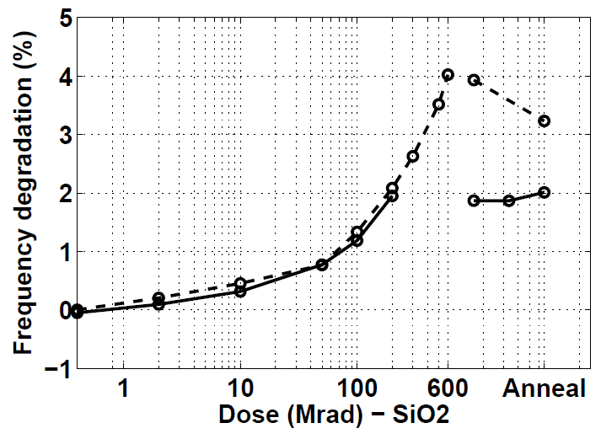
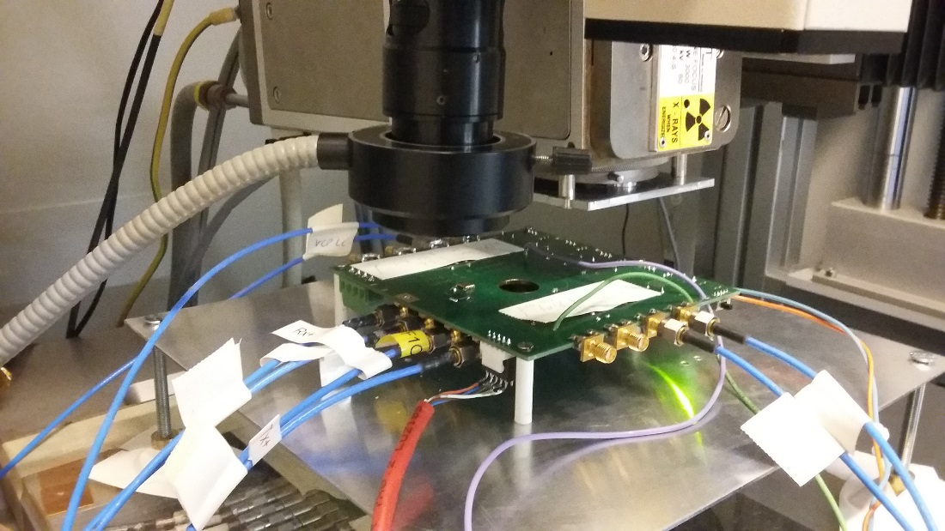
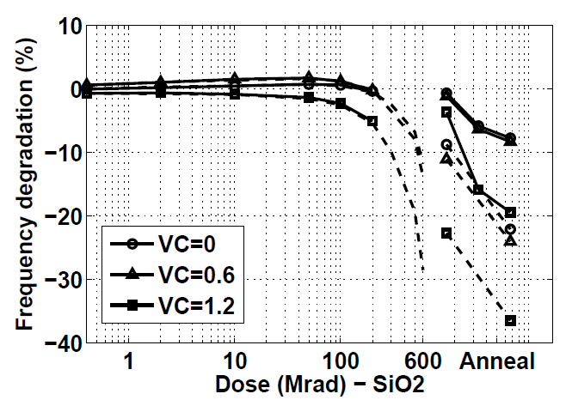
TID Experiments
LC
Xray irradiation (60 keV)
@ 90 kGy/hr
Ring

Slide 33
Conclusion 1 contd.
LC
  Oscillation frequency= 1/(2.pi.sqrt(LC))
    First order: transistor parameter independent!
  Rather insensitive to radiation
  Remaining effects from –GM capacitance and varactor characteristics changes
Ring
  Oscillation frequency ~ I/C ~ gm/C
  gm changes (decreases) with radiation dose!

Slide 34
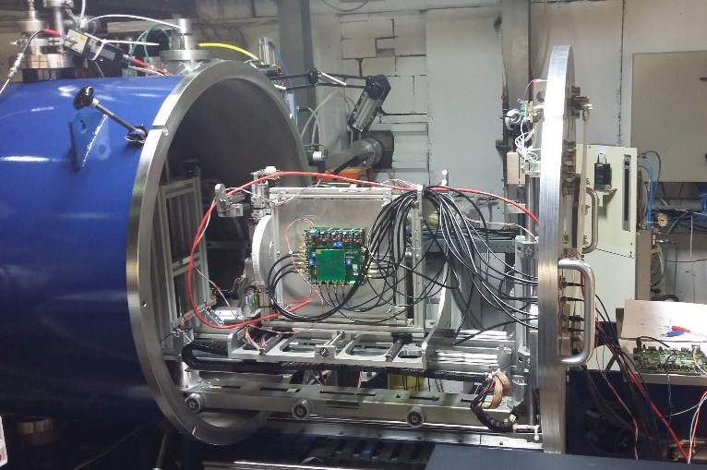
Single event tests
Heavy ion tests @ UCL Belgium
TPA laser tests @ KU Leuven
62-3.3 MeV.cm²/mg
2 Channel TDC
Trigger on 200ps phase error

Slide 35
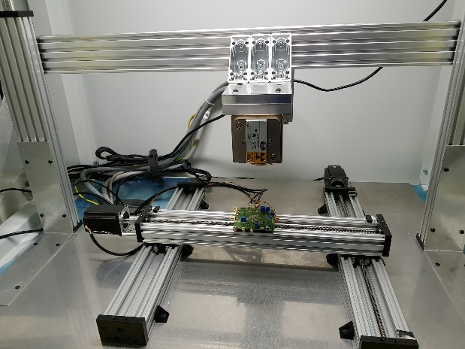

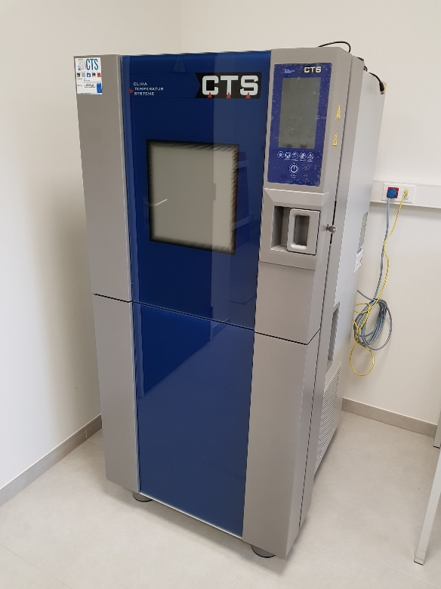
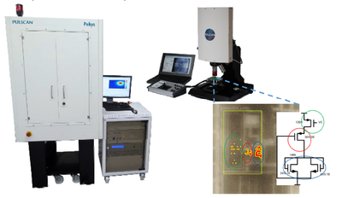
KU Leuven ADVISE RELY LAB facility
X-ray total dose testing
Climate control
Laser radiation
test system

Slide 36



Single vs. two photon absorption
Two-Photon Laser experiments
Two
Photon
Single
Photon
Z. Huang

Slide 37





Single event tests
Conventional LC oscillator
Varactors are nwell devices
SET on Vtune → Frequency error

Slide 38



Radhard VCO
Avoid nwell tie to vtune
Biasing of varactor node to ground
No active nodes to Vtune
J Prinzie et al., A 2.56-GHz SEU Radiation Hard -Tank VCO for High-Speed Communication Links in 65-nm CMOS Technology, TNS 2017

Slide 39



Time-dependent radiation effects
Phase error depends on the moment of impact!

Slide 40



Time-dependent radiation effects
J. Prinzie, V. De Smedt, Time-Dependent Radiation effects in CMOS LC-oscillators, TNS 2019

Slide 41


Time-dependent radiation effects
Low charge density

Slide 42

Time-dependent radiation effects
High charge density

Slide 43


Time-dependent radiation effects
Low charge density
High charge density

Slide 44
Conclusion
High speed PLLs are required in many applications
Also in HEP systems
Solid architecture knowledge required to understand radiation effects
PLLs are both analog AND digital, require different strategies
LC integrated oscillators are less prone to SEUs

Slide 45


Want to know more?
https://www.springer.com/gp/book/9783319786155
https://www.springer.com/gp/book/9783319090023

Slide 46
Want to know more?
Workshop on radiation tolerant integrated circuits
Wednesday September 18th
Location: Innovation Labs/Frugal Hall, 3rd floor, Guadalupe Hall, Santa Clara University
8:00am-8:30am – Check-in
8:30am-8:45am – Introductions
8:45-9:30am: Radiation effects on semiconductor devices
9:30-10:15am: Hardening techniques for integrated circuits
10:15am-10:30am Break
10:30-11:15am: Radiation hardened integrated circuits and design cases.
11:15-12:00pm: Testing and experimental verification.
12:00pm-1:00pm: Lunch and networking

Slide 47
Thank you
Dr. Jeffrey Prinzie
Prof. Dr. Valentijn De Smedt
Jeffrey.Prinzie@kuleuven.be

Slide 48
backup

Slide 49


Charge-pump
TID
Non-Lmin for current sources (TID) ~ also good for Ro
Current mirror compensates
for most of the degradation effects
  Ro slightly reduces
Resistors boost Ro
ELT in the switches!

Slide 50

Charge-pump
SEE
Transients induce frequency
transients!
Bias currents
  Decoupling capacitors
  (vbp & vbn)
Switches
  PLL BW affects transient
  time AND amplitude
  Cross section = low

Slide 51

The MOS field-effect transistor
“Ok up to ~1MGy”
PMOS
  LDD implant become
  high resistive
  Effective current reduces
  Effect relatively more dominant for short devices
NMOS
  LDD implants have less effect
  Degradation due to HCI
Short channel
“Ok up to 4-6 MGy”
65nm CMOS transistor

Slide 52

TID effects
Introduction
65 nm CMOS
Target radiation level = 200 Mrad
  NMOS: -20%
  PMOS: -60%
Larger L = better
  Logic needs minimum L
Larger W = better
  Power
ELT = best!
For critical analog: No Lmin
For critical digital: only NMOS (cml)

Slide 53

Radiation hardened digital circuits
Triple Modular Redundancy (TMR)
non-minimal W for DRC
Good TID resistance
High speed
Larger power consumption
More switching noise
500 Mrad -80% -40% -30% -10%

Slide 54

VCO
LC oscillator

Slide 55

VCO
Ring oscillator

Slide 56
Single event tests

