Slide 1
Job scheduling on next generation HPCs
erhtjhtyhy
Doug Benjamin
HEP Division ANL

Slide 2
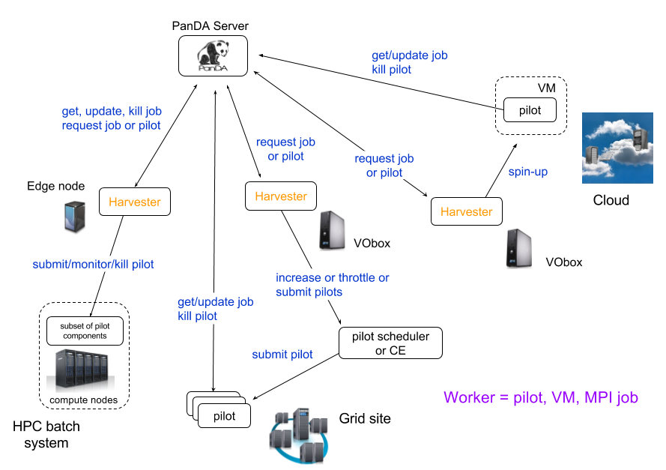
HPC operations
Harvester is used to connect PanDA jobs to HPC centers

Slide 3
Yoda
Jumbo Jobs
Normal ATLAS simulation jobs 1000 events - designed for 8 cores for up to 24 hrs
Single ATLAS simulation job for Event Service – sized to fit HPC batch submission.
(many 100k events)

Slide 4
Yoda
yoda_droid
Rank 0
Rank 1
Rank N
Yoda
Droid
Droid
Harvester
Work Manager
Transform Manager
Transform Manager
File Manager
JobComm
JobComm
…
MPIService
MPIService
MPIService
Yoda developed by Taylor Childers ANL/ALCF
Shared File System
Queue message
MPI Communication

Slide 5
Why Jumbo Jobs?
HPC center’s WMS (SLURM, Cobalt,…..) limit the number of submission per users.
On grid typically one batch submission per 8 cores (or so).
For ATLAS means 1 pilot per job and one job per batch slot.
On HPC’s with limited number of submissions in the queue – need multimode submissions.
At NERSC Harvester requests 250 KNL nodes per worker (batch submission)
Why Event Service?
Because Torre likes it. ;-)
Fine grain event simulation leads to efficient use of CPU resources.

Slide 6
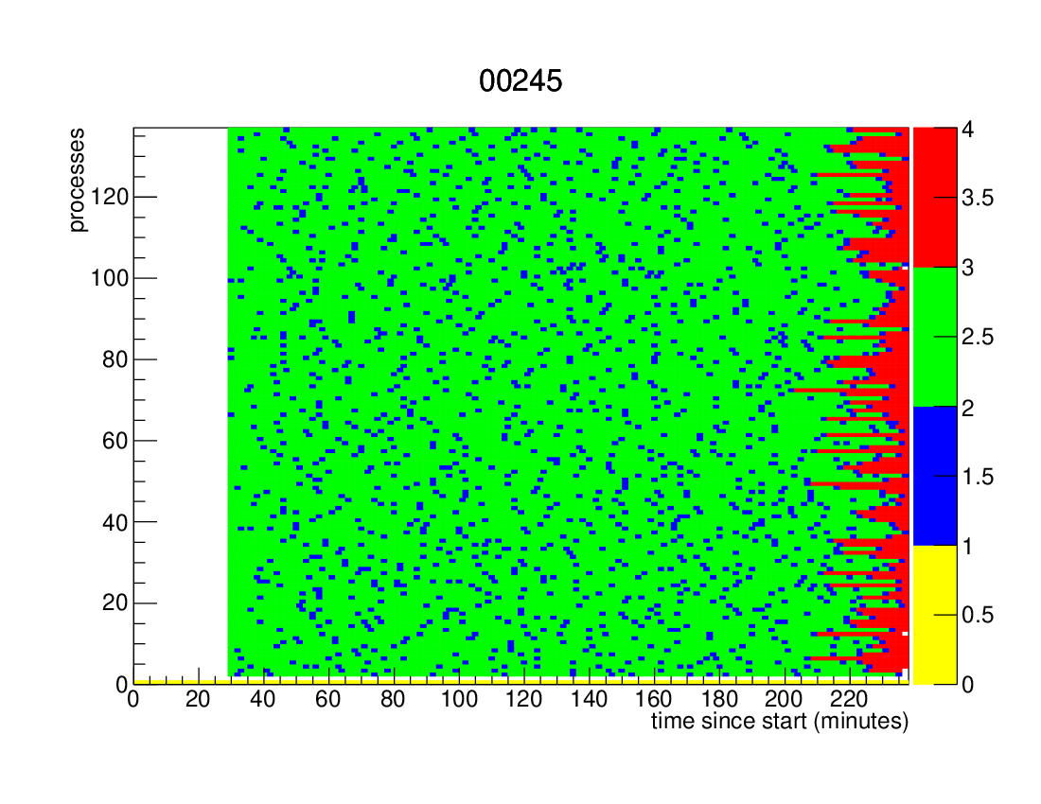
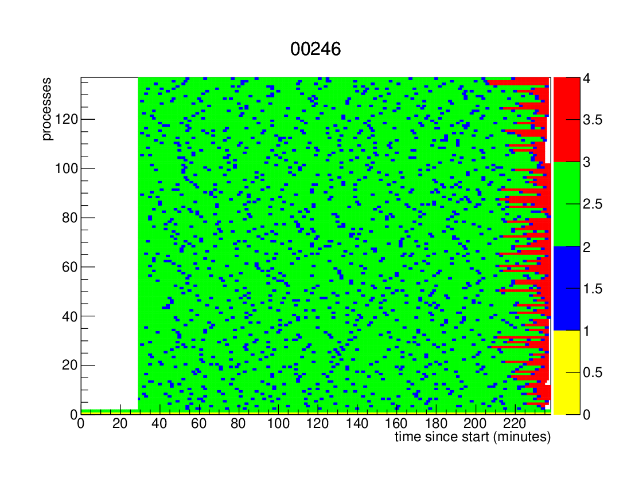
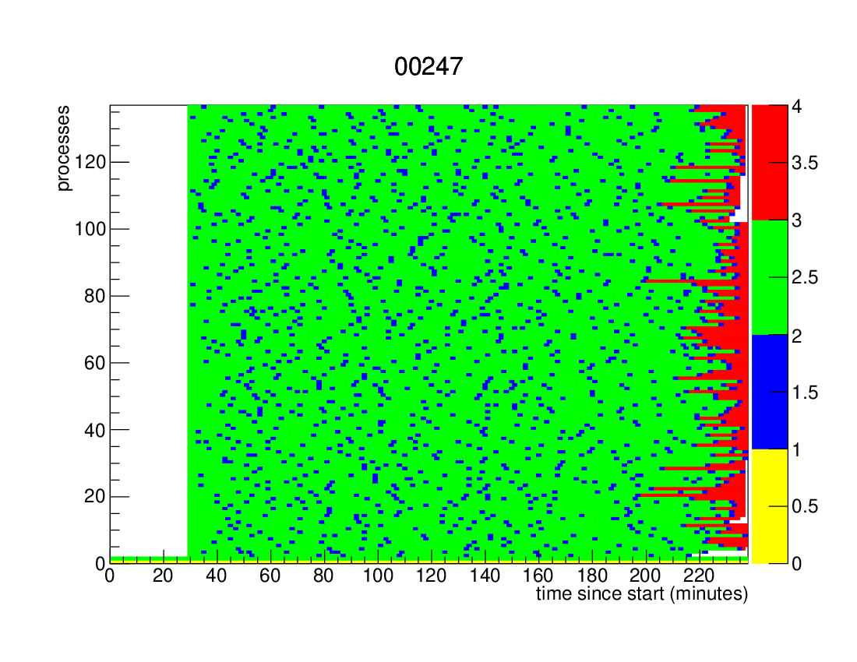
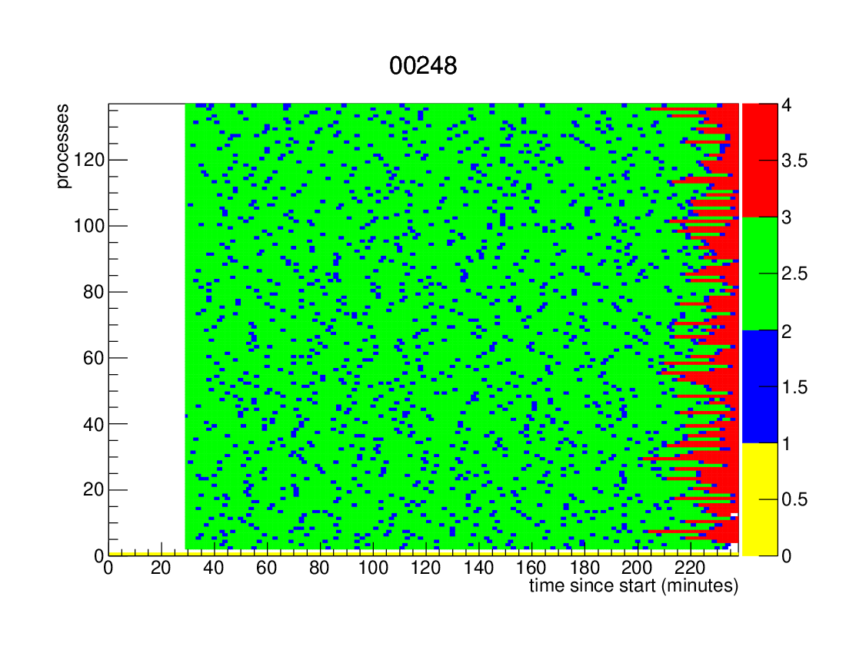
NERSC
Cori
G4 Simulation
Efficient
Running
250 nodes

Slide 7
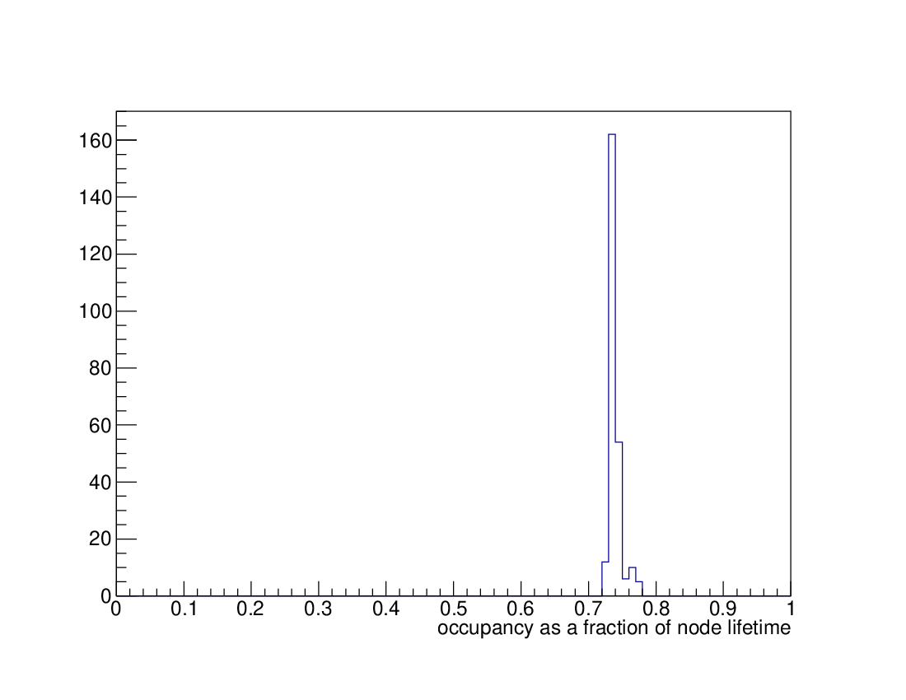
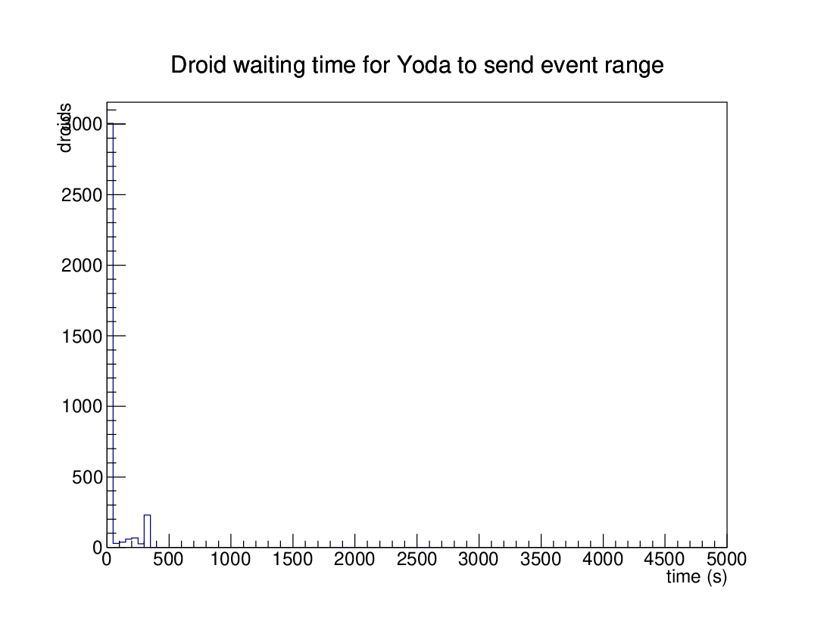
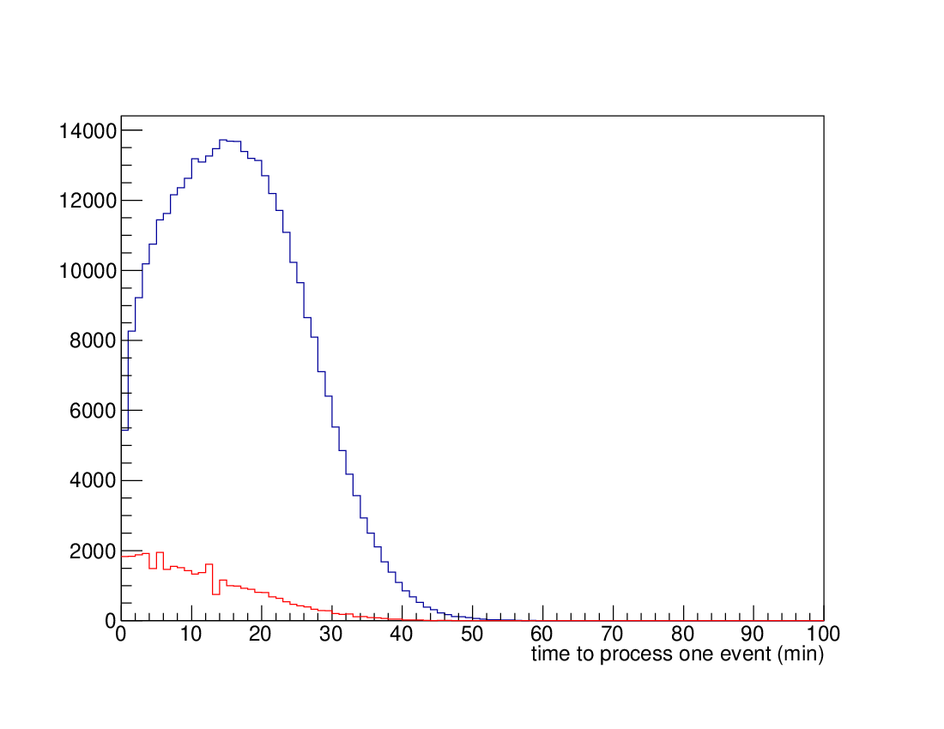
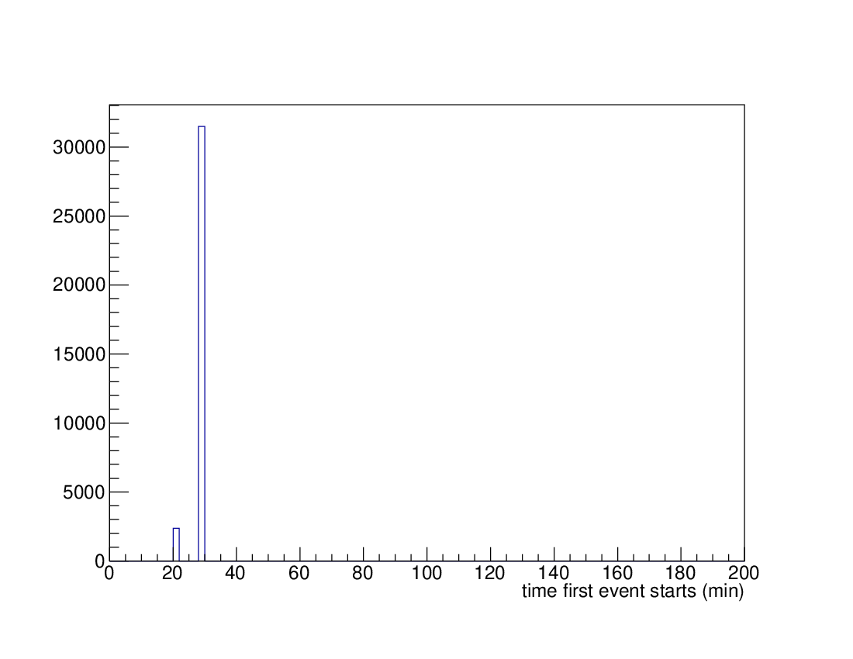
Fraction of Time spent simulating events
Time spent simulating events

Slide 8
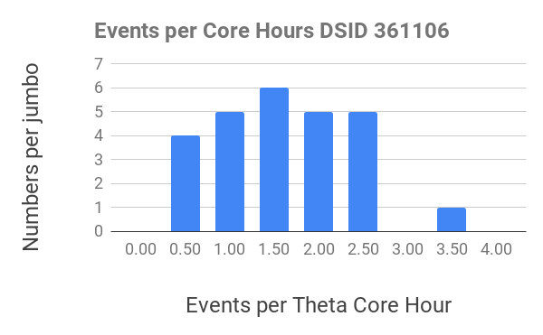
Efficient use of Allocations
Recently add code to Harvester to “hover – up” the simulated events not transferred from Yoda to Harvester.
Allows Event Services jobs to run a larger scale at the HPC centers.
At NERSC large jobs (>= 1024 nodes) receive a 40% on the Cori KNL nodes.
There is still work to do:
Big spread in the number of events per core hours. 0.5-3.5
Working to understand if there is a communication bottleneck some in the Yoda/Droid code

Slide 9
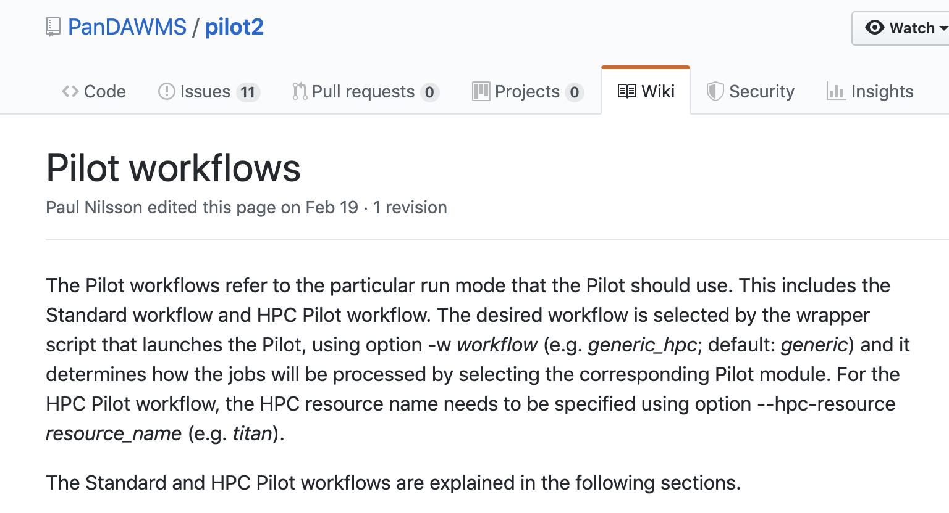
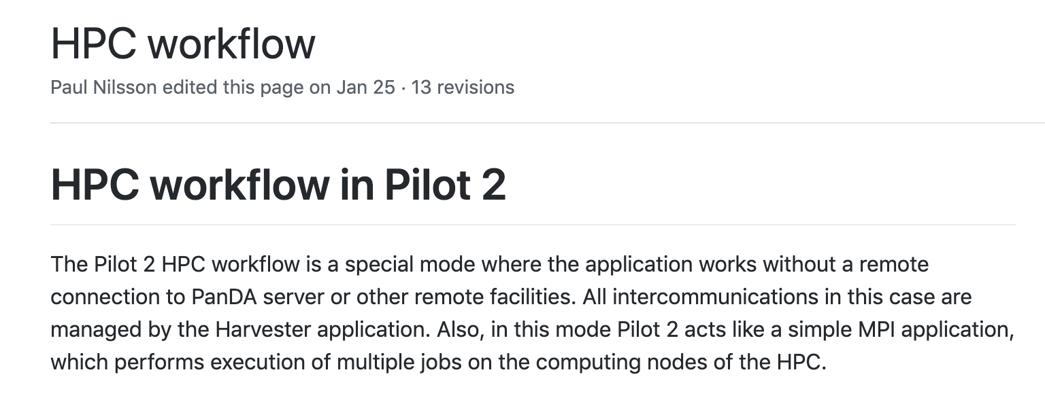
Pilot V2
Panda Pilot has been modernized and rewritten
https://github.com/PanDAWMS/pilot2

Slide 10
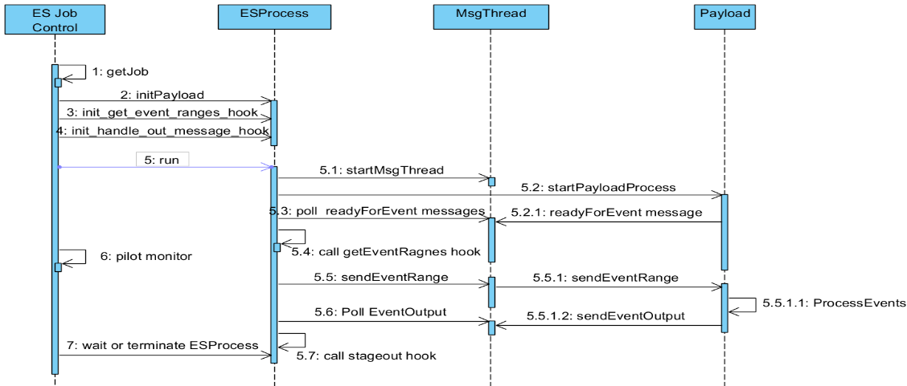
Pilot V2 Event Service
https://twiki.cern.ch/twiki/bin/view/PanDA/EventService
https://github.com/PanDAWMS/pilot2/tree/master/pilot/eventservice

Slide 11
Pilot V2 Event Service
When ever possible the pilot must run on the computer nodes
This allows for consistent monitoring between grid jobs and non grid jobs
Reduces code duplication because many functions are already written and test
Provides for better test software because it is run in many sites
Implication –
Need a glue layer between Harvester and pilot for jumbo jobs.
Specifically code communicate with Harvester and pass information to/from the pilot via the shared file system.
ES code in pilot v2 has a plugin structure that allows for such code
This is independent of what technology is used to orchestrate the multiple compute nodes (Yoda/Droid or Ray)

Slide 12
Jumbo Jobs and Event Service have been very effective for HPC’s.
Pilot V2 allows for better integration of HPC workflows into ATLAS Distributed computing environment.

