Slide 1
I/O challenges and lessons learned
erhtjhtyhy
Doug Benjamin
Computational Scientist
Argonne High Energy Physics Division

Slide 2
ATLAS HPC IO Challenges seen at OLCF
From our Monthly Quarterly report in 2018
In October-November «Harvester» was extended with backfill capabilities. That allowed to get rid from previous solution, which had significant scale limitations. New solution allowed to use simultaneously up to 1/3 of Titan (~6000 nodes) . Unfortunately, short payloads based of ATHENA framework (ATLAS Software framework) generate significant IO, which cause issues with NFS at OLCF, so for the moment loading from ATLAS side reduced to a safe level.
This was due to how ATLAS accesses it libraries especially at the start of a job and and the end of a job.
OLCF provided read only NFS to the compute nodes on Titan because ATLAS jobs would reek havoc on the Lustre file system
Through much collaboration with the OLCF Staff, ATLAS was able run on over 6000 Titan nodes 1/3 the machine reliably eventually.

Slide 3
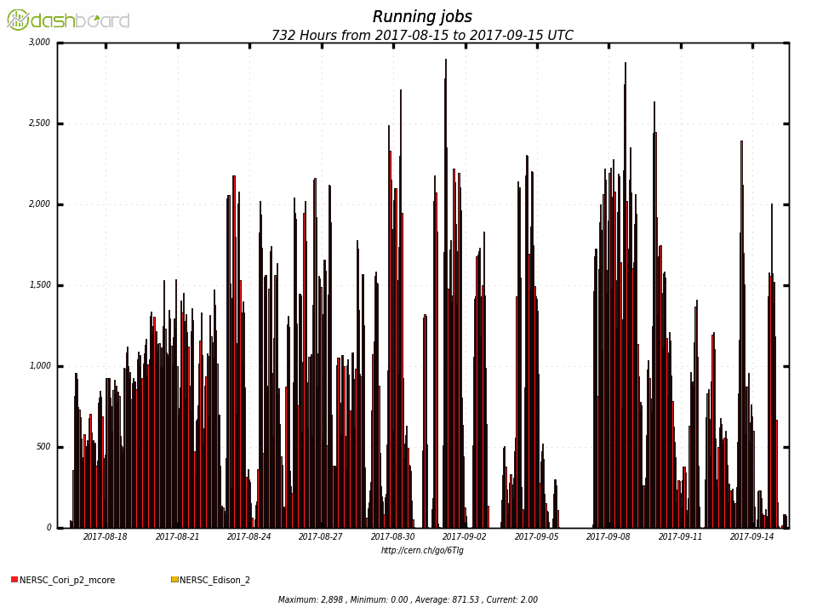
Effect of using shifter containers at NERSC
~3K
Running jobs
Containers and output to Shared file system
2.2K
Containers and loopback filesystem for output
Running in Shared File system only - at limit
1.5K
Very Bursty usage
Fast ramp up
0
28 days 1 hour bins
Example of effect of using the Shared File System alone, using Containers and Shared file system for output and Containers and loopback file system for output

Slide 4
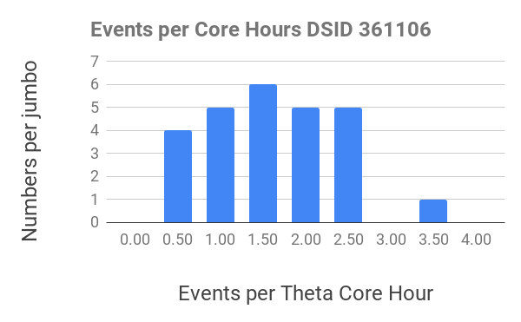
Other IO issues seen NERSC/ALCF (using containers) and Event Service – Jumbo jobs
Recently add code to Harvester to “hover – up” the simulated events not transferred from Yoda to Harvester.
Allows Event Services jobs to run a larger scale at the HPC centers.
At NERSC large jobs (>= 1024 nodes) receive a 40% on the Cori KNL nodes.
There is still work to do:
Big spread in the number of events per core hours. 0.5-3.5
Working to understand if there is a communication bottleneck some in the Yoda/Droid code

Slide 5
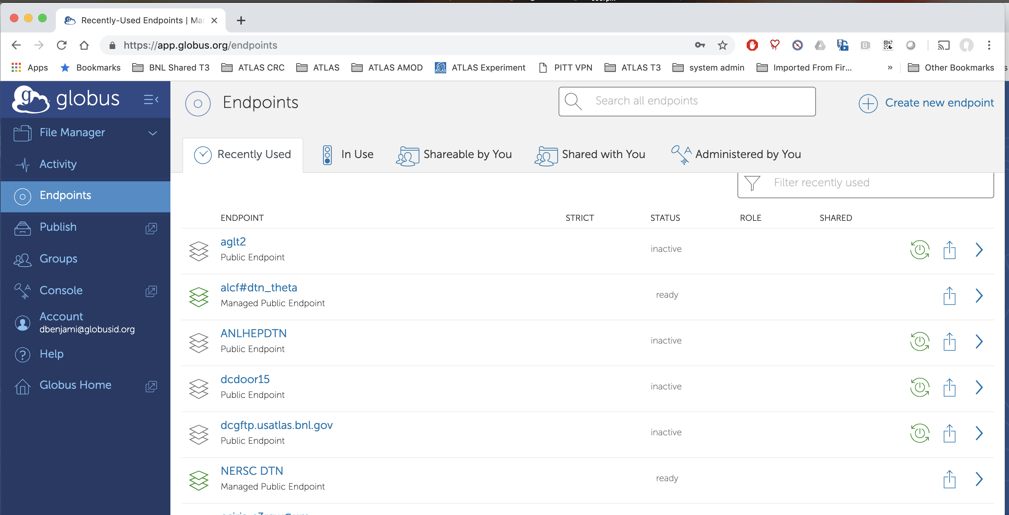
HPC operations
Data Flows –
Each HPC center has a collection of Data Transfer Nodes (DTN) that are used for transferring data to/from the local HPC storage (large Parallel File System – ie Lustre, GPFS etc)
Harvester plugins used for data transfer between HPC and US ATLAS (BNL/SLAC).
OLCF – Harvester runs on DTN and data flows to/from BNL w/ Rucio Clients
ALCF, NERSC – Harvester triggers Globus Transfer
Globus - Common tool recommended by all large US HPC centers
Web interface for users
Python-SDK for programmatic access - Used by ATLAS for ~ 2 years
- Note – Not integrated with Rucio

Slide 6
Database access
When running Simulation only jobs. We used stand alone DB release file appropriate for the Software release we were using.
To run reconstruction or Event Service file merging (??!!!??) need access to conditions database some files through cvmfs and others through Frontier system.
Requires a frontier squid cache on the edge of HPC Center and accessible to the compute nodes.

Slide 7
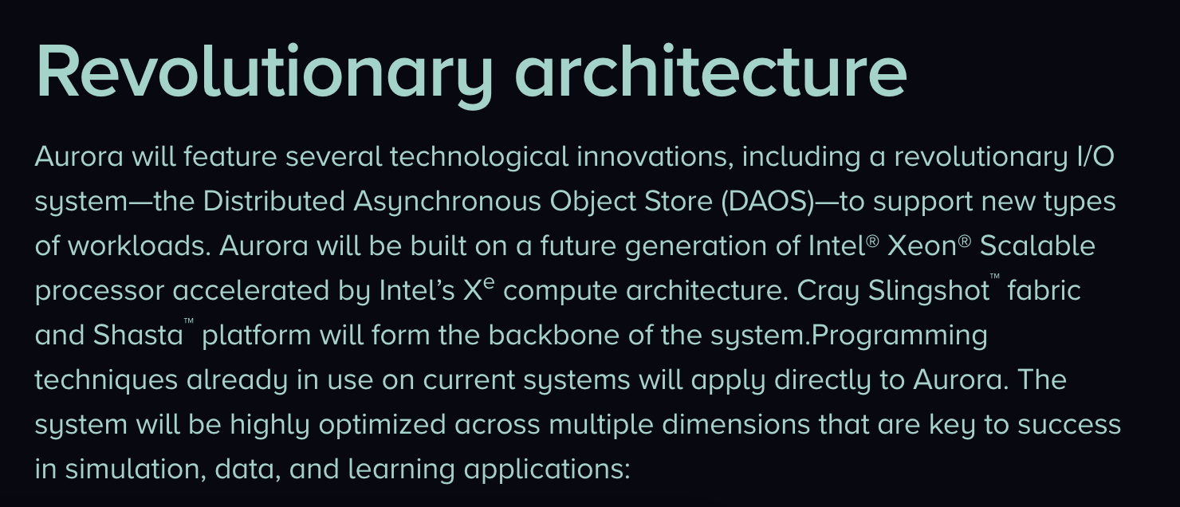
IO Future
Glenn can speak to NERSC’s Plan better that I ever could.
From Aurora press release – https://press3.mcs.anl.gov/aurora/
Object Store are part of the future. ROOT should handle them natively.

