Slide 1
ATLAS I/O Overview
Peter van Gemmeren (ANL)
gemmeren@anl.gov

Slide 2
Overview
The Basics: High level overview of ATLAS Input/Output framework and data persistence.
Athena: The ATLAS event processing framework
The ATLAS event data model Persistence:
Writing Event Data: OutputStream and OutputStreamTool
Reading Event Data: EventSelector and AddressProvider
ConversionSvc and Converter
More Details: Timeline
Run 2: AthenaMP/Shared I/O, xAOD, EventService/Yoda
Run 3: AthenaMT
Run 4: Serialization, Streaming, MPI, ESP
CCE Proposal: Discussion

Slide 3
The Basics

Slide 4
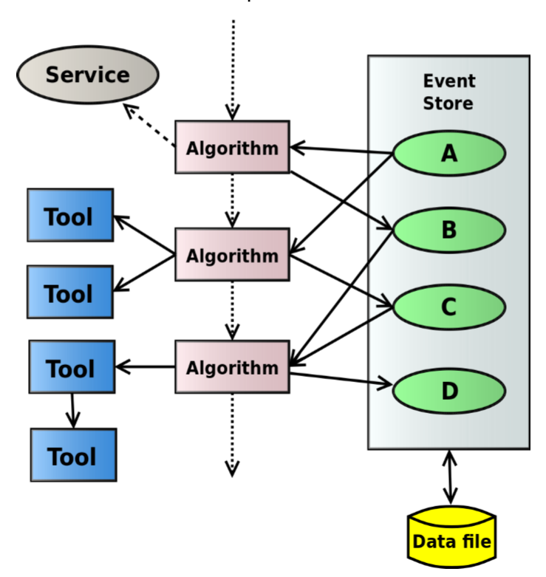
Athena: The ATLAS event processing framework
Simulation, reconstruction, and analysis/derivation are run as part of the Athena framework:
Using the most current (transient) version of the Event Data Model
Athena software architecture belongs to the blackboard family:
StoreGate is the Athena implementation of the blackboard:
A proxy defines and hides the cache-fault mechanism:
Upon request, a missing data object instance can be created and added to the transient data store, retrieving it from persistent storage on demand.
Support for object identification via data type and key string:
Base-class and derived-class retrieval, key aliases, versioning, and inter-object references.

Slide 5
Workflows and I/O
Step | Total Read (incl. ROOT and P->T) |  | Total Write (w/o compression) |  | ROOT compression |  | Total CPU evt-loop time
EVNTtoHITS | 0.006 | 0.01% | 0.017 | 0.02% | 0.027 | 0.03% | 91.986
HITtoRDO | 1.978 | 5.30% | 0.046 | 0.12% | 0.288 | 0.77% | 37.311
RDOtoRDO-Trigger | 0.125 | 1.23% | 0.153 | 1.51% | 0.328 | 3.23% | 10.149
RDOtoESD | 0.166 | 1.88% | 0.252 | 2.85% | 0.444 | 5.02% | 8.838
ESDtoAOD | 0.072 | 23.15% | 0.147 | 47.26% | 0.049 | 15.79% | 0.311
AODtoDAOD | 0.052 | 5.35% | 0.040 | 4.06% | 0.071 | 7.24% | 0.979
RAWtoALL | N/A | N/A | 0.112 | 0.72% | 0.043 | 0.28% | 15.562
Athena is used for different workflows in Reconstruction, Simulation and Analysis (mainly Derivation).

Slide 6
The ATLAS event data model
The transient ATLAS event model is implemented in C++, and uses the full power of C++, including pointers, inheritance, polymorphism, templates, STL and Boost classes, and a variety of external packages.
At any processing stage, event data consist of a large and heterogeneous assortment of objects, with associations among objects.
The final production outputs are xAOD and DxAOD, which were designed for Run II and after to simplify the data model, and make it more directly usable with ROOT.
More about this later…

Slide 7
Persistence
Dynamic Attr Reader
Store
Gate
On-demand single attribute retrieval
Conv. Service
Opt.
T/P
POOL
Svc
APR:Database
ROOT
On-demand single object retrieval
APR:Database
ROOT
Input File
ATLAS currently has almost 400 petabytes of event data
Including replicated datasets
ATLAS stores most of its event data using ROOT as its persistence technology
Raw readout data from the detector is in another format.
Compressed baskets (b)
Baskets (B)
Persistent State (P)
Transient State (T)
read
decompress
stream
t/p conv.

Slide 8
Backup Slide: Writing Event Data
Sequence Diagram for writing Data Objects via AthenaPOOL:
The AthenaPool-OutputStreamTool is used for writing data objects into POOL/APR files and hides any persistency technology dependence from the Athena software framework.
AthenaPool
AthenaPool
AthenaPool
PoolSvc
Output
CnvSvc
Converter
StreamTool
connect
new
Data
Output()
Header
setProcess
Tag(
pTag
stream
)
Objects()
loop
createRep
(
obj
,
addr
)
createRep
(
obj
,
addr
[object in
)
DataObject
item list]
ToPool
()
T
-
P sep.
transToPers
[trans.
(
-
pers.
obj,pObj
conversion]
)
registerForWrite
place,
pObj
(
,
desc
)
registerForWrite
(place,
pObj
,
desc
)
token
token
addr
addr
insert(
addr
)
Register
DataHeader
in
POOL,
commit
get token and insert to self
commitOutput
(
Output()
outputName
, true)
alt
commit()
[full
commit]
[else]
commitAndHold
()

Slide 9
OutputStream and Output-StreamTool
OutputStreams connect a job to a data sink, usually a file (or sequence of files).
Configured with ItemList for event and metadata to be written.
Similar to Athena algorithms:
Executed once for each event
Can be vetoed to write filtered events
Can have multiple instances per job, writing to different data sinks/files
OutputStreamTools are used to interface the OutputStream to a ConversionSvc and its Converter which depend on the persistent technology.

Slide 10
Backup Slide: Reading Event Data
EventSelector
PoolSvc
Sequence Diagram for reading Data Objects via AthenaPOOL:
An EventSelector is used to access selected events by iterating over the input DataHeaders.
An Address-Provider preloads proxies for the data objects in the current input event into StoreGate.
AthenaPool
next()
alt
getCollectionCnv
[no more
()
events in
collection]
new
Pool
CollectionCnv
initialize()
createCollection
(type,
create (type, des,
POOL::
connection, input, context)
mode, session)
ICollection
executeQuery
()
newQuery
()
iterator
iterator
[else]
next ()
iterator
loadAddr
retrieve(
iterator
,
eventRef
esses()
ref)
()
token
retrieve(token)
T
-
P sep.
persToTrans
(
ptr
[pers.
,
DataHeader
-
trans.
dataHeader
conversion]
)
Element
setObjPtr
(
context)
ptr
, token,
loop
dataHeader
getAddress
[element
()
!= end()]

Slide 11
EventSelector and Address-Provider
The EventSelector connect a job to a data sink, usually a file (or sequence of files).
For event processing it implements the next() function that provides the persistent reference to the DataHeader.
The DataHeader stores persistent references and StoreGate state for all data objects in the event.
It also has other functionality, such as handling file boundaries for e.g. metadata processing.
An AddressProvider is called automatically, if an object retrieved from StoreGate has not been read.
AddressProvider interact with ConversionSvc and Converter

Slide 12
More Details

Slide 13
Run 2, Multi Process: AthenaMP
Since Run II, ATLAS has deployed AthenaMP, the multi-process version of Athena.
Starts up and initializes as single (mother) process.
Optionally processes events
Forks of (worker) processes that do the event processing in parallel.
Utilizes Copy On Write, thereby saving large amounts of memory.
Each worker has its own address space, no sharing of event data.
In default mode, workers are independent of each others for I/O: Read their own data directly from file and write their own output to a (temporary) file.
Input may be non-optimal as worker have to de-compress the same buffers to process different subsections of events -> cluster dispatching
output from different workers needs to be merged, which can create a bottleneck -> deployment of SharedWriter

Slide 14
AthenaMP with Shared I/O

Slide 15
SharedWriter
The Shared Writer collects output data objects from all AthenaMP workers via shared memory and writes them to a single output file.
This helps to avoid a separate merge step in AthenaMP processing.

Slide 16
SharedReader
The Shared Data Reader reads, de-compresses and de-serializes the data for all workers and therefore provides a single location to store the decompressed data and serve as caching layer.

Slide 17
More Run 2, Multi Process: EventService and Yoda for HPC
EventService uses fine grained processing to minimize potential loss and maximize parallelism
Yoda is its implementation for HPC
Both use AthenaMP as their payload processor.
Producing lots of output files and accessing input data from many processes
Potentially overburden File System
Need support for fine grained I/O, see later.

Slide 18
Also Run 2, xAOD Data Model
Each xAOD container has an associated data store object (called Auxiliary Store).
Both are recorded in StoreGate.
The key for the aux store should be the same as the data object with ‘Aux.’ appended.
The xAOD aux store object contains the ‘static’ aux variables.
It also holds a SG::AuxStoreInternal object which manages any additional ‘dynamic’ variables.

Slide 19
xAOD: Auxiliary data
Most xAOD object data are not stored in the xAOD objects themselves, but in a separate auxiliary store.
Object data stored as vectors of values.
(“Structure of arrays” versus “array of structures.”)
Allows for better interaction with root, partial reading of objects, and user extension of objects.
Opens up opportunities for more vectorization and better use of compute accelerators.

Slide 20
Run 3, Multi Thread: AthenaMT
Task scheduling based on the Intel Thread Building Blocks library with a custom graph scheduler.
Data Flow scheduling:
Algorithms declare their inputs and outputs. Scheduler ﬁnds an algorithm with all inputs available and runs it as a task.
Algorithm data dependencies declared via special properties.
Dependencies of tools will be propagated up to their owning algorithms.
Flexible parallelism within an event.
Can still declare sequences of algorithms that must execute in ﬁxed order (“control ﬂow”).
Number of simultaneous events in ﬂight is conﬁgurable

Slide 21
Things about ROOT
ROOT is solidly thread safe:
After calling ROOT::EnableThreadSafety() switches ROOT into MT-safe mode (done in PoolSvc).
As long as one doesn’t use the same TFile/TTree pointer to read an object
Can’t write to the same file
In addition, ROOT uses implicit Multi-Threading
E.g., when reading/writing entries of a TTree
After calling ROOT::EnableImplicitMT(<NThreads>) (new! in PoolSvc).
Very preliminary test show Calorimeter Reconstruction (very fast) with 8 threads gain 70 - 100% in CPU utilization

Slide 22
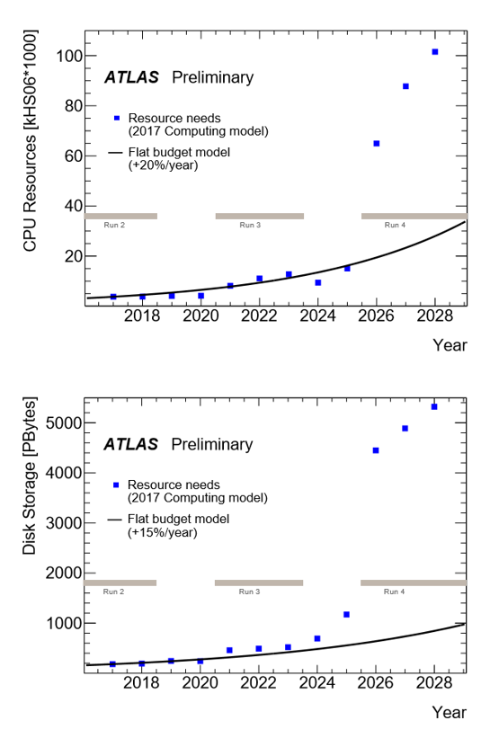
Run 4: Challenge for LHC computing
Assuming ATLAS’ current compute model, CPU and storage needs for Run 4 will increase to a factor of 5-10 beyond what is affordable.
The answer on how to mitigate the shortfall is better, wider and more efficient, use of HPC:
ATLAS software, Athena, was written for serial workflow
Migrated to AthenaMP in Run 2, but still dealing with improvements.
Required only Core and I/O software changes.
In process, but behind schedule, to move to AthenaMT for Run 3.
Limited changes non-Core software, but clients need to adjust to new interfaces.
Changes to allow efficient use of heterogeneous HPC resources (including GPU/accelerators) for Run 4 will be more intrusive.
Figures taken from:
arXiv:1712.06982v3

Slide 23
Run3 -> Run 4
ATLAS is currently reviewing its I/O framework and persistence infrastructure.
Clearly efficient utilization of HPC resources will be a major ingredient for dealing with the increase of compute resource requirements in HL-LHC.
Getting data onto and oﬀ of a large number of HPC nodes eﬃciently will be essential to eﬀective exploitation of HPC architectures.
SharedWriter already in production (e.g., in AthenaMP) and the I/O components already supporting multithreaded processing (AthenaMT) provide a solid foundation for such work
A look at integrating current ATLAS shared writer code with MPI underway at ANL & LBNL

Slide 24
Streaming data
ATLAS already employs a serialization infrastructure
for example, to write high-level trigger (HLT) results
and for communication within a shared I/O implementation
Developing a uniﬁed approach to serialization that supports, not only event streaming, but data object streaming to coprocessors, to GPUS, and to other nodes.
ATLAS takes advantage of ROOT-based streaming.
An integrated, lightweight approach for streaming data directly would allow us to exploit co-processing more eﬃciently.
E.g.: Reading an Auxiliary Store variable (like vector<float> directly onto GPU (as float []).

Slide 25
Conclusion
ATLAS has successfully used ROOT to store almost 400 Petabyte of event data.
ATLAS will continue to rely on ROOT to support its I/O framework and data storage needs.
At least for some of its workflows/data products.
Run 3 and 4 will present challenges to ATLAS that can only be solved by efficient use of HPC …
and we need to prepare our software for this.
ATLAS and ROOT

Slide 26
CCE Proposal

Slide 27
Fine-Grained I/O and Storage (IOS)
Efficiently serialize and de-serialize multiple events in parallel within a node and across multiple nodes
Have a persistent representation that provides efficient data access on HPC systems, optimized for HEP I/O patterns (specifically Write-Once Read-Many)
Support partial reads from storage of only the data needed by a given algorithm
Optimize memory layout of same data objects in sequential events to enable batch operations that span multiple events

Slide 28
Backup

Slide 29
TMPI File
Work done by Amit Bashyal (CCE summer student, Advisor: Taylor Childers) and Yunsong Wang.
TFile like Object that is derived from TMemFile and uses MPI Libraries for Parallel IO.
Process data in parallel and write them into disk in TFile as output.
Works with TTree cluster
Worker collect events, compresses and sends to collector.

