Slide 1
Scaling Distributed Machine Learning using HPC
Abid M. Malik
Meifeng Lin (PI)
Collaborators: Amir Farbin (UT) , Jean Roch ( CERN)
Computer Science and Mathematic Department
Brookhaven National Laboratory (BNL)

Slide 2
Distributed ML for HEP
Scientific data is more complex. ImageNet images are typically resized to 224 x 224 with 3 color channels. Numerical simulations have images 2048 x 2048 with 18 channels
Characteristic of the data is also different
HEP images are cats and dogs!
Prevailing distributed efforts does not work well especially when it comes to convergence of models using distributed learning
We are looking into distributing learning strategies effective for ML models for HEP

Slide 3
Horovod for Distributed Learning
The main feature of this framework is its usability
One needs to make few changes to transfer single-GPU programs to distributed GPU programs

Slide 4
Horovod for Distributed Learning
Currently working on distributing 3D GANs on Summit using Horovod
Detailed performance analysis using nvprof from Nvidia
Accuracy analysis
Tuning ring all reduce for further performance improvement
Results from an experiments at CERN: Using Horovod with KNL

Slide 5
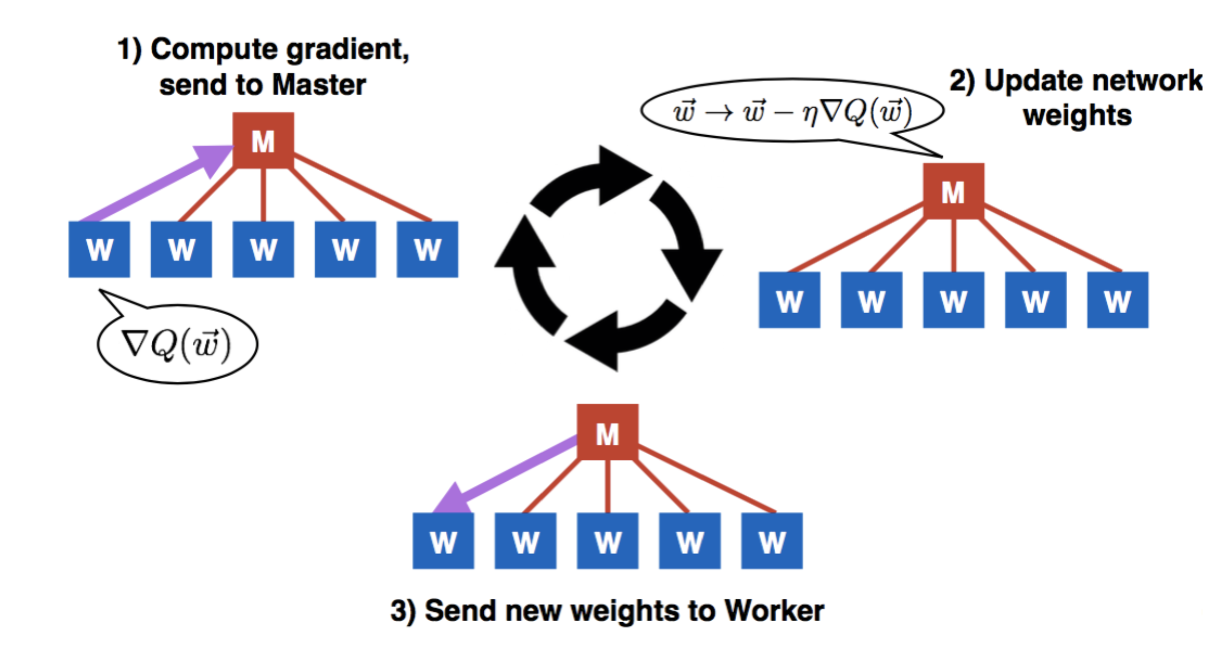
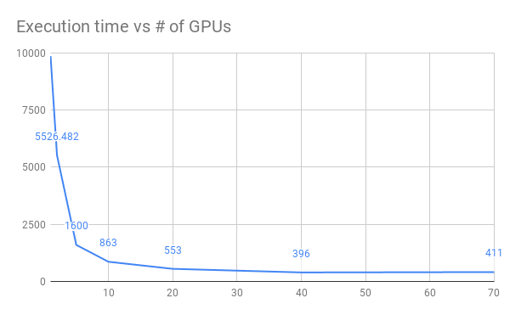
MPI_Learn Framework
Using openmpi for the all_reduce communication
Developed by the Openlab group at CERN
Distributed Training of Generative Adversarial Networks for Fast Detector Simulation
Simple implementation of a synchronized parameterized master worker model
Showed poor scalability performance when tested on the Summit machine at ORNL
High communication over head
https://insidehpc.com/2019/01/fast-simulation-with-generative-adversarial-networks/
Summit Performance:
Execution time vs Number of GPUs

Slide 6
MPI_Learn Framework
Working closely with the developing team
Simple master – worker model
Need more efficient approach which is tuned to HEP machine learning needs
The framework has Horovod support but it is not properly integrated
Hierarchical approach
Need to tune ring formation
The APIs to integrate model
Currently this is missing
The framework structure needs overhauling

Slide 7
New Approaches: Layered Stochastic Gradient Decent
Layered SGD: A Decentralized and Synchronous SGD Algorithm for Scalable Deep Neural Network Training
https://arxiv.org/abs/1906.05936
Using VGG11 on CIFAR10 data set

Slide 8
What are the Goals?
Which ML distributed framework is better for HEP ML need?
Horovod
MPI_Learn
LBANN
Deep500
Mesh TensorFlow
Other distributed ML models
What are characteristics of ML algorithms?
Communication algorithms ( main point of attention )
Memory ( main bottleneck for efficient GPU usage )
Convergence ( Key parameters for convergence, important for hyper parameter optimization)
Building a Template/Wrapper that a domain scientist can use to port his/her ML/DL model on distributed computing with ease
Hyperparameter Optimization

Slide 9
Thank you
Email = amalik@bnl.gov

