Slide 1


OLCF BigPanDA Collaboration
BigPanDA Workflow Management on Titan for High Energy and Nuclear Physics and for Future Extreme Scale Scientific Applications
Kaushik De, Shantenu Jha, Alexei Klimentov, Jack Wells
The fourth US ATLAS HPC meeting@LBL
26 September 2019
This research used resources of the Oak Ridge Leadership Computing Facility at the Oak Ridge National Laboratory, which is supported by the Office of Science of the U.S. Department of Energy under Contract No. DE-AC05-00OR22725.

Slide 2
Thanks
To Kaushik De for his slides for DOE ASCR PIs meeting

Slide 3
ATLAS Collaboration with Oak Ridge in one slide
Successful collaboration between ATLAS and Oak Ridge for the past five years
ATLAS and ORNL workshop in early 2013 to discuss how ATLAS simulation code (and Geant4 in general) can be ported to Titan and how to do it efficiently
BigPanDA (DOE HEP and ASCR) project to integrate Leadership Class Facilities (like Titan) with the HEP Distributed computing (2013-2015).Titan was the first LCF used by ATLAS in bulk production and it was integrated with the ATLAS Grid facilities, it is acknowledged in O(100) ATLAS scientific papers
BigPanDA++ project (DOE ASCR supported project : BNL, ORNL, UTA, Rutgers U) to use system developed for ATLAS (and HEP, PanDA) for non-HEP data intensive science (MD, NP, ...)
ATLAS code was built on Titan and Summit, the first demonstration how ATLAS SW release could be built on HPCs
Regular Technical interchange meetings (TIM) in 2015-2019, many discussions, talks and common computing papers in the past 3-4 years to describe a joint research between ATLAS and ORNL, in particular
J.Wells, OLCF Director of Science, gave a plenary talk at ATLAS SW&C workshop
ATLAS members S.Campana, A.Klimentov were invited to give key-note talks at Smoky Mountains conferences hosted by ORNL . ATLAS+ORNL talks (including plenary talks) at CHEP, ACAT and NEC conferences
James Catmore, Sep 18, 2019

Slide 4
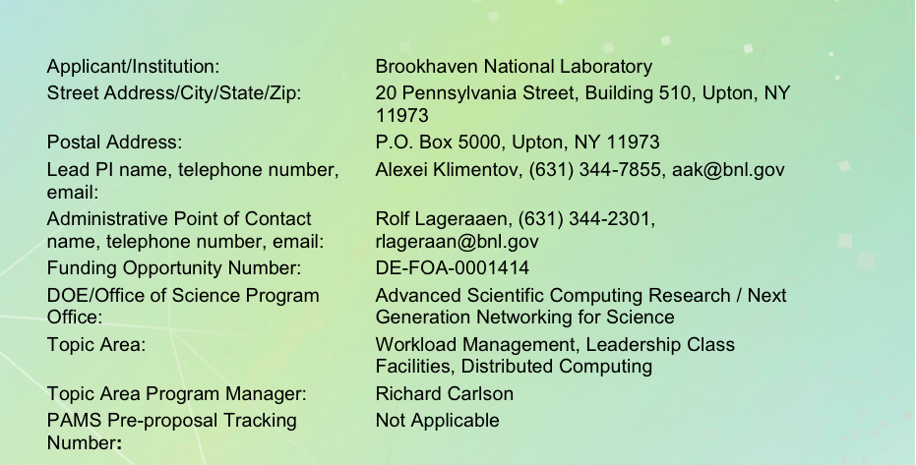
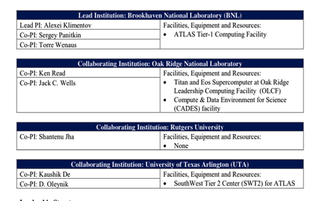
Jan 15, 2015 17:05 CET
DOE ASCR Funded Project 2015-2019
Collaborators : BNL, OLCF, Rutgers University, UTA,
  Institutes PIs : K.De, S.Jha, A.Klimentov, J.Wells
Sponsor DOE ASCR : Rich Carlson

Slide 5
BigPanDA Team
BNL :
  Alexei Klimentov
  Sergey Panitkin
  Pavlo Svirin (→ ATLAS)
UTA :
  Kaushik De
  Ruslan Mashinistov (→ BelleII)
  Danila Oleynik (→ JINR)
  Artem Petrosyan (→ COMPASS)
  Sean Wilkinson (→ ORNL)
Rutgers U :
  Shantenu Jha
  Alessio Angius
  Andre Merzky
  Matteo Turilli
ORNL :
  Jack Wells
  Valentine Anantharaj
  Oral Sarp

Slide 6
Motivations for BigPanDA Project
HPC Integration with HTC
(Google Cloud Platform integration the ATLAS Distributed Computing System has been successfully demonstrated by BigPanDA team in early 2013)

Slide 7
Research Challenges
Motivation:
  Demand for resources greatly outstrips supply
  New payloads are being developed well suited for HPC architectures
Challenge: Resource management approaches, policies and software are different for each HPC, and Grids, and Clouds
Objectives:
  How can we provide existing workload management capabilities (PanDA) uniformly across HPC, Grids and Clouds?
  Use it to utilize otherwise unusable resources on HPC as well as traditional allocations queue-based resource management

Slide 8
The Opportunity for HPC-Grid (HTC) Integration I
How do we efficiently integrate HPC resources and distributed High-Throughput Computing (HTC, or Grid) resources?
From the perspective of large supercomputer centers, how best to integrate large capability workloads, e.g., the traditional workloads of leadership computing facilities, with the large capacity workloads emerging from, e.g., experimental and observational data?
Workload Management Systems (WLMS) are needed to effectively integrate computing for experimental and observation data into HPC data centers.

Slide 9
The Opportunity for HPC-Grid (HTC) Integration II
The ATLAS experiment provides an attractive science driver, and the PanDA Workflow Management System has attractive features for capacity-capability integration (2013 meeting at ORNL)
• The Worldwide LHC Computing Grid and a leadership computing facility (LCF) are of comparable compute capacity.
  WLCG (ATLAS share): 350,000’s x86 compute cores
  Titan: 300,000 x86 compute cores and 18,000 GPUs
• There is a well-defined opportunity to increase LCF utilization by increasing backfill opportunities.
  Batch scheduling prioritizing leadership-scale jobs results in ~90% utilization of available resources at DOE’s LCFs.
  Up to 10% of Titan’s cycles (~400M core hours) are available if a very large volume of capacity jobs can be run in backfill mode.

Slide 10
Selected Results from BigPanDA

Slide 11
Deploying PanDA on Titan
Titan’s architecture, configuration and policies posed several challenges to the deployment of PanDA e.g., :
  The default deployment model of PanDA Pilot is unfeasible on Titan:
    Pilot requires communication with the PanDA Server to pull jobs to execute, but
    This not possible on Titan because worker nodes do not offer outbound network connectivity
  The specific characteristics of the execution environment require re-engineering of ATLAS application frameworks, e.g., absence of local storage on the worker nodes, and modules tailored to Compute Node Linux
Given various constraints and challenges, the Monte Carlo detector simulation task is most suitable for execution on Titan
  Accounts for ≈ 60% to 70% of all the jobs on WLCG, making them a primary candidate for offloading
  Task is mostly computational-intensive, requiring less than 2GB of RAM at runtime and small input data

Slide 12
OLCF Titan Integration with ATLAS Computing
Pre-Harvester
D. Oleynik, S. Panitkin, M. Turilli, A. Angius, S. Oral, K. De, A. Klimentov, J. C. Wells and S. Jha,
”High-Throughput Computing on High-Performance Platforms: A Case Study”,
IEEE e-Science (2017) available as: https://arxiv.org/abs/1704.00978

Slide 13
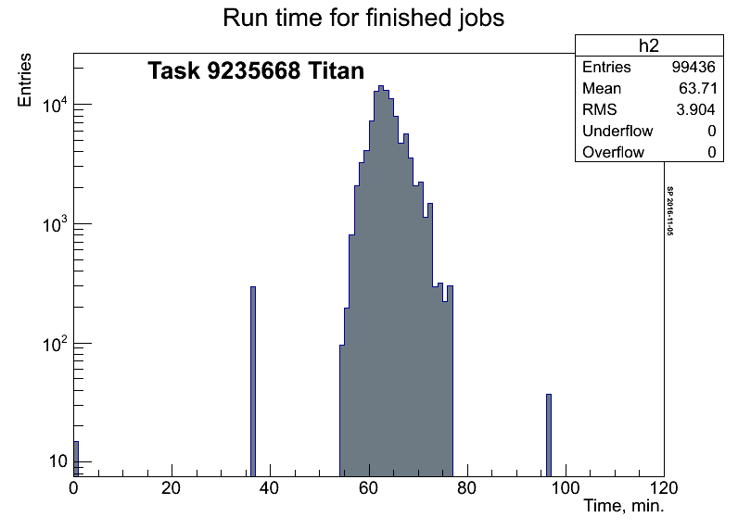
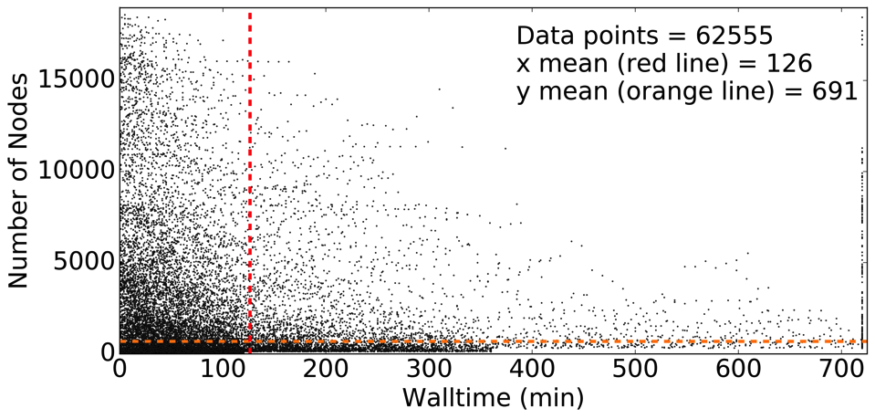
Learning Backfill Capabilities on Titan
Job size are flexible, scaling from 1
node to 300 nodes on Titan
Job runtime can be relatively short.
  Duration of recent ATLAS simulation workload is approximately 65 min.
  With shorter workload duration, backfill efficiency will increase.

Slide 14
Operational Demo: Scaling Up Active Backfill
Consumed 370 Million Titan core hours from Jan. 2016 to Sep. 2018
  This is 2.8 percent of total available time on Titan over this period
Remaining used backfill slots are often too short or too small for assigned ATLAS payloads

Slide 15
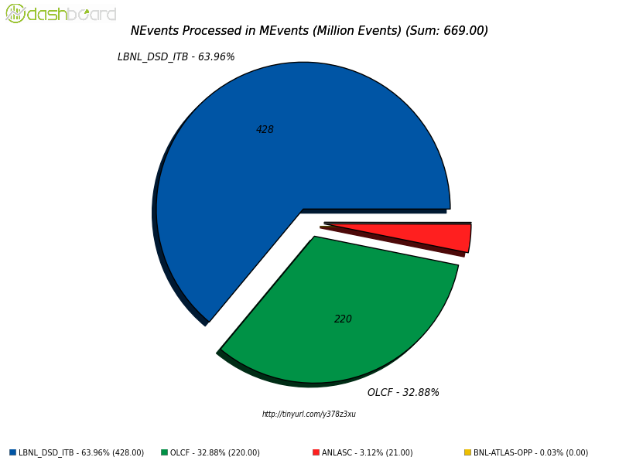
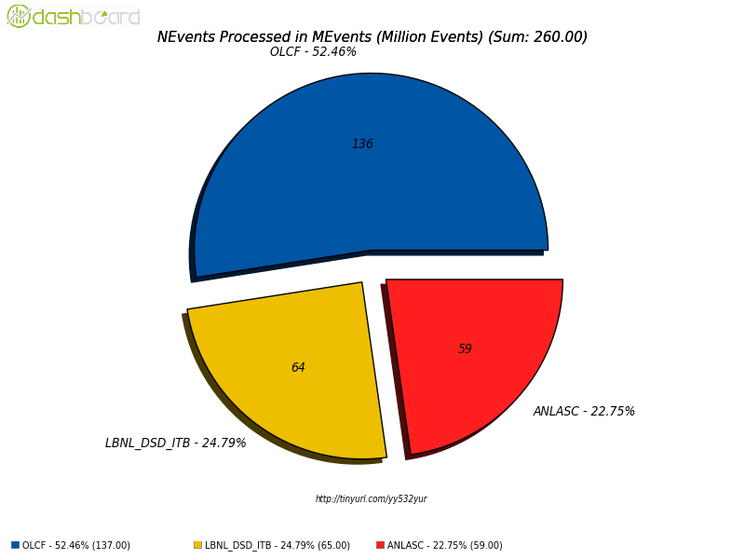
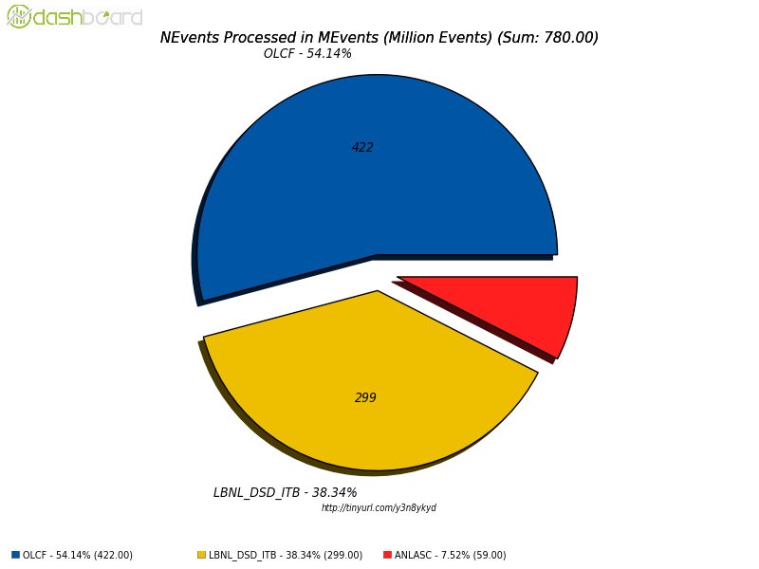
DOE HPC Utilization by ATLAS
2018: OLCF ALCC+Backfill
2017: OLCF Backfill
Through BigPanDA
2019: OLCF ALCC+Backfill

Slide 16
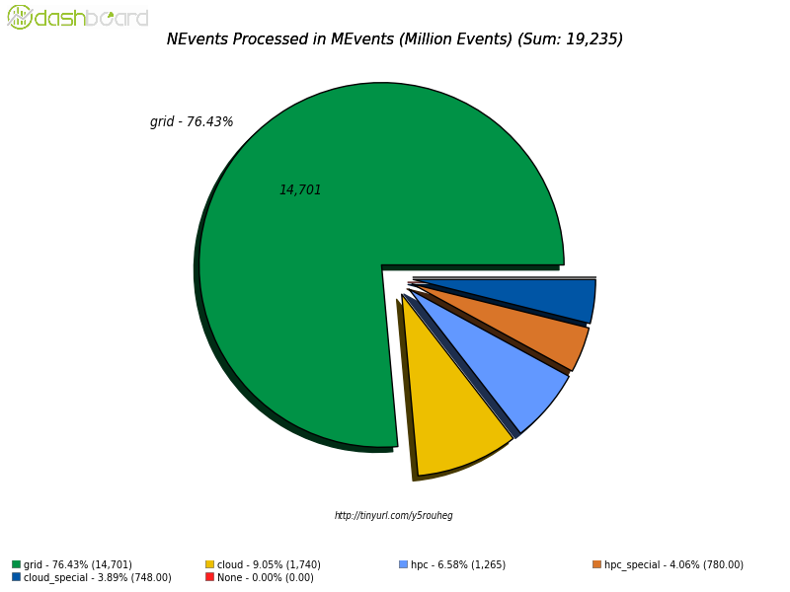
HPC Impact on ATLAS
Calendar Year 2018
HPC
Key to LHC physics success: integration of Grid with HPC and Cloud resources

Slide 17
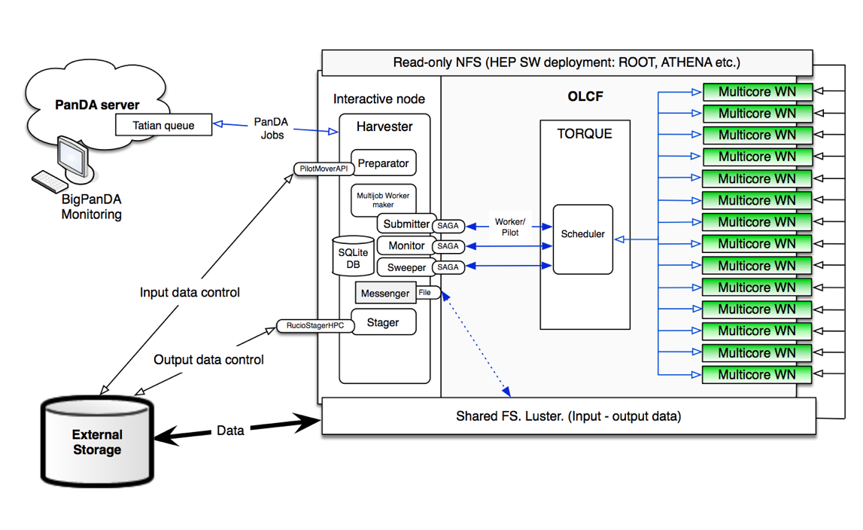
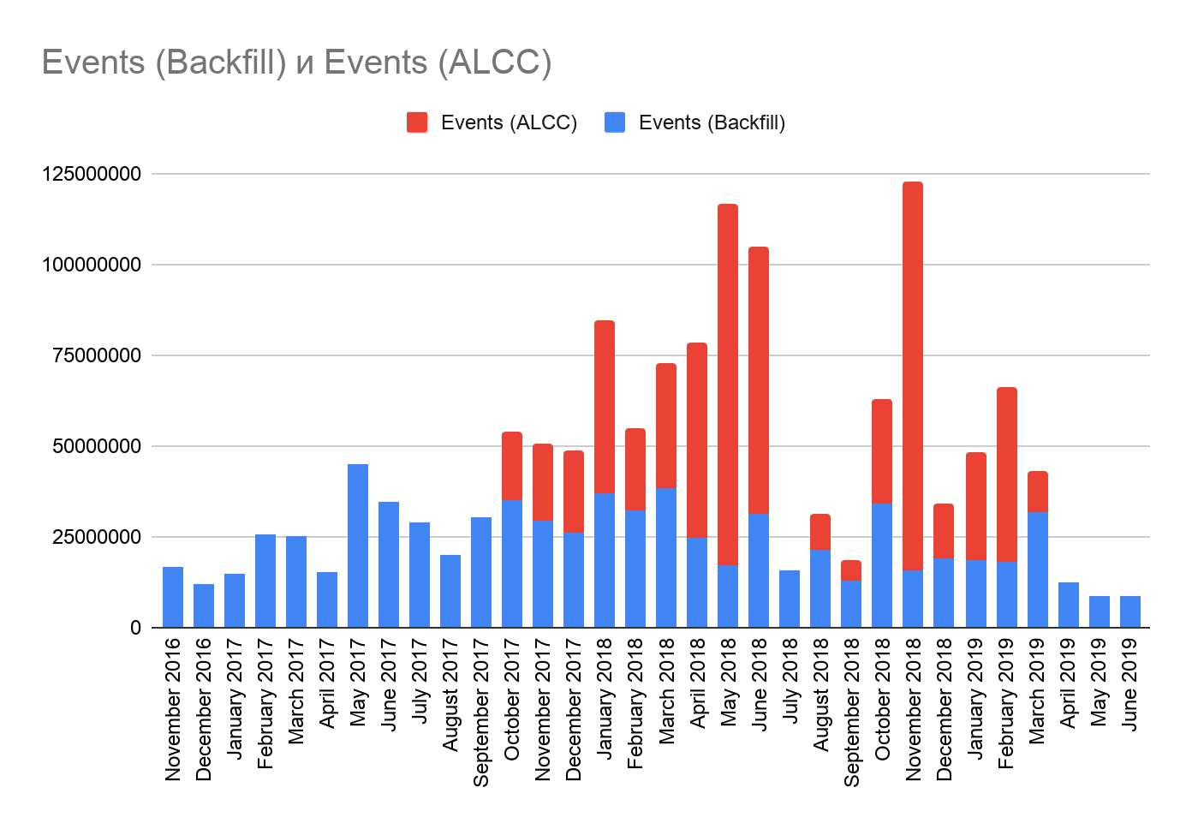
ATLAS production at OLCF (Nov. 2016 - Jun. 2019)
1,406,426,900 Events produced, 755,575,900 - "Backfill”, 650,851,000 - "ALCC"
New architecture for BigPanDA (Harvester) was developed to increase ALCC utilization

Slide 18
Summary of Titan Utilization through BigPanDA
BigPanDA project clearly demonstrated HPC integration with HTC
  With backfill utilization: increased MC simulations benefitting ATLAS physics results, while increasing LCF overall utilization
  Enabled ATLAS to win ALCC allocation in support of LHC physics goals
  New modes for use of HPC for data intensive sciences
BigPanDA opened the door for using HPC to advance HEP science
  Increased annual allocation for ATLAS at Titan, NERSC and ALCF
  Major new efforts to port HEP applications to HPC architectures
  Increased use of HPC resources worldwide
  HPC is part of HEP official strategy to solve future LHC challenges
BigPanDA spurred workload management software development
BigPanDA opened the door for HPC use by other scientific communities
BigPanDA created new avenues for CS research in HPC modeling
While PanDA Broker implementation is resource specific, it was successfully ported to other supercomputers (Significant impact on HEP planning for computing resources).

Slide 19
Opening Doors for New Domains and Looking to the Future
Using BigPanDA Services at OLCF beyond HEP
ATLAS Software Release build on Summit
Future Workflows and PanDA / Pegasus integration
Next Generation Executor

Slide 20
ATLAS Software Release Builds for the Next Generation of Supercomputers
ATLAS Comprehensive Supercomputer Compilation [ACSC] project – aims at porting ATLAS software on supercomputers
Installation from sources (means re-compilation)
Use available compilation procedures for external components: work on numerous platforms (with gcc versions => gcc4.8)
ROOT
Available on
linux, macos, openbsd
In preparation
linuxarm
linuxarm64
linuxppc64gcc
LCG Common HEP Software Collection
compiled on
Fedora, SLC, CentOS, Ubuntu, MacOS
Geant4
and other HEP Simulation Tools
compiled on
SLC, CentOS, Ubuntu, gcc[567]
GAUDI
HEP Software Framework compiled on CentOS 7, SLC6
with gcc6
  methodology was initially developed and successfully tested on Titan at OLCF (x86)
  Few tweaks to ATLAS compilation procedures developed (e.g. adjustments of compiler macro)
  ATLAS detector simulation tasks ran OK on Summitdev and Summit
Alex Undrus (BNL)

Slide 21
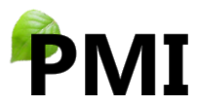
PanDA Server at OLCF: Broad application across domains
In March 2017 a new PanDA server instance has been set up at ORNL to serve various experiments. This installation the first at OLCF to demonstrate application of a container cluster management and orchestration system, Red Hat OpenShift Origin.
  We are looking forward for experimenting with a wide variety of payloads.
OpenShift, when fully in production, will give OLCF users the ability to deploy and manage infrastructure services
  https://www.olcf.ornl.gov/2017/06/05/olcf-testing-new-platform-for-scientific-workflows/
nEDM

Slide 22
PanDA Server at OLCF: PanDA WMS beyond HEP
Biology / Genomics: Center for Bioenergy Innovation at ORNL
Molecular Dynamics: Prof. K. Nam (U. Texas-Arlington)
IceCube Experiment
Blue Brain Project (BBP), EPFL
LSST (Large Synoptic Survey Telescope) project
LQCD, US QCD Project
nEDM, (neutron Electric Dipole Moment Experiment, ORNL
nEDM

Slide 23
Backfill on Summit
First look at backfill opportunities on Summit
Data collected by querying LCF scheduler on Summit for a number of days from May to July 2019
Data show significant opportunities for backfill on Summit that may be utilized to run ATLAS workloads using approach similar to the one successfully used by BigPanDA project on Titan
  Dynamic job size and duration shaping, based on real-time backfill information
First statistical analysis of the data showed positive autocorrelations over large time intervals
We are working on application of statistical (ARIMA, etc) and ML (LSTM, etc) models to the data, with the goal to develop smart, data driven algorithm for efficient backfill jobs submission

Slide 24
WGANCalo Model – New Modes of HPC Use
WGANCalo model developed by ATLAS LAL group (Aishik Gosh) was ported to Summit
  The model is aimed at generation of showers in ATLAS calorimeter using GAN approach
  Model training even with current limited dataset takes about 2 days on a single P100 GPU at LAL, pretty slow on Summit V100 GPU as well
  Currently the model can use single GPU only.
  Most likely the model training can benefit from adaptation for distributed ML frameworks like Horovod
  After porting and testing on Summit the model was transferred to BNL’s Horovod expert Abid Malik
  The model was developed for Python 2, hence required installation of IBM PowerAI ML stack for that Python version
S.Panitkin

Slide 25
Containers on Summit
  Singularity is available on Summit, v3.2.1-1 is installed
  There is no native container builder for Summit at OLCF yet, but this is in works according to Jack Morrison
  S.P. tried a couple of ppc64 Docker images from ibmcom Docker hub branch
  Converted Docker containers to Singularity native (sif) format
    Advantage, in terms of IO, of single file access instead of multi file Docker format
    One can do the conversion without superuser privileges
  With addition of external directory on local disk that hosted missing Python packages S.P. was able to run ATLAS b-tagging example in container on Summit
S.Panitkin

Slide 26
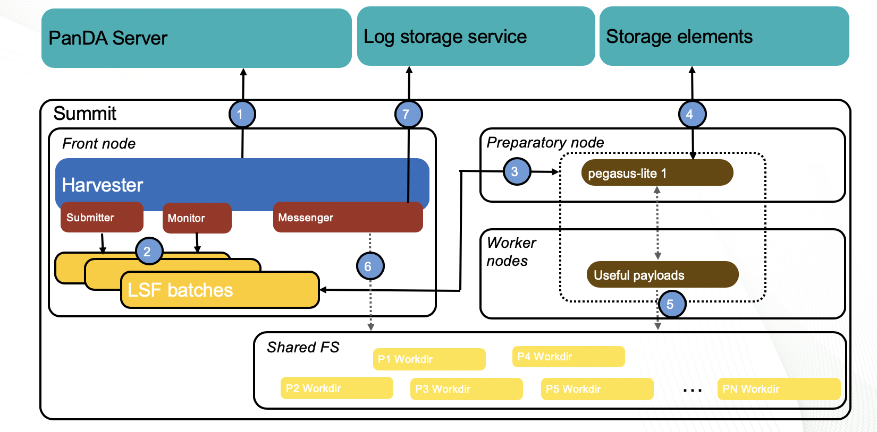


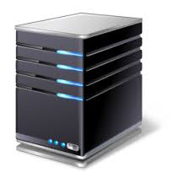
PanDA/Pegasus. Target computing environment
Active phase started in November 2018
We managed to build a communication between Pegasus and PanDA
We are experimenting with real workflows:
  LQCD
  SKA
  LSST/DESC
  IceCube
OSG
Bellarmine
BNL
PanDA
EC2 instance
Users
submitting jobs
BNL IC
Summit
NERSC Cori
With data exchange over RUCIO

Slide 27
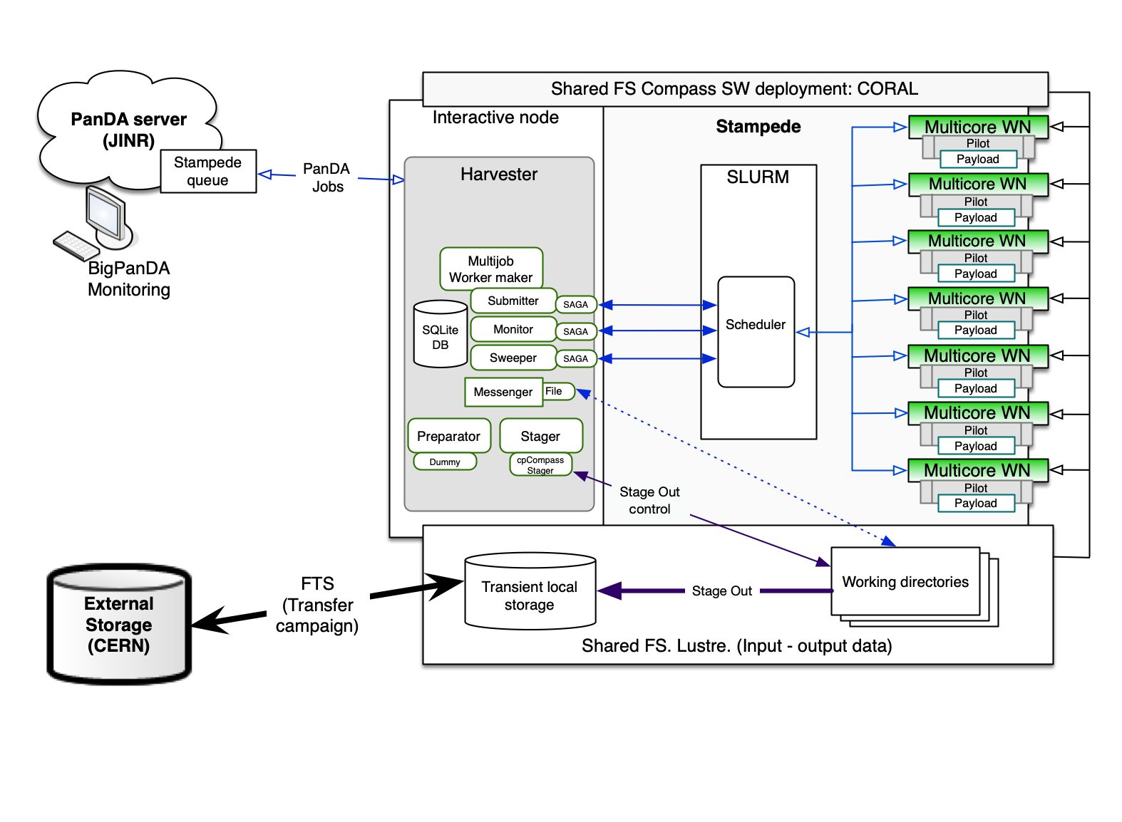
PanDA@NCSA (Stampede for COMPASS experiment)
COMPASS production system manages distributed data processing through PanDA WMS.
Stampede supercomputer was recently integrated.
Method of integration is the same as for OLCF. Harvester on the edge node, ManyToOne workflow. A few plugins had to be implemented: facility-specific plugins, stager plugin.
Compass has no advanced data management system yet, so sites wide data transfers organised as campaigns through FTS. Production system takes care of the proper definition of data placement in the job definition. Harvester assumes, that input data already placed and does not take care about pre-staging of the input data, the output data are placed on the local storage according to an internal convention. Compass HPC Pilot is the application for supporting of Compass specific workflow on HPC working nodes. In the nearest plan: incorporate this workflow into PanDA Pilot2.

Slide 28
Future of BigPanDA
PanDA and Next Generation Executor

Slide 29
Next Generation Executor (NGE)
NGE: interface to RADICAL-Pilot (RP)
RP: pilot system specifically designed for HPC resources.
NGE+RP works on major HPC resources in USA: Summit, Frontera, Stampede2 and many others.
Enables pilot capabilities on HPC, i.e., HTC execution model on HPC resources.
NGE
RP Client
HPC Machine
Compute node
RP Pilot
Compute node
job
job
Compute node
job
job
Compute node
job
job
Compute node

Slide 30
PanDA and NGE: Unifying Paradigm and Tools
Same deployment model for Grid and HPC resources
HPC resources exposed as yet another batch queue
PanDA pilot(s) executed on HPC compute nodes via NGE and RP
Same PanDA pilot used for Grid resources, i.e., monitoring, accounting and execution environment
Challenges: porting/containerizing root, AthenaMP, etc., to different architectures.
PanDA Server
Harvester
NGE
RP Client
HPC Machine
Compute node
RP Pilot
Compute node
PanDA Pilot
Compute node
PanDA Pilot
Compute node
Compute node

Slide 31
BigPanDA NGE Vision
DOE Office of Science is advancing an integrated vision for exascale computing ecosystem, including data-intensive applications, e.g., experimental and observational data.
BigPanDA deployment of Titan shows the potential of distributed high-throughput computing to be integrated with high-performance computing infrastructure.
  Offers significate value for other projects beyond HEP
Solving this problem of HPC-HTC integration, even in this “proof-of-concept” demonstration, has opened new vistas for HENP computing.
BigPanDA project provided the initial motivation for the development of OLCF’s strategy for container orchestration for user-specified HPC middleware services.

Slide 32
Conclusions
BigPanDA successes on many fronts
  HPC integration with HTC
  Use of HPCs by HEP
  New models of HPC usage
  Benefit for scientific communities beyond HEP
Many challenges remain
  Integration across HPCs – not point solutions
  Application porting to new architectures
  BigPanDA team will continue the work – same people are now working at ORNL, BNL, ATLAS, COMPASS etc on related projects

Slide 33
Backup Slides

