Slide 1
FastCaloSim on GPUs
BNL CSI: Zhihua Dong, Kwangmin Yu, Meifeng Lin
ATLAS: Tadej Novak, Ahmed Hasib, Heather Gray
+ Others

Slide 2
FastCaloSim
Fast simulation of ATLAS calorimeter system
Relatively self-contained => initial target for performance analysis and GPU porting exploration
Original standalone version runs under the ROOT interpreter
Difficult to use standard profiling tools
Parallelization/GPU porting would also be difficult
Developed a compiled version of standalone FCS
program → ”runTFCSShapeValidation”
Project funded by HEP-CCE
Collaboration between ATLAS and BNL Computational Science Initiative

Slide 3
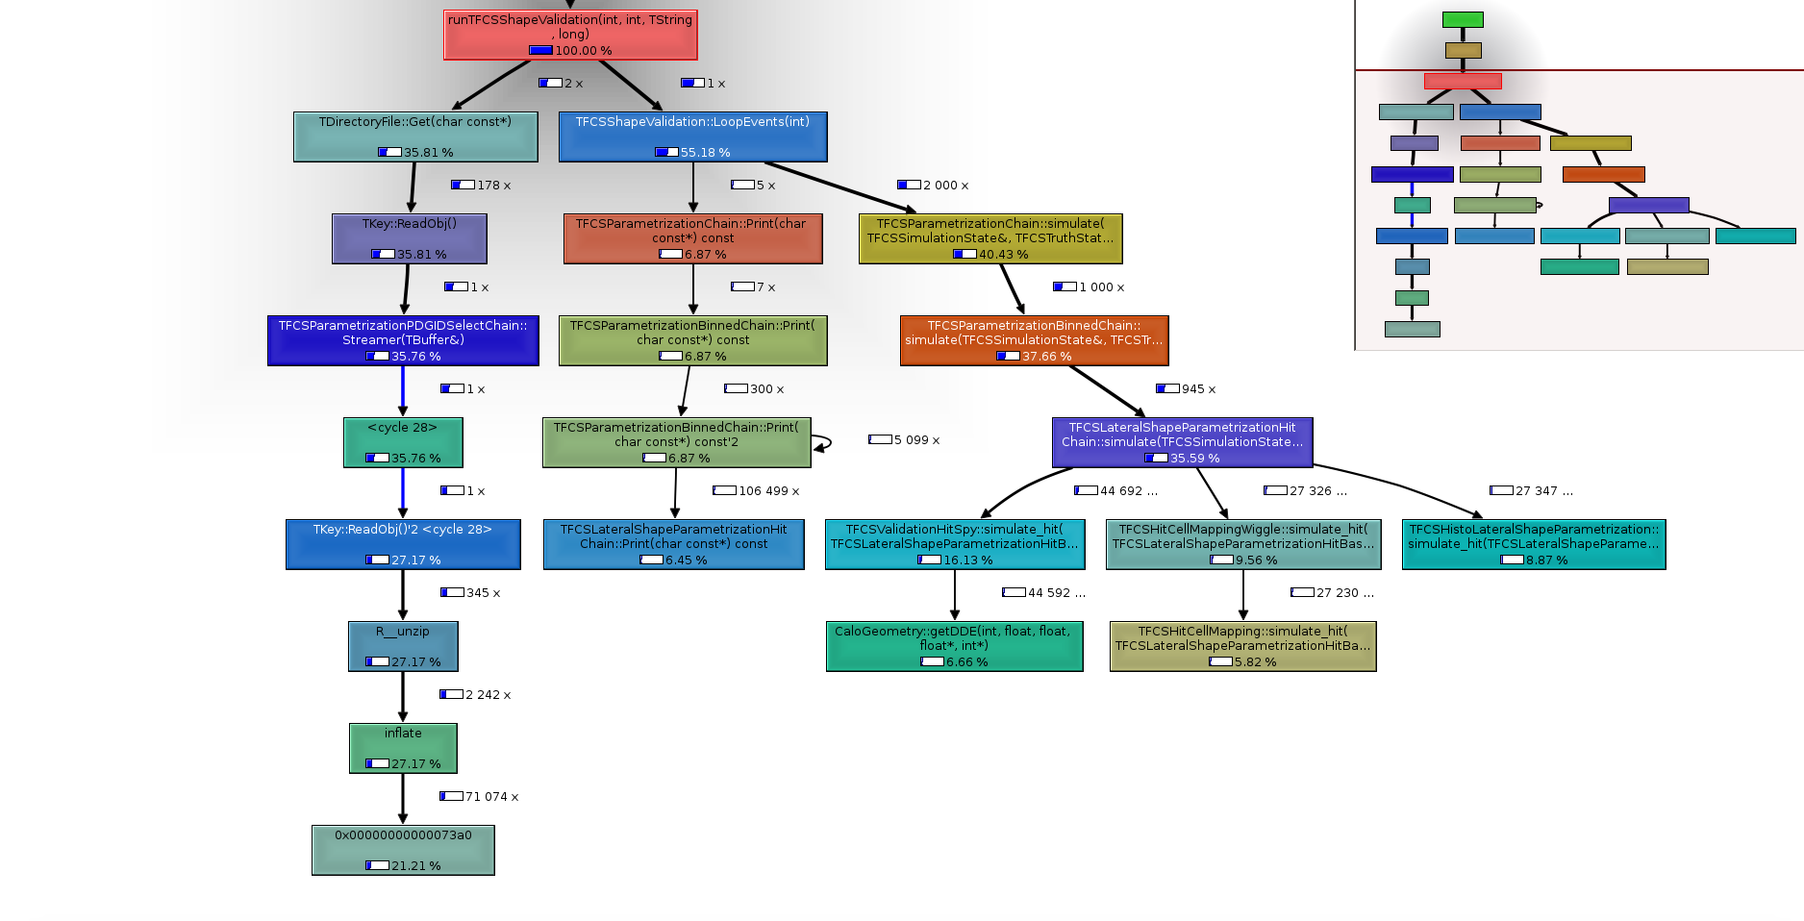
Performance Profile
TFCSLateralShapeParametrizationHitChain::simulate() is the most significant routine except I/O parts.
TFCSLateralShapeParametrizationHitChain::simulate() The running time scale with the number of events .
TFCSLateralShapeParametrizationHitChain::simulate() is our target to parallelize.
1000 event
I/O routines

Slide 4
Analysis
TFCSLateralShapeParametrizationHitChain::simulate() Structure
TFCSLateralShapeParametrizationHitChain::simulate() {
…
…
Loop on nhit
…
Loop on hit_simulation_chain
Call
End Loop
…
End Loop
…
}
Possible Parallelization
Impossible Parallelization because of data dependency

Slide 5
GPU Porting
Dependence on ROOT and C++ nature of FCS would make it difficult to use OpenACC/OpenMP
Initial path: using CUDA
Port the parallelization possible part in TFCSLateral~~~HitChain::simulate()
Implemented CUDA kernel & device functions
Data structure relocation from CPU to GPU
Geometry data can be loaded once and be reused

Slide 6
FCS GPU acceleration
For validation against GEANT4
Loop on Nhits
~50000/event
TFCSCalculateCenterPosition::
simulate_hit
Save Extraop center info (simple)
Identify hit Cell
Fill Various Histograms from Cell geo and Hit coordinates.
Save Hit (cell )
TFCSValidationHitSpy::
simulate_hit
TFCSHistoLateralShapeParametrization::
simulate_hit
Setup Hit (phi, eta, Z, E)
CUDA
Wiggle hit phi
Identify new cell
Add cell to a map
Accumulate cell’s Hit count
(or Eerngy) in “Simlustate”
TFCSHitCellMappingWiggle::
simulate_hit
GPU version of the 4 functions
Fill Various Histograms from Cell geo and Hit coordinates.
If new cell match previous cell
Fill few more Histograms
1st stage
Nhits Threads
TFCSValidationHitSpy::
simulate_hit
(AGAIN)
End Loop

Slide 7
Tasks for Porting to GPU
GPU Function to identify cell. getDDE( sample, eta, phi )
Load Geometry Info to GPU. (Deep Copy)
~200,000 Calo Cells in 24 Layers (samples). → 20+MB
(code setup run on Layer 2 has around 20,000 cells)
Various regions’ Geo info and cell pointers
Re-implement GPU CaloGeomory structure and supporting Classes
Simpler, no ROOT Dependence, only needed methods
GPU Histograms
Multi-Stage CUDA kernels
Block-wise atomic update with shared memory
Reduction of results from all blocks
GPU Hit Cell Counting
~50000 hits end up in < ~200 cells (out of ~20,000)
Multi Stage CUDA kernels
Extra step to narrow down hit cells
before standard GPU Histogram(count).

Slide 8
Each Event.
Total 40.4ms
Prepare
Simulation
3.4ms
31.3ms
ValidationEnergyAndCells
Loop on hits. ~50K
PrametrizationChain
CenterPositionCalculation
ValidationEnergy
LateralShapeParametrizationHitChain
ValidationHitSpy
PrametrizationChain
Parametrization
EbinChain
HistoLateralShapeParametrization
WriteCellsToTree
HitCellMappingWiggle
ValidationHitSpy
ValidationEnergy
~4.5K
PrametrizationChain
LateralShapeParametrizationHitChain
CenterPositionCalculation
ParametrizationEbinChain
HistoLateralShapeParametrization
HitCellMappingWiggle
3.3ms
Total
~6.5K
LateralShapeParametrizationHitChain
…
Engergy
Interplotion
Spline
Prametrization
PDGIDSelectChain
Parametrization
AbsEtaSelectChain
ParametrizationEkinSelectChain
LateralShapeParametrizationHitChain
…
Parametrization
EbinChain
LateralShapeParametrizationHitChain
…
LateralShapeParametrizationHitChain
…
PrametrizationChain
ValidationEnergyAndHit
…
LateralShapeParametrizationHitChain
…
2ms

Slide 9
Code Strucuture
G++
nvcc (host code)
Device Code
Load_geometry() ;
…
for (ievent=0; ievent<nevent ievent++) {
rand_gen_init();
Init_gpu () ;
Prepare_simulation();
for( auto ichain : m_chains) {
ichain-> simulate()
}
finish_gpu()
rand_gen_finish()
}
Simulate_Hit_gpu(args){
…
cuMalloc(…);
malloc(…) ;
rand_gen();
blocksize=512;
nblock=args.nhits/blocksize
Kernel_A<<<nblock, blocksize>>>(args);
blocksize=64 ;
nblock=ncells/blocksize ;
kernel_B<<<nblock, blocksize>>>(args) ;
cudaMemcpy( hitcells,…) ;
cudaMemcpy(num_hitcells…) ;
…
Kernel_C<<<….>>>(args);
…
Kernel_D<<<….>>>(args)
…
cudaMemcpy( hitcells_counts,…) ;
HitSpy_stage2<<<…>>>(args)
HitSpy_stage3<<<…>>>(args)
cuFree(…)
Free(…)
}
__global__
kernel_A(args){
Hit hit;
CenterPositionCal(hit&, args);
If(spy) HitSpy(args, hit&);
HistoLateralHit(args,hit&);
CellMapWiggle(args,hit&);
If(spy) HitSpy(args, hit& );
}
TFCSLateralParametrizationChain::Simulate(){
…
If(nhits>2000 && my_chain_type ) {
Load_2Dfuction() ;
Load_wiggle1Dfunction();
args=prepare();
Simulate_Hit_gpu(args)
} else {
for(ihit=0;ihit<nhit; nhit++)
for(auto ichain : m_chain)
ichain->SimulateHit_cpu();
}
….
}
…..

Slide 10
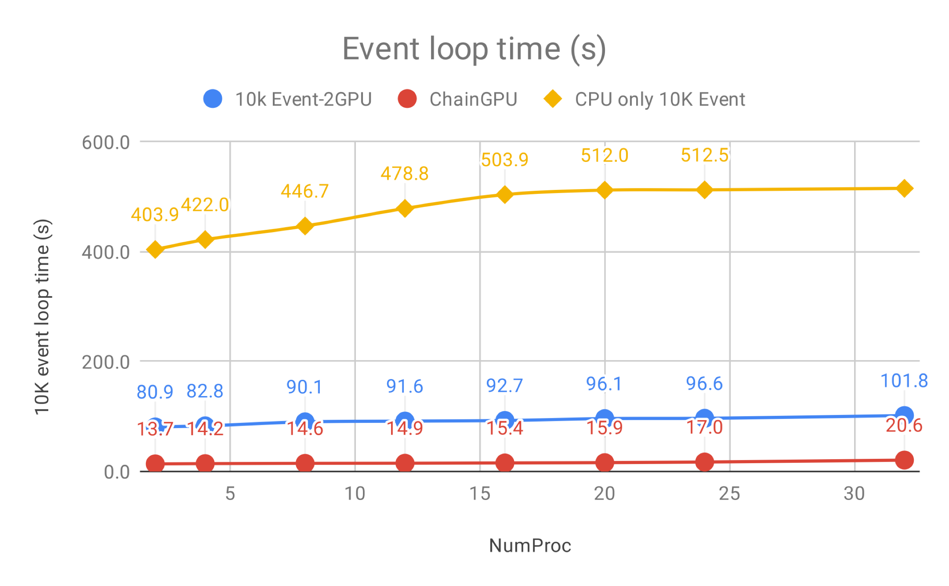
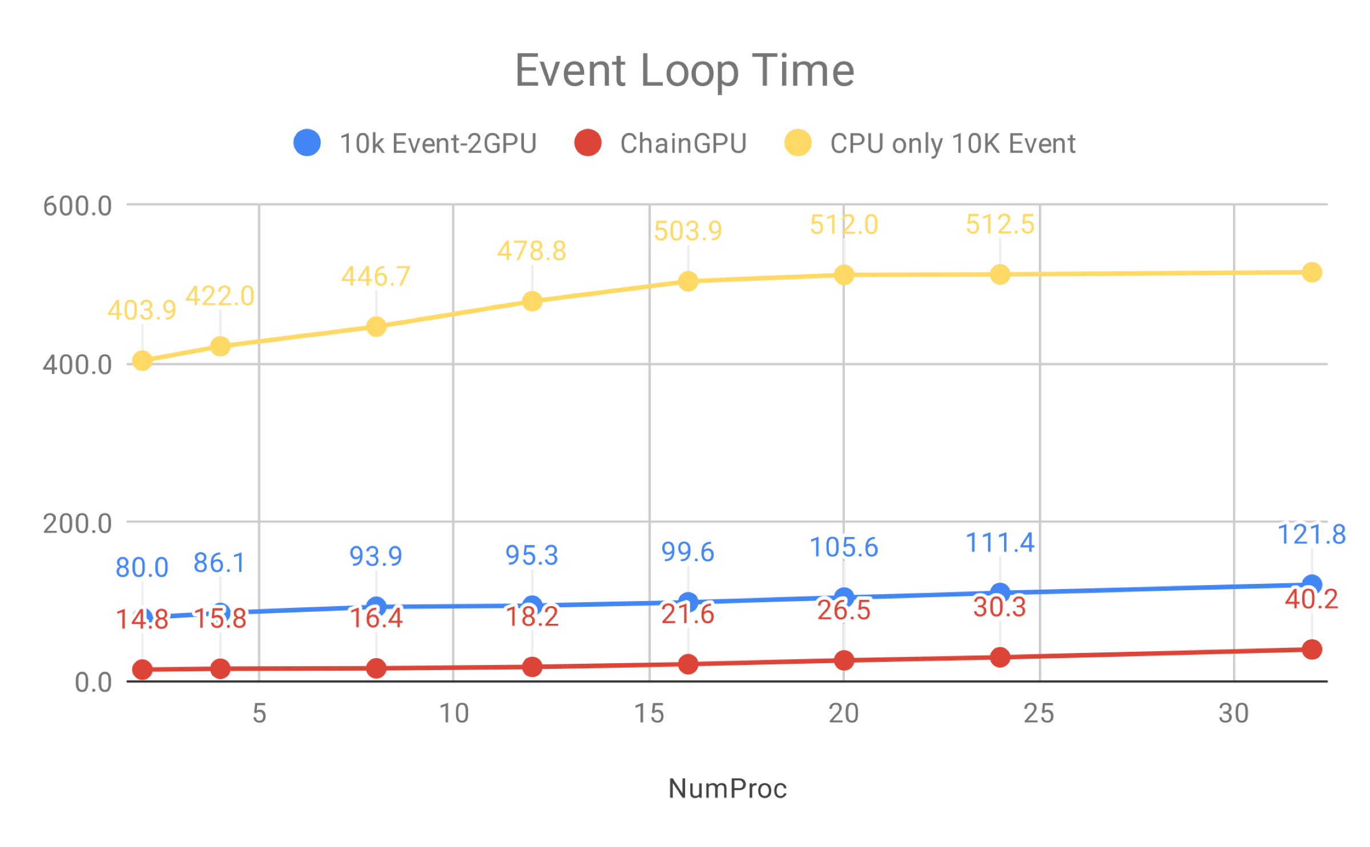
Tests with multiple instances running
Validation against GEANT4 most time consuming (~50K hits)
Run sample program on the same node with up to 32 instances
Use CUDA-MPS to share 2 P100 GPUs on BNL Institutional Cluster
~5X gain with 50K hits compared to CPU only runs (32 parallel processes).
Without hitspy
With Hitspy

Slide 11
Progress at Hackathon this week
Trying to optimize the code for production-like environments
More particles and energies studied
Fewer hits needed than Validation against Geant4
Particle | Energy | Min Eta | CPU (s) / 10K event | GPU (s) / 10K event
Electron | 65536 | 0 | 18.3 | 8.3
Electron | 65536 | 0.2 | 18.8 | 8.0
Electron | 65536 | 1 | 19.2 | 7.9
Electron | 65536 | 2.2 | 19.8 | 8.5
Photon | 65536 | 0.2 | 18.7 | 6.9
Pion | 65536 | 0.2 | 7.7 | 5.7
Pion | 32768 | 0.2 | 4.5 | 4.4
Max nhits ~4000-5000
Max nhits ~2000-2500
Only some events use GPU

Slide 12
TODO
Further optimize the CUDA code
Use shared memory for the simulation
Multiple particles/energies per event => potentially increase GPU utilization
Parallelize hits at different layers (right now only one layer at a time)
Kernel fusion to reduce overhead
Try out portable solutions: Kokkos, RAJA, OpenMP/OpenACC, SyCL

