Slide 1

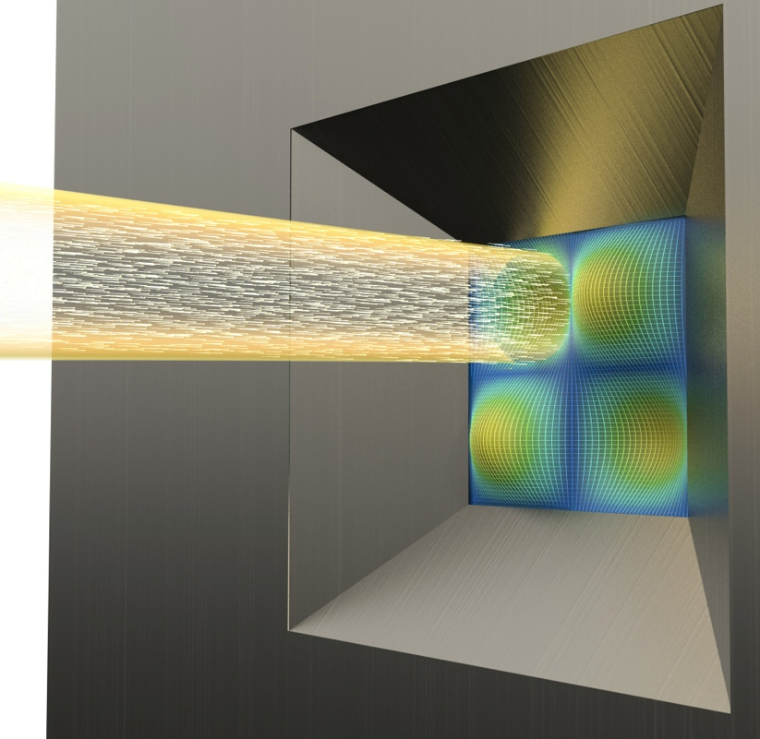
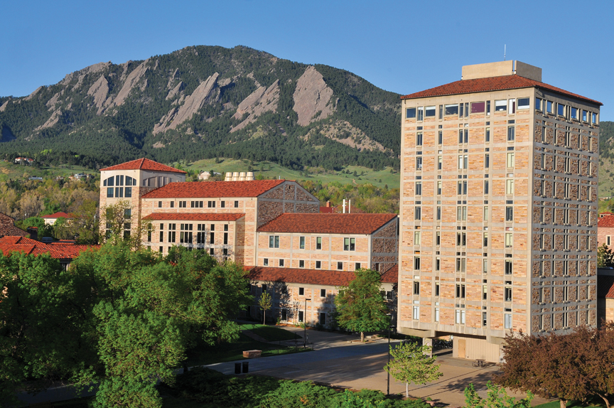
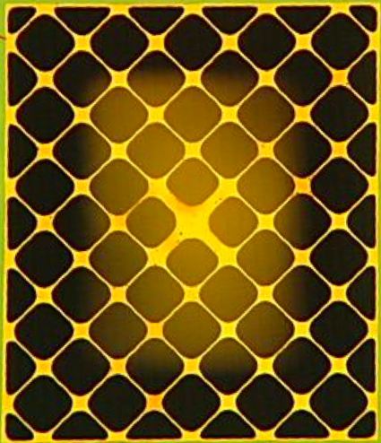
Quantum measurement and sensing
with membrane cavity optomechanics
Cindy Regal

Slide 2
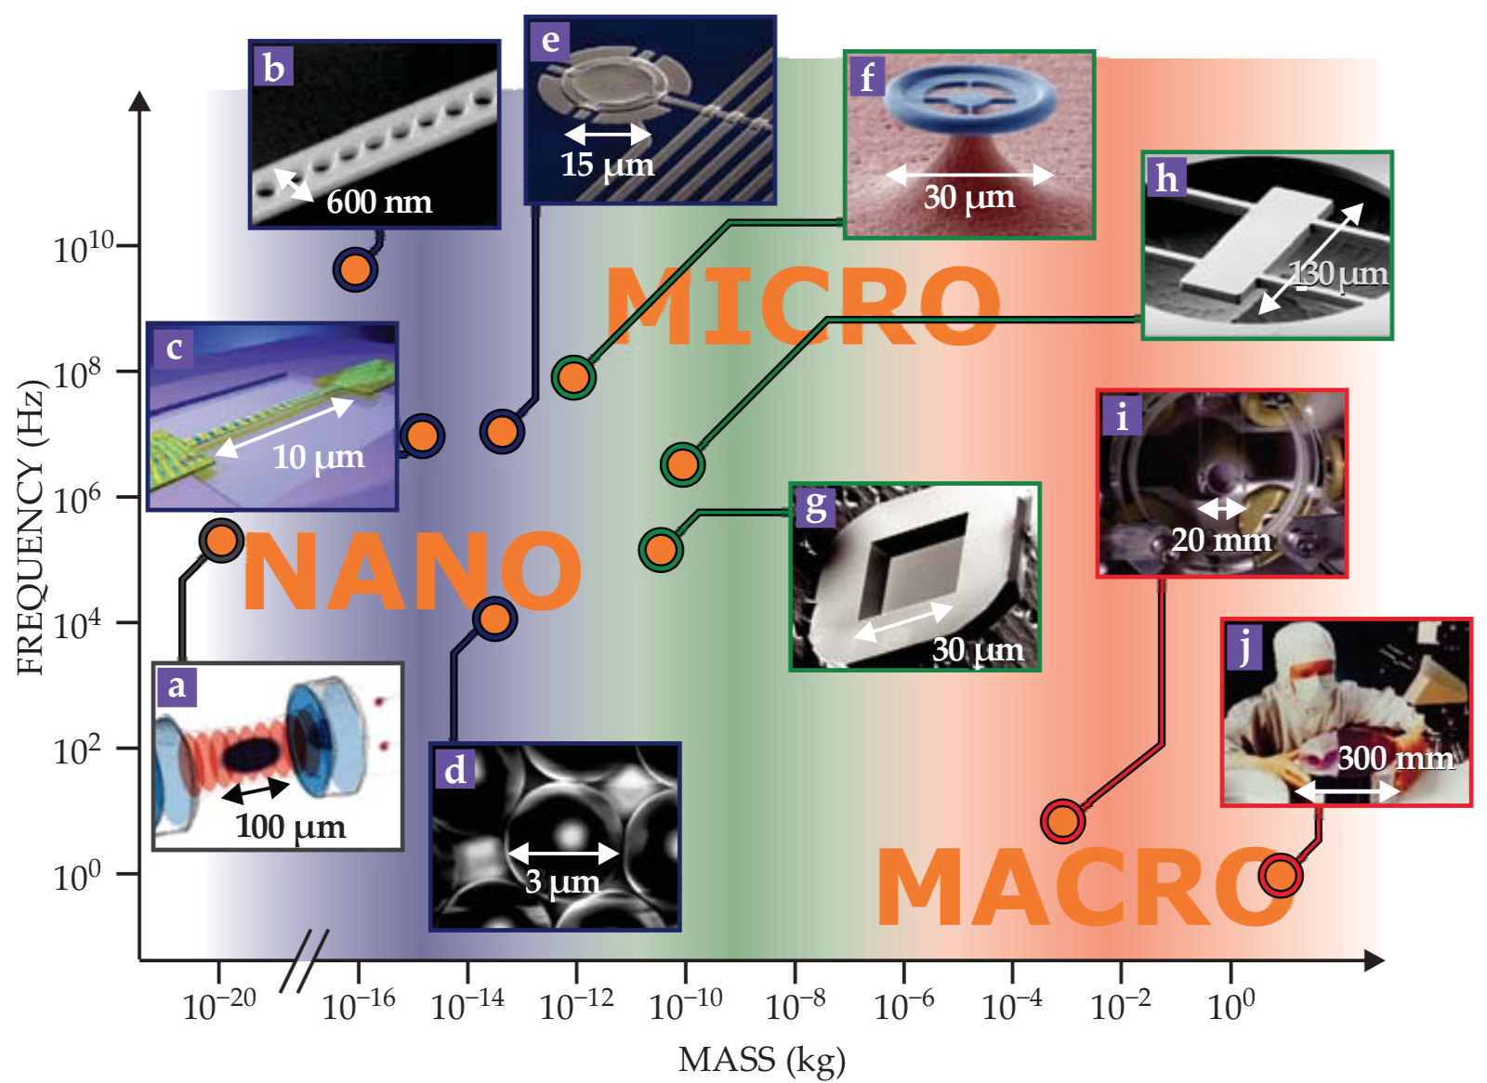
Optomechanical and electromechanical devices
Lisa Pathfinder
Bulk Acoustic Waves
….
M. Aspelmeyer et al., Rev. Mod. Phys. (2013)

Slide 3
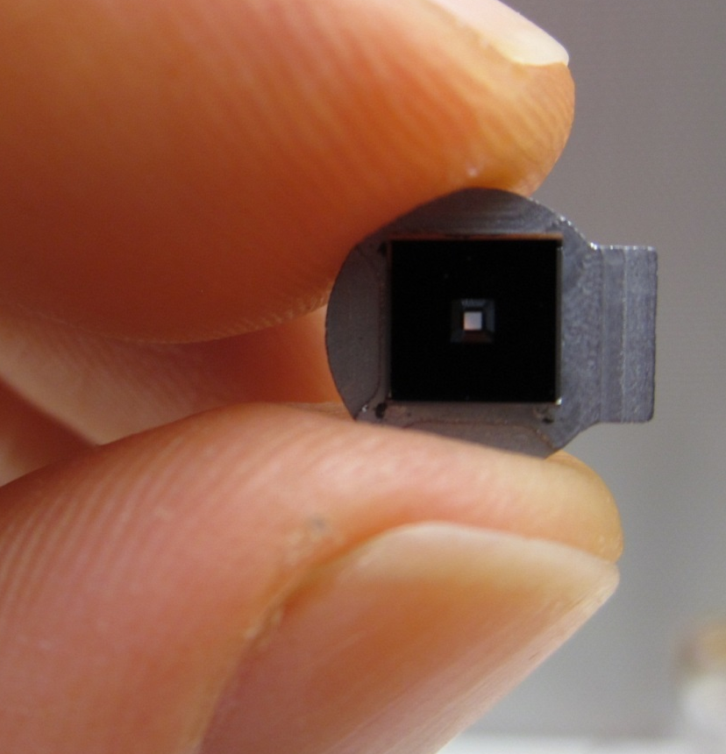
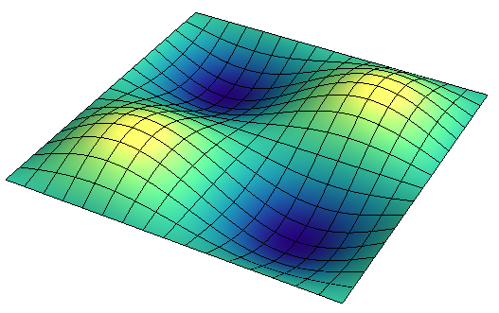
Mechanical membranes
1 GPa
Quantum
Computing
0.5 mm
Q_{m} up to 10⁸
SiN membrane
50 nm thick drum
Change resonant frequency with stress
Dissipation stays approximately same
Related to optical springs, suspensions
10 ng
10¹⁴ atoms
kHz
MHz (10⁻⁸ eV)
J. D. Thompson…J. G. E. Harris, Nature (2008)
Notes:
P=50; n = 0; qe=1;
Groups: 292 – sql; 293 – ql; 270 – lines; 289 – pm; 286 – p=25; 282 – VR homodyne; 273 – synodyne (beta=1.04); 278 – VR synodyne.

Slide 4
Outline
Quantum
Mechanical Sensing

Slide 5
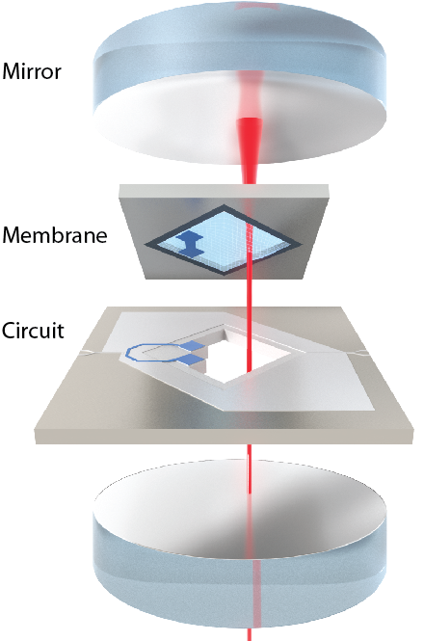
Outline
Optical cavity
Quantum
Ongoing motivation:
Useful roles for mechanical motion in quantum devices
Microwave-to-optical single-photon upconversion
LC circuit
Mechanical Sensing

Slide 6
Outline
Quantum
Ongoing motivation:
Useful roles for mechanical motion in quantum devices
Microwave-to-optical single-photon upconversion
Today:
Limits to continuous displacement detection
  – micromechanical, resonant/off-resonant
Improving measurement with ponderomotive squeezing
1.2
shot noise
1.0
Power Spectrum / SN
0.8
1.50
1.52
1.54
1.56
Frequency (MHz)
Mechanical Sensing

Slide 7
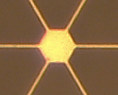
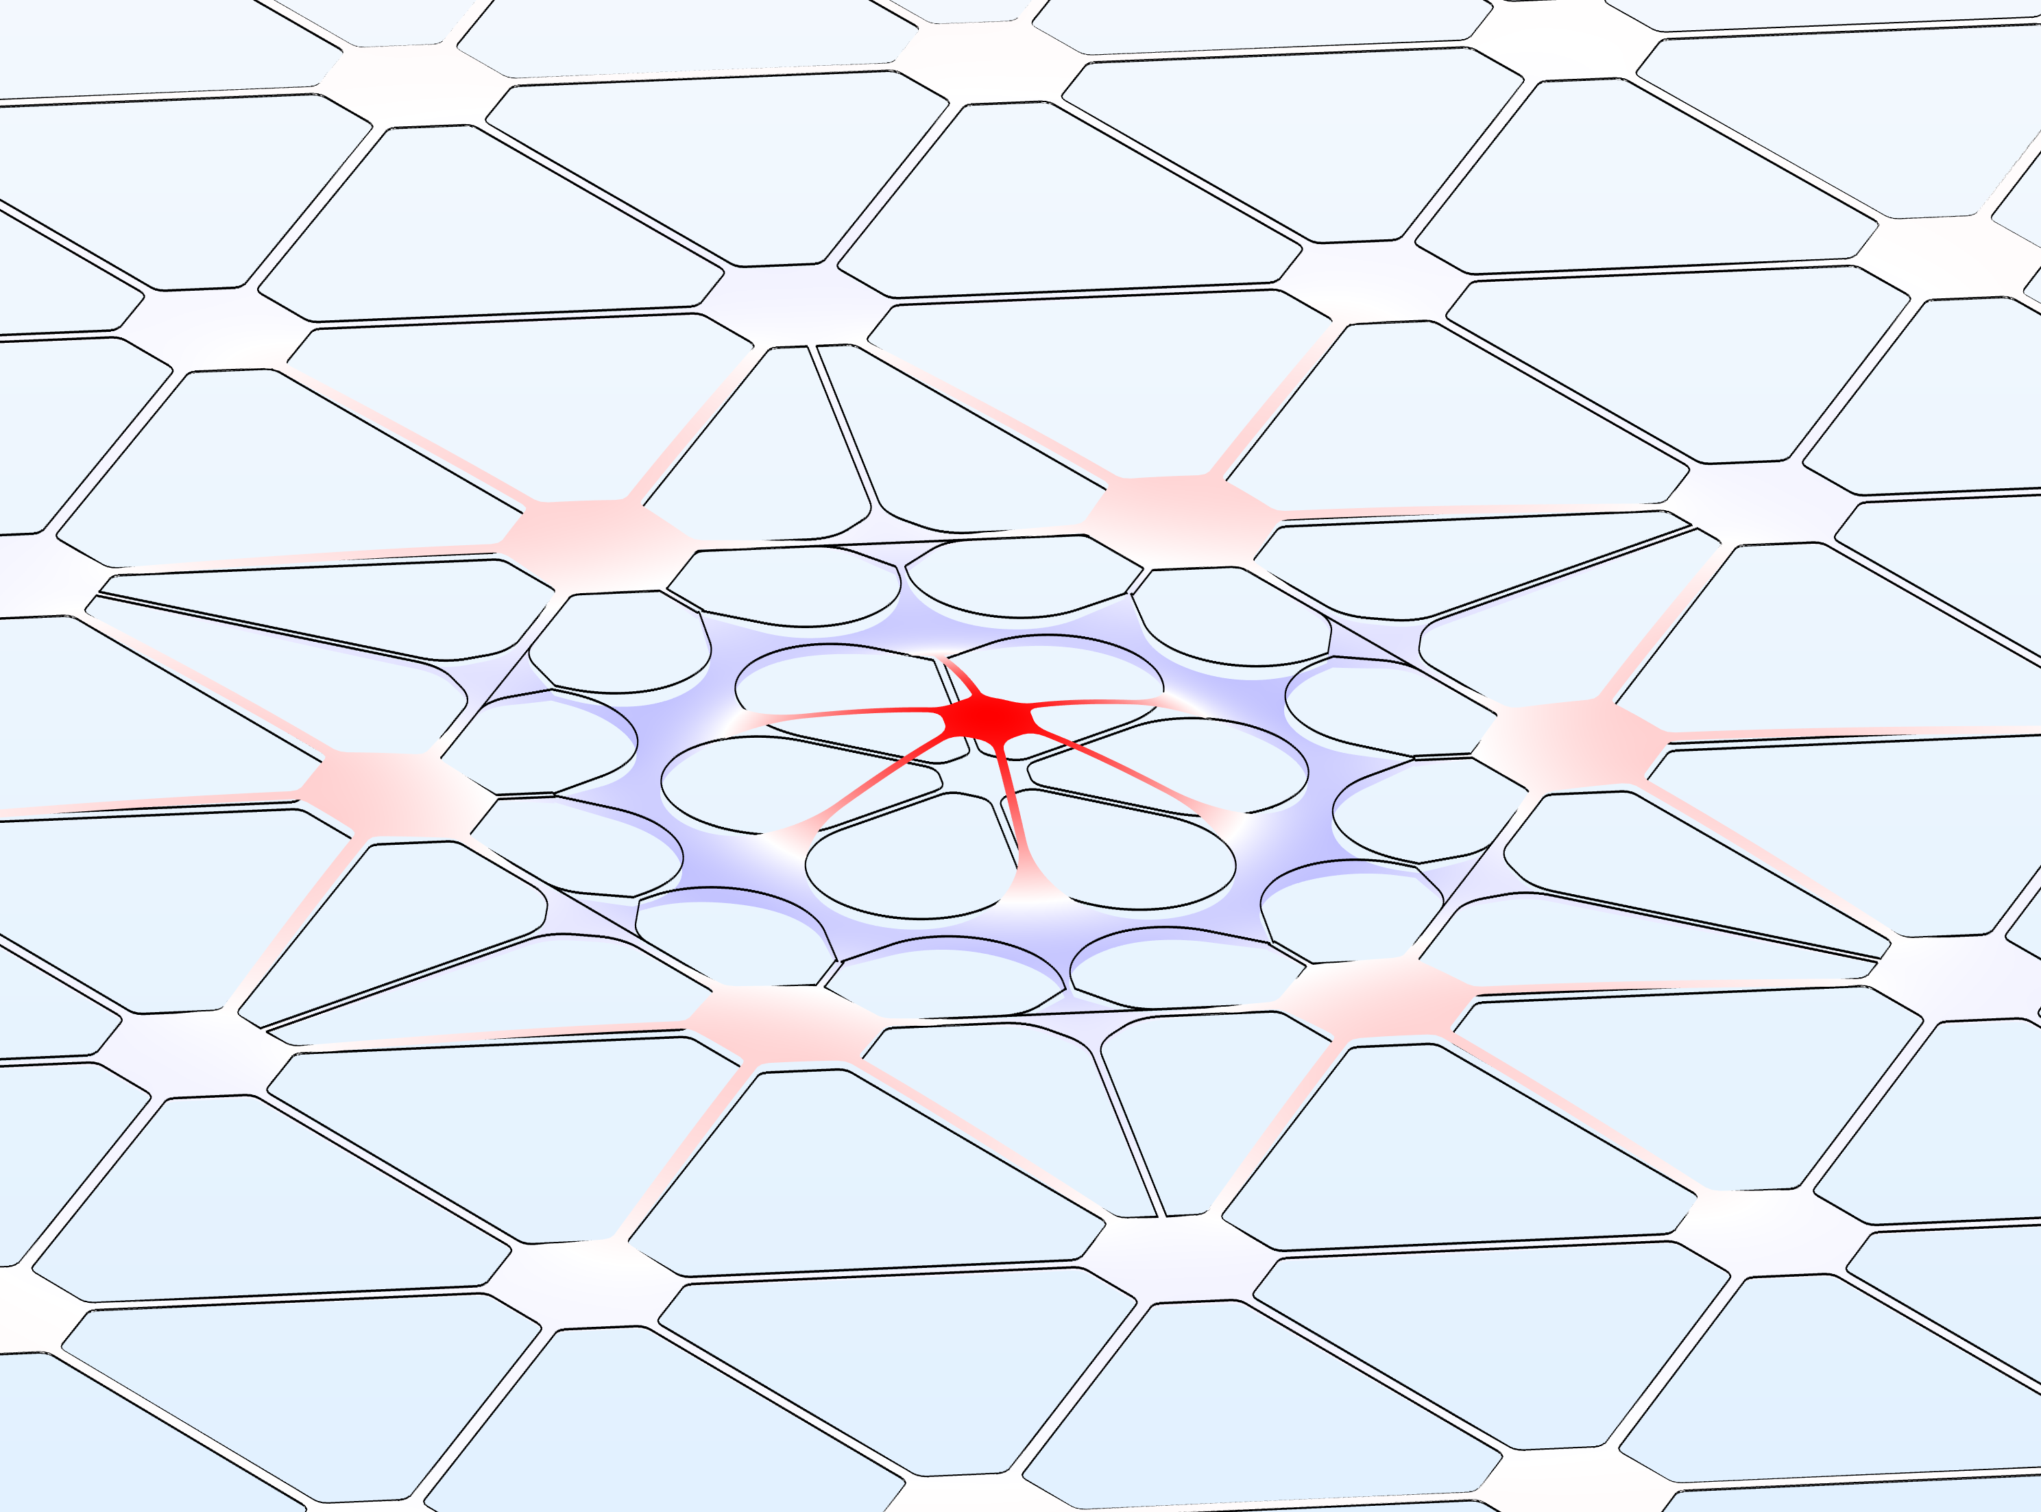
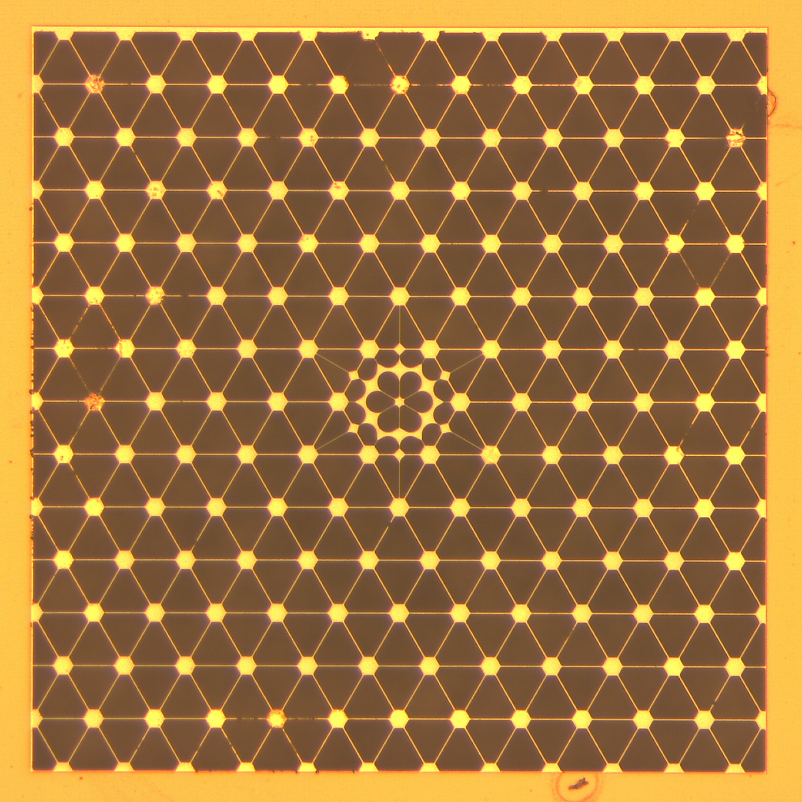
Outline
Quantum
SiN
Ongoing motivation:
Useful roles for mechanical motion in quantum devices
Microwave-to-optical single-photon upconversion
Today:
Limits to continuous displacement detection
  – micromechanical, resonant/off-resonant
Improving measurement with ponderomotive squeezing
1 mm
Mechanical Sensing
Acoustic bandgaps for membranes
Thermal noise
smaller
bigger
force sensors
(detecting spins)
accelerometers?

Slide 8
Cavity optomechanics
Radiation pressure
Optically damp and cool mechanics with drive red-detuned of cavity
Coupled harmonic oscillators
Cavity response function

Slide 9
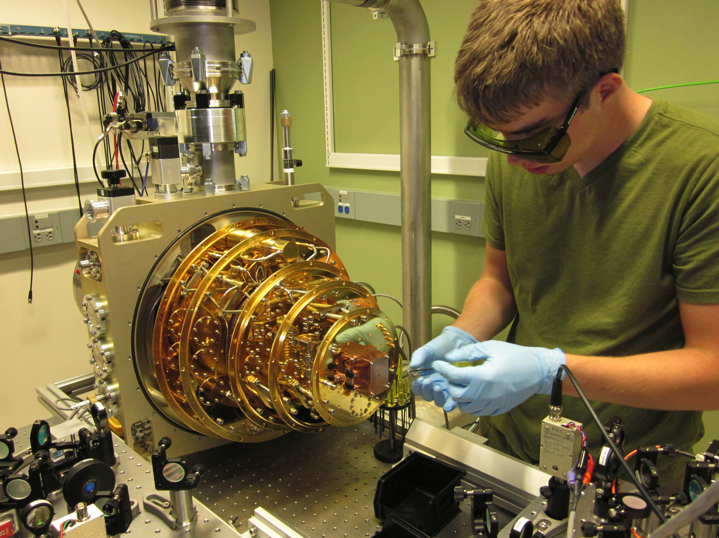
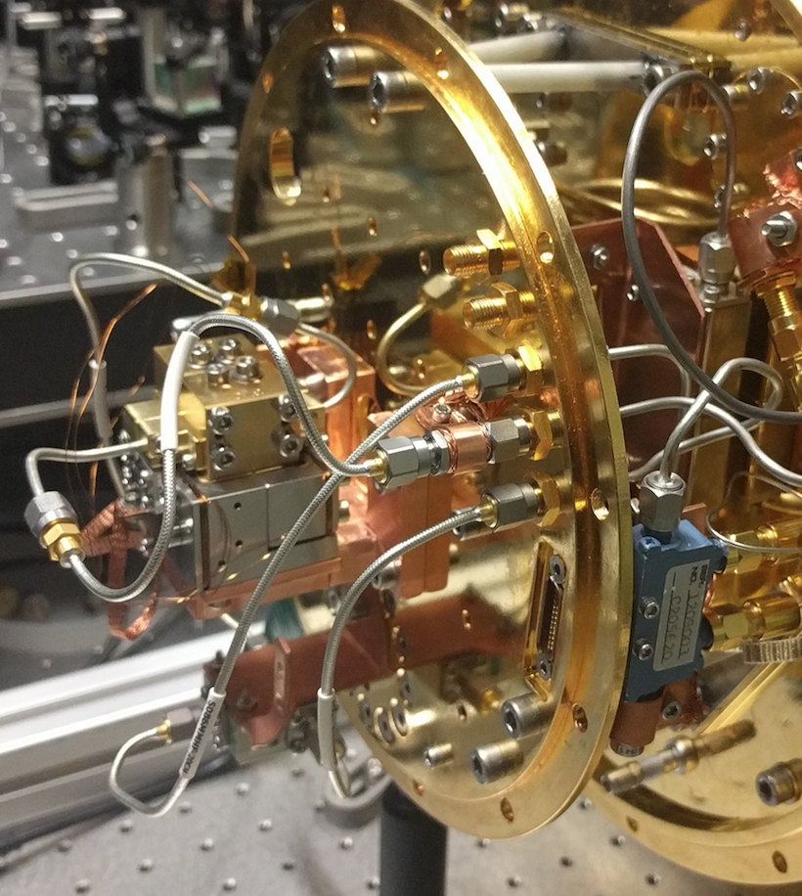
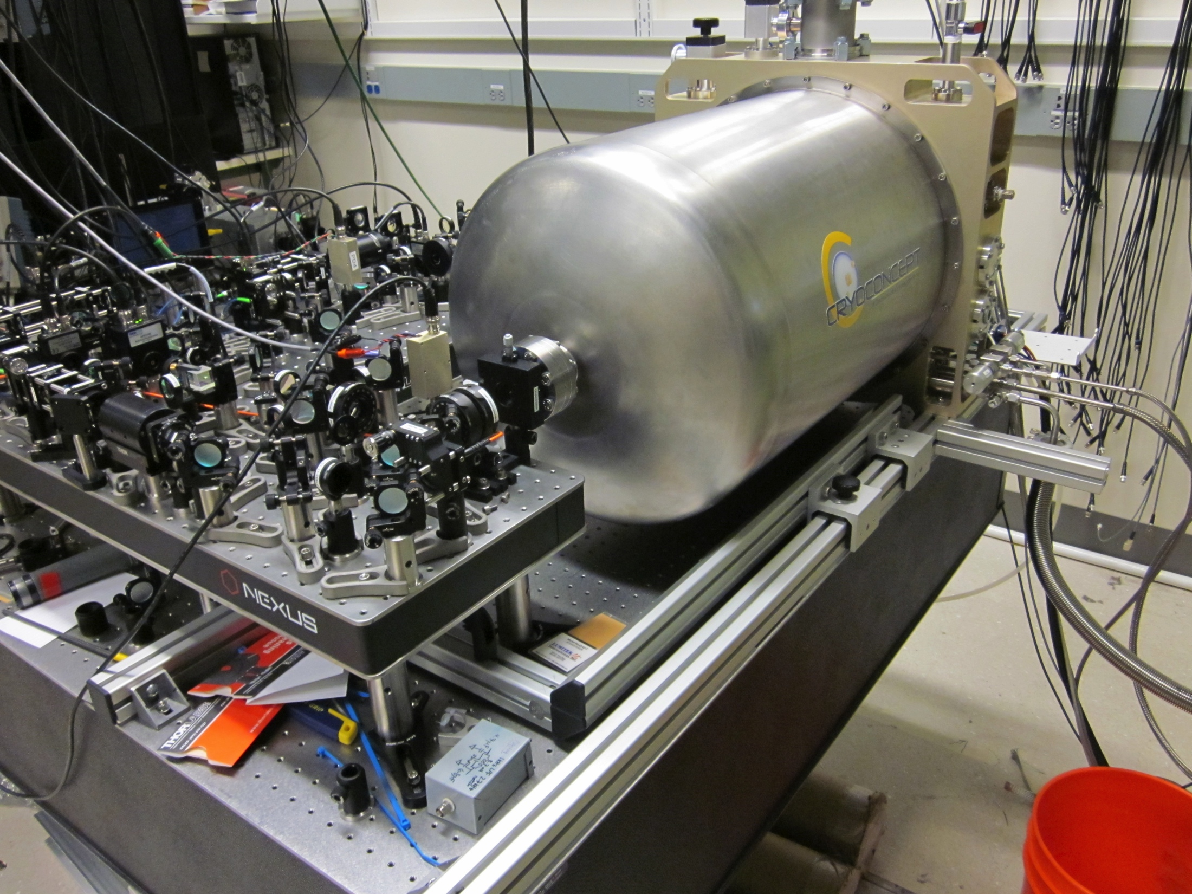
Cryogenic measurements
Base = 40 mK
Mechanics thermalizes to 80 mK with light on

Slide 10
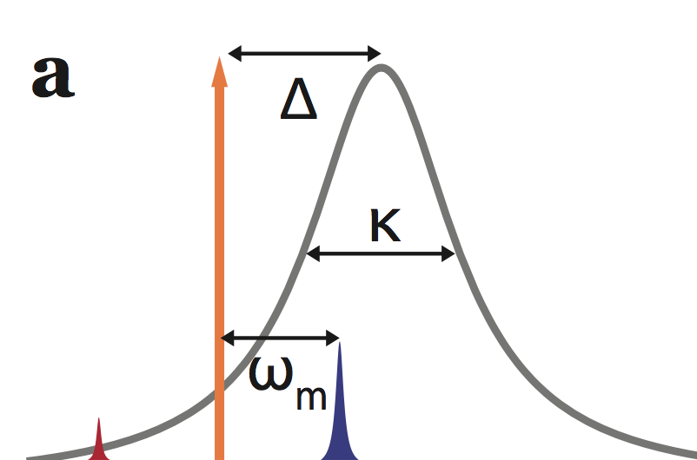






Optomechanical ground-state cooling
n
Limit: sideband resolution
o
i
t
$$n_{limit }={\left(\frac{κ}{4ω_{m}}\right)}^{2}$$
a
p
10
u
$$∆$$
c
c
o
l
a
m
via sideband asymmetry
r
e
$$κ$$
h
t
l
1
a
$$ω_{m}$$
c
i
n
a
h
c
e
reach
$$\overline{n}=0.2$$
M
$$\overline{n}$$
‘extraneous’ occupation <0.03
0.1
phonons 10⁻⁸ eV
10
2
10
3
10
4
10
5
optomechanical damping (Hz)

Slide 11
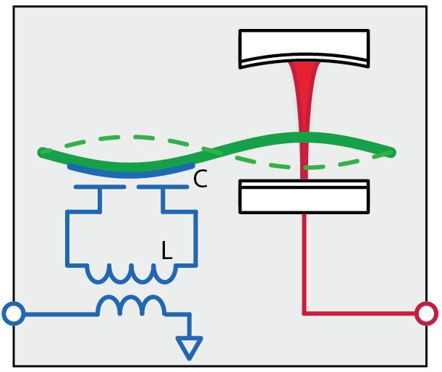
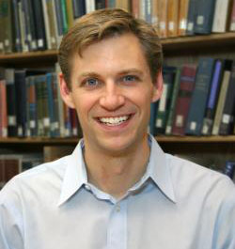
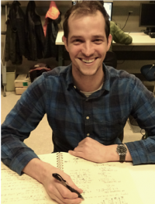
Electro-optic converter based on mechanical motion
electrical
mechanical
optical
Requirements:
Bi-directional
(unitary conversion)
7 GHz
1 MHz
280 THz
Efficient
(photon number
preserving)
microwaves
light
Low added noise
(N_{add})
Poster: Ben Brubaker
Konrad Lehnert

Slide 12
Electro-optic converter based on mechanical motion
electrical
mechanical
optical
Requirements:
Bi-directional
(unitary conversion)
7 GHz
1 MHz
280 THz
Efficient
(photon number
preserving)
microwaves
light
Low added noise
(N_{add})
Currently:
50% conversion efficiency
10 photons added noise

Slide 13


Standard quantum limit in continuous detection
$$S_{xx}$$
Frequency
Frequency
Frequency
Added
SQL on mechanical resonance
Measurement added noise
Backaction
Ideal and ‘standard’ probe
$$S_{xx}\left(ωm\right)$$
shot-noise
Mechanical zero-point level
normalized probe power
Notes:
P=50; n = 0; qe=1;
Groups: 292 – sql; 293 – ql; 270 – lines; 289 – pm; 286 – p=25; 282 – VR homodyne; 273 – synodyne (beta=1.04); 278 – VR synodyne.

Slide 14
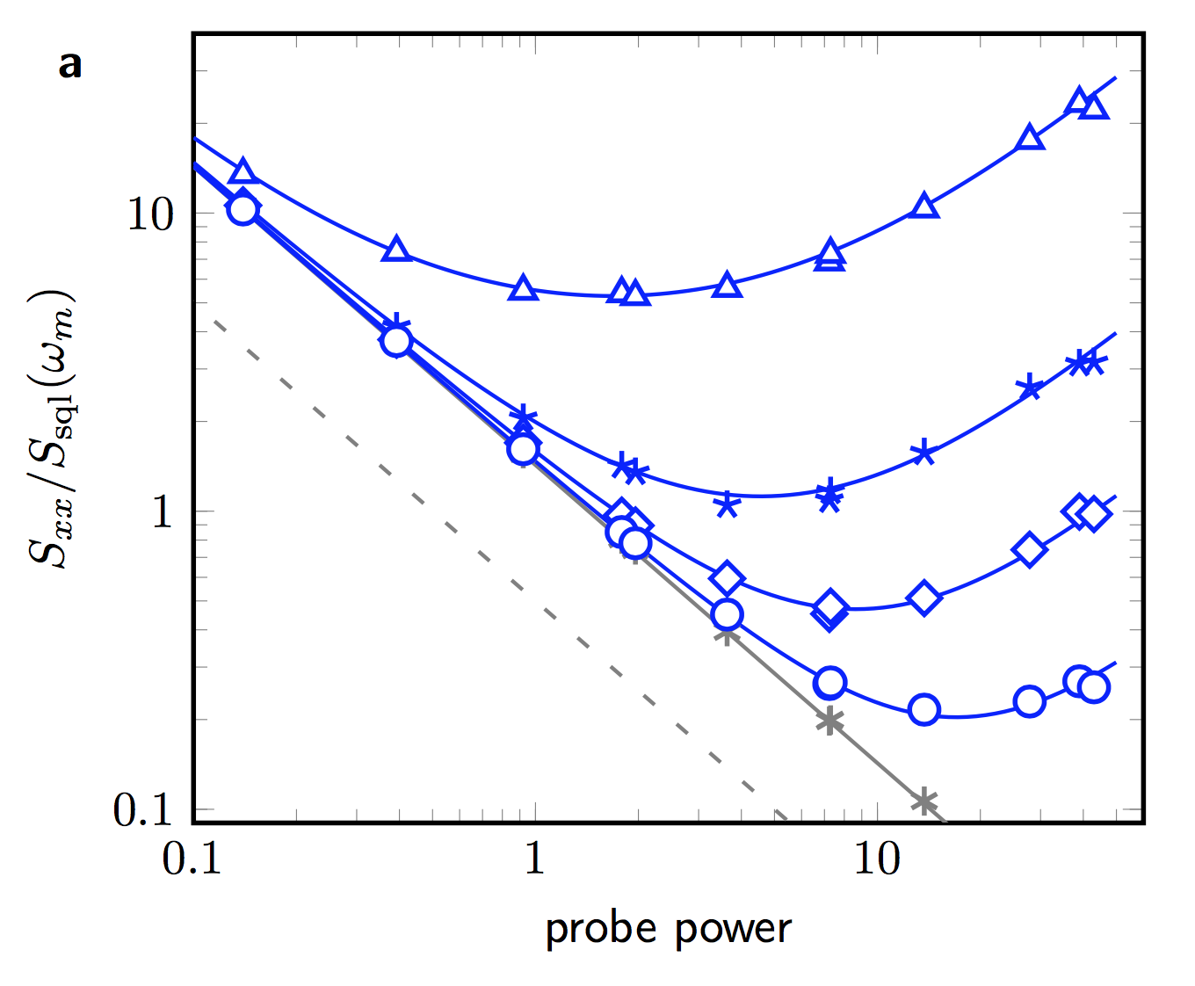


Data: SQL and off-resonant SQL measurements
Probe damped mechanics with on-cavity-resonance probe
Shot noise limit given
finite optical efficiency (35%)
$$\overline{n}=1.3$$
on mechanical
resonance
$$S_{xx}$$
Shot noise limit
10 linewidths
off resonance
Normalized probe power

Slide 15

Ponderomotive squeezing
Ponderomotive squeezing:
mechanically-mediated squeezing
Mechanical element for nonlinear material
Radiation pressure shot noise (amplitude of light) drives mechanics, writes back onto cavity (phase of light)

Slide 16
Ponderomotive squeezing
Ponderomotive squeezing:
mechanically-mediated squeezing
Radiation pressure shot noise (amplitude of light) drives mechanics, writes back onto cavity (phase of light)
impostor
Q
Relative Photocurrent
1.0
Ι
0.8
shot noise
Frequency (MHz)
A.-H. Safavi-Naeini…O. Painter, Nature (2013); T. P. Purdy et. al., PRX (2013)
Broadband RPSN: J. Cripe…T, Corbitt, Nature Physics (2019).

Slide 17
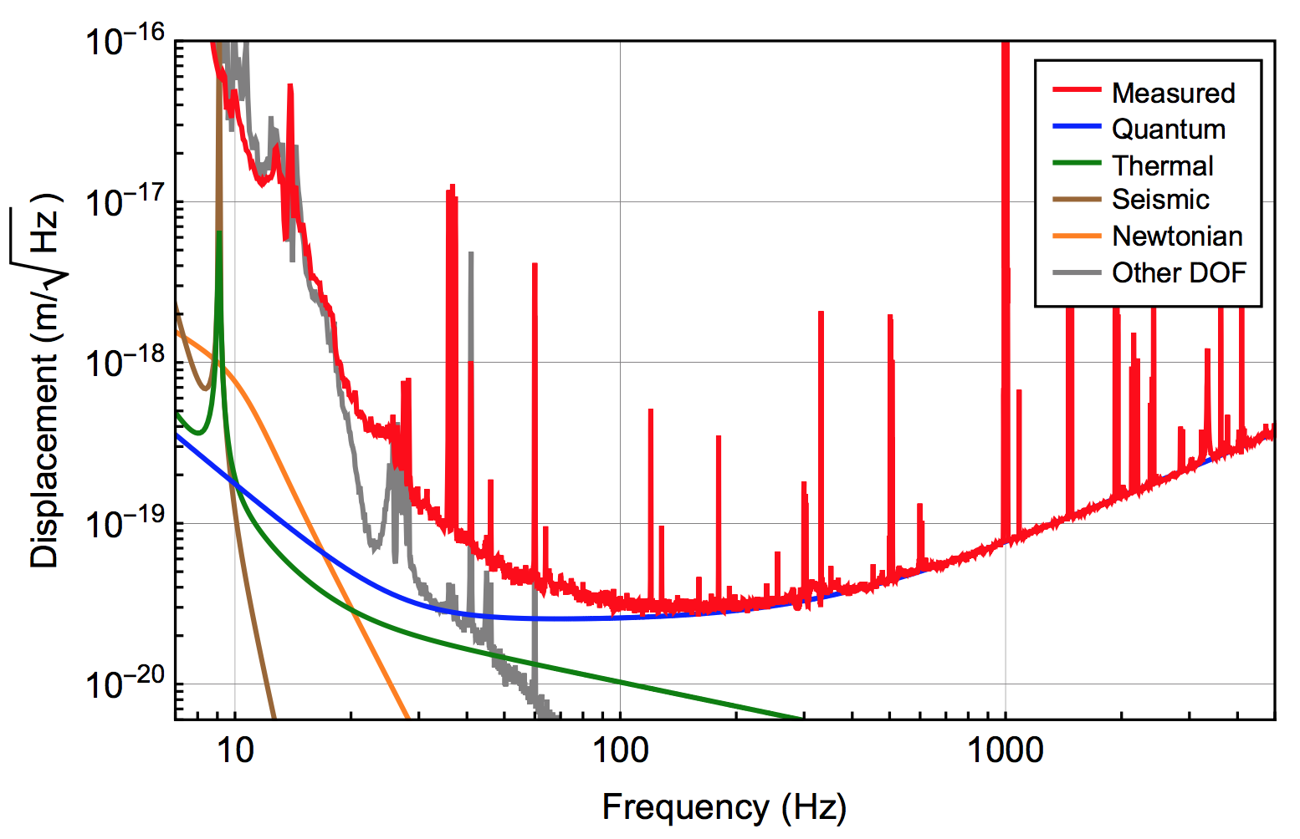
LIGO measurement context
O1 run of advanced LIGO
0.1
1
10
1
2
5
10
20
50
LIGO collaboration

Slide 18
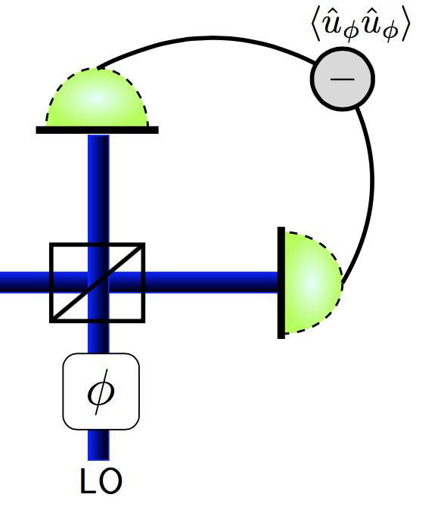
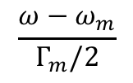


Illustrated guide
10
back
action
$$φ=90°$$
1
$$S_{xx}\left(ω\right)$$
0.1
zero-point
motion
0.01
shot-noise
QL
SQL
0.1
1
10
100
$$\frac{ω−ω_{m}}{Γ_{m}/2}$$
QL – quantum limit for two mechanical quadrature measurement
Notes:
P=50; n = 0; qe=1;
Groups: 292 – sql; 293 – ql; 270 – lines; 289 – pm; 286 – p=25; 282 – VR homodyne; 273 – synodyne (beta=1.04); 278 – VR synodyne.

Slide 19


Using ponderomotive squeezing
10
back
action
$$φ=90°$$
Variational readout
Varied $φ$
1
$$S_{xx}\left(ω\right)$$
0.1
zero-point
motion
$$φ=25°$$
0.01
shot-noise
QL
SQL
0.1
1
10
100
$$\frac{ω−ω_{m}}{Γ_{m}/2}$$
S. P. Vyatchanin and E. A. Zubova, Phys. Lett. A (1995)
A. A. Clerk, RMP (2010)
Notes:
P=50; n = 0; qe=1;
Groups: 292 – sql; 293 – ql; 270 – lines; 289 – pm; 286 – p=25; 282 – VR homodyne; 273 – synodyne (beta=1.04); 278 – VR synodyne.

Slide 20
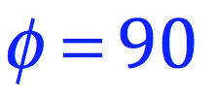


Measurement near the SQL off resonance
As always, efficiency
defines efficacy
$\frac{ω−ω_{m}}{Γ_{m}/2}$
N. S. Kampel…C. A. Regal, PRX (2017)
D. Mason…A. Schliesser, Nature Physics (2019)

Slide 21

Idea of variational readout
$\frac{ω−ω_{m}}{Γ/2}$
S. P. Vyatchanin and E. A. Zubova, Phys. Lett. A (1995)
N. S. Kampel…C. A. Regal PRX (2017)

Slide 22
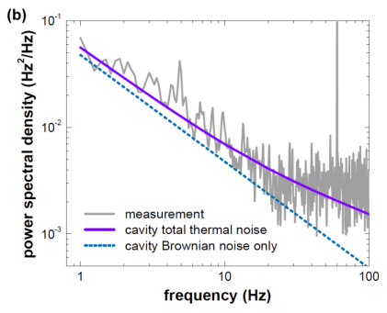
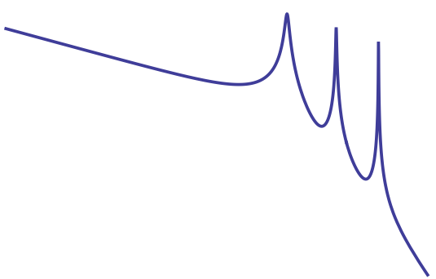
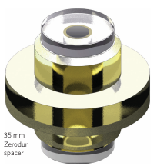
Thermal noise
Thermal noise: everywhere!
LIGO has know well for long time
Reference cavities for precision clocks
State of the art reference cavities
G. D. Cole et al. Nature Photonics (2013)
Tail grows with material loss (smaller Q)
Crystalline materials are desired

Slide 23
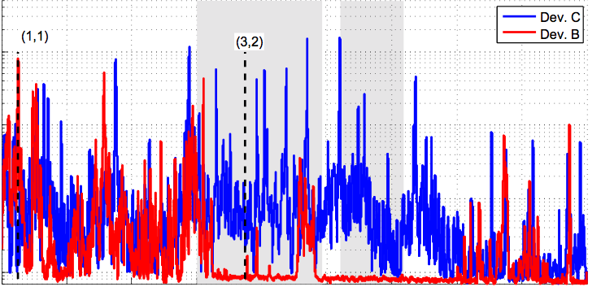
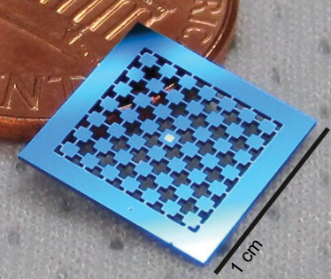
Phononic crystal
Period structures: Phononic crystal
Control mode structure
Reduce acoustic energy at lossy boundary
Our case – maintain stress
Displacement on membrane
predicted
bandgap
with crystal
plain chip
displacement (m)
1
2
3
4
5
frequency (MHz)
mm periodicity for gap in MHz
Nanophononic crystals: T. P. Mayer-Alegre…O. Painter, Optics Express (2011)
Membranes: P.-L. Yu…C. A. Regal, APL (2014)

Slide 24
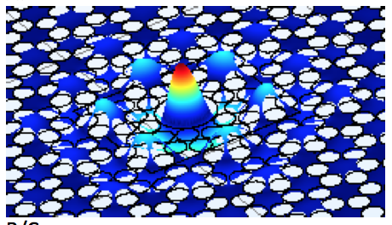
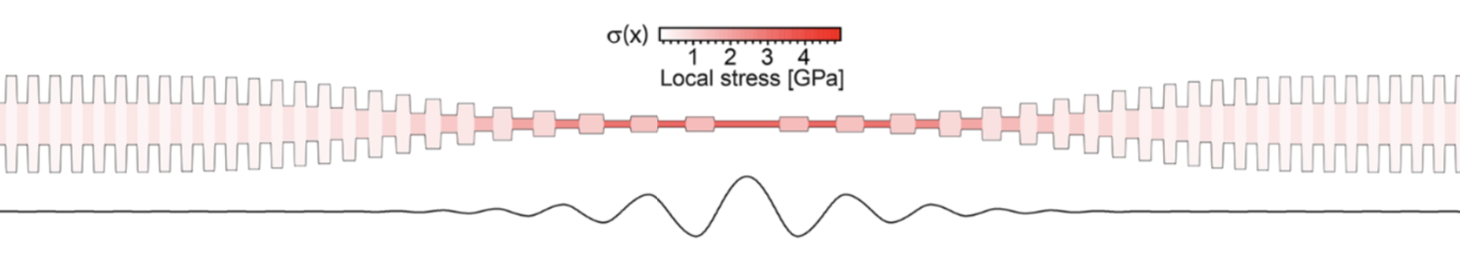
Phononic crystals in membranes
stress maintained with holes
bandgap
‘soft-clamping’ of defect
1 mm
Y. Tsaturyan…A. Schliesser., Nature Nanotech (2017)
A. Ghadimi…T. Kippenberg, Science (2018)

Slide 25
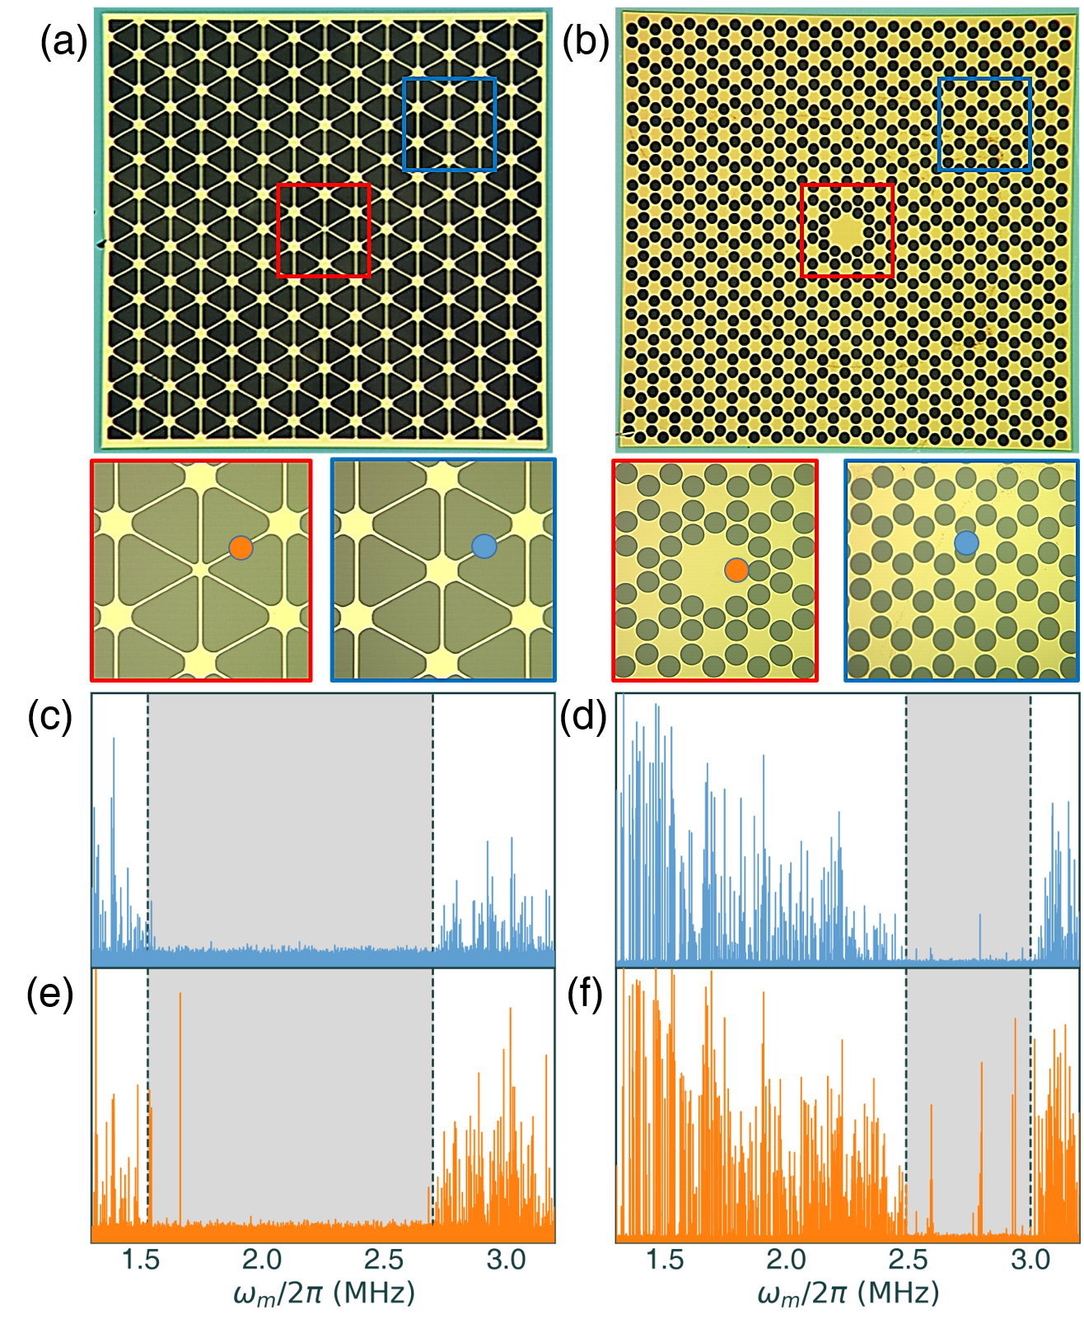
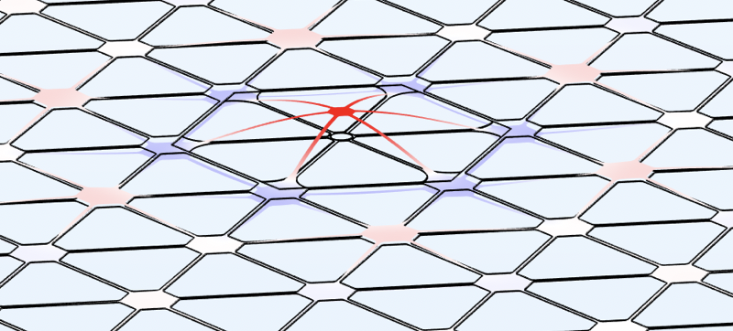
Larger bandgaps
$$100 μm$$

Slide 26
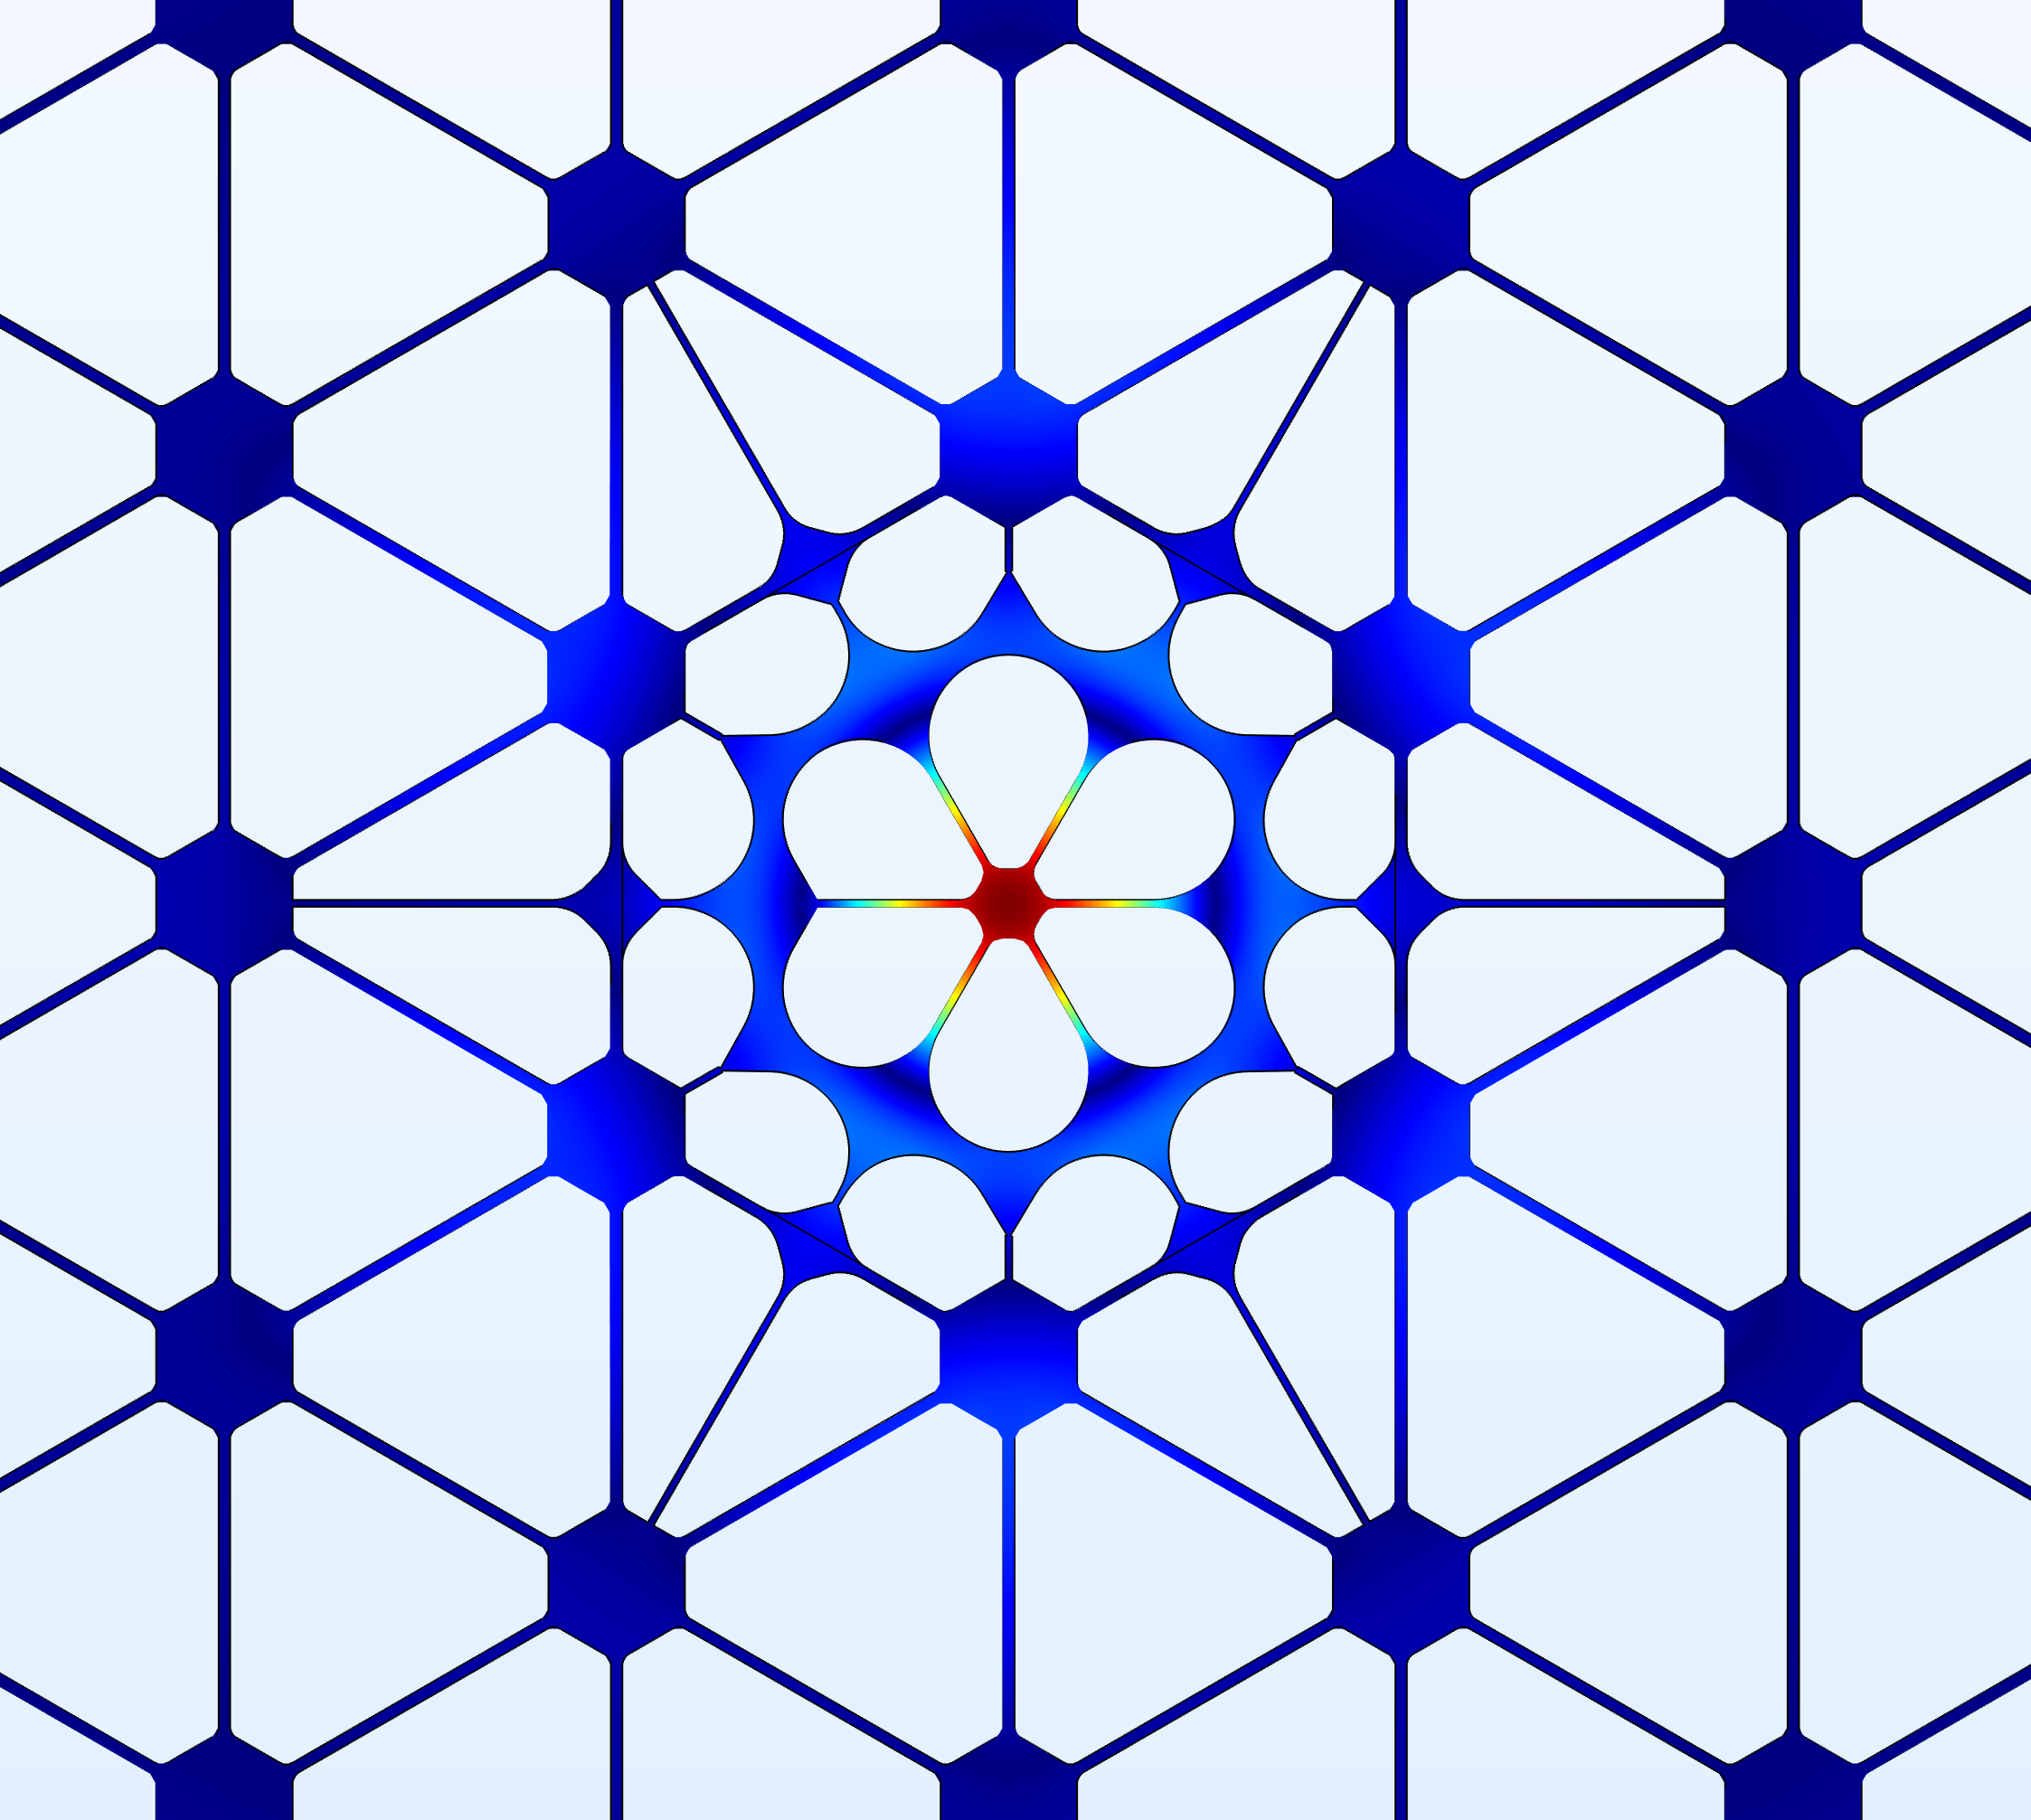
Phononic crystals
$$100 μm$$
displacement
moves defect mode
to center of bandgap
“snowflake”

Slide 27
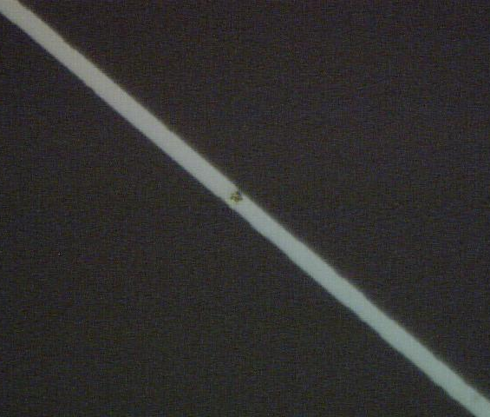
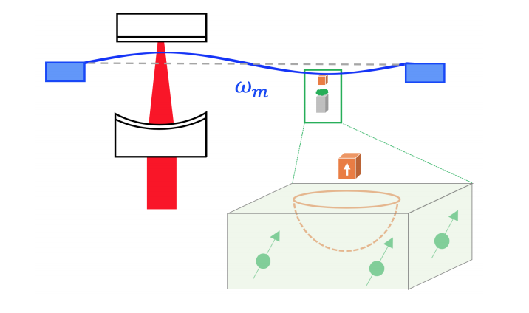

Attaching things to membranes
Magnetic functionalization
Make bigger, or add mass
magnetic grain
500 μm
$$S_{F}=4k_{b}Tmγ_{m}$$
N. Scozzaro et al., J. Mag. Resonance (2016)
R. Fischer et al., NJP (2018)

Slide 28
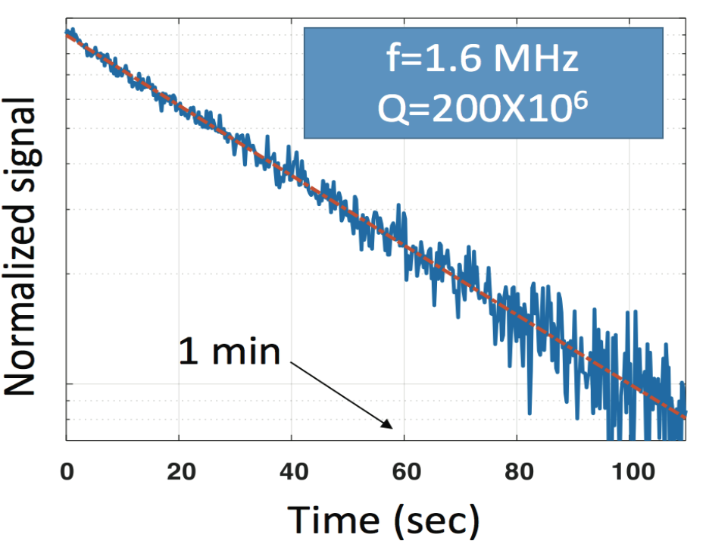
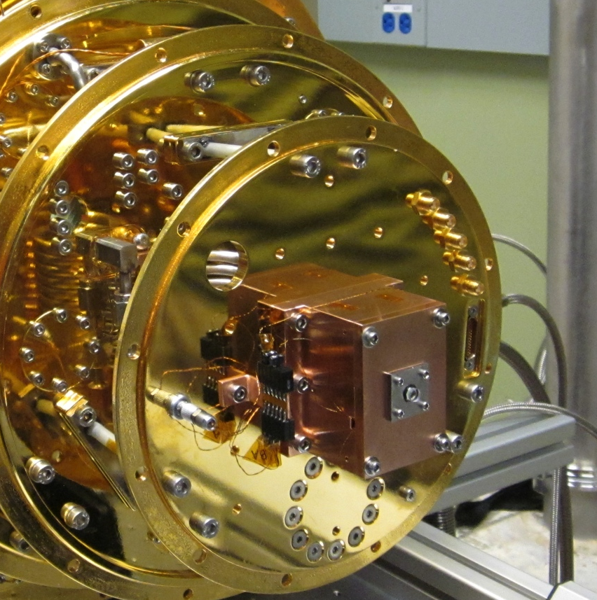
Less material loss below 100 mK
Drive membrane and watch energy decay
T = 40 mK

Slide 29
Outline
Quantum
SiN
Ongoing motivation:
Useful roles for mechanical motion in quantum devices
Microwave-to-optical single-photon upconversion
Today:
Limits to continuous displacement detection
  – micromechanical, resonant/off-resonant
Improving measurement with ponderomotive squeezing
1 mm
Mechanical Sensing
Acoustic bandgaps for membranes
Thermal noise
smaller
bigger
force sensors
(detecting spins)
accelerometers
freq band, arrays

Slide 30




The team and acknowledgements
Mechanics team:
Nir Kampel
Ran Fischer
Chris Reetz
Gabriel Assumpcao
Ravid Shaniv
Andrew Higginbotham
Ben Brubaker
Pete Burns
Max Urmey
Sarang Mittal
Our group: Quantum physics with neutral atom arrays and micromechanical motion

