Slide 1
A Traversable Wormhole Teleportation Protocol in SYK
Aspen 2020: Quantum Information and Systems for Fundamental Physics
Ping Gao, MIT

Slide 2
Outline
Review of traversable wormholes
Circuit of traversable wormhole teleportation
Effectiveness
Discussion and conclusion

Slide 3
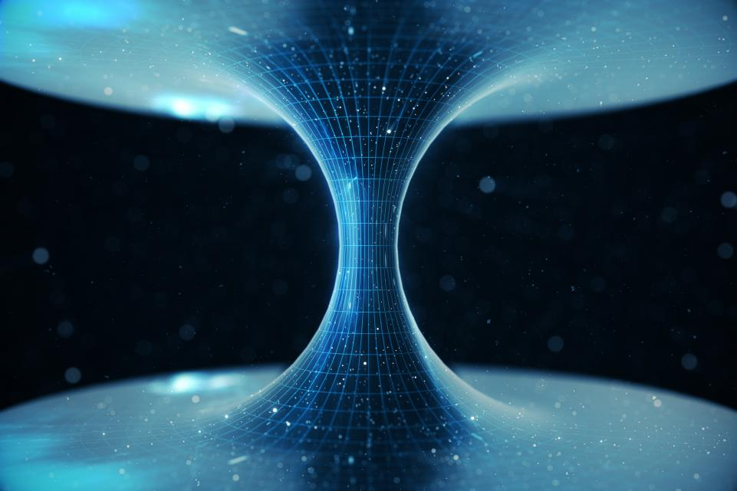
Traversable wormholes
Traversable wormhole is a “tunnel” in the universe connecting two parts that one can get through in finite time.
Its existence requires violation of averaged null energy condition. In other words, it requires “negative energy/mass” → “repulsive gravitational force”

Slide 4
Traversable wormholes
Impossible classically, but can be generated by quantum effect
Consider eternal AdS black holes. This are two identical black holes in thermal field double state.
This state is highly entangled and corresponds to the connected geometry. Two BHs are connected but nontraversable.
By AdS/CFT, two CFTs living on the boundaries are entangled and in TFD state.
Coupling two CFTs by $e^{igO_{L}O_{R}}$ at $t=0$generates negative energy and make it traversable.
$$t$$
$$t=0$$
$${−t}^{′}$$

Slide 5
Traversable wormholes
Particle (may carry information) gets through from one CFT to the other CFT via the traversable wormhole.
From boundary point of view, this should be dual to quantum teleportation. Quantum info transmitted.
Two CFTs in highly entangled state. Like EPR pair
Gravity: coupling $e^{igO_{L}O_{R}}$ at $t=0$ produces negative energy Boundary:
$$e^{igO_{L}O_{R}}=\int{dxδ(O_{L}−x)e^{igxO_{R}}}$$
$$t$$
$$t=0$$
$${−t}^{′}$$
classical outcome
measurement
unitary
Same steps of quantum teleportation!

Slide 6
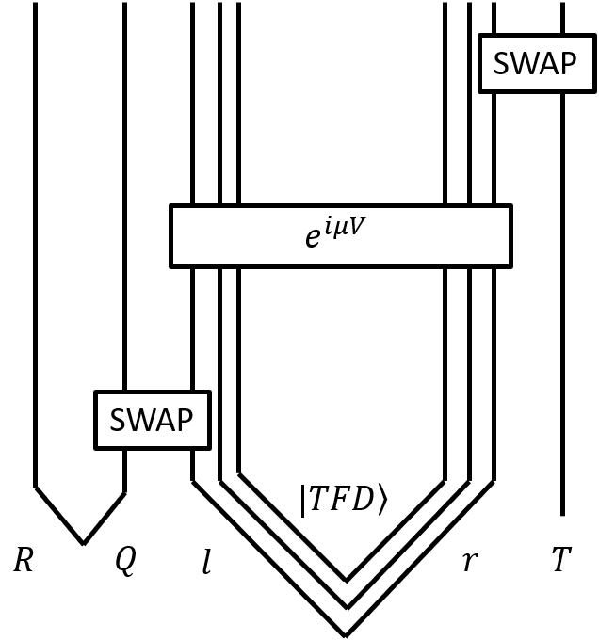
Circuit of traversable wormholes teleportation protocol
Question: Can we have a qubit model with gravity feature?
Answer: YES! We constructed a simple protocol using SYK model.
Why SYK? 1) dual to AdS₂ 2) Fermion model defining qubits easily
Circuit: 5 systems. 1) R, Q and T are 1-qubit site 2) l and r are two SYK model. Each consists N Majorana fermions $ψ_{l,r}^{j}$, namely N/2 qubits
In the beginning, R and Q are in $\left.|φ\right\rangle =(\left.|00\right\rangle +\left.|11\right\rangle )/\sqrt{2}$, T is in $\left.|0\right\rangle$; l and r are in TFD state.
1
1
N/2
N/2
1
$$\left.|φ\right\rangle$$
$$\left.|TFD\right\rangle$$
$$\left.|0\right\rangle$$

Slide 7
Circuit of traversable wormholes teleportation protocol
The protocol has three steps. 1) SWAP between Q and l at ${−t}^{′}$. 2) apply $e^{iμV}$ at $t=0$; $V=i\sum{ψ_{l}^{j}ψ_{r}^{j}}$ 3) SWAP between r and T at $t$. (time evolution in l and r is governed by SYK Hamiltonian)
If teleportation succeeds, final mutual information between T and R should be maximal, 2log2.
The coupling can be written explicitly as measurement on left with unitary on right acting on each pair of qubits, e.g. $e^{ig∙iψ_{l}^{2j}ψ_{r}^{2j}}=[P_{y+}^{l}e^{\frac{igY^{r}}{2}}+P_{y−}^{l}e^{−\frac{igY^{r}}{2}}]$ (at j-th qubit)
$$t$$
$$t=0$$
$${−t}^{′}$$
1
1
N/2
N/2
1
$$\left.|φ\right\rangle$$
$$\left.|TFD\right\rangle$$
$$\left.|0\right\rangle$$

Slide 8
Circuit of traversable wormholes teleportation protocol
SWAP: 1) construct Dirac fermions ${χ }_{l,r}^{j}=\frac{1}{\sqrt{2}}\left(ψ_{l,r}^{2j−1}+iψ_{l,r}^{2j}\right)$ 2) SWAP between Q and l is For $χ$ in 2 by 2 representation, it becomes ordinary SWAP between two qubits.
After 3 steps, the state becomes
To check mutual information between R and T, we calculate reduced density matrix. The matrix elements are correlation functions of these fermions in TFD state.
$$t$$
$$t=0$$
$${−t}^{′}$$
1
1
N/2
N/2
1
$$\left.|φ\right\rangle$$
$$\left.|TFD\right\rangle$$
$$\left.|0\right\rangle$$

Slide 9
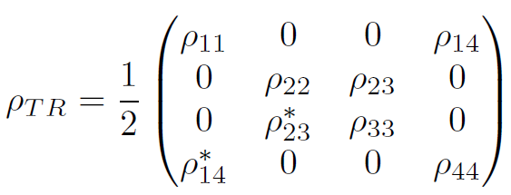
Circuit of traversable wormholes teleportation protocol
Reduced density matrix
If MI is maximal (success) we get
$$t$$
$$t=0$$
$${−t}^{′}$$
Fermion cannot be created/annihilated twice
Left-right causal correlation reaches maximum
1
1
N/2
N/2
1
$$\left.|φ\right\rangle$$
$$\left.|TFD\right\rangle$$
$$\left.|0\right\rangle$$

Slide 10
SYK model
SYK model has N Majorana fermions with all-to-all q-local coupling in Hamiltonian. The coupling constant is Gaussian random.
It is maximally chaotic. Low energy effective action is Schwarzian, which can be derived from AdS₂ JT gravity.
Define TFD state with two identical Hailtonian in left and right. 1) Define EPR state between l and r, $ψ_{l}^{j}+iψ_{r}^{j}\left.|I\right\rangle =0$ for all $j$ 2) TFD is Euclidean evolution of total Hamiltonian
Correlation function can be understood as Euclidean path integral, e.g.
$$β/2$$
0
$e^{−iμV}$
$$χ_{r}^{†}$$
$e^{iμV}$
$$χ_{l}$$
$$β/4$$

Slide 11
SYK model
$$3β/4$$
Use trick to define a stitching field and combine left and right fermions
Define bilinear field G (its vev in TFD state is correlation of fermions)
Effective action is
Large N limit. Equation of motion
Adding the coupling $e^{iμV}$ around Euclidean time $τ_{0}=β/4$ is equivalent to shift boundary condition of correlation functions
$$χ^{†}$$
$$β/2$$
0
$$β/2$$
0
$e^{−iμV}$
$e^{iμV}$
$e^{−iμV}$
$$χ_{r}^{†}$$
$e^{iμV}$
$$χ_{l}$$
$$χ$$
$$β/4$$
$$β/4$$

Slide 12
Effectiveness
In large q limit, we can solve this twist boundary condition explicitly.
Real time correlation is analytic continuation of the Euclidean G, e.g.
It turns out that MI $I_{RT}$ only depends on causal correlation function
Clearly when $\left|𝒦\right|=1$, MI saturates as 2log2

Slide 13
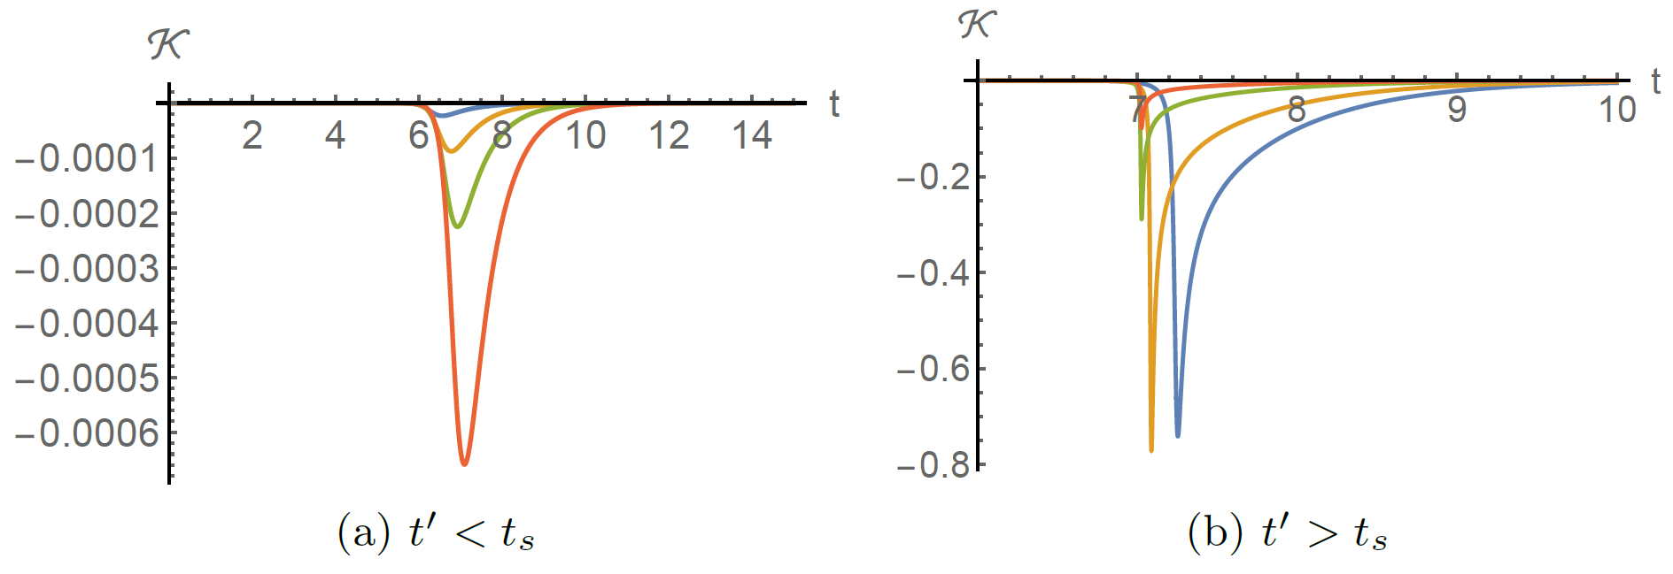
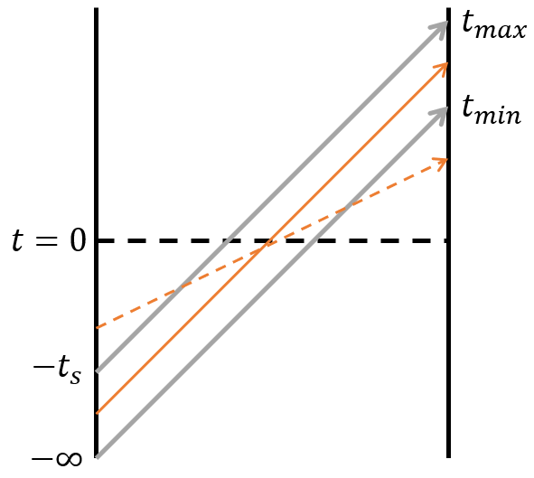
Effectiveness
We take a double limit $N→∞, e^{\#(t+t^{′})}/N$ fixed. Time scale is $t\sim logN$.
High T, we have
If $βJ→0$, there is a “pole” when $μ<0$. Required by traversable wormhole!
“Pole” is resolved by numerator $π/βJ$ as a peak. Boundedness required by fermion.
$e^{iπ/βJ}$ is “stringy” correction
Lyapunov exponent $2π/β$ in high T
There is a transition time $t_{s}$, insertion before/after it will have different signal ordering. Range preserving ordering is semiclassical.
After the peak, , exponential decay of thermalization.

Slide 14
Effectiveness
However, the peak is not high enough. It turns out
When large q, it is too small to reach maximal MI.
But, if we can make $q=2$, $|𝒦|=1$and the teleportation is perfect!
$1/q$ is the conformal weight of Majorana fermion. If we make p fermions together, the weight is $p/q$. Then we can choose $p=\frac{q}{2}+1$to make an effective $q≈2$ fermion.
Improvement construction:
$\left|𝒦\right|→1$ in large q limit

Slide 15
Discussion
Partial coupling. $V=i\sum{ψ_{l}^{j}ψ_{r}^{j}}$ couples all fermions between left and right. Indeed, we can couple less. One can choose arbitrary $αN$ pairs of Majorana fermions to couple for O(1) $α$. The protocol still works to maximal MI.
Multiple qubits. Here we only consider SWAP in one qubit. But we can duplicate Q and R systems and apply tensor product of SWAPs as long as the their number is o(N). In SYK model, all these SWAPs factorize, and we have independent o(N) channels.
Measuring $αN$ qubits and generating $2αN$ bits to send o(N) qubit is compatible with standard teleportation inequality 2bits+1EPR$≥$1qubit.
Black hole is fastest scrambling system. Gravity is supposed to have features of QEC. This protocol is automatically equipped with QEC as information travels into the interior of black holes and through the traversable wormhole.

Slide 16
Conclusion
We proposed a simple teleportation protocol in SYK model. This protocol includes the process of standard teleportation but also shares many common feature as traversable wormholes.
It requires 3 steps: 1) SWAP-in at early time; 2) weak coupling; 3) SWAP-out at later time. Time scale is $t\sim logN$.
In low T, it matches with semiclassical gravity. 1) peak; 2) signal ordering preserved.
It can be improved to get maximal fidelity by encoding the qubit into $p=\frac{q}{2}+1$ Majorana fermions.

Slide 17
Thank you!

