Slide 1

Picosecond timing resolution with scintillators for a new generation of HEP detectors and Time-of-Flight PET scanners
Paul Lecoq
CERN, Geneva
This work and presentation are made
in the frame of the ERC Advanced Grant Agreement N°338953–TICAL
Notes:
Stefan: Paper ID: #2558
Title: Systematic assessment of novel scintillator and SiPM technologies for highest TOF resolution in PET and HEP
Session: N-25, 'Scintillation Detectors I’
Poster panel (face) ID: 19
Poster Number: M-03-019
Paper ID: #1605
Title: Impact on the time resolution of double sided crystal readout in TOF-PET
Session: M-03, 'Poster'
Julien Rossignol: Paper ID: #2617
Title: Time-of-Flight Computed Tomography: Proof of Principle and Challenges
Session: M-06, 'MIC Plenary 3: IEEE NPSS Christopher J Thompson Student Award Finalists’
Rosana: Paper ID: #1150
Title: Timing performance of a two-active material sampled pixel: LYSO plates coated with CdSe/CdS nanoplatelets
Session: N-25, 'Scintillation Detectors I’
Paul&Rosana: Poster panel (face) ID: 4
Poster Number: M-03-004
Paper ID: #1291
Title: A Metamaterial approach in the frame of the 10ps Time-of-Flight PET challenge
Session: M-03, 'Poster'

Slide 2


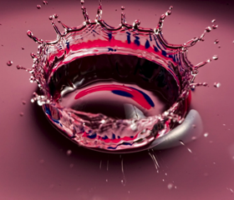
Why fast timing?
1/5 sec
1/500 sec
1/5000 sec

Slide 3
Why 10ps timing resolution
Time-of-Flight techniques to alleviate the pile-up problem and help improving energy resolution at high luminosity colliders
Improve resolution of finely segmented homogenous calorimeters
Time-of-Flight PET sanners with > 10 fold improvement in sensitivity
CT X-Ray imaging
Imaging in turbid media
hyperspectral time resolved spectroscopy for high precision dynamic studies of fast phenomena
Notes:
HEP ... because we are looking at very rare events and to produce only a few of them we need to use high luminosity colliders, with a huge number of uninteresting collisions
Need for X-Ray and hyperspectral time resolved spectroscopy ...
also because there is a demand for a 10 fold increase in molecular imaging sensitivity and TOFPET can allow this

Slide 4

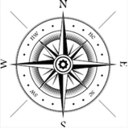


Detection of ionizing radiation
What matters?
TOF
When
Where
Energy
Particle ID
Finely segmented
calorimeters
Notes:
Link time ID (Finely segmented Time Imaging calorimeter) and time spatial localisation (TOF)
We see now coming a growing request for better timing resolution, boosted by emerging technologies opening the management of time at the ps level.

Slide 5
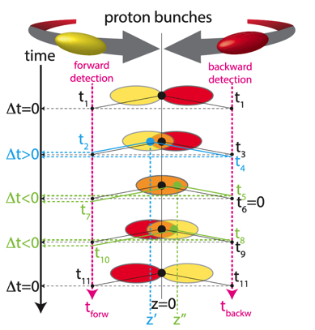
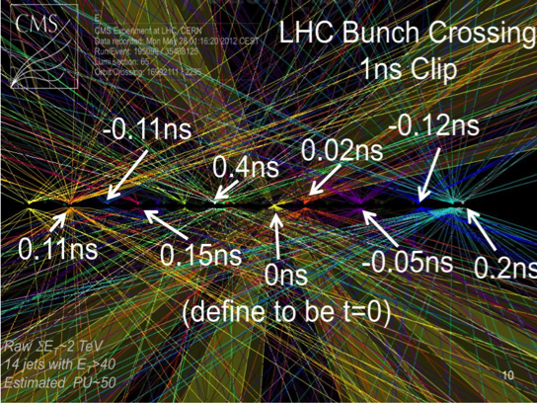
HEP
Principle of pile-up mitigation
For a luminous region distributed
over ~ 10cm, collisions will be
distributed over ~ 300ps
Use the tracker to determine the z position
of the vertex (large angle tracks)
Use TOF to associate a time to a vertex
Requires 10ps timing resolution !!!

Slide 6
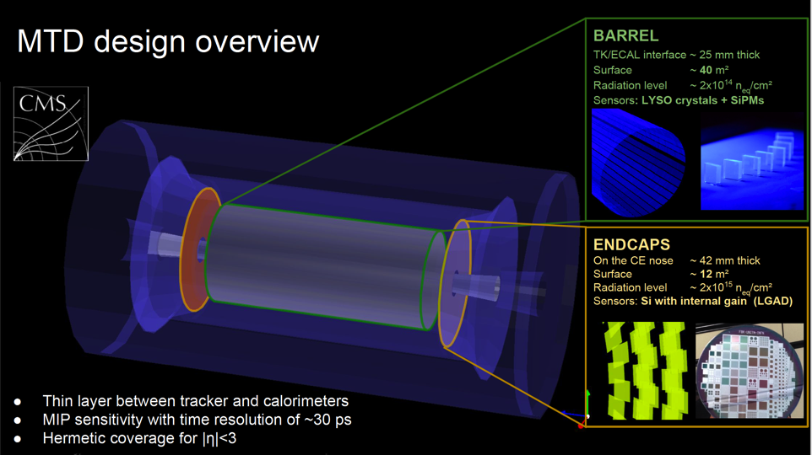
HEP: CMS timing layer
248’832 LYSO/SiPM
The CMS Collaboration, Technical Proposal for a Mip Timing Detector in the CMS Experiment Phase 2 Upgrade, CERN-LHCC-2017-027 ; LHCC-P-009
Notes:
And we are now discussing a new generation of detectors, like the timing layer of the CMS upgrade (scheduled for 2020), and which requires very fast and high gain photodetectors and which will use a quarter of a million SiPMs

Slide 7
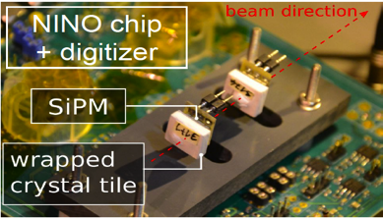
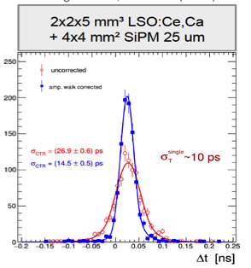
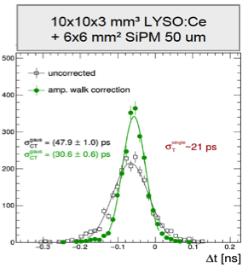
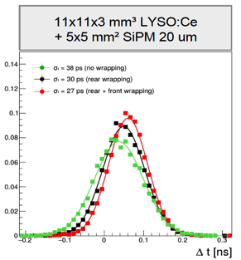
CMS timing layer: beam tests with mip’s
≈ 5 MeV
≈ 3 MeV
≈ 3 MeV
30 ps
Smaller SiPM / crystal area coverage
A.Benaglia, M. Lucchini et al., NIM 830 (2016) 30

Slide 8
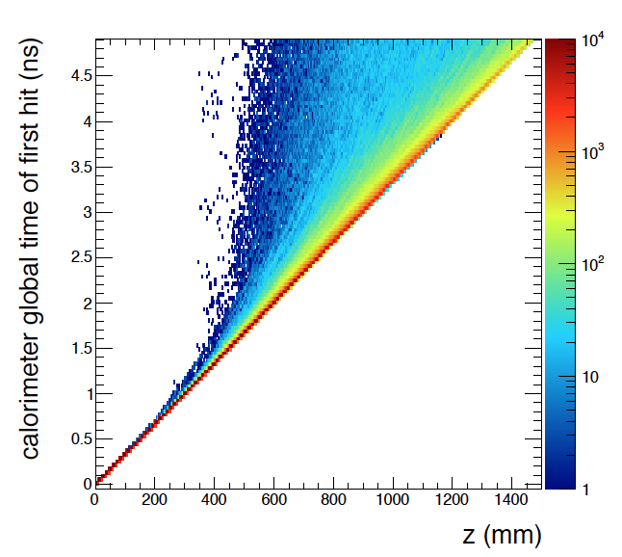
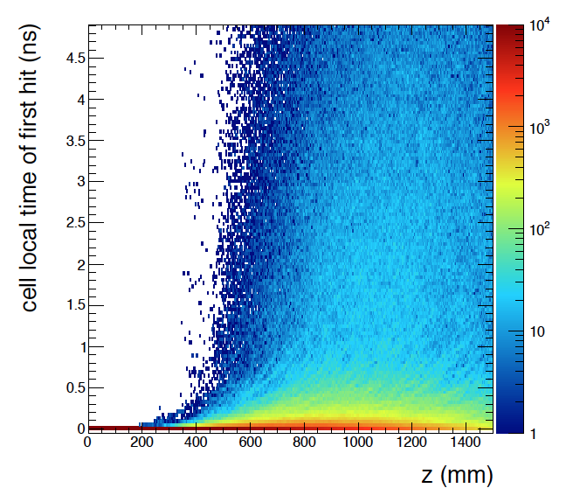
Hadron energy deposition in a segmented hadron calotimeter
Global time t
Local time t-z/c
50GeV proton in a 1x1x3m³ iron block
segmented in 1mm thick layers
About 1 MeV/mip/layer
A. Benaglia, E. Auffray, P. Lecoq, H. Wenzel, A. Para, IEEE Trans. Nucl. Sc. VOL. 13, NO. 9, Sept. 2014
Notes:
Precise timing in one or more EM? HAD? Calorimeter layers to associate jets with primary vertex (TOF) and reduce pile-up
Use timing information to help PFA association and to reduce the confusion term
Use event-by-event space-time evolution of energy deposition to improve the energy resolution

Slide 9
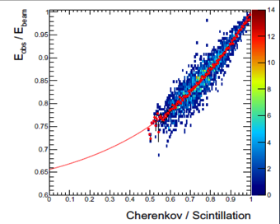
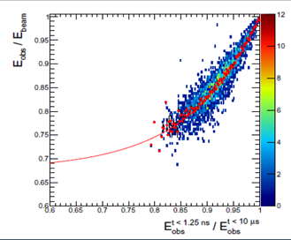
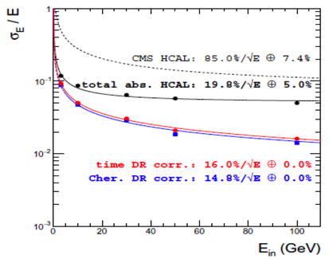
Dual Gate (scintillation) vs
Dual Readout (Scint. + Cher.)
A. Benaglia, E. Auffray, P. Lecoq, H. Wenzel, A. Para, IEEE Trans. Nucl. Sc. VOL. 13, NO. 9, Sept. 2014

Slide 10
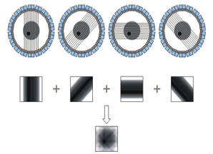
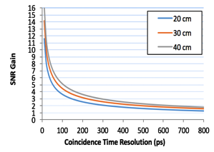
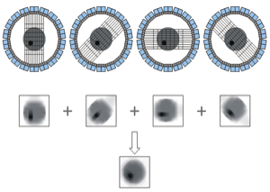
Time of Flight PET
Detector B
Δt = t_{A} – t_{B} = [(d+d₁) – (d-d₁)]/c
d₁ = c Δt/2
t_{B}
d
d₁
Patient
e⁺
10ps TOF resolution
δx = 1.5mm
SNR_{TOF}/SNR_{CONV}= 16!
e⁻
t_{A}
SNR_{TOF} = √(2D/cDt) · SNR_{conv}
Detector A
δt (ps)
δx (cm)
SNR*
10
100
300
500
0.15
1.5
4.5
7.5
16
5.2
3.0
2.3
State-of-the-art
* SNR gain for 40 cm phantom
Notes:
But there is also a request for good timing resolution for another important application of scintillating crystals. PET scanners.

Slide 11


Why 10ps TOFPET?
TOF for direct 3D information
  Requires 10ps TOF resolution for 1.5mm resolution along LOR
Allows limited angle tomography without artifacts
> 15-fold improvement in S/N ratio, even more with high random rate
  Equivalent potential in dose reduction (0.5mSv/scan)
    Annual natural background: 2.4mSv
    Return flight Paris SFO: 0.11mSv
  Allows longer longitudinal studies per injection
  Reduce the cost of radiotracer production infrastructures
Less sensitive to incorrect attenuation correction and normalization
  Less stringent requirements on CT: cost, dose reduction
  Reduce problems of not direct attenuation measurement in PET/MR
Open PET to new categories of patients (children, fœtus)
Current state of the art for PET commercial devices: 500-250ps
Current state of the art in the lab: 60-100ps (3-20mm crystals)
Conventional PET
10ps TOFPET
Notes:
- 10ps resolution correspond to 1.5mm resolution along the LOR and opens the way to reconstructionless PET
- this would considerably reduce the constraints associated to the tomographic principle, which requires full angular coverage of the ROI, and allow limited angle tomography without artifacts
- 10ps resolution would bring a > 15 fold ...

Slide 12
Where are we today for PET?
Measured with FBK NUV-HD (25μm SPAD size, 4x4mm² device size)
2x2mm² crystal cross section, T=15°C
NINO
30%
98ps
44%
58ps
Breaking news
HF electronics
S. Gundacker et al, 2016 JINST 11 P08008
Notes:
In red assume LTE =100%
In green: influence of LTE
In Yellow: influence of PTS

Slide 13
The detection chain
Crystal
SiPM
electronics
γ
How to extract the
best time estimator
from the signal?
Δt
θ2
t_{kth pe} =
Δt
+ t_{k’ ph}
+ t_{transit}
+ t_{SPTR}
+ t_{TDC}
Conversion depth
Scintillation
process
Transit time
jitter
Single photon
time spread
TDC
conversion time
Random deletion 1
Absorption
Self-absorption
Unwanted pulses 1
DCR, cross talk
Afterpulses
Random deletion 2
SiPM PDE
Unwanted pulses 2
DCR
Notes:
I will show again this slide that I have prouced several years ago, and which ihas become very popular.

Slide 14
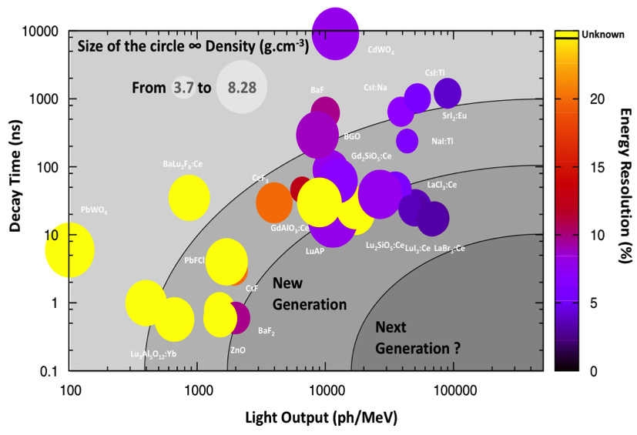
Classification of scintillators
Ideal
Scintilllator
Notes:
The Quest for the ideal very dense, very bright, very fast scintillator is going on.
But can we have a scintillators with 10 times higher LY and 10 times faster decay time than LSO?

Slide 15
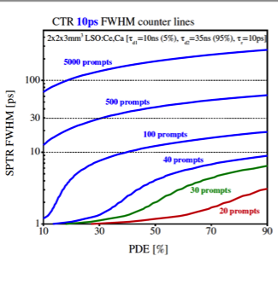
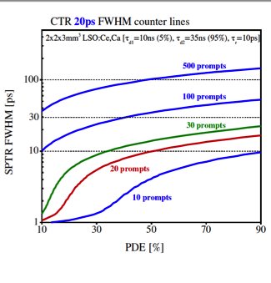
Prompt photons to boost the timing resolution
Cramer Rao calculations including photon transfer time spread (PTS) and light transfer efficiency (LTE) of a 2x2x3mm³ LYSO:Ce ,Ca crystal, glue-coupled to a 4mm² FBK-NUV HD SiPMs with 40um SPAD size
S. Gundacker, CERN
Notes:
The pDE being already quite high the factor on which to play is the SPTR

Slide 16
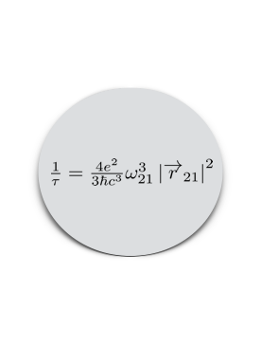


Possible sources of prompt photons ( < 1ns)
Ce³⁺ Activator: 5d-4f
Ca²⁺ & Mg²⁺ co-doping
τ_{r} ~ 20 ps τ_{d} ~ 16 ns
Excitons/Bi-exciton
stable at 300 K
Hot Intraband Luminescence
0.1 - 10 ps
High donor band semiconductors <1ns
quenched at room temperature
Cross Luminescence
<1ns
<300 nm – low LY
Cerenkov
τ ~ 5-10 ps
Notes:
Cross luminescence. Very fast but not taken too seriously so far because of a relativelylow LY and an emission in the UV. But this situation can change with the development of new solid state photodetector with a QE as high as 20% @ 200nm.
High donor band semiconductor, introduced by Lehman in 1966 with ZnO and CdSe, and reactivated by S. Derenzo and M. Weber in 2002 with PbI2, HgI2, CuI

Slide 17
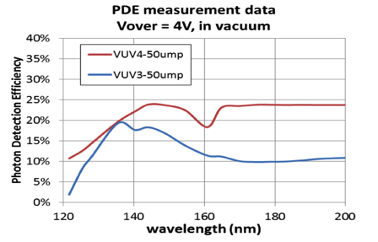
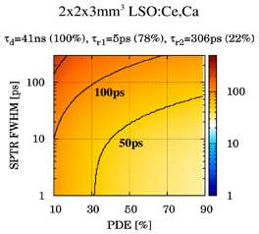
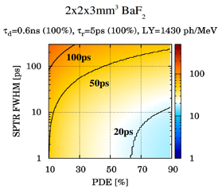
LSO:Ce,Ca / BaF2
E_{g}
1400ph/MeV
600ps
220nm
Courtesy of Hamamatsu
hν
Crossluminescence
σ
50
σ
50
Glue coupling: LTE = 68%
Air coupling: LTE = 35%
S. Gundacker, CERN
Notes:
SPTR in sigma
LSO:Ce:0.4%Ca scintillator to 4x4mm2 FBK NUV-HD SiPMs with 40m m SPAD size
BaF2 air coupled to SiPM Hamamatsu VUV (S13370) 1400ph/MeV 600ps 220nm

Slide 18
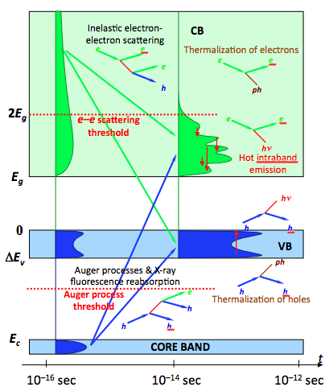
Hot intraband luminescence
The small energy relaxation rate below the ionization threshold leads to:
  a high density of optical and acoustic phonons
    local heating, shock wave, transient absorption
  a dynamic e population change from the top to the bottom of the conduction band
If the density of states is not uniform in the conduction band a competition can take place between phonon mediated non-radiative relaxation and radiative relaxation between conduction sub-bands
Notes:
See Cs2CdI4 paper Pidzirailo
Alos list of crystals propsed by Oimelkov and Vasiliev

Slide 19
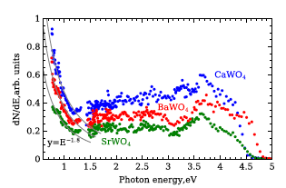
Hot intraband luminescence
Ultrafast emission ≤ 10⁻¹²s
  e-IBL: broad spectrum in visible range
  H-IBL: NIR psectrum
Independant of temperature
Independant of defects
Absolute Quantum Yield
  W_{hν}/W_{phonon} = 10⁻⁸/(10⁻¹¹-10⁻¹²)
  ≈ 10⁻³ to 10⁻⁴ ph/eh pair
Higher yield if structures or dips in CB? Interesting to look at CeF3
Omelkov et.al., J. Lum., 176 (2016) 309–317
Notes:
Vaisburd,.Evdokimov, phys.stat.sol.(c)2(2005)216-222
If we can manage to have a non uniform density of electron states in the conduction band (symetrically of holes in the valence band) we can have a competition between phonon assisted non radiative relaxation and photon assisted radiative recombinations

Slide 20
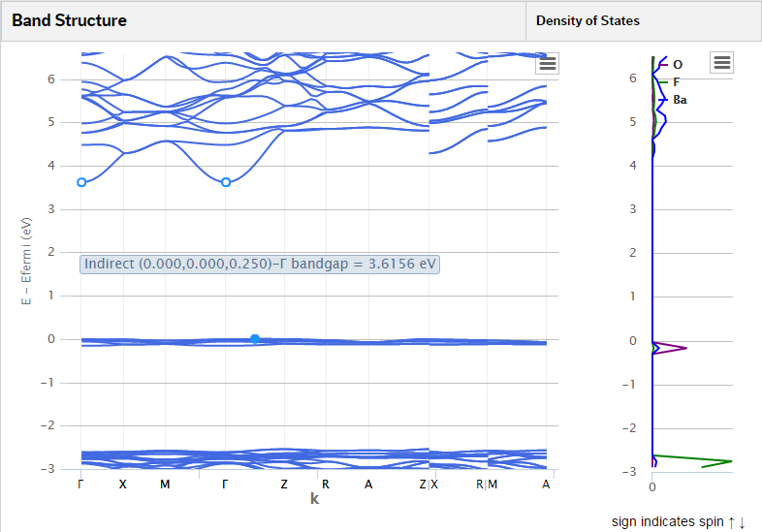
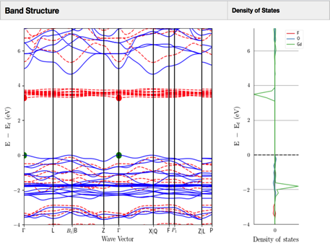
Search for Candidates for Hot intraband luminescence
Search for materials with splitting of the conduction/valence band
Search for materials with flat sub-bands for a perfect delocalization of the electrons/holes
  Examples Oxy-halide compounds
Ba₄OF₆ 4.61g/cm³
GdOF 7.51g/cm³

Slide 21
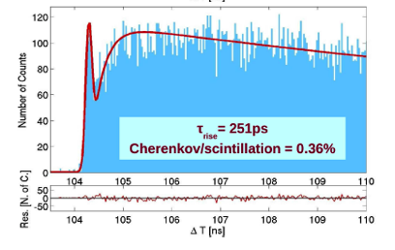
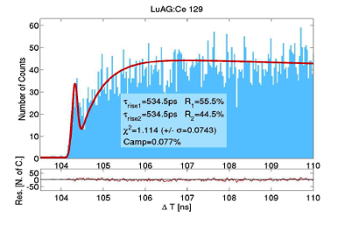
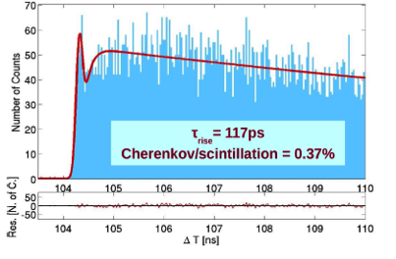
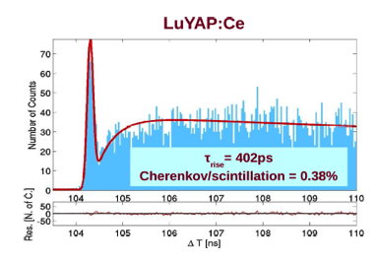
Cerenkov contribution
LuAG:Pr
LuAG:Ce
3,4 Cerenkov photons
0,28%
LuAG:Pr, Ca
S. Gundacker, E. Auffray, K. Pauwels, and P. Lecoq, Phys. Med. Biol. , vol. 61, pp. 2802–2837, 2016.

Slide 22
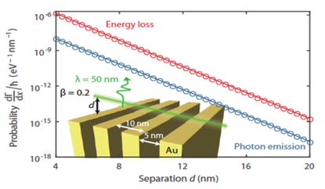
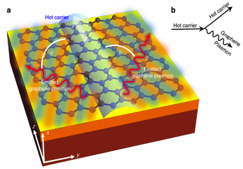
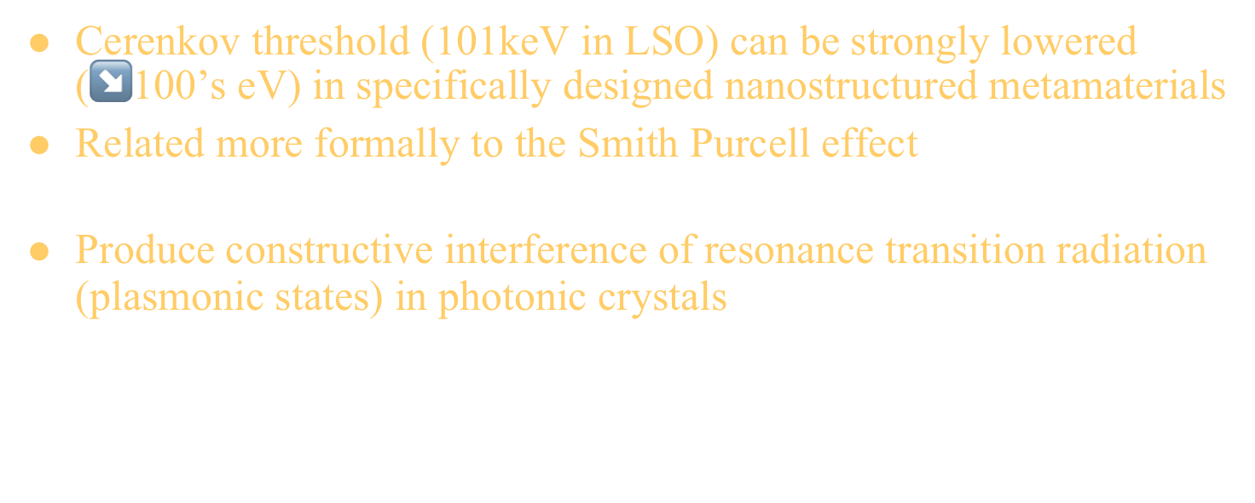
Lowering Cerenkov threshold ?
Cerenkov threshold (101keV in LSO) can be strongly lowered (↘100’s eV) in specifically designed nanostructured metamaterials
Related more formally to the Smith Purcell effect
  A kind of Cerenkov or transition radiation emission ➝ free electron lasers
Produce constructive interference of resonance transition radiation (plasmonic states) in photonic crystals
  $λ= \frac{a}{m}\left(\frac{1}{β}−cosθ\right)$ !! No velocity threshold !!
Y. Yang et al., Nature Phys. Lett., 16 July 2018
I. Kaminer et al., Nature Comm., 13 June 2016
Notes:
Also Smith–Purcell effect (at the basis of free electron lasers): Essentially, this is a form of Cherenkov radiation where the phase velocity of the light has been altered by the periodic grating. a is periodicity m diffraction order.
Transitionm Radiation: a form of electromagnetic radiation emitted when a charged particle passes through inhomogeneous media, such as a boundary between two different media.
Free electron lasers: coherent emission has been observed with e energy as low as 250eV
Engineering of a metamaterial with low permittivity to reduce the phase velocity. The plasmonic-polaritons on the surface produce constructive interferences of the resonance transition radiation

Slide 23
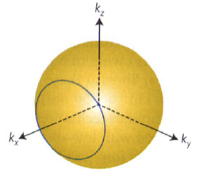
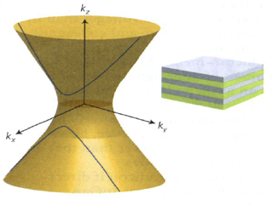


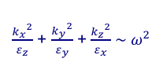
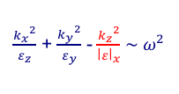
Lowering Cerenkov threshold with hyperbolic metamaterials
Isofrequency contour from dispersion formula: k $= \frac{2π}{λ}$ $\sim$ $ω\frac{n}{c} \sim ω\sqrt{ε}$
Isofrequency contour from dispersion formula: k $= \frac{2π}{λ}$ $\sim$ $ω\frac{n}{c}$
for isotropic dielectric material
for anisotropic hyperbolic material
$\frac{{k_{x}}^{2}}{ε_{z}}$ + $\frac{{k_{y}}^{2}}{ε_{y}}$ + $\frac{{k_{z}}^{2}}{ε_{x}}$ $\sim ω^{2}$
$\frac{{k_{x}}^{2}}{ε_{z}}$ + $\frac{{k_{y}}^{2}}{ε_{y}}$ - $\frac{{k_{z}}^{2}}{{\left|ε\right|}_{x}}$ $\sim ω^{2}$
Finite density of photonic states in dω
Infinite density of photonic states in dω
k_{z}
k_{z}
k₊
k₊
Fast e⁻
k_{x}
Slow e⁻
k_{x}
k₋
M. Silverinha, Nature Photonics, Vol. 11, May 2017
k₋
Notes:
In isotropic dielectric materials only fast electrons, associated to short transverse wavevectors can couple to photonic states k+ and k-
HMM: Nanostructures having dielectric properties in some directions and metallic properties in other directions.
Originally introduced to overcome the diffraction limit of optical imaging
Number of interesting and unusual properties due to their high density of photonic states
Photonic hypercrystals combine the most interesting features of photonic crystals and hyperbolic metamaterials
HMM are a fantastic playing field, which starts to be successfully exploited in photonics, and in photovoltaic, but which has not entered yet our domain of radiation detectors. Its potential is huge, only limited by our imagination.

Slide 24
Multi-exciton quantum confinement
X
XX
XXX
Γ_{x}
Γ_{xx}= 4Γ_{x}
Γ_{xxx}= 9Γ_{x}
CdSe/ZnS
τ_{x} ~ 1ns
τ_{xx} = 196ps
τ_{xxx} = 69ps
Padilha et.al., Nano Lett. 2013, 925-932
Notes:
Padhila, Klimov, Nano lett 2013, 13, 932-932 Response of NCs to high energy excitations
Fortunately the excitation density is high due to the very inhomegeous dE/dx energy deposition of the recoil electron

Slide 25
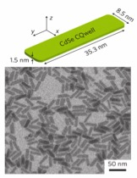
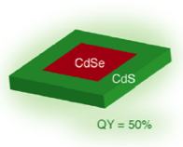
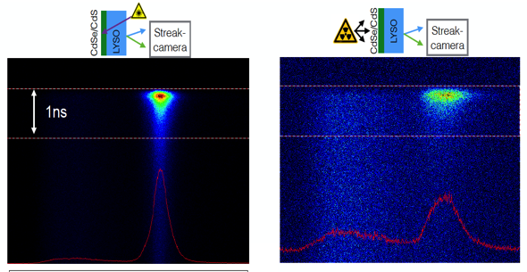
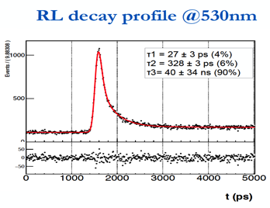
GOS in 1D quantum confined systems
J.Grim, I. Moreels
ITT, Italy
LYSO plate 200μm thick
+ CdSe/CdS nanoplate film 20μm thick
372 nm laser or X-rays
20μm CdSe film
deposition
LYSO
200μm
Streak
Camera
Focal spot
optical
table
530nm
420nm
530nm
R. Martinez Turtos et al., JINST_068P_06
Notes:
Left: Streak focussed on CdSe: Fast peak from laser excitation of CdSe. Long tail CdSe excitation by LSO scintillation light. Emission >540nm = LSO emissionnot absorbed by CdSe
Right: Streak focussed on LSO
This opens the way to composite scintillators, and more generally to metamaterials

Slide 26
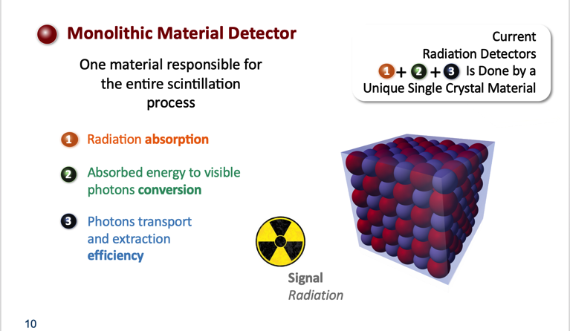

Limits of bulk materials
Performance Limitation
Courtesy of G. Bizzari, Cranfield University

Slide 27
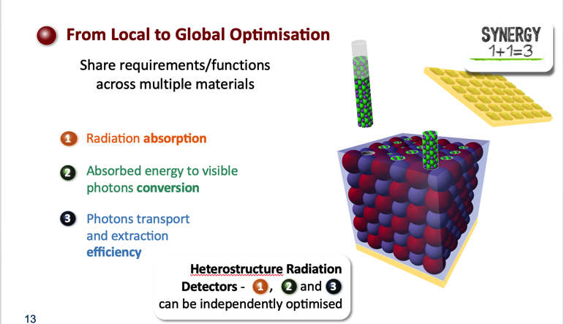

Towards heterostructures
Performance Optimisation
Courtesy of G. Bizzari, Cranfield University

Slide 28

Metamaterials
From the Greek meta-, « metamaterials » means « beyond materials » (i.e. natural materials)
High stoping power
L(Y,G)SO, (La,Ce)Br3,
BGO, CsI
Prompt emission
Quantum confined (bi)-excitons
in nanocrystals
Light transport to SiPM
Photonic crystals, photonic fibers

Slide 29
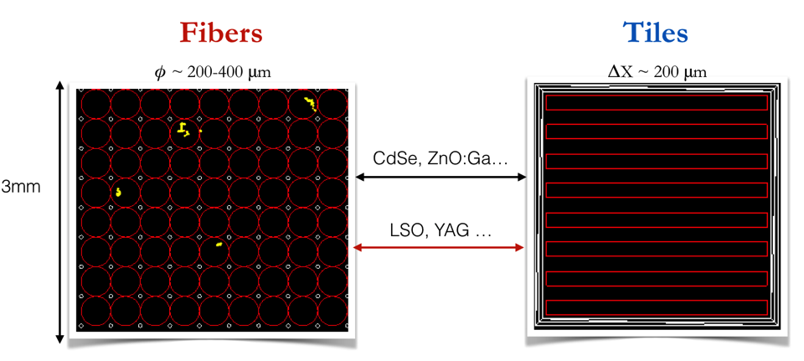
Metapixels under study
Evaluation of the photodetection efficiency in a sampling geometry with 2 active materials
Evaluation of the energy leakage from the dense to the fast material
CTR estimation from a full MC simulation of prompt and scintillation photons
Notes:
CdSe 3% in weight in polystyrène

Slide 30
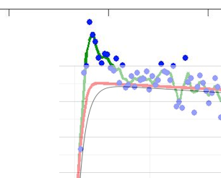
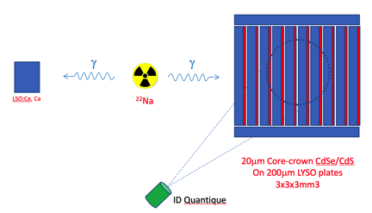
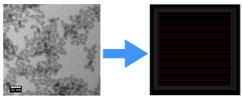

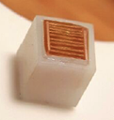


CdSe/LYSO plates Metapixel
Fit on
Rise & decay
Time w/o peak
200μm thick LYSO plates
+ 20μm effective thickness
CdSe/CdS nanoplatelet film
3x3x3mm³
LSO
τ_{rise} = 70ps
S. Gundacker, R. Martinez-Turtos, CERN
Notes:
LSO with 70ps rise time

Slide 31


CdSe/BGO plates Metapixel
200μm thick
Naked BGO plates
2x2x3mm³
200μm thick BGO plates
+ 20μm thick
CdSe/CdS nanoplatelet film
2x2x3mm³
S. Gundacker, R. Martinez-Turtos, CERN

Slide 32



Energy sharing studies
BGO block 2x2x3mm3
NUV-HD SiPM 40μm SPAD (FBK)
CTR with
57ps LSO
pixel
LYSO block 2x2x3mm3
NUV-HD SiPM 40μm SPAD (FBK)
121ps
BGO DTR=107ps
BC418&BC422 block 2x2x3mm3
NUV-HD SiPM 40μm SPAD (FBK)
LYSO DTR=54ps
BC422 DTR=25ps

Slide 33






BC422/BGO plates Metapixel
125keV
300keV
⚫️
200μm thick BGO plates
+ 200μm tBC422
2x2x3mm³
CTR with
57ps LSO
pixel
CTR with
57ps LSO
pixel
CTR with
57ps LSO
pixel
CTR with
57ps LSO
pixel
110ps
87ps
70ps
87ps
S. Gundacker, R. Martinez-Turtos, CERN
Notes:
BC 422
Light output = LYSO/3
Td —> 1.3ns
Tr —> 30ps
CTR nino ~ 50ps

Slide 34



Considerations for heterostructures design
Keep the density/photofraction close to the scintillator host (BGO, LSO)
Reach a reasonable balance between the standard/prompt photon light yield
Transport efficiently the light from both components
So far, simple and non optimised proof-of-concept designs
UCLA
CdZnS/CdS
BGO comb
200μm ZrO₂ plates
100μm holes, 300μm spacing
3D printing
CERN

Slide 35

Particularities of energy sharing in heterostructures
Timing resolution is different for all events
For a given fraction F of events sharing their energy, the number of events benefiting from a CTR improvement is: F(2-F) > F
  2/3 events share energy in 100μmBGO/100μmBC422
  89% events will have a CTR better than bulk BGO
CTR is much less dependant on detection threshold

Slide 36
Conclusion- Potential of metamaterials
By making use of light-management strategies, Nanophotonics privides a playground to make the unimaginable come closer.
This opens the way to transformation optics (a kind of extrapolation of Maxwell’s equations invariance under Lorenz transformation), allowing to envision a distortion of real space that results in a desired functionality:
  Ultrafast emission
  Enhanced fluorescence yield through plasmonic resonances
  Redirect light into preferred directions
  Electromagnetic cloaks
  Improve thermal dissipation
  In our case, this is a fertile field for developing innovative solutions for ultrafast
    Light production
    Light transport
    Light photoconversion
Notes:
The ability of deep subwavelength plasmonic structures to show strong light–matter interactions is forming the basis of an entirely new class of optical materials.

Slide 37

The best metapixel requires the best SiPM

Slide 38

New SiPM concept
The Quantum Silicon Detector

Slide 39

The 10ps challenge:
  a spur on the development of fast timing
  an opportunity to get together
  an incentive to raise funding
  a way to shed light on nuclear instrumentation for medical imaging
One unique challenge launched for 5 to 10 years and operated by an international organisation with rules issued by the community based on the measurement of CTR combined to sensitivity
Several milestones and prices:
  3 years after the launch of the challenge: 1M€ expected for the Flash Gordon prices for the realisation of 3 important milestones
  until the end of the challenge: 1M€ expected for the Leonard McCoy price for the first team meeting successfully the specifications of the challenge
Notes:
The essence of a challenge is to think big and to gather the multidisciplinarity expertise for a real breakthrough
We have of course to assume the risk of an ambitious challenge
In my view the most important risk is to underestimate the physical barriers (ex. The Heisenberg uncertainty principle )
The two other risks that need to be considered are:
The technological risk:
can we find a technology or a combination of technologies that will provide a solution to the challenge
Answer: if there are no physical barrier, solutions will be developed, sooner or later
The cost:
Can be mitigated by the progress of the technologies and the importance of the impact

Slide 40
Conclusion
Disruptive technologies
Nano-photonics
New
perspectives
New, intelligent
Multifunctional sensors
“Impossible”
is not a French word
Napoléon
Notes:
A number of disruptive technologies, particularly in the very rich domain of nano-photonics open completely new perspectives for new, intelligent and multifunctional sensors

Slide 41

Many thanks to
Notes:
At this stage I need to thank many people, first of all my group at CERN, which is now run very efficiently by Etiennette Auffray
But also a number of colleagues, all over the world, for their encouragements and stimulating and enriching discussions
CERN and the European commisssion for the financial support through a number of projects, all related to fast timing
And I would not like to forget all of you for your attention

Slide 42
Meta-X-γ Detector Block for
Low Energy Applications
Shown at NSS/MIC 2008, Dresden
Quantum dot
loaded polymer
with a gradient
of QD radius
along the fibre
Photonic fibers
Φ = 100μm
Heavy scintillating fibers
(LuAG, LSO …)
Φ = 500μm

