Slide 1
Pixel QC working group
Arisa, Hide, Minoru, Lingxin, Egor, Cesar, Dima, Ben, Gabriele, Filippo, Valentina

Slide 2
Working group tasks
Local Storage Organisation
Disconnected bumps scan
QC scripts + documentation
Optimisation of scan times
Lab equipment/DCS integration
Bonus task: stuck pixel scan

Slide 3
Local storage organisation

Slide 4
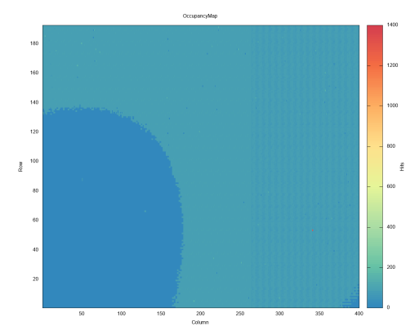
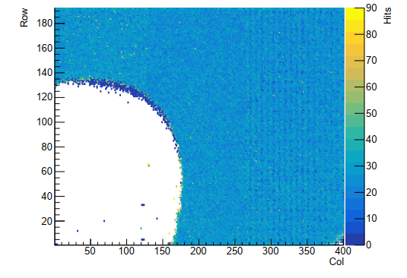
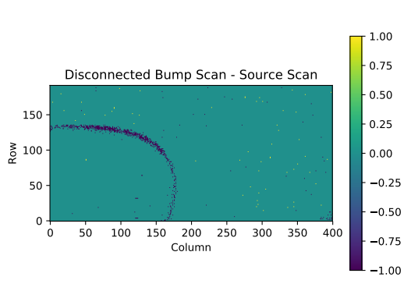
Disconnected bump scan
Worked on implementing the disconnected bumps scan
Scan working and compared with source scan
Branch ready to merge
Source scan
Disconnected bump scan
The difference

Slide 5
QC scripts + documentation
This is work on the travelling module
Purpose to make every potential commissioning site to use the same chip / module
Gain experience with running the setup at each site
Compare results and eliminate problems
Practice to use the same testing protocol and database
Created simple “one stop shop” scripts for each FE to perform basic scans and generate meaningful output before and after tuning
Tested the scripts on two independent machines
Continued work on writing instructions on the web page
Practiced the use of the local database [to be implemented in the travel module run routine]

Slide 6
Optimisation of scan times
Extensive discussion was had about how to approach the task
Concluded that more understanding and experience with the setup and software is needed
Quality time was spent using the setup, installing software, running scans
Everyone in the group gained experience and confidence in running the setup and software

Slide 7
Lab equipment/DCS integration
See Ben’s talk

Slide 8
Bonus task: stuck pixel scan
Discussed the pathway for implementation
Started coding, “stuck_pixel_scan” branch for those to follow closely
Currently testing and optimising

Slide 9
Thank you!
Thank you to everyone! All worked very hard during this workshop
We achieved a lot, but learned way more that a lot
Special thanks to Timon and Aleksandra for hosting us and organising this event
YAAAARRRR

