Slide 1
RD53A Emulator Demo
By Douglas Smith

Slide 2
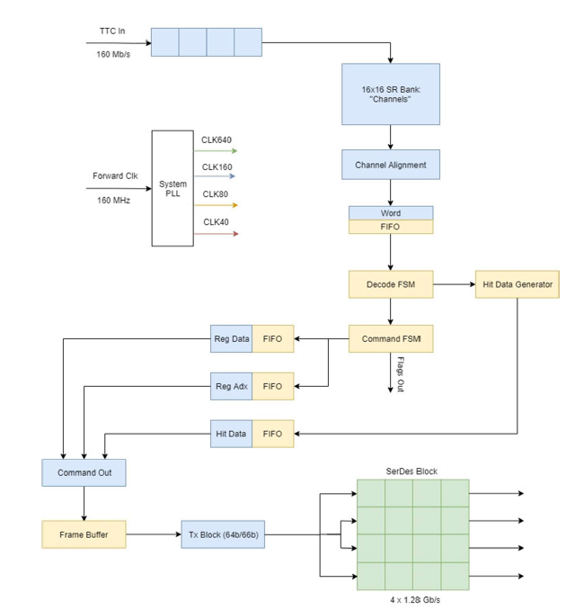
What is it?
It is a digital emulator of the RD53A chip.
Written in Verilog
Targeted to FPGAs(KC705)
Designed by ACME lab at UW
Work of numerous graduate and undergraduate students
Emulator outline shown on right

Slide 3
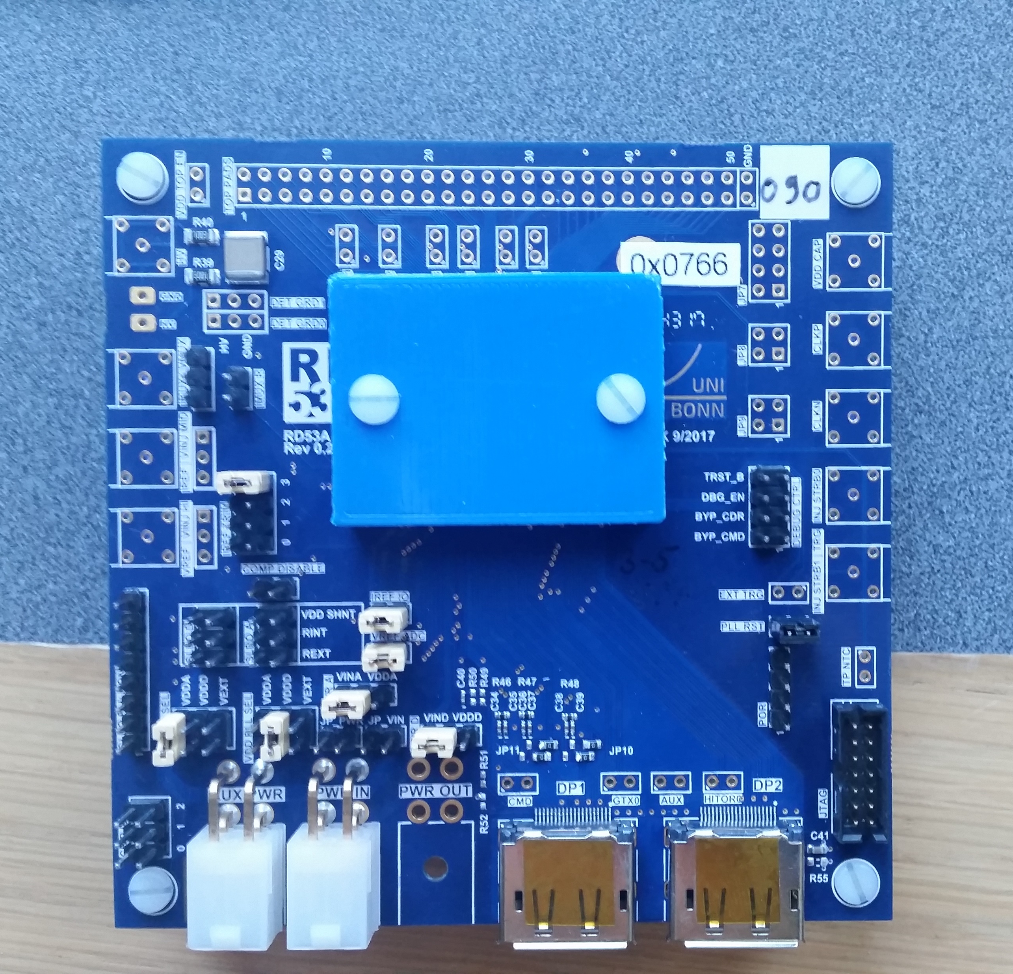
Motivation 1
Original use cases
(1): Act as stand in for real chip
(2): Early debugger for readout systems under development
The real chip was released and most interest groups now have an RD53A
Use case shifted to producing realistic hit data

Slide 4
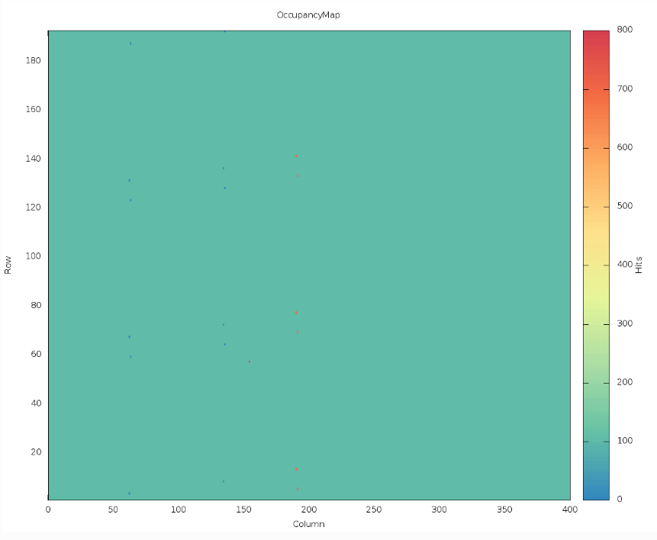
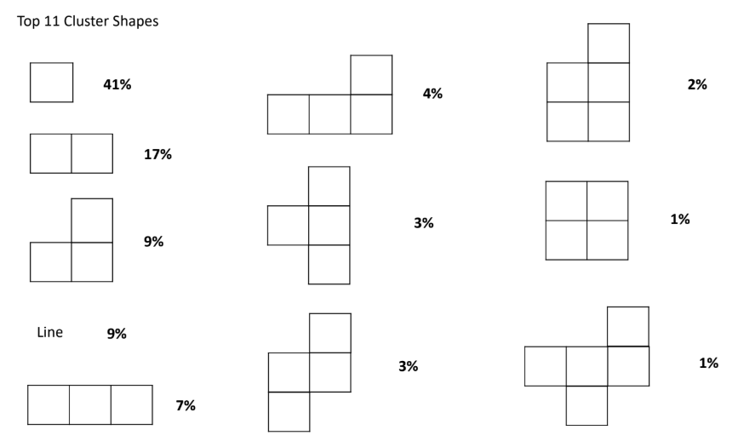
Motivation 2
Not every lab has an onsite particle accelerator or an easy way to excite the chip. Most of the data being collected is not interesting.
Use Case (1): Produce realistic hit data.
Resembles what would be produced if the RD53A was put into the LHC.
Accomplished by studying actual data collected at CERN.
Analyzed the data using clustering/line detection
It was determined most of the hit data consisted of simple Tetris pieces or lines.
Having realistic hit data useful for debugging

Slide 5
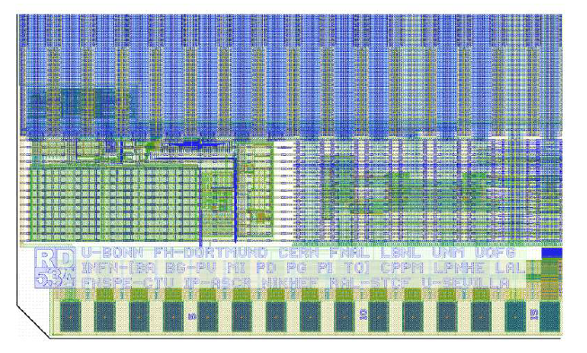
Motivation 3
Use Case (2): General debugging and a point of comparison.
The RD53A is a black box.
The emulator is easier to look inside and debug for issues.
Use Case (3): The emulator easily modifiable.
Bugs fixed on a much shorter timescale than developing a new chip
New features can be added
Use Case (4): Starting point for new interest groups for initial testing and debugging.

Slide 6
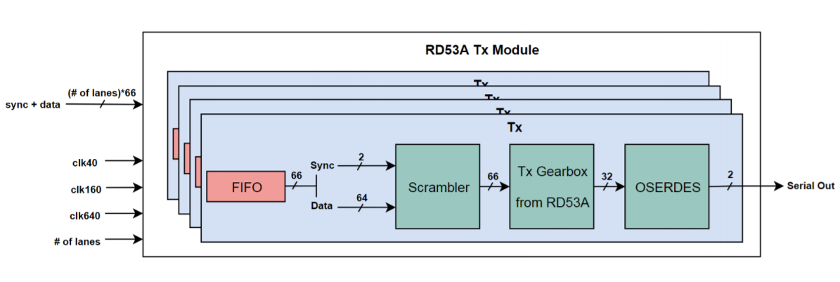
Current Features
Input data is properly received.
The emulator receives 160 Mbps data.
Correctly performs synchronization/channel alignment.
Input frames are properly decoded using rd53a protocol into commands, triggers, and data
Output data of the emulator is properly encoded using the aurora 64/66B protocol
640 Mbps over four lanes.
Custom implementation that uses Xilinx SERDES modules.

Slide 7
Current Features 2
Reading/writing of global registers works.
The read out registers are sent through lane 0.
Auto read sent when there is no data.
Trigger commands
Properly stored/responded too triggers outputting clumps of realistic hit data.
Formatting follows the RD53A protocol.
Large amount of configurability
The output level of the hit data is controllable by a configuration register.

Slide 8
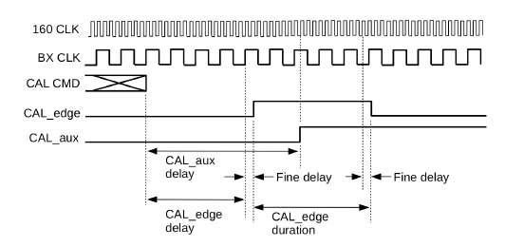
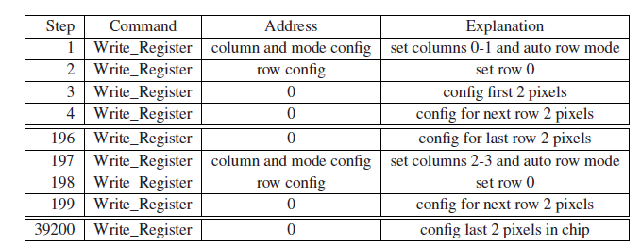
Limitations
RD53A features that involve analog circuitry have been greatly simplified or removed entirely.
Simplification: Pixels are represented by large block, not individual emulated pixels
Removed: Calibration and writing to pixels
A 160 MHz input clock is required as an input.
Don’t perform CDR
ECR, BCR, and CAL commands are received but have no external impact.

Slide 9
Readout Systems
Recently, a large portion of the effort at UW has been establishing communication with various readout systems for the RD53A.
The emulator isn’t particularly useful if it can’t communicate with the DAQ readout systems.
The three big readout systems we have been working on are YARR, RCE and FELIX.

Slide 10
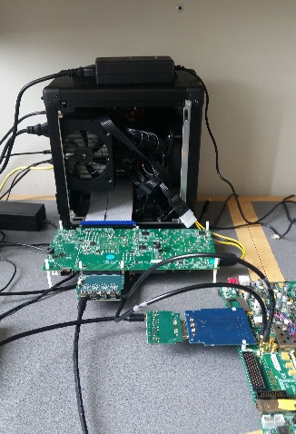
YARR
YARR developed by LBNL
Timon Heim spearheading the project
The emulator has established communication with a slightly modified YARR.
Rearranging the clocks on the YARR side.
Added a counter to manage the Ohio MMC chip.
Sent a 250 MHz clock was sent.
Required hardware
Two KC705 Xilinx Board
A VHDCI to FMC chip
A VHDCI to Quad DP Rev A. chip
The Ohio Multi Chip FMC
Two SMI cables
A mini-DP to mini-DP cable

Slide 11
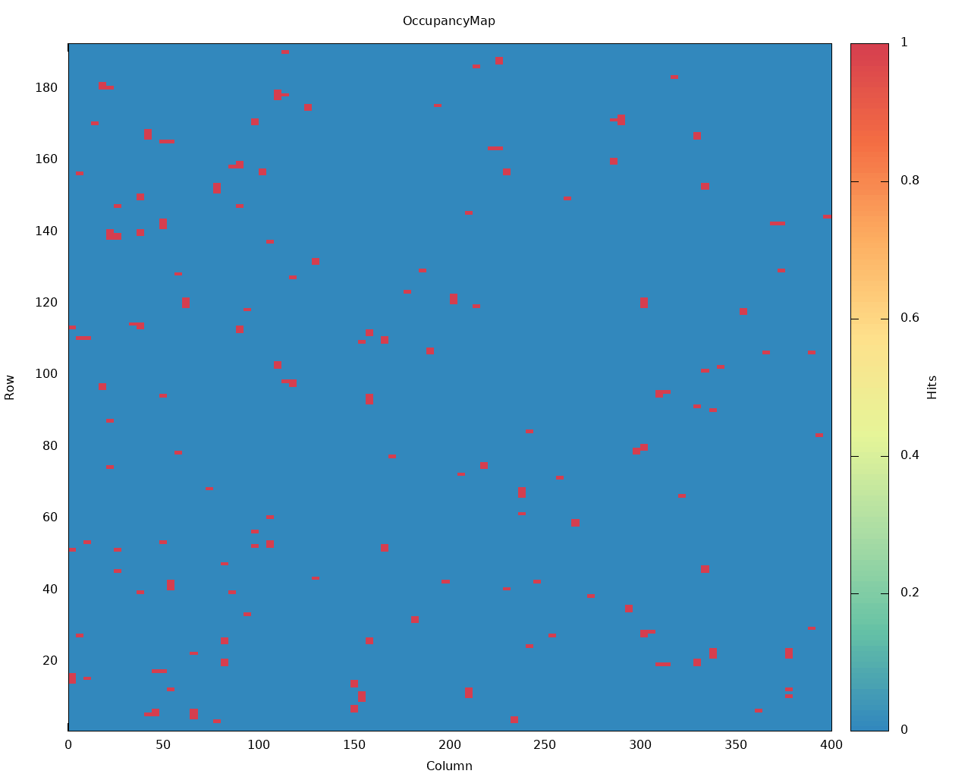
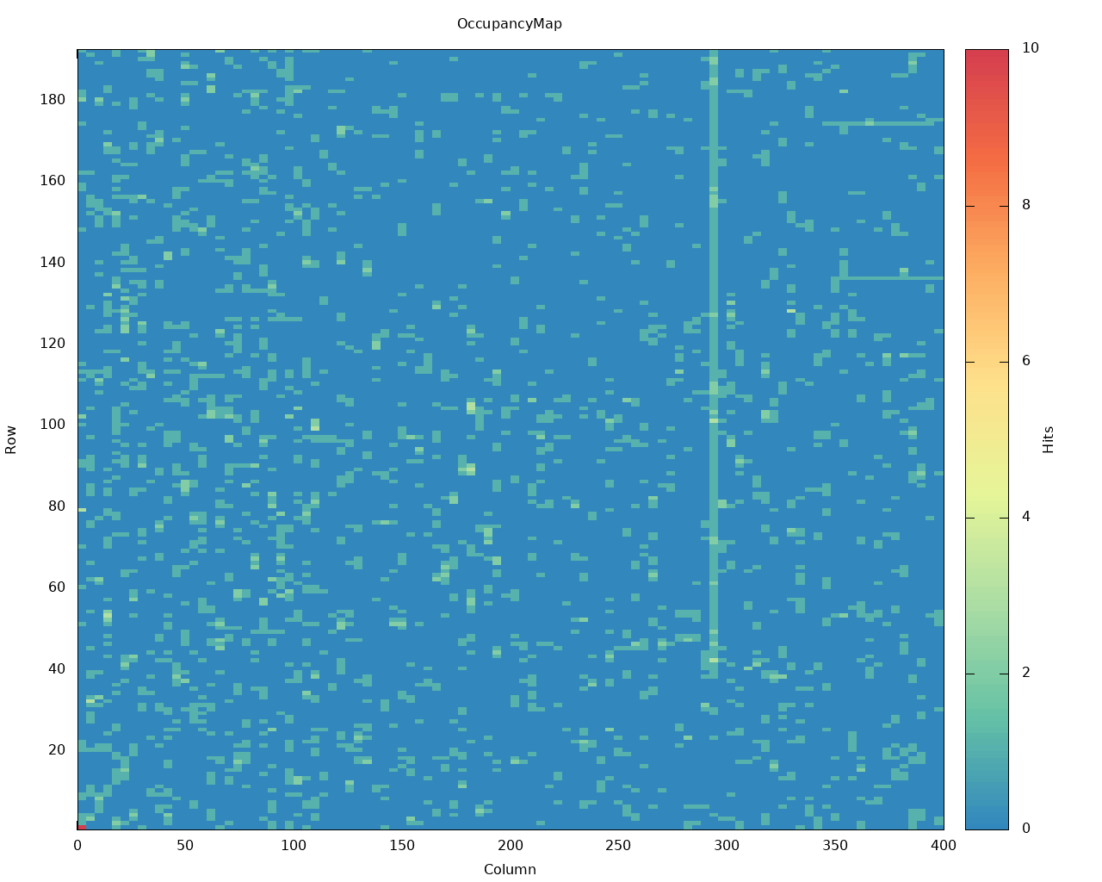
YARR 2
Features
The YARR test suite, digital scan, analog scan, rd53a_readreg
Communication at 640 Mbps
Can configure the hit data generation rate
An example of data received with the YARR setup at the UW.
Shows both high data generation rate and low data generation rate

Slide 12
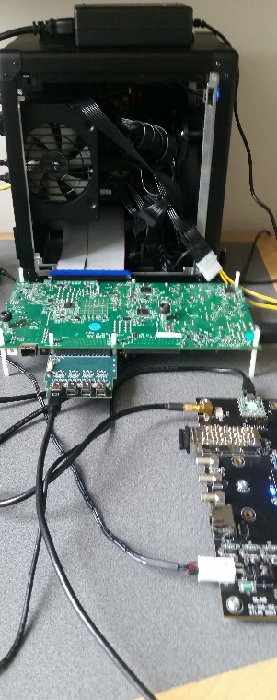
RCE
Required hardware
HSIO2/DTM + FEB ( HSIO2 is a standalone RCE system)
PC + 10G-Eth card
FEB
Features
The same functionality as with YARR is supported
160 Mbps communication
Setup at UW is not the full setup, but consider close enough for debugging and testing purposes

Slide 13
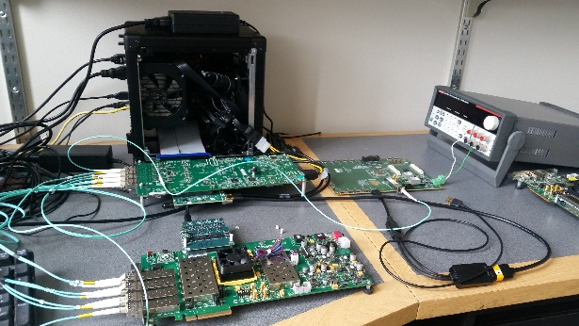
FELIX
Required hardware
A VLDB board
2 VC709 Xilinx Board
TTC mezzanine card
The Ohio Multi Chip FMC
Two SMI cables
A mini-DP to micro-HDMI cable
4 optical cables
Features
Not currently running at UW, but working hard on getting the system setup
Testing FELIX with a simpler PC

Slide 14
Where next?
RD53A is completed at a high level perspective.
Focus will shift to continuous support
Bug fixing
Adding additional features
Work will continue on the FELIX setup.
A simple mock up of FELIX has worked.
More work is required to get the system fully operational.
The next big direction of the project is the RD53B.

Slide 15
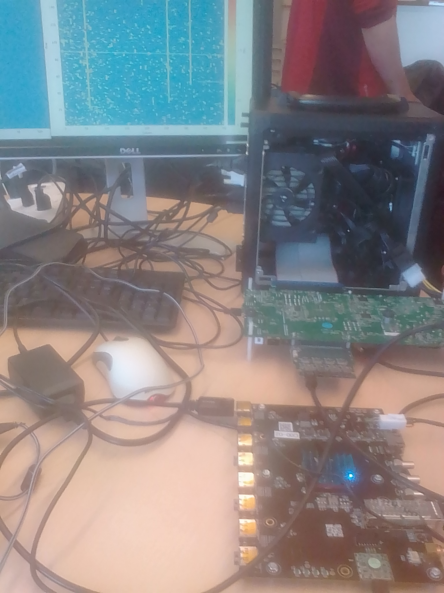
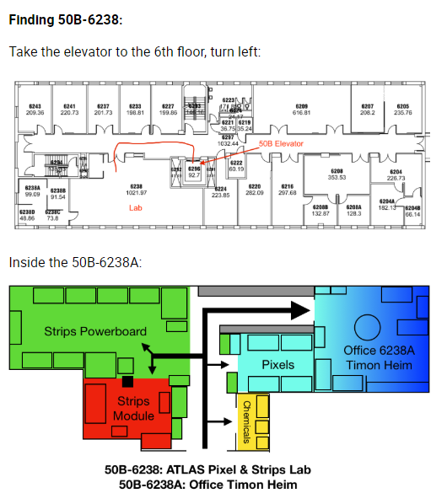
System Demo
Website: https://rd53a-doc.readthedocs.io/en/latest/
Your feedback is highly appreciated and desired
Live demo
Questions?

