Slide 1
Cesium-Francium Atomic Fountain for Measuring CP –Violation by the Electron Electric Dipole Moment
Charles Munger, Jr.
As part of the Electron EDM Collaboration:
Ben Feinberg, Harvey Gould, Juris Kalnins, Charles Munger, Hiroshi Nishimura, Chris Tomassi, and Shawn Zhao (Lawrence Berkeley National Laboratory)
Ulrich Jentschura (Missouri University of Science and Technology)
John Behr and Matt Pearson (TRIUMF)
Supported by the Electron Electric Dipole Moment Research Foundation

Slide 2
Recent reported e-EDM limits
Thallium-205 ≤ 1.6 10^-27 e cm 2002, beam
YbF ≤ 1.05 10^-27 e cm 2011, beam
ThO ≤ 8.8 10^-29 e cm 2014, beam
HfF+ ≤ 1.3 10^-28 e cm 2017, trap
Our experiment is an experiment on Cs, and then on Fr from the TRIUMF accelerator, with a target sensitivity of 8 10^-30 e cm. The method is an atomic fountain, where a beam is slowed to rise and reverses under gravity. (Fr atom edm is 900x the electron edm; Cs atom edm is 120x). Both atoms will use the same apparatus.

Slide 3
Electric dipole moments are predicted by the Standard Model to exist, but have never been seen. Violate P, T, and CP.
Some Standard Model ingredients:
Effect:
QED, Weinberg-Salaam model of the weak interaction
QCD with no CP violation (ϴ=0)
Lepton doublets and quark doublets
3 generations
Quark mass eigenstates ≠ weak eigenstates (CKM matrix)
CP violation only in the quark sector (if it is in the neutrino sector too, its effect is even smaller)
A CP-violating phase of O(1) is largely hidden by the small flavor mixing in the CKM matrix
Any e-edm appears at high order requiring many intermediate W’s, which have large mass, and many loops.

Slide 4
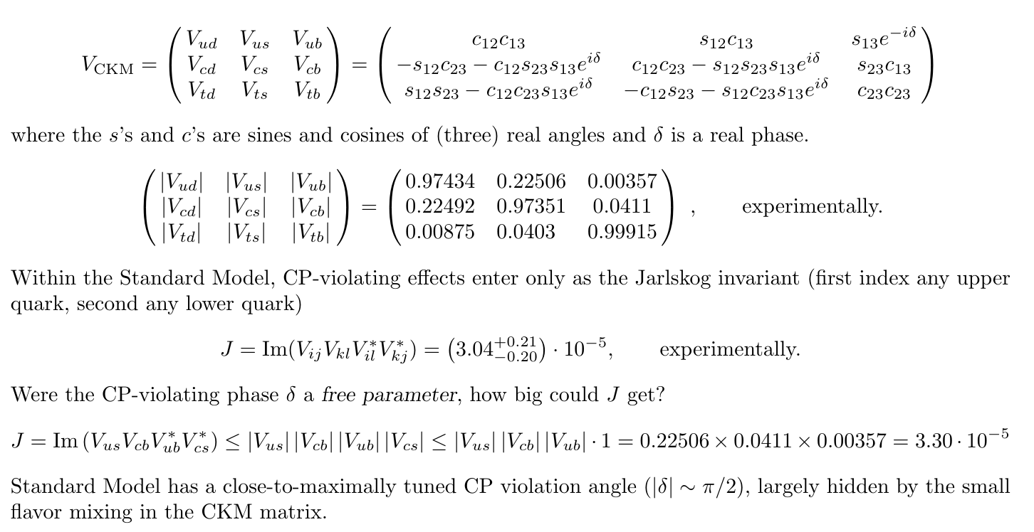

Slide 5
Standard Model Generic beyond SM
Example: Generic Supersymmetry, with O(1) CP-violating phases and superpartner masses of O(100 GeV) will violate our target e-edm bounds by a factor of 10^4.

Slide 6
Atomic beam systematics
An atom at rest, with a magnetic and an electric dipole moment, will precess in magnetic and electric fields (top left). The rotation angle is the edm observable; we seek a rotation with a shift odd in E.
If small transverse magnetic fields are present, they will cause small rotations about the transverse axes (top right). Rotations about both x and y generate a net rotation about z. Acceptable: the rotation is even in E.
If the atom moves with velocity v, there is generated in the atom’s rest frame a “motional” magnetic field
B = (1/c) v x E (bottom left) That interacts with the component of the magnetic field parallel to the atomic velocity to generate a rotation odd in E.
Desirable to reduce any component of the magnetic in the direction of the beam velocity , and also to combine data for beams of opposite signs of the velocity.
Fountains reverse the velocity by the rise and fall of atoms under gravity. Velocity of a few m/s reduces the systematic by a factor of 100 compared to thermal atomic beams at a few hundreds of m/s.
Effect of magnetic and electric fields on an atom with both a magnetic dipole moment and an electric dipole moment.
2

Slide 7
Energy shifts of ground-state levels 7s |FM> in 211-Fr (F=5)
Scalar Stark Effect in 10^7 V/m Electric field:
Increases binding energy by h x 800 MHz; atoms pulled toward strong electric fields. All levels |FM> shift identically (force on atoms independent of M).
Zeeman Effect in a field of 330 pT (magnitude equal to the motional field for an atom at 3 m/s in 10^7 V/m)
Tensor Stark effect in 10^7 V/m field
Electron edm

Slide 8
Looks straightforward…
Collect 10^8 atoms in a magneto-optical trap.
Turn off the trap’s magnetic fields, tune the up-angled trap lasers blue and the down-angled lasers so that the frame where the frequencies are equal moves upward at a few m/s.
Turn off the trap lasers, let the atoms ascend into a magnetically shielded region—no fields at all!
Optically pump the atoms into a single state.
Let the atoms enter between plates that provide a big electric field; let them turn around under gravity and exit.
Optically pump the altered atomic state to encode any e-edm shift as a difference in the population of the (two) ground-state hyperfine levels. Again, no fields here!
Let the atoms fall out of the shielded region, and measure the difference in the populations by scattering photons by optical pumping. …And repeat.

Slide 9
A naïve design won’t work, one needs:
Focusing of neutral atoms by magnetic lenses using the Zeeman effect
|F,-F> adiabatically follows the direction of field lines and the atom is attracted by strong fields.
|F,F> adiabatically follows the direction of field lines and is the atom is repelled by strong fields.
Analog to charged beams: there quadrupole lenses focus and defocus. Here the forces are on a dipole, the required symmetry of a magnetic lens is hexapole. (But, the lens focuses equally in both transverse directions).

Slide 10
A naïve design won’t work, one needs:
Focusing of neutral atoms by magnetic lenses using the Zeeman effect
Focusing of neutral atoms by electrostatic lenses using the Stark effect

Slide 11
Atomic optics: Stark effect makes atoms seek strong electric fields (same force independent of magnetic quantum number)
Rising atoms would defocus at the edge of a pair of flat electric field plates
Plates whose cross section show a curve will both focus and defocus
|Z|

Slide 13
Simulation of the emittance envelope of our ``gravitational’’ atomic accelerator.
Current design returns 75% of Fr atoms to the MOT for reuse
---------
---------
Red trace: 1 mm displacement, zero transverse velocity.
Blue trace: zero displacement, transverse velocity of 14 mm/s.
Black trace: 1 mm displacement and 14 mm/s transverse velocity.
X: displacement from center, parallel to electric field plates (mm).
Y: displacement from center, perpendicular to the plates (mm).

Slide 14
A naïve design won’t work, one needs:
Focusing of neutral atoms by magnetic lenses using the Zeeman effect
Focusing of neutral atoms by electrostatic lenses using the Stark effect
Special materials to avoid magnetic fields due to thermally activated electric currents (Johnson noise).

Slide 15
Johnson/Nyquist magnetic noise from conductors
Thermodynamics: A resistor R at a finite temperature T will manifest an random, thermally driven alternating voltage across it (between points 1 and 2); this voltage an a current in the circuit, and shows up as a random field inside an inductor L. (Blackbody radiation; a resistor absorbs; it must also emit.)
Therefore a solid slab of electrically conducting material also at a finite temperature T will manifest random, thermally driven whorls of current, and these will generate random magnetic fields near the slab. (The fields are smaller, further away, because there is more averaging over the whorls).

Slide 16
*
…can’t use.
…can’t use.
…so, segment!
…with the right glass.
*Ratio of the rms fluctuation in the magnetic field, as integrated over the path of a bunch of 10^8 atoms, to the shot noise due to the finite number of atoms in the bunch.

Slide 17
(Goal achieved on half-scale prototype)

Slide 18
A naïve design won’t work, one needs:
Focusing of neutral atoms by magnetic lenses using the Zeeman effect
Focusing of neutral atoms by electrostatic lenses using the Stark effect
Special materials to avoid magnetic fields due to thermally activated electric currents (Johnson noise).
Robust error cancellation
…and a few other things I won’t tell you (don’t try this at home).

Slide 19
Locking certain phases to integers simplifies the analysis…

Slide 20
Optical pumping provides very detailed information about changes…

Slide 21
Verifying a signature works is trivial; how on Earth does one find it in the first place?
Break U into a product of 3 series in small parameters (each of which one checks against exact solutions).
Then multiply and cancel enough terms!
The small parameters are:
Within the electric field, the ratio of the Zeeman splitting to the tensor Stark splitting, O(5e-3).
Outside the electric field, the small angle of rotation, O(1e-2) or less.
In the transition region, the ratio of the time spent traversing it to the ti.me in the electric field, O(1e-2)
Time variation of the fields applied to an atom in a fountain: electric in red, motional magnetic in green, and static magnetic in blue.

Slide 22
The hard series is the one inside the field.
(published)
Here mu is the inverse of the small parameter, about 200.
Fortunately, the observable we use proves to be a function of 1/mu^2, not 1/mu; terms of order 1/mu^4 are utterly negligible, so we only need the terms of 1/mu and 1/mu^2 in the series.
We can not only cancel all the spurious terms odd in the electric field, we can measure them separately and make their magnitudes small by tuning the static fields.

Slide 23
Systematics can be isolated from an e-edm.
There remain two E-field-odd terms that don’t cancel by mere symmetry, for all angles of the linear polarization of the analysis laser. At particular angles, these terms are big, while the contribution of an e-edm is zero.
We will verify this theory using Cs by mimicking an e-edm by reversing a small magnetic in synch with the reversal of the electric field.

Slide 24
Cesium-Francium Atomic Fountain for Measuring CP-Violation by the Electron Electric Dipole Moment
Timeline:
3 years—measure the e-edm in Cs to 8e-29 e-cm (matching current reported molecular limits).
1-2 years later—measure the e-edm in Fr at TRIUMF to 8e-30 cm (better by 10x)

