Slide 1
Low Energy CPT Tests with Antimatter
Andrew Christensen

Slide 2
CPT Theorem
Lorentz Invariance, Local QFT –> CPT Symmetry
Peskin & Shroeder

Slide 3
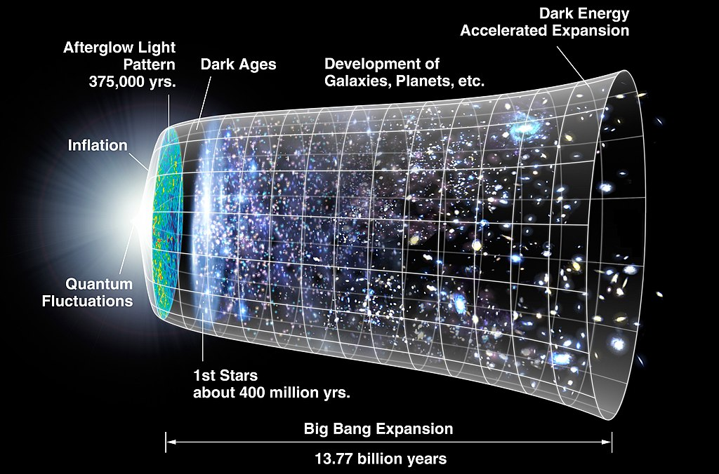
Baryogenesis and the Sakharov Conditions
Baryon number violation
C and CP symmetry violation
Interactions out of thermal equilibrium
Or CPT asymmetry

Slide 4
Neutral Kaon CPT Tests
CPT TESTS IN THE NEUTRAL KAON SYSTEM BY FNAL E773
Bernhard Schwingenheuer
1.4 parts in 10^14
Within 1 degree

Slide 5
Low Energy CPT Tests
“Antihydrogen is the CPT of Hydrogen”
Natrual antiprotons and electrons have the opposite handedness of antiprotons and electrons
We compare the Emission spectrum of matter with the absorption spectrum of antimatter (Kirchov’s law of thermal radiation makes this a moot point)
Antiproton and positron masses, charges, and magnetic moments should be equal to those for protons and electrons

Slide 6
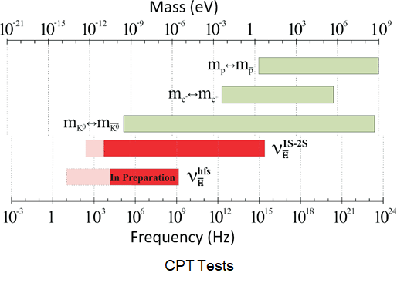
ALPHA 1S-2S and hyperfine measurements are now more precise, on an absolute energy scale, than the kaon system test, which is commonly regarded as the “best” CPT test.
Our tests are model independent tests.
CAVEAT: The BASE result on the antiproton magnetic moment is not readily plotted on these axes and is not included in the graph.

Slide 7
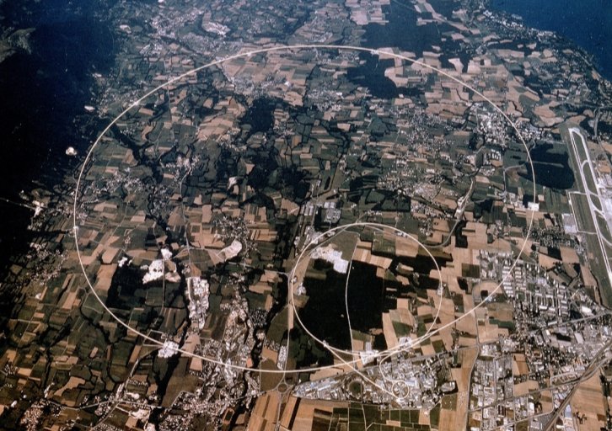
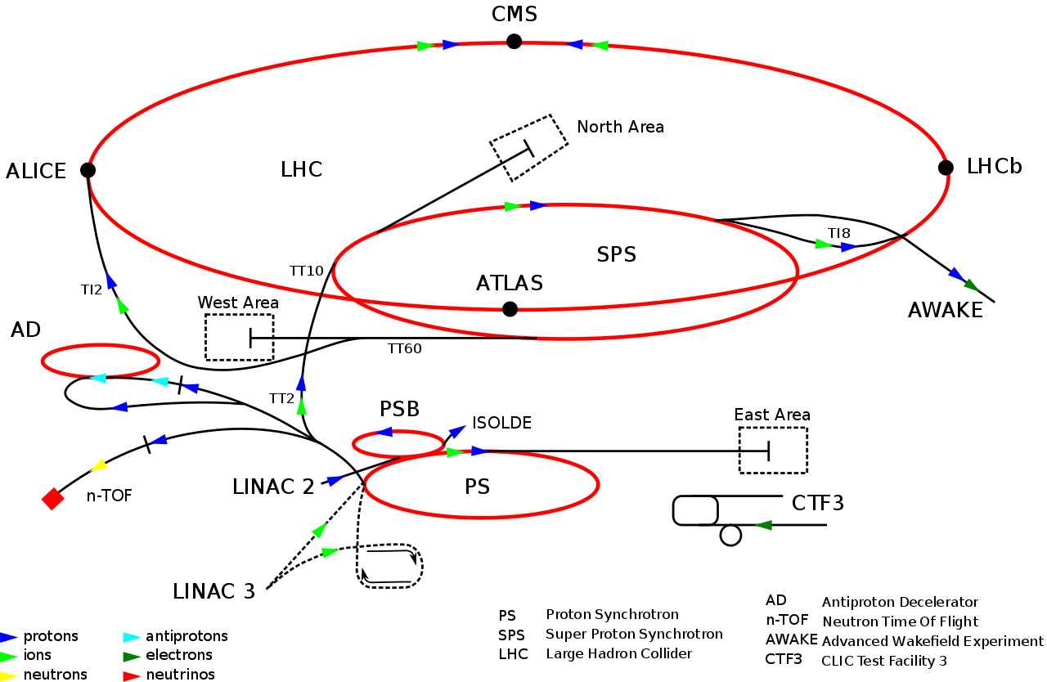
Antiproton Decelerator

Slide 8
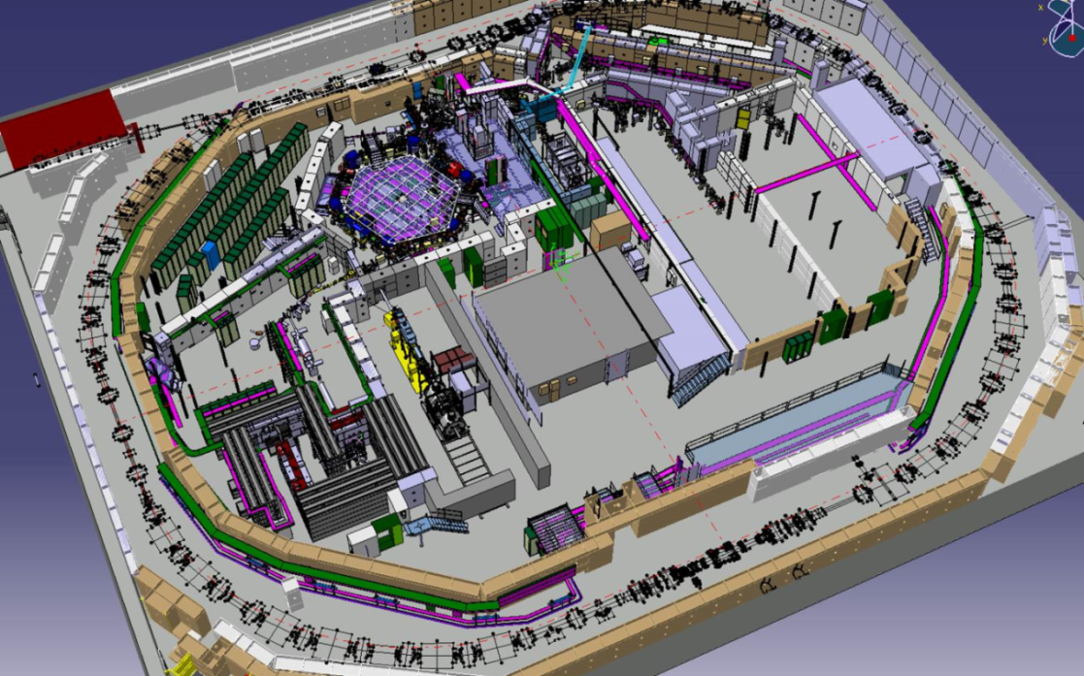
Antiproton Decelerator
ATRAP
Properties of the antiproton: ATRAP, BASE
Antihydrogen spectroscopy (1S-2S, and more): ATRAP, ALPHA
Antihydrogen Hyperfine measurements: ALPHA, ASACUSA
Charge neutrality of antihydrogen: ALPHA
Antiprotonic Helium spectroscopy: ASACUSA
Antihydrogen gravitation: ALPHA, GBAR, AEGIS
AEGIS
BASE
ELENA
ALPHA
ASACUSA
GBAR

Slide 9
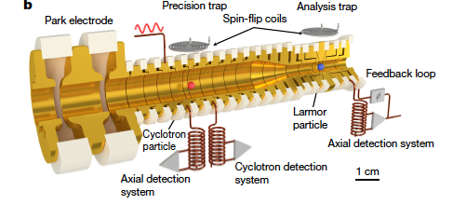
Base Collaboration

Slide 10
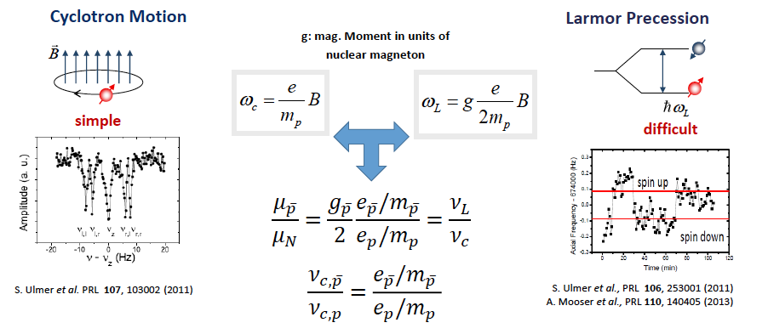
Comparison of the Cyclotron Frequency and the Larmor Frequency
Slide: S. Ulmer

Slide 11
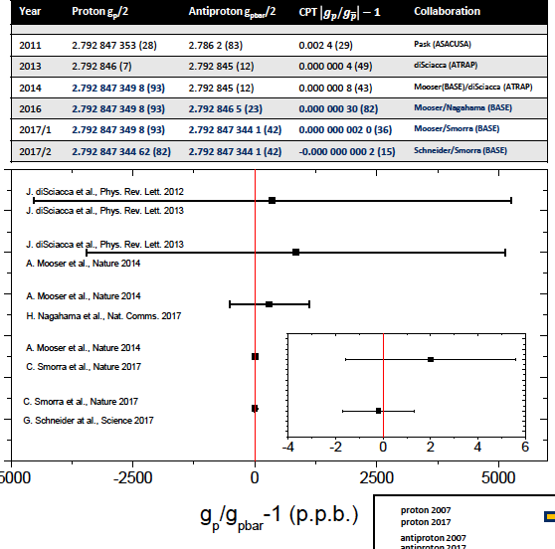
Slide: S. Ulmer

Slide 12
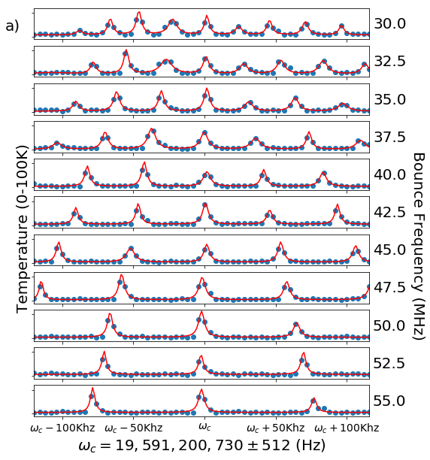
Electron Cyclotron Resonance

Slide 13
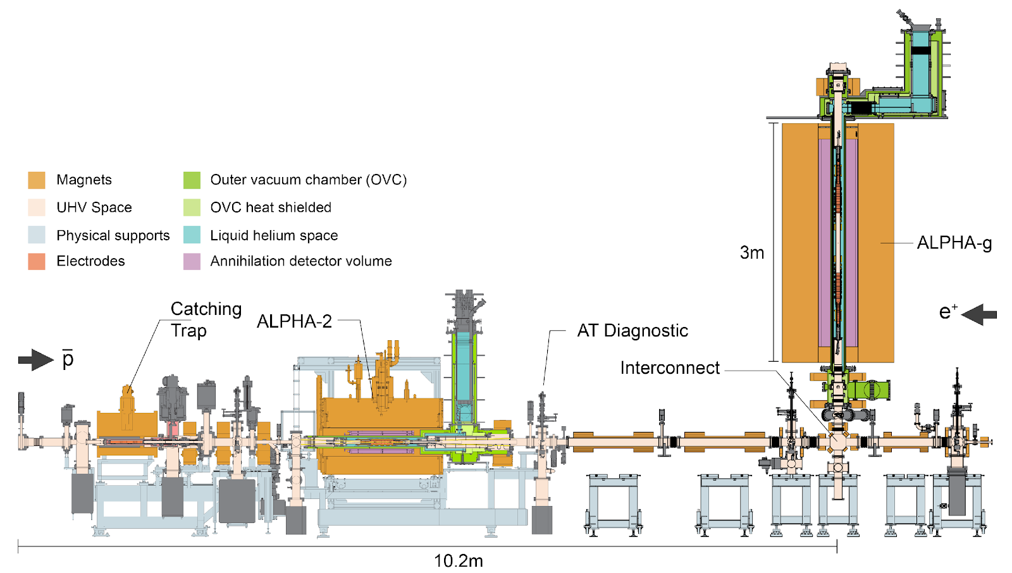

Slide 14
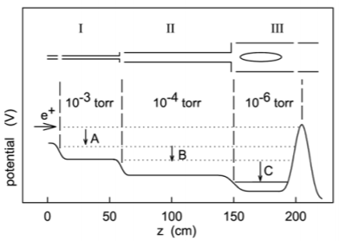
Surko-Style Positron Accumulator
Accumulation, Storage and Manipulation of Large Numbers of Positrons in Traps I. – The Basics
Clifford M. Surko

Slide 15
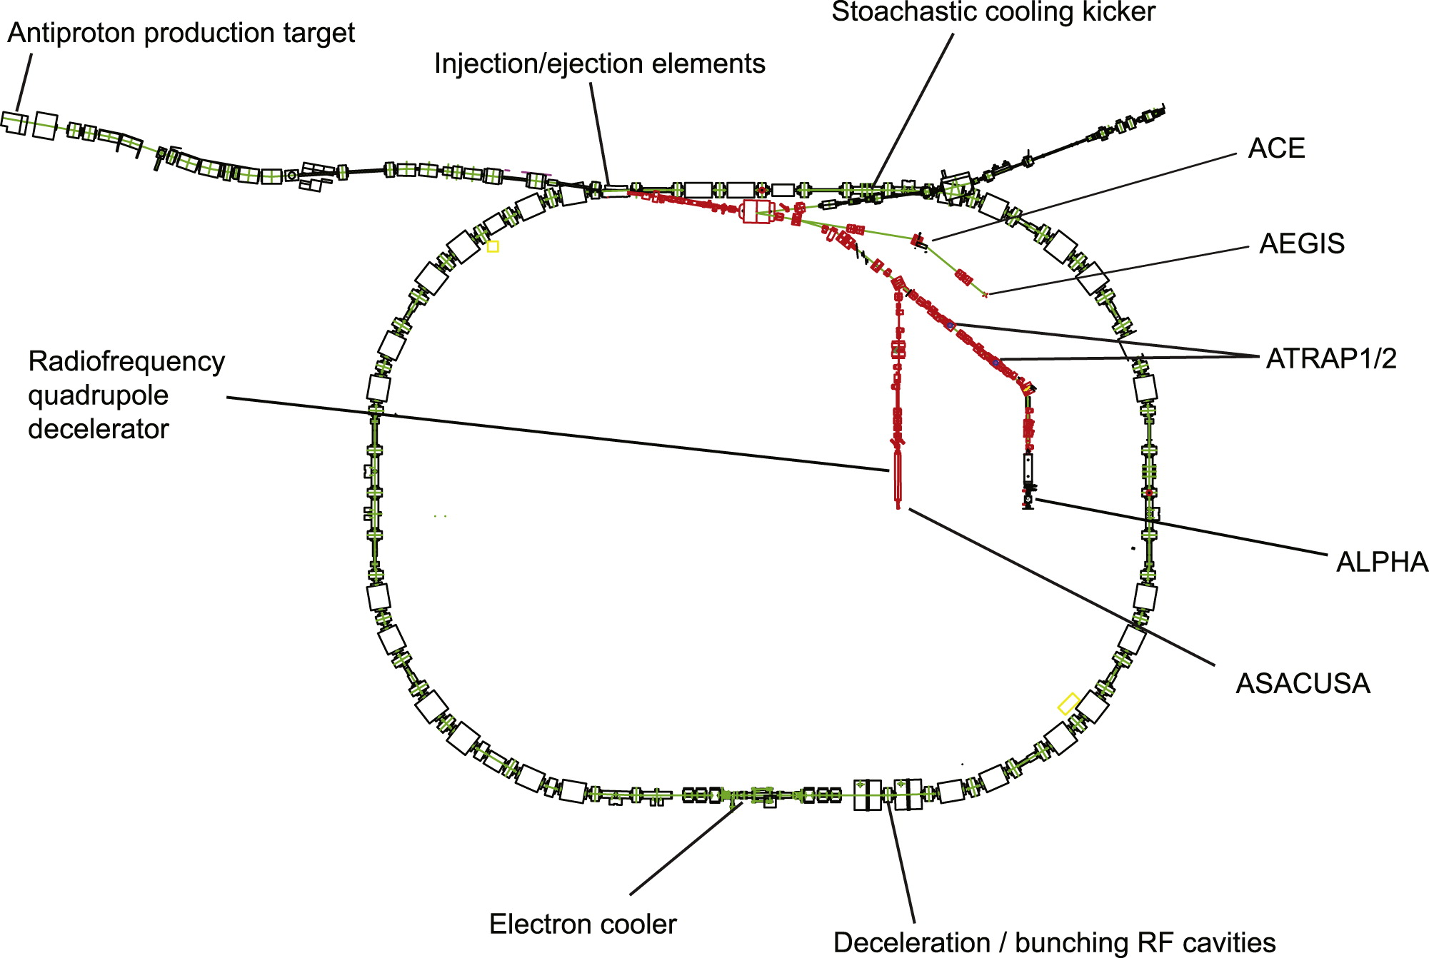
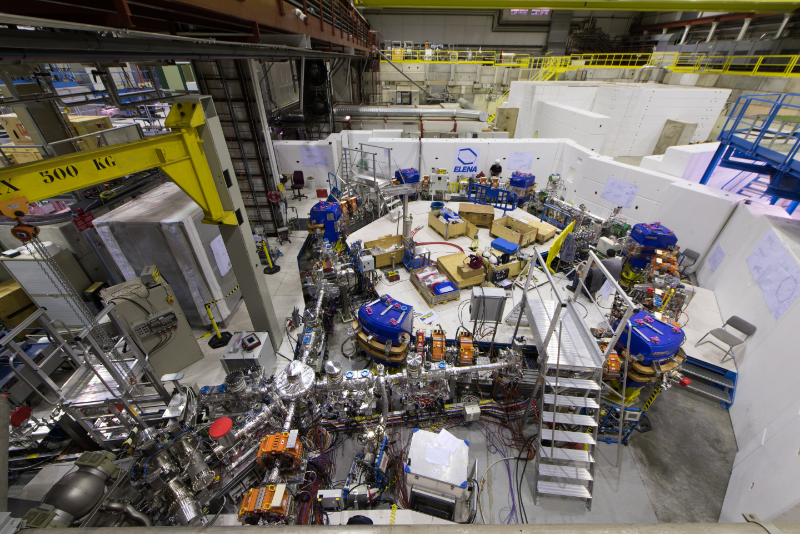
Collecting Antiprotons

Slide 16
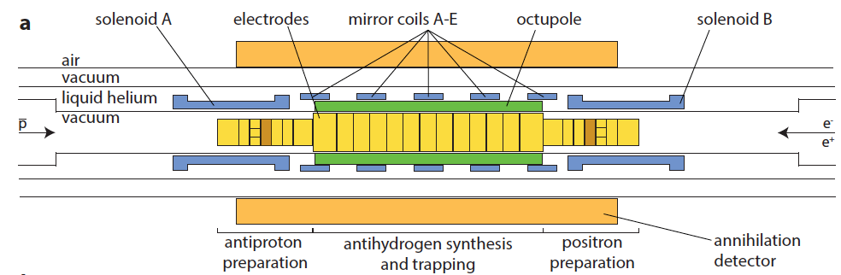
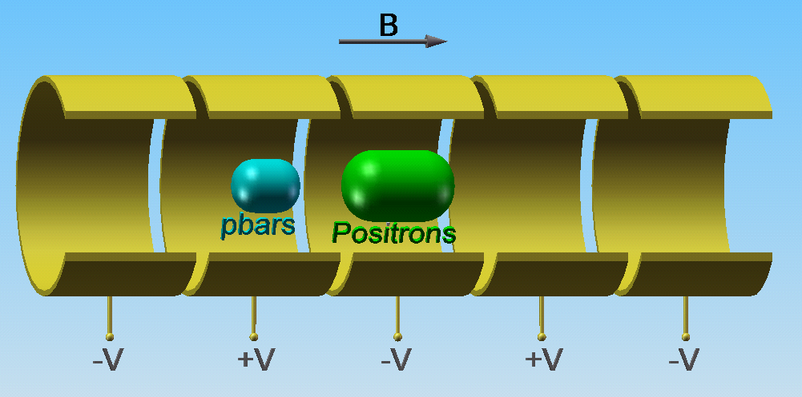
Forming Antihydrogen
Penning-Malmberg Plasma Trap

Slide 17
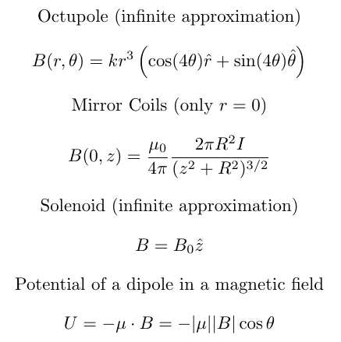
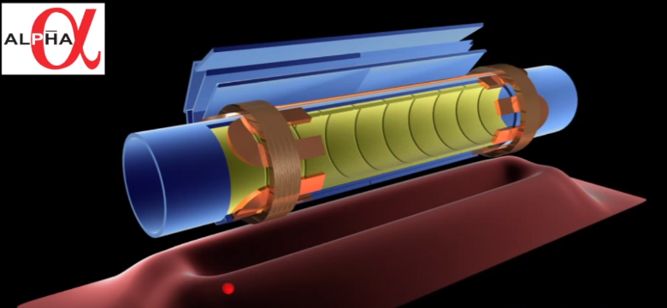
Trapping Antihydrogen

Slide 18
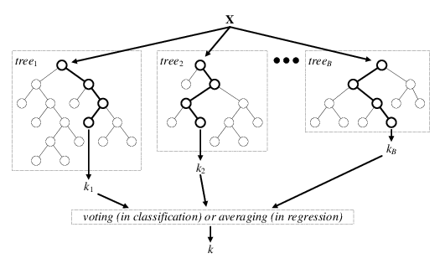
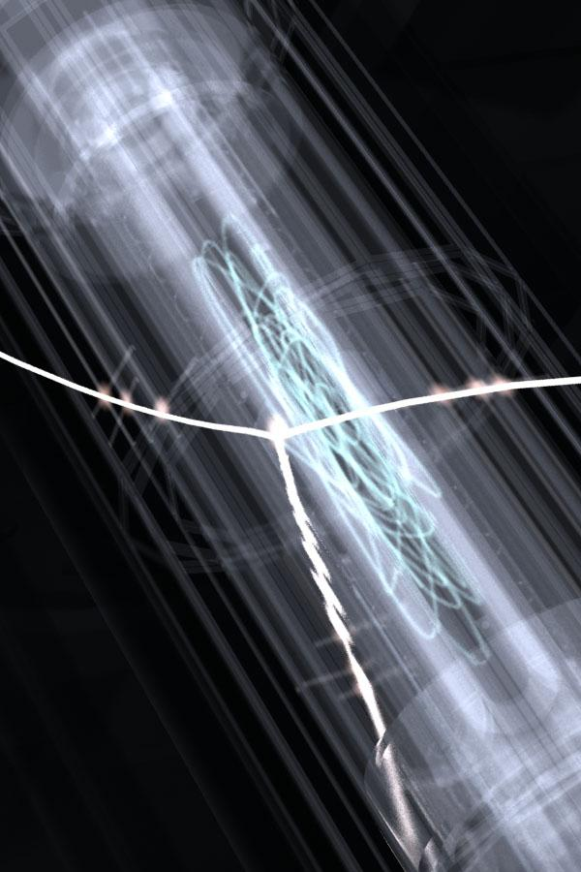
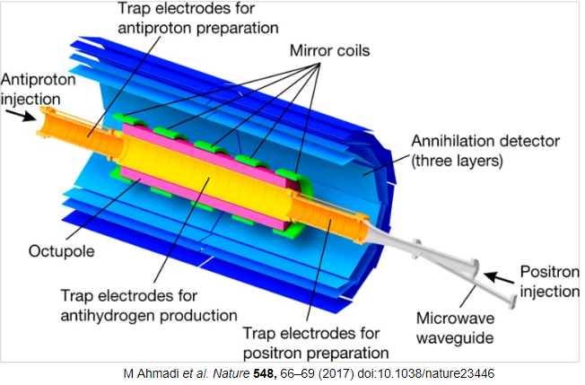
Detecting Annihilations

Slide 19
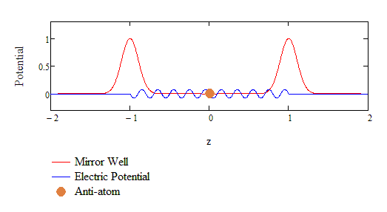
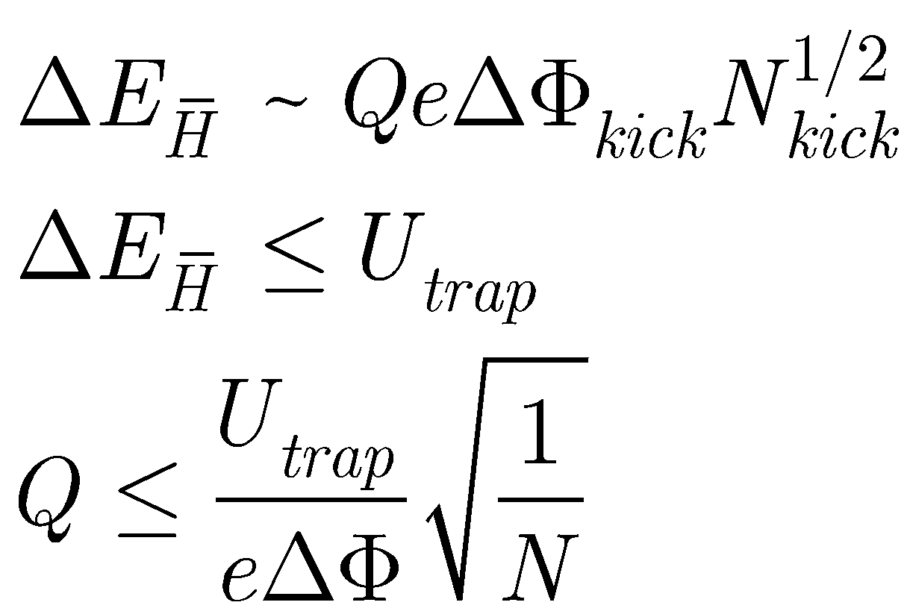
Antihydrogen Charge

Slide 20
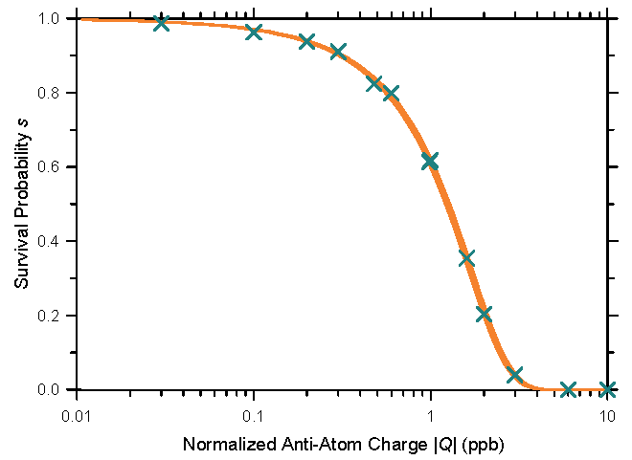
 | Number of Trials | Observed Antiatoms
Stochastic Trials | 10 | 12
Null Trials | 10 | 12

Slide 21
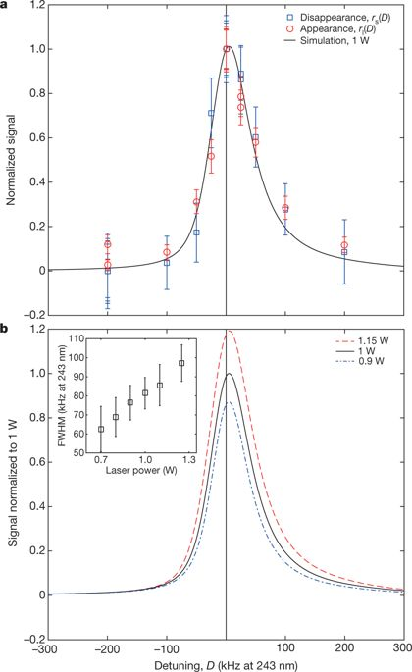
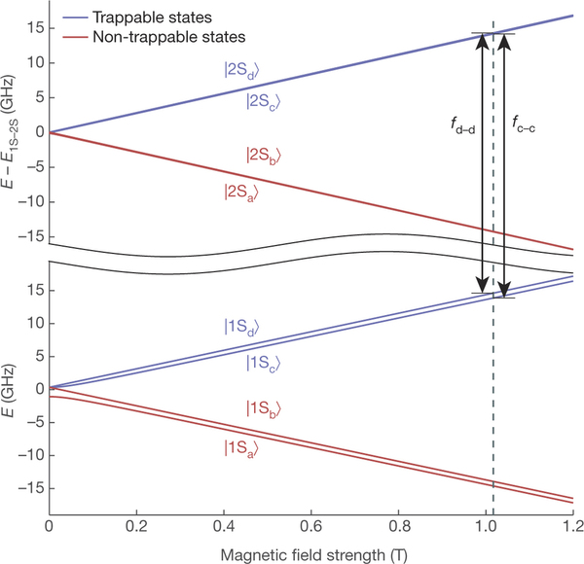
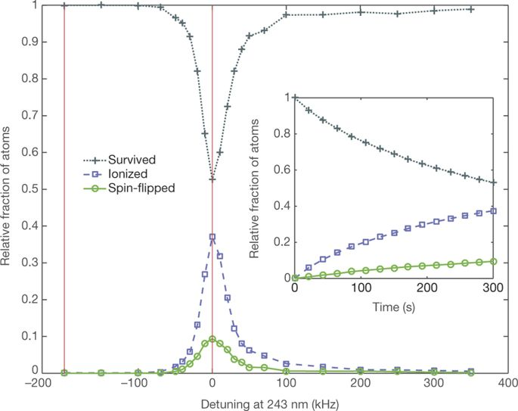
1s to 2s Transition in Antihydrogen
4 parts in 10^10

Slide 22
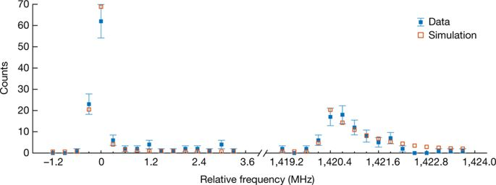
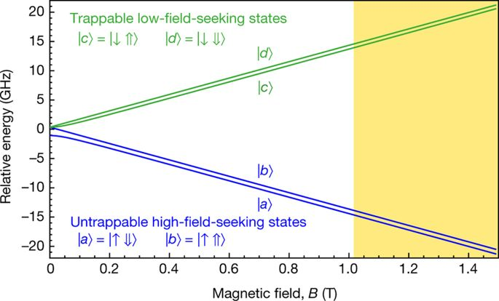
Hyperfine Structure in Antihydrogen
4 parts in 10^4

Slide 23
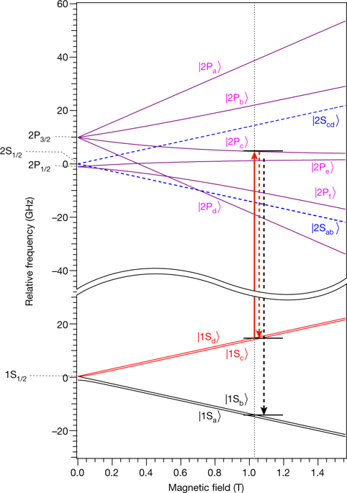
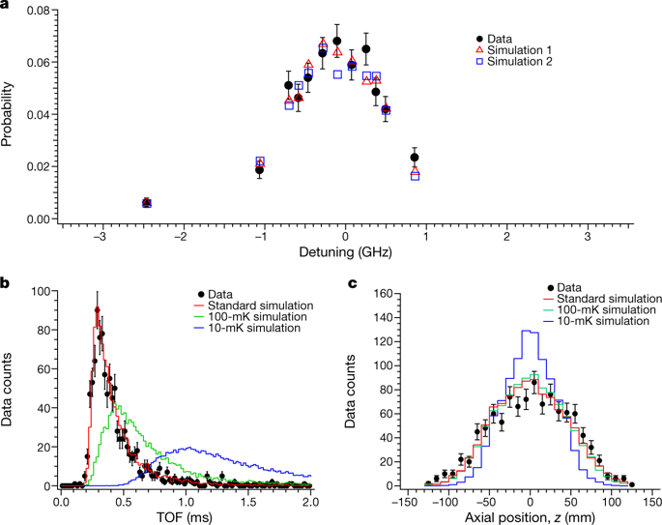
Lyman-Alpha Transition in Antihydrogen

Slide 24
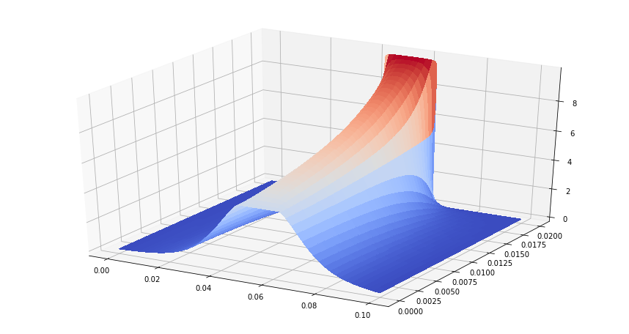
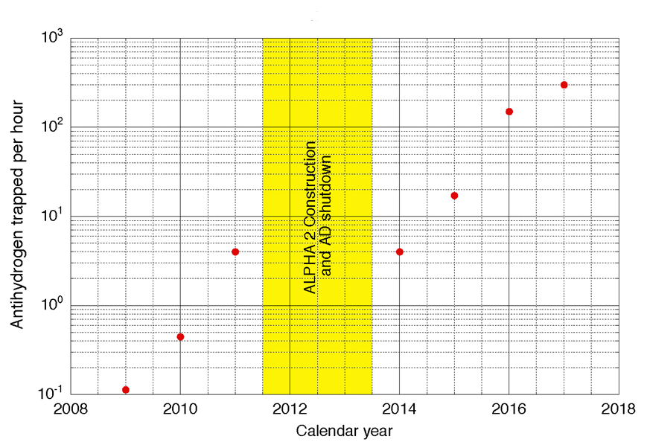
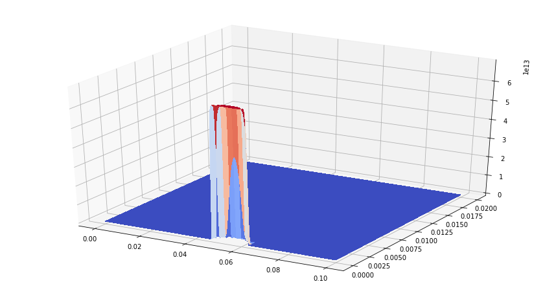
Future Improvements – Trapping Rate
$${Fraction Trappable\sim T}^{−3/2}$$

Slide 25
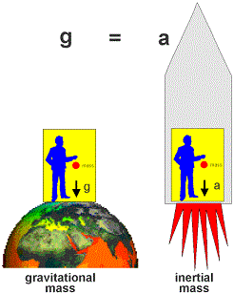
WEP
The Weak Equivalence Principle states that the gravitational and inertial masses are equal
The inertial masses of antimatter particles have already been tested by BASE
The gravitational force on antimatter has not yet been tested

Slide 26
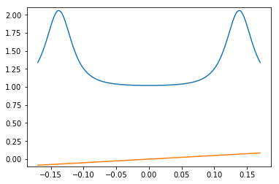
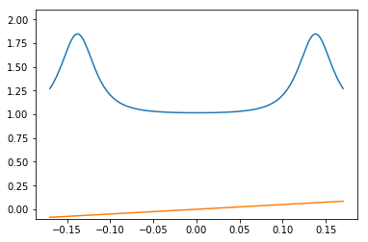
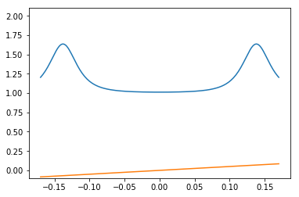
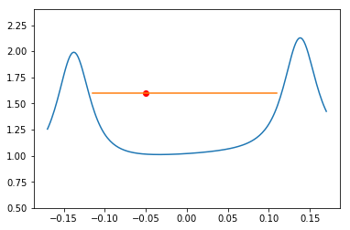
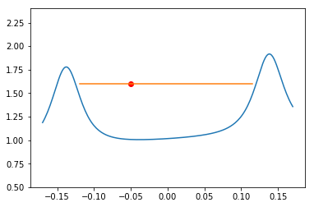
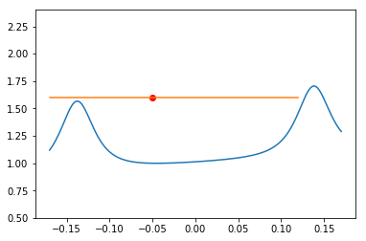
Up Versus Down Gravity Measurement

Slide 27
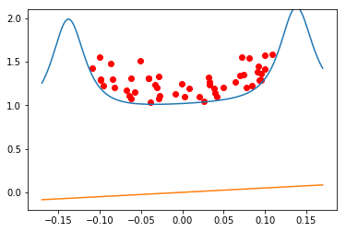
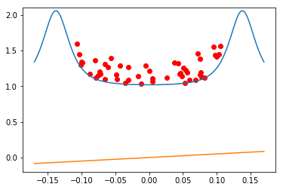
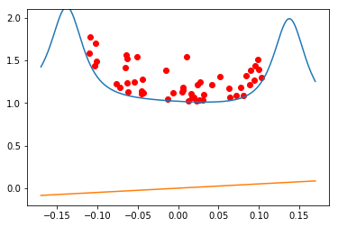
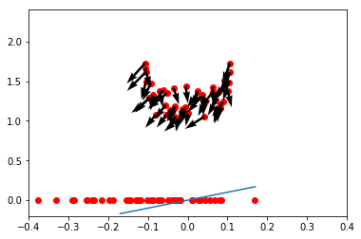
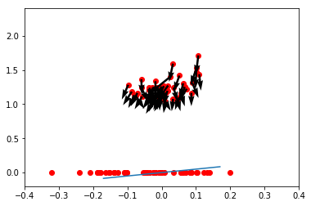
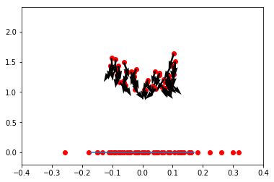
Precision Gravity Measurement

Slide 28
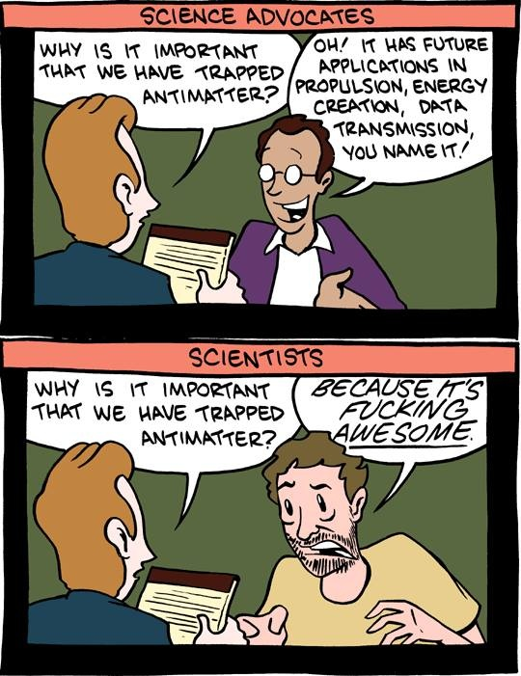
Testing
CPT
And
WEP
Source: SMBC

