Slide 1
LArPix R&D:
Demonstration of large-area 3D charge readout for LArTPCs
Peter Madigan
NorCal HEP-EXchange
December 2018
Notes:
Hi I’m Peter, a grad student here at berkeley and I’m going to be talking about an r and d effort I’ve been involved in here at berkeley to demonstrate complete 3D charge readout from liquid argon tpcs.

Slide 2
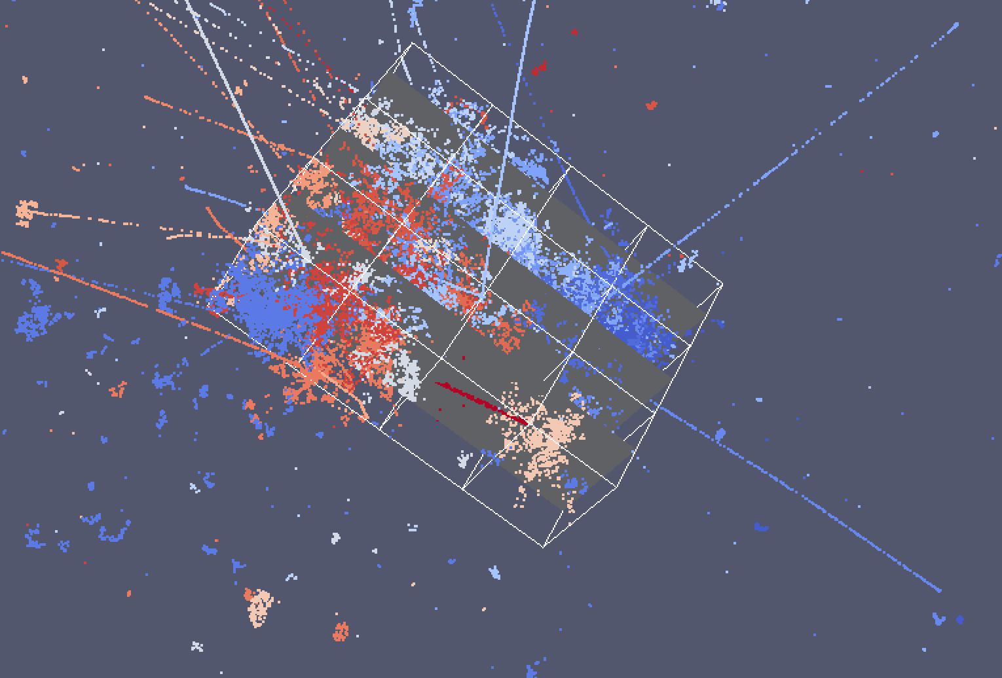
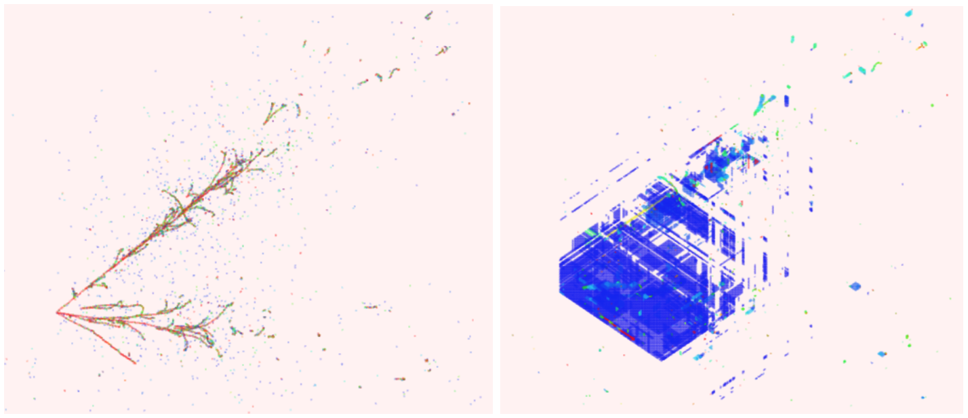
LArTPCs in high rate environments
Liquid argon TPC:
Electric field
Drifting electron cloud
e-
e-
e-
e-
Ionizing particle
e-
Cathode
Readout wire planes
Reconstruction ambiguities with wire readout:
Simulated charge distribution
Estimated charge distribution
For DUNE
Near detector is expected to have O(10) neutrino interactions per spill
Using wire-plane readout, pile-up increases the likelihood of ambiguities
A different approach is needed…
Simulated 3 GeV electron neutrino interaction
Notes:
The trouble with LArTPCs:
Long readout time set by electron drift velocity (~1.5mm/us drift at typical drift fields)
In a high-activity environment, interaction pile-up becomes significant
Standard projective wire-plane readout is insufficient due to reconstruction ambiguities!

Slide 3

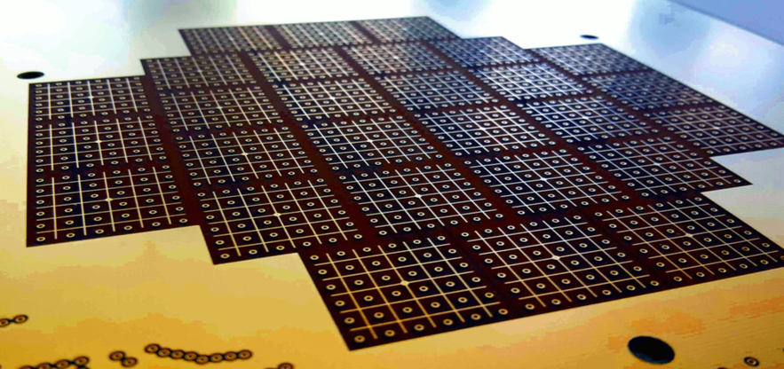
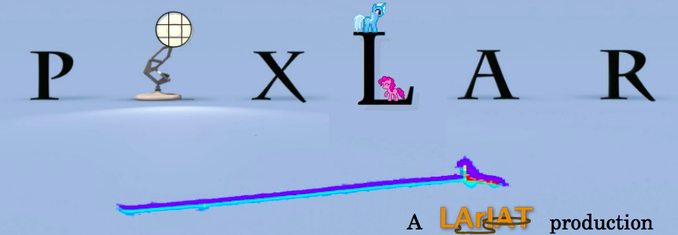
Pixelated TPCs as 3D LArTPCs
Pixelated TPCs are not new – they have been used for decades in gaseous TPCs
  e.g. the ALICE detector uses a pixelated gaseous TPC for track ID in a very high multiplicity environment
ArgonCube and PixLar groups have shown that pixelated sensors are feasible
Challenges facing liquid argon readout:
  cryogenic operation – must develop cold-ASICs to either drive signals out of the cryostat or perform digitization within the cryostat
  thermal constraints – cold-side electronics power consumption is set by cryo-cooling
Example event display from the ALICE detector
A prototype LArTPC pixel sensor (University of Bern)
Notes:
So one way to remove these ambiguities, is to instrument the anode with a pixelated collection grid. This is not a new idea – many experiments have used pad-based readout in TPC, for example the ALICE detector is primarily a gaseous TPC that uses pixelated readout to perform track ID in a very high multiplicity environment.
However, in liquid argon you have a few specific challenges to overcome, most critically your readout electronics have to deal with

Slide 4
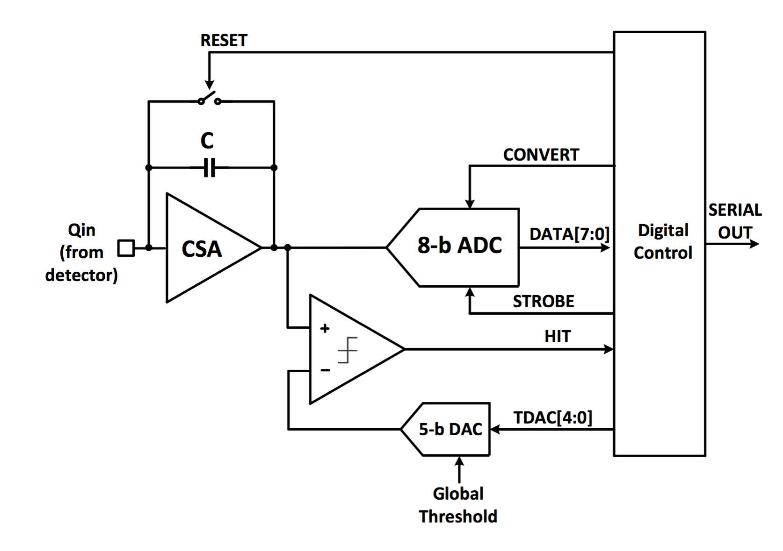
LArPix concept
The idea - Use self-triggered ADC and readout to limit chip activity and thus power consumption
Central control logic and digital multiplexing
Charge integrator-amplifier front-end
Standard 6 bit SAR ADC
Configurable threshold self-trigger
Complete 3D charge information is preserved by attaching a timestamp and a unique (chip id, channel id) pair to each hit record
Notes:
The idea
Single chip design for amplification, digitization, and digital multiplexing of many channels (limit cryostat penetrations)
Use a self-triggered ADC and digital readout to limit chip activity (low-power)
3D charge information can be reconstructed from a unique chip id, channel id pair

Slide 5
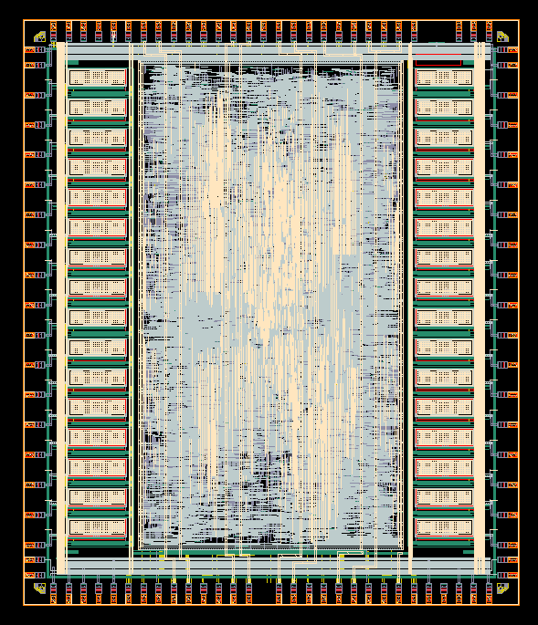
LArPix v1 ASIC
LArPix v1 ASIC
Cryogenic-compatible 180 nm CMOS chip
For up to 32 channels:
  Charge integrator / amplifier
  Self-trigger
  6-bit ADC
Within each chip:
  Custom UART communication protocol
  FIFO memory buffer
  Integrated test pulser
  21 user-configurable parameters:
    External trigger
    Burst mode
    Cross-channel trigger
    More!
x 32
Notes:
At the core of LArPix readout is the LArPix ASIC. A custom cryogenic system-on-a-chip integrated circuit, designed here at LBL by our IC engineers. Each chip contains 32 unique charge integrator / amplifiers, discriminator, and 6-bit ADCs for 32 channels.

Slide 6
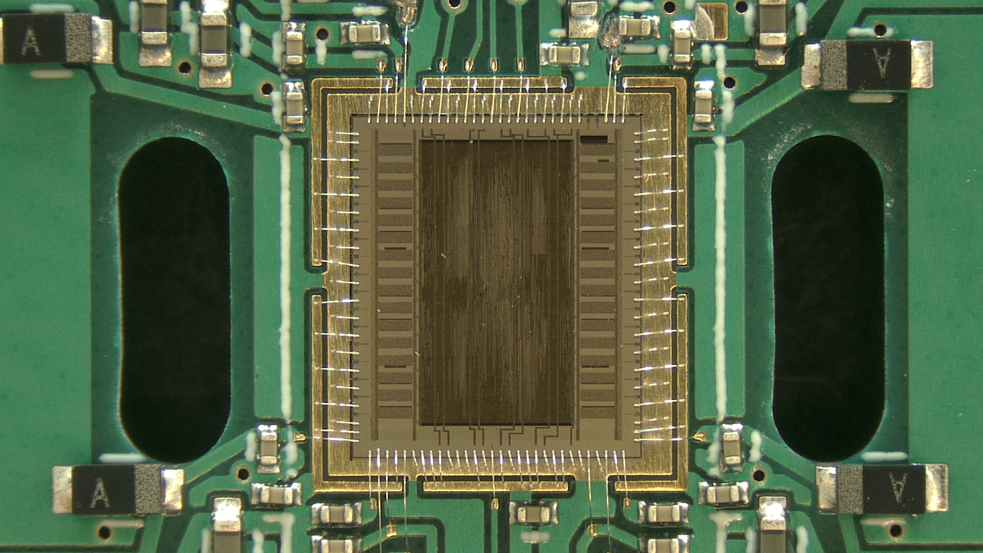
LArPix v1 ASIC performance
LArPix v1 ASIC wire-bonded to test PCB
Both digital and analog power meet low-power requirement of <100 uW/channel:
System Power [uW/channel]
Analog 24
Digital 38
Total: 62 uW/channel
Low-noise amplification and digitization:
Gain measured using built-in internal pulser:
Room temperature (290K)
LN2 temperature (77K)
Requirement (77K): <300 e- ENC
Observed (77K): ~250 e- ENC
Consistent with expected gain of 250 e-/mV
Notes:
So how does the chip perform?
Quite well, especially for a version 1 chip.
Additionally, we showed that the design meets the two most critical design requirements on the power consumption and noise performance
Namely, we showed that the chip power consumption is … (digital) and ... (analog)
and the chip noise performance is ... (at room temperature) with an expected reduction to ... (at liquid nitrogen temperatures)
We also excercised the internal test pulser to verifiy that the chip gain is consisten with our expected 250e / mV

Slide 7
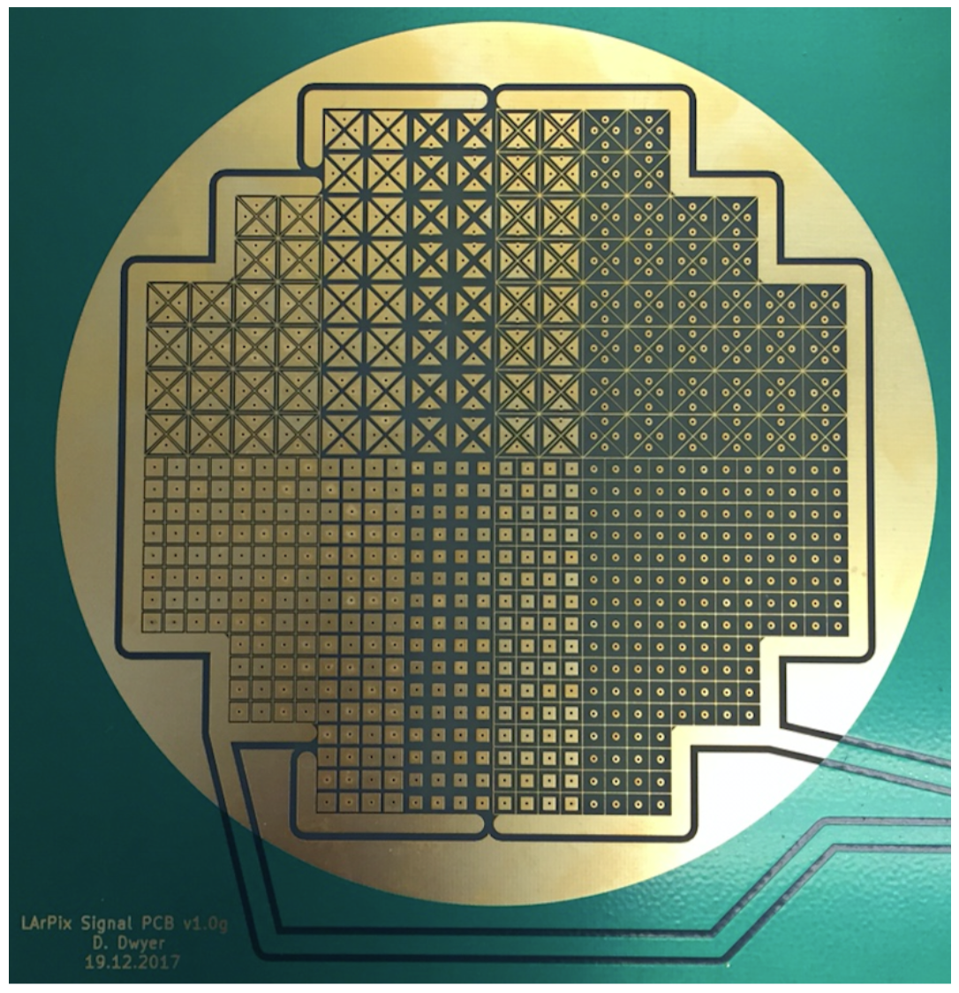
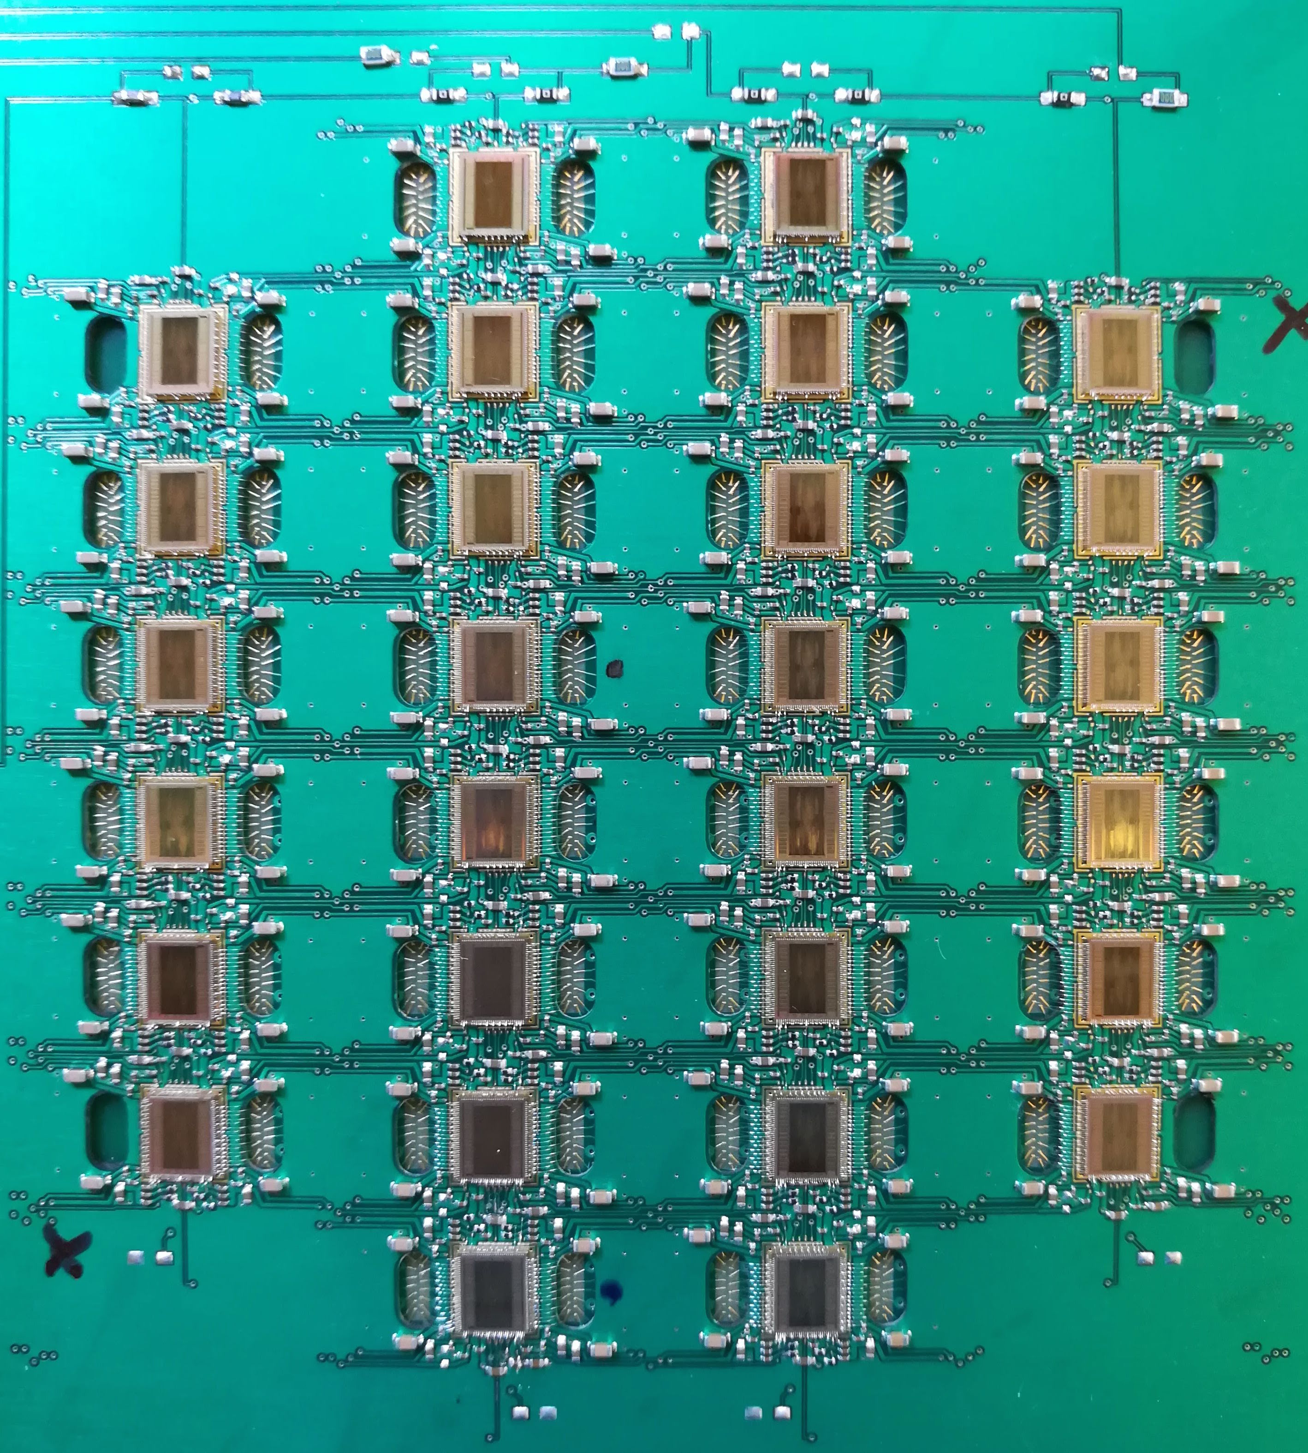
LArPix anode assembly
Cross-section:
LArPix v1 ASIC
Signal wirebonds
LArPix v1 ASICs
Collection pads
Data PCB
Sensor PCB
Shielding layer
Notes:
To test the chip in a tpc, we designed and produced a prototype anode assembly which consists of two sandwiched PCBs with a copper shielding layer between. The upper PCB hosts an array of up to 28 LArPix ASICs along with routing for analog power, digital power, and IO. ASIC IO is daisy chained across chips, so data packets from all channels are transmitted via two IO lines.
The lower PCB hosts the conductive collection pads as well as a biasing grid to enhance the charge collection efficiency. This PCB design in particular has a variety of pixel geometries that we would like to compare to look at things like charge sharing between pads. The signals from the collection pads are routed up through the PCB and wire-bonded to the LArPix ASIC.

Slide 8
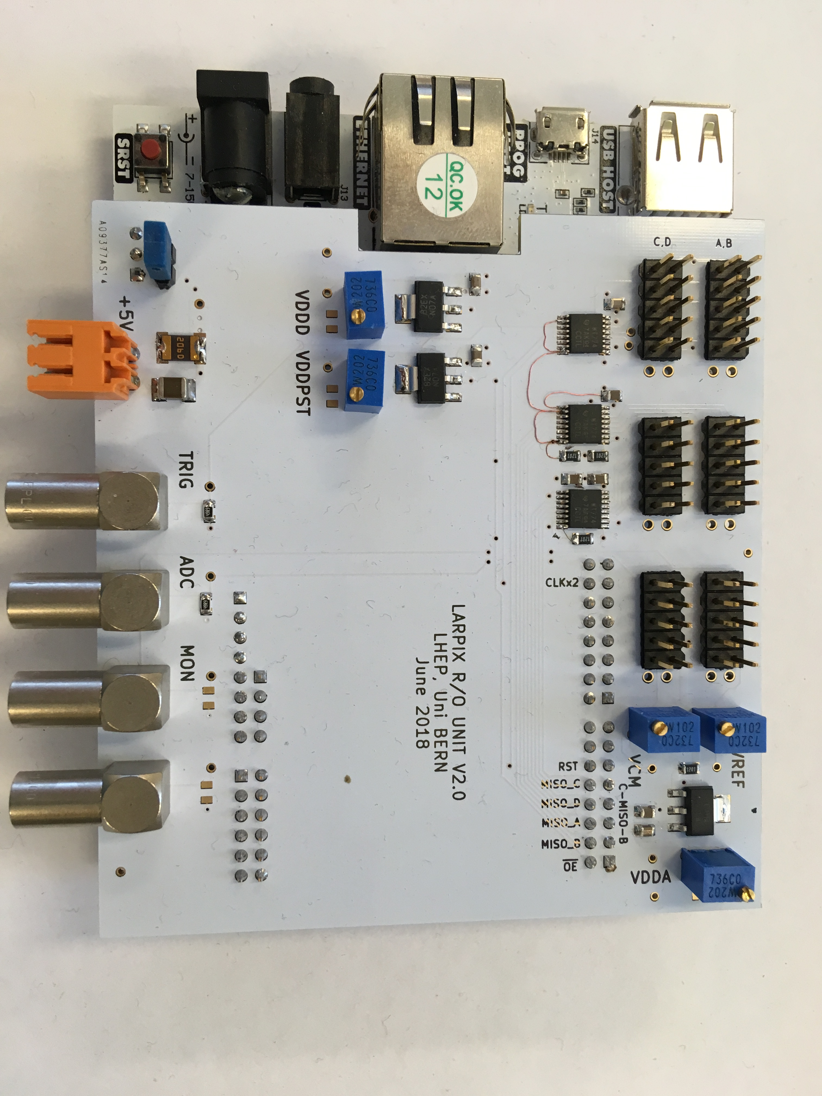
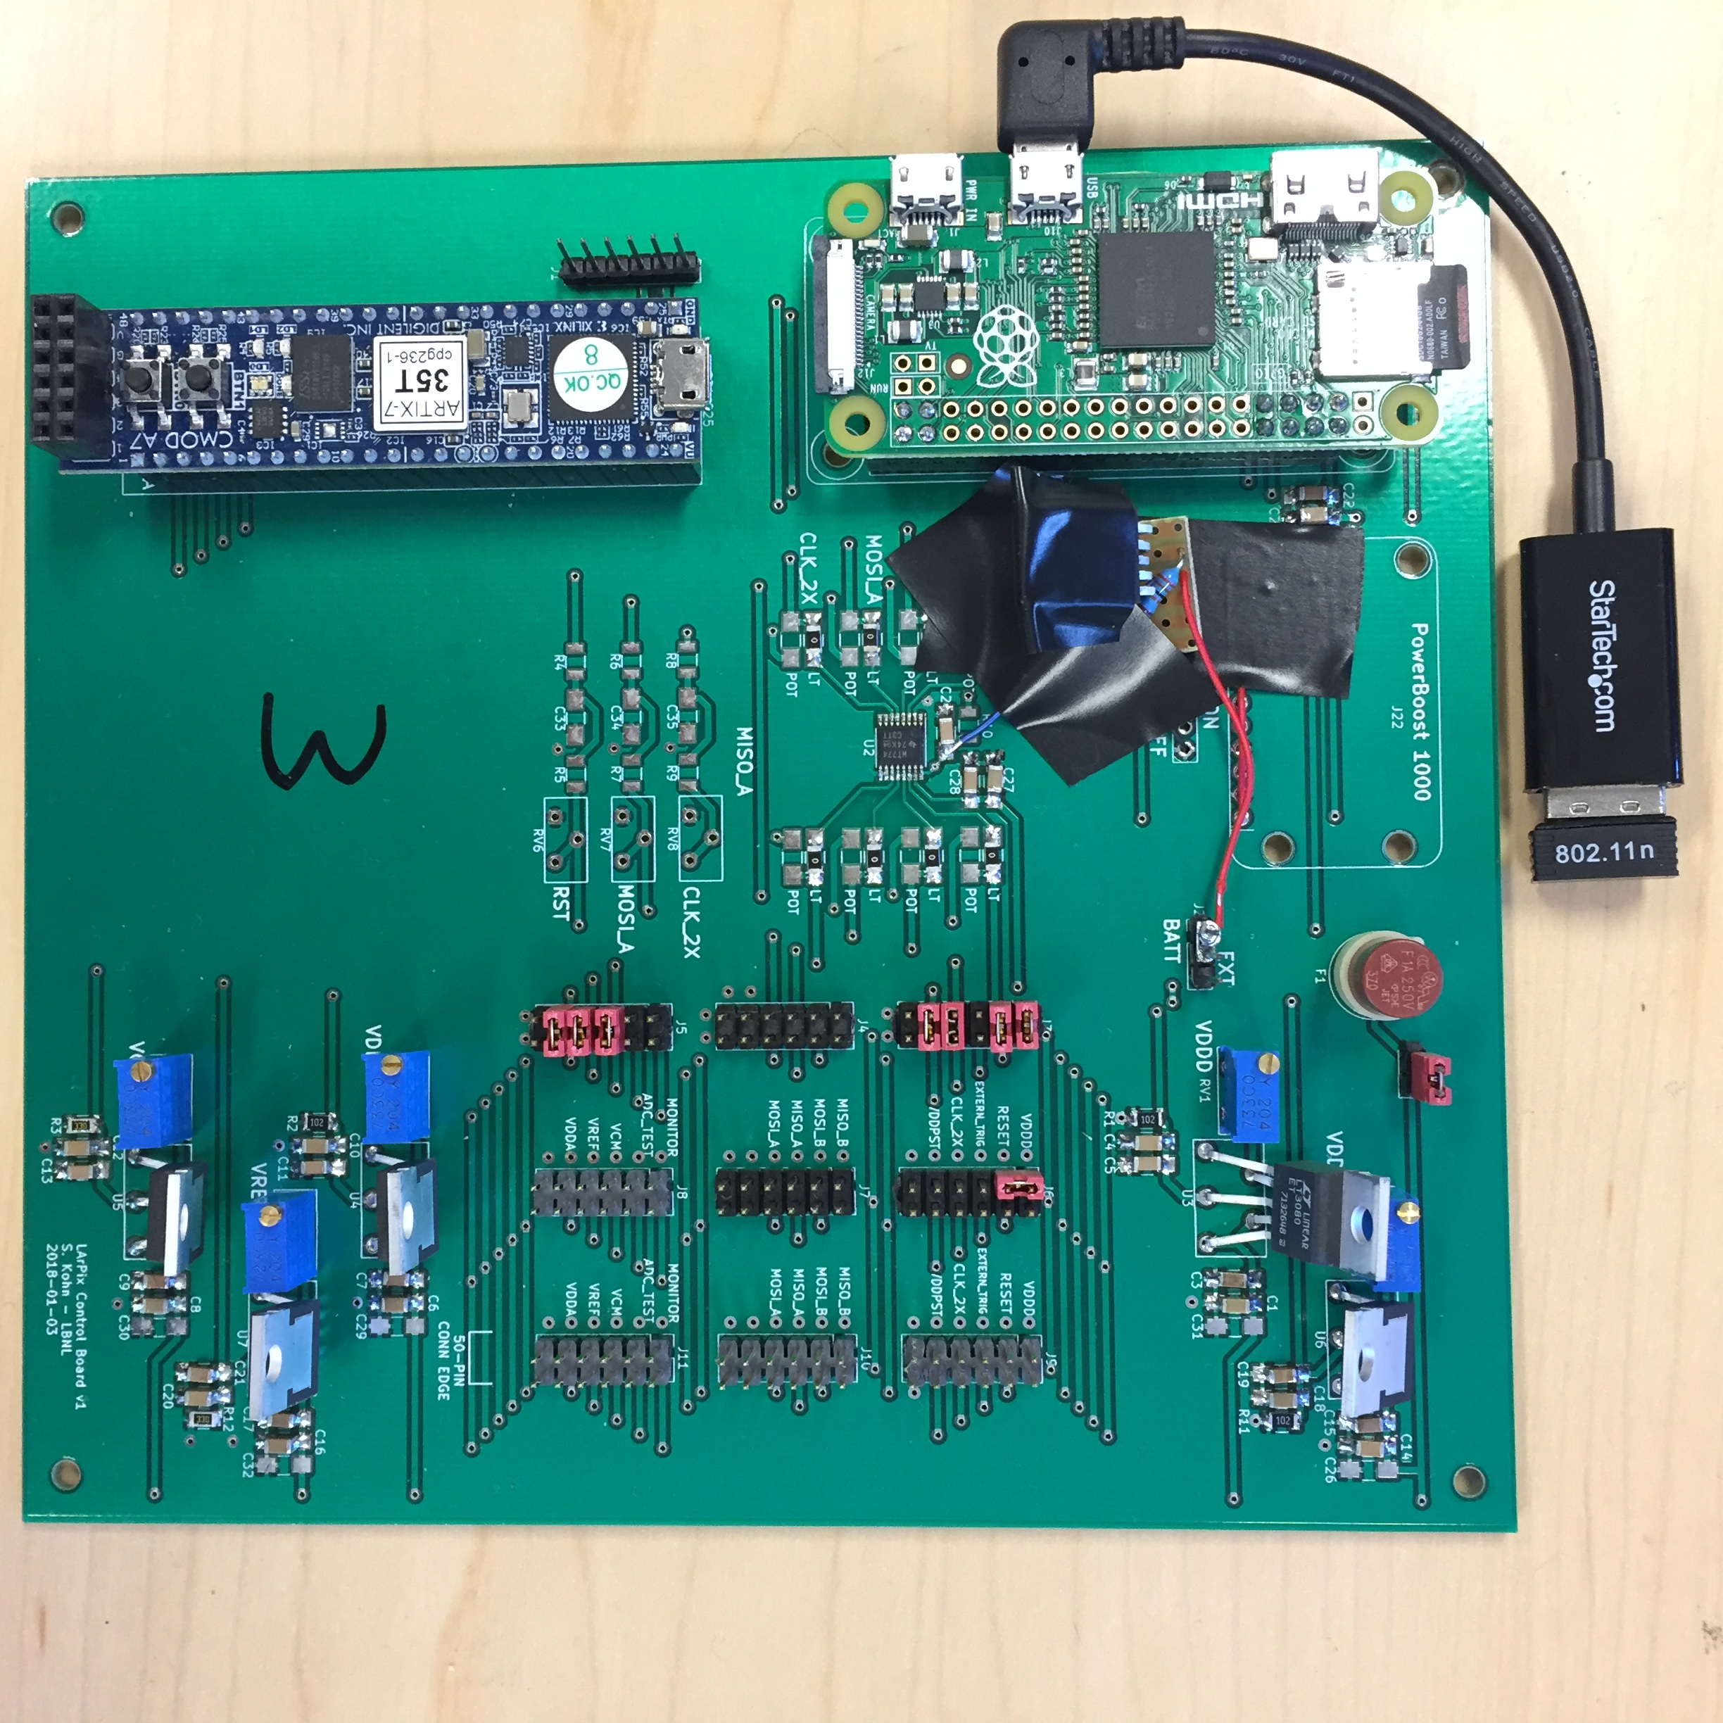
LArPix DAQ
Prototype DAQ:
  Artix FPGA to handle custom UART protocol and act as FIFO buffer
  User control and data storage provided by RPi0
  Electronics power / reference voltage supplied by low-noise voltage regulators
  Can control up to O(10k) pixels
Meter-scale DAQ (control
  Arty Z7-20 development board with integrated CPU and FPGA
  Custom power / reference shield with interface to LArPix anode assembly
  Commands and data are transmitted via ZeroMQ protocol
  Can control O(100k) to O(1M) pixels
Thanks to I. Kreslow (Bern)!

Slide 9
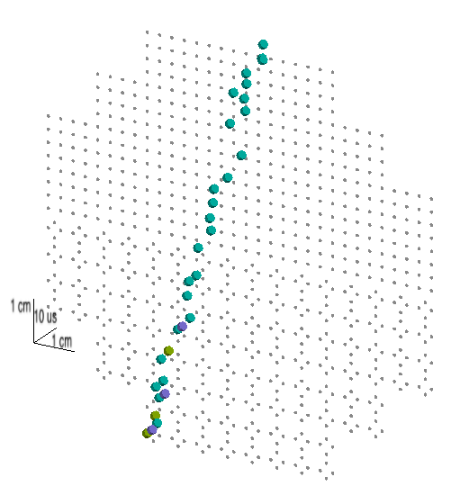
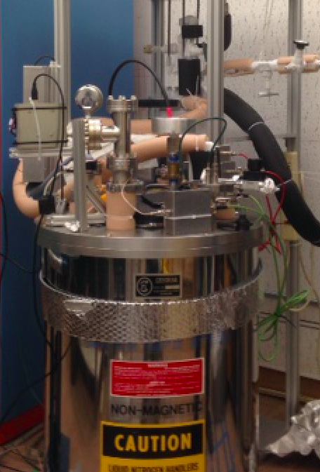
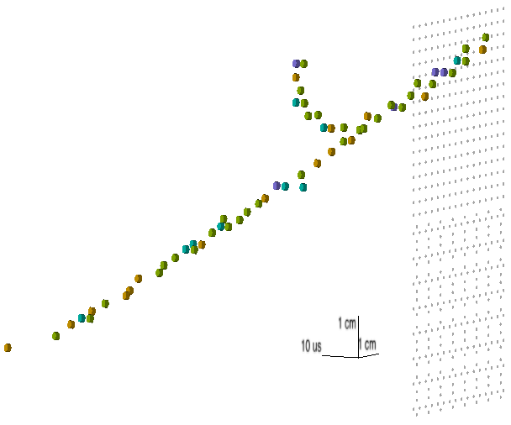
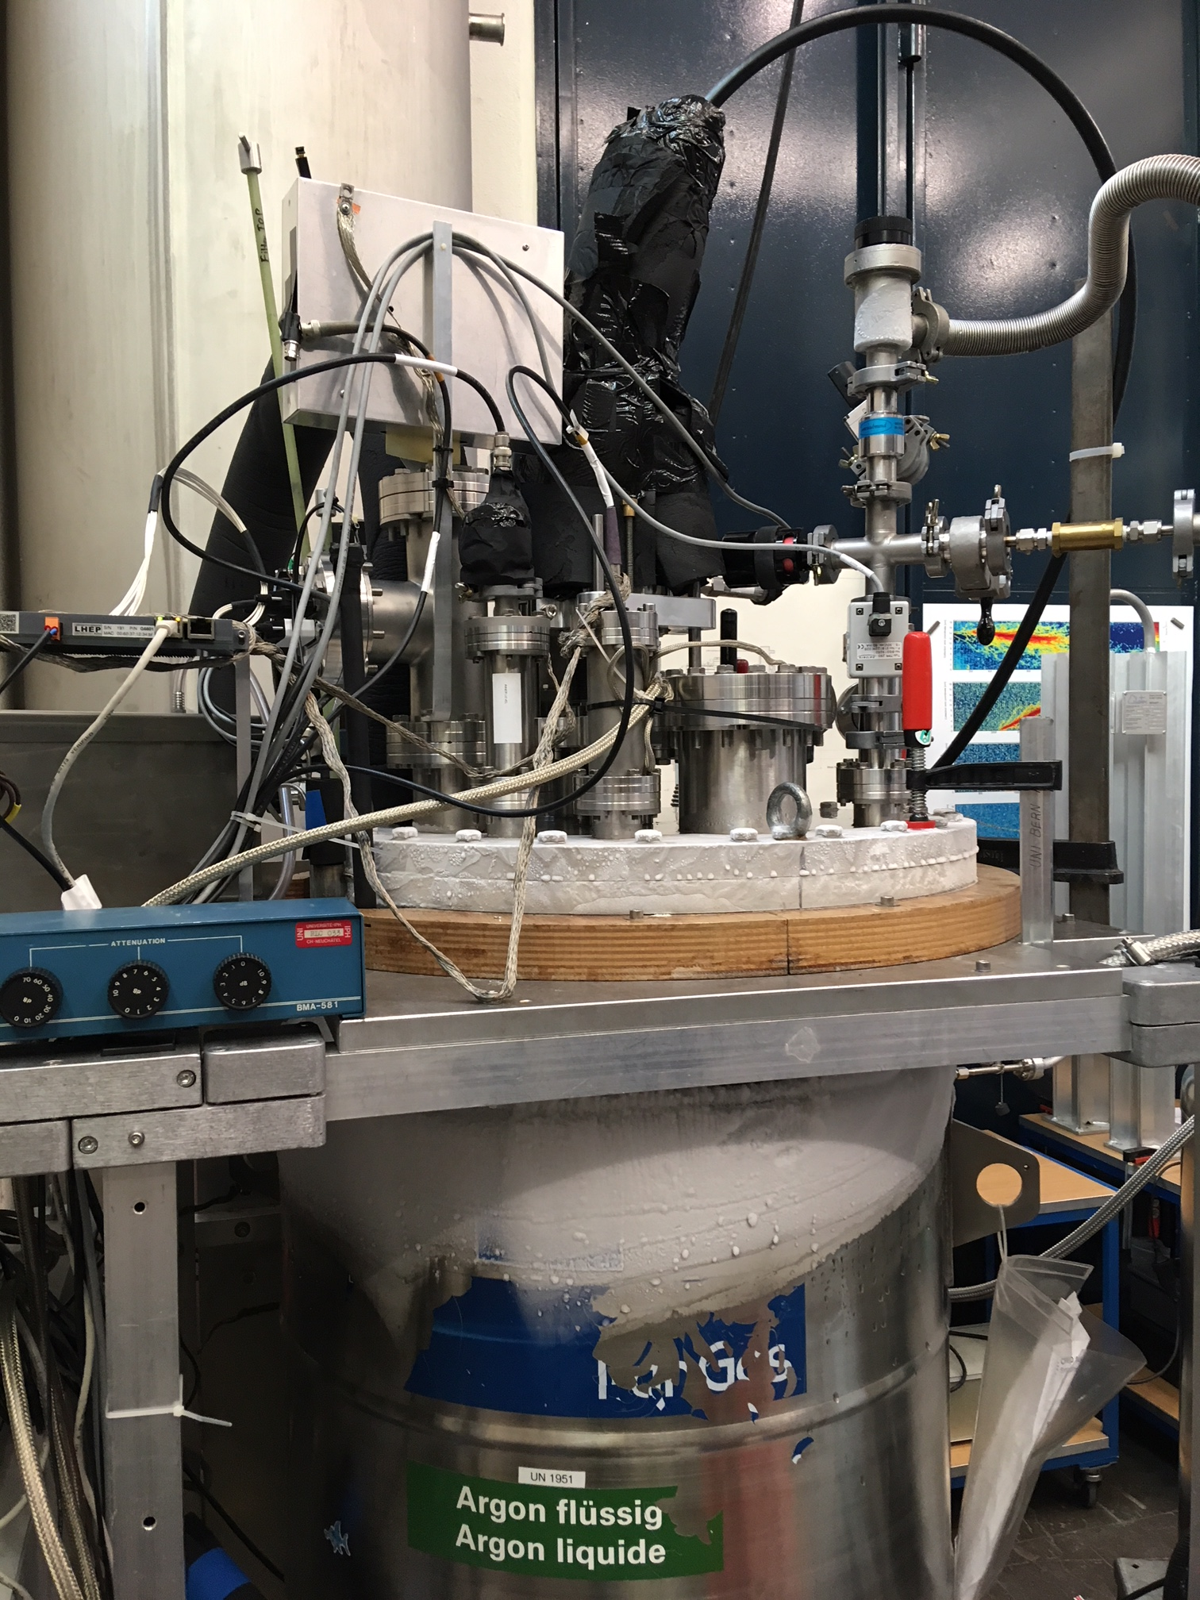
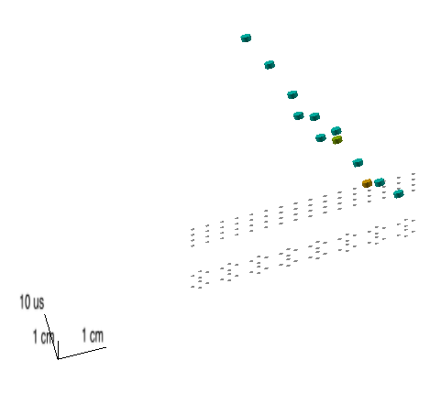
Demonstration with cosmic rays
MIP track imaged using a fully instrumented 10 cm anode assembly (28-chips)
Initial demonstration performed at LBNL using a small 4-chip board
Subsequent tests at Bern and LBNL using a 28-chip board have successfully demonstrated MIP-signal readout
University of Bern’s 60cm TPC cryostat
LZ 20L high-purity argon test stand
First tantalizing view of short (~1cm) track segments using 4-chip anode assembly
A convincing track with delta ray observed using a 16-chip anode assembly at Bern
Thanks LBL LZ group!
Thanks Bern gang!

Slide 10
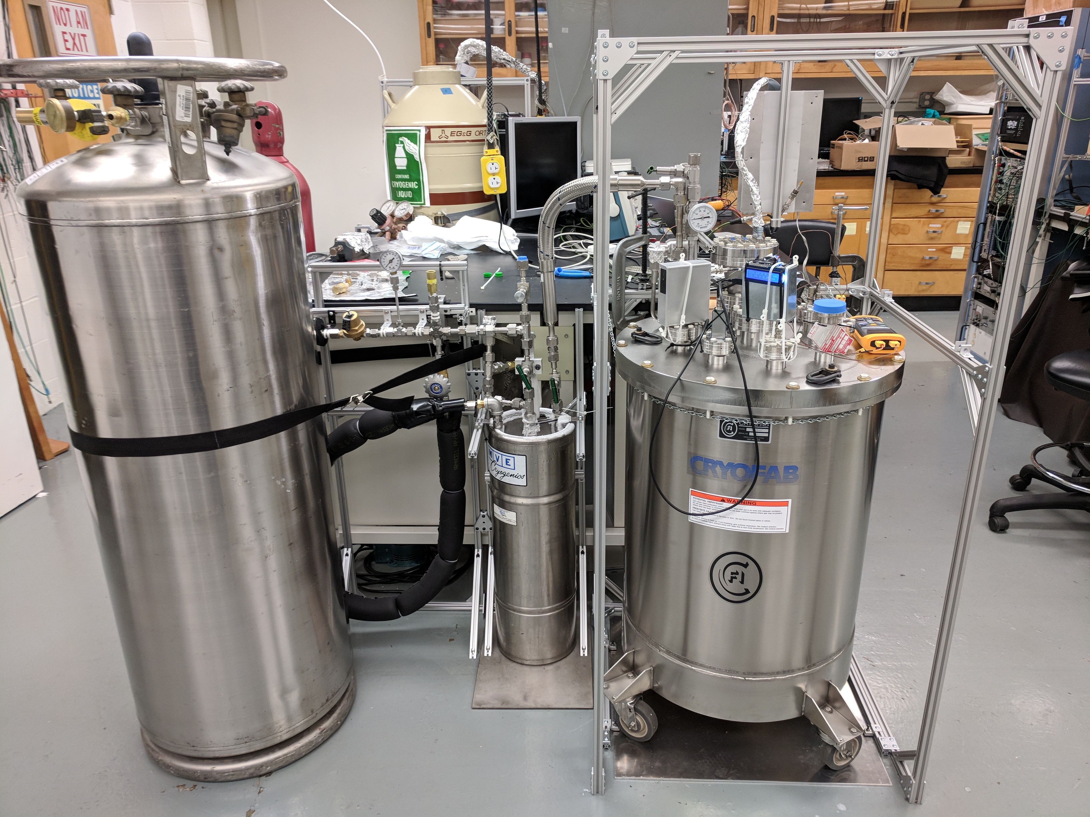
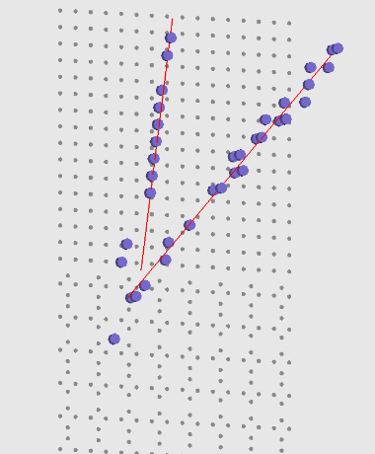
3D LArTPC reconstruction
Basic reconstruction software:
  Iterative hough transform and PCA
  Provides basic event parameterization – direction, end point, t0, simple track discrimination
Reproduces expected cosmic ray distributions on Bern data
Looking into developing ML / DL-based algorithms specifically optimized for 3D LArTPC reconstruction in collaboration with SLAC
Cryogenic commissioning of our local high-purity liquid argon test stand is complete
We will use this system to provide a comprehensive characterization of the LArPix design
  e.g. performance of different pad geometries
  sensor performance to a variety of signal types

Slide 11
Summary and on the horizon
At this point
Benchtop and cryogenic functionality of the LArPix v1 ASIC has been verified
Successfully demonstrated complete 3D MIP-signal TPC readout using LArPix!
Cryogenic commissioning of a small high-purity liquid argon test stand is complete
Coming soon
The v1 LArPix ASIC front end is undergoing comprehensive characterization to benchtop and MIP signals
The v2 LArPix ASIC design is being reviewed and will be in production in the next couple months
The LArPix anode assembly is being redesigned into a scalable ~30cm x 30cm single multi-layer PCB
And beyond
Aggressive schedule to provide electronics and anode assembly for a meter-scale ArgonCube module by end of 2019
Also looking into collecting test beam data with LArIAT TPC at Fermilab
Thanks!

Slide 13
LArPix event display
See http://portal.nersc.gov/project/dune/larpix/ for an interactive event display of raw LArPix data

