Slide 1
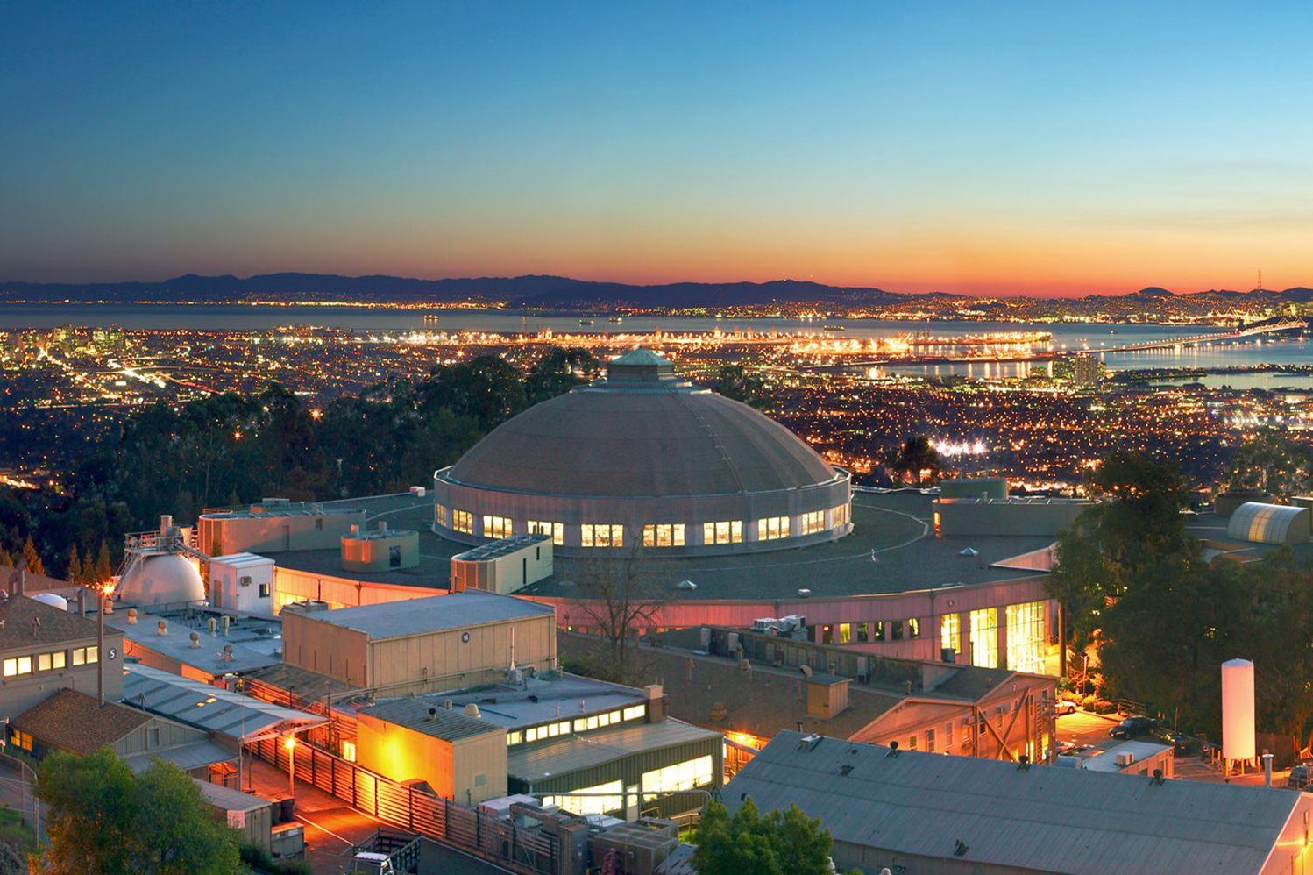
VISITOR SAFETY INFORMATION

Slide 2
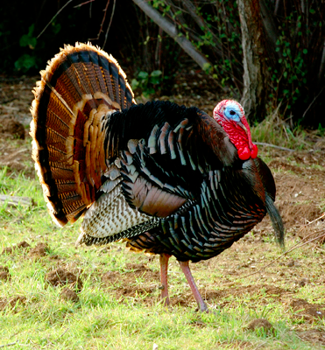
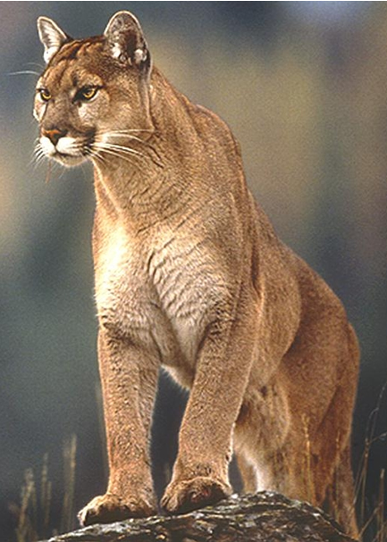
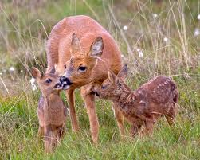
Safety at LBNL
US DOE Facility
Obey all posted signs
Pedestrian Safety
Use sidewalk and crosswalks
Watch your step!
Do not interact with wild animals
Traffic Safety
Speed limit is 15 mph on most of site due to construction
Follow traffic, parking and pedestrian signs and markings
Smoking
In designated areas only

Slide 3
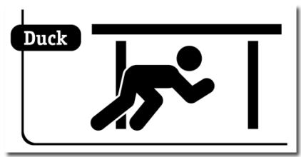
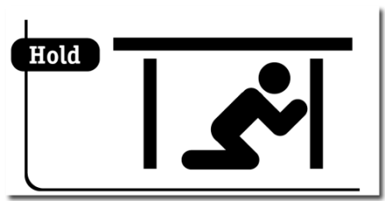
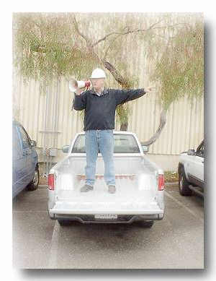
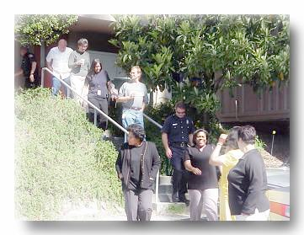
Earthquake Response
Drop down on the floor
Cover under a sturdy desk, table
or other furniture
Hold onto it and be prepared to move with the furniture
Evacuate to assembly area (usually in parking lot). Take personal items.
Follow Directions from the Building Emergency Team

Slide 4
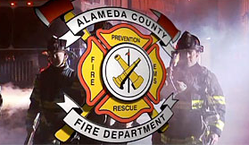
Reporting Emergencies
Dial 911 for life threatening emergencies
Dial 6999 for non-life threatening events
Notes:
UCPD dispatches law enforcement
ACRECC dispatches fire

