Slide 1
Calibrating Electromagnetic Calorimeter
D. Dixit
290E Sp-18

Slide 2
Purpose of Electromagnetic Calorimeters (EMCals)
Measuring energy of two special particles
Electrons
Photons
Photons and electrons are very common decay products so their energies (and momentum) provides information about the parent
Examples of particles with photon or electron decay products:
Pions, etas
Higgs
W/Z bosons
Additionally photons can also come from initial processes just as QCD Compton scattering.
arXiv:1111.0561

Slide 3
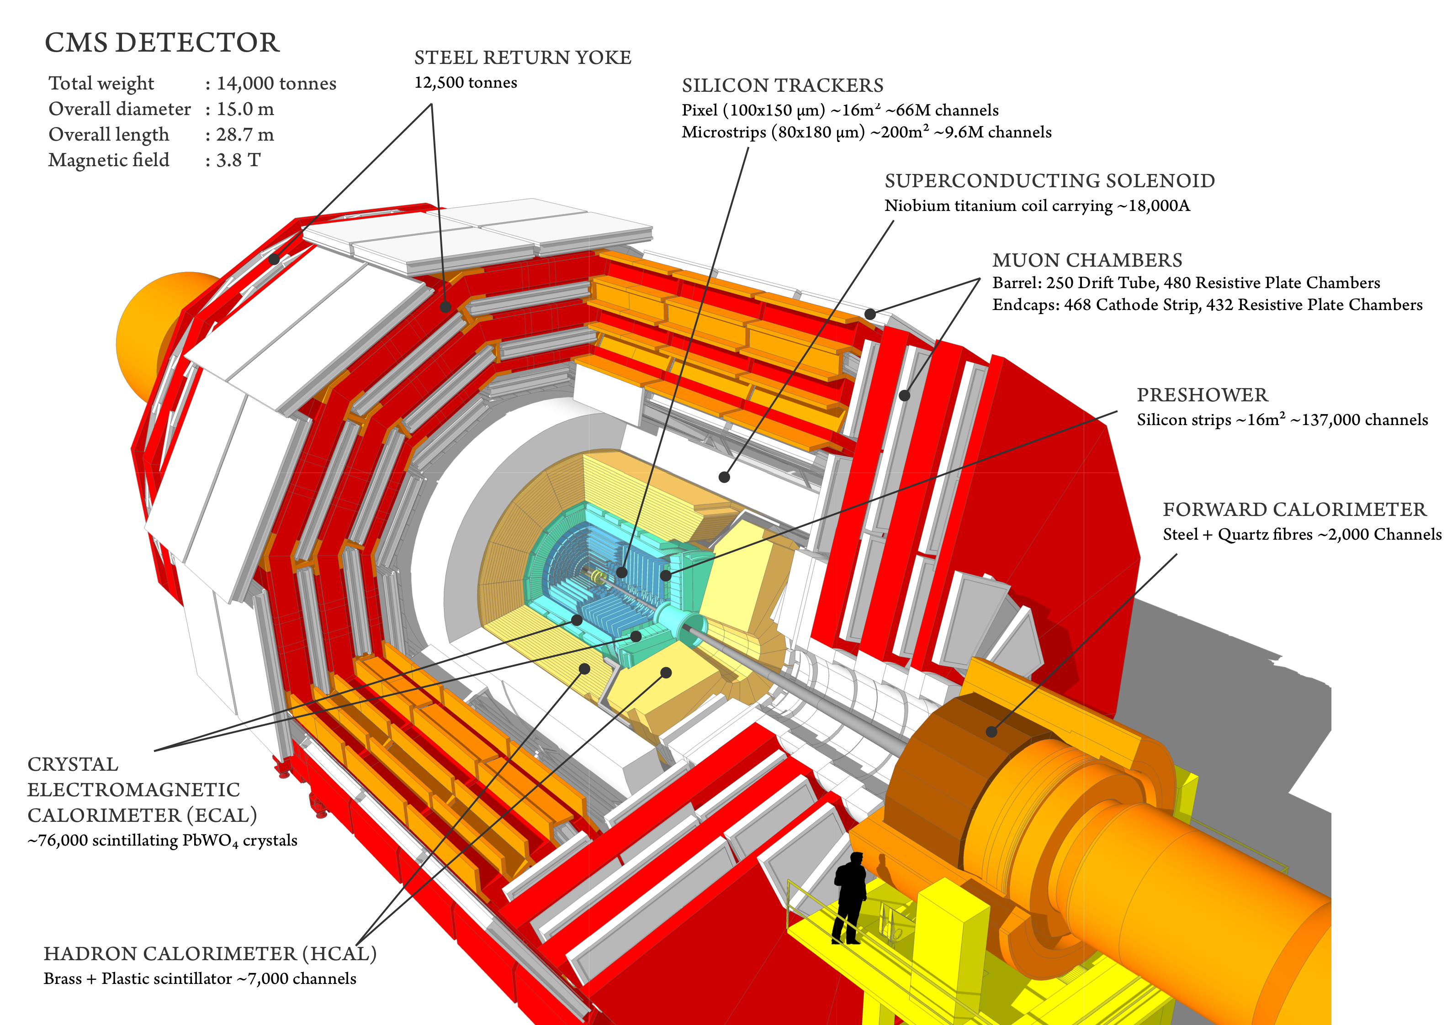
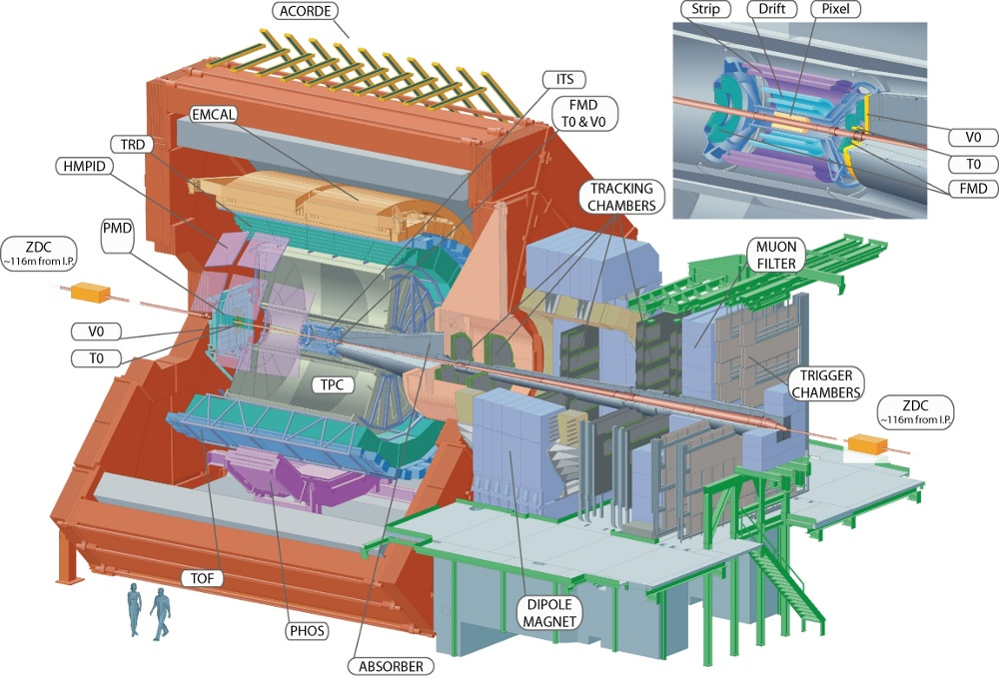
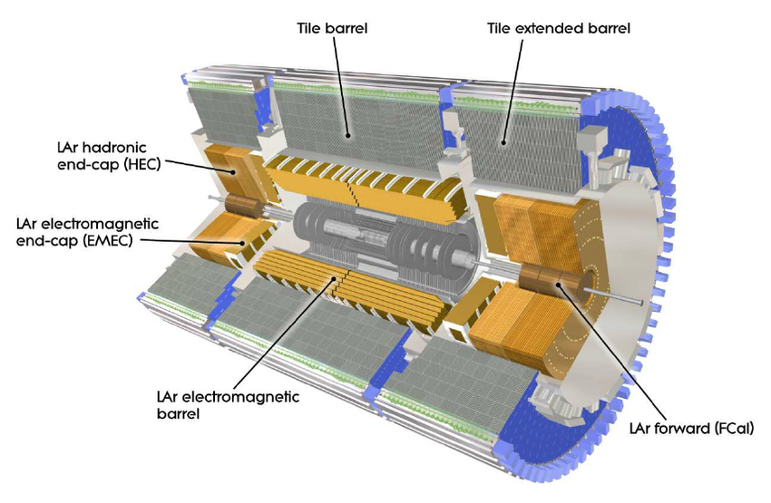
Calorimeters at the LHC
CMS: PbWO₄ Homogenous Calorimeter
ATLAS: Lead/Liquid Argon Sampling Calorimeter
ALICE: Lead-Scintillator Sampling Calorimeter
https://www.quantumdiaries.org/2010/10/13/meet-the-alice-electromagnetic-calorimeter/
Design and implementation of the Front End Board for the readout of the ATLAS liquid argon calorimeters. Journal of Instrumentation. 3. P03004. 10.1088/1748-0221/3/03/P03004.
http://cms.web.cern.ch/news/cms-detector-design

Slide 4
Different Calibrations
When we think calibrations of EMCals, we think about energy calibrations
There is more than the just energy which needs to be corrected
Other calibrations:
Timing Calibration
Temperature Calibration

Slide 5
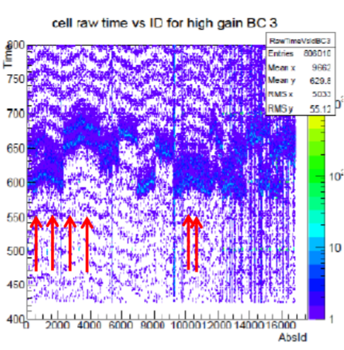
Timing Calibration
Purpose: To correct cell time information by the average cell time over a period
While an entire event is read in simultaneously, each cell is read out individually
Due to this, we can cell-to-cell offsets, which need to be corrected.
How to correct:
Use a recursive method: find phases between each cell on a run by run bases
Create coefficients from those phases to correct for the offests
ALICE EMCAL workshop March 2018

Slide 6
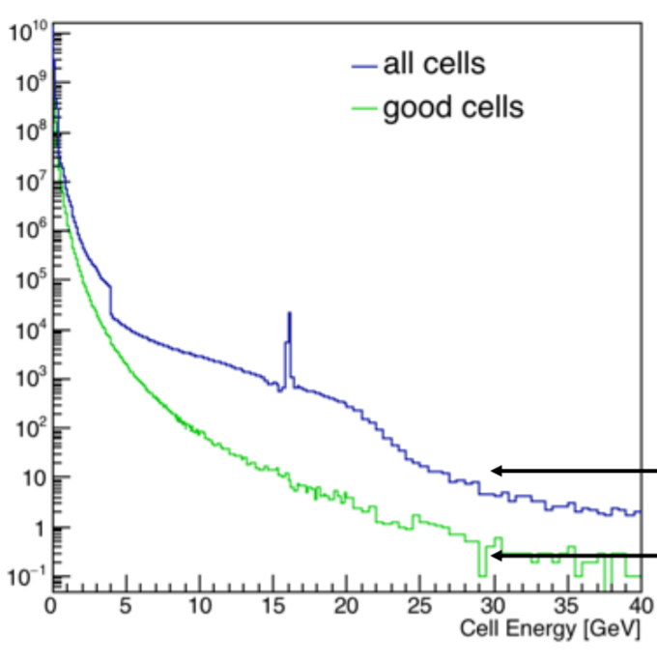
Energy Calibrations
Absolute calibrations: We know the deposited energy and we correct accordingly
Mass peak reconstruction
Calibrations using a test beam
Relative calibrations: We have some cells which are mis calibrated, so we adjust their spectrum according to the "good" cells.
ALICE EMCAL workshop March 2018

Slide 7
Energy Calibrations
Due to various reasons (radiation exposure, weird electronics, individual cell responses, etc) cells will measure a different energy than the truth.
Thus, the measured energy will not be correct, and be off by some factor
$$Emeasured=\frac{Etruth}{a}$$
What we need to do find the calibration coefficient (a), so that if we multiple by both sides by a, we get the true energy.

Slide 8
Test Beam Calibrations
Take the detector to a test beam facility
Shoot electrons at it
The beam will be coming in with a certain energy
We look at the energy we measured, and compare it with the expected energy and adjust coefficients accordingly
This is nice, but once the calorimeter is installed for a long period, it is not practice to remove it and bring it to test beam before every run year.

Slide 9
Calibrating using a mass peak
The mass of many hadron is known very well, and to a very precision.
Neutral pion mass: 134.976 6 ± 0.000 6 MeV/c²
Eta mass: 547.862 ± 0.018 MeV/c²
Since these hadrons decay into photons, we can combine the photon energies to obtain the invariant mass of the pion and the eta.
$$\text{m}\text{γγ}\text{ = }\sqrt{\text{2}\text{E}\text{1}\text{E}\text{2(1 − }\text{cos} \text{θ}\text{)}}$$
To ensure it is a photon, we look at clusters in the EMCal and reject thoses with associated tracks. Then we pair all photons with each other to create a mass peak.

Slide 10
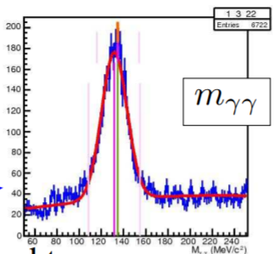
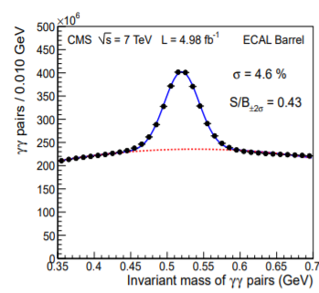
Mass Peak
Pion (135 MeV/c²) Mass peak
Eta (0.547 GeV/c²) Mass peak

Slide 11
Relative Calibrations
If we have known well calibrated cells, then we can compare the energy spectrum of those with uncalibrated cells, and find the calibration coefficient from that.
Procedure (How I do it for ALICE):
Sum energy spectrum of good cells
Fit a power law ($y= {ax}^{g}$) spectrum to it within (1.5-5 GeV) to find g
Apply that to the uncalibrated cells to find a.

Slide 12
Summary
Electromagnetic calorimeters are important detector in particle physics experiments.
In order to be able to use them reliably, they need to be well calibrated.
There are many different calibrations such as energy, temperature, and time.

Slide 13
References
Energy calibration and resolution of the CMS electromagnetic calorimeter in pp collisions at √ s = 7 TeV (arXiv:1306.2016)
Calibration of the ATLAS electromagnetic calorimeter using calibration hits (CDS:1046248)
ALICE EMCAL Workshop March 2018

