Slide 1
Heterologous Protein Solubility Prediction in E. Coli
Zak Costello

Slide 2
What are Proteins?
Chains of Amino Acids that are Translated from RNA.

Slide 3
Proteins are nanomachines that do all of the ‘Work’ in the Cell
Rubisco: The most abundant enzyme on earth. This is responsible for carbon fixation
Aquaporin: a pump which tightly controls water flow in and out of a cell.
Luciferase: A protein responsible for the glow of fireflies.
*Image Credit: Protein Database - https://www.rcsb.org/

Slide 4
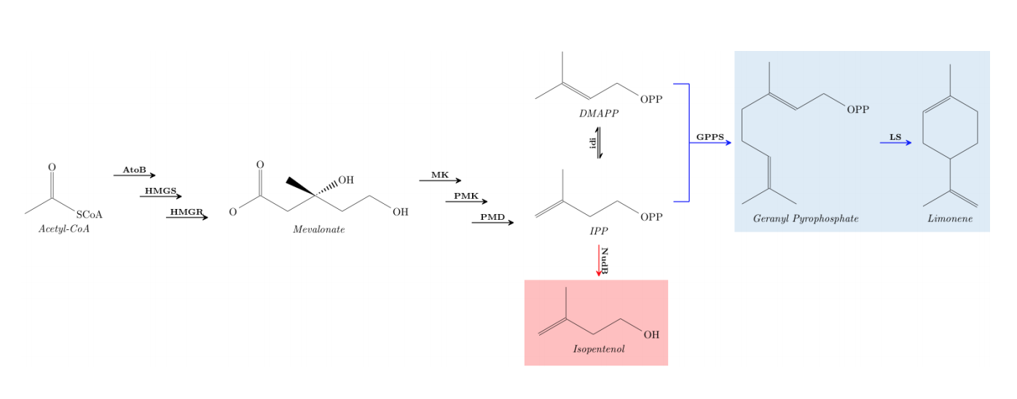
In Metabolic Engineering we express new enzymatic pathways in organisms to make target molecules
Engineered Pathway

Slide 5
Protein solubility is a Necessary Condition for Protein Function In Synthetic Biology Applications
Soluble Proteins Perform their functions
Insoluble proteins aggregate and can be toxic. Also, they do not function
In metabolic engineering we are concerned with the creation of enzymatic pathways
When expressing heterologous enzymes, we want our pathway proteins to be soluble
It is important for Metabolic Engineers to know if the proteins they express are soluble in their host

Slide 6
PROBLEM: Solubility Assays are Time Consuming, So Can We Predict it with easy to gather data?
Also, Lets internally build some proficiency with modern machine learning methods and libraries.

Slide 7
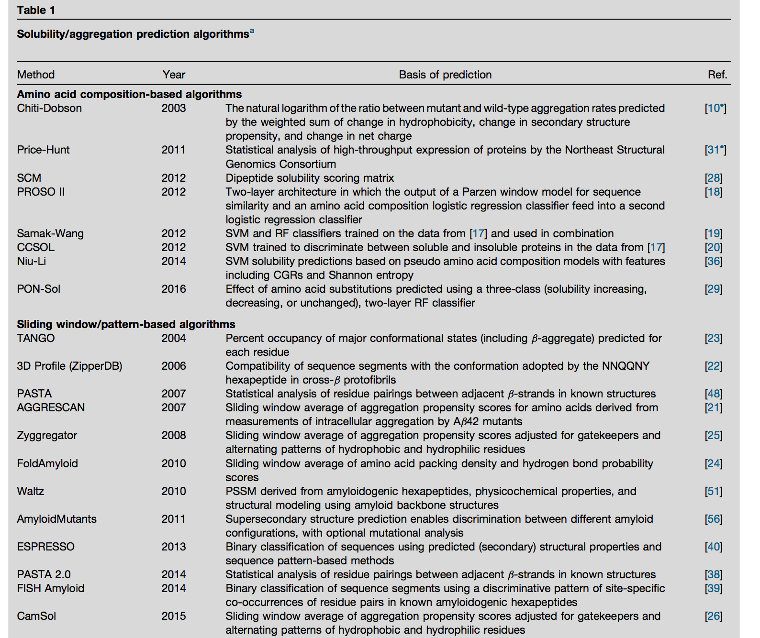
There is rich literature of people attempting to solve this problem with Various methods

Slide 8
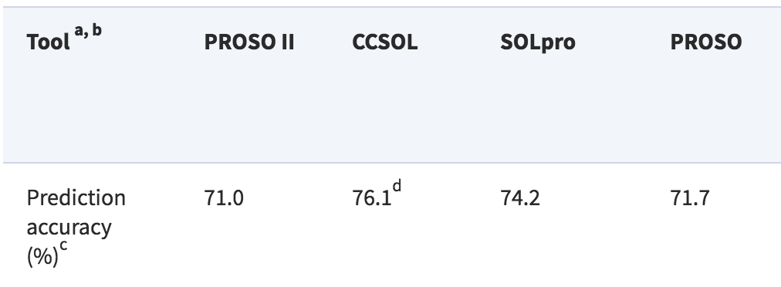
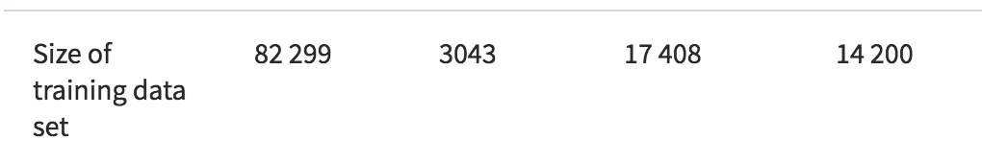
There are Several Tools which Attempt to Classify Proteins Based on Sequence.
The Best Performing Algorithm We’ve found reported has around 76.1% accuracy. However, they do not use modern deep learning techniques.
Chang, Catherine Ching Han, et al. "Bioinformatics approaches for improved recombinant protein production in Escherichia coli: protein solubility prediction." Briefings in bioinformatics 15.6 (2013): 953-962.

Slide 9
Initial Note: It is Difficult to Apply Modern ML Techniques to Biological Data Sets
Experimental Data Sets are Small, On the order of 10 to 100 samples.
Data Available from databases are lumped from multiple experiments and are subject to reporting bias.
Biological Data is noisy, and the noise is from inconsistent sources between experimenters.
Biological experiments can be sensitive to initial conditions and this might not be reported
Not understanding these issues can cause poor results.

Slide 10
What Data Sets Do I use?
PDB Dataset
N = 117,378
Currated From PDB
Experimental Dataset
N = 165
From JBEI Experiments
Contains
Protein Sequence
Binary Solubility
Contains
Protein Sequence
Qualitative Solubility Assessment
Proteomics:16 Aggregation proteins
Proteomics: Target Protein
Issues
[Bias] Insoluble proteins determined by no one reporting that they have successfully expressed them.
[Inconsistency] Curated from many different experiments so solubility metrics may have been different.
Issues
[Repeatability] Qualitative solubility metric determined by a single experimenter.
[Noise] Proteomics noise not able to be determined due to lack of replicates.

Slide 11
High Level Modeling Approach
PDB
Sequence
LSTM Classifier
Binary Solubility Prediction
76.0%
State of the Art!
Experiment
LSTM Classifier
(Pretrained on PDB Data)
51%
TPOT Metalearner
63%
16 Aggregation Proteins
TPOT Metalearner
64.0%
16 Aggregation Proteins

Slide 12
LSTM Classifier
Implemented in PyTorch
Protein Sequences Mapped onto One Hot Tensors
Last Hidden Layer Mapped through a dense layer onto two outputs (soluble / insoluble)
Output: Solubility Prediction
INPUT: Amino Acid Sequence
*Image Credit: http://colah.github.io/posts/2015-08-Understanding-LSTMs/

Slide 13
Our Method has Achieved 76.0% Accuracy so far on the Test Set
Best Performing Hyperparameters:
  Hidden Size: 512
  Layers: 3
  Batch Size: 64
  Learning Rate: 0.0001
  Bidirectional
I am currently applying hyper parameter optimization techniques to improve performance further.
PDB

Slide 14
TPOT Metalearner
TPOT is a library which automates scikit-learn pipeline creation by using genetic algorithms to test out many learning pipelines.
It includes 11 ML algorithms, and 18 Preprocessors
These are mixed together to find the model with the best cross validated performance.
The resulting model can then be used for prediction.

Slide 15
Performance on the Experimental Dataset still needs some work
Experiment

Slide 16
Whats Next?
Improving Performance of Classifiers
Implementing 5 Fold Cross Validation to get good statistical accuracies for performance.
Outputting Contributions from the Sequence Prediction, So I can understand what the classifier is weighting most heavily for each prediction.

Slide 17
Thanks!
Project Collaborators:
Chris Petzold
Yan Chen
Hector Garcia Martin
Affiliations:

