Slide 1


Long-range compensation simulations with wires for the LHC and HL-LHC
Alexander Valishev
Together with S.Fartoukh, Y.Papaphilippou, D.Shatilov, A.Patapenka, A.Rossi, G.Sterbini, G.Stancari, M.Fitterer, M.Hostettler, M.Zobov, F. Antoniou, R. De Maria, H.Schmickler
Beam-Beam Efects in Circular Colliders
7 February 2018, LBNL

Slide 2
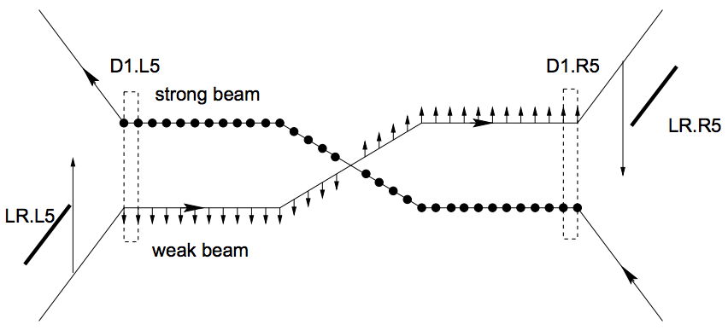
Long-Range Compensation Concept
J.P. Koutchouk, LHC Project Note 223 (2000)
  This note shows that the long-range beam-beam interactions, presently considered as the most drastic limitation of LHC performance, can be rather accurately corrected for both their linear and non-linear perturbations. The principle of the corrector is simple though departing from classical multipolar lenses. It requires a conductor running parallel to the beam and carrying a current of about 60 A over 2 m or 600 A over 20 cm. Ideally 8 such correctors would be needed, grouped in 4 boxes on either side of IP1 and IP5, placed at about 40 m from the exit face of D2 towards D1.

Slide 3
Long-Range Compensation Concept
Beam-beam (LR) kick (round beams)
with beam separation
Neglecting form factor (sufficiently large separation), can be approximated by an “infinite” wire
with wire separation
The simple conditions for matching the effects are
corresponds to 5.5 A×m per encounter for LHC

Slide 4
Previous work: SPS BBLR Tests
U. Dorda, J. Koutchouk, R. Tomas, J. Wenninger, F. Zimmermann, R. Calaga, W. Fischer, EPAC08 (2008)
F. Zimmermann, J.-P. Koutchouk, F. Roncarolo, J. Wenninger, T. Sen, V. Shiltsev, Y. Papaphilippou, PAC05 (2005)
J.-P. Koutchouk, J. Wenninger, F. Zimmermann, EPAC04 (2004)
  … machine experiments explored the dependence of beam loss, beam size, and beam lifetime on the beam-wire distance and on the wire excitation. They appear to conﬁrm the predicted effect of the long-range collisions on the beam dynamics.

Slide 5
Previous work: RHIC BBLR Tests
R. Calaga, W. Fischer, G. Robert-Demolaize, N. Milas, PRST-AB, 14, 091001 (2011)
  … experiments complement the experience with long-range beam-beam interactions in the SppS and Tevatron, wire experiments in the SPS, and the partial long-range compensation in DANE. The RHIC wires created strong localized long-range beam-beam effects, comparable in strength to the effect expected in the LHC, with a beam that has a lifetime typical of hadron colliders, and including head-on beam-beam collisions… A single attempt to compensate long-range beam-beam interaction via a DC wire showed evidence of compensation.
R. Calaga, W. Fischer, G. Robert-Demolaize, IPAC10 (2010)
+ many …

Slide 6
Previous work: Simulations of BBLR
H.J. Kim, T. Sen, N. Abreu, W. Fischer, PRST-AB, 12, 031001 (2009)
  Frequency maps, DA, BTF – predictions for RHIC experiments
U. Dorda, F. Zimmermann, W. Fischer, V. Shiltsev, PAC07 (2007)
  Predictions for LHC and LHC upgrade.
T.L. Rijoff, R.J. Steinhagen, F. Zimmermann, IPAC12 (2012)
  …Suitably placed LHC wire compensators should allow for a reduction of the crossing angle by the equivalent of at least 1-2σ while maintaining the same stable region in phase space, or, alternatively, for a substantial increase in beam current (e.g. by a factor of 2) at constant crossing angle…

Slide 7
DAFNE Lifetime Optimization with BBLR
C. Milardi, D. Alesini, M.A. Preger, P. Raimondi, M. Zobov, D. Shatilov, http://arxiv.org/abs/0803.1544 (2008)
  … During the operation for the KLOE experiment two such wires have been installed at both ends of the interaction region. They produced a relevant improvement in the lifetime of the weak beam (positrons) at the maximum current of the strong one (electrons) without luminosity loss, in agreement with the numerical predictions.
  The only prior demonstration of long-range compensation with wires in collider operations.

Slide 8
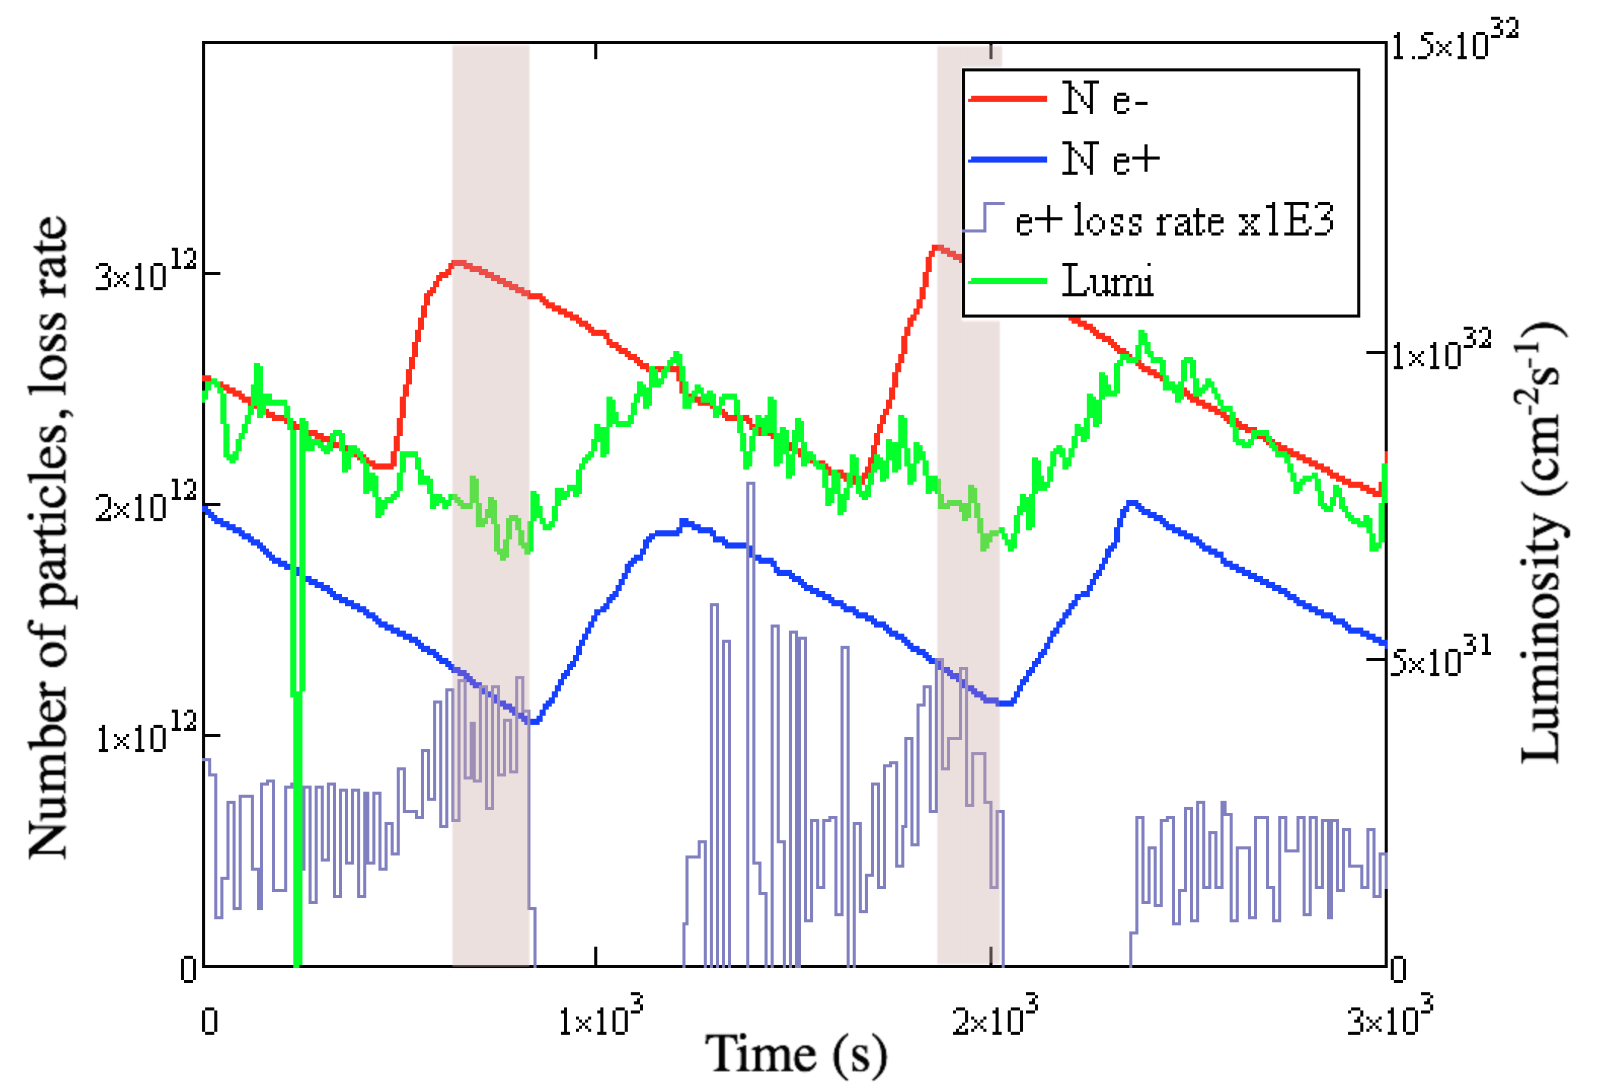

Reduction of DAFNE Experimental Data
WIRES OFF τ_{BB}=1,200 ±175 s

Slide 9
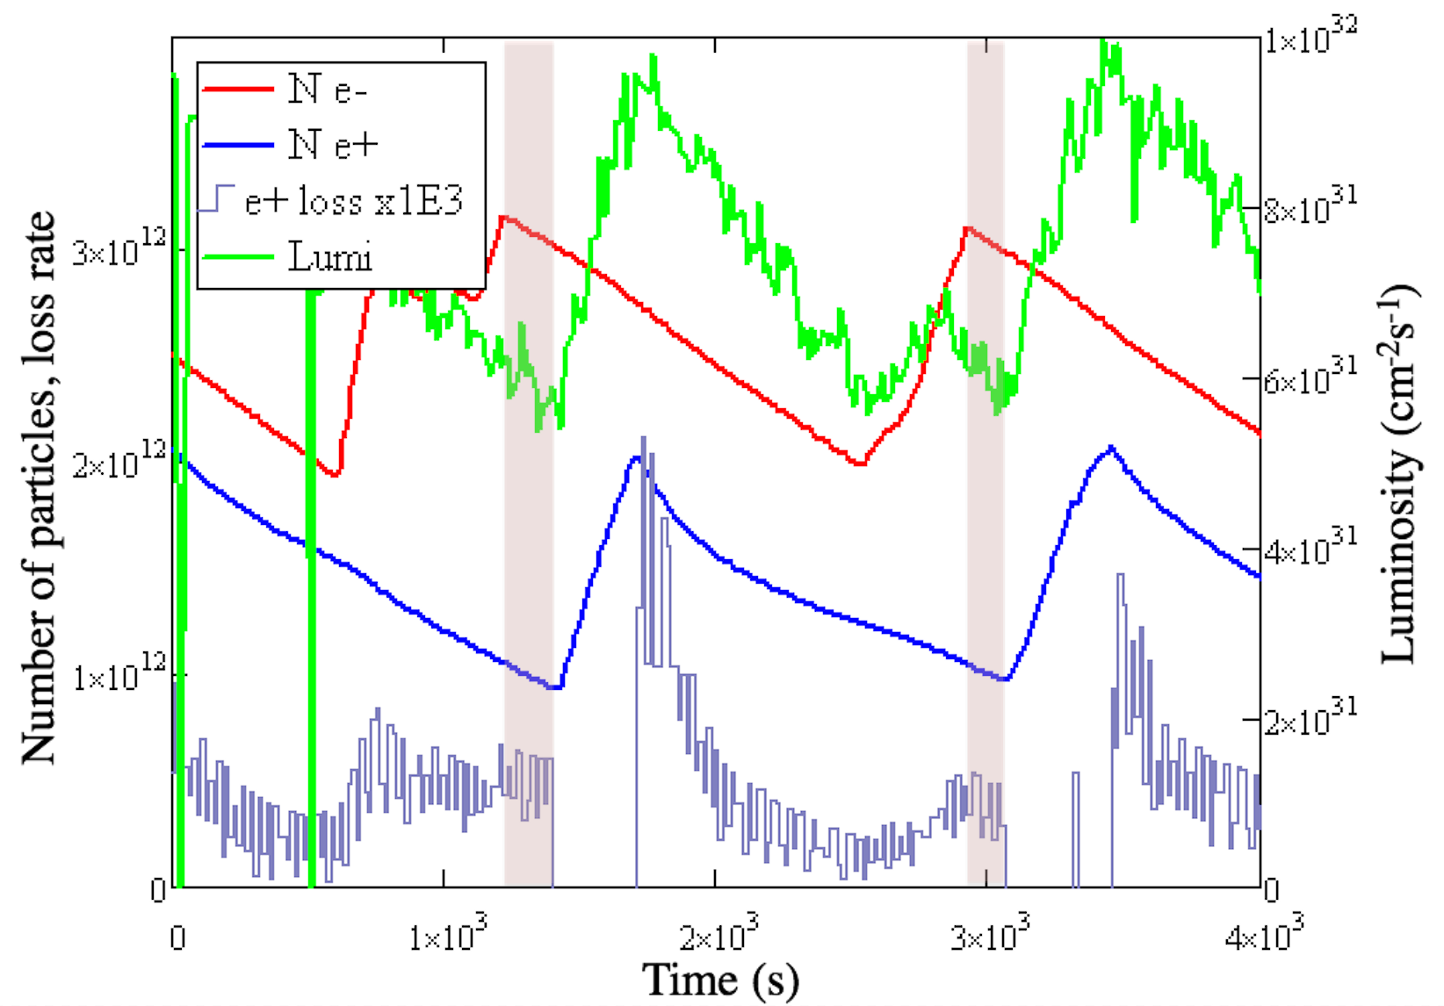
Reduction of DAFNE Experimental Data
WIRES ON τ_{BB}=2,000±360 s

Slide 10
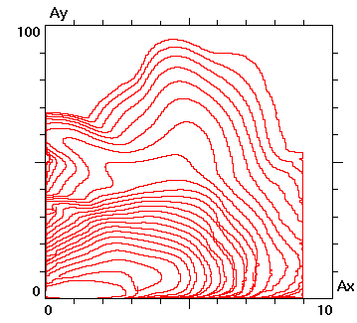
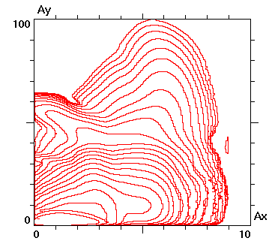
Validation of Lifetrac Simulation using
DAFNE BBLR Experimental Data
The conclusions of 2005-2006 campaign have been reproduced. Full machine detail was implemented, including strong coupling in the IR due to experimental solenoid sextupoles. Main results:
No effect on specific luminosity from BBLR – in quantitative agreement with experiment
Aperture model implemented and lifetime effect reproduced quantitatively
A.Valishev et al, IPAC’15, MOPMA022

Slide 11
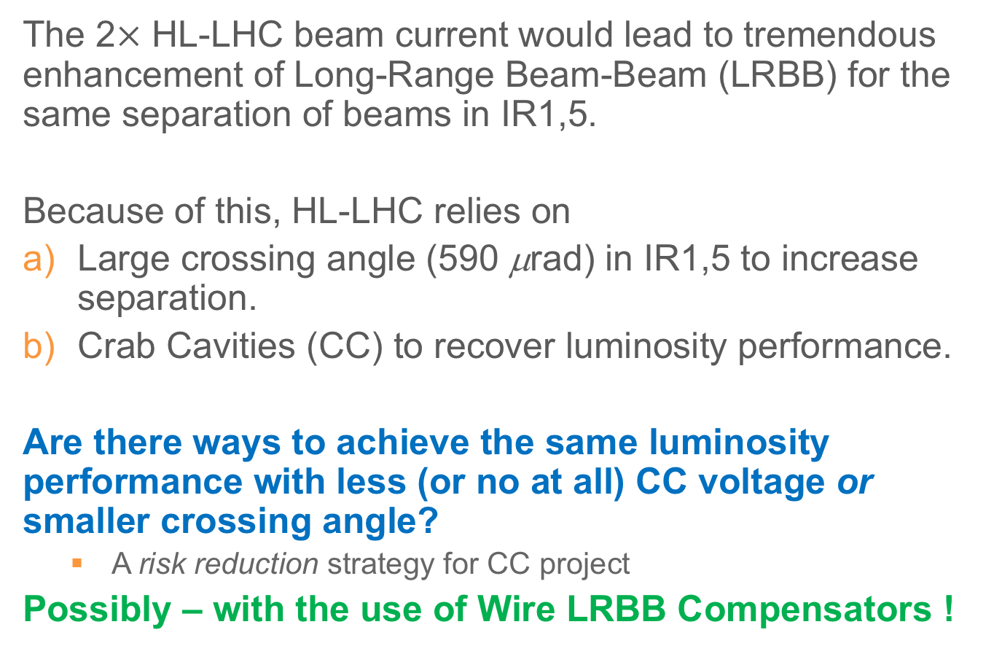
Motivation for Long-Range Beam-Beam Compensation in HL-LHC
The 2$×$ HL-LHC beam current would lead to tremendous enhancement of Long-Range Beam-Beam (LRBB) for the same separation of beams in IR1,5.
Because of this, HL-LHC relies on
Large crossing angle (590 μrad) in IR1,5 to increase separation.
Crab Cavities (CC) to recover luminosity performance.
Are there ways to achieve the same luminosity performance with less (or no at all) CC voltage or smaller crossing angle?
  A risk reduction strategy for CC project
Possibly – with the use of Wire LRBB Compensators !

Slide 12
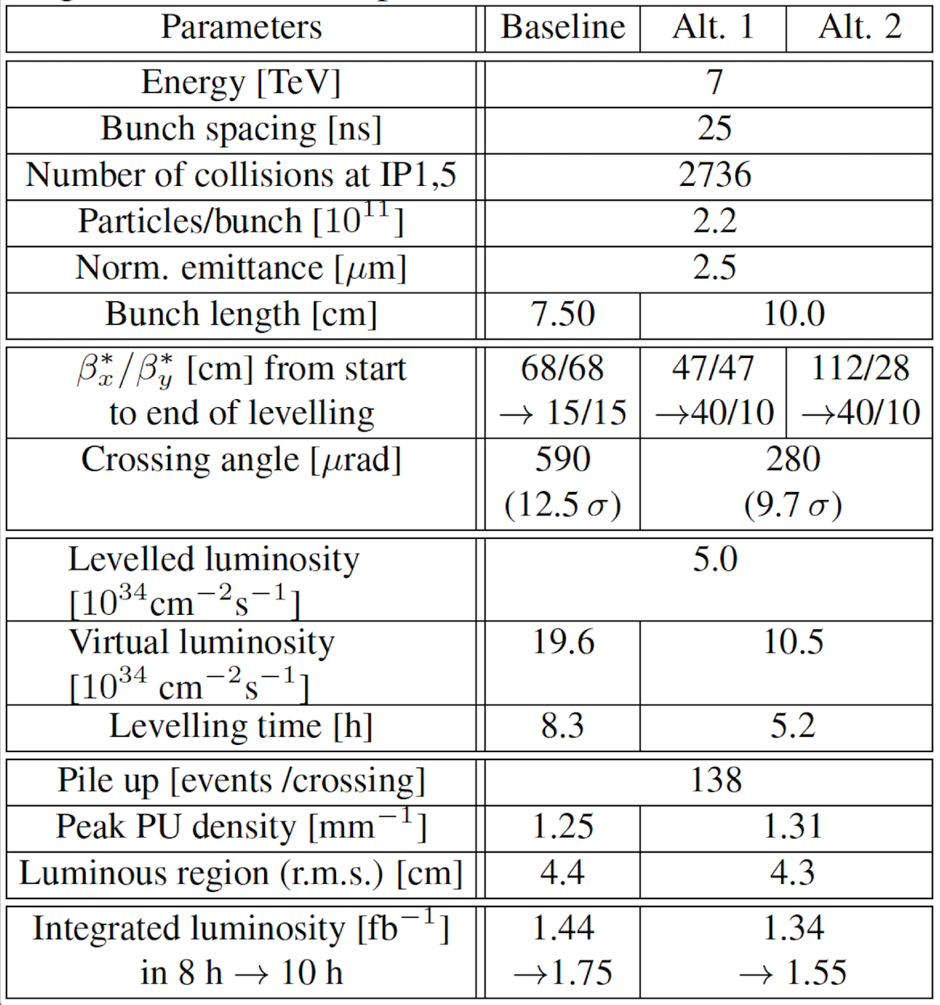
Luminosity Leveling at 5×10³⁴
S.Fartoukh et al., PRSTAB 18, 121001 (2015)

Slide 13
Luminosity Leveling at 5×10³⁴ baseline vs. alternative scenarios
Clearly a small separation!

Slide 14

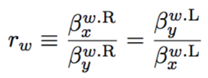
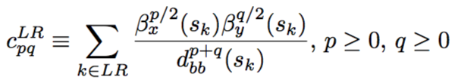
BBLR Correction Algorithm
S.Fartoukh et al., PRSTAB 18, 121001 (2015)
LRBB and wire field
Beam-beam separation
Beta-function ratio
Resonance Driving Terms
10.5A per LR collision at Np=2.2E11

Slide 15
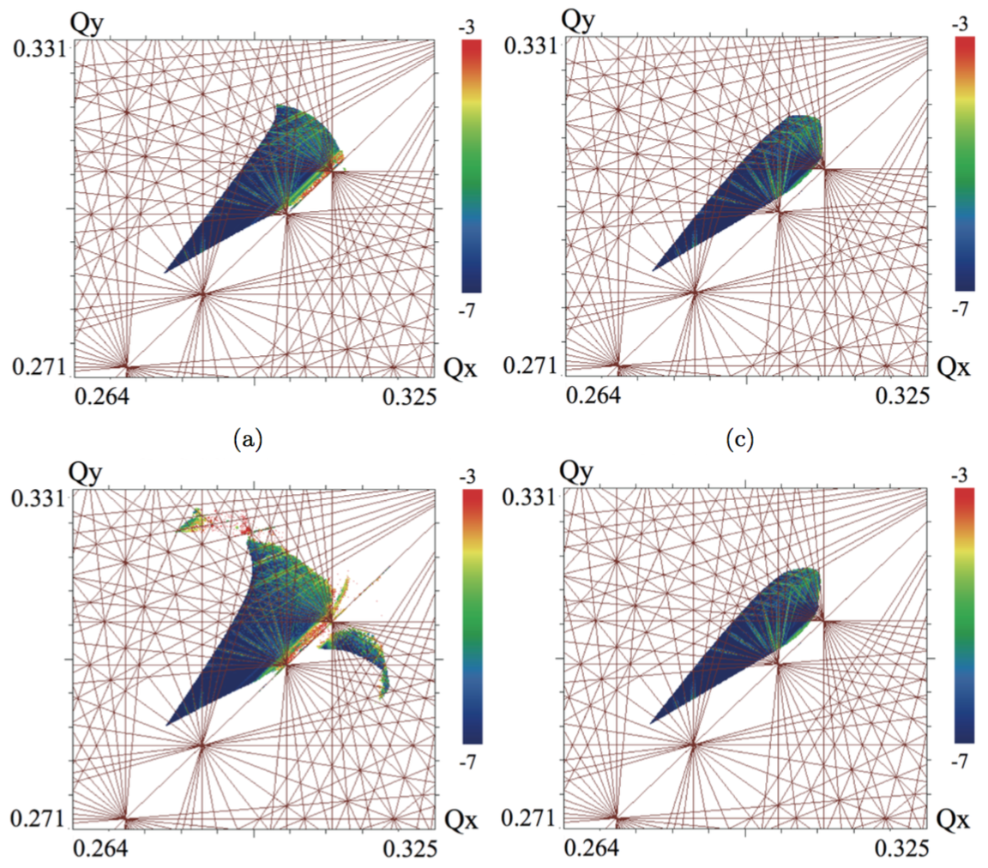
FMA – Round Optics 15/15, Np=2.2×10¹¹
590 μrad
No correction
With correction
450 μrad

Slide 16
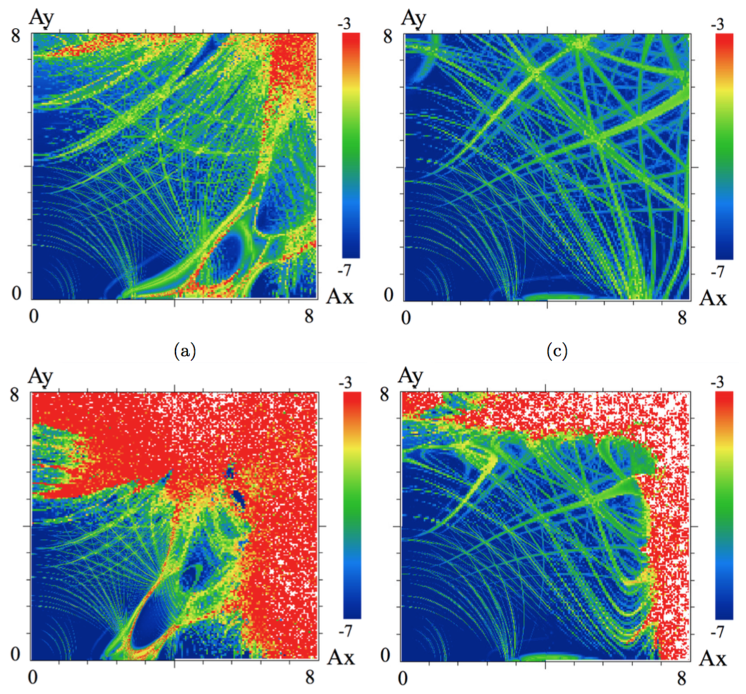
FMA – Round Optics 15/15, Np=2.2×10¹¹
590 μrad
No correction
With correction
450 μrad

Slide 17
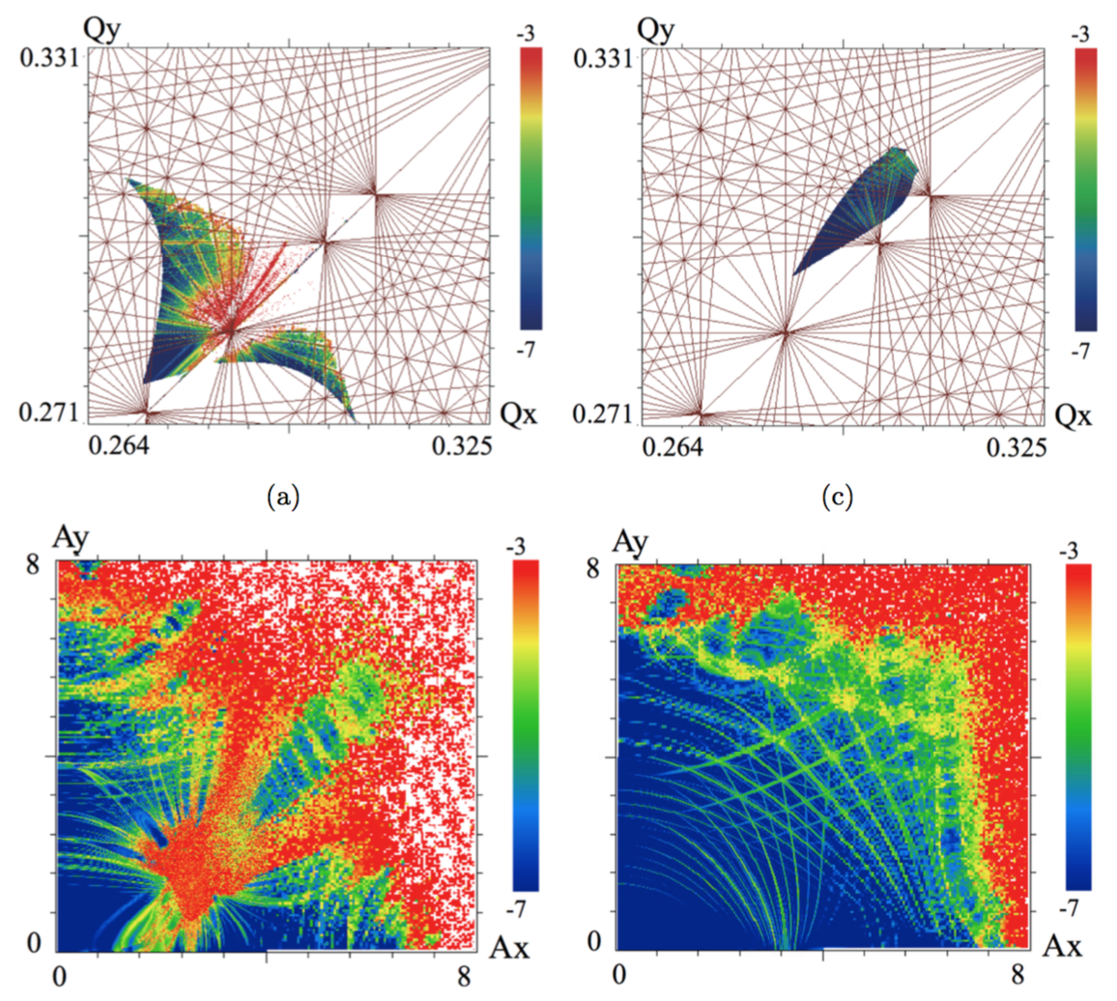
FMA – Flat Optics 10/40, 300μrad, Np=2.2×10¹¹
No correction
With correction

Slide 18
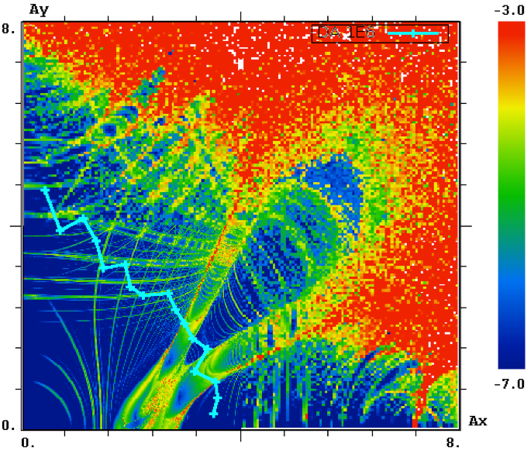
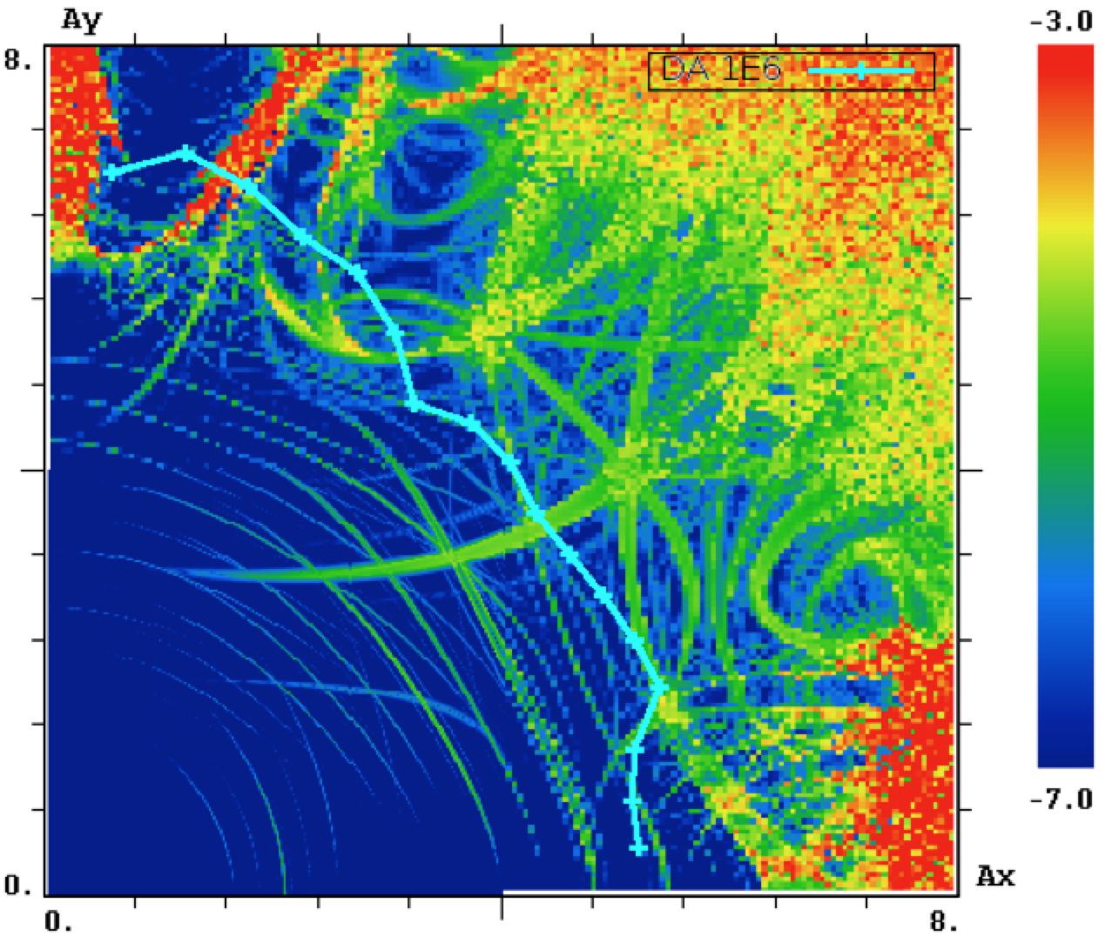
FMA/DA Flat Optics β*=40/10cm, 280urad, Np=1.5×10¹¹ – end of leveling
BBLR=off, DA=3.2
BBLR=on, DA=5.4

Slide 19
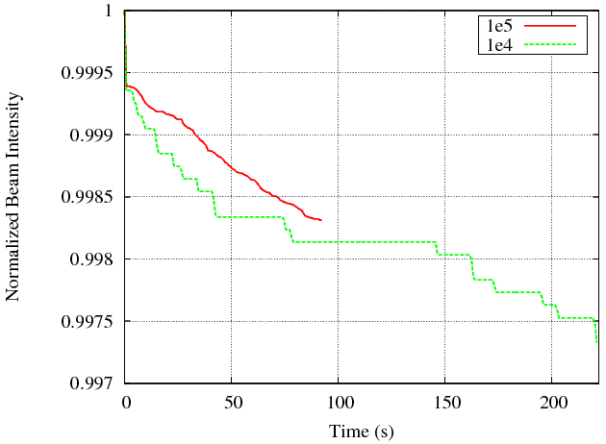
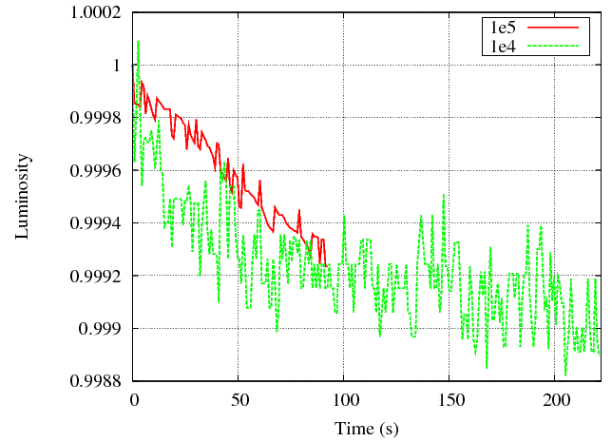
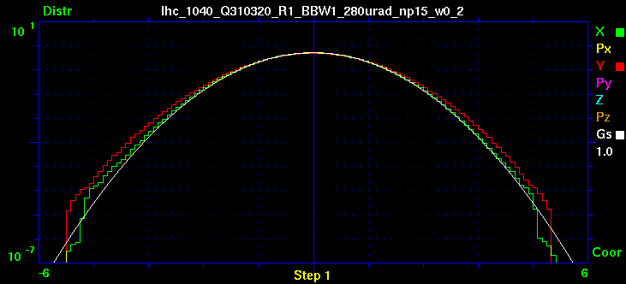
BBLR OFF – Flat Optics β*=40/10cm, 280urad, Np=1.5×10¹¹ – end of leveling
τ_{N} ~15 hr
τ_{L} ~34 hr

Slide 20
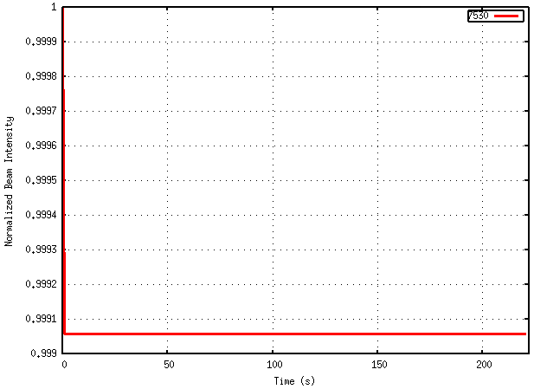
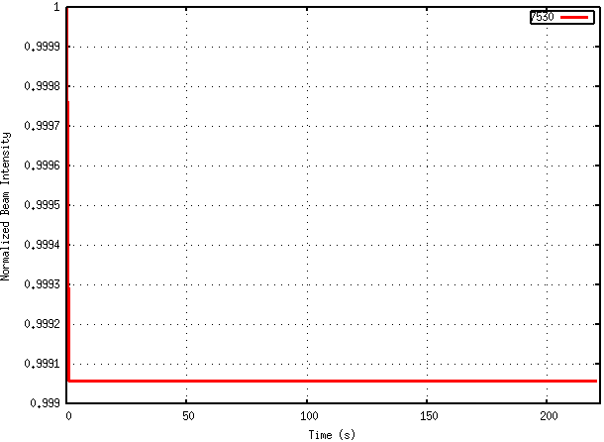
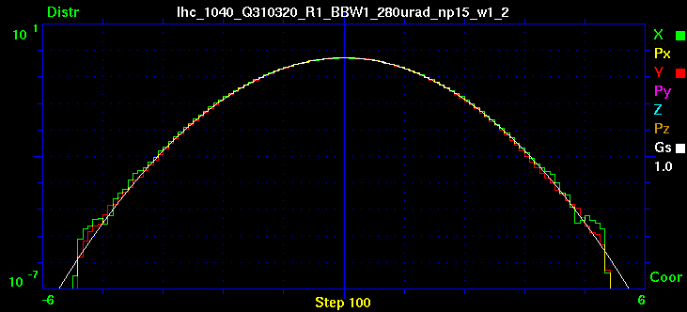
BBLR ON – Flat Optics β*=40/10cm, 280urad, Np=1.5×10¹¹ – end of leveling

Slide 21
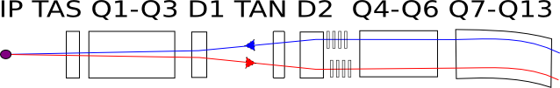
Discussion of Implementation
BBLR
BBLR
Distance from IR 150m (r=1, not most optimal)
Distance from IR 197 m (r=0.5)
Minimum distance to beam 9.3σ, current 125A×m
for wire embedded in TCT: wire-jaw=3mm, +10σ beam = total distance 14σ beam
E-beam wire is a possible solution
  125 A×m corresponds to ~20 A×m for 5keV e- beam.
  Ie=7A for L=3m

Slide 22
Motivation for BBLR Experiment at LHC
Proof-of-principle experiments with wire-in-collimator devices in the LHC in 2017 and 2018
  Demonstrate compatibility with high energy hadron collider operations
  Demonstrate improvement of beam dynamics in realistic configuration scenario
Very limited time and resources – less-than-optimal configuration
  2 wires at IP5 acting on beam2 available in 2017
  Full set of 4 wires for beam2 (IP1,5) in 2018
  Aim at demonstration with minimum machine configuration changes to reduce study time

Slide 23
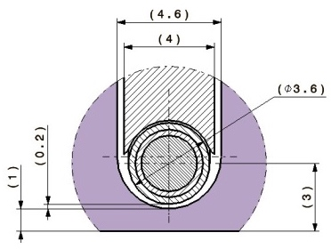
Boundary Conditions for Wires
L= 1000 mm
?
6σ coll min
3mm
L. Gentini (EN-MME) & O. Aberle (EN-STI)
ATS Optics (3/2017 S.Fartoukh)
Place | 𝝱_{x} (m) | 𝝱_{y} (m) | 𝝈_{x} coll (mm) | 𝝈_{y} coll (mm) | Min. Sep. (mm) | Min Sep. (𝞂 2.5 μm) | Min Sep. (𝞂 5 μm)
L5 TCL.4L5.B2 | 887 | 1297 | 0.67 |  | 7.0 | 12.4 | 8.8
R5 TCTPH.4R5.B2 | 1319 | 945 | 0.82 |  | 7.9 | 11.4 | 8.1
L1 -172.2 from IP1 | 400 | 1029 |  | 0.72 | 7.3 | 12.0 | 8.5
R1 TCTPV.4R1.B2 | 1341 | 1003 |  | 0.71 | 7.2 | 12.0 | 8.5

Slide 24
Basic Parameters Used to Plan Experiment
Minimum changes to the machine / optics configuration from the nominal operation
The study scenario would be weak-strong with 1(2,3) weak bunches and trains in the ‘strong’ beam.
Machine: 6.5TeV, collisions at IP1 and IP5
Optics: β*=40cm (33cm), ‘2016 collision’ and/or ATS
Beam parameters
  ‘Strong’ beam1: ε=2.5μm N_{p}=1.15×10¹¹ (1.25×10¹¹)
  ‘Weak’ beam2: ε=2.5μm or 5μm
Parameter to vary: crossing angle θ
Constants:
  Betatron tunes Q_{x}=0.31, Q_{y}=0.32 (with and without wire)
  Chromaticity = 15
  I_MO=550A

Slide 25
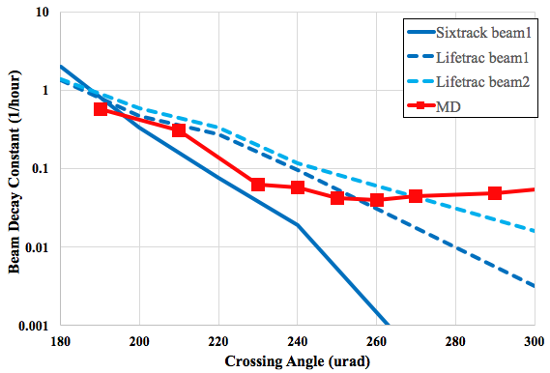
Simulation Benchmark vs. MD Data
ε=2.5μm, 2016 collision optics
τ = 5-10 hour
6σ beam
10σ
Difference in treatment of aperture between two codes
Big statistical error at low loss (large separation)
Losses at 180urad → 90% vertical
Notes:
Which beam was observed in MD?

Slide 26
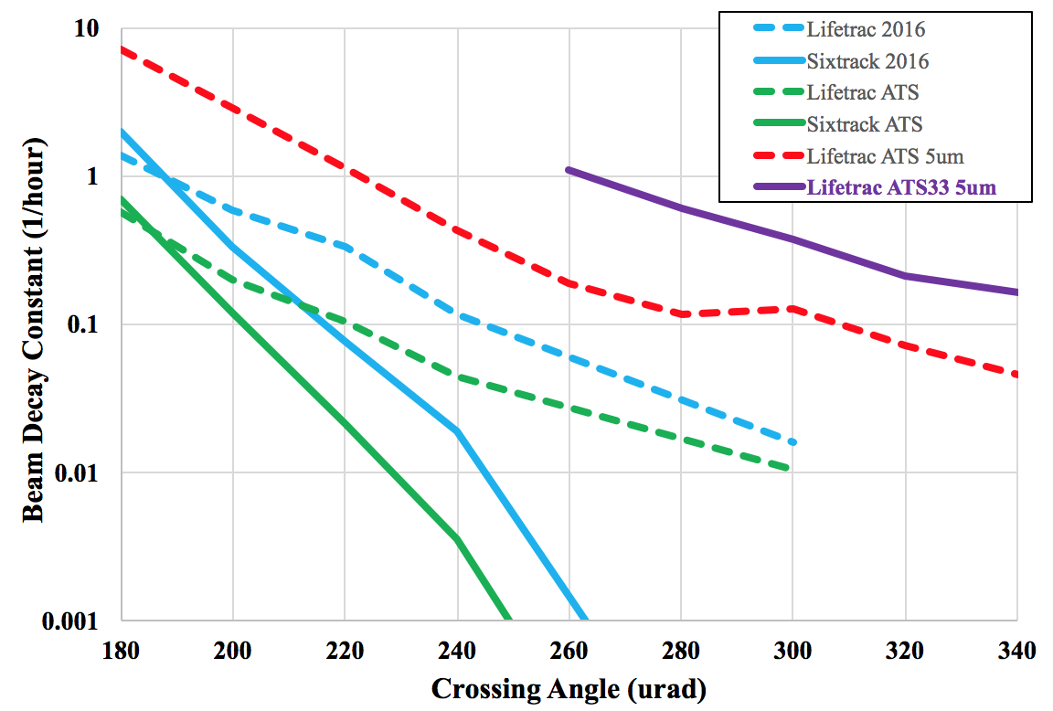
Effect of Optics and Beam Emittance
6σ 2.5um beam
4σ 5um
11σ 2.5um
8σ 5um
6σ 5um
Difference in treatment of aperture between two codes
Big statistical error at low loss (large separation)
Losses at 180urad → 90% vertical (70% in ATS)

Slide 27
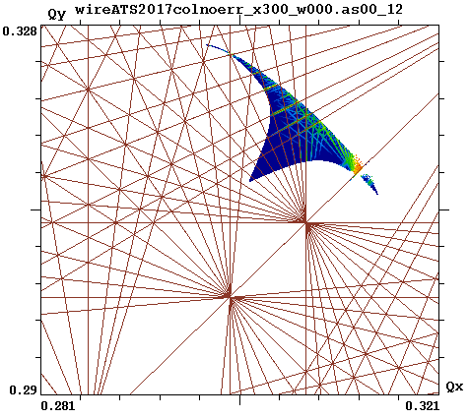
Effect of Crossing Angle on Footprint
Lifetrac simulation
ATS optics

Slide 28
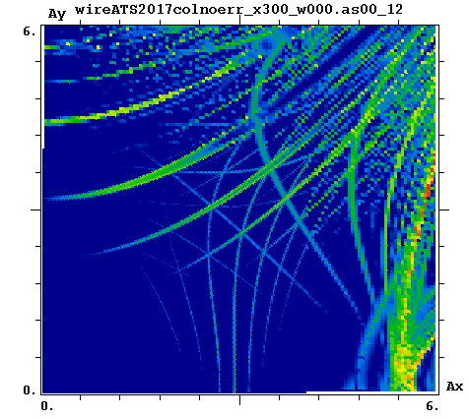
Effect of Crossing Angle on DA
Lifetrac simulation
ATS optics

Slide 29
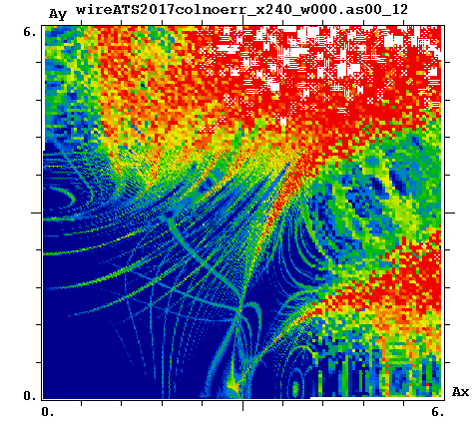
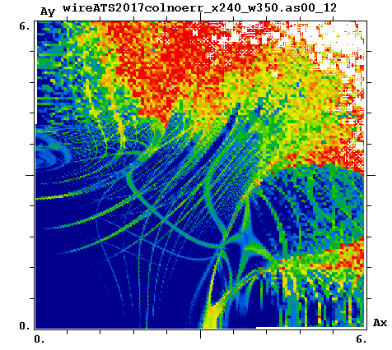
Impact of 2 IP5 Wires at θ=180urad (5.6σ sep.)
Increased Wire Distance
Lifetrac simulation
ATS optics, ε=5um
Wires at 8.8 beam sigma – current increased to 350A
L5 collimator jaw at 6 collimation sigma 😀

Slide 30
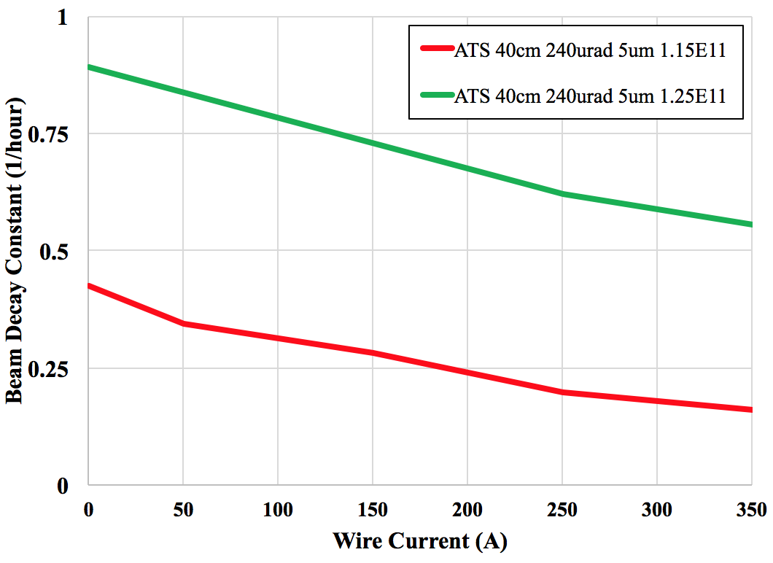
Predicted Impact of 2 IP5 Wires on Lifetime
L5 collimator jaw at 6σ coll.

Slide 31
Parameters during MD2202, 10 hours of beam
July 1, 2017
Minimum changes to the machine / optics configuration from the nominal operation
The study scenario was weak-strong with 3 weak bunches and 1 train in the ‘strong’ beam.
  Non-colliding bunch
  Only Head-On collisions
  Full head-on and long-range
Machine: 6.5TeV, collisions at IP1 and IP5
Optics: β*=40cm, ATS
Beam parameters
  ‘Strong’ beam1: ε=3μm N_{p}=1.15×10¹¹ (0.98×10¹¹ for the head-on bunch)
  ‘Weak’ beam2: ε_{x}=6μm, ε_{y}=4μm
  Bunch length 8.4cm, momentum spread 1.3×10⁻⁴
Parameter to vary: crossing angle θ
Constants:
  Betatron tunes Q_{x}=0.31, Q_{y}=0.32 (with and without wire)
  Chromaticity = 15
  Octupole current = 325A

Slide 32
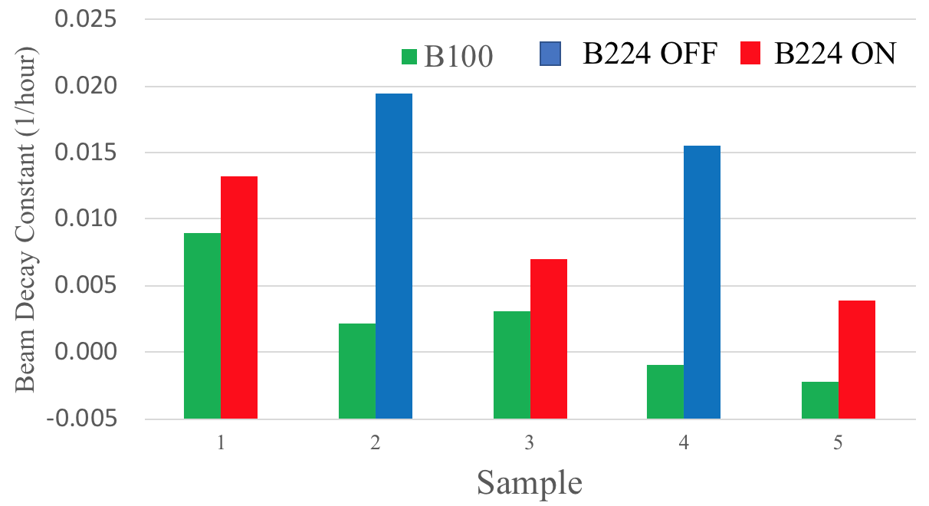
Compensation Effect in MD2202
2×𝞂×L=5×10⁵ 1/s
0.017 OFF
0.008 ON

Slide 33
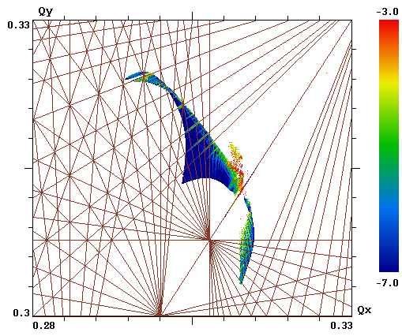
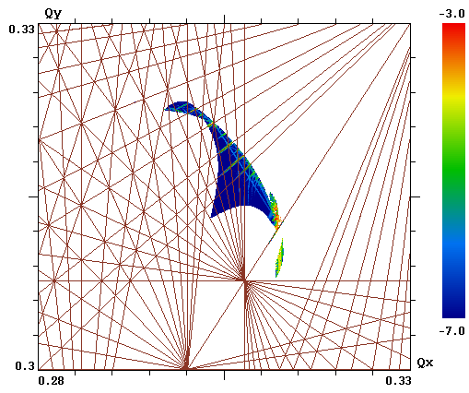
(post) Predicted Impact of Wires in MD2202
OFF
ON (350A)
Lifetrac simulation ATS optics β=0.4m
θ=240urad ε=6um (x), 4um (y)
Corresponding to LRBB separation 5.1σ (x) and 6.2σ (y)
Wire at 7.4σ

Slide 34
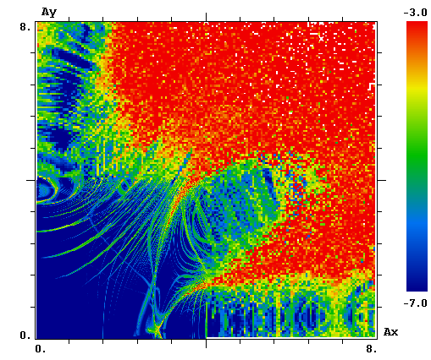
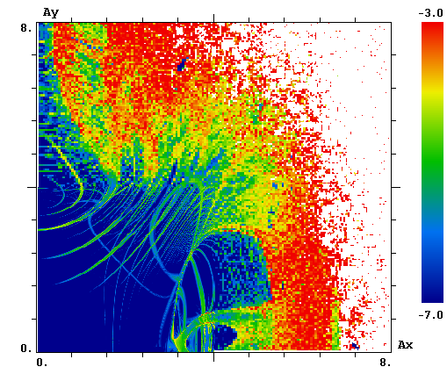
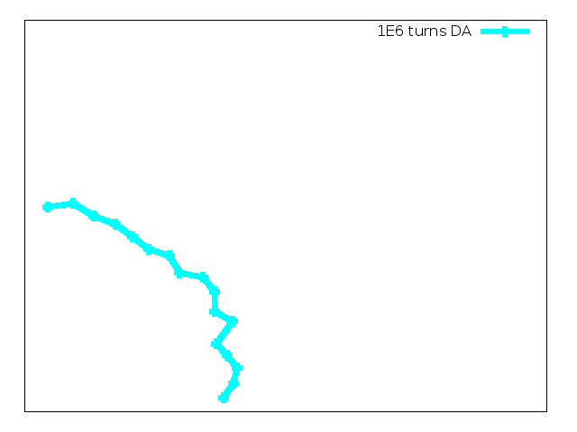
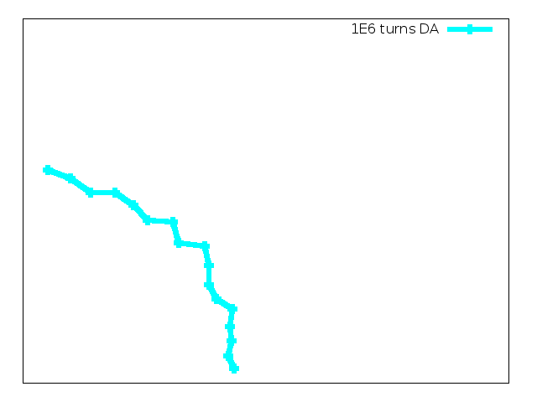
(post) Predicted Impact of Wires in MD2202
OFF
ON (350A)
DA_{min}=3.0σ
DA_{min}=3.4σ
Lifetrac simulation ATS optics β=0.4m
θ=240urad ε=6um (x), 4um (y)
Corresponding to LRBB separation 5.1σ (x) and 6.2σ (y)
Wire at 7.4σ

Slide 35
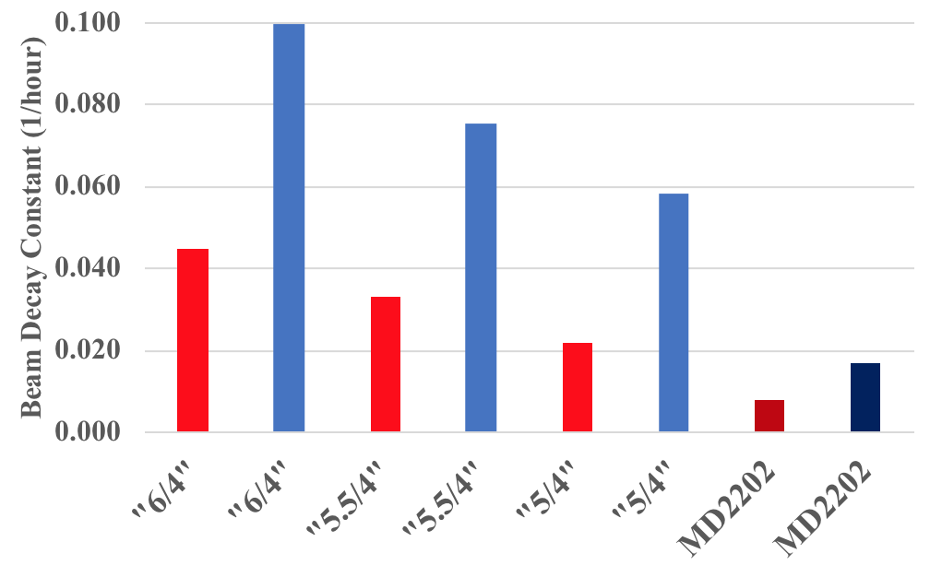
(post) Predicted Impact of Wires in MD2202

Slide 36
Summary – 1
Alternative HL-LHC scenario with reduced crossing angle and flat optics to restore performance without CC is feasible with long-range beam-beam compensation
Wires restore DA from 3 to almost 6 sigma at smallest separation of 9.4 at end of fill (worst case, non-optimal wire location). Macroscopic parameter evolution is unaffected by beam-beam
Wires need to be at 9.3 sigma, which presents a difficulty in implementation
  Wires need to be turned on towards the end of fill, the required current is 125 A×m – good for immaterial wire with beam, would require 20 A×m EL

Slide 37
Summary – 2
In present LHC without major changes to machine configuration, beam lifetime degradation due to long-range begins at separations of <6σ
Less than ideal scheme of long-range beam-beam compensation with just 2 wire-in-collimator devices produces a measureable and well reproducible positive effect
  Predicted non-luminous losses improvement by about factor 2
  A test was in relatively good agreement with predictions
An almost 20-year-old idea finally comes close to fruition

