Slide 1

E-lens test stand at CERN
Adriana Rossi (CERN BE-BI-EA)
With contributions from Alexey Levichev, Danila Nikiforov, Alexey Barnyakov, Mariya Maltseva (BINP), Sergey Sadovich (CERN), Giulio Stancari (FNAL)
Mini-workshop on Beam-Beam Effects in Circular Colliders – LBL 5-7 Feb. 2018

Slide 2
Outline
Context: electron beam applications
Brief description of electron lenses and electron beam dynamics
Mention to preliminary BBRL e-beam studies
Motivations and description of a test stand at CERN
Summary and outlook

Slide 3
Context
Electron beams can be used in conjunction with proton/ion beams for
Electron cooling (for ex. at CERN LEIR, AD, ELENA, GSI SIS18),
Space charge compensation (GSI SIS18 *, FNAL IOTA)
Beam-beam compensation (at FNAL Tevatron and BNL RHIC)
Halo diffusion enhancement (at FNAL Tevatron)
At HL-LHC e-lenses are being studied for:
  BBLR for Beam-Beam Long-Range compensation
  BBHO for Beam-Beam Head-On compensation?
  HEL for Halo diffusion enhancement
  Landau damping? (Not needed according to Sasha’s talk)
* under study with the ARIES project (Accelerator Research and Innovation for European Science and Society)

Slide 4
Electron beam applications
Electron cooling : shrink emittance (size, divergence, and energy spread = lower the temperature) of a charged particle beam without removing particles from the beam. Electron are injected at the same velocity as the ion/proton beam, via Coulomb scattering they exchange momentum and at thermodynamic equilibrium, since the electrons are much lighter, they will have increased their velocity, and the opposite for the ions/protons.
  5 mA × ~.3 kV electrons, 25mm, for CERN-ELENA,
  1 A x 7 kV, 25mm for GSI-SIS18
Space charge compensation : electric field generated by electron beams (Gabor lenses) used to focus ion/proton beams, whose space charge would otherwise cause emittance blow-up.
  Electron beam with transverse and longitudinal distribution plus current intensity ~ matching beam to be focused
  10 A average - 20 A peak current, 50x70 mm size, 25kV for GSI studies

Slide 5
Electron beam applications
Beam-beam compensation: The strongly nonlinear beam-beam force excites high-order betatron resonances, particles diffuse into the tails of the transverse distributions causing emittance growth and beam losses.
Beam-beam tune spread might be reduced by:
x_{w} y_{w}
  for Long-Range Beam-Beam (parasitic encounters)
    compensation with e-beam wire
    at HL-LHC required electron beam ~ 200Am (for 2 wires per HL IP)
    ~ 60Am (=20A x 3m) × several tens of kV (2 e-lenses per HL IP) wire like
  for Head-On Beam-Beam (IP collisions)
    collisions of the proton bunch with a space charge of a low energy e-beam, having the same Gaussian transverse distribution as the p-beam
    at RHIC ~0.2A proton beam with beam-beam parameter 0.007
    used total of 2 e-lenses with ~2Am (=1A × 2m) × 5kV (2 IPs)
    HL-LHC ~1.1A proton beam with beam-beam parameter 0.033
    ~ 10Am (scaling with current and e-energy plus 2 e-lenses per HL IP) × 15-20kV

Slide 6
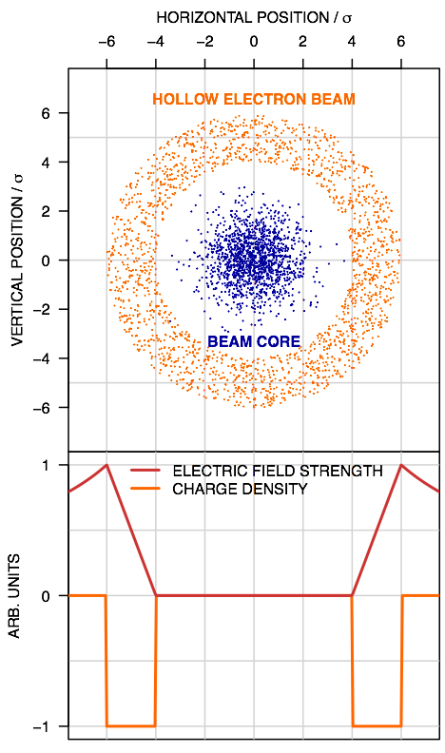
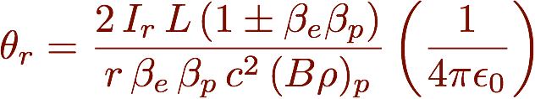
Electron beam applications
Halo diffusion enhancement: Loss spikes have already affected the operation of the LHC, and control of beam losses is recognised as a critical concern for performance at HL-LHC due to the higher beam energies and intensities (for ex. for Crab Cavity failure).
Hollow electron lenses are being designed and (if approved as baseline) will be installed in IR4 (during LS3) as active mean to increase diffusion rate of halo particles. Halo
  at HL-LHC required hollow electron beam
  ~ 15Am (3m e-lens per beam) 5A × 15kV
Courtesy of
G. Stancari

Slide 7
Outline
Context: electron beam applications
Brief description of electron lenses and electron beam dynamics
Mentions to some BBRL e-beam studies
Motivations and description of a test stand at CERN
Summary and outlook

Slide 8
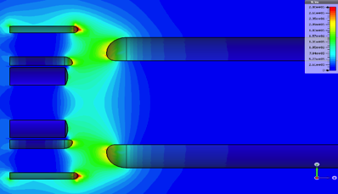
Electron Lens schematics (typical values for HEL)
Instrumentation
Electron gun (A)
Modulator (KHz to MHz)
BPMs
Collector
Overlap/transvers profile monitors
Main SC solenoid 4-6 T
Gun solenoid > 0.2T
Bending SC solenoids ~3T
S at LHC - U at Tevatron and RHIC
International Review on the e-lens concept readiness for integration into the HL-LHC baseline 19 Oct. 2017

Slide 9
Electron beams
An electron in a uniform B field will gyrate along beam lines with
  cyclotron frequency
  gyroradius
In the presence of an electric field (self field of e-beam), assuming that the induced B field change is <<

Slide 10
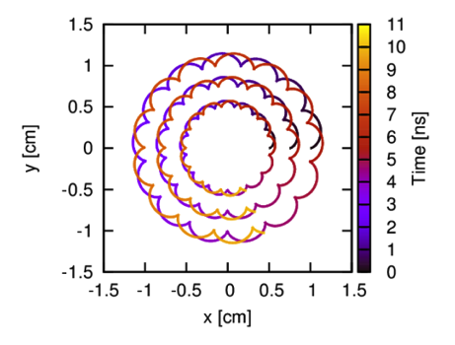
Electron beam in electron lens
Courtesy of Daniel Noll
Beam is further compressed : stronger SC
several A e-beam
~10mm @ cathode
In case of azimuthally non-uniform beam there could be an angular component of the electric field causing further beam tilt.
Beam is compressed and bent
Notes:
Drift velocity due to electric filed (smaller at larger B)
Drift velocity due to difference in gyroradii across a field gradient (smaller at larger B)
Drift velocity when the field lines are not straight (smaller at larger curvature radius and larger B)

Slide 11
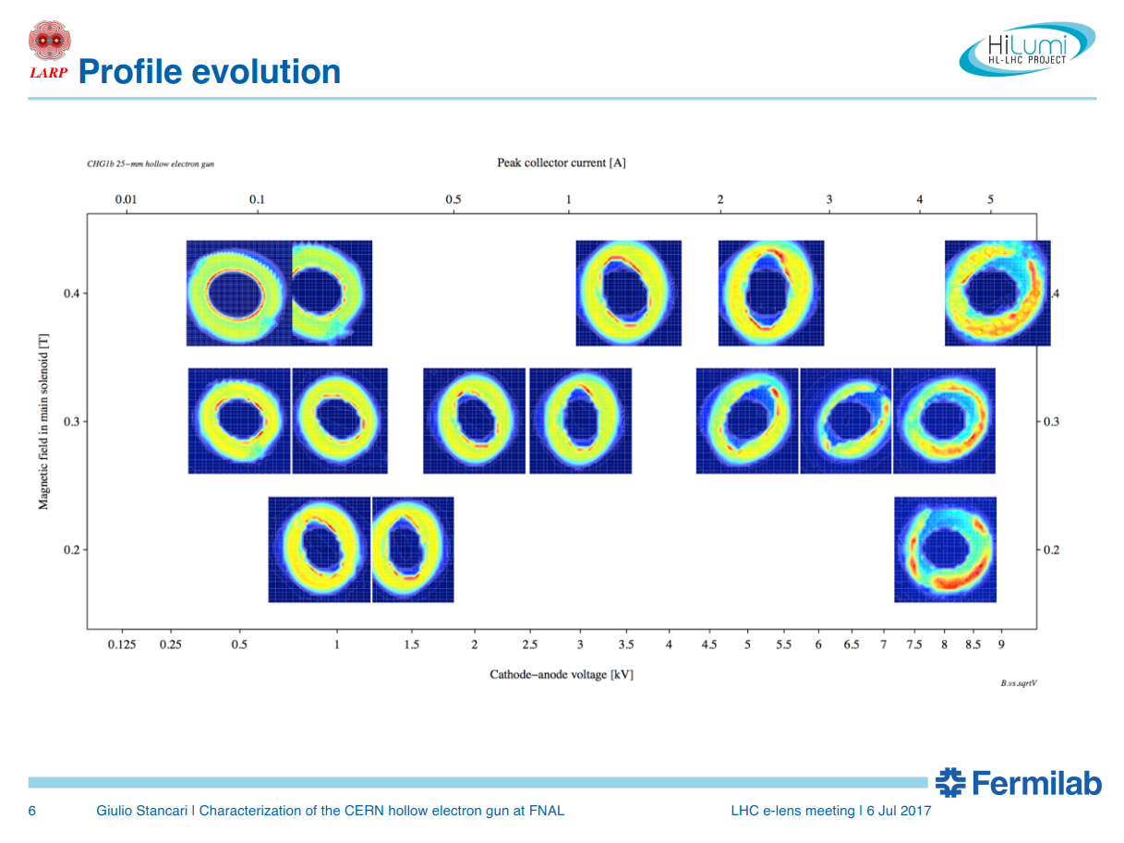

CHG1B Ø 25mm cathode – Ø 63mm chamber
peak collector current [A^{1/2}]
magnetic field in main solenoid
(gun solenoid at 0.2T)
cathode-anode voltage [kV^{1/2}]
Courtesy of Giulio Stancari

Slide 12
Outline
Context: electron beam applications
Brief description of electron lenses and electron beam dynamics
Mentions to some BBRL e-beam studies
Motivations and description of a test stand at CERN
Summary and outlook

Slide 13
HL-LHC layout as from WP15 Oct. ’16
187.44m 193.6m from IP
Note BBLR compensation not in HL-LHC baseline

Slide 14
Assumptions for e-lens simulations for BBLR in HL-LHC (optics v1.2)
Proton beam dimension relevant only in the crossing plane
For HL IP5 (reverse plane for IP1) B2, symmetric for B1
In the simulations by A. Levichev et al. it was assumed an electron beam of Ø 2 mm given space available if electron beam wire placed at 10 σ_{x}
 |  | β_{x} (m) | σ_{x} (mm) | β_{y} (m) | σ_{y} (mm)
Round | left | 1000 | 0.58 | 2000 | 0.82
 | right | 2000 | 0.82 | 1000 | 0.58
Flat | left | 500 | 0.41 | 4000 | 1.16
 | right | 1000 | 0.58 | 2000 | 0.82

Slide 15

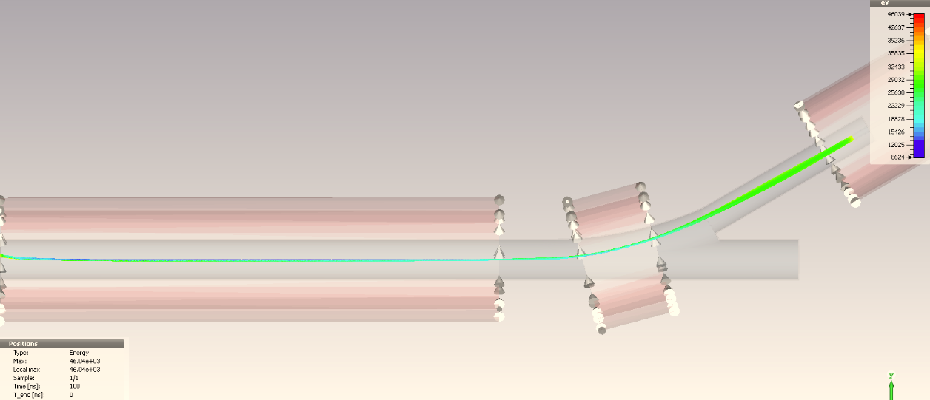
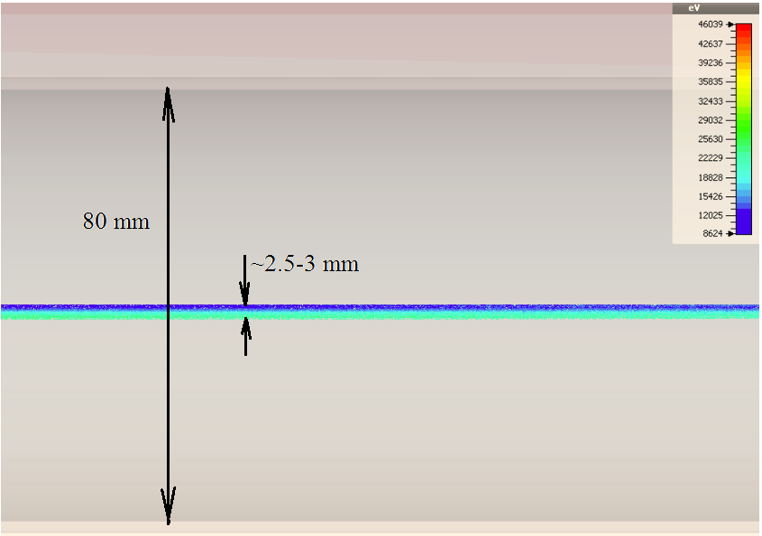
Beam dynamics I=20 A, U₀=35 kV
BINP
A. Levichev, D. Nikiforov, A. Barnyakov, BINP

Slide 16
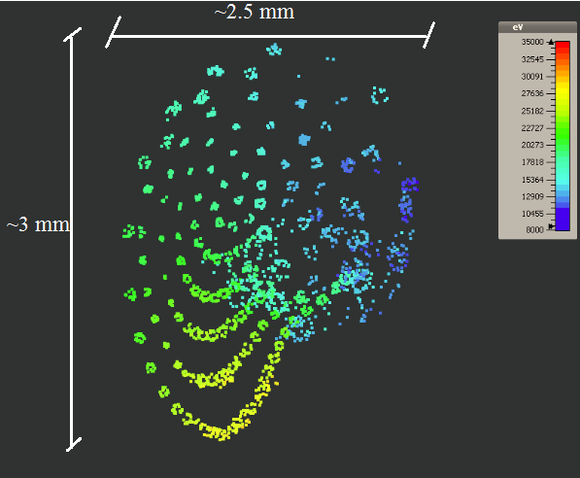
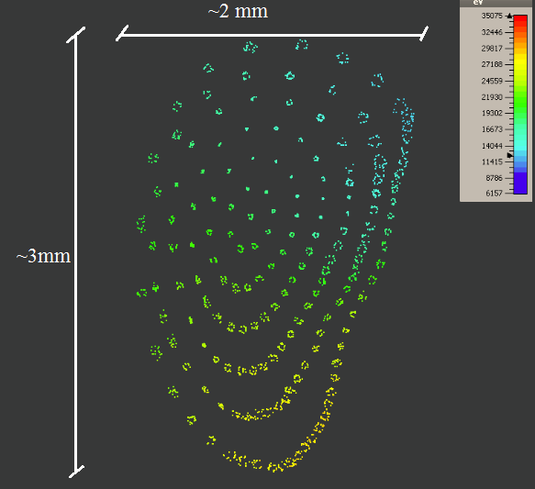
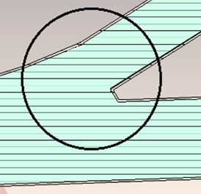
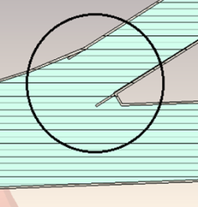
Preliminary BBLR electron studies
Effect of vacuum chamber geometry
BINP
Transverse electron profile for a 20A - 35 kV source (~1cm²). The radial energy distribution and transverse dimensions are shown for 2 different pipe geometries.
Note: statistics/meshing probably too low/large to see full dynamics.
A. Levichev, D. Nikiforov, A. Barnyakov, BINP

Slide 17
Outline
Context: electron beam applications
Brief description of electron lenses and electron beam dynamics
Mentions to some BBRL e-beam studies
Motivations and description of a test stand at CERN
Summary and outlook

Slide 18
Test facility at CERN
Foreseen for ARIES studies WP16 –
Intense, RF modulated E-beams (IRME)
  Design and build a test stand for testing this gun including instrumentation suitable for measuring the transverse and longitudinal profiles of the RF modulated electron beam
  Measure the properties of the RF modulated electron beam created by the gun using this test stand
  50x70mm oval e-beam, 5-10A, 22kV for the ion beam at the Heavy Ion Synchtron SIS18 (to be used as injector to SIS100) for Space Charge Compensation
  matched transversally and longitudinally

Slide 19
Test facility at CERN
Foreseen to test high intensity e-gun for
Beam-Beam Long Range compensation
  Few mm round e-beam, up to 20A, 20-35kV
  Modulated at 40MHz for bunch by bunch (for BMP measurements)
  Could be modulated at 4MHz (102nd HiLumi WP2 Meeting)
  Test Gas Curtain Monitor [see ref.]
If HEL becomes baseline to do at CERN (15kV)
  Characterise e-guns
  Validate, commission modulators
  Test beam instrumentation, modulators, interlocks,
  Learn safety and technical aspects of e-lenses operation
  Prepare infrastructure for test and commissioning of components of HEL@LHC

Slide 20
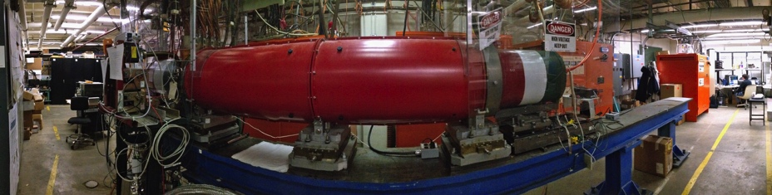
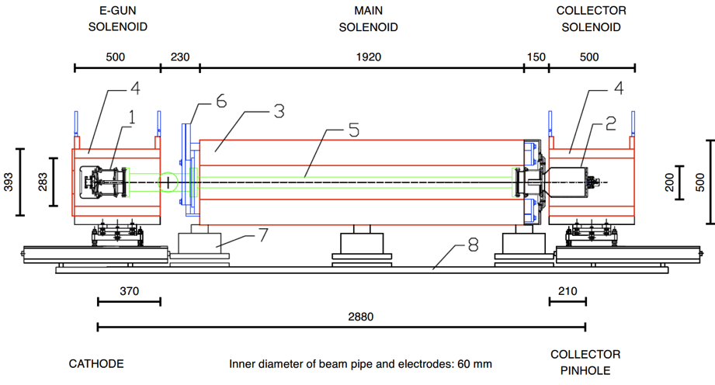
E-lens test stand at FNAL
https://cdcvs.fnal.gov/redmine/projects/elens/wiki/Test_Stand
Operational, up to 10 kV, 8μs x 1Hz pulses (or higher at < 5A)
Used to test CERN guns, will be used for testing guns for space-charge compensation at IOTA ring. Could be used to test HF modulators.

Slide 21
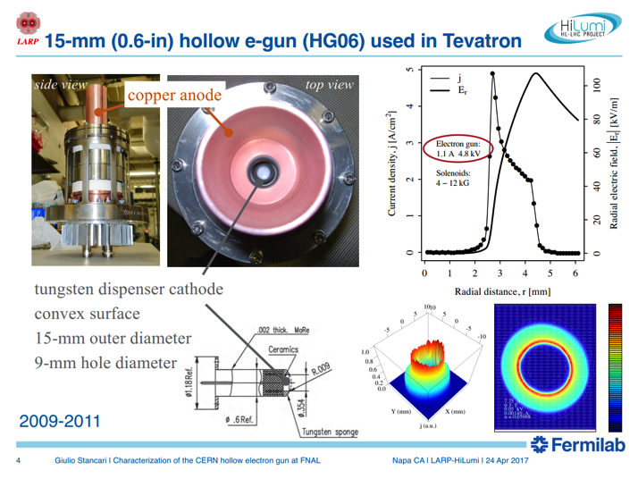
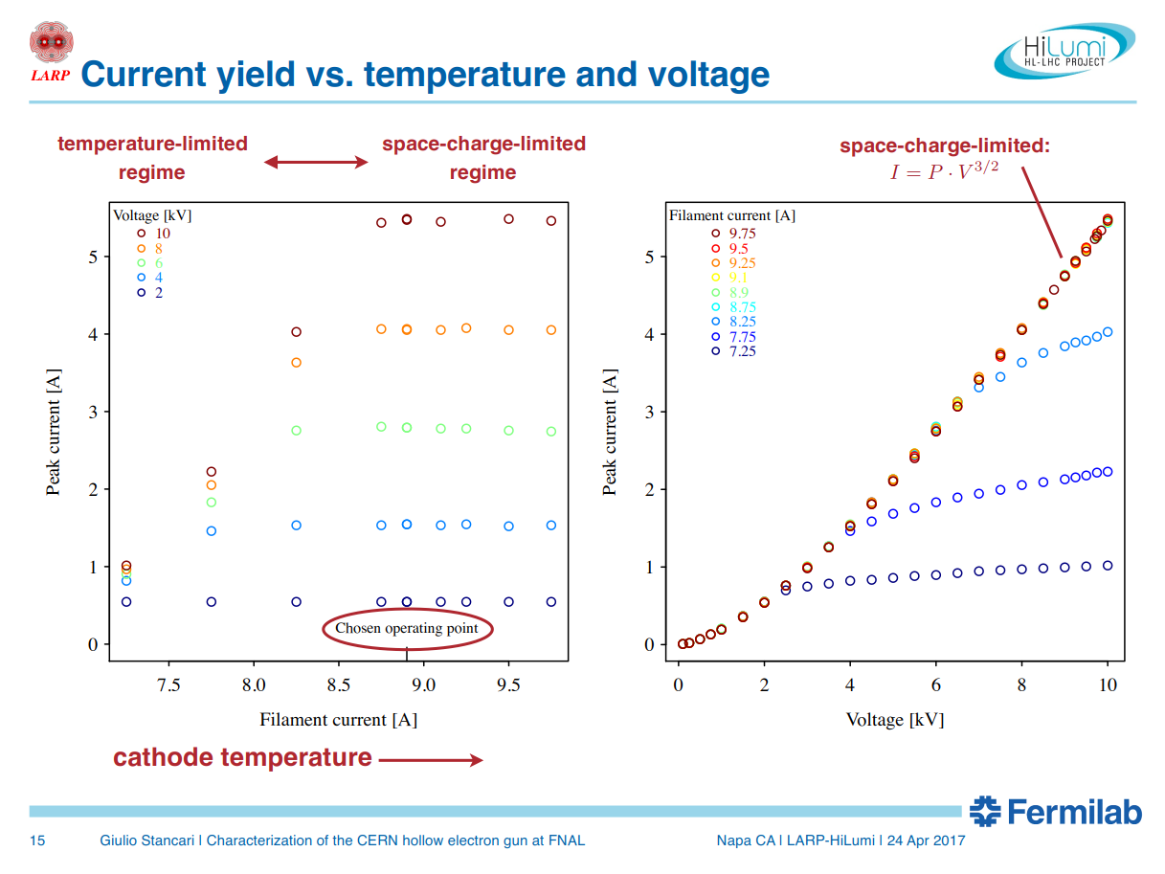
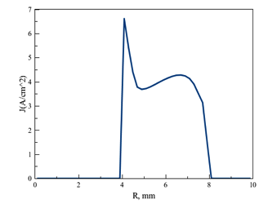
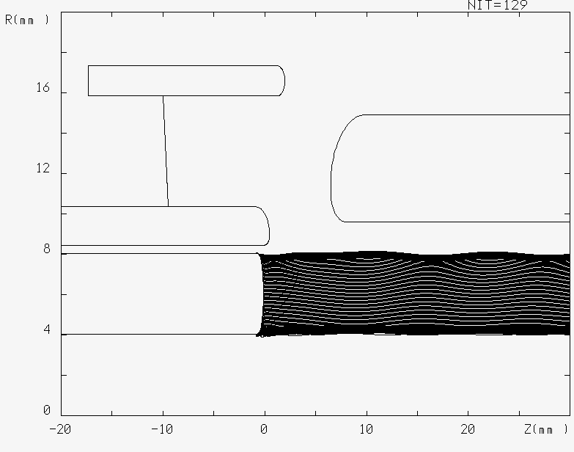
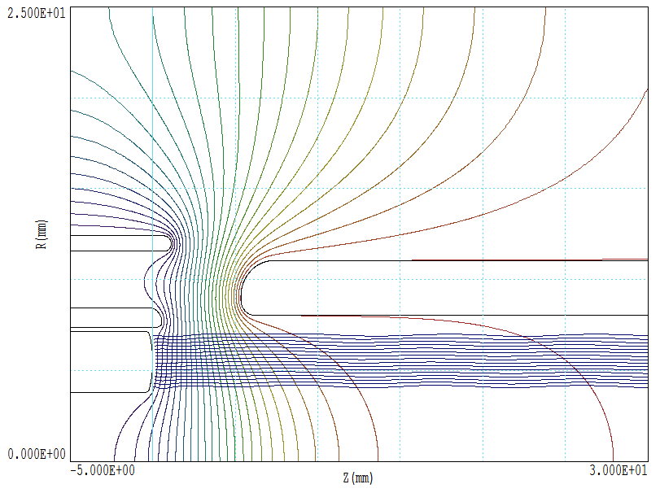
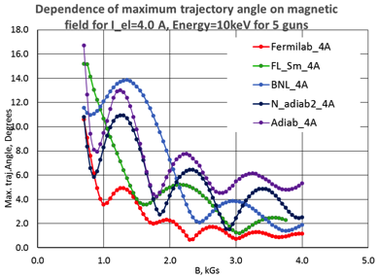
G. Stancari FNAL – WARP code
G. Stancari FNAL
A. Levichev et al. BINP – UltraSAM code
A. Pikin BNL
TRACK code
Electron gun characterisation

Slide 22
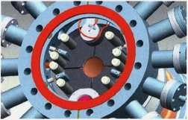
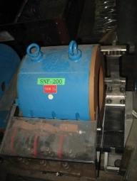
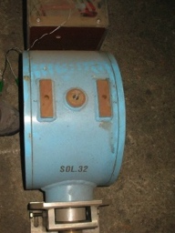
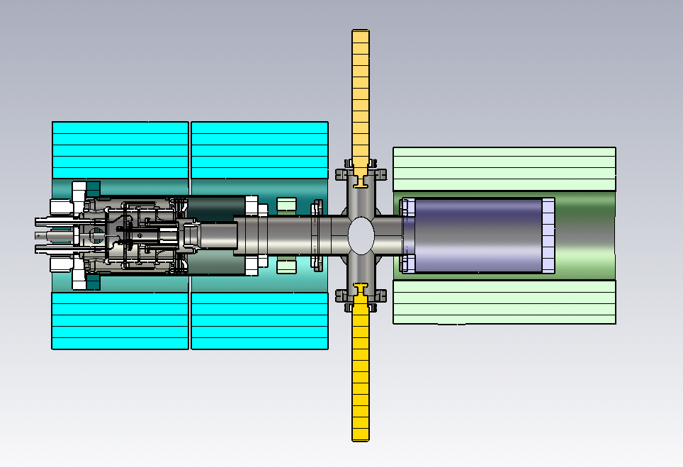
Test-stand development at CERN:
Basic configuration – stage 1
Example of diagnostic box at RHIC e-lenses
Up to 0.2T
Up to 0.42T (400A)
magnets at CERN
Purpose of this stage:
  Preparation:
    Commissioning diagnostic procedures (current, profile, position)
Commissioning HV system
Safety and technical aspects of operation
Electron gun tests: characterization & simulations
Design diagnostic box
Tests with Beam Gas Curtain monitor
Gun solenoid (twins), collector solenoid, diagnostic box (pin-hole Faraday cup with bias V [distribution and energy] + YAG screen monitor), 40 HV system.
A. Rossi, Mini-workshop on Beam-Beam Effects in Circular Colliders, 5-7 February 2018, LBL Berkeley CA

Slide 23
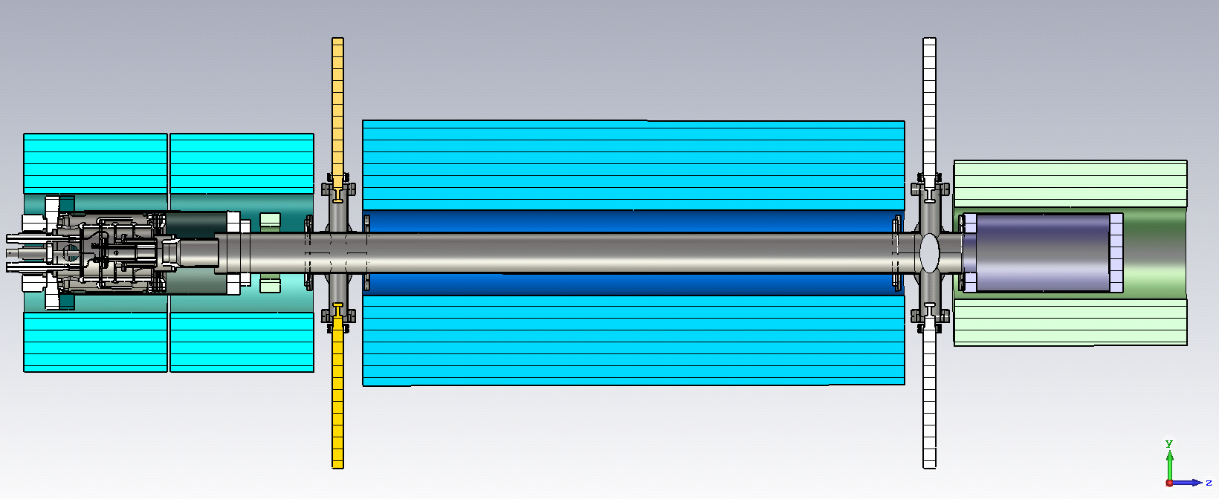
Test-stand development at CERN. Upgrade
Addition of main solenoid – stage 2
Main solenoid could be
0.4-0.5T x 1.2m or higher
(in the latter case a dry SC solenoid may be cheaper and would expand range of investigation)
Purpose of this stage:
Allow drift and see beam deformations/rotations/…
Test Beam Position Monitor ‘shoe-box’ or ‘strip-line’ with very HF modulation
Test effect of very HF modulation (~10% current) on beam dynamics (microbunching?)
Study electron beam dynamics in regime close to virtual cathode
Computer model validation
Study electron beam dynamics with compression or pushing current
A. Rossi, Mini-workshop on Beam-Beam Effects in Circular Colliders, 5-7 February 2018, LBL Berkeley CA
Notes:
For ~200 kGBP we can find a dry SC solenoid with 4T, ~240mm bore, 980mm length. 5G stray field around 500 mm Price include a cold head, compressor and lines.

Slide 24
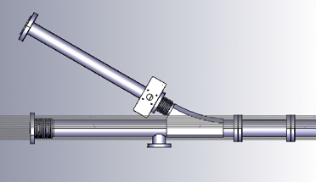
Test-stand development at CERN. The future!
Addition a bend – stage 3
Purpose of this stage:
Measure effect of B x gradB on deformation of beam with high current density
Computer model validation
A. Rossi, Mini-workshop on Beam-Beam Effects in Circular Colliders, 5-7 February 2018, LBL Berkeley CA
Notes:
For ~200 kGBP we can find a dry SC solenoid with 4T, ∅240mm bore, 980mm length. 5G stray field around 500 mm Price include a cold head, compressor and lines.

Slide 25
Summary and outlook
A test stand at CERN is being constructed in a phased approached.
Phase 1 it will be/ can be used to:
  E-gun characterisation both for HL-LHC HEL (in parallel or after FNAL) and SIS18 SCC lens.
  E-guns for BBLR compensation lenses.
  Test and commission BGC [see ref.]
Phase 2 needed to:
  Test RF modulation for SIS18 SCC lens.
  Test BPM for electrons (HF or LF modulation).
  Investigate electron beam dynamics and benchmark simulation codes like CST, WARP, UltraSAM, …

Slide 26
Thank you for your attention
References for Beam Gas Curtain (or Jet) monitor:
H. Zhang et al, DEVELOPMENT OF A SUPERSONIC GAS JET BEAM PROFILE MONITOR, IBIC2015
V. Tzoganis et al, EXPERIMENTAL RESULTS OF A GAS JET BASED BEAM PROFILE MONITOR, IPAC14
V. Tzoganis et al, Design and first operation of a supersonic gas jet based beam profile monitor,
Phys. Rev. Accel. Beams 20, 062801, 12 June 2017

Slide 27
Spare slides

Slide 28
Hollow Electron Lens
Electron gun 5Ax15-20kV
Collector
V_{CA}
cathode
grid
anode
+
–
+
–
+
–
Cathode
Heater
10Ax40V
Control electrode
4kVx40mA
V_{CA}≤20kV, I_{anode}
33kHz,
200ns rise time
V_{CO}
Anode modulator
Anode/grid modulator 40MHz
– +
Cathode –
Collector
PC
–
+
High voltage (~15kV)
High current
V_{CA}-V_{CO}, I_{beam}=5A
Cathode
PC
High voltage (15-20kV)
low current (losses)
V_{CA}, I_{tube}

Slide 29
Electron Lens schematics (typical values)
Electron gun (A)
Modulator (KHz to MHz)
Collector
Main SC solenoid 4-6 T
Gun solenoid > 0.2T
Bending SC solenoids ~3T

Slide 30
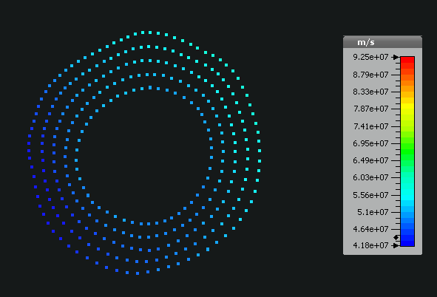
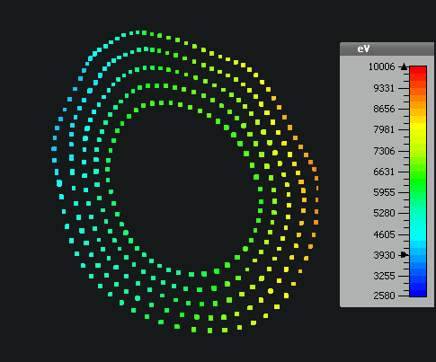
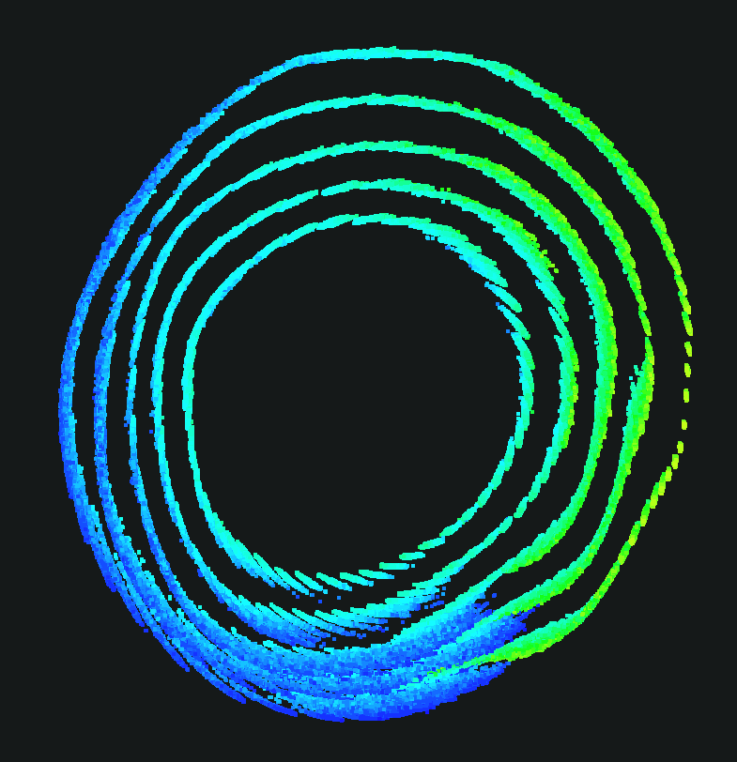
Effect of drift velocity
BINP
CST simulation of a 5A beam x 12kV deforming along the HEL (BINP) in 4T solenoid
Space charge dominates and deteriorates beam shape over 3 m
A.Levichev, D.Nikiforov, A.Barnyakov, M. Maltseva , BINP

Slide 31
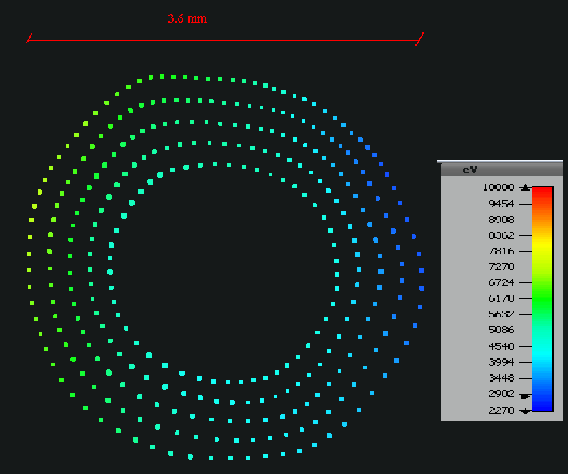
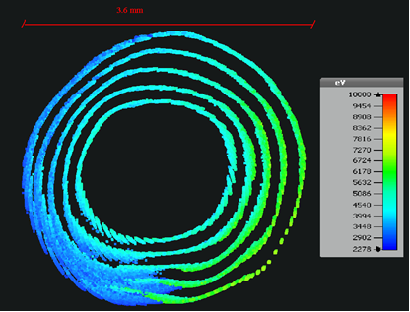
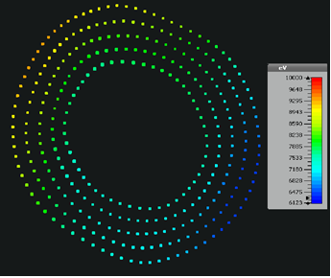
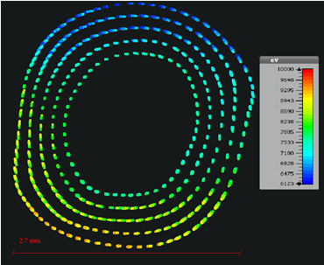
Effect of larger e-beam potential and B
BINP
(I=4 A, U₀=10 kV) Beam profiles close to the beginning (left) of the main solenoid (4T) and the end (right)
(I=4 A, U₀=12 kV) Beam profiles close to the beginning (left) of the main solenoid (6T) and the end (right)
Higher B = lower rotation velocity
Higher accelerating potential (larger than the perveance limit) helps.
Larger main solenoid magnetic field stabilises the e-beam further.
A.Levichev, D.Nikiforov, A.Barnyakov, M. Maltseva , BINP

Slide 32
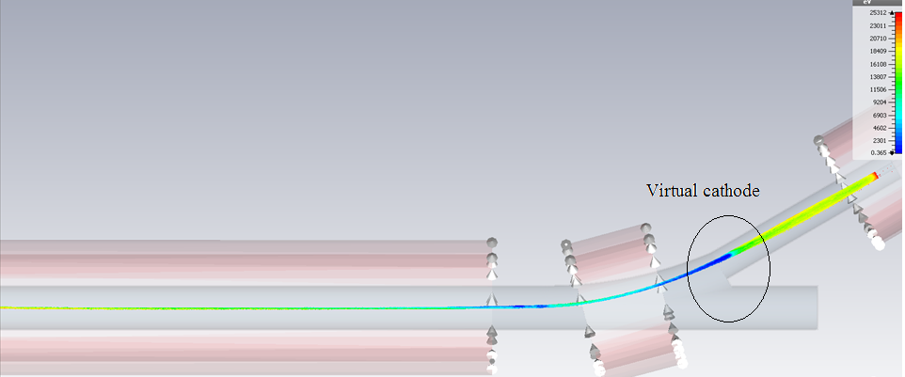
BBLR electron studies
Beam dynamics I=20 A, V=10 kV
BINP
A. Levichev, D. Nikiforov, A. Barnyakov, BINP

Slide 33
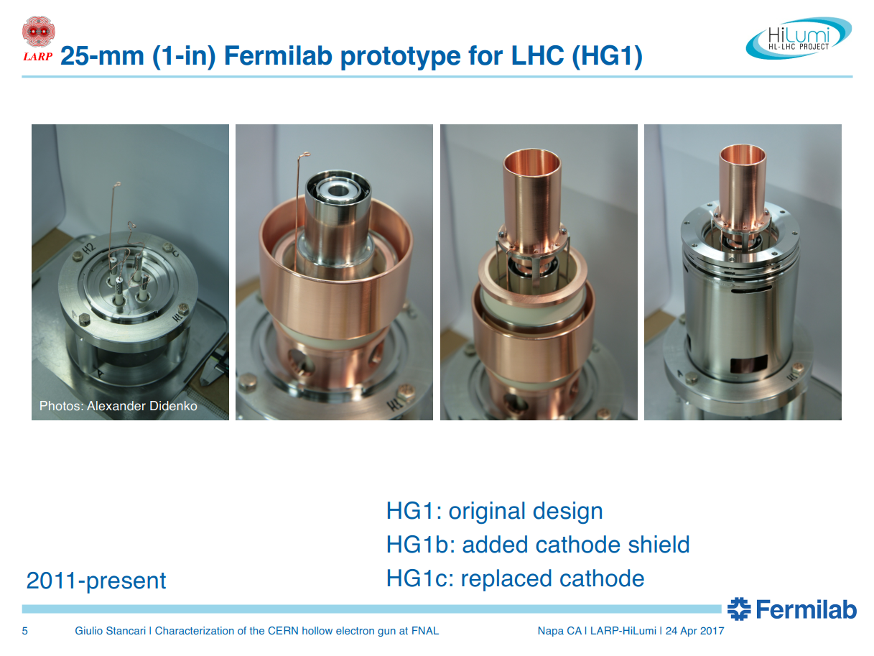

Slide 34
Existing electron lenses and HL-LHC hollow electron lenses
O. Brüning, Chamonix LHC Performance Workshop 2018

