Slide 1

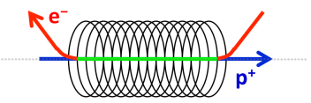
The RHIC electron lenses - technology and e-beam measurements
Xiaofeng. Gu, W. Fischer, Z. Altinbas, M. Anerella, E. Bajon, M. Bannon, D. Bruno, M. Costanzo, Drees, D. M. Gassner, R. C. Gupta, J. Hock, M. Harvey, A. K. Jain, J. P. Jamilkowski, P. Kankiya, R. Lambiase, C. Liu, Y. Luo, M. Mapes, A. Marusic, C. Mi, R. Michnoff, T. A. Miller, M. Minty, S. Nemesure, W. Ng, D. Phillips, A. I. Pikin, P. J. Rosas, G. Robert-Demolaize, T. Samms, J. Sandberg, V. Schoefer, T. C. Shrey, Y. Tan, R. Than, C. Theisen, P. Thieberger, J. Tuozzolo, P. Wanderer, and W. Zhang
Thank the Committee for invitation!
February. 05 ~ February. 07, 2018
The ICFA Mini-Workshop on Beam-Beam Effects in Circular Colliders

Slide 2
Outline
Introduction
Technology
e-beam Measurement
Summary

Slide 3
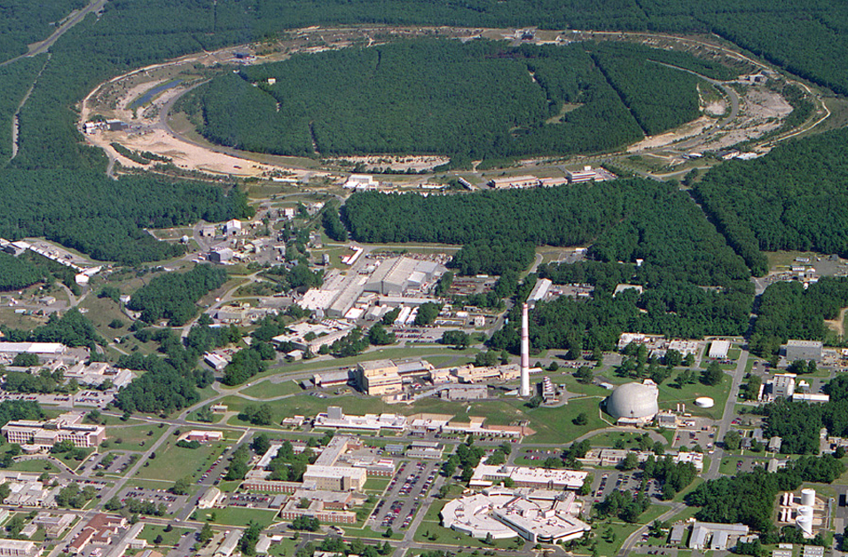
RHIC – a High Luminosity (Polarized) Hadron Collider
E-lens
10:00 o’clock
RHIC
LEReC 2:00 o’clock
PHENIX
8:00 o’clock
STAR
6:00 o’clock

Slide 4
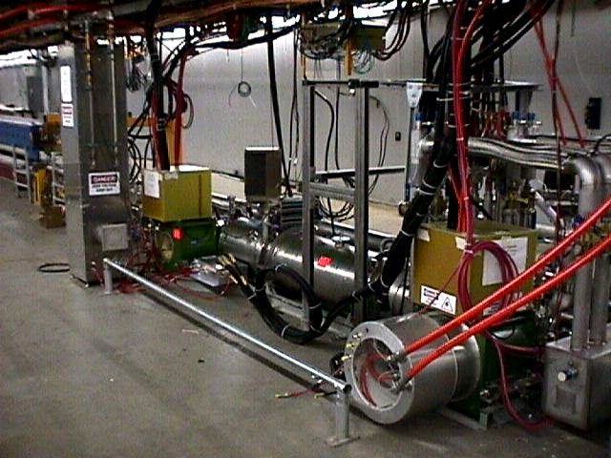
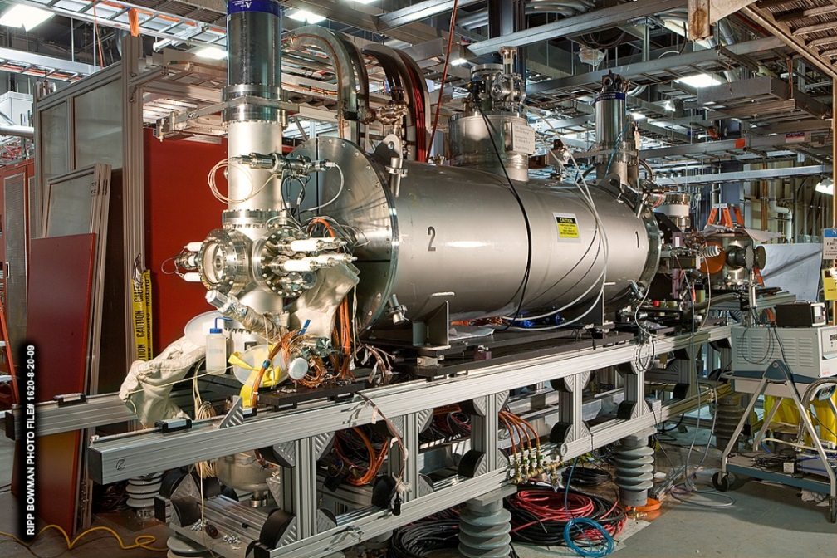
Introduction -- Technology
Fermilab Tevatron E-lens
BNL Electron Beam Ion Source
V. Shiltsev, A. Burov, A. Valishev,
G. Stancari, X.-L. Zhang, et al.
2 lenses in Tevatron:
Solenoid field 6 T
Solenoid length 2.7 m
e-beam energy 5/10 kV
e-beam current 0.6/3 A (pulsed)
J. Alessi, E. Beebe, D. Raparia,
M. Okamura, A. Pikin et al.
Ion source for RHIC:
Solenoid field 5 T
Solenoid length 2 m
e-beam energy 20 kV
e-beam current 10 A (pulsed)
RHIC e-lens
6 T (±50 μm straight)
2 m
10 kV
1 A (pulsed&DC)

Slide 5
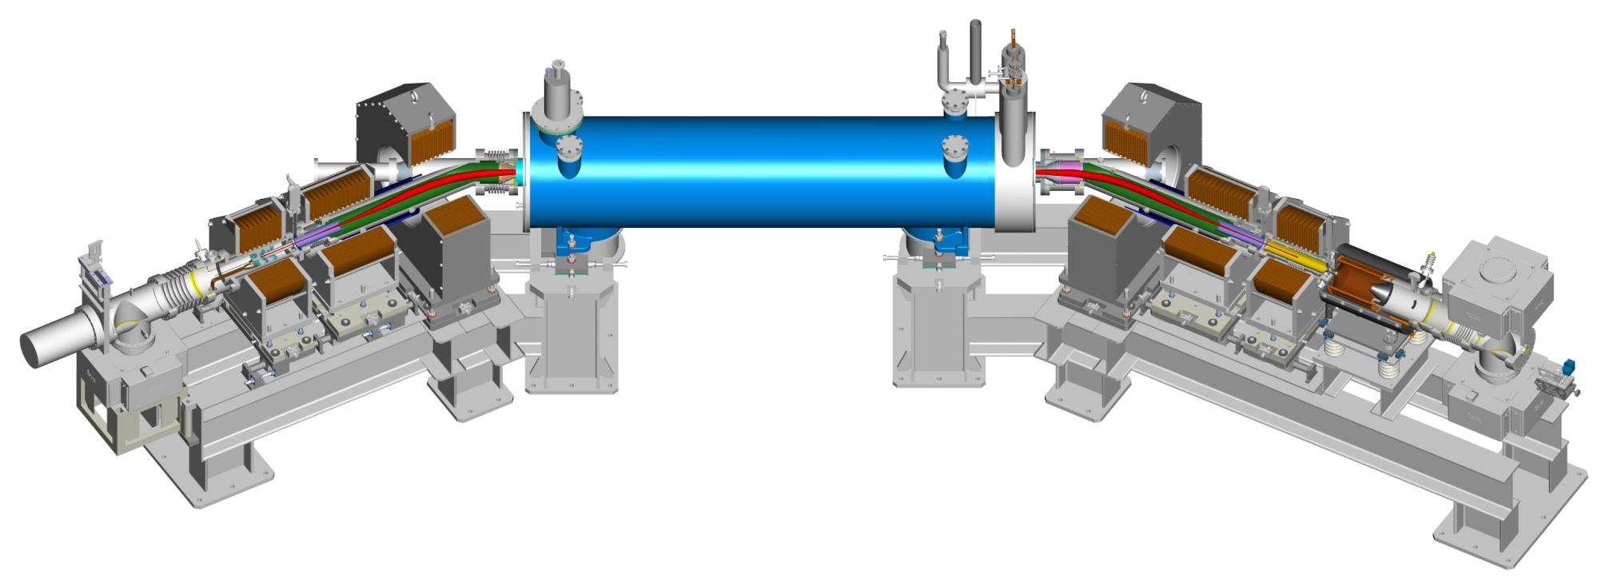
Introduction –One E-lens Layout
SC main solenoid
B = 6 T, I = 440 A
+ 16 more magnets
(fringe fields, correctors)
warm solenoids
warm solenoids
p
p
e⁻
orbit steerers
orbit steerers
e⁻
e⁻
Gaussian Beam
1A DC current
78 kHz pulsed beam
5~10 keV
Features:
Independent beam size control
Transvers beam position control
electron gun
electron collector
[Wolfram Fischer et al., Phys. Rev. Accel. Beams 20, 091001, 2017]
[Wolfram Fischer et al., PRL 115, 264801 (2015)]

Slide 6
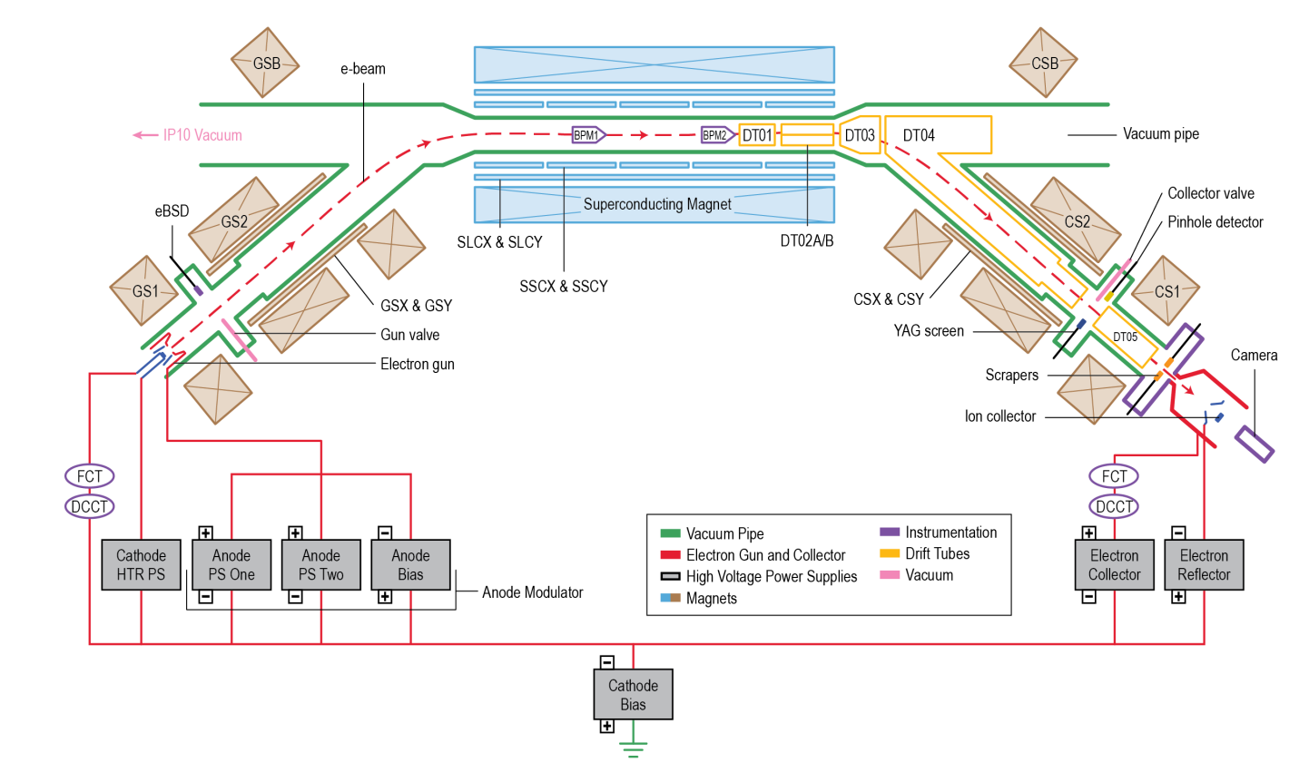
Introduction – Instrumentation and Beam control
BPM (e & p)
eBSD Detector
Anode Voltage M
YAG screen
Collector & Sensor
CTs
Ion Collector
Drift Tubes
Cathode profile->Beam profile
Anode Voltage->Beam Current
Cathode Bias-> Beam Energy
GSX&Y>Beam Position
SLCX&Y>Beam Angle
GS1/Solenoid-> Beam Size
[Xiaofeng Gu et al., Phys. Rev. Accel. Beams 20, 023501, 2017]

Slide 7
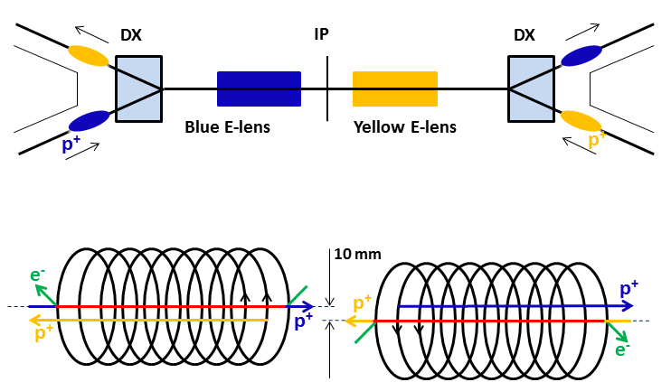
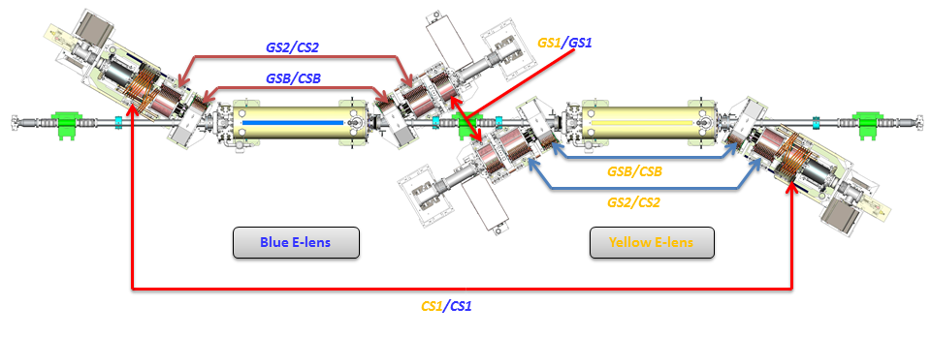
Introduction – Two Lenses Layout
Top view
Side view
−6 T
+6 T

Slide 8
Outline
Introduction
Technology
e-beam Measurement
Summary

Slide 9
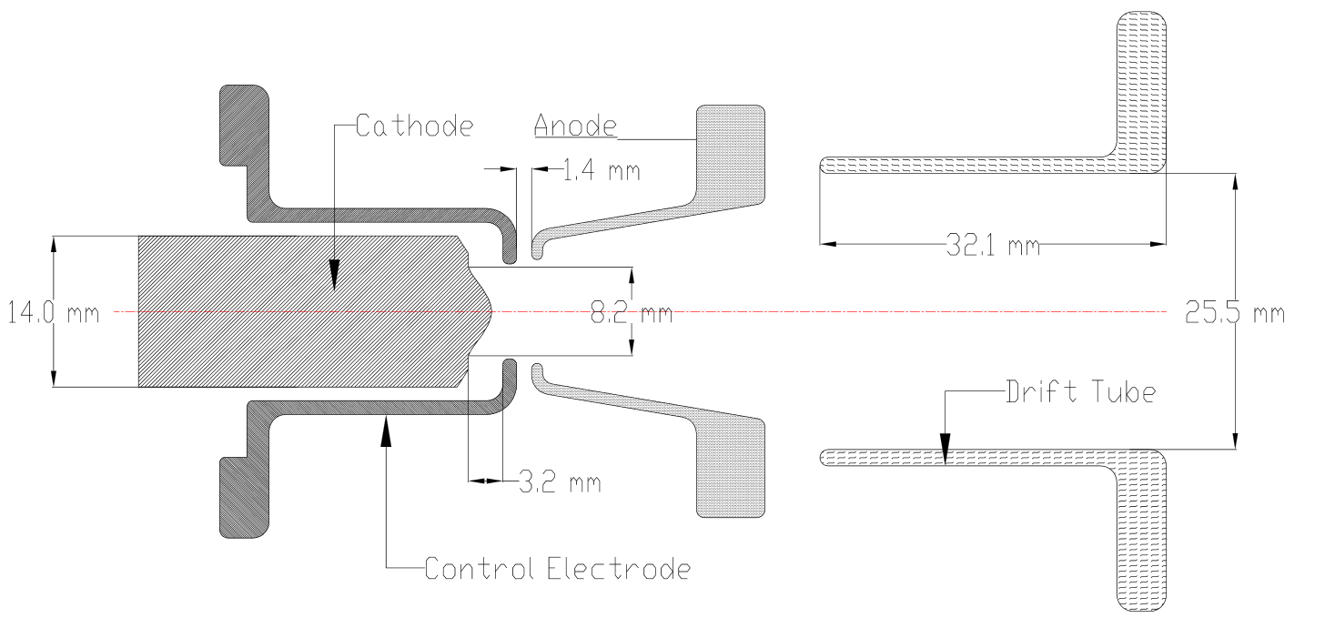
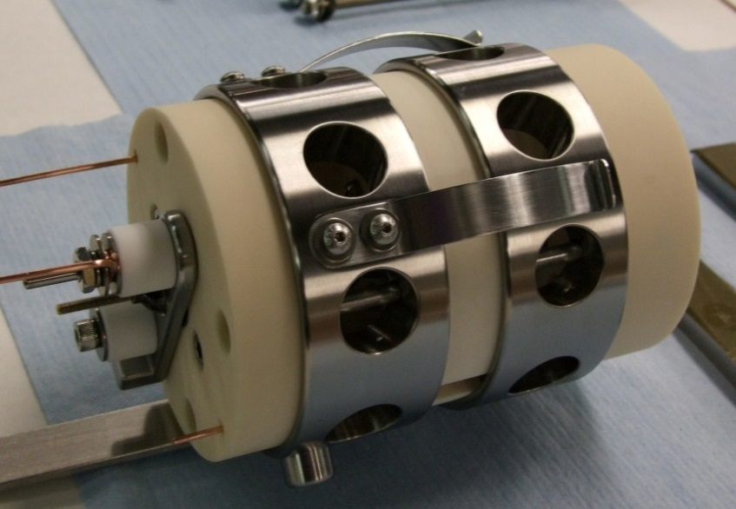
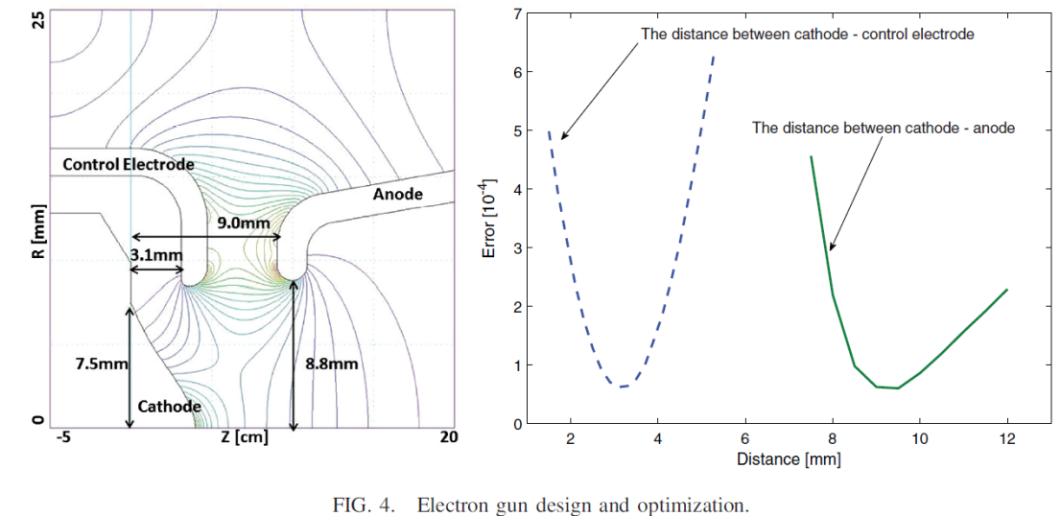
E-gun Design for 100GeV and 250GeV Proton
100GeV
Cathode
Anode
Control electrode
Drift tube
Thermal cathode
IrCe (above) and Tungsten (below)
Minimize error between simulated profile and Gaussian Profile
250GeV
[Xiaofeng Gu et al., NIMA, Volume 743 (2014)]

Slide 10
E-gun Simulation With Model
Cathode Profile
The electron beam has to have Gaussian profile with r/σ≈3: overlapping the proton beam .
Courtesy of A.I. Pikin

Slide 11
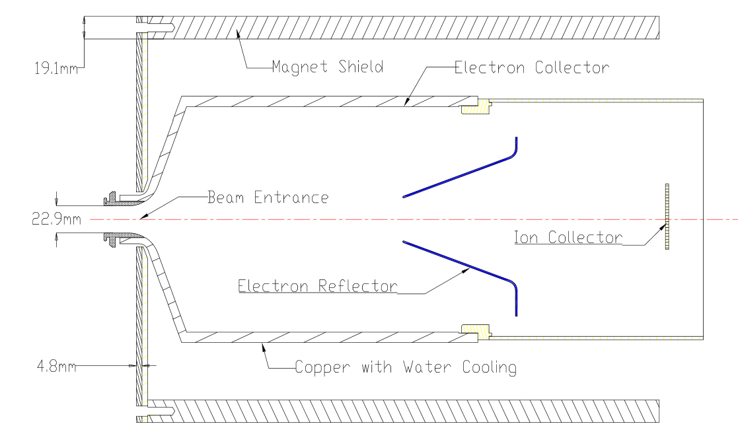
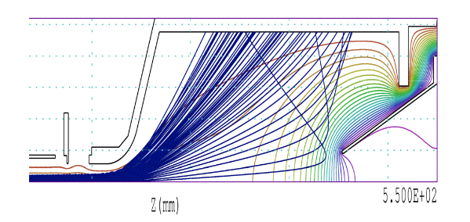
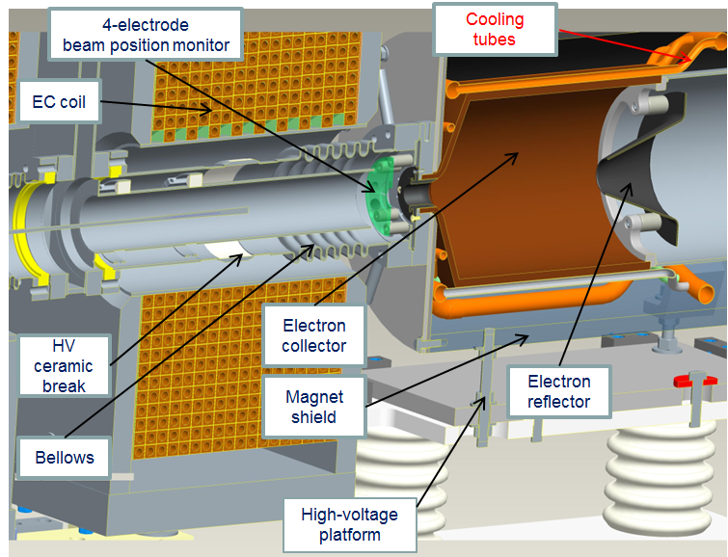
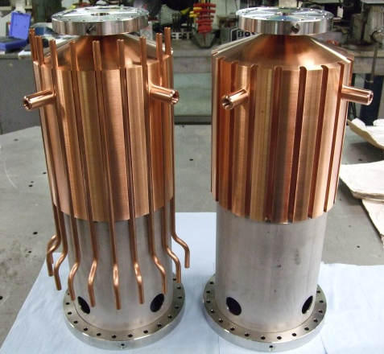
Collector Design
Collector
Reflector (open path for camera)
Ion collector (movable)
Water cooling
Magnetic shield
Yellow E-lens
8 RTD
[Xiaofeng Gu et al., NIMA, Volume 743 (2014)]

Slide 12
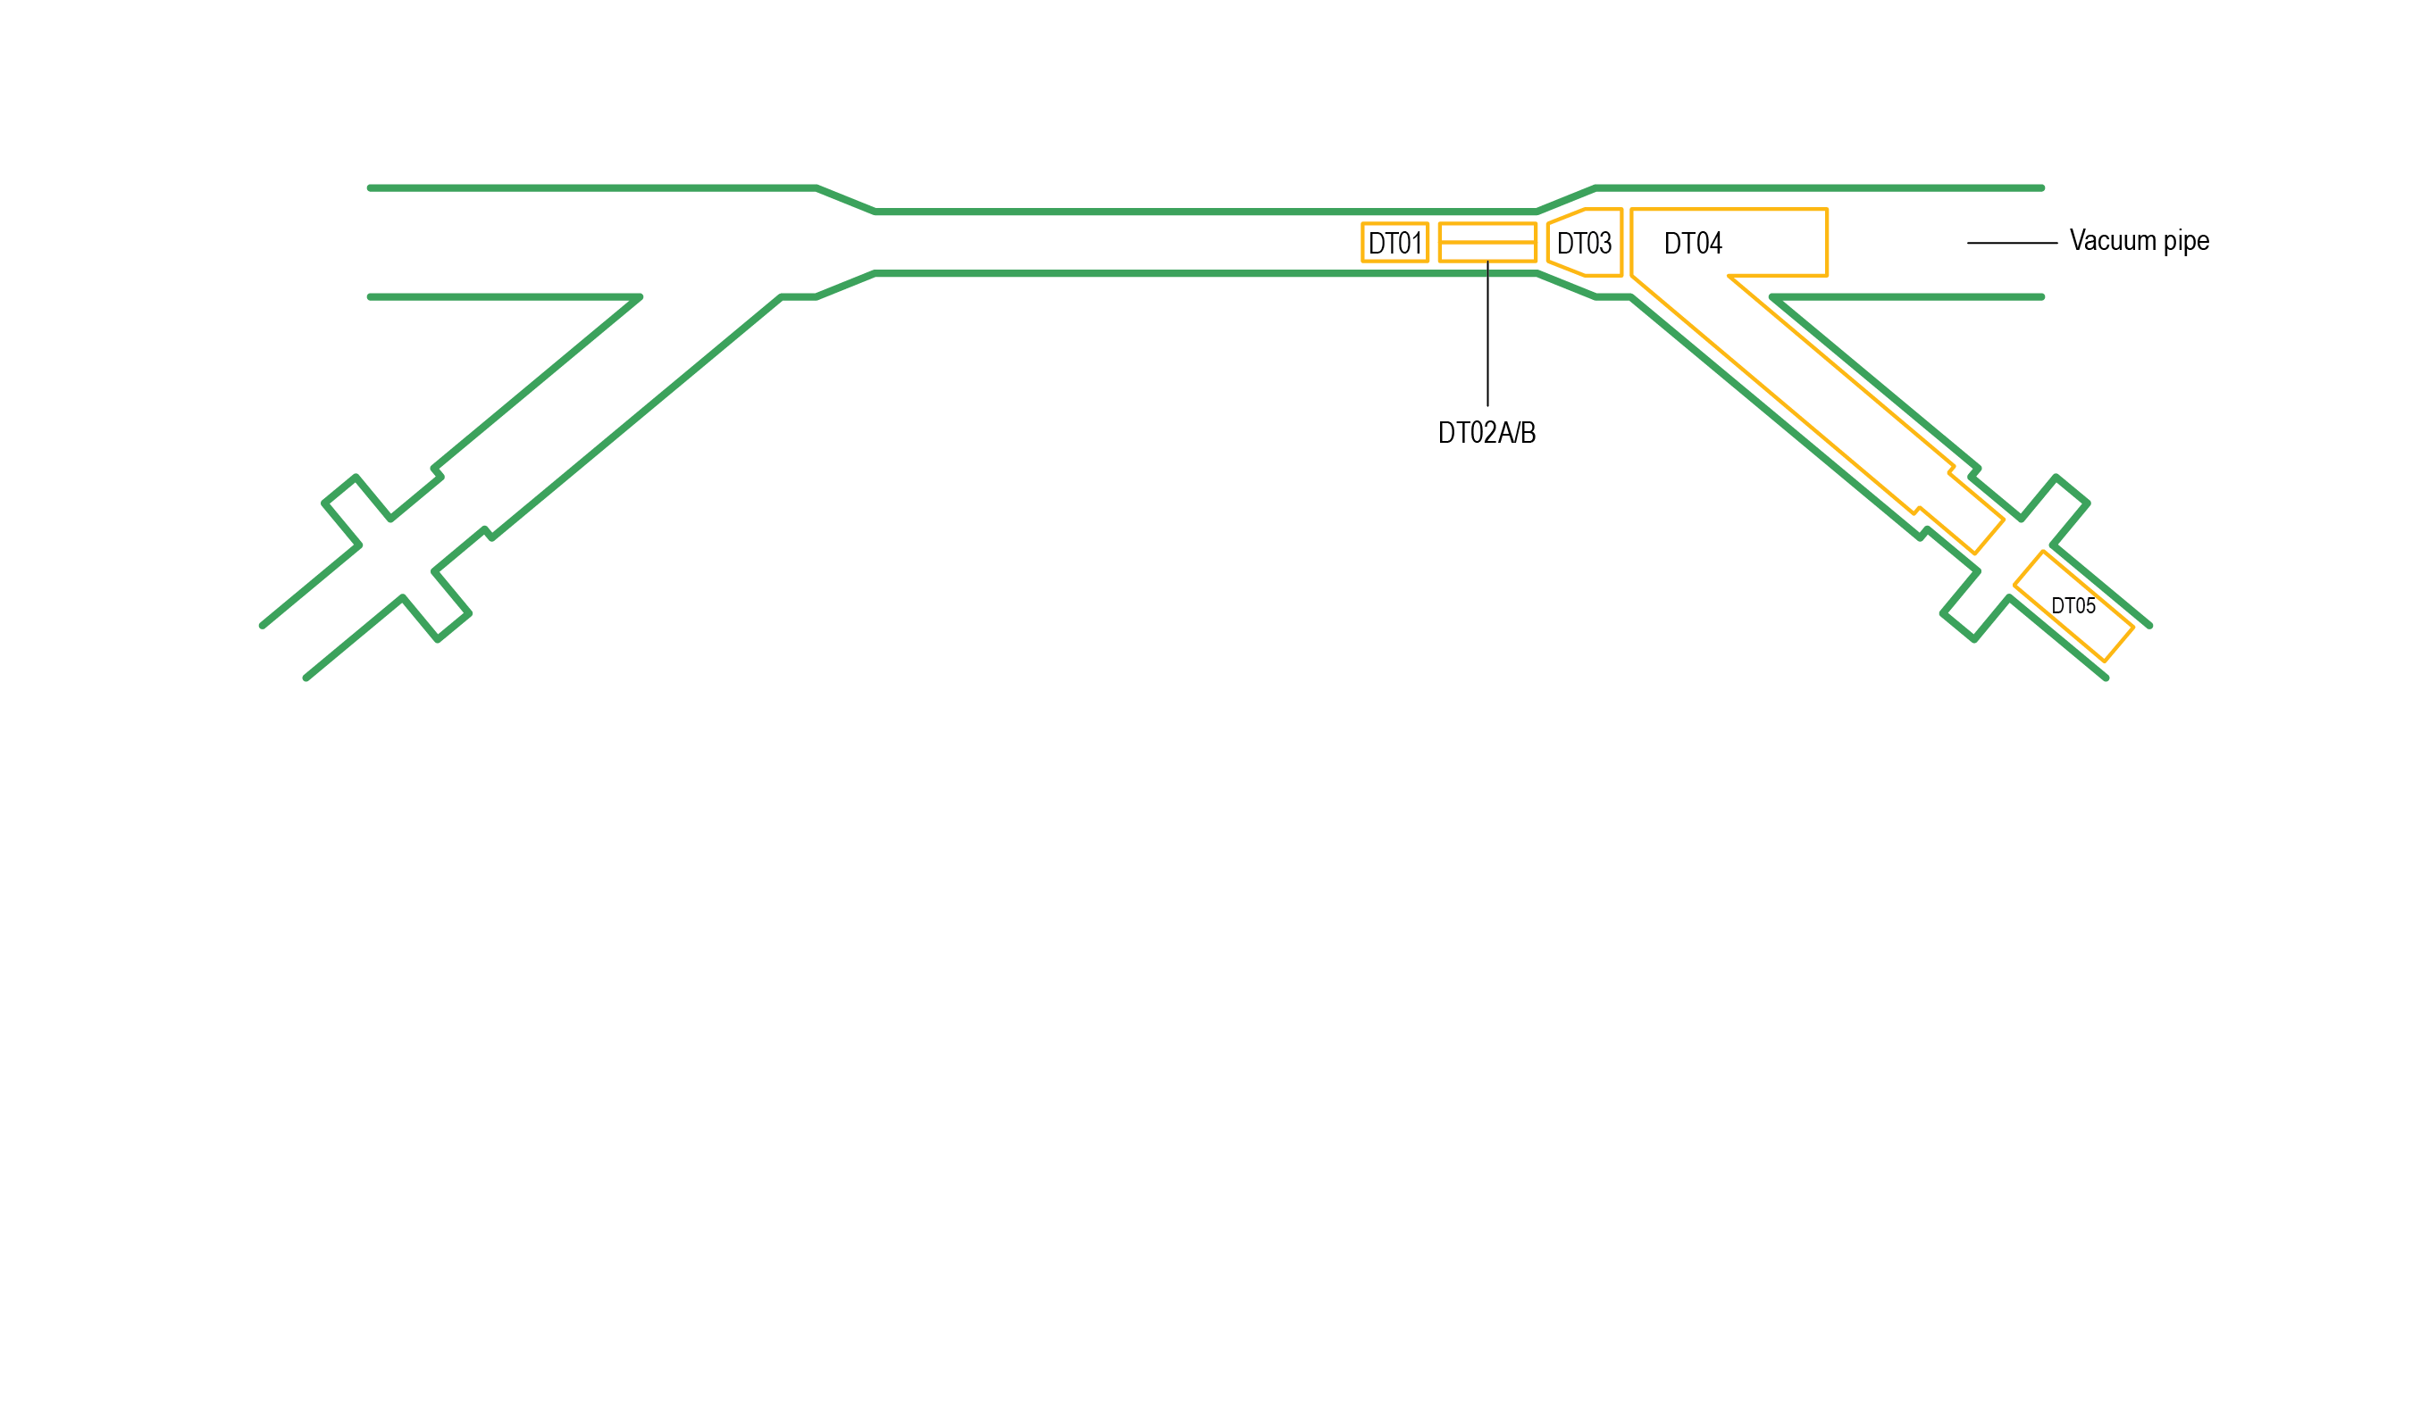
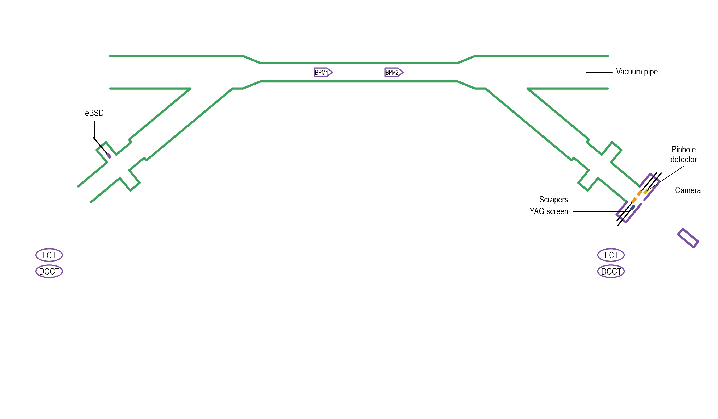
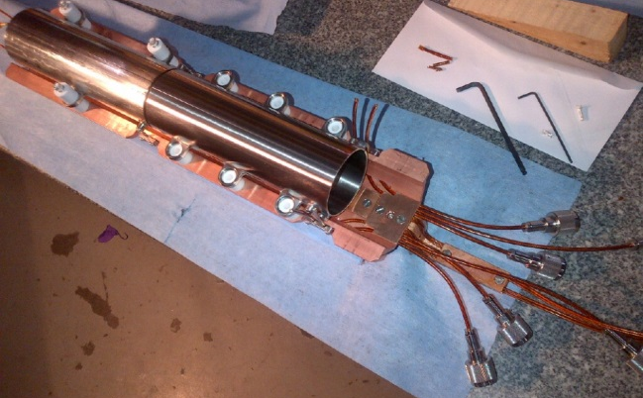
Instrumentation System
BPM
E-Beam Instrumentation System
Beam Alignment : BPM (2) (also for p-beam), Backscattered electron monitor(1)
E-beam Current : BCT (4), e-beam Loss (drift tubes)
E-beam Profile : YAG Screen (1), Pin-hole detector (1)
Ion Current : Ion collector (1)
Collector Temperature: RTD (8)
[Toby Miller et al., IBIC2014 mopf08]

Slide 13
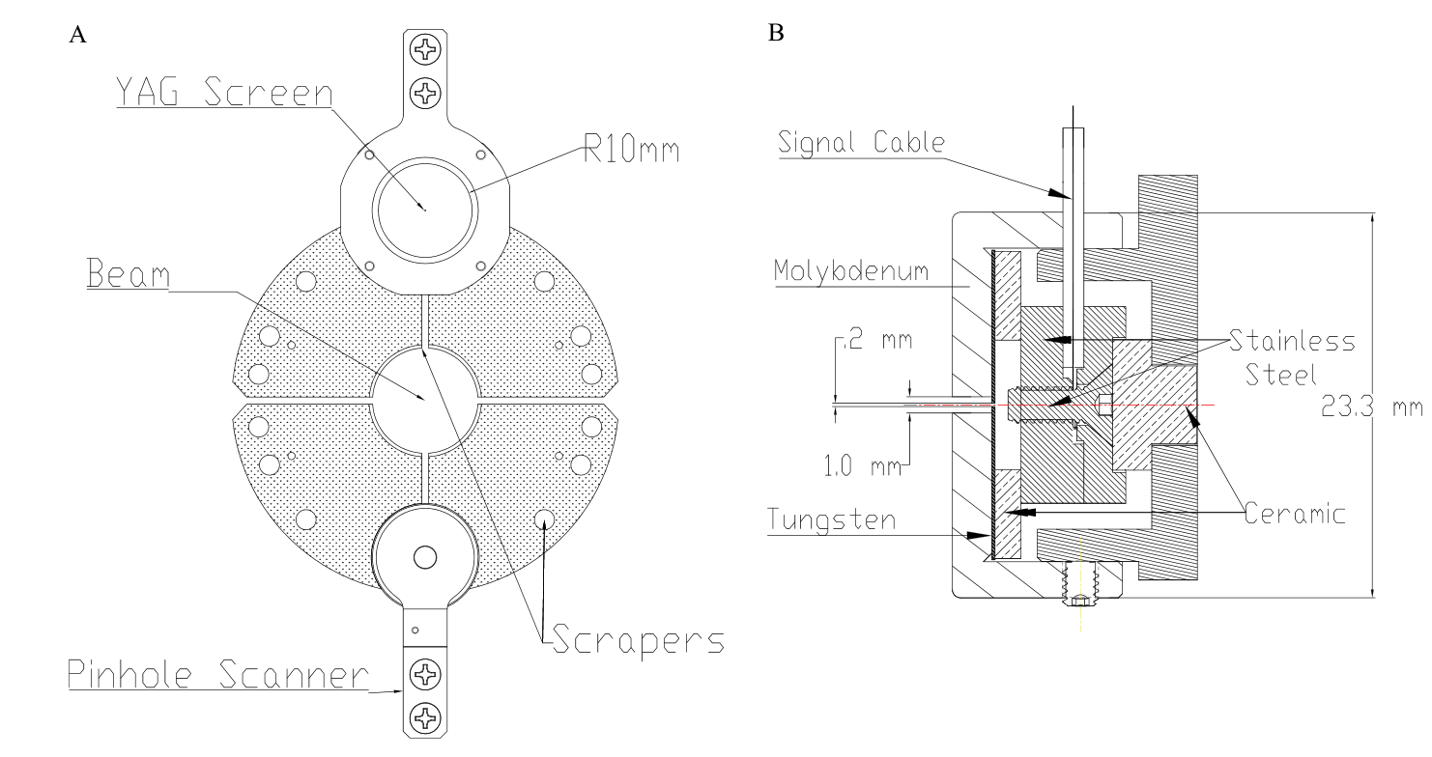
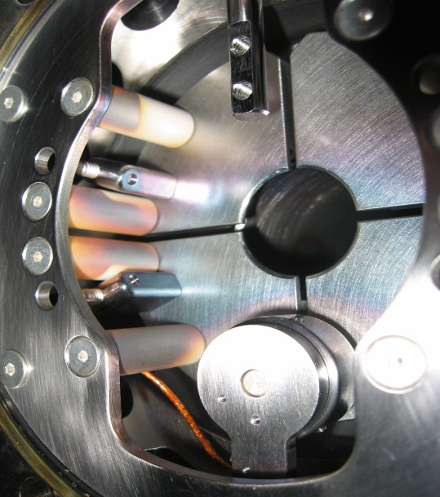
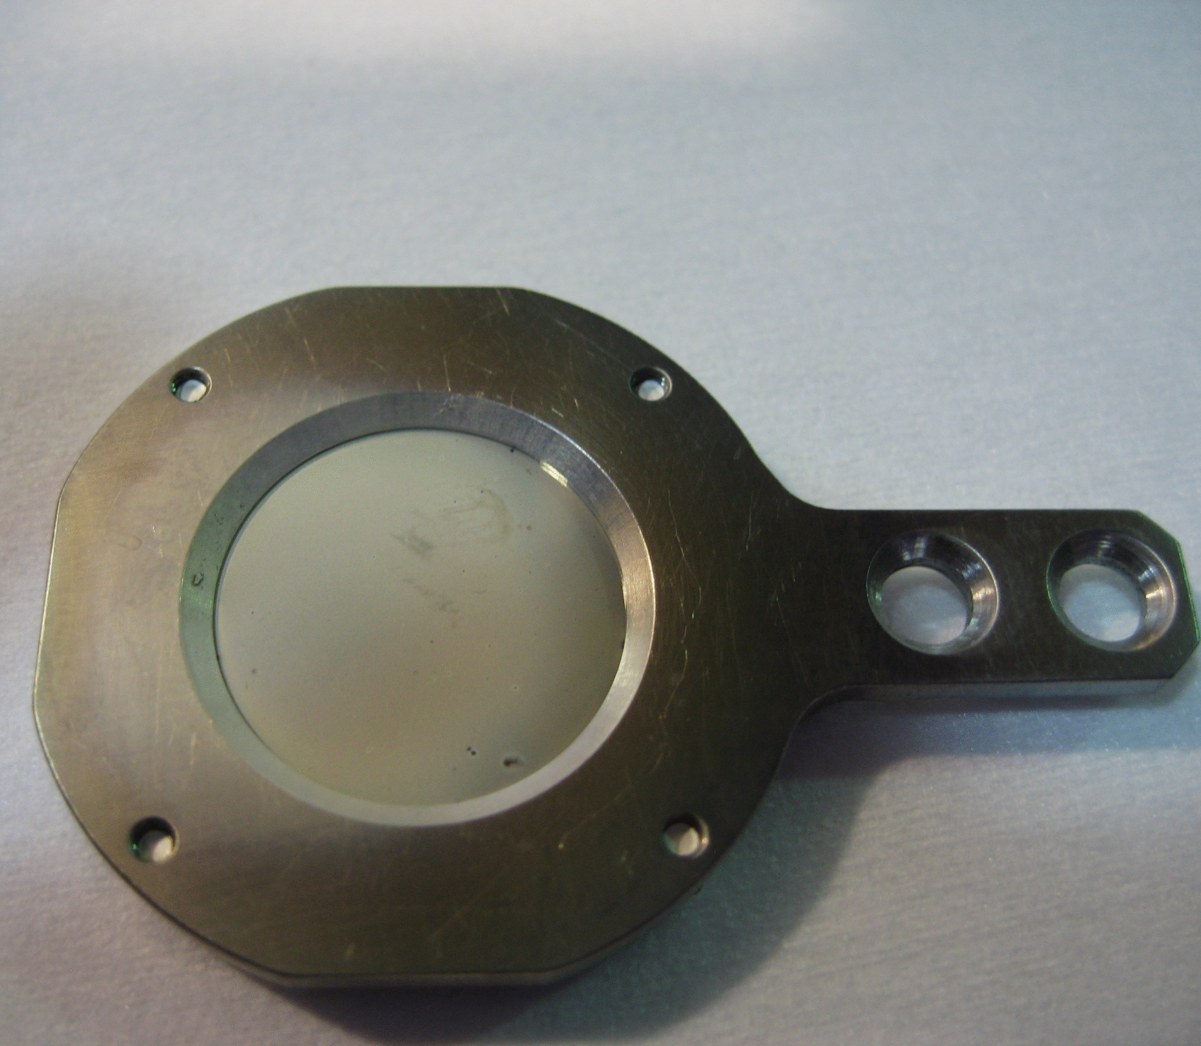
YAG, Pinhole and Scrapers
Scrapers (alignment to collector)
YAG screen
Pinhole Scanner
Collector potential > 0
Yellow E-lens
[Xiaofeng Gu et al., NIMA, Volume 743 (2014)]

Slide 14
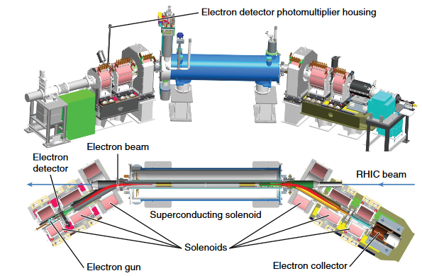
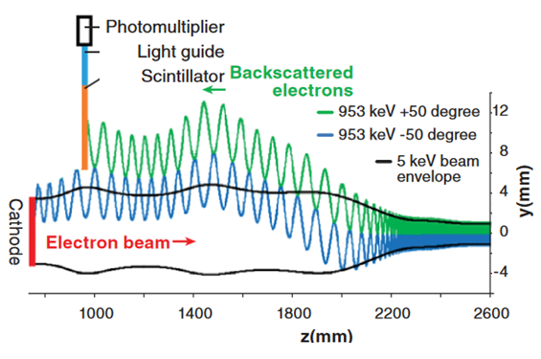
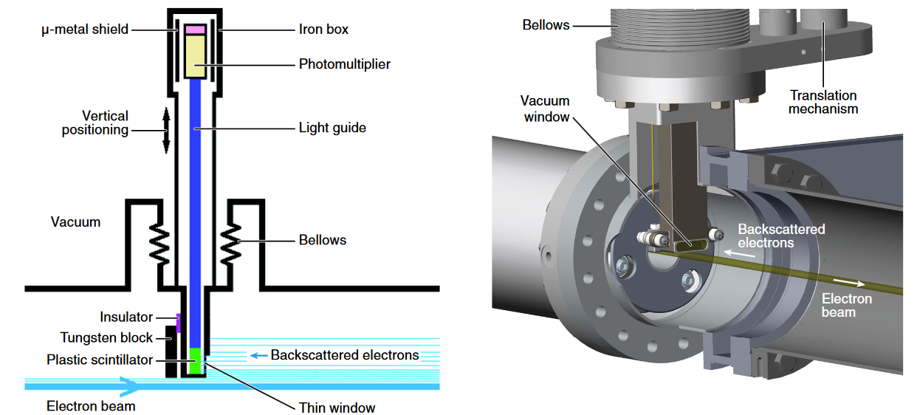
Electron beam backscattering detector (eBSD)
Solenoid #1 In tunnel
Yellow E-lens
[Peter Thieberger et al., Phys. Rev. Accel. Beams 19, 041002, 2016]

Slide 15
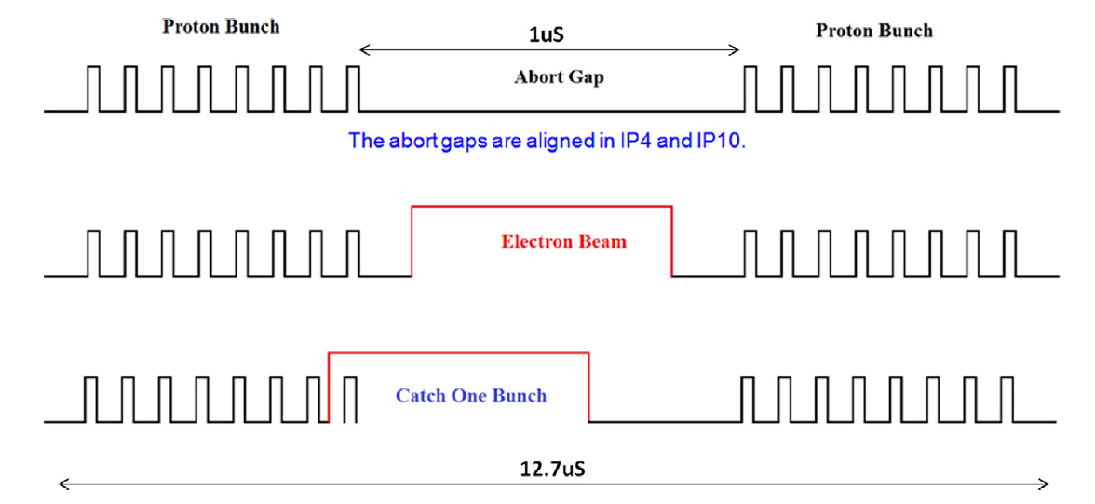
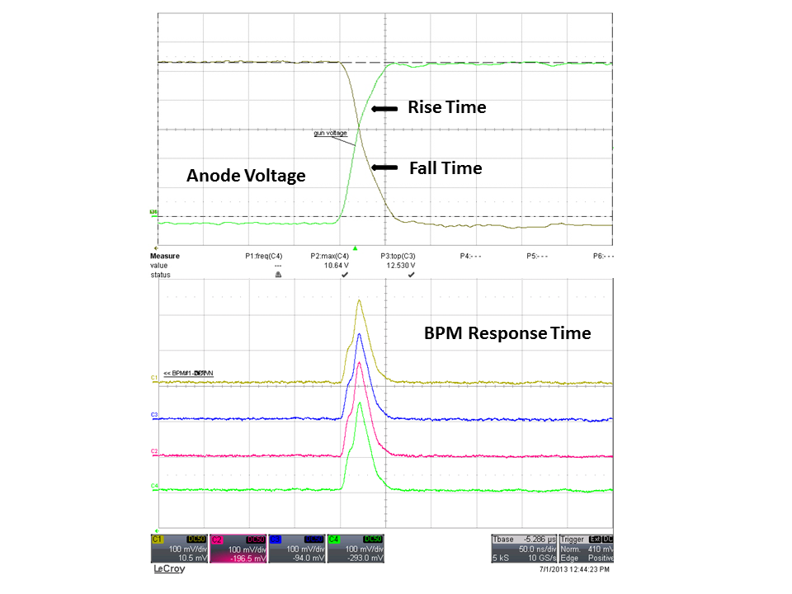
Timing and modulator design
RHIC Beam: 360 bucket, 111 bunches, 1 bunch occupies 3 bucket; 30 empty bucket for beam abort gap; the last bunch bucket number is 331;
DC mode: The electron beam is always ON. DC mode is used for beam-beam compensation operation;
Parasitic mode: the electron beam can be run within RHIC beam abort gap during physics store, from 2 Hz to 78 kHz. That means more hardware commissioning time for e-lens.
Pulse mode: When there is NO RHIC beam, the pulse mode electron beam pulse length can be changed up to 500 mS.
100nS
50nS
Yellow E-lens
[Yugang Tan et al., DOI: 10.1109/PPC.2013.6627405

Slide 16
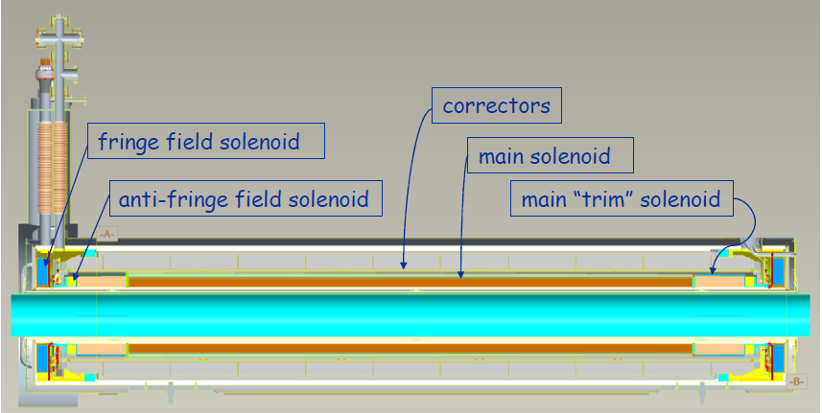
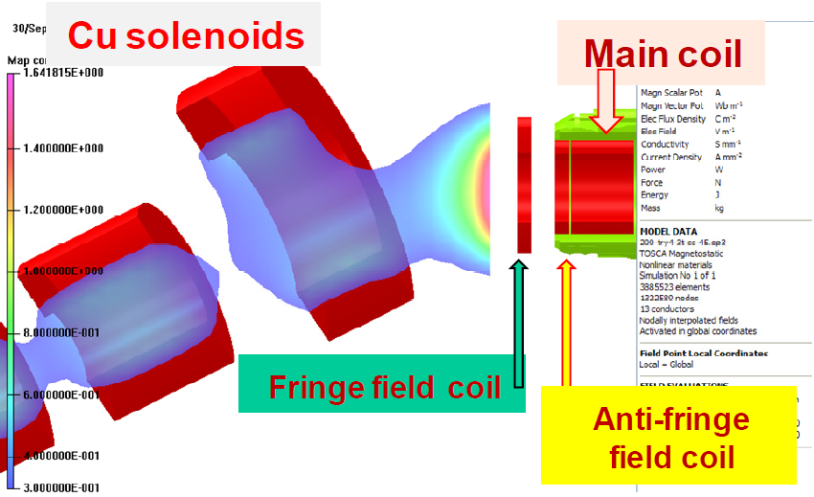
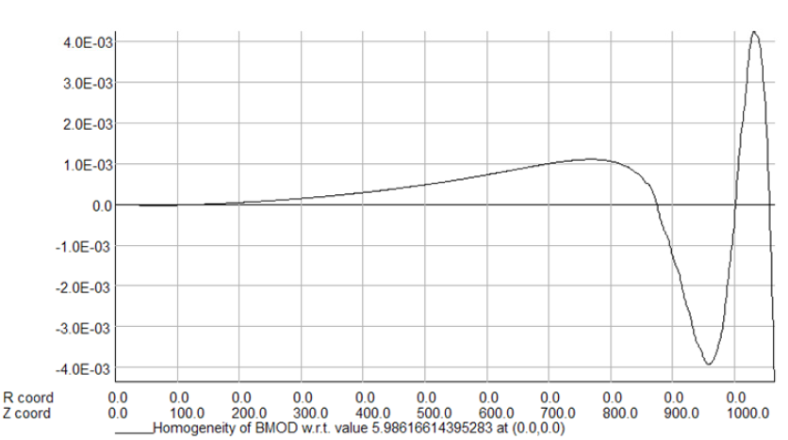
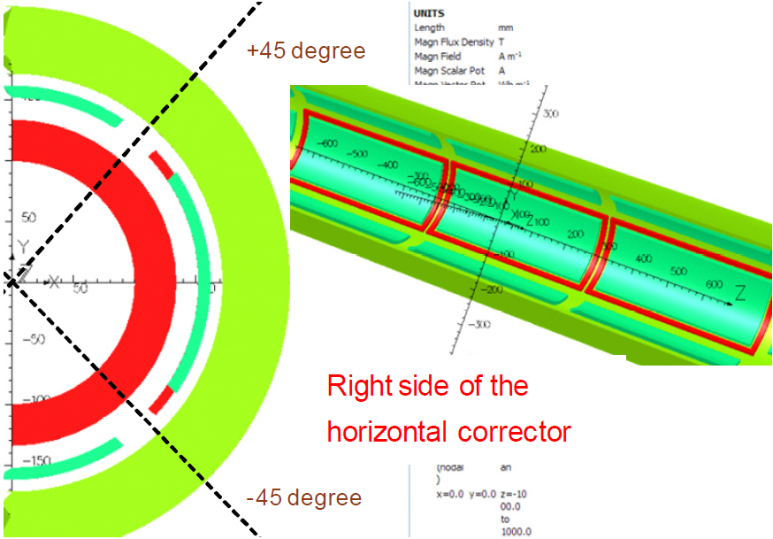
Superconducting Solenoid Design
6T field
Field straightness (10 short correctors)
Angle correctors (2)
2.8 m long total
Fringe solenoid
[Ramesh Gupta et al., PAC2011 pp. 1130-1132]

Slide 17
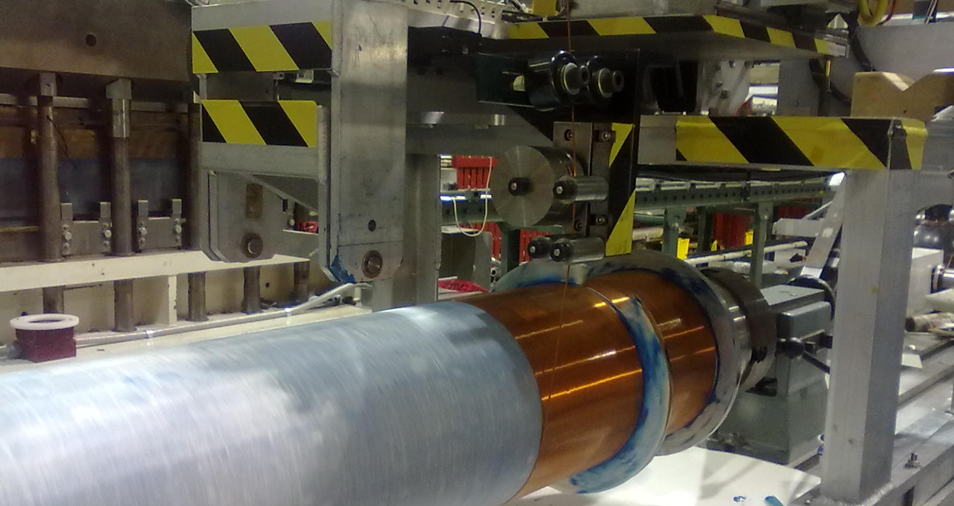
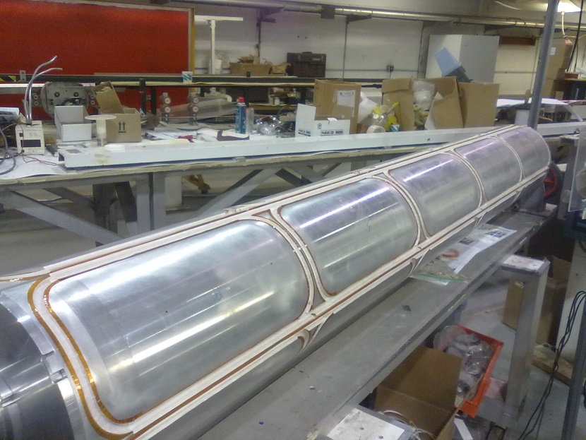
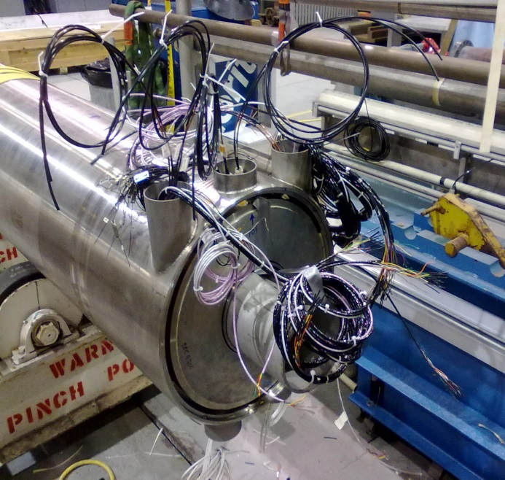
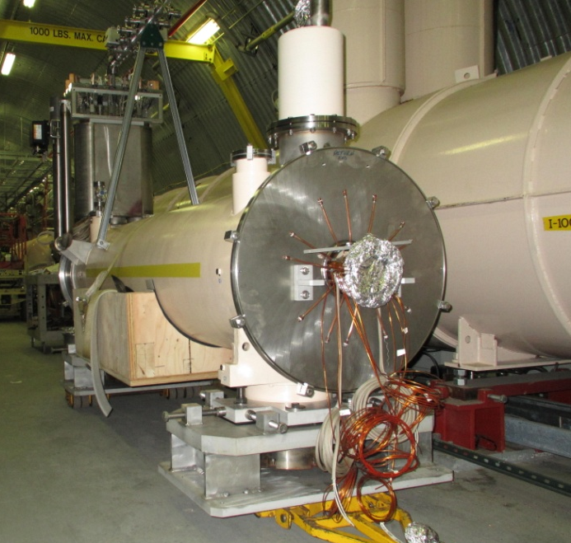
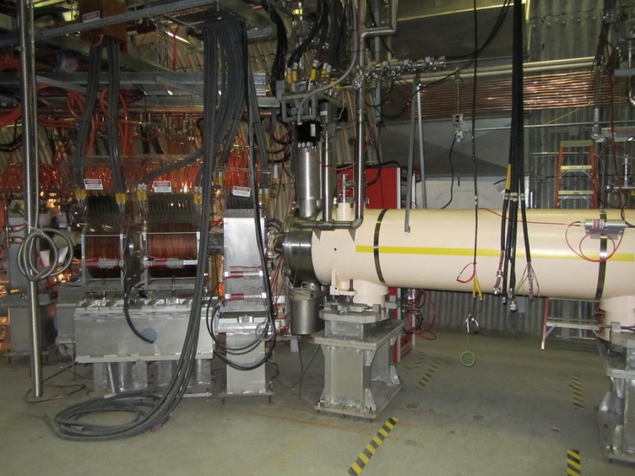
Superconducting magnet
winding at BNL
22 layers, ~25000 turns
shell with correctors
[J. Muratore et al., IEEE Trans. Appl.Supercond. 24, 4100505 (2014)]
End preparation
Solenoid #1 In tunnel
Yellow E-lens
[M. Anerella et al., IEEE Trans. Appl.Supercond. 24, 4101804 (2014)]

Slide 18
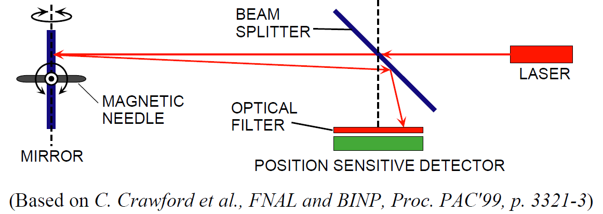
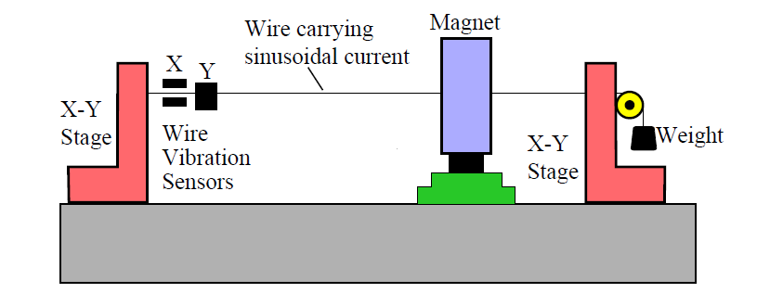
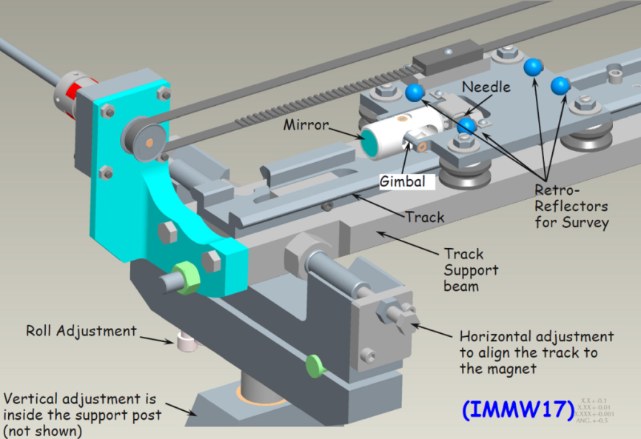
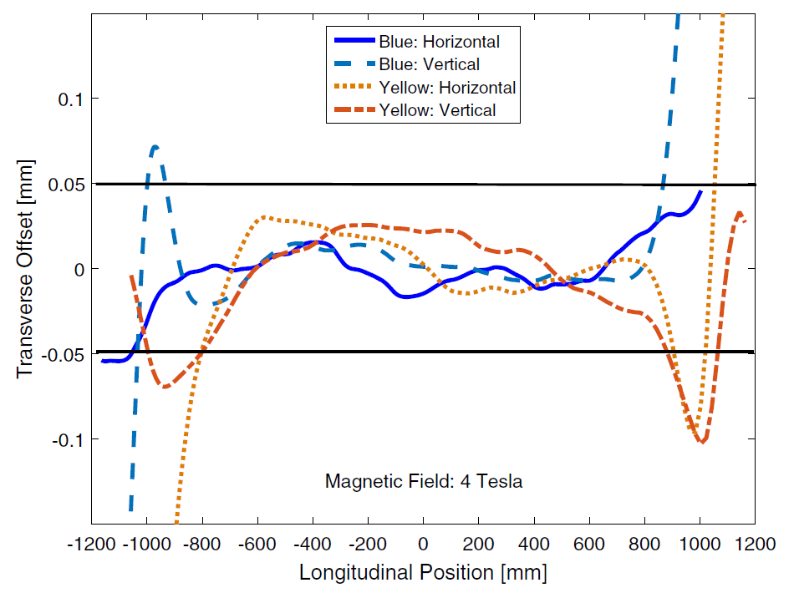
Superconducting Magnet
A maximum ±50 μm deviation of the main solenoid field lines within ±800 mm
Vibrating Wire
Needle & mirror
Tolerance ± 50 μm
±1000 mm good field
Operated at 6T.
[A. Jain, Proceedings of the International Magnetic Measurement Workshop 2015, Hsinchu, Taiwan]
Courtesy of A. Jain

Slide 19
Outline
Introduction
Technology
e-beam Measurement
Summary

Slide 20
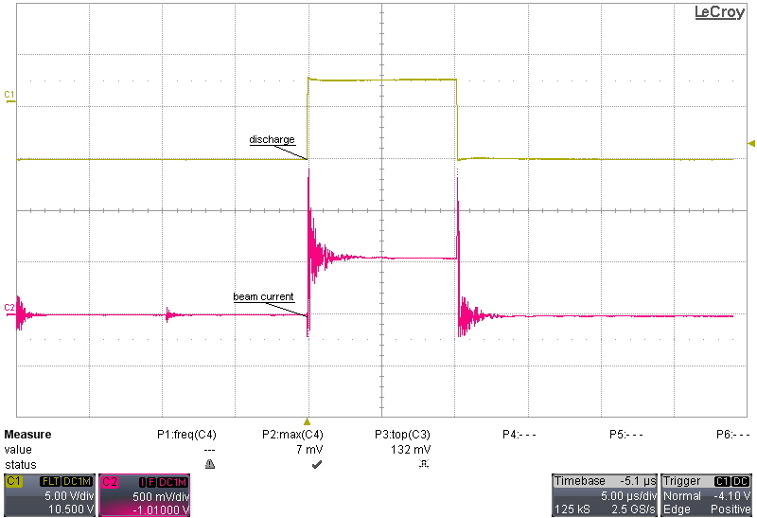
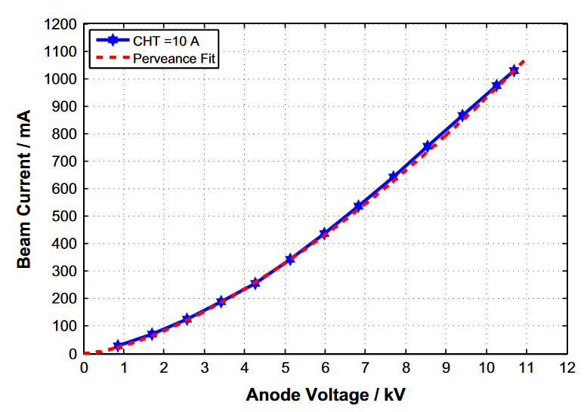
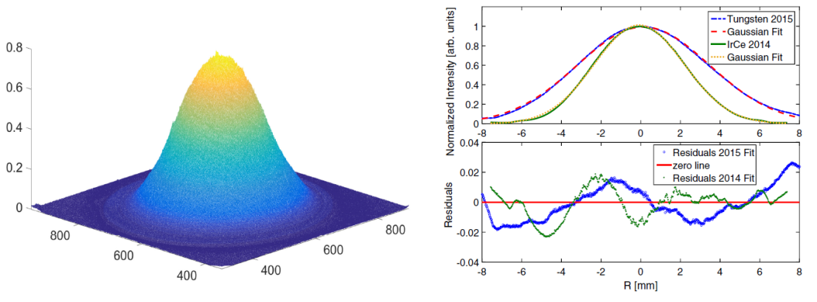
Electron Beam Measurement
Anode Voltage
Electron Beam
1A Current
DC or pulsed
Two cathode sizes

Slide 21
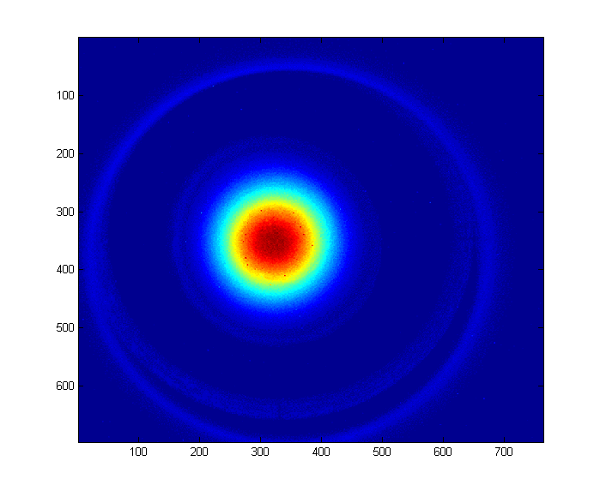
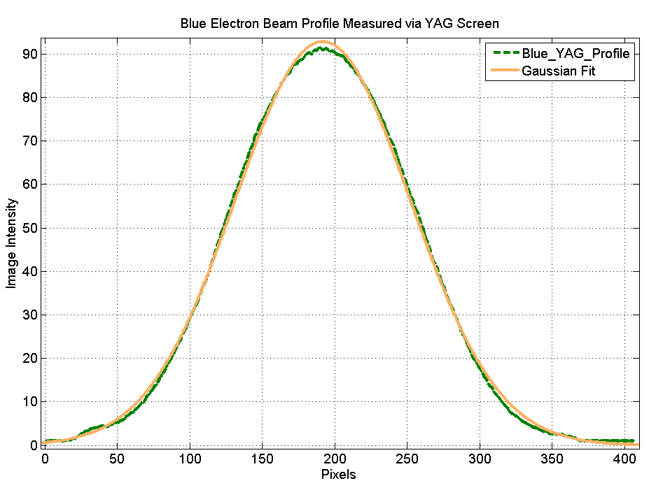
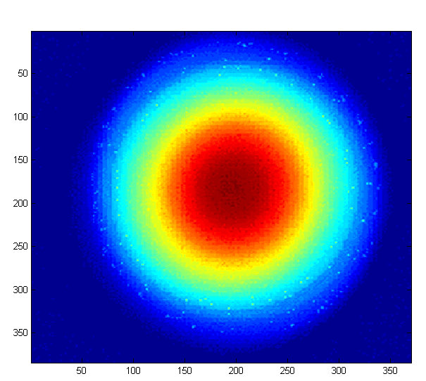
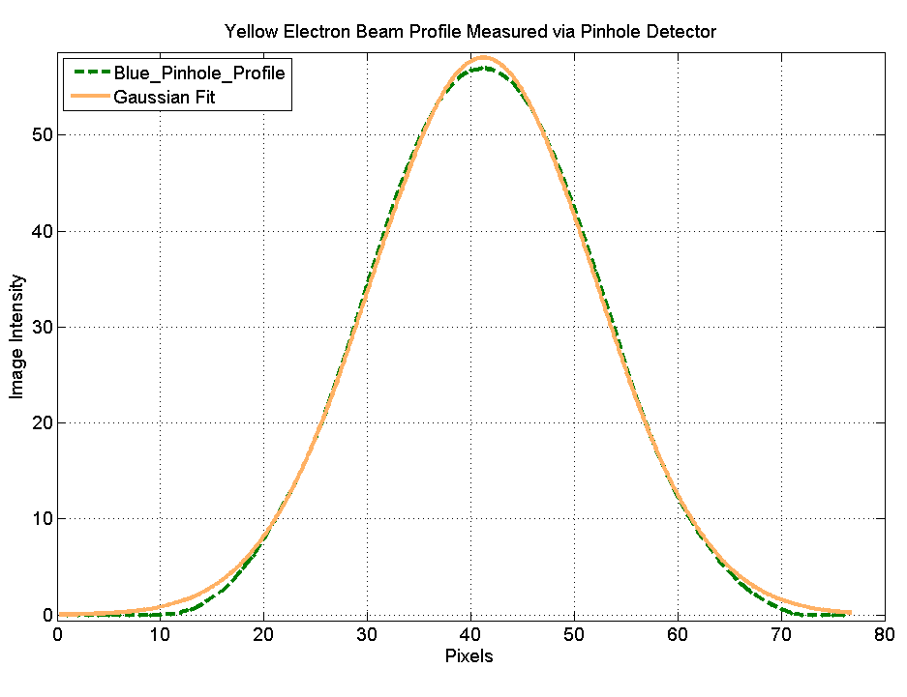
Electron beam profile measurement (2014)
Current 70 mA
Beam profile from YAG is a Gaussian
Profile does not change with current
Current 1150 mA.
Pinhole profile is
Gaussian
YAG screen
Pinhole Detector
[Xiaofeng Gu et al., NIMA, Volume 798, p36-43 (2015)]

Slide 22
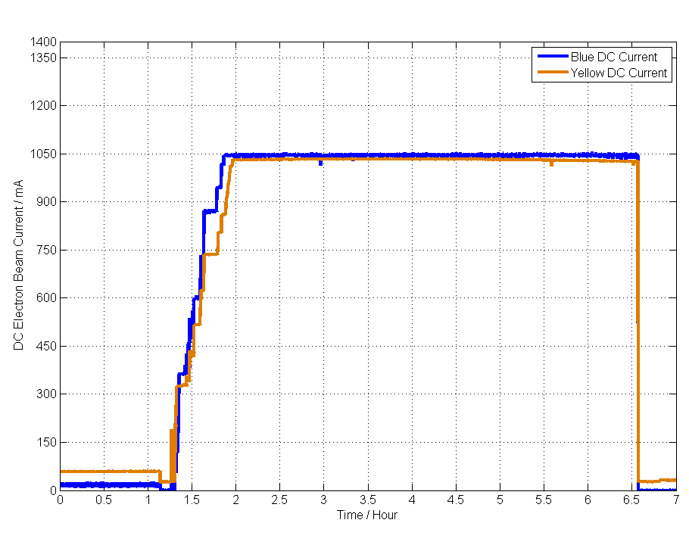
DC beam
NO RHIC ion beam
Blue and Yellow were running simultaneously
Beam current was 1 A
Blue was running for 9.5 hours during 2013 commissioning.
Blue DC 1A electron beam
Yellow DC 1A electron beam

Slide 23
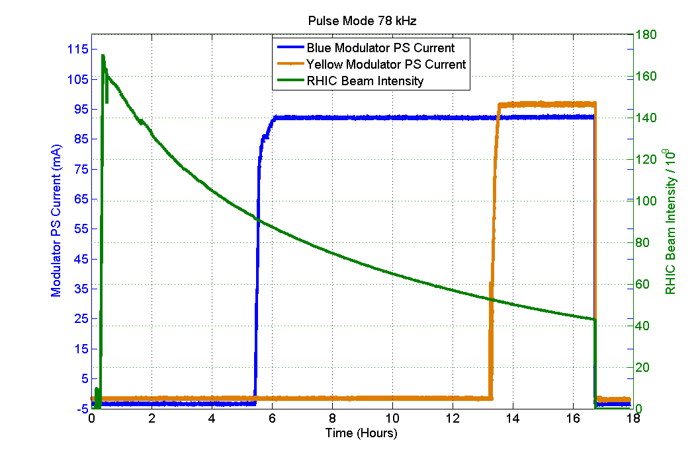
Parasitic Mode Electron Beam
Modulator current indicates 78 kHz is running.
Blue and Yellow were running 78 kHz pulse mode with 1A simultaneously within RHIC beam abort gap;
Parasitic to RHIC beam provides more commissioning time;
Blue e-lens 78 kHz was running for 14 hours;
Blue 78 kHz 1A electron beam
Yellow 78 kHz 1A electron beam
RHIC ion beam

Slide 24
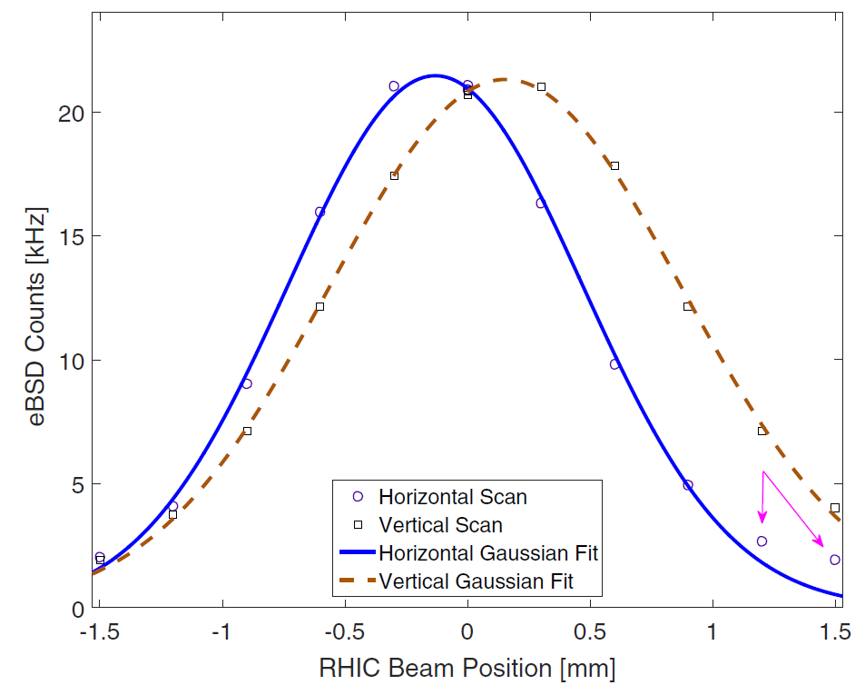
Transverse e-Beam Alignment
Two methods to do transverse position and angle alignment: BPM or eBSD (detector)
BPMs in both lenses to bring e-beam and ion beam for overlap (transverse and angle)
Backscattered electron detector to maximize overlap (transverse and angle)
e-BPMs, E-beam scan
eBSD, ion beam scan

Slide 25
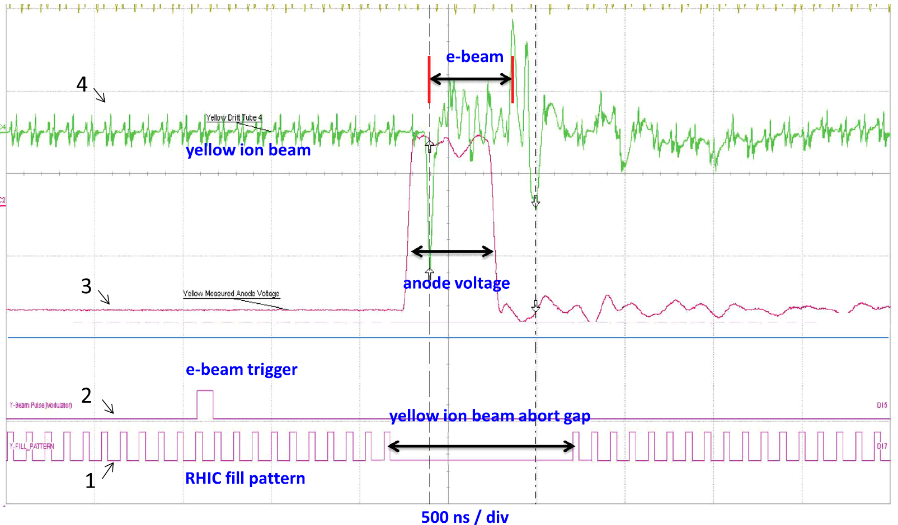
Longitudinal alignment
Yellow E-lens

Slide 26

Example of Alignment

Slide 27
Outline
Introduction
Technology
e-beam Measurement
Summary

Slide 28
Summary
Two e-lenes were built at BNL, according to Fermilab Tevatron E-lens and BNL EBIS technology.
These low risk technologies are used for beam current, profile, size, energy, positon and angle control and measurement.
The e-beam parameters are satisfied with beam-beam compensation requirement.
eBSD was developed and used for beam alignment.
The two e-lenes were operated although RHIC 2015 run. The head-on beam-beam compensation scheme, consisting of new lattice (RDT compensation) + e-lenses (DQ compensation) result:
L_{peak} +150% L_{avg} +90%

Slide 29
Acknowledgements
Brookhaven National Laboratory
M. Anerella, M. Bai, C.D. Dawson, A.K. Drees, B. Frak, G. Ganetis, D.M. Gassner, R.C. Gupta, P. Joshi, K. Hock, L. Hoff, P. Kovach, R. Lambiase, K. Mirabella, M. Mapes, A. Marone, A. Marusic, K. Mernick, M. Minty, C. Montag, J. Muratore, S. Nemesure, S. Plate, G. Robert-Demolaize, L. Snydstrup, S. Tepikian, C.W. Theisen, J. Tuozzolo, P. Wanderer, W. Zhang
STAR and PHENIX experiments – supported e-lens commissioning
Institutions
FNAL: TEL experience, beam-beam experiments and simulations
US LARP: beam-beam simulation
CERN: beam-beam experiments and simulations
Individuals
H.-J. Kim, V. Shiltsev, T. Sen, G. Stancari, A. Valishev, G. Kuznezov, FNAL; G. Kuznezov, BINP; X. Buffat, R. DeMaria, J.-P. Koutchouk, T. Pieloni, F. Schmidt, F. Zimmermann, CERN; V. Kamerdzhiev, FZJ; A. Kabel, SLAC;
P. Goergen, TU Darmstadt

