Slide 1
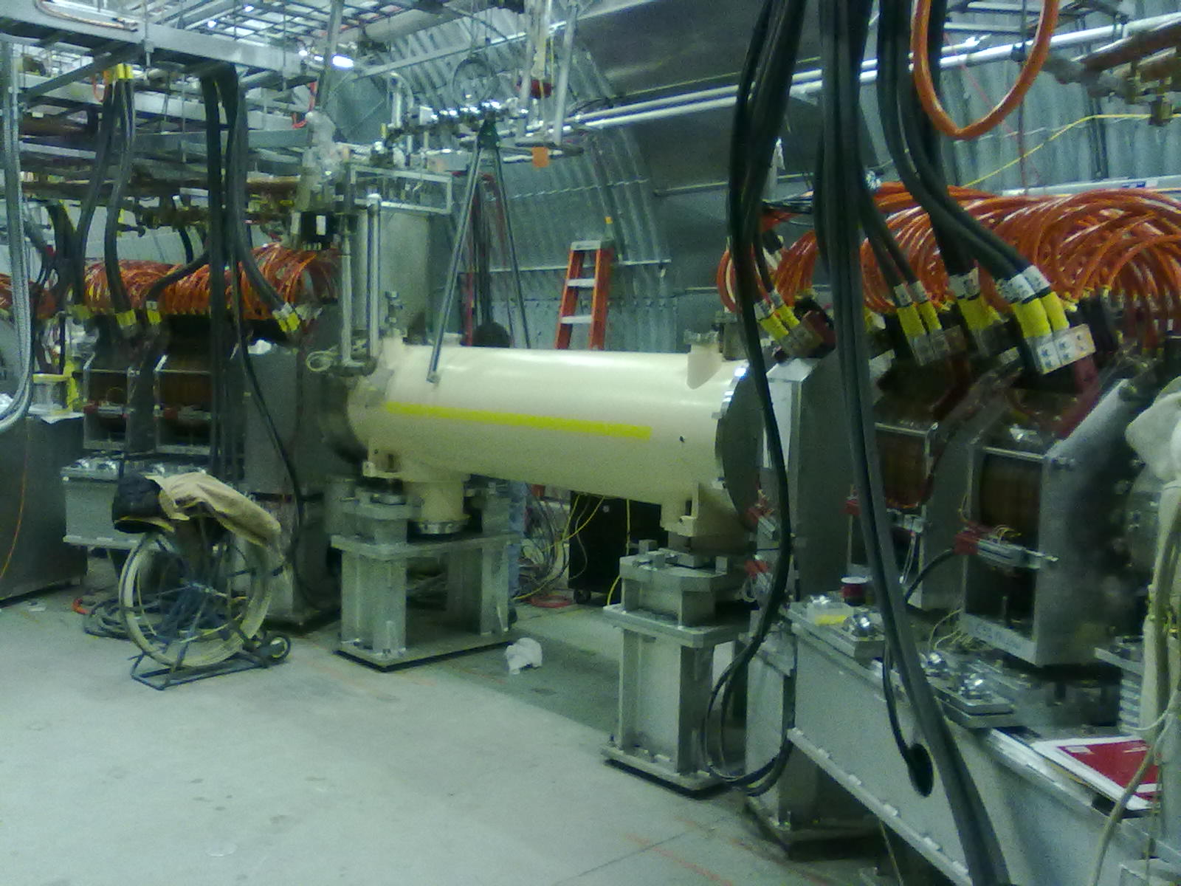
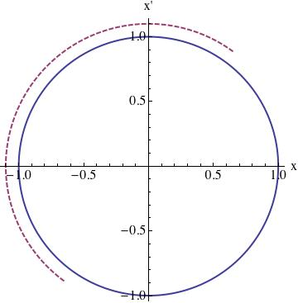
Head-on beam-beam compensation in RHIC
Principle
r’
Yellow electron lens
r
W. Fischer, X. Gu, K.A. Drees, C. Liu, Y. Luo, A. Marusic, R. Michnoff, T.A. Miller, M. Minty, C. Montag, A.I. Pikin, G. Robert-Demolaize, V. Schoefer, P. Thieberger, and S.M. White
[Phys. Rev. Accel. Beams 20, 091001 (2017)]
ICFA Mini-Workshop on Beam-beam Effects in Circular Colliders
5-7 February 2018, LBNL
Notes:
30 min = 25 slides

Slide 2
Contents
Principle of head-on beam-beam compensation
  History at DCI (Orsay, 1970s)
Implementation at RHIC
  Lattice design and verification
  RHIC e-lens technology => presentation by Xiaofeng Gu
Tune distribution widths with e-lenses
Operational use in 2015
  Luminosity gain
  Impact on beam loss rate, emittance growth, background

Slide 3
Peer-reviewed references RHIC HOBBC
X. Gu, M. Okamura, A. Pikin, W. Fischer, and Y. Luo, "The effects of realistic pancake solenoids on particle transport", Nucl. Instrum. and Methods A 637, pp.190-199 (2011).
Y. Luo, W. Fischer, N.P. Abreu, X. Gu, A. Pikin, and G. Robert-Demolaize, "Six-dimensional weak-strong simulation of head-on beam-beamcompensation in the Relativistic Heavy Ion Collider", Phys. Rev. ST Accel. Beams 15, 051004 (2012).
X. Gu, F.Z. Altinbas, E. Beebe, W. Fischer, B.M. Frak, D.M. Gassner, K. Hamdi, J. Hock, L. Hoff, P. Kankiya, R. Lambiase, Y. Luo,
M. Mapes, J. Mi, T. Miller, C. Montag, S. Nemesure, M. Okamura, R.H. Olsen, A.I. Pikin, D. Raparia, P.J. Rosas, J. Sandberg, Y. Tan,
C. Theisen, J. Tuozzolo, and W. Zhang, ”The electron lens test bench for the relativistic heavy ioncollider at Brookhaven National Laboratory”, Nucl. Instrum. and Methods A 743, pp. 56-67 (2014).
W. Fischer, X. Gu, Z. Altinbas, M. Costanzo, J. Hock, C. Liu, Y. Luo, A. Marusic, R. Michnoff, T.A. Miller, A.I. Pikin, V. Schoefer,
P. Thieberger, and S.M. White, "Operational head-on beam-beam compensation with electronlenses in the Relativisitc Heavy Ion Collider", Phys. Rev. Lett. 115, 264801 (2015).
X. Gu, Z. Altinbas, M. Costanzo, W. Fischer, D.M. Gassner, J. Hock, Y. Luo, T. Miller, Y. Tan, P. Thieberger, C. Montag, and A.I. Pikin, "Tansverse profile of the electron beam for the RHIC electron lenses", Nucl. Instrum. and Methods A 798, pp. 36-43 (2015).
Y. Luo, W. Fischer, and S. White, "Analysis and modeling of proton beam loss and emittance growthin the Relativisitc Heavy Ion Collider", Phys. Rev. Accel. Beams 19, 021001 (2016).
P. Thieberger, Z. Altinbas, C. Carlson, C. Chasman, M. Costanzo, C. Degen, K. A. Drees, W. Fischer, D. Gassner, X. Gu, K. Hamdi,
J. Hock, A. Marusic, T. Miller, M. Minty, C. Montag, Y. Luo, A.I. Pikin, and S.M. White, "High energy Coulomb-scattered electrons for relativisticparticle beam diagnostics", Phys. Rev. Accel. Beams 19, 041002 (2016).
X. Gu, W. Fischer, Z. Altinbas, M. Anerella, E. Bajon, M. Bannon, D. Bruno, M. Costanzo, A. Drees, D. M. Gassner, R. C. Gupta,
J. Hock, M. Harvey, A.K. Jain, J.P. Jamilkowski, P. Kankiya, R. Lambiase, C. Liu, Y. Luo, M. Mapes, A. Marusic, C. Mi, R. Michnoff,
T.A. Miller, M. Minty, S. Nemesure, W. Ng, D. Phillips, A. I. Pikin, P.J. Rosas, G. Robert-Demolaize, T. Samms, J. Sandberg, V. Schoefer, T.C. Shrey, Y. Tan, R. Than, C. Theisen, P. Thieberger, J. Tuozzolo, P. Wanderer, W. Zhang, and S. M. White, "Electron lenses for head-on beam-beam compensation in RHIC", Phys. Rev. Accel. Beams 20, 023501 (2017).
W. Fischer, X. Gu, K.A. Drees, C. Liu, Y. Luo, A. Marusic, R. Michnoff, T.A. Miller, M. Minty, C. Montag, A.I. Pikin, G. Robert-Demolaize, V. Schoefer, P. Thieberger, and S.M. White, "Compensation of head-on beam-beam induced resonance drivingterms and tune spread in the Relativistic Heavy IonCollider", Phys. Rev. Accel. Beams 20, 091001 (2017).

Slide 4
History of head-on beam-beam compensation (HOBBC)
Head-on compensation schemes
[S. Peggs, Handbook (1999); J.P. Koutchouk, V. Shiltsev, Handbook (2013)]:
Direct space charge compensation (4 beams)
Indirect space charge compensation (electron lenses)
Resonance compensation between interaction points (not implemented)
Octupoles for reduction of nonlinearities (VEPP-4, no clear improvement)
Reduction of BB resonance strength with crab-waist (DAΦNE, SuperKEKB)
Proposals/studies of direct/indirect space charge compensation:
COPPELIA ⇒ 4-beam (J.E. Augustine, HEACC, 1969)
DCI ⇒ 4-beam (G. Arzelia et al., HEACC, 1971) ⇒ only operational attempt before RHIC
CESR ⇒ e-lens (R. Talman, unpublished, 1976)
SSC ⇒ e-lens (E. Tsyganov et al., SSCL-PREPRINT-519 ,1993)
LHC ⇒ e-lens (E. Tsyganov et al., CERN SL-Note-95-116-AP, 1995)
Tevatron ⇒ e-lens (Shiltsev et al., PRST-AB, 1999)
e⁺e⁻ collider ⇒ 4-beam (Y. Ohnishi and K. Ohmi, Beam-Beam’03, 2003)
RHIC ⇒ e-lens (Y. Luo, W. Fischer, BNL C-A/AP/286, 2007) ⇒ implementation in 2015
FCC-hh ⇒ e-lens? (no head-on limit observed in the LHC)

Slide 5
Head-on beam-beam compensation Principle
Correction in same turn, need to fulfill 2 conditions:
(1) kπ phase advance minimizes beam-beam
resonance driving terms – implemented with
ATS type lattice
[Y. Luo et al., PRSTAB 15, 051004 (2012);]
(2) Same amplitude correction kick as bb
kick reduces beam-beam tune spread –
implemented with electron lenses (not
possible with magnets)

Slide 6




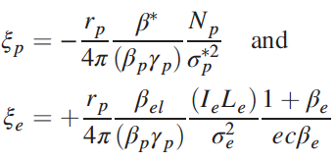
Head-on beam-beam compensation Principle
Beam-beam kicks:
<= effect of Gaussian p-beam on proton
<= effect of Gaussian e-beam on proton
Matching condition implies:
<= electron lens current
<= matched beam-beam parameters

Slide 7
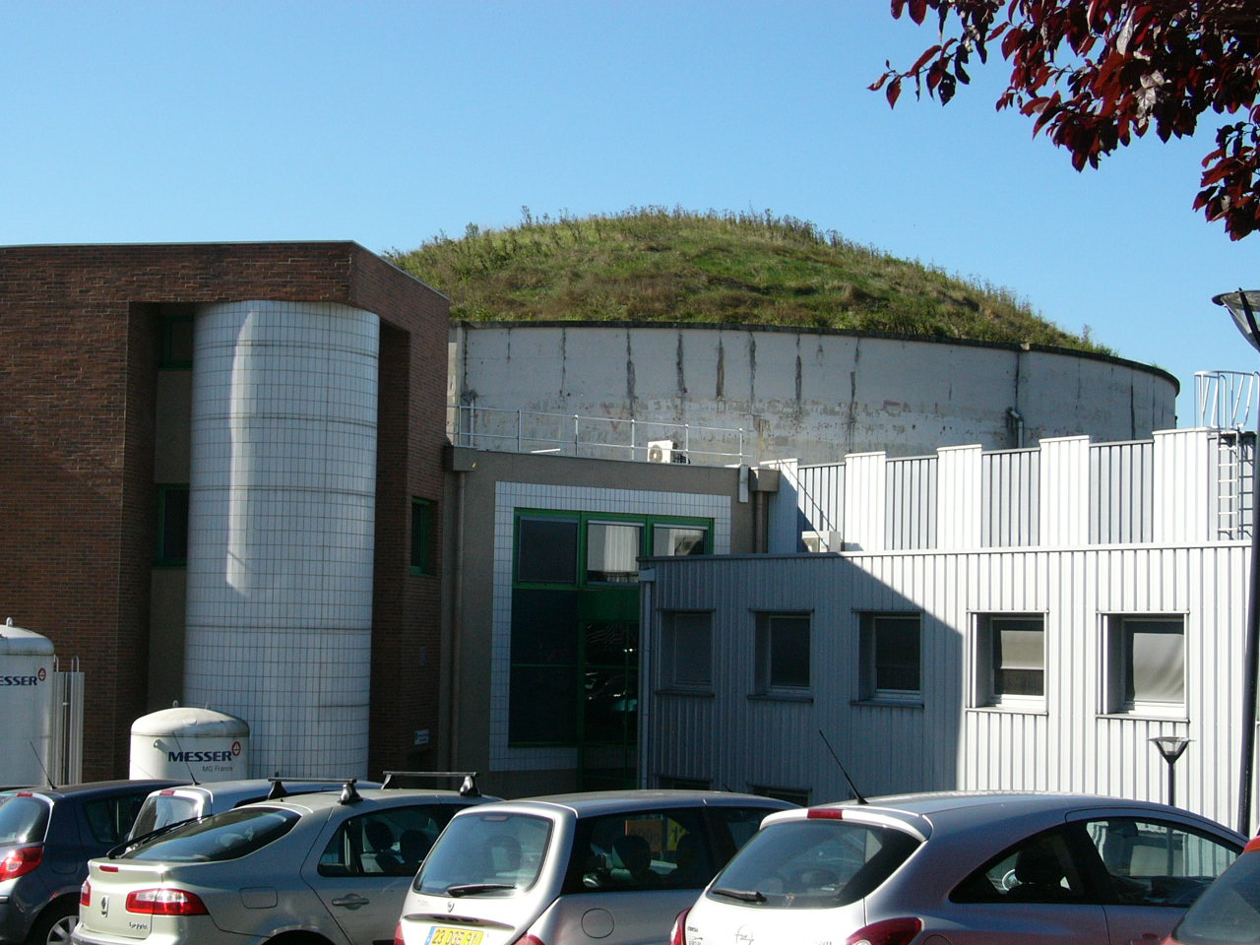
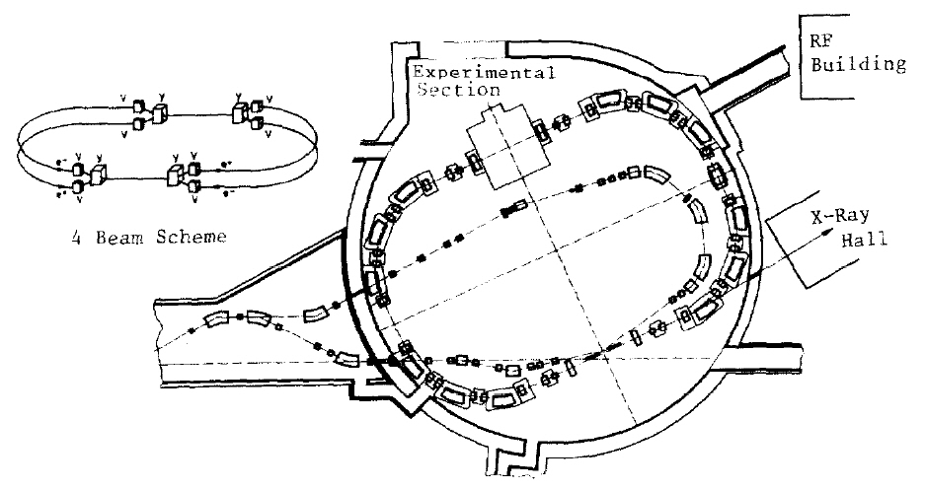
Head-on beam-beam compensation in DCI
DCI Hall, LAL Orsay
Operational head-on beam-beam compensation was only
tested in DCI (starting in 1976) – 4-beams (e⁺e⁻e⁺e⁻)
Main parameters:
  Circumference 94.6 m
  Energy 1.8 GeV
  Beam-beam ξ ~0.05-0.1
  Luminosity (design) ~10³² cm⁻²s⁻¹
Luminosity fell short
by ~100x compared
to expectations
(2-, 3-, and 4-beam L about
the same)
The Orsay Storage Ring Group,
“Status report on D.C.I.”, PAC77
The Orsay Storage Ring Group,
“Status report on D.C.I.”, PAC79
Limited by unanticipated
coherent motion of e⁺ and
e⁻ beams
Notes:
References:
- Ya. S. Derbenev, “Collective instability of compensated colliding beams”, Nuclear Physics Institute, Siberian Division, Academy of Sciences
USSR, Novosibirsk, Report No IYAF 70-72, in Russian (1972), SLAC-TRANS 151 in English.
- N.N. Chau and D. Potau, “Stabilité des oscillations transverse dans un anneau à charge d’espace compensée”, LAL Orsay (1974 and 1975).
- B. Podobedov and R.H. Siemann, “Coherent beam-beam interaction with four colliding beams”, Phys. Rev. E 52, No 3, pp. 3066-3073 (1995).

Slide 8
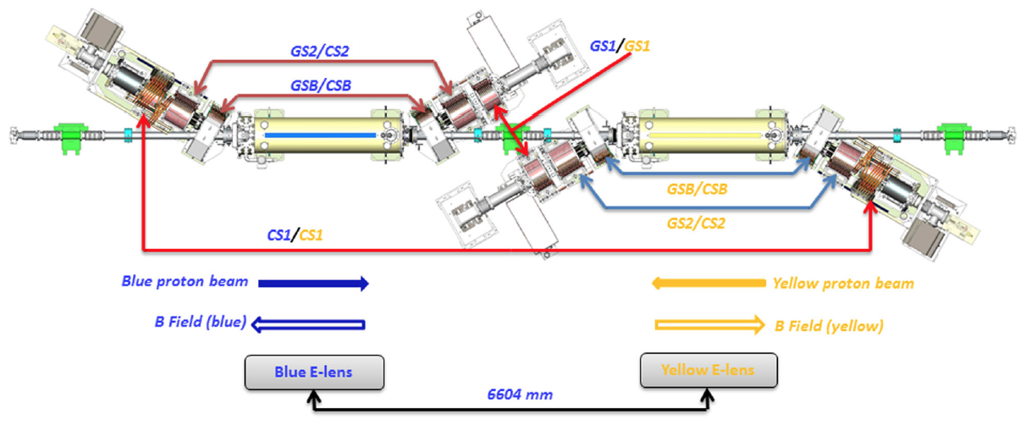
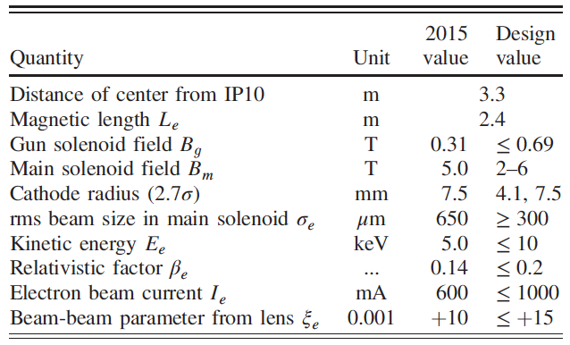
Implementation at RHIC Overview
<= RHIC electron lenses
(based on Tevatron lenses and RHIC EBIS)
with 2 solenoids of opposite
polarity coupling and spin
effect are compensated locally
Δψ = kπ
[X. Gu et al., PRAB 20, 023501 (2017), presentation X. Gu]

Slide 9
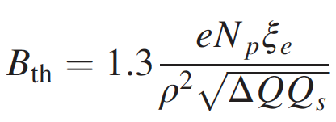
Implementation at RHIC Lattice design
Lattice requirements:
Phase advance between IP8 and
e-lenses kπ (k integer)
Large β-function (beam size) at e-lens
  easier alignment with large beams
  better stability with large beams
  found marginal stability in simulations at 255 GeV
  [S. White, CERN, Report No. CERN-2014-004, 2014, p. 133]
  test with Au and 1.5 T solenoid field found better stability than in simulation
Small nonlinear chromaticity
  correlates with large DA (simulations by Yun Luo)
approx. stability threshold
[A. Burov, PRE 59, 3605 (1999)]

Slide 10
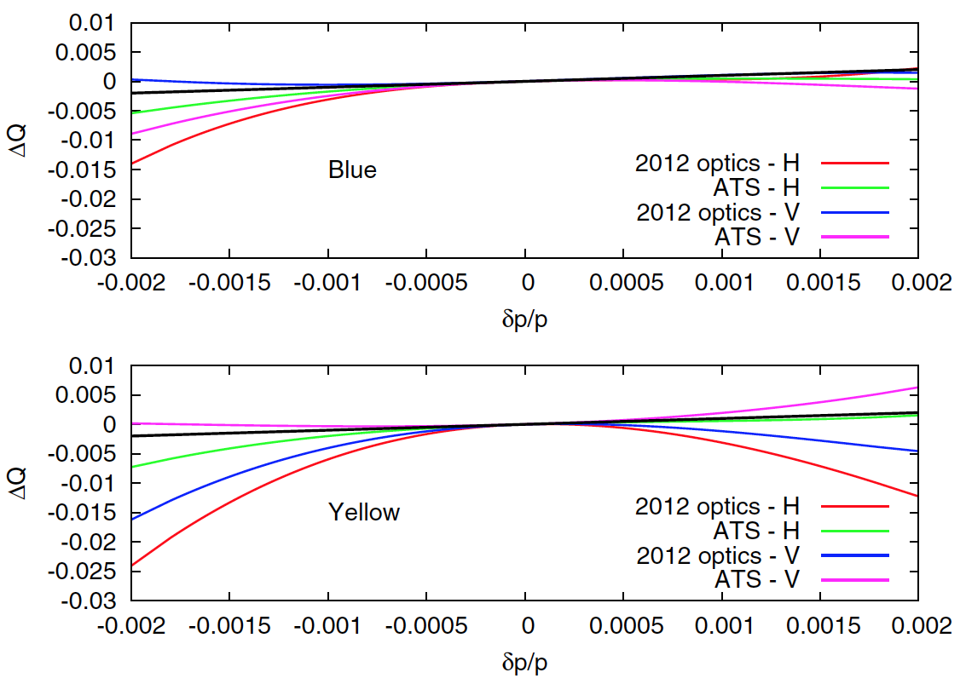
Implementation at RHIC Lattice design
ATS lattice for
Blue ring
β-wave over 2 IPs
[S. Fartoukh, PRSTAB 16,
111002 (2013); S. White
BNL-105550-2014-IR,
C-A/AP/519 (2014)]
Nonlinear chromaticity
smaller in all planes
except Blue vertical
(still smaller than Yellow 2012)

Slide 11
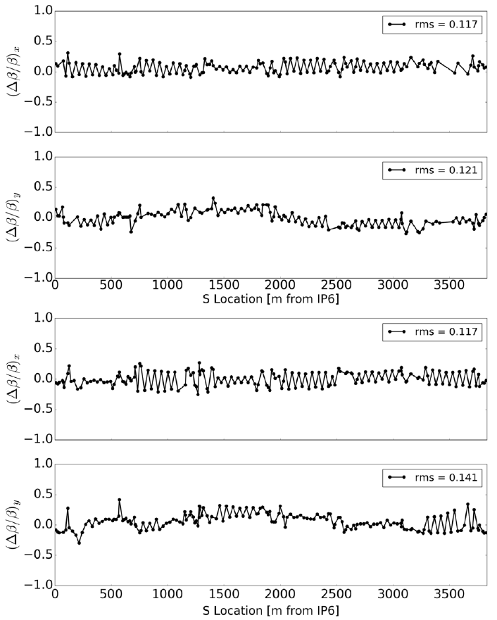
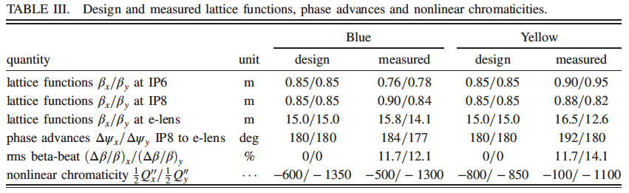
Implementation at RHIC Lattice verification
measured beta-beat
Blue hor: 11.7% rms
Blue ver: 12.1% rms
significant discrepancy for
Yellow nonlinear chromaticity
Yellow hor: 11.7% rms
Yellow ver: 14.1% rms

Slide 12

E-lens orbit and tune effect Linear effects
Tune and orbit change due to vertical displacement with Au beam
[Simon White]

Slide 13
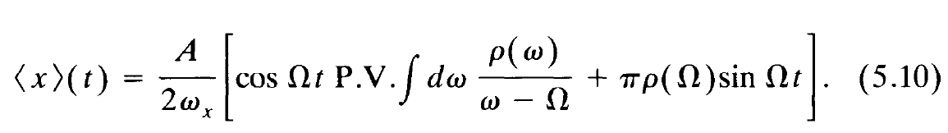
Tune distribution width BTF measurement
Use Beam Transfer Function measurement for widths of distribution:
observe beam response <x> to small transverse harmonic excitation
Acos Ωt around betatron tune Ω [A. W. Chao, Physics of collective …”, Ch. 5 (1993)] :
Complex response function
R(Ω) := C_{R}(Ω) + iC_{I}(Ω)
Width of tune distribution:
Non-zero ρ(Ω) if non-zero Im(R)/(R)
(Note: shape of R(Ω) has more information
– under investigation by Yun Luo)
coherent beam
response <x>
excitation
frequency Ω
tune distribution ρ(Ω)
RHIC BTF application

Slide 14
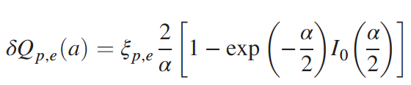



Tune distribution width Expectation
BB tune shift
at amplitude a
BB tune spread
from zero to amplitude a
total tune spread from zero
to amplitude a, assuming
Q₀ and Q_{bb} are uncorrelated
few particles at large amplitudes a – resulting in small BTF signal
maximum amplitude a with detectable BTF signal not known a priori

Slide 15
Tune distribution width e-beam current and size
e-lens current scan
e-lens size scan
Measured tune widths match expectation for a <= 2.5 σ_{p}

Slide 16
Tune distribution width with collisions BTF
Limitation:
Coherent BB modes prevent extraction of incoherent tune distribution widths.
Successful in simulation [P. Görgen et al., NIMA 777, 43-53 (2015)], not with RHIC data.
π-modes
σ-modes
2x BB
π-modes
σ-modes
1x BB
No observable change in tune
distribution width with e-lens
Can suppress coherent modes with tune separation,
done in operation with p+Al, p+Au collisions (Q_{p} ~ 0.68, Q_{A} ~0.23)

Slide 17
Tune distribution width BB footprint compression
=> Demonstrated
beam-beam generated
footprint compression
with election lens
compression
no BB
2x BB
e-lenses can only compress BB
generated tune spread, not
from other source (e.g. Q’ and δp/p)
Further increase in e-lens current
will increase tune spread again
Measured tune widths match expectation for a <= 3.5 σ_{p}

Slide 18
Operational use in 2015 collisions at 2 experiments
2
3
luminosities
e-lenses turn on before collision
(112 stores with both lenses without
a single turn-on failure)
Beams into collision at PHENIX,
collimators to store positions
(requires PHENIX collisions)
Beams into collision at STAR
and e-lenses
e-lenses prevent emittance
growth for large bb param. ξ
Lenses are gradually turned
off when lattice alone can
sustain bb parameter ξ
3
IPM emittances
1
3
e-lens e-beam currents
eBSD rate [Hz]
4
backscattered
electron rates

Slide 19
Luminosity p↑+p↑ at 100 GeV 2012 vs in 2015
2015: with HOBBC
L_{avg} increasing with N_{b}
2012: without HOBBC
L_{avg} not increasing any
more with increase in N_{b}
Average store luminosity saturated in 2012 despite increase in bunch intensity.

Slide 20
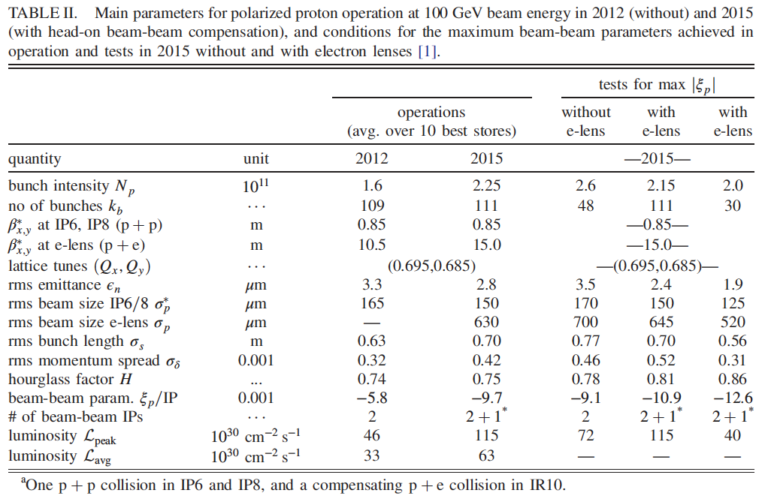
Luminosity p↑+p↑ at 100 GeV 2012 vs in 2015
Note: possible that
higher beam-beam
parameters can be
demonstrated in the
future in all situations,
thereby changing the
relative gains.
Luminosity increase L_{avg} : +91% (measured)
2/3 from lattice alone, 1/3 from e-lens (calculated from measured ξ_{p} values)
Increase in bb parameter ξ_{p} from e-lens: +38%(measured)

Slide 21
Effect of e-lenses on beam loss rate, emittance growth
fast slow
2 stores Yellow e-lens on for
6.75 & 5.28 h respectively
(other stores 0.45–1.83 h)
Beam loss rate 1/τ₂
Hor. emittance
Additional beam loss rate:
0.5-1.0%/h
Additional emittance growth:
6% over full store length (~3% avg.)
Ver. emittance

Slide 22
Effect of e-lenses on experimental background
2 stores Yellow e-lens on for
6.75 & 5.28 h respectively
(other stores 0.45–1.83 h)
Scintillator N2 indicative of machine generated background
from Yellow beam
Background rate (PHENIX N2):
  2-3x higher with e-lens
  (2015 background rates 3-4x smaller than 2012, despite L 2x higher)
  acceptable

Slide 23
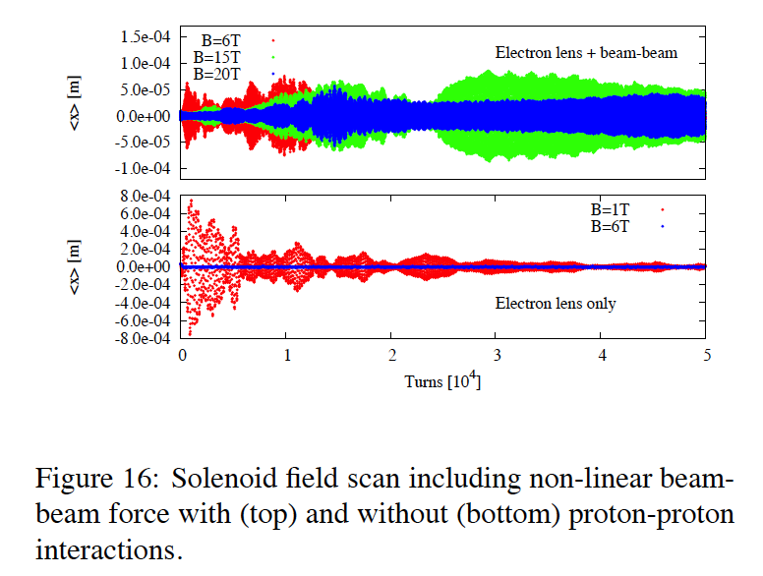
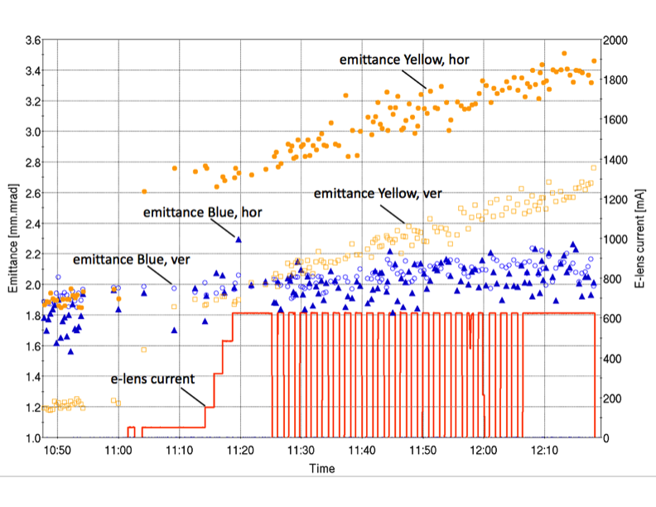
Further experiments with electron lenses
PHENIX experiment rebuilt into sPHENIX
next polarized proton operation only after sPHENIX compeletion (>2023)
Instability test at higher energy
255 GeV – smaller beam size
unstable in simulations (S. White, BB2013)
=> may require damper
eRHIC stepwise e-bunch replacement
=> presentation Christoph Montag
Hollow e-lens tests in 2018
=> HL-LHC collimation improvements, presentation Adriana Rossi

Slide 24
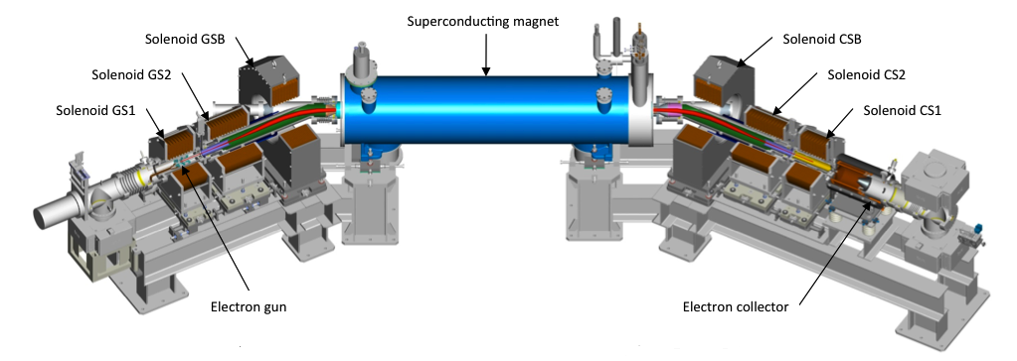
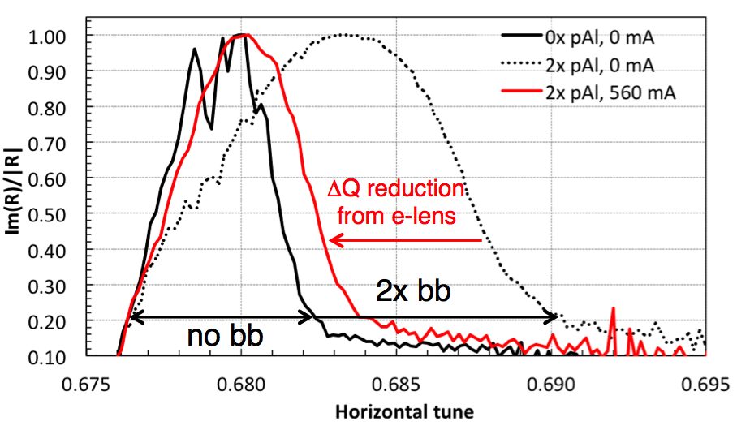
Summary Head-on beam-beam compensation in RHIC
First successful operational
implementation of head-on
beam-beam compensation,
39 years after DCI 4-beam scheme
  New ATS-type lattice (Δψ = kπ)
  E-lenses build and commissioned
Demonstrated beam-beam generated
footprint compression with e-lens
2x luminosity gain gain with new head-on
beam-beam compensation scheme
2/3 of gain from lattice alone, 1/3 from e-lens
Measured detrimental effects of e-lens on beam loss rate (0.5-1.0%/h), emittance growth (+6% over 8h stores) and background (+2-3x, acceptable)

Slide 25
Acknowledgements
Brookhaven National Laboratory
Z. Altinbas, M. Anerella, M. Bai, E. Bajon, M. Bannon, D. Bruno, M. Costanzo, C.D. Dawson, A. Drees, B. Frak, G. Ganetis, D.M. Gassner, R.C. Gupta, P. Joshi, J. Hock, K. Hock, M. Harvey, L. Hoff, A.K. Jain, J.P. Jamilkowski, P. Kankiya, P. Kovach, R. Lambiase,
K. Mirabella, M. Mapes, A. Marone, K. Mernick, J. Muratore, C. Mi, S. Nemesure, W. Ng,
D. Phillips, A.I. Pikin, P.J. Rosas, T. Samms, J. Sandberg, T.C. Shrey, L. Snydstrup,
S. Tepikian, Y. Tan, R. Than, C. Theisen, J. Tuozzolo, P. Wanderer, W. Zhang
Groups of BNL Collider-Accelerator Department
BNL Superconducting Magnet Division
STAR and PHENIX experiments – supported parasitic commissioning
Institutions
FNAL: TEL experience, beam-beam experiments and simulations
US LARP: beam-beam simulation
CERN: beam-beam experiments and simulations
Individuals
H.-J. Kim, V. Shiltsev, T. Sen, G. Stancari, A. Valishev, G. Kuznezov, FNAL;
G. Kuznezov, BINP; X. Buffat, R. DeMaria, W. Herr, J.-P. Koutchouk, F. Schmidt,
F. Zimmermann, CERN; U. Dorda, DESY; T. Piloni EPFL; N. Milas, ESS;
V. Kamerdziev, FZJ; K. Ohmi, KEK, J. Qiang, LBNL; A. Kabel (formerly SLAC);
P. Goergen, (formerly TU Darmstadt)

