Slide 1
Beam-beam modelling revision in SIXTRACK
G. Iadarola with input from:
J. Barranco, X. Buffat, R. De Maria, S. Furuseth, N. Karastathis,
Y. Papaphilippou, D. Pellegrini, K. Sjobaek
Workshop on Beam-beam effects in Circular Colliders
Berkeley 5-7 Feb 2018

Slide 2
Outline
Introduction
SixTrack
Beam-beam effects in SixTrack
Review of the 6D beam-beam routines
Numerical model
Transverse generalized kicks
Linear coupling treatment
Energy change
Performed tests
Overview
Boost/anti-boost
Linear coupling
What next

Slide 3
Outline
Introduction
SixTrack
Beam-beam effects in SixTrack
Review of the 6D beam-beam routines
Numerical model
Transverse generalized kicks
Linear coupling treatment
Energy change
Performed tests
Overview
Boost/anti-boost
Linear coupling
What next

Slide 4
SixTrack
SixTrack is CERN’s workhorse for tracking studies in high energy rings (e.g. LHC, HL-LHC, FCC), extensively used for:
Dynamic Aperture studies (evaluating the effect of magnetic imperfections and beam-beam)
Collimation studies (loss maps, collimation efficiency, background at the experiments)
Study of failure scenarios (e.g. for crab cavities)
It supports Linux, Windows, MAC in a numerically portable way
It is integrated in the LHC@Home volunteer computing platform, based on BOINC (bits of tracking studies performed by volunteers on their pc)
http://sixtrack.web.cern.ch/SixTrack/
http://lhcathome.web.cern.ch
http://boinc.berkeley.edu

Slide 5
Beam-beam in SixTrack
Beam beam effects are simulated using the weak-strong approach
The typical simulation includes both head-on and long-range beam-beam encounters:
Long-range encounters are modeled with 4D beam-beam lenses (Bassetti-Erskine, only transverse kicks)
Head-on encounters are simulated using the “6D” modeling based on Hirata’s “Synchro-beam mapping” → main topic of this talk
The effect of linear coupling of the strong beam can be taken into account in the simulation (never really tested/used)
Example LHC DA study
N. Karastathis
In the past the optics of the strong beam was computed from the optics of the weak beam assuming an anti-symmetry conditions
An expert mode was recently introduced to have fully independent optics and closed orbit of the strong beam. Necessary for LHC and HL-LHC studies involving flat optics and/or crab cavities (details here)

Slide 6
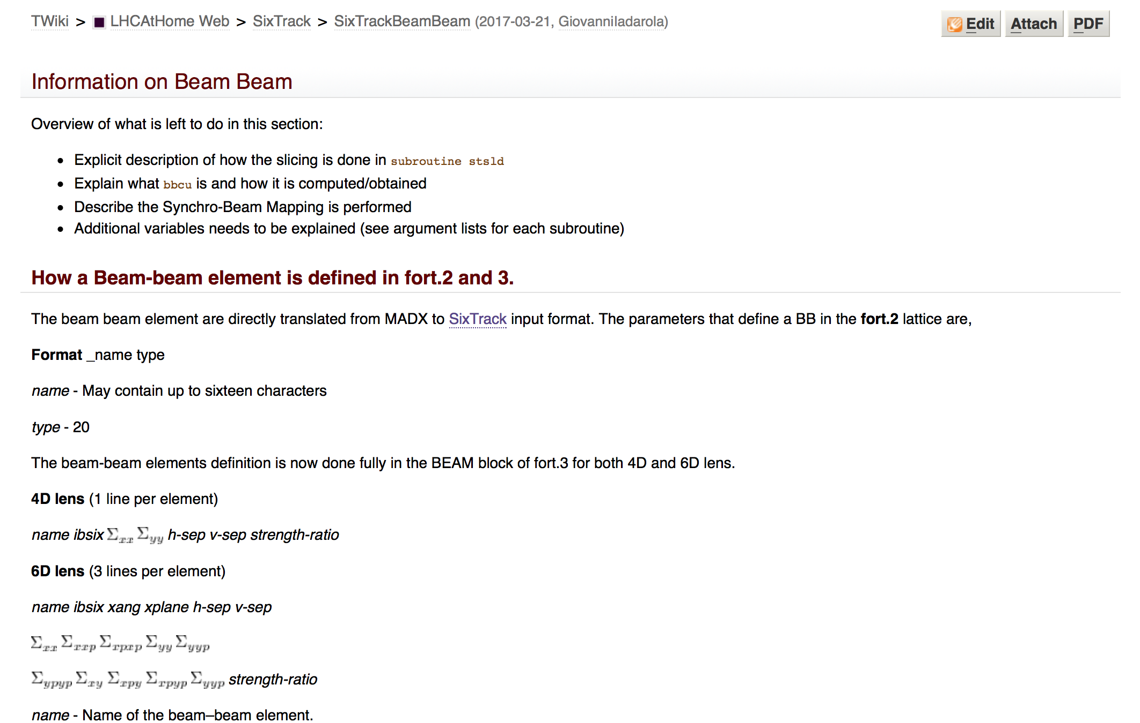
Review of the 6D beam-beam routines
Implementation based on Hirata’s BBC code [1,2], later extended by Leunissen, Schmidt and Ripken [3] to include the effect of linear coupling of the strong beam
Active work on core beam-beam routines stopped in the early 2000’s, and slowly the knowledge on the implementation details got a bit “forgotten”
code review activity recently launched, driven by needs of the HL-LHC upgrade
Code structure and interface documented in SixTrack Wiki (mainly by J. Barranco)
Invested some time in understanding and re-constructing the mathematical treatment trying to use as little as possible the source code as a reference
Parts not available in literature were re-derived (mainly inverse Lorentz boost, and a large fraction of the coupling treatment) → prepared a document including the full set of equations [4]
[1] A symplectic beam-beam interaction with energy change, by K. Hirata, H. W. Moshammer, F. Ruggiero, 1992
[2] Don't be afraid of beam-beam interactions with a large crossing angle, by K. Hirata, 1993
[3] 6D Beam-Beam Kick including Coupled Motion, by L.H.A. Leunissen, F. Schmidt, G. Ripken, 2001
[4] 6D beam-beam interaction step-by-step, G. Iadarola, R. De Maria, Y. Papaphilippou

Slide 7
Outline
Introduction
SixTrack
Beam-beam effects in SixTrack
Review of the 6D beam-beam routines
Numerical model
Transverse generalized kicks
Linear coupling treatment
Energy change
Performed tests
Overview
Boost/anti-boost
Linear coupling
What next

Slide 8
A dance of reference systems
y
We assume that we are in the reference system of the weak beam
The Interaction Point (IP) is at s=0
The crossing plane is defined by our s-axis and by the strong beam
Weak beam
Strong beam
x
α
We call α the angle between the crossing plane and the x-s plane
We call φ the half crossing angle
Crossing plane
s
2φ

Slide 9
A dance of reference systems
Barycentric reference frame
We look at the problem in the crossing plane
We introduce the “barycentric” reference system in which the weak and the strong beam are at +φ and -φ respectively
Crossing plane
IP
Weak beam
φ
Strong beam

Slide 10
A dance of reference systems
Barycentric reference frame
In the crossing plane the interaction looks like this…
To apply the Hirata, Moshammer, Ruggiero treatment we practically need to suppress the angle for the two beams (impossible by simple rotation)
Crossing plane
Strong beam
Weak beam
IP
S

Slide 11
A dance of reference systems
Barycentric reference frame
In the crossing plane the interaction looks like this…
To apply the Hirata, Moshammer, Ruggiero treatment we practically need to suppress the angle for the two beams (impossible by simple rotation)
Crossing plane
Strong beam
Weak beam
IP
S
S*
This can be achieved by using a boosted frame that is moving w.r.t. the lab
Boosted
reference frame

Slide 12
A dance of reference systems
In the boosted frame the interaction looks like this
Crossing plane
Weak beam
Strong beam
IP
S*
Boosted
reference frame

Slide 13
The synchro-beam method: transverse “generalized kicks”
The strong beam is cut in several slices having different transverse offset
Crossing plane
Weak beam
Strong beam
IP
S*
Boosted
reference frame

Slide 14
The synchro-beam method: transverse “generalized kicks”
A particle with z=0 and a slice having z=0 collide at the IP
Crossing plane
z=0
z=0
IP
S*
Boosted
reference frame

Slide 15
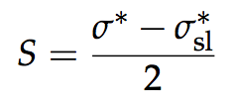
The synchro-beam method: transverse “generalized kicks”
A particle and a slice with generic z coordinates will collide at a different s coordinate, Collision Point - CP, given by:
Crossing plane
(in sixtrack jargon z is called σ)
z=0
z=0
z>0
IP
S*
Collision Point
(CP)
Boosted
reference frame

Slide 16
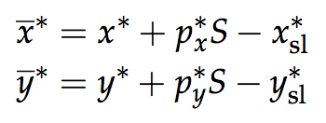
The synchro-beam method: transverse “generalized kicks”
We proceed as follows:
We drift the slice and the weak particle from the IP to the CP
Crossing plane
w.r.t. the slice centroid
(a particle and having an angle will probe the strong-beam electric field at a different transverse coordinates)
z=0
z=0
IP
Transverse kicks need to be computed based on the shape of the strong beam…
S*
We apply the kick a the CP:
z>0
p_{x}>0
Collision Point
(CP)
Boosted
reference frame
We drift the particles back from the CP to the IP using the new angles:

Slide 17
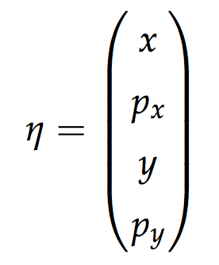
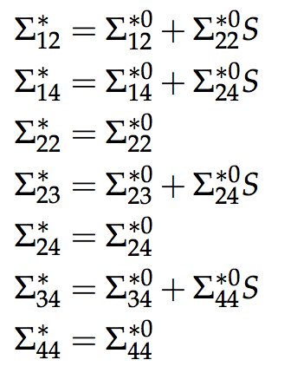
Optics of the strong beam: Σ matrix
The shape of the strong beam is described by 4D correlation matrix (Σ-matrix)
The phase space distribution can be written as:
Σ contains all the information about the beam shape and divergence (including linear coupling) and can be transported from the IP to the CP (assuming that we are in a drift):
with
Points having same phase space density lie on hyper-elliptic manifolds defined by the equation:
Convention:
1→x, 2→p_{x}, 3→y, 4→p_{y}

Slide 18
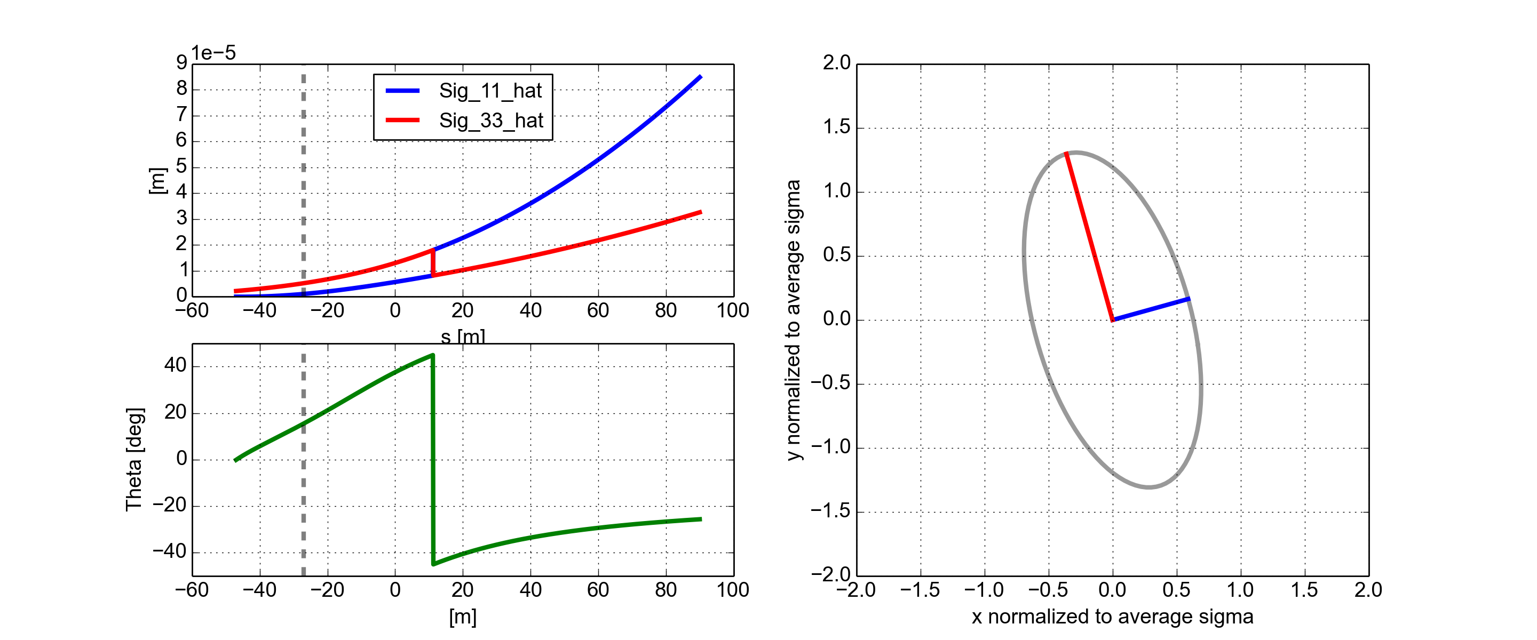
Transverse kicks - linear coupling of the strong beam
In general, linear coupling of the strong beam can be present:
The coupling angle and the beam sizes in the decoupled frame can be obtained by diagonalization of the Σ-matrix
Coupling angle depends on the s-coordinate

Slide 19
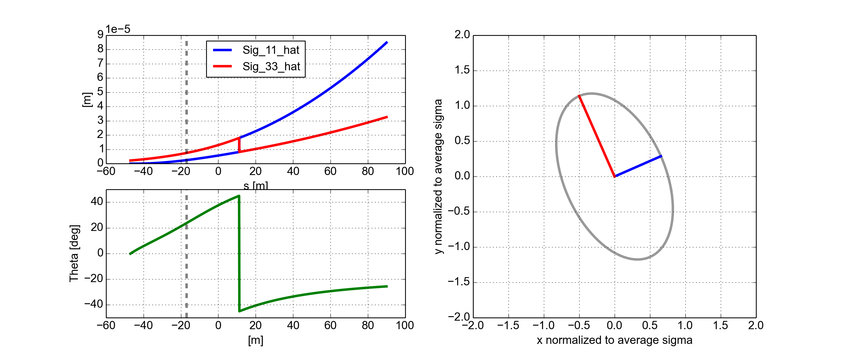
Transverse kicks - linear coupling of the strong beam
In general, linear coupling of the strong beam can be present:
The coupling angle and the beam sizes in the decoupled frame can be obtained by diagonalization of the Σ-matrix
Coupling angle depends on the s-coordinate

Slide 20
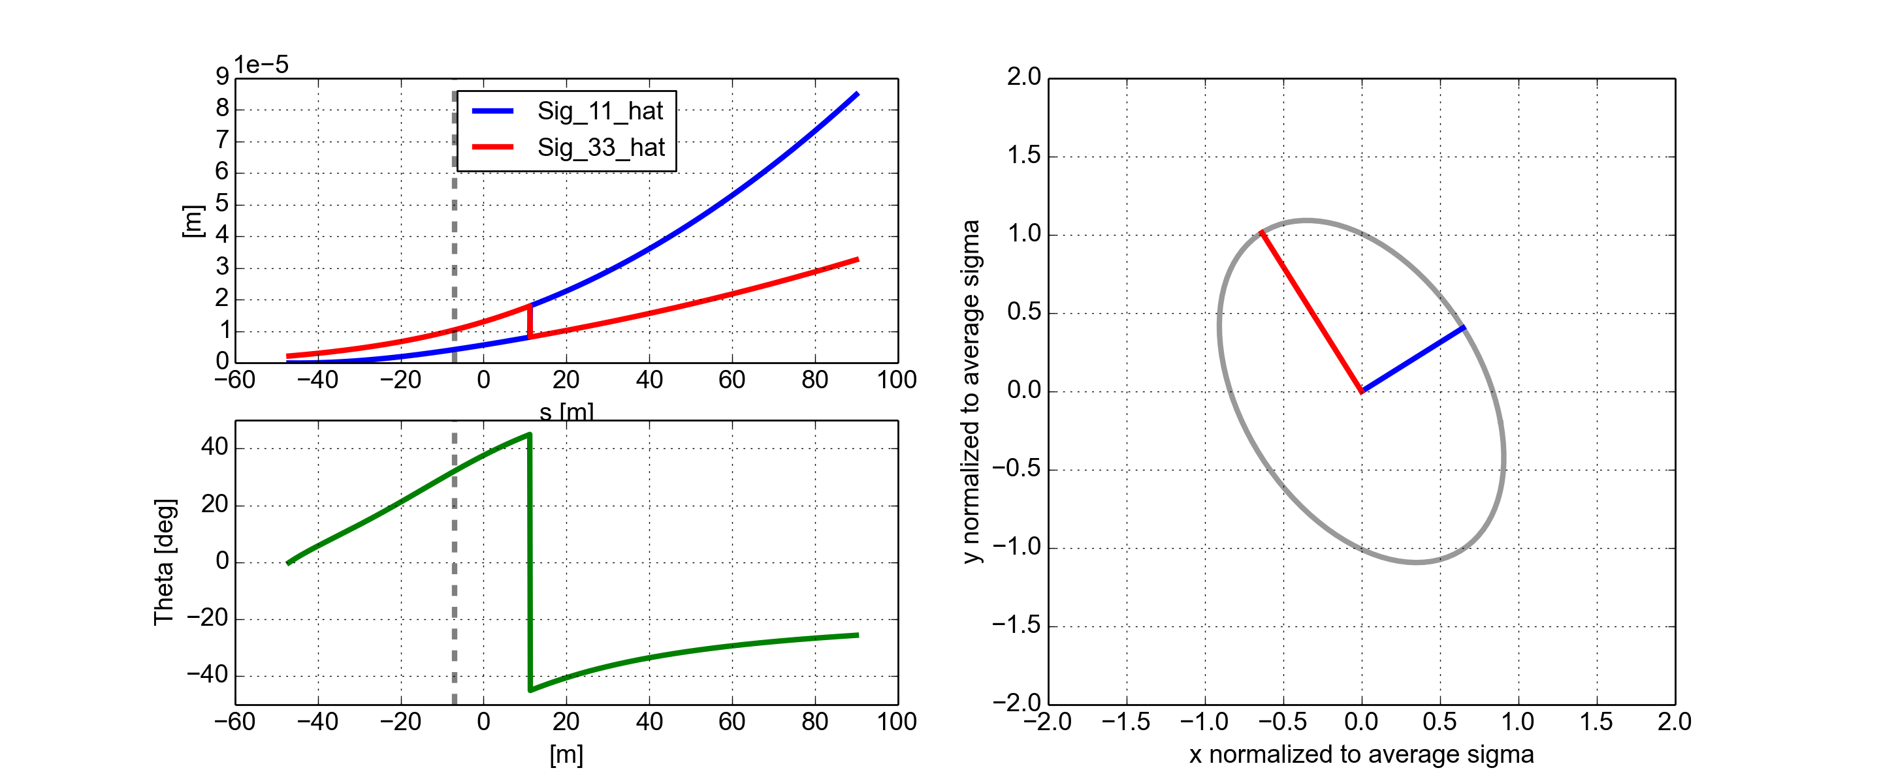
Transverse kicks - linear coupling of the strong beam
In general, linear coupling of the strong beam can be present:
The coupling angle and the beam sizes in the decoupled frame can be obtained by diagonalization of the Σ-matrix
Coupling angle depends on the s-coordinate

Slide 21
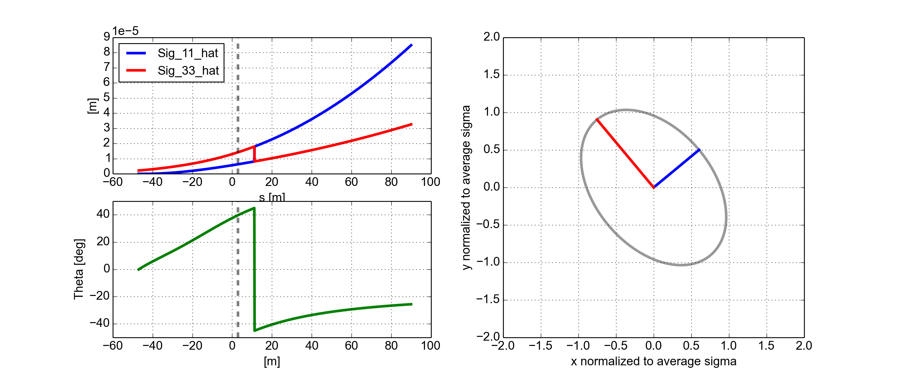
Transverse kicks - linear coupling of the strong beam
In general, linear coupling of the strong beam can be present:
The coupling angle and the beam sizes in the decoupled frame can be obtained by diagonalization of the Σ-matrix
Coupling angle depends on the s-coordinate

Slide 22
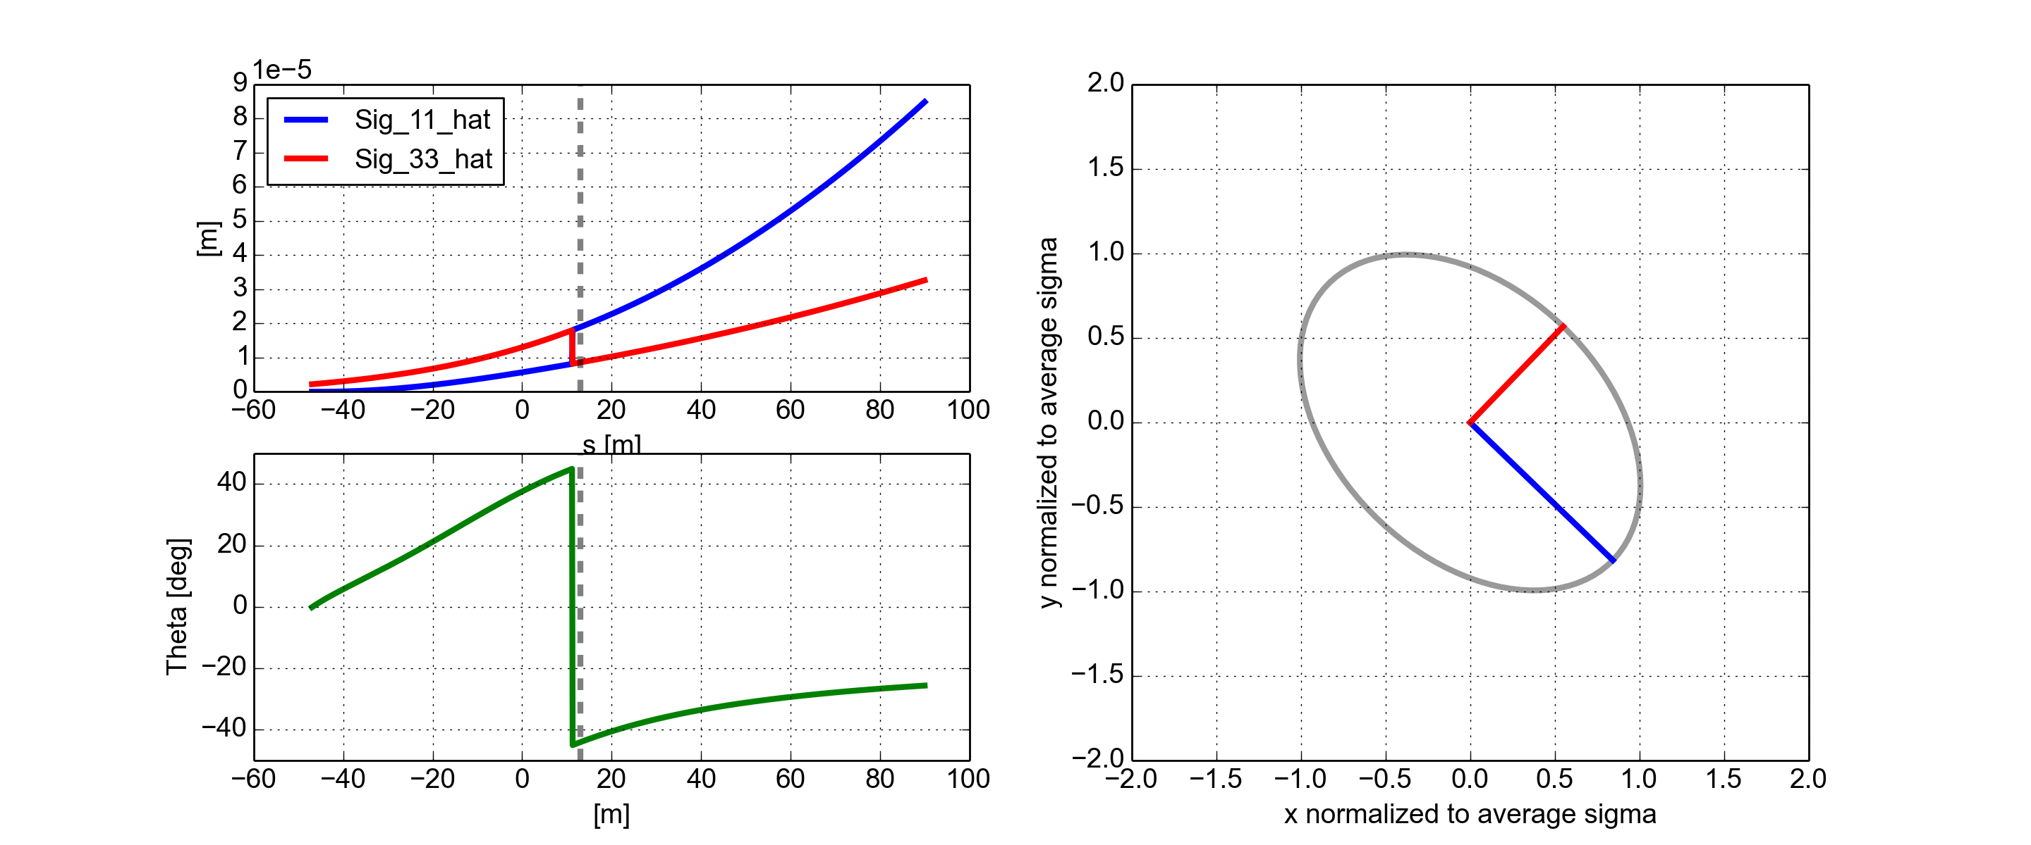
Transverse kicks - linear coupling of the strong beam
In general, linear coupling of the strong beam can be present:
The coupling angle and the beam sizes in the decoupled frame can be obtained by diagonalization of the Σ-matrix
Coupling angle depends on the s-coordinate

Slide 23
Transverse kicks - linear coupling of the strong beam
In general, linear coupling of the strong beam can be present:
The coupling angle and the beam sizes in the decoupled frame can be obtained by diagonalization of the Σ-matrix
Coupling angle depends on the s-coordinate

Slide 24
Transverse kicks - linear coupling of the strong beam
In general, linear coupling of the strong beam can be present:
The coupling angle and the beam sizes in the decoupled frame can be obtained by diagonalization of the Σ-matrix
Coupling angle depends on the s-coordinate

Slide 25
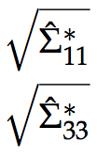
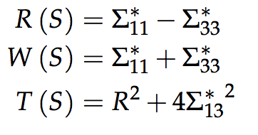
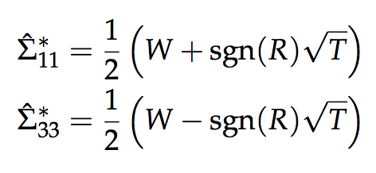
Transverse kicks - linear coupling of the strong beam
In general, linear coupling of the strong beam can be present:
The coupling angle and the beam sizes in the decoupled frame can be obtained by diagonalization of the Σ-matrix
Coupling angle depends on the s-coordinate
θ
Coupling angle and beam sizes in the de-coupled frame need to be evaluated:
Semi-axes in the decoupled frame:

Slide 26
Transverse kicks - linear coupling of the strong beam
In general, linear coupling of the strong beam can be present:
The coupling angle and the beam sizes in the decoupled frame can be obtained by diagonalization of the Σ-matrix
Coupling angle depends on the s-coordinate
θ
Coupling angle and beam sizes in the de-coupled frame need to be evaluated:

Slide 27
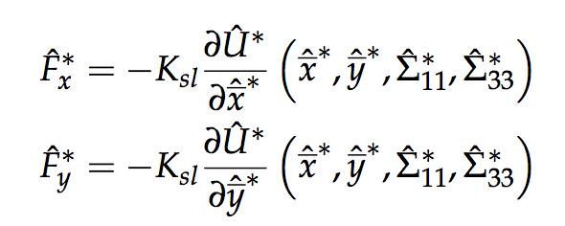
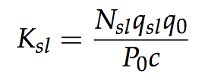
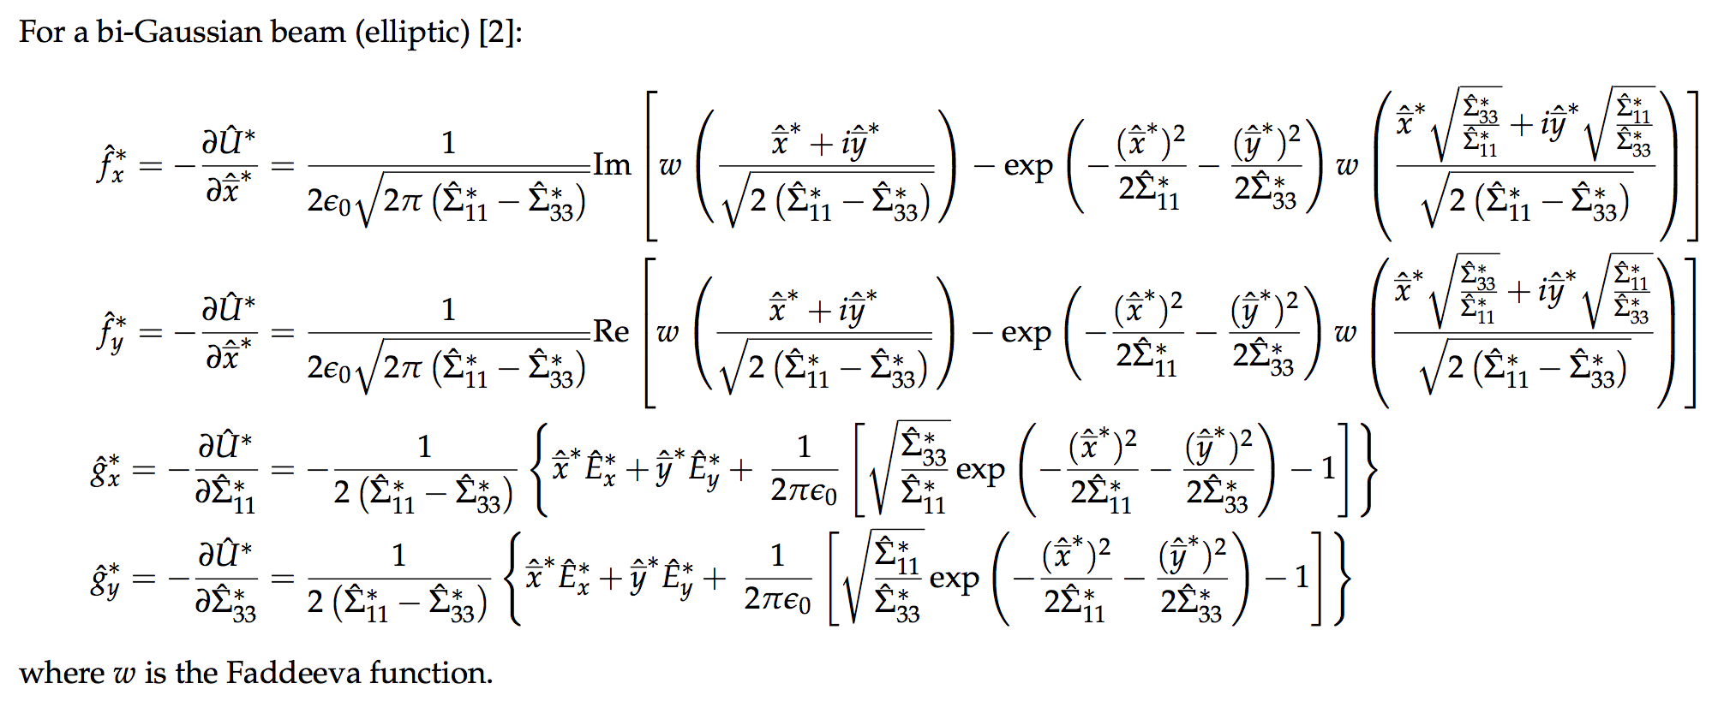
Transverse kicks - linear coupling of the strong beam
Once the coupling angle and the beam sizes in the decoupled plain are known, we proceed as follows:
We calculate the particle coordinates in the decoupled frame at the CP:
We calculate the kick from the slide in the decoupled reference frame:
θ
is the electric potential
where
For Gaussian (uncoupled) beams, closed forms exist to evaluate these quantities.
Bassetti-Erskine

Slide 28
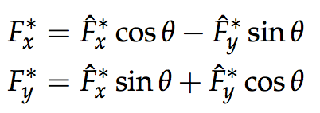
Transverse kicks - linear coupling of the strong beam
Once the coupling angle and the beam sizes in the decoupled plain are known, we proceed as follows:
We calculate the particle coordinates in the decoupled frame at the CP:
We calculate the kick from the slide in the decoupled reference frame:
θ
is the electric potential
where
For Gaussian (uncoupled) beams, closed forms exist to evaluate these quantities.
This map by itself is not symplectic → it becomes symplectic when longitudinal forces are also included [1]…
We rotate the kicks to de coupled reference frame
We apply the kicks to the transverse momenta and drift back to the IP (as explained before)

Slide 29
Energy change: effect of the angle
The longitudinal kick has two components:
The trajectory is, in general, not perpendicular to the transverse fields of the strong beam → this introduces this term in the longitudinal kick (see Hirata [1] for detailed explanation)
E_{strong}
v
IP
z>0
p_{x}>0
S*
Collision Point
(CP)
Boosted
reference frame

Slide 30
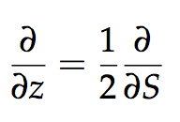
Energy change: grad-phi effect
The longitudinal kick has two components:
Another component of the longitudinal kick arises from the fact that the transverse shape of the strong beam is changing along z (hour-glass effect, “rotating” coupling angle)
The electric potential depends on z
The gradient of the electric potential (i.e. the electric field) has a z component
There is a z-kick, i.e. again a change in the particle energy
We need to evaluate the derivative w.r.t. z of the electric potential
As we have written down most of the involved quantities as a function of the coordinate of the CP (capital-S) we just notice that:
(in sixtrack jargon
z is called σ)

Slide 31
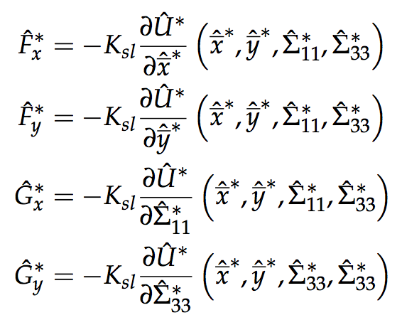
Energy change: grad-phi effect
Derivative rule for nested functions:
We need to evaluate these eight terms…
where:

Slide 32
Energy change: grad-phi effect
For these four terms a closed forms exist for transverse Gaussian beams
Bassetti-Erskine

Slide 33
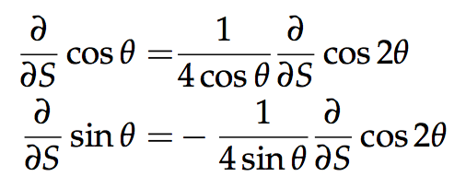
Energy change: grad-phi effect
Terms coming from linear coupling
Where:
With some some goniometric trick

Slide 34
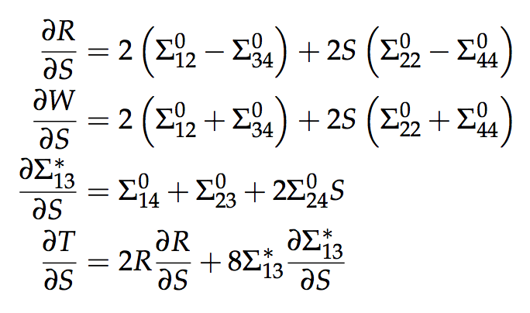
Energy change: grad-phi effect
Terms coming from hourglass effect
Derivatives of R, T and W

Slide 35
Handling the denominators
We have all the pieces, but on the way we introduced some denominators which can become zero! → not handled in SixTrack, properly treated in [4]

Slide 36
Outline
Introduction
SixTrack
Beam-beam effects in SixTrack
Review of the 6D beam-beam routines
Numerical model
Transverse generalized kicks
Linear coupling treatment
Energy change
Performed tests
Overview
Boost/anti-boost
Linear coupling
What next

Slide 37
Validation tests
Very difficult to identify problems by using the full tracking simulations
Need to test the single routine “on the bench”
Procedure performed for each functional block:
Built a C/python implementation from the equations in the document [5]
Extracted the corresponding sixtrack source code and compiled as of a stand-alone python module (f2py)
“Stress test” performed on the two: consistency checks, comparison against each other

Slide 38
Validation tests
Part of the code | Tests performed | Outcome
Boost/anti-boost | Comparison Sixtrack vs C/python routine Checked that the two cancel each other | Bug identified and corrected
Beam-beam forces (with potential derivatives w.r.t. sigmas) | Comparison sixtrack vs C/python routine Force compared against Finite Difference Poisson solver (PyPIC) Other derivatives compared against numerical integration/derivation | All checks passed
Beam shape propagation and coupling treatment | Comparison Sixtrack vs C/python routine Comparison against MAD for a coupled beam line Crosscheck with numerical derivation | Bug identified and corrected Vanishing denominators not treated correctly → correct treatment developed and implemented in the library, to be ported in SixTrack
Slicing | Check against independent implementation | Passed but precision is quite poor (1e-3)
Computation of the kicks | Check against independent implementation | All checks passed
In the following I comment only on these two parts…

Slide 39
Boost/anti-boost
Boost and anti-boost should cancel each other exactly
Problem identified in the Sixtrack implementation
Error after boost + anti-boost (example)
Python test module
x 4.3e-19
px 0.0
y 4.3e-19
py 3.e3-17
sigma 0.0
delta 1e-16
SixTrack routine
x 6.5e-19
px 0.065
y 4.3e-19
py 0.027
sigma 0.0
delta 2.0e-17
SixTrack corrected
x 6.5e-19
px 5.55e-17
y 4.3e-19
py 0.1e-19
sigma 0.0
delta 2.0e-17
Discrepancy found between in the anti-boost between derived equations and SixTrack source code:
TRACK(2)=(TRACK(2)+CALPHA*SPHI*H1)*CPHI
TRACK(4)=(TRACK(4)+SALPHA*SPHI*H1)*CPHI
TRACK(2)=(TRACK(2)*CPHI+CALPHA*TPHI*H1)
TRACK(4)=(TRACK(4)*CPHI+SALPHA*TPHI*H1)
Digging a bit we found out that the issue was already present in BBC (1996), on which the Sixtrack implementation is based, and quietly survived for >20 years

Slide 40
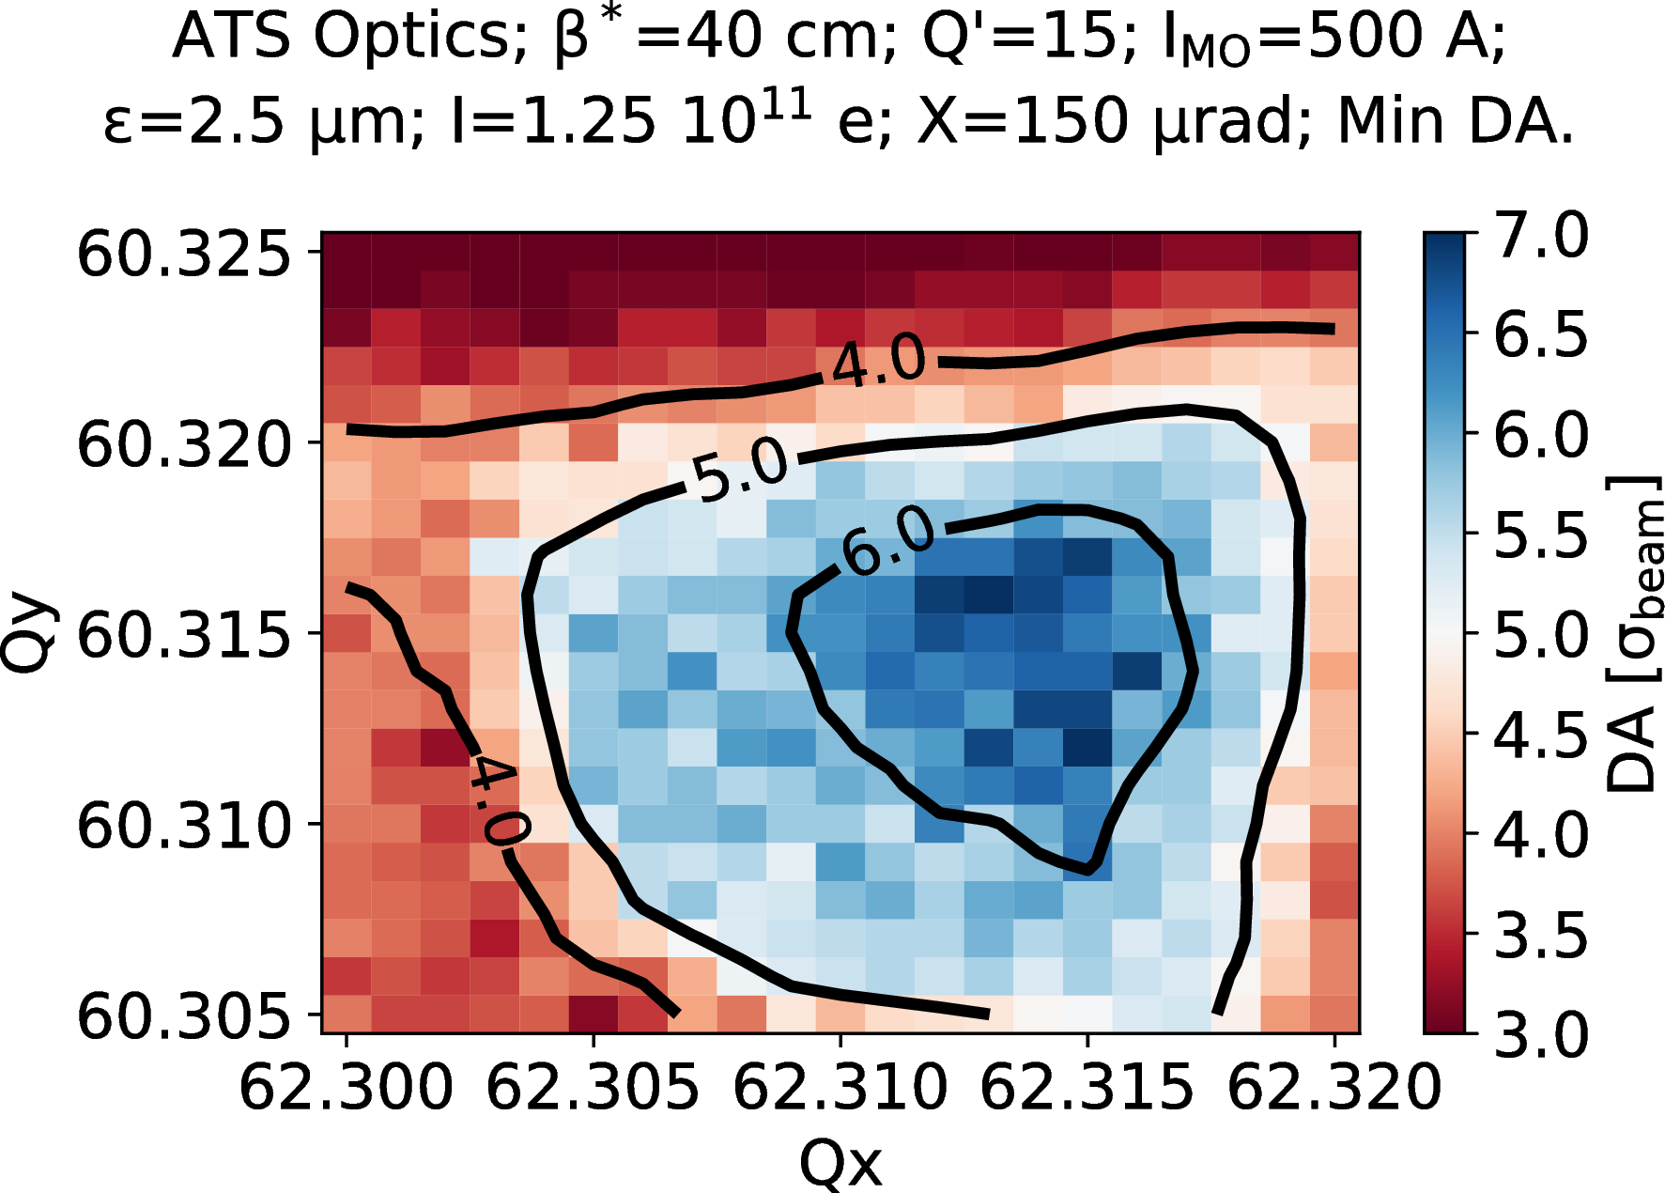
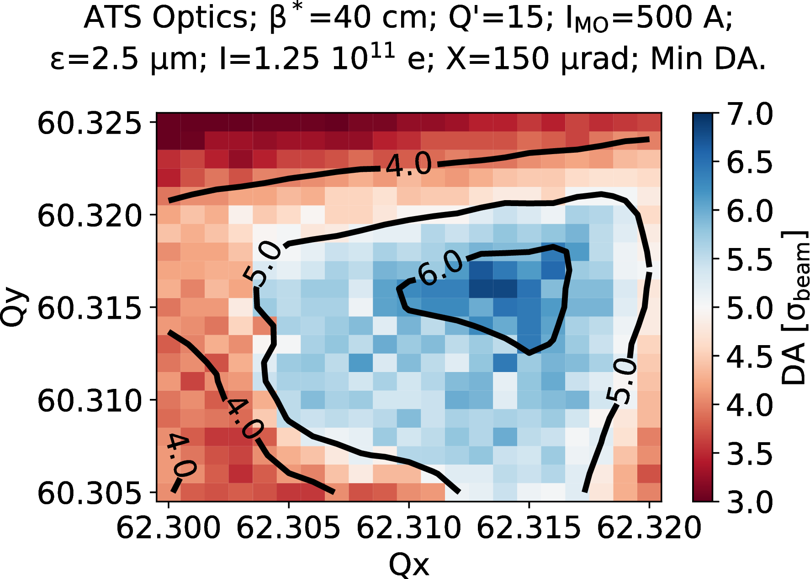
Boost/anti-boost
Impact on realistic simulation study assessed by D. Pellegrini
Tune scans comparison with 2017 ATS optics show no dramatic change, but slightly worse DA
Old version
Corrected version

Slide 41
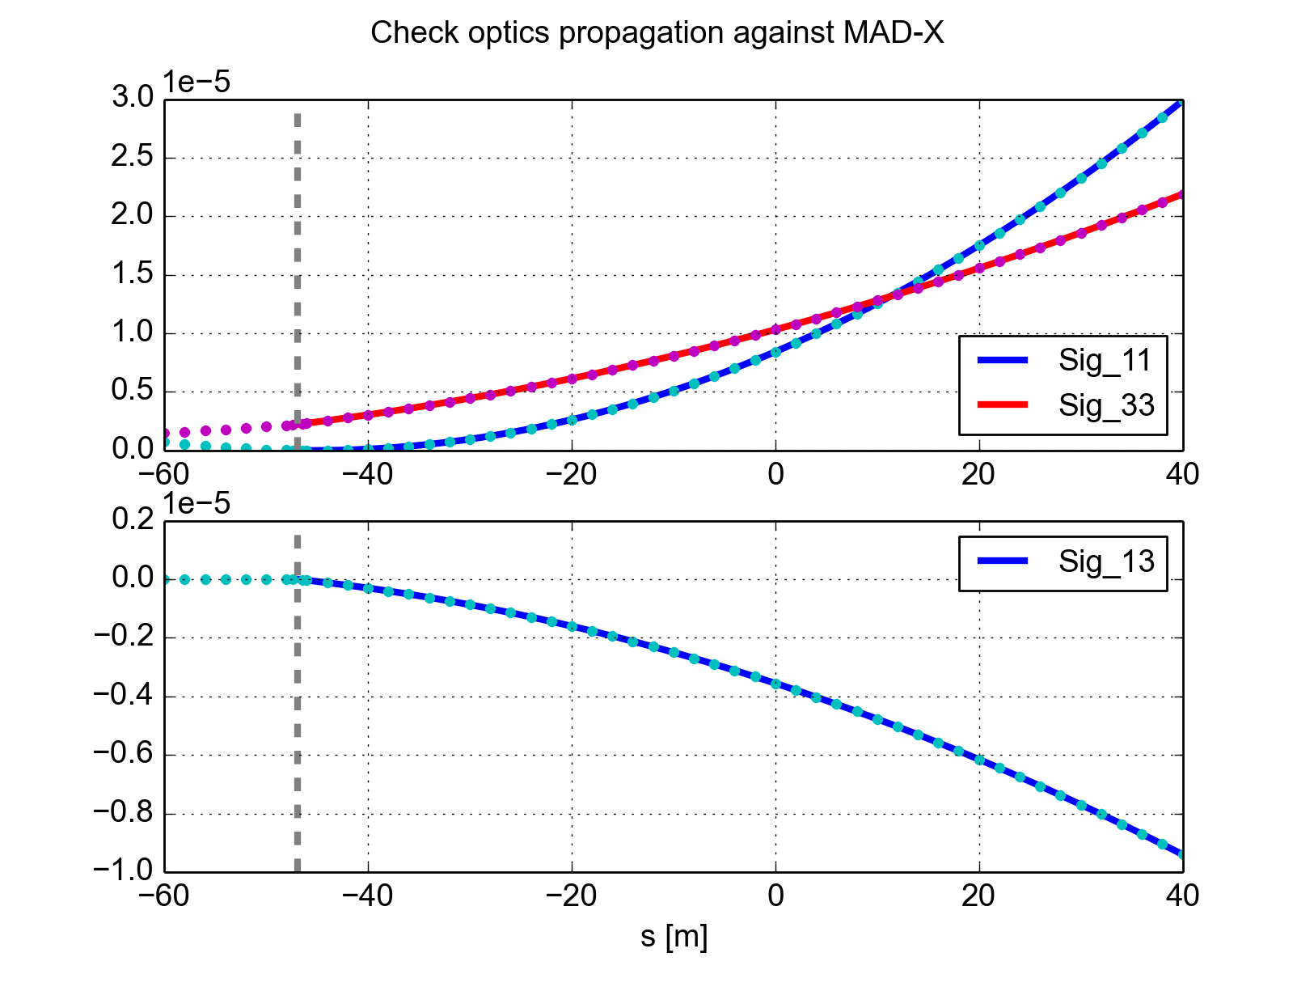
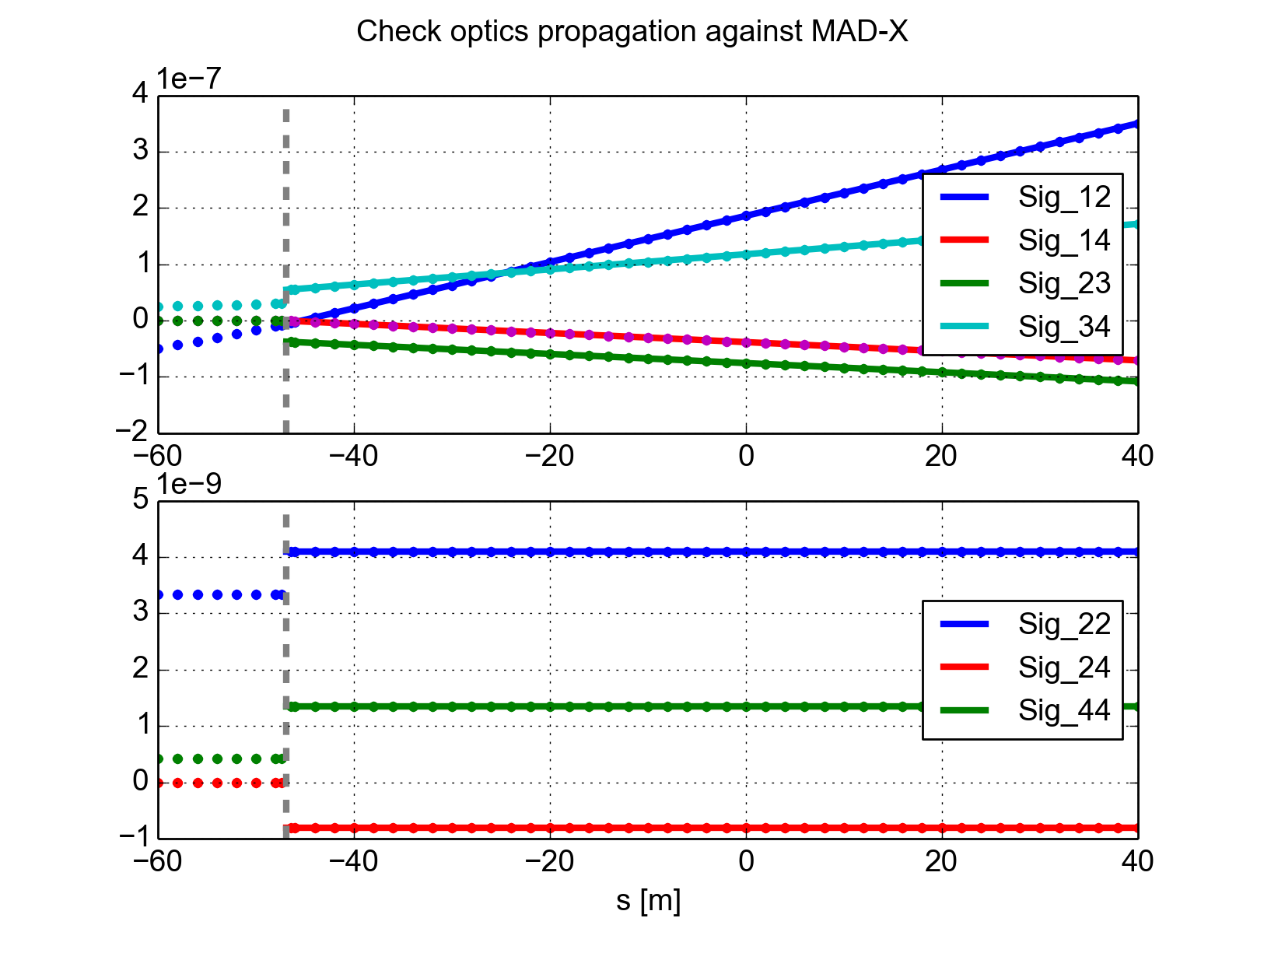
Σ-matrix propagation with linear coupling
Library tested against MAD-X:
Built a simple line with a strong skew quadrupole
Entering with a de-coupled beam
Saves Σ-matrix at regularly spaced markers for comparison
Skew
quadrupole
Skew
quadrupole
Dots: MAD-X
Lines: SixTrack

Slide 42
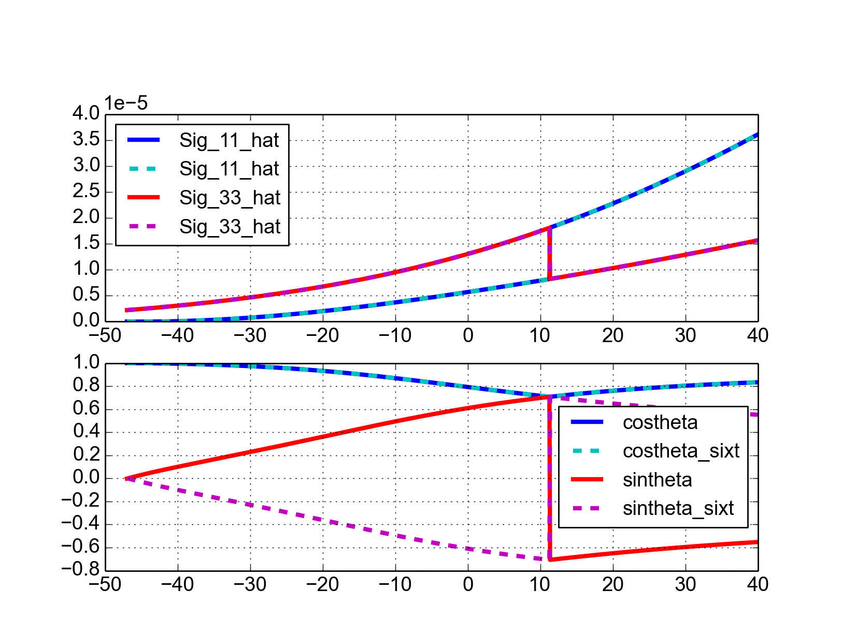
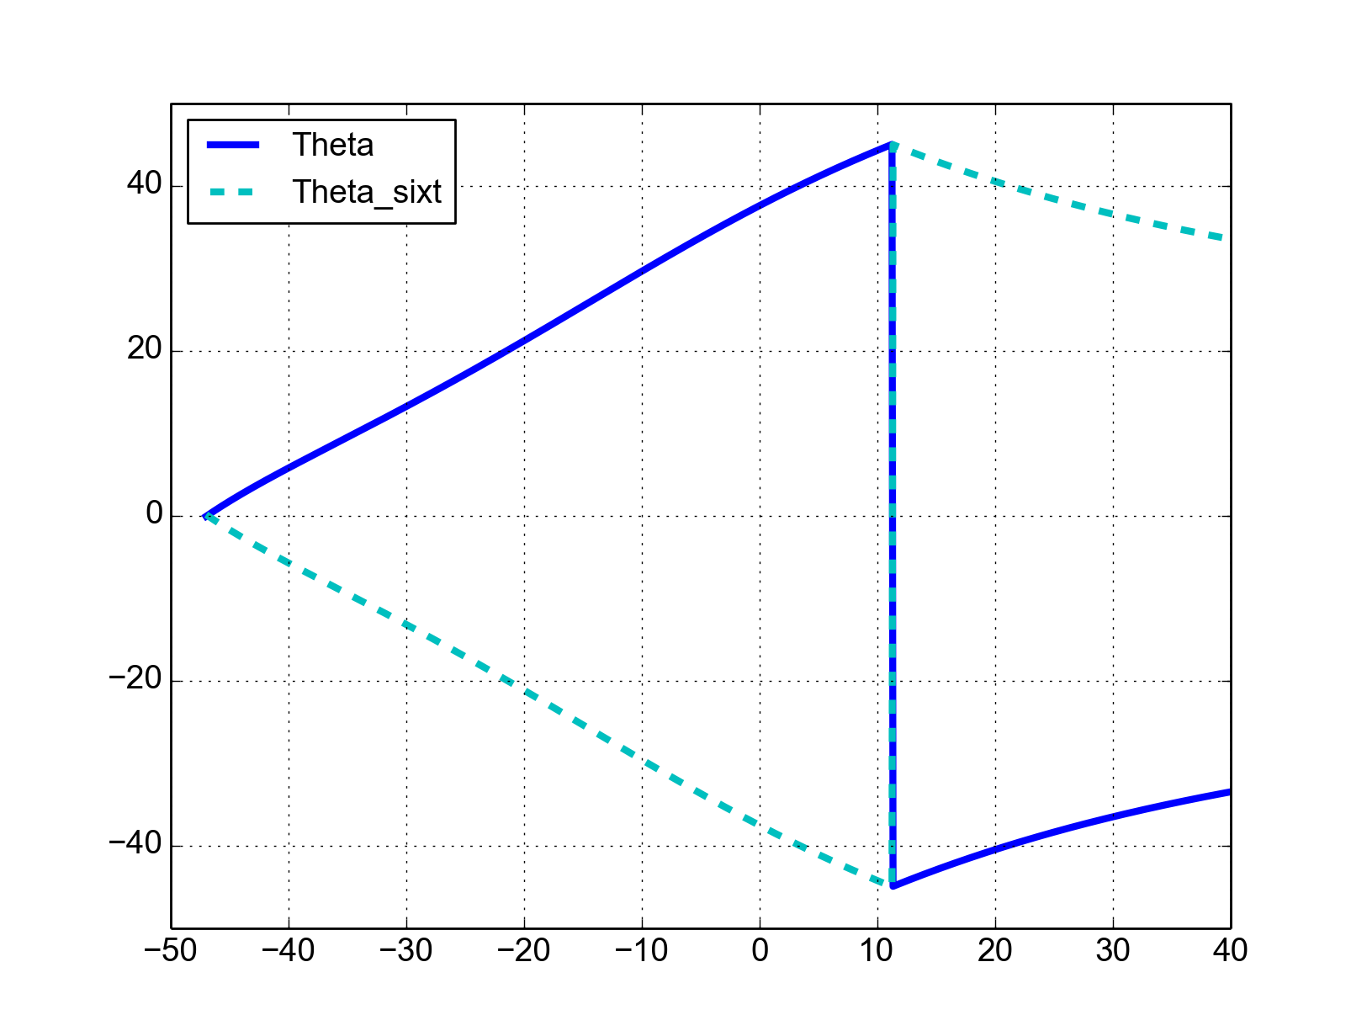
Σ-matrix transformation to un-coupled frame
Verified against numerical diagonalization of the Σ-matrix:
Sign error in the computation of the coupling angle
if(abs(sinth).gt.pieni) then
sinth=(-1d0*sfac)*sqrt(sinth)
else
sinth=zero
endif
Original source code:
Coupling angle [deg]

Slide 43
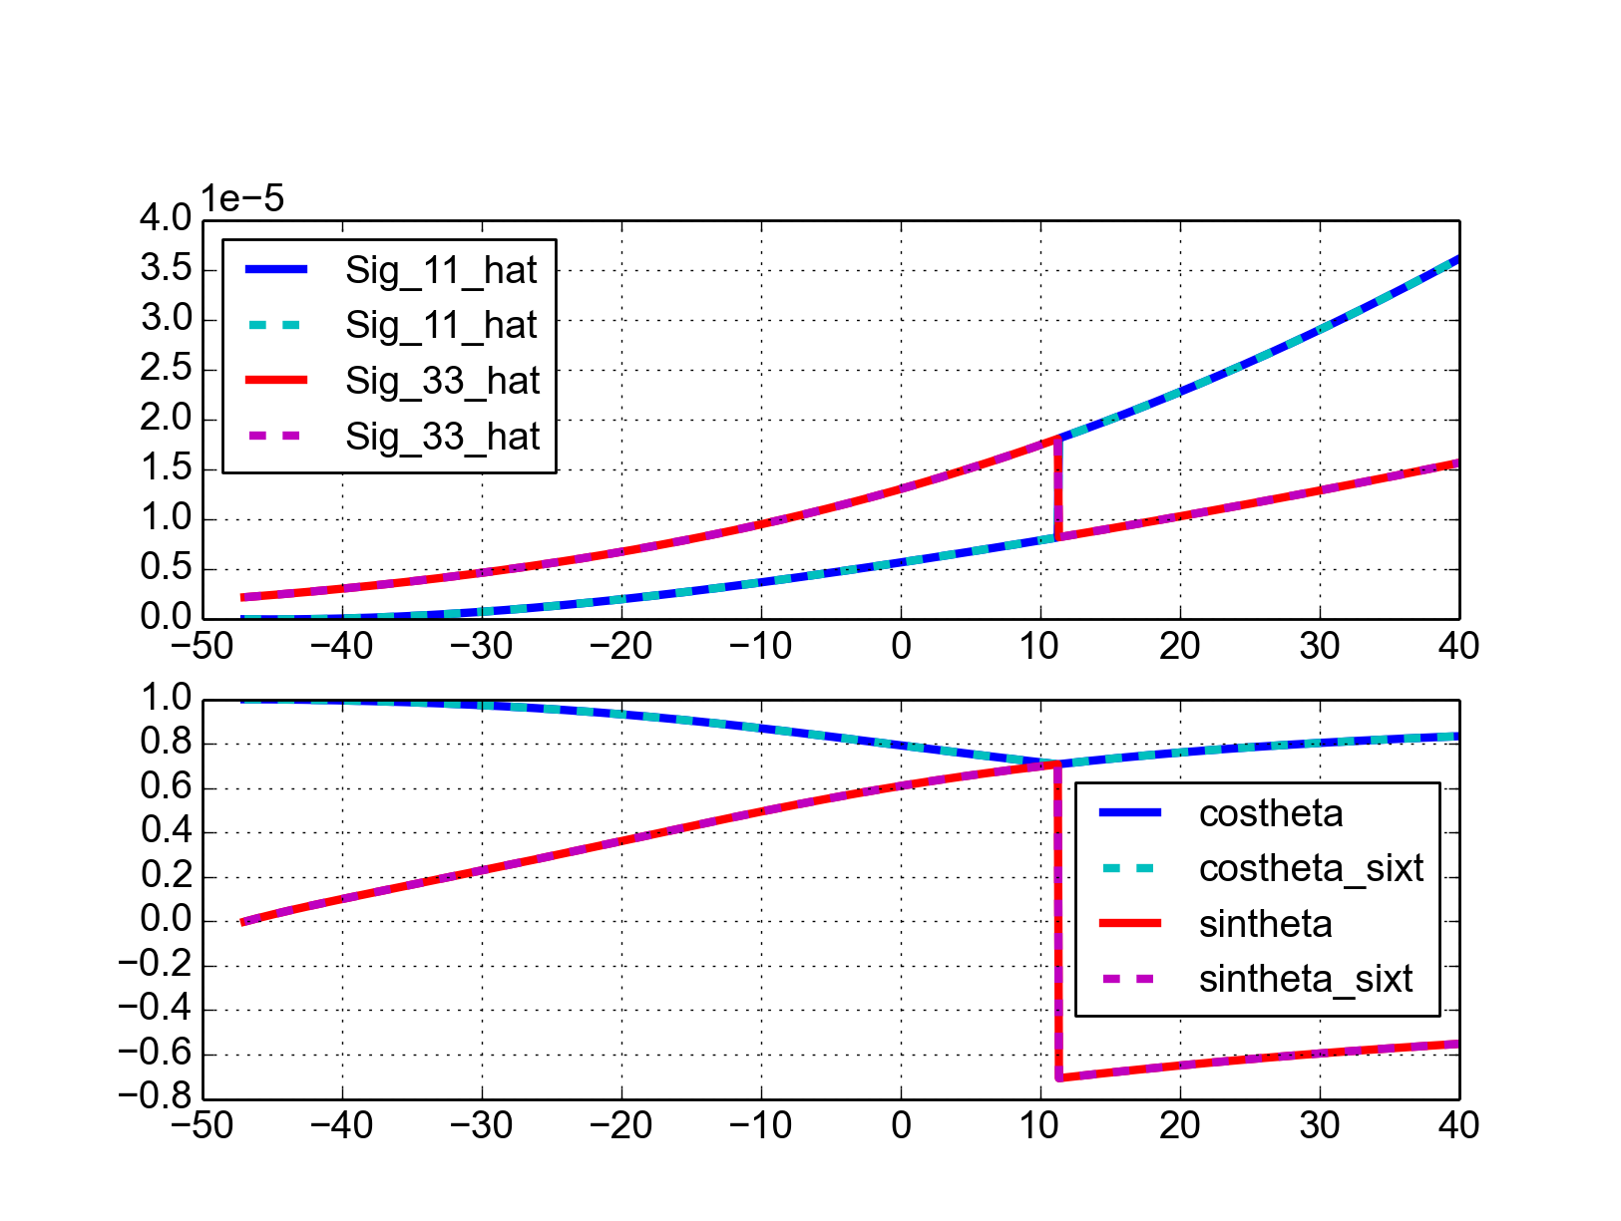
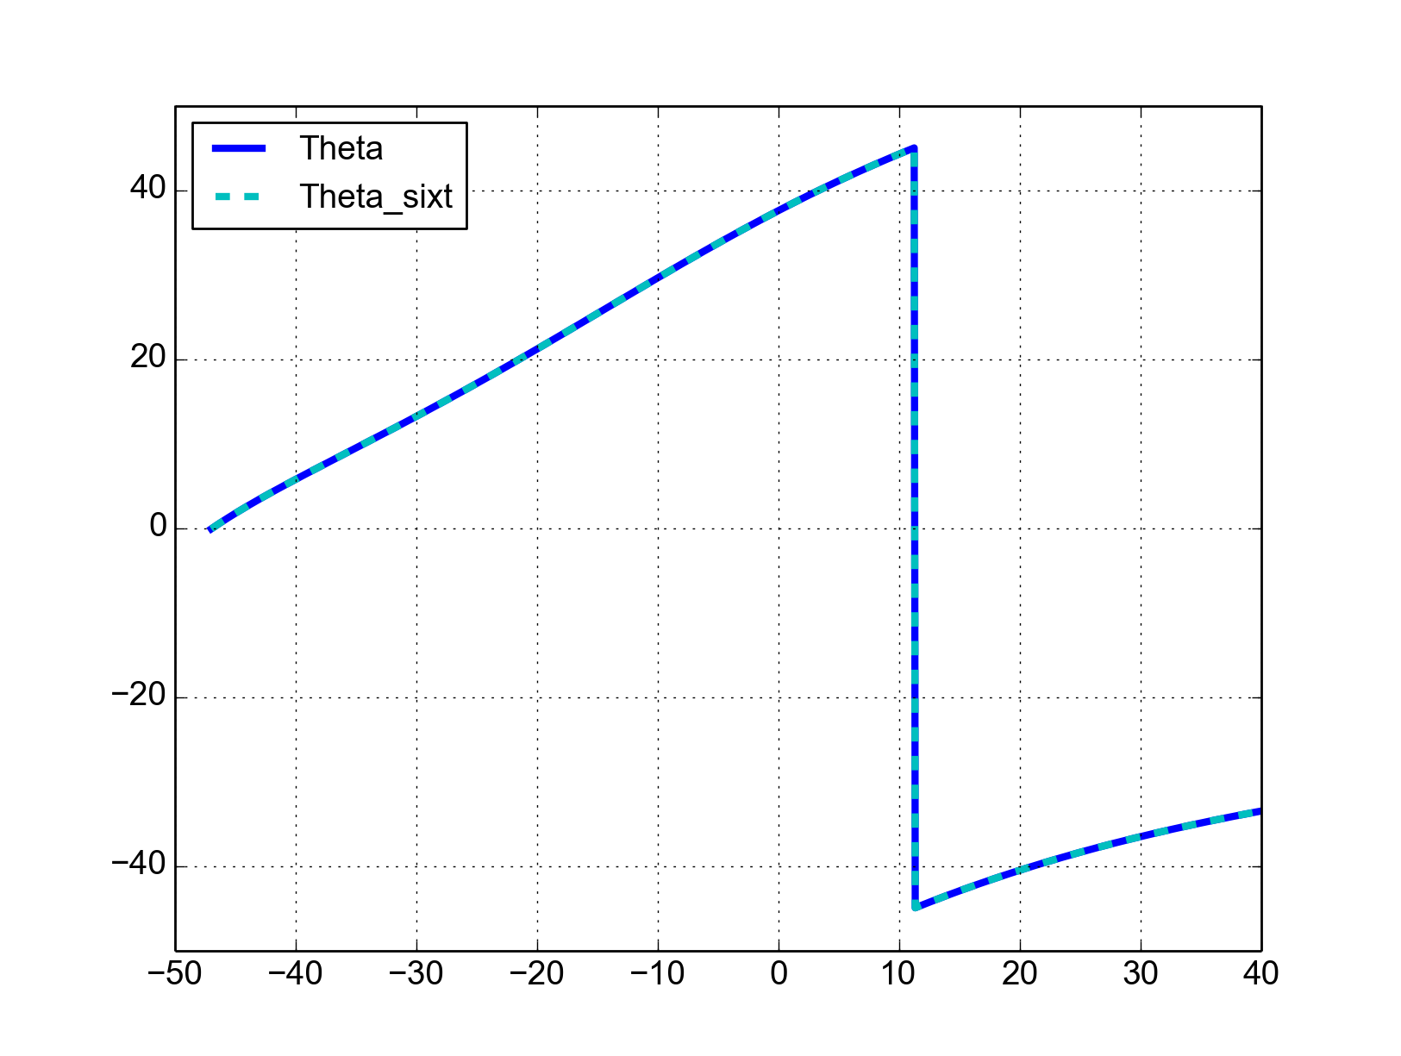
Σ-matrix transformation to un-coupled frame
Verified against numerical diagonalization of the Σ-matrix:
Sign error in the computation of the coupling angle
if(abs(sinth).gt.pieni) then
sinth=(sfac)*sqrt(sinth)
else
sinth=zero
endif
Corrected source code:
Coupling angle [deg]

Slide 44
Σ-matrix transformation to un-coupled frame
Input sigma matrix:
{'Sig_11_0': 2.1046670129999999e-05, 'Sig_12_0': 2.7725426699999999e-07, 'Sig_13_0': 5.9207071659999999e-06, 'Sig_14_0': 1.2224001670000001e-07, 'Sig_22_0': 3.6622825020000002e-09, 'Sig_23_0': 7.4141336339999994e-08, 'Sig_24_0': 1.495491124e-09, 'Sig_33_0': 3.165637487e-06, 'Sig_34_0': 7.9058234540000002e-08, 'Sig_44_0': 2.040387648e-09}
Checked using full SixTrack simulations (numerical divergence of the computed kicks)
Original
Corrected
K. Sjobaek
More info at: https://github.com/SixTrack/SixTrack/issues/267#issuecomment-307333656

Slide 45
Outline
Introduction
SixTrack
Beam-beam effects in SixTrack
Review of the 6D beam-beam routines
Numerical model
Transverse generalized kicks
Linear coupling treatment
Energy change
Performed tests
Overview
Boost/anti-boost
Linear coupling
What next

Slide 46
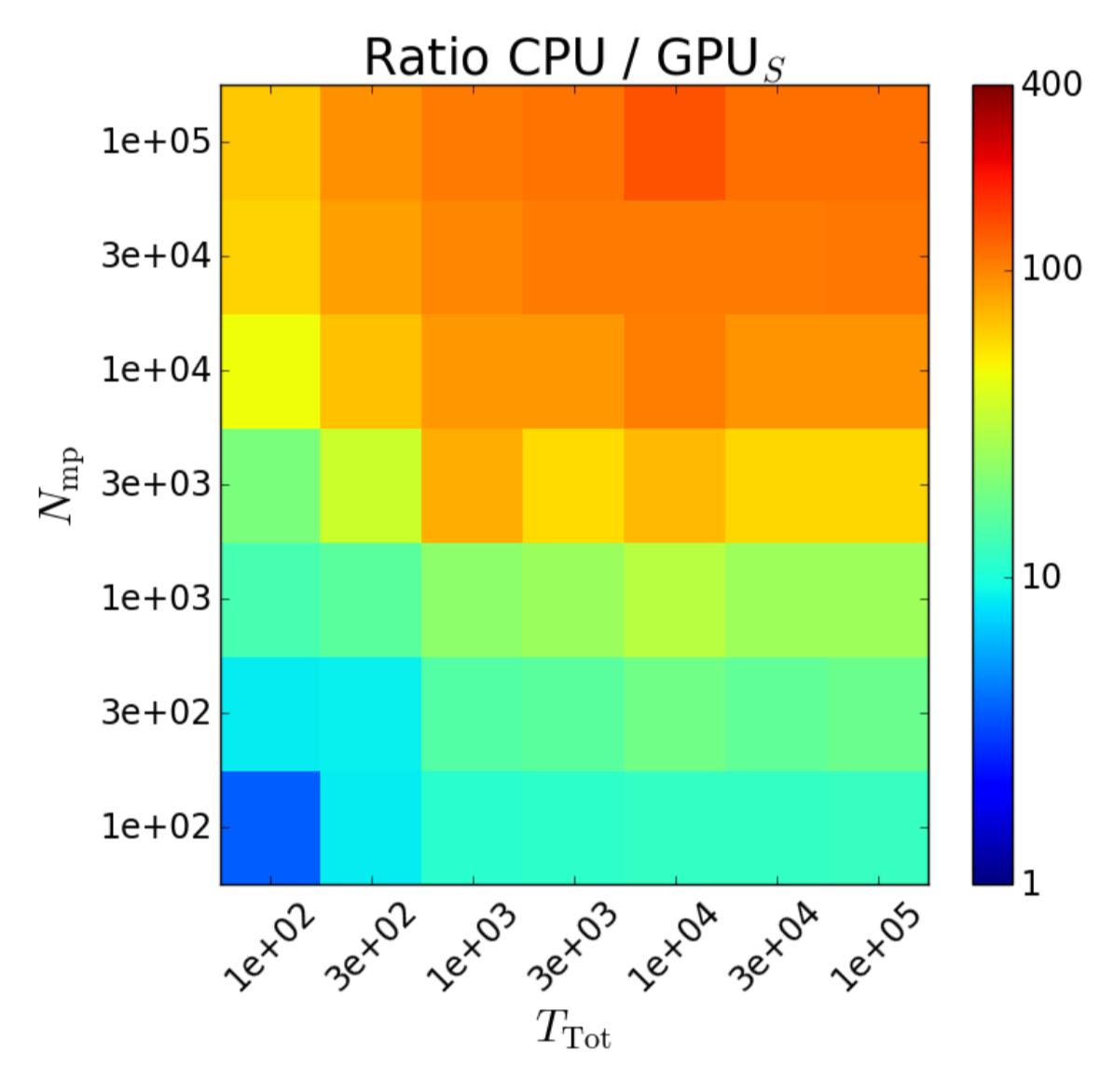
What next
We want to move from the monolithic structure of the SixTrack FORTRAN code into a much more flexible tool
The idea is to bring the knowledge from the SixTrack experience into a modern modular library called SixTrackLib aiming at:
Better integration with other simulation and analysis tools (via a python interface)
Improving efficiency of further development and maintenance
Retaining SixTrack computational efficiency (core routines written in C)
Profiting of huge computing power offered by GPU computing (via OpenCL)
Thanking with beam-beam on GPU already exploited for FCC studies using a simplified model (linear map + head-on kicks) → extremely promising (more info on S. Furuseth’s thesis)
Next challenge will be to keep a significant speed-up while tracking the full LHC lattice with all long-range and head-on encounters
Plan to have first pilot studies by the end of 2018
S. Furuseth, X. Buffat

Slide 47
Thanks for your attention!

Slide 48
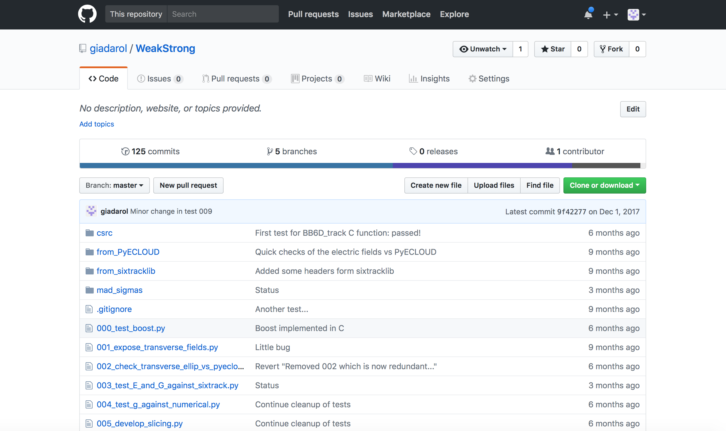
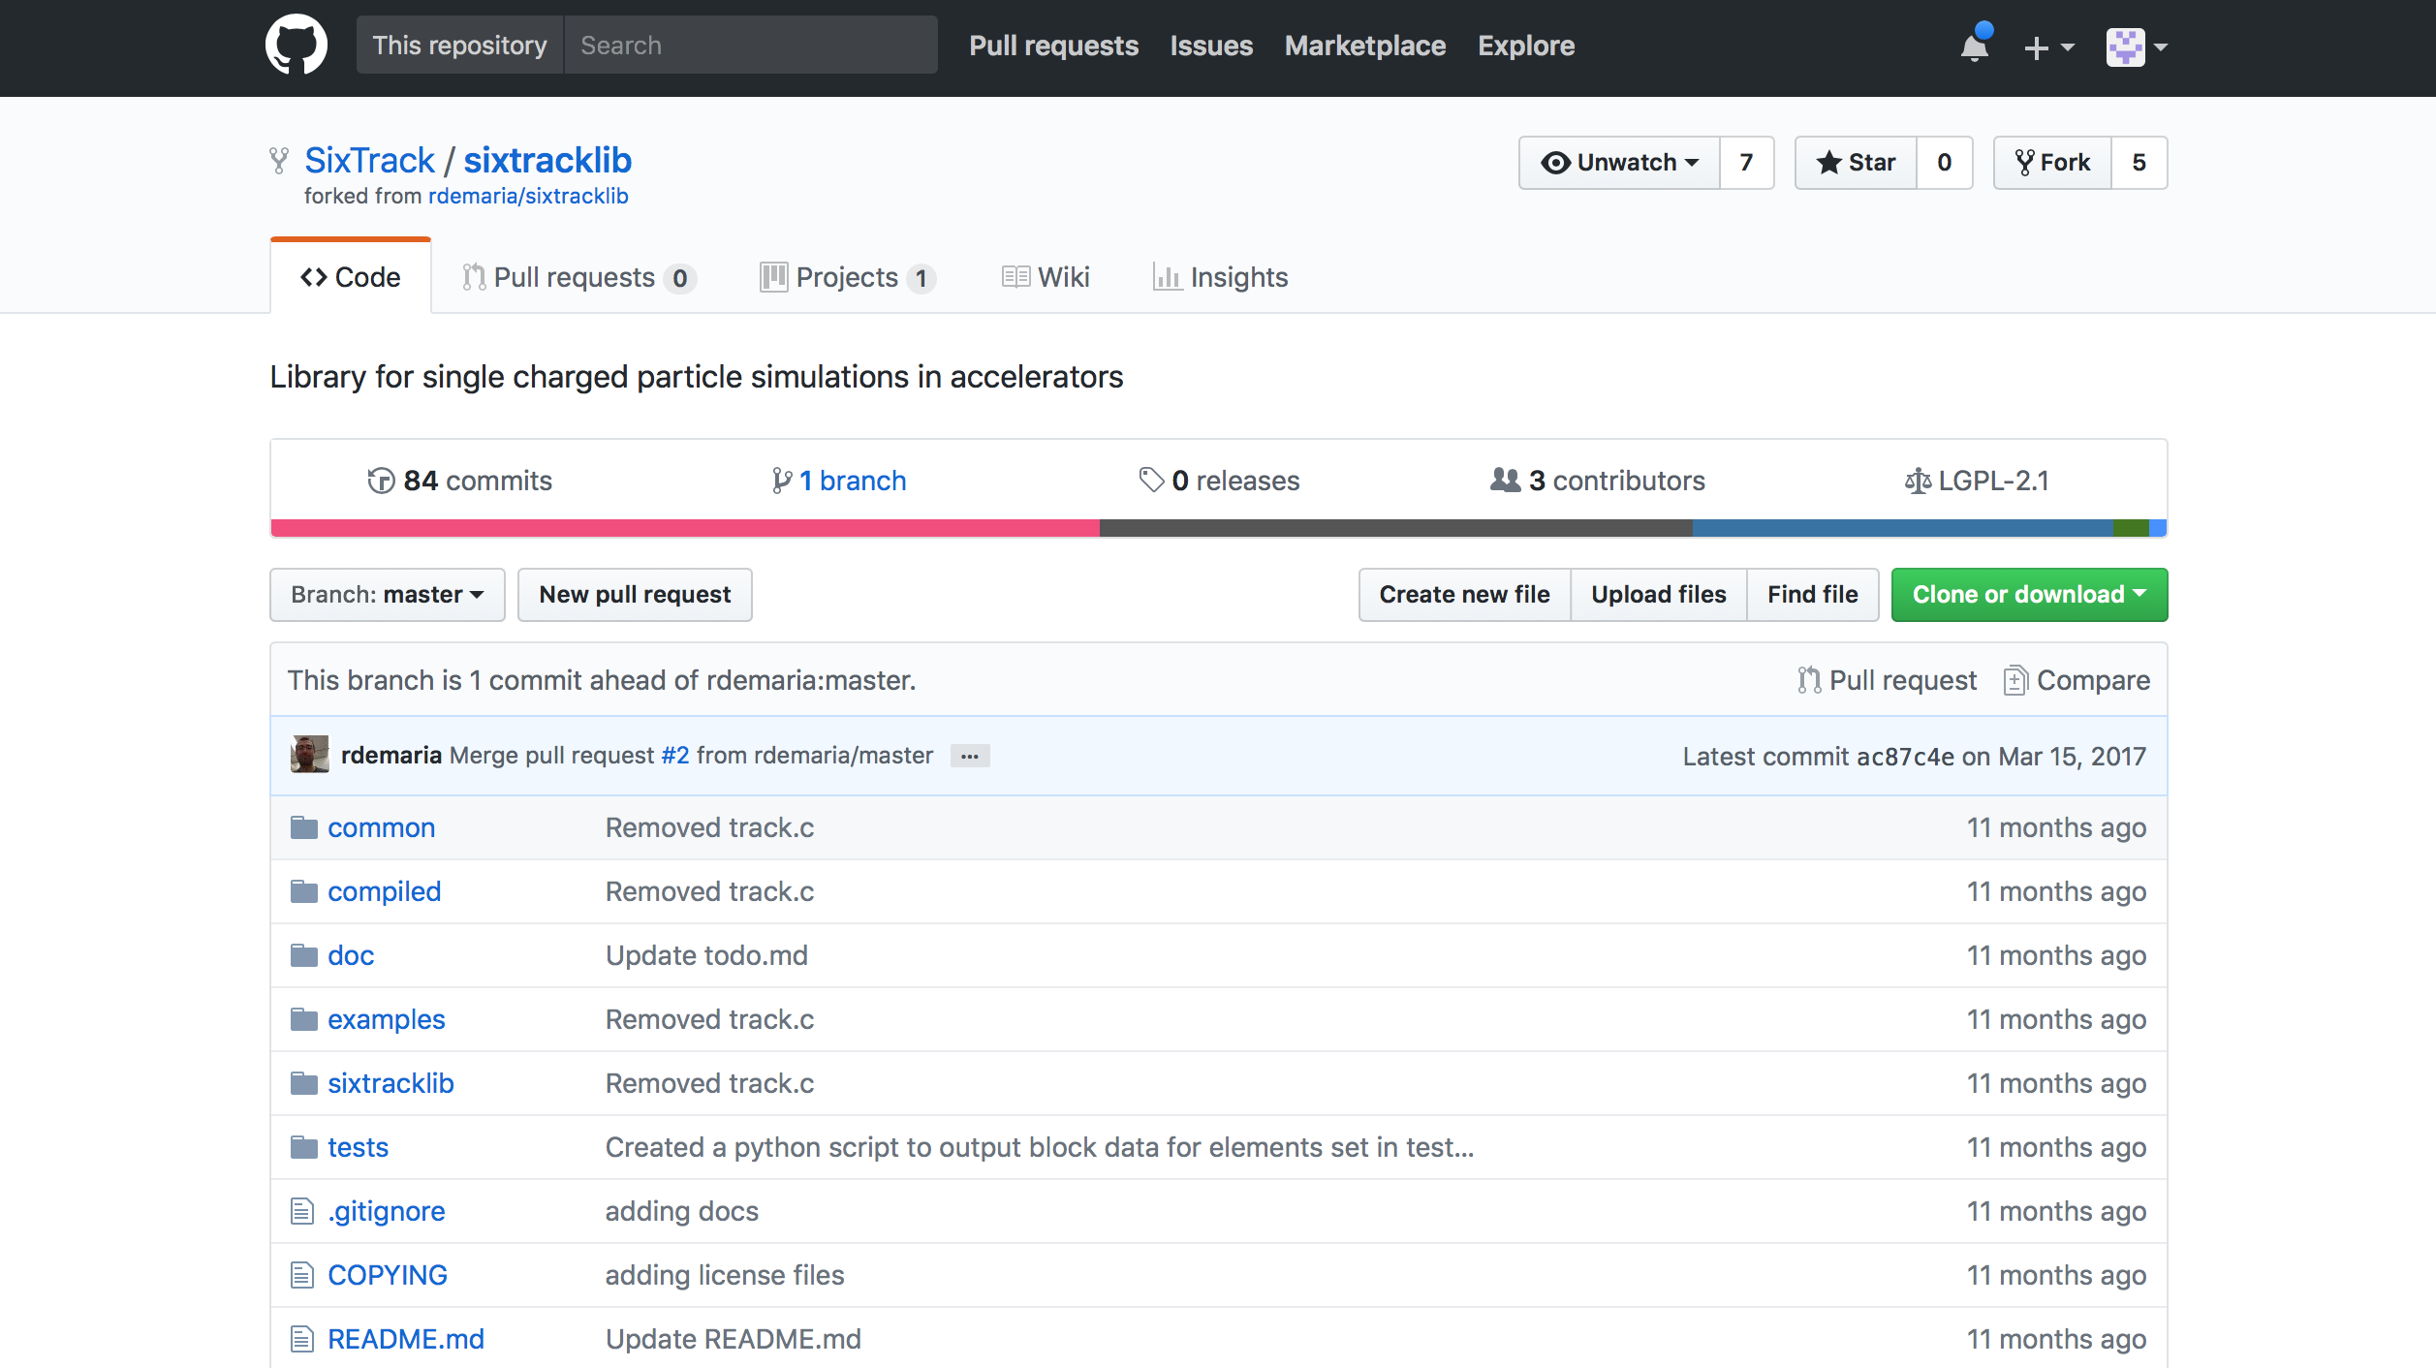
Next steps
We want to move from the monolithic FORTRAN structure of SixTrack into a much more flexible tool
The idea is to bring the knowledge from SixTrack experience into a modern modular library called SixTrackLib aiming at:
Better integration with other simulation and analysis tools (via a python interface)
While retaining SixTrack computational efficiency (core routines written in C)
Profiting of huge computing power offered GPU computers (via OpenCL)

