Slide 2
beam-beam orbit effects in the LHC
A. Gorzawski, M. Hostettler, Y. Papaphilippou, G. Papotti, T. Pieloni
thanks to X. Buffat, K. Fuchsberger, W. Herr, R. de Maria, T. Persson, D. Pellegrini, J. Wenninger the CMS experiment and the LHC shift crews

Slide 3
overview
introduction
the LHC and its operation
the cause of beam-beam orbit effects
observations
beam separation scans
simulations
the TRAIN code
compare simulations to observations

Slide 4
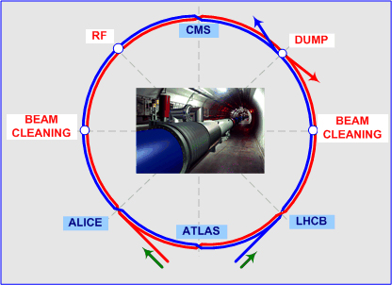
the Large Hadron Collider
2-ring hadron collider (mostly p-p)
4 experiments at “Interaction Points” (IPs):
IP1: ATLAS – high-luminosity
IP5: CMS – high-luminosity
IP2: ALICE – levelled by separation (factor ~ 0.005)
IP8: LHCb – levelled by separation (factor ~ 0.1)
beam parameters
top energy: 6.5 TeV / beam
bunch intensities of ~1.2 ∙ 10¹¹ ppb
25 ns bunch spacing, ~2000 bunches
crossing angles of ~150 urad to avoid parasitic collisions

Slide 5
LHC interaction regions
common vacuum chamber around the Interaction Points
starting from separation dipole (59m from IP): design orbit separation
separation dipole
Interaction Point (IP)
inner triplet
recombination dipole
LHC design report
common vacuum chamber: 153m from the IP
separate vacuum chambers

Slide 6
crossing angle and long-range beam-beam
bunch spacing (25ns = 7.5m) < distance to separation dipole (59m)
crossing angle to avoid parasitic collisions
2 x ~150 urad ≈ 9σ separation on the first encounter outside the nominal IP
vertical in ATLAS, horizontal in CMS
“long-range” beam-beam encounter every 25ns/2 = 12.5ns = 3.75m
up to the separation dipole: 16 encounters (no design orbit separation)
in the common beam pipe: 41 encounters total
long-range beam-beam
head-on
beam-beam

Slide 7
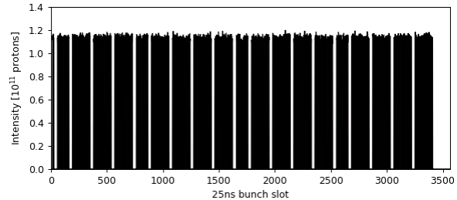
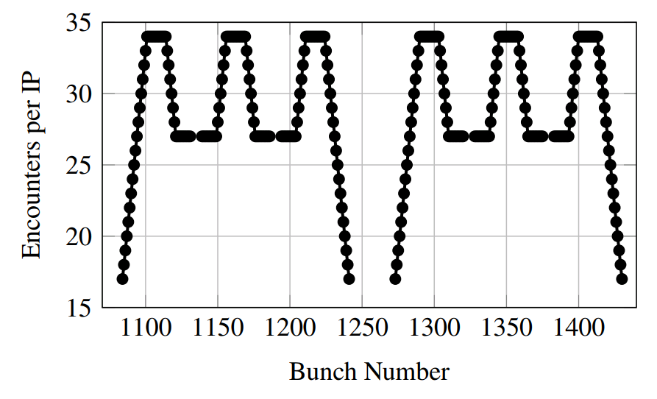
“PACMAN” effects
LHC filled with several “bunch trains”
gaps between trains (> 8 bunch slots)
“PACMAN” effect:
bunches next to the gaps have less long-range encounters
trains
gaps
short gaps
short gaps
missed
long-range encounter
batch of 3 trains
long gap

Slide 8
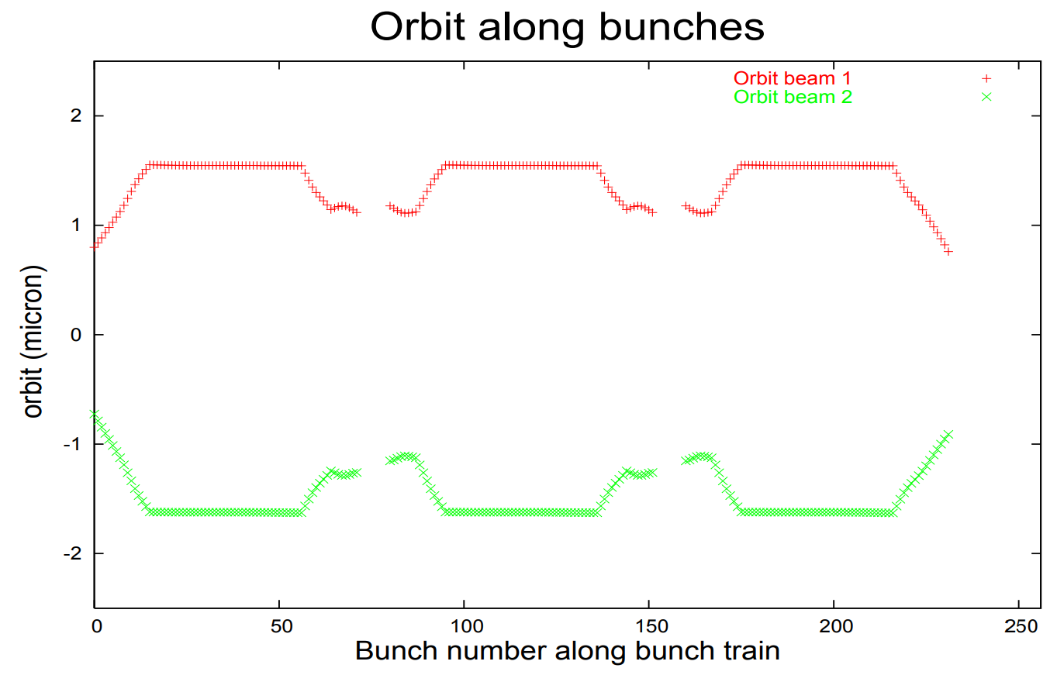
impact of PACMAN effects
bunch-to-bunch differences in
closed orbit (few um)
tune (few 10⁻³)
chromaticity
not correctable by orbit steering or DC wire
would need to act on individual bunches
partial self-compensation by H/V alternating crossing at symmetric IPs (ATLAS and CMS in LHC)
must be kept well under control
avoid differences in lifetime
avoid instabilities & resonances (e.g. tune)
W. Herr, “Features and implications of different LHC crossing schemes”, LHC project report, 2003

Slide 9
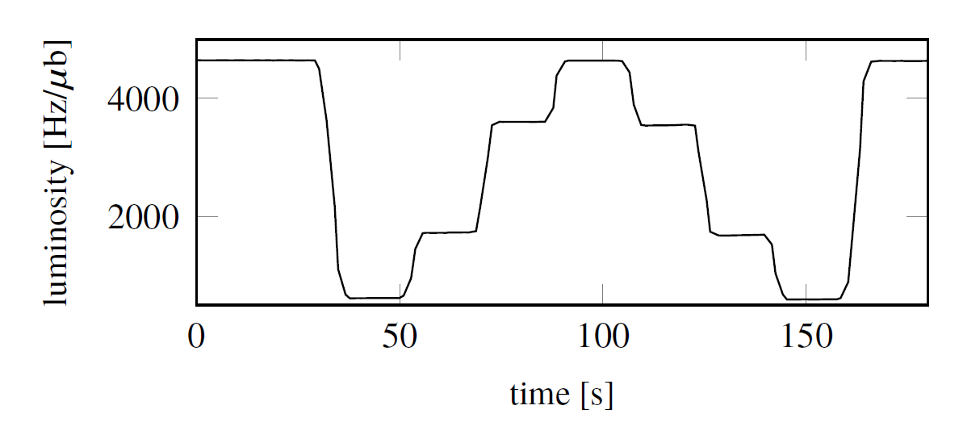
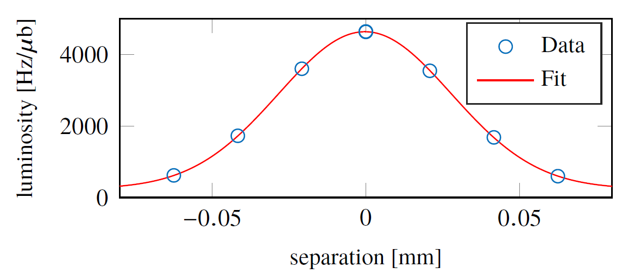
observations: emittance scans
beam separation scans
~3 σ separation, < 5 minutes
regularly done at CMS since 2015
ATLAS scans foreseen in 2018
bunch-by-bunch luminosity available
fit parameters per bunch: Σ, L₀, s
Σ: convoluted beam width – emittance
L₀: peak luminosity
s: closed orbit separation – LRBB orbit
s
L₀
Σ

Slide 10
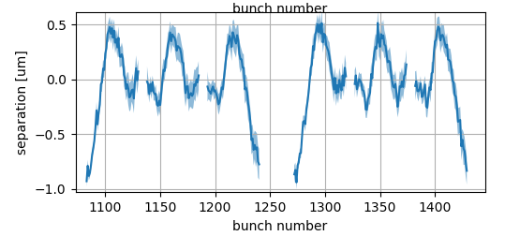
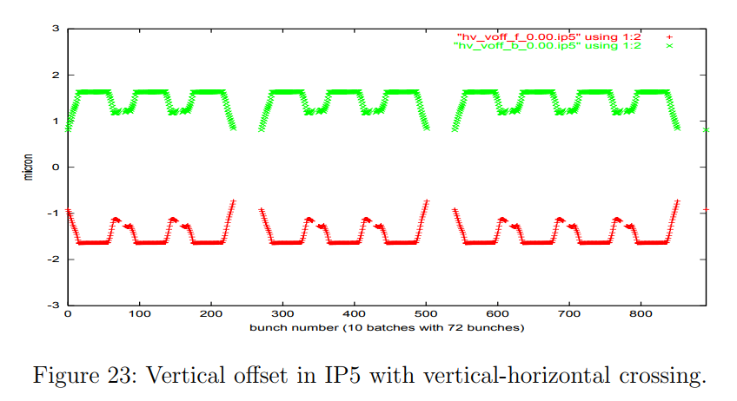
observed closed-orbit effects
H
V
LHC fill 5976
W. Herr, “Features and implications of different LHC crossing schemes”, LHC project report, 2003
⇒ good qualitative agreement in the V (separation) plane

Slide 11
simulations: the TRAIN code
self-consistent simulation of beam-beam long-range effects
FOTRAN77 code from 1995 by F. C. Iselin, later used and improved by W. Herr, H. Grote, T. Pieloni, A. Gorzawski …
orbit offsets, tunes, chroma due to beam-beam and PACMAN effects
“post-processor” for MAD-X using TWISS files and SECTORMAP output (1st and 2nd order transport maps)

Slide 12
recent improvements to TRAIN
MAD-X SECTORMAP generation
small (ancient) breaking change in MAD-X
disagreement between TRAIN and MAD-X TWISS
support for more than 15 LR encounters
design orbit separation beyond the separation dipole

Slide 13
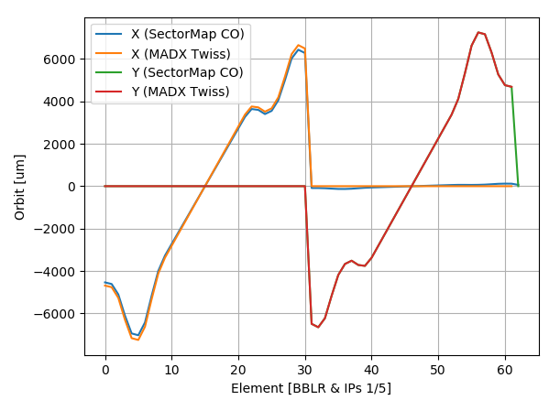
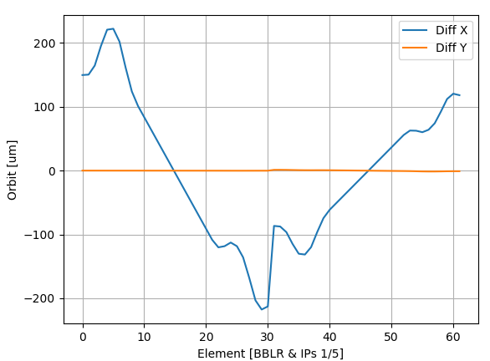
MAD-X TWISS vs. TRAIN
discrepancy of up to few 100 um between TRAIN and MAD-X for nominal LHC
even with beam-beam effects OFF
own CO search based on the MAD-X SECTORMAP output: same result as TRAIN
 | X [um] | PX [urad]
MAD-X TWISS
IP1 | 0 | 0
IP5 | 0 | 150
Own Python code
IP1 | -2.690072 | 2.610515
IP5 | -3.587271 | 145.338086
TRAIN
IP1 | -2.690070 | 2.611
IP5 | -3.587270 | 145.338

Slide 14
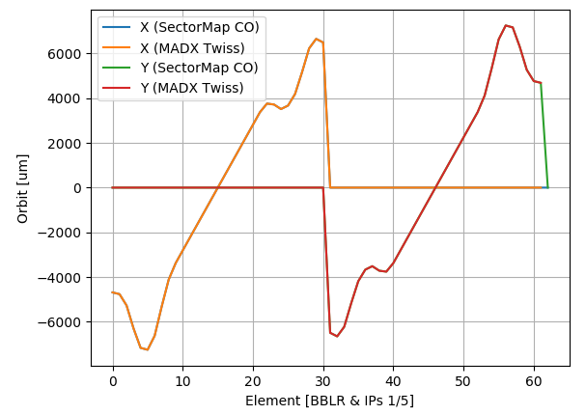
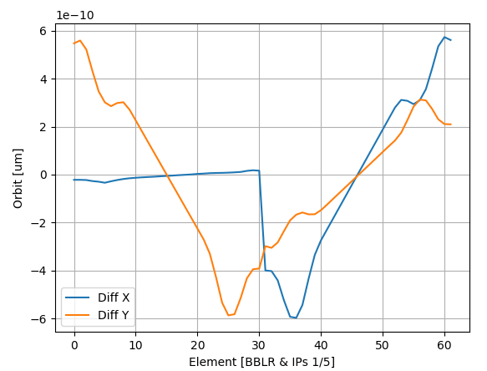
MAD-X TWISS vs. TRAIN (II)
tracked back to a breaking code change in ~2003
after fix: agreement up to ~1e-16m (floating point precision)
 | X [um] | PX [urad]
MAD-X TWISS
IP1 | 0 | 0
IP5 | 0 | 150
Own Python code
IP1 | 0 | 0
IP5 | 0 | 150
TRAIN
IP1 | 0 | 0
IP5 | 0 | 150

Slide 15
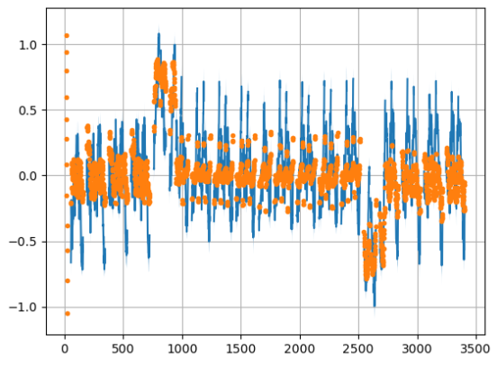
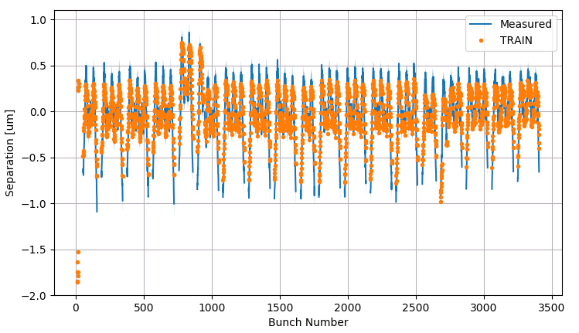
more than 15 long-range encounters ?
TRAIN was limited to 15 long-range encounters per IP-side
no design orbit separation
only valid from IP up to separation dipole
small effect for LHC design optics
large separation, small kicks …
discrepancy to emittance scans observed for 2017 “ATS” optics
most pronounced in CMS H (crossing)
CMS H
CMS V

Slide 16
TRAIN with more than 15 long-range encounters
beam-beam separation =
closed orbit (MAD-X TWISS)
design orbit (MAD-X SURVEY)
Z
survey coordinates
X
X
X
IP2
IP8
IP1
X
orbit coordinates
ATS2017 @ 40cm CMS H right
$${∆X}_{BBLR}=\sqrt{{∆X}_{survey}^{2}+{∆Z}_{survey}^{2}}$$ $+ {∆X}_{closed−orbit}$
improved TRAIN code at: https://gitlab.cern.ch/agorzaws/train/blob/development/bin/mtrain.f

Slide 17
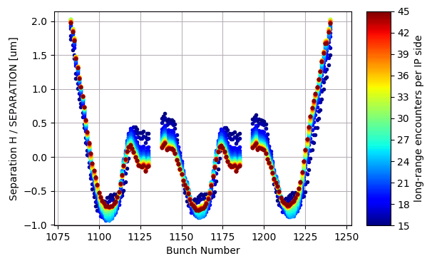
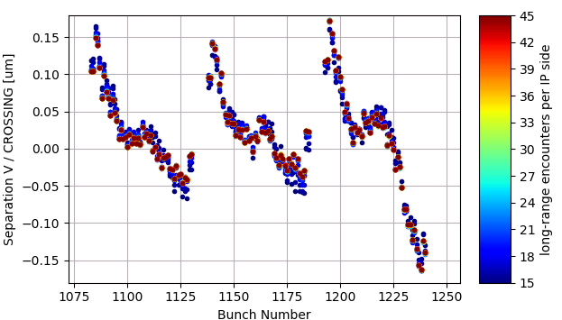
impact of extra long-range encounters: ATLAS
run the TRAIN simulation for 15 to 45 long-range encounters
small effect in ATLAS H
~ no effect beyond 17 encounters in ATLAS V
ATLAS H
ATLAS V

Slide 18
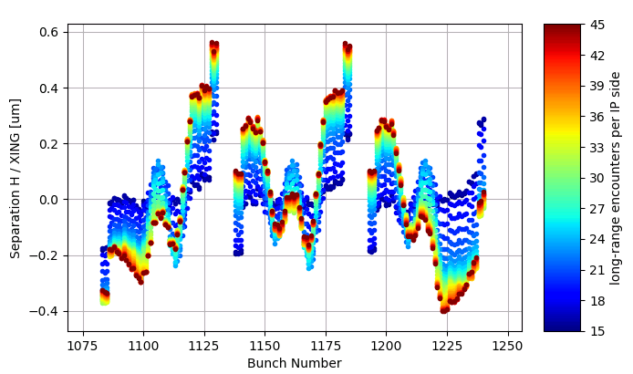
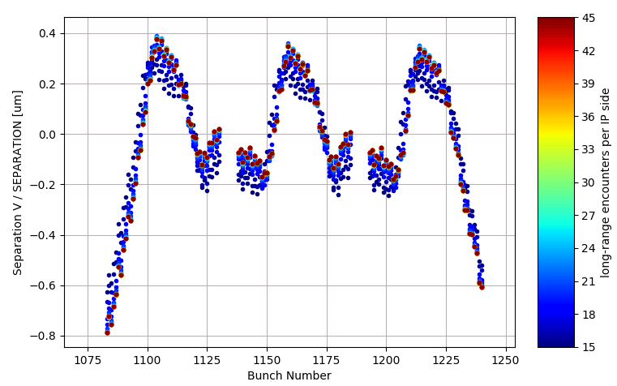
impact of extra long-range encounters: CMS
significant impact in CMS H (crossing) plane
~ no effect beyond encounter 17 in CMS V
CMS H
CMS V
⇒ the pattern with full long-range resembles the emittance scan results

Slide 19
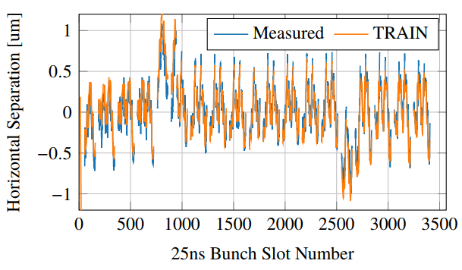
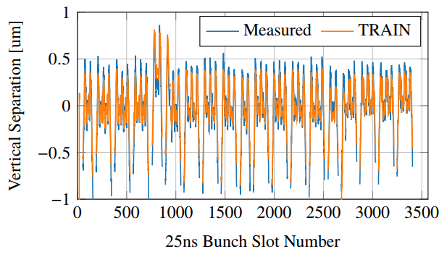
comparison to emittance scans
CMS H
CMS V
⇒ good agreement in both planes

Slide 20
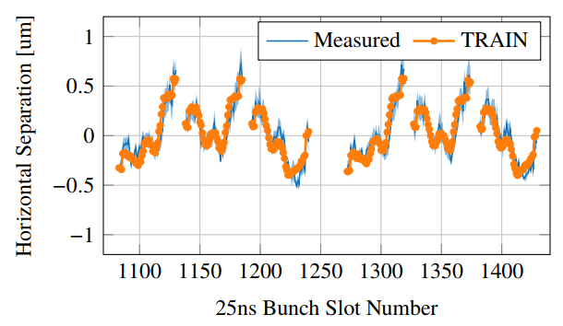
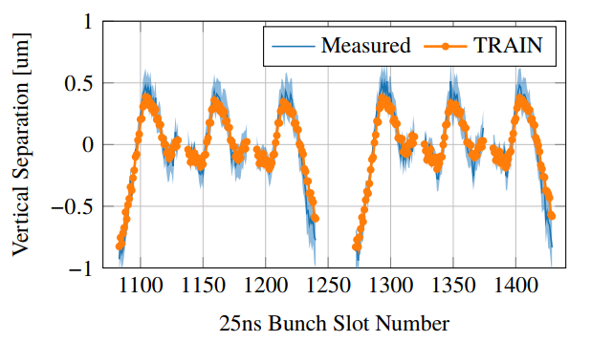
comparison to emittance scans
IP5 H
IP5 V
⇒ good agreement in both planes

Slide 21
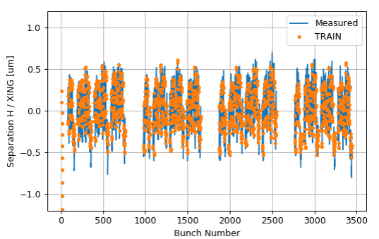
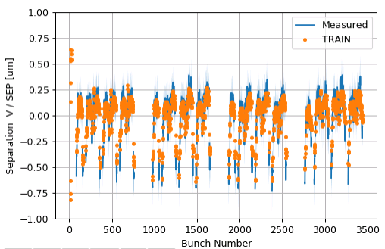
comparison: different 2017 filling patterns
⇒ this also holds for different bunch filling patterns
(e.g. “8b4e” – 8 bunches, 4 empty slots, repeat)
CMS H
CMS V

Slide 22
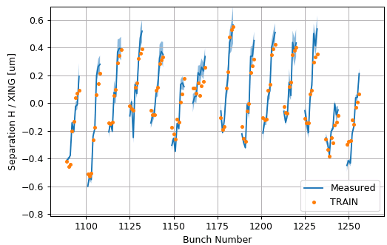
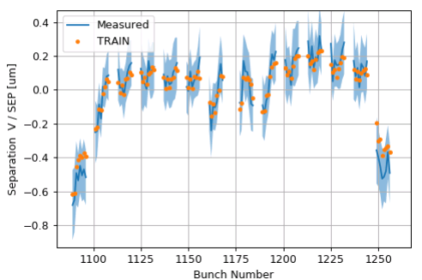
comparison: different 2017 filling patterns
⇒ this also holds for different bunch filling patterns
(e.g. “8b4e” – 8 bunches, 4 empty slots, repeat)
CMS H
CMS V

Slide 23
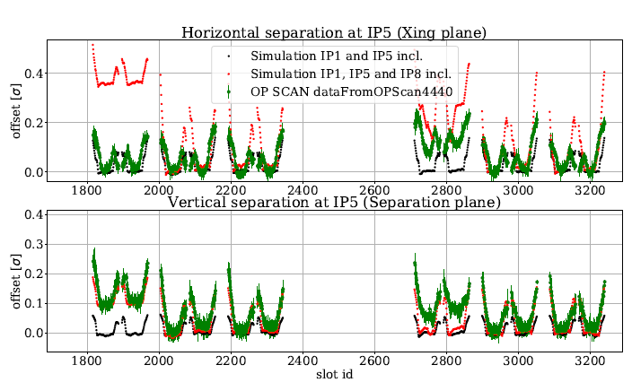
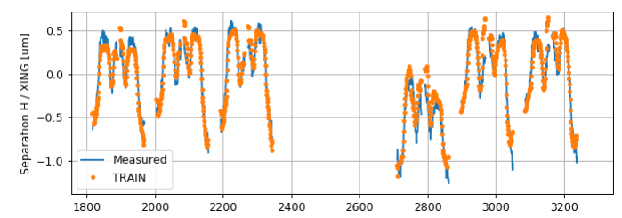
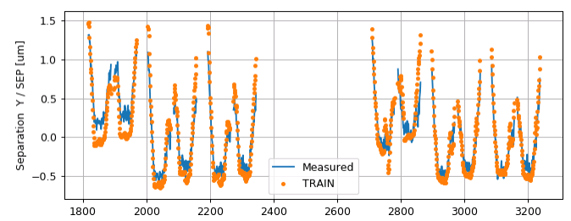
comparison: different (non-”ATS”) optics
⇒ for “nominal” optics (e.g. 2015 LHC), the impact of the additional long-range encounters is smaller
(but considering them still improves the agreement with the measurement)
original TRAIN, 15 long-range encounters
improved TRAIN, 45 long-range encounters
CMS H
CMS H
CMS V
A. Gorzawski, IPAC 2017
CMS V

Slide 24
conclusions
LHC bunches see different long-range beam-beam effects
“PACMAN” effects: closed orbits, tunes, chromaticities, …
observation through beam separation scans (“emittance scans”)
done regularly since 2015 at the CMS experiment
scans at ATLAS foreseen for 2018
gives bunch-by-bunch emittances & closed orbit differences
clear PACMAN beam-beam pattern observed
TRAIN simulations explain the observed PACMAN effects
simulation code improved on the way
old breaking change in MAD-X SECTORMAP generation identified
full beam-beam long-range encounters supported
improved code applicable to other (new) machines: HL-LHC, FCC-hh, … ?

