Slide 1
Bunch Replacement in the eRHIC Electron Storage Ring
Christoph Montag

Slide 2
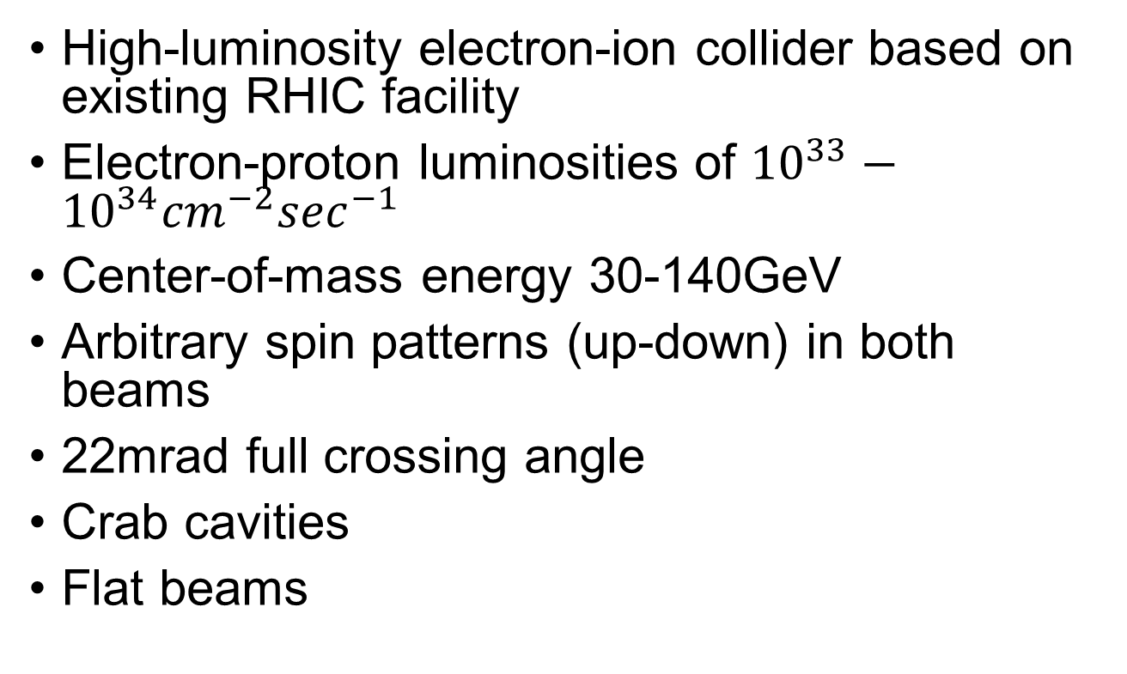
eRHIC
High-luminosity electron-ion collider based on existing RHIC facility
Electron-proton luminosities of ${10}^{33}−{10}^{34}{cm}^{−2}\sec^{−1}$
Center-of-mass energy 30-140GeV
Arbitrary spin patterns (up-down) in both beams
22mrad full crossing angle
Crab cavities
Flat beams

Slide 3
eRHIC Concept
Install a 5-18GeV electron storage ring in existing RHIC tunnel
3.8km circumference
381m tunnel curvature radius

Slide 4
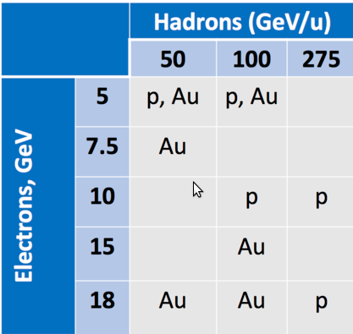
e-Au and e-p Energy Combinations
Large center-of-mass energy range
Discrete number of individual beam energies (γ’s)

Slide 5


Polarization
Ramping would destroy electron polarization
Electrons self-polarize at store due to synchrotron radiation (Sokolov-Ternov effect):
Self-polarization is not viable except at highest energies
Need a full-energy polarized injector

Slide 6
Fully Flexible Electron Spin Patterns
Electron spin patterns with alternating polarization (as in RHIC proton fills) are required for single-spin physics
Such fill patterns can be generated by a full-energy polarized injector
Bunches with the “wrong” (unnatural) polarization direction will slowly flip into the “right” (natural) orientation. Time scale given by Sokolov-Ternov self-polarization time
Bunch-by-bunch replacement at 1Hz (330 bunches in 5.5 minutes) yields sufficient polarization even at full energy where τ = 26min
Requires good intensity lifetime (> 1h) to minimize the beam-beam effect of electron bunch replacement on proton bunches, and fast kickers that only effect one bunch in the fill

Slide 7
Bunch Replacement
50nC bunches require accumulation in electron storage ring – injector limited to ~10nC
Bunch replacement has to happen in collision
Accumulation in longitudinal phase-space to avoid synchrotron radiation background issues in dispersion-free IR
Each replacement will cause transient beam-beam effects on the proton beam, resulting in emittance growth

Slide 8
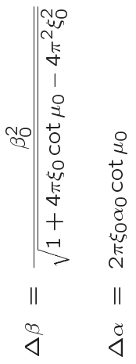
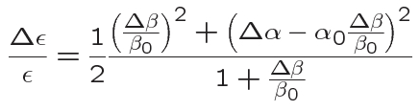
Analytical Prediction
Instantaneous change of electron bunch intensity modifies Twiss functions at the IP:
Resulting emittance increase after filamentation:

Slide 9
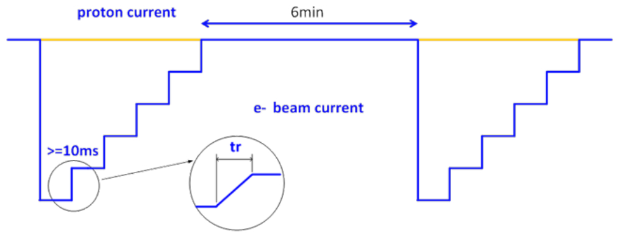
Experiments Using e-lens
Stepwise increase of the electron lens intensity to simulate eRHIC electron beam accumulation

Slide 10
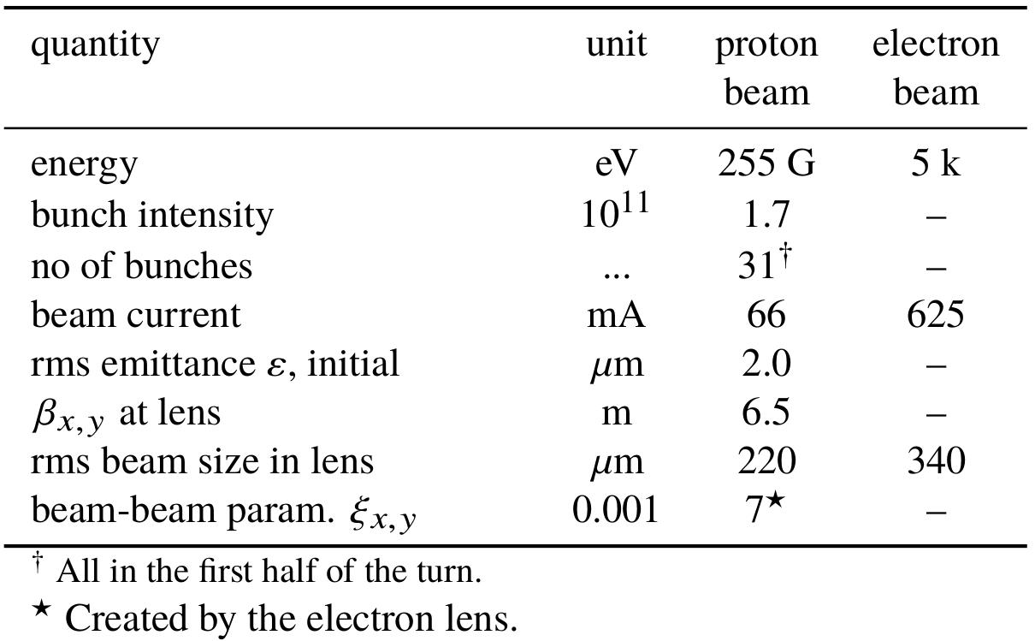
Experimental Parameters

Slide 11
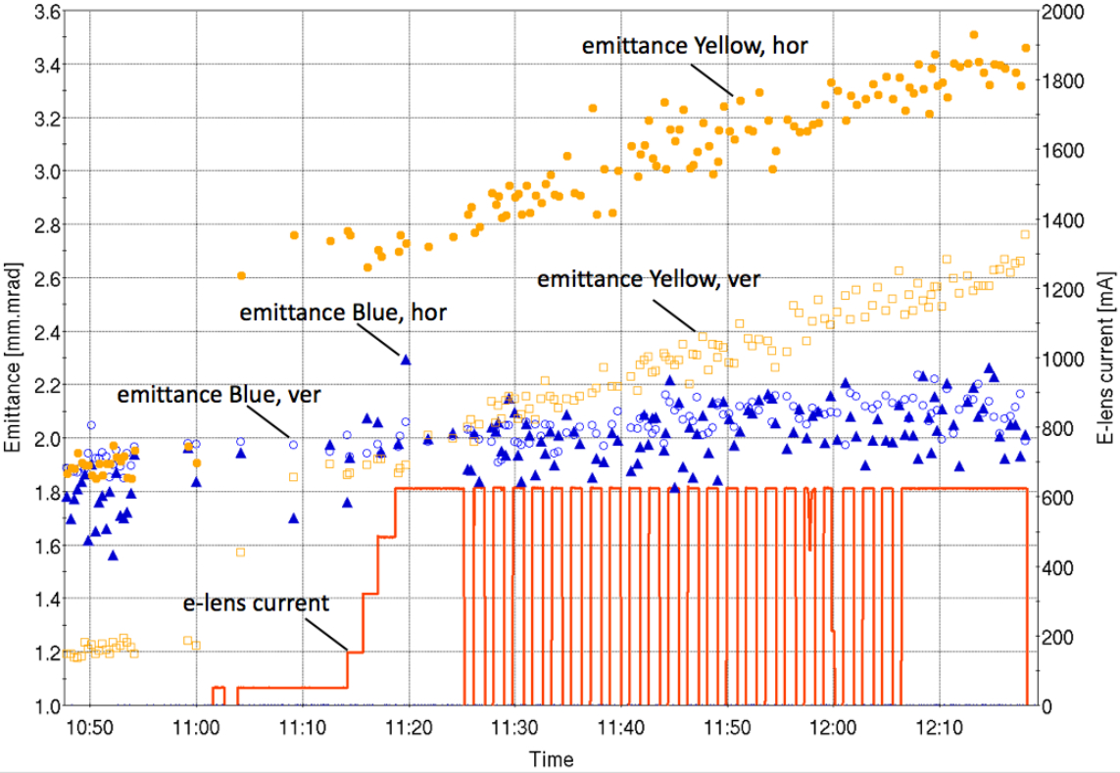
Measured Emittance Evolution
Blue beam serves as reference to subtract IBS effects
26 accumulative bunch replacements simulated

Slide 12
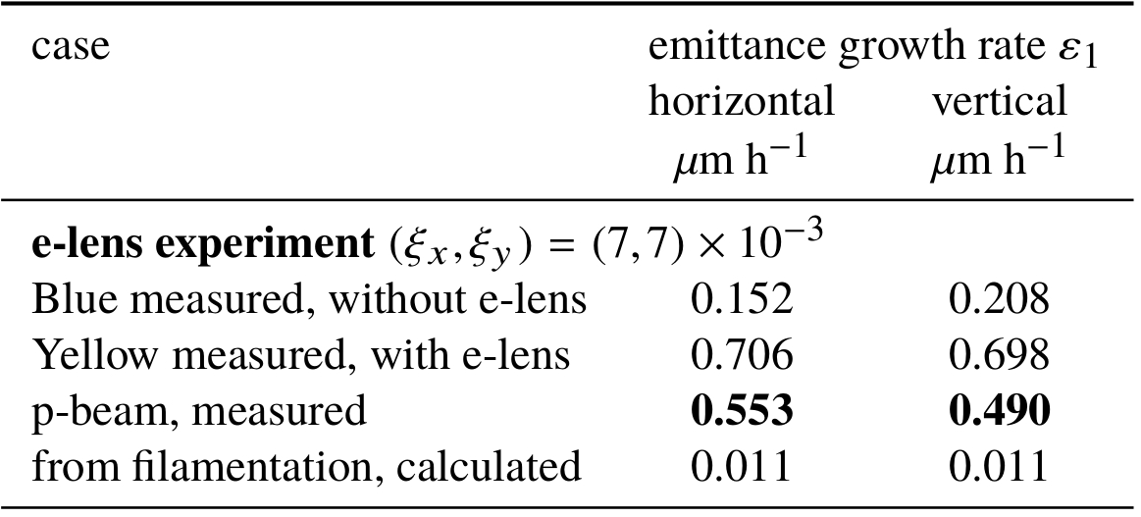
Measured Growth Rates
Effects from IBS are eliminated by subtracting Yellow and Blue growth rates
Difference between measured growth rates and calculated growth rates cannot be explained by filamentation

Slide 13
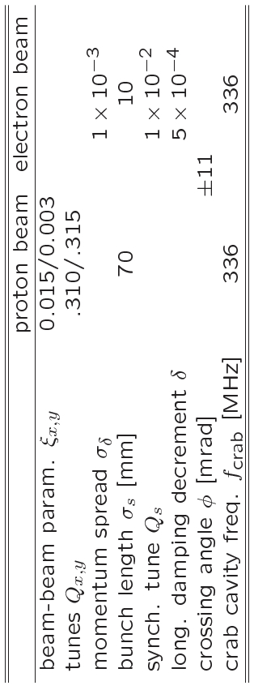
Simulation Parameters

Slide 14
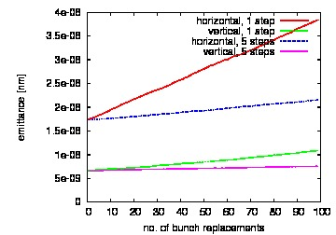
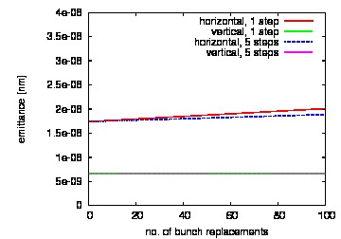
Accumulation vs. Instant Replacement
Tracking results Analytical results
Accumulation yields slower emittance growth than instant replacement
Growth rates from tracking exceed analytical growth rates from filamentation by far

Slide 15
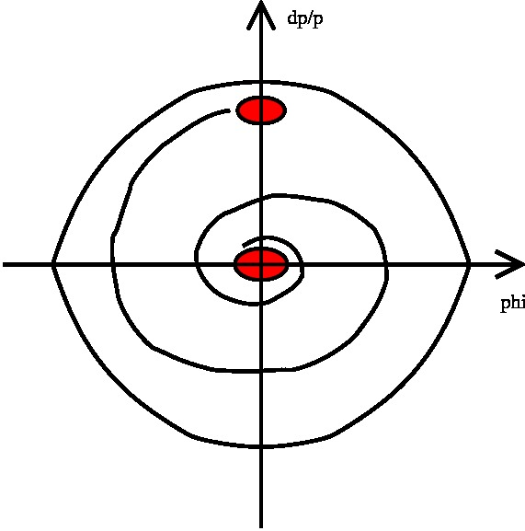
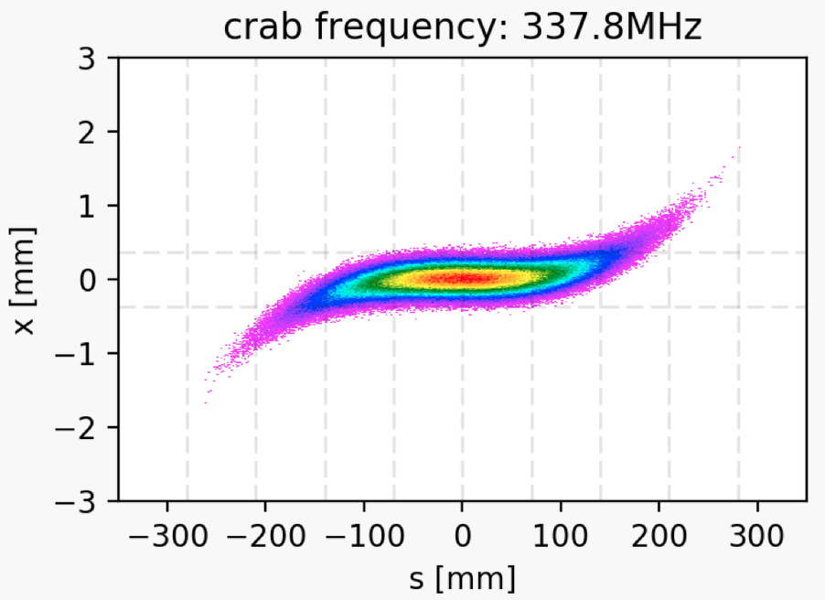

Crab Crossing Effects
Electron bunch is injected with 8$σ_{δ},$ and spirals towards the bucket center due to synchrotron motion and radiation damping
Large longitudinal oscillation amplitudes and finite crab cavity wavelength result in large transverse offsets
(figure courtesy Y. Hao)

Slide 16
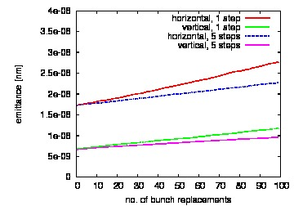
Simulations with Crab Crossing
Crab crossing Head-on
Crab crossing growth rates agree with head-on rates within a small factor; discrepancies very sensitive to tunes

Slide 17
Summary
Both experiments and simulations yield higher emittance growth rates than expected from filamentation
Observed growth rates are still acceptable for eRHIC
With crab crossing, emittance growth rates are very sensitive to tunes, but still acceptable
Effect of crab crossing needs better understanding, and eventually strong-strong studies

