Slide 1
Achromatic Telescopic Squeezing (ATS) scheme in the context of long-range beam-beam compensation techniques
S. Fartoukh, CERN, Beams Department
with contributions from several LHC teams: Operation,
Optics-Measurement-and-Correction, Collimation, Lumi, Beam-beam ..
Beam-beam Workshop 2018

Slide 2
Contents
ATS motivations and basic principles
Effective construction of ATS optics and summary of by-products
BBLR mitigation with octupoles for telescopic optics with highlights from MD
BBLR compensation with wires with emphasize on flat optics
Summary and outlook

Slide 3
ATS Motivations
Lower β* need magnets of larger aperture, and new HW or sophistication (crab-cavity, flat optics) to “profit from the low β*”.
the HL-LHC Project
But this does not tell how to produce the β*
→ the ATS scheme (PRSTAB 18-111002, 2013) which solves many optics limitations coming from the overall ring:
1. Optics matchability to the arcs:
  Some IR quads going to 0 T/m, others to max. field (200T/m)
  Simply the matching section becomes too short at some point!
  2. Correctability of the chromatic aberrations induced, not only Q’, but also Q’’, Q’’’,…, and off-momentum b-beating.
  → Arc sextupole strength (<600A)

Slide 4
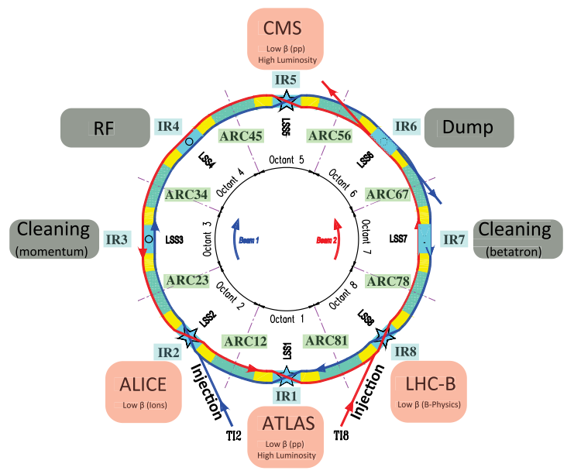
Basic principles
How: a squeeze in two steps
1. The Pre-squeeze:
An “almost” standard squeeze,
→ acting on the matching quads of IR1 and IR5 with new matching constraints on the left/right IR phase,
→ till reaching some limits on matching quads (or sextupoles)
The Tele-Squeeze:
A further reduction of β*,
→ Acting only on IR2/8 for squeezing IR1 and IR4/6 for IR5,
→ Inducing β-beating bumps in s81/12/45/56 to boost the sextupole efficiency, but also the octupoles (see later).

Slide 5
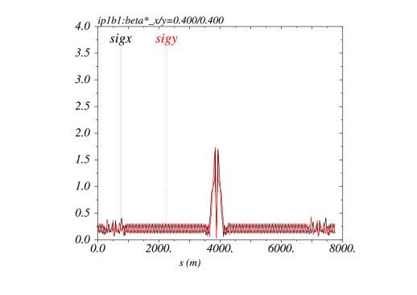
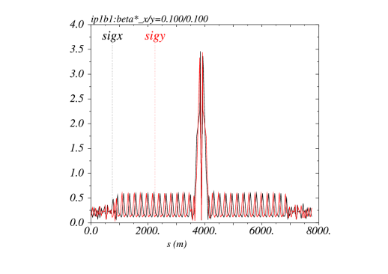
Un-precedent β* w/o chromatic limit (see later) can now be reached based on a kind of generalized squeeze involving 50% of the ring
Beam sizes [mm] @ 7 TeV from IR8 to IR2 for typical ATS “pre-squeezed” optics (left) and “telescopic” collision optics (right)
β*= 40 cm
β*= 10 cm
The new IR is sort of 8 km long !

Slide 6
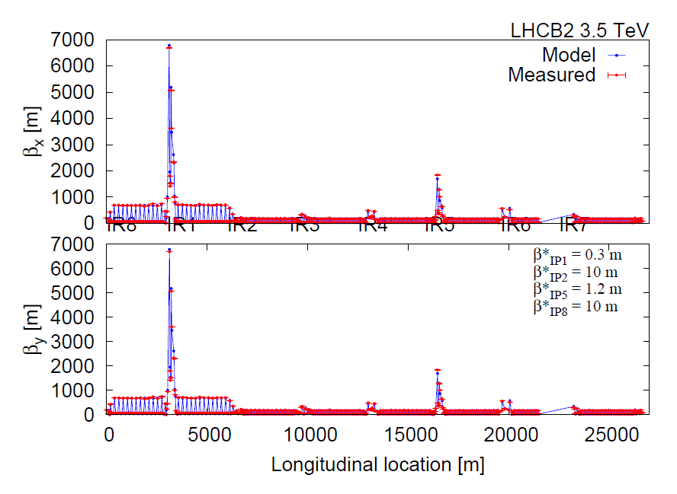
First demonstration with beam in 2011 (.. already with 30 cm β* !)
→ Telescopic principle (×4) demonstrated in IR1
Thanks to G. Vanbavinckhove & OMC team

Slide 7
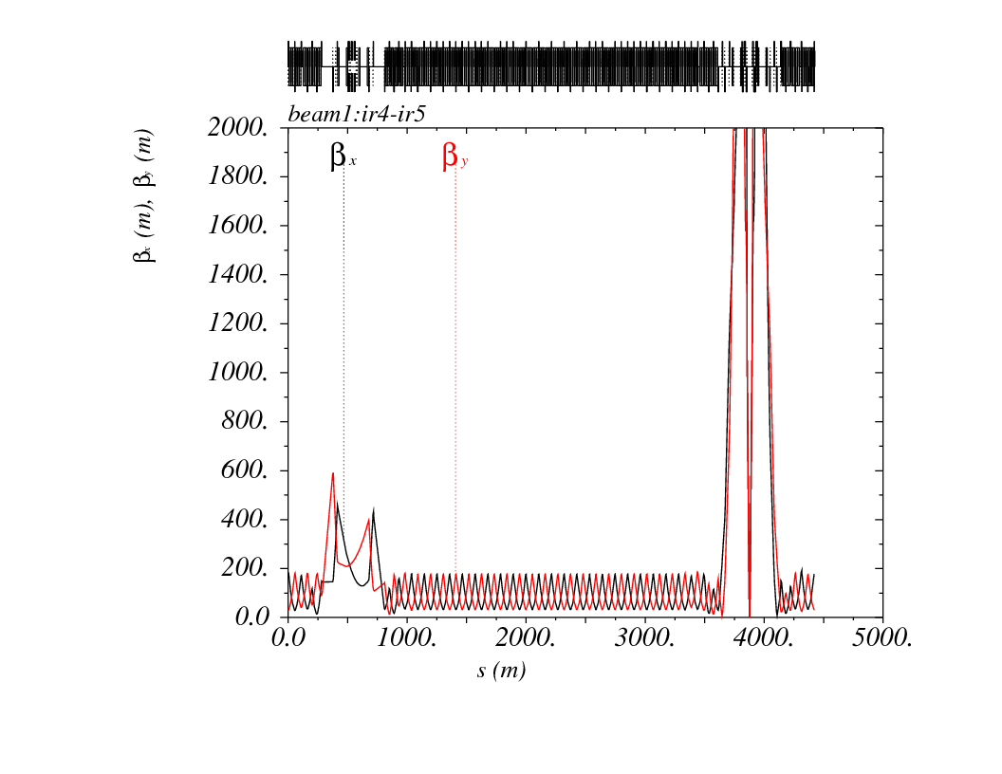
Effective Construction
The magic lies in the choice of the betatron phases
Zoom in arc45: Pre-Squeeze to β*=40/40 cm (round optics)
Δμ_{y} ≡ π between strong SD’s (every other FODO cells)
Δμ_{y} (Q11→ IP ) = 1.25×π + ε_{y}
with ε_{y} ~ 1/2 tan⁻¹ (β_{min}/β_{max})
(β_{arc}× β*)_{V} ≅ cst
Δμ_{x} ≡ π between strong SF’s
(every other FODOcells)
Δμ_{x}(Q10→ IP ) = 0.75×π + ε_{x}
with ε_{x} ~ - 1/2 tan⁻¹ (β_{min}/β_{max})
⇔ (β_{arc}× β*)_{H} ≅ cst
π/2 phase in the arc cells
2 sextupole families per plane but
only one used for triplet correction
◊ π/2 on the left/right side of the IR
IR4
(RF insertion)
IR5
(CMS insertion)

Slide 8
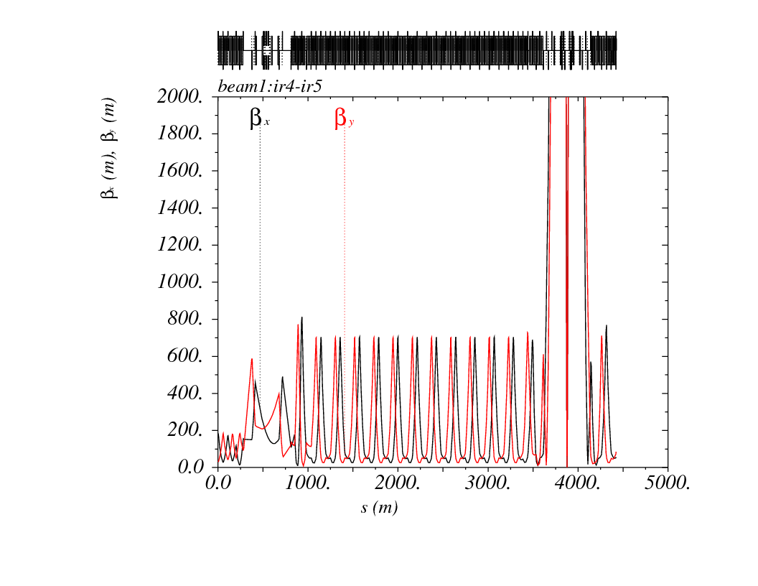

Zoom in arc45: Squeeze to β*=10/10 cm (round optics)
→ Tele index of 4H×4V
Δμ_{y} ≡ π between strong SD’s (every other FODO cells)
Δμ_{y} (Q11→ IP ) = 1.25×π + ε_{y}
with ε_{y} ~ 1/2 tan⁻¹ (β_{min}/β_{max})
(β_{arc}× β*)_{V} ≅ cst
$$β_{\text{Sextupole}}∝1/β^{∗}$$
Δμ_{x}(Q10→ IP ) = 0.75×π + ε_{x}
with ε_{x} ~ - 1/2 tan⁻¹ (β_{min}/β_{max})
⇔ (β_{arc}× β*)_{H} ≅ cst
Δμ_{x} ≡ π between strong SF’s
(every other FODOcells)
IR4
(RF insertion)
IR5
(CMS insertion)

Slide 9
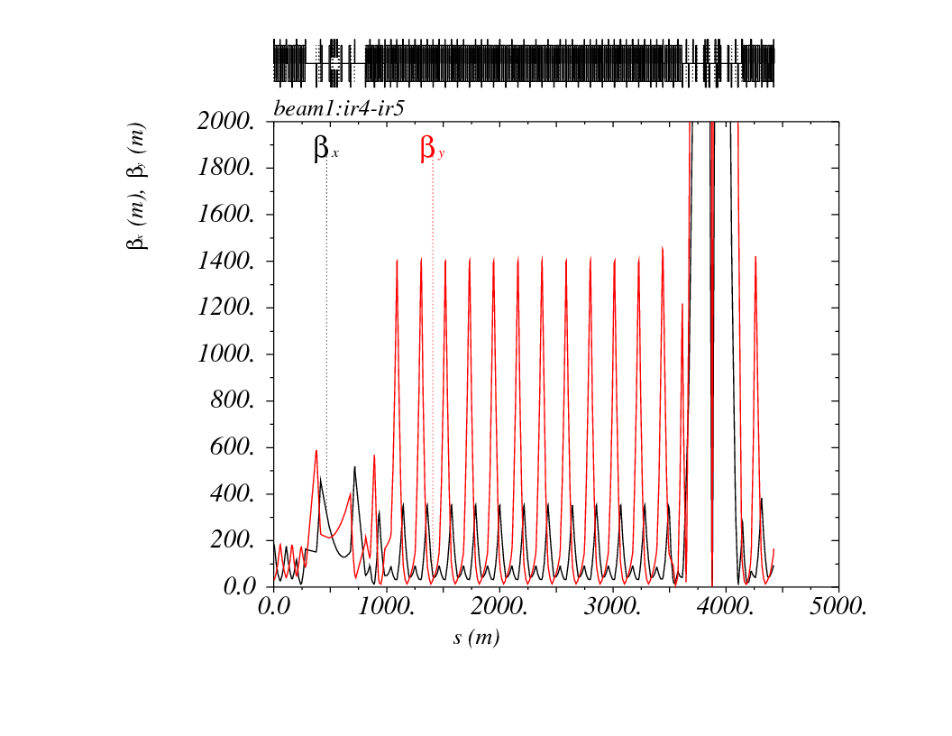
Zoom in arc45: Squeeze to β*=20/5 cm (flat optics)
→ Tele index of 2H×8V
Δμ_{y} ≡ π between strong SD’s (every other FODO cells)
Δμ_{y} (Q11→ IP ) = 1.25×π + ε_{y}
with ε_{y} ~ 1/2 tan⁻¹ (β_{min}/β_{max})
(β_{arc}× β*)_{V} ≅ cst
$$β_{\text{Sextupole}}∝1/β^{∗}$$
Δμ_{x}(Q10→ IP ) = 0.75×π + ε_{x}
with ε_{x} ~ - 1/2 tan⁻¹ (β_{min}/β_{max})
⇔ (β_{arc}× β*)_{H} ≅ cst
Δμ_{x} ≡ π between strong SF’s
(every other FODOcells)
IR4
(RF insertion)
IR5
(CMS insertion)

Slide 10
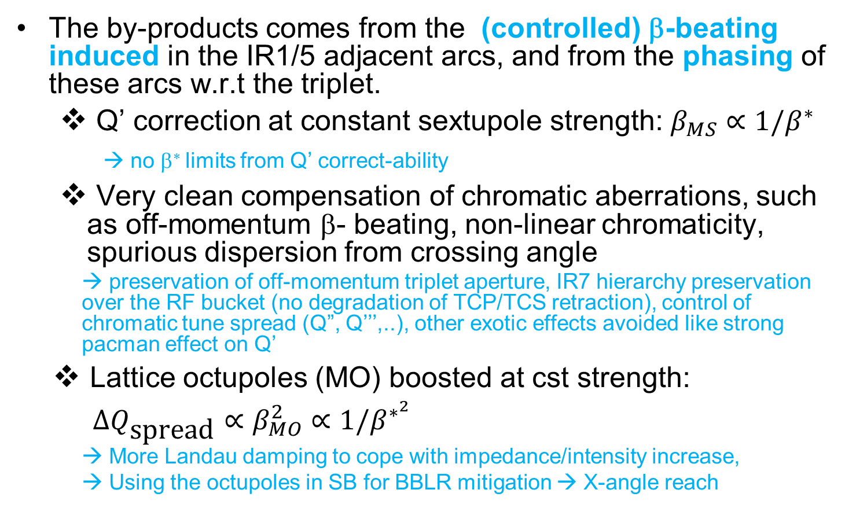
By-products (a summary)
The by-products comes from the (controlled) β-beating induced in the IR1/5 adjacent arcs, and from the phasing of these arcs w.r.t the triplet.
  Q’ correction at constant sextupole strength: $β_{MS}∝1/β^{∗}$
  → no β∗ limits from Q’ correct-ability
  Very clean compensation of chromatic aberrations, such as off-momentum β- beating, non-linear chromaticity, spurious dispersion from crossing angle
    → preservation of off-momentum triplet aperture, IR7 hierarchy preservation over the RF bucket (no degradation of TCP/TCS retraction), control of chromatic tune spread (Q”, Q’’’,..), other exotic effects avoided like strong pacman effect on Q’
  Lattice octupoles (MO) boosted at cst strength:
  $∆Q_{\text{spread}}∝β_{MO}^{2}∝1/β^{∗^{2}}$
    → More Landau damping to cope with impedance/intensity increase,
    → Using the octupoles in SB for BBLR mitigation → X-angle reach

Slide 11
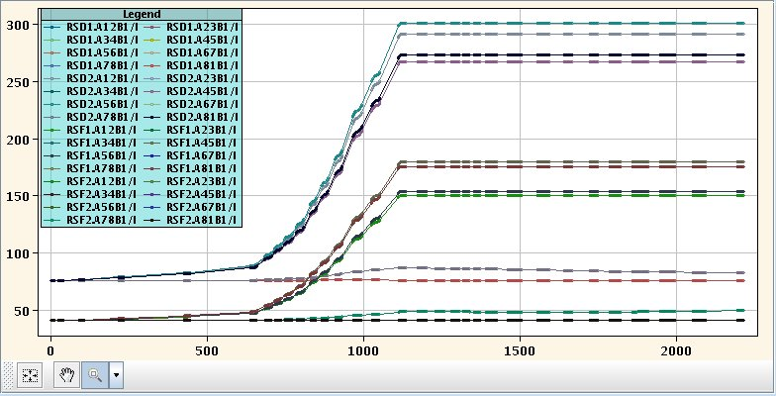
.. Some illustration: Chromatic corrections (Q’): No β* limits
Typical sextupole settings [A] for the 32 families available per beam (from MD in 2011 @ 3.5 TeV)
β*: 40 cm → 10 cm
During the telescopic part, the chromatic correction is achieved by the β-beating!
β*> 40 cm
Only 25% of the RS circuits participates to the chromatic correction during the pre-squeeze
→ All sextupole then kept ~ constant during the tele-squeeze

Slide 12
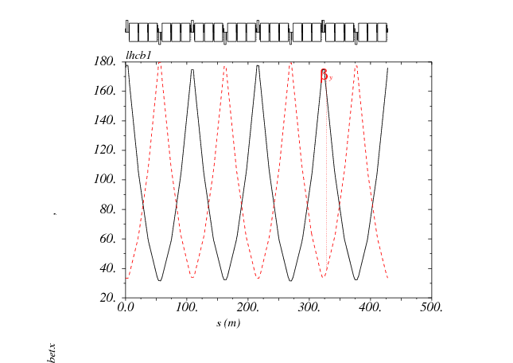
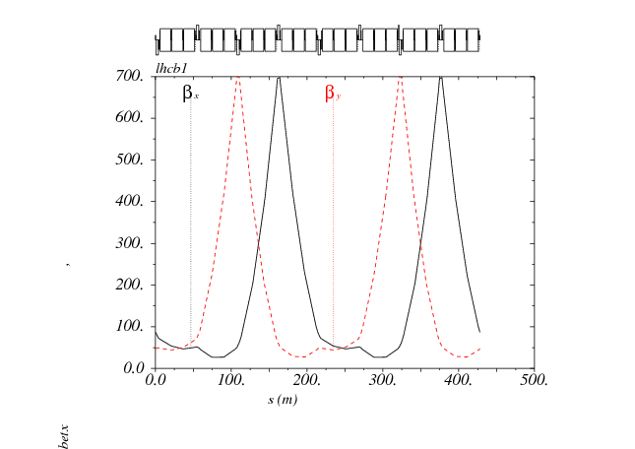
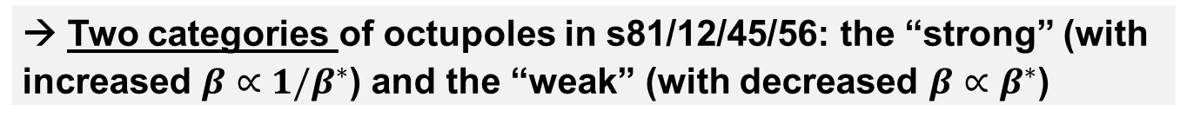
β’s at the MO’s vs. telescopic index
BBLR mitigation with octupoles
→ Two categories of octupoles in s81/12/45/56: the “strong” (with increased $β∝1/β^{∗}$) and the “weak” (with decreased $β∝β^{∗}$)
Strong OD
Strong OF
Weak OF
Telescopic squeeze
(× 4x, × 4y)
Weak OD
Beam 1/2 | “Strong“ OF.b1/OD.b2 | Weak OF.b1/OD.b2 | Strong OD.b1/OF.b2 | Weak OD.b1/OF.b2
Sector 45 (81) | 22.R4(8), 26.R4(8), 30.R4(8), 34.R4(8), 30.L5(1), 26.L5(1), 22.L5(1) | 24.R4(8), 28.R4(8), 32.R4(8), 32.L5(1), 28.L5(1), 24.L5(1) | 25.R4(8), 29.R4(8), 33.R4(8), 31.L5(1) | 31.R4(8), 33.L5(1), 29.L5(1), 25.L5(1)
Sector 56 (12) | 31.R5(1), 33.L6(2), 29.L6(2), 25.L6(2) | 25.R5(1), 29.R5(1), 33.R5(1), 31.L6(2) | 22.R5(1), 26.R5(1), 30.R5(1), 34.R5(1), 30.L6(2), 26.L6(2), 22.L6(2) | 24.R5(1), 28.R5(1), 32.R5(1), 32.L6(2), 28.L6(2), 24.L6(2)
Total | 7+4 = 11 | 6+4 =10 | 4+7 =11 | 4+6=10

Slide 13
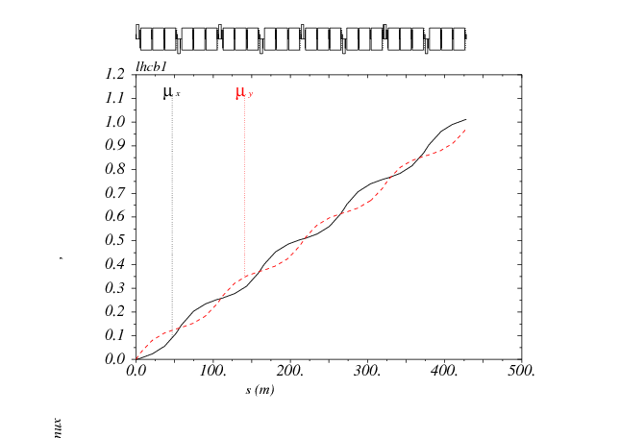
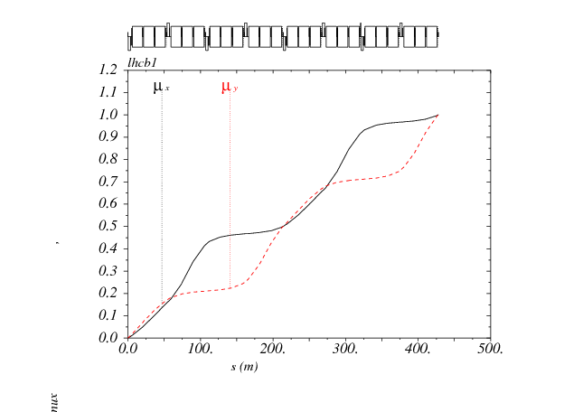
Phases at the MO’s vs. telescopic index
As for the strong sextupoles (participating to the IT chromatic correction), all the strong OF (resp. OD) are located at an H phase (resp. V phase) very close to π/2+ kπ w.r.t. the IP, so π w.r.t. the triplet and the LR beam-beam encounters.
Telescopic squeeze
(× 4x, × 4y)
 π/2 + ε
 π/2 - ε
→ A clean mitigation of the BBLR effects is a priori within reach for both the octupole tune spread and the (4,0), (0,4) and (2,±2) driving terms

Slide 14
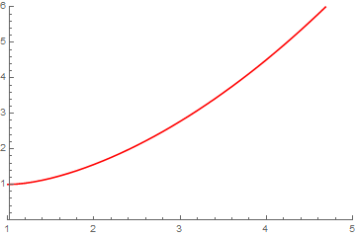
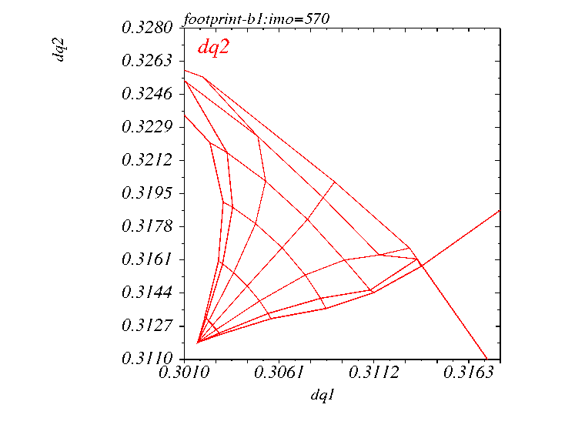

Guidance from simulations for MD preparation
At large tele-index (>3), the MO’s are so efficient that they can mitigate
the long-range Beam-Beam effect
MO tune spread amplification at
constant strength during the Tele-Squeeze
ΔQ_{spread} $∝β_{MO}^{2}$ $∝1/β^{∗2}$
~ 60 % for a tele-index of 2
(very reasonable for LHC)
> 400% for a tele-index of 4
(typical HL-LHC)
Tele-index r_{tele}
Simulated MO scan with 150 μrad X-angle
N_{b}=1.2E11, γε=2.5 μm, and r_{tele} ~ 3 (from 1 m to 35 cm)

Slide 15
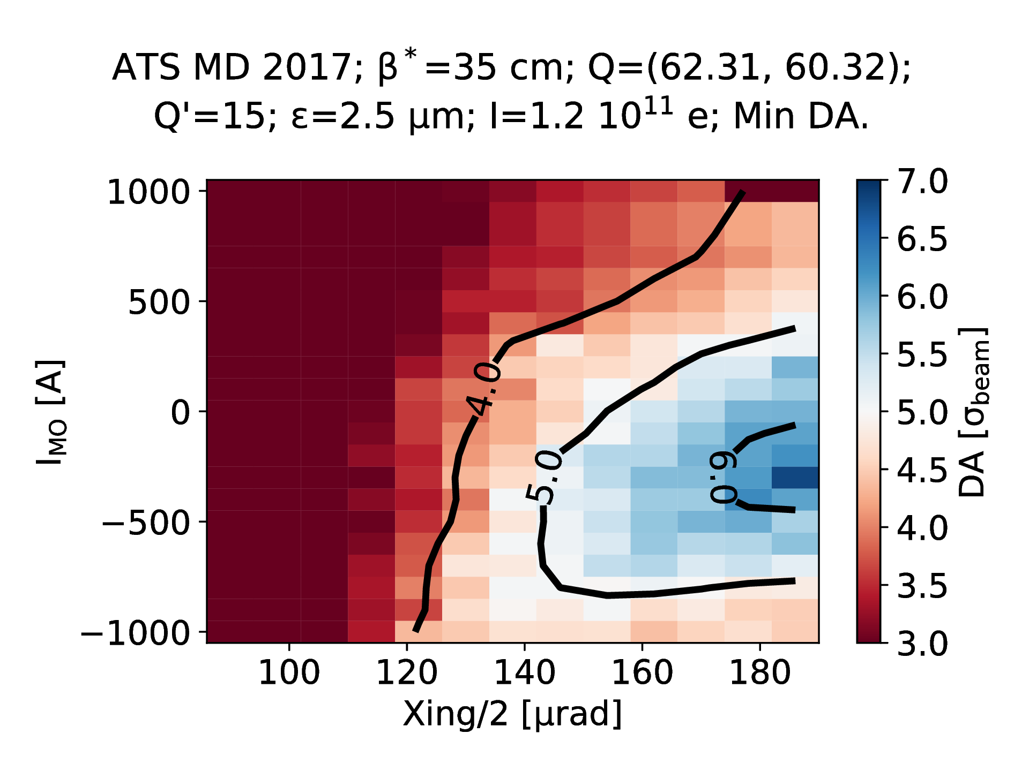
MD Optics choice: tele-index of 3
(stopping the pre-squeeze @ 1 m, and reaching β*=35 cm telescopically)
Thanks to D. Pellegrini
→ Significant reduction of the crossing angle going from positive to negative octupole polarity.

Slide 16
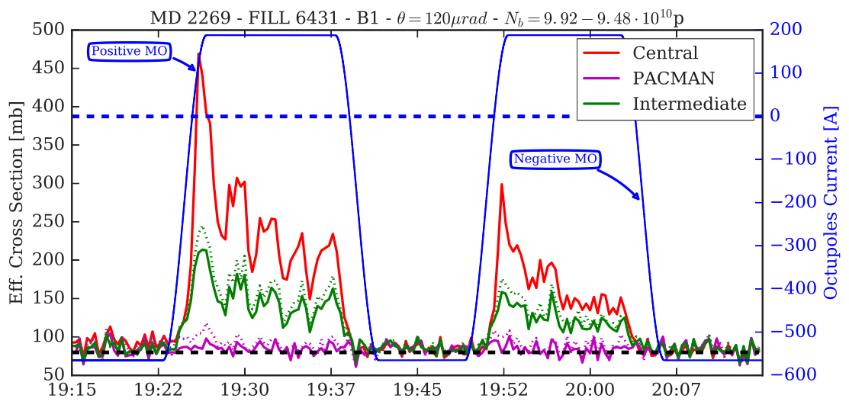

MD results
→ Preparation and validation for high intensity of this special telescopic optics to reach this beautiful result in the end of 2017 !
$$σ_{{\text{eff}}_{i}}≝\frac{{|dN}_{i}/dt|}{ℒ_{i}}$$
Burn-off limit
@ 80 mb
Courtesy of A. Poyet, G. Sterbini, and LHC Beam-Beam team

Slide 17
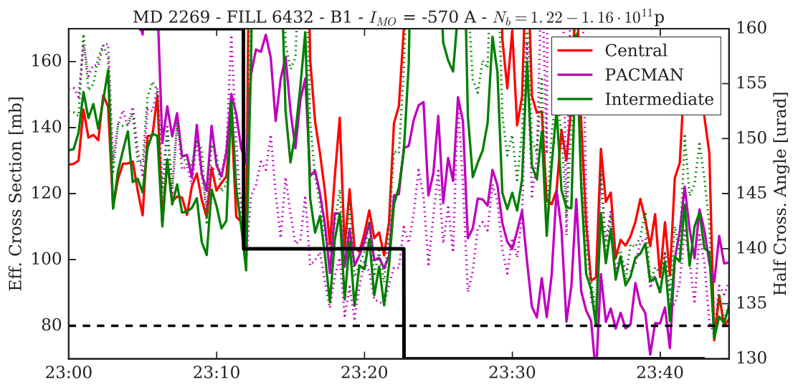
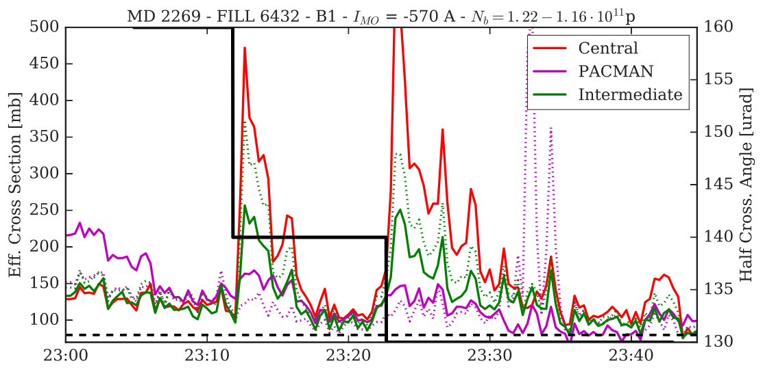
→ X-angle reach: starting with MO<0 in another fill, the life time improved by reducing the X-angle ! Up to 20 μrad (10%) could be gained in X-angle
Zoom
Courtesy of A. Poyet, G. Sterbini, and LHC Beam-Beam team

Slide 18
Flat optics and wire compensation
Motivation: Flat optics (not flat beams!) means
.. with the crossing plane corresponding to the plane of largest β* (i.e. smallest β in the triplet).
  To preserve/gain aperture in the triplet (smaller X-angle requested)
  To maximize the luminosity via a mitigation of the geometric loss factor
Luminosity calculated for head-on colliding round beams
Full normalized X-angle (9-10 σ for LHC, up to 12.5 σ for HL-LHC with more current and longer triplet with more LR’s )
r.m.s. bunch length (7.5 cm nominally but 9-10 cm in practice for various reasons)
Increasing the β* aspect ratio could in principle rapidly mitigate the geometric luminosity loss w/o need of crab-cavities.
But w/o dedicated action, the normalized X-angle should unfortunately increase as well together with the β* aspect ratio …

Slide 19
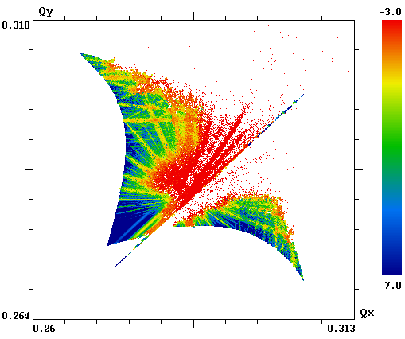
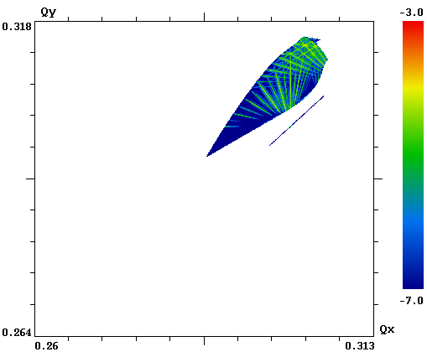
Flat optics example: HL-LHC plan B for 10³⁵ virtual luminosity w/o crab-cavities but BBLR wire (PRSTAB 18-121001, 2015)
→ β*=40/10 cm at IP1&5 (i.e. r=4), Θ_{c}=300 μrad, i.e. about halved vs. baseline but still 10.5 σ at β*=40 cm in the X-plane, ho collision at full current in 3 IPs
A ``monster’’ before correction (ΔQ_{ho}=0.025, ΔQ_{LR}=0.015)
→ Contrary to round optics, no self-compensation between IR1 and IR5 for b2 (tune shift), b6 (“wings”), b10 …
A regular HO footprint after correction (ΔQ_{ho}=0.025, ΔQ_{LR}=0.0)
with wire installed at optimal position (see later)
Courtesy of S. Valishev and D. Shatilov

Slide 20
The “magic” of the BBLR compensation with wires.. that “simple mitigation” with octupoles cannot provide
Normalized beam-beam separation at LR encounters
for typical LHC collision optics
R ~ 1/2
R ~ 2
With LR encounters taking place at non uniform normalized beam-beam separation, can we compensate all RDT’s with only 1 or 2 wires?
If yes, can we build an automatic tool for setting generation (transverse wire position and current) working for arbitrary optics (flat or round) and crossing angle ?
Are there any preferences (based on beam dynamics criteria) where to install the wire, i.e. at which β-function aspect ratio ? Is an aspect ratio of 1 really the optimal choice?
The choice of β aspect ratio at the wires is crucial.
β_{x}/β_{y} = 1 is a very poor compromise with only 1 wire/IR (although thought optimal for many years).
With 2 wires/IR, symmetric left/right @ β_{x}/β_{y} ~ 2 and ½ (thank to the LHC-like optics anti-symmetry), the compensation is optimal for all driving terms (see details in PRSTAB 18-121001, 2015)!

Slide 21
Assuming two wires/IR and with optics anti-symmetry, a priori only 2 (+2) RDTs can be corrected.
But actually much more can be achieved by a proper choice of the β aspect ratio at the wire.
Correction (04)-(40)-(60)-(06)
Correction (04)-(40)-(28)-(82)
Regardless of the correction type all the RDTs are vanishing at
r_{w} ~ 2 and r_{w} ~1/2
Correction (22)-(55)
From 1rst to 3rd order
From 4th to 8th order
From 9th to 10th order

Slide 22
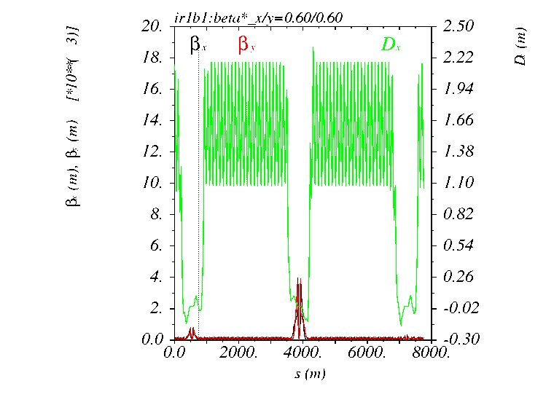
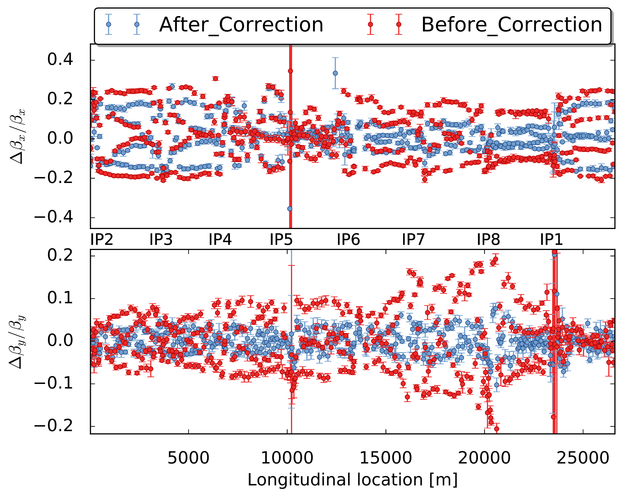
Machine Development at the LHC:
→ First flat optics MD took place end of the 2017 with small intensity beams, for optics measurements and correction, with already very encouraging results.
Pre-squeezed stopped at 60/60 cm followed
by two tele-squeeze segments
To reach 60/15 cm at IP1 and 15/60 at IP5
Then 30/12 cm at IP1 and 12/30 cm at IP5
Courtesy of T. Persson and OMC team
Optics measurement and correction at (60/15)-(15/60)
→ 20% level in H and 10% level in V !

Slide 23
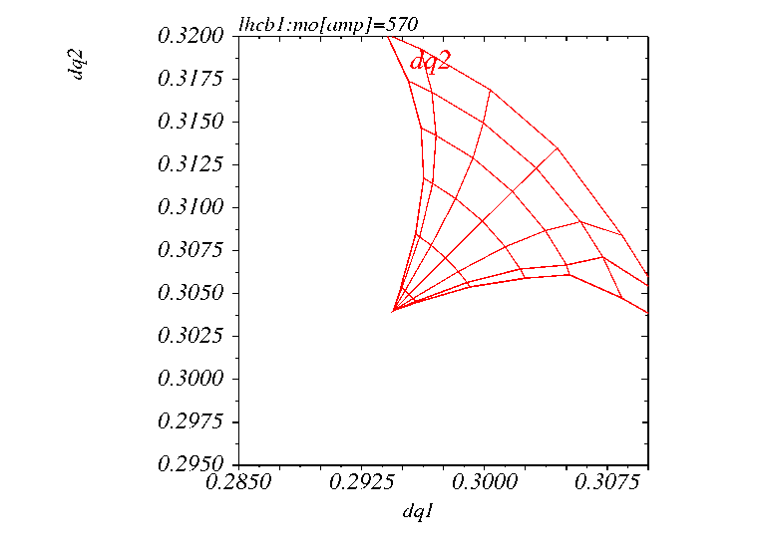
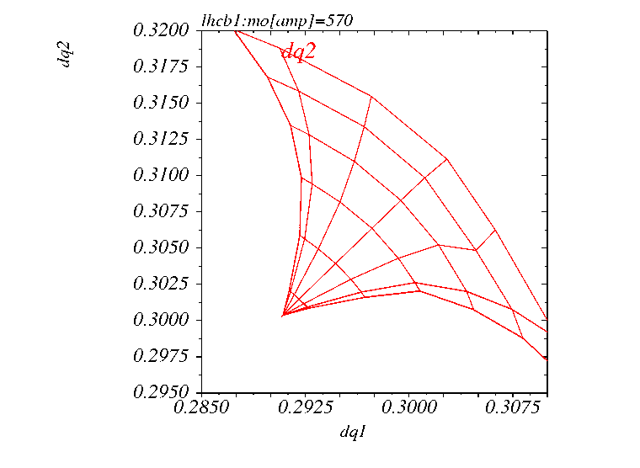
More to come in 2018: X-angle reach with flat optics ??
→ In the range of 12-13 σ for a β* aspect ratio of 4 and for LHC type beams (up to 15 σ for HL-LHC beams), compared to ~9 σ in LHC for round optics (self-compensation of the BBLR spread between IR1 and IR5 for round optics)
→ Is the mitigation with octupole enough to reach the 10 σ level for flat optics, or will we effectively need the wires??
ΔQ=0.025
ΔQ=0.025
(60/15)-(15/65) flat optics @ 150 μrad
→ 12.2 σ @ γε=2.5 μm and 6.5 TeV
Note ΔQ_{LR} ~ - 0.007 along the diagonal
(60/15)-(15/65) flat optics @ 125 μrad
→ 10 σ @ γε=2.5 μm and 6.5 TeV
Note ΔQ_{LR} ~ - 0.010 along the diagonal
The MO are still very efficient on the BBLR spread but not on tune shift (typically ΔQ_{LR} ~ - 0.01 along the diagonal @ 1.25E11 /bunch), which is also changing from bunch to bunch (pacman effect)
Also, the footprint wings (b6-like effects) are left uncorrected !

Slide 24
Preliminary results with LHC flat optics (60/15)
(full study done by N. Karastathis)
WP optimization
@ MO=0 and 1.25E11
(.31/.32)
150 μrad (12.2 σ)
challenging @ 1.25E11 !
Pacman bunches remains to be checked
Octupole to - 550A
(only small gain)
X-angle reach vs. intensity
with new WP and MO@-550A
125 μrad (10.0 σ)
should be easy @ 1.25E11 !

Slide 25
Summary
The ATS scheme is not only the key for low β* collision optics at the (HL-)LHC, but it also opens a new world of applications, in particular:
The possible mitigation of the BBLR effects with the arc Landau octupoles and therefore some reduction of the X-angle and gain in performance → LHC Run III
The feasibility of flat optics with even smaller β* in one of the two transverse planes, which a priori needs the cleanest possible BBLR compensation (wires, TBC) to fully exploit their potential → HL-LHC Plan B

Slide 26
Spare

Slide 27
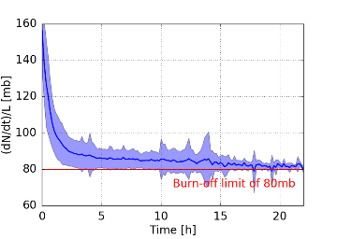
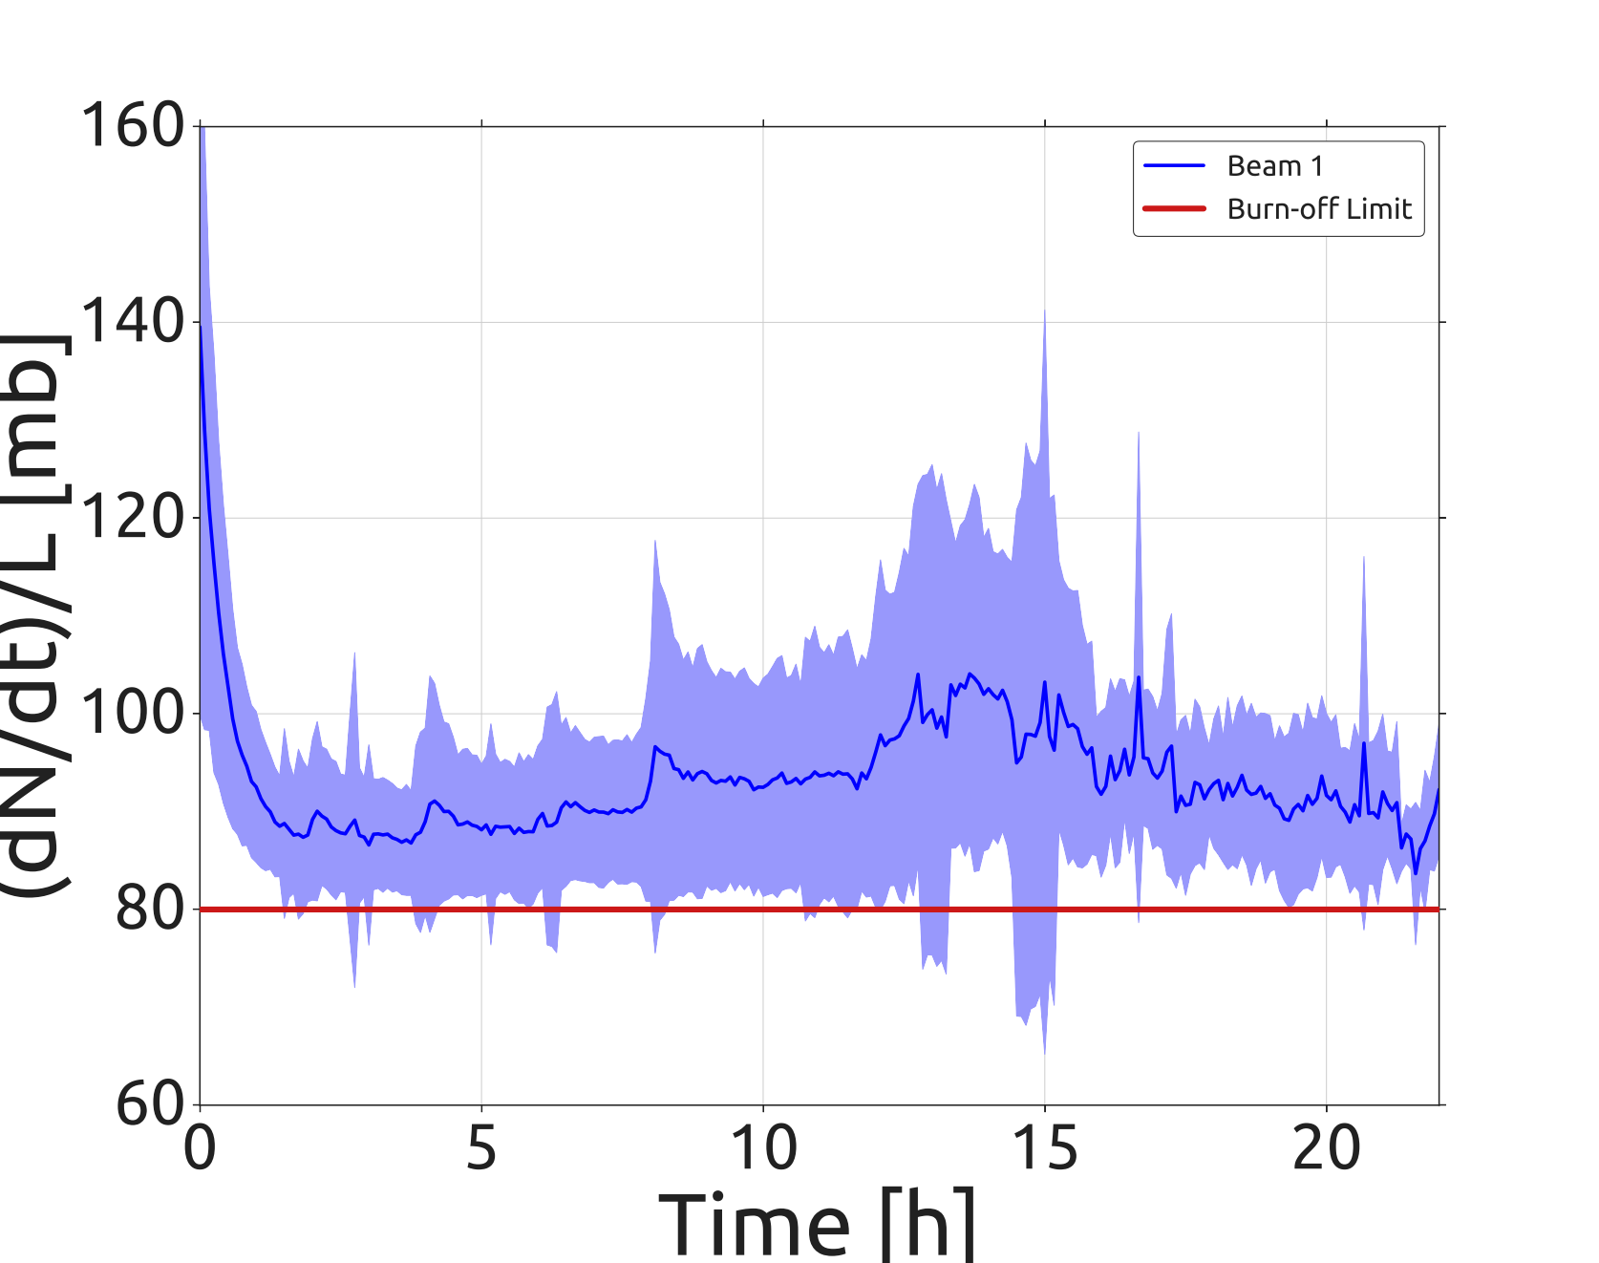
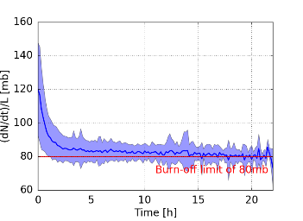
Life time: effective cross section in Stable Beam (all fills)
2016
(150 μrad @ β*=40 cm)
2017
(with X-angle levelling: 150→ 120 μrad)
Further X-step tried out for a couple of fills only
Beam 1
Beam 1
X-angle steps
Beam 2
Beam 2
Beam Stabilization @ ~2.3h
Beam Stabilization @ ~1.6h
Courtesy of G. Iadarola, N. Karastathis
and Lumi team

Slide 28
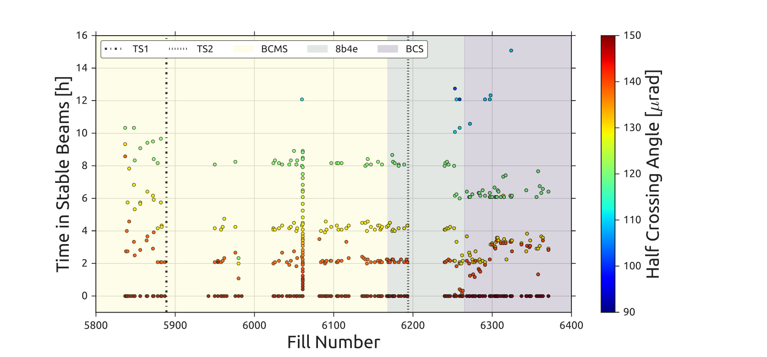
X-angle steps in 2017
Courtesy of N. Karastathis and Lumi team

