Slide 1
Beam Beam effects for JLEIC
Yves Roblin
Jefferson Lab
Beam Beam effects in circular colliders
Berkeley
Feb 5-7, 2018

Slide 2
Introduction
JLEIC parameter range
Optimization strategy for beam beam effects
Aperture scans, dynamic apertures, initial studies
Incorporating non linear maps
Other effects (crabbing, cooling, gear changing)
Conclusion

Slide 4
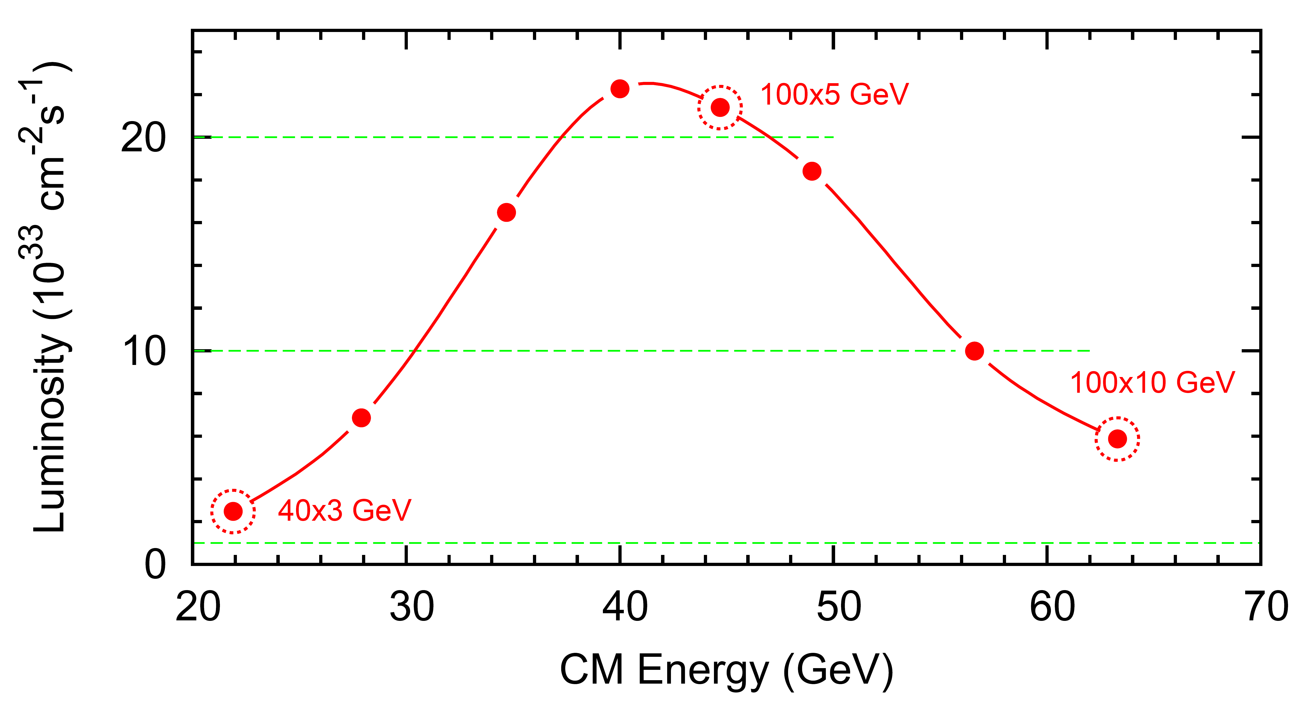
JLEIC Luminosity
10³⁴
√s (GeV) | p energy (GeV) | e⁻ energy (GeV) | Main luminosity limitation
22 | 40 | 3 | space charge
45 | 100 | 5 | beam-beam
63 | 100 | 10 | synchrotron radiation

Slide 5
JLEIC Parameters
CM energy | GeV | 21.9 (low) |  | 44.7 (medium) |  | 63.3 (high)
 |  | p | e | p | e | p | e
Beam energy | GeV | 40 | 3 | 100 | 5 | 100 | 10
Collision frequency | MHz | 476 |  | 476 |  | 476/4=119
Particles per bunch | 10¹⁰ | 0.98 | 3.7 | 0.98 | 3.7 | 3.9 | 3.7
Beam current | A | 0.75 | 2.8 | 0.75 | 2.8 | 0.75 | 0.71
Polarization | % | 80% | 80% | 80% | 80% | 80% | 75%
Bunch length, RMS | cm | 3 | 1 | 1 | 1 | 2.2 | 1
Norm. emittance, hor / ver | μm | 0.3/0.3 | 24/24 | 0.5/0.1 | 54/10.8 | 0.9/0.18 | 432/86.4
Horizontal & vertical β* | cm | 8/8 | 13.5/13.5 | 6/1.2 | 5.1/1.0 | 10.5/2.1 | 4/0.8
Ver. beam-beam parameter |  | 0.015 | 0.092 | 0.015 | 0.068 | 0.008 | 0.034
Laslett tune-shift |  | 0.06 | 7x10⁻⁴ | 0.055 | 6x10⁻⁴ | 0.056 | 7x10⁻⁵
Detector space, up/down | m | 3.6/7 | 3.2/3 | 3.6/7 | 3.2/3 | 3.6/7 | 3.2/3
Hourglass(HG) reduction |  | 1 |  | 0.87 |  | 0.75
Luminosity/IP, w/HG, 10³³ | cm⁻²s⁻¹ | 2.5 |  | 21.4 |  | 5.9

Slide 7
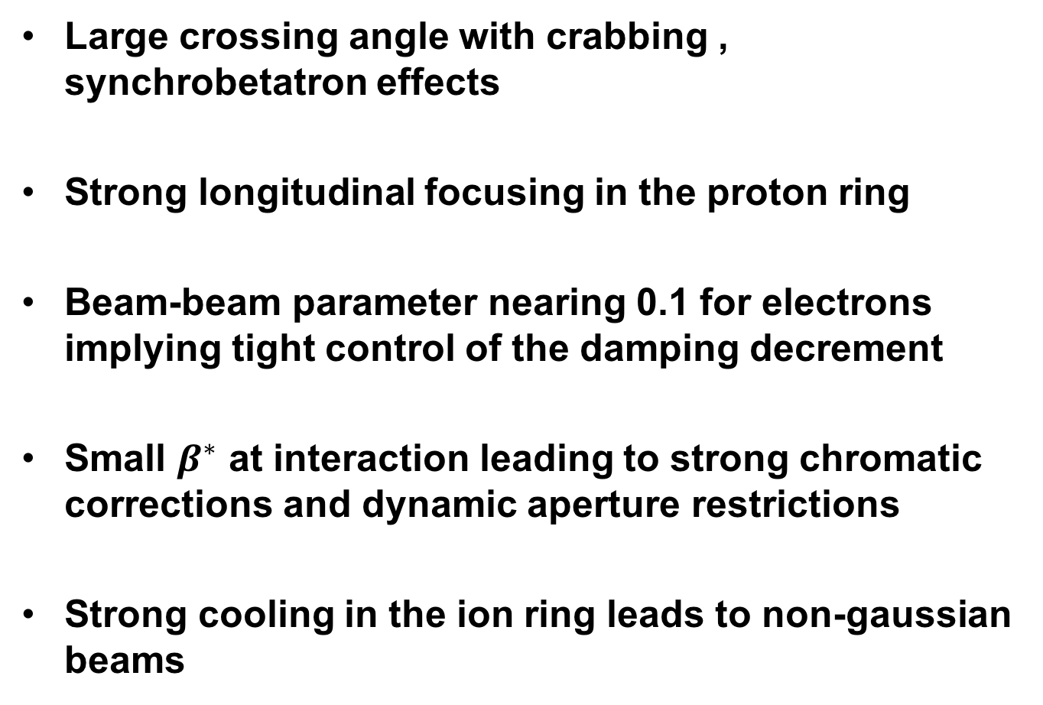
Beam beam challenges
Large crossing angle with crabbing , synchrobetatron effects
Strong longitudinal focusing in the proton ring
Beam-beam parameter nearing 0.1 for electrons implying tight control of the damping decrement
Small $β^{∗}$ at interaction leading to strong chromatic corrections and dynamic aperture restrictions
Strong cooling in the ion ring leads to non-gaussian beams

Slide 8
Optimization strategy
Perform dynamic aperture scans for both e- and ion rings, select zones with adequate dynamic aperture
Perform a weak-strong scan with linear optics
Study stability of working point under various beam-beam conditions
Perform strong-strong simulations around the candidate working points
Produce a fma map around the candidate working points
Refine/identify issues, eventually correct lattice aberations

Slide 9
Optimization strategy (cont)
Include magnet errors, generate a set of perturbed lattices
Extract one turn map to high order
  Using ELEGANT by tracking
  Using MAD-X PTC via Lie Algebra/DA
  Using Cosy-infinity
Beam Beam 3D supports up to fourth order.
Perform frequency map analysis with BB3D, refine working points
Study running with two IP’s

Slide 10
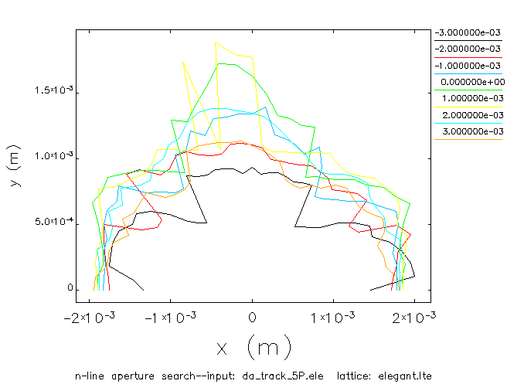
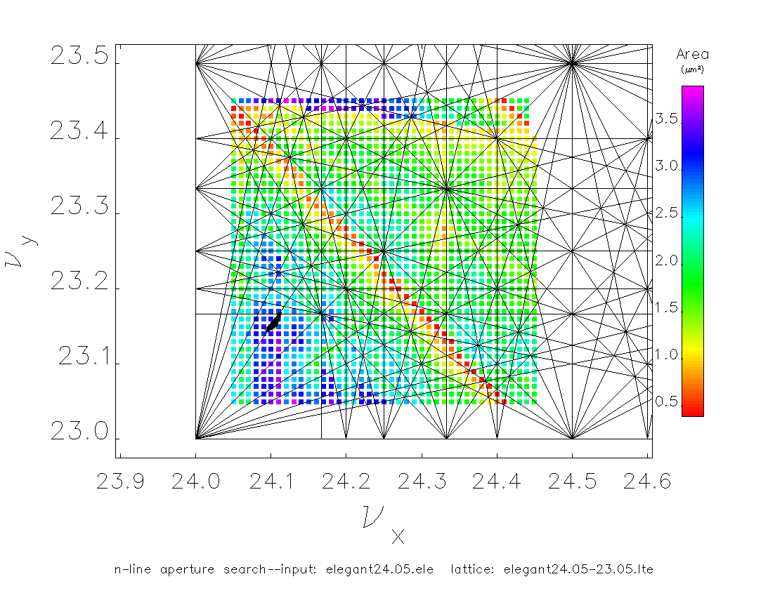
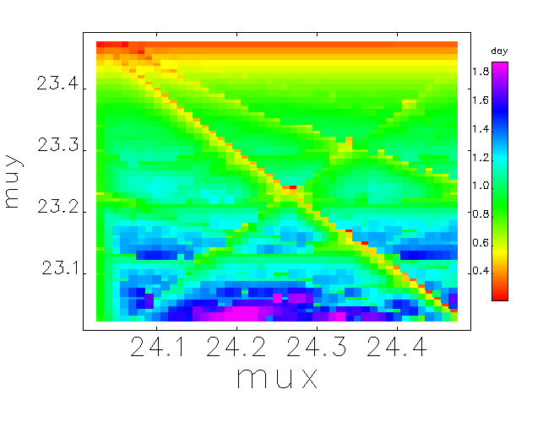
Ion ring dynamic aperture scan
Tune footprint
adequate aperture for choice of working
Point.

Slide 11
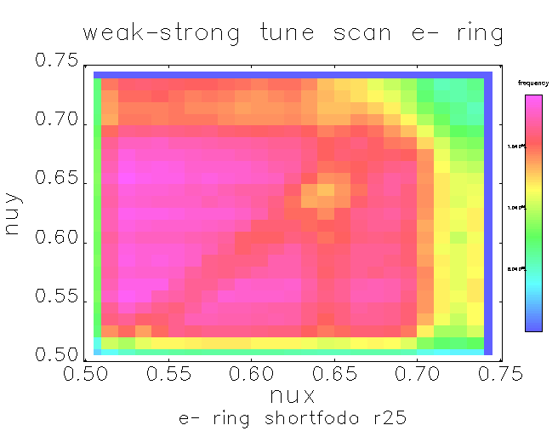
Weak-strong scan e- ring
Initial choice of working point

Slide 12
Mad-x PTC versus ELEGANT
Example for T5xx coefficients
-16.49/-14.55
7.16/6.89 | -0.72/-0.62
0/0 | 0/0 | -291.5/-305.5
0/0 | 0/0 | -2.99/-2.14 | 0/-0.027
0.149/0.107 | 0/-0.0094 | 0/0 | 0/0 | 0/-0.00418
0.629/0.673 | -0.795/-0.785 | 0/0 | 0/0 | 0.0615/0.093 | -12.74/-12.91
Tracking with ELEGANT and extracting coefficients (first number)
Calculating coefficients with MAD-X PTC (second number)
T511
T521 T522
T531 T532 T533
T541 T542 T543 T544
T551 T552 T553 T554 T555
T561 T562 T564 T564 T565 T566

Slide 13
Initial working point choices
Ion ring : 0.23/0.16, e- ring 0.53/0.567
Initial study with strong-strong and non linear optics show adequate behavior
Choice of damping decrement in electron ring is important. Currently transverse damping is 11000 turns. May need to lower this number

Slide 14
Crabbing studies
JLEIC crossing angle is 50 mrad
Crabbing was modeled as thin kicks using two 952 Mhz cavities , 90 degrees away from the IP
So far, assume ”perfect” crabbing cavities
The real implementation has more than two cavities per side (between 7 and 10)

Slide 15
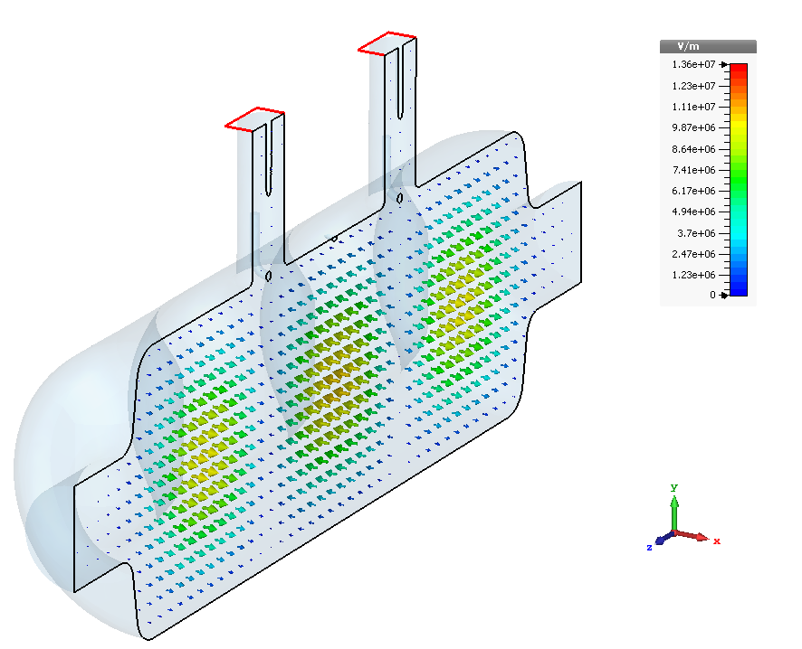
Crab cavity for JLEIC
 | Squashed Elliptical | Single-Cell RFD | Multi-Cell RFD | Unit
Frequency | 952.6 |  |  | MHz
Aperture | 70 |  |  | mm
LOM | 697.6 | None | 757, 862 | MHz
LOM Mode Type | Monopole | – | Dipole
1st HOM | 1033.1 | 1411.5 | 1335 | MHz
E_{p}/E_{t} | 2.29 | 5.4 | 5.89
B_{p}/E_{t} | 7.46 | 13.6 | 11.33 | mT/(MV/m)
[R/Q]_{t} | 49.4 | 50 | 259 | Ω
G | 341 | 166 | 168 | Ω
R_{t}R_{s} | 1.7×10⁴ | 8.3×10³ | 4.34×10⁴ | Ω²
Total V_{t} (e/p) (per beam per side) | 2.81 / 20.8 |  |  | MV
V_{t} (per cavity) | 1.5 | 0.86 | 3.1 | MV
No. of cavities (e/p) | 2 / 14 | 4 / 25 | 1 / 7
E_{p} | 21 | 30 | 39 | MV/m
B_{p} | 74 | 75 | 75 | mT
R_{s} [R_{res} =10 nΩ & 2.0 K] | 16.3 |  |  | nΩ
P_{diss} (per cavity) | 2.2 | 1.5 | 3.6 | W
Electric field in the fundamental mode of a 3-Cell RFD with coaxial couplers.
Courtesy Salvador Sosa, ODU

Slide 16
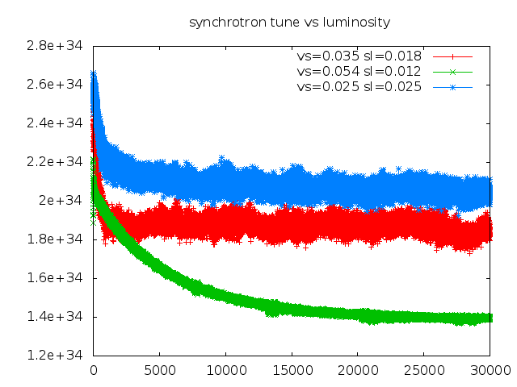
Luminosity vs proton sync. tune
Crabbing is on

Slide 17
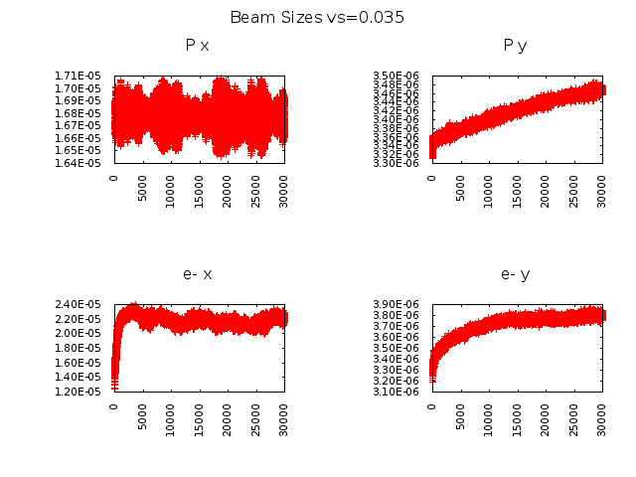
Beam sizes for vs=0.035

Slide 18
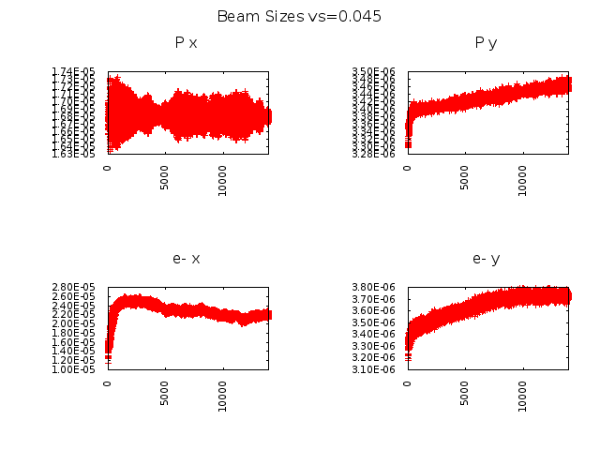
Beam sizes for vs=0.045

Slide 19
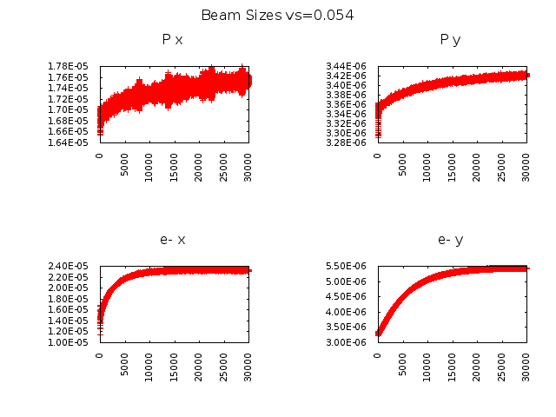
Beam sizes for vs=0.054

Slide 20
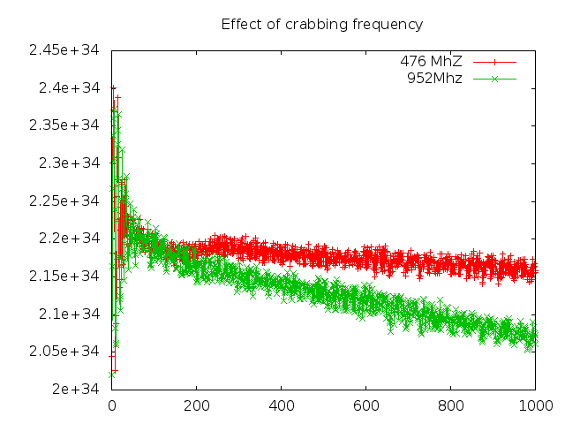
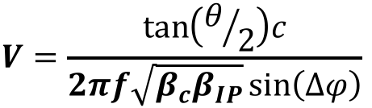
Effect of crabbing frequency
$$V=\frac{\tan\left(θ/2\right)c}{2πf\sqrt{β_{c}β_{IP}}\sin\left(∆φ\right)}$$
Pic noise contribution?

Slide 21
Damping decrement in e- ring
Currently we have tx=ty=11400,tz=5700 (turns)
What is the optimal damping decrement one needs to use to have an optimal lattice ?
Can we push up the beam-beam parameter by optimizing the damping decrement ?
In practice, it requires a lattice redesign

Slide 22
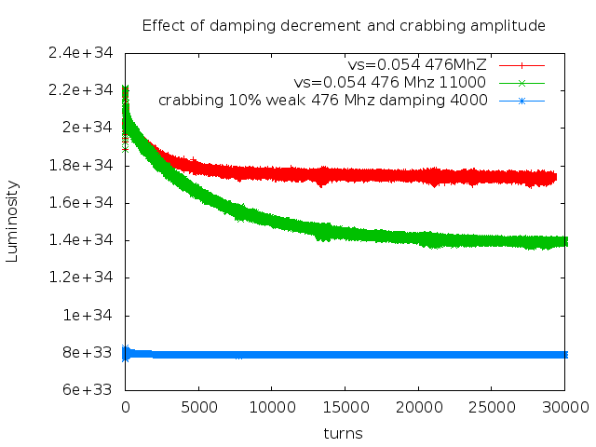
Damping decrement and crabbing amplitude

Slide 23
Effect of cooling the ion beam
JLEIC has bunch by bunch cooling in the ion ring
This leads to non-gaussian beams
Need for careful self-consistent calculations
Assumption: Time scale is different from beam-beam (much longer), so we will initialize the beam beam simulations using the cooling distributions

Slide 24
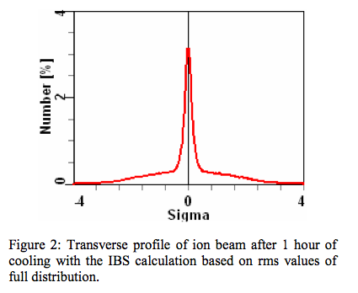
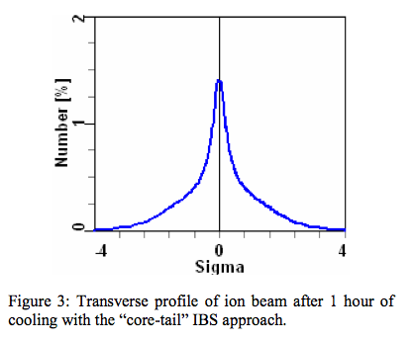
Dense Core of Ion Beam After e-Cooling
The dense core of the ion beam formed after strong electron cooling can induce
strong nonlinear beam-beam force on the electron bunch and shortening luminosity lifetime.
Figures from : A.V Fedotov et al, IBS for Ion Distribution Under Electron Cooling, PAC2005, Knoxville, Tennessee
Notes:
From Rui:
A.V. Fedotov, IBS for Ion Distribution Under Electron cooling, Proceedings of PAC2005, Knoxville, Tennessee, U.S.A., 2005
This is implemented in betacool.

Slide 25
Ring Synchronization
Baseline for JLEIC is to use chicanes/bypass lines.
In some kinematics, the discrepancy between e- beam and ion beam is significant (up to 25 cm pathlength shift)
Investigate the possibility to use ”gear changing”:
  Combination of chicanes and harmonic number changes between rings
  Leads to significant dynamical effects in beams.
  We are developing simulation code to test it (GHOST)

Slide 26
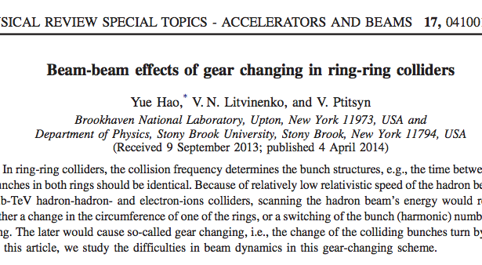
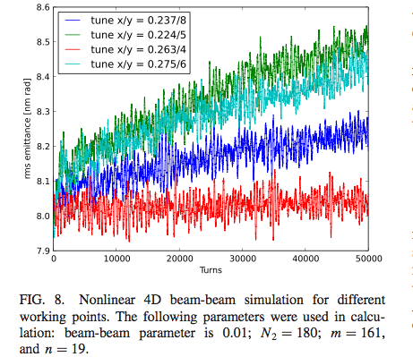
Coupled Bunch Beam-Beam Instability due to “Switching Gear”
We need to address the challenge of
coupled bunch beam-beam instability if we use
bunch harmonics for synchronization.
Notes:
This was recently pointed out again by Hao et al, in the context of the RHIC. This is a scheme that has to be studied.

Slide 27
Conclusions
JLEIC beam-beam studies ongoing
  Initial choice of working point
  Crabbing studies in progress
  Lattices optimizations in progress
Initial studies indicate that one can reach the design luminosity
Code development for gear changing (GHOST) in progress.

