Slide 1
Landau Damping Using Electron Lenses in Future Circular Colliders
Vladimir Shiltsev, Yuri Alexahin, Alexei Burov, Sasha Valishev
Fermilab
2018 Beam-Beam Workshop, LBNL, February 2018

Slide 2
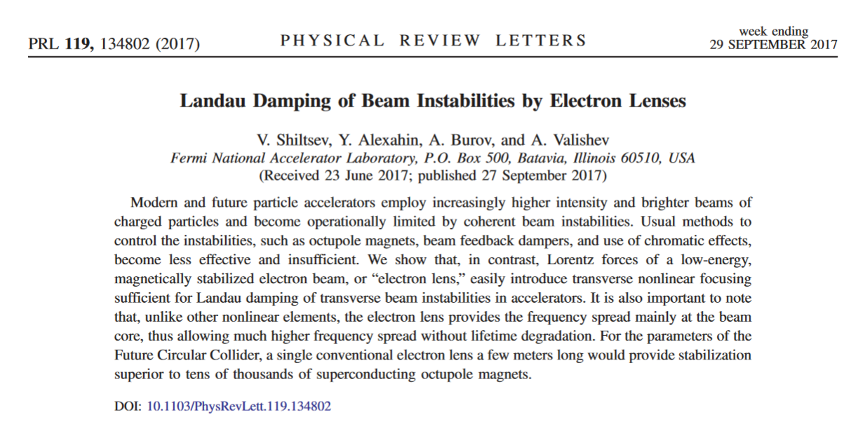
Disclaimer
This talk mostly follows recent PRL article:

Slide 3
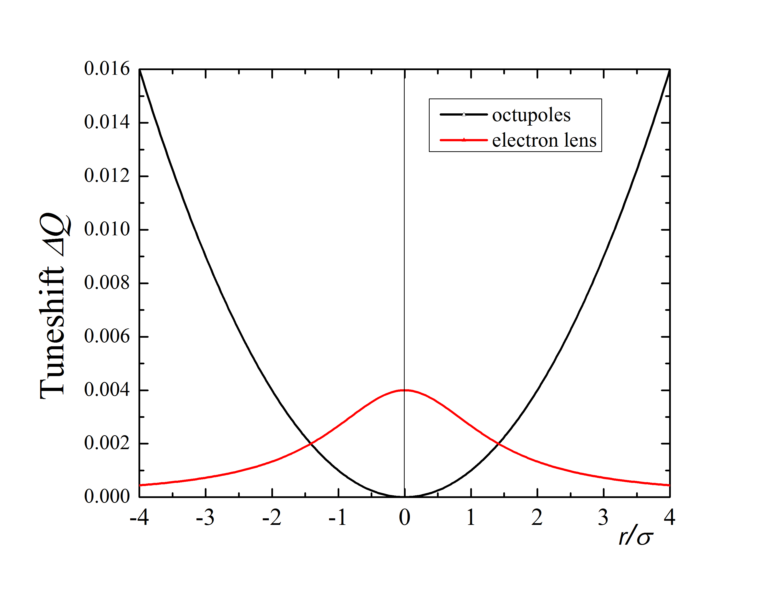
Electron Lenses for Landau Damping
(the concept, circa 2006)
Landau damping needs incoherent betatron frequency spread
Two issues with octupoles – required strength grows approx as ~E² leads to Dynamic Aperture degradation
(Gaussian) electron lens ~2 m and 2 А – would give enough stabilization even for the 50 TeV FCC without detrimental effects on particles with larger amplitudes A
Betatron frequency shift versus amplitude

Slide 4
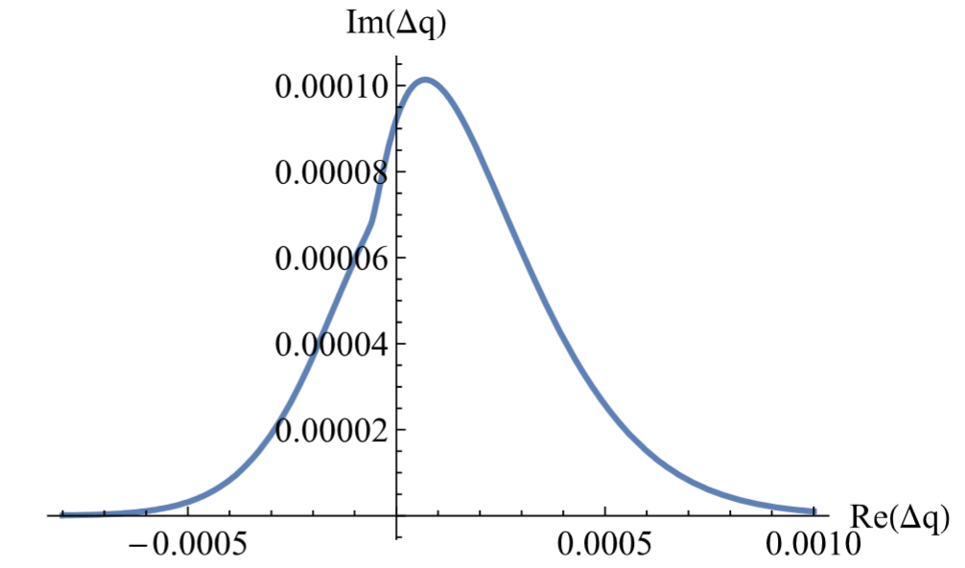
Let’s Start with Octupoles : Stability Diagram (SD)

Slide 5
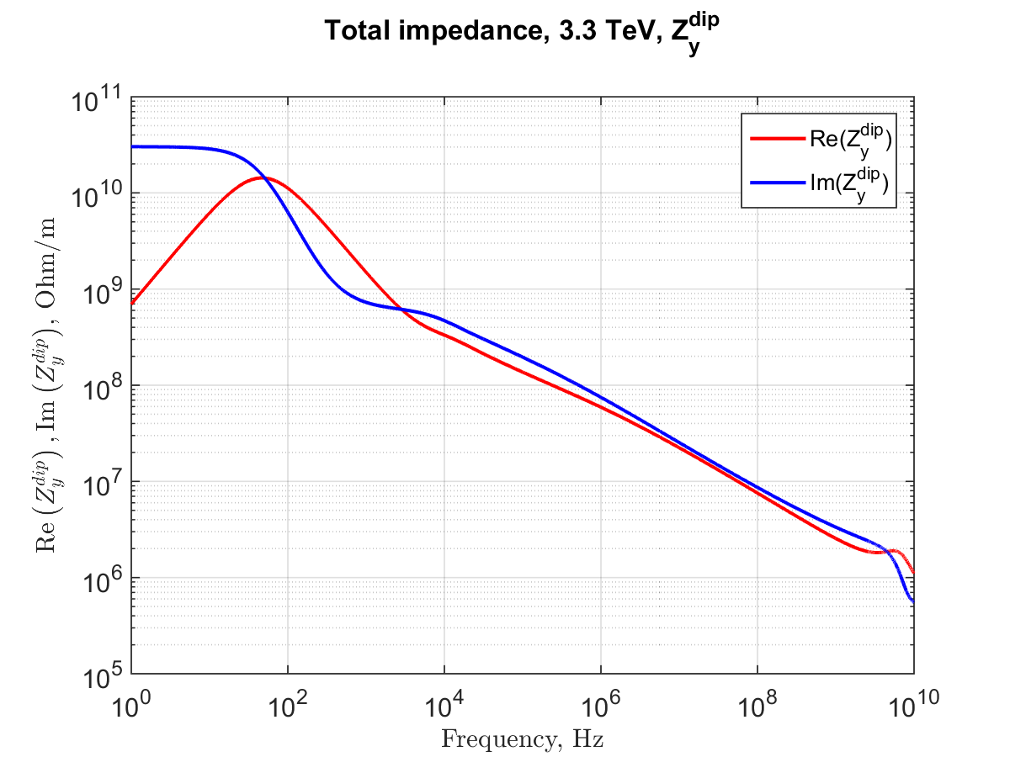
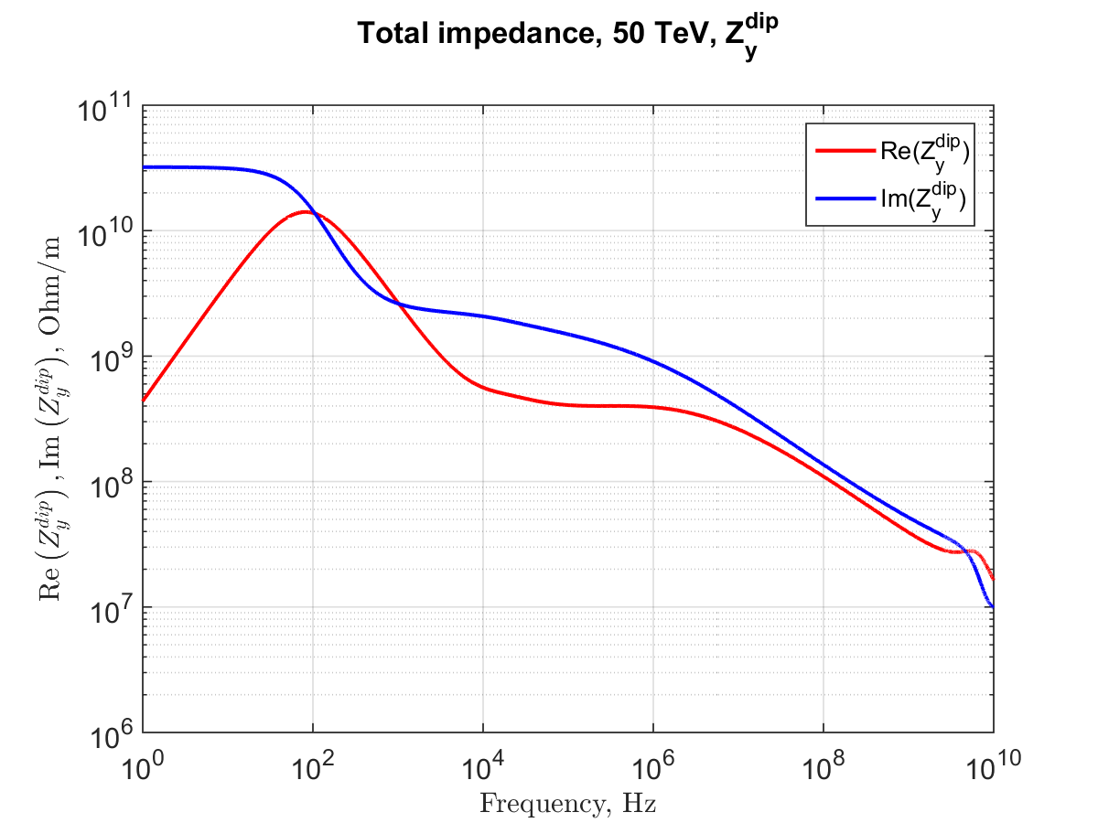
Worrisome FCC Impedance Estimates
Current is high, aperture is small, collimators are close,
electron cloud with SR uncertain
by Sergey Arsenyev
On top of that:
CC HOM (the most dangerous)
f=1.3GHz, Q=2.3 ×10⁴ , R_{s}= 3.7 / 65 MOhm/m

Slide 6
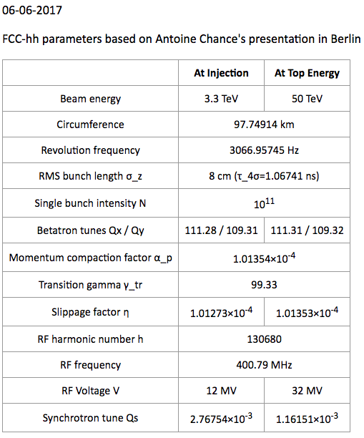
So, the Concern is VERY Real
For the FCC beams
the growth rates are (approx.):
 | Injection, 3.3TeV | Top, 50 TeV | damping
CB, low-f | 100 turns | 500 turns | damper
CB, HOM | 10⁵ turns | 10⁵ turns | Landau
SB | 5000 turns | 5000 turns | Landau
CB = coupled-bunch
SB = single-bunch
https://impedance.web.cern.ch/impedance/fcchbeam_dynamics_parameters.html

Slide 7
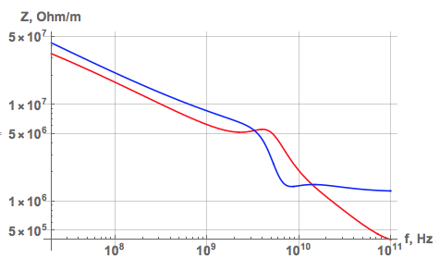
Number of Octupoles to Ensure Stability
at 50 TeV
FCC
LHC
AB

Slide 8
So the problem is:
Impedances grow
DA concerns grow
Spread diminishes
As the result:
Tevatron – 1 TeV beams – 35 SC octupoles (1m, 50 A)
LHC – 7 TeV beams – 336 SC octupoles (0.32 m, 550A)
FCC – 50 TeV beams – 12,000 “LHC-type” octupoles

Slide 9
All that makes octupoles unsuitable
Octupoles provide too little non-linearity where it is needed
and too high where it is detrimental
Too many are needed
Unreliable: tail-sensitive
Stability diagram collapse problem
Experienced recently in the LHC (interplay of LR beam-beam and octupoles during the squeeze)
Cannot vary along the beam
Dynamic aperture problems

Slide 10
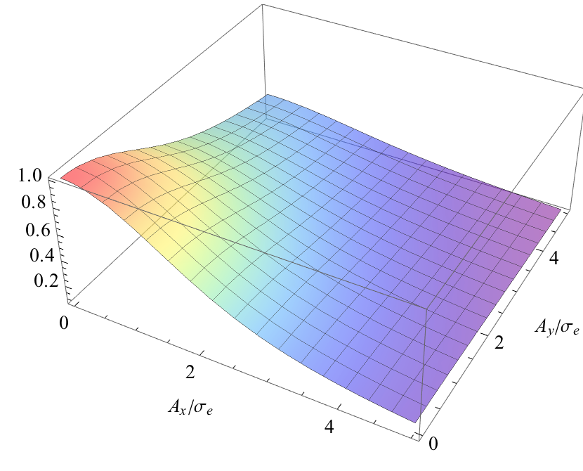
E-Lens as a Perfect Landau Element
E-Lens can deliver nonlinearity just where it is needed:

Slide 11
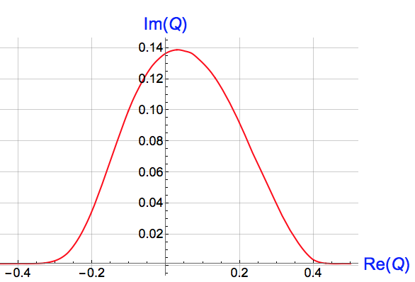
Stability Diagram with e-lens
Note high ratio of Im/Re (~1/3) compared to octupoles (~1/10) = sign of higher efficiency of e-lens which acts on the core rather than on the tails
In the units of max betatron tuneshift

Slide 12
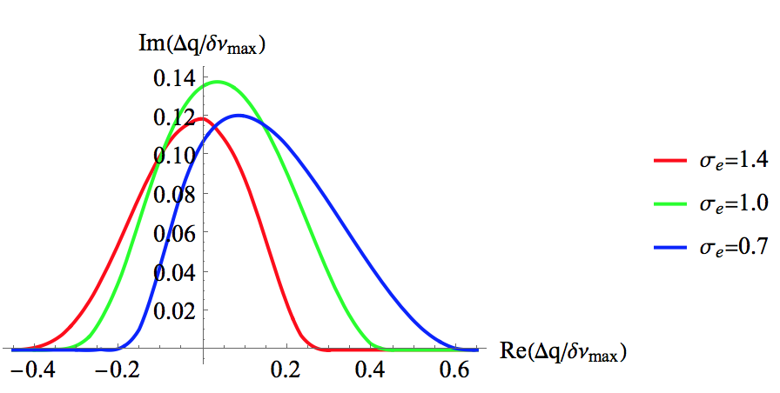
E-Lens Stability Diagrams for Different Sizes
SDs for various lens sizes with the same max current density
AB

Slide 13
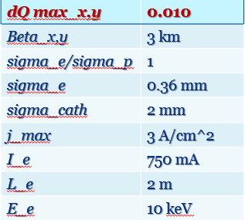
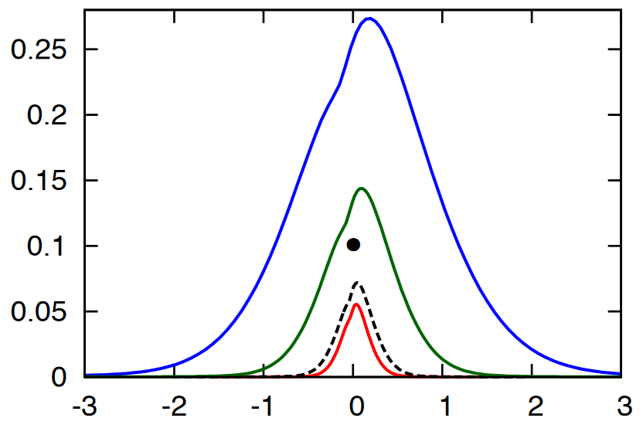
FCC Stability Diagram
1.5
0
e-lens dQ=0.01
(can be further increased)
1.4
1.3
1.2
1.0
Impedance model est. with collimators (scaled LHC)
0.9
0.8
0.7
Octupoles:
3646
1848
814
0.6
0.5
Impedance model w/o collimators (FCC2016)
0.4
0.3

Slide 14
Possible e-Lens Parameters
Length | 2 m
Beta-function at e-lens | 1.5 km
Electron current | 0.7 A
Electron energy | 10 kV
E-lens rms radius | 0.25 mm
Fields in main/gun solenoids | 6.5 T / 0.2 T
Max tune shift | 0.01
E-Lens parameters for the proton emittance 2.2 microns, at 50 TeV
At the injection, the same tune shift is achieved at lower e-current.

Slide 15
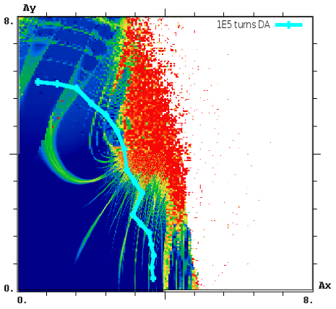
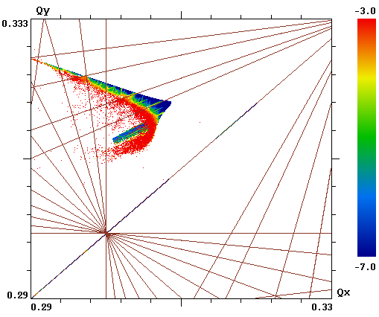
Effect of Stabilizing Elements on Dynamic Aperture
HL-LHC with octupoles
DA_{min} = 3.7 σ
Energy 7TeV, no collisions, HL-LHC optics Version 1.0 with multipole errors (1 seed), Chromaticity = 3
- For simulation with octupoles, current increased to -2000 A to create tune spread of 0.005 at 2.5 sigma
- Single electron lens at IR4 – the location of Hollow Electron Beam Collimator, Electron beam size matched to size of proton beam (sigma=0.28 mm). Current of EL corresponds to tune spread of 0.005 at 2.5 sigma

Slide 16
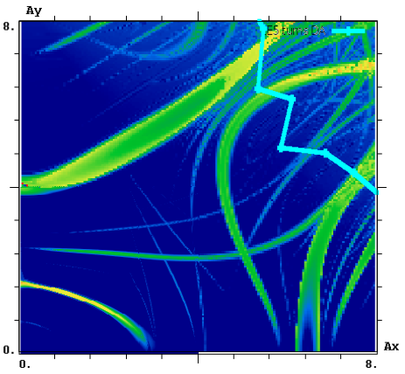
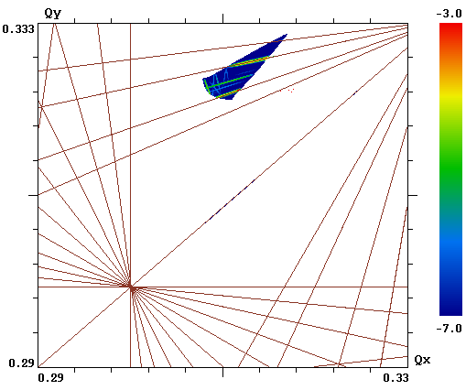
Effect of Stabilizing Elements on Dynamic Aperture
HL-LHC with E-Lens
DA_{min} = 8.0 σ
Energy 7TeV, no collisions, HL-LHC optics Version 1.0 with multipole errors (1 seed), Chromaticity = 3
- For simulation with octupoles, current increased to -2000A to create tune spread of 0.005 at 2.5 sigma
- Single electron lens at IR4 – the location of Hollow Electron Beam Collimator, Electron beam size matched to size of proton beam (sigma=0.28 mm). Current of EL corresponds to tune spread of 0.005 at 2.5 sigma

Slide 17
Landau lens test at RHIC?
Two Gaussian lenses operational in RHIC
Questions that can be answered:
Predicted SD vs. measurement
Effects of imperfections in implementation
Is E-Lens different from head-on beam-beam?
RHIC beams are generally stable, the 2 possible ways to make the beam unstable are
Injection damper
Chromaticity
Store is preferred due to better alignment. A likely experiment (W.Fischer)
ramp to store
align hadron beam with electron beam at given current
lower chromaticity until beam becomes unstable
repeat with: new ramp, lower electron beam current
Notes:
Dig up email from Wolfram et al

Slide 18
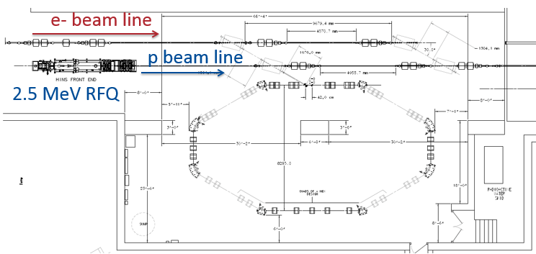
Landau Lens test at IOTA
40 м, e- 150 МeV/c p+ 70 МeV/c
Non-linear lenses for IO
Electron Lens
osc

Slide 19
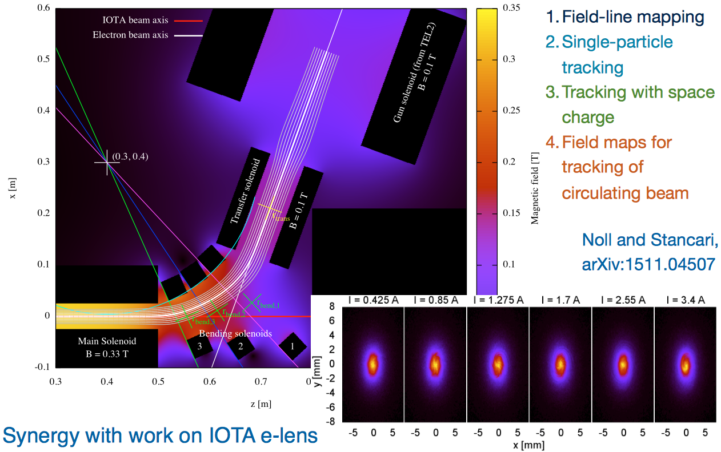
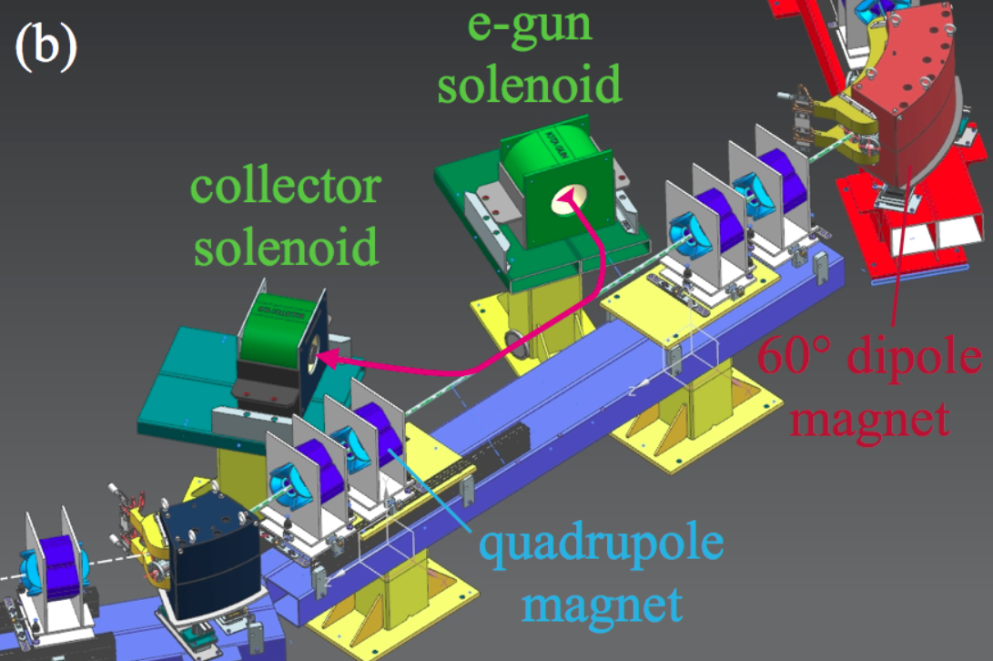
IOTA Electron Lens
Capitalize on the Tevatron and RHIC experience, LARP work
Re-use Tevatron Electron Lens components:
Removed TEL-2 gun & collector from Tev tunnel
Refurbishment in progress
Computer modeling for IOTA e-Lens in progress

Slide 20
Summary
Higher the energy of hadron beams, the harder to maintain coherent stability with octupoles (eg O(10⁴) in FCC-hh)
A “standard technology”, few meters long e-lens would do the job of ~20 000 LHC-type octupoles for the LHC or FCC.
E-lens SD is core-based, so it is robust, little effect on DA
Contrary to octupoles
E-Lens can be bunch-dependent
A problem of SD collapse can be fully excluded
E.g. like those due to LR beam-beam in the LHC squeeze
Experimental studies would be very interesting
RHIC, or IOTA

Slide 21
BACK UP SLIDES

Slide 22
RF Quads ?
RF Quads (A. Grudiev et al.) are novel interesting Landau elements.
There are serious beam-lifetime and DA concerns related to synchrobetatron coupling induced by the RFQ
Their effectiveness of the RFQ is sensitive to
predictability and reproducibility of the longitudinal tails of the bunches.
An ideal Landau element would be independent on the distribution tails.

Slide 23
Stability Diagram, weak head-tail, No SC
Stability diagram (SD) is defined as a map of real axes on the complex plane :
To be stable, the coherent tune shift has to be below the SD.

