Slide 1



Beam-Beam Simulations for the LHeC Project
Edward Nissen
Beam-Beam Effects in Circular Colliders Workshop
2/6/2018

Slide 2
Outline
Machine and code background
Effects on the spent electron beam
Effects on the recirculated proton beam
Potential analytical treatments for the proton beam
Conclusions

Slide 3
LHeC Design
Loss compensation 2 (90m)
Loss compensation 1 (140m)
Linac 1 (1008m)
Matching/splitter (31m)
Injector
Matching/combiner (31m)
Arc 1,3,5 (3142m)
Arc 2,4,6 (3142m)
Bypass (230m)
Linac 2 (1008m)
Matching/combiner (31m)
IP line
Detector
Matching/splitter (30m)
A 3 pass up, 3 pass down recirculating electron linac at 60 GeV top energy. This would interact with the LHC beam at the current ALICE detector.

Slide 4
Beam code and Parameters
The code in use is Guinea-Pig, a strong-strong code.
 | Value | Nominal Parameters | High Luminosity
Particle number (ion/electron) | 10¹⁰ | 17/0.3 | 22/0.2
β* ion | mm | 100 | 50
β* electron | mm | 120 | 32
ϵ_{x,y} ion | mm mr | 3.75 | 2
ϵ_{x,y} electron | mm mr | 50 | 50
Beam-Beam Tune Shift (i/e) |  | 9.61x10⁻⁵/0.76 | 1.20x10⁻⁵/0.987
Beam Beam Disruption parameter (i/e) |  | 3.62x10⁻⁶/5.99 | 9.05x10⁻⁶/29.1

Slide 5
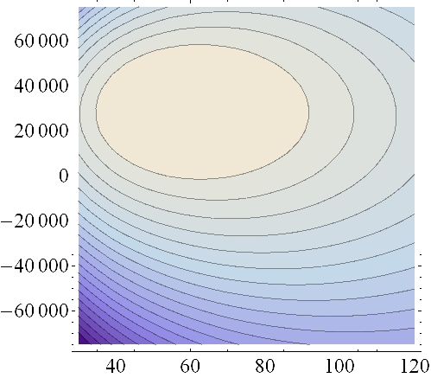
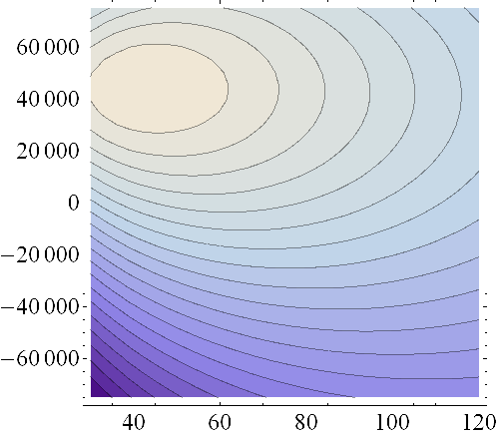
Waist Shift and Beta Function Optimization
Nominal
High Luminosity
Waist Shift (μm)
Waist Shift (μm)
β* (mm)
β* (mm)
β*~57mm,
WS~30mm,
Luminosity Increase~7.4%
β*~42mm,
WS~45mm,
Luminosity Increase~17.8%

Slide 6
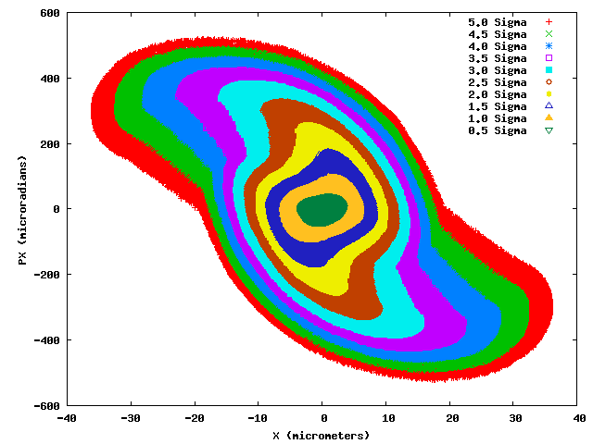
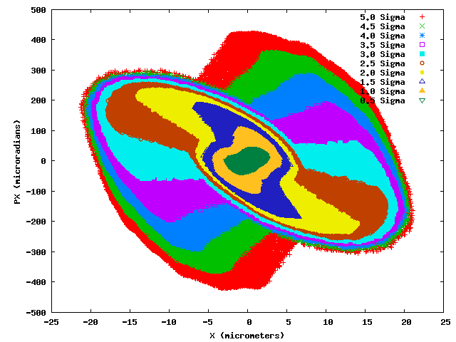
Spent Electron Beam
Nominal Parameters
High Luminosity Parameters

Slide 7
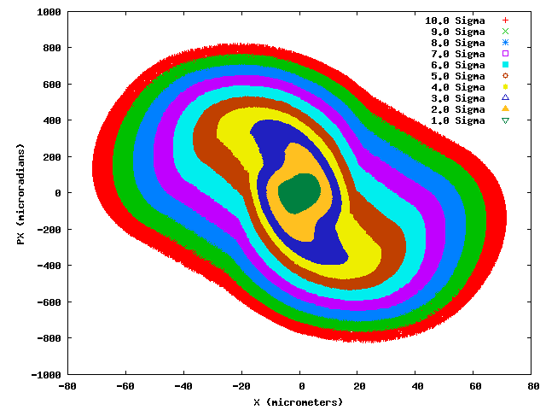
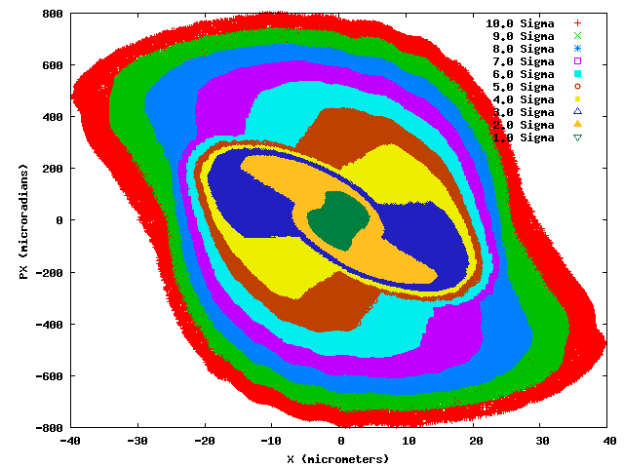
Spent Electron Beam
Nominal Parameters
High Luminosity Parameters

Slide 8
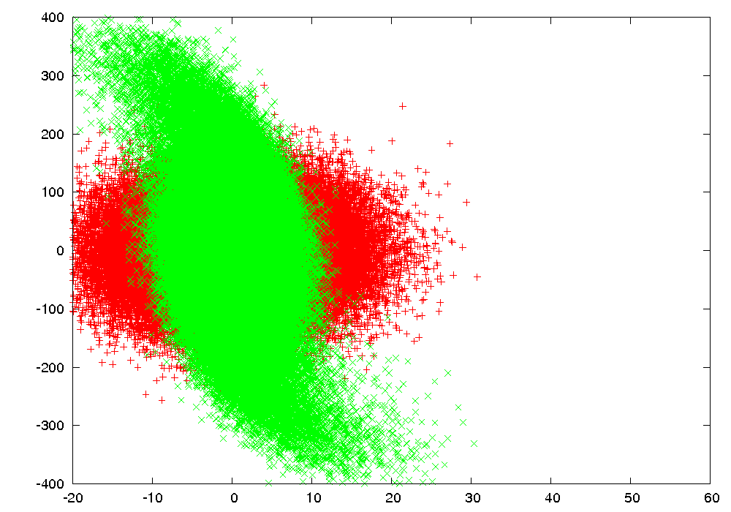
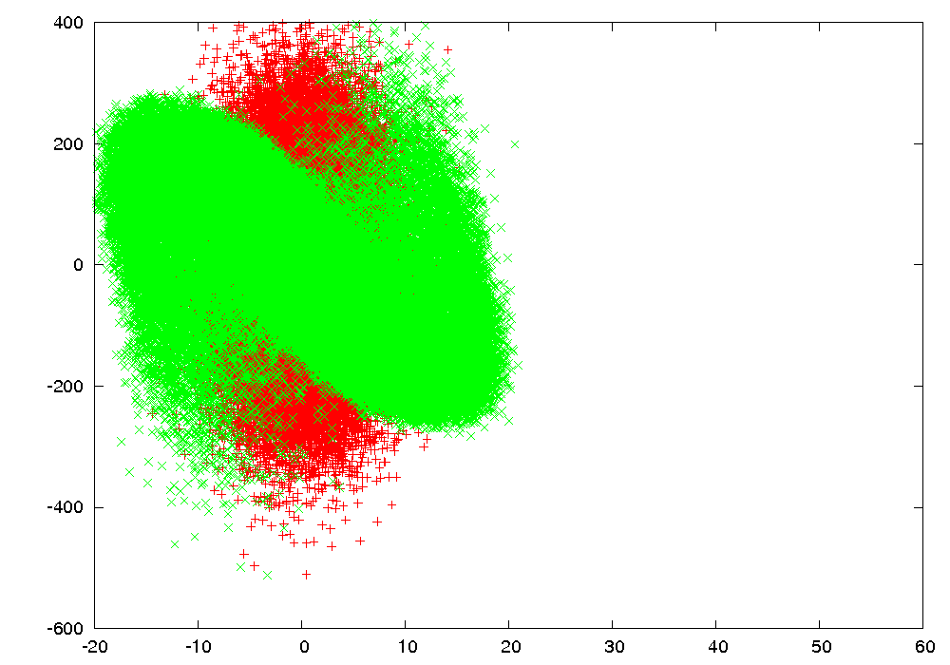
Spent Electron Beam
Nominal Parameters
High Luminosity
X’ (μr)
X’ (μr)
X (μm)
X (μm)
Red particles show the beam without beam-beam effects, green particles show the electron beam with beam-beam effects. Each frame is a single interaction at an increasing offset.

Slide 9
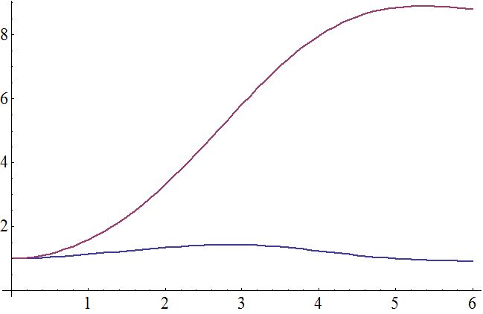
Spent Electron Beam Emittance
Relative to center of pipe
ɛ_{x}/ɛ_{x0}
Relative to center of beam
Offset (σ_{x})

Slide 10
Electron Linac (kicker correction system)
n_{kicks} | Δt (nanoseconds) | Δs (meters)
1 | 3434.351419 | 1029.592654
2 | 148.7120948 | 44.58276442
Assuming a circular arc, with a depth of 56 m
Using numbers from FONT1 latency is 65ns and voltage is 350 volts
The 1km radius is sufficient to allow for feedback within the same turn in each arc by cutting across

Slide 11
Electron Linac (kicker parameters)
Voltage | 350 kicks | 2
energy | max kick μrad | beta | geometric emittance (nm) | σ_{px} (μr) | max offset σ
10.5 | 1.3333 | 100 | 2.43321 | 4.9328 | 0.540603
20.5 | 0.6829 | 100 | 1.24631 | 3.5303 | 0.386893
30.5 | 0.4590 | 25 | 83.7691 | 5.7886 | 0.158594
40.5 | 0.3457 | 50 | 63.0856 | 3.5521 | 0.194636
50.5 | 0.2772 | 50 | 50.5935 | 3.1810 | 0.174303
60 | 0.2333 | 50 | 42.5830 | 2.9183 | 0.159909
Using one set of kicks at the opposite side, a 1σ offset can be corrected with a voltage of ~4400V

Slide 12
Long Term Beam Evolution
The beam beam interaction is modeled using Guinea-Pig
This is combined with a linear 1-turn map of the LHC for the protons, and a new beam for the electrons.

Slide 13
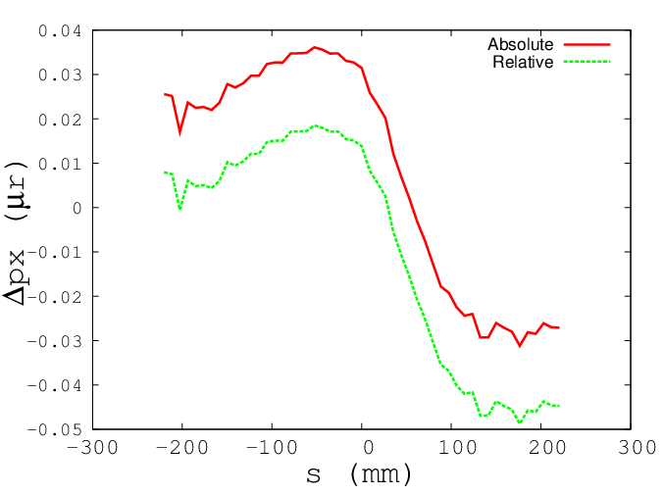
Emittance Growth from Transverse Offsets

Slide 14
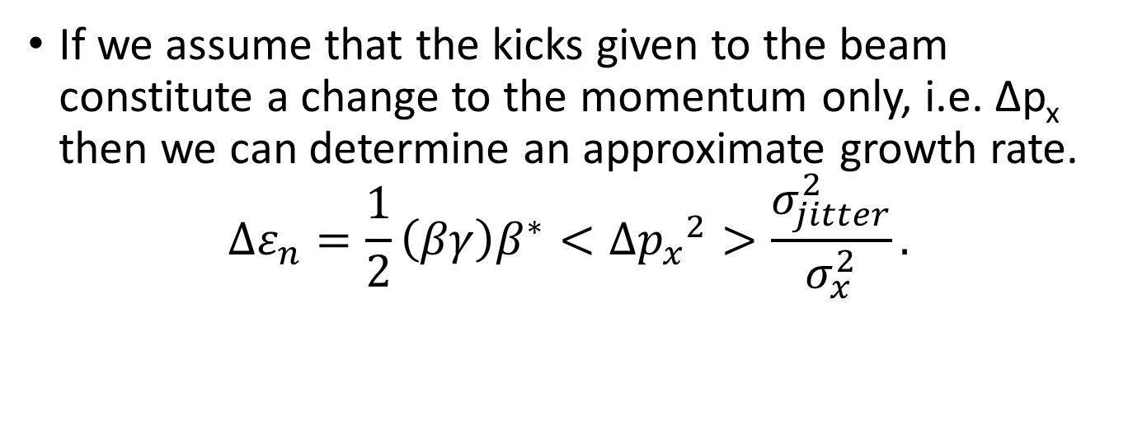
Predicting the Emittance Growth Rate
If we assume that the kicks given to the beam constitute a change to the momentum only, i.e. ∆p_{x} then we can determine an approximate growth rate.
$$∆ε_{n}=\frac{1}{2}\left(βγ\right)β^{∗}<∆{p_{x}}^{2}>\frac{σ_{jitter}^{2}}{σ_{x}^{2}}.$$
The next step is to determine <∆p_{x}²>.

Slide 15

Predicting Emittance Growth Rates
We can use the round beam approximation of the Basetti-Erskine formula,
$$∆p_{x}=−\frac{2Nr_{e/p}}{γ}\frac{(e^{\frac{−x^{2}}{2σ_{x}^{2}}}−1)}{x}$$
With
$$σ_{x}\left(z\right)=\sqrt{ε(β^{∗}+\frac{z^{2}}{β^{∗}})}$$
To solve,
$$<∆{p_{x}}^{2}>={(\frac{2Nr_{p}}{γ})}^{2}\frac{\int{\frac{{(e^{\frac{−x^{2}}{2σ_{x}^{2}}}−1)}^{2}e^{\frac{−z^{2}}{2σ_{z}^{2}}}}{x^{2}}dz}}{\int{e^{\frac{−z^{2}}{2σ_{z}^{2}}}dz}}$$
Now we need to determine X(z)

Slide 16



Predicting Emittance Growth Rates
The path through the proton beam can be tracked using Guinea-Pig, and can also be calculated directly using a numerical solver and the Basetti-Erskine formula.
Other approximations can be used to try to create an analytic formula for the growth rate.
One ansatz tested is,
$$A=\frac{φ−\frac{r_{0}}{z_{0}}}{2z_{1}−z_{0}}$$
$$B=\frac{2r_{0}\frac{z_{1}}{z_{0}}−z_{0}φ}{2z_{1}−z_{0}}$$
$$x\left(z\right)=Az^{2}+Bz$$

Slide 17
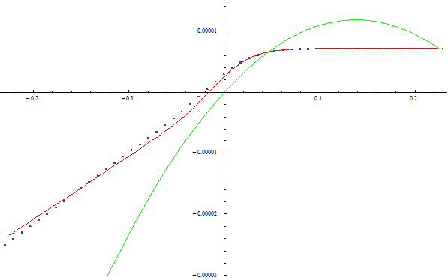
Path Through Proton Beam
X (m)
Z (m)
The dotted line is the path calculated with Guinea-Pig. The red line is the path integrated directly, and the green is the ansatz

Slide 18
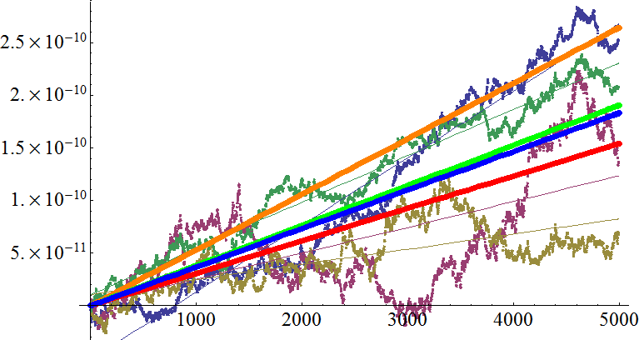
Predicted Growth Rates
5.28x10⁻¹⁴ m/turn
3.81x10⁻¹⁴ m/turn
Δε_{n} (m)
3.66x10⁻¹⁴ m/turn
3.08x10⁻¹⁴ m/turn
Turns
Rate predicted by Guinea-Pig
Rate Predicted by Ansatz
Average Simulation Rate
Rate Predicted by Integration

Slide 19
Emittance Growth Rates and Correction Tolerances
 | Time Growth Rate (m/s) | Doubling time (s) | Ɛ0 (m) | Jitter tolerance
Simulations Average | 1.01667E-08 x(σ_{jitter}/σ_{x})² | 86400 | 0.00000375 | 6.53%
Guinea-Pig | 1.46667E-08 x(σ_{jitter}/σ_{x})² | 86400 | 0.00000375 | 5.44%
Numerically Integrated | 8.55556E-09 x(σ_{jitter}/σ_{x})² | 86400 | 0.00000375 | 7.12%
Ansatz | 1.05833E-08 x(σ_{jitter}/σ_{x})² | 86400 | 0.00000375 | 6.40%

Slide 20
Growth Rate with Charge (LHeC)
Δϵ/turn (m)
Bunch population (x10¹⁰)
Calculated for a 20%σ offset jitter

Slide 21
Other Possibilities
FCC is modeled using the 100km FCC-hh design with 25 ns bunch spacing
Electron beam is the LHeC linac
 |  | Nominal |  | Ultimate
 |  | Proton | Electron | Proton | Electron
Energy | GeV | 50000 | 60 | 50000 | 60
β* | mm | 1100 | 109 | 300 | 9.692
ϵ_{x,yn} | μm | 2.2 | 50 | 0.7333 | 50
σ_{z} | mm | 75 | 0.3 | 75 | 0.3
Particle number | 10¹¹ | 1 | 0.03 | 1 | 0.03
Beam-Beam Tune Shift |  | .000164 | 0.45 | .000426 | 0.382

Slide 22
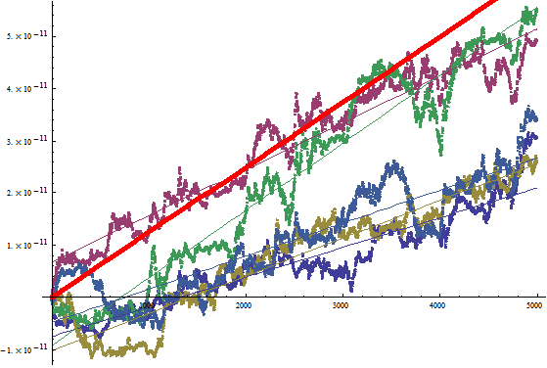
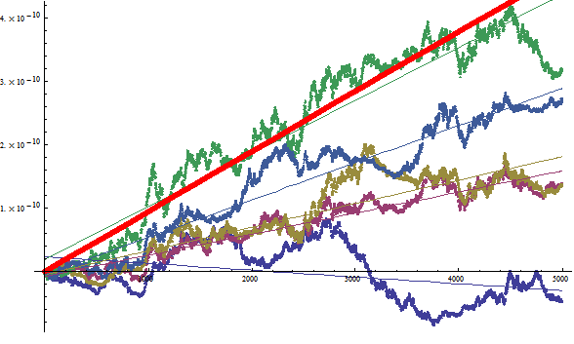
Multipass Emittance Growth FCC-he
Nominal Parameters
Ultimate Parameters
5
4
4
3
3
2
Δϵ_{xn} (x10⁻¹⁰)(m)
Δϵ_{xn} (x10⁻¹¹)(m)
2
1
1
Turn Number
Turn Number
Predicted rate 9.470x10⁻¹⁴
Predicted rate 1.249x10⁻¹⁴
Mean calculated rate 4.046x10⁻¹⁴
Mean calculated rate 8.212x10⁻¹⁵
Δϵ_{xn}/Δt=7.095x10⁻⁹(σ_{jitter}/σ_{x})²m/s
Δϵ_{xn}/Δt=9.36102x10⁻¹⁰(σ_{jitter}/σ_{x})²m/s
Doubling time 1 day σ_{jitter}/σ_{x}=5.99%
Doubling time 1 day σ_{jitter}/σ_{x}=9.5%

Slide 23
Assumptions for an Analytical Approach
One beam’s position an be considered constant (Reference beam) while the other is colliding with it (colliding beam). (i.e. weak-strong)
Both beams are round transversely (σ_{x}=σ_{y})
They have Gaussian profiles (Basetti-Erskine an be used)
When calculating the kick on the stationary (or ”Rest”) beam, the colliding beam an be modeled as a Gaussian disk of charge acting on a line of charge at the centroid.
23

Slide 24
Determining Angular Spread
We take the differential equation for the beams,
And using the Beam-beam disruption parameter,
We can reduce it to,
Note: the subscripts refer to which beam “sees” the given factor. D_{C} is the disruption parameter
experienced by the colliding beam.
24

Slide 25
Determining Angular Spread (cont’d)
By casting the equations of motion in D-coordinates the angular spread can be calculated with,
Where N(D_{C}) is a dimensionless factor determined by D_{C}. For non-hourglass beams it becomes,
25

Slide 26
Determining Angular Spread (cont’d)
If we want to compensate for the overall angular kick given to the reference beam we subtract it out,
26

Slide 27
Determining Angular Spread (cont’d)
N(D), I(D), N(D)-I(D) (Dimensionless)
D_{C} (Dimensionless)
27

Slide 28
What about the Hourglass?
If we assume a factor e=σ_{z}/β* for the stationary beam it will alter the path of the colliding beam,
28

Slide 29
Second Hourglass
e_c=1
e_c=0
e_R (dimensionless)
e_R (dimensionless)
D_C (dimensionless)
D_C (dimensionless)
29

Slide 30
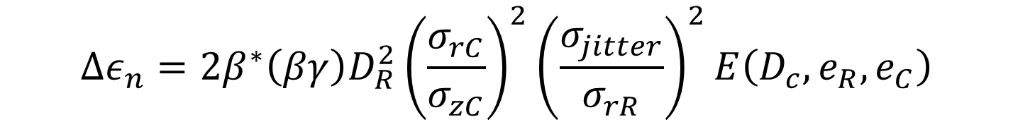
Roundup
$$∆ε_{n}=2β^{∗}\left(βγ\right)D_{R}^{2}{\left(\frac{σ_{rC}}{σ_{zC}}\right)}^{2}{\left(\frac{σ_{jitter}}{σ_{rR}}\right)}^{2}E\left(D_{c},e_{R},e_{C}\right)$$
$E\left(D_{c},e_{R},e_{C}\right)$= $N\left(D_{c},e_{R},e_{C}\right)$-k$I\left(D_{c},e_{R},e_{C}\right)$
With choices of e_{R} e_{C} as appropriate. If no hourglass is needed in a given system, then the appropriate e_{R} and/or e_{C} would be set to zero. K is either 1 or 0 depending on whether the overall motion of the beam is damped or not. If a machine has perfect correction systems, then k=1. If no corrections are given then k=0.
30
Notes:
30

Slide 31
Examples
Rate calculated from GP 5.28E-14
Simulations AVG 3.66E-14
dE/E (emittance)
N(D,e_R) 3.25E-14
N(D) 3.05E-14
N(D,e_R,e_C) 2.98E-14
N(D)-I(D) 2.8E-14
Turns
Example is the LHeC nominal parameters with 4 separate random seeds using Guinea Pig with a linear
particle advancing code.
31

Slide 32
Conclusions
The LHeC exists in a regime where the beam-beam effect can affect the luminosity of the beam.
As long as the return arcs of the recirculating linac remain linear, and proper damping is applied, then the electron beam should be energy recoverable.
The beam-beam effect can cause an emittance growth in the proton beam, but it is manageable with appropriate beam damping.
The nature of the parameter sets for the LHeC can allow an analytic understanding of the growth of the beam based on its parameters.

Slide 33
Thank You for Your Attention

Slide 34
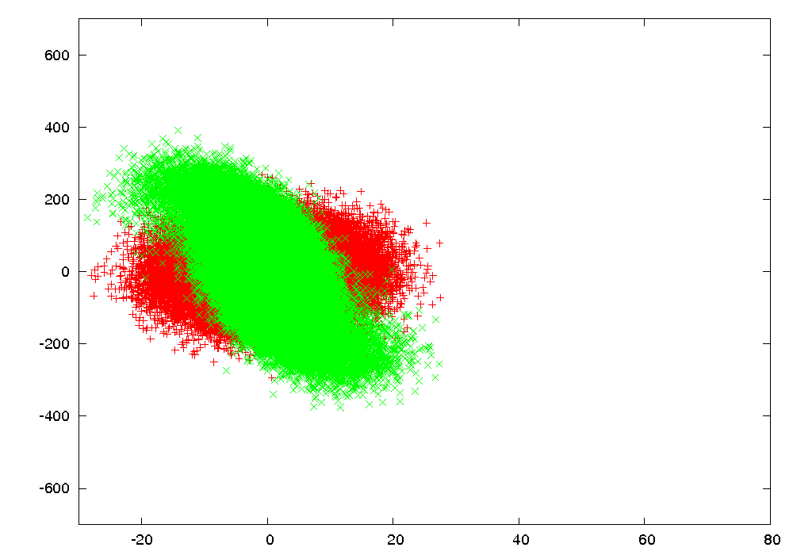
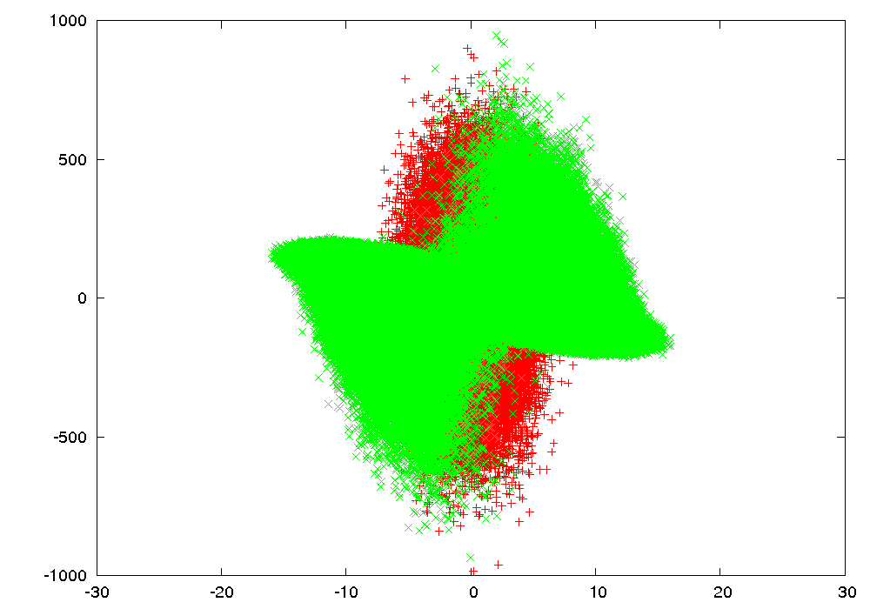
Spent Electron Beam (FCC-he)
Nominal Parameters
Ultimate Parameters
Px (μr)
Px (μr)
X (μm)
X (μm)
The green data represent the spent beam after beam-beam focusing, the red shows the electron beam without the beam-beam effect for comparison. The blue circle shows the position of the proton beams, the beam is offset from 0 to 6σ in 0.1σ intervals.

