Slide 1
Beam-beam effects in KEKB/SuperKEKB
K. Ohmi (KEK)
Beam-beam workshop 2018@LBNL
5-7 Feb, 2018
Thanks to E. Forest, Y. Funakoshi, K. Hirosawa, N. Iida, H. Koiso, A. Morita,
Y. Ohnishi, N. Ohuchi, K. Oide, H. Sugimoto, Y. Zhang, D. Zhou

Slide 2
KEKB
LER 3.5GeV(e+) x HER 8GeV(e-) asymmetric circular collider with circumf. 3016m.
L=2.16x10³⁴ cm⁻²s⁻¹ was achieved.
Overcome the Electron cloud effects.
Day-by-day tuning of coupling and its chromaticity.
SuperKEKB
LER 4GeV(e+) x HER 7GeV(e-) asymmetric circular collider (3016m).
Target L=8x10³⁵ cm⁻²s⁻¹.
Large crossing angle, σ_{z}θ_{h}/σ_{x}=20, no crab waist.
Extremely low β*, β_{x}*=3cm, β_{y}*=0.3mm. Low emittance.

Slide 3
Parameters of KEKB/SuperKEKB
 | KEK (LER) | KEKB (HER) | SuperKEKB (LER) | SuperKEKB (HER)
ε_{x}(nm)/ ε_{y} (pm) | 18/180 | 24/240 | 3.2/8.64 | 4.6/11.5
β_{x}/ β_{y} (mm) | 1200/6 | 1200/6 | 32/0.27 | 25/0.3
σ_{z}(mm)/σ_{δ}(10⁻⁴) | 7/7 | 6/7 | 6/7.7 | 5/6.3
θ(mrad), θ_{P} | 0.011, 1 | - | 0.0415, 20 | -
N_{e} | 6.4x10¹⁰ | 4.7x10¹⁰ | 9x10¹⁰ | 6.5x10¹⁰
N_{bunch}, t_{sp} (ns) | 1576 | 1576 | 2500 | 2500
L_{tot} (cm⁻²s⁻¹) | 2.11x10³⁴ | - | 8x10³⁵ | -
ξ_{x}/ ξ_{y} | 0.127/0.129 | 0.102/0.09 | 0.0028,0.088 | 0.0012/0.081

Slide 4
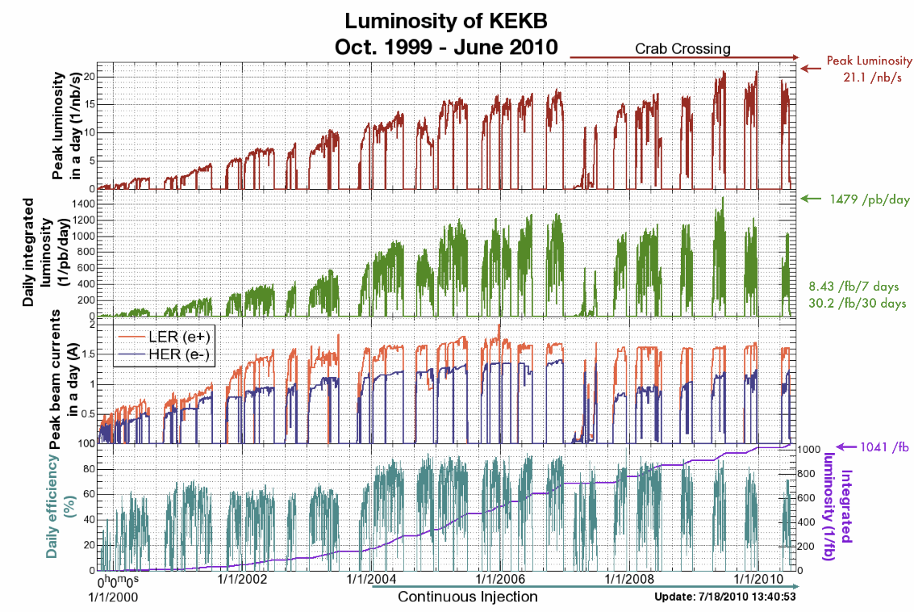
Electron cloud cure and IP optics tuning
Chromatic coupling correction

Slide 5
Commissioning of KEKB, IP optics tuning
IP orbit/optics tuning, Δx, Δy, α_{y}, β_{y} (waist), r₁₋₄, η_{y}, η_{y}’ every hour was essential for maintain KEKB operation.
Chromatic optics parameters, β_{y}, r₁₋₄, η_{y}. were corrected later.
Parametrization of one turn matrix at IP
dispersion subtraction, 4+2 matrix
x-y coupling

Slide 6
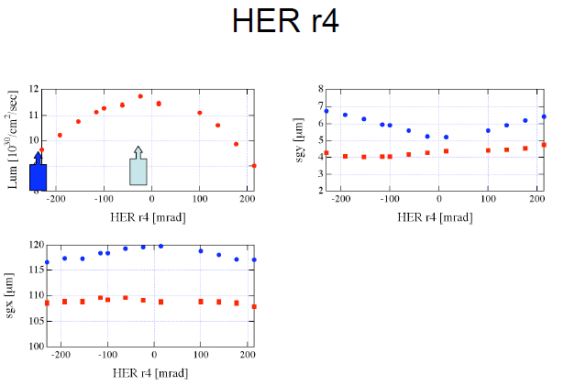
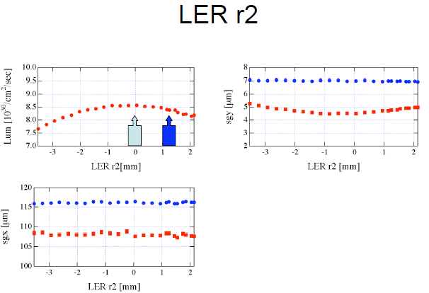
Strong-strong simulation in SuperKEKB
Luminosity simulation was performed with scanning the optics parameters as is done in the operation. Simulation using M₆(s*).

Slide 7
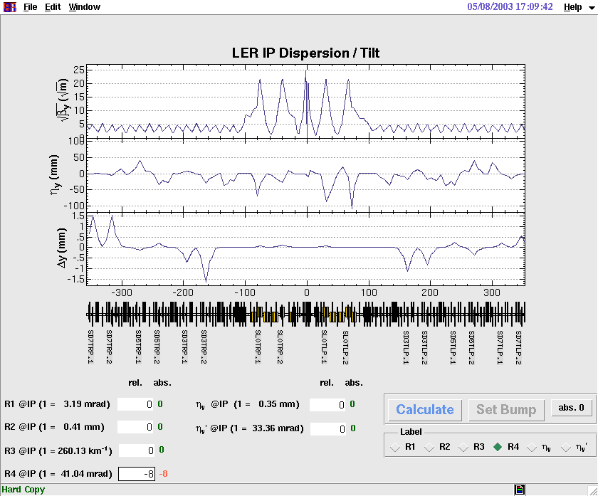
Optics parameters are controlled by local bumps
Local bump at sextupole magnets induces x-y coupling at IP.

Slide 8
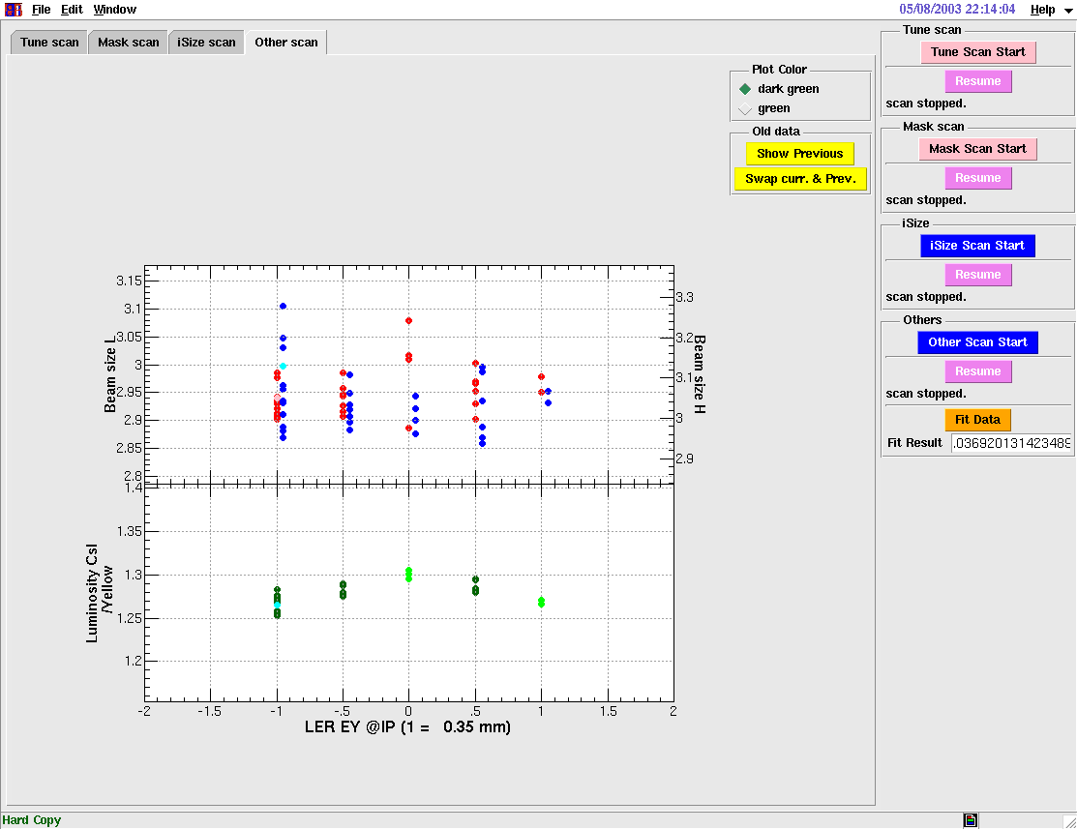
Dispersion at IP, tuning
Beam size and luminosity are measured with changing ηy parameters.

Slide 9
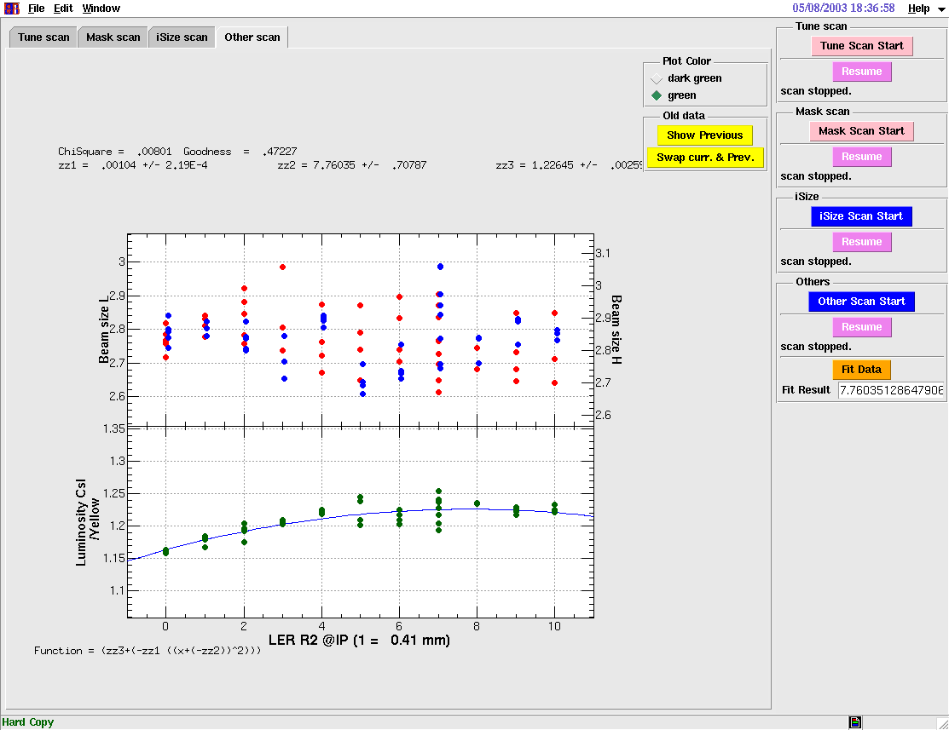
X-y coupling LER R₂ , tuning
Beam size and luminosity are measured with changing R2 parameters.

Slide 10
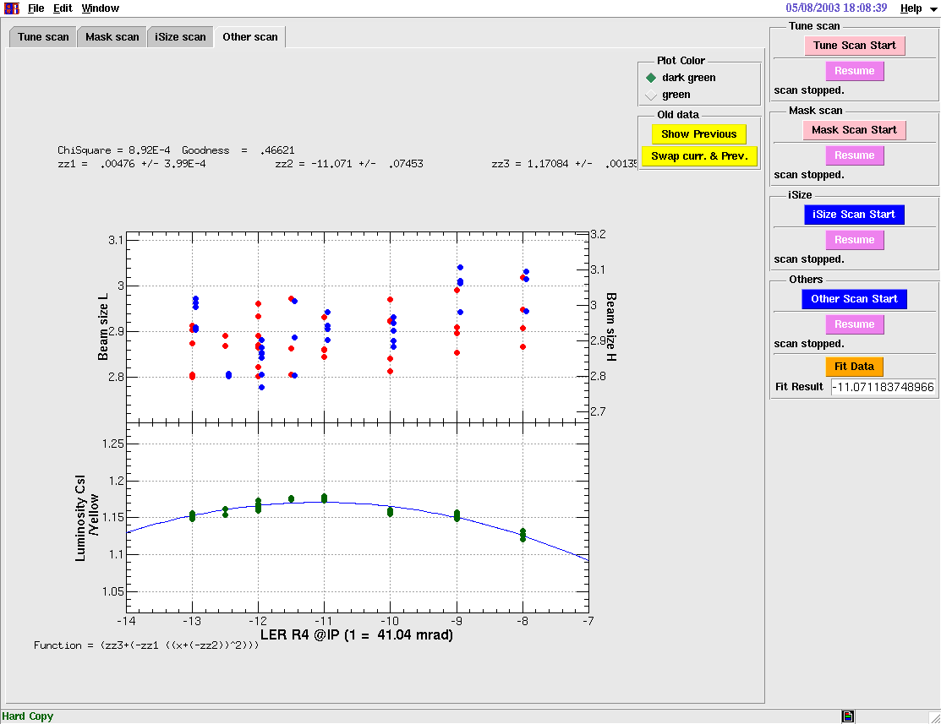
X-y coupling LER R₄ , tuning
Beam size and luminosity are measured with changing R4 parameters.

Slide 11
Measurement of IP optics
IPAC10
Octopos BPM
Octopos BPM
773mm
552mm
Take turn-by-turn position data
Reconstruct phase space plot at IP.
Phase space ellipse

Slide 12
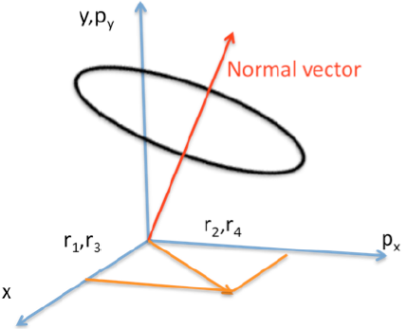
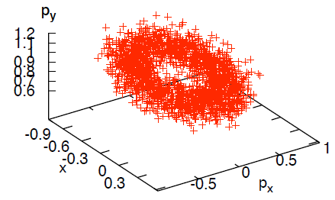
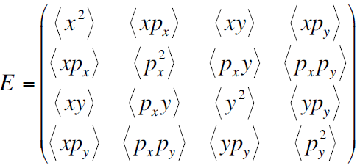

Slide 13
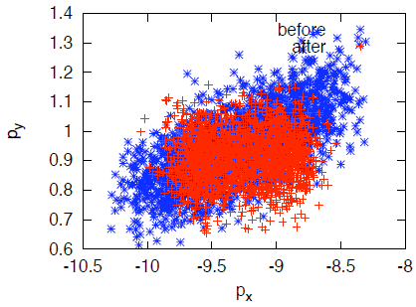
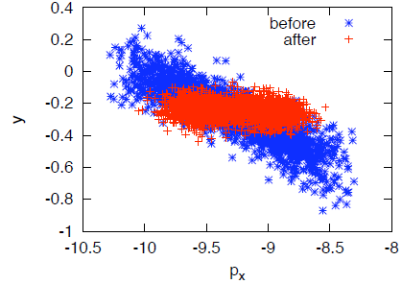
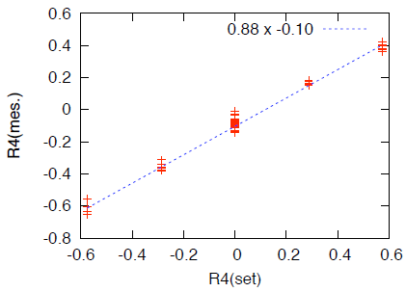
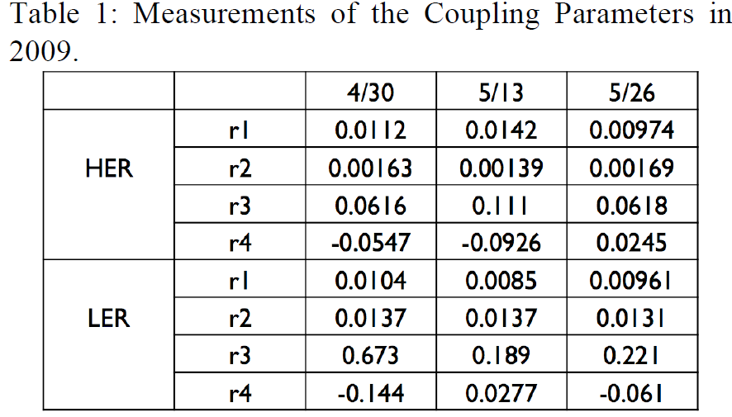

Slide 14
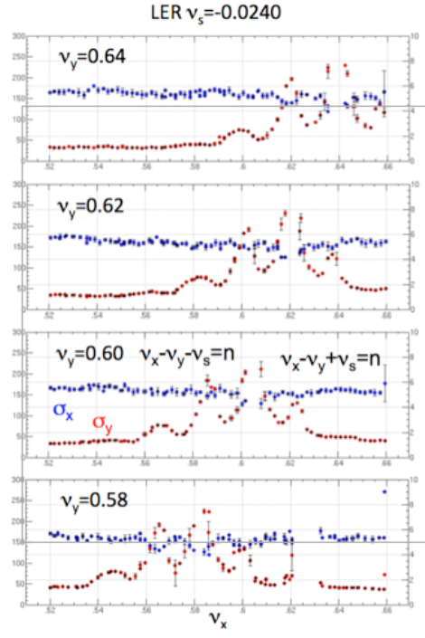
Chromatic coupling at IP
Beam size blow-up was seen at ν_{x}-ν_{y}+-ν_{s}.
Existence of coupling term of xyz.
We correct chromatic coupling at IP using skew sextupole magnets.
Luminosity increases 20%, due to the crab cavity and chromatic coupling correction even lower beam current compare with the peak.

Slide 15
Electron cloud cure and IP optics tuning
Chromatic coupling correction
Lower beam current

Slide 16
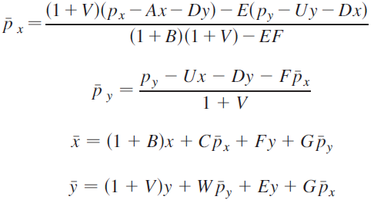
Beam-beam simulation with chromatic coupling
Generating function of chromatic coupling transformation
e_{n}, f_{n},g_{n},h_{n} are related to chromatic coupling.
Determine a-w for a given chromaticity (measurement or model)
Transfer using H(a,b,..)
…

Slide 17
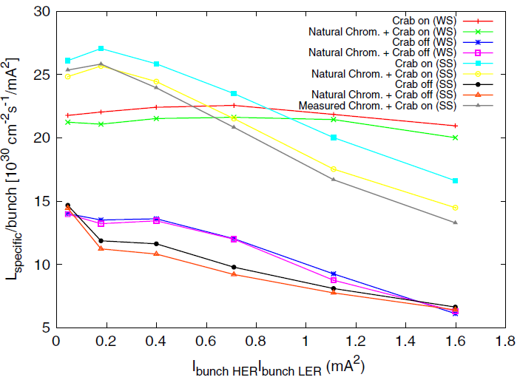
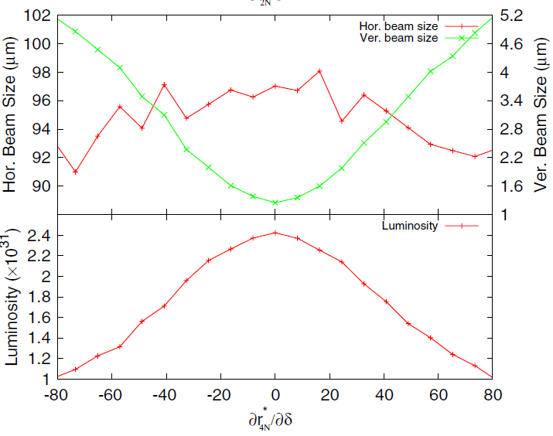
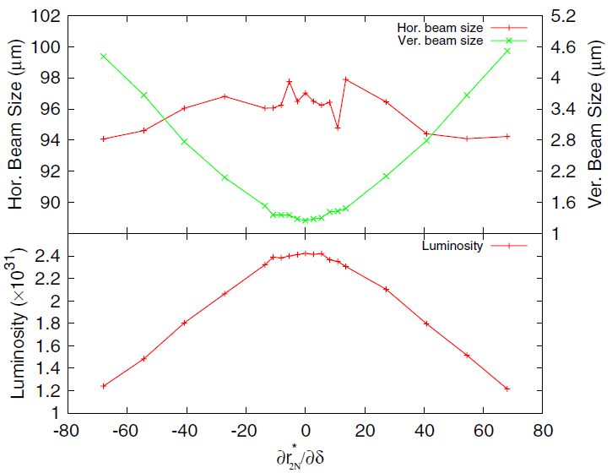
Weak-strong simulation w and w/o chromatic coupling
D. Zhou et al., PRSTAB 13, 021001 (2010)
Specific luminosity w and w/o chromatic
coupling
Scanning dr₄/dδ and dr₂/dδ

Slide 18
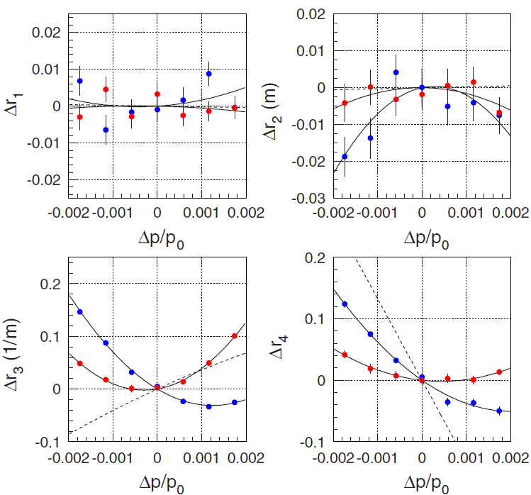
Measurement of chromatic coupling
x-y coupling parameters are measured for RF freq shift.
Blue and red is before and after correction.
Luminosity increases 20% after the correction.
Y. Ohnishi et al., PRSTAB 12, 091002 (2009)

Slide 19
SuperKEKB
Luminosity upgrade strategy changes the crab cavity to the large crossing angle scheme.
Extremely low β IP optics, β_{x}*=3cm β_{y}*=0.3mm.
Large Piwinski angle,
Commissioning with collision starts from this spring.
IP beta is squeezed step by step,
(8xβ_{x}*,8xβ_{y}*), (4xβ_{x}*,8xβ_{y}*), (4xβ_{x}*,4xβ_{y}*),…, (β_{x}*,β_{y}*)
Two subjects are discussed,
IR nonlinearity
Coherent beam-beam instability

Slide 20
Y. Ohnishi, Dec. 2017

Slide 21
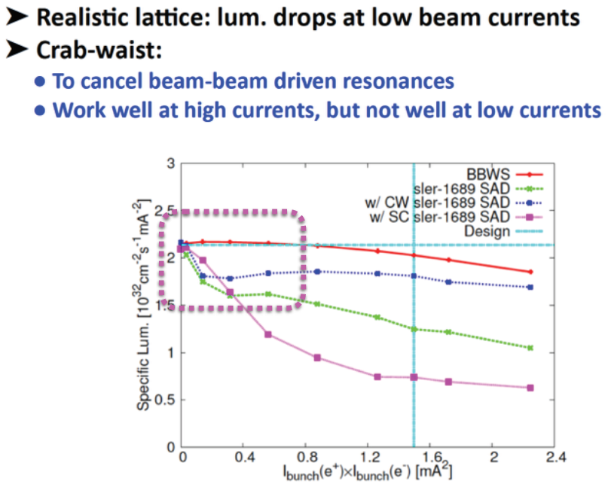
IR magnets and their nonlinearity
There are many nonlinear field components in IR magnets.
Chromatic coupling
D. Zhou, SKEKB MAC 2015
BBWS : arc expressed by simple transfer matrix
SAD: complex lattice structure

Slide 22
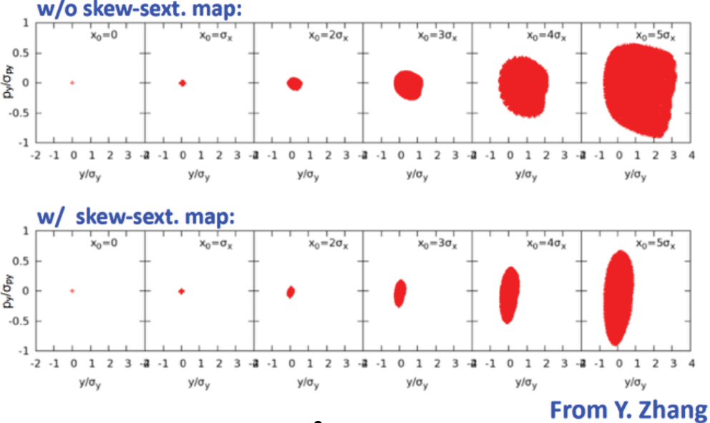
Y. Zhang’s (IHEP) work at KEK
Vertical orbit is induced by a large horizontal betatron oscillation.
Skew sextupole term at IP, x²y, is suspected for the luminosity degradation.

Slide 23
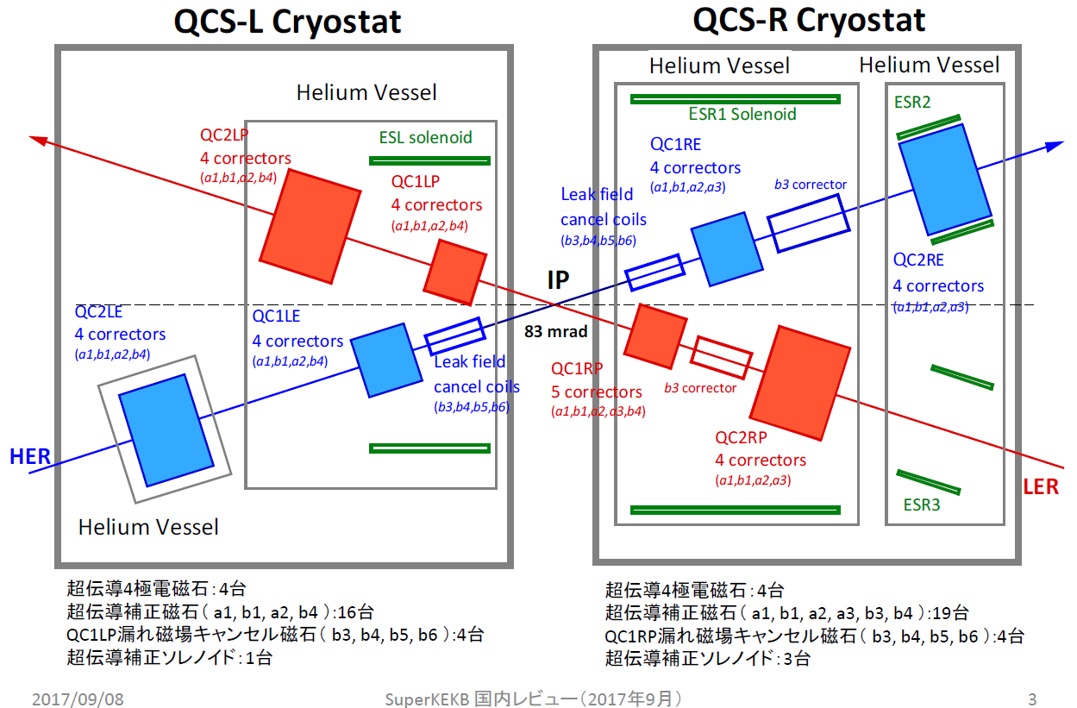
QCS superconducting magnet system
N. Ohuchi et al.

Slide 24
N. Ohuchi et al.

Slide 25
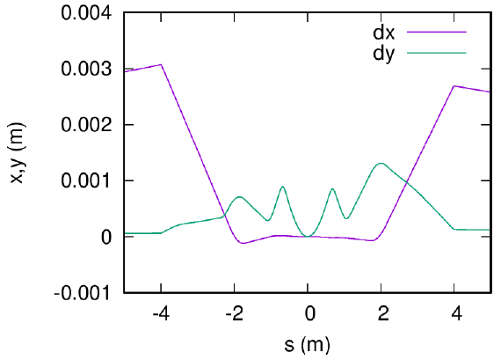
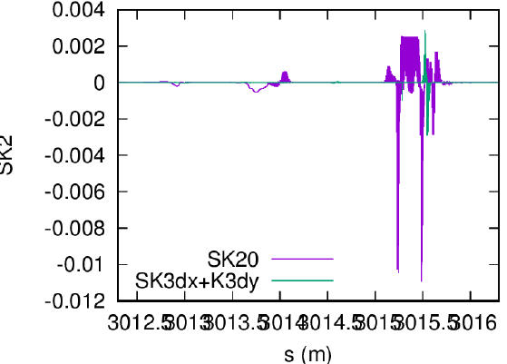
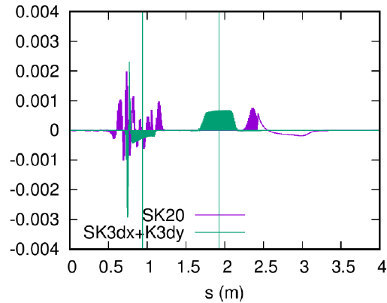
Evaluation of nonlinear term
Focus on skew sextupole component.
Reference axes in solenoid is chosen as a straight line with half crossing angle.
Magnet components are defined on the reference orbit.
Beam orbit deviate from the reference orbit.
Skew sextupole component is induced by Skew sextupole and octupole with a vertical orbit.
Skew sextupole component
upstream of IP downstream

Slide 26
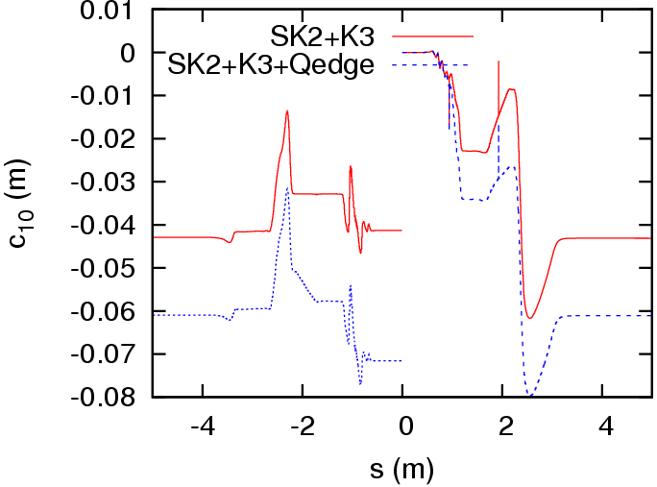
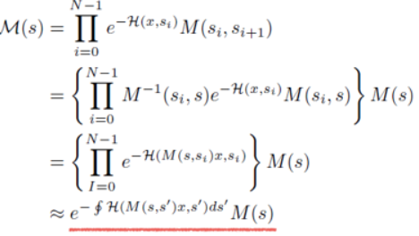
C₁₀ from SK2 and K3+yCOD
Contribution to SK2 is coming from explicit Skew Sext SK2₀ and octupole, K3+COD
No contribution from higher order than K3.
Skew sextupole coming from higher order nonlinearity is small.
There are 10 skew components.
$$y^{3}, y^{2}p_{y}, yp_{y}^{2}, p_{y}^{3}$$
$$x^{2}y, x^{2}p_{y},{xp_{x}y,xp_{x}p_{y},p}_{x}^{2}y, p_{x}^{2}p_{y}$$
$$H=c_{10}p_{x}^{2}p_{y}$$

Slide 27
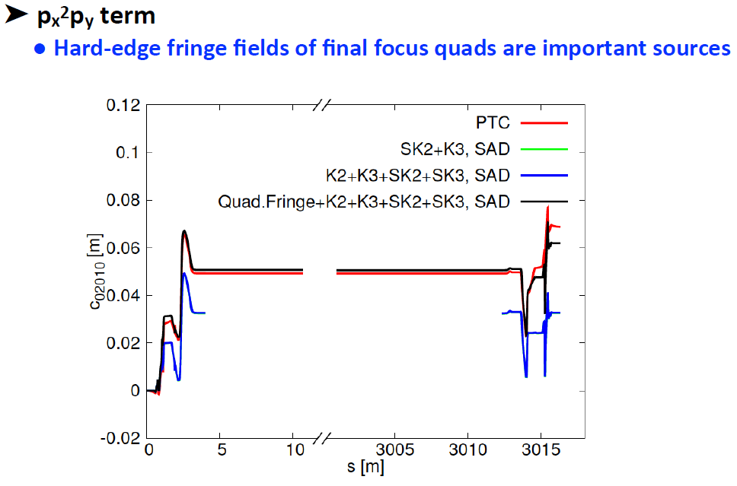
Comparison with PTC
D. Zhou

Slide 28
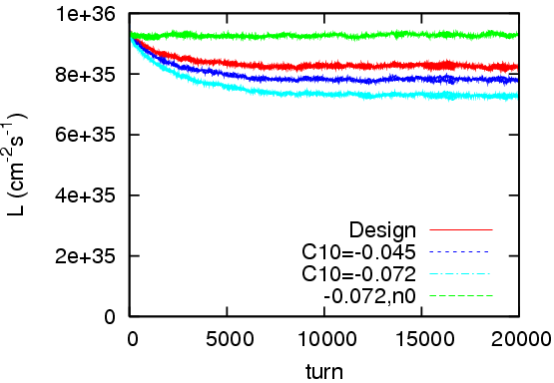
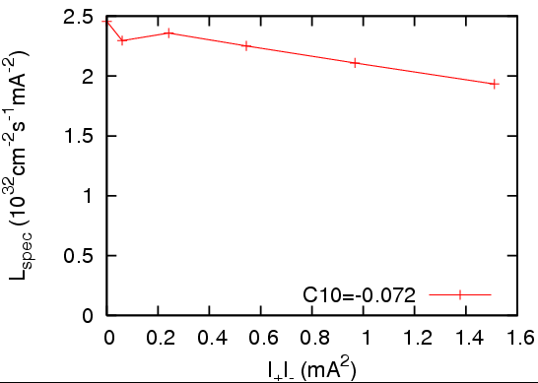
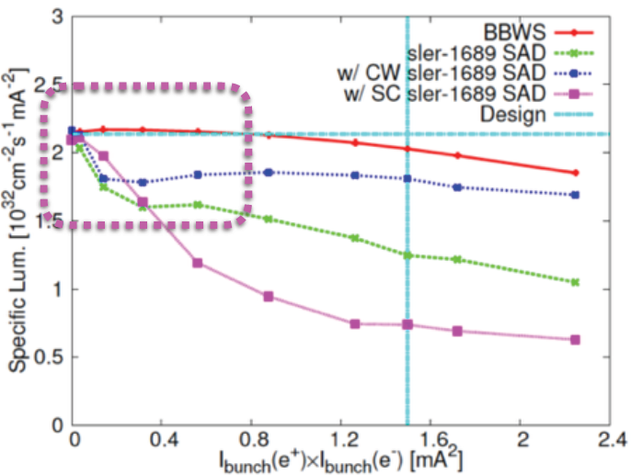
Luminosity for H=c₁₀p_{x}²p_{y}
The luminosity degradation due to c10 is weaker than that of beam-beam simulation with SAD.
There may be still unknown nonlinearity?

Slide 29
Detuning β*
c₁₀=0.072 m is kept for β*change, because IR magnets are fixed in SuperKEKB.
For normalized coordinates, $P_{i}=\sqrt{β_{i}}p_{i}$, $X_{i}=x_{i}/\sqrt{β_{i}}$
C₁₀=136.9 m^{-1/2} for β_{x}*=3.2cm, β_{y}*=0.27mm
Normalized C₁₀ directly affects the beam dynamics. $∆Y=C_{10}P_{x}^{2}$
The effect is reduced by Detune of β*.
C₁₀ is 4.4% for 8x8, 8.8% for 4x8.
$$C_{10}=\frac{c_{10}}{β_{x}^{∗}\sqrt{β_{y}^{∗}}}$$
$$H=c_{10}p_{x}^{2}p_{y}$$
$$H_{N}=C_{10}P_{x}^{2}P_{y}$$
$$∆Y=C_{10}P_{x}^{2}≈136.9ε_{x}≈0.15\sqrt{ε_{y}}$$
for β_{x}*=3.2cm, β_{y}*=0.27mm

Slide 30
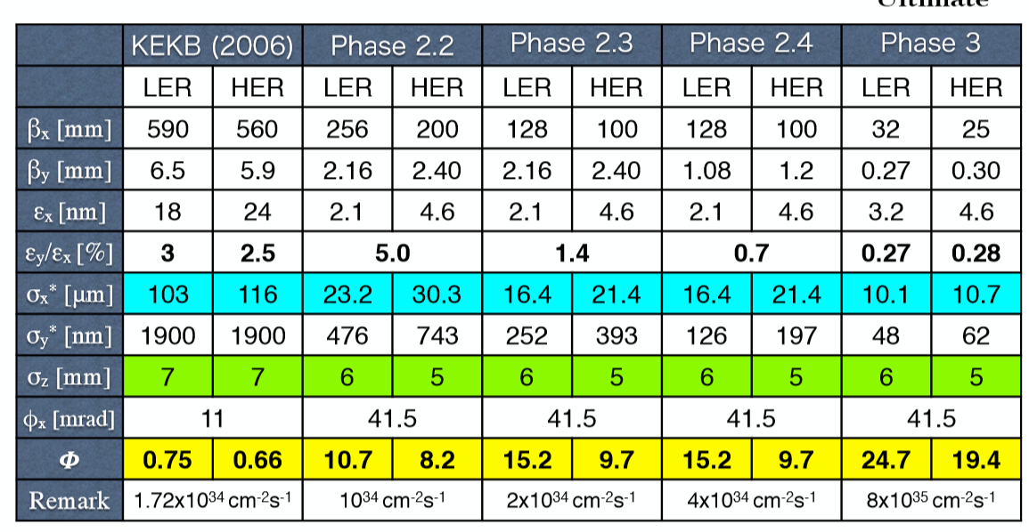
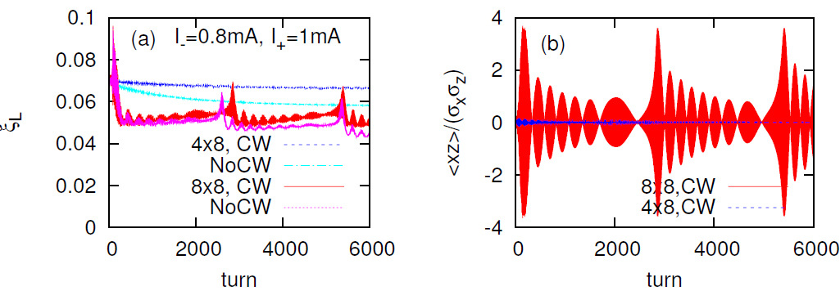
Measurement of the Coherent beam-beam instability
Y. Ohnishi, Dec. 2017
Beam-beam instability should be observed at detuned lattice (8x8x) in commissioning of Phase-II (this year).
Design parameters of SuperKEKB was stable.

Slide 31
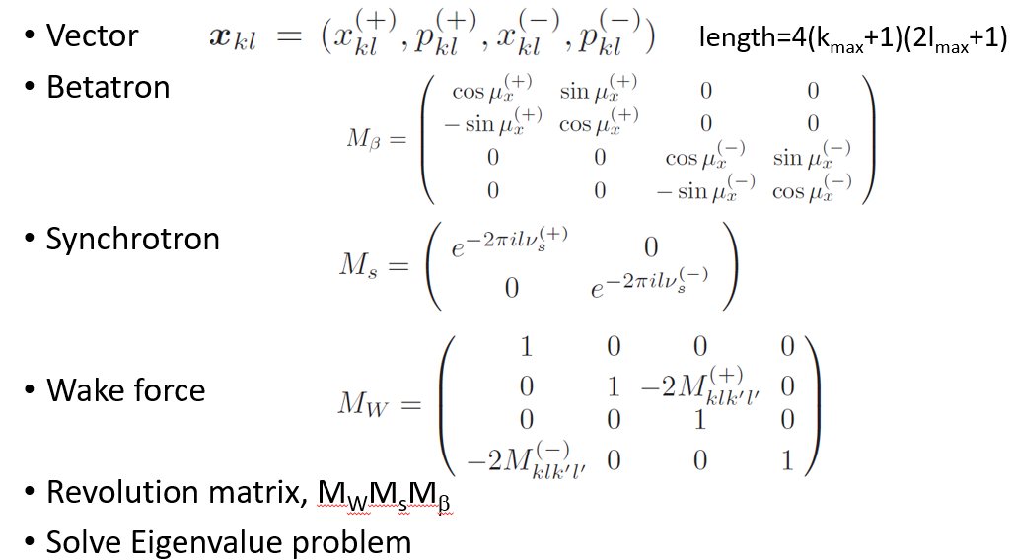
Analysis of the instability
Beam-beam eigenmode analysis. Solve eigenvalues of 1000x1000 matrix.
Eigen tune is ν=ν_{x}+-Lν_{s}. Mode coupling or synchro-beta resonance is casued.
Synchrotron tune, ν_{s}(LER)=0.0247, ν_{s}(HER)=0.0280.
Number of Sidebands increases. More unstable.
strong-strong beam-beam
simulation.

Slide 32
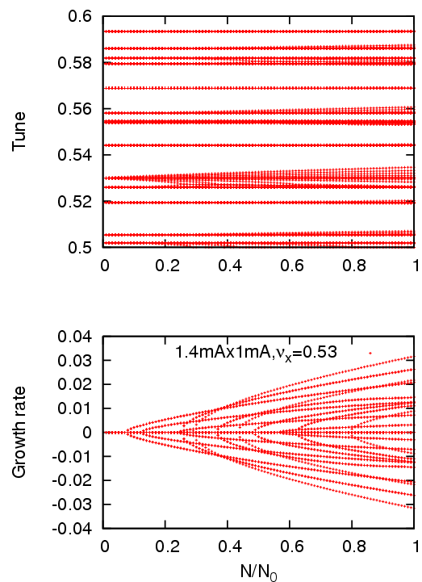
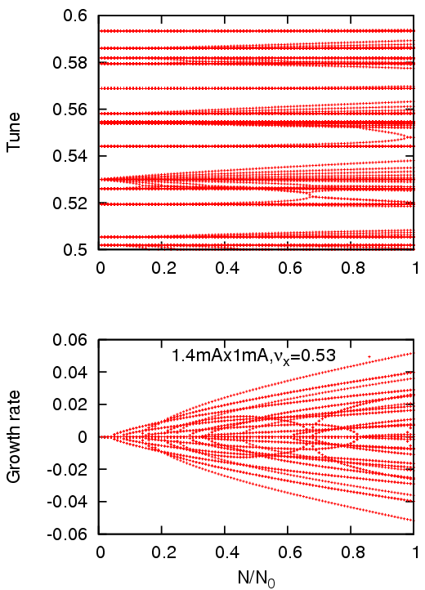
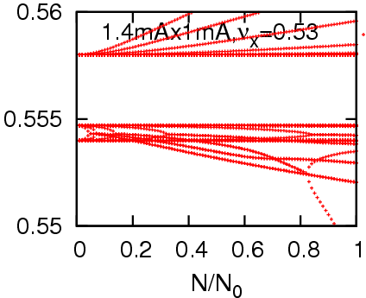
Eigen mode analysis for ν_{x}=0.53
8x8x 4x8x
ν_{x}+ν_{s}⁽⁺⁾
ν_{x}-3ν_{s}⁽⁻⁾
skb8x8xb

Slide 33
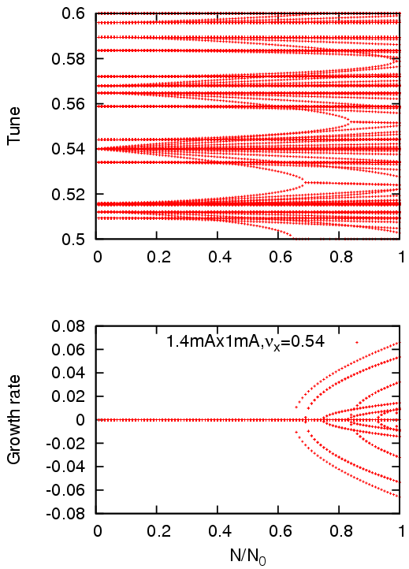
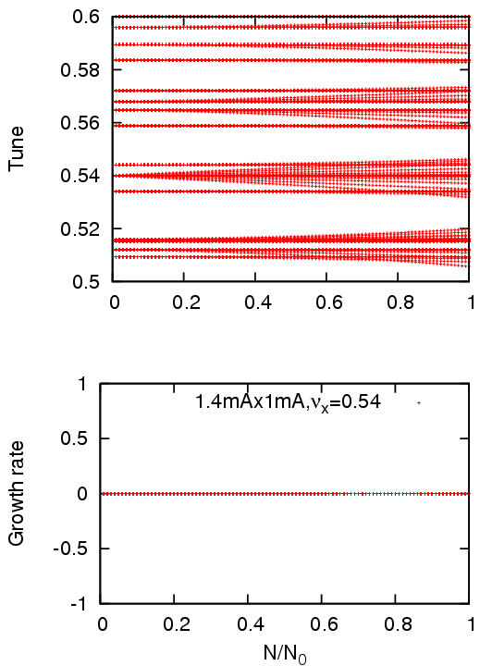
Eigen mode analysis for ν_{x}=0.54
8x8x 4x8x
skb8x8xc

Slide 34
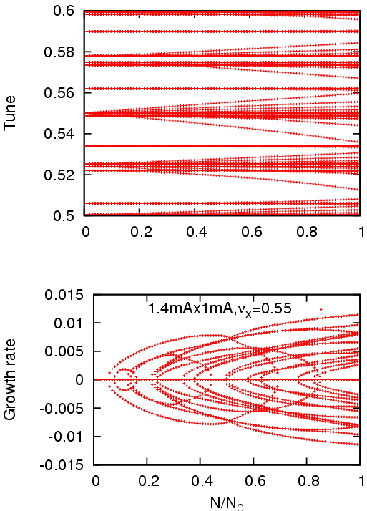
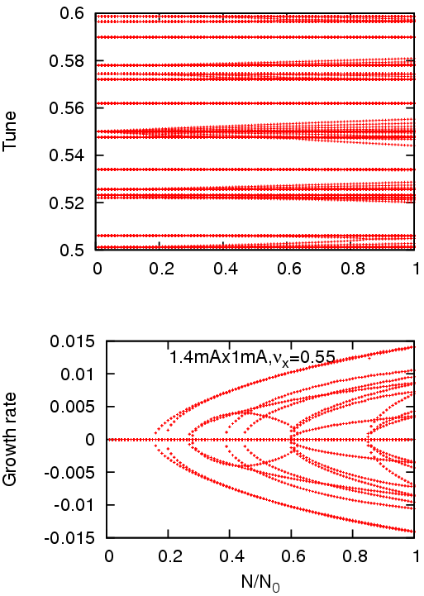
Eigen mode analysis for ν_{x}=0.55
8x8x 4x8x
skb8x8xd

Slide 35
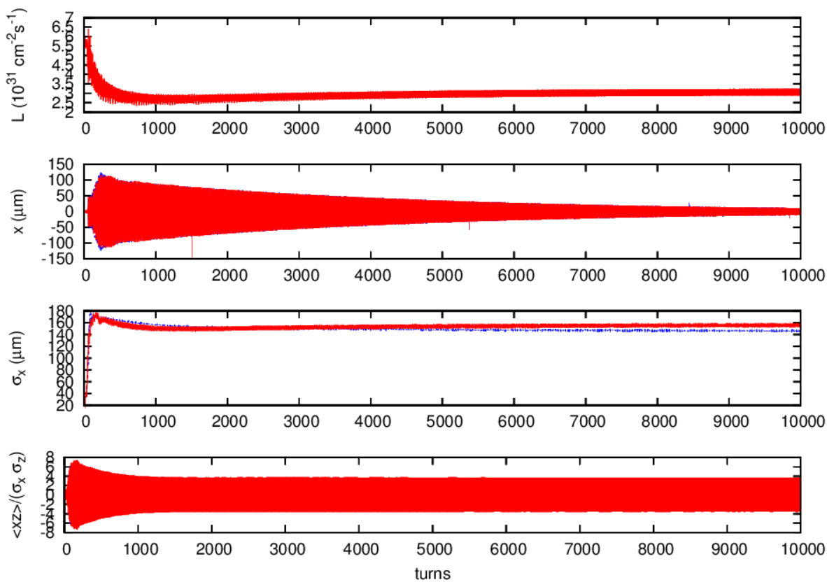
Strong-strong beam-beam simulation 8x8x, 1.44mAx1.04mA, ν_{x}=0.53
skb2a

Slide 36
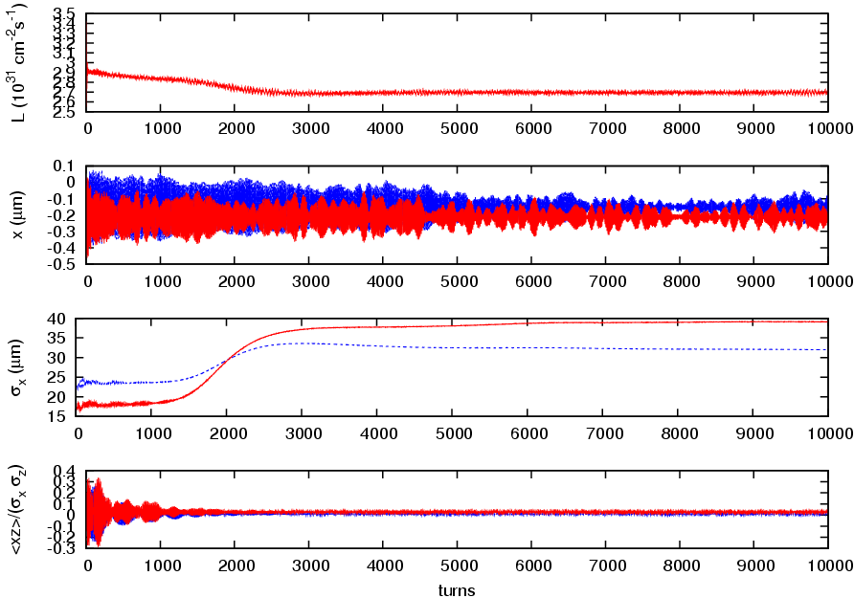
4x8x, 1mAx0.8mA , ν_{x}=0.53
skb21b

Slide 37
Summary of the strong-strong simulation
I=1.44mA x 1.04mA
ν_{x} | 8x8x L/L₀, σ_{x}/σ_{x0} (L & H) osc. | 4x8x L/L₀, σ_{x}/σ_{x0} (L & H) osc.
0.53 a | 0.58-0.66 6.5 4.5 | 0.75-1.0 3.0-7.5 2.2-6.2
0.535 g | 0.70-0.95 2.5-6.2 1.4-4.0 | 1.04 1.2 1.0
0.54 d | 0.75-0.95 2.5-6.0 1.4-4.0 | 1.05 2.1 1.1
0.545 f | 0.83 7.2 1.2 no osc. | 0.94 5.2 1.7
0.55 e |  | 0.75-0.77 8.6 3.5
Horizontal emittance growth does not contribute luminosity drop in collision with a large crossing angle, when β_{y} is large.
Crab waist on in the simulation. CW-off may be serious for the horizontal emittance growth.

Slide 38
Summary
SuperKEKB collision starts this spring (Phase II).
Beta function is squeezed step-by-step.
From the beam dynamics, these two issues are
1. IR nonlinearity
2. Coherent beam-beam in head-tail mode
Also studies to be continued
3. Electron cloud/ion
4. IR linear optics

Slide 39
Thank you for your attention

Slide 40
Commissioning of KEKB
Electron cloud effect, this is not subject of this work shop.
IP orbit/optics tuning, Δx, Δy, α_{y}, β_{y} (waist), r₁₋₄, η_{y}, η_{y}’.
Chromatic optics parameters, β_{y}, r₁₋₄, η_{y}.
Parametrization of one turn matrix at IP

