Slide 2
Luminosity modelling and beam lifetimes in the LHC
ICFA workshop on Beam-beam effects in Circular Colliders, 5-7 February, 2018, Berkeley, CA, USA
Y. Papaphilippou
thanks to
F. Antoniou, G. Arduini, J. Boyd, I. Efthymiopoulos, S. Fartoukh, M. Hostettler, G. Iadarola, N. Karastathis, S. Papadopoulou, D. Pellegrini, B. Salvachua Ferrando, C. Schwick, G. Trad, J. Wenninger

Slide 3
Content
  LHC luminosity modelling in the LHC
  Bunch-by-bunch (b-by-b) emittance evolution, observations and modelling
  Beam lifetime at collisions
  Impact of degradation mechanisms to luminosity

Slide 4
Luminosity modelling in the LHC

Slide 5
Luminosity model
  Bunch-by-bunch (b-by-b) and for each beam
    Emittance evolution
      Intrabeam scattering (IBS), Synchrotron Radiation (SR), elastic scattering
    Intensity evolution
      Luminosity burn-off
    Bunch length evolution
      IBS, SR Longitudinal emittance blow-up
    Combination of estimations (or observations) in a self-consistent way for computing luminosity iteratively
      Luminosity leveling, x-ing angle anti-leveling options
      Or using measured data
F. Antoniou, et al, Evian 2016, S. Papadopoulou et al. Evian 2017

Slide 6
Performance follow-up
  Measured parameter evolution
    Intensity from fast Beam Current Transformer (fBCT),
    Emittance from Synchrotron Radiation Telescope (BSRT) and “ convoluted” estimates from emittance scans, luminosity and luminous region
    Bunch length from Beam Quality Monitor
    Luminosities from Luminosity Monitors of ATLAS and CMS (continuously calibrated data, a.k.a. “Massi” files)
  Automated tool for performance follow-up (emittance, lifetime, luminosity,…) based on extracted data from logging system and modelling
  Compiled and used during the 2016-2017 run, providing weekly summaries to machine coordination with detailed fill-by-fill plots
F. Antoniou, M. Hostettler, , G. Iadarola, I. Efthyimiopulos, N. Karastathis, YP

Slide 7
Emittance evolution in the LHC

Slide 8
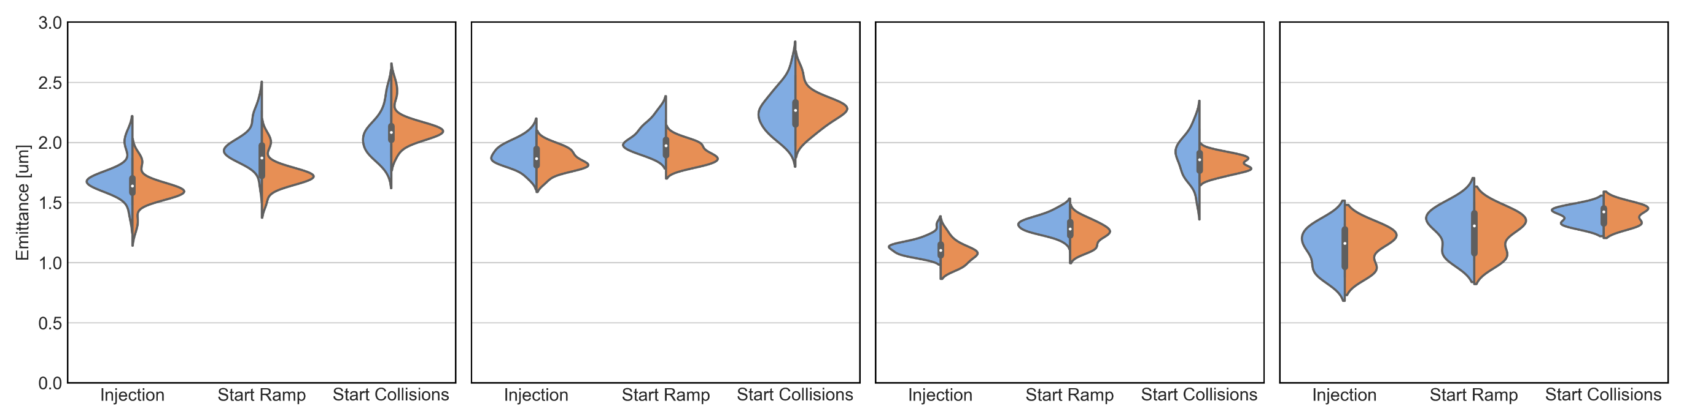
Emittance evolution until collisions
BCMS 25ns
8b4e
8b4e BCS
2.51 TeV
horizontal
vertical
N. Karastathis, et al.

Slide 9
Emittance evolution until collisions
BCMS 25ns
8b4e
8b4e BCS
2.51 TeV (BCS)
horizontal
vertical
Relative Emittance Blow-Up [%]
N. Karastathis, et al.
BCMS | H [%] | V [%]
flat bottom | 15 % 0.3 μm | 9 % 0.1 μm
ramp | 5 % 0.1 μm | 22 % 0.4 μm
total injection - collisions | 21 % 0.4 μm | 31 % 0.5 μm
8b4e | H [%] | V [%]
flat bottom | 6 % 0.1 μm | 3 % 0.05 μm
ramp | 12 % 0.3 μm | 20 % 0.4 μm
total injection - collisions | 19 % 0.4 μm | 24 % 0.45 μm
8b4e BCS | H [%] | V [%]
flat bottom | 17 % 0.2 μm | 15 % 0.15 μm
ramp | 43 % 0.6 μm | 45 % 0.6 μm
total injection - collisions | 68 % 0.8 μm | 68 % 0.7 μm
2.51 TeV | H [%] | V [%]
flat bottom | 16 % 0.2 μm | 11 % 0.1 μm
ramp | 8 % 0.1 μm | 8 % 0.1 μm
total injection - collisions | 25 % 0.3 μm | 21 % 0.2 μm

Slide 10
Emittance evolution until collisions
BCMS 25ns
8b4e
8b4e BCS
2.51 TeV (BCS)
horizontal
vertical
Relative Emittance Blow-Up [%]
N. Karastathis, et al.
BCMS | H [%] | V [%]
flat bottom | 15 % 0.3 um | 9 % 0.1 um
ramp | 5 % 0.1 um | 22 % 0.4 um
total injection - collisions | 21 % 0.4 um | 31 % 0.5 um
8b4e | H [%] | V [%]
flat bottom | 6 % 0.1 um | 3 % 0.05 um
ramp | 12 % 0.3 um | 20 % 0.4 um
total injection - collisions | 19 % 0.4 um | 24 % 0.45 um
8b4e BCS | H [%] | V [%]
flat bottom | 17 % 0.2 um | 15 % 0.15 um
ramp | 43 % 0.6 um | 45 % 0.6 um
total injection - collisions | 68 % 0.8 um | 68 % 0.7 um
2.51 TeV | H [%] | V [%]
flat bottom | 16 % 0.2 um | 11 % 0.1 um
ramp | 8 % 0.1 um | 8 % 0.1 um
total injection - collisions | 25 % 0.3 um | 21 % 0.2 um
  Emittance growth at injection compatible with IBS model, plus some extra growth, in particular for BCMS in the V-plane

Slide 11
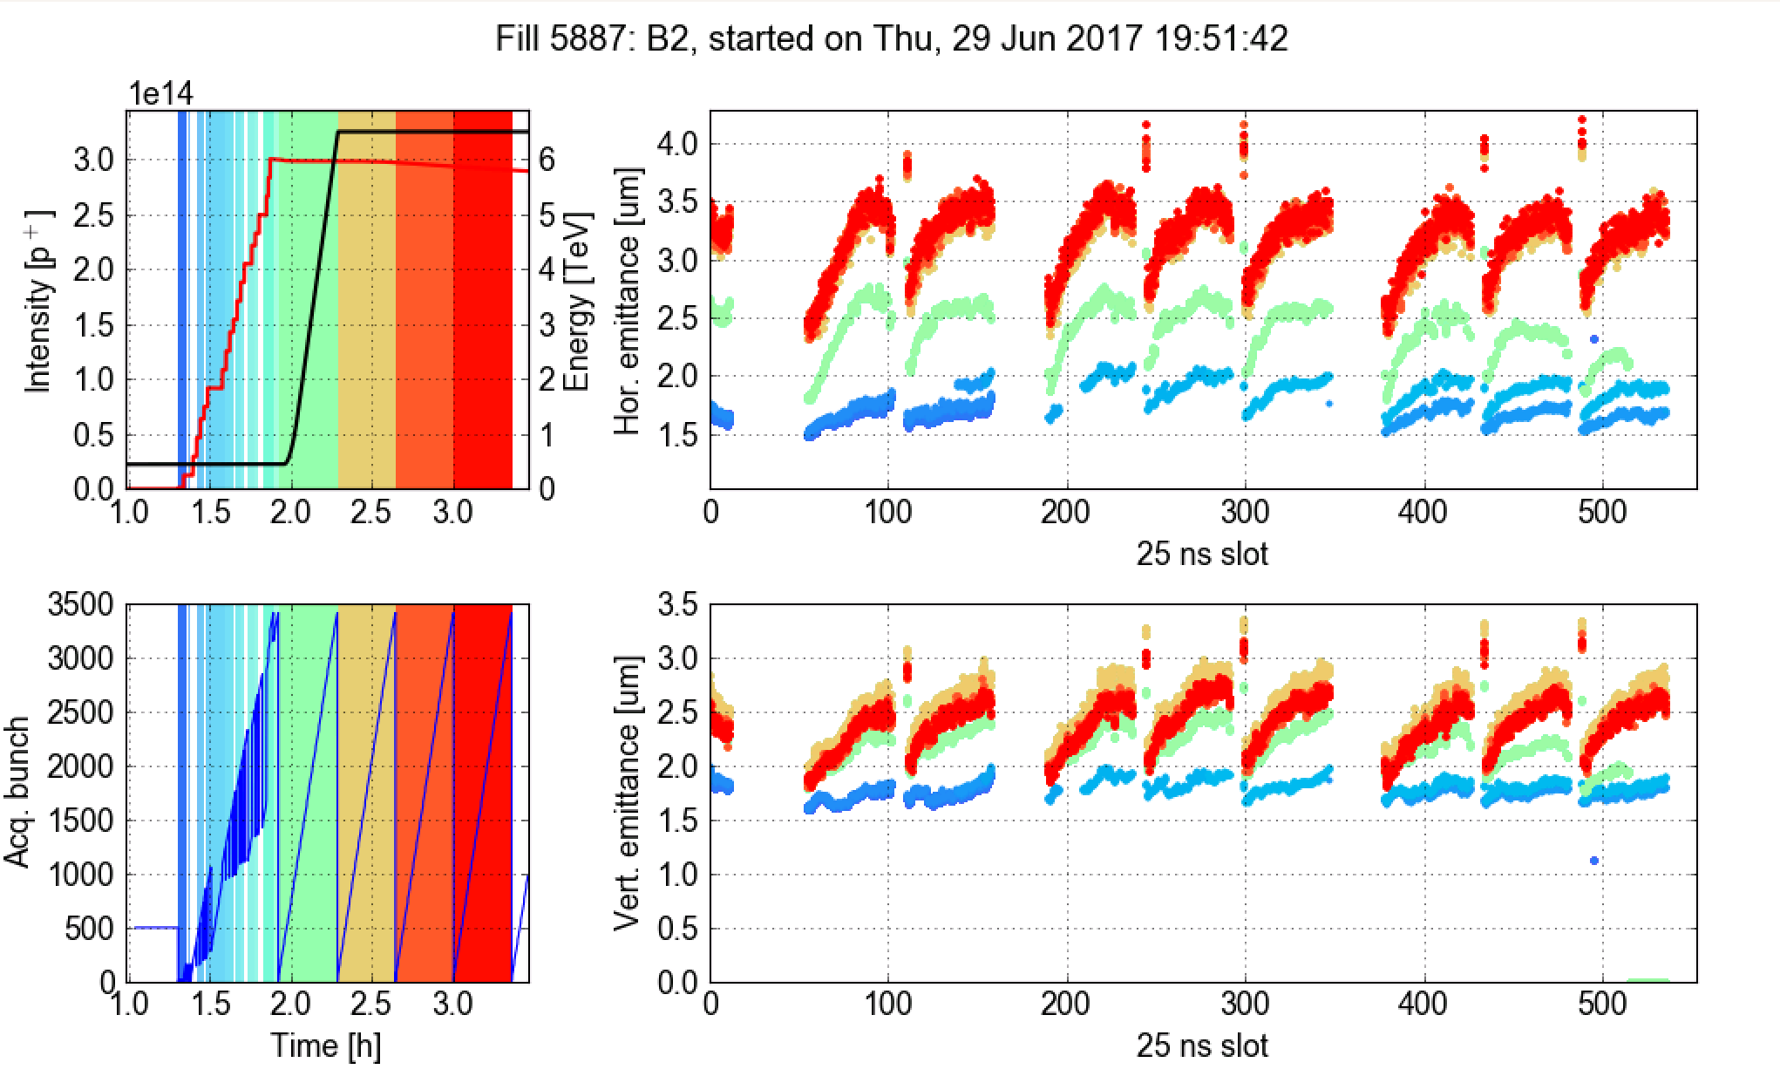
E-cloud pattern for BCMS
At high energy
After 40 mins at injection
Right after injection
G. Iadarola, et al.

Slide 12
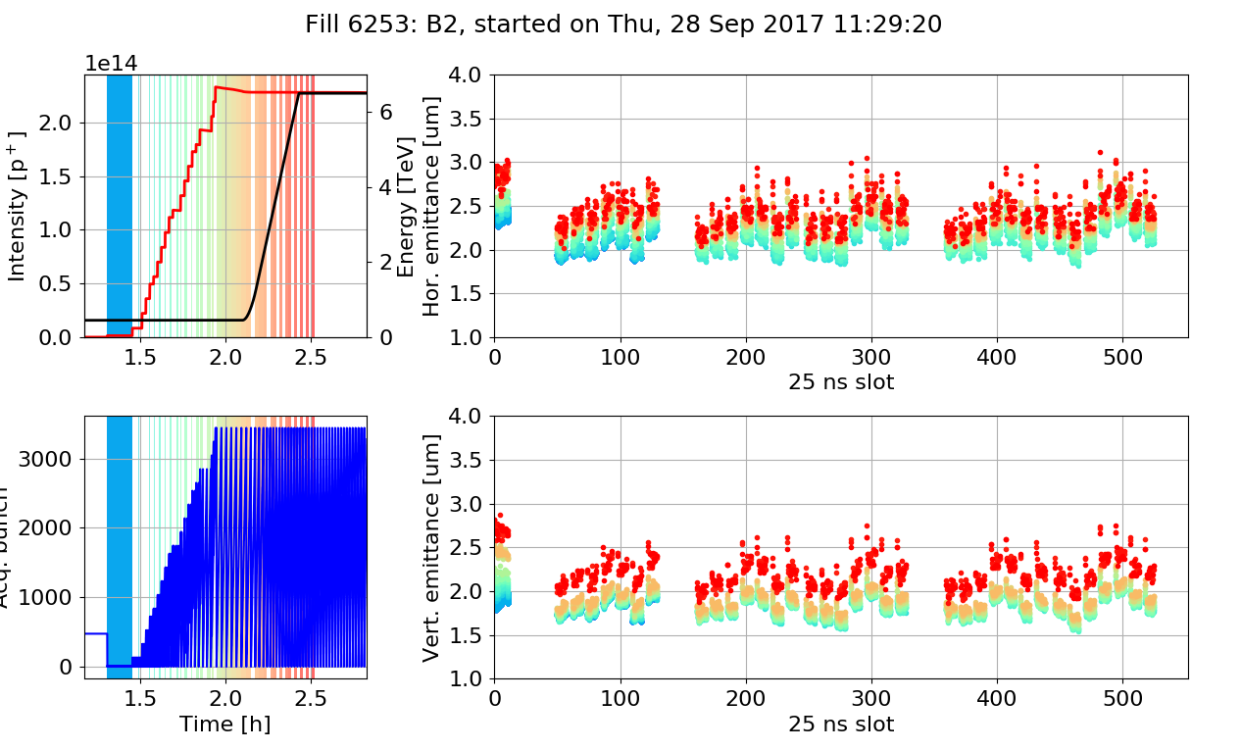
Emittance along the trains for 8b4e
  E-cloud pattern disappeared with 8b4e

Slide 13
Emittance evolution until collisions
BCMS 25ns
8b4e
8b4e BCS
2.51 TeV (BCS)
horizontal
vertical
Relative Emittance Blow-Up [%]
N. Karastathis, et al.
BCMS | H [%] | V [%]
flat bottom | 15 % 0.3 um | 9 % 0.1 um
ramp | 5 % 0.1 um | 22 % 0.4 um
total injection - collisions | 21 % 0.4 um | 31 % 0.5 um
8b4e | H [%] | V [%]
flat bottom | 6 % 0.1 um | 3 % 0.05 um
ramp | 12 % 0.3 um | 20 % 0.4 um
total injection - collisions | 19 % 0.4 um | 24 % 0.45 um
8b4e BCS | H [%] | V [%]
flat bottom | 17 % 0.2 um | 15 % 0.15 um
ramp | 43 % 0.6 um | 45 % 0.6 um
total injection - collisions | 68 % 0.8 um | 68 % 0.7 um
2.51 TeV | H [%] | V [%]
flat bottom | 16 % 0.2 um | 11 % 0.1 um
ramp | 8 % 0.1 um | 8 % 0.1 um
total injection - collisions | 25 % 0.3 um | 21 % 0.2 um
  Largest part of BU occurs during the ramp, similar for H and V
    In particular for “bright” BCS type beams
    BSRT indicates that B1 BU is worse than B2
  Much lower BU for shorter 2.51 TeV ramp (with 8b4e BCS)

Slide 14
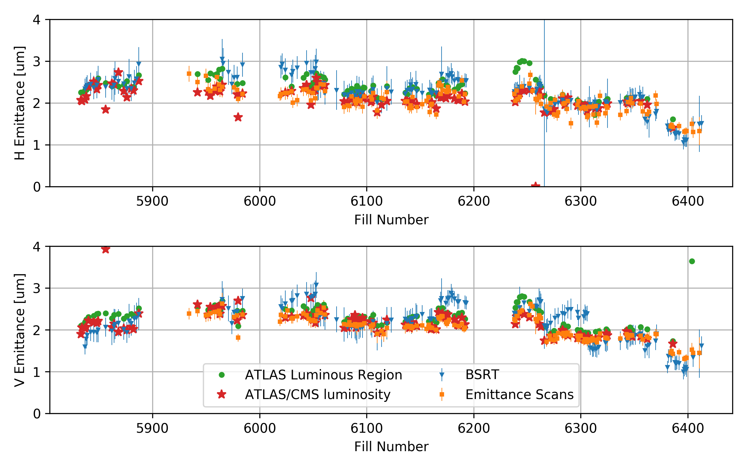
Emittances @ start of collisions
Int. Ramp Up (BCMS)
BCMS 25ns
8b4e
8b4e BCS
2.51 TeV
H
Emittance
ε [μm] | BCMS | 8b4e | 8b4e BCS | 2.51 TeV
H emittance scan | 2.0 | 2.3 | 1.9 | 1.4
V emittance scan | 2.1 | 2.3 | 1.9 | 1.4
H BSRT | 2.3 | 2.5 | 1.7 | 1.3
V BSRT | 2.2 | 2.7 | 1.6 | 1.2
V
  Good general agreement between BSRT and alternative emittance estimates
    BSRT degradation (image intensifier aging) clearly visible
    Important to follow-up and analyse systematically emittance evolution (as in 2017), triggering instrument re-calibration
M. Hostettler, N. Karastathis, S. Papadopoulou, et al., Evian 2017

Slide 15
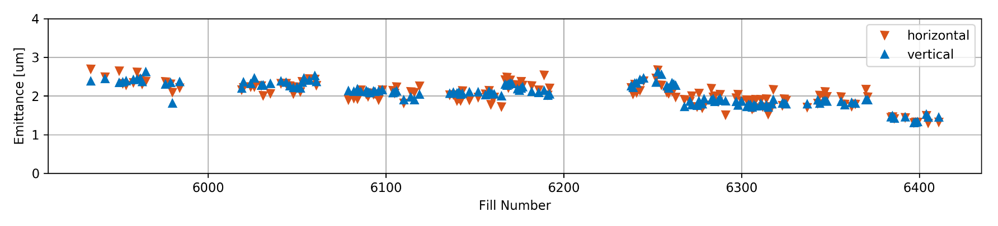
Beam roundness @ collision
2016
emittance start of
collisions [um]
BSRT
(emittance scans agree)
2017
emittance scans
  Emittances round @ collision in 2017, not in 2016
  ATLAS/CMS luminosity ratio of 0.95 in 2016 -> 1 in 2017
M. Hostettler, et al., Evian 2017

Slide 16
Emittance evolution during collisions
Beam 1
  Average emittance growth rate @ collision (beyond model)
    0.05 μm/h in H
    0.10 μm/h in V
  No visible impact of levelling
Beam 2
S. Papadopoulou, F. Antoniou et al., Evian 2017

Slide 17
Emittance evolution during collisions
G. Iadarola et al.,
  Fill 5205 (2016) went in collision with one non-colliding BCMS train in B2
  Non-colliding bunches blow-up less → 2-beam effects play a significant role

Slide 18
Luminosity evolution
S. Papadopoulou et al., Evian 2017
  Luminosity model sensitive to initial conditions
  Using measured emittance evolution and intensity decay
  Validate data by accurately reproducing measured luminosity and bunch length through model

Slide 19
Luminosity evolution
S. Papadopoulou et al. Evian 2017

Slide 20
Luminosity evolution
S. Papadopoulou et al. Evian 2017

Slide 21
IBS simulations for non-Gaussian profiles
  Measured longitudinal profile evolution for a bunch during 11.5 h at collision
  The initial (arriving at FT) non-Gaussian longitudinal bunch profiles become Gaussian in time
S. Papadopoulou, PhD thesis 2018
  Multi-particle tracking (SIRE) with measured initial longitudinal distribution
  Intensity evolution (BO) and observed extra (on top of IBS) transverse emittance (Gaussian) growth taken into account

Slide 22
IBS simulations for non-Gaussian profiles
S. Papadopoulou, PhD thesis 2018
  The agreement between DATA and SIRE is excellent for generalized distributions, while diverges for longer time-spans in particular with respect to analytical models (MADX)

Slide 23
Lifetime evolution at collision

Slide 24
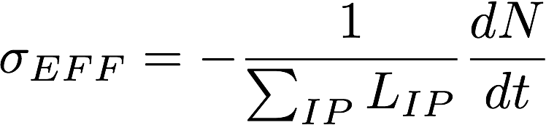
Beam losses @ 1h (2016)
F.Antoniou et al., Evian 2016
(dN/dt)/L [mb]
Fill number
  Beam 1 worse lifetime than Beam 2 (Beam1 generally larger)
  Losses depend on LHCb polarity, beam flavor (standard vs BCMS), crossing angle choice
  Can be mitigated with lowering octupoles and chromaticity and working point choice
See talk by D. Pellegrini

Slide 25
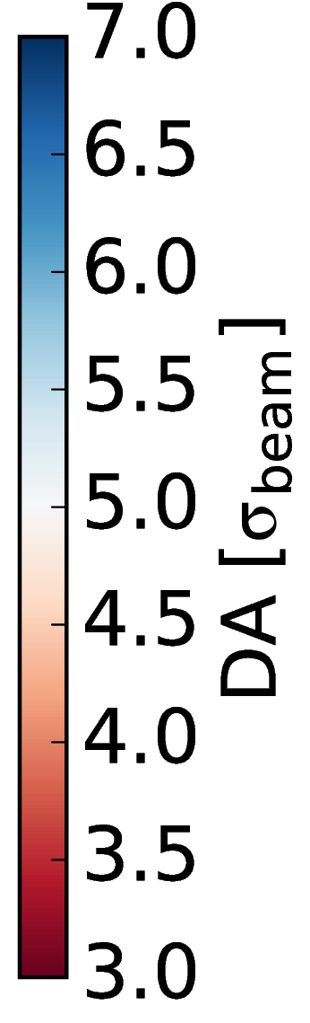
LHCb operation
  LHCb impact to beam lifetime and its dependence to spectrometer polarity confirmed by DA simulations
  Mitigated in operation by WP tuning (B1)
No IR8
D.Pellegrini
Positive polarity
Negative polarity

Slide 26
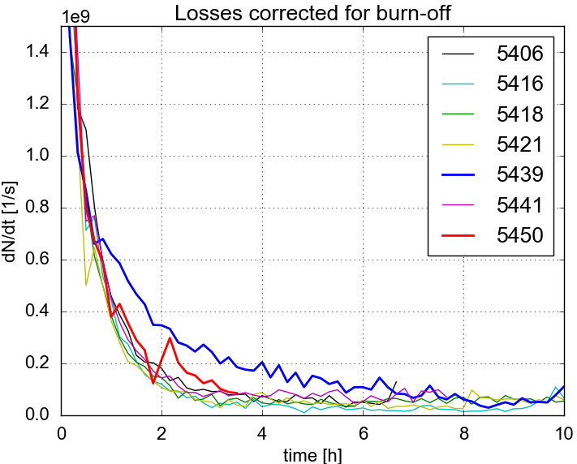
Levelling tests in 2016
  Levelling by separation demonstrated in test fills during 2016
    Fine tune adjustments and reduction of octupoles/chromaticity necessary to improve lifetime during levelling
    Satisfying request of experiments (pile-up) or when reaching cryogenics’ limit
F.Antoniou

Slide 27
Lifetime & Losses
2017
  Losses on-top of burn-off (BO) are observed
    Larger for B1 (also during ramp and squeeze)
    X-ing angle steps affect lifetime, mainly towards the end of the fills
S. Papadopoulou et al. Evian 2017

Slide 28
Lifetime & Losses
2017
2016
  Losses on-top of burn-off (BO) are observed
    Larger for B1 (also during ramp and squeeze)
    X-ing angle steps affect lifetime, mainly towards the end of the fills
  In 2017 losses reach burn off limit earlier than in 2016
    Impact of WP optimisation
S. Papadopoulou et al. Evian 2017

Slide 29
Losses along the fill for 8b4e
140 μrad
130 μrad
120 μrad
100 μrad
110 μrad
TS1
8b4e
TS2
  Reduction of x-ing angle at 140 μrad just after SB declaration almost transparent
  Last steps at 110 and especially 100 μrad quite aggressive
  Can profit always from tune optimisation in each step
Notes:
TS1

Slide 30
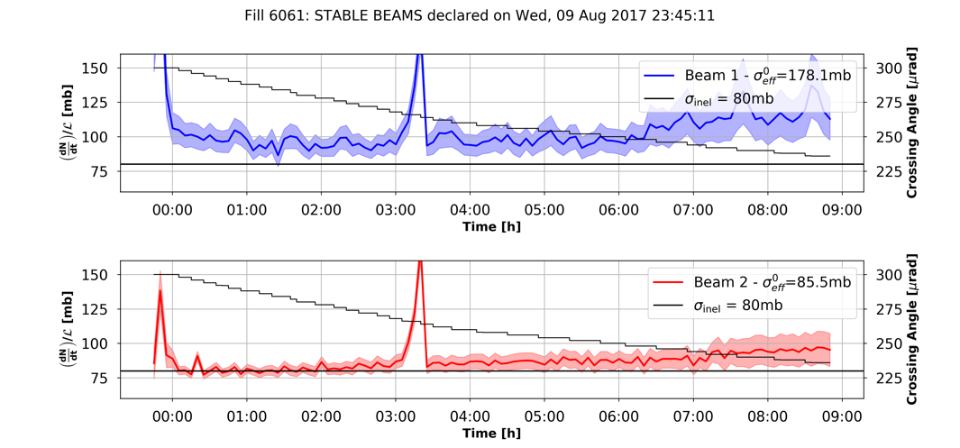
Anti-levelling for 2018
N. Karastathis et al. LMC 2017
  Reduction of x-ing angle in small steps along the fill (6061) quite smooth wrt to lifetime
    In operation during 2018, to be optimised for observed emittance evolution

Slide 31
Lifetime & Losses (2016)
  Burn-off corrected losses averaged over many fills for Beam 1 and 2
    x-ing angle of 185 μrad (top) and 140 μrad (bottom)
  More losses at the end of trains for the large x-ing angle → e-cloud traces
  More losses at the middle of many trains (with full LR encounters) observed after x-ing angle reduction
  Effect is more pronounced during the first 30 min (less for B2)
D. Pellegrini et al.

Slide 32
Lifetime & Losses (2017)
  B2 very close to BO
  B1 slightly worse, improved with low emittance (relaxed x-ing angle for 8b4e)
  No visible impact of separation levelling
After 1.5h in SB | Lifetime [h] | Effective Cross-Section [mb]
B1 | 28.8 | 88.1
B2 | 32.2 | 80.51
N. Karastathis et al.

Slide 33
Impact of beam degradation in luminosity
  Extra losses have very small impact on delivered integrated luminosity
  Impact of extra emittance blow up is significant
S. Papadopoulou et al., Evian 2017

Slide 34
Summary
  Emittance growth along the fill for different beam flavors
    Due to e-cloud for 25 ns beams mostly @ injection, on top of IBS and other non-modelled mechanisms (coupling, noise,...)
    Significant (still unexplained) emittance blow-up during the ramp, (mostly on B1H) for all beam flavors
    Beams @ collision are round, luminosity imbalance of 2016 disappeared
    Slow emittance growth during collisions
  Luminosity modelling helps certifying data consistency
  On-going work on modelisation of beam-distribution evolution at collisions
  Beam lifetime monitored and optimised
    Working point optimization, x-ing angle choice, anti-levelling
    Difference of B1 vs B2 lifetime observed (larger emittances and tails?)
  Impact of losses on integrated luminosity smaller than emittance blow-up

Slide 35
Thank you

Slide 36
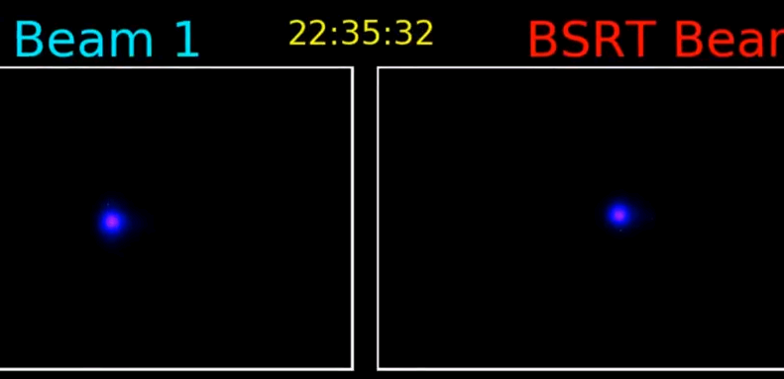
Emittance measurements
  Beam Synchrotron Radiation Telescope (BSRT)
    Continuous measurement throughout the cycle
    Uncertainty (in absolute) of measurements during the ramp
G. Trad et al., Evian 2017

Slide 37
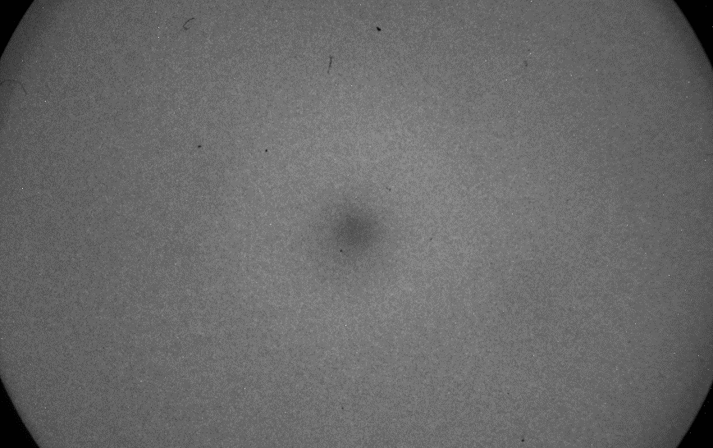
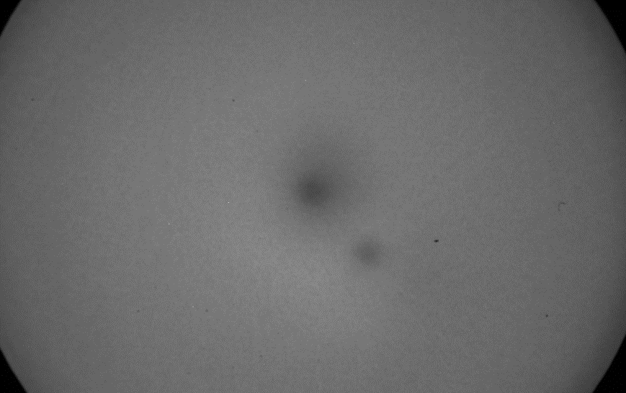
Emittance measurements
  Beam Synchrotron Radiation Telescope (BSRT)
    Continuous measurement throughout the cycle
    Uncertainty (in absolute) of measurements during the ramp
    Good performance in 2017 with some caveats due to ageing of Image Intensifier (II) -> three calibrations
    Continuously move the SR spot on the camera during 2018 to wear out uniformly the II (calibration)
June 2017
September 2017
G. Trad et al., Evian 2017

Slide 38
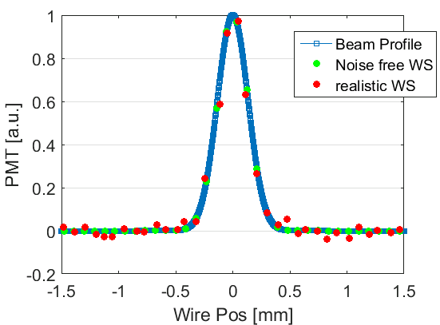
Emittance measurements
  Wire scanners (WS)
    LHC emittance reference measurement throughout the cycle
    Intensity/energy limitations
      240 bunches @ Injection, 12 bunches @ flat top (FT) for protons
    Used mainly at injection, in MDs and for BSRT calibration
    Investigating issues with H-size precision at FT (1.2 points/σ for 1 μm emittance) and system reliability
G. Trad et al., Evian 2017

Slide 39
Emittance measurements
  Wire scanners (WS)
    LHC emittance reference measurement throughout the cycle
    Intensity/energy limitations
      240 bunches @ Injection, 12 bunches @ flat top (FT) for protons
    Used mainly at injection, in MDs and for BSRT calibration
    Investigating issues with H-size precision at FT (1.2 points/σ for 1 μm emittance) and system reliability
  At collision convoluted emittance estimates, independent from instrumentation
    Luminosity, emittance scans, luminous region
G. Trad et al., Evian 2017

Slide 40
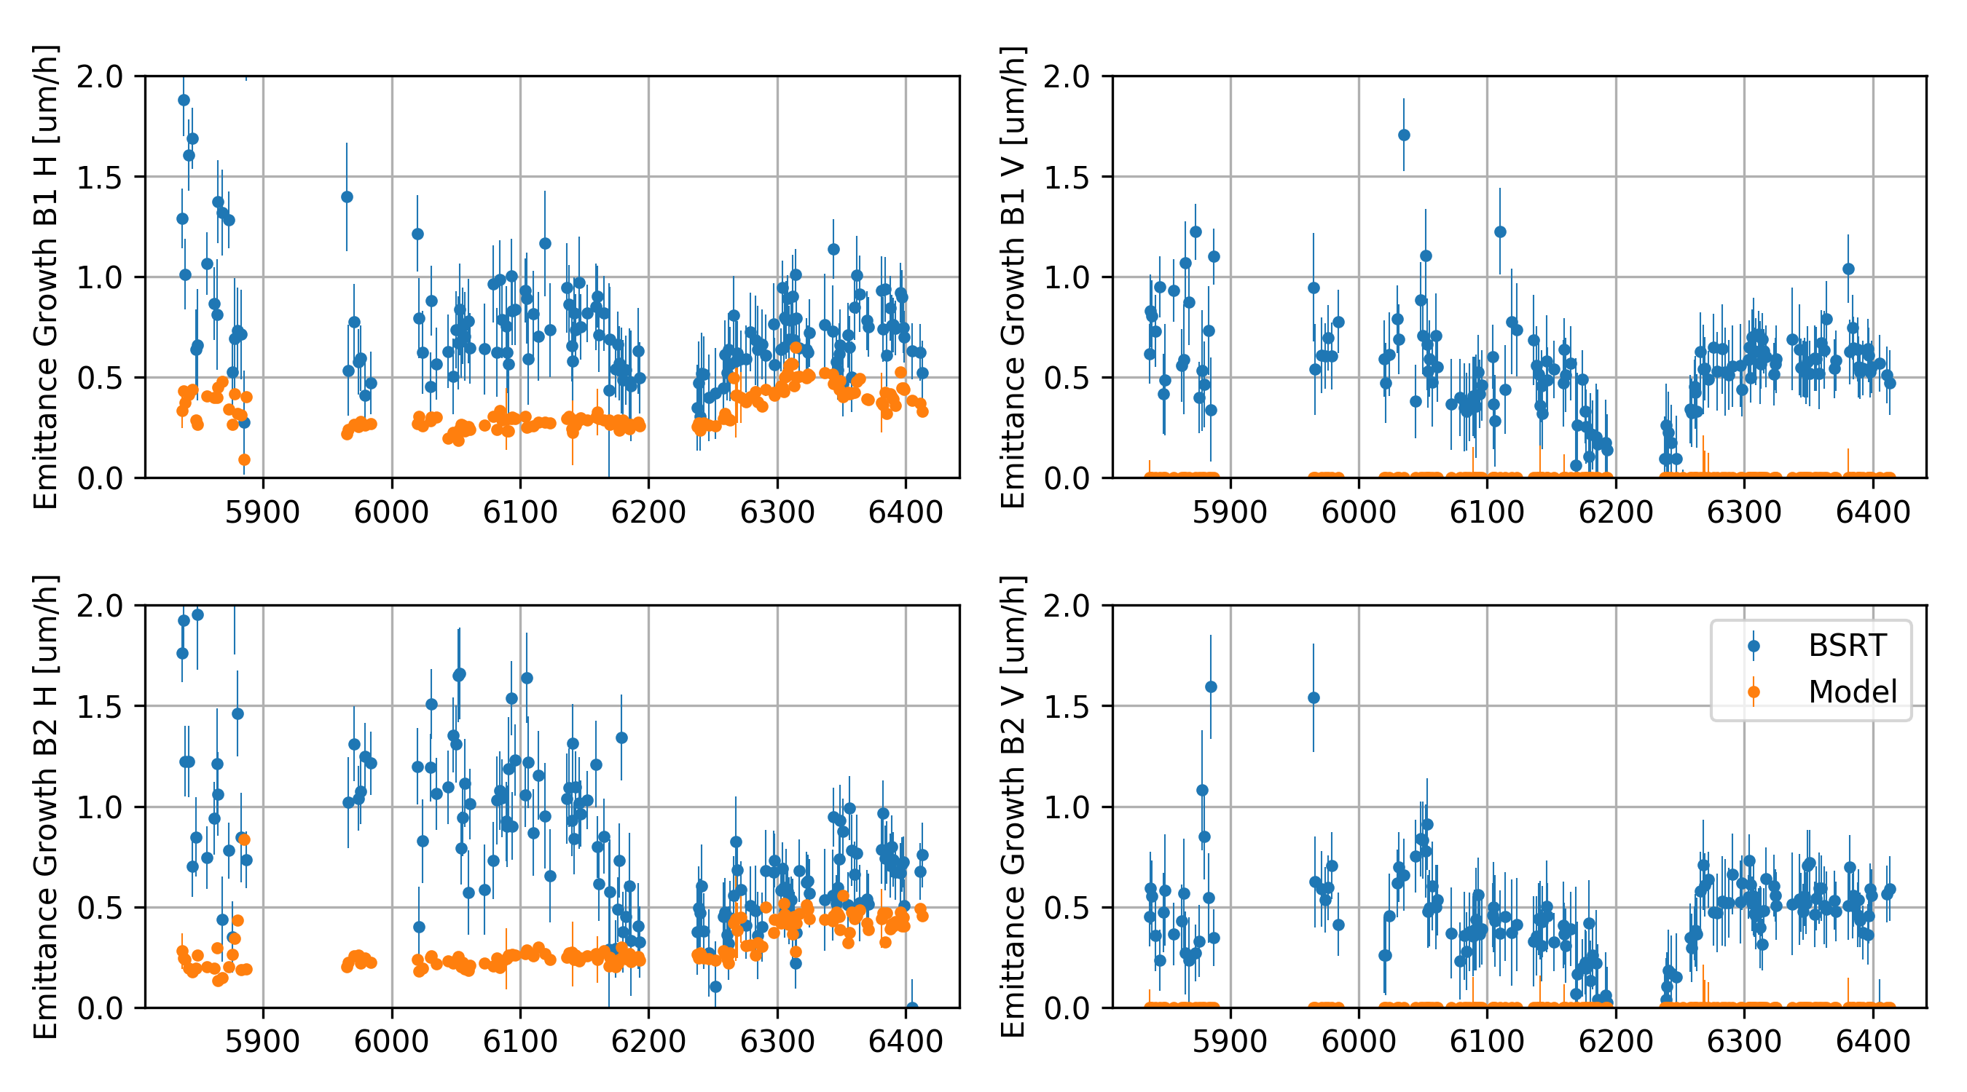
Emittances evolution at flat bottom
M. Hostettler, N. Karastathis et al., Evian 2017
B1 H
B1 V
BCMS
8b4e
BCMS
8b4e
B2 H
B2 V
  Emittance growth rate [μm/h]: b-by-b difference normalized by time spent at flat bottom (FB)
  Dominated by intra-beam scattering (IBS) at injection energy (mainly in H)

Slide 41
Emittances evolution at flat bottom
M. Hostettler, N. Karastathis et al., Evian 2017
B1 H
B1 V
emittance growth rate
[μm/h] | BCMS | 8b4e | 8b4e BCS
H meas. | 0.90 | 0.47 | 0.65
H model | 0.27 | 0.26 | 0.47
V meas. | 0.45 | 0.20 | 0.56
BCMS
8b4e
BCMS
8b4e
B2 H
B2 V
F. Antoniou et al.
  Predictions from IBS model
    Negligible growth in V (coupling and vertical dispersion + noise?)
    Around 0.3 - 0.5 μm/h growth in H (following brightness)
      Extra blow-up of 0.6 μm/h (BCMS) and 0.2 μm/h (8b4e)

Slide 42
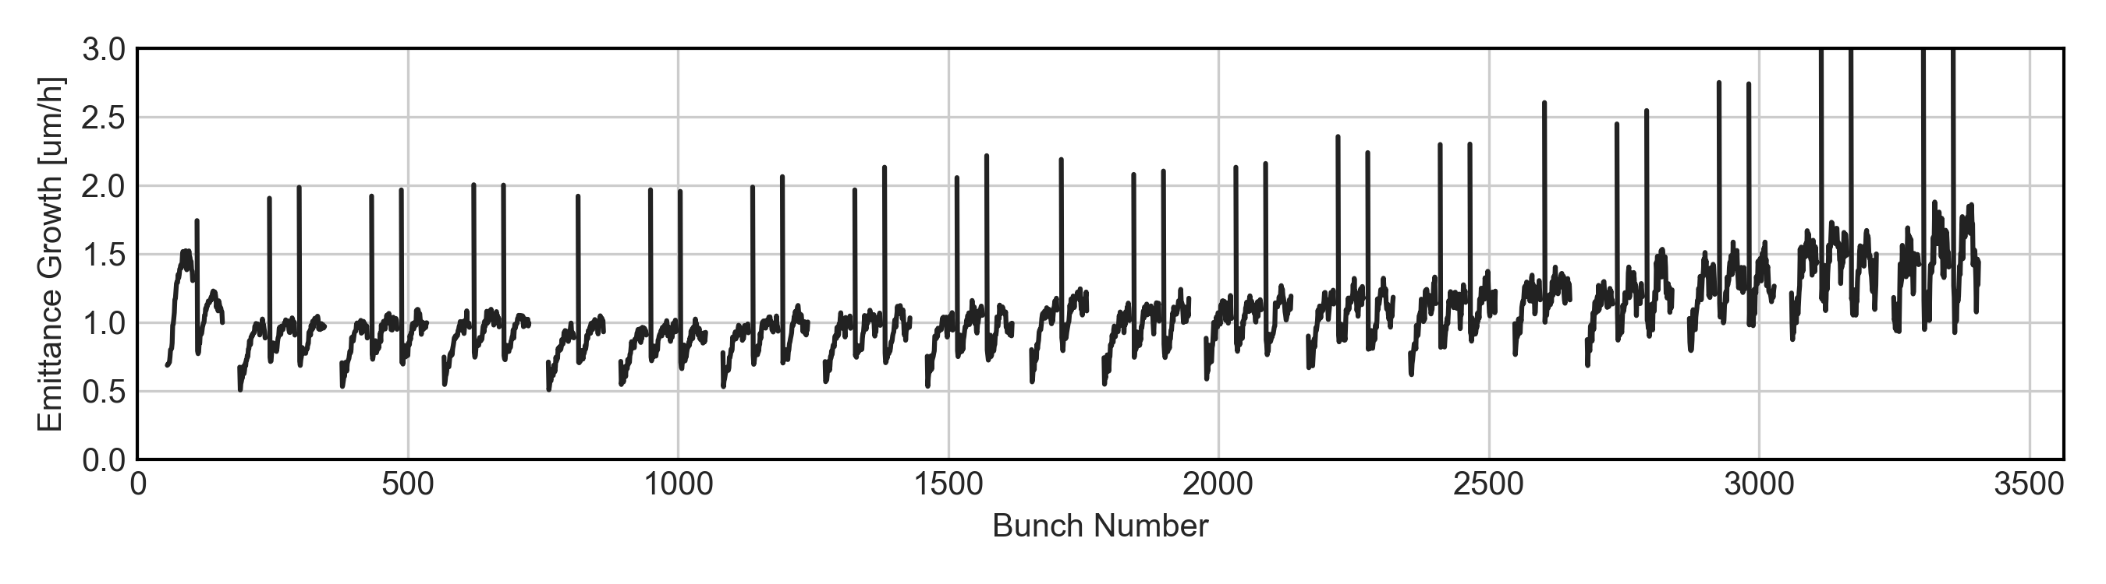
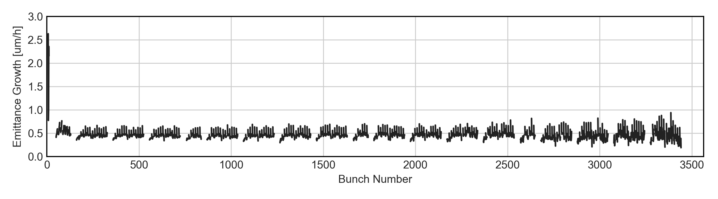
Extra-blow-up at flat bottom
BCMS 25ns
H-emittance growth average [μm/h]
8b4e
M. Hostettler, et al., Evian 2017
  E-cloud pattern (both H and V) for BCMS, disappeared for 8b4e
    Around 0.5 μm/h, matching missing part of model
    Need to further investigate growth rate dependence along the batch (e.g. bunch at the edge of the SPS trains)

Slide 43
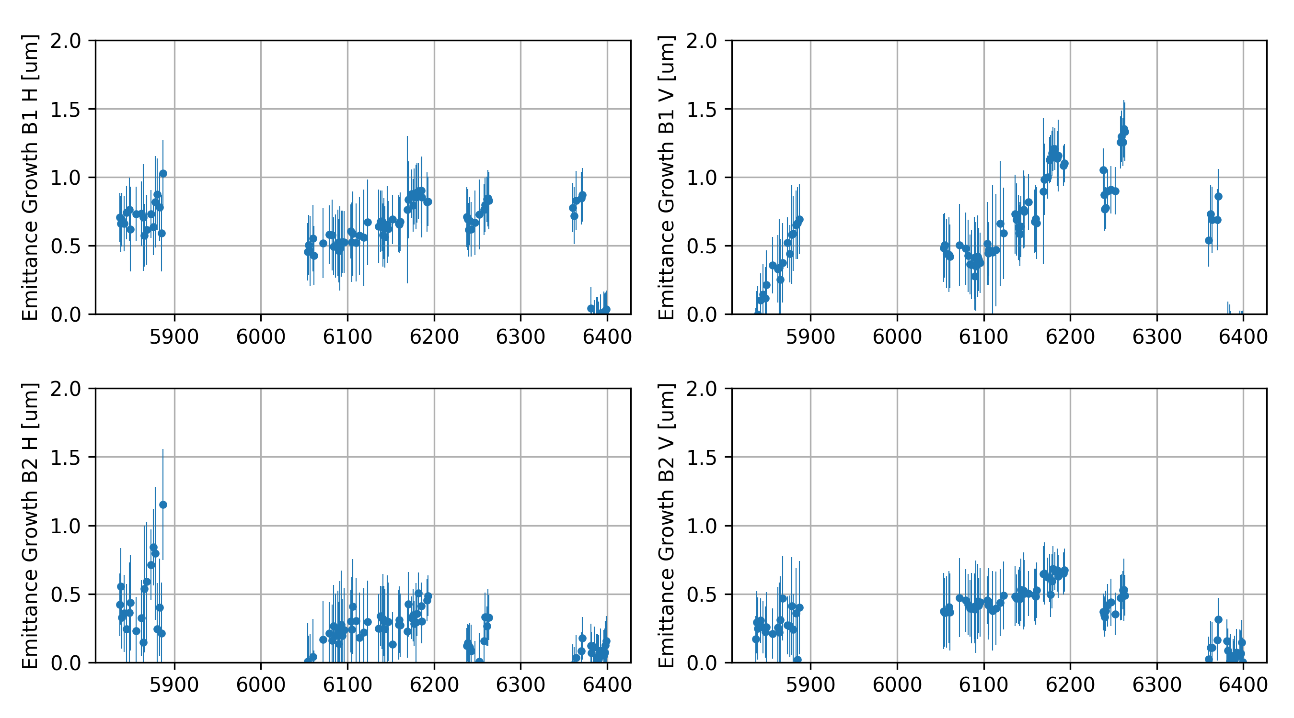
Emittances blow-up during the ramp
Int. Ramp Up (BCMS)
BCMS 25ns
8b4e
8b4e BCS
2.51 TeV
B1 H
B1 V
B2 H
B2 V
  Emittance blow-up (BU): b-by-b emittance difference between FT and FB
    No calibrated measurement during ramp
    Exclude measurement outliers due to BSRT degradation (mostly at FT) -> low statistics
M. Hostettler, N. Karastathis et al., Evian 2017

Slide 44
Emittances blow-up during the ramp
Int. Ramp Up (BCMS)
BCMS 25ns
8b4e
8b4e BCS
2.51 TeV
emittance BU
B1 H
B1 V
[μm] | BCMS | 8b4e | 8b4e BCS | 2.51 TeV
B1H | 0.56 | 0.82 | 0.82 | -0.01
B1V | 0.48 | 1.11 | 0.64 | -0.14
B2H | 0.24 | 0.29 | 0.04 | 0.07
B2V | 0.44 | 0.52 | 0.10 | 0.05
B2 H
B2 V
  BU in Beam 1 (B1) larger than Beam 2 (B2)
    Especially in H and for 8b4e
  No BU in 2.51 TeV ramp
    Shorter and different ramp (as in 2018)
    BSRT calibration?
  Emittance blow-up (BU): b-by-b emittance difference between FT and FB
    No calibrated measurement during ramp
    Exclude measurement outliers due to BSRT degradation (mostly at FT) -> low statistics
M. Hostettler, N. Karastathis et al., Evian 2017

