Slide 1
Cross wake force and correlated head-tail instability in collisions with a large crossing angle
K. Ohmi (KEK)
Beam-beam workshop 2018@LBNL
5-7 Feb, 2018
Thanks to N. Kuroo, K. Oide, D. Shatilov, D. Zhou, F. Zimmermann

Slide 2
Contents
0. Introduction, Coherent beam-beam instability seen in strong-strong simulations.
Mechanism of the beam-beam instability
Cross Wake force induced by beam-beam collisions with a large crossing angle.
Beam-beam (σ/π) mode and reduction to single bunch wake force.
Particle tracking simulation using the cross wake force.
Mode coupling/head-tail instability caused by the cross wake force.
Mode coupling/head-tail instability caused by the cross wake force.

Slide 3
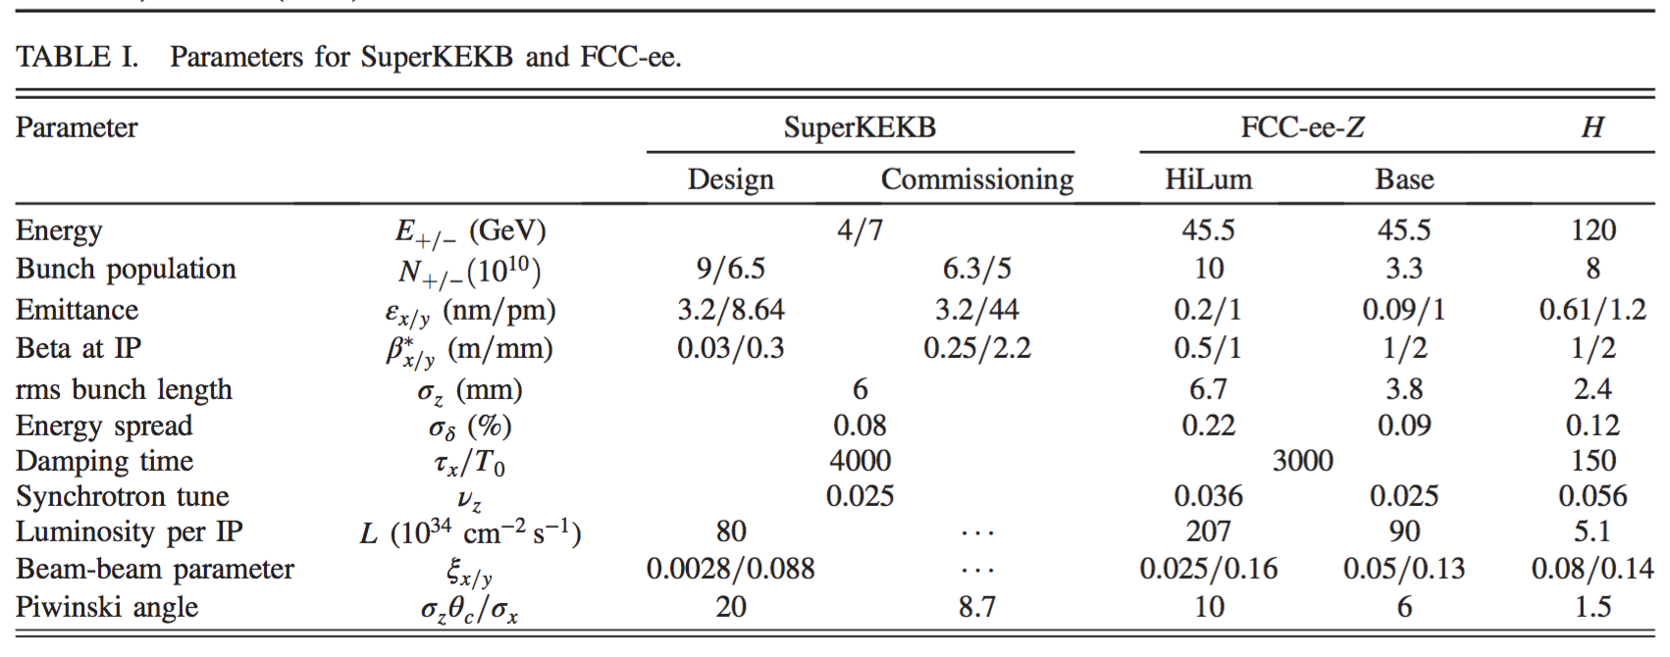
Parameters
CERN-FCCee 2016
Pwinski angle :θ_{P} = σ_{z}θ_{c}/σ_{x}

Slide 4
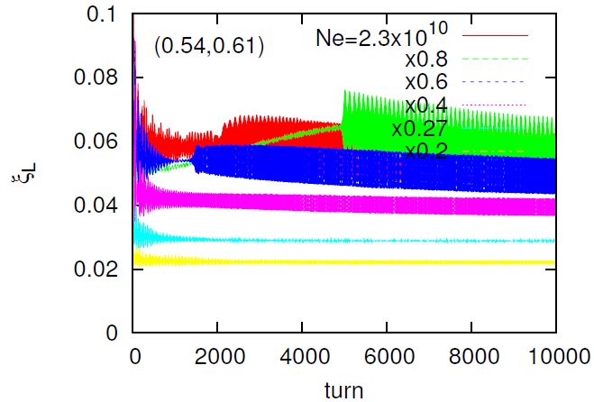
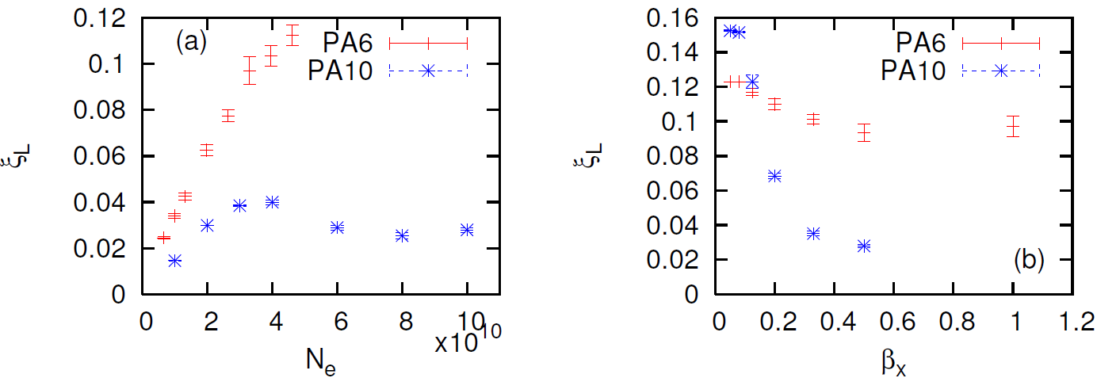
Coherent beam-beam Instability seen in strong-strong simulation （FCCee-Z)
Strong coherent beam-beam instability in head-tail mode has been seen in the design stage of FCCee-Z, W, H.
Squeezing bx and increasing Piwinsi angle, the instability is suppressed and the design is being fixed.

Slide 5
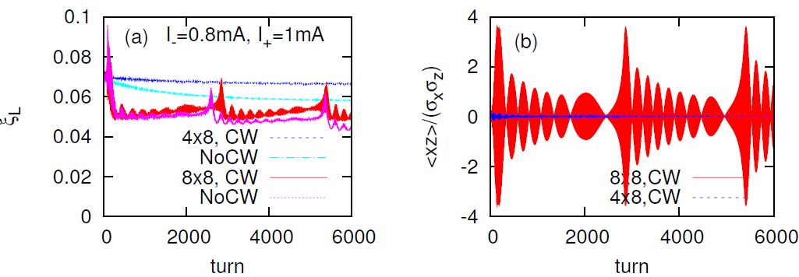
Coherent beam-beam Instability seen in strong-strong simulation （SuperKEKB)
Design parameters of SuperKEKB was stable.
We squeeze β* step-by-step.
Instability was seen in detuned β* (8x,8x).
We plan to study this instability in Phase II commissioning this year.

Slide 6
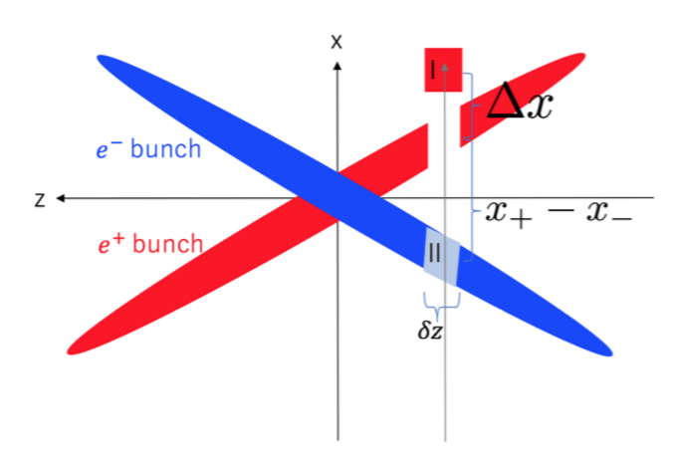

Mechanism of the instability- Cross wake force
Usual wake force gives correlation between bunch head to tail. Head-tail instability is induced by synchrotron motion
Cross wake field gives correlation of two colliding beam by convolution of each dipole moment.
Cross wake force induced by the beam-beam interaction is localized at IP.

Slide 7

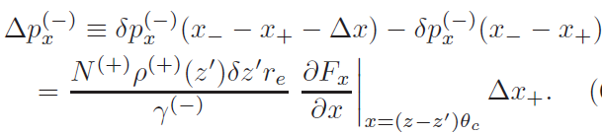
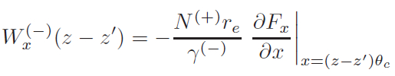

Derivation of the cross wake force
Beam-beam force
Difference for Δx
Definition of the wake force
Cross wake force
For flat beam, neglect y, sy terms.

Slide 8



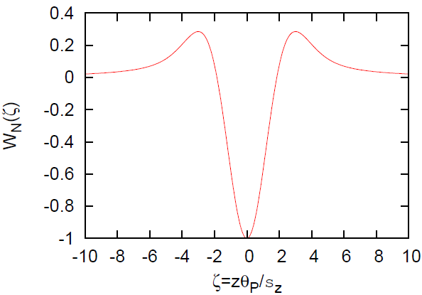
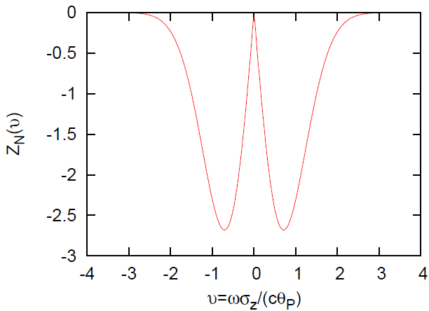
Cross wake force and its impedance
Normalized Wake force is symmetric for z.
Impedance is pure imaginary and symmetric for freq.

Slide 9
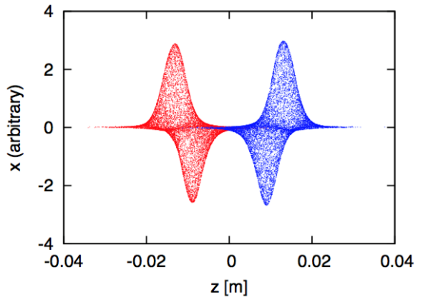

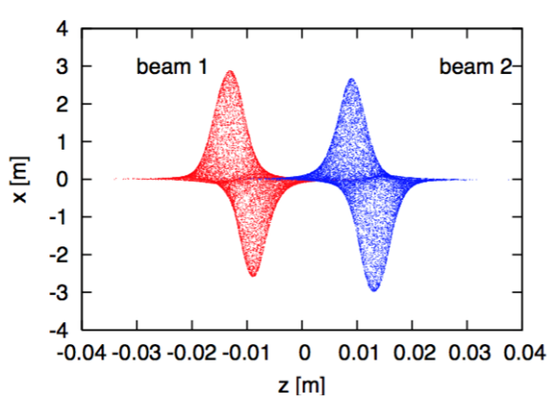


σ and π mode for correlated head-tail motion
σ mode: the dipole moment of two beams is identical
π mode: the dipole moment of two beams is opposite
Cross wake force can be treated as ordinary wake force
-/+ :

Slide 10
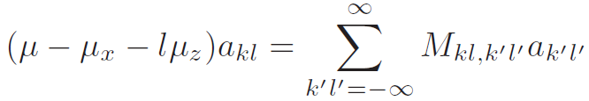
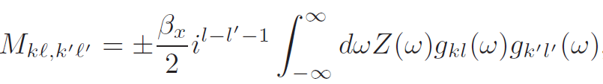
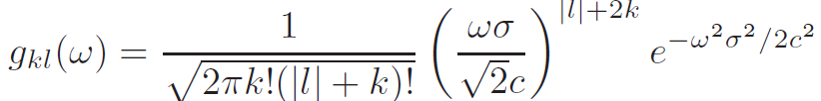
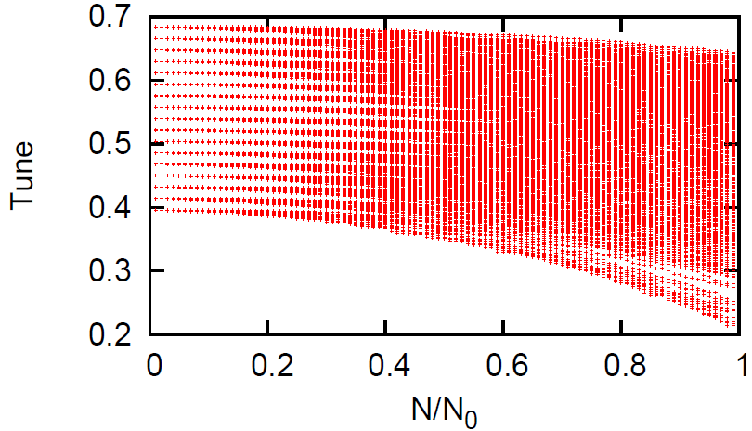
Ordinary mode coupling theory
A. Chao,
M is real and symmetric matrix.
The eigenvalues are real. No instability.
Couple to the same parity modes.

Slide 11


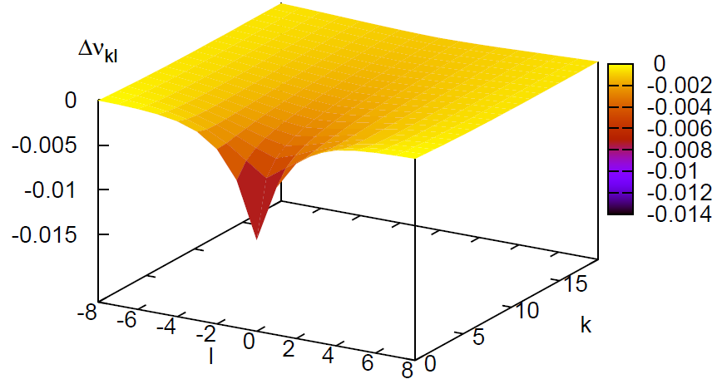
Diagonal component of M, tune shift
Tune shift of σ mode is negative, while that of π mode is positive.

Slide 12


Particle tracking using the cross wake force
Wake force is localized at IP.
Tracking algorithm
  Revolution (synchro-betatron motion)
  Wake force at IP
    Cross wake force
    single bunch wake force assuming σ/π mode.
-/+ :

Slide 13
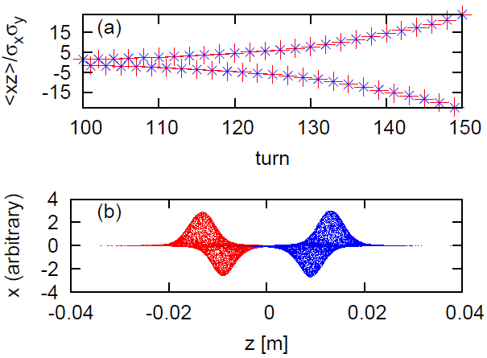
Tracking simulation results for two beams using the cross wake force
SuperKEKB detuned b 8x8xβ.
<xz>’s of e+/e- beams are the same (σ mode).
The beam distributions showed a clear σ mode instability.

Slide 14
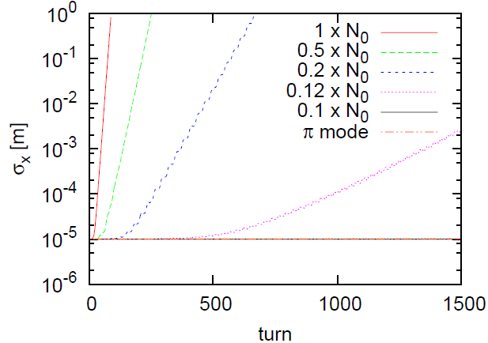
Tracking simulation results using single bunch wake force assuming σ/π mode
FCCee-Z. The bunch population was scanned, where N₀ is the design value.
The threshold is 0.1N₀.
Assuming π mode, the beam is stable.
Two beam simulation showed the same
result.

Slide 15
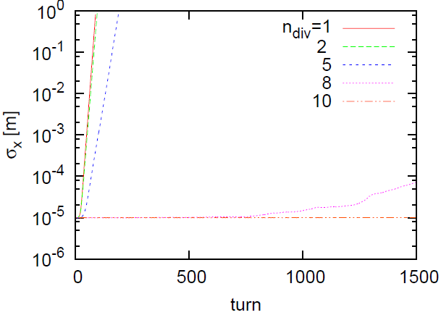
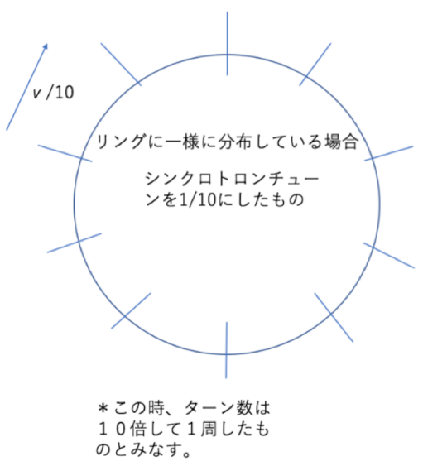
Uniformly distributed wake
Ring is divided into n_{div} parts with an equal synchrotron phase advance.
Instability disappears at n_{div} =8.
It seems to be essential that the cross wake force is localized at IP.

Slide 16
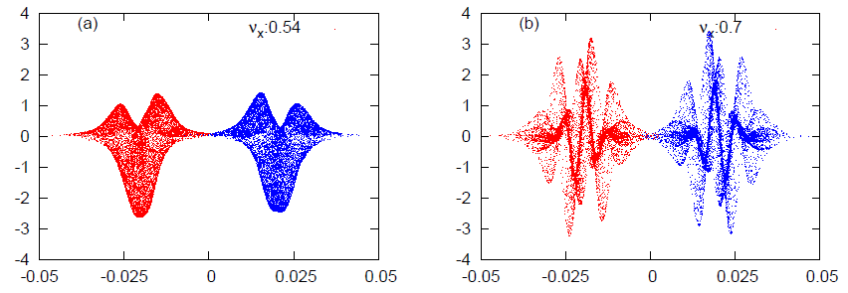
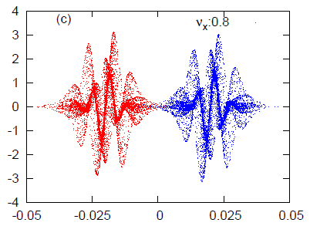
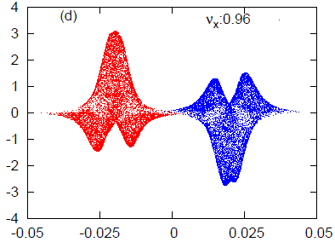
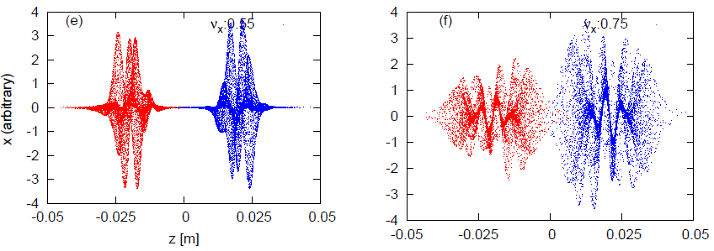
Tune dependence of the instability in the simulation
νx=0.7, σ mode
νx=0.8, π mode
νx=0.54, σ mode
νx=0.96, π mode
νx=0.75,
νx=0.55, N=0.4N₀, π mode

Slide 17
What we know from the tracking simulation
Clear σ mode instability was seen at ν_{x}=0.54 for localized wake at IP.
When the wake force distribute along the ring, the instability disappear.
Localized wake force is essential for the instability.
Simulations for single and cross wake force showed the same results.
Distributions of ν_{x}=0.54 and 0.96 are similar, though different mode σ/π .
Distributions of ν_{x}=0.7 and 0.8 are similar, though different mode σ/π.
Basically, σ mode is dominant at ν_{x}<0.75, while π mode is dominant at ν_{x}>0.75
π mode instability can be induced at ν_{x}=0.55.
Complex mode is seen at ν_{x}=0.75.

Slide 18


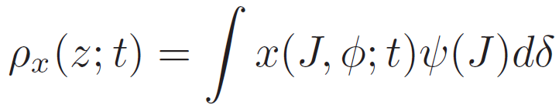
Mode coupling theory for localized single bunch wake force assuming σ/π mode
Dipole amplitude in the longitudinal phase space at t-th turn.
Density in the longitudinal phase space, independent of t.
Dipole moment density .

Slide 19
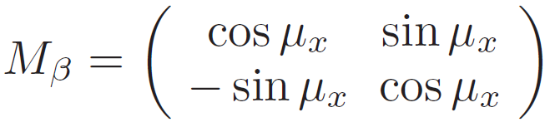
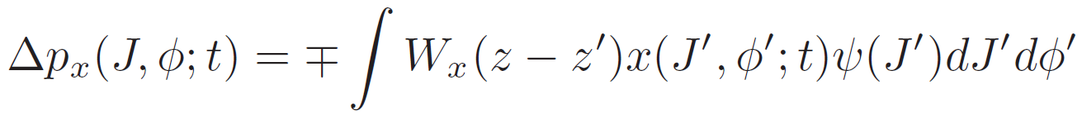
One turn transformation
Betatron oscillation for .
Synchrotron oscillation
Wake

Slide 20



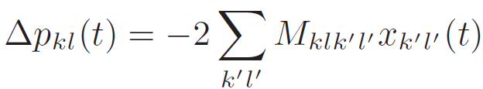


Mode expansion using Laguerre-Fourier base
Expand x and p_{x} with k l modes.
Synchro-betatron motion, transformations for .
Momentum kick due to the wake force
Revolution matrix M₀M_{w}.
Solve eigenvalue problem for M₀M_{w}.
matrix size=[2(k_{max}+1)(2l_{max}+1)]²

Slide 21

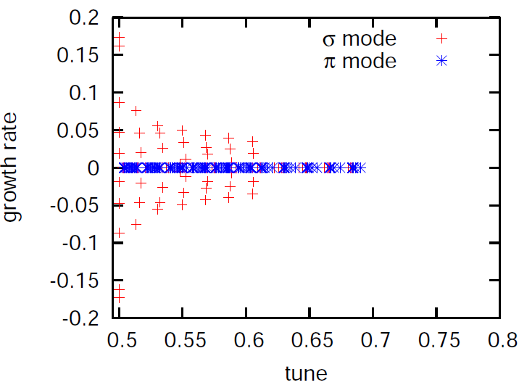
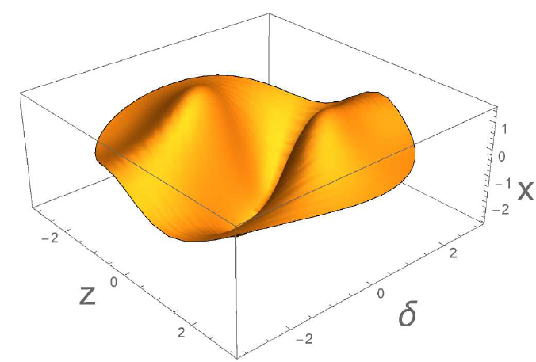
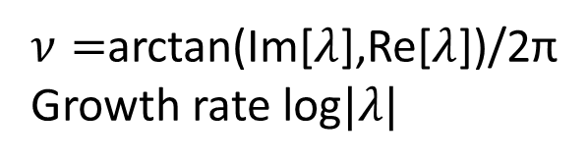
Eigenvalue
Eigenvalues appears as , where μ=2πν is complex.
The real part is tune, and the imaginary part is growth rate per turn.
l_{max}=8, k_{max}=20
Eigenvector with the highest growth rate.
l=2 mode
$ν=$arctan(Im[$λ$],Re[$λ$])/2π
Growth rate log$|λ|$
L=2 mode is induced.

Slide 22
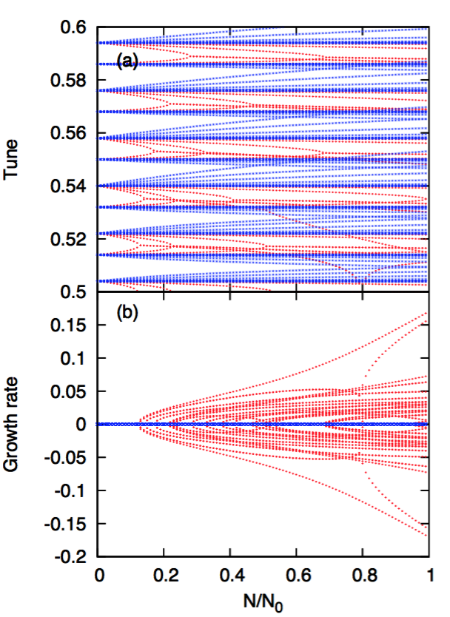
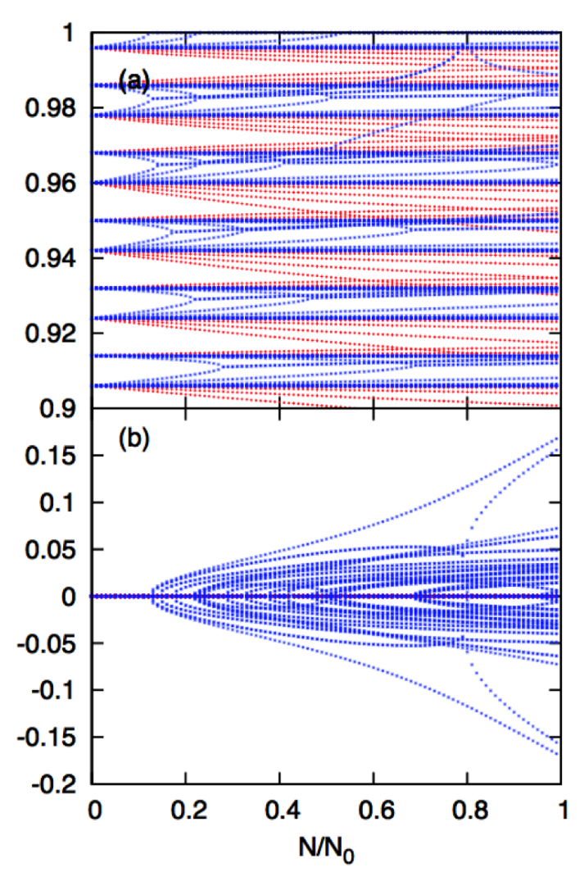
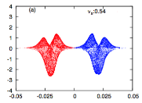
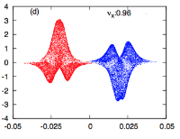
Tune/growth for localized single bunch wake, ν_{x} =0.54,0.96
When two modes merge or tune reach to 0.5, beams are unstable.
<ν_{x} =0.54>
<ν_{x} =0.96>
l_{max} =8、k_{max} =20
ν=ν_{x} ± l ν_{s} at N= 0
l=0
l=-4
νs=0.018
<σ mode>
Mode coupling between l=0,-4、l=-1,-3 wit hthe same parity.
ν(l=-2) arrives to 0.5, unstable at N=0.1N₀.
l=-1
l=-3
l=-2
<π mode>
No coupling between l = −2 and l = −3, though the tunes cross each other at N/N0 = 0.7.
red plot σ mode
blue plot π mode
ν=0.486 is wrapped to 0.514
ν=0.54 and 0.96 are symmetric tune for 0.75. Dominant mode are σ/π, respectively, the same growth, symmetric behavior.
Consistent with particle tracking

Slide 23
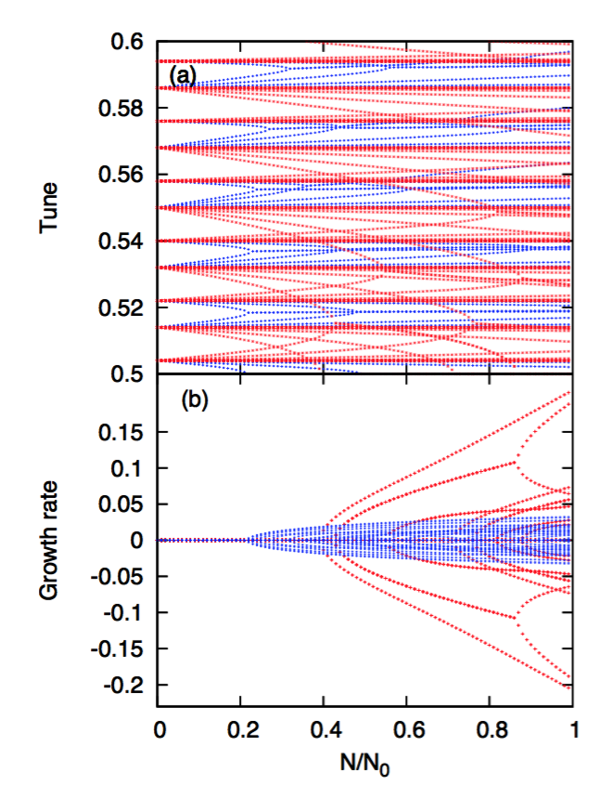
Tune/growth for localized single bunch wake, νx=0.55
<σ mode>
Wrapped l = −3 mode of σ mode is closed to 0.5. Tune shift is positive thus stable.
σ mode instability is caused for l=-2 mode. The threshold for νx = 0.55 is 4 times higher than that of νx = 0.54. Similar growth rate at N₀.
l＝０
l=-1
l=-2
l=-3
<π mode>
Wrapped l = −3 mode of π mode approach to 0.5, and becomes unstable.
π mode becomes unstable than s mode lower N. The particle tracking showed the π mode instability at νx=0.55.
Instability is 不安定が起こるモードというのは、それぞれのモード(σ,π)のチューンシフトの 動き(負/正)により、カップリングを起こす l, l′ どうしが接近しやすいかどうかによる。

Slide 24
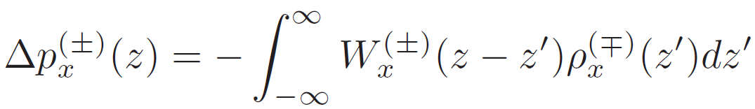
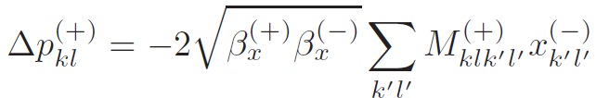
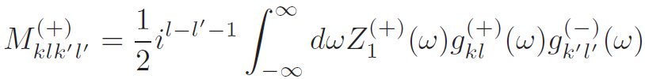
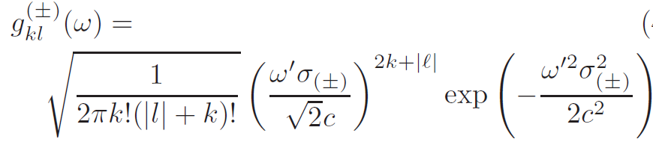
Mode coupling theory for localized cross wake force - two beam amplitude
Momentum kick due to the cross wake force
Mode expansion

Slide 25

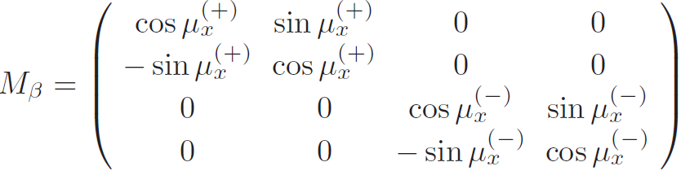
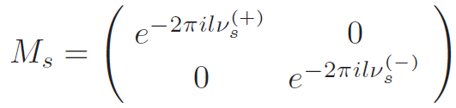
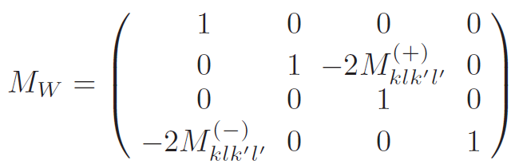
Revolution matrix for the cross wake force
Vector
Betatron
Synchrotron
Wake force
Revolution matrix, M_{W}M_{s}M_{β}
Solve Eigenvalue problem
length=4(k_{max}+1)(2l_{max}+1)

Slide 26
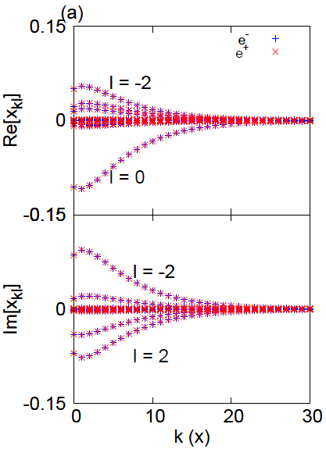
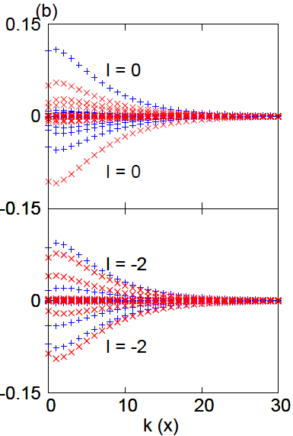
Result for the two beam model
ν_{x}=0.54
ν_{x}=0.96
Eigenvector of the most unstable mode.
For ν_{x}=0.54, eigenvectors of e+/e- beam is identical, σ mode.
For ν_{x}=0.96, eigenvectors of e+/e- beam is opposite, π mode.
Perfect agreement with single bunch analysis assuming σ/π mode.
νx=0.54, σ mode
νx=0.96, π mode

Slide 27
What we know from eigenvalue analysis using the cross wake force
Single bunch wake force assuming σ/π mode.
Tune shift of σ mode is negative, while π mode is positive.
When tune of a mode arrives at 0.5, or two modes with the same parity are merged, beam-beam system becomes unstable.
Mode coupling is caused two modes between those w and w/o wrapping at 0.5.
σ mode is dominant for ν_{x}<0.75, while π mode is dominant for ν_{x}>0.75. The behavior is symmetric for ν_{x}=0.75.

Slide 28
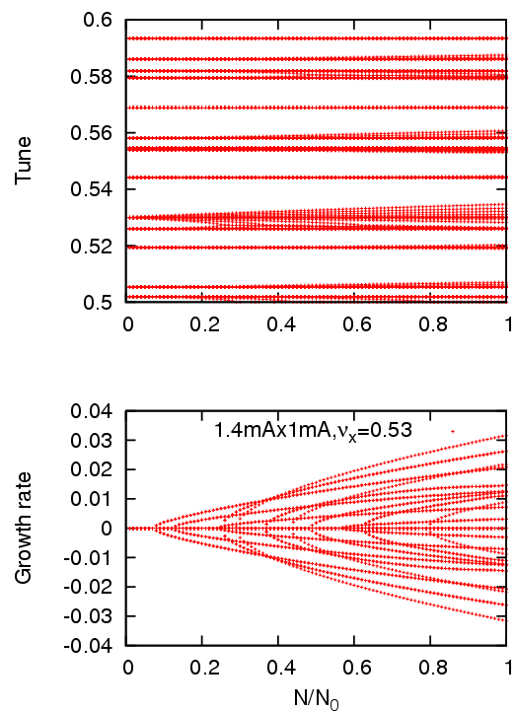
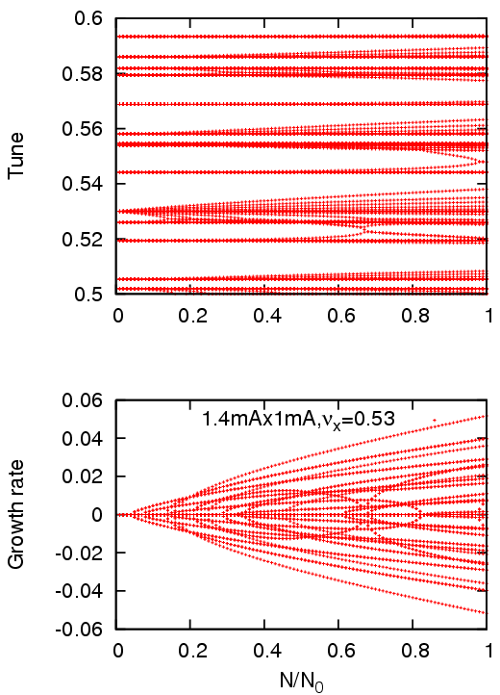
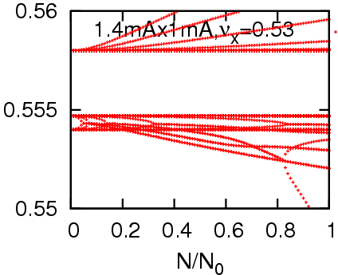
Eigen mode analysis for ν_{x}=0.53 ν_{s}(LER)=0.0247, ν_{s}(HER)=0.0280
8x8x 4x8x
ν_{x}+ν_{s}⁽⁺⁾
ν_{x}-3ν_{s}⁽⁻⁾
skb8x8xb

Slide 29
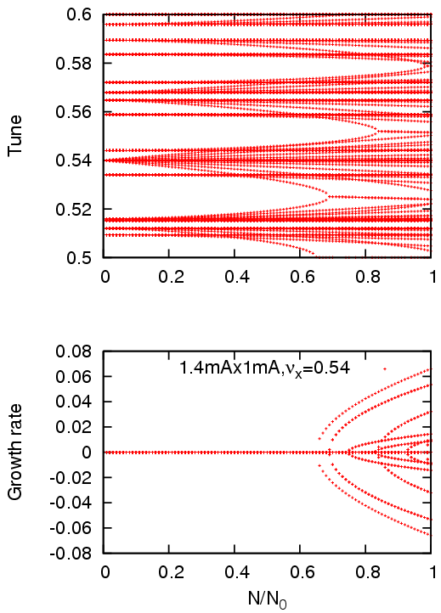
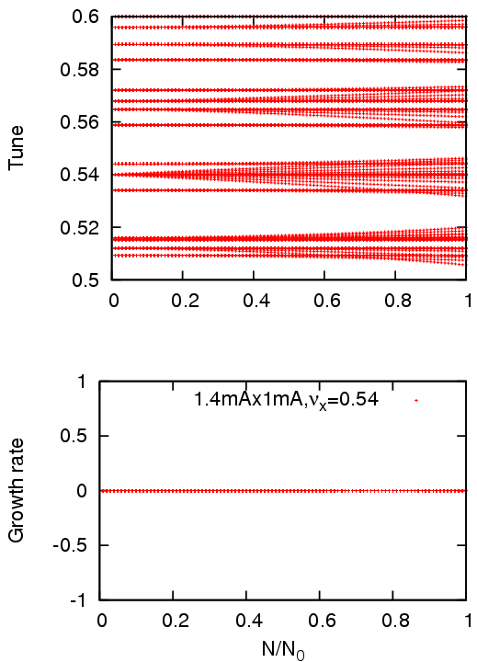
Eigen mode analysis for ν_{x}=0.54
8x8x 4x8x
skb8x8xc

Slide 30


Eigen mode analysis for ν_{x}=0.55
8x8x 4x8x
skb8x8xd

Slide 31

Strong-strong beam-beam simulation
8x8x, 1.44mAx1.04mA, ν_{x}=0.53
skb2a

Slide 32

4x8x, 1mAx0.8mA , ν_{x}=0.53
skb21b

Slide 33
Summary of the strong-strong simulation
I=1.44mA x 1.04mA
ν_{x} | 8x8x L/L₀, σ_{x}/σ_{x0} (L & H) osc. | 4x8x L/L₀, σ_{x}/σ_{x0} (L & H) osc.
0.53 a | 0.58-0.66 6.5 4.5 | 0.75-1.0 3.0-7.5 2.2-6.2
0.535 g | 0.70-0.95 2.5-6.2 1.4-4.0 | 1.04 1.2 1.0
0.54 d | 0.75-0.95 2.5-6.0 1.4-4.0 | 1.05 2.1 1.1
0.545 f | 0.83 7.2 1.2 no osc. | 0.94 5.2 1.7
0.55 e |  | 0.75-0.77 8.6 3.5
Horizontal emittance growth does not contribute luminosity drop in collision with a large crossing angle, when β_{y} is large.
Crab waist on in the simulation. CW-off may be serious for the horizontal emittance growth.

Slide 34
Conclusions
Strong-strong beam-beam simulation showed a strong coherent beam-beam instability in head-tail mode at the collisions wit ha large crossing angle.
To explain the instability, the cross wake force is introduced, particle tracking and eigenmode analysis were performed.
The particle tracking gave guiding toward a complete theory based on the eigenmode analysis.
It is essential that the wake force is localized at IP.
Eigenmode analysis represents characteristics of this instability.
Experiments in SuperKEKB is done soon.

