Slide 1

Dynamic Aperture Simulations of Colliding Beams and Operational Scenarios of HL-LHC
Nikos Karastathis
with contributions of
G. Arduini, X. Buffat, F. Cerutti, S. Fartoukh, G. Iadarola, R.de Maria, E. Metral, Y. Papaphilippou, D. Pellegrini, L. Rossi, A. Tsinganis, R. Tomàs Garcia
Beam-beam Effects in Circular Colliders Workshop, 5-7 Feb. 2018

Slide 2
Outline
Present the baseline operational scenario of HL-LHC for proton operation, focusing on the part.
Define the Dynamic Aperture (DA) targets that need to be met to fully validate the scenario in terms of DA/lifetime
Overview of the dependence of HL-LHC DA during levelling on various parameters
  Working point, high chromaticity and octupole current
  Crossing Angle → adaptive crossing angle scenario
Propose an alternative adapting crossing angle levelling scenario and showcase its advantages.
Evaluate the impact of the field errors during collisions.

Slide 3
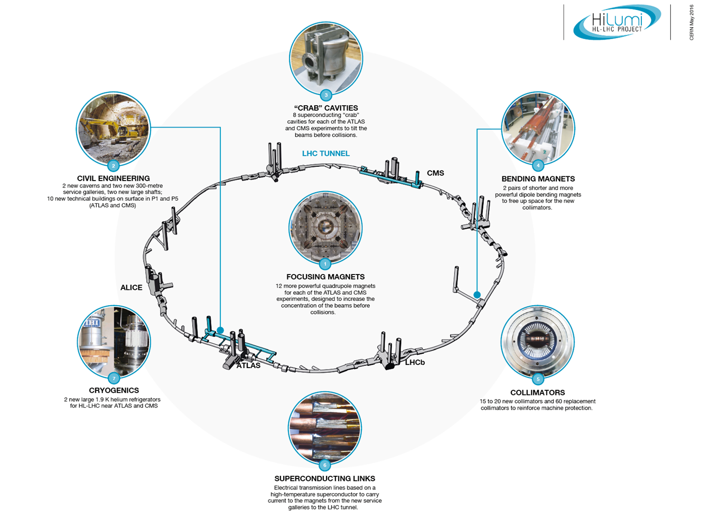
HL-LHC Project
Established in Nov. 2010

Slide 4
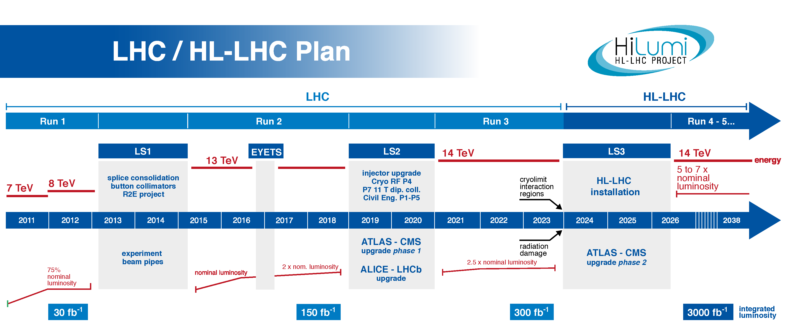
HL-LHC Project
Higgsino
Announcement
Higgs
Announcement
You are here!
We’re half-way through the
design/constrution period!

Slide 5
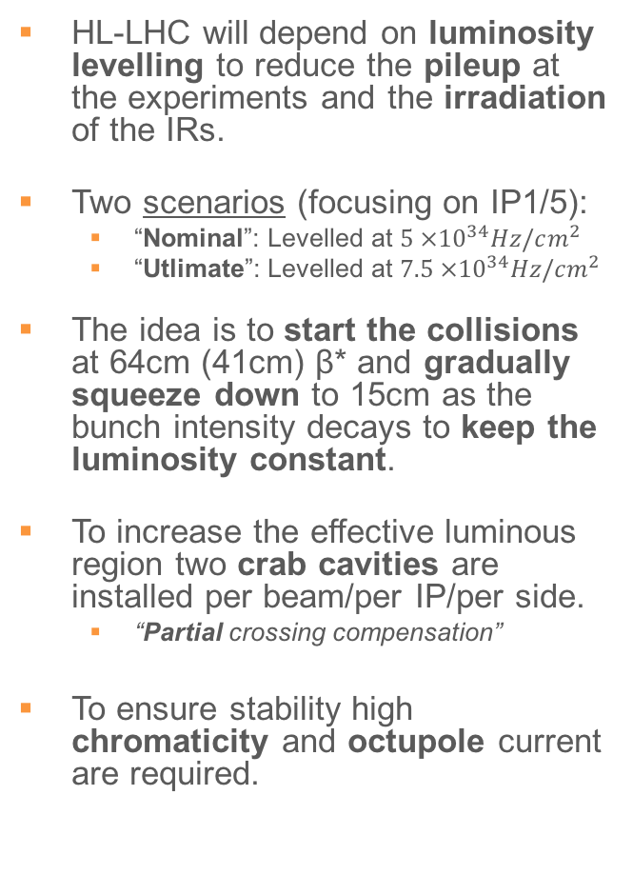
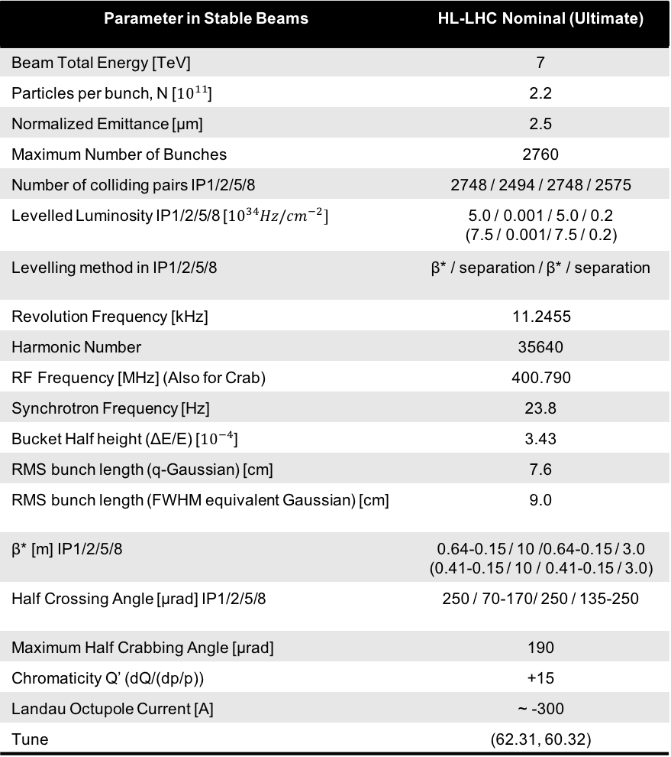
HL-LHC Beam Parameters @ Stable Beams
Parameter in Stable Beams | HL-LHC Nominal (Ultimate)
Beam Total Energy [TeV] | 7
Particles per bunch, N [${10}^{11}$] | 2.2
Normalized Emittance [μm] | 2.5
Maximum Number of Bunches | 2760
Number of colliding pairs IP1/2/5/8 | 2748 / 2494 / 2748 / 2575
Levelled Luminosity IP1/2/5/8 [${10}^{34}Hz/cm^{−2}]$ | 5.0 / 0.001 / 5.0 / 0.2 (7.5 / 0.001/ 7.5 / 0.2)
Levelling method in IP1/2/5/8 | β* / separation / β* / separation
Revolution Frequency [kHz] | 11.2455
Harmonic Number | 35640
RF Frequency [MHz] (Also for Crab) | 400.790
Synchrotron Frequency [Hz] | 23.8
Bucket Half height (ΔΕ/Ε) [${10}^{−4}$] | 3.43
RMS bunch length (q-Gaussian) [cm] | 7.6
RMS bunch length (FWHM equivalent Gaussian) [cm] | 9.0
β* [m] IP1/2/5/8 | 0.64-0.15 / 10 /0.64-0.15 / 3.0 (0.41-0.15 / 10 / 0.41-0.15 / 3.0)
Half Crossing Angle [μrad] IP1/2/5/8 | 250 / 70-170/ 250 / 135-250
Maximum Half Crabbing Angle [μrad] | 190
Chromaticity Q’ (dQ/(dp/p)) | +15
Landau Octupole Current [A] | ~ -300
Tune | (62.31, 60.32)
HL-LHC will depend on luminosity levelling to reduce the pileup at the experiments and the irradiation of the IRs.
Two scenarios (focusing on IP1/5):
  “Nominal”: Levelled at $5 ×{10}^{34}Hz/cm^{2}$
  “Utlimate”: Levelled at $7.5 ×{10}^{34}Hz/cm^{2}$
The idea is to start the collisions at 64cm (41cm) β* and gradually squeeze down to 15cm as the bunch intensity decays to keep the luminosity constant.
To increase the effective luminous region two crab cavities are installed per beam/per IP/per side.
  “Partial crossing compensation”
To ensure stability high chromaticity and octupole current are required.
“Update on the HL-LHC operational scenarios for proton operation”, E.Metral et al, CERN-ACC-NOTE-2018-0002

Slide 6
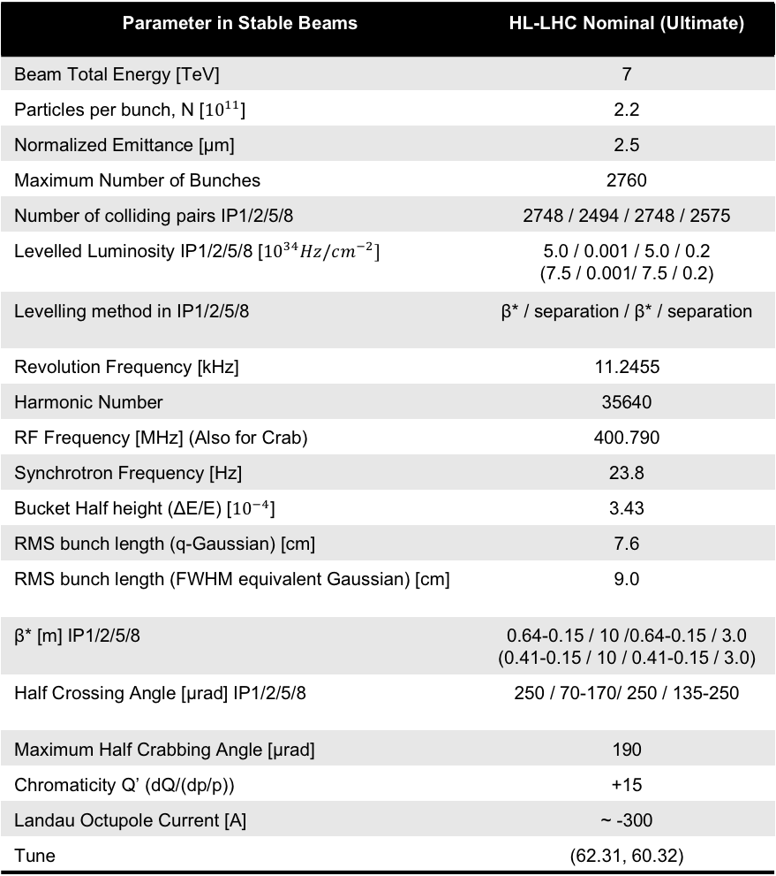
HL-LHC Beam Parameters @ Stable Beams
Parameter in Stable Beams | HL-LHC Nominal (Ultimate)
Beam Total Energy [TeV] | 7
Particles per bunch, N [${10}^{11}$] | 2.2
Normalized Emittance [μm] | 2.5
Maximum Number of Bunches | 2760
Number of colliding pairs IP1/2/5/8 | 2748 / 2494 / 2748 / 2575
Levelled Luminosity IP1/2/5/8 [${10}^{34}Hz/cm^{−2}]$ | 5.0 / 0.001 / 5.0 / 0.2 (7.5 / 0.001/ 7.5 / 0.2)
Levelling method in IP1/2/5/8 | β* / separation / β* / separation
Revolution Frequency [kHz] | 11.2455
Harmonic Number | 35640
RF Frequency [MHz] (Also for Crab) | 400.790
Synchrotron Frequency [Hz] | 23.8
Bucket Half height (ΔΕ/Ε) [${10}^{−4}$] | 3.43
RMS bunch length (q-Gaussian) [cm] | 7.6
RMS bunch length (FWHM equivalent Gaussian) [cm] | 9.0
β* [m] IP1/2/5/8 | 0.64-0.15 / 10 /0.64-0.15 / 3.0 (0.41-0.15 / 10 / 0.41-0.15 / 3.0)
Half Crossing Angle [μrad] IP1/2/5/8 | 250 / 70-170/ 250 / 135-250
Maximum Half Crabbing Angle [μrad] | 190
Chromaticity Q’ (dQ/(dp/p)) | +15
Landau Octupole Current [A] | ~ -300
Tune | (62.31, 60.32)
Can we operate with sufficient lifetime (DA) with this strategy?
  Can we squeeze down to 15cm?
  What is the effect on my working point due to the beam-beam interactions throughout the intensity decay?
  How does high chromaticity and high octupole current affect my lifetime?
  While at the back of our minds, can I go for the ultimate?

Slide 7
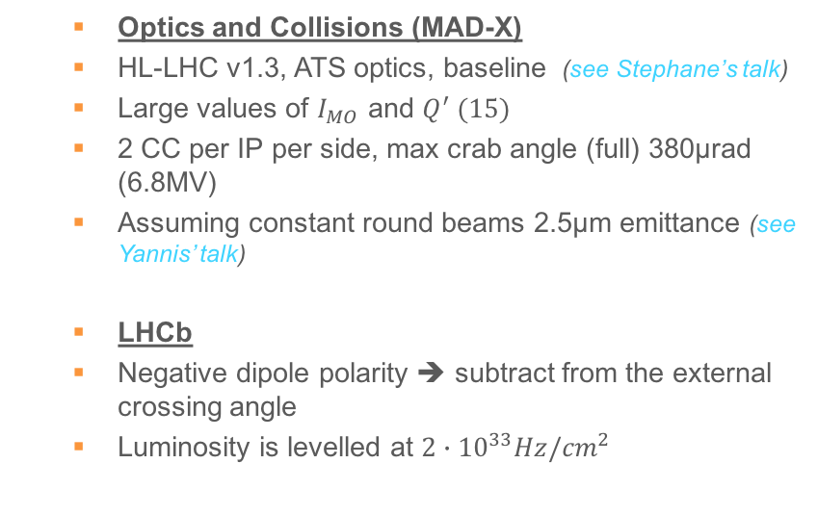
Estimator & Simulation Setup
  Our estimator for the operational lifetime is based on the Dynamic Aperture simulations, usually performing multi-parametric scans to find correlations between beam parameters.
  Our DA targets consist of (see Dario’s talk)
    4σ : corresponds to lifetime close to burn-off
    5σ : grants lifetimes above ~100h ➔ Minimum target for LHC operation
    6σ : target for studies in the presence of larger uncertainties (e.g. multi-pole errors)
  Optics and Collisions (MAD-X)
  HL-LHC v1.3, ATS optics, baseline (see Stephane’s talk)
  Large values of $I_{MO}$ and $Q^{′} (15)$
  2 CC per IP per side, max crab angle (full) 380μrad (6.8MV)
  Assuming constant round beams 2.5μm emittance (see Yannis’ talk)
  LHCb
  Negative dipole polarity ➔ subtract from the external crossing angle
  Luminosity is levelled at ${2∙10}^{33}Hz/{cm}^{2}$
  Tracking (SixTrack) (see Gianni’s talk)
  Weak-Strong regime
  1M turns
  5 angles in the (x,y) space
  Particle amplitudes up to 10σ
  Estimator: minimum Dynamic Aperture over the angles and amplitudes
  Targets
  6σ ➔ ”Relaxed”
  5σ ➔ ”Aggressive”

Slide 8
Optimal Working Point: Start of Levelling
Fully exploiting the octupole current at -570A
(.320, .325)
The design WP when BB is on results in DA ~4σ.
(.31, .32)
An optimal working point can be identified close to (.320, .325)
Can I reach the target of 15cm with this octupole current?

Slide 9
Optimal Working Point: End of Levelling
    “Octupoles provide too little non-linearity where it is needed and too high where it is detrimental.” – Sasha V.
  ⇑ Octupole Current ➪ ⇓ DA
  However, for stability in terms of instabilities, the octupole current must be at least -300A (mainly to damp instabilities of the non-colliding bunches, the colliding ones are stabilized by the BB – see Xavier’s, Claudia’s talks)
  We stick to -300A for the moment

Slide 10
Optimal Working Point: During the Levelling
(.320, .325)
  The optimal WP has been shifted compared to the one at the start of the levelling
  New optimal WP for 15cm at (.315, .320)
(.31, .32)
(.315, .320)

Slide 11
Optimal Working Point: During the Levelling
(.320, .325)
(.320, .325)
(.31, .32)
(.31, .32)
(.315, .320)
(.315, .320)
(.320, .325)
(.31, .32)
(.315, .320)
(.320, .325)
(.320, .325)
(.31, .32)
(.31, .32)
(.315, .320)
(.315, .320)

Slide 12
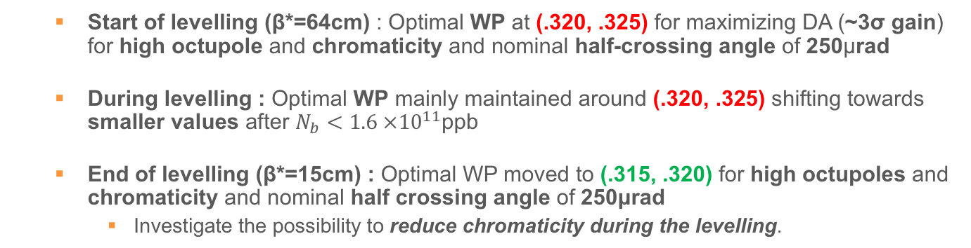
Optimal Working Point
(.320, .325)
(.320, .325)
(.31, .32)
(.315, .320)
(.31, .32)
(.315, .320)
  Start of levelling (β*=64cm) : Optimal WP at (.320, .325) for maximizing DA (~3σ gain) for high octupole and chromaticity and nominal half-crossing angle of 250μrad
  During levelling : Optimal WP mainly maintained around (.320, .325) shifting towards smaller values after $N_{b}<1.6 ×{10}^{11}$ppb
  End of levelling (β*=15cm) : Optimal WP moved to (.315, .320) for high octupoles and chromaticity and nominal half crossing angle of 250μrad
    Investigate the possibility to reduce chromaticity during the levelling.

Slide 13
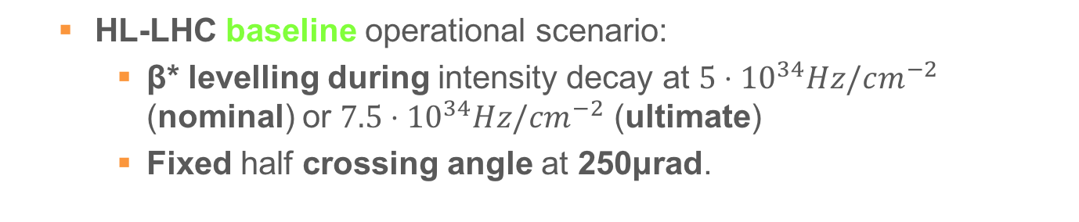
Baseline and Adaptive Crossing Angle Levelling Scenarios
  HL-LHC baseline operational scenario:
    β* levelling during intensity decay at $5⋅{10}^{34}Hz/cm^{−2}$ (nominal) or $7.5⋅{10}^{34}Hz/cm^{−2}$ (ultimate)
    Fixed half crossing angle at 250μrad.
  Adaptive crossing angle levelling scenario by using DA margin to enhance performance
    As β*/bunch intensity evolves for a certain levelled luminosity, trace alternative half crossing angle path corresponding to a DA target
    “Relaxed” at 6σ
    “Aggressive” at 5σ

Slide 14
Start of levelling: $N_{b}=2.2⋅10^{11}$ ppb
relaxed
DA [σ]
Baseline
aggressive

Slide 15

Start of levelling: $N_{b}=2.2⋅10^{11}$ ppb
relaxed
DA [σ]
Luminosity [${10}^{34}Hz/{cm}^{2}$]
Baseline
aggressive
Relaxed (6σ)
Aggressive (5σ)
Ultimate Relaxed (6σ)
Ultimate Aggressive (5σ)

Slide 16

Start of levelling: $N_{b}=2.2⋅10^{11}$ ppb
  Reduction of crossing angle at constant luminosity, reduces the pileup density (by elongating the luminous region) and triplet irradiation
relaxed
DA [σ]
Luminosity [${10}^{34}Hz/{cm}^{2}$]
r.m.s Length of Luminous
Region [cm]
Baseline
aggressive
Relaxed (6σ)
Aggressive (5σ)
Ultimate Relaxed (6σ)
Ultimate Aggressive (5σ)
Scenario | Half-crossing angle [μrad] | β* [cm]
Baseline | 250 (21.8σ) | 64
Relaxed | 154 (14.0σ) | 69
Aggressive | 133 (12.1σ) | 69
Ultimate Relaxed | 209 (15.1σ) | 44
Ultimate Aggressive | 179 (13.1σ) | 45

Slide 17
During the levelling: $N_{b}=1.9⋅10^{11}$ ppb
  Following the path as the intensity decays.
relaxed
DA [σ]
Luminosity [${10}^{34}Hz/{cm}^{2}$]
r.m.s Length of Luminous
Region [cm]
Baseline
aggressive
Relaxed (6σ)
Aggressive (5σ)
Ultimate Relaxed (6σ)
Ultimate Aggressive (5σ)
Scenario | Half-crossing angle [μrad] | β* [cm]
Baseline | 250 (18.3σ) | 45
Relaxed | 183 (14.1σ) | 50
Aggressive | 162 (12.6σ) | 51
Ultimate Relaxed | 251 (14.5σ) | 28
Ultimate Aggressive | 206 (12.7σ) | 32

Slide 18
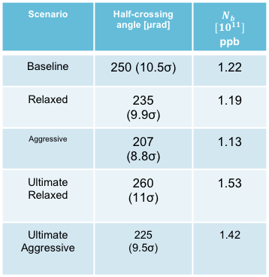
End of levelling
  Exit of levelling is determined by intensity and associated crossing angle at β*=15cm
DA [σ]
Luminosity [${10}^{34}Hz/{cm}^{2}$]
r.m.s Length of Luminous
Region [cm]
Baseline
Relaxed (6σ)
Aggressive (5σ)
Ultimate Relaxed (6σ)
relaxed
Ultimate Aggressive (5σ)
aggressive
Scenario | Half-crossing angle [μrad] | $$N_{b}$$ $[10^{11}]$ ppb
Baseline | 250 (10.5σ) | 1.22
Relaxed | 235 (9.9σ) | 1.19
Aggressive | 207 (8.8σ) | 1.13
Ultimate Relaxed | 260 (11σ) | 1.53
Ultimate Aggressive | 225 (9.5σ) | 1.42

Slide 19
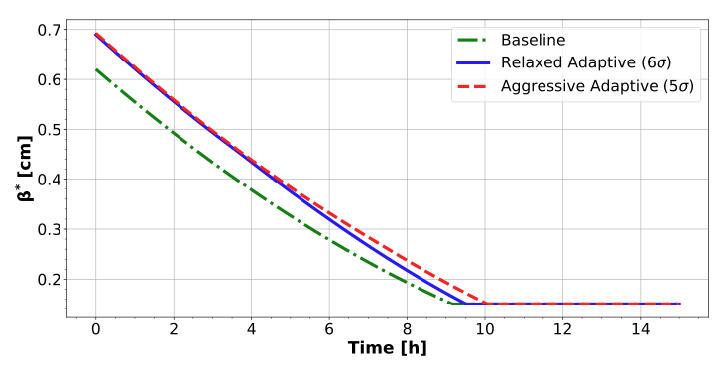
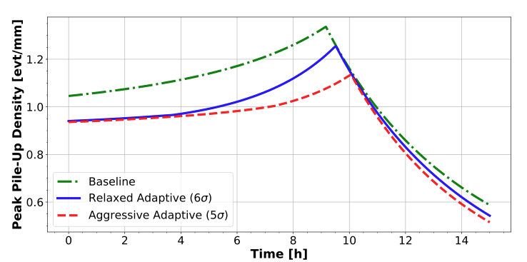
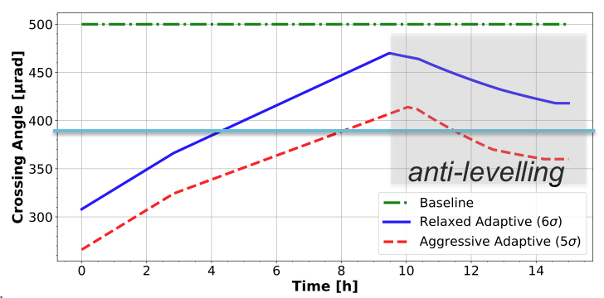
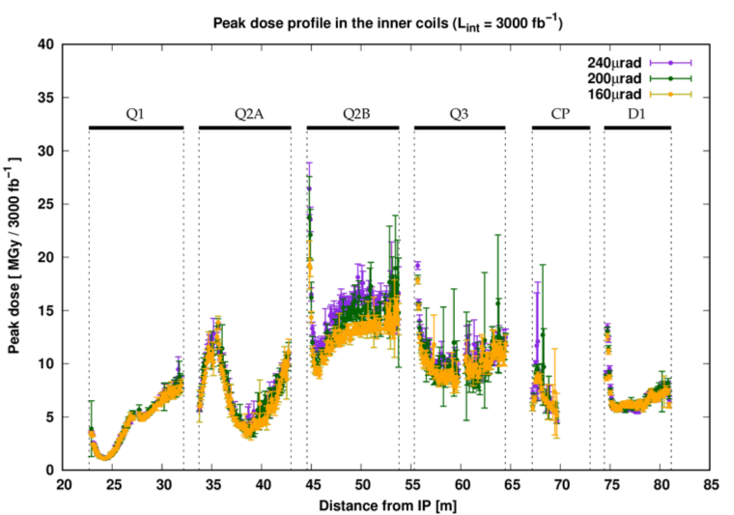
Evolution of Parameters
  Minor increase on levelling time and therefore integrated luminosity (~$2fb^{−1}$/10h fill)
  Luminous region increase of ~15% leads to peak pile-up density reduction of ~7%
F. Cerutti, A. Tsinganis,
Chamonix Workshop 2018
  Include crossing angle “anti-levelling” à la LHC after the end of β* levelling
  Average reduction of half crossing angle by 40-50μrad
  Leads to reduction of triplet peak dose ➔ 10% more lifetime for both nominal & ultimate scenarios.

Slide 20
Field Errors at the End of Levelling
  So far our simulations did not include any errors.
  To identify the impact of magnetic field errors we focus on a few interesting confugurations at the most critical point, the end of the levelling
Baseline
Relaxed (6σ)
Aggressive (5σ)
Ultimate Relaxed (6σ)

Slide 21
Field Errors at the End of Levelling
Aggressive
Relaxed
Baseline
Ultimate Relaxed

Slide 22
Field Errors at the End of Levelling
  Repeat the study for 60 different realizations of the machine (seeds) and calculate the minimum DA over the 5 angles.
6.9σ
6.6σ
6.6σ
6.4σ
6.0σ
6.0σ
5.6σ
5.1σ
5.4σ
5.2σ
5.0σ
4.3σ
STD: 0.3σ
STD: 0.3σ
STD: 0.3σ
STD: 0.3σ
  Average spread of the various realizations of 0.3σ
  Justifies the 6σ DA target for beam-beam without errors

Slide 23
Field Errors at the Start of Levelling

Slide 24
Field Errors at the Start of Levelling
Aggressive
Relaxed
Baseline
Ultimate

Slide 25
Field Errors at the Start of Levelling
7.3σ
7.2σ
6.3σ
6.7σ
6.6σ
5.7σ
5.9σ
5.1σ
5.3σ
5.8σ
4.8σ
4.6σ
STD: 0.1σ
STD: 0.3σ
STD: 0.3σ
STD: 0.3σ
Spread of 0.3σ, with the exception of the aggressive at ~0.1σ

Slide 26
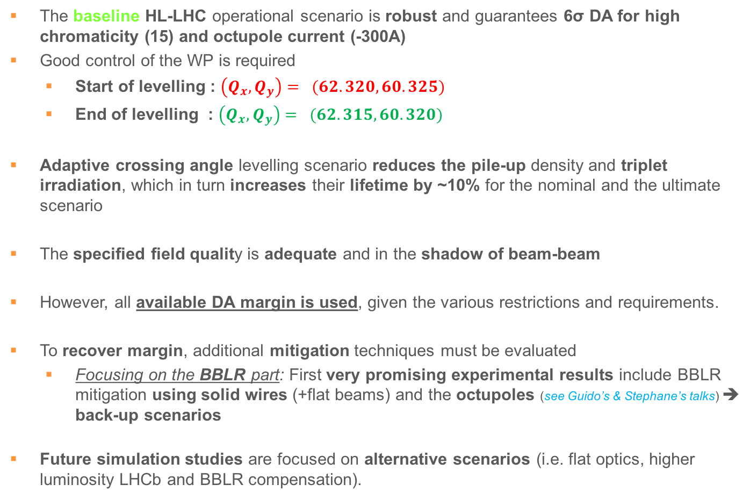
Summary
  The baseline HL-LHC operational scenario is robust and guarantees 6σ DA for high chromaticity (15) and octupole current (-300A)
  Good control of the WP is required
    Start of levelling : $\left(Q_{x},Q_{y}\right)= (62.320, 60.325)$
    End of levelling : $\left(Q_{x},Q_{y}\right)= (62.315, 60.320)$
  Adaptive crossing angle levelling scenario reduces the pile-up density and triplet irradiation, which in turn increases their lifetime by ~10% for the nominal and the ultimate scenario
  The specified field quality is adequate and in the shadow of beam-beam
  However, all available DA margin is used, given the various restrictions and requirements.
  To recover margin, additional mitigation techniques must be evaluated
    Focusing on the BBLR part: First very promising experimental results include BBLR mitigation using solid wires (+flat beams) and the octupoles (see Guido’s & Stephane’s talks) ➔ back-up scenarios
  Future simulation studies are focused on alternative scenarios (i.e. flat optics, higher luminosity LHCb and BBLR compensation).

Slide 27
Thank you for your attention
and many thanks to all the volunteers!

Slide 28
2017 Rebaseline
Scope: save 120 MCHF (2/3 on equip., 1/3 on T.I.) to transfer to C.E.
Crab Cavity: reduction of CC system from 4 to 2 cavities/beam-side: 16 CCs + 4 spares (vs. 32+8 previous). Small impact on performance also thanks to higher availability (demonstrated by LHC) and new optic features
Shifting installation of new MQYY as new Q4 (90 mm aperture), if needed. HL will start using as Q4 the present 70 mm MQY modified for 1.9 K.
Reduction of TCLD (DS collimator in P7 from 4 to 2 per side), with no 11 T for in DS2, and with 11 T dipole in DS7 (during LS2). Reduction of TCTPM in CuCD from 16+3 to 8+2
Powering the IPQs in the MS (Q4-Q5-Q6) from the RR, via existing EPCs, DFBLs and either a new DSL or the existing DSL + 12 local CLs.
  (for various reasons this last solution proved to be less effective than expected in terms of cost saving)

Slide 29

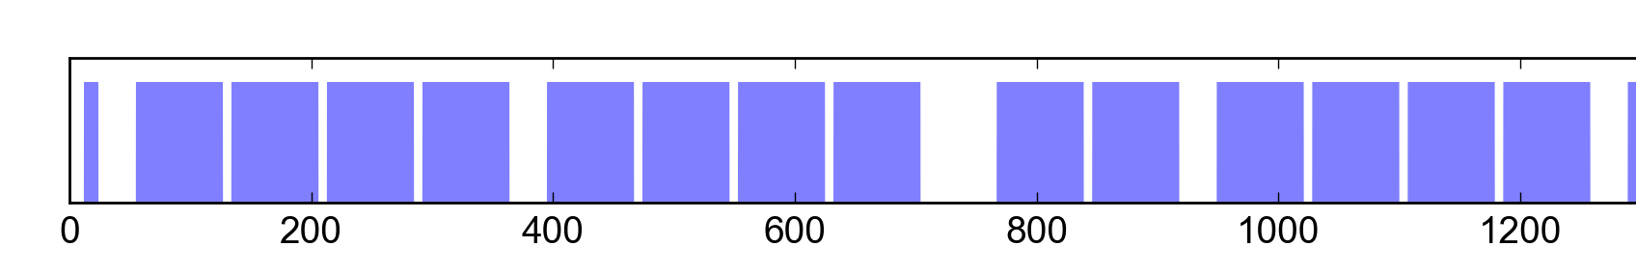
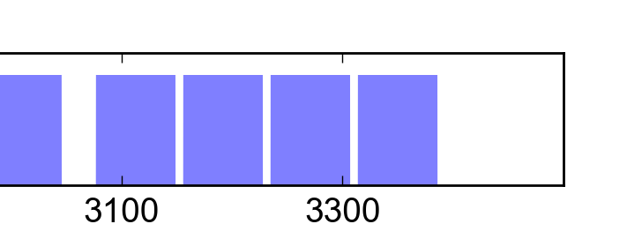
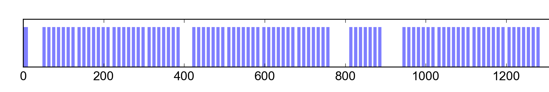
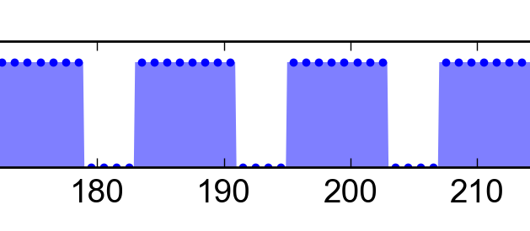
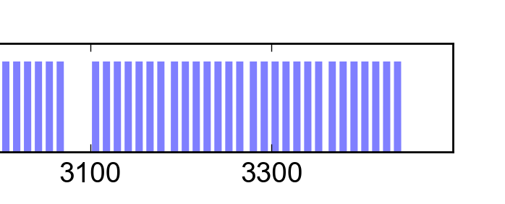
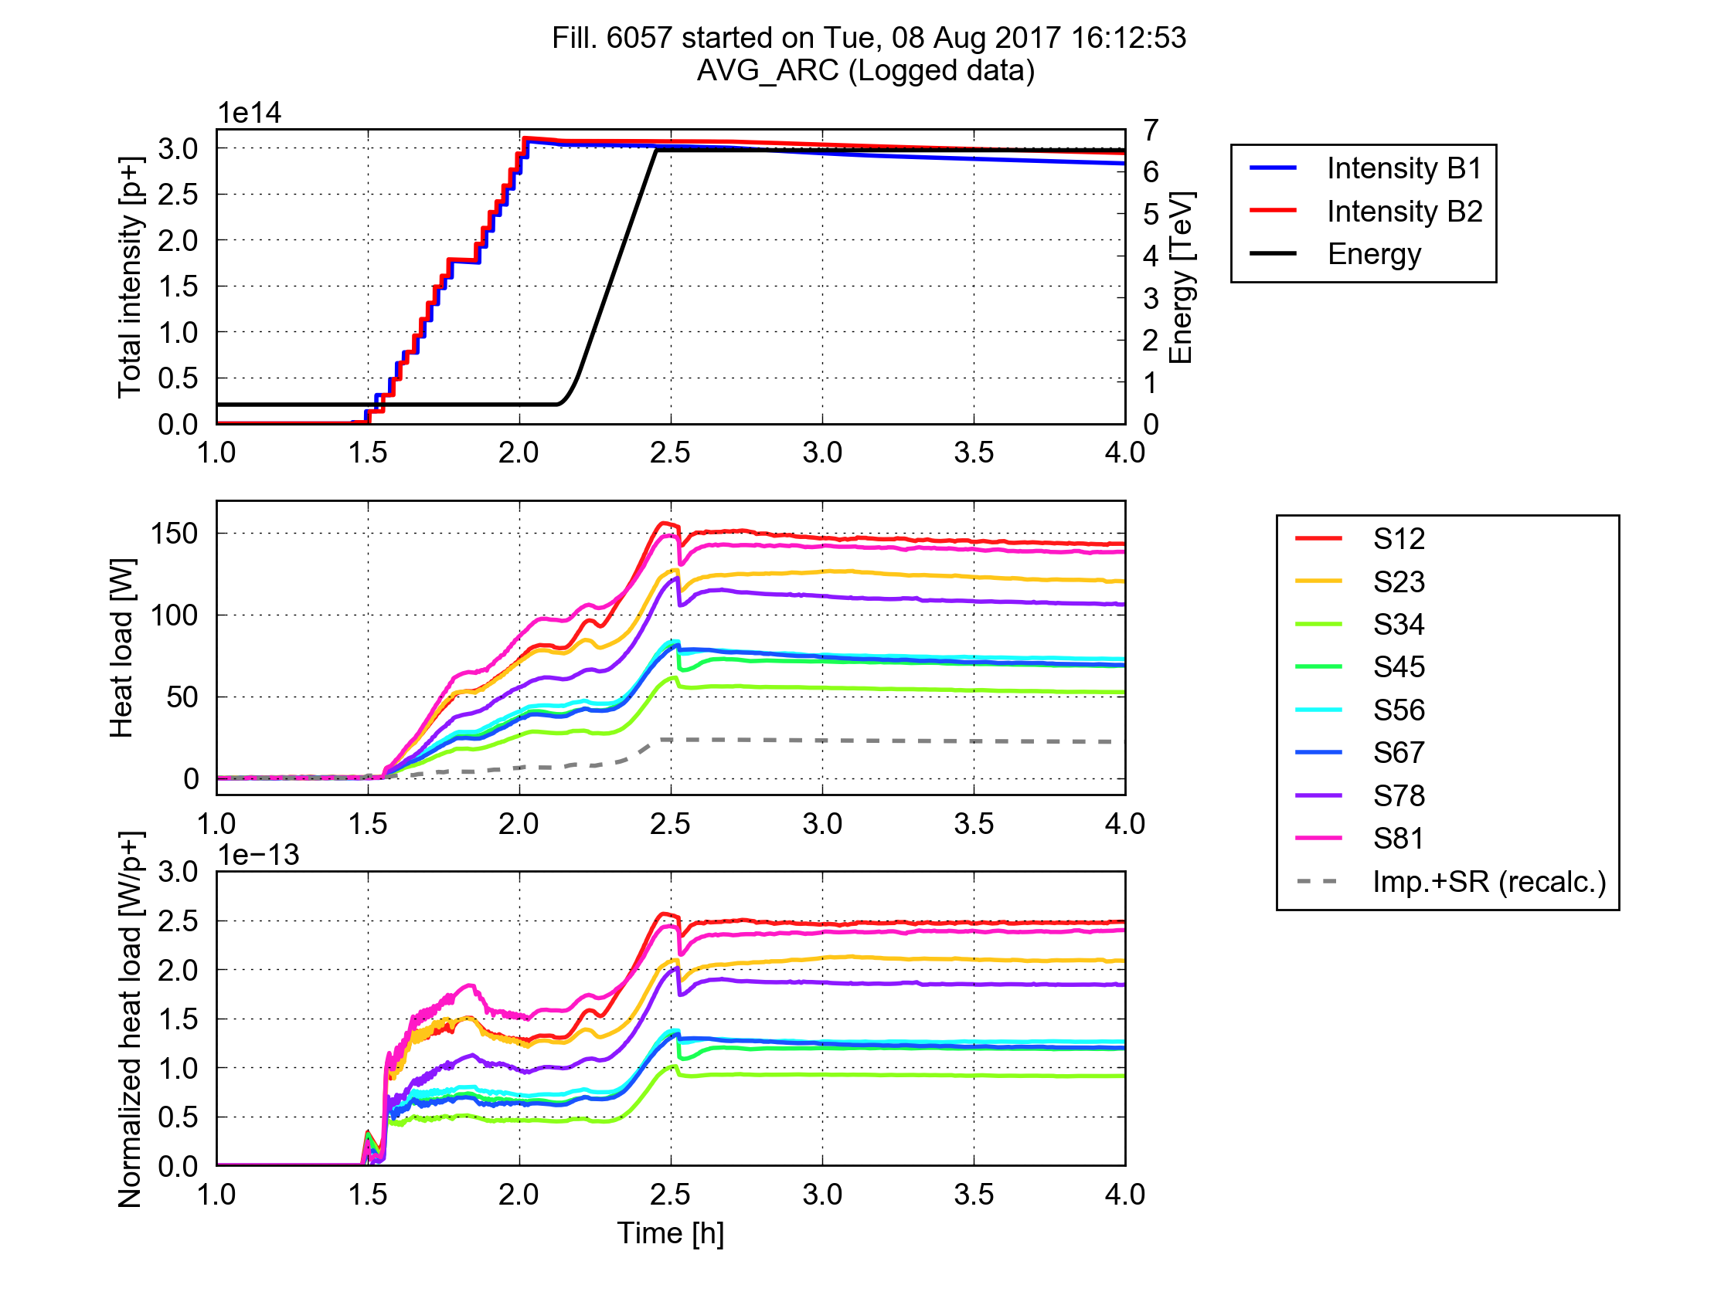
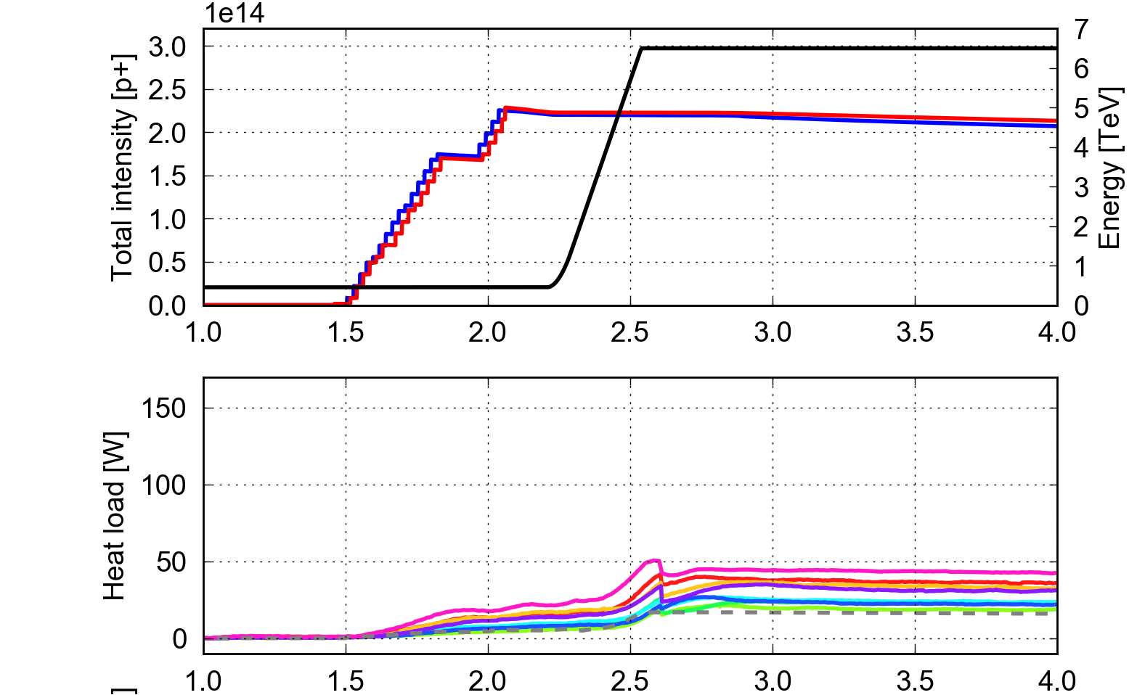
Arc heat loads - 8b+4e backup scheme
8b+4e: filling pattern conceived to suppress the e-cloud and hence reduce the heat loads. Price to pay: 30% less bunches.
25 ns (2760b)
72b
25 ns slot
8b+4e (1972b)
8b
4e
8b
4e
8b
4e
8b
25 ns slot
Successfully tested in the LHC in 2015 and used in operation in the last part of the 2017 Run (to mitigate fast losses in 16L2)
25 ns
(2017)
8b+4e
(2017)

Slide 30
Effect of Field Multipole Errors
Estimate the effect of the multipolar errors on the DA with beam-beam.
Track particles using 60 realizations of the machine (seeds)
Apply field errors from table “errortable_v5”.
Not correcting for D2 and MCBXF ➔ under study (Massimo et al)
We focus on a few interesting configurations at the start and at the end of the levelling:
  Aggressive, Relaxed adaptive Scenarios
  Baseline Nominal Scenario
  Ultimate Scenario
We perform a statistical analysis in terms of minimum and average DA of the results over the 5 angles and 5 amplitude ranges.

Slide 31
Field Errors at the End of Levelling
8.2σ
7.5σ
7.5σ
7.8σ
7.0σ
6.8σ
6.8σ
6.8σ
6.5σ
5.9σ
6.1σ
5.0σ
STD: 0.3σ
STD: 0.3σ
STD: 0.3σ
STD: 0.4σ
Average spread of the various realizations of 0.3σ (0.4σ for ultimate)

Slide 32
Field Errors at the Start of Levelling
8.7σ
8.0σ
7.5σ
7.7σ
6.8σ
7.0σ
6.3σ
6.5σ
5.3σ
6.0σ
5.1σ
4.9σ
STD: 0.1σ
STD: 0.2σ
STD: 0.2σ
STD: 0.2σ
Spread of 0.2σ, with the exception of the aggressive at ~0.1σ

Slide 33
Positive Octupoles
(.320, .325)
(.31, .32)
(.315, .320)

Slide 34
End of Levelling with WP of start of levelling

Slide 35
Parameter Evolution

Slide 36
Low Chroma / Octupoles

Slide 37
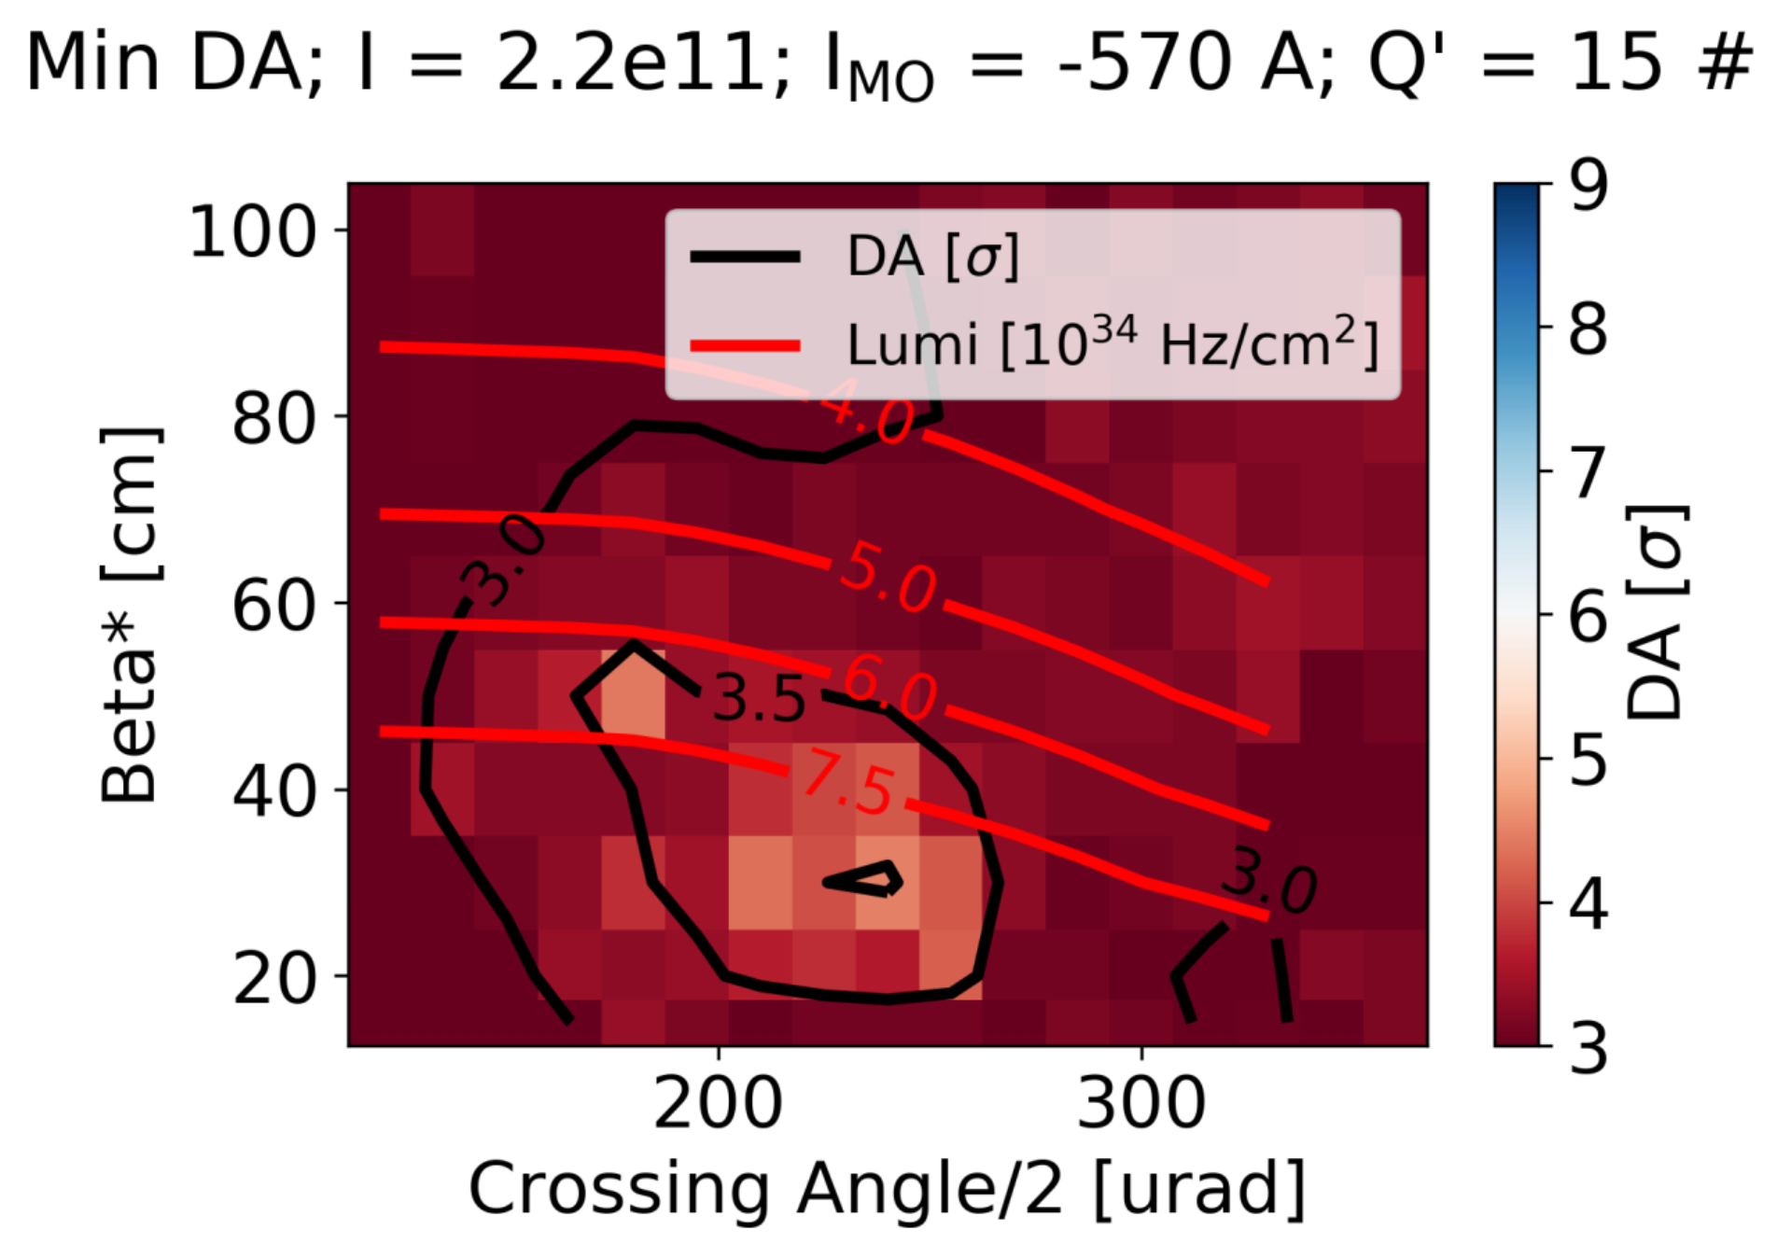
High Chroma / Octupoles

