Slide 1
Deep Neural Networks for whole, multi-jet event classification and generation
Wahid Bhimji, Steve Farrell, Thorsten Kurth, Mustafa Mustafa, Michela Paganini, Prabhat, Evan Racah
Lawrence Berkeley National Laboratory
Machine Learning for Jets: 30th November 2017
HEP Centre for
Computing Excellence
HEP Centre for
Computing Excellence
HEP Centre for
Computing Excellence

Slide 2
Topics in this talk…
Explore Deep Neural Networks:
  On data from whole calorimeter /detector (not around jets/objects) and without seeking to reconstruct objects
  Directly for physics analysis (classification): without tuning of variables
  Also exploring GANs for generating whole-detector events
Optimize running efficiently on supercomputers:
  Optimizations for CPUs including Knights Landing (KNL)
  Distributed training (up to 10k KNL nodes)
  Thoughts on future architectures

Slide 3
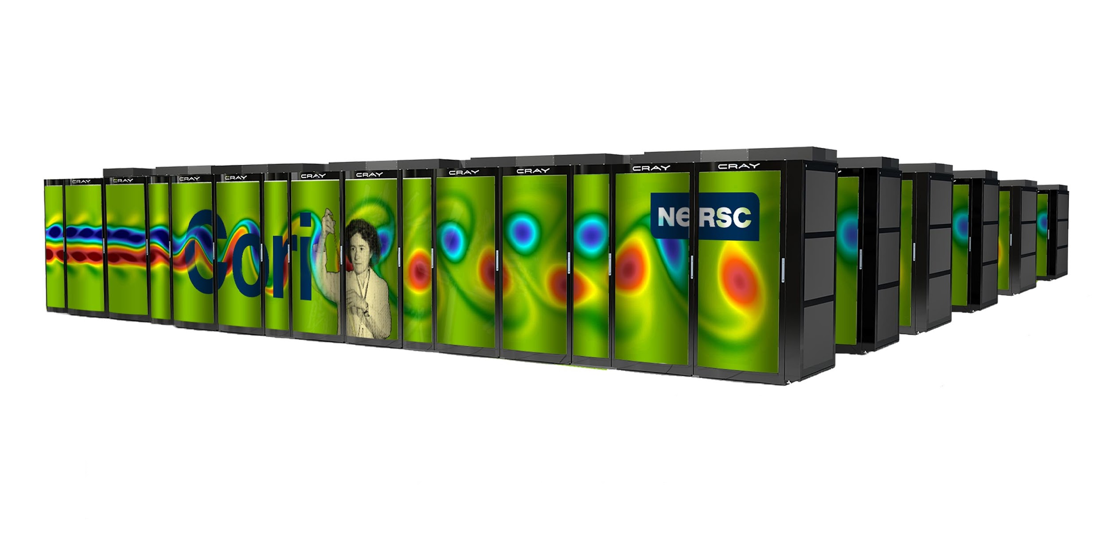
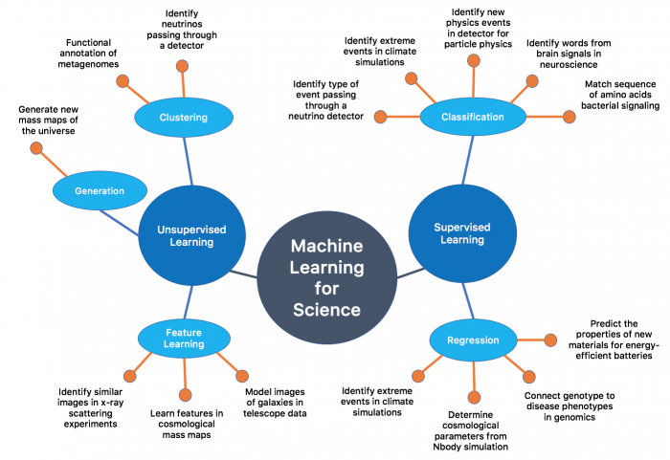
NERSC
NERSC at LBL, mission HPC center for US Dept. of Energy
Cori – NERSC’s Newest Supercomputer – Cray XC40 (31.4 PF Peak)
  Phase 2: 9668 Intel Knights Landing (KNL) nodes: XeonPhi 68-core (1.4 GHz)
Data and analytics (DAS) group:
  Tools for machine learning;
  Optimize those for large scales;
  Encourage cutting-edge methods;
  Training etc.
  Many example studies and popular:
  deeplearning frameworks available

Slide 4
Deep networks for whole event classification
See also: WB, Steve Farrell Thorsten Kurth, Michela Paganini, Prabhat, Evan Racah
https://arxiv.org/abs/1711.03573

Slide 5
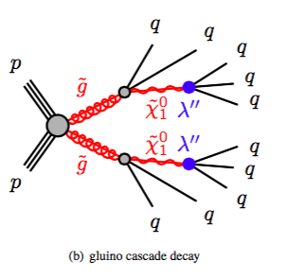
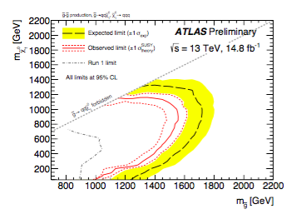
Physics Use-Case
RPV SUSY gluino decays
  Multi-jet final state
  Analysis from ATLAS-CONF-2016-057 as benchmark
  Classification problem: RPV Susy vs. QCD
  Generation problem: Generate new samples
Simulated training samples
  Pythia - event gen. (matching ATLAS config)
    Cascade m_{g ̃}= 1400 , m_{χ ̃0}=850 default
      explore other masses
  Delphes detector simulation (ATLAS card)
    Use output calorimeter towers (and tracks)
From ATLAS-CONF-2016-057:
Notes:
Mention filter with baseline analysis cuts.
Replace m_glu wit proper symbols

Slide 6
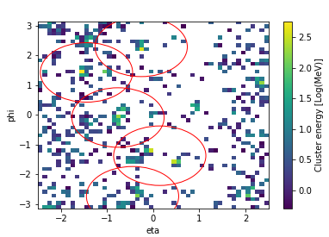
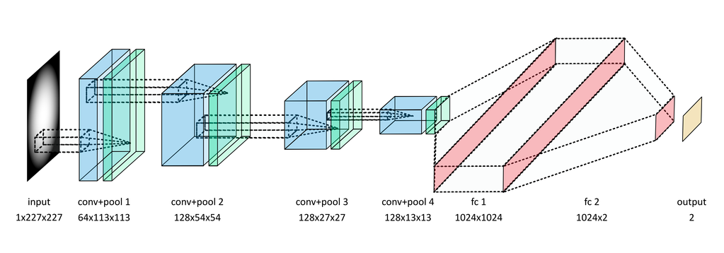
Data and CNN Architecture
Bin tower Energy in η/ɸ to form an ‘image’
  64x64 bins (~0.1 η/ɸ towers) or 224x224
Also 3 ‘channels’:Energy in Electromagnetic and Hadronic Calorimeters and no. of tracks in bin¹
Reconstruct jets using same algorithm as physics analysis (AntiKt R=1.0 trimmed) for benchmark comparison and pre-selection
Use 3 alternating convolutional and pooling layers (or 4 for large images): with bias and/or batch normalization
QCD generated in P_{T} ranges:
  X-sec weight in training loss and
  evaluation
¹Similar to
arXiv:1612.01551
Input Conv+Pool(1) Conv+Pool(2) Conv+Pool(3) (Conv+Pool(4)) Fully Connected (FC) FC Output
1(or3)x64x64 64x32x32 128x8x8 256x4x4 4096 512 1
Notes:
Add some one line explanation of CNN;
Put full network in backup;
Change figure to represent most used network (not caffe/ GB one)

Slide 7
CNN performance
  Compare to physics selections (see backup)
Also compare to (gradient) boosted decision tree (GBDT) and 1 hidden-layer NN (MLP)
  Input jet variables used in the physics analysis (Sum of Jet Mass, Number of Jets, Eta between leading 2 jets) and 4-mom of first 5 jets
Increased signal efficiency (from 0.41 to 0.77) at same background rejection as selections without using jet variables. Approximate significance increase of 1.8x
Notes:
Drop LR ? - change LABELS to BDT and 1-layer NN?
Animate with just Cluster CNN first

Slide 8
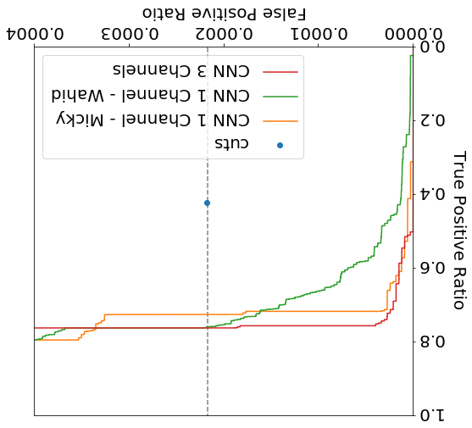
Further improving performance
Three channel CNN:
Energy in E-Cal and H-Cal
No. tracks in the same Eta/Phi bin
Weights:
Cross-section weights applied in training loss – also try log of weights
  More stable implementation
Implementation with full weights and that with log weights focus differently on signal and background
  Can ensemble these by taking mean of predictions - gives best performance
Notes:
Add what this signal efficiency corresponds too in terms of its value and its sensitivity.
Ensembling green and blue.
Why does red go below
(describe in more detail - averaging )
Define Background REjection and False positive rate.
Background rejection - in atlas normally means 1/ false postive rate. Higher is better.

Slide 9
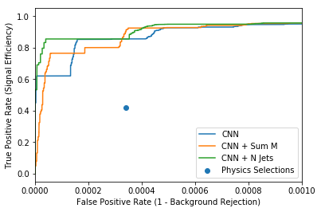
Robustness and interpreting
Robust to pileup (see backup) and can apply without retraining to other signal masses
Captures power of jet variables – e.g. add selections to CNN output in a 1 layer NN
  Little/no increase in performance

Slide 10
Deep networks for whole event generation
Very preliminary

Slide 11
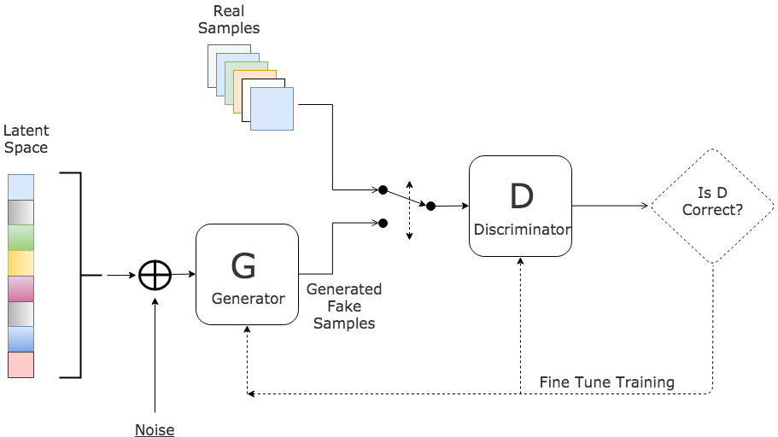
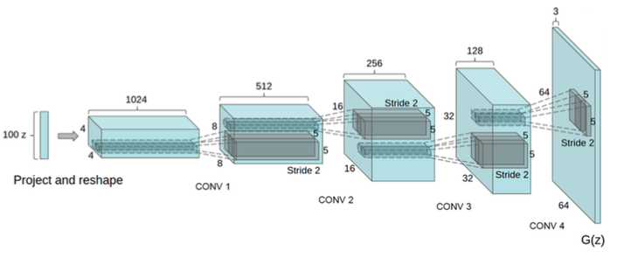
Generative Adversarial Networks GAN
GAN works by joint optimization of Discriminator and Generator Networks
‘Natural image’ GANs can be unstable, physics problems may have advantages:
  Underlying physics structure
  Existing simulation samples
  Metrics (e.g. jet variables) and ‘downstream tasks’ for evaluation
We use vanilla DCGAN architecture – following on from successful application to cosmology mass maps: (Mustafa et al. https://arxiv.org/abs/1706.02390)
Goodfellow et al.
https://arxiv.org/abs/1406.2661
https://arxiv.org/abs/1701.00160
DCGAN:https://arxiv.org/abs/1511.06434
Notes:
DCGAN 64-; normal prior z ∼ N (0, 1). The first layer is a fully connected layer whose output is reshaped into a stack of feature maps. The rest of the network is four layers of transposed convolutions that lead to a single channel 256×256 image. A rectified linear unit (ReLU) activation [34] is used for all except the output layer where a hyperbolic-tangent (tanh) is used.

Slide 12
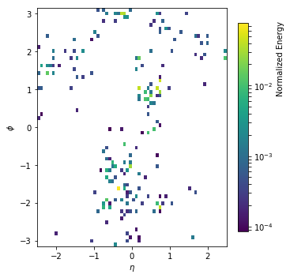
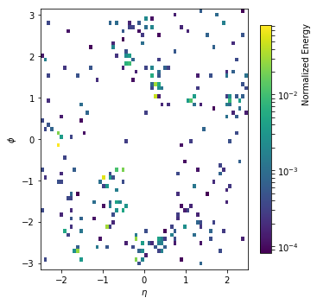
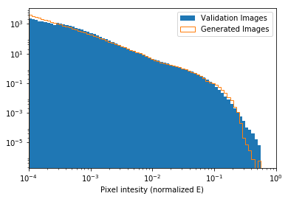
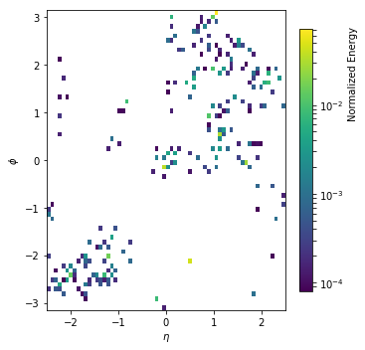
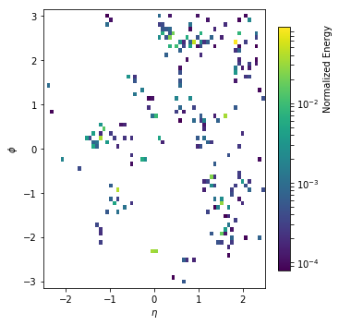
RPV-GAN
Very preliminary results – e.g. no stopping algorithm for optimum epoch
Some pixel intensity and structure agreement, over orders of magnitude
Originals:
Generated:

Slide 13
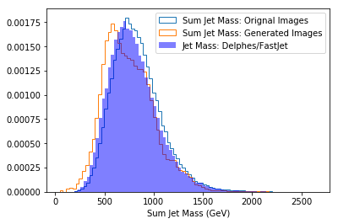
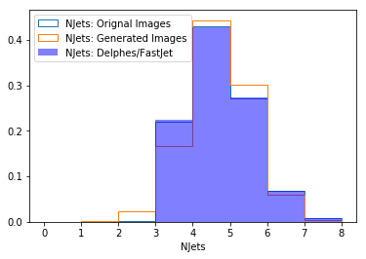
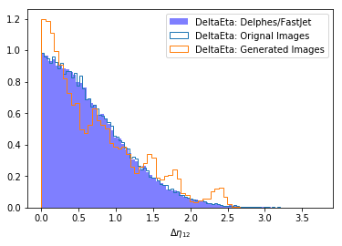
Jet variables
FastJet (anti-Kt R=1) clustering on images (via pyjet)
  Compare also to original Delphes jets (those jets are trimmed and also effects from binning in images)
Some agreement but need stability (e.g. W/OT-GAN)
Easily generate > 32k images/min/GPU

Slide 14
Optimizing training times and distributed training

Slide 15
Timing and CPU Optimization
  GPU: Titan X (Pascal)
  (10.2 TeraFlops (single-precision))
  CPU: Haswell E5-2698 v3 32 cores @ 2.3 GHz (2.4 TF)
  KNL: Xeon Phi 7250 68 cores @1.4 GHz (6 TF)
Implemented the model in multiple frameworks and compared training times on GPU, Cori Haswell, and Cori KNL
Collaborating with Intel to drive CPU performance (– e.g. for Tensorflow) to competitive CPU training times
CPU times approaching GPU and can scale to multiple nodes

Slide 16
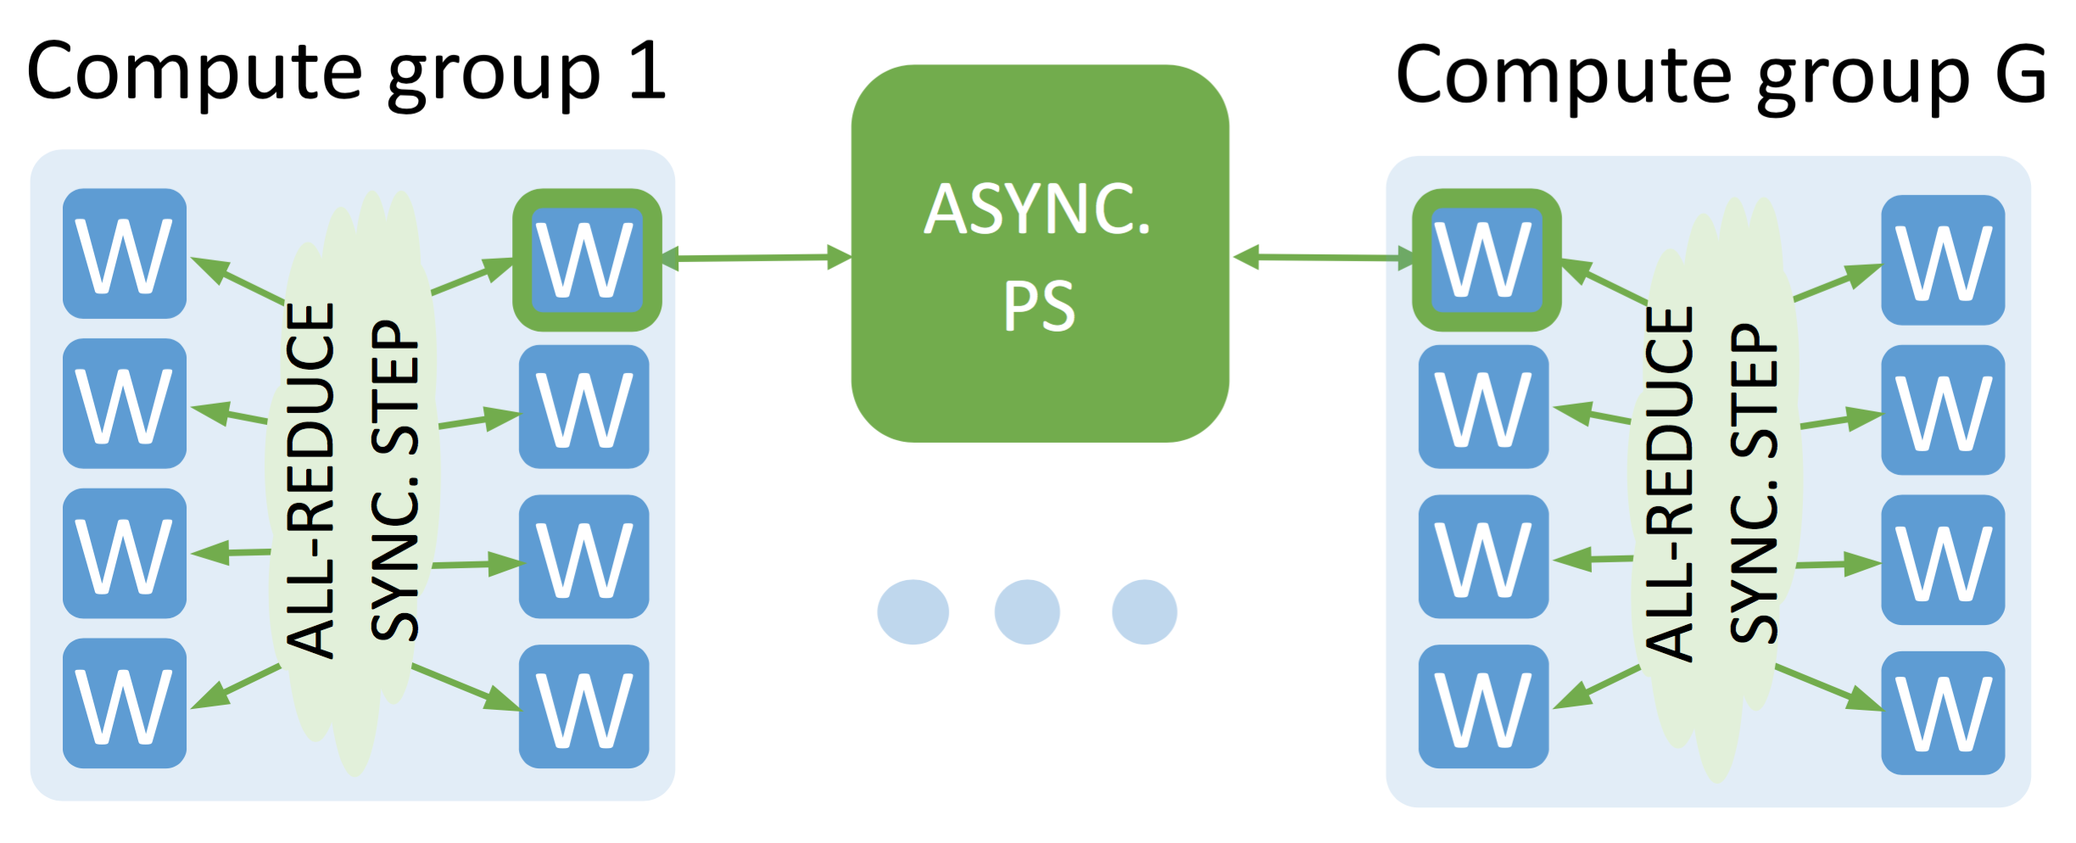
Extreme distributed training
Thorsten Kurth, Jian Zhang, Nadathur Satish, Ioannis Mitliagkas, Evan Racah, Mostofa Patwary, Tareq Malas, Narayanan Sundaram, Wahid Bhimji, Mikhail Smorkalov, Jack Deslippe, Mikhail Shiryaev, Srinivas Sridharan, Prabhat, Pradeep Dubey, Deep Learning at 15PF (presented at SC17) arXiv:1708.05256
Train on 10 Million 224x224 3-channel images (7.4 TB) on entire Cori Ph2, 9600 KNL nodes - data parallel
Caffe implementation:
  Use Intel MLSL library (wraps comms - portable)
Modify our CNN layers to reduce communication: remove batch norm. and replaced big (~200MB) fully connected layers with convolutional layer
Sync/Async and Hybrid strategies:
  Sync: barriers so nodes iterate together
    can have straggler nodes and limit batch size
  Async: users parameter servers to scale better
    can have old gradients so not converge faster.
  Hybrid: Sync within a group and async across
Dedicated parameter servers for each layer of network
Hybrid Architecture:
Notes:
MLSL - wraps communication layer… portable code - (uses high-performance MPI/Aries at NERSC) . Could offload communications - e.g. depending on message size.

Slide 17
Extreme distributed training- results
T Kurth et. al., Deep Learning at 15PF
(presented at SC17) arXiv:1708.05256
Single node 1.9 TF (⅓ peak)
Strong scaling (overall batch size fixed):
  Hybrid approach reduces communication and straggler effects
Weak scaling (const batch per node):
  Good scaling - though affected by variability from communication after fast convolutional layers
Scaled to 9600 KNL nodes - 11.73 PF (6170x 1-node) (single-precision)
Time to solution (a target loss) also scales (1024 node time 1/11 of 64-node time )
  Train on 224x224 images in ~12 min
Strong
scaling
Weak
scaling
Notes:
Hybrid gives a faster convergence to a given loss.
Time to solution.

Slide 18
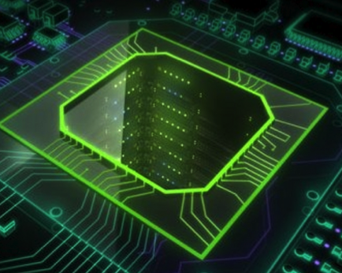
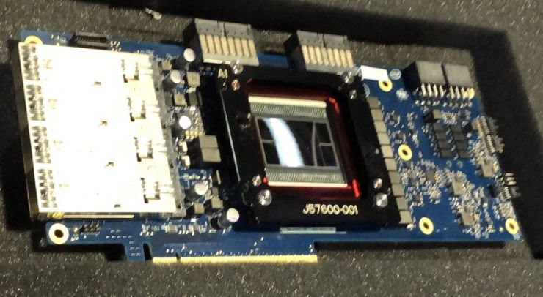
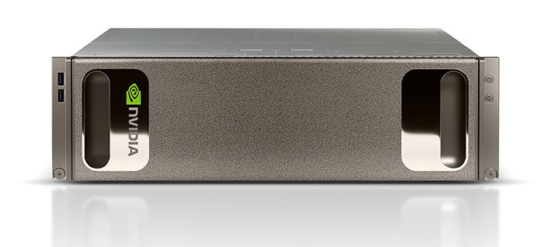


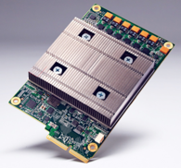
Rise of AI focused hardware
Intel adding mixed precision to Xeon Phi (Knights Mill)
Bought startup, Nervana
FPGA company, Altera
NVIDIA builds deep learning appliance with P100 and now V100 Voltas
Microsoft and Baidu deploy FPGA’s
Google designs its own TPU
Many stealthy startups
Extra motivation to use (pure-)ML/DL based algorithms/frameworks?

Slide 19
Conclusions
Implemented deep CNNs on large whole detector ‘images’
  Directly for physics analysis classification: outperforms jet-variable based selections and shallow classifiers without jet reconstruction. Further improvements from (for example) adding 3 channels
  Network robust to pileup and to apply other signal masses, and appears to learn physics of interest
  Exploring GANs for whole event generation
Improved popular deep learning libraries on CPU
  Demonstrated distributed training up to 9600 KNL nodes
  If you have big DL problems to run at NERSC contact us!…
Increased architecture specialization for ML/DL also motivates choice of algorithms that can fully exploit

Slide 20
Thanks: Ben Nachman and Brian Amadio for discussions and physics input.
Example Code; Scripts for NERSC and sample datasets at: https://www.nersc.gov/users/data-analytics/data-analytics-2/deep-learning/deep-networks-for-hep/
WE’RE HIRING!! MACHINE LEARNING ENGINEER AT NERSChttps://lbl.referrals.selectminds.com/jobs/machine-learning-engineer-206

Slide 21
Backups

Slide 22
Benchmark Analysis
Fat-jet object selection:
AntiKt R=1.0 trimmed (R_{trim}= 0.2, P_{Tfrac}= 0.05)
P_{T} > 200 GeV , |η| < 2.0
Preselection
Leading Fat-jet P_{T} > 440 GeV
N_{Fat-Jet} > 2
Analysis Selection
|∆η₁₂| between leading 2 Fat-jets < 1.4
N_{Fat-Jet} >= 4 && Sum M_{Fat-jet} > 800 GeV
Or N_{Fat-Jet}>= 5 && Sum M_{Fat-jet} > 600 GeV

Slide 23
Keras CNN Model
x = Input(shape=(images.shape[1], images.shape[2], images.shape[3]))
h = Conv2D(64, kernel_size=(3, 3), activation='relu', strides=1, padding='same')(x)
# h = BatchNormalization()(h)
h = MaxPooling2D(pool_size=(2, 2))(h)
# h = Dropout(0.5)(h)
h = Conv2D(128, kernel_size=(3, 3), activation='relu', strides=2, padding='same')(h)
# h = BatchNormalization()(h)
h = MaxPooling2D(pool_size=(2, 2))(h)
# h = Dropout(0.5)(h)
h = Conv2D(256, kernel_size=(3, 3), activation='relu', strides=1, padding='same')(h)
# h = BatchNormalization()(h)
h = MaxPooling2D(pool_size=(2, 2))(h)
h = Flatten()(h)
h = Dense(512, activation='relu')(h)
# h = Dropout(0.5)(h)
y = Dense(1, activation='sigmoid')(h)

Slide 24
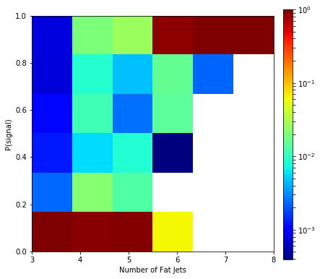
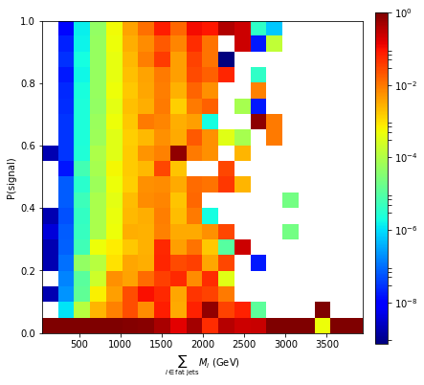
Comparing CNN to jet variables
Plot NN output (P(signal)) vs benchmark analysis variable
Clear correlation
  (Signal cuts:
NJets >= 4 /5
MJet >= 800/600 GeV)
Add jet variable to CNN output in a 1 layer NN
  Little/no increase in performance

Slide 25
Different signals and pileup
Repeat analysis with Delphes pileup card (mu=20)
Apply to nearby signal points without retraining

Slide 26
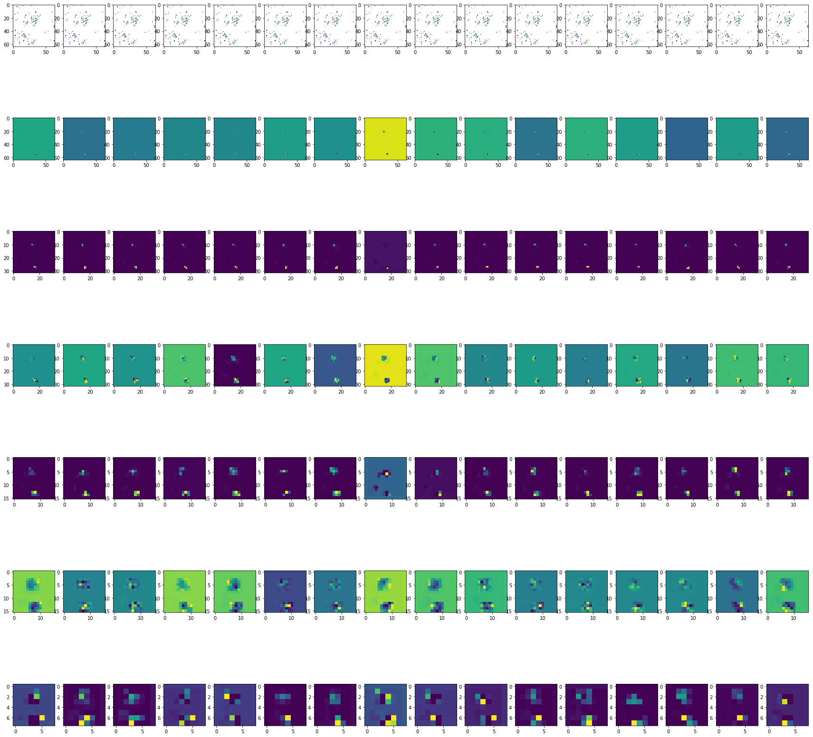
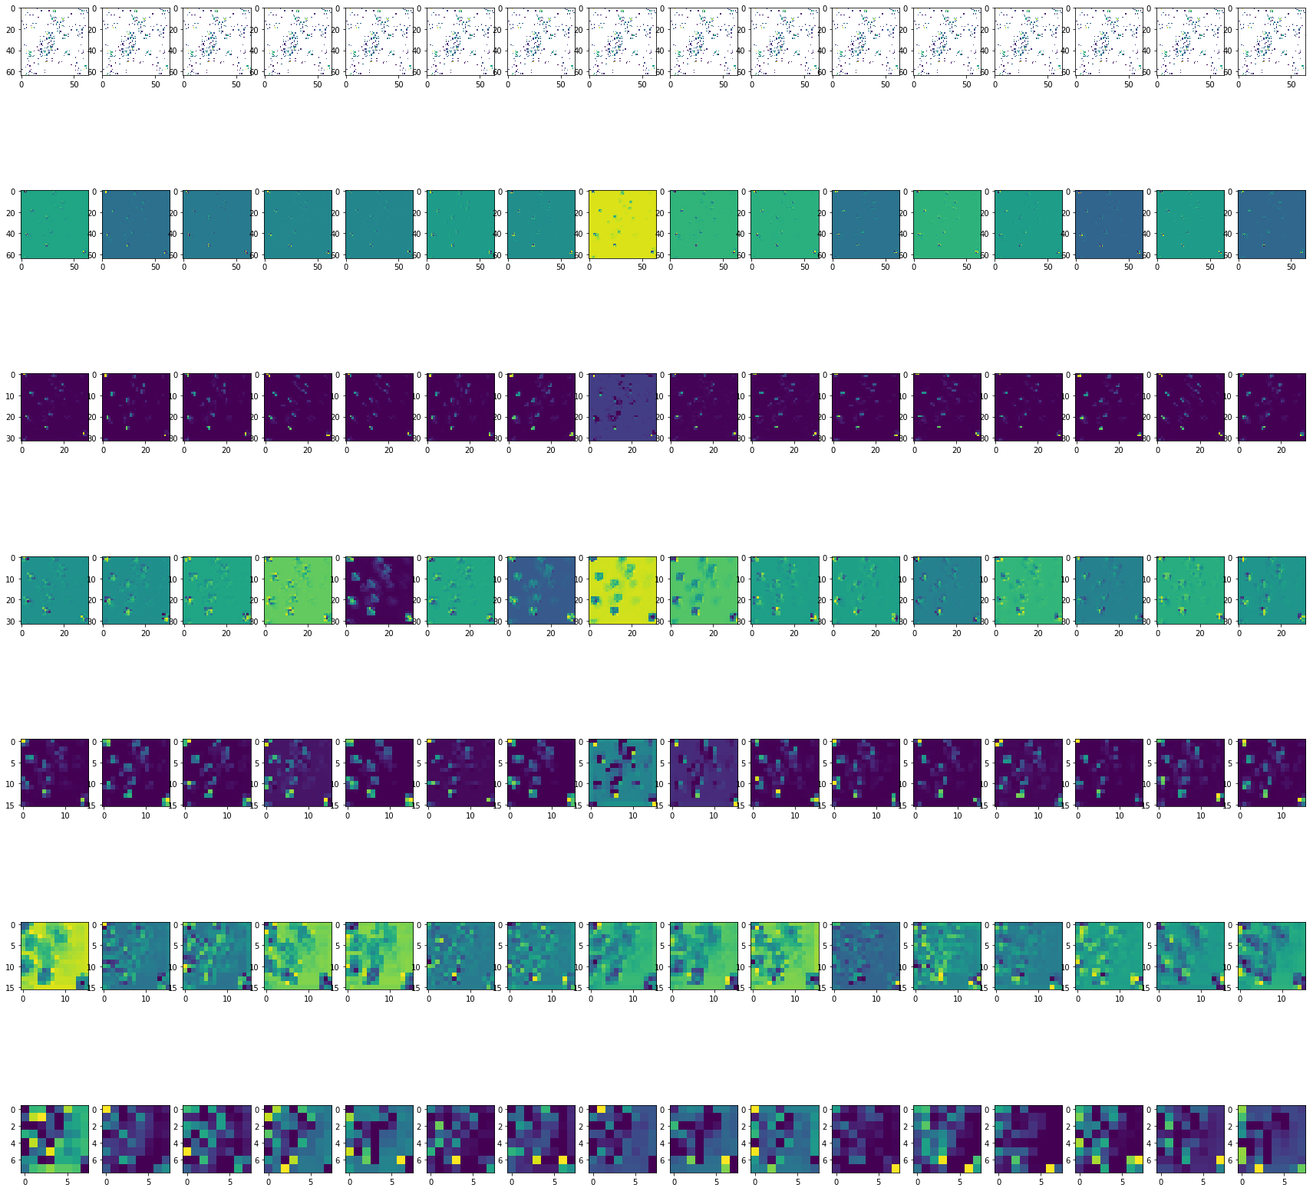
Interpretation - feature maps
Background QCD event:
Signal RPV event:

Slide 27
Timings and Tensorflow
CPU performance of default TF 1.2 was poor
Intel optimisations with Intel Math Kernel Library (MKL) e.g. Conv layers multi-threaded,vectorize channels/ filters and cache blocking
  Released in main TF-repo
Further optimisations (now also upstreamed): e.g. MKL element-wise operations (avoid MKL->Eigen conversions)
Batch Size: 512
(Intel)Caffe similar optimizations and Multi-node with MLSL library e.g. scale to 8 nodes time 6x faster for this 64x64 network
Notes:
Optimised convlutions - multithreaded and vectorisation - in MKL-Ml/DNN for TF...

Slide 28
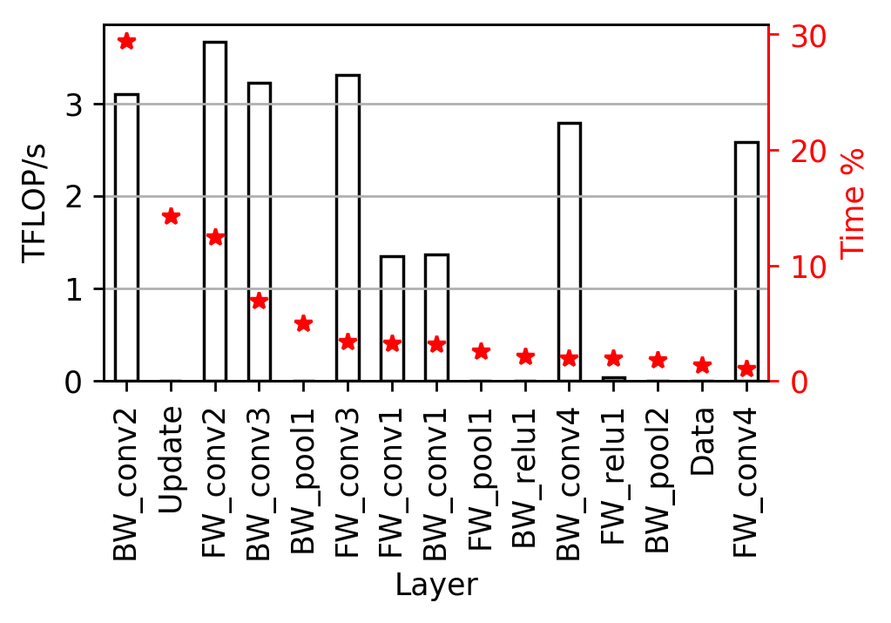
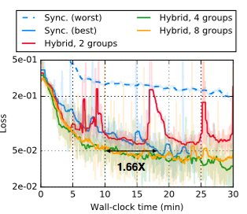
Scaling
Single node performance per layer for 224x224 Caffe implementation
Time to 0.05 loss (corresponds to fixed significance)
At 1024 nodes: time is 11x 64-node (scales as expected) and Hybrid time is 1.66x Sync.

Slide 29
Scaling other frameworks
Scaling GRPC Tensorflow on up to 512 nodes of Cori Supercomputer – (Presented at NIPS 2017 Workshop: Deep Learning At Supercomputer Scale)
Amrita Mathuriya, Thorsten Kurth, Vivek Rane, Mustafa Mustafa, Lei Shao, Debbie Bard, Prabhat, Victor W Lee
Pure-tensorflow implementation
  Scaled using GRPC communication
  1 parameter server
Other more complex networks (e.g. ResNet50) scale worse (and need more parameter servers)

Slide 30
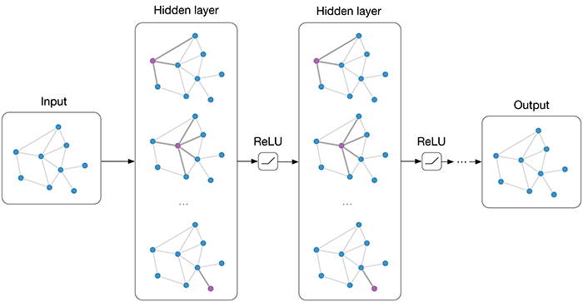
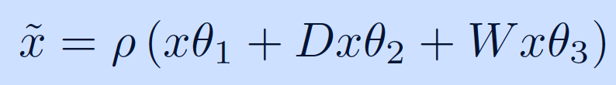
Graph CNNs for classification
Problems with images
  They’re sparse => challenging for learning
  The detector is not really uniform => lose information in binning/projecting
We can instead utilize the structure of the data (clusters) itself in a dense representation (graph) and learn on that => graph neural networks
Appropriate construction of the graph operations can give equivalent benefits as CNNs => graph convolutional neural networks
Initial investigations looked promising (collaboration with Joan Bruna, Gaspar Rochette)
  Use the eta-phi plane and Gaussian kernel to weight edges
  Stack graph layers with residual connections and single binary classification output
graph layer
http://geometricdeeplearning.com/

Slide 31
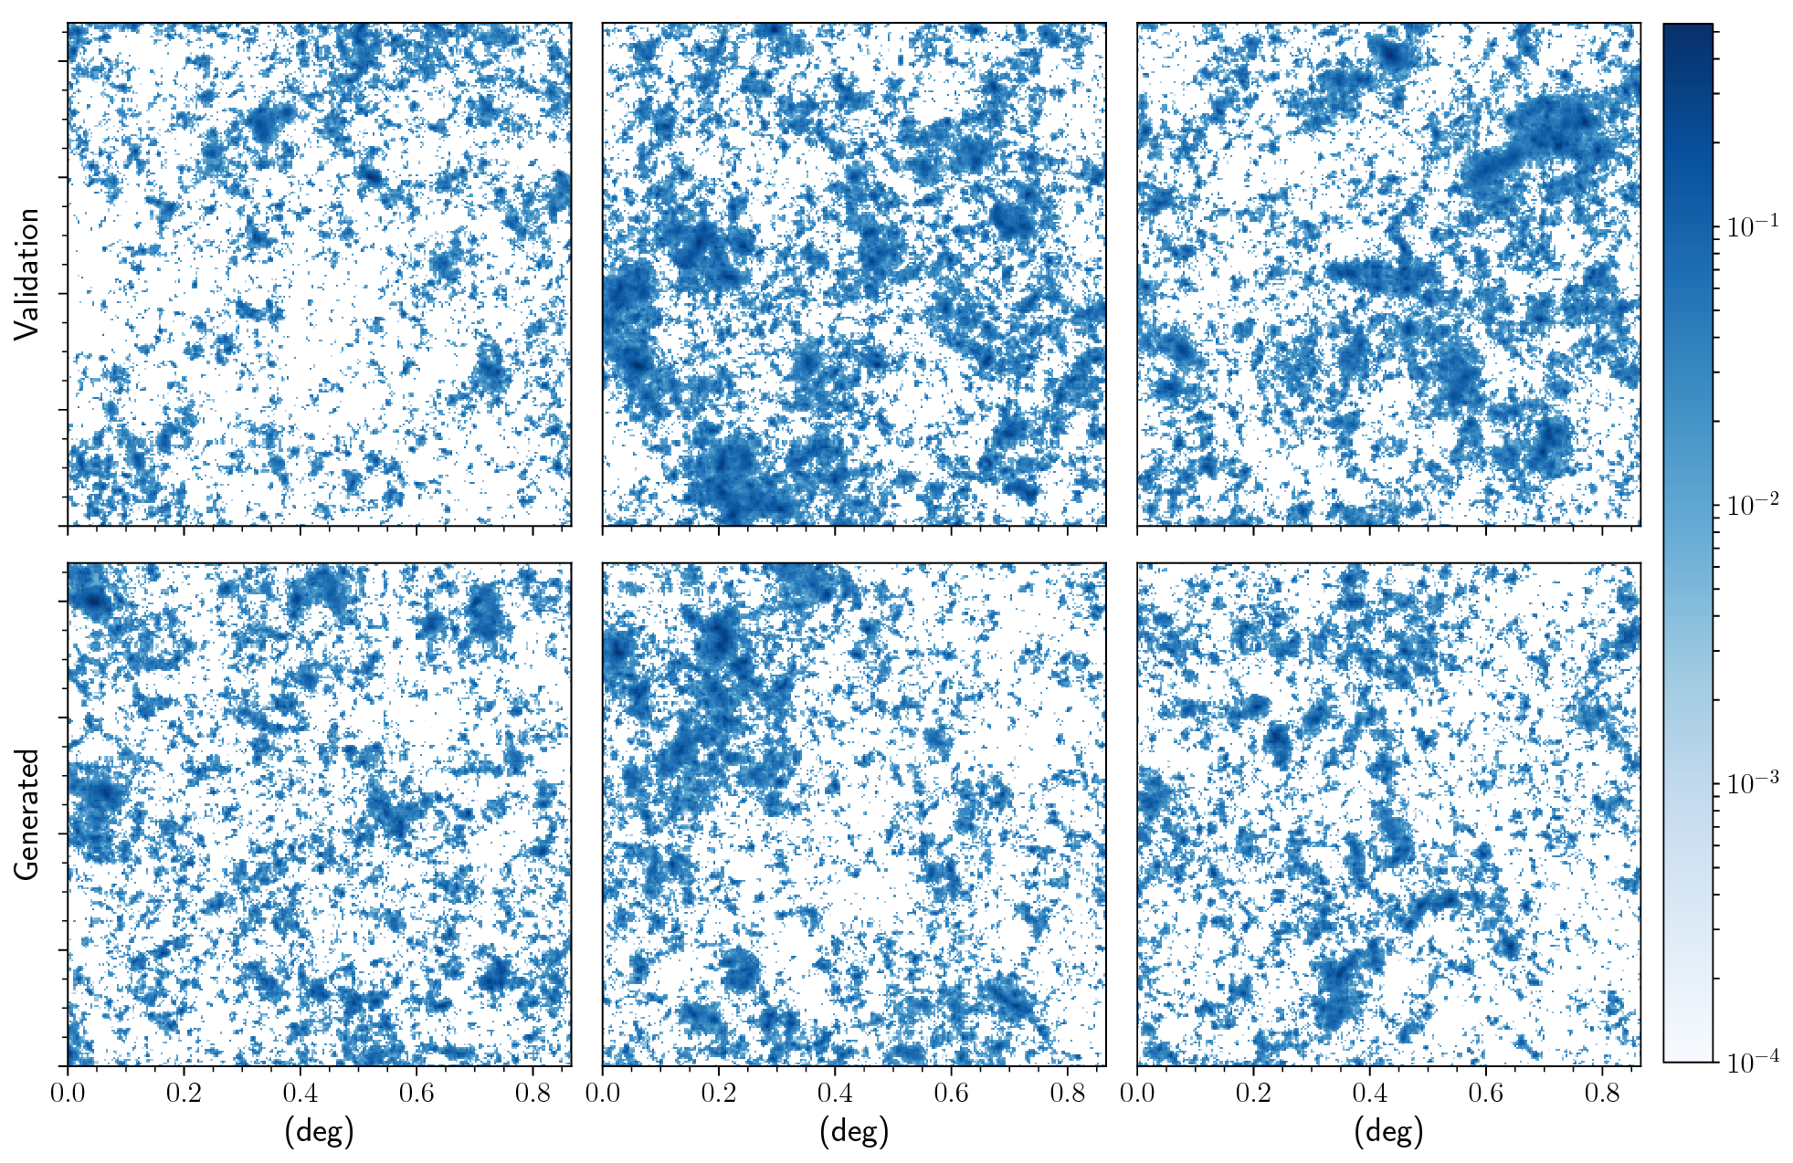
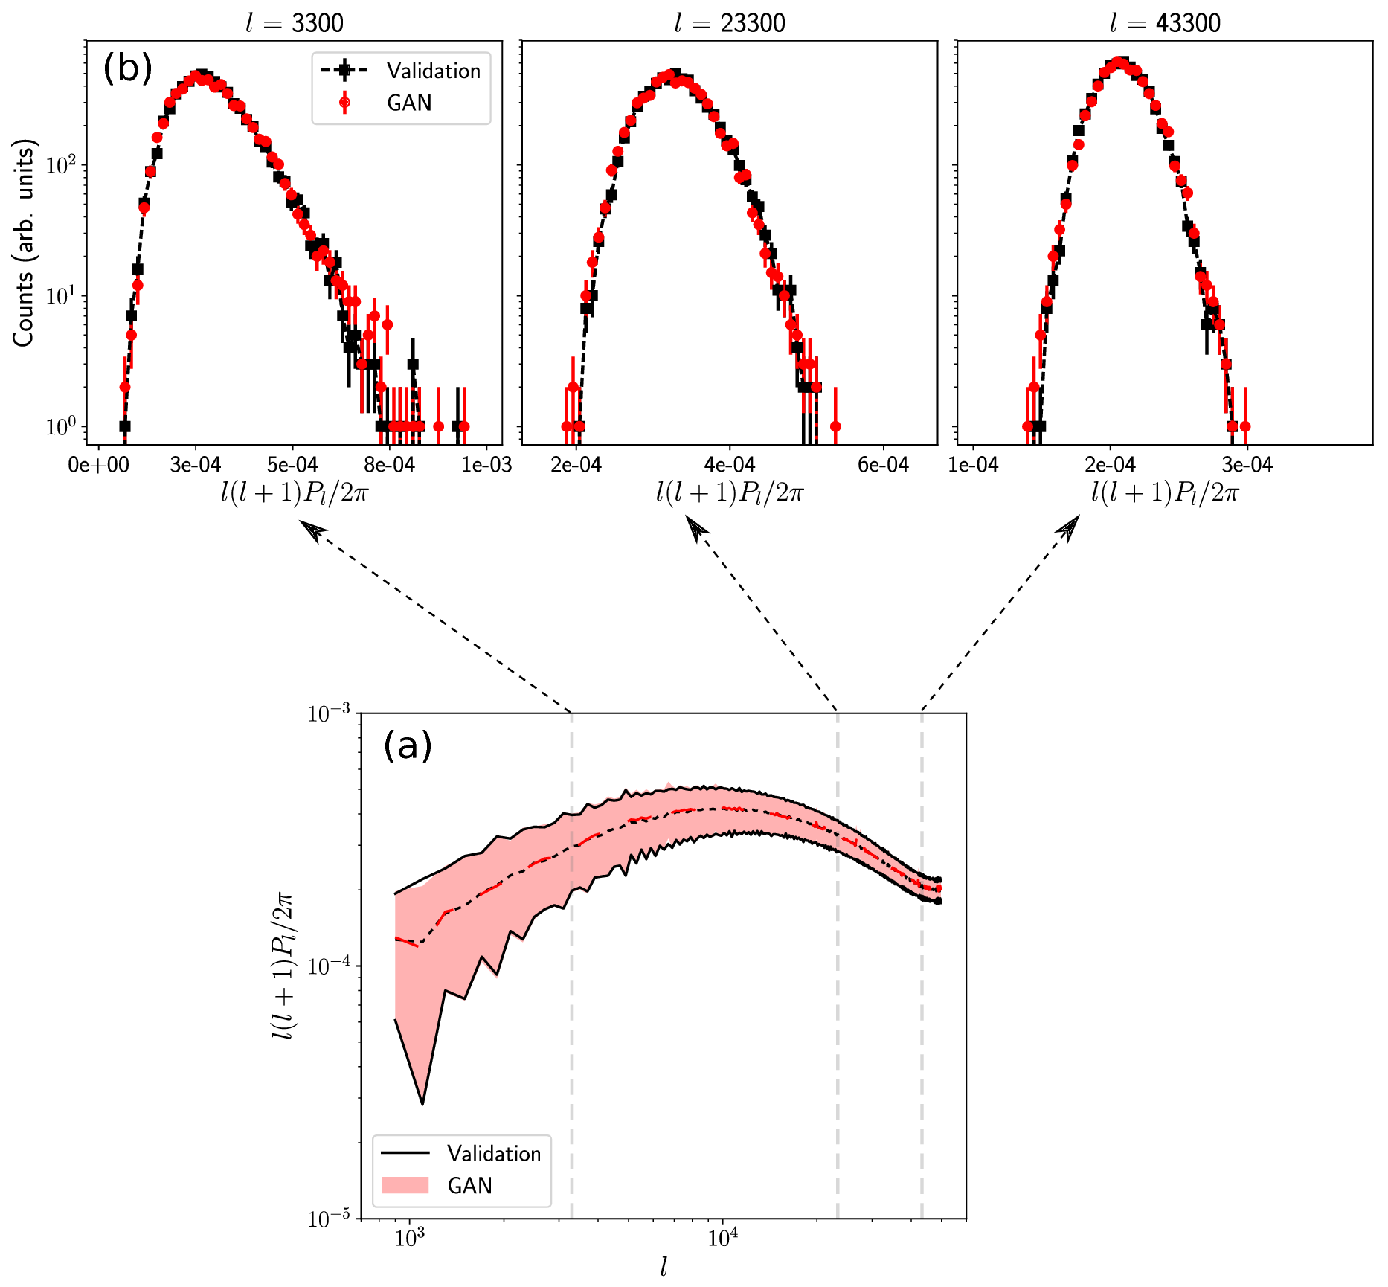
CosmoGAN
  M.Mustafa …, WB, et al. https://arxiv.org/abs/1706.02390
Power spectrum (and non-gaussian structures) of generated maps match validation with high fidelity
Produce > 1000 maps/min on a laptop CPU (or 48k /min on GPU)
Related but different to CaloGANhttps://arxiv.org/abs/1705.02355)
?

Slide 32
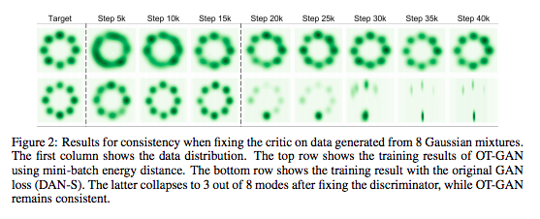
OT-GAN
https://openreview.net/pdf?id=rkQkBnJAb

