Slide 1

Single Molecule Fluorescent Imaging
&
Neutrinoless Double Beta Decay
Austin D McDonald
Dr. Ben J.P. Jones, Dr. David R Nygren
Department of Physics

Slide 2

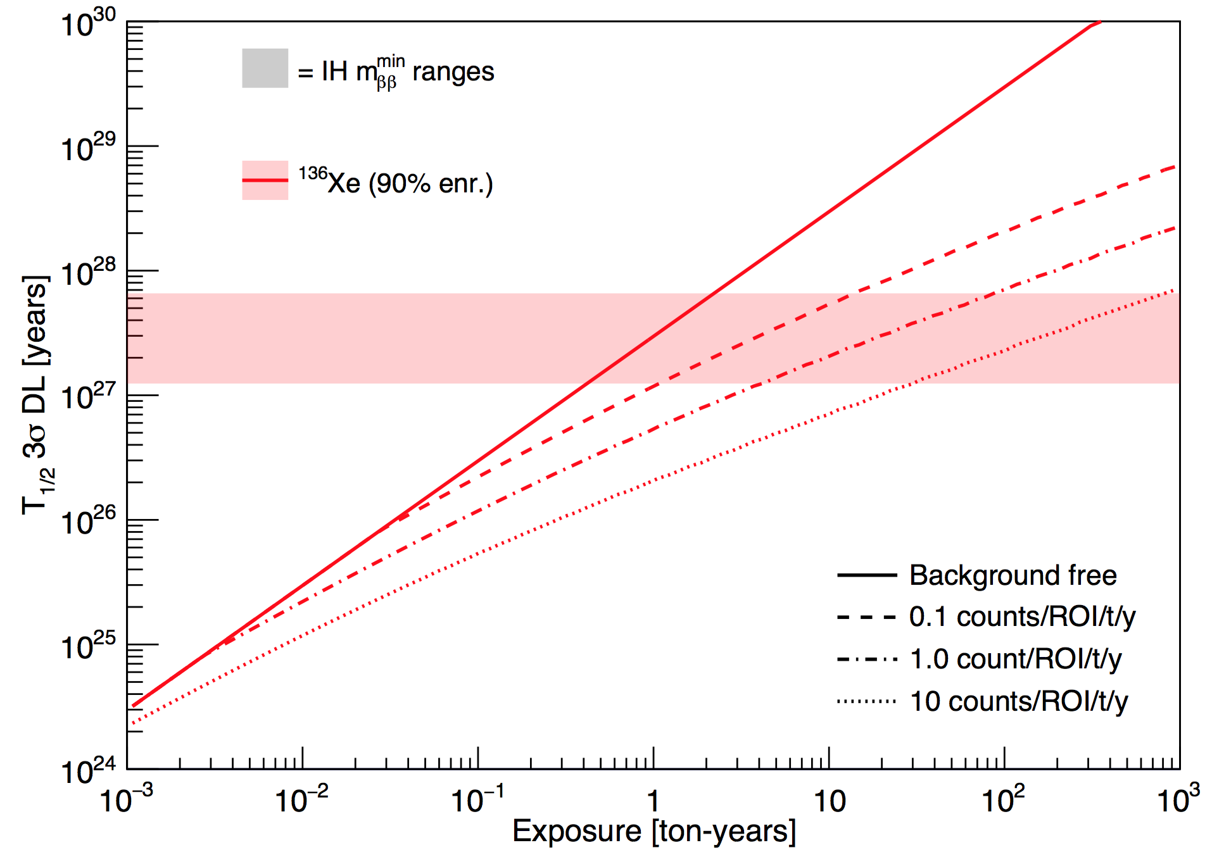
Background Impact
1 year
10 years!?!
Presence of background in the ROI severely impacts the sensitivity
Plot from Jason Detweiler

Slide 3
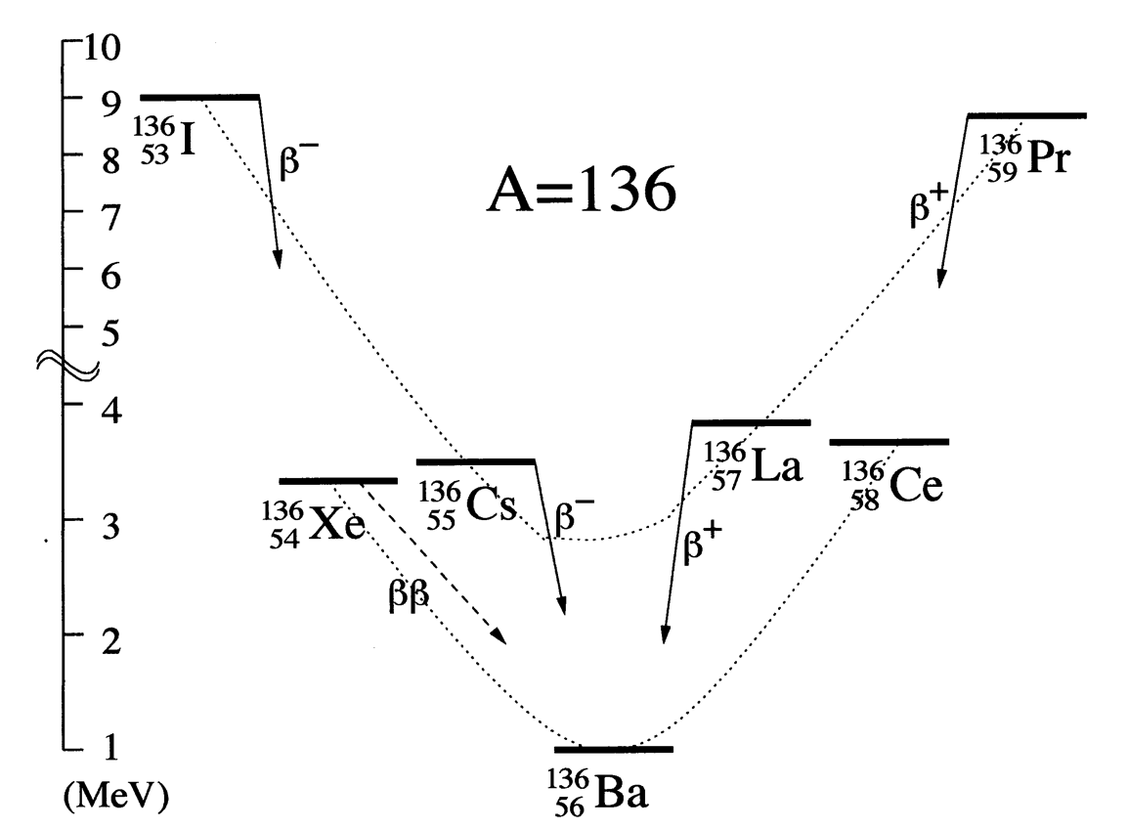
Barium Daughter
Xe double beta decays into Ba++
No natural sources can make Ba++
Dications can be detected using SMFI

Slide 4
SMFI Barium Tagging
R&D steps:
1. Use Single Molecule Fluorescence Imaging to detect single Barium dications in aqueous solution.
2. Develop and characterize custom molecules for use in Xenon
3. Produce Ba⁺⁺ beam and characterize barium transport in Xenon gas
4. Show single Ba⁺⁺ sensitivity in HPGXe

Slide 5
In pure Xenon, Barium is only produced by double beta decay

Slide 6
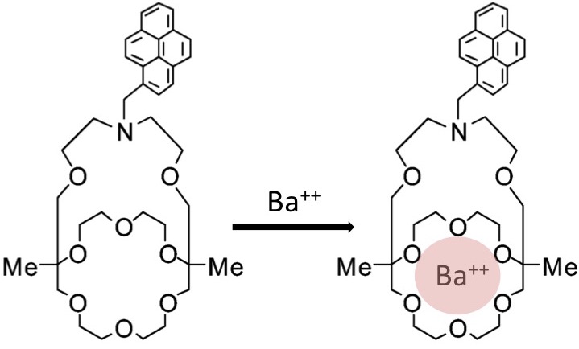
Single Molecule Imaging
Molecules become fluorescent after capturing Ba++
Non-fluorescent
Fluorescent
Dye
Receptor
Various molecule exist for fluorescence detection

Slide 7
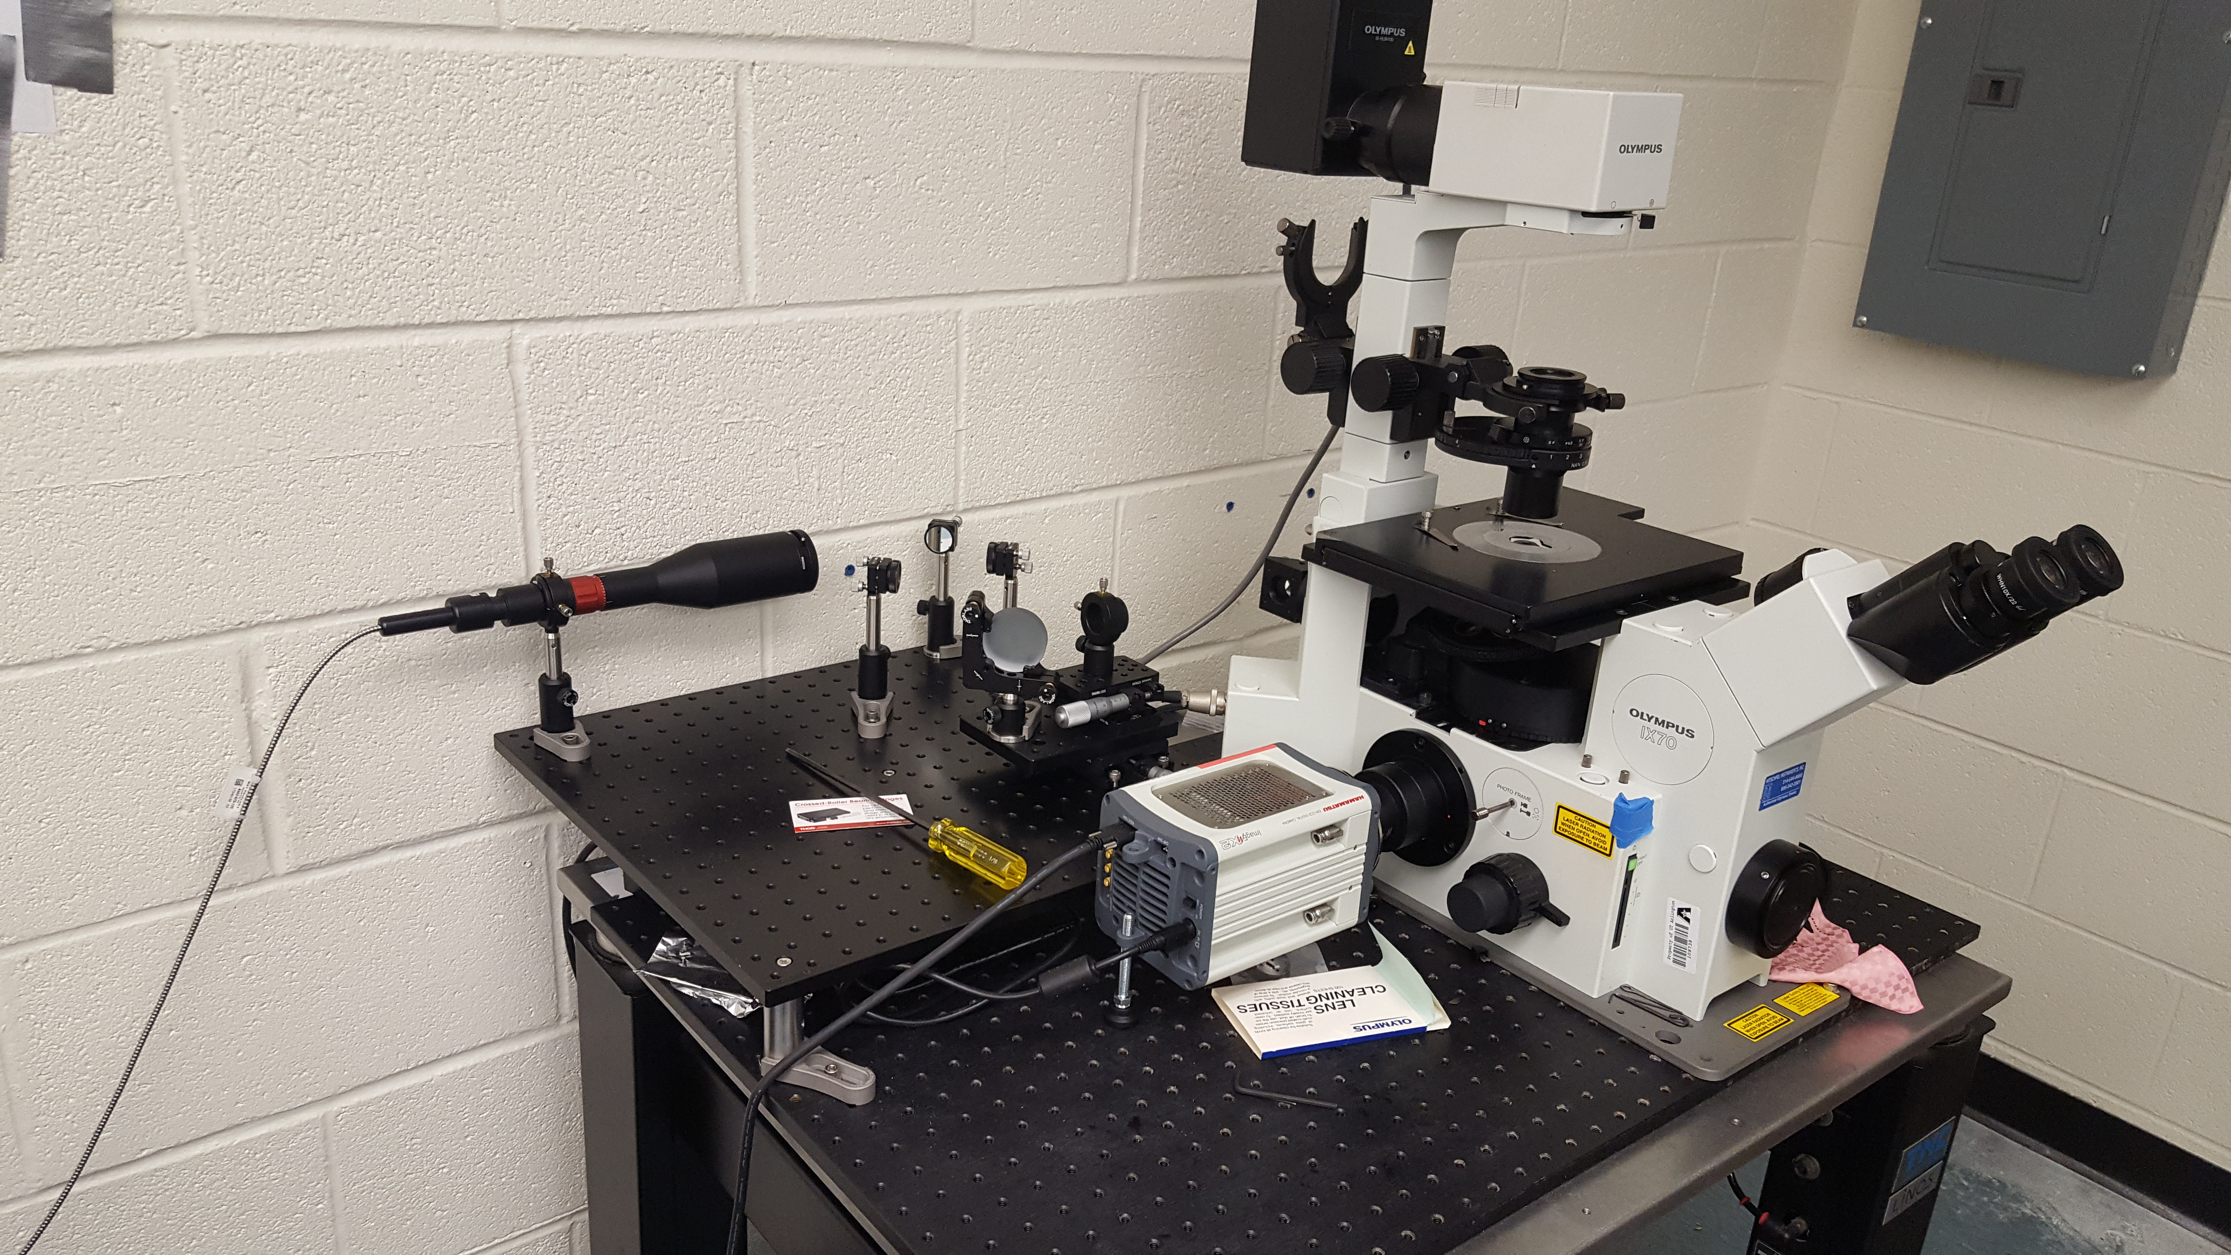
Total Internal Reflection Fluorescence (TIRF)
Olympus IX-70 with total internal reflection optical setup and a Hamamatsu imagEM X2
Electron Multiplying-CCD camera
TIR optics
EM-CCD

Slide 8
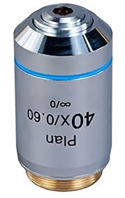
TIRF
Schematic view of TIRF

Slide 9
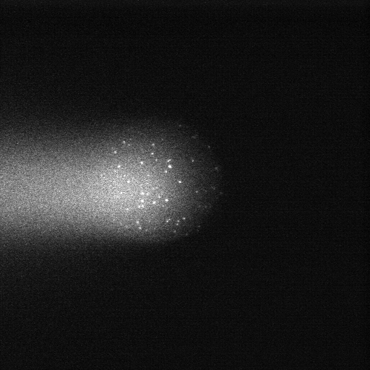
Into TIRF!
Demonstration with 220nm fluorescent microspheres
Background due to deep scattering is drastically reduced when the critical angle is reached.
Enhanced sensitivity to the surface molecules (all are surface molecules in dry HPGXe system)

Slide 10
Single Molecule TIRF
Single Barium TIRF Image

Slide 11
Single Molecule TIRF
Single Barium TIRF Image
Molecules that are close to the surface are identifiable through there intensity
They are then scanned for appearance and disappearance

Slide 12
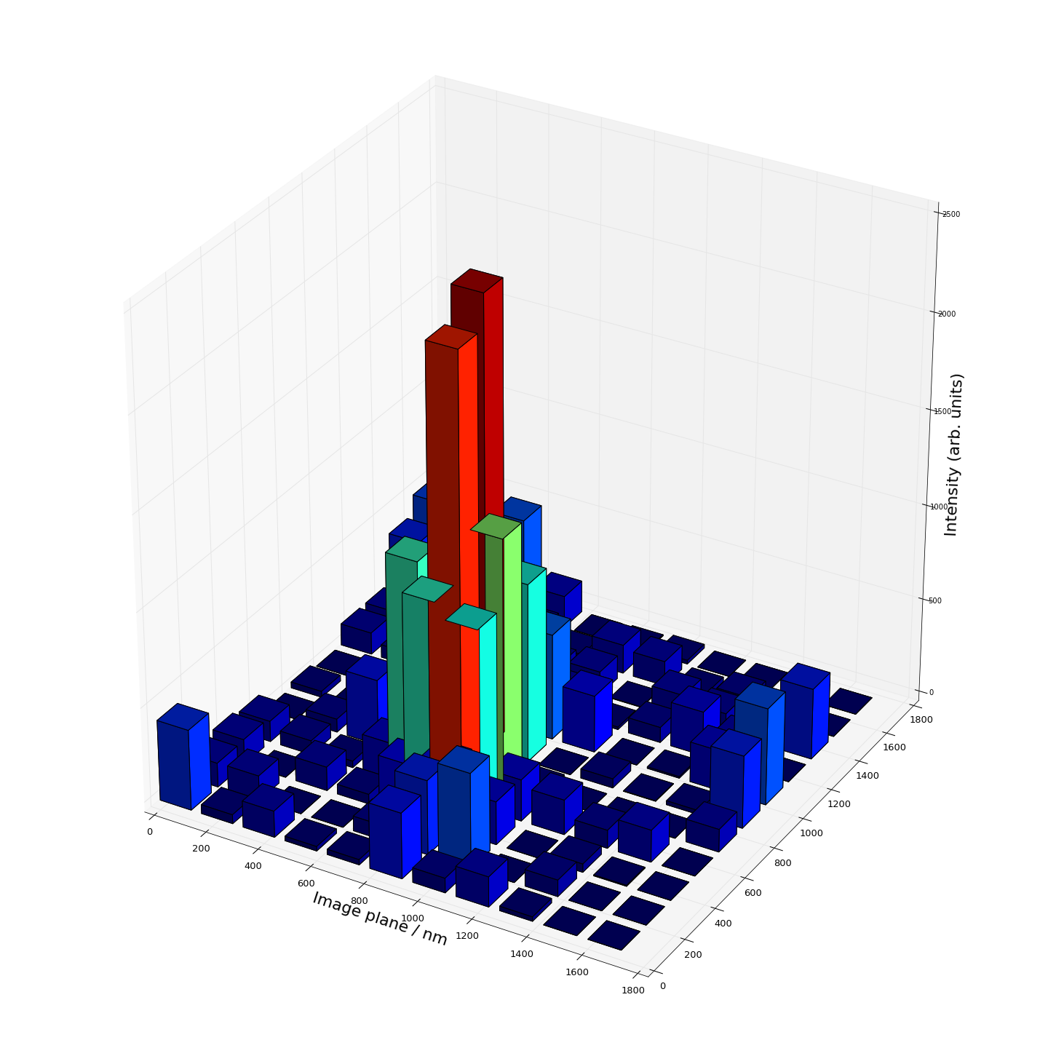
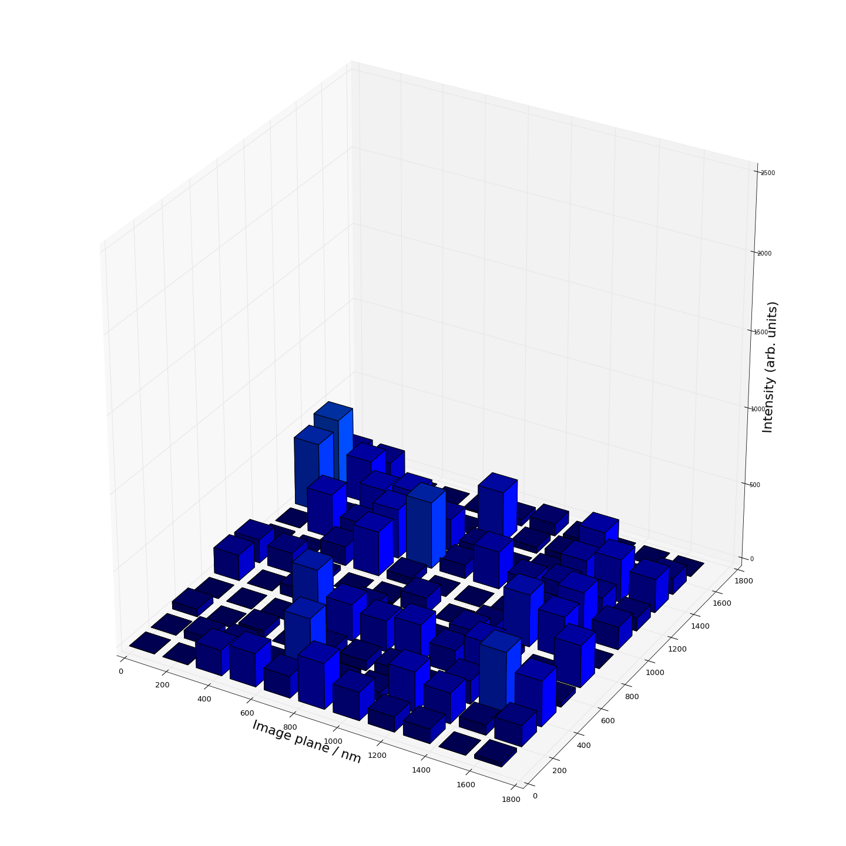
Single Barium
Single step photo-bleaching confirms single molecule interpretation
one second exposure before and after bleaching

Slide 14
Single Barium
We have demonstrated for the first time single barium ion identification with SMFI

Slide 15
Onto the gas phase
Develop and characterize custom molecules for use in Xenon
Measure the mobility of Barium species in Xenon gas
Test the molecules in Xenon gas

Slide 16
Custom molecules
Working with Frank Foss(UTA) to develop several custom
molecules that are Ba++ sensitive and can work in a dry
Environment e.g. Xenon gas.
Diner, C., Scott, D. E., Tykwinski, R. R., Gray, M. R., & Stryker, J. M. Scalable, Chromatography-Free Synthesis of Alkyl-Tethered Pyrene-Based Materials. Application to First-Generation “Archipelago Model” Asphaltene Compounds. J. Org. Chem. 2015, 80(3), 1719–1726.

Slide 17
Barium mobility in xenon gas

Slide 18
How to test in HPGXe?

Slide 19
How to test in HPGXe?

Slide 20
How to test in HPGXe?

Slide 21
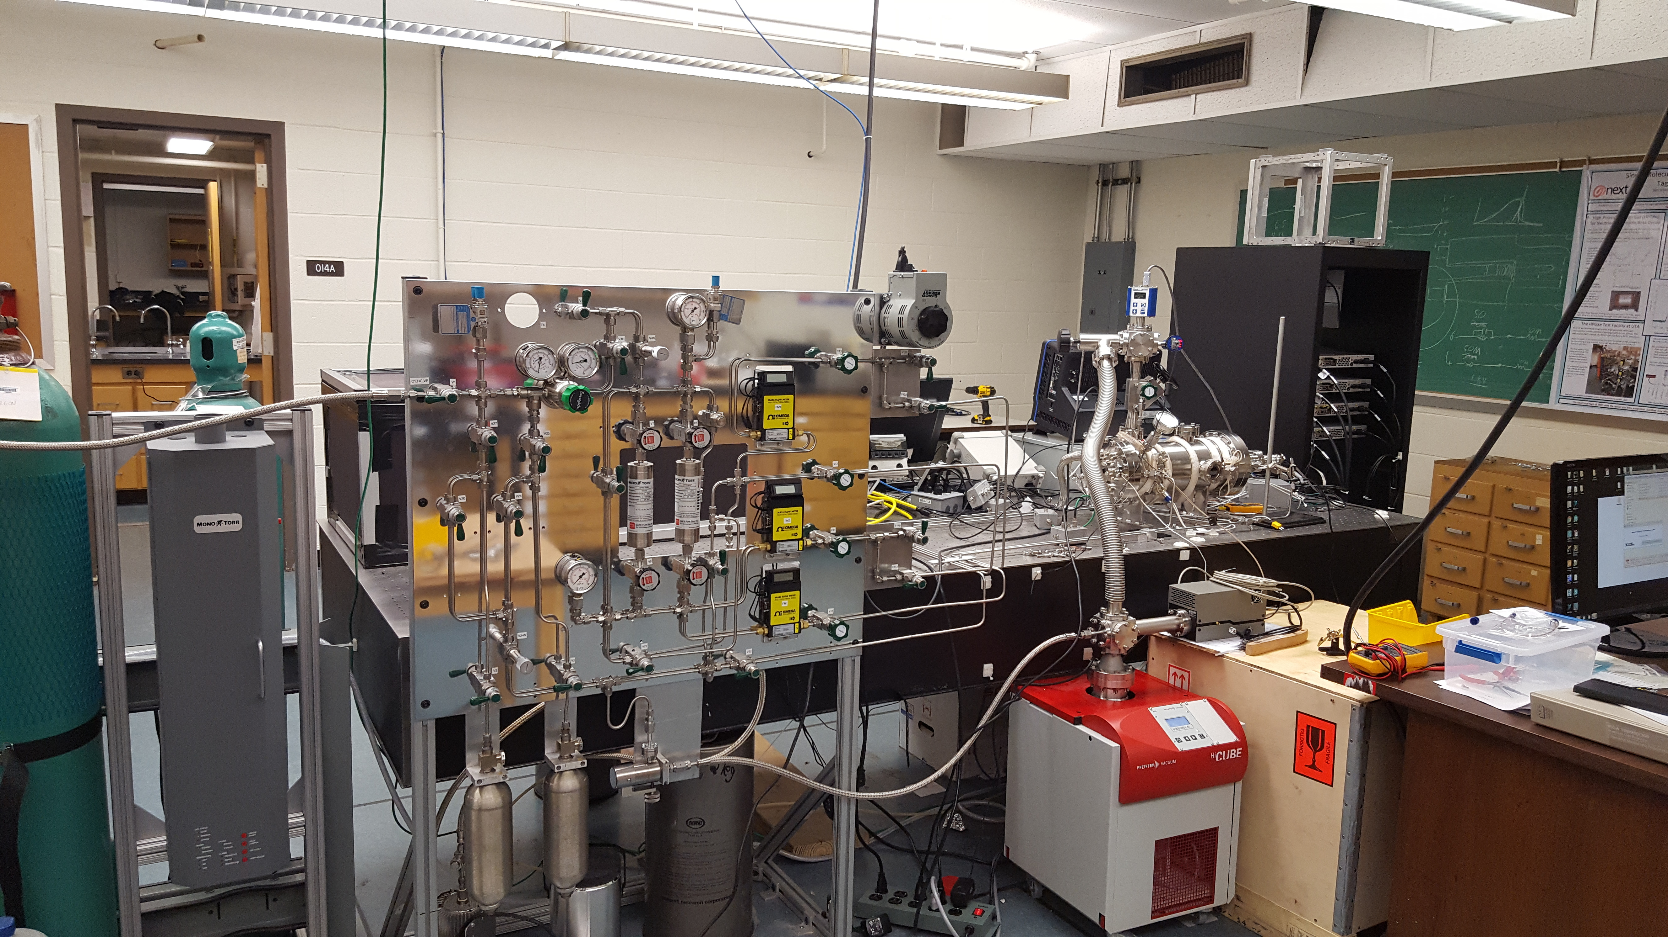
HPGXe system
Hot getter
Data collection scope
HV supplies
RGA

Slide 22
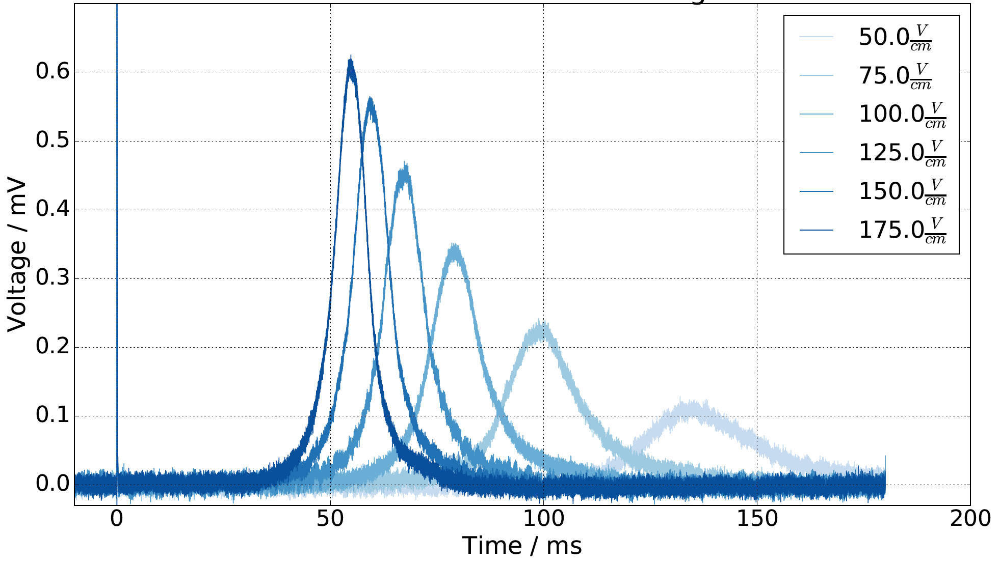
Argon ion drift

Slide 23
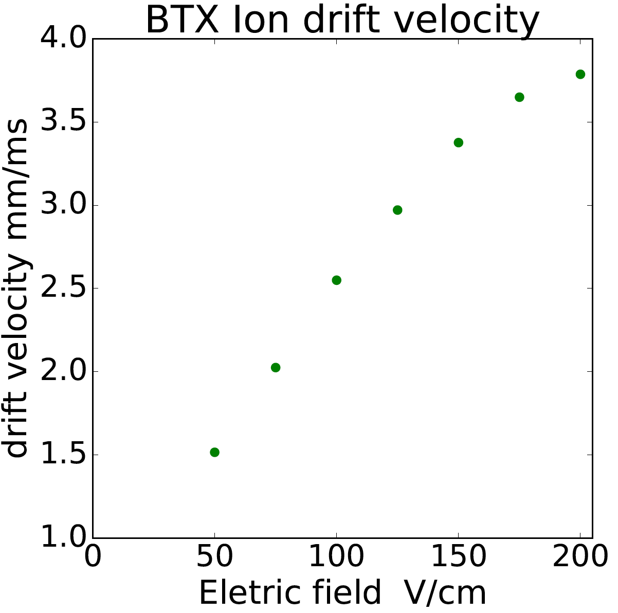
Argon mobility
Mobility of molecular argon(Ar_2+) is 1.83
Mobility of ionized argon(Ar+) is 1.4
Mobility of doubly ionized argon(Ar++) is 2.6
Electric field V/cm

Slide 24
Summary
HPGXe TPC with internal real-time fluorescent tagging of barium daughter at room temperature may offer a new way to eliminate gamma ray backgrounds in NLDBD search

Slide 25
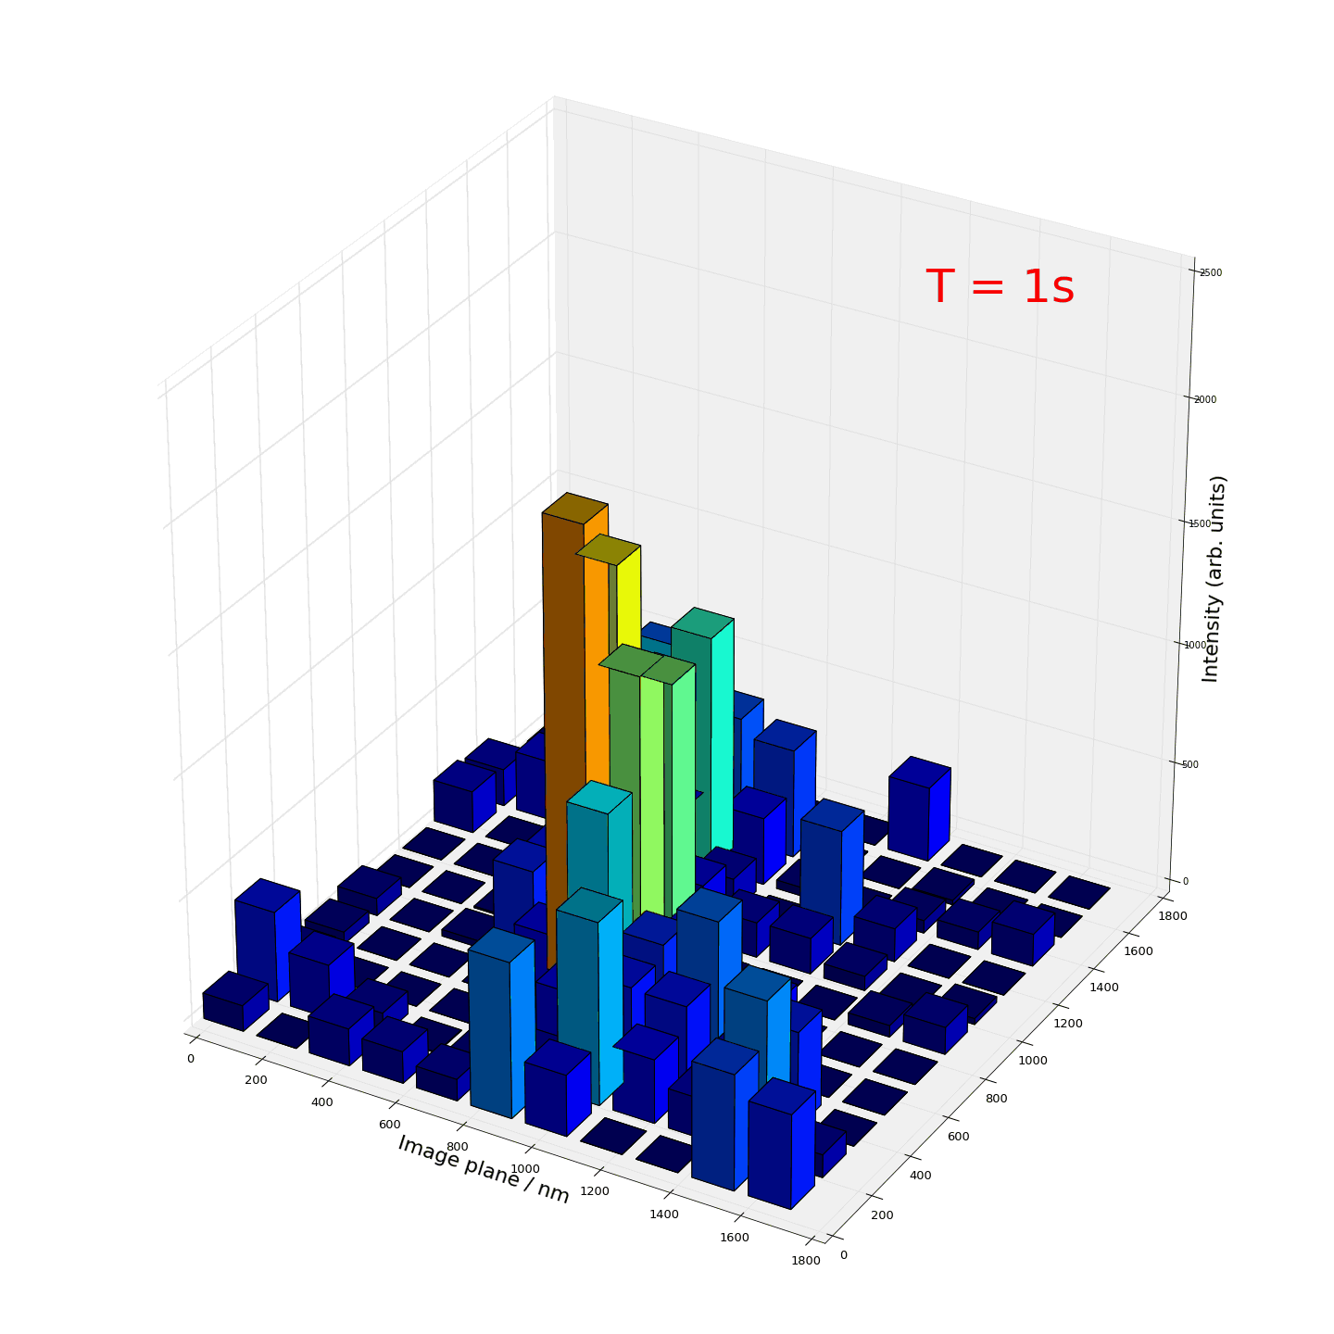

Slide 26
Backup

Slide 27
Going Bigger: SURF and TIRF
RF ion surfing
SMFI sensor
RF carpets already demonstrated in HPGXe, and for large surfaces (44cm) with high efficiency
1mm²
Objective lens on xyz stage
HPGXe
Quartz viewport
Air
To camera
Dichroic mirror
similar optics to our existing setup externally
From laser

Slide 29
Dry phase
Some standard dyes appear to not “work” in the dry phase.
There are several reason and work around for this

Slide 30
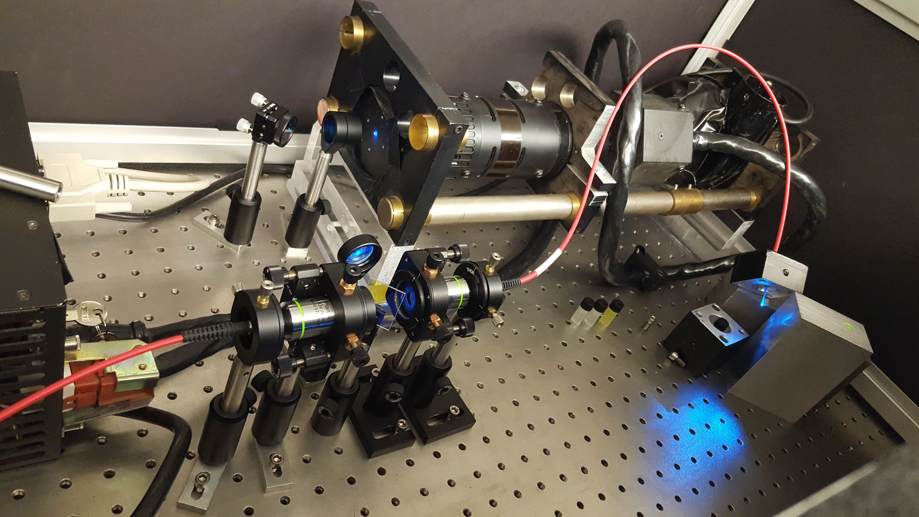
Aqueous solution

Slide 31
Aqueous solution

Slide 32
Aqueous solution

Slide 33
Measurements

Slide 34

What is SMFI?
Marko Kaksonen, Christopher P Toret, and David G Drubin. “Harnessing actin dynamics for clathrin-mediated endocytosis”. In: Nature Reviews Molecular Cell Biology 7.6 (June 2006), pp. 404–414. ISSN: 1471-0072. URL: http://dx.doi.org/10.1038/nrm1940.
Christien J Merrifield. “Seeing is believing: imaging actin dynamics at single sites of endocy- tosis”. In: Trends in Cell Biology 14.7 (Oct. 2015), pp. 352–358. DOI: 10.1016/j.tcb. 2004.05.008. URL: http://dx.doi.org/10.1016/j.tcb.2004.05.008.

Slide 35
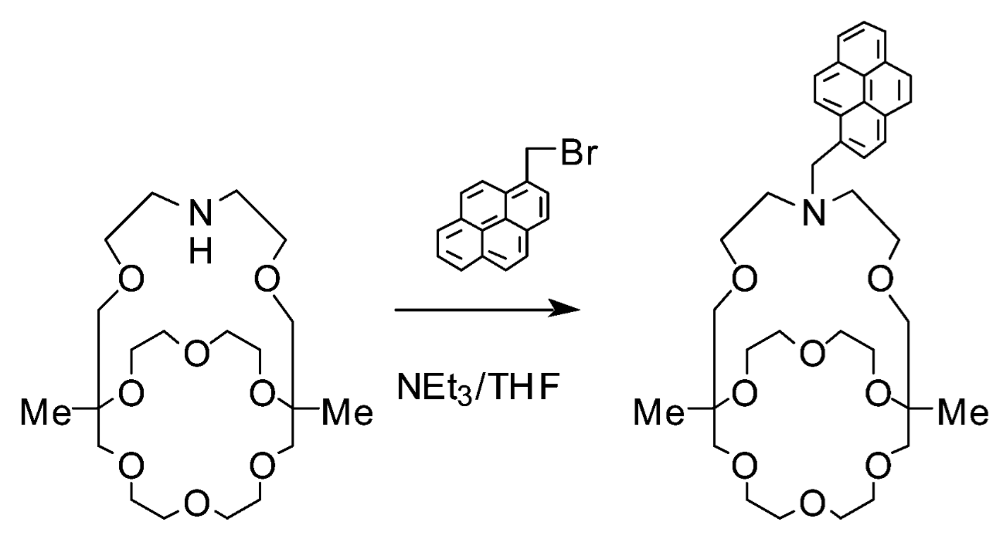
How does it work?
The plug and play of chemistry
Frank Foss at UTA specializes in bonding these molecules

Slide 36
Sample preparation
Buffer solution
Moderates the H+ OH-
Keeps the pH stable when adding chemicals to the solution
Fluo is slightly acidic when reconstituted
The dication solution is slightly acidic

Slide 37
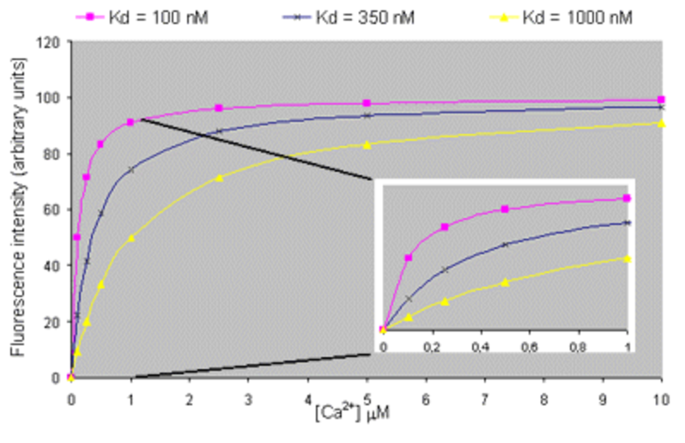
Make more slides
Sample preparation
Most dyes have kd in the nM range
Fluo-4 kd is 325 nM
The low kd makes SMFI extremely sensitive to ions
http://www.embl.de/eamnet/html/calcium/quantifying2.htm

Slide 38
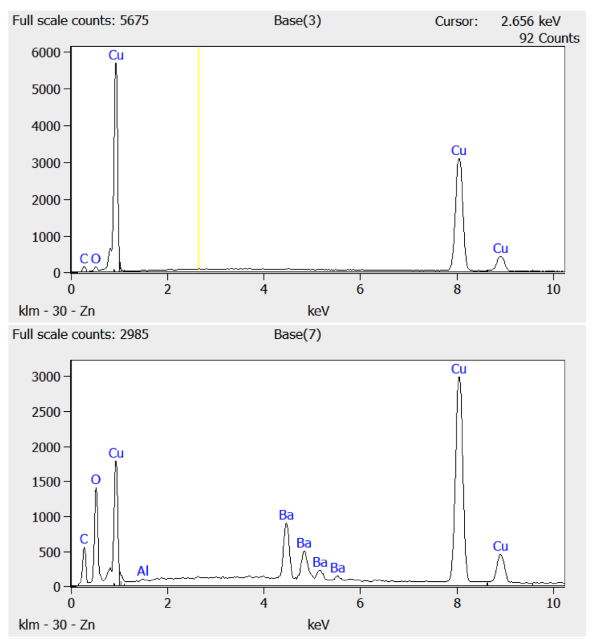
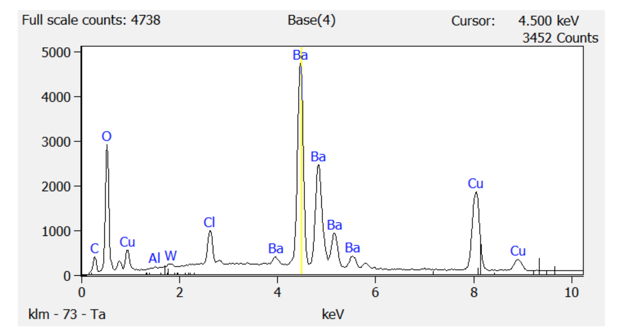
How to test in HPGXe?
Have optimized the protocol for plating barium onto copper rods
EDX spectra of the surface shows an increase in barium and decrease in copper
Bare copper
Early Ba plating
Best Ba plating

Slide 39
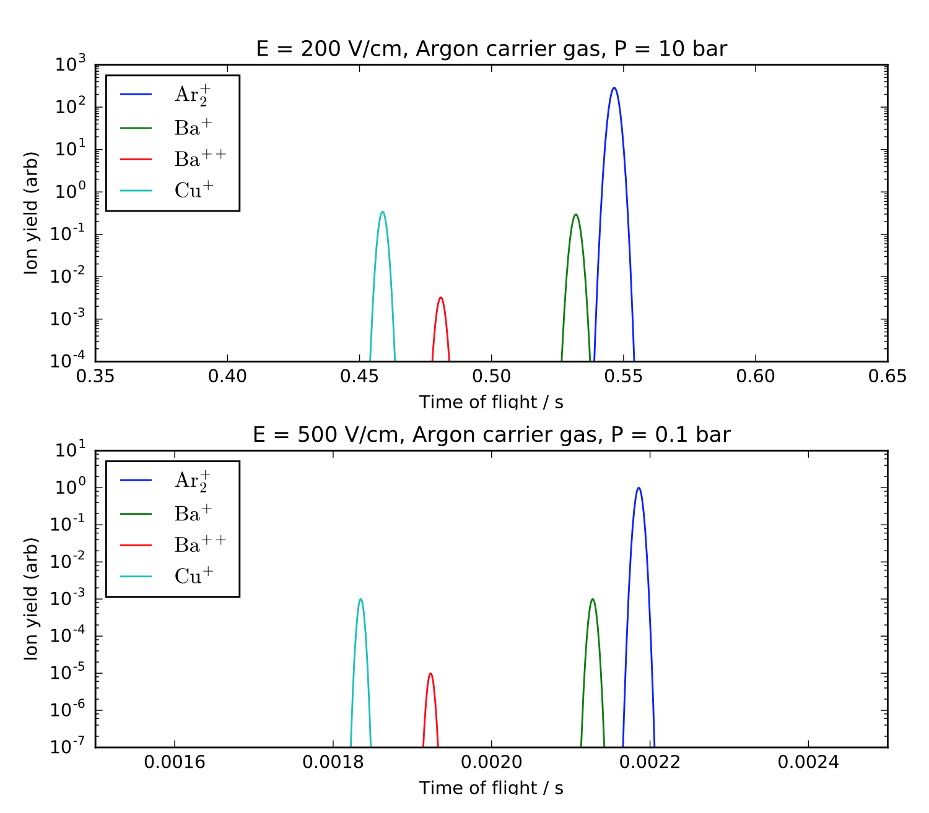
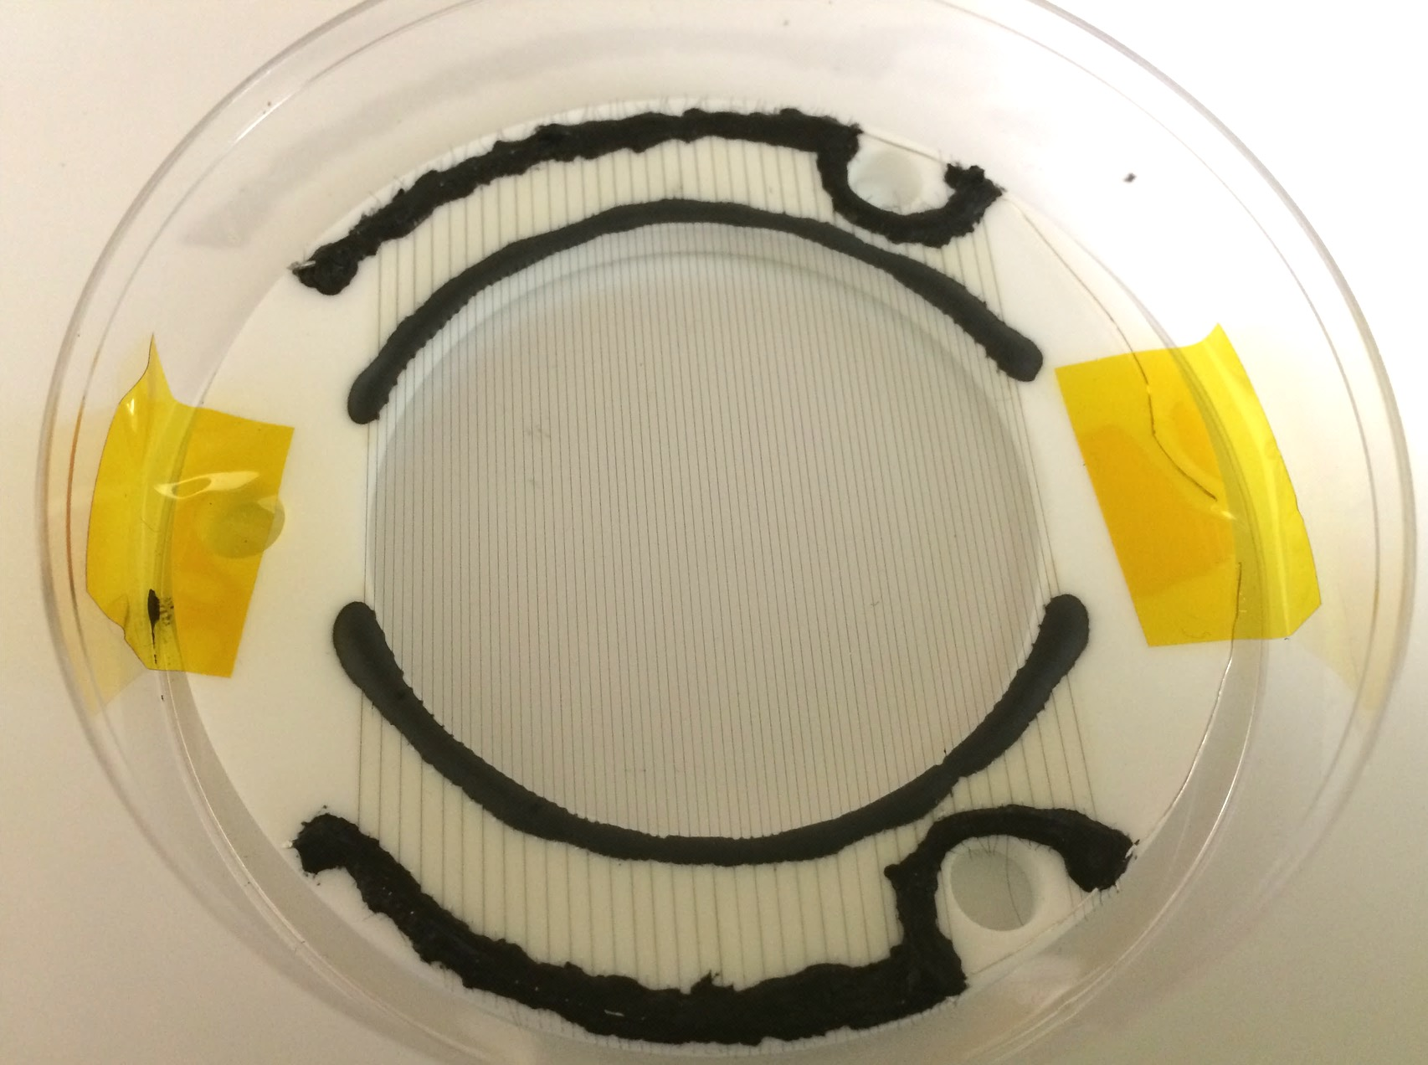
How to test in HPGXe?
Gates have been constructed

Slide 40
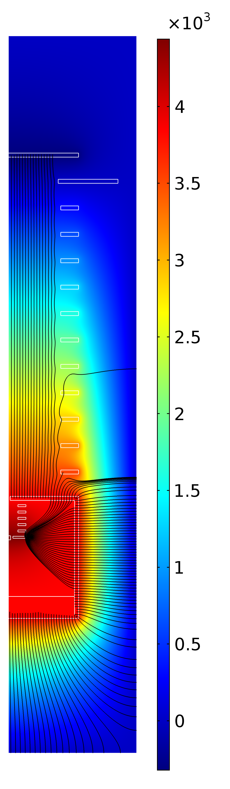
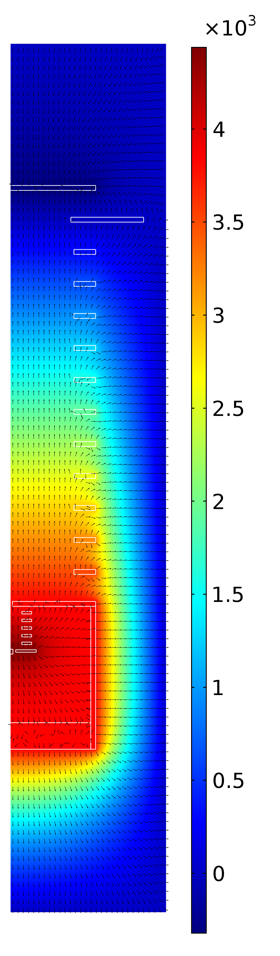
Field Simulations:
Calculated potential (kV)
Field directions (arrows)
Field lines (emanating from Faraday box)
213 V/cm applied field with 320 V ring to ring in main field cage.
600 V spark potential stepped down in 100 V steps over mini-field-cage

