Slide 1

Neutrino detection with noble elements
Ben Jones
University of Texas at Arlington

Slide 2
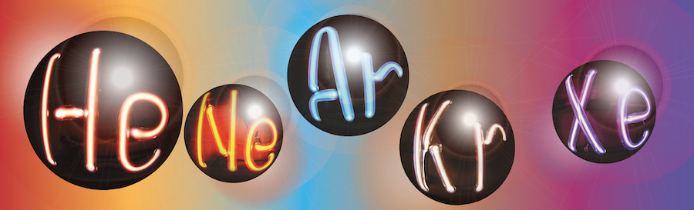
My charge from the organizers:
“This year we are starting the conference with two community overview talks, one covering techniques in neutrino detection with noble elements and one on dark matter detection techniques, and we would like to invite you to give the neutrino overview talk.
[…] please provide a perspective on the challenges of neutrino physics, the approaches that have been taken by various noble element-based detectors, and the roles light detection has played.”
I choose to interpret as LArTPCs for accelerator neutrinos, and Xe TPCs for 0νββ

Slide 3
Generalities
The main requirement for neutrino detectors is to be big.

Slide 4
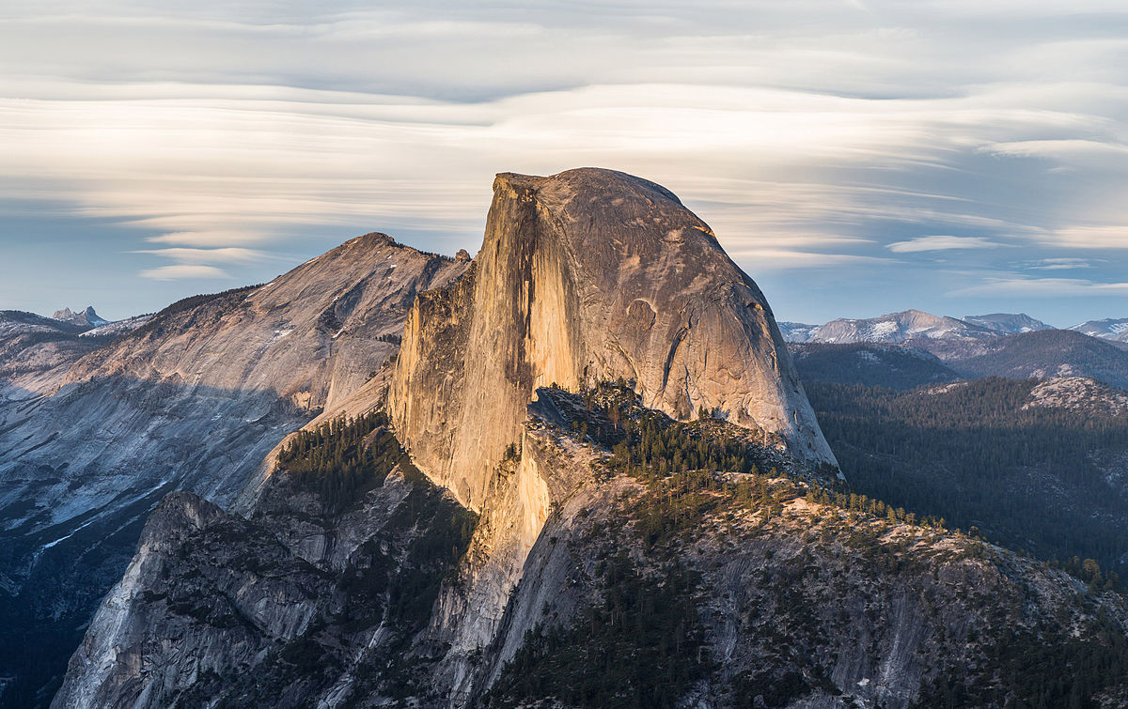
Big, but a bad neutrino detector

Slide 5
Generalities
The main requirement for neutrino detectors is to be big.
And preferably also sensitive.

Slide 6
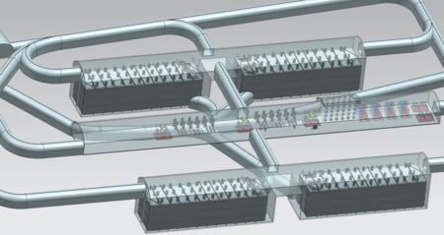
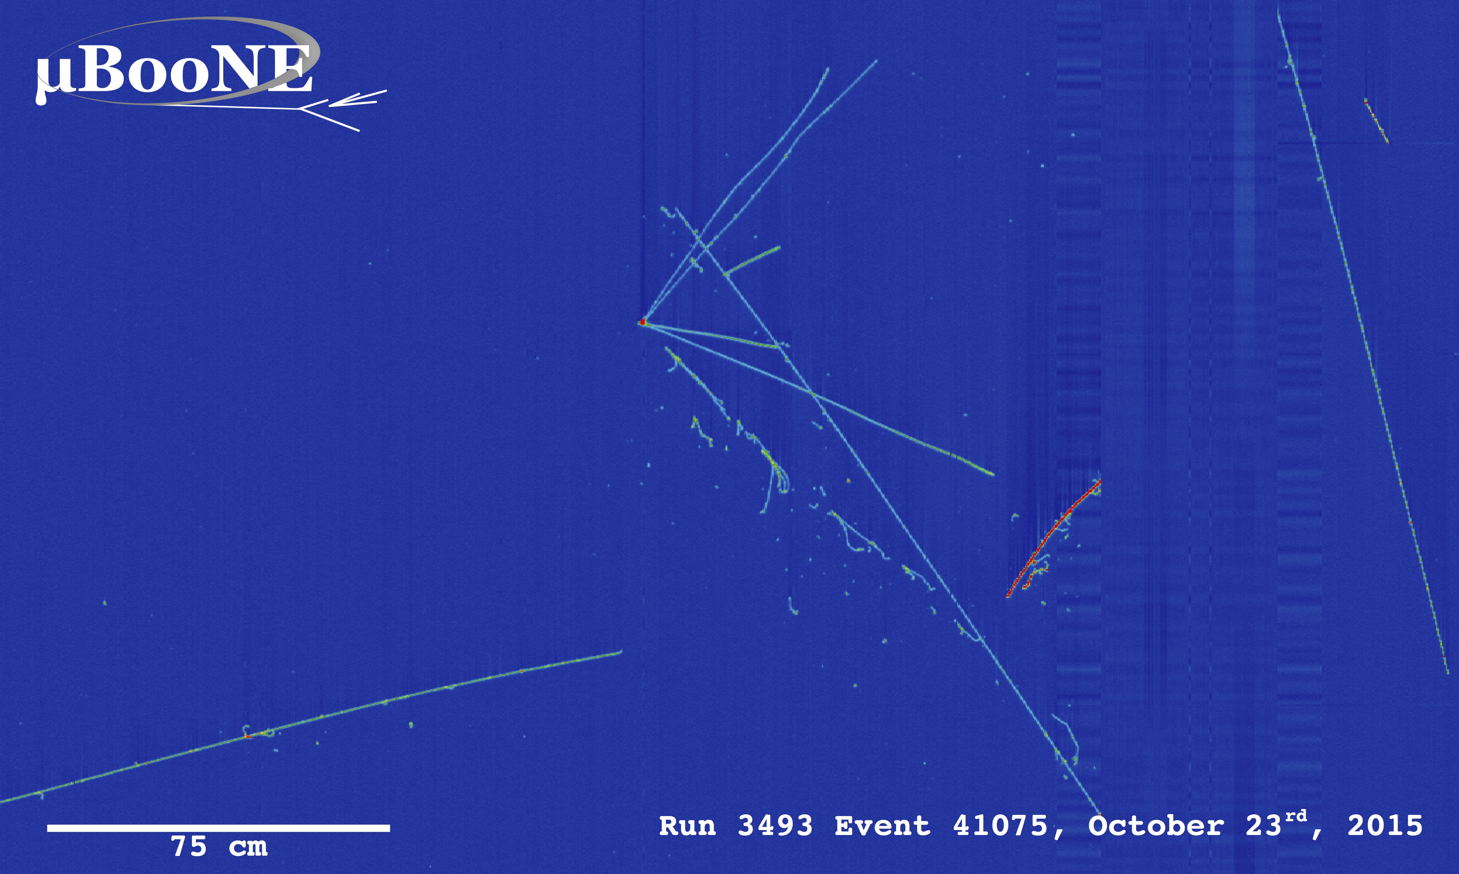
SIZE
DUNE
202x
SENSITIVITY
Noble TPCs have become pervasive because they are at the confluence of size and sensitivity.

Slide 7
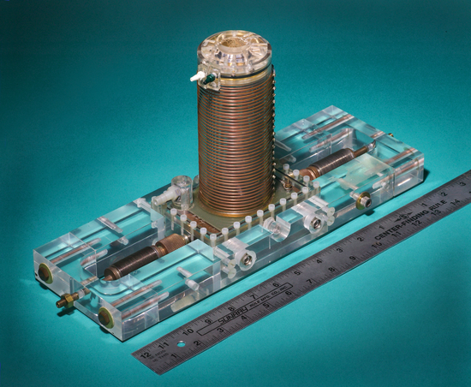
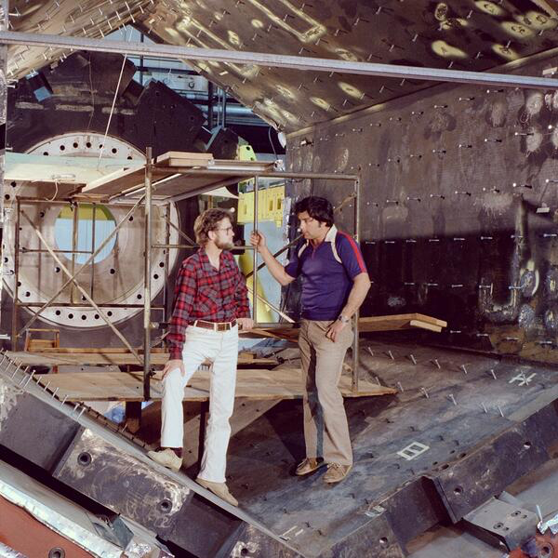
The TPC
1974
1981

Slide 8
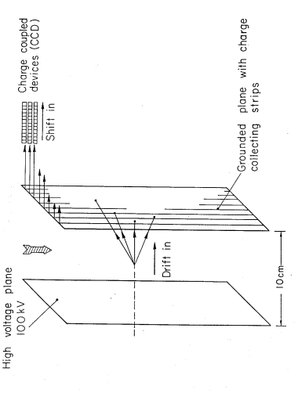
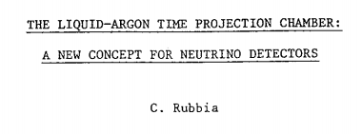
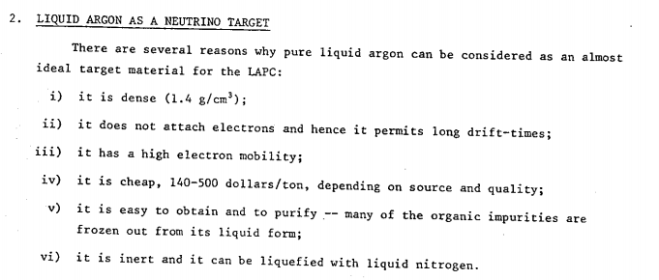
1977: First proposal of a liquid argon TPC to detect neutrinos

Slide 9
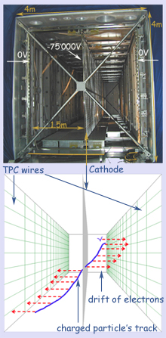
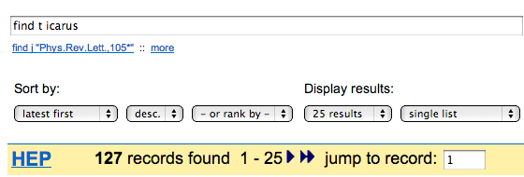
1980-2010: Development of the ICARUS detector
Over 30 years the ICARUS collaboration pioneered LArTPC technology.
The detector has been operated as:
- Cosmic ray detector
- Solar neutrino detector
- Long baseline far detector (CNGS beam)
Latest news : Rubbia proposes to magnetize ICARUS and bring it to the Booster beam at Fermilab.

Slide 10
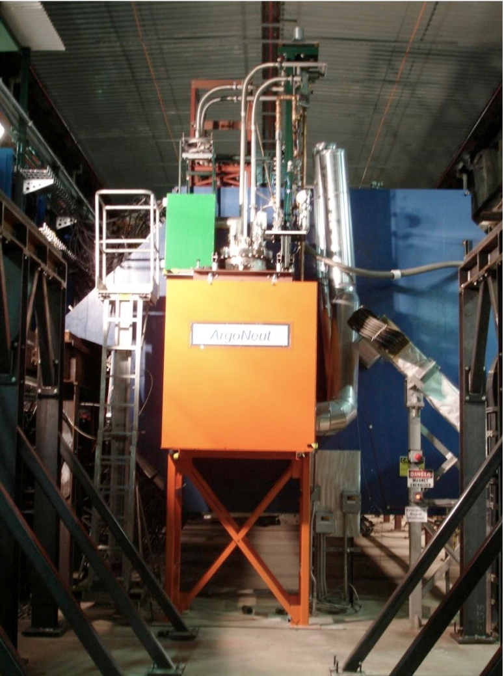
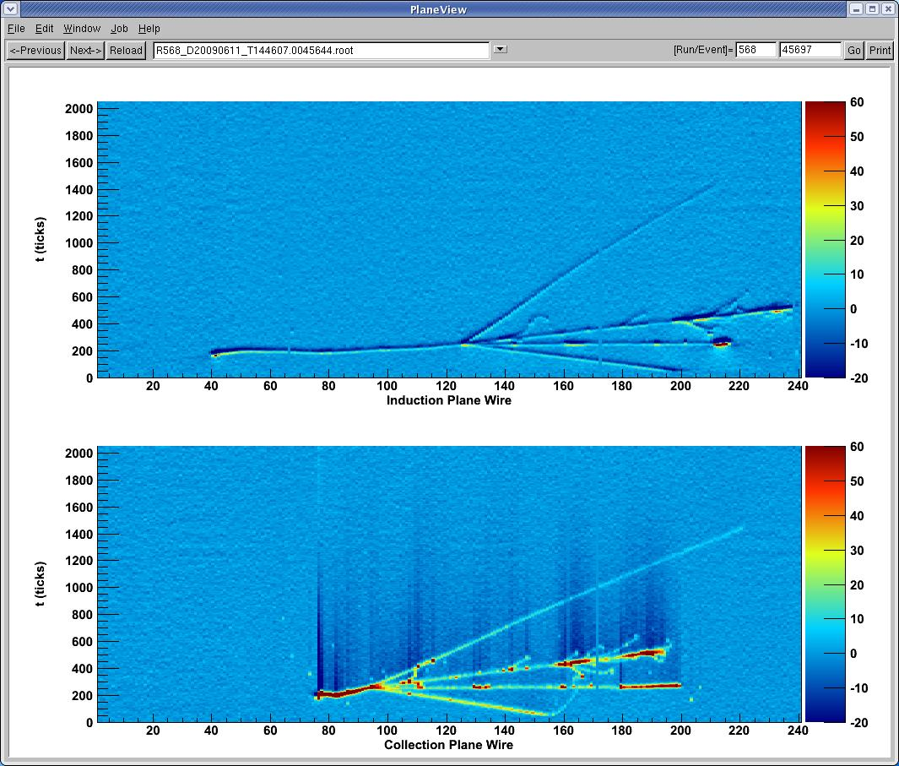
2009: Deployment of the ArgoNeuT test stand in the NuMI neutrino beam at Fermilab
Now repurposed as LArIAT test beam experiment
→ The little detector that just keeps giving!

Slide 11
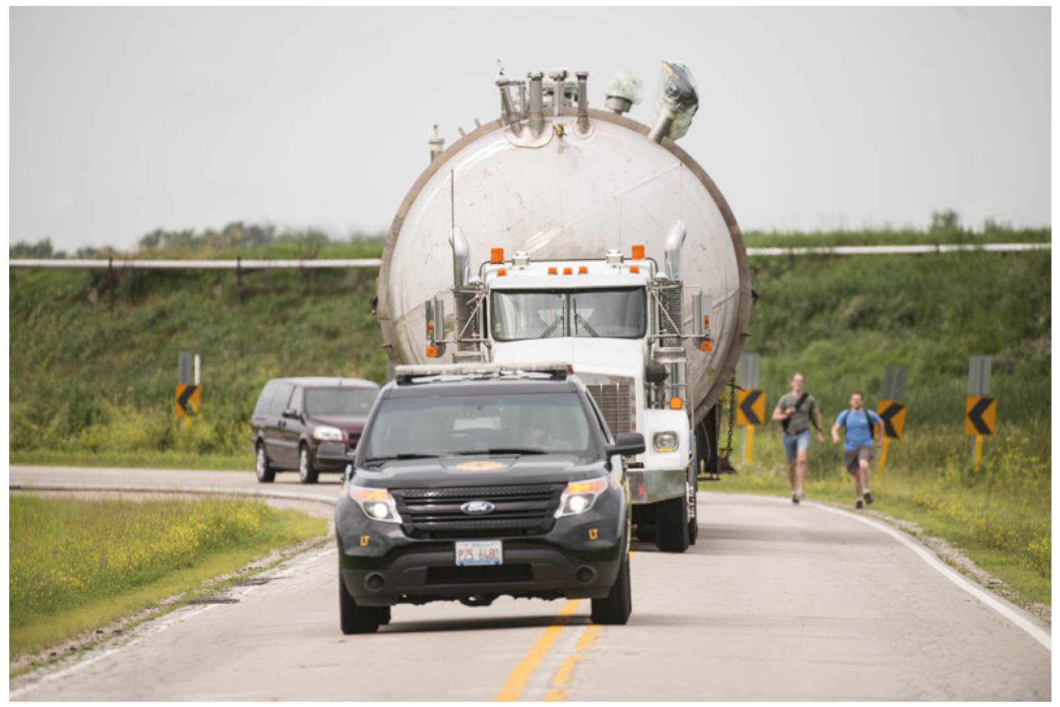
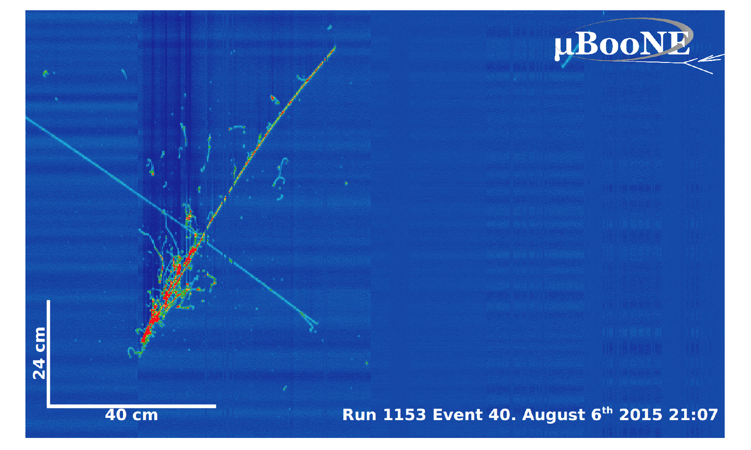
2016: MicroBooNE running in Fermilab BNB

Slide 12
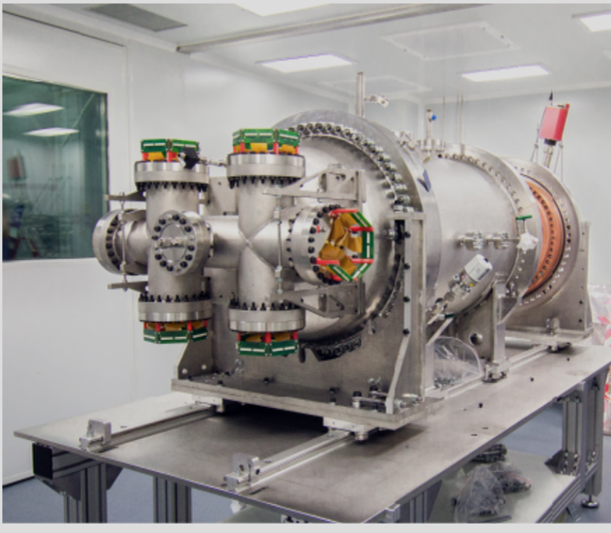
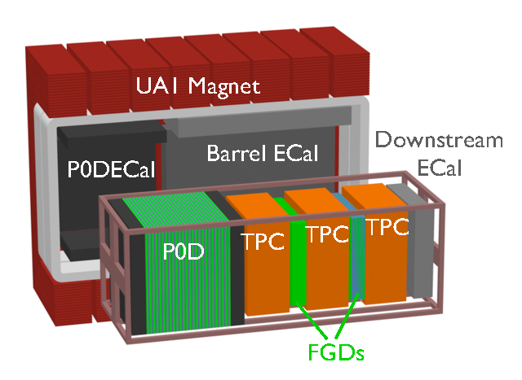
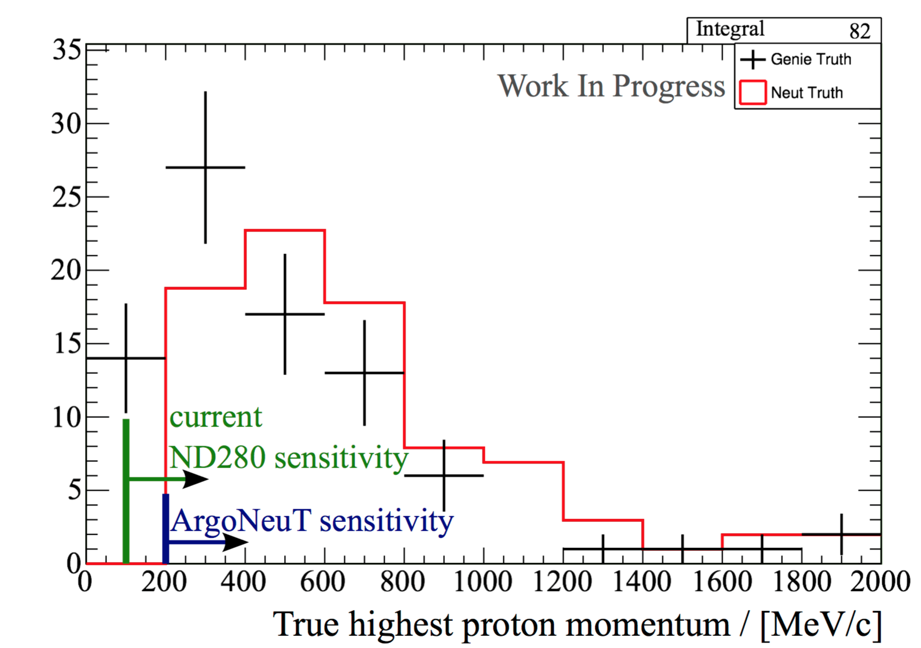
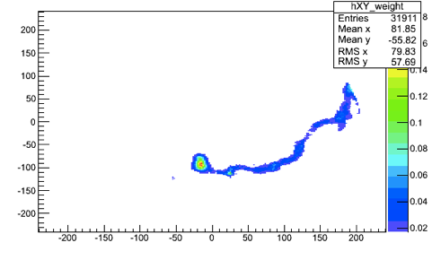
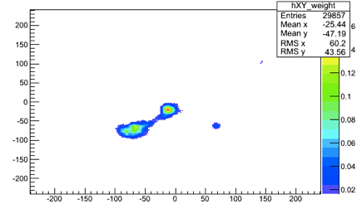
Lets not forget gas detectors
Improved precision, at the cost of lower density:
ND280
Gas TPCs
NEXT
0νββ
Background-like
Signal-like

Slide 13
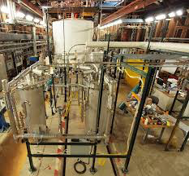
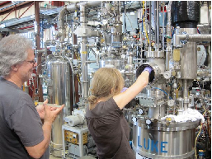
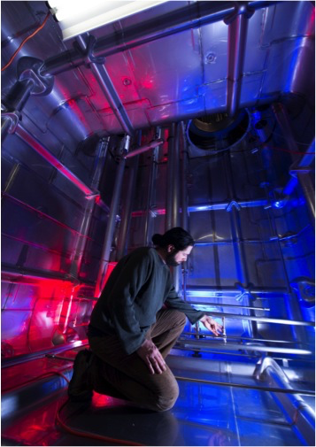
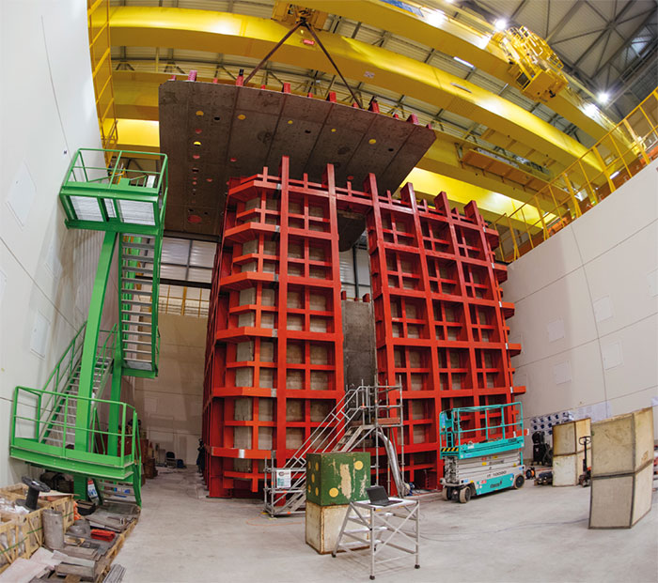
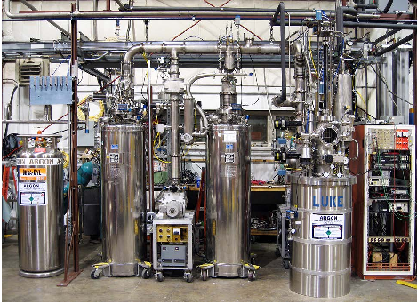
And all the prototypes, engineering tests, test stands, and all who sail in them….
Notes:
5 minutes

Slide 14
And now…
The rest of my talk will be about these two things, and the relationship of light collection to them:
1. Utterly gigantic LArTPCs for long baseline physics.
  (LETS DO IT, BECAUSE I WANT TO KNOW WHAT δ_{CP} IS!)
2. Utterly low background 0νββ TPCs.
  (LETS DO IT, BECAUSE I WANT TO DISCOVER MAJORANA NEUTRINOS!)

Slide 15
And now…
The rest of my talk will be about these two things, and the relationship of light collection to them:
1. Utterly gigantic LArTPCs for long baseline physics.
  (LETS DO IT, BECAUSE I WANT TO KNOW WHAT δ_{CP} IS!)
2. Utterly low background 0νββ TPCs.
  (LETS DO IT, BECAUSE I WANT TO DISCOVER MAJORANA NEUTRINOS!)

Slide 16
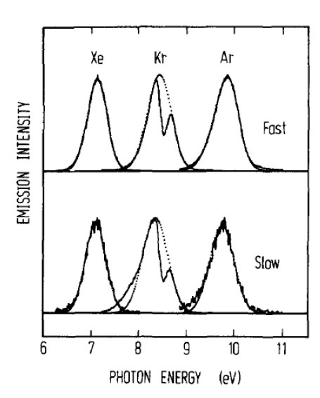
The Basics:
J Chem Phys vol 91 (1989) 1469 E Morikawa et al
Light yield ~ few 10,000’s of photons per MeV (dependences on E field, particle type and purity)
Wavelength of emission is 128nm (Ar) or 175 nm (Xe)
Light with two characteristic time constants, often called “fast” and “slow” from singlets and triplets.
Elements are highly transparent to their own scintillation light.
But most other materials are not → need either special VUV devices, or a wavelength shifter (often TPB)

Slide 17
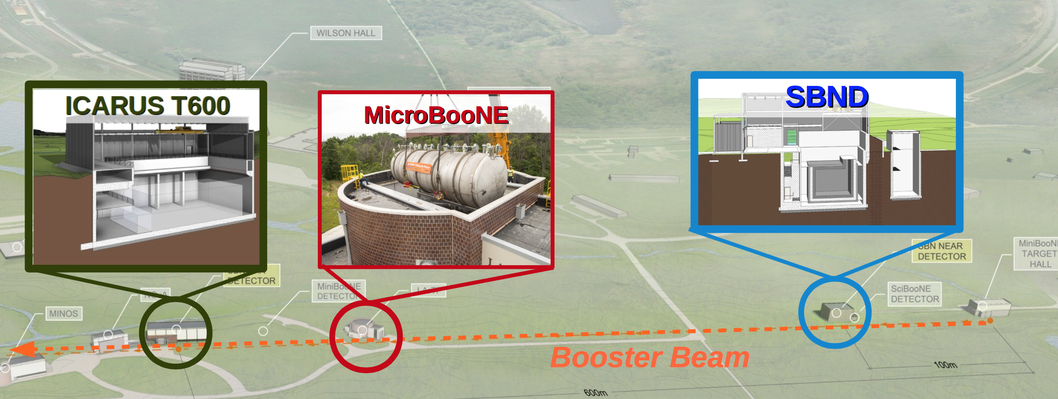
Light collection in surface TPCs
The primary goal of light collection in surface TPCs is cosmic background rejection (which may include triggering).
Light out of time with the pulsed beam must be background.

Slide 18
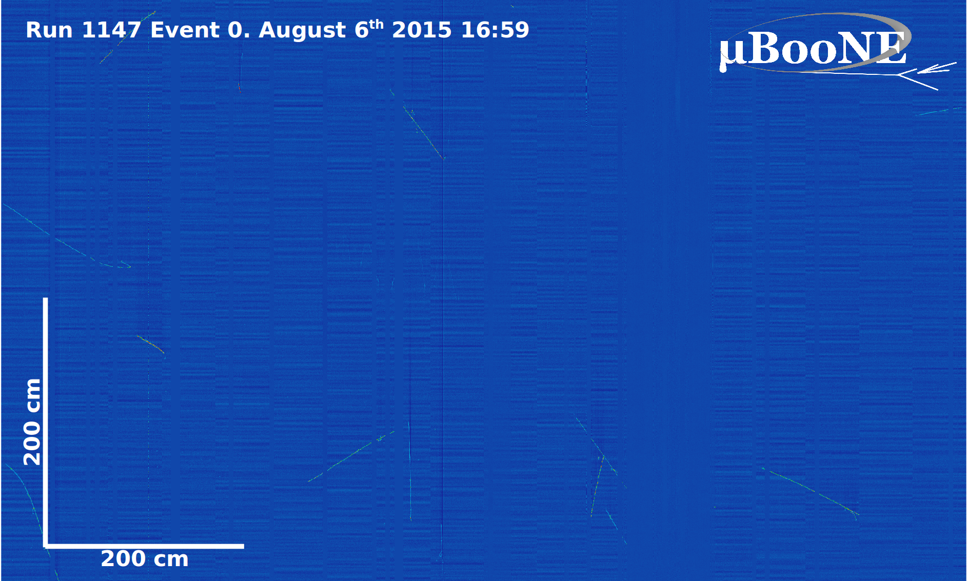
MicroBooNE Event Zero:

Slide 19
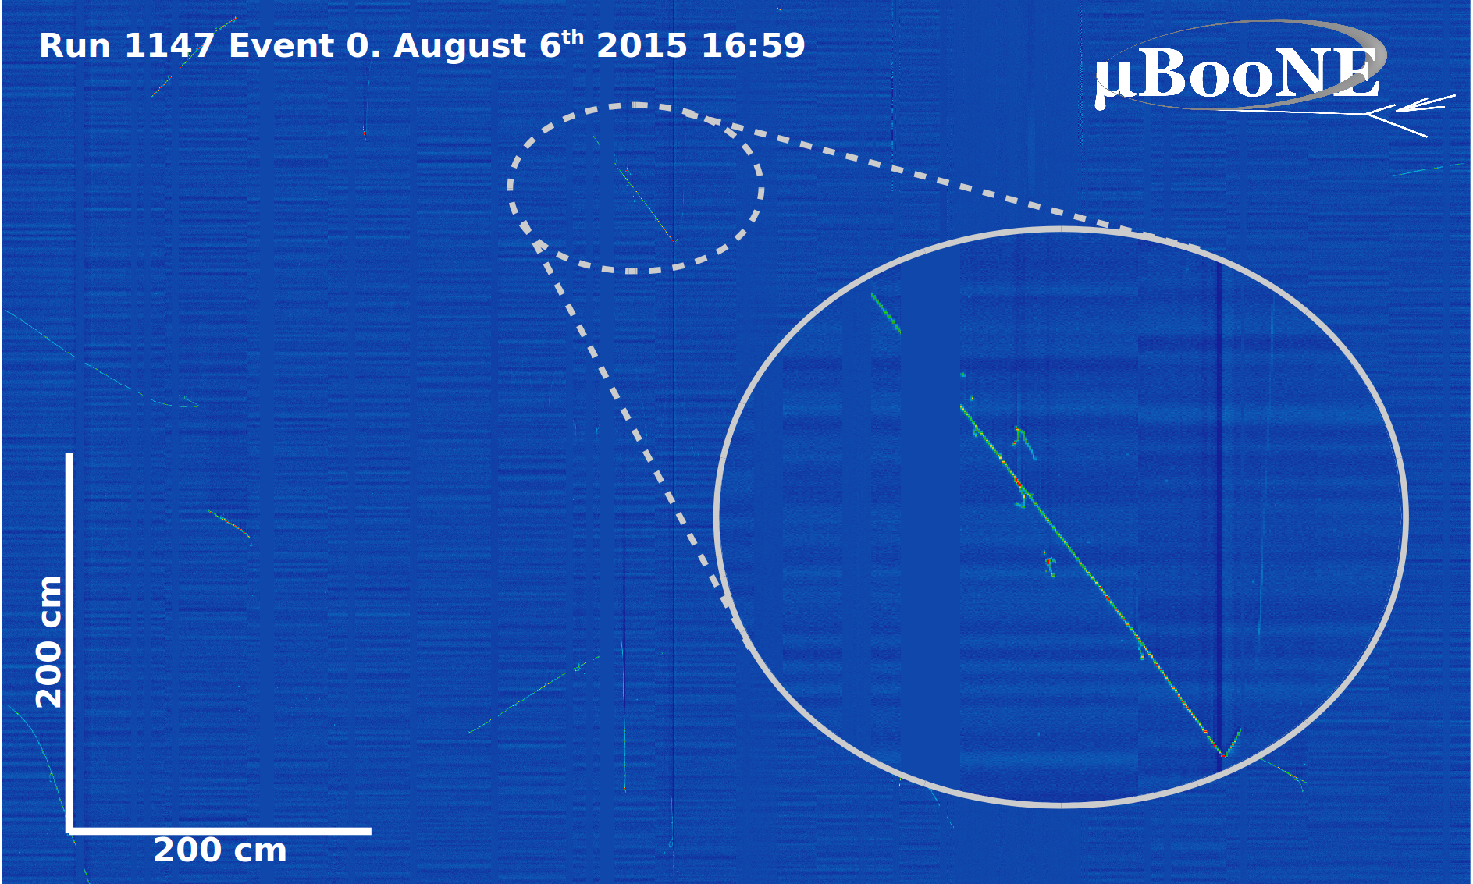
MicroBooNE Event Zero:

Slide 20
MicroBooNE Event Zero:

Slide 21
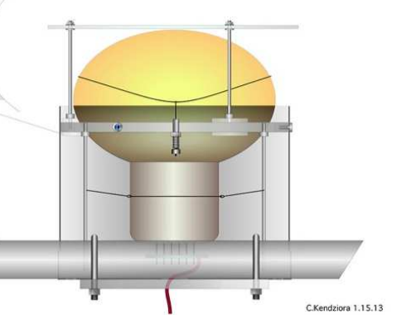
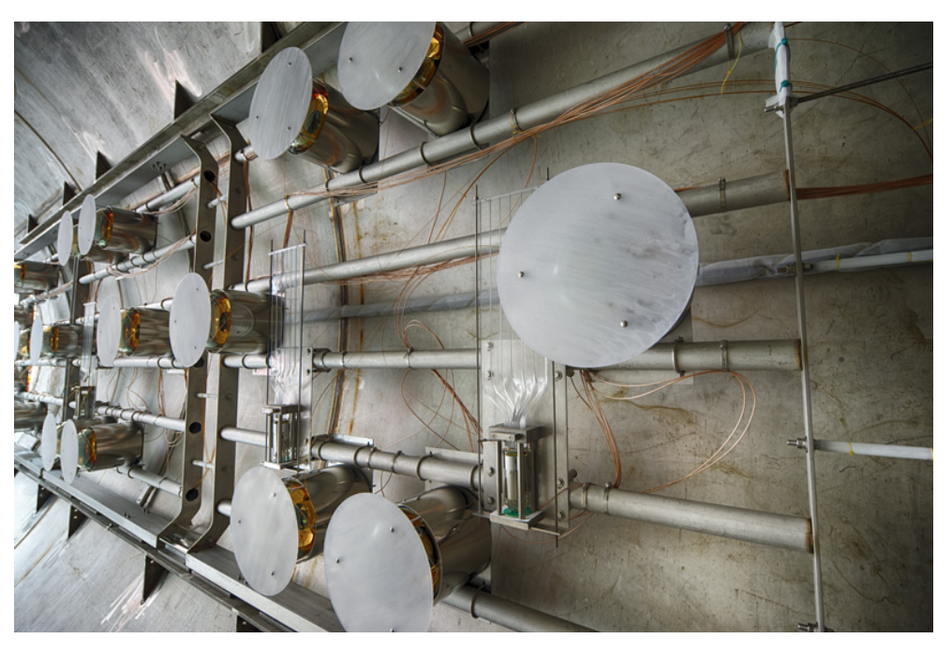
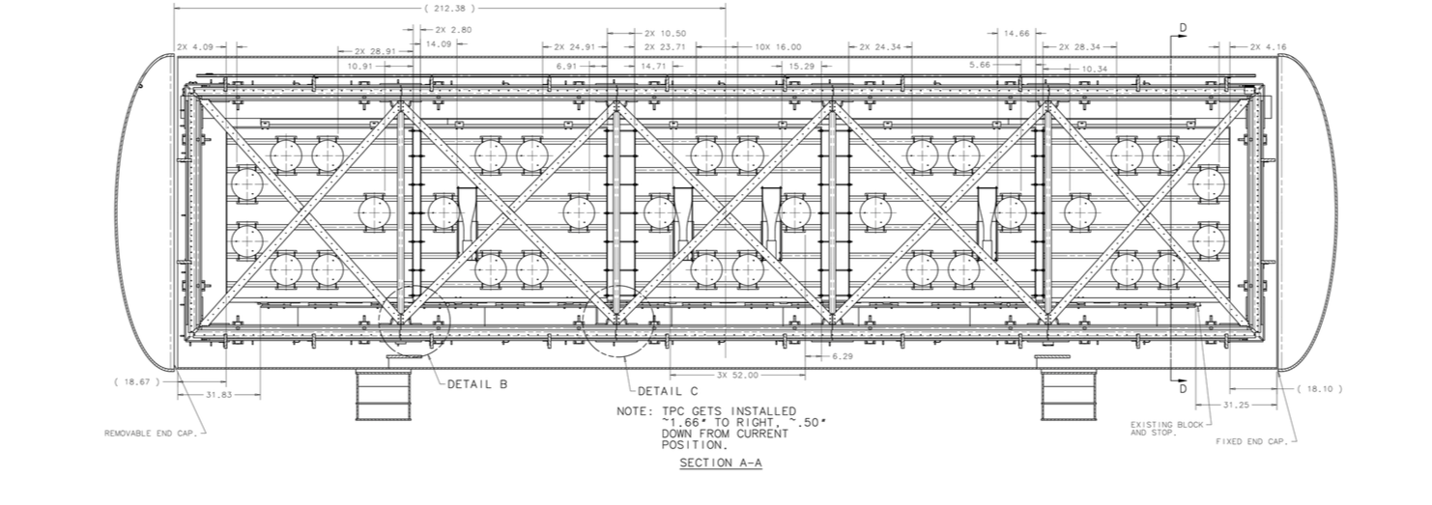
For this task, granularity is crucial.
UV
TPB coated plate
VIS
Cryo PMT
MicroBooNE
optical system
Based on ICARUS; SBND baseline is similar, too, up to details.
JINST 12 (2017) no.02, P02017

Slide 22
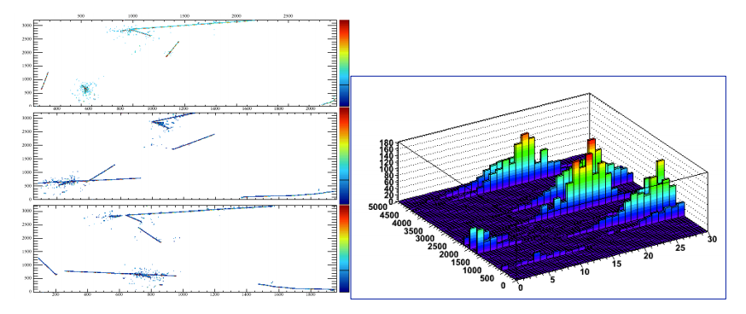
High quality photons:
Problem is geometrical in nature, many small light sensors add up to more than a few big ones
Not just photons, but high quality photons, are needed.
One “Flash”
time
PMT ID
(Shout-out to MicroBooNE: please approve some new flash matching plots!)

Slide 23
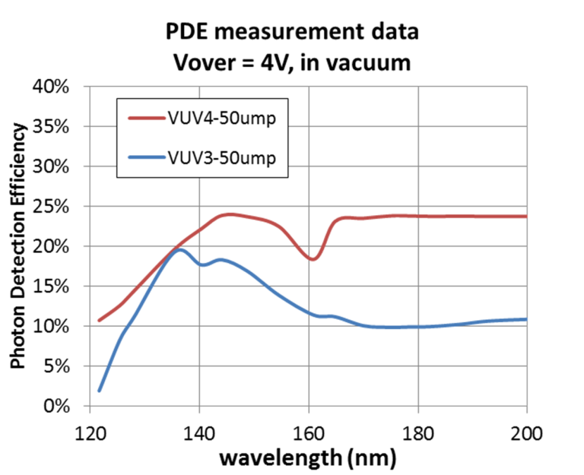
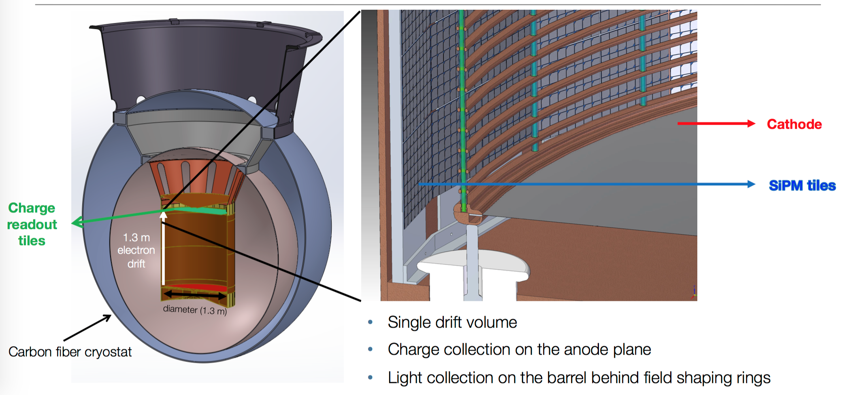
The granularity frontier
Granularity necessarily implies many readout channels, which increases system complexity
The ultimate granularity would be fully active, VUV-sensitive SiPM plane. ASIC’s and internal signal processing become mandatory.
A complicated but powerful system. nEXO working on it for their ton-scale neutrinoless double beta decay concept.
I have not heard of a similar plan for LAr (but it may exist).
nEXO

Slide 24
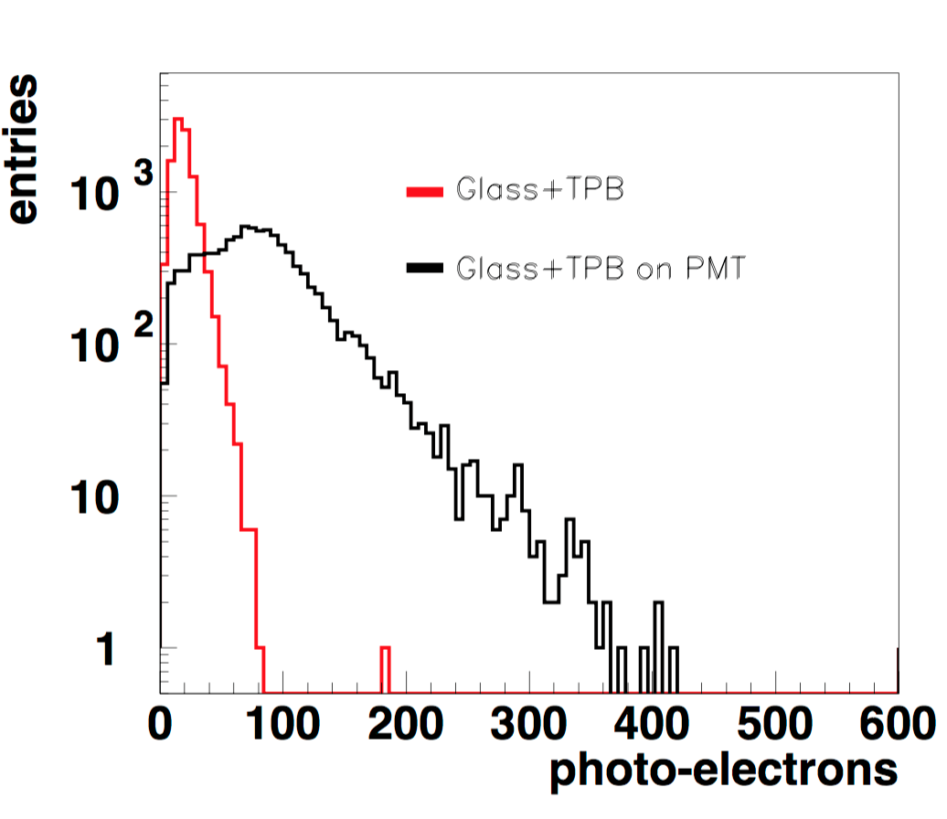
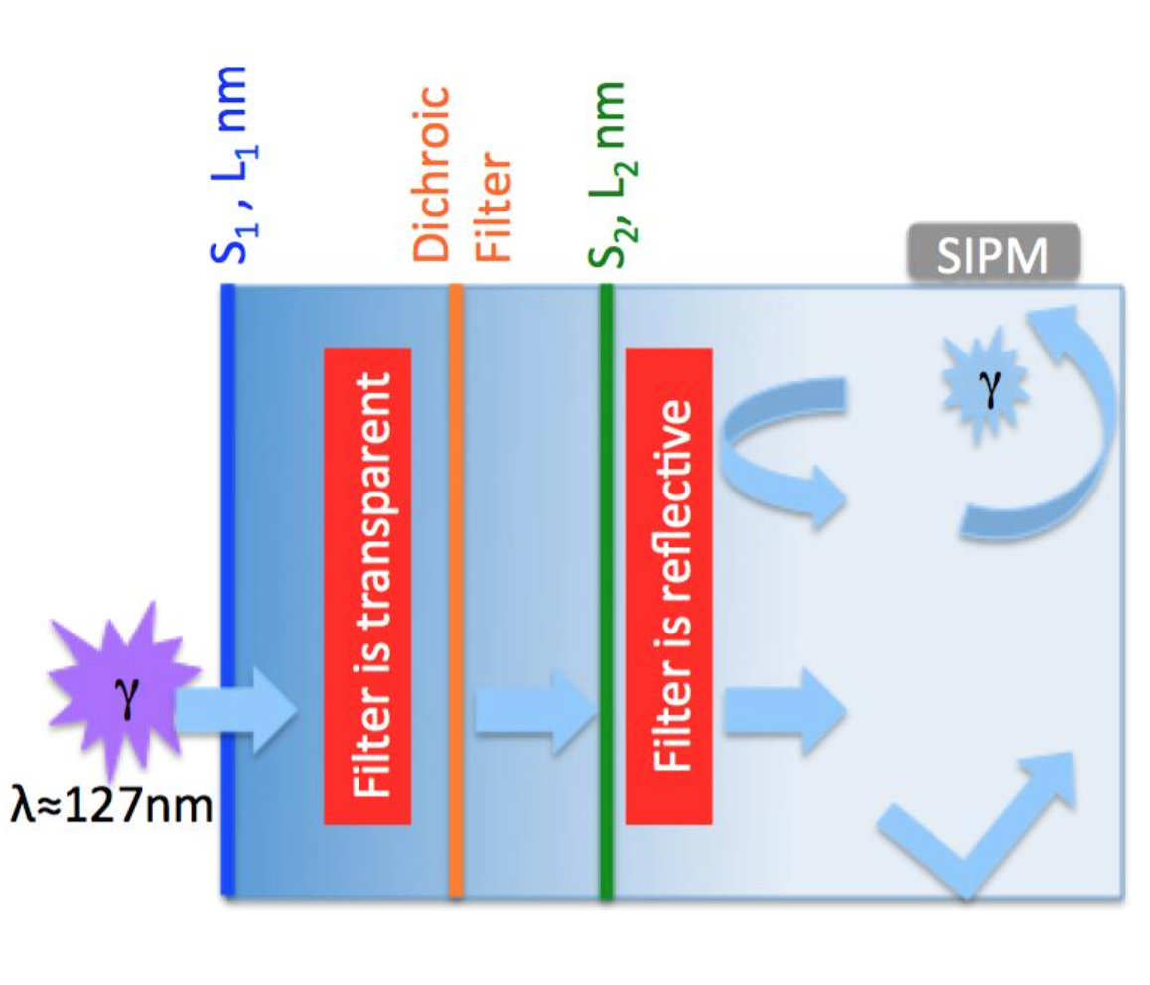
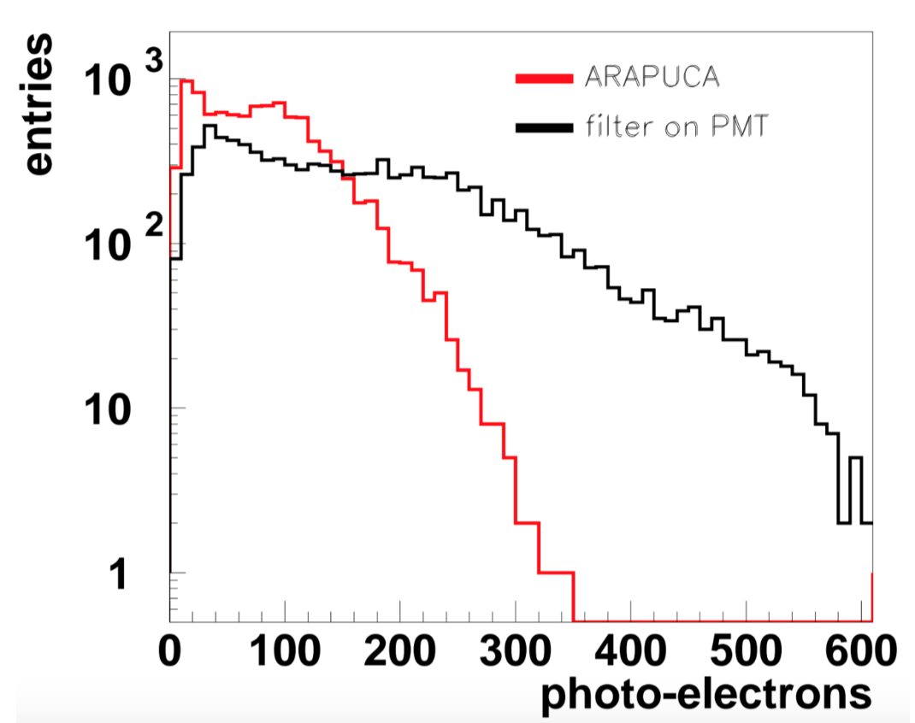
ARAPUCA
The ARAPUCA offers a compromise on channel count, capturing more light than a bare SiPM using dichroic mirrors.
← TPB+SiPM
With concentrating filter →
JINST 11 (2016) no.02, C02004

Slide 25
Deep detectors have different needs:
Very low cosmogenic backgrounds to main physics program.
Reasonable assumption that photocathode coverage unlikely to be large enough to give a significant aid to calorimetry.
So main roles become:
  Precise timing: For example, time-structure based identification of p →Kμ, p→ Kν and p→Kμπ proton decay candidates.
  Off-beam drift correction: Locate off-beam events in Z direction to apply drift corrections and properly measure energy (solar, supernova, atmospherics, etc)
For low rate applications we need lots of light to push down thresholds, but granularity is less vital.

Slide 26
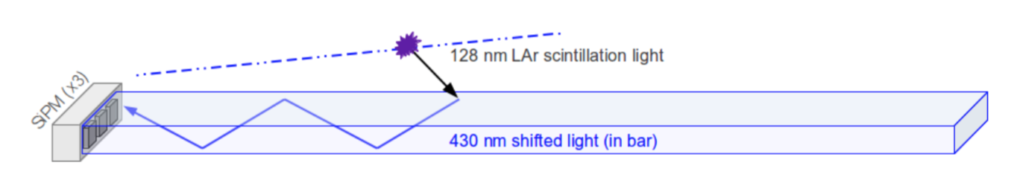
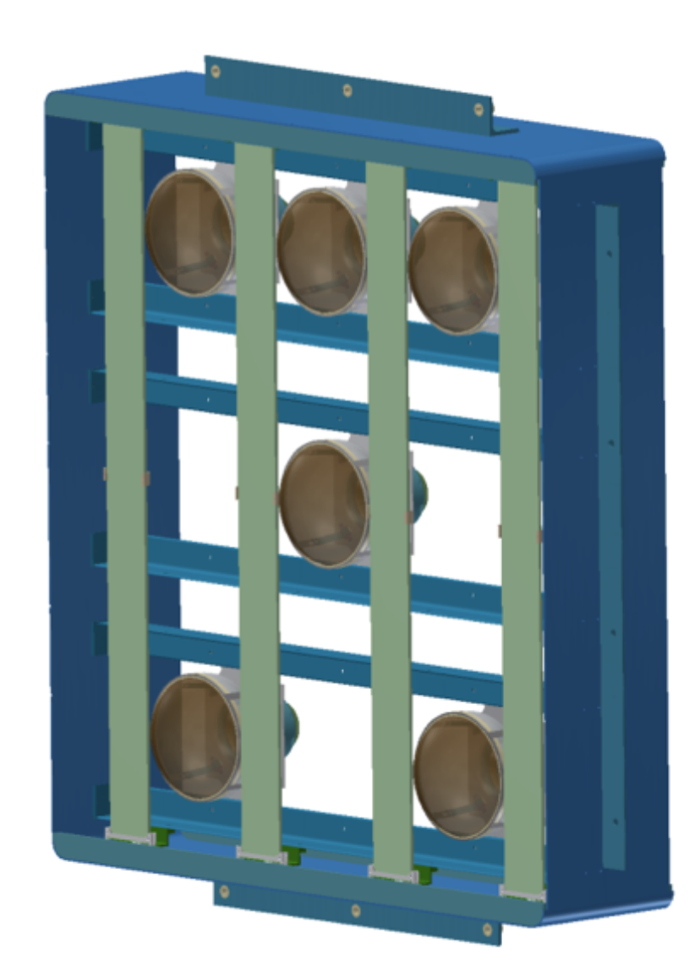
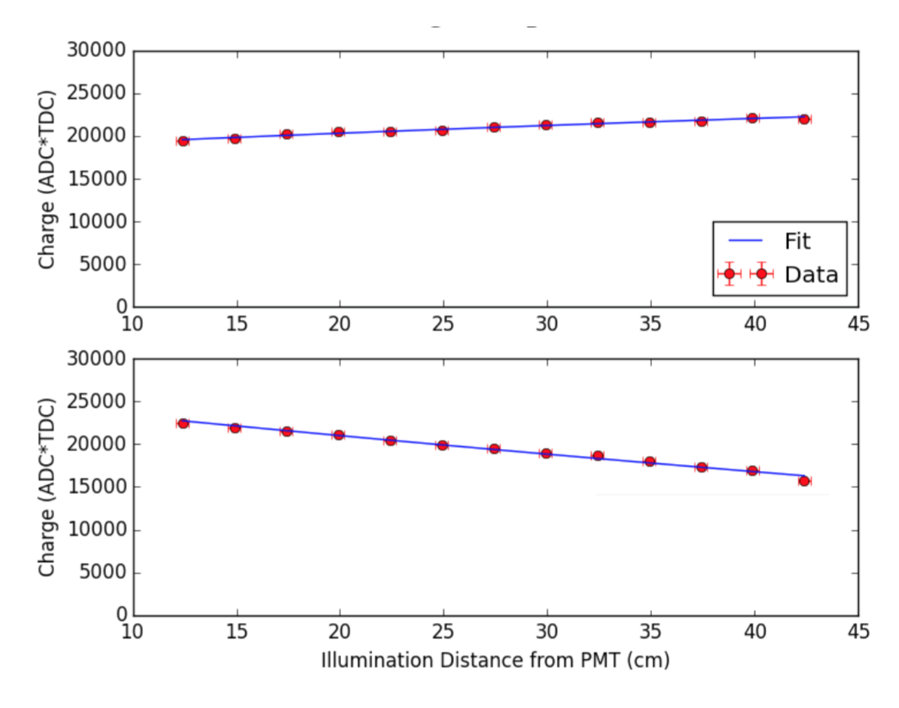
Getting lots of light
arXiv:1604.03103
JINST 10 (2015) no.08, P08017
JINST 11 (2016) no.05, P05016
(etc)
Prevalent idea is to use TPB coated light guides:
Excellent attenuation lengths now achieved with Wunderbars
Thicker coating
Concept for SBND light detectors

Slide 27
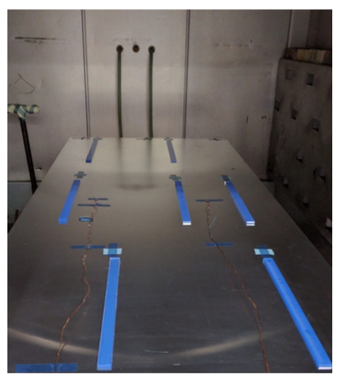
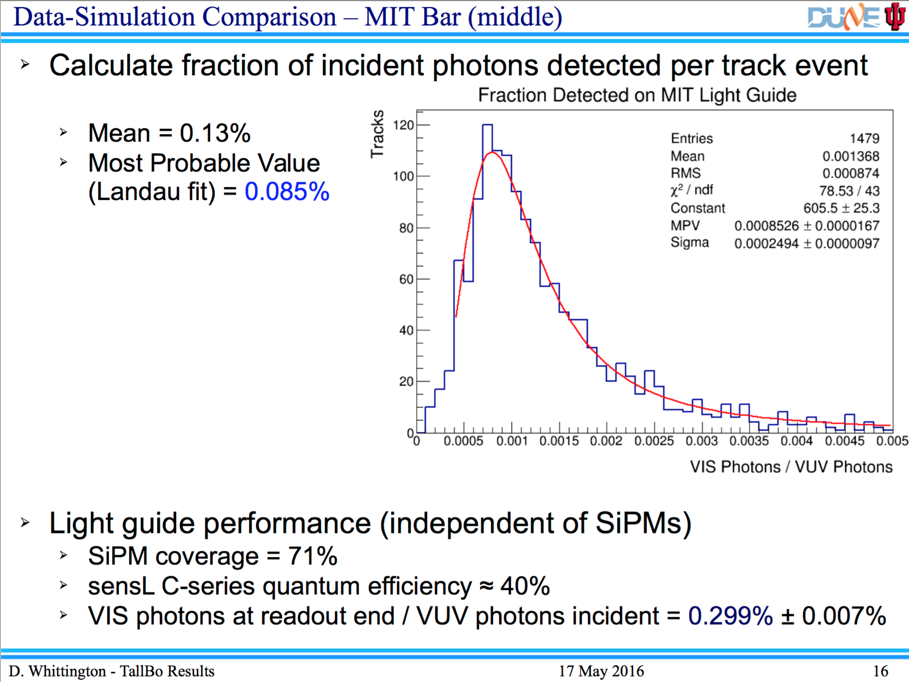
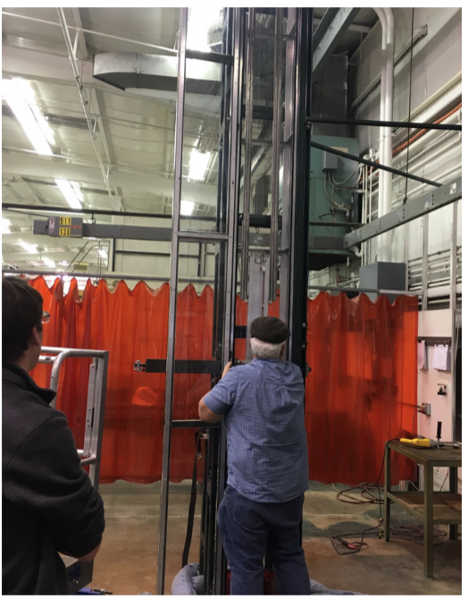
Light guide status
Long attenuation lengths (now multiple meters) allow large area coverage with small channel number.
Efficiency is lower than PMT+Plate, but improving all the time.
0.13% efficiency achieved with 12 SiPMs (~0.01 % eff. per channel)
Scaling up production at Fermilab →

Slide 28
“Jones’s rule of light collection”:
Any light detector concept can be proven to be more efficient than any other light detector concept via a suitable choice of reasonable-sounding figure of merit.
Photons per electronics channel?
Photons per square inch?
Photons per device?
Photons per dollar?
Photons out per photon incident?
(Don’t push it… it’s a rule with exceptions…)

Slide 29
“Jones’s rule of light collection”:
Any light detector concept can be proven to be more efficient than any other light detector concept via a suitable choice of reasonable-sounding figure of merit.
Photons per electronics channel?
Photons per square inch?
Photons per device?
Photons per dollar?
Photons out per photon incident?
The best choice of figure of merit is the one that most directly maximizes sensitivity within constraints imposed by the experiment
(in practice probably $_electronics, electronics_complexity or $_photodetectors)

Slide 30
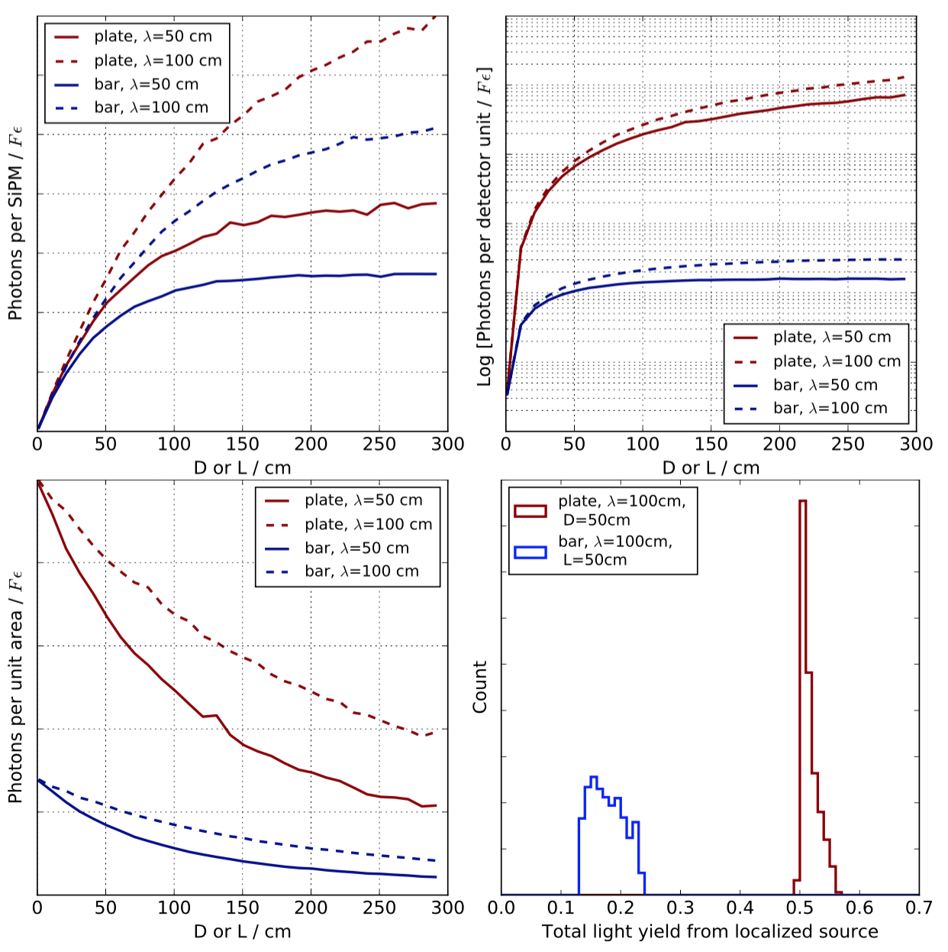
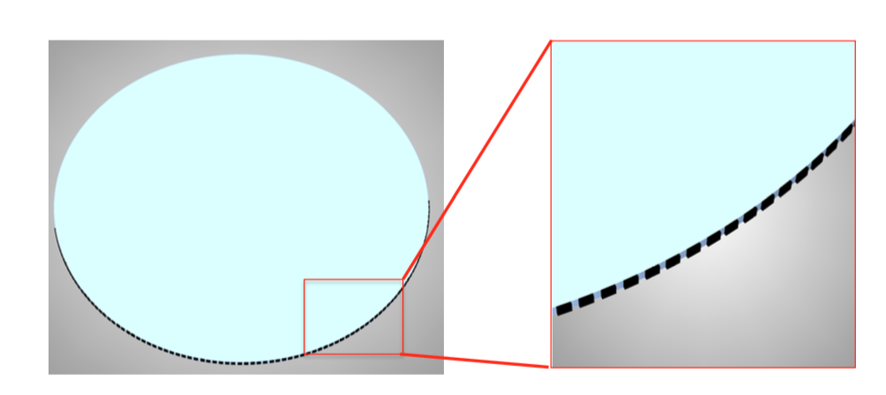
SiPMWheel Concept
(Please still account for Jones’s law)
Disc-geometry light guide will instrument more surface area with less SiPMs, have shorter typical propagation distances and less reflections per ray.
Laser cut and spin coated with TPB+PS.
Undergoing both bench tests and characterization in HPGXe and LAr

Slide 31
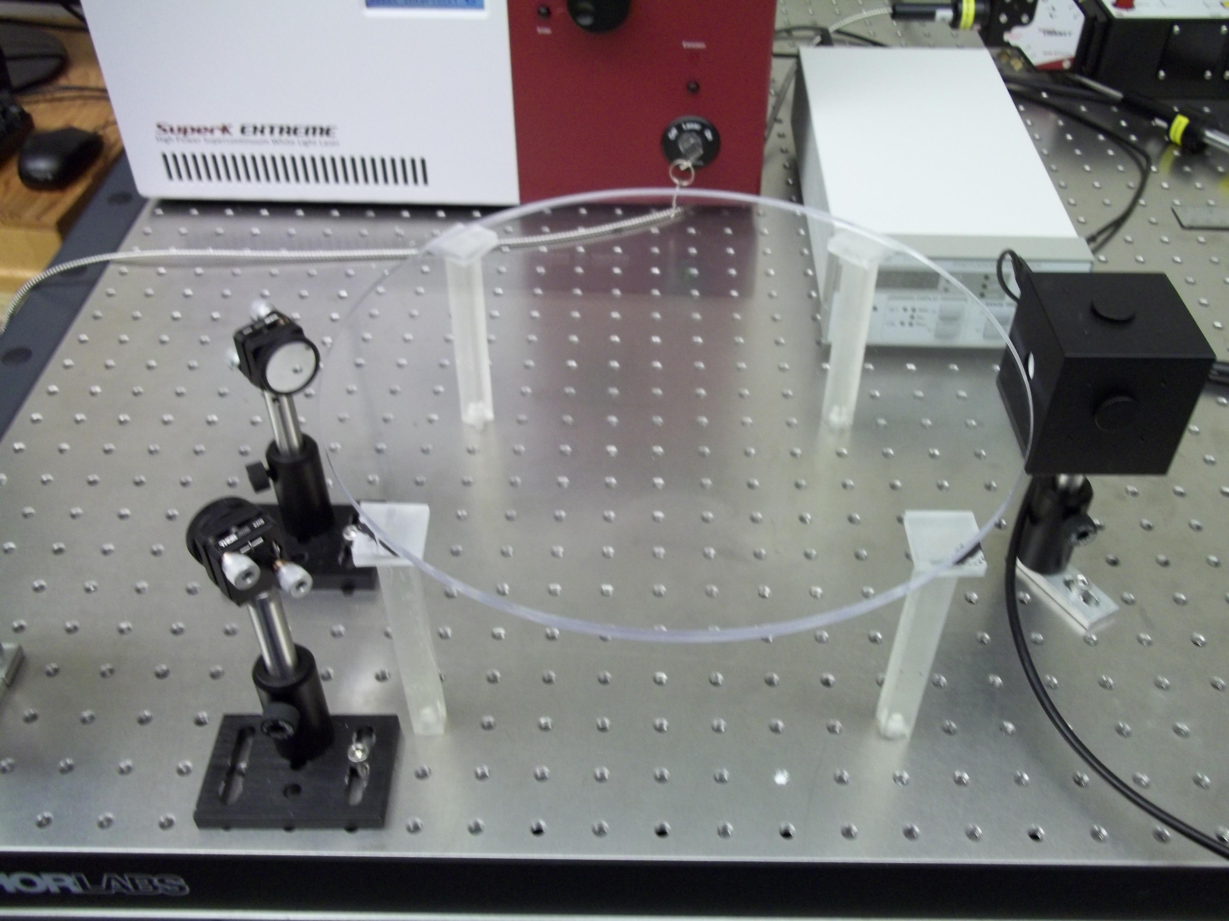
SiPMWheel Disc Characterization @ UTA
Profile light losses
  vs wavelength
  vs number of reflections
  vs path length in bar
  As independent degrees of freedom
Supercontinuum laser (tunable to 2nm)
Integrating sphere w/
photodiode
Steerable mirrors for scanning rays in 3D
Small prototype WLS coated disc

Slide 32
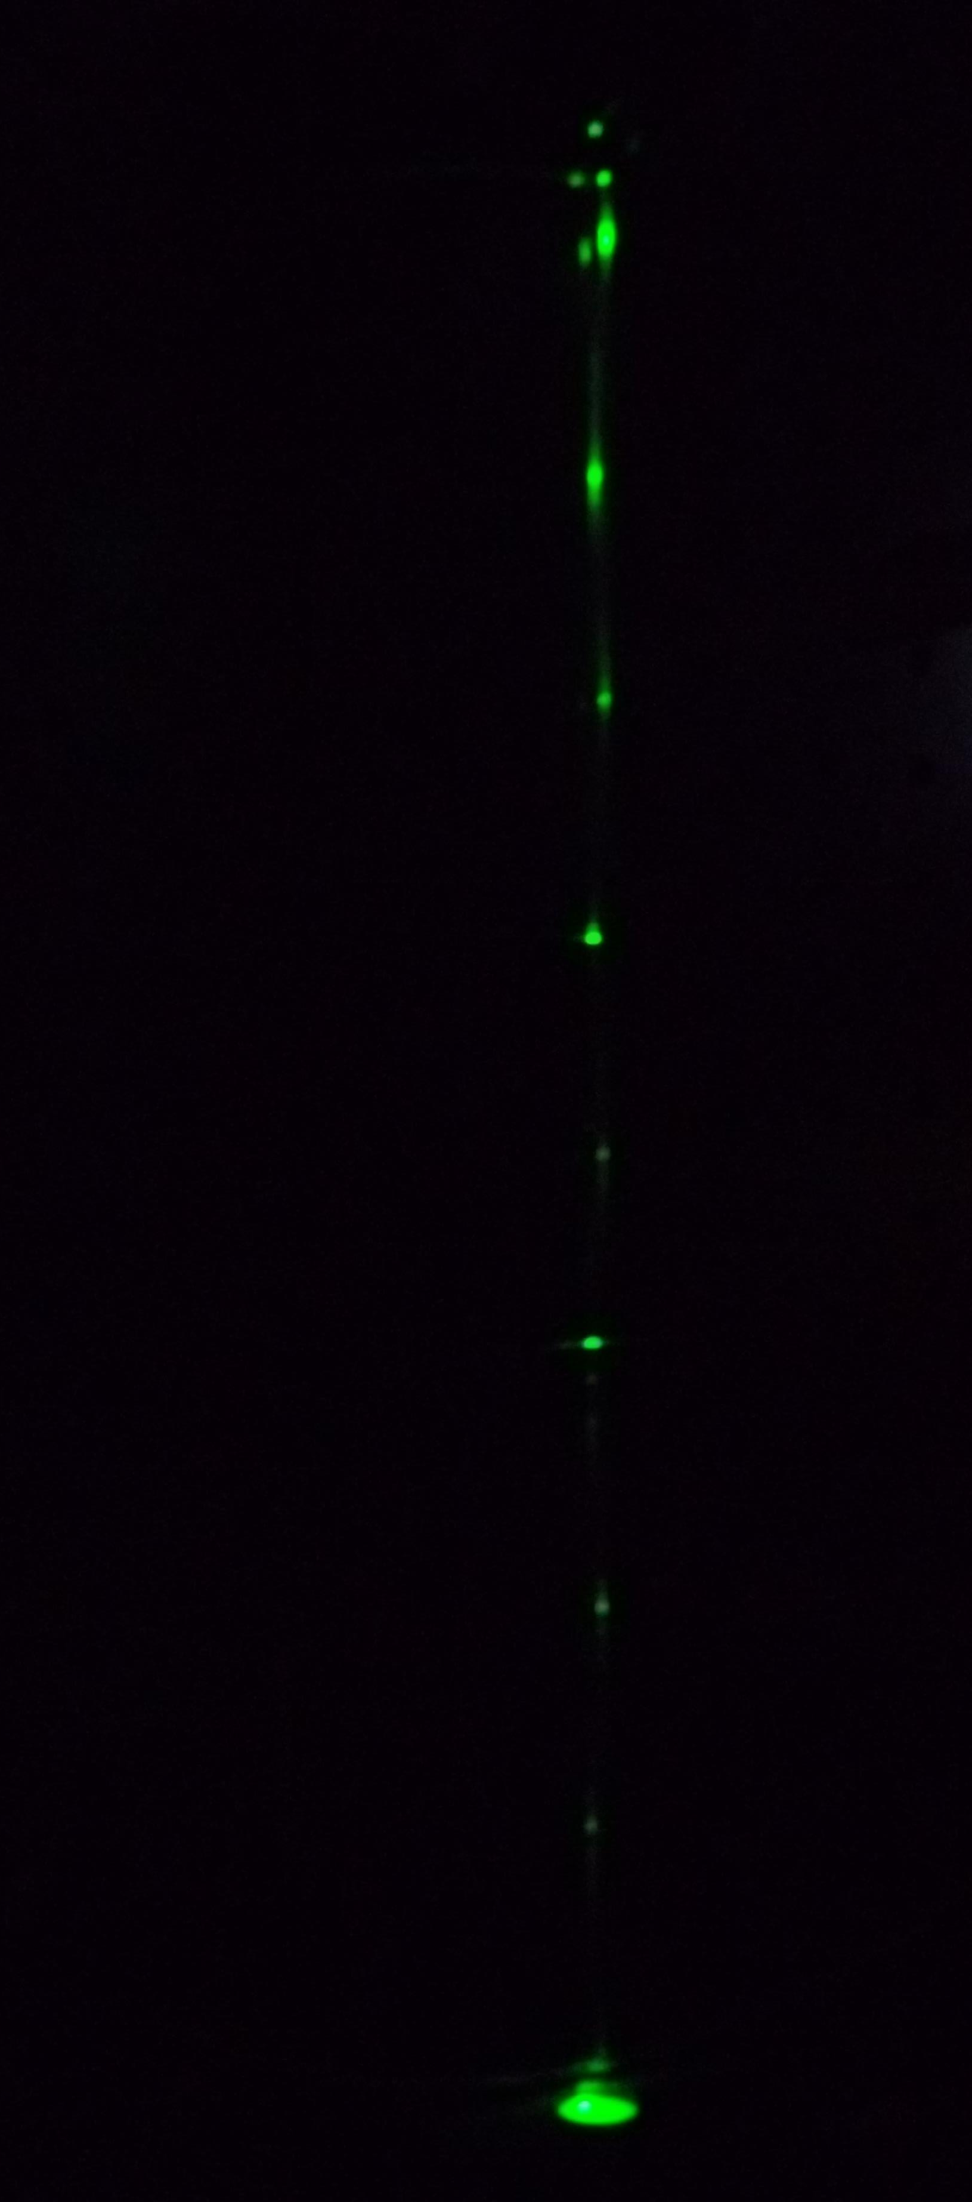
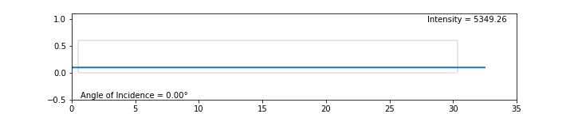
(surface nodes)
1A,1T
1A,0T
2A,2T
3A,2T
2A,1T
3A,3T
Less TPB absorption at longer WL
Bright nodes on TPB side, dim ones acrylic
Dips where new TPB nodes give surface absorption
This data mutl-D enough to tune a detailed model without degeneracies:
Surface and bulk absorption, re-emission efficiency, etc

Slide 33
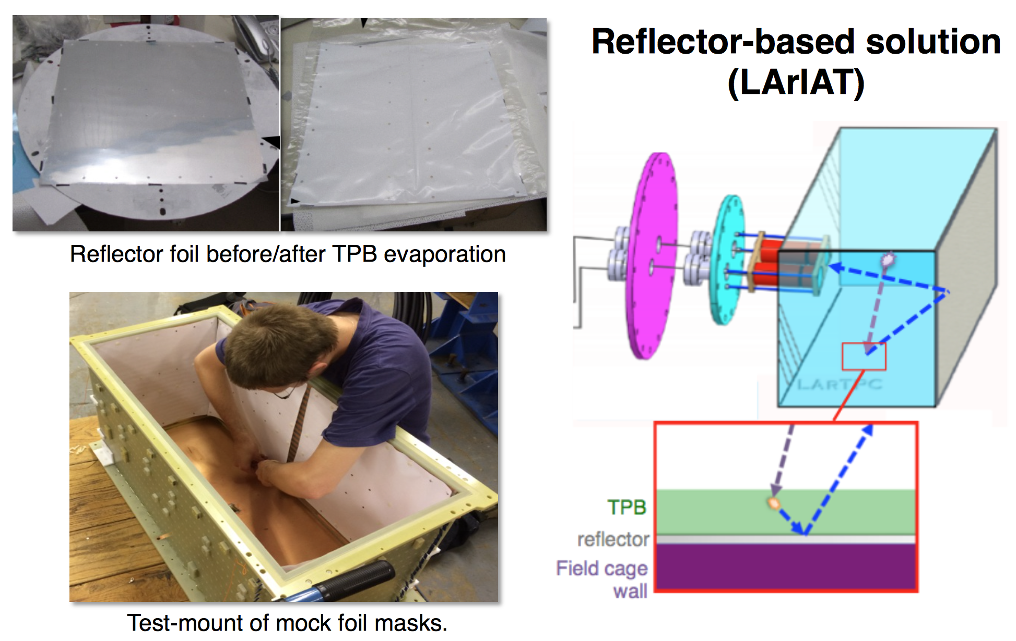
TPB Foils
Lots of light, but no granularity.
Great for getting energy thresholds down!

Slide 34
Doping
Adding stuff to argon or xenon to make it better or brighter.
Some aspects of gas doping will be discussed later in the week (too detailed for me to go into now…)
A commonly revisited scheme is Ar+Xe doping to shift light to 175 nm.
First proposed (I think) by ICARUS, and re-proposed by many since.
*
Ar
Ar
Ar
Ar
Xe
Xe
*
Xe
Xe
(would emit 175nm)
(emits 128nm)

Slide 35



Xe Doping
A SLIDE I SHOWED AT CPAD2016:
Addition of xenon can produce excitation transfer which moves light to earlier times.
Common myth : “TPB is brighter at LXe wavelengths” – not true!
But bringing late light to earlier times after the pulse makes it more easily collectable, and more useful.
~100 ppm required → multiple tons for DUNE. Not a cheap proposal.
Gehman et al.
Nucl.Instrum.Meth. A654 (2011) 116-121
LAr scintillation
Lxe
scintillation
Wahl et al. JINST 9 (2014) P06013

Slide 36

Xe Doping
Addition of xenon can produce excitation transfer which moves light to earlier times.
Common myth : “TPB is brighter at LXe wavelengths” – not true!
But bringing late light to earlier times after the pulse makes it more easily collectable, and more useful.
~100 ppm required → multiple tons for DUNE. Not a cheap proposal.
Gehman et al.
Nucl.Instrum.Meth. A654 (2011) 116-121
LAr scintillation
Lxe
scintillation
Wahl et al. JINST 9 (2014) P06013

Slide 37



Brand new paper on TPB efficiency, with some of the old collaborators, changes this conclusion entirely.
Also major implications for several absolute MC model calibrations used today.
Gehman et al 2011
Benson, Orebi Gann &Gehman, 2017
Xe: 0.4
Ar: 1.2
Xe: 0.8
Ar: 0.3
→ Xenon doping should give both more light AND better light!

Slide 38


TPB as a dopant (whether you want it to be or not)
New result from UTA: Data indicate TPB soluble in LAr at >10ppb level
TPB
coated
stuff
Sintered disk
(remove flakes)
Assay sieves w/fluorescence and GCMS
Extracted by mol. sieves- recirculating detectors should reach some secular equilibrium (depends on vol exch/day)
10ppb may be enough to make argon “glow”. We are testing for this presently.
Paper in prep, more in backups

Slide 39
And now…
The rest of my talk will be about these two things, and the relationship of light collection to them:
1. Utterly gigantic LArTPCs for long baseline physics.
  (LETS DO IT, BECAUSE I WANT TO KNOW WHAT δ_{CP} IS!)
2. Utterly low background 0νββ TPCs.
  (LETS DO IT, BECAUSE I WANT TO DISCOVER MAJORANA NEUTRINOS!)
Notes:
25 minutes

Slide 40


The challenge:
Precise energy resolution (<2% FWHM) required to reject 2 neutrino mode requires strong light collection for calorimetry.
Very low backgrounds (NSAC stated criterion: <0.1 count per ton per year in the ROI) required for >10²⁷yr sensitivity

Slide 41
Liquid and gas TPCs for 0νββ use light very differently!

Slide 42
Ionization.
+
+
p
Xe
Xe
e
-
Ionization
A well defined energy fraction is converted into ionization electrons
“Intrinsic” energy resolution achievable by measuring ionization only, at 2400MeV is around 0.3% at Q_{ββ}
Fano Factor = 0.15

Slide 43
At high densities…
+
+
e
-
p
Xe
+
*
-
Xe
Xe
Xe
Xe
Xe
e
Ionization
Thermalization of electrons
Recombination
At high densities, ionization charge is lost to recombination
The recombination process is random, and this introduces fluctuations → intrinsic resolution is degraded
(ionization no longer carries a well known fraction of event energy)

Slide 44
Energy resolution in liquid and gas Xe TPCs, ionization only
NIM A 396 (1997) 360-370
Liquid
Recombination
Limited gas
Intrinsic (up to ~15 bar)

Slide 45
Everyone gets this light:
+
Xe
γ
p
*
*
Xe
Xe
Xe
Xe
Xe
Atomic Excitation
Self-trapping
Radiative decay
As well as ionization, charged particles cause excitations that emit light – “self-trapped exciton luminescence”
This primary light exists in both liquid AND gas (we all use it to measure t₀).

Slide 46
This light only in liquid:
+
+
e
-
p
Xe
+
*
-
Xe
Xe
Xe
Xe
Xe
e
Ionization
Thermalization of electrons
Recombination
Radiative
decay
Xe
γ
In liquid, where density is high, there is another component to the light, “recombination luminescence”
This light exists in liquid but not in gas. Its fluctuations anti-correlate with random charge fluctuation.
Xe

Slide 47

In liquid:
7kV/cm
662 keV
Liquid, no correction
Liquid, with correction
NEXT-DBDM
Gas, ionization only
Caveat-ish:
- All the liquid lines are E-field dependent
- Gas has minimal recombination so ~no E-field dependence

Slide 48
Amplifying the charge in gas
In high pressure gas, measuring ionization charge alone gives excellent energy resolution (0.3%) in principle.
Now the challenge is to amplify it without introducing fluctuations.
Use electroluminescent gain mechanism:
Avalanche mode
-HV
EL mode
-HV
e⁻
e⁻
e+Xe → e⁻ +Xe*
e+Xe → 2e⁻+Xe⁺
e+Xe → e⁻+Xe*
Collect this secondary light to measure charge
γ
γ
GND
GND
Electrons get enough energy to ionize as well as excite Xe:
→ big fluctuations in photon yield
Only enough energy to excite Xe
→ small fluctuations in photon yield

Slide 49

Light collection strategies in liquid and gas 0νββ TPCs experiments are different:
In GAS:
  Measure primary charge
  Do it by turning it into light through fluctuationless EL gain (1000 γ per e)
  Count enough photons with enough uniformity to know original number of electrons to <0.5%.
  Main scaling challenge (to ton-scale): EL region needs to be ~1.5m diameter & uniform (after calibration)
In LIQUID:
  Measure both charge + light, combine to remove recombination fluctuations
  Original primary photons need to be measured with very high efficiency to maintain resolution.
  Main scaling challenge (to ton-sale): Very high photocathode coverage, w/high efficiency & low noise is required.
NEXT-NEW
EXO-200

Slide 50

Light collection in nEXO:
Fully active SiPM planes on all walls proposed to achieve high photocathode coverage:
IEEE Trans.Nucl.Sci. 62 (2015) no.4, 1825-1836
Ongoing R&D to find + characterize best SiPMs and develop system aspects

Slide 51



Light collection in NEXT:
PMTs for energy
SiPMs for tracking
(possible future addition of SiPMWheel as anode → Enable calorimetry at tracking end)

Slide 52
NEXT-NEW first(ish) light:
Extrap. <1% FWHM at Q_{ββ} at energy plane (PMTs)
Single vs double electron discrimination demonstrated at tracking plane (SiPMs)
Talk by Neus Lopez March on Sunday

Slide 53
Summary
A rapid tour through light collection strategies in LAr, LXe and HPGXe.
My review was incomplete, but hey, we have this whole workshop to hear more!
Many inventive approaches to a hard problem exist.
Through hard work they all keep getting better.
Probably none of them yet good enough to exhaust physics potential of next-generation experiments.
Lets hear more about all the great work going on!

Slide 54



Slide 56



More on solubility:

Slide 57



Next tests:
HPGXe and liquid argon tests of SiPMWheel in preparation
1.7m
HPGXe tests (Jones lab)
LAr tests (Asaadi Lab)

Slide 58
Mechanisms of Scintillation in LAr
In liquid argon, there are two important scintillation mechanisms:

Slide 59
Mechanisms of Scintillation in LAr
1: “Self-trapped exciton luminescence”
+
Ar
γ
p
*
*
Ar
Ar
Ar
Ar
Ar
Atomic Excitation
Self-trapping
Radiative decay

Slide 60
Mechanisms of Scintillation in LAr
+
+
e
-
p
Ar
+
*
-
Ar
Ar
Ar
Ar
Ar
e
Ionization
Thermalization of electrons
Recombination
Radiative
decay
Ar
γ
2: “Recombination luminescence”
Ar
Recombination step involves an electron cloud around the track core
-> E-Field dependent scintillation yield
-> dE/dx dependent scintillation yield
-> Charge and light anti-correlation

Slide 61
Self-trapped exciton luminescence
+
Ar
γ
p
*
*
Ar
Ar
Ar
Ar
Ar
Recombination luminescence
+
+
e
-
p
Ar
+
*
-
Ar
Ar
Ar
Ar
Ar
e

Slide 62
Something to note:
+
Ar
γ
p
*
*
Ar
Ar
Ar
Ar
Ar
+
+
e
-
p
Ar
+
*
-
Ar
Ar
Ar
Ar
Ar
e
Both pathways rely on the formation of excimers

Slide 63
Ground state of 2 argon atoms is unbound
Excimer states are Rydberg states : Ar²⁺ core with a bound electron
Ar
Ar
e⁻
Ar₂⁺

Slide 64

Calculations of the excimer state energies of xenon, as a function of nuclear separation
J. Chem Phys 52, 5170 (1970)
e⁻
Ar₂⁺

Slide 65
Calculations of the excimer state energies of xenon, as a function of nuclear separation
J. Chem Phys 52, 5170 (1970)
There are two low lying excited states:
A singlet state 1Σu⁺
A triplet state 3Σu⁺
Singlet and triplet refer to how the spin of the electron and argon dimer couple in the rydberg “atom”.
e⁻
Ar₂⁺

Slide 66
All scintillation light comes from excimer decay
*
Ar
Ar
Ar
γ
Ar

Slide 67
Calculations of the excimer state energies of xenon, as a function of nuclear separation
Why are LAr / LXe transparent to their own scintillation light?
J. Chem Phys 52, 5170 (1970)
128 nm photon emission

Slide 68
How about the reverse process (absorption?)
γ
Ar
Ar
*
Ar
Ar

Slide 69
Calculations of the excimer state energies of xenon, as a function of nuclear separation
Why are LAr / LXe transparent to their own scintillation light?
J. Chem Phys 52, 5170 (1970)
Typical separation in the liquid phase ground state
(~4A, naively from liquid density)
128 nm photon emission

Slide 70

Impurities in LAr
Ultra-pure argon is very transparent. Dirty argon is not.
All liquid argon will have trace impurities at some level.
Some impurities are important for drift, some for light, some for both.
Impurities which are difficult / expensive to remove are those which are
  1) present in the raw gas
  2) similar in boiling point to LAr
  3) not removable by regenerable filtering techniques
The composition of impurities depends on the source of the raw gas.
An argon isolation plant

Slide 71


Industrial argon for large neutrino detectors
Large quantity required at low cost
Raw gas : air
Produced by industrial distillation and then purification with molecular sieves and filters
Contaminants include nitrogen (ppm), oxygen and water (<ppb)
Underground argon for dark matter detectors
Low radioactivity from ³⁹Ar required
Raw gas : CO₂ from underground wells
Produced by VPSA, cryogenic distillation and filtering
Contaminants include helium, methane, O₂, CO₂ H₂O
Supply
Molecular sieve
Activated copper
Cryostat
Flare filter + sieve system (FNAL)
Underground argon distillation column (FNAL)

Slide 72


Absorption by Nitrogen
Shown at last years LArTPC workshop – absorption due to dissolved nitrogen at the ppm level:
BJPJ et al, 2013 JINST 8 P07011
Monitor light yield from 2 sources as nitrogen is injected
(near source)
27ppb N2
3.7ppm N2
7.4ppm N2
15.5 ppm N2
Expected attenuation length due to N2 at 2ppm (MicroBooNE cryo spec) is ~30m.

Slide 73


Absorption by Methane
New for this year’s meeting – the effects of methane have also been studied in both visible and UV:
BJPJ et al, 2013 JINST 8 P12015
Absorption is accompanied by no visible re-emission (reported in gas phase)
<10ppb methane contamination is required for modern DM experiments.

Slide 74
Self-trapped exciton luminescence
+
Ar
γ
p
*
*
Ar
Ar
Ar
Ar
Ar
Recombination luminescence
+
+
e
-
p
Ar
+
*
-
Ar
Ar
Ar
Ar
Ar
e

Slide 75
~35%
Self-trapped exciton luminescence
Ar
Ar
*
+
Ar
γ
p
*
~65%
Ar
Ar
Ar
*
Ar
Ar
Recombination luminescence
~50%
+
+
e
-
Ar
Ar
Ar
*
p
+
Ar
e
-
Ar
Ar
~50%
Ar
Ar
*
The production of singlets and triplets is not equally weighted between the two processes

Slide 76
The fate of the excimer states
6 ns
Ar
γ
The singlet decays into two argon atoms and a photon, in 6ns
*
Ar
Ar
Ar
1500 ns
The triplet decays in ~1500 ns
Some disagreement in the literature as to whether this decay proceeds via the singlet, or directly to the ground state
Either way, time constant much longer than the singlet.
*
Ar
Ar

Slide 77

Typical pulse on a PMT, from an a alpha source scintillating in LAr
(from Bo test stand at Fermilab)
Prompt light, from singlet (6ns time constant)
Delayed light from triplet
(1500ns, dribbling in as single photons)

Slide 78

Time Constants of LAr Scintillation
An example from:
2010 JINST 5 P06003
(WArP collaboration)
Summing up many pulses to get an average waveform, you can measure time constants

Slide 79
Quenching of Scintillation Light
Ar
γ
*
Scintillation process
Ar
Ar
Ar
*
Ar
Ar
Ar
Ar
Competing Excimer Dissociation Process
N
N
*
N
N
Rate dependent on the density of excimers and density of impurity

Slide 80


Quenching by Nitrogen
First measured by WArP:
Acciarri et al 2010 JINST 5 P06003
Quenching shortens long time constant and reduces total scintillation yield. significant above ~2 ppm N₂
In MicroBooNE & LBNE/F, quenching and absorption may both be observable, but likely not problematic.

Slide 81

Quenching by Methane
We observed quenching by methane, but at concentrations much above where absorption is problematic
BJPJ et al, 2013 JINST 8 P12015
Single photoelectron shape
Averaged LAr scintillation pulse (alpha)
Deconvolved LAr scintillation pulse (linear y)
Deconvolved LAr scintillation pulse (log y)
Late time const fit

Slide 82



Excitation Transfer to Xenon
Excitation can also be transferred to a dopant which then decays with a photon.
Eg xenon : first studied by ICARUS, and more recently for dark matter detection (left)
175 nm rather than 128 nm emission gives a moderate improvement to light collection capability (depends on WLS coating)
Also brings late light to shorter timescales
From JINST 9 (2014) P06013
Wahl et al

Slide 83
Back to pure argon :
6 ns
Ar
γ
*
Ar
Ar
Ar
1500 ns
*
Ar
Ar

