Slide 1
SLAC DAQ of LArTPC
Mark Convery
6 Apr 17

Slide 2
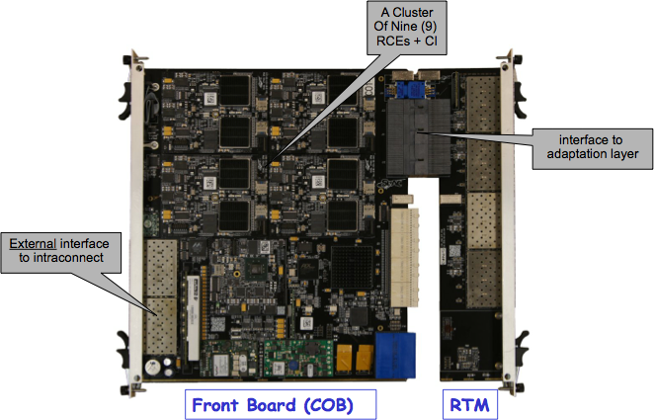
SLAC RCE-based DAQ
SLAC AIR group develops electronics and DAQ systems for HEP, Astronomy and Photon science
Focus development of toolkits that can be applied to multiple experiments
Reconfigurable Cluster Element (RCE) is most prominent example
RCE based on Xylinx Zynq FPGA
  Tight coupling of CPU and Programmable logic
Used in ATLAS CSC, LSST, DUNE 35-ton prototype, ProtoDUNE,…
Cluster-on-board (COB) holds 8 RCEs and is generic to multiple experiments (almost off-the-shelf)
Rear Transition Module (RTM) is experiment-specific and allows wide customization:
  Copper/Fiber
  Timing/Trigger inputs
  Could even do ADC on board
For small prototypes single RCEs (rather than full COB) can be used
ATCA board with 8 RCE’s
Capable of processing up to
96 inputs at 2 Gbit/s

Slide 3
35-ton Readout Overview
timing
& trigger
ATCA
Backend
computing
Cryostat
DTM
~1Gbps
x 4
Cryostat Flange
4x20x3=240
Cu in: Optical out
16
wires
Analog
ASIC
ADC
ASIC
RCE0
RCE1
4 fibers/
bundle
Analog
ASIC
ADC
ASIC
FE FPGA
RCE2
RCE3
10Gbps
ethernet
TPC DAQ PC
Analog
ASIC
ADC
ASIC
~8 ASICs
8x2 into
FPGA
RCE4
RCE5
(one PC/COB)
Analog
ASIC
ADC
ASIC
20
total
8
total
RCE6
RCE7
x4 FEB/APA
OTB
8 FE/COB
(2 COBs total)
x4 APA
FE configuration & control done over same high-speed connections
as signal, with dedicated I2C links as a backup
System operated cold at PC4
Demonstrated readout of 64 Gb/s
16 fiber bundles: Total cross section ~ 1cm²
Timing/Control also sent over fibers
  Won’t be done that way in ProtoDUNE

Slide 4
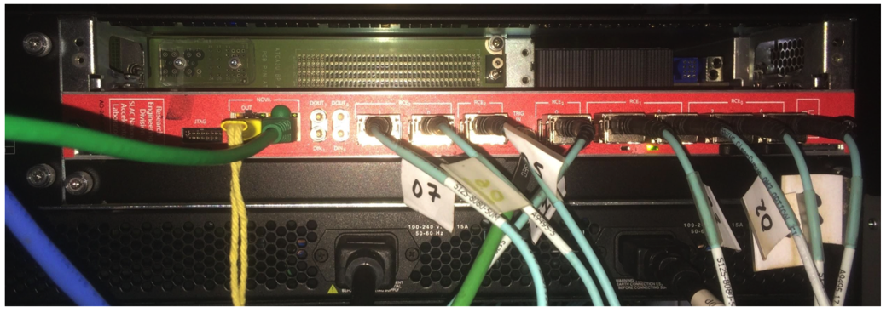
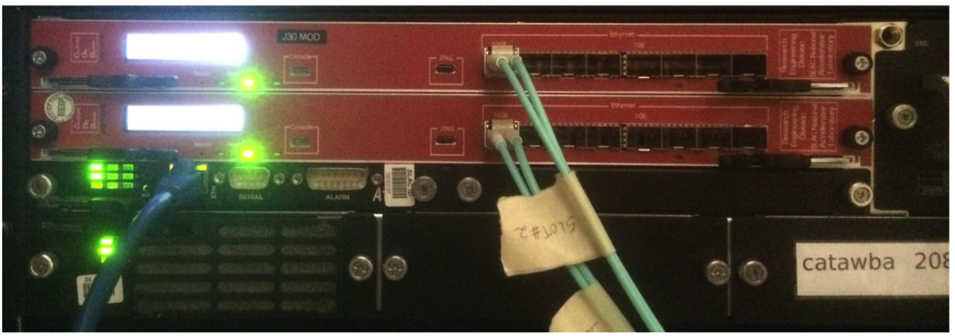
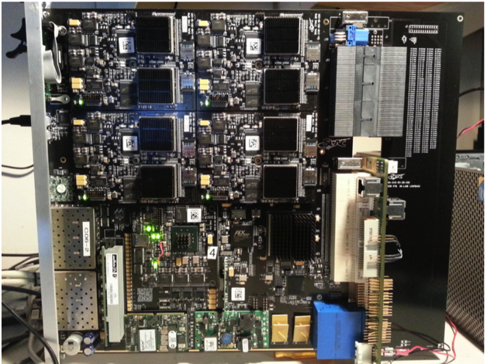
35-ton Prototype System
Recently completed 35-ton prototype run at FNAL
16 SLAC RCE’s (2 COBs) used to readout
  16 BNL Cold FEMBs (2048 channels) through Cu->optical converter with PGP protocol
  Data rate per fiber 1 Gb/s
  Total input data rate 64 Gbit/second
  Xylinx firmware running in RCE, Altera firmware running in FEMBs
RCE’s used to buffer data while waiting for 1 Hz trigger
  Send data on to back-end using TCP/IP
  Also planned to test zero-suppression algorithms – not implemented due to high noise, short run
COB Board:
8 RCEs on one
ATCA blade
Possible SLAC Contributions to ICARUS DAQ

Slide 5
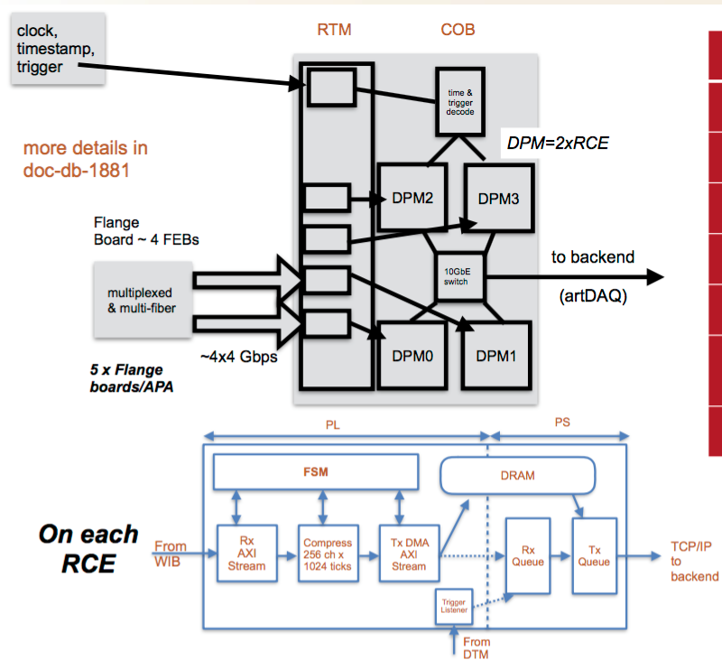
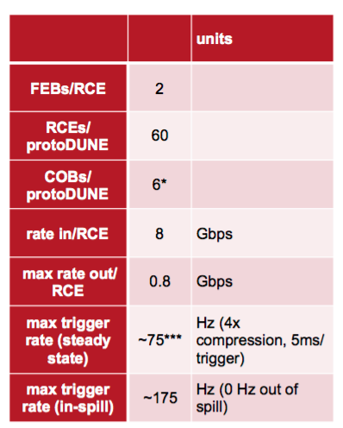
ProtoDUNE RCE-based DAQ Design
SLAC-developed RCEs used to readout WIBs and
  Compress losslessly
  Receive triggers
  Buffer data
Supporting multiple test stands employing RCEs

Slide 6
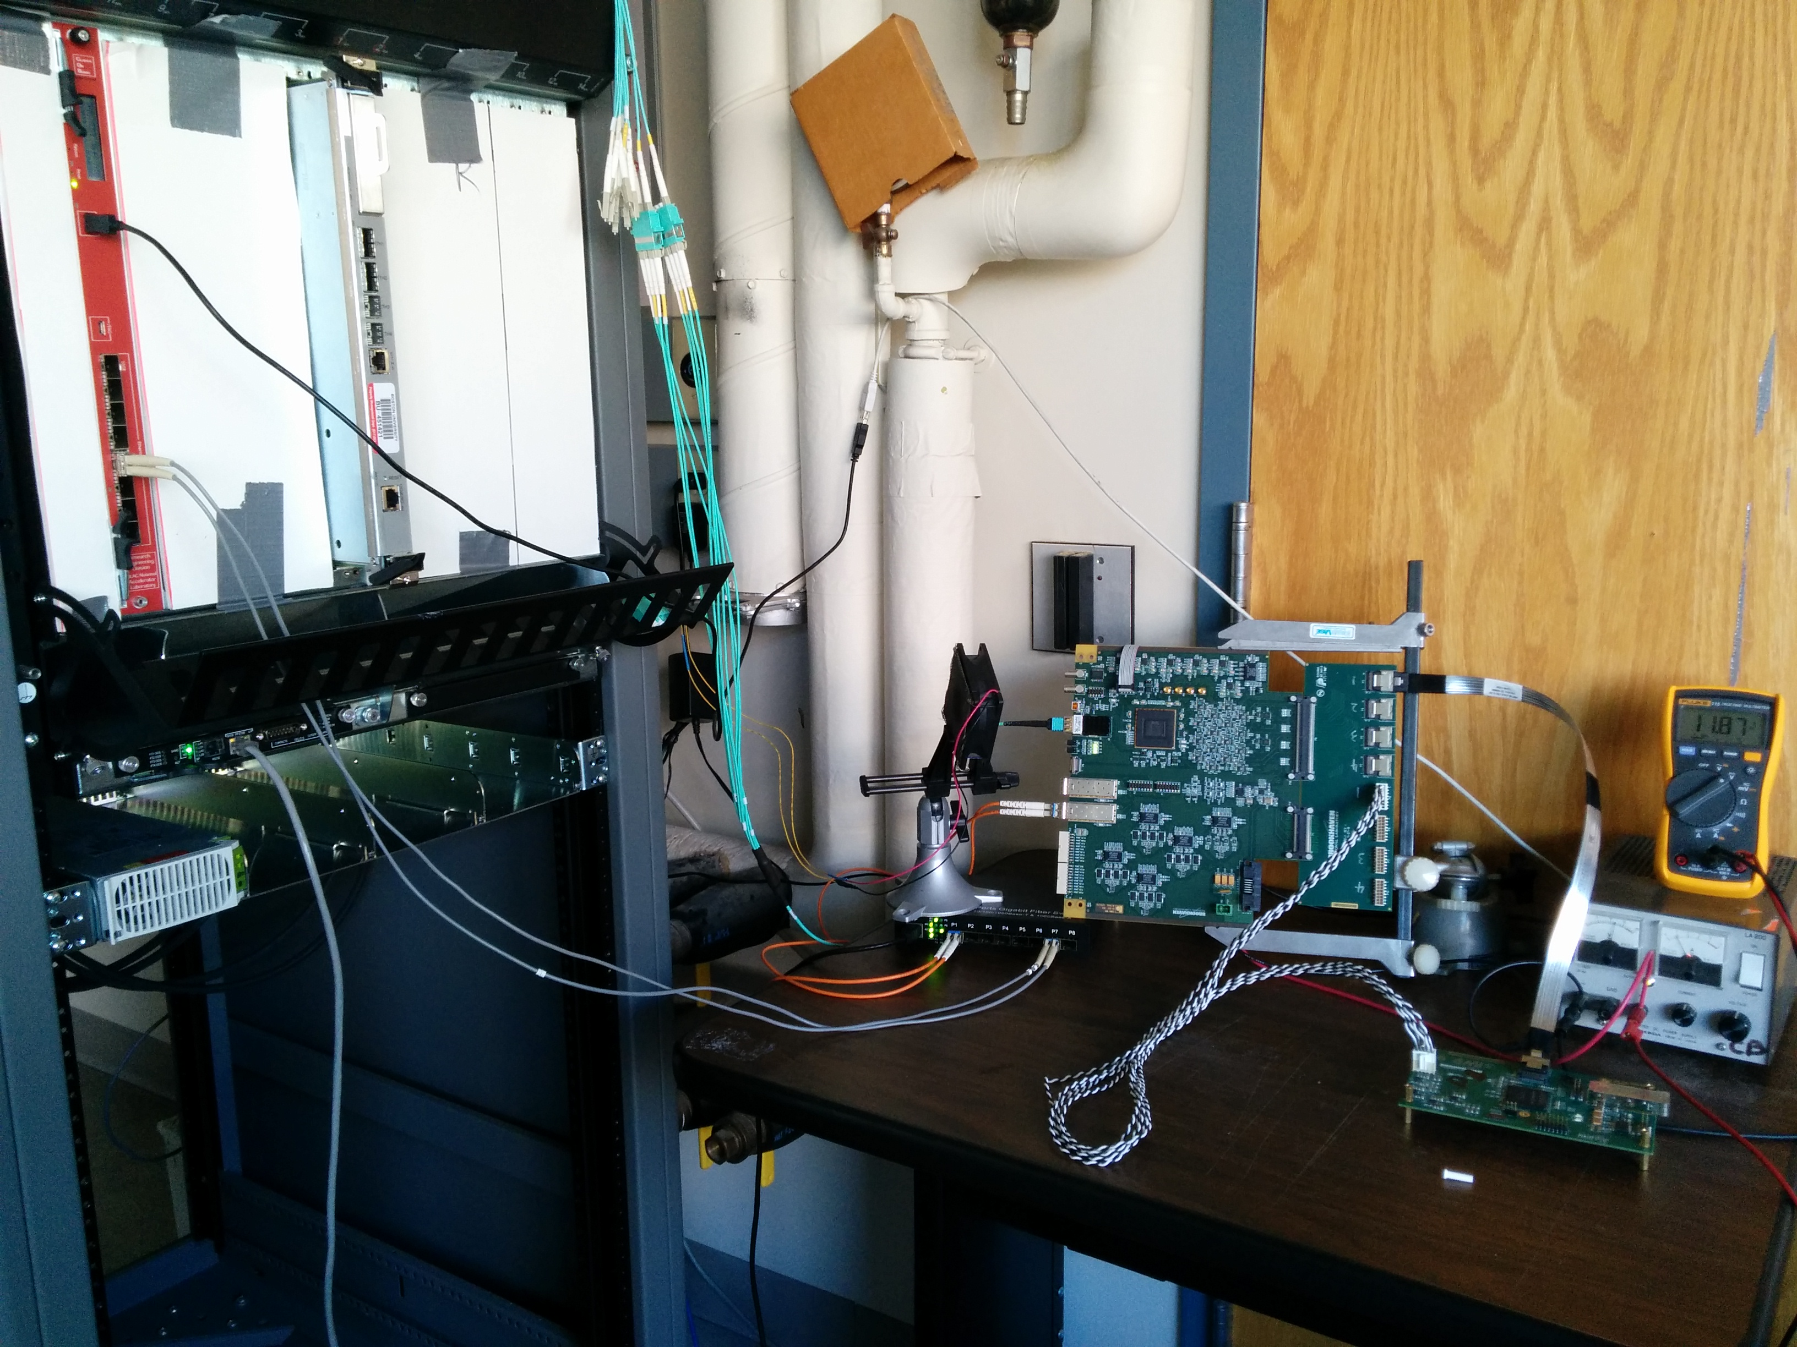

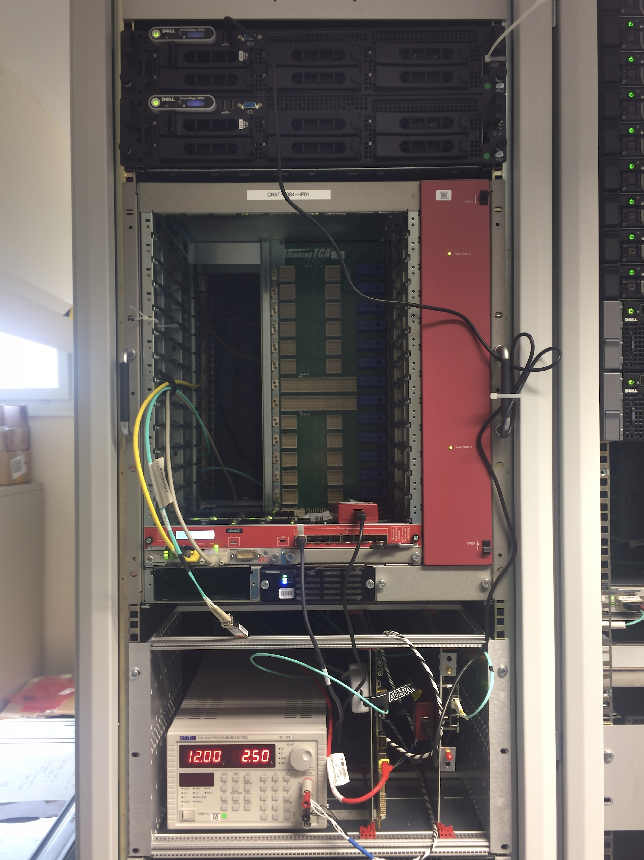
DUNE RCE DAQ Test Stands Around the World
FNAL:
Noise Test
using RCE DAQ
Boston:
WIB/RCE
integration
Oxford:
ArtDAQ with RCE data source
SLAC: Compression,
Firmware support
CERN:
Vertical Slice
Development,
Tests with timing
board

