Slide 1

QCD in the nucleus
Selected topics in
*
^
Peter Jacobs
Lawrence Berkeley National Laboratory
* The proton is also a nucleus (complex QCD bound state)…just a small one.
We therefore expect smooth rather than dramatic changes in properties when going from protons to light nuclei to heavy nuclei.

Slide 2
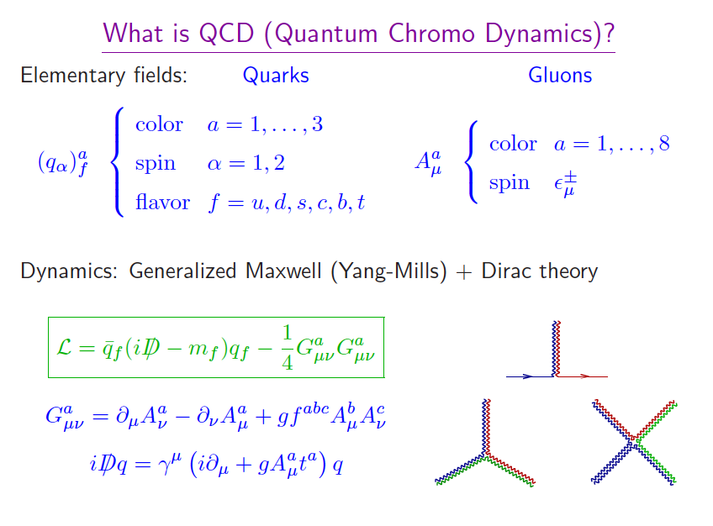
Quantum Chromo-Dynamics: the field theory of the strong (nuclear) force
Same basic structure as QED….
….except that gluons (“QCD photons”) carry color charge…
….so they interact amongst themselves, generating complex structures…

Slide 3

Running of the coupling
Consider the interaction of two elementary particles:
Momentum transfer Q²
  small Q² ⇒ large distance scales
  large Q² ⇒ small distance scales
Q²
Quantum mechanics:
  Virtual pairs (loops) screen bare interaction
  ⇒ Q²-dependent interaction strength

Slide 4
Running of the coupling: QED vs QCD
negative
QED:
Smaller |Q²| (larger distance) ⇒ weaker coupling
similar to screening of charge in di-electric material
QCD:
=+(33-12)/12π = positive!
Smaller |Q²| (larger distance) ⇒ stronger coupling
And that makes a huge difference!

Slide 5
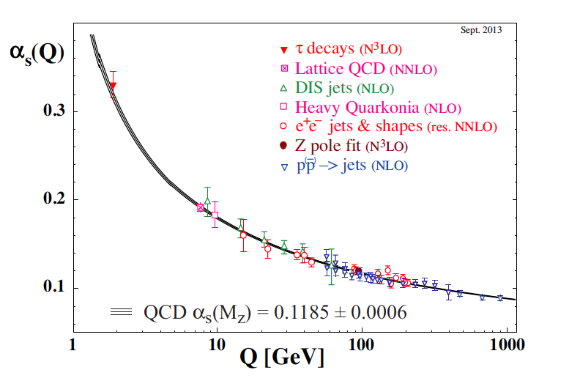
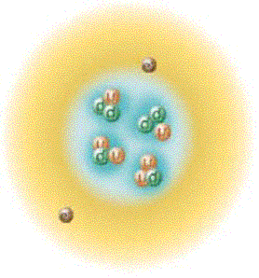
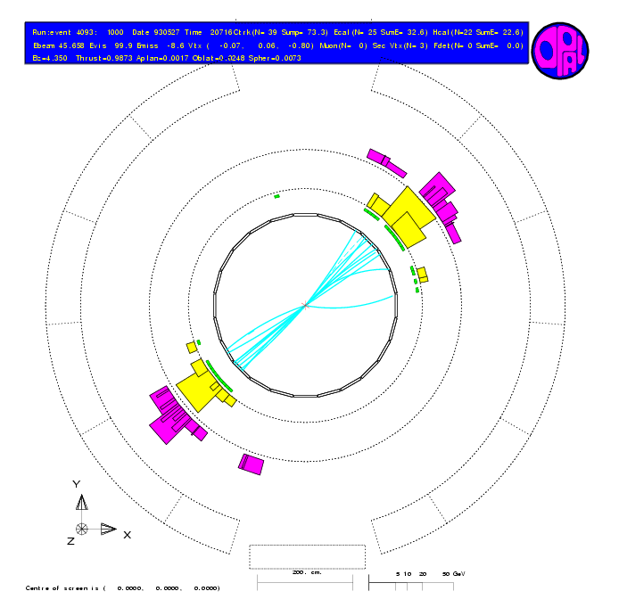




The hallmark of QCD: running of the coupling constant
Asymptotic Freedom
Confinement
Low momentum
High momentum
Gross Politzer Wilczek

Slide 6
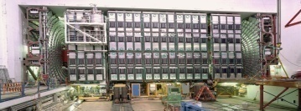
QCD jets in reality…
Final State Radiation
(FSR)
Detector
{π,K,p,n,…}
Initial State Radiation
(ISR)
Hadronization
Jet
p
Beam
Remnants
=
(uud)
Beam
Remnants
p
=
(uud)

Slide 7
Inclusive jet cross sections
CMS, Eur. Phys. J C76 (2016) 451
Magnificent achievement of QCD
needed 30 years of development in theory, experiment, and algorithms to connect the two
Infrared and colinear-safe (IRC) jet reconstruction algorithms:
Integrate out all hadron degrees of freedom
Same procedures applied pQCD theory and experiment
Enables direct, precise and improvable comparison of theory/experiment
  ➔ jets measure partons (quarks and gluons)

Slide 8
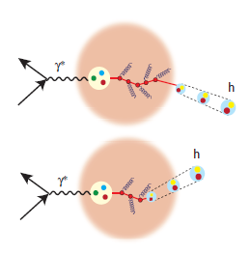
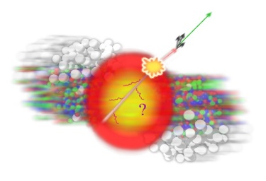
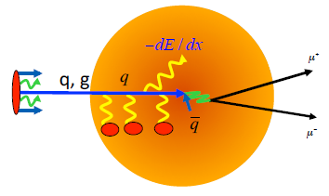
What happens if we put a hard QCD process in QCD matter?

Slide 9
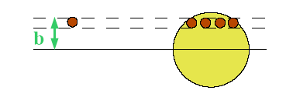
Nuclear geometry and scaling of hard process rates
Glauber scaling for hard processes with large momentum transfer
  short coherence length ⇒ successive NN collisions independent
  Assume p+A is incoherent superposition of N+N collisions
Normalized nuclear density ρ(b,z):
Nuclear thickness function
Inelastic cross section for
p+A collisions:
Hard processes are rare:

Slide 10
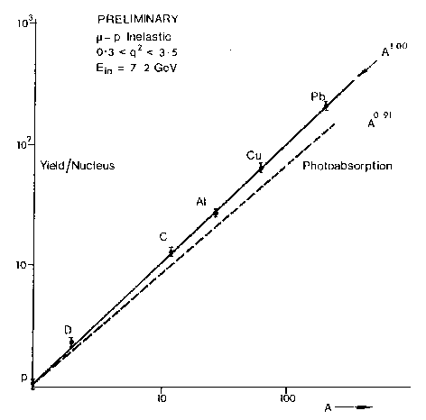
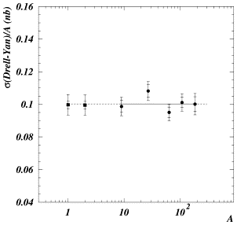
Experimental tests of Glauber scaling: hard cross sections in p(μ)+A collisions
Glauber scaling expectation:
σ_{inel} for 7 GeV muons on nuclei
σ_{Drell-Yan}/A in p+A at SPS
A^{1.00}
NA50 Phys Lett B553, 167
M.May et al, Phys Rev Lett 35, 407 (1975)
A
Hard cross sections in p+A scale as A^{1.0}

Slide 11
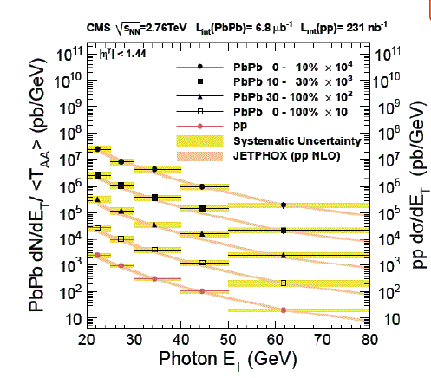
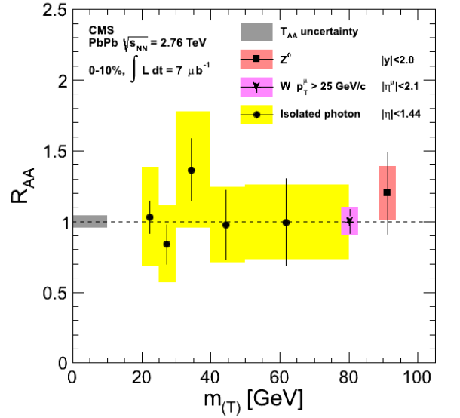
Glauber scaling tests at LHC:
Scaling of direct photon, Z, W yields in Pb+Pb vs p+p
EW bosons do not interact with Quark-Gluon Plasma – should see perturbative production rates in Pb+Pb collisions
Yields all scale with N_{bin}: Glauber scaling OK for hard processes

Slide 12
Z-production in Pb+Pb collisions
Hard-process production rates obey Glauber scaling
Glancing
Head-on
Glancing
Head-on

Slide 13
Parton Distribution Functions (PDFs) and their nuclear modification

Slide 14
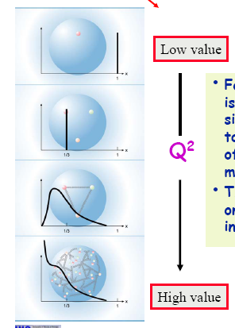
Q² (scale) evolution of Parton Distribution and Fragmentation Functions
Q² evolution
x = momentum fraction of proton
Parton Distribution Functions (PDFs) and Fragmentation Functions (FF) are not calculable ab initio in pQCD
Non-perturbative in origin (soft, long distance physics) and must be extracted from data at some scale Q₀²
pQCD specifies how PDFs and FFs evolve from Q₀² to any other scale Q² (DGLAP evolution equations)
small Q² (large scale)
large Q² (small scale)
0.1
1.0
x

Slide 15
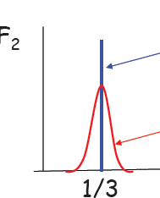
Probing the structure of the proton with DIS
Define a new quantity F₂:
parton density for flavor i
Sum over quark flavors
charge for flavor i
If a proton were made up of 3 quarks, each carrying 1/3 of proton’s momentum:
F₂
with some smearing due to quantum mechanics
x
If partons are point-like and incoherent then Q² shouldn’t matter
Bjorken scaling: F₂ has no Q² dependence

Slide 16
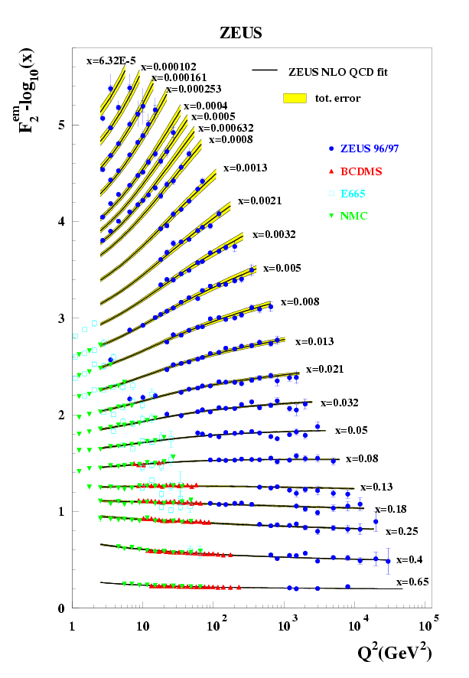
Measurement of proton F₂ at HERA/DESY
Measurements in 1980’s-90’s
Tour de force for perturbative QCD:
  Q² does matter!
    Partons are not point-like and incoherent.
    Hadronic structure depends on the scale at which you probe it!
  Spectacular agreement with DGLAP evolution

Slide 17
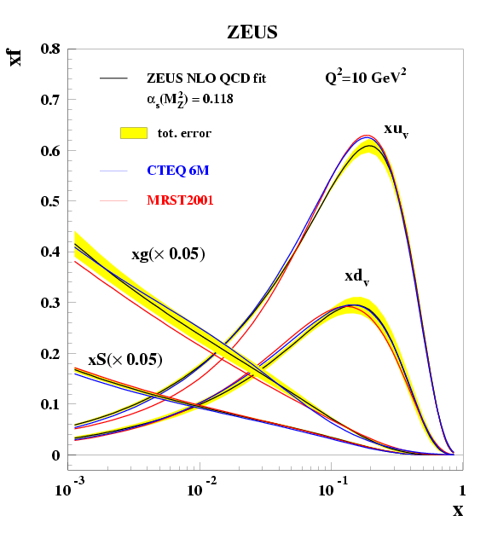
Parton Distribution Functions of the proton
x-dependence of quark and gluon densities at moderate Q²
Q² evolution
small Q²
large Q²
Soft gluons
Valence quarks (p = uud)
x ~ 1/3

Slide 18
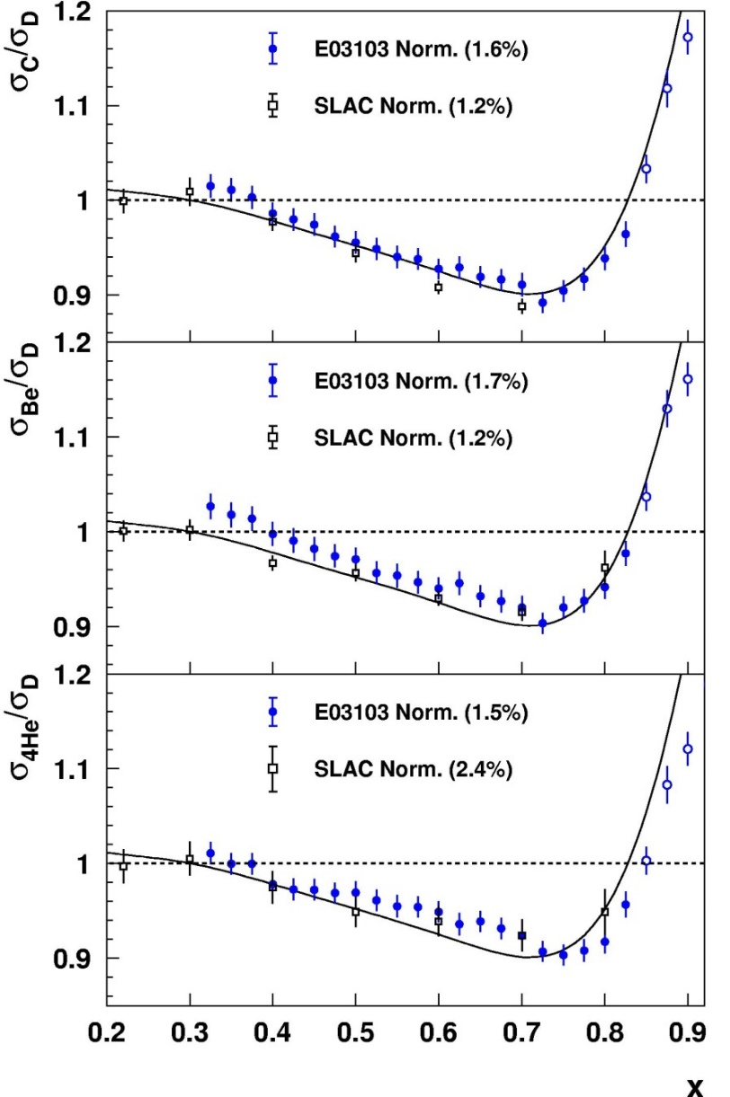
Deep Inelastic Scattering with nuclear targets: EMC effect
Fit slope of ratios for 0.3<x<0.7; compare across nuclei
EMC slope doesn’t scale with A or with avg nuclear density…
J.Seely, A. Daniel, et al., PRL103, 202301 (2009)
J.Seely, A. Daniel, et al., PRL103, 202301 (2009)

Slide 19
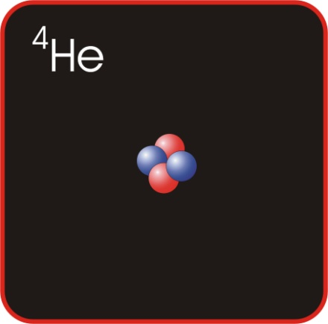
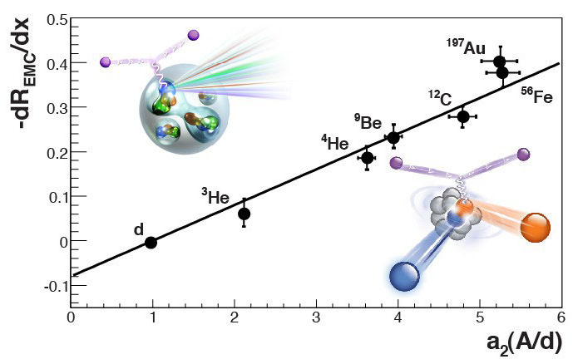
DIS with nuclear targets: EMC effect
But scales with local density!
This tells us how parton distribution functions are modified in the nuclear environment
Density determined from ab initio few-body calculation
S.C. Pieper and R.B. Wiringa,
Ann. Rev. Nucl. Part. Sci 51, 53 (2001)
Hen, Piasetzky, Weinstein,
Phys. Rev. C85, 047301 (2012)
~Local density

Slide 20
Nuclear PDFs
H. Paukkunen, QM17
In practice the nuclear effects are small…

Slide 21
Nuclear PDFs: data
Determine the nuclear modification of PDFs by a global fit to selected data
H. Paukkunen, QM17

Slide 22
Forward/backward asymmetry in p+Pb collisions

Slide 23
Jet quenching in Pb+Pb collisions: p_{T}^{jet}~ 1 TeV ?
M. Spousta, QM17
!
Possibilities:
~50% of all 1 TeV jets are lost; where does the energy go?
A 1 TeV jets loses ~100 GeV in the medium on average; where does the lost energy go?
Nuclear modification of PDFs: our expectation that AA is an incoherent superposition of NN collisions is not correct

Slide 24
Nuclear PDFs and high p_{T} jet suppression
Rough “calculation”, not to be taken literally
Essential lesson: jets at ~1TeV are in EMC-shadowing region, need accurate calculation including nPDFs

Slide 25
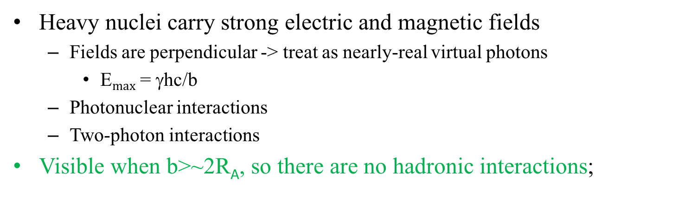
Ultra-peripheral collisions (UPCs)
Heavy nuclei carry strong electric and magnetic fields
  Fields are perpendicular -> treat as nearly-real virtual photons
    E$max$ = γhc/b
  Photonuclear interactions
  Two-photon interactions
Visible when b>~2R_{A}, so there are no hadronic interactions;
Energy | AuAu RHIC | pp RHIC | PbPb LHC | pp LHC
Photon energy (target frame) | 0.6 TeV | ~12 TeV | 500 TeV | ~5,000 TeV
CM Energy W_{γp} | 24 GeV | ~80 GeV | 700 GeV | ~3000 GeV
Max γγ Energy | 6 GeV | ~100 GeV | 200 GeV | ~1400 GeV
UPC@LHC provides clean production channel γγ ➞Higgs (Cahn and Jackson ~1990)
In practice: LHC heavy ion lumi too low to be competitive

Slide 26
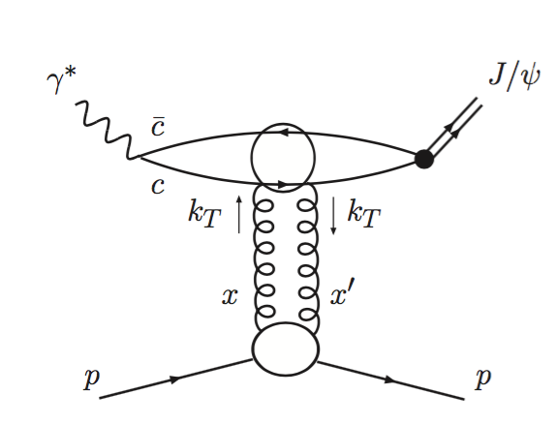
Photo-nuclear VM production
Photo-nuclear J/𝜓 production may be sensitive to nuclear gluon density:
arXiv:1603.01919
Data: ALICE
J/𝜓 in Pb+Pb collisions
MSTW: no nuclear effects
EPS, nDS: nuclear PDFs
In principle can probe gluon density of proton at LHC down to x~10⁻⁶
But interpretation as PDF is controversial: factorization not strictly respected

Slide 27
Gluon density vs Q²
Fix Q² and consider what happens as x is decreased…
Q² evolution
small Q²
large Q²

Slide 28
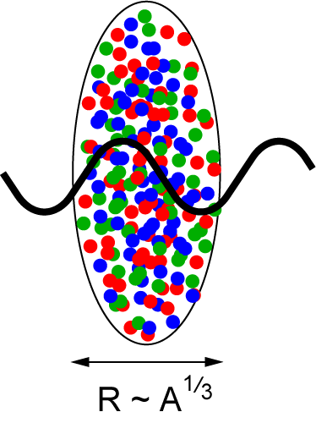
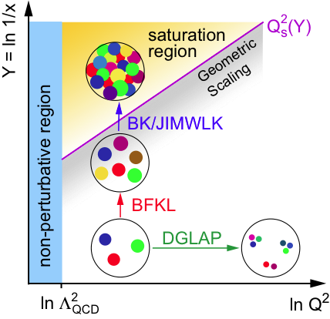
Gluon density in heavy nuclei
Long wavelength (low Q²) gluon density much higher in nuclei that in protons, due to the geometry of nuclei
⇒ saturation regime reached at
significantly lower √s in nuclei
Au: ~200 times smaller effective x

Slide 29
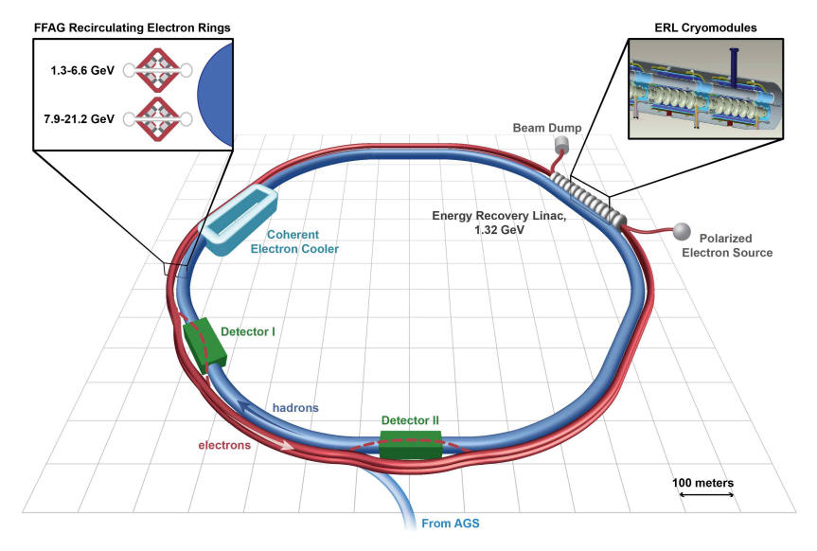
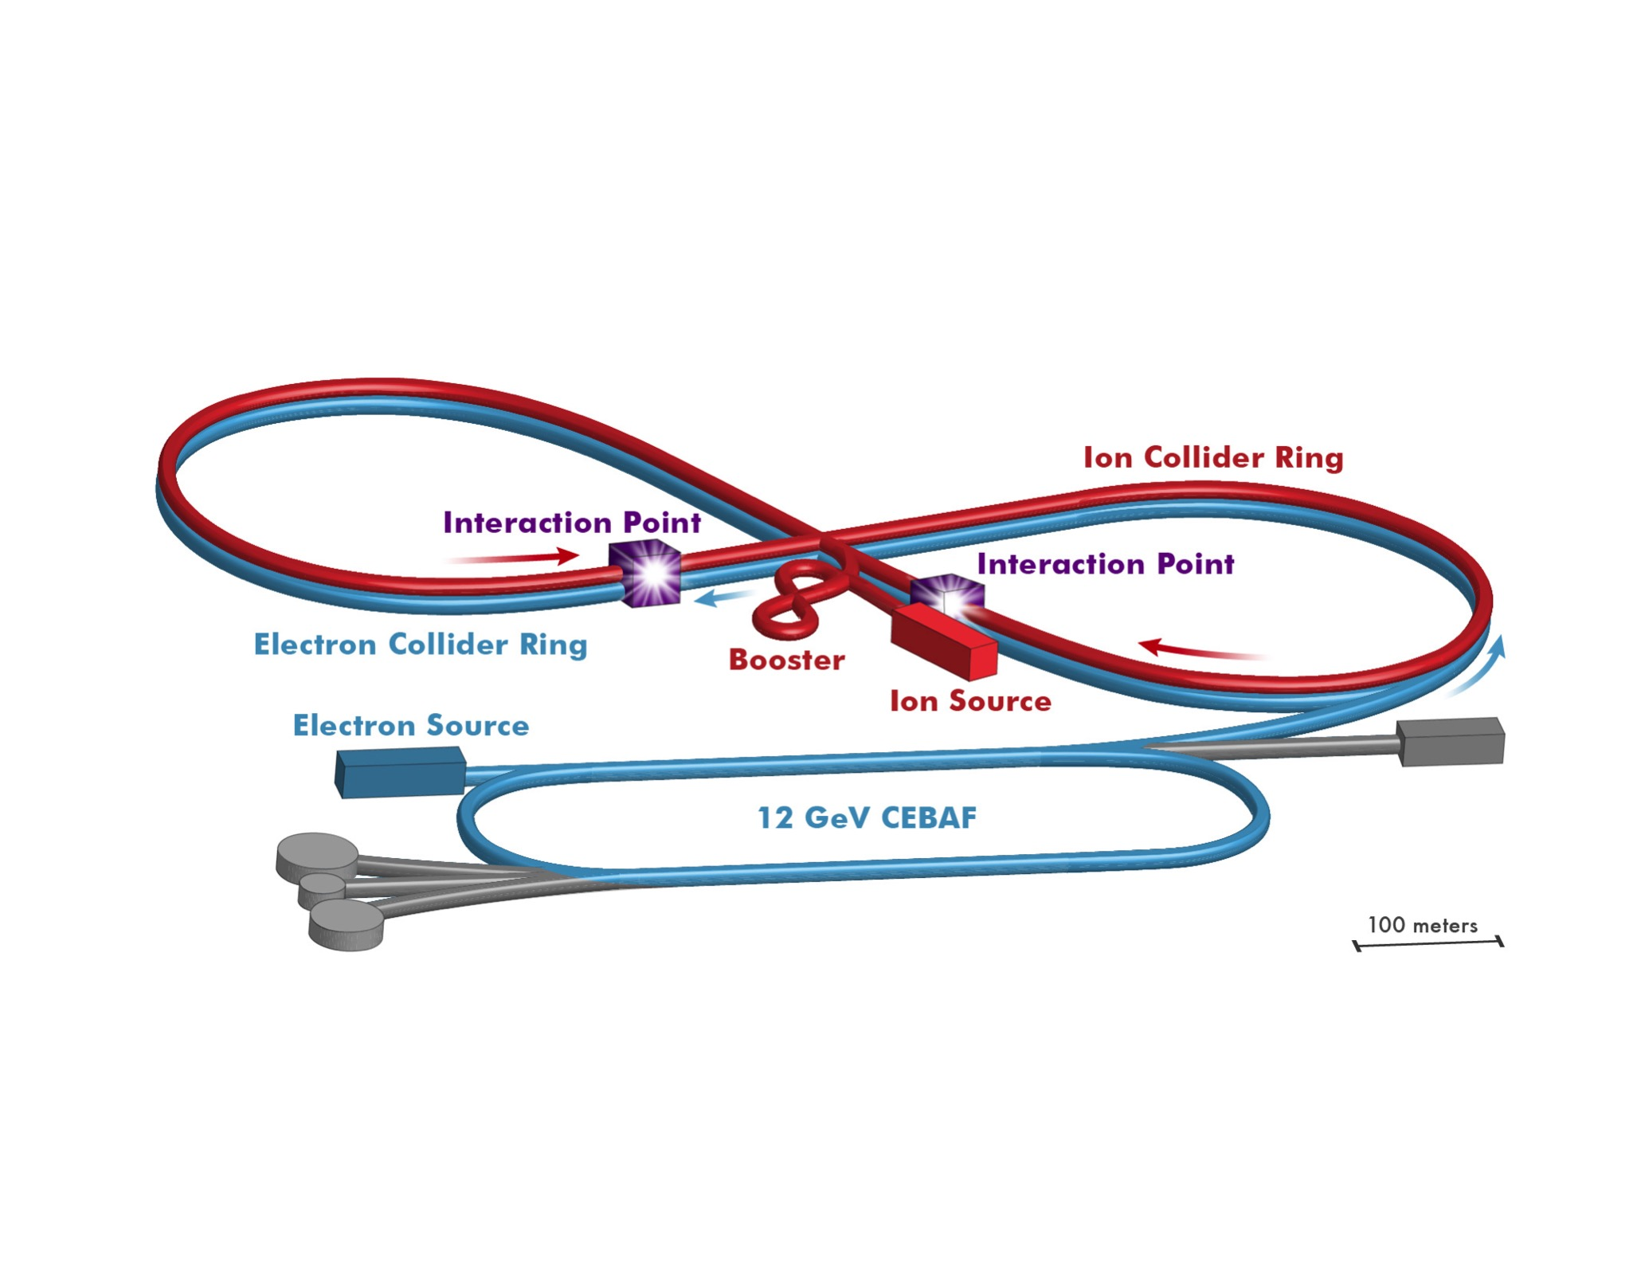
Long-term future for QCD in the nucleus: Electron-Ion Collider

