Slide 1
‘RPV Susy’- LHC Calorimeter classification
Evan, Steve, Thorsten, Wahid

Slide 2
Physics Problem and CNN
Classification problem – finding ‘RPV Susy’ Signal against ‘QCD’ background (i.e. the analysis in ATLAS- CONF-2016-057, 2016 )
Benchmark is the selections in that analysis paper
Before training we apply the ‘baseline’ physics selections of ATLAS- CONF-2016-057 (to make datasets smaller)
The CNN treats ‘ATLAS’ Calorimeter as an image
Similar to Jet Images (etc.) except that we use whole calorimeter and directly for analysis (not for types of jets).
Bin cluster or tower energy in eta/phi to make the image – no other pre-processing
Gaspar’s approach (graph CNN) does not do this binning

Slide 3
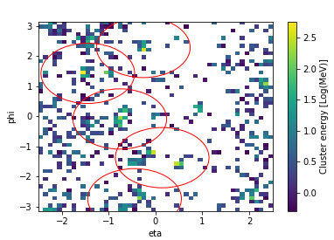
Dataset
Simulated, labeled data from Pythia (with configuration matching ATLAS) and Delphes (default ATLAS detector card)
mGlu = 1400 mNu =850
We also have ATLAS full-simulation xAOD samples – decent agreement.
Bin cluster/tower Energies in 64x64 EtaxPhi
Arbitrary but not far from 0.1x0.1 resolution
[For large-scale studies on Cori used this problem with 224x224 bins – and 3 channels (EM fraction and n_tracks)]
Circles in this plot are jets in physics cut analysis (not used in CNN)

Slide 4
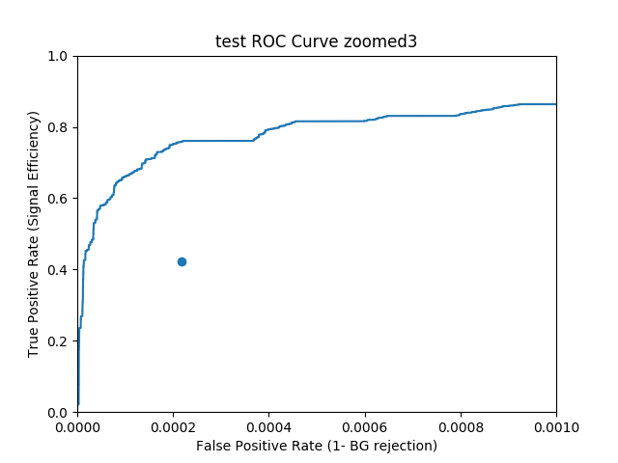
Current CNN performance
‘Simple’ Convolutional architecture
Alternating Convolutional and Pooling layers with batch normalization and no dropout.
Backgrounds generated in pt ranges
Weight these in correct ratio for evaluation and in loss for training
Need decent signal efficiency (true positive rate) and very high background rejection (low false positive rate)
Physics selections
(cuts)
Validation dataset
Cuts not tuned for this delphes data:
Will compare to shallow classifiers
(and we see similar improvement with real ATLAS samples )

Slide 5
Some interpretation stuff

Slide 6
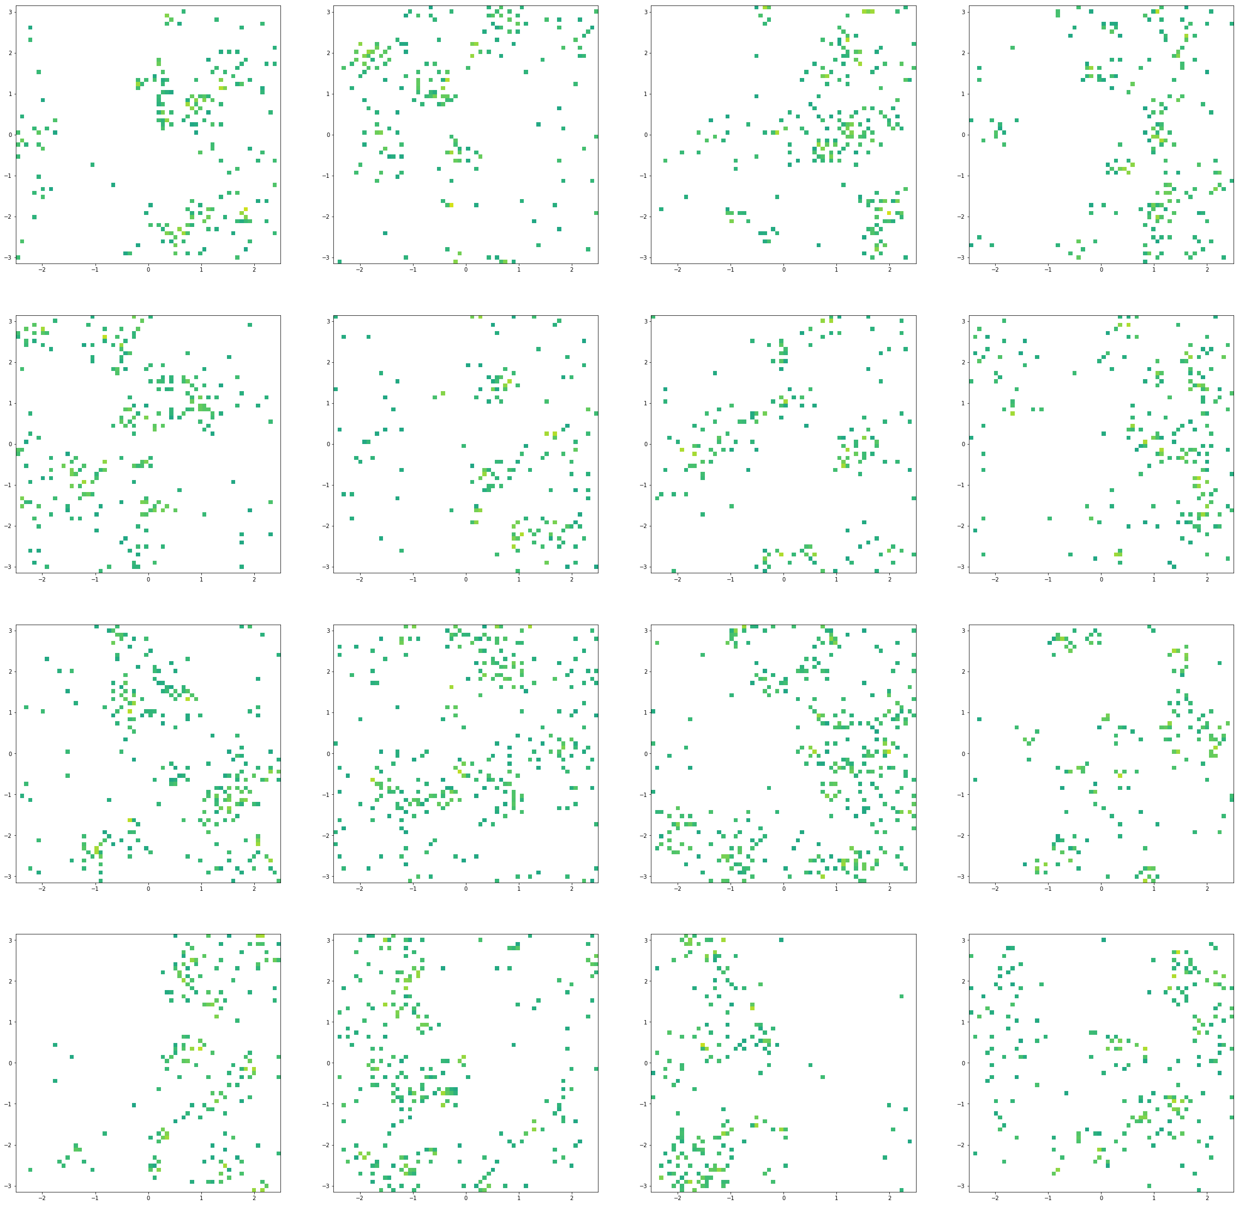
Example images which are signal and cuts say so but network has prob < 0.01

Slide 7
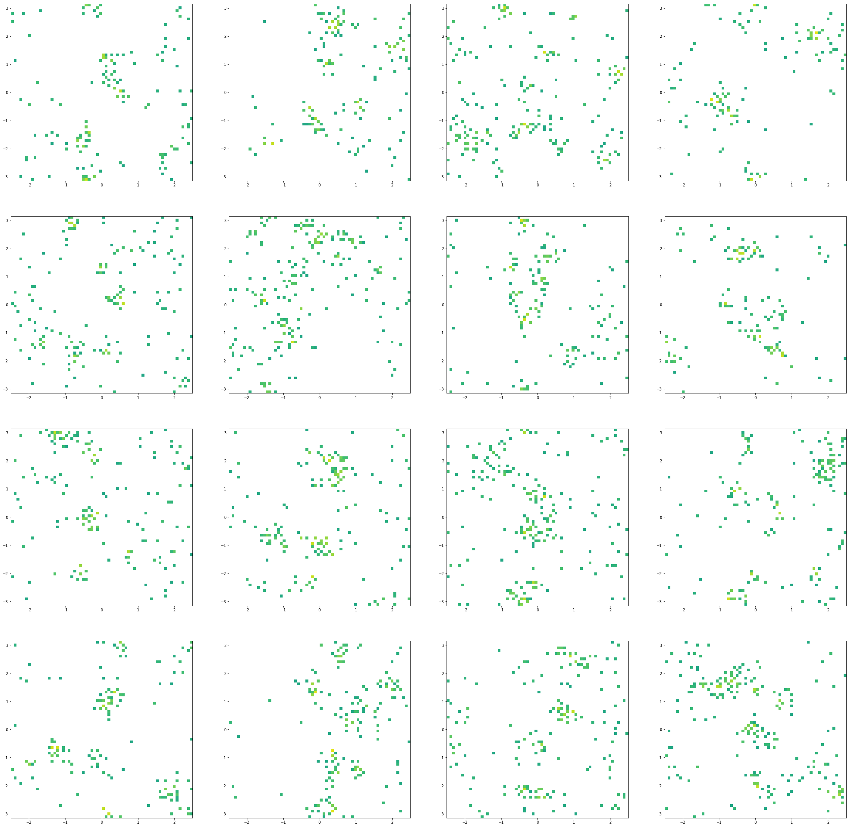
Example images which are bg and cuts say so but network has prob > 0.01

Slide 8
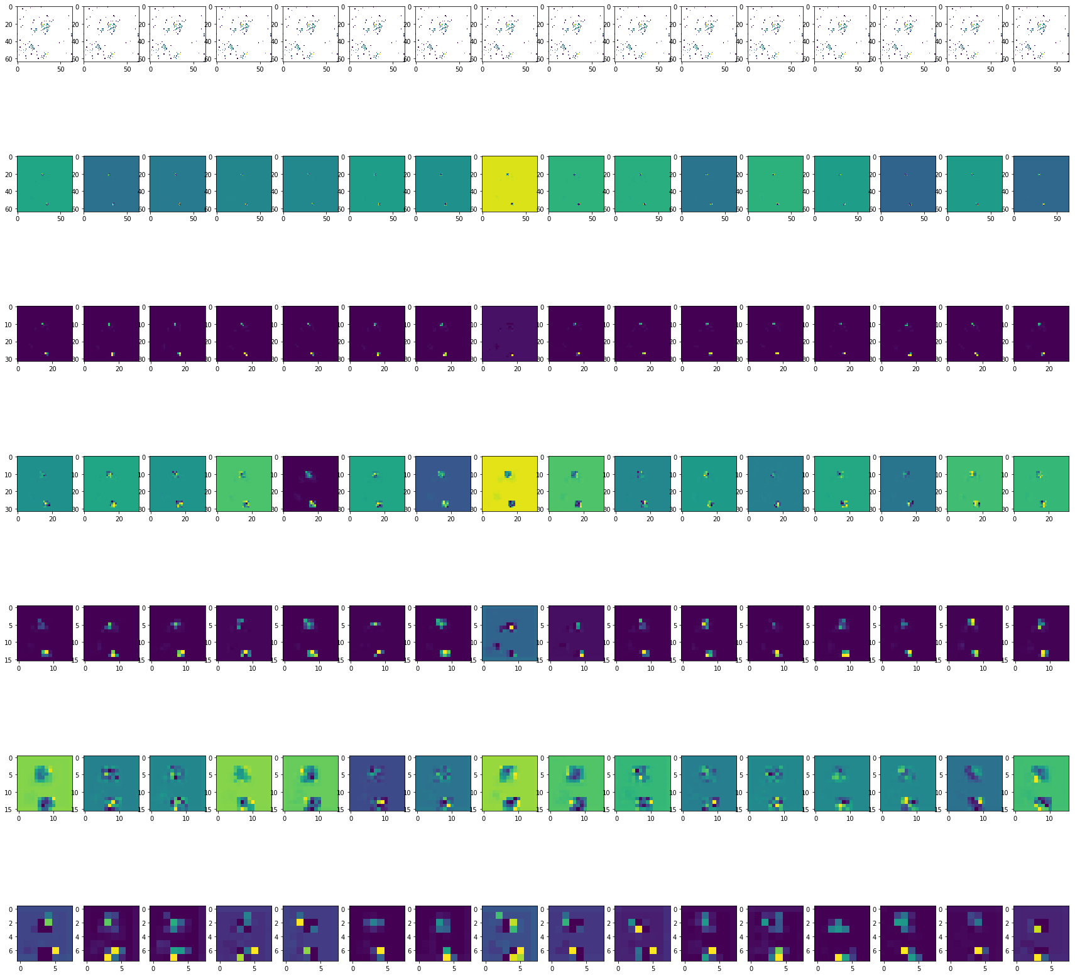
Feature Maps: Background example

Slide 9
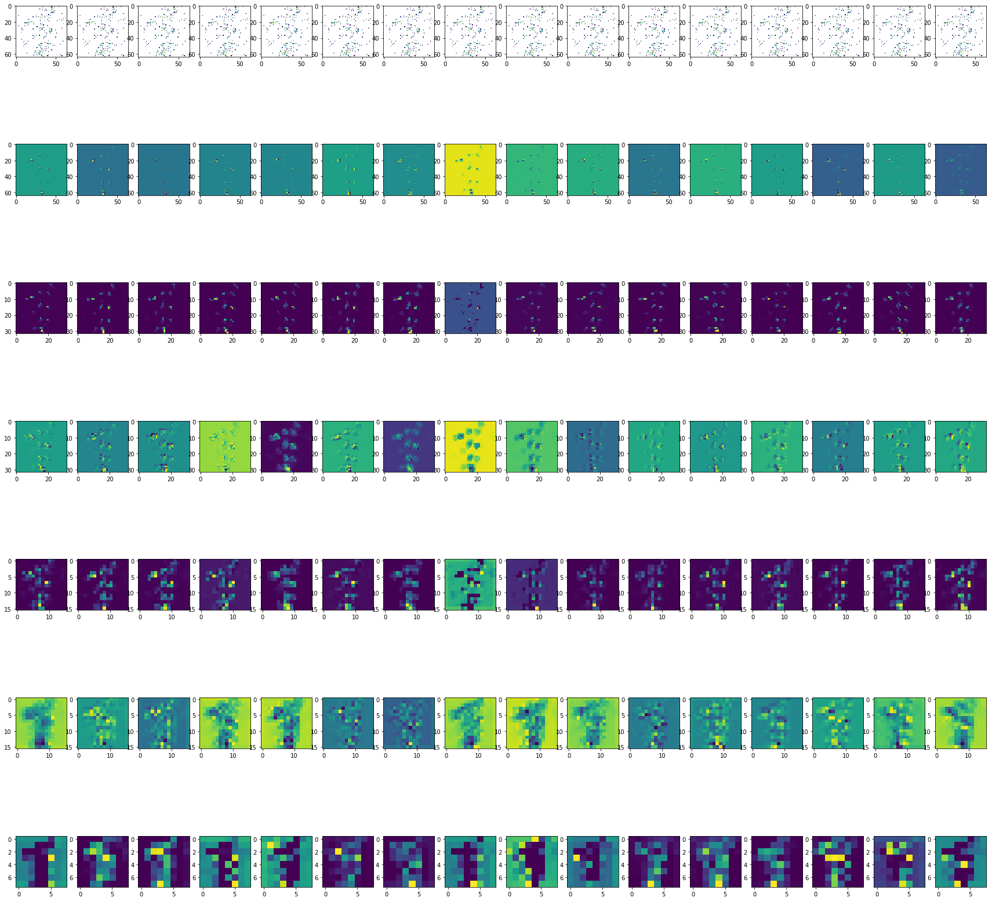
Signal example (both cuts and network think signal)

Slide 10
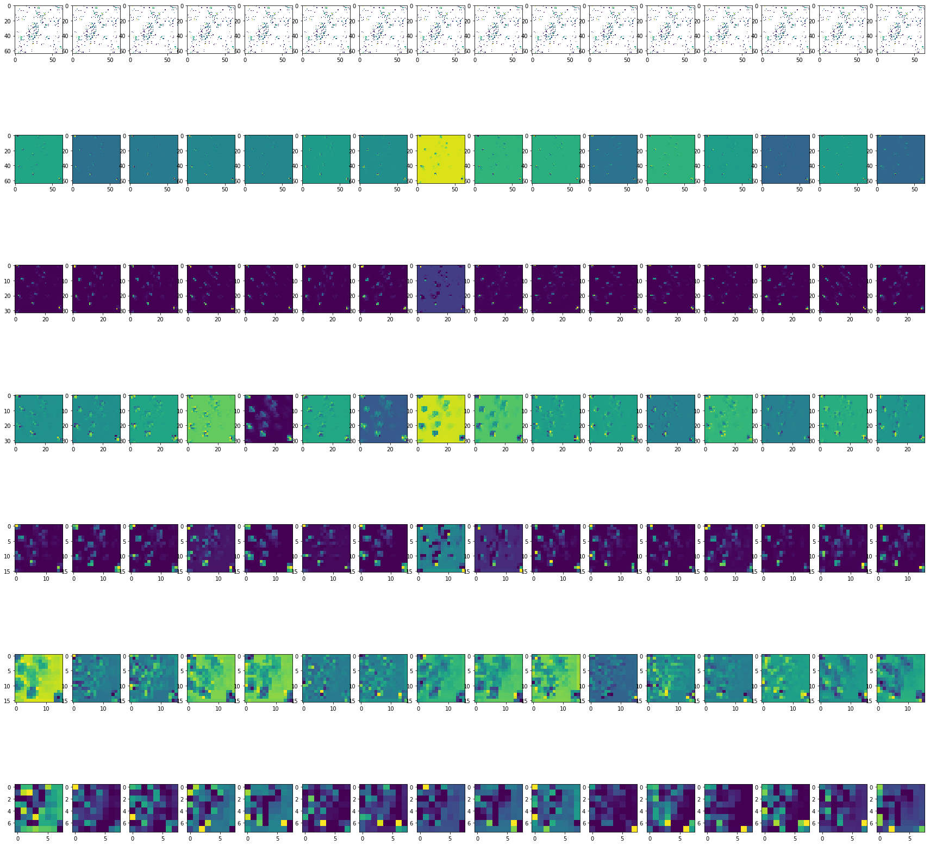
Signal that network found but cuts did not

Slide 11
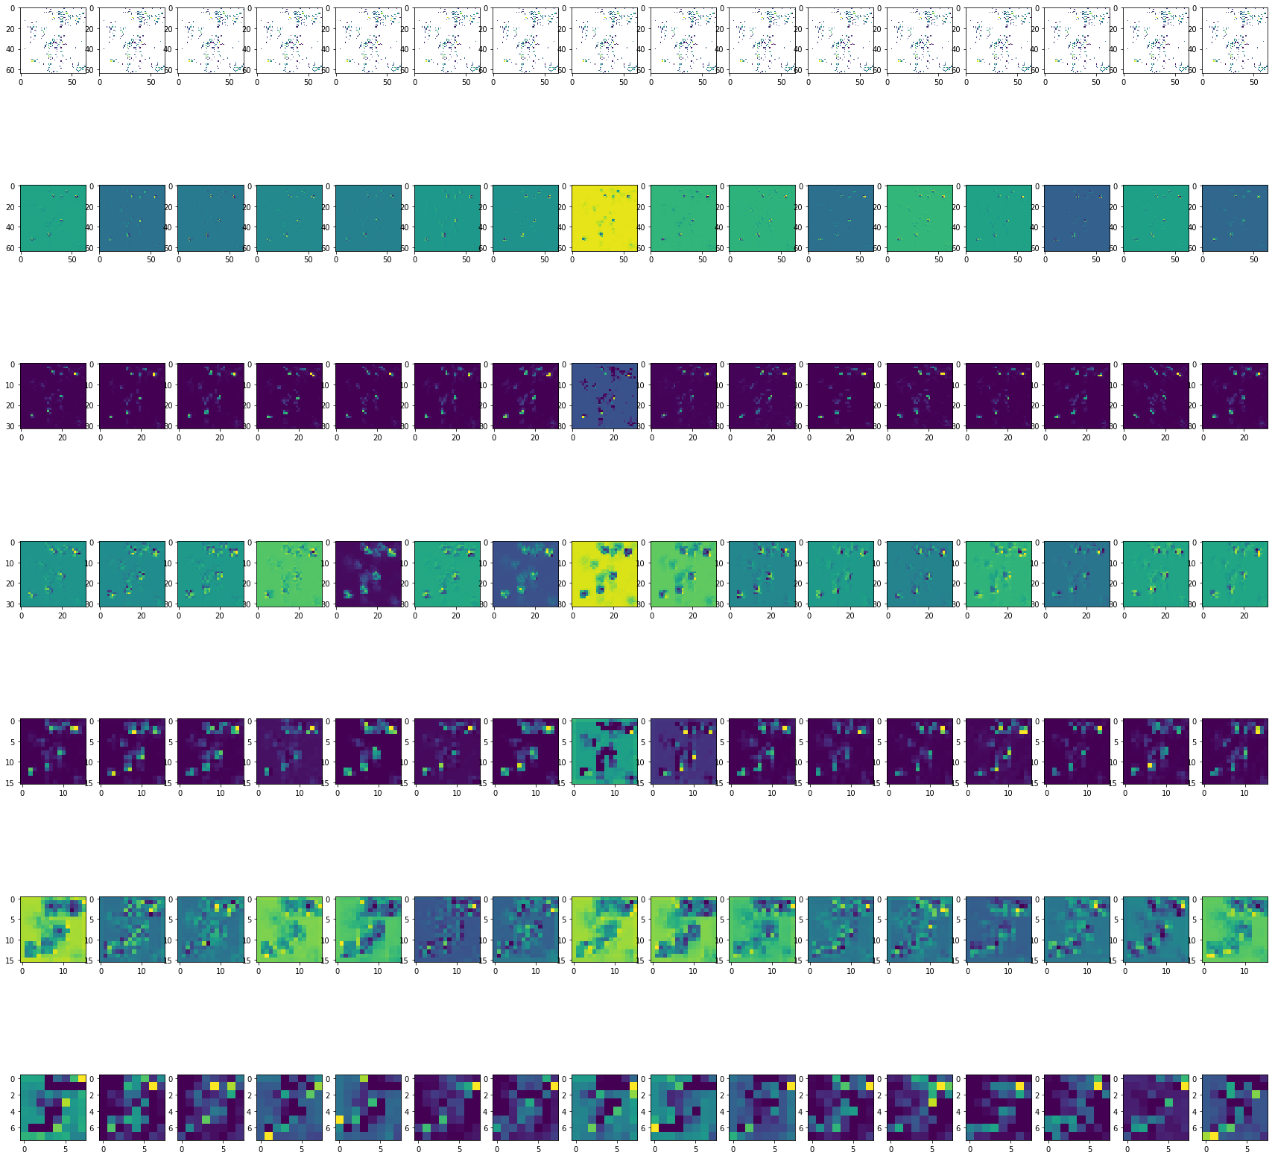
Network says signal feature map – but not signal

Slide 12
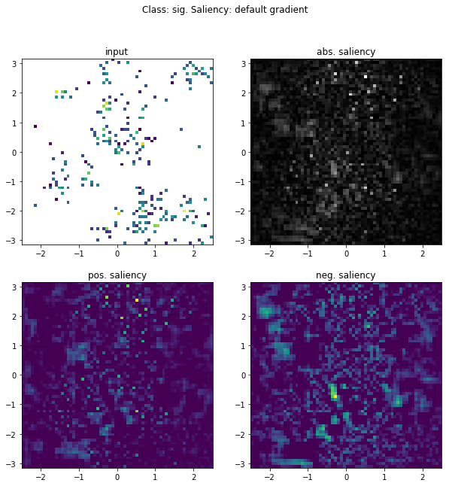
Saliency/ backprop.
Making predicted Signal even more signal-like
(not labelled signal)
(not interesting)

Slide 13
Todo list
Improvements
Wrap padding
Different size images ; different channels
Interpretations
Compare to physics variables
Shallow classifier comparison
Different RPV signal samples (retraining or not)
Computing CPU / GPU comparisons
GANs / Autoencoders

Slide 14
BACKUP / background

Slide 15
Architecture - implementation
<lasagne.layers.input.InputLayer object at 0x7f7334067110> : (None, 1, 64, 64)
<lasagne.layers.conv.Conv2DLayer object at 0x7f732f9778d0> : (None, 128, 64, 64)
<lasagne.layers.normalization.BatchNormLayer object at 0x7f732f999e10> : (None, 128, 64, 64)
<lasagne.layers.special.NonlinearityLayer object at 0x7f7334067b90> : (None, 128, 64, 64)
<lasagne.layers.pool.MaxPool2DLayer object at 0x7f732f9773d0> : (None, 128, 32, 32)
<lasagne.layers.conv.Conv2DLayer object at 0x7f732f9772d0> : (None, 128, 32, 32)
<lasagne.layers.normalization.BatchNormLayer object at 0x7f732f977290> : (None, 128, 32, 32)
<lasagne.layers.special.NonlinearityLayer object at 0x7f732f935250> : (None, 128, 32, 32)
<lasagne.layers.pool.MaxPool2DLayer object at 0x7f732f935410> : (None, 128, 16, 16)
<lasagne.layers.conv.Conv2DLayer object at 0x7f732f935450> : (None, 128, 16, 16)
<lasagne.layers.normalization.BatchNormLayer object at 0x7f732f935710> : (None, 128, 16, 16)
<lasagne.layers.special.NonlinearityLayer object at 0x7f732f935c10> : (None, 128, 16, 16)
<lasagne.layers.pool.MaxPool2DLayer object at 0x7f732f935dd0> : (None, 128, 8, 8)
<lasagne.layers.noise.DropoutLayer object at 0x7f732f977890> : (None, 128, 8, 8)
<lasagne.layers.dense.DenseLayer object at 0x7f732f935e50> : (None, 512)
<lasagne.layers.noise.DropoutLayer object at 0x7f732f93d410> : (None, 512)
<lasagne.layers.dense.DenseLayer object at 0x7f732f93d650> : (None, 2)
This ‘baseline’ with No dropout and batch norm
num_fc_units : 512
num_filters : 128

Slide 16
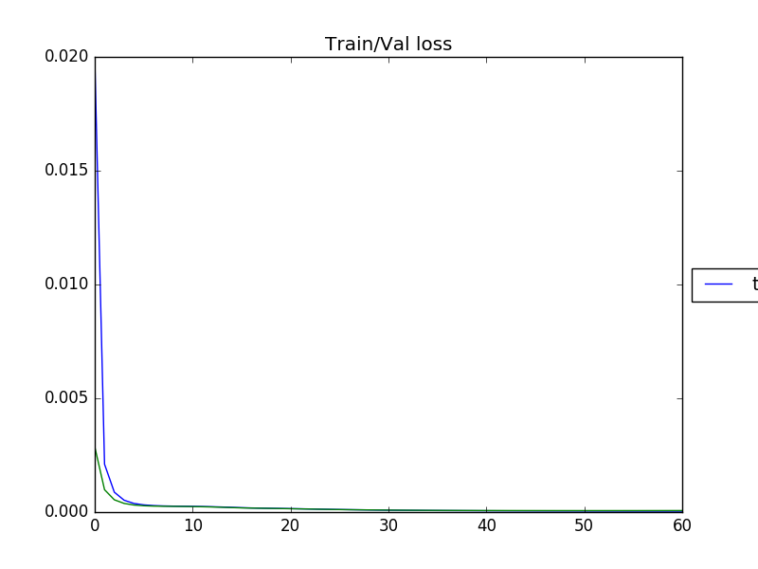
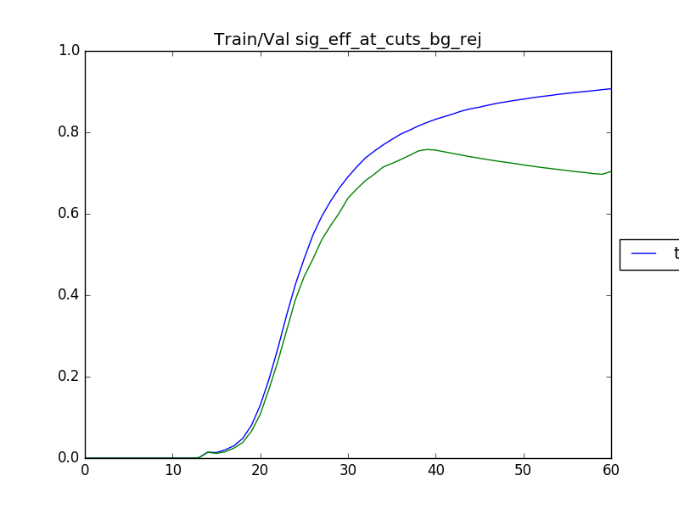
Learning curves

Slide 17
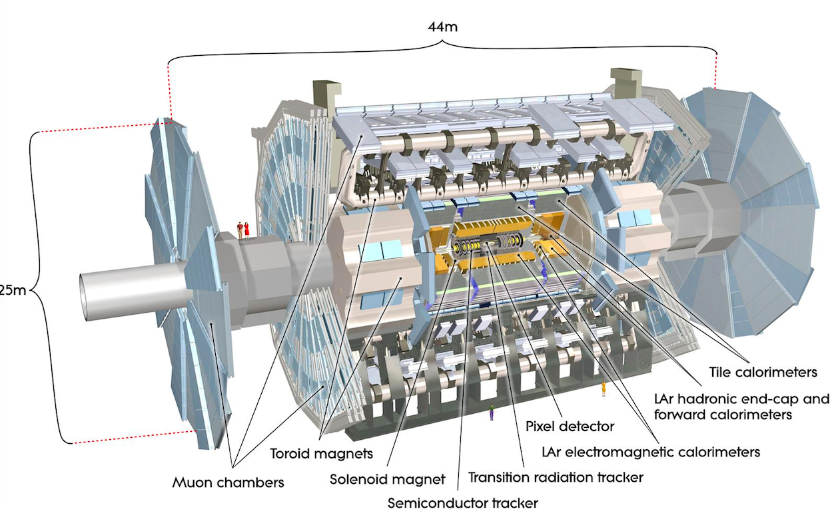
ATLAS detector

