Slide 1









Towards Loop String Hadron formulation for SU(3) Yang-Mills theory
PRD 111 (2025) 7, 074516 and in preparation
Saurabh Kadam
with
Jesse Stryker
Ahiri Naskar
Indrakshi Raychowdhury
Lawrence Berkeley National Laboratory
InQubator for Quantum Simulation, University of Washington
BITS Pilani Goa Campus, India

Slide 2

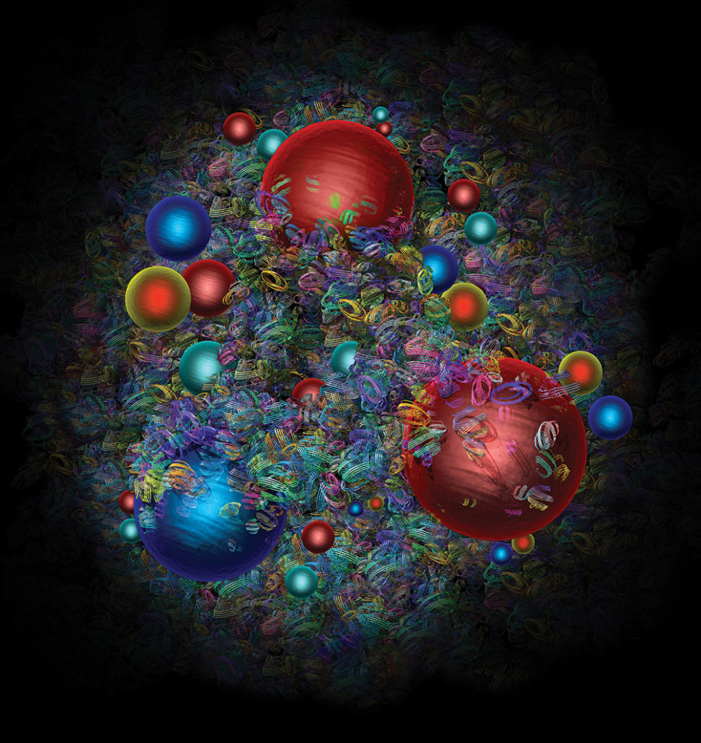

Hamiltonian Lattice Gauge Theory
Discretized space, continuous time
Quantum simulation of LGTs, someday Quantum Chromodynamics
Different reformulations
Kogut-Susskind
Quantum Link Model
Fully Gauged-Fixed
Kogut & Susskind PRD 11, 395 (1975)
Chandrasekharan & Wiese Nucl. Phys. B 492 (1997)
Grabowska, Kane, & Bauer
arXiv:2409.10610
Removing Fermions
Orbifold Lattice
Bauer, D'Andrea, Freytsis, & Grabowska
arXiv:2307.11829
Zohar & Cirac PRD 99, 114511 (2019)
Bergner, Hanada, Rinaldi, Schafer JHEP 2024, 234 (2024)
(Hyper-)Honeycomb
Zohar & Cirac PRB 98, 075119 (2018)
Large-$N_{c}$ limit
Muller & Yao
PRD 108, 094505 (2023)
Ciavarella & Bauer PRL. 133 (2024) 11
Loop-String-Hadron
Illa, Savage & Yao
arXiv:2504.21575
*Raychowdhury and Stryker PRD 101, 114502 (2020)
Q-deformed
Credit:
D. Dominguez/CERN and Gemini
SK, Raychowdhury, & Stryker
PRD 107 (2023) 9, 094513
Zache, González-Cuadra & Zoller PRL. 131 (2023)
And many more
SK, Naskar, Raychowdhury, & Stryker
PRD 111 (2025) 7, 074516

Slide 3
Outline
Loop-String-Hadron formulation for SU(3) LGT in 1+1D with dynamical fermions
The procedure
Loop-String-Hadron formulation for SU(3) Yang-Mills theory
What has been done?
What needs to be done?
What are the challenges?
Conclusions and outlook

Slide 4
Loop-String-Hadron formulation for SU(3) in 1+1D with dynamical fermions
Kadam, Raychowdhury, and Stryker
Phys.Rev.D 107 (2023) 9, 094513

Slide 5
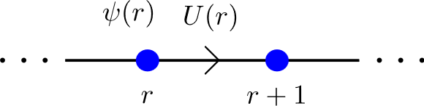






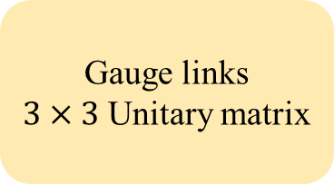
SU(3) gauge theory in 1+1 D with dynamical matter field
Kogut-Susskind Hamiltonian for SU(3)
From staggering
Gauge links
$3×3$ Unitary matrix
3 colors

Slide 6
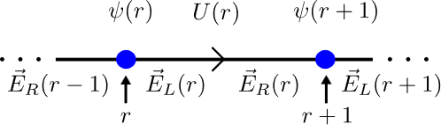

Kogut-Susskind Hamiltonian for SU(3)
with
Gauss’ law operators
Gell-Mann matrices
Physical Hilbert space is given by states that satisfy:
Non-commutative Gauss’s law constraints

Slide 7
LSH Formulation for SU(3) lattice gauge theory in 1+1 D
The procedure
Kogut-Susskind Hamiltonian for SU(3)
Schwinger Bosons
Prepotential Formulation

Slide 8






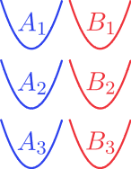


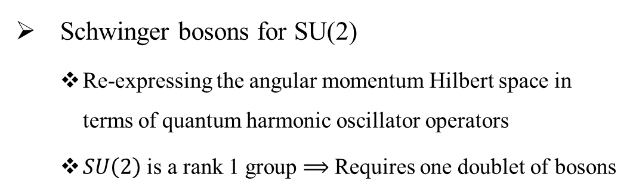
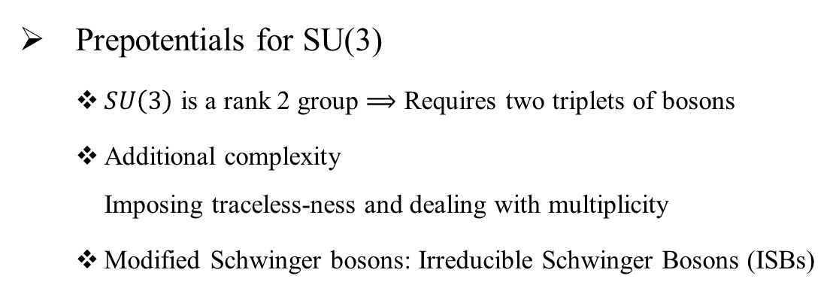
Prepotential Formulation
Schwinger bosons for SU(2)
Re-expressing the angular momentum Hilbert space in terms of quantum harmonic oscillator operators
$SU\left(2\right)$ is a rank 1 group $⟹$ Requires one doublet of bosons
Prepotentials for SU(3)
$SU\left(3\right)$ is a rank 2 group $⟹$ Requires two triplets of bosons
Additional complexity Imposing traceless-ness and dealing with multiplicity
Modified Schwinger bosons: Irreducible Schwinger Bosons (ISBs)
Chaturvedi and Mukunda J. Math. Phys. 43, 5262 (2002)
Anishetty, Mathur, and Raychowdhury J.Math.Phys. 50 (2009) 053503
J.Phys.A 43 (2010) 035403

Slide 9
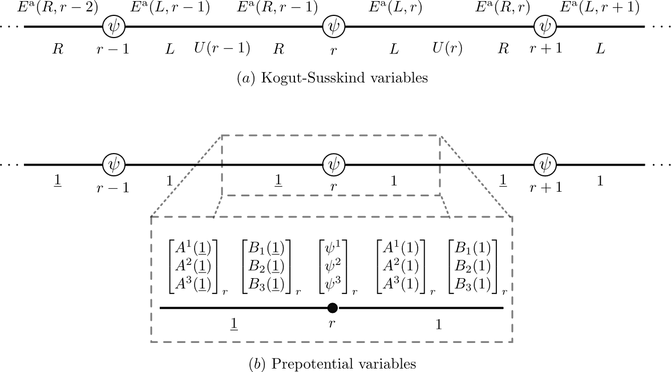


Prepotential Formulation
with
with
Abelian Gauss’ laws
Chaturvedi and Mukunda J. Math. Phys. 43, 5262 (2002)
Anishetty, Mathur, and Raychowdhury J.Math.Phys. 50 (2009) 053503
J.Phys.A 43 (2010) 035403
Notes:
Two notational changes:
1 bar and 1
r to keep everything local

Slide 10
LSH Formulation for SU(3) lattice gauge theory in 1+1 D
The procedure
Kogut-Susskind Hamiltonian for SU(3)
Schwinger Bosons
Prepotential Formulation
Construct LSH basis
Gauge invariant operators

Slide 11
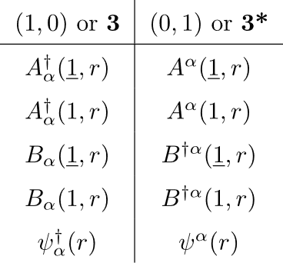

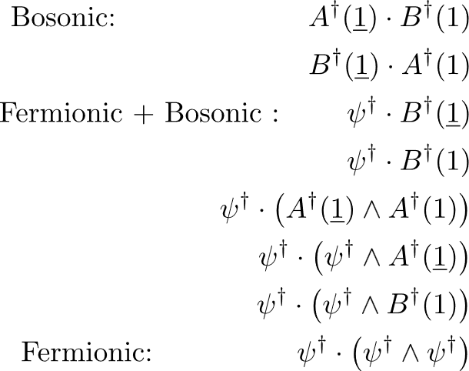
Construct LSH basis
Basis Construction
Must be a gauge singlet operator
Must have only creation type operators
Should not be a null operator
Local degrees of freedom
Local singlets using
Only a subset of them is required to reconstruct the Hamiltonian

Slide 12
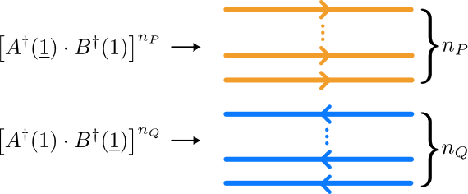

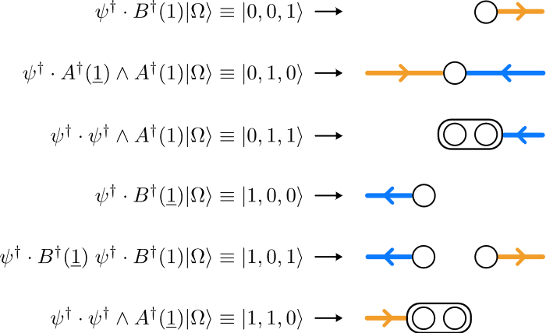
Construct LSH basis
Loops:
Bosonic
Vacuum
Strings:
Fermionic + Bosonic
Local singlet Hilbert space is constructed
Hadron:
Fermionic

Slide 13
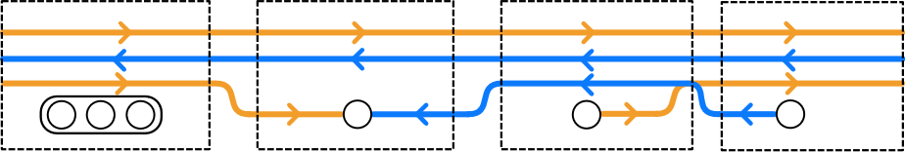
Construct LSH basis
Global Hilbert space
Non-locality is only through these Abelian Gauss’ laws

Slide 14

LSH Formulation for SU(3) lattice gauge theory in 1+1 D
A step towards quantum simulation of QCD
Kogut-Susskind Hamiltonian for SU(3)
Schwinger Bosons
Prepotential Formulation
Construct LSH basis
Gauge invariant operators
LSH Hamiltonian

Slide 15
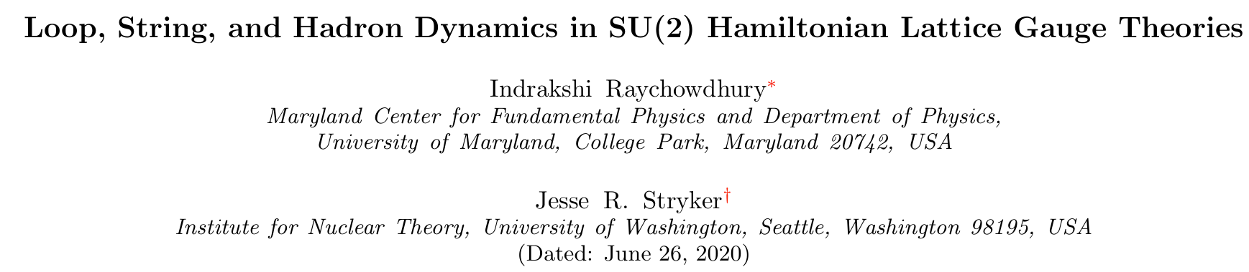
LSH Features and Status
DOF: Local gauge singlets namely loops, strings, and hadrons
Local Hilbert space is complete and orthogonal
Non-Abelian constraints are removed, only the Abelian constraints are left
Matrix elements for operators in Hamiltonian are known
Local Hamiltonian and non-locality only through the Gauss’s law
Complete LSH formulation for SU(2) LTG in 1+1D, 2+1D, and 3+1D has been developed, including single flavor of fermions
Raychowdhury and Stryker Phys. Rev. D 101, 114502 (2020)

Slide 16
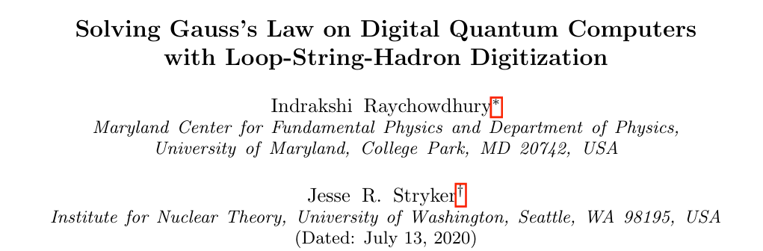
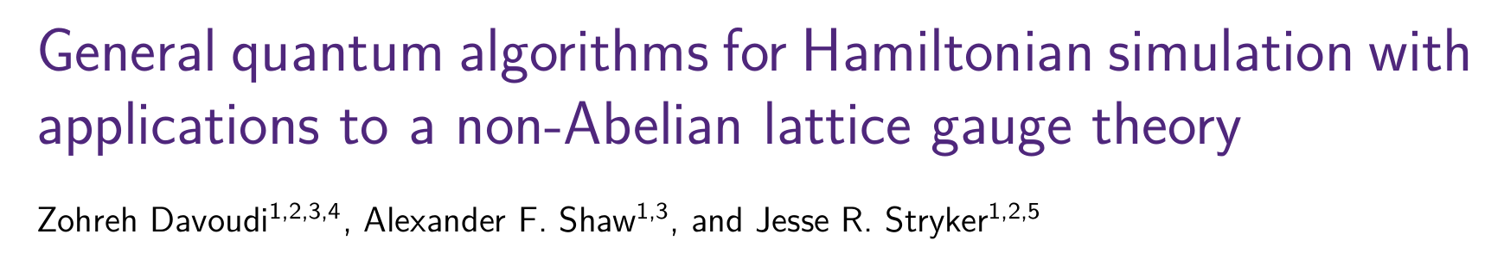
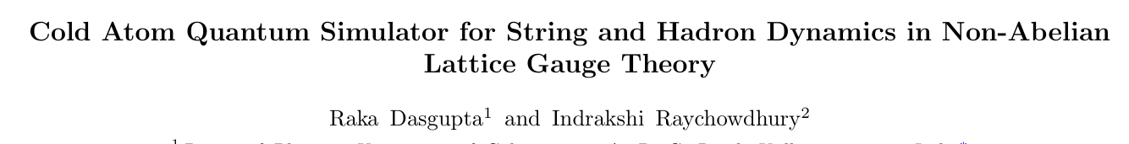
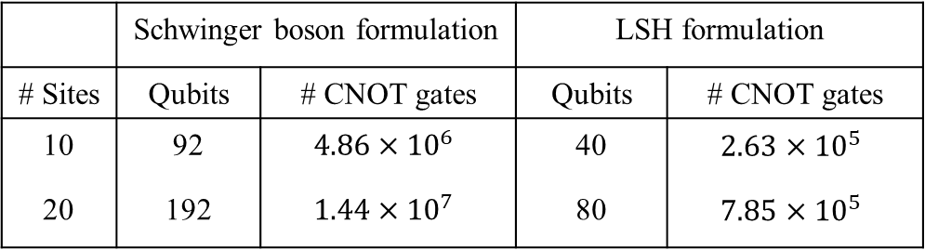
LSH in work
Quantum Simulation Proposals:
Phys. Rev. Research 2, 033039 (2020)
Quantum 7, 1213 (2023)
 | Schwinger boson formulation |  | LSH formulation
# Sites | Qubits | # CNOT gates | Qubits | # CNOT gates
10 | 92 | $$4.86×{10}^{6}$$ | 40 | $$2.63×{10}^{5}$$
20 | 192 | $$1.44×{10}^{7}$$ | 80 | $$7.85×{10}^{5}$$
arXiv:2009.13969

Slide 17
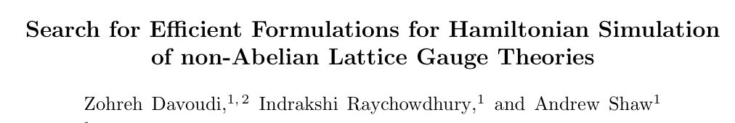
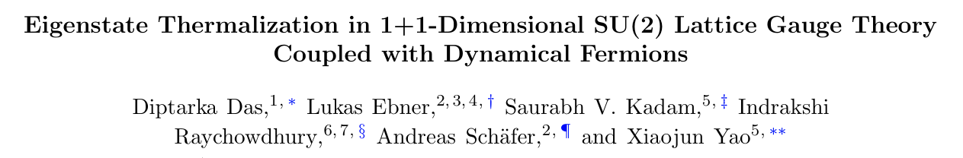
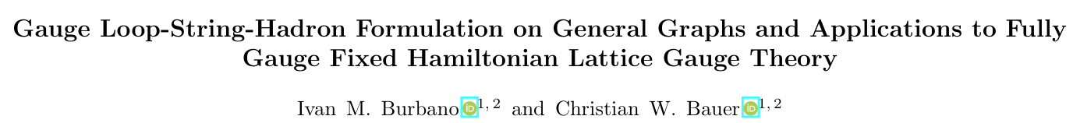
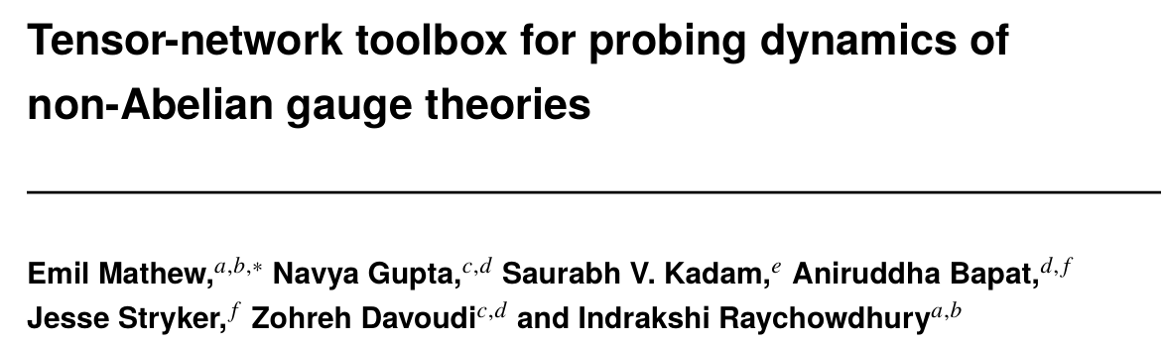
LSH in work
Phys. Rev. D 104, 074505 (2021)
arXiv:2509.18269
Poster by Lukas Ebner
arXiv:2409.13812
Proceedings LATTICE2024
In preparation
arXiv:2404.12158

Slide 18
Towards Loop-String-Hadron formulation for SU(3) Yang-Mills Theory
Kadam, Naskar, Raychowdhury, and Stryker
Phys.Rev.D 111 (2025) 7, 074516

Slide 19
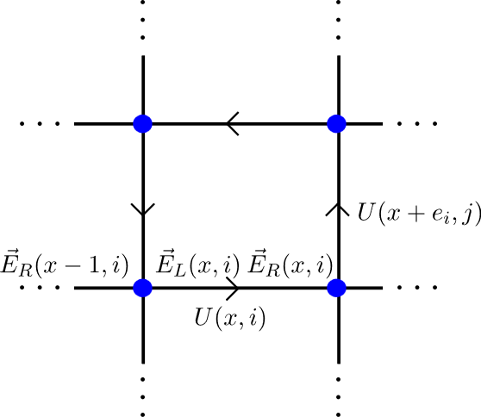


LSH Formulation for SU(3) Yang-Mills Theory
Kogut-Susskind Hamiltonian for SU(3)
Gauge links
$3×3$ Unitary matrix

Slide 20
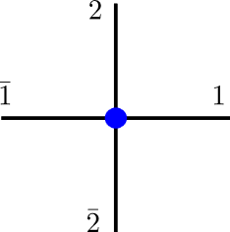
Kogut-Susskind Hamiltonian for SU(3)
Physical Hilbert space is given by states that satisfy:
Non-commutative Gauss’s law constraints

Slide 21
LSH Formulation for SU(3) Yang-Mills Theory
The procedure
Kogut-Susskind Hamiltonian for SU(3)
Schwinger Bosons
Prepotential Formulation

Slide 22
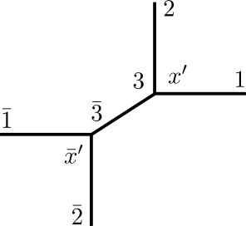
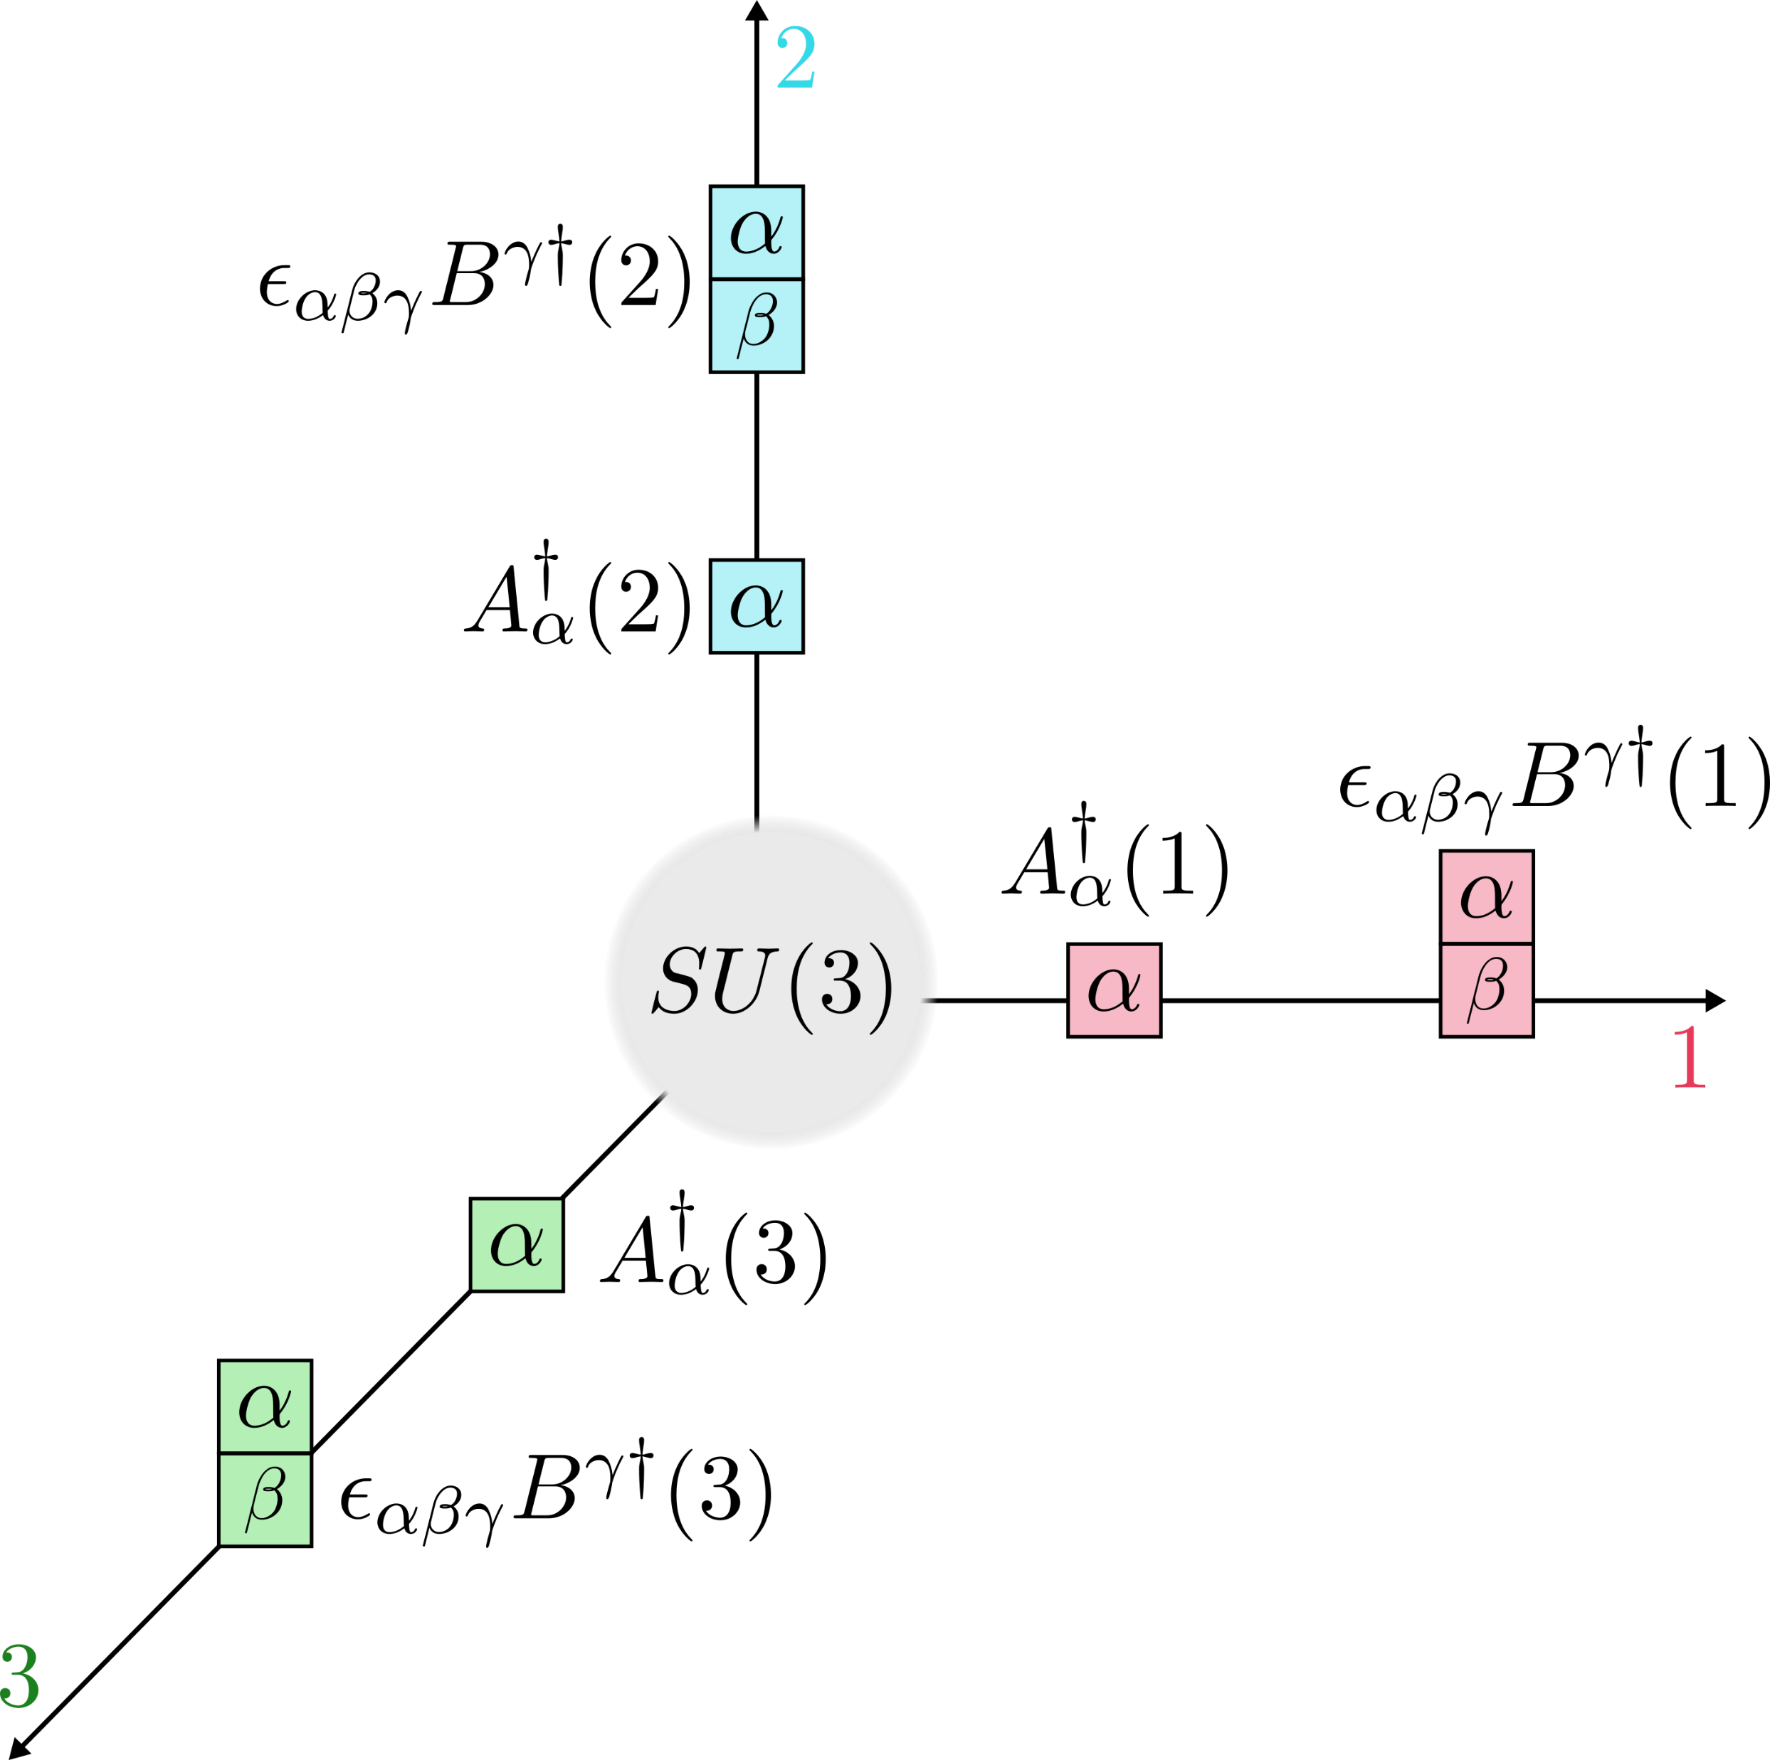
Prepotential Formulation
Point splitting
The building block of multidimensional space is taken as a trivalent vertex through point splitting
The prepotentials are situated on the trivalent vertices
Notes:
Two notational changes:
1 bar and 1
r to keep everything local

Slide 23
LSH Formulation for SU(3) Yang-Mills Theory
The procedure
Kogut-Susskind Hamiltonian for SU(3)
Schwinger Bosons
Prepotential Formulation
Construct LSH basis
Gauge invariant operators

Slide 24
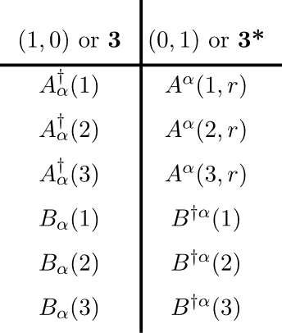

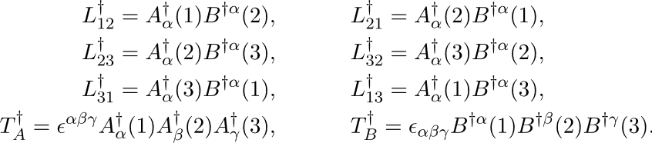
Construct LSH basis
Basis Construction
Must be a gauge singlet operator
Must have only creation type operators
Should not be a null operator
Local degrees of freedom
Local singlets using
Contains both bilinear and trilinear excitations
Naively

Slide 25
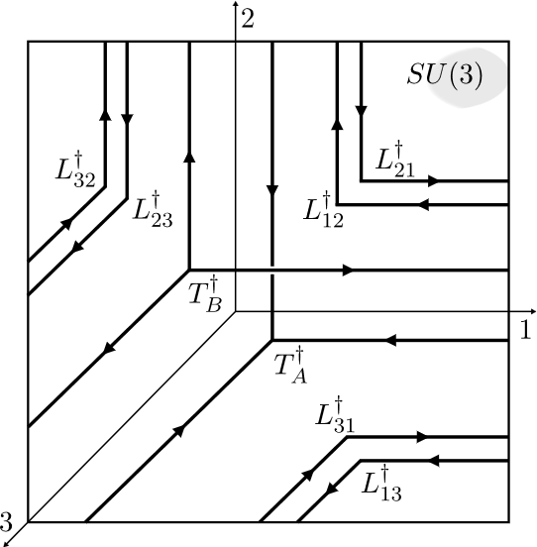
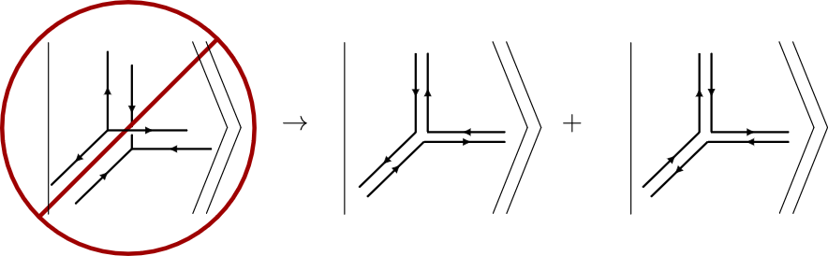
Independently, they are valid excitations. But when present together, they can be expressed in terms of other states
Construct LSH basis
Naively
Issue: States are not linearly independent

Slide 26


Construct LSH basis
Resolution: Restrict combined trilinear excitations
Results in a linearly independent and complete local Hilbert space
Issue: Non-orthogonal states

Slide 27
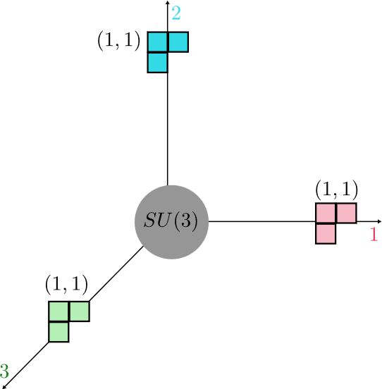
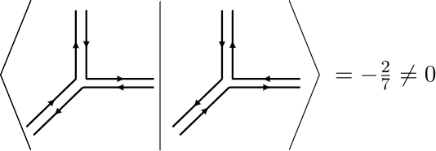



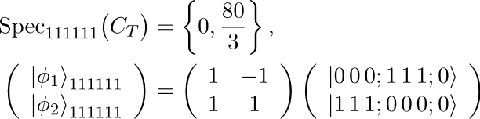
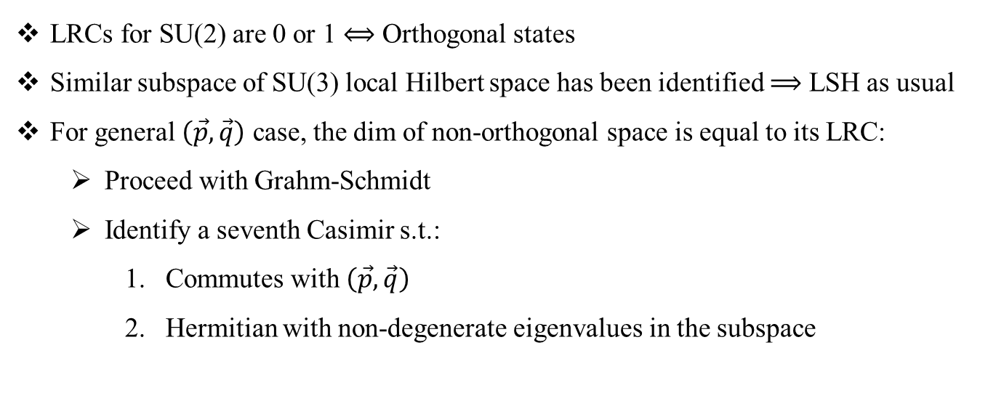
Issue: Non-orthogonal states
Two copies of the singlet
LRCs for SU(2) are 0 or 1 $⟺$ Orthogonal states
Similar subspace of SU(3) local Hilbert space has been identified $⟹$ LSH as usual
For general $\left(\vec{p}, \vec{q}\right)$ case, the dim of non-orthogonal space is equal to its LRC:
Proceed with Grahm-Schmidt
Identify a seventh Casimir s.t.:
Commutes with $\left(\vec{p}, \vec{q}\right)$
Hermitian with non-degenerate eigenvalues in the subspace
Littlewood-Richardson coefficients
Mathematica notebook published on PRD & GitHub
Kadam, Naskar, Raychowdhury, and Stryker
PRD 111 (2025) 7, 074516

Slide 28
Towards Loop-String-Hadron formulation for SU(3) Yang-Mills Theory
Kogut-Susskind Hamiltonian for SU(3)
Schwinger Bosons
Prepotential Formulation
Construct LSH basis
Gauge invariant operators
LSH Hamiltonian
Ongoing efforts

Slide 29
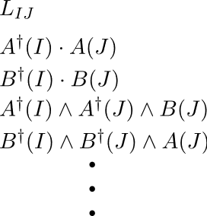
Towards Loop-String-Hadron formulation for SU(3) Yang-Mills Theory
LSH Hamiltonian
Ongoing efforts
Easy: becomes a number operator
Examples
Contains number operators and various corner operators, i.e., contractions involving two link ends
Their actions on the LSH basis are being evaluated

Slide 30
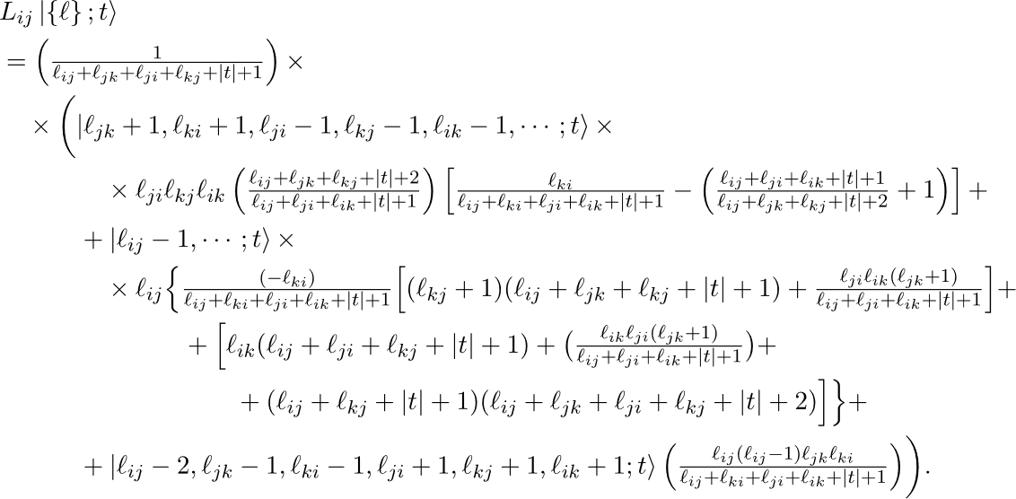
Towards Loop-String-Hadron formulation for SU(3) Yang-Mills Theory
For example:

Slide 31
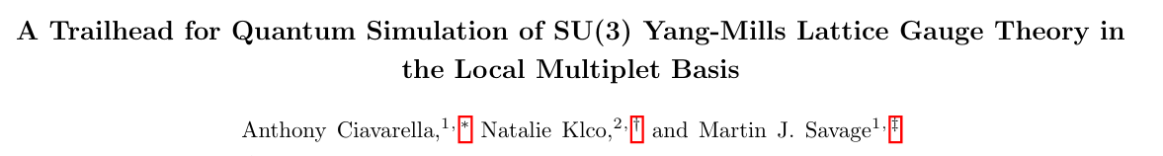
Towards Loop-String-Hadron formulation for SU(3) Yang-Mills Theory
Kogut-Susskind Hamiltonian for SU(3)
Schwinger Bosons
Prepotential Formulation
Construct LSH basis
Gauge invariant operators
LSH Hamiltonian
Two plaquette spectrum for $\{1, 3, \overline{3}\}$ agrees with
Ongoing efforts

Slide 32
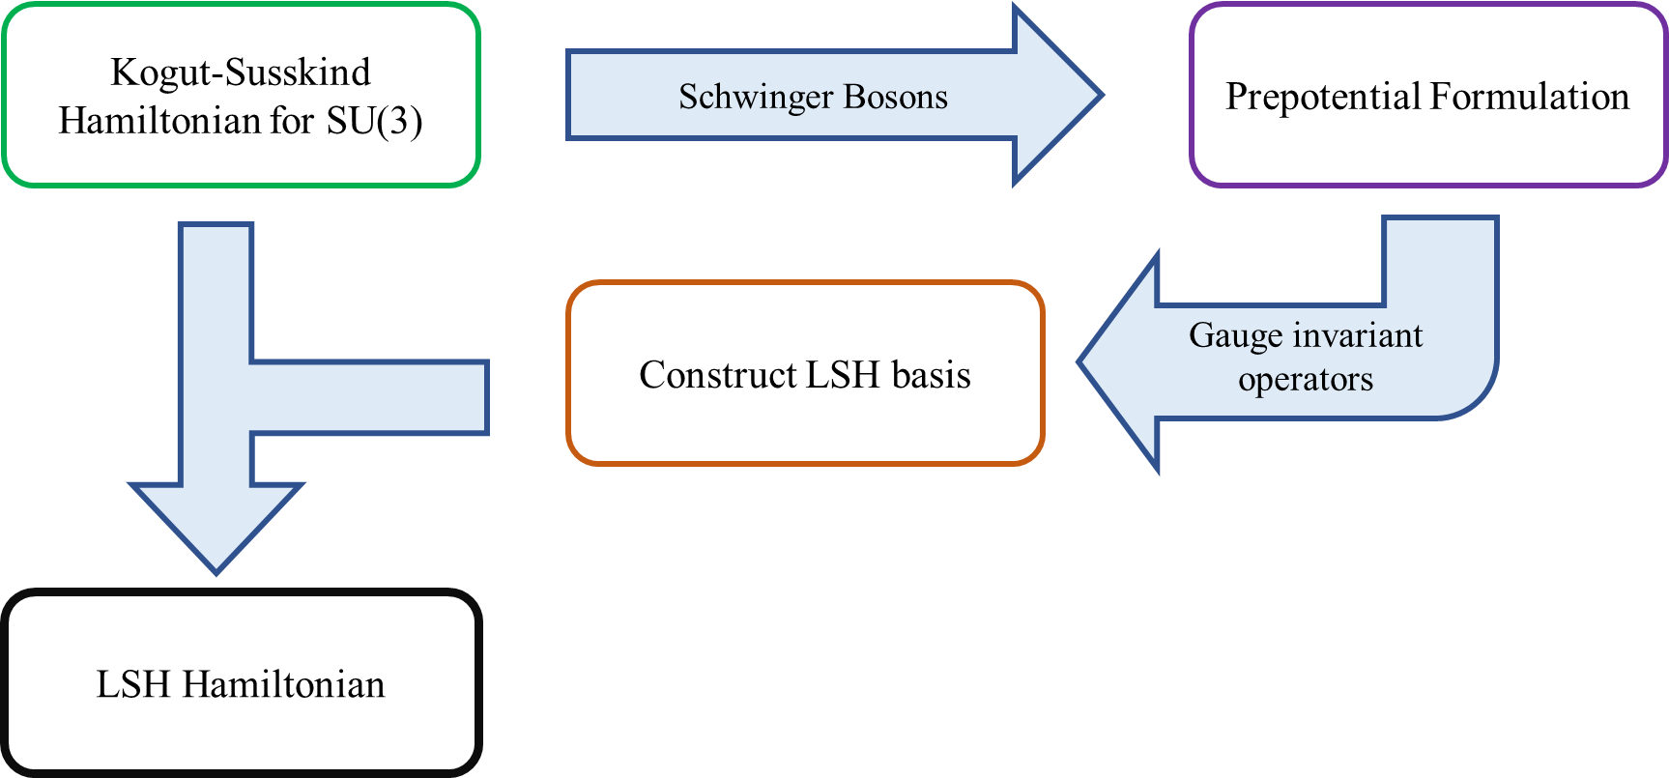

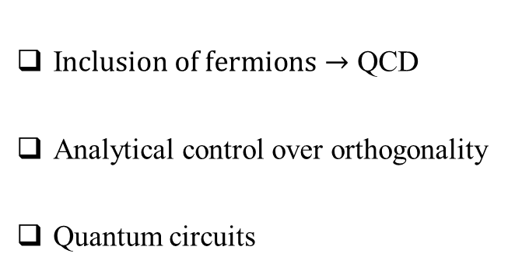
Conclusions
Outlook
Loop-String-Hadron formulation for SU(3) Yang-Mills Theory
I$nclusion of fermions→$ QCD
Analytical control over orthogonality
Quantum circuits
Thank You !

Slide 33
Appendix Slides

Slide 34





LSH Formulation for SU(3) lattice gauge theory in 1+1 D
LSH Hamiltonian
Fermion-like number operators
Fermion-like and loop number operators
Ladder operators
Fermion quantum number
Total gauge flux quantum number

