Slide 1
Quantum Computing for HEP
Zachary Goff-Eldredge
Program Manager, QIS
Office of High Energy Physics
Notes:
Template Instructions: Please insert your name and title. You can also pull in information from the event you are attending – the organization's logo, etc. Doing so is inclusive.
Please don't forget ALT TEXT on your images. Use PowerPoint accessibility checker – preferably each time when you start a presentation. In the ribbon, go to VIEW > Accessibility Checker. Try to send slides (at least a draft) to attendees in advance, that also helps with accessibility.
Please remember – this is a template. You should be downloading a copy of it and then making it your own. Feel free to remove slides not relevant to your presentation and augment the presentation as you see fit.
Consider adding a picture of yourself or your team to the Welcome slide or at the end of the deck. Pictures of people who work at our Labs and for DOE and SC are excellent communication tools.
In this presentation, each slide is made so you can easily add to it. The footer at the bottom of the slide does not change. If you would like to use a more specific URL to your program or division, please include it in the body of the slide.

Slide 2
Agenda
Key Message: Quantum computing is an exciting opportunity for high energy physics, and vice versa. DOE encourages researches to identify and attack the parts of the problem that are differentiated in their HEP efforts.
Agenda
Groundwork: HEP in Context at DOE
Current HEP QIS Portfolio
Vision and Strategy for HEP-QC Research

Slide 3

National Quantum Initiative
National Quantum Initiative Act (2018)
Established the National Quantum Initiative (NQI)
NQI is a whole-of-government quantum thrust
Authorizes research at NIST, NSF, DOE
Created interagency coordinating bodies:
National Science and Technology Council Subcommittee on QIS
National Science and Technology Council Subcommittee on Economic/Security Implications of QIS
National Quantum Coordination Office
NQI Advisory Committee
NQI encompasses 23 agencies, $2.6B in investments, 14 major research centers, >150 companies
HEP QIS program collaborates with NQI activities

Slide 4
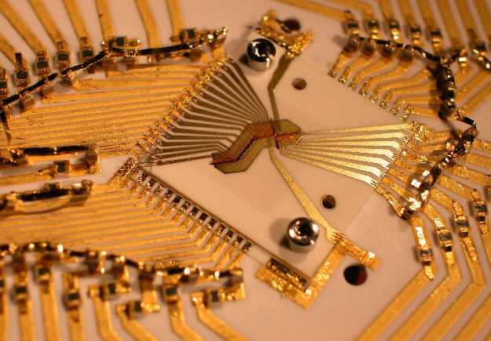
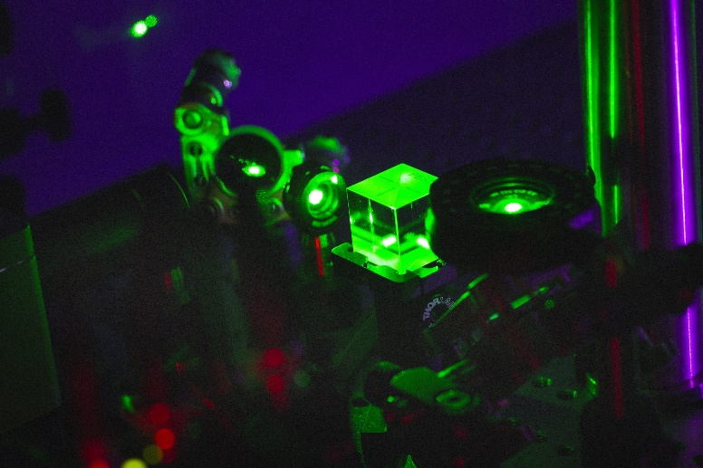
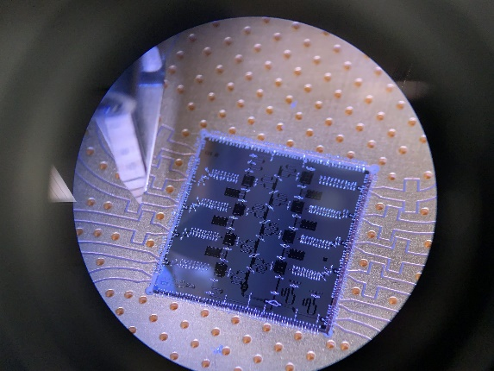
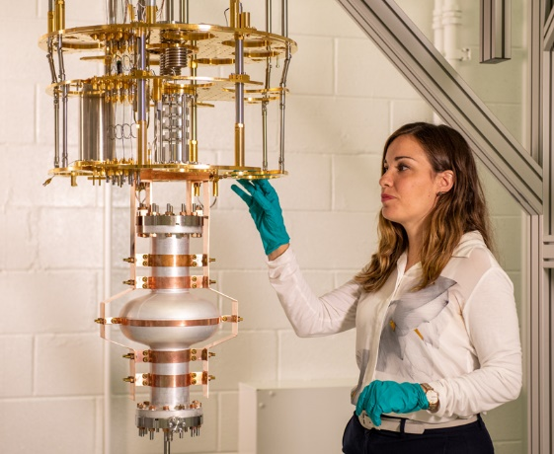
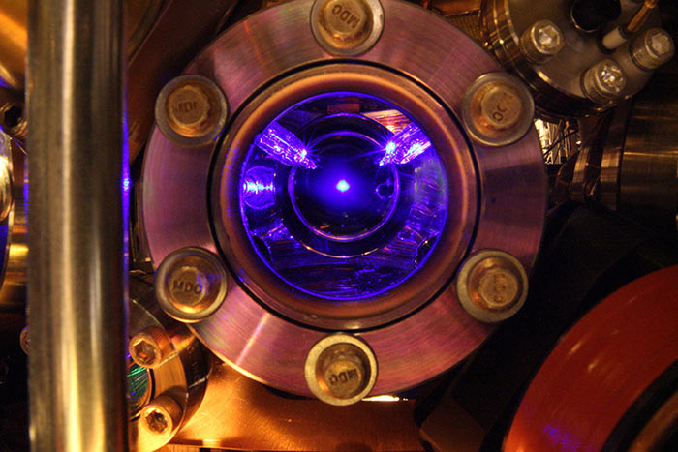
QIS Means Many Approaches
Subfields
Platforms
theory
neutral atoms
sensing
computing
superconducting
foundations
ions
solid-state
networks
photonics
Expertise
physicists
comp sci
engineers
mathematicians
materials
All images from quantum.gov image gallery

Slide 5





HEP-QIS Program
I sit in the technology division of HEP.
My program is defined by the search for tools and technologies that can boost the HEP mission.

Slide 6
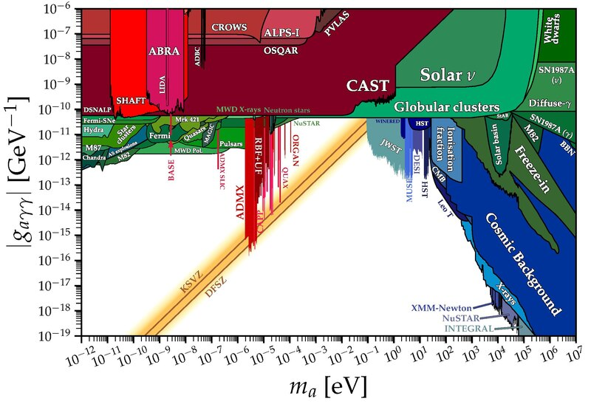
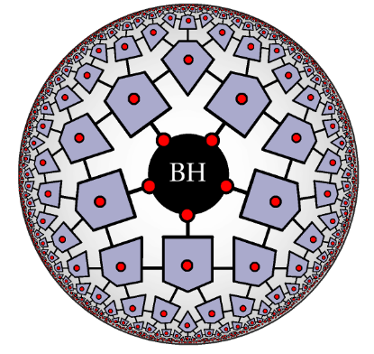
Goals of the HEP-QIS Program
Use the tools, techniques, and concepts of quantum information science to…
Wikimedia
Phys. Rev. D 111, 054501
…solve intractable problems
…detect rare and weak signals of new physics
arXiv2102.02619
…bring new theory to bear on the microscopic universe

Slide 7
HEP QIS Current Activities

Slide 8
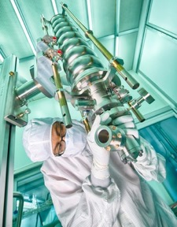
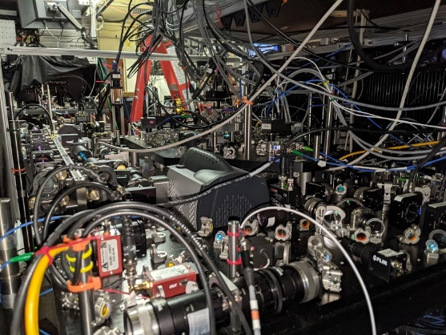
QIS Organization at OHEP
Fermilab’s Superconducting Quantum Materials and Systems (SQMS) center is our coupling to the NQI, pursuing foundational quantum information science and technology development in global partnerships with academia, industry, and government.
UW-Madison
Our Quantum Information Science Enabled Discovery (QuantISED) program has funded dozens of research groups at universities and laboratories across the country since 2018 to advance theory and experiment of QIS in pursuit of HEP science goals.
Fermilab
Together, these programs define a robust portfolio with deep roots in both QIS and HEP communities enabling next-generation discoveries

Slide 9
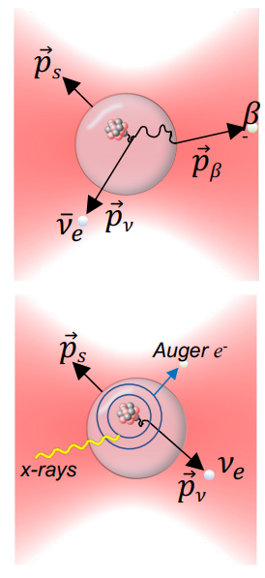
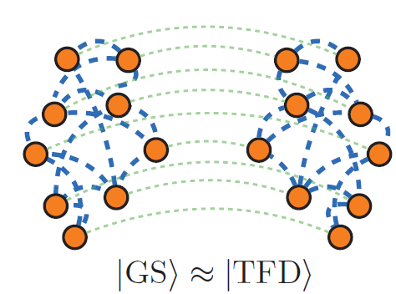
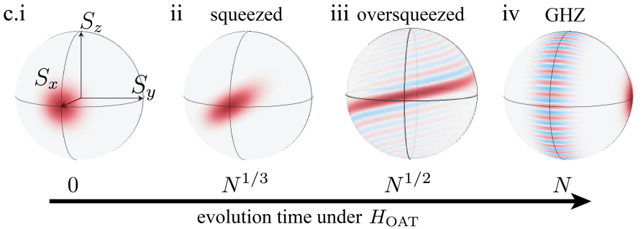
QuantISED: New Tools for High Energy Physics
Quantum Information Science Enabled Discovery is HEP’s core research program in QIS, started in 2017.
Advancing HEP science will require:
Sensing for new physics, like dark matter or dark energy
Computers to understand complex systems, like the universe just after the Big Bang or the behavior of quarks
→ Great HEP potential for QIS (e.g., quantum sensors and computers) to unlock new HEP scientific potential. → Great benefit for QIS from HEP, as early adopters and rigorous testers with expertise in quantum physics.
QuantISED seeks to realize this potential by
Advancing QIS applications and techniques across the HEP portfolio, from theory to experiment.
Working across disciplines to train a new generation of quantum scientists.
Building facilities and capacities at universities and labs across the country.
Figures from QuantISED 2.0 selected projects.
Notes:
Figure descriptions
Top left: This is from Bousso – UC Berkeley – GeoFlow Collaboration; exploring how quantum gravity theories can be used to understand entanglement in current and near-future quantum technology.
Top right: David Moore at Yale – using optomechanics to detect single neutrinos emitted from radioactive nanobeads to search for physics beyond the standard model.
Bottom: From Emily Davis – NYU – exploring using cavities to create entanglement between spins in solid-state devices, enabling entanglement enhanced dark matter searches.

Slide 10
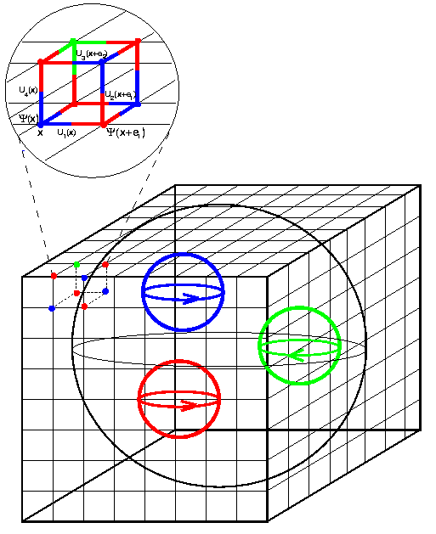
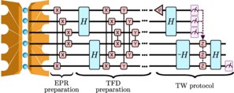
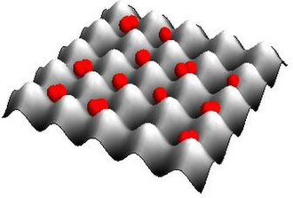
Computing and Simulation in QuantISED 2.0
Quantifying and improving errors
Addressing high resource requirements
Exploring novel platforms
Complexity constraints
Black holes, firewalls
Physics of error correction
Implementing HEP on QCs
QIS for HEP foundations, esp. gravity
Analog computation for HEP models
T. Schuster et al., Phys. Rev. X 12, 031013
US QCD
Atom simulators of arbitrary Hamiltonians
Synthetic geometries, space-time
Wikimedia

Slide 11





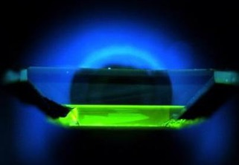
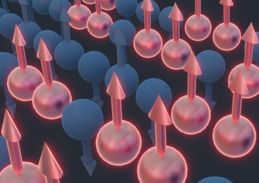
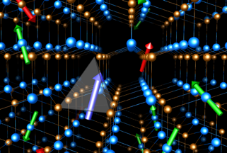
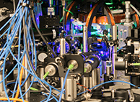
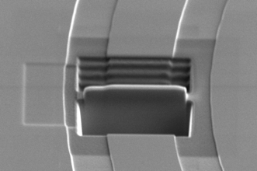





DOE National QIS Research Centers
Quantum
Systems
Accelerator
Bringing useful quantum computing within reach with disruptive technological advances
(Program lead: BES)
Catalyzing US QIS leadership with broad transformational advances in atom, ion and superconducting qubit technologies for quantum computing and sensing
(Program lead: ASCR)
Building on Fermilab’s unique accelerator expertise and facilities to advance quantum S&T
(Program lead: HEP)
Developing quantum co-design principles to target software and algorithms, devices, and materials
Attacking the problem of scalable quantum entanglement
(Program lead: BES)
Identifying and mitigating loss channels in superconducting quantum devices and build prototypes for computing, communication and sensing
Designing quantum materials, new quantum devices and sensors to characterize topological states
Developing the technology to store, control and distribute entangled states of matter for computing, communication and sensing
Driving innovations in quantum-accelerated computing.
(Program lead: ASCR)
Co-designing quantum prototypes with algorithms in three technologies: neutral atoms, trapped ions, and superconducting circuits
Notes:
The NQISRCs, established in 2020 following passage of the National Quantum Initiative Act, represent the first large-scale QIS effort to cross the technical breadth of Office of Science.
Each Center, led by a National Laboratory, is a partnership of labs, universities, and industry. Total funding for the centers will be $575M over 5 years.
The Centers take distinct yet complementary approaches to tackle major cross-cutting challenges in areas of significant national impact, and significantly leverage DOE investments in user facilities and other resources.
The Centers play a central role in stewardship of the QIS ecosystem, including broad industry engagement and support for the development of a robust and dynamic workforce.
Coordination across the Centers is maintained by an Executive Council.

Slide 12
Collaborations Across Offices & Agencies
DOE-HEP exists within a landscape of both other DOE offices and other science agencies.
Agencies with overlapping science missions may have similar projects; agencies with technological missions may have relevant capabilities.
Collaboration can be formal or informal.
Other DOE offices
Nuclear Physics (NP) – often similar science targets to HEP
Basic Energy Sciences (BES) – materials/device work that enables QIS technologies
Advanced Scientific Computing Research (ASCR) – architecture and programming efforts that build towards large-scale QC
Other agencies
NIST – focus on measurement and precision often overlaps with HEP needs
NSF – wide range of partners and scientific efforts
DoD research – frequently developing targeted capabilities of use

Slide 13
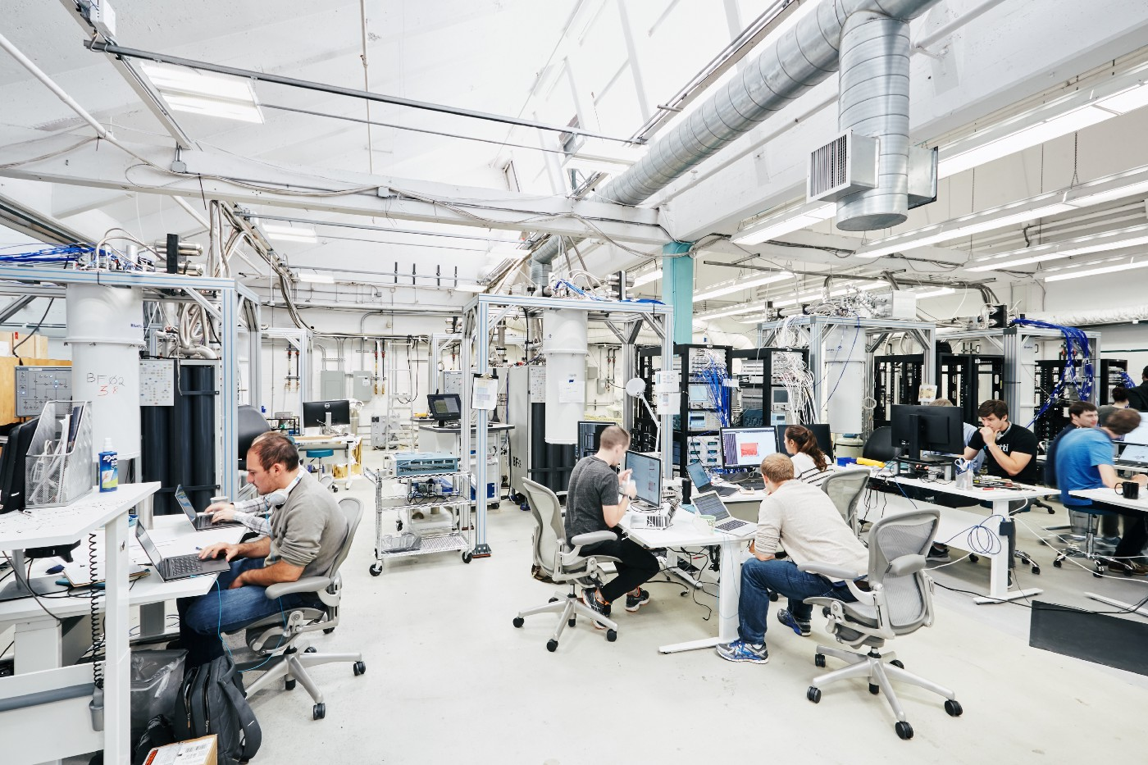
Industry and HEP-QIS
Industry is an important partner on QIS.
Ex: Fermilab partners with Rigetti, IBM, Diraq, Unitary Foundation…
What we get:
Access to technology
Implementation experience
Connection with other QIS efforts
What they get:
Deployment opportunities
Rigorous testing and benchmarking, lab facilities
Opportunities to benefit from next-generation developments
Rigetti testbed, SQMS collaboration

Slide 14
HEP QIS Computing Vision

Slide 15
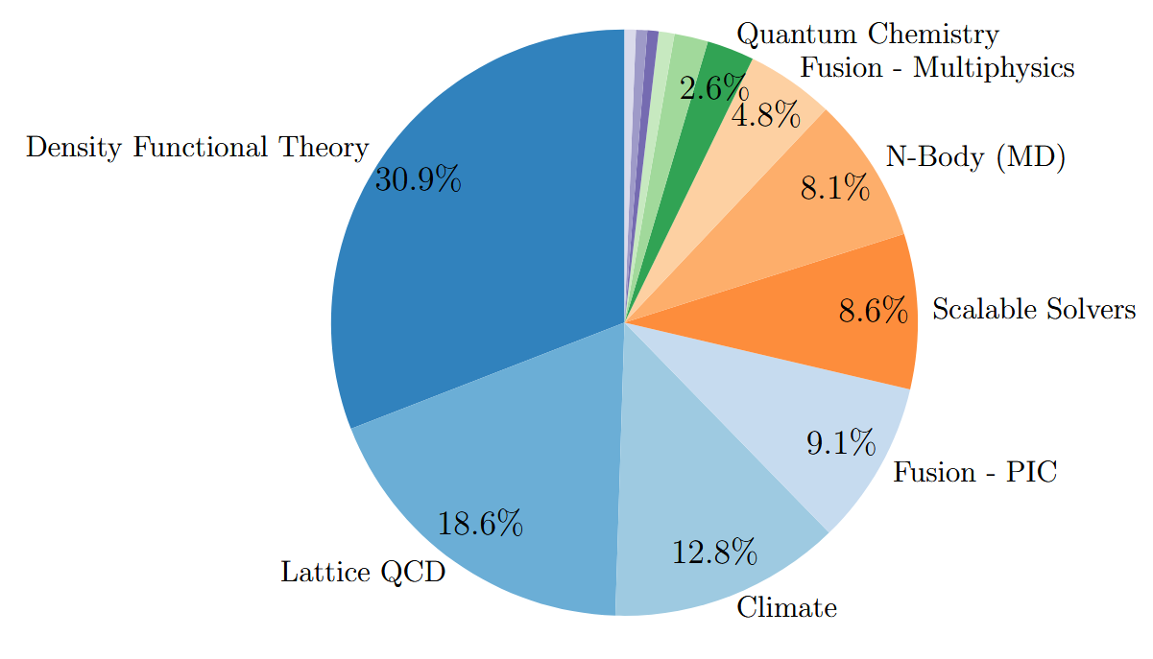
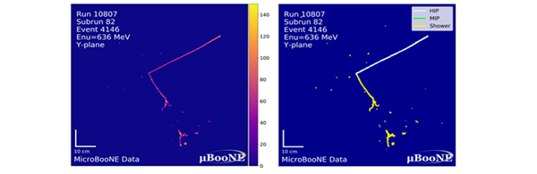
HEP and Computing
NERSC Workload
Lattice QCD alone makes up nearly 20% of the NERSC workload, and has a clear quantum computing application.
LHC generates 100 PB/year of data
Each neutrino event at DUNE will generate about 6GB of data; a nearby supernova could generate 100TB of data.
arXiv:2509.09882
AI-assisted event interpretation from MicroBooNE

Slide 16
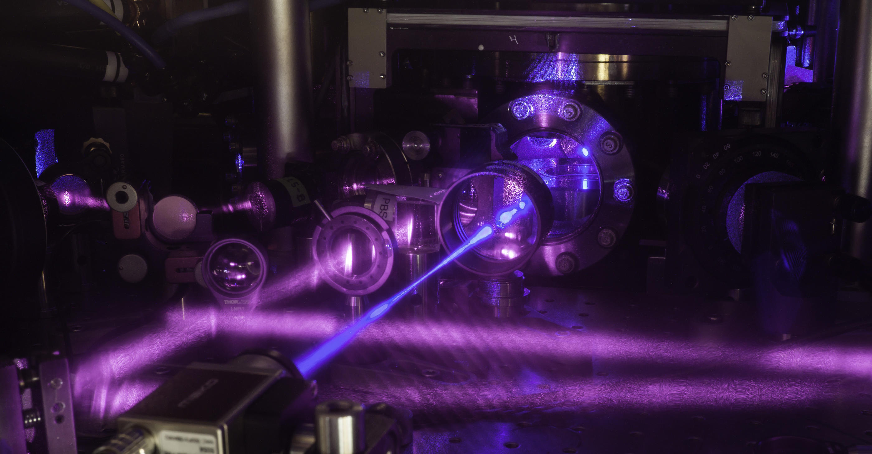
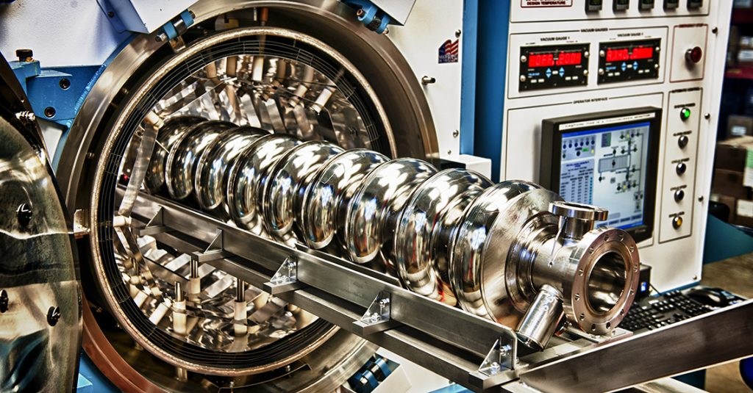
Hardware Opportunities
NIST
Analog simulations (with all attendant asterisks) – need to be clear on impact, scalability, etc.
“Edge” hardware needed to deploy QC in specific applications.
Specific hardware needs for HEP applications of quantum computing?
Theory and algorithms work needed to substantiate this.
“Head-starts” before universal FTQC
SQMS

Slide 17
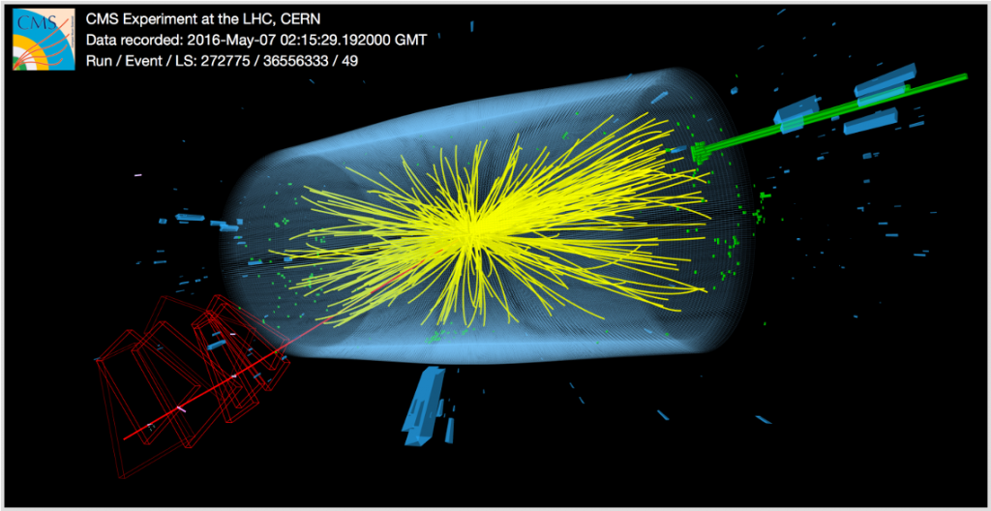
Software Opportunities
arXiv.2509.09882
Formal theory to algorithms – how do we formulate for computation?
QECC – what does physics tell us anything about relative importance of errors?
Resource costs – what drives them, how do we make them less?
Expand realm of ask-able questions – where is QC going to do something one of a kine?
Other HEP activities with potential QC overlaps.
Event generation
Modeling detectors
Data analysis
AI/ML

Slide 18
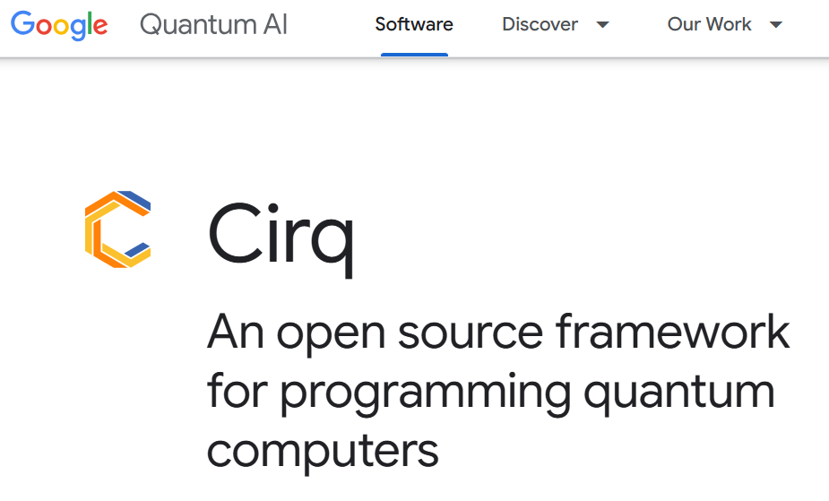
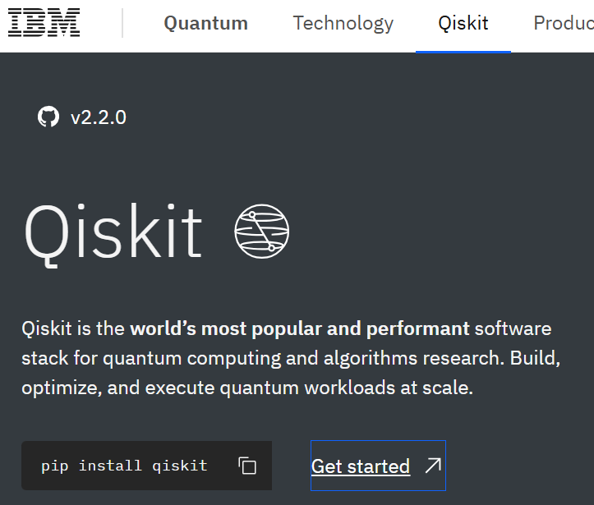

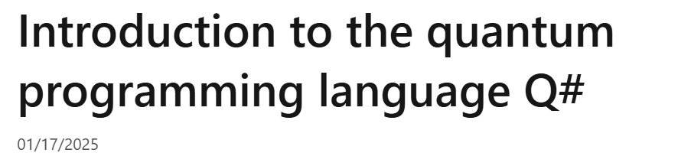
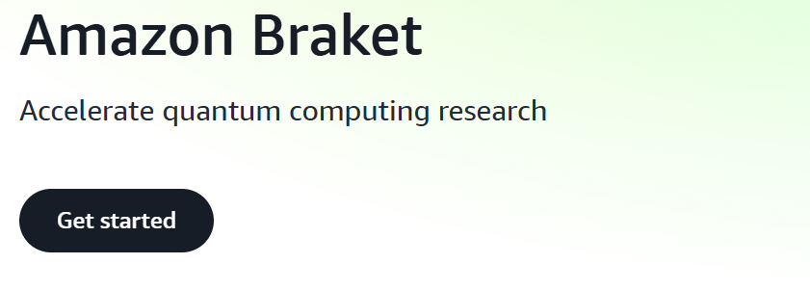
Everything In Between?
Compilers, controls, middleware
We have to learn to use machines we did not build for purposes their designers may not have anticipated.
Software solutions for HEP researchers
What can make QC useful for physicists with minimal QC expertise?
General theme: lowering the barriers between HEP and QC research

Slide 19
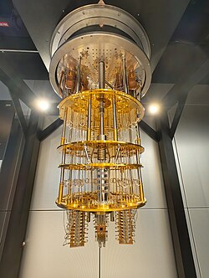
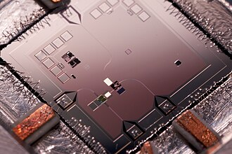
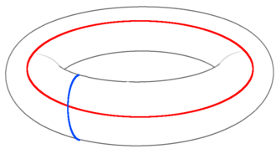
Key Word: Differentiation
Our office (HEP) is not interested in “general purpose” quantum computing research:
Building a better qubit
Scaling up a QC
Error correction
Why? Comparative advantage, limited resources.
Improving qubits and devices -> NQISRCs, BES, ASCR, private sector…
We want to seize unique opportunities.

Slide 20
Overall Vision – Usefully Chaotic
HEP problems (demand side)
Optimization
Design
Simulation
Data analysis
Quantum capabilities inspire us to identify HEP applications
HEP-direction inspires the creation of new quantum resources
Machines
…
Algorithms
Frameworks
Quantum solutions (supply side)

Slide 21
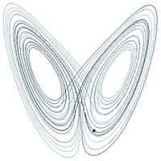
Overall Vision – Usefully Chaotic

Slide 22
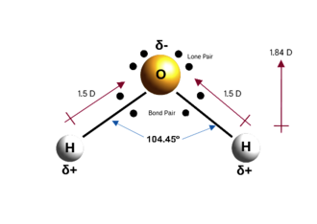

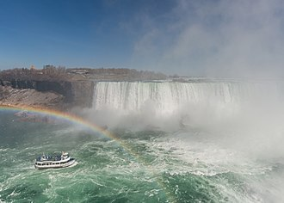
What Does the Long Term Look Like?
Near-term (<5): NISQ Devices
Proof of concept – few sites, limited time scales
Formulating observables, operators, etc
No direct contribution to discovery science
Mid-term (5-10): Small logical devices
Demonstrations equivalent to classical computing across many physical settings
Special-interest problems with quantum advantage (rigorous or not)
Understanding structure of problems and areas of advantage
Long-term (10+): Fault-tolerance
Quantum computing as the standard workhorse for frontier simulations
Considering large-scale challenges in e.g. data analysis
New horizons identified based on early success
Wikimedia

Slide 23

2025:
Thank you!
zachary.goff-eldredge@science.doe.gov

