Slide 1
Scientific discovery with quantum computers
Bert de Jong
Director Quantum Systems Accelerator
Director MACH-Q Program
wadejong@lbl.gov

Slide 2
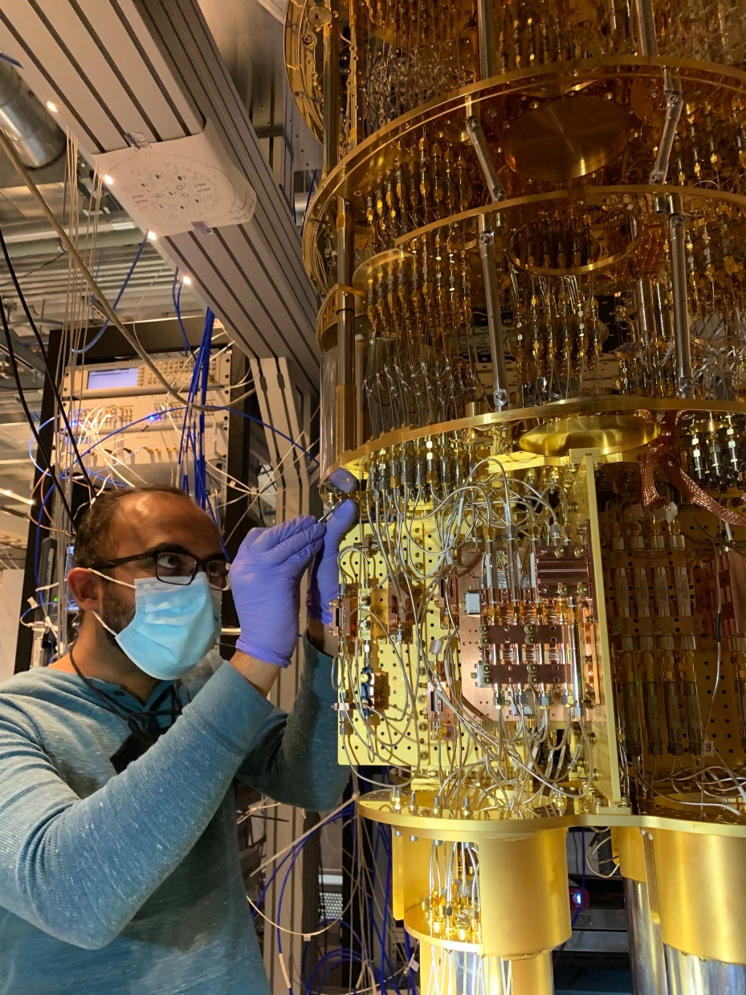
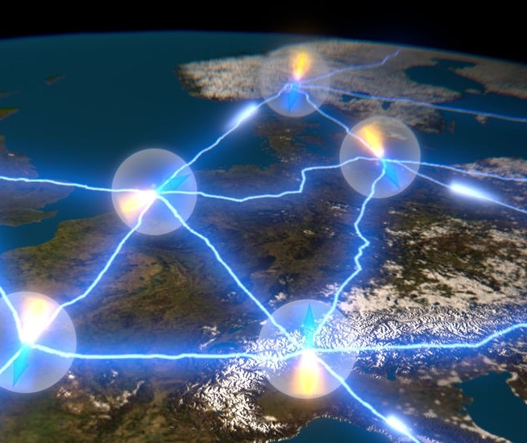
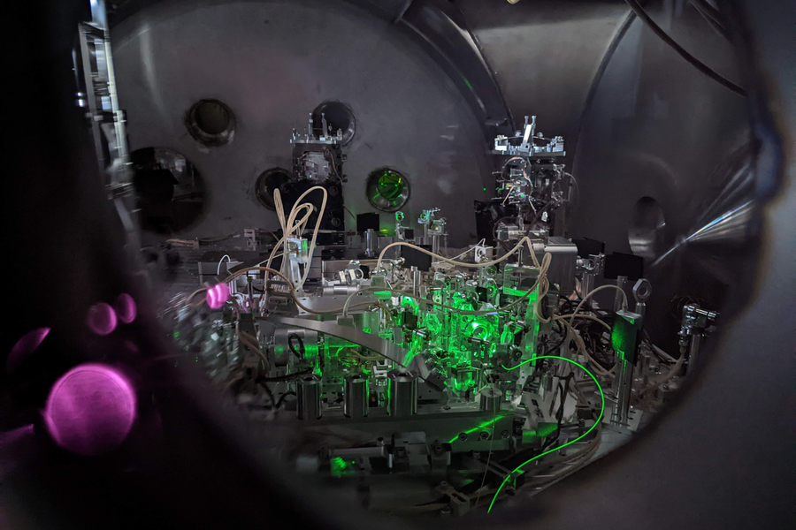
Twenty-first century ushered in second quantum revolution
Quantum computing
Next-level simulations
Quantum networks
Secure data communication
Quantum sensors
From materials to gravitational waves
Credit: Georgia Mansell/LIGO Hanford

Slide 3
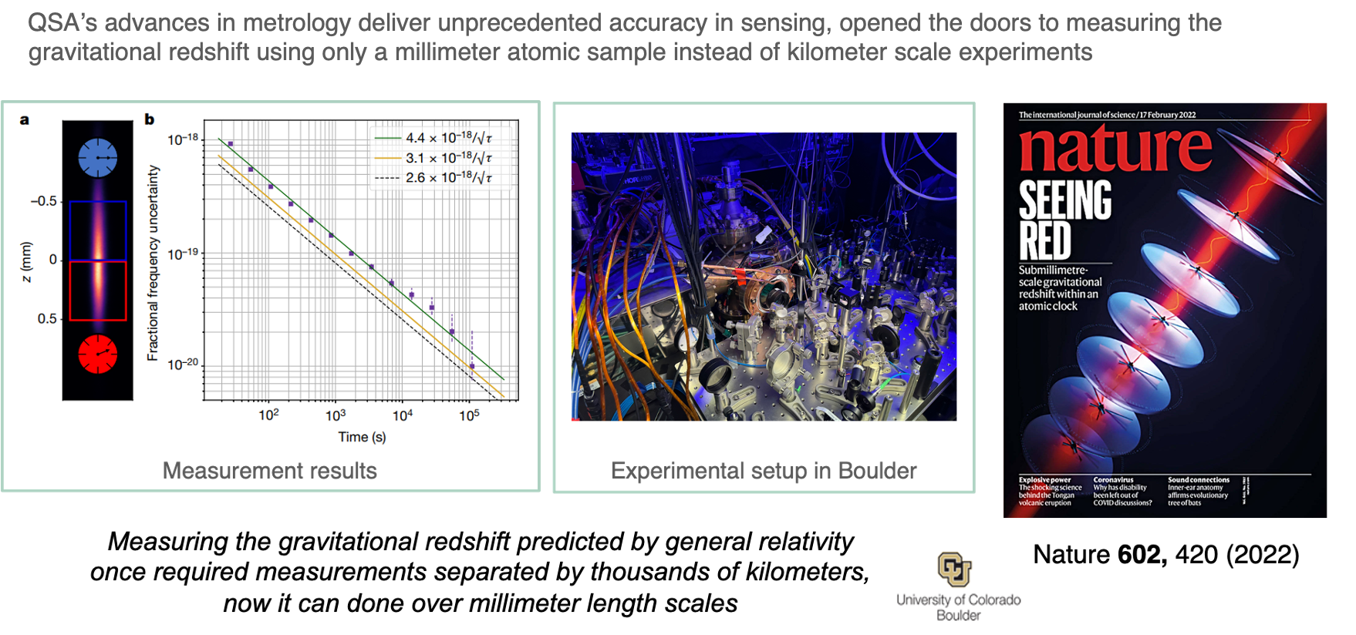
Sensing has moved clock precision to 21st digit

Slide 4
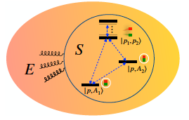
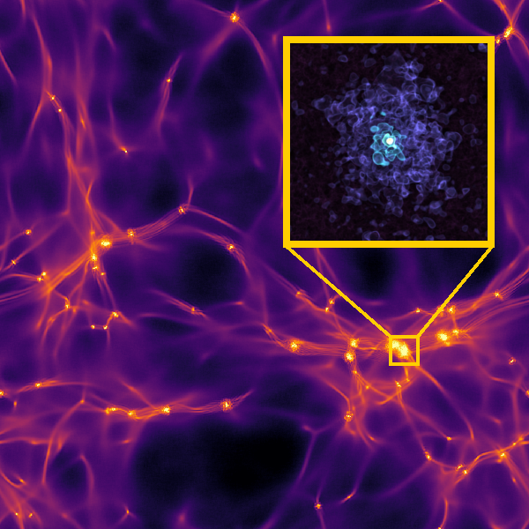
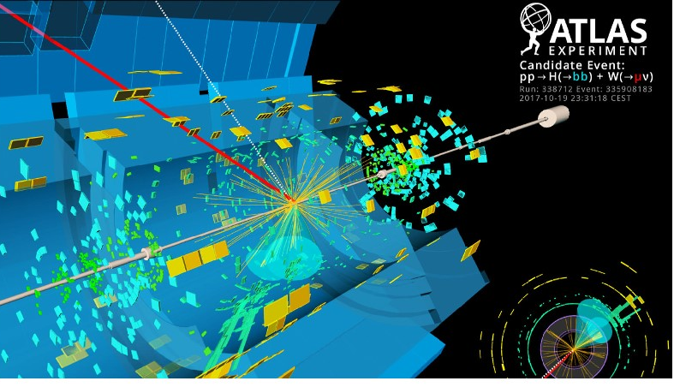
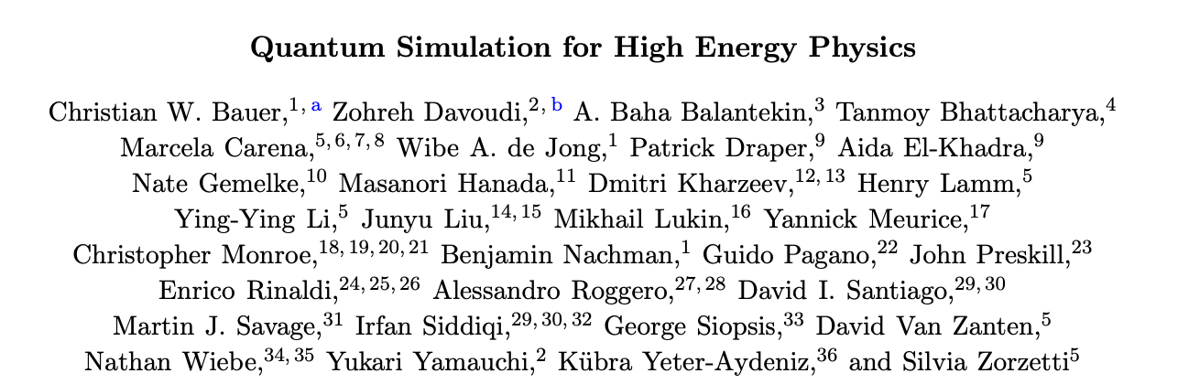
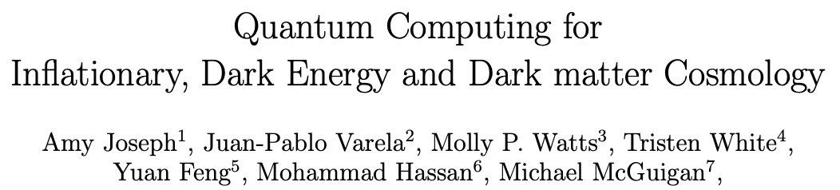
Quantum advantage exploring fundamental laws of physics
Image inspired by JHEP 02 (2009) 007, Courtesy Nachman (LBNL)
Image from arXiv:2101.05821
arXiv:2105.13849
PRX Quantum 4, 027001 (2023)

Slide 5
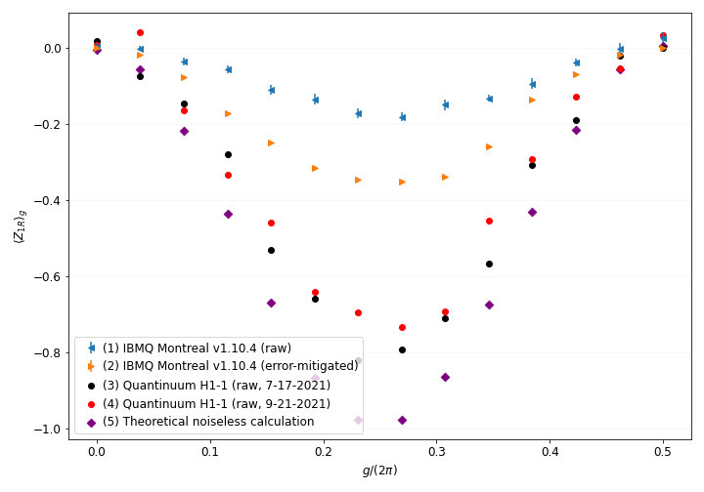
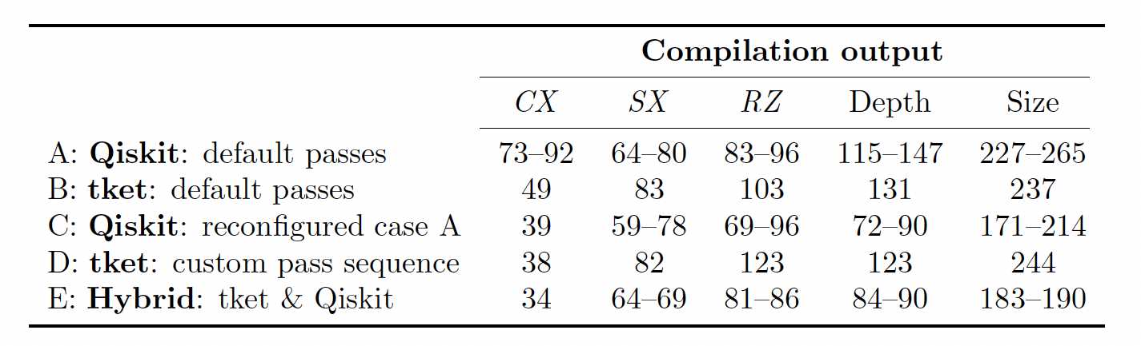
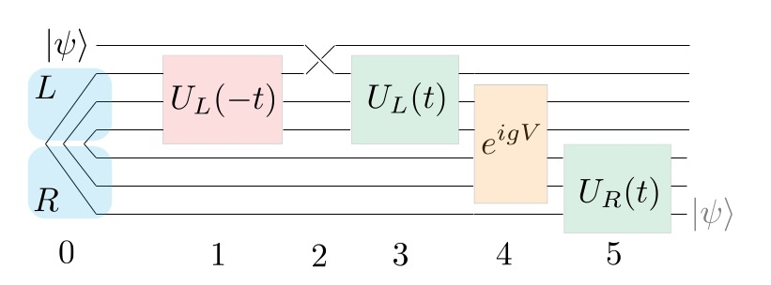
Wormhole inspired teleportation (WIT)
From 7 to 6 qubits with mid-circuit measurement
Good compilation is important
- 4 -
Quantum 7, 1138 (2023)

Slide 6
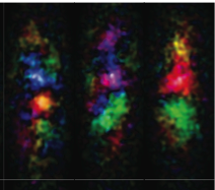
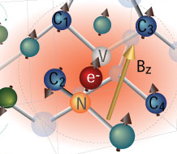
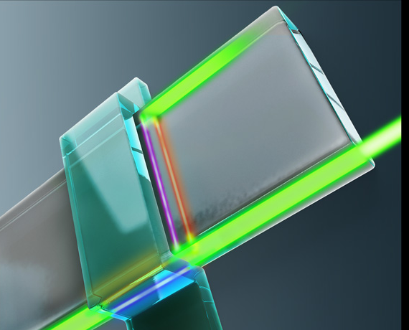
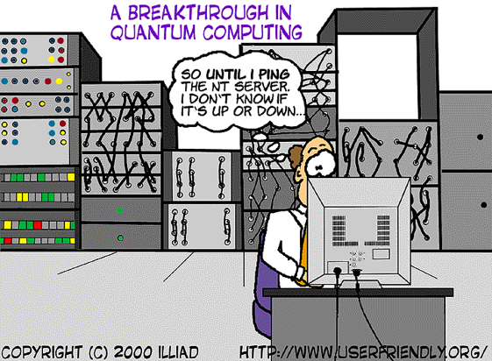
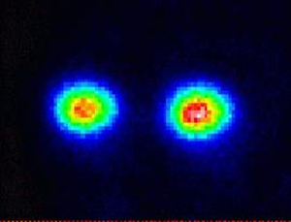
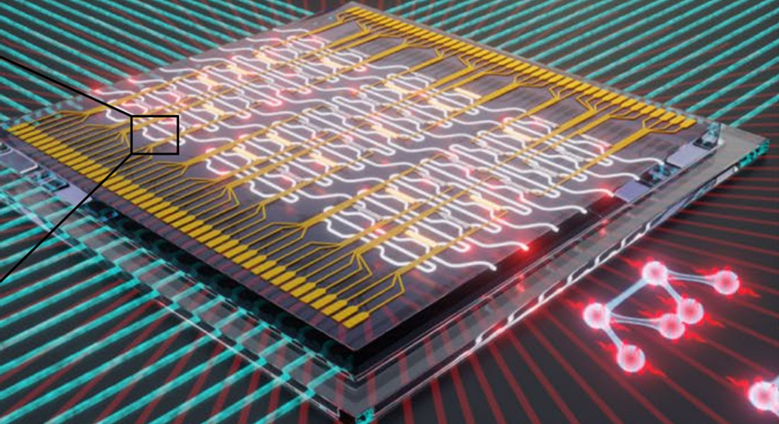
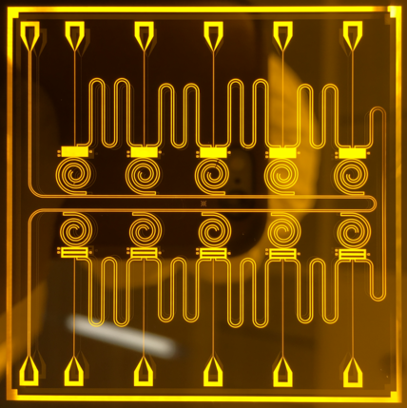
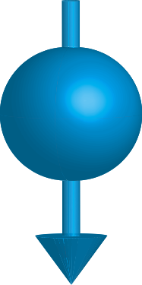
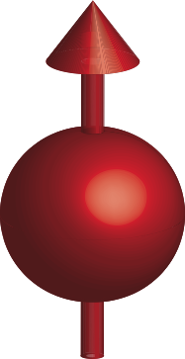
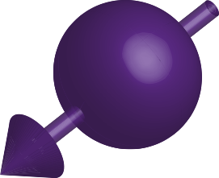
Many flavors of quantum computers
ATOMS
SOLID STATE
(spins)
MAJORANA
QUASI-PARTICLE
Currently Leading in the Field
IONS
PHOTONS
ELECTRONS
SPIN UP + SPIN DOWN
SUPERCONDUCTING

Slide 7
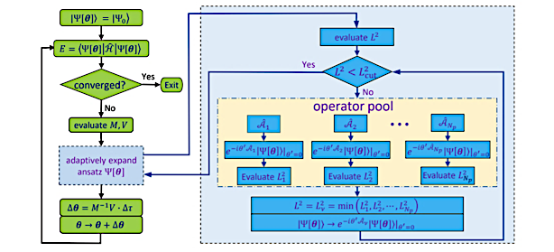
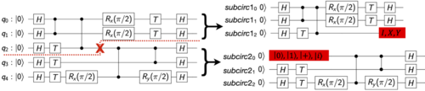
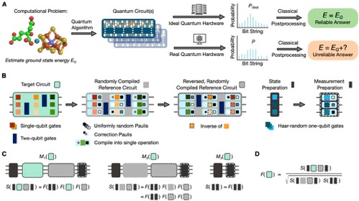
How does a quantum program operate?
Peruzzo, et al. Nat. Comm. 5, 4213 (2014)
Gomes, et al. Adv. Quant. Tech. 4, 2100114 (2021)
Tang, et al. ASPLOS’21, 473 (2021)
Quantum program will have classical and quantum components, it’s hybrid!
Proctor et al., arXiv:2204.07568

Slide 8




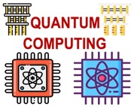
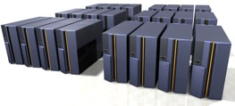

Most widely used interface to quantum computer
User
Quantum Provider
Queue
Compute Answer
Create circuit (assembler programming), get bit strings back to calculate answer

Slide 9


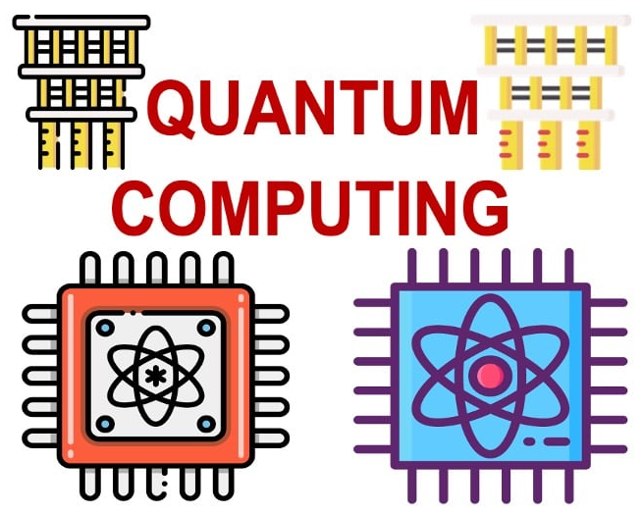
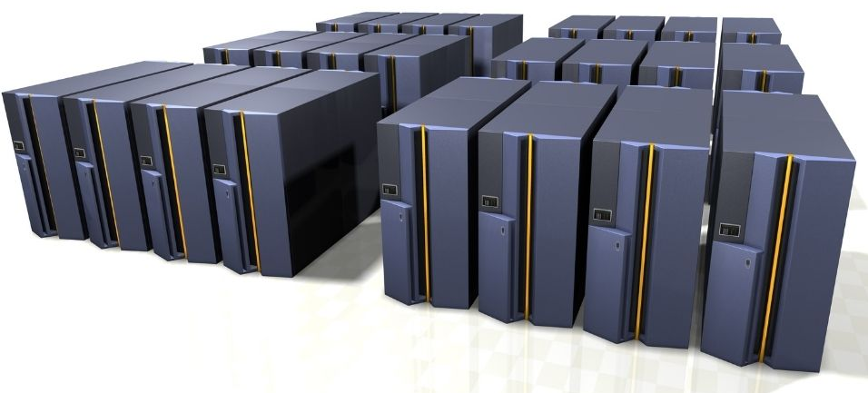
Hybrid quantum computers key in foreseeable future
User
Cloud Provider
from SomeSimulationPackage import Molecule, SCFDriver
from SomeSimulationPackage import GroundStateEigensolver
molecule = Molecule(geometry=[['H', [0., 0., 0.]], ['H', [0., 0., 0.735]]], charge=0, multiplicity=1)
driver = SCFDriver(molecule = molecule, basis='sto3g’)
calc = GroundStateEigensolver(algorithm=VQE, qubits=4)
res = calc.solve(driver)
Queue
Compute Answer or new circuit
Final answer
Target is the end-users in academia and industry without quantum knowledge
Notes:
Software startups play a major role here

Slide 10
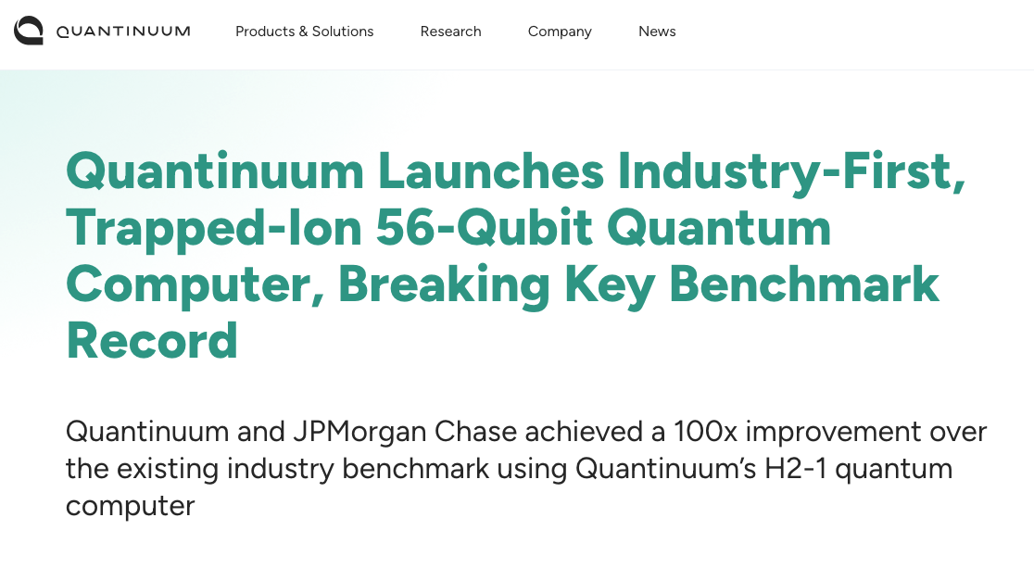
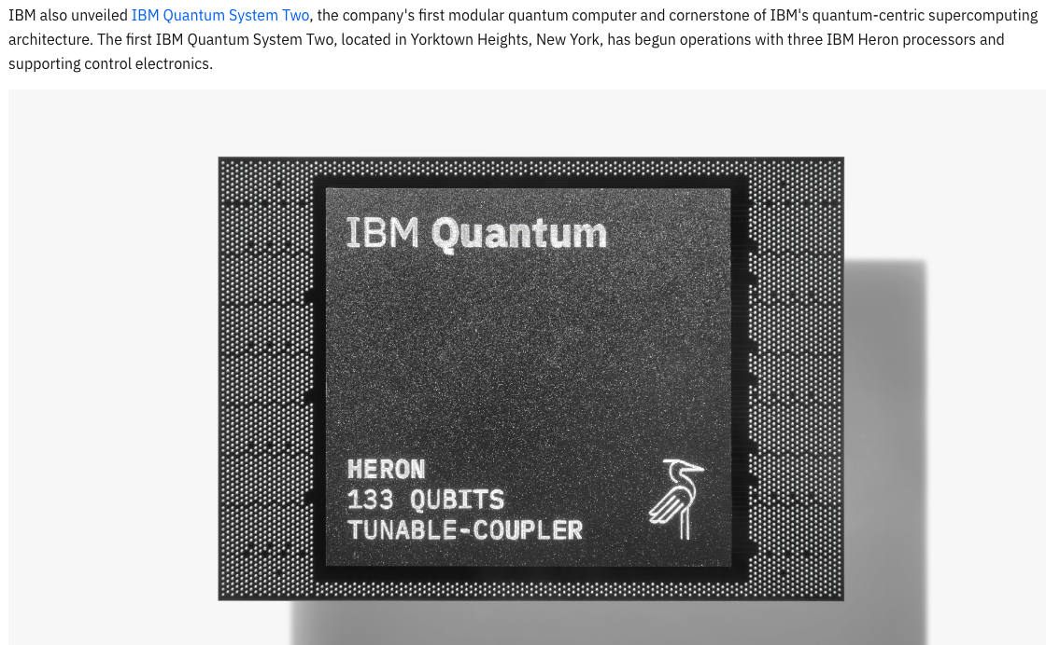
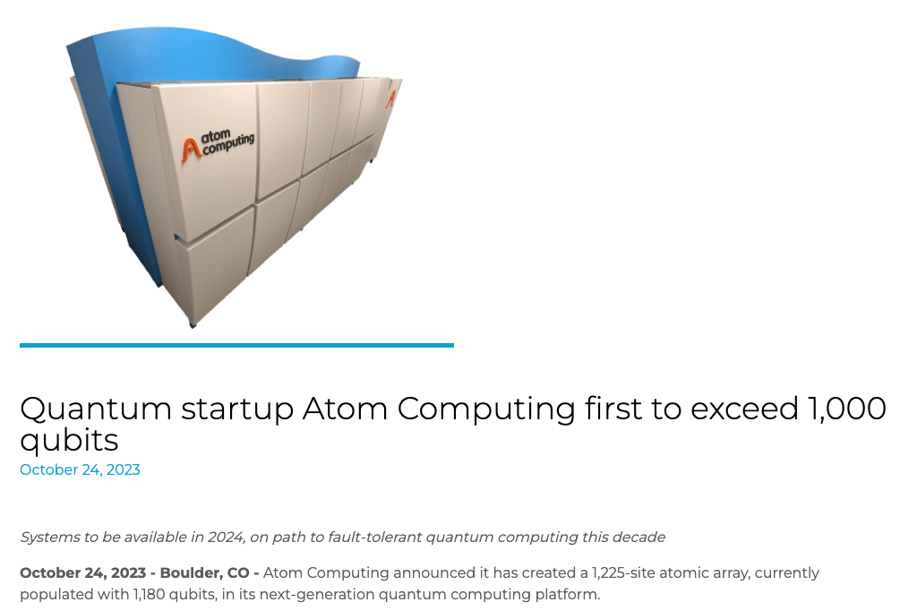
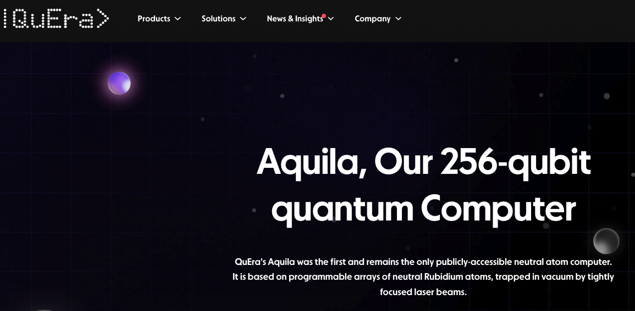
Number of qubits in quantum systems is growing
Challenging our ability to simulate and validate
Notes:
This is where tensor networks are becoming critical.

Slide 11
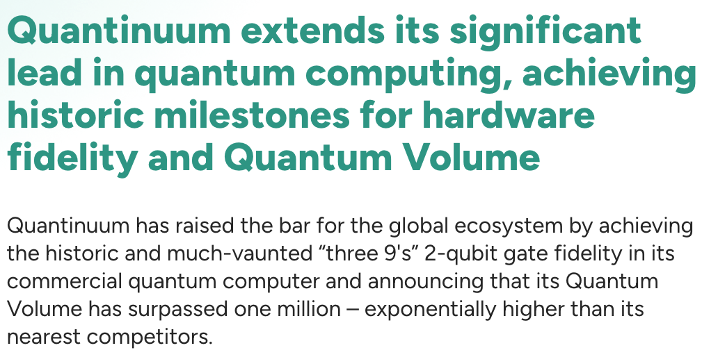
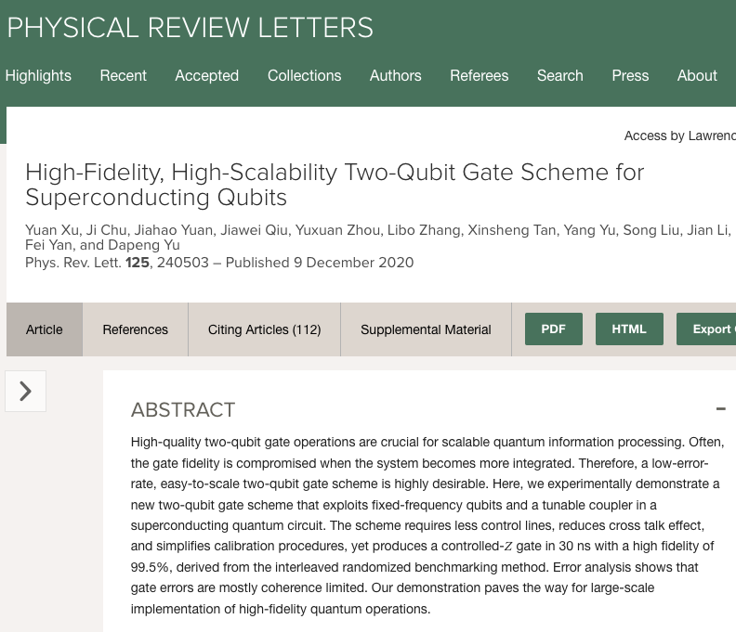
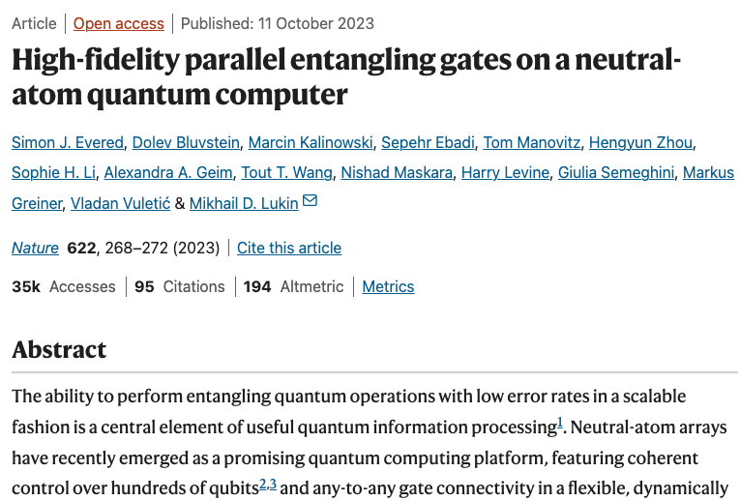
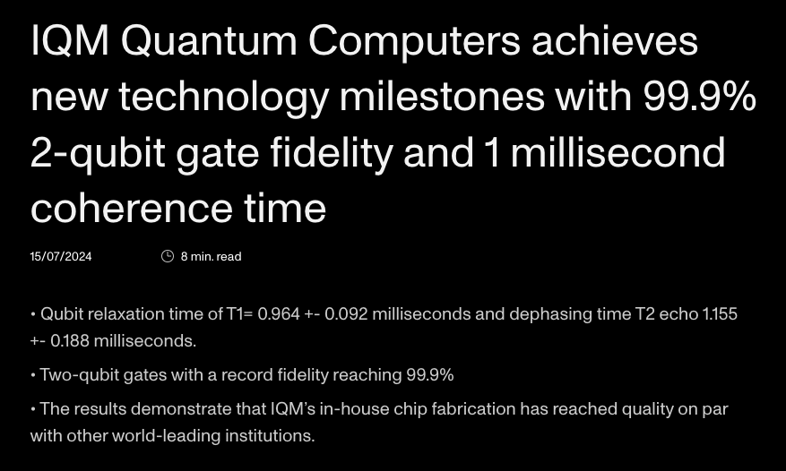
Quantum systems are getting higher gate fidelities
Different technologies achieve 99.99% fidelity on 2-qubit entangling gates
Different technologies achieve 99.9% fidelity on 2-qubit entangling gates

Slide 12
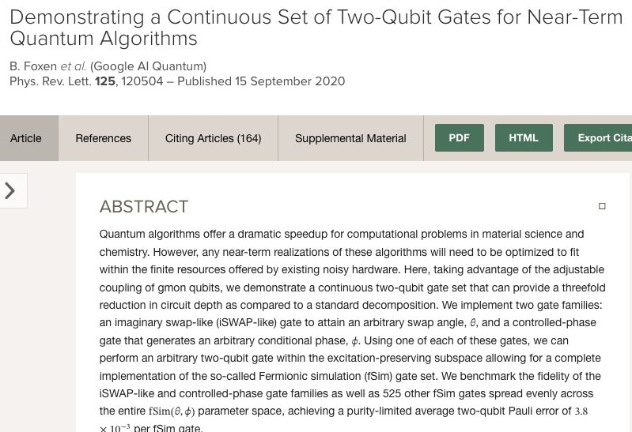
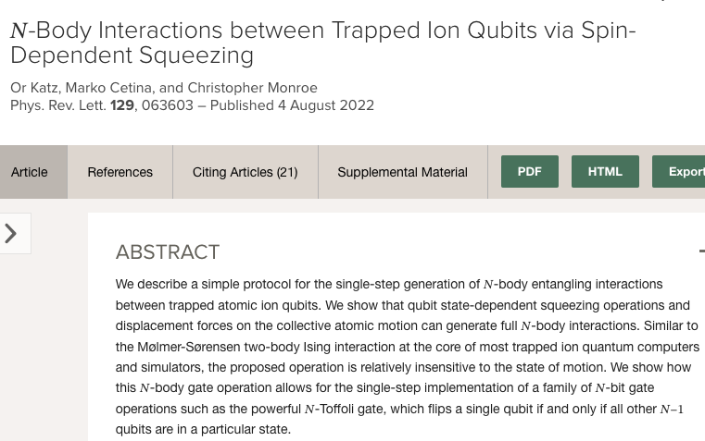
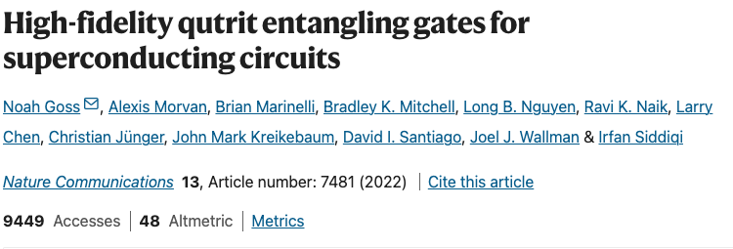
Quantum systems get new operation capabilities
New types of two-qubit gates
Multi-qubit gates
Parallel gates
Qutrit operations
Mid-circuit measurement
….

Slide 13
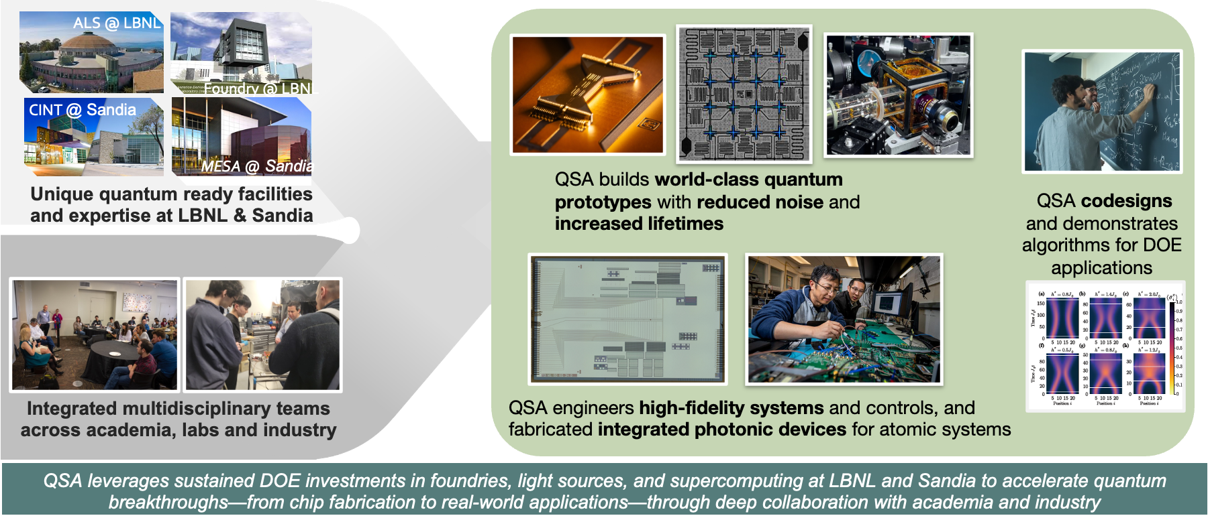
QSA: Driving breakthrough science and engineering to realize scalable, high-fidelity atom-based and superconducting quantum simulators
- 12 -

Slide 14
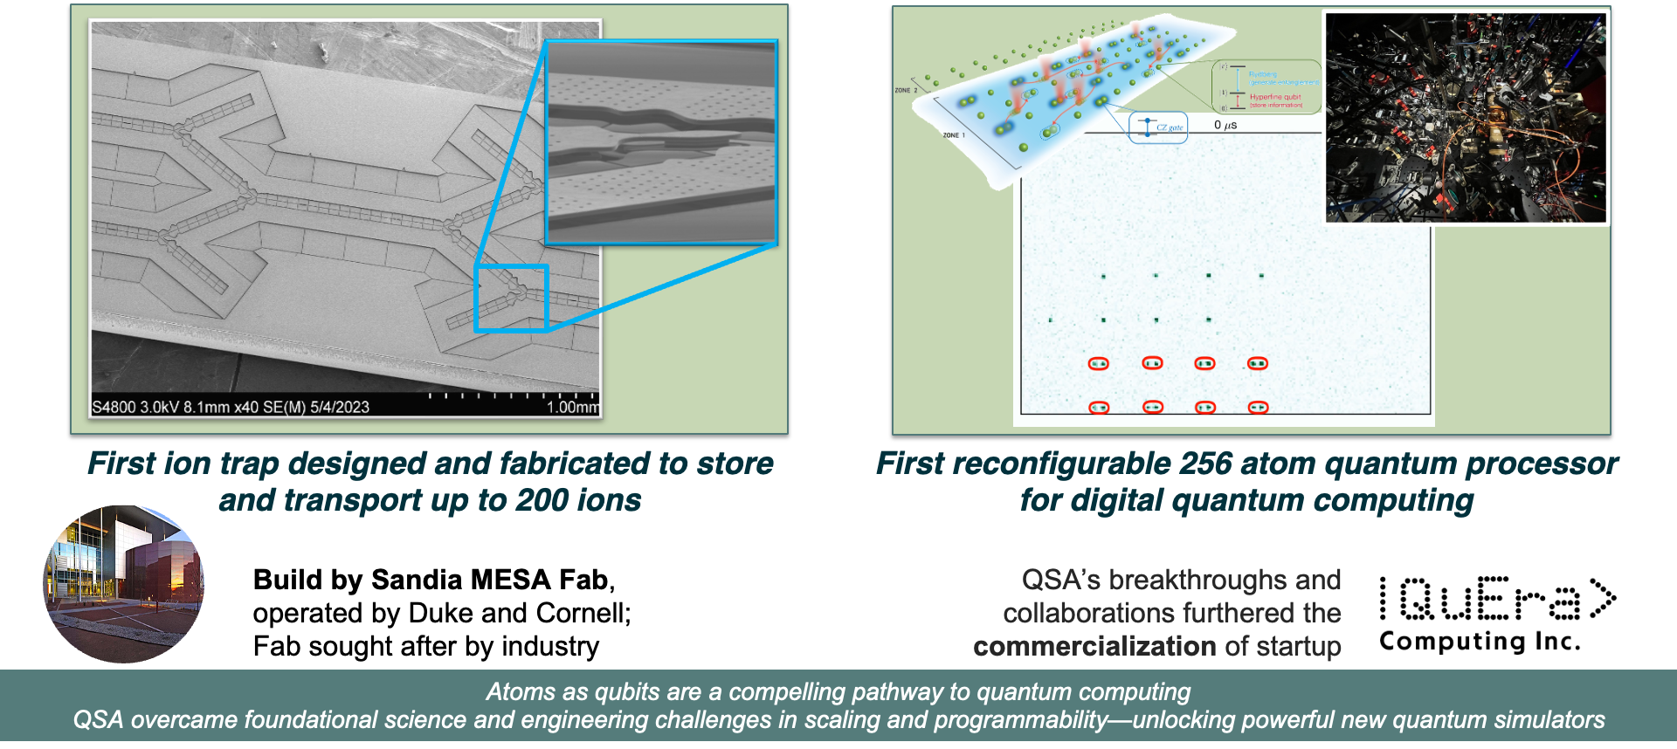
QSA first to build and operate atom-based quantum simulators with over two hundred qubits
- 13 -

Slide 15
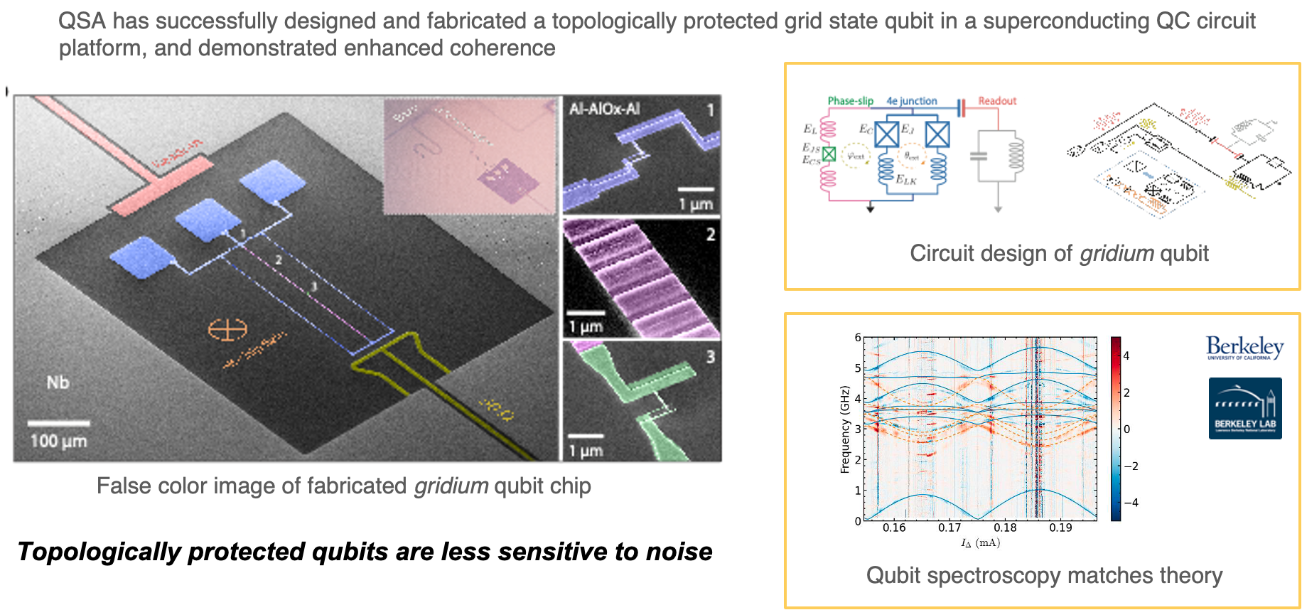
Delivering the first demonstration of a noise protected grid state qubit
arXiv:2509.14656

Slide 16
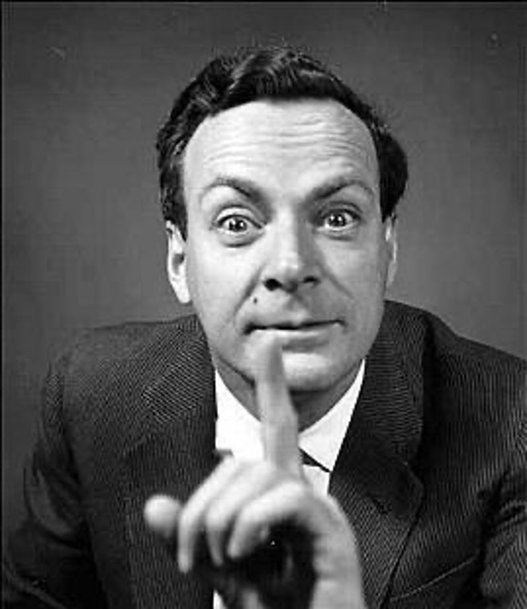
Quantum vs conventional computing…for science?
Simulating evolution of a quantum system on a classical computer in an efficient way is impossible (Feynman, 1982)

Slide 17
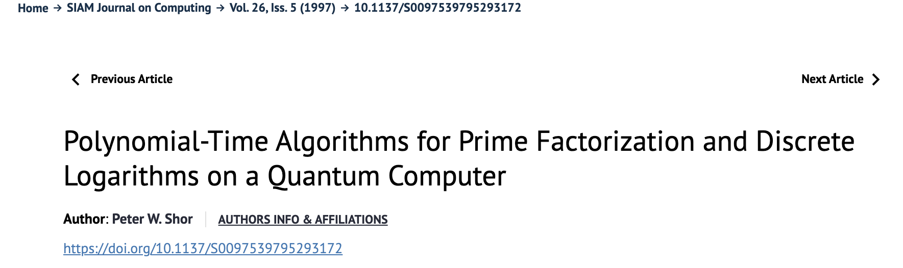
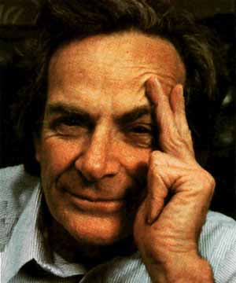

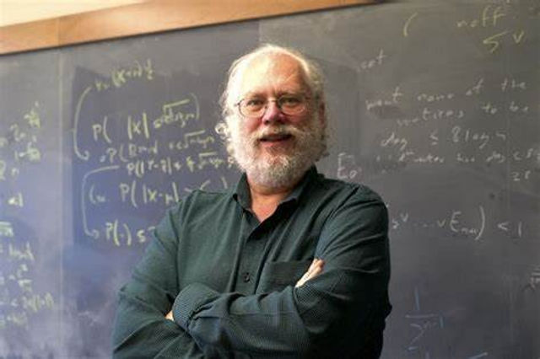
Using analog or digital quantum computers for science
Discovering digital algorithms
Simulating evolution of a quantum system on a classical computer in an efficient way is impossible
(Feynman, 1982)
- 16 -

Slide 18
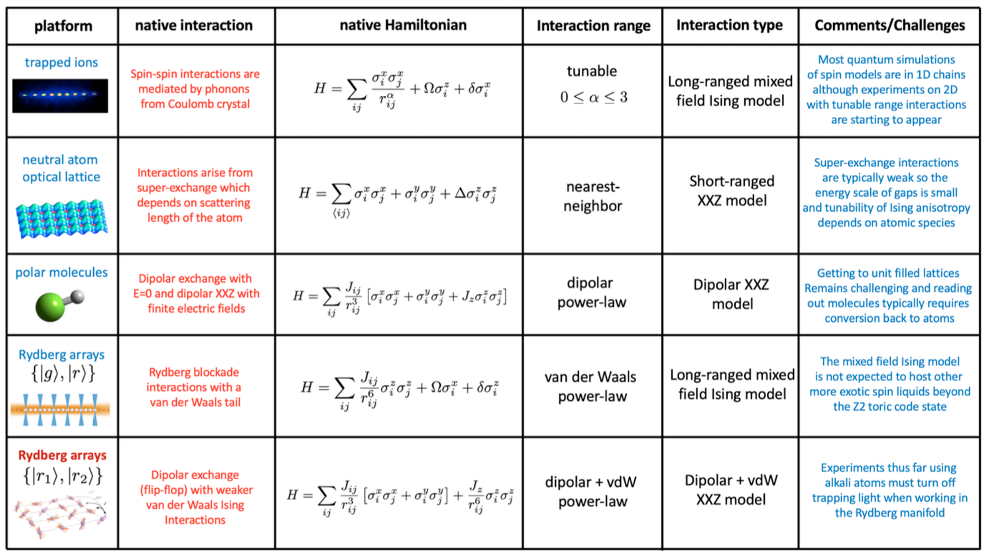
Simulators based on nature each have their strengths

Slide 19
Simulators based on nature each have their strengths
Superconducting qubits can access similar Hamiltonians, and potentially others, though with different types of interactions and couplings between qubits

Slide 20
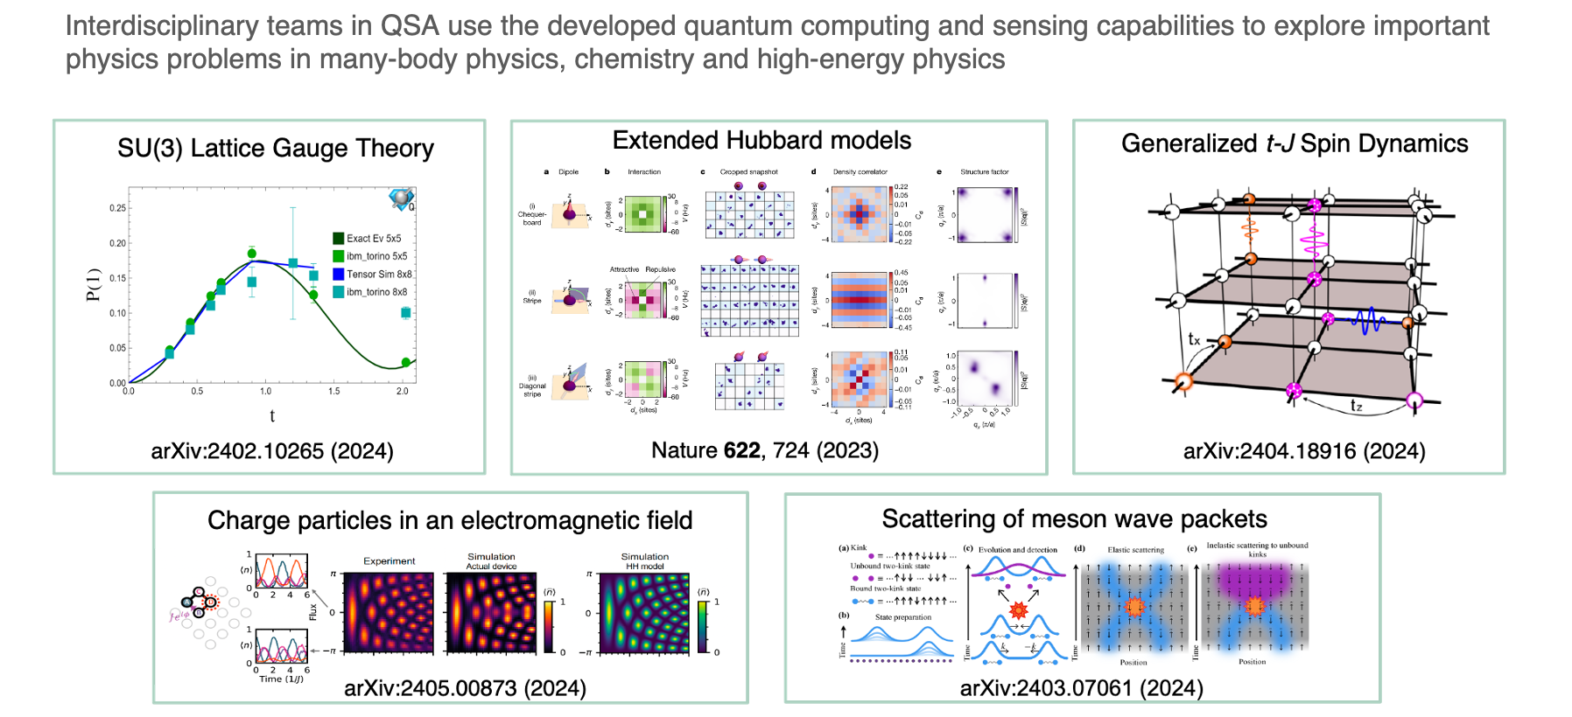
Analog simulations are advancing science already

Slide 21
Road to useful quantum computers still challenging
Almost enough good qubits for specialized quantum use
Coherence - available compute time - is short, driven by noise and errors
Advances in algorithms, software tools and compilers are needed to make quantum computing broadly approachable
Designing better qubits is hard

Slide 22
Moving towards quantum advantage for science
Scientific algorithms and software
Hardware technology
Increasing qubit count
Increasing lifetimes
Increasing fidelity and reducing errors
Reducing qubit count
Decreasing operation counts
Incorporating error resiliency

Slide 23
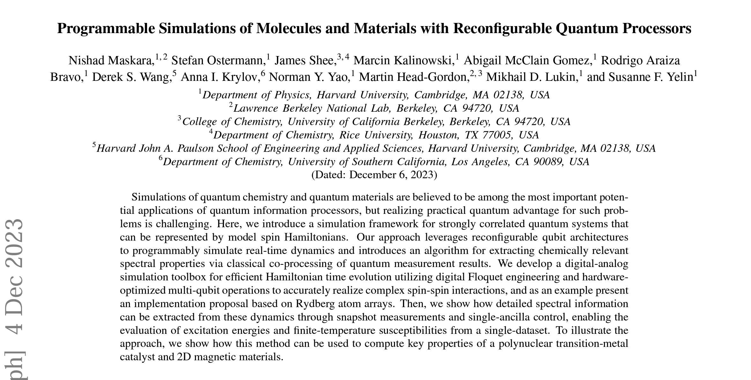
Co-design is critical to advance quantum computing
- 22 -
arXiv:2312.02265

Slide 24


Compilers are a critical piece in the tool chain, HPC is important here
QUEST
https://bqskit.lbl.gov
Powerful and Portable Quantum Compiler Framework
Compilation is an NP-hard problem and for large qubit counts needs HPC
…and can benefit from AI!
QFast

Slide 25

Variational quantum eigensolver has advanced
Special care needs to be taken in general eigensolver due to noise in data!
- 24 -
J. Chem. Theory Comput. 16, 5425 (2020)

Slide 26







Building on Quantum Subspace Expansion:
Real-time evolution for eigenvalue extraction
Real time evolution to generate a basis of expansion states:
…
Initial vector
Use as a basis to solve:
Possible to extract eigenstates by the cancellation of phases of components of the initial vector.
Promising because unlike imaginary, real time evolution is native to quantum computing.
- 25 -
PRX Quantum 3, 0202323 (2022)

Slide 27

Building on quantum subspace expansion to extract excited states: Variational Quantum Phase Estimation (VQPE)
Toeplitz structure means that we only need a linear number of measurements instead of quadratic
Approach allows extraction of the maximal number of excited states!
- 26 -
PRX Quantum 3, 0202323 (2022)

Slide 28
Physical sciences needs dynamics in realistic environment
Open quantum systems
Systems at finite temperature/interacting with environment
Thermofield double (TFD) states - Phys. Rev. Lett. 123, 220502 (2019)
Quantum Markov Chain Monte Carlo - Quant. Sci. Tech. 7, 025017 (2022)
Canonical thermal pure quantum (TPQ) state - arXiv:2109.01619
ADAPT-VQE-Gibbs - arXiv:2203.12757
Fluctuation relations (Jarzynski) - arXiv:2203.08882 (LANL), arXiv:2103.09846 (LBNL)
Ground, excited and thermal states
Quantum Imaginary Time Evolution (QITE) with Qlanczos - Nature Physics 16, 205 (2020)
Imaginary evolution version of VQPE

Slide 29



Quantum Markov Chain Monte Carlo with Driven Dissipative Dynamics on Quantum Computers
Development of a quantum algorithm to sample from Boltzmann distributions on quantum computers by engineering open-quantum system dynamics
Algorithm can prepare robust, thermal states on quantum computers enabling finite-temperature simulations on quantum computers relevant to chemistry, materials and machine learning quantum applications
a) Principal qubits (blue) locally connected to ancilla qubits (red). b) Time-dependent ancilla frequency combs the system energy spectra and resonantly exchanges energy with different energy transitions in the system at different times c) Quantum circuit to implement the interaction cycle dynamical map
Metcalf, Stone, Klymko, Kemper, Sarovar, de Jong Quant. Sci. Tech. 7, 025017 (2022)
- 28 -
Notes:
Notes: Include 200 word highlight summary….

Slide 30




Open quantum systems in heavy-ion collisions
Two-level system of heavy quark-antiquark pair (H_{s}) interacting with quark-gluon plasma (H_{e}) via interaction Hi with strength g.
de Jong, Metcalf, Mulligan, Ploskon, Ringer, Yao, Phys. Rev. D 104, 051501 (2021)
- 29 -

Slide 31




Exploring the evolution of the quantum system itself
Phys. Rev. Lett. 121, 170501 (2018) - Rigetti
Materials Theory 6, 13 (2022) - IBM
- 30 -

Slide 32



Adaptive Variational Quantum Dynamics Simulations
(Looks a lot like ADAPT-VQE)
$$L^{2}=2var\left[H\right]+\sum_{μν}{Vμ}{Mμν}^{−1}Vν$$
We start from an initial state $|\left.Ψ0\right\rangle$ and an operator pool $\left[A_{0},A_{1},…,A_{M−1}\right]$ ;
Selectively append a new unitary $e^{−iθ_{μ}A_{μ}}$ to $|\left.Ψ0\right\rangle$ until the updated McLachlan distance satisfies $L^{2}<L_{cut}^{2}$
The expanded variational parameter vector is subsequently updated at the time step
- 31 -
Adv. Quant. Tech. 4, 2100114 (2021)

Slide 33

We used AVQDS to calculate Green’s functions
Retarded Green’s function versus time
Spectral function
Two site Hubbard model on 4 qubits of IBM Kolkata quantum computer
Imaginary part of $G^{R}(ω)$ using Pade approximation
- 32 -
JCTC 19, 3313 (2023)

Slide 34


Adaptive variational simulation for open quantum systems
Variationally solves either a vectorized or a stochastically unraveled Lindblad equation – Challenge is McLachlan lower bound not well defined
Vectorization (N=2, 4 qubits)
Trajectory (N=4, 5 qubits)
Simulation run with 100,000 shots on IBM Kolkata quantum computer
Resolution Enhancement Technique key to error mitigation
- 33 -
Quantum 8, 1252 (2024)

Slide 35

Noise in quantum systems is the biggest nemesis
Credit: N. Hanacek/NIST
Any interaction between the qubits and their environment leads to information loss
But, we need interactions to do quantum operations

Slide 36



New error correction codes are being developed
Surface code Low-Density Parity Code Heavy-Hexagon
npj Quant. Inf. 4, 55 (2018) Quant. Inf. Comput. 14, 1338 (2014) Phys. Rev. X 10, 011022 (2020)
Full error correction (hardware or software) a long-term solution, driven by increases in qubit counts and increases in fidelity
For science problems we may not need full error correction

Slide 37


Decoding is expensive, but HPC might not be needed in real-time

Slide 38








First demonstrations of error correction in 2024

Slide 39

Accurate magnetic materials simulation with quantum computers
Combination of both existing and LBNL’s new “estimation circuits” mitigation approaches enabled larger scale simulations leading to quantum circuits with hundreds of operations to be run on quantum computer
Team science, requiring physicists, chemists, computer scientists and applied mathematicians needed to achieve this result
Would require a Quantum Volume of > 48,000
Quantinuum H2 hardware 2²³ = 8,388,608 (2025)
Advances were adopted by High-Energy Physics researchers to enable 100+ qubit simulations with 300+ gates
Effect of mitigation: Time evolution of a six-qubit magnetic model calculated without and with error mitigation.
Depth simulation = 210 CNOTs
- 38 -
Phys. Rev. Lett. 127, 270502 (2021)

Slide 40
Integrating approximate error correction and mitigation
Bringing together partial error correction and partial error mitigation to minimize the resources needed to achieve reliable information from a quantum computer
- 39 -
On arXiv soon
Notes:
Error correction: qubit resources and circuit depth
Error mitigation, probabilistic error cancellation (PEC): Measurement bottleneck

Slide 41
Part of this work was supported by the U.S. Department of Energy, Office of Science, Office of Advanced Scientific Computing Research through the Accelerated Research in Quantum Computing Program
This material is based upon work supported by the U.S. Department of Energy, Office of Science, National Quantum Information Science Research Centers, Quantum Systems Accelerator
Bert de Jong wadejong@lbl.gov

