Slide 1

Ground State Preparation in SU(3) Lattice Gauge Theory
QuantISED Program
Drishti Gupta
UIUC
LBNL, Sept 29 2025
Based on <insert paper details here>
QuantISED Program

Slide 2
CONTENT
Description of the SU(3) Lattice Hilbert Space, and methods of truncation.
Preparation methods and Results in d=2 and d=3

Slide 3
THE HILBERT SPACE

Slide 4
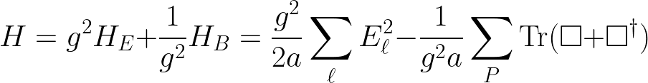
The SU(3) Kogut-Susskind Hamiltonian
The “electric” part is perturbative in weak-coupling limit
The “magnetic” part is perturbative in strong-coupling limit
GOAL: Prepare an approximate ground state of this Hamiltonian in qubit encoding
We work in the “electric basis”: diagonalizing the magnetic hamiltonian in this basis is the hard task.

Slide 5


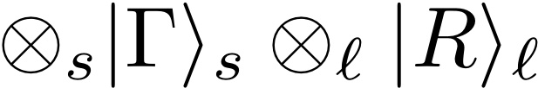
The Reduced Electric Basis
s1
r1
s2
r2
s3
The standard electric basis¹:
r3
r4
r5
supplemented by Gauss Law at every vertex:
s4
r6
s5
r7
s6
equivalent to requiring a singlet in the tensor product of half links at every vertex
r8
r9
r10
s7
r11
s8
r12
s9
The “reduced” electric basis²:
specification of a singlet at each vertex
irrep on each link
Color index on links gets replaced by site singlets
1. Phys. Rev. A 73 (2006): Tim Byrnes, Yoshihisa Yamamoto
2. Phys.Rev.D 103 (2021): Anthony Ciavarella, Natalie Klco, Martin J. Savage; Phys.Rev.X 7 (2017): Mari Carmen Bañuls, Krzysztof Cichy, J. Ignacio Cirac, Karl Jansen, Stefan Kühn; Phys.Rev.D 112 (2025): Praveen Balaji, Cianan Conefrey-Shinozaki, Patrick Draper, Jason K. Elhaderi, Drishti Gupta, Luis Hidalgo, Andrew Lytle, Enrico Rinaldi

Slide 6
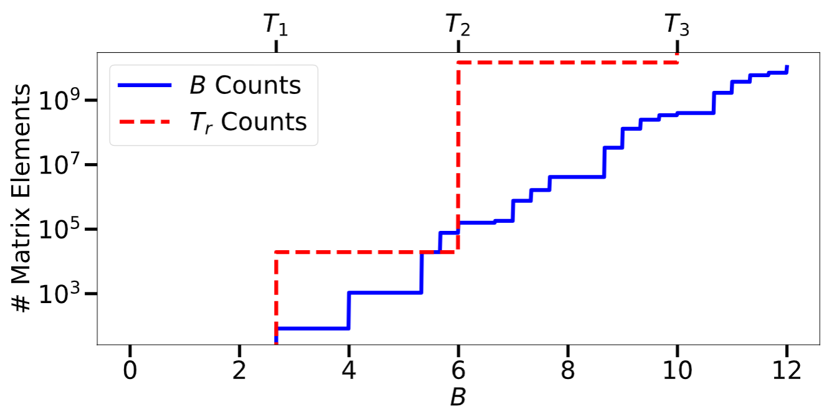


Truncation of Representations
The irreps need to be truncated in order to have a finite qubit encoding.
Standard Method: Truncation by highest electric energy allowed at link.
Modified Method: Truncation by highest electric energy (“B”) allowed at vertex.
Truncation | irreps allowed
T1 | {1,3,3}
T2 | {1,3,3,6,6,8}
In this approach:
number of singlets at a vertex has sudden jump from T1 to T2: In d=2; T1 has 6 singlets at a vertex, but T2 has 66.
number of matrix elements in ☐ also jumps: from ~20k in T1 to ~15B in T2 in d=2.
1
1
3
1
1
8

Slide 7
GROUND STATE PREP METHODS, RESULTS

Slide 8
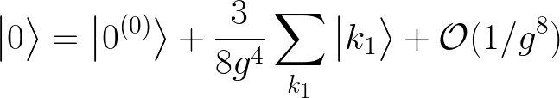
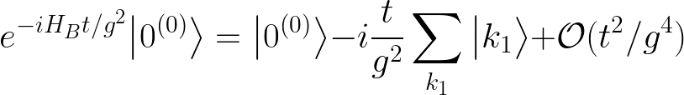
KS Ground State Ansatz
A variational approach:
Define an ansatz
Find optimal parameters that minimize energy of anstaz.
Our choice of ansatz was informed by strong -coupling perturbation theory.
In first-order perturbation theory:
trivial irrep state, or “electric vacuum”
single plaquette excitation
Observation: The time-evolution operator
creates the same states at order t/g² as perturbation theory.
P
We already knew how to build time-evolution operators!

Slide 9
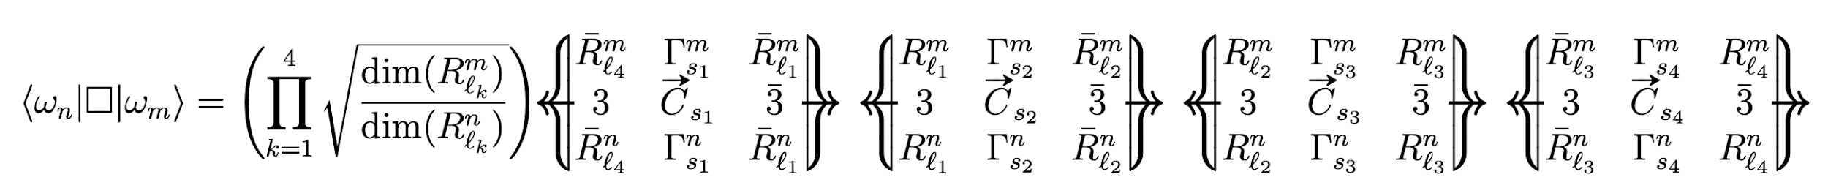
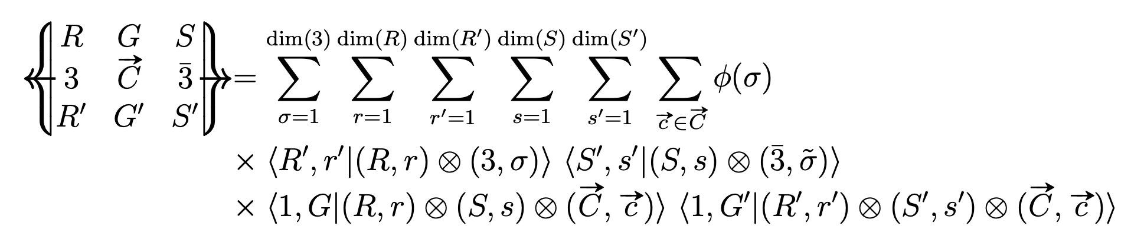
Brief Interlude: Quantum Circuits for SU(3) LGT
In our previous work, we described a quantum algorithm for time evolution of pure SU(3) lattice gauge theory. Key points:
Trotterization to individual Givens rotations from plaquette state . Transition amplitudes classically pre-computed using the master formula:
sum over internal states
conventional phase relating states of R* to Rbar
CGs for active link states
initial state singlet CG
final state singlet CG
Phys.Rev.D 112 (2025): Praveen Balaji, Cianan Conefrey-Shinozaki, Patrick Draper, Jason K. Elhaderi, Drishti Gupta, Luis Hidalgo, Andrew Lytle, Enrico Rinaldi ;
Phys.Rev.D 103 (2021): Anthony Ciavarella, Natalie Klco, Martin J. Savage

Slide 10
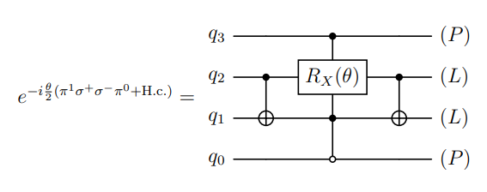

Brief Interlude: Quantum Circuits for SU(3) LGT
2. Givens rotations performed using multi-controlled rotations. Example:
3. To reduce the number of controls on multi-control gates, the methods of “control fusion” and “control pruning” are introduced.
4. More info about our SU(3) circuits and the open-source ymcirc package: look for Jason Elhaderi’s poster on Wednesday!
ymcirc public repo: https://github.com/hepqis-uiuc/ymcirc
Phys. Rev. D 112 (2025): Praveen Balaji, Cianan Conefrey-Shinozaki, Patrick Draper, Jason K. Elhaderi, Drishti Gupta, Luis Hidalgo, Andrew Lytle, Enrico Rinaldi

Slide 11






KS Ground State Ansatz
The idea: Use electric and magnetic evolution operators to build the ansatz.
Define:
The ansatz states:
“EM” ansatz
“EMEM” ansatz
In the strong-coupling limit, θ₁ and θ₃ are perturbative but θ₂ and θ₄ are not-perturbative parameters that fix the relative phase between vacuum and the plaquette states.
Comparing to first-order PT tells us , .
The EMEM ansatz is expected to work better than EM because it has more parameters.

Slide 12
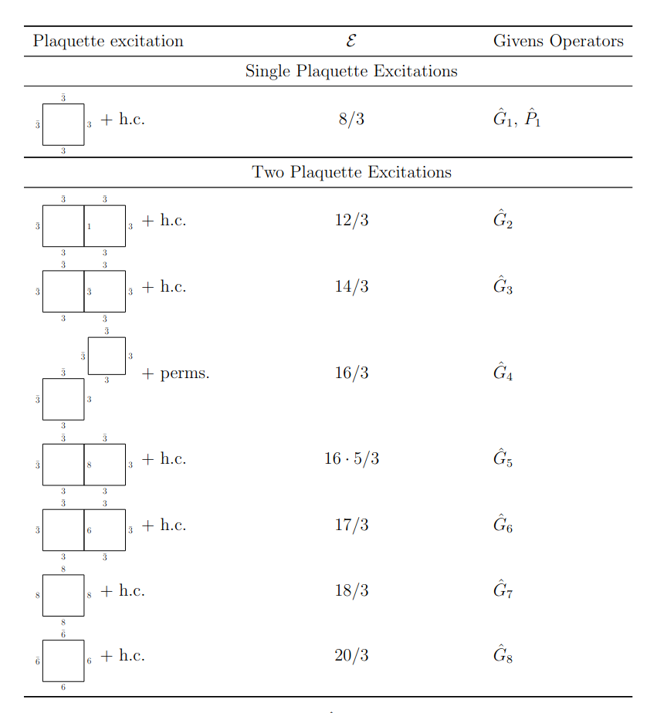
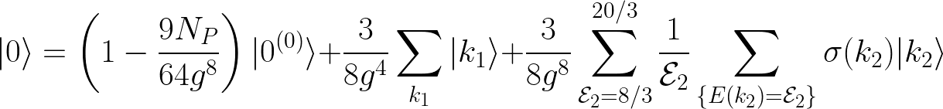
GIVENS PARAMETERS: Systematic matching to PT
Second Order Perturbation Theory:
“Multi” Ansatz
Electric vacuum and single plaquette
double plaquette excitations
We can create the states of 2nd order perturbation theory using 8 Givens Rotations and 1 Phase Rotation. All of these rotations are individually parametrized.
Moral: We can choose the rotations that are “important” upto particular order in perturbation theory and individually parametrize them.
This approach introduces more parameters and reduces ansatz circuit depth.

Slide 13
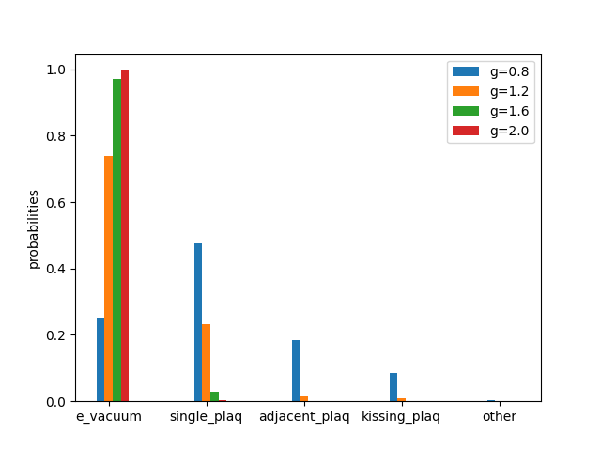
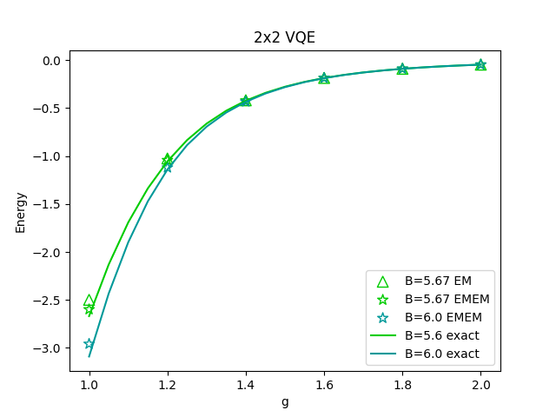
EM and EMEM results for 2x2 Lattice
Truncations: B= 5.67 {1,3,3bar,8}, B= 6.0 {1,3,3bar,8,6,6bar}
Qubit Count: 20 (B=5.67), 28 (B=6.0)
States generated in B=6.0 EMEM ansatz

Slide 14
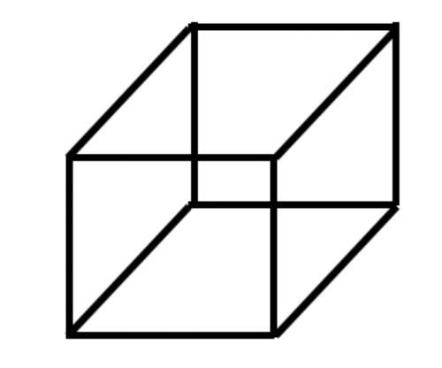
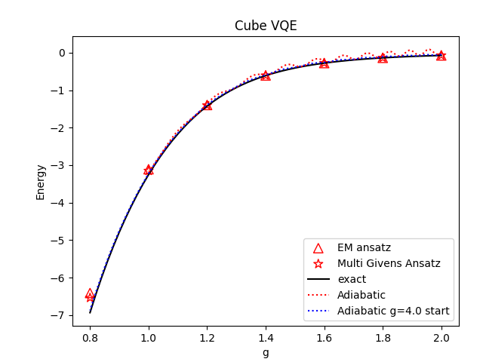
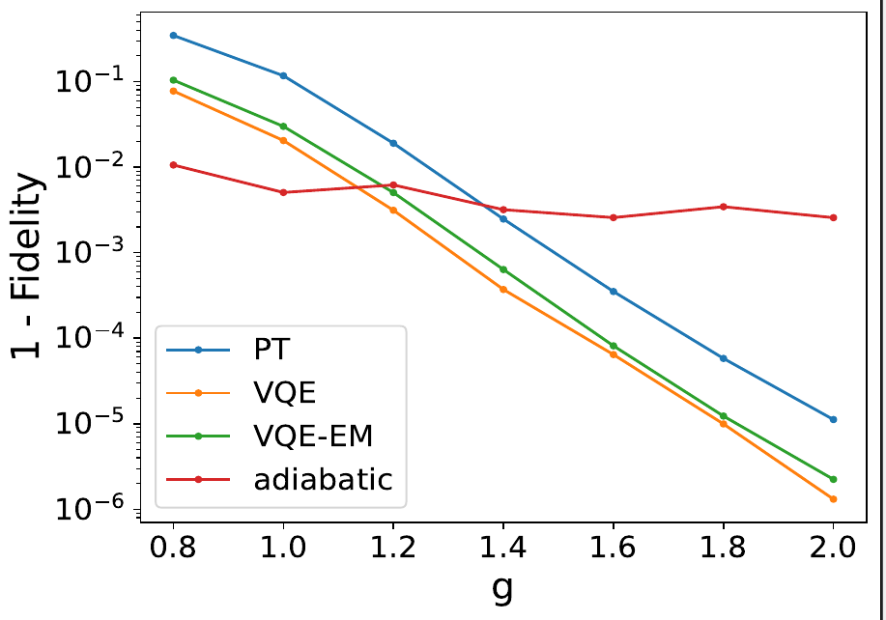

State Preparation in d=3
Need to start adiabatic evolution at g~4 for stable energy plot
Truncation: B= 4.0 {1,3,3bar}
Qubit Count: 24
cube with open boundary conditions
Adiabatic evolution retains fidelity
Individual Givens rotations parametrized

Slide 15
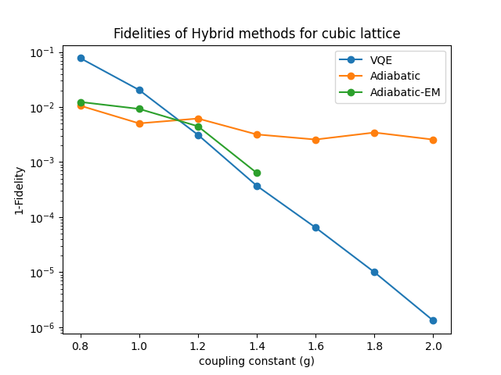
Resource Costs for d=3 state preparation
Method | Gate Count
VQE-EM | 26,000
VQE-Multi | 8,000
Adiabatic | 26,000 x 320
Gate count reduced by picking important rotations
number of adiabatic steps needed to go from g=4.0 to g=0.8
hybrid only needs 25 adiabatic steps
Adiabatic has good fidelities but huge circuit depths; VQE has shallower circuits but fidelity is compromised.
SOLUTION: A Hybrid Approach; use VQE to prepare state at g~1.4, and adiabatically evolve.

Slide 16
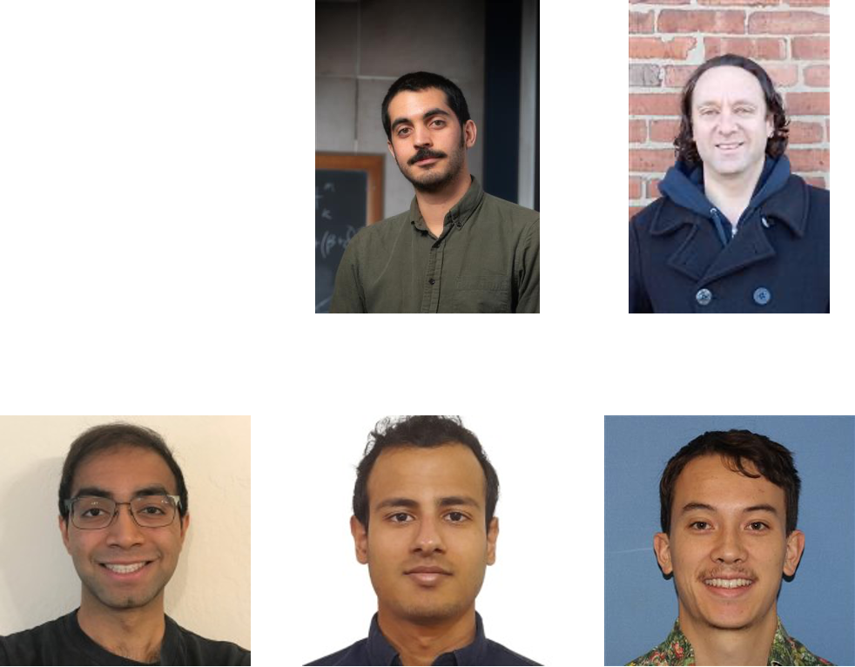
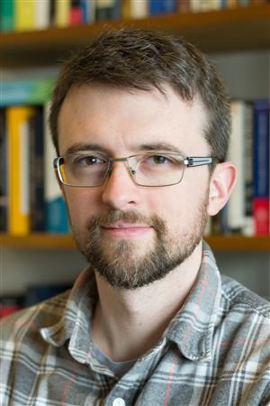

Ongoing Work
HEP/QIS @ Illinois
Tensor Networks for large lattices.
Comparison of the resource cost and performance of global basis encodings as compared to local basis (look for Praveen’s poster on Wednesday!)
Measurement of operators like ☐ and ☐† for ground state and other states of interest.
Simulations of 3x1, 2x2 and the open boundary cube on IBM Heron and Quantinuum processors.
Addition of matter to the lattice.
Circuit Optimizations.
Patrick Draper
Jason K. Elhaderi
Andrew Lytle
Praveen Balaji
Luis Hidalgo
Cianan Conefrey-Shinozaki

