Slide 1






Simulating Real-Time Dynamics of Lattice Gauge Theories with Fermions at Large $N_{c}$
Neel Modi
Anthony Ciavarella Christian Bauer Jad Halimeh

Slide 2
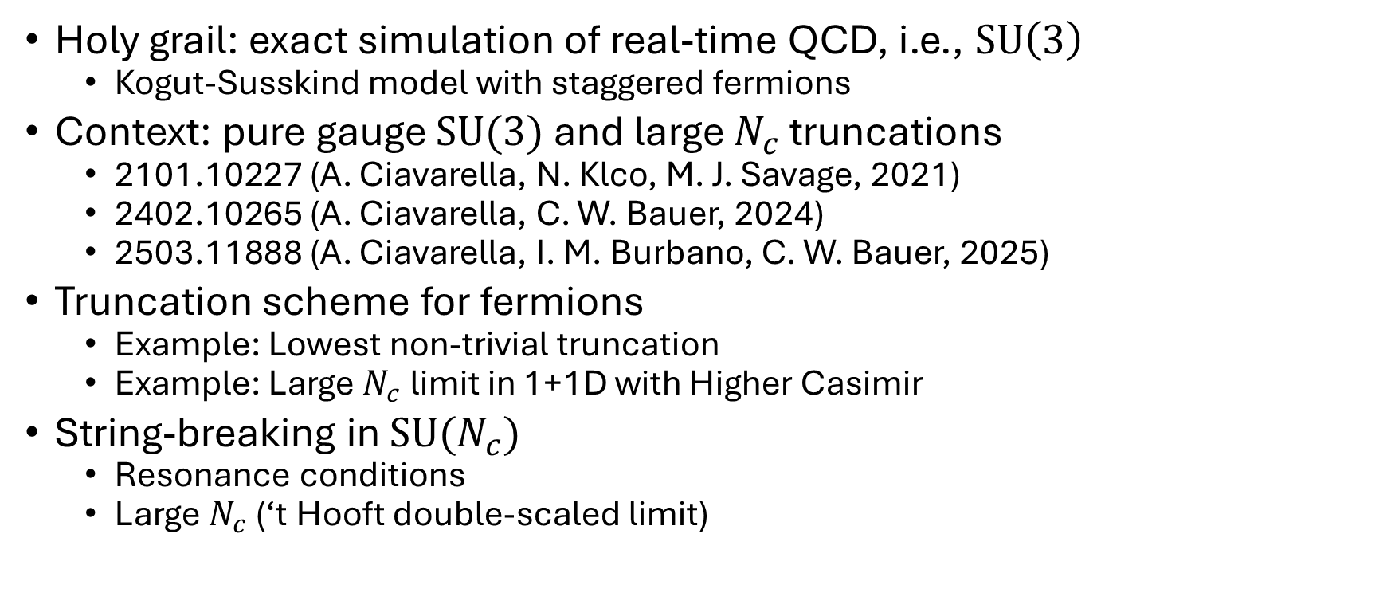
Outline
Holy grail: exact simulation of real-time QCD, i.e., $SU\left(3\right)$
Kogut-Susskind model with staggered fermions
Context: pure gauge $SU(3)$ and large $N_{c}$ truncations
2101.10227 (A. Ciavarella, N. Klco, M. J. Savage, 2021)
2402.10265 (A. Ciavarella, C. W. Bauer, 2024)
2503.11888 (A. Ciavarella, I. M. Burbano, C. W. Bauer, 2025)
Truncation scheme for fermions
Example: Lowest non-trivial truncation
Example: Large $N_{c}$ limit in 1+1D with Higher Casimir
String-breaking in $SU(N_{c})$
Resonance conditions
Large $N_{c}$ (‘t Hooft double-scaled limit)

Slide 3
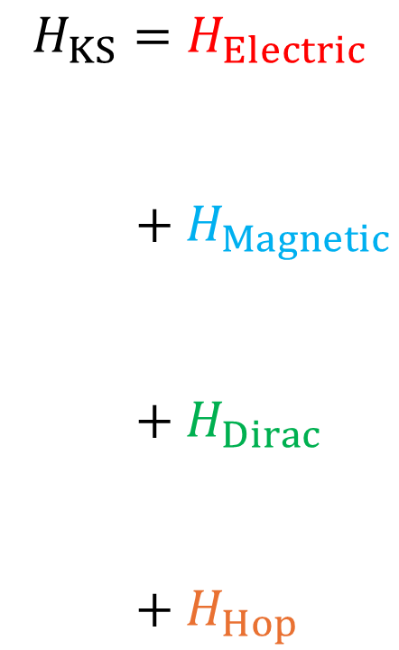
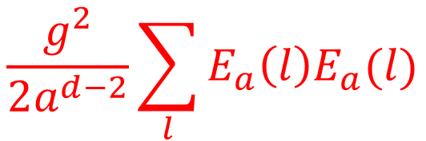

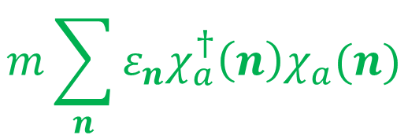
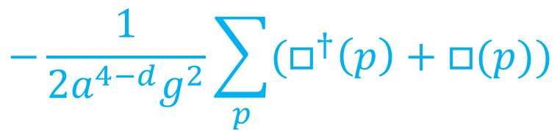
Kogut-Susskind Model (with Matter)
$$\frac{g^{2}}{2a^{d−2}}\sum_{l}{E_{a}\left(l\right)E_{a}(l)}$$
$$H_{KS}=H_{Electric}$$
$$+{ H}_{Magnetic}$$
$$+ H_{Dirac}$$
$$+ H_{Hop}$$
Pure gauge
$$−\frac{1}{2a^{4−d}g^{2}}\sum_{p}{(□^{†}\left(p\right)+□(p))}$$
Absent in 1+1D
$$m\sum_{n}{ε_{n}χ_{a}^{†}\left(n\right)χ_{a}(n)}$$
$$\frac{1}{2a}\sum_{l}{η_{l}χ_{a}^{†}\left(l^{+}\right)U_{ab}\left(l\right)χ_{b}\left(l^{−}\right)+h.c.}$$

Slide 4





















Kogut-Susskind Model (with Matter)
$$R_{13}$$
$$R_{14}$$
$$R_{15}$$
$$H_{KS}=H_{Electric}$$
$$+{ H}_{Magnetic}$$
$$+ H_{Dirac}$$
$$+ H_{Hop}$$
$$R_{1}$$
$$R_{2}$$
$$R_{3}$$
$$R_{4}$$
$$R_{5}$$
$$R_{6}$$
$$R_{7}$$
$$R_{16}$$
$$R_{18}$$
$$R_{17}$$
$$R_{8}$$
$$R_{9}$$
$$R_{10}$$
$$R_{11}$$
$$R_{12}$$
$$R_{19}$$
$$R_{21}$$
$$R_{20}$$

Slide 5
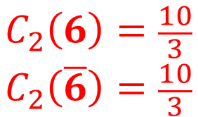
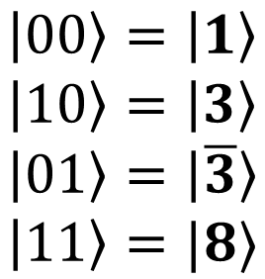
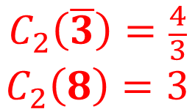


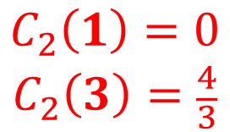


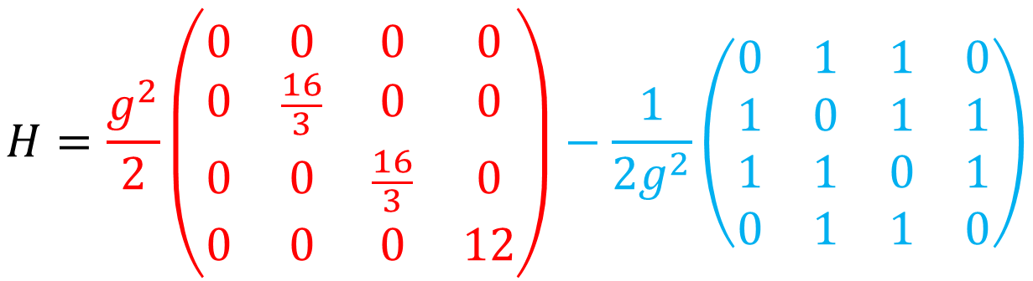

Context: Pure Gauge $SU(3)$
$$ℋ=span\left(\left|1\right\rangle , \left|3\right\rangle , \left|\overline{3}\right\rangle , \left|8\right\rangle , \left|6\right\rangle , | \overline{6}\right\rangle ,…)$$
$$R$$
$$R$$
$$R$$
$$C_{2}\left(1\right)=0$$
$$C_{2}\left(3\right)=\frac{4}{3}$$
$$C_{2}\left(\overline{3}\right)=\frac{4}{3}$$
$$C_{2}\left(8\right)=3$$
$$C_{2}\left(6\right)=\frac{10}{3}$$
$$C_{2}\left(\overline{6}\right)=\frac{10}{3}$$
$$R$$
$$H=\frac{g^{2}}{2}\left(\begin{matrix}0 & 0 & 0 & 0 \\ 0 & \frac{16}{3} & 0 & 0 \\ 0 & 0 & \frac{16}{3} & 0 \\ 0 & 0 & 0 & 12\end{matrix}\right)−\frac{1}{2g^{2}}\left(\begin{matrix}0 & 1 & 1 & 0 \\ 1 & 0 & 1 & 1 \\ 1 & 1 & 0 & 1 \\ 0 & 1 & 1 & 0\end{matrix}\right)$$
$$\left|00\right\rangle =\left|1\right\rangle$$
$$\left|10\right\rangle =\left|3\right\rangle$$
$$\left|01\right\rangle =\left|\overline{3}\right\rangle$$
$$\left|11\right\rangle =|8⟩$$

Slide 6
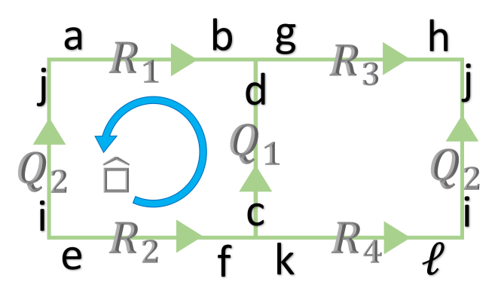


Context: Pure Gauge $SU(3)$
arxiv: 2101.10227
Anthony Ciavarella Natalie Klco Martin Savage

Slide 7




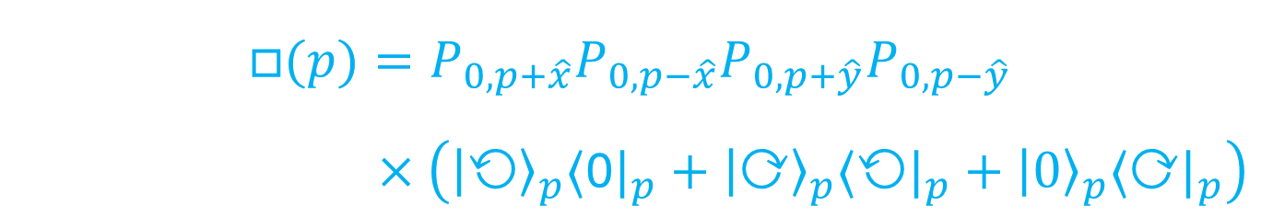

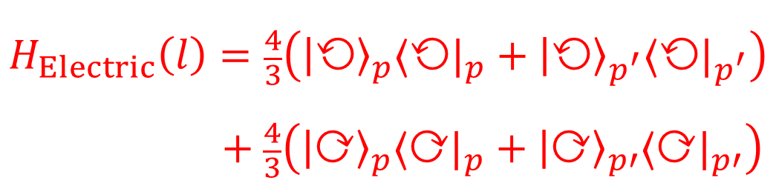


Context: Pure Gauge $SU(3)$
arxiv: 2402.10265
$$p$$
$$H_{Electric}\left(l\right)=\frac{4}{3}\left({\left|\text{⟲}\right\rangle }_{p}⟨\text{⟲}|_{p}+{\left|\text{⟲}\right\rangle }_{p^{′}}⟨\text{⟲}|_{p^{′}}\right)$$
$$+ \frac{4}{3}\left({\left|\text{⟳}\right\rangle }_{p}⟨\text{⟳}|_{p}+{\left|\text{⟳}\right\rangle }_{p′}⟨\text{⟳}|_{p′}\right)$$
$$p′$$
$$+\hat{y}$$
$$p$$
$$+\hat{x}$$
$$−\hat{x}$$
$$□(p)=P_{0,p+\hat{x}}P_{0,p−\hat{x}}P_{0,p+\hat{y}}P_{0,p−\hat{y}}$$
$$×\left({\left|\text{⟲}\right\rangle }_{p}⟨\text{0}|_{p}+{\left|\text{⟳}\right\rangle }_{p}⟨\text{⟲}|_{p}+{\left|\text{0}\right\rangle }_{p}⟨\text{⟳}|_{p}\right)$$
$$−\hat{y}$$
Anthony Ciavarella Christian Bauer

Slide 8



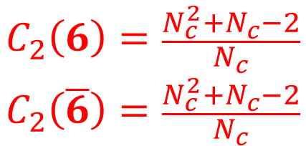
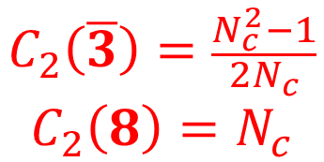

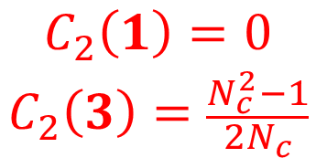

Context: Pure Gauge $SU(3)$
arxiv: 2402.10265
$$ℋ=span\left(\left|1\right\rangle , \left|3\right\rangle , \left|\overline{3}\right\rangle , \left|8\right\rangle , \left|6\right\rangle ,\left|\overline{6}\right\rangle ,\left|"3"\right\rangle ,\left|"\overline{3}"\right\rangle ,…\right)$$
$$R$$
$$C_{2}\left(1\right)=0$$
$$C_{2}\left(3\right)=\frac{N_{c}^{2}−1}{2N_{c}}$$
$$C_{2}\left(\overline{3}\right)=\frac{N_{c}^{2}−1}{2N_{c}}$$
$$C_{2}\left(8\right)=N_{c}$$
$$C_{2}\left(6\right)=\frac{N_{c}^{2}+N_{c}−2}{N_{c}}$$
$$C_{2}\left(\overline{6}\right)=\frac{N_{c}^{2}+N_{c}−2}{N_{c}}$$
$$R$$
$$R$$
$$R$$
Limit transitions based on powers of $1/N_{c}$
Truncation scheme for electric energy density
Anthony Ciavarella Christian Bauer

Slide 9




Context: Pure Gauge $SU(3)$
arxiv: 2402.10265
Limit transitions based on powers of $1/N_{c}$
Creation
Extension
Interposition
$$\left\langle f\left|□(p)\right|i\right\rangle =1$$
$$\left\langle f\left|□(p)\right|i\right\rangle ∝\frac{1}{N_{c}}$$
$$\left\langle f\left|□(p)\right|i\right\rangle ∝\frac{1}{N_{c}^{2}}$$
Anthony Ciavarella Christian Bauer

Slide 10
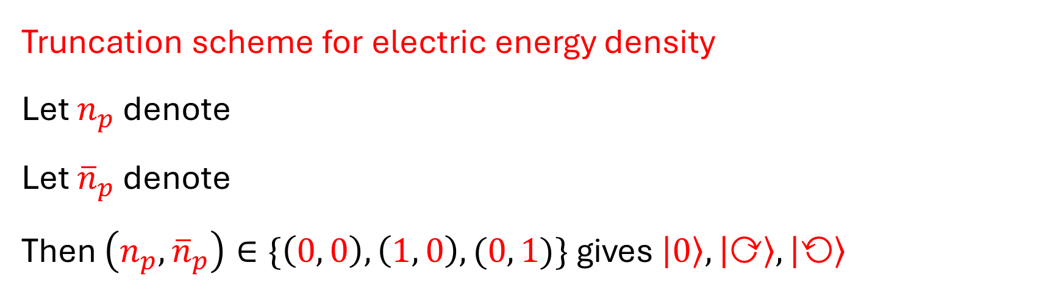
Context: Pure Gauge $SU(3)$
arxiv: 2402.10265
Truncation scheme for electric energy density
Let $n_{p}$ denote
Let ${\overline{n}}_{p}$ denote
Then $\left(n_{p},{\overline{n}}_{p}\right)∈\{\left(0, 0\right), \left(1, 0\right), (0, 1)\}$ gives $\left|0\right\rangle ,\left|\text{⟳}\right\rangle ,\left|\text{⟲}\right\rangle$
Anthony Ciavarella Christian Bauer

Slide 11
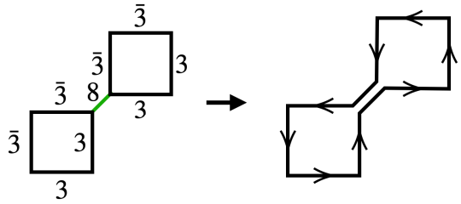
Context: Pure Gauge $SU(3)$
arxiv: 2402.10265
Point-splitting (technicality)
Anthony Ciavarella Christian Bauer

Slide 12



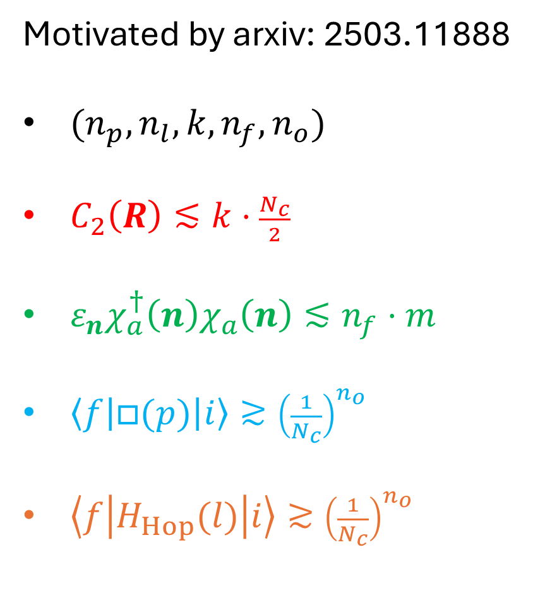
Truncation Scheme for Fermions
Anthony Ciavarella
Ivan Burbano
Christian Bauer
Motivated by arxiv: 2503.11888
$(n_{p}, n_{l}, k, n_{f}, n_{o})$
$C_{2}\left(R\right)≲k⋅\frac{N_{c}}{2}$
$ε_{n}χ_{a}^{†}\left(n\right)χ_{a}\left(n\right)≲n_{f}⋅m$
$\left\langle f\left|□(p)\right|i\right\rangle ≳{\left(\frac{1}{N_{c}}\right)}^{n_{o}}$
$\left\langle f\left|H_{Hop}(l)\right|i\right\rangle ≳{\left(\frac{1}{N_{c}}\right)}^{n_{o}}$
$$k$$
$$n_{l}$$

Slide 13



Example: $\left(n_{p},n_{l},k,n_{f},n_{o}\right)=(0, 1, 1, 1, 0)$ in 1+1D
$$\left\langle f\left|H_{Hop}\right|i\right\rangle ∝\sqrt{N_{c}}$$
$$\left\langle f\left|H_{Hop}\right|i\right\rangle ∝\frac{1}{\sqrt{N_{c}}}$$
No string-breaking at this truncation!

Slide 14

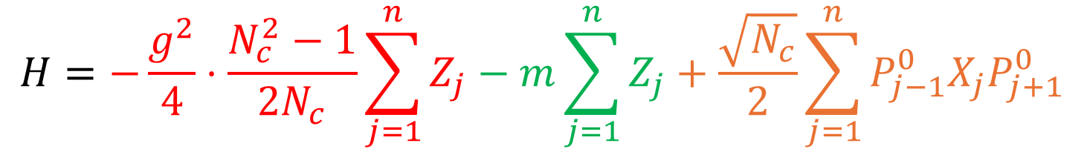



Example: $\left(n_{p},n_{l},k,n_{f},n_{o}\right)=(0, 1, 1, 1, 0)$ in 1+1D
$$|1⟩$$
$$|0⟩$$
$$|0⟩$$
$$|1⟩$$
$$H=−\frac{g^{2}}{4}⋅\frac{N_{c}^{2}−1}{2N_{c}}\sum_{j=1}^{n}{Z_{j}}−m\sum_{j=1}^{n}{Z_{j}}+\frac{\sqrt{N_{c}}}{2}\sum_{j=1}^{n}{P_{j−1}^{0}X_{j}P_{j+1}^{0}}$$

Slide 15


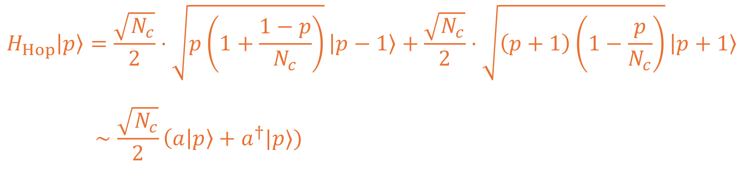
Example: Large $N_{c}$ in 1+1D with Higher Casimir
$$|p⟩$$
$$H_{Hop}\left|p\right\rangle =\frac{\sqrt{N_{c}}}{2}⋅\sqrt{p\left(1+\frac{1−p}{N_{c}}\right)}\left|p−1\right\rangle +\frac{\sqrt{N_{c}}}{2}⋅\sqrt{\left(p+1\right)\left(1−\frac{p}{N_{c}}\right)}\left|p+1\right\rangle$$
$$∼\frac{\sqrt{N_{c}}}{2}\left(a | p\right\rangle +a^{†}|p⟩)$$

Slide 16

String-Breaking, Abelian and $SU(2)$ Case
(G. Cataldi, S. Orlando, J. C. Halimeh, 2025)
(K. Xu et al., 2025)
(Y. Tian et al., 2025)
(U. Borla et al., 2025)
(T. A. Cochran et al., 2025)
(D. Gonzalez-Cuadra et al., 2025)
(A. Krippa, K. Jansen, E. Rinaldi, 2024)
(A. De et al., 2024)
(Y. Liu et al., 2024)
(C. Alexandrou et al., 2025)

Slide 17
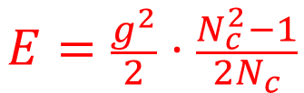
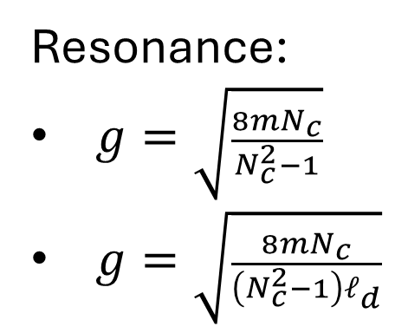

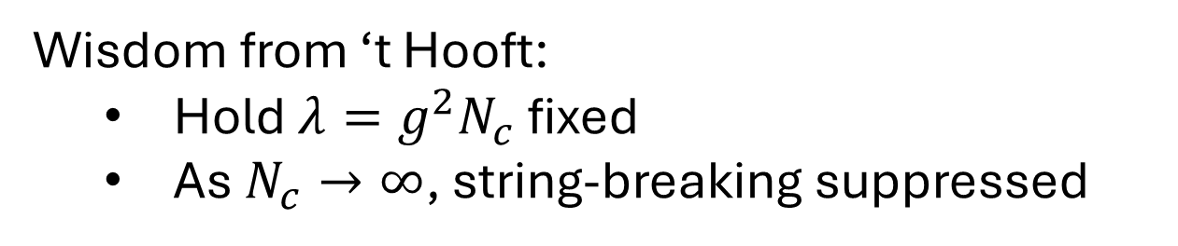
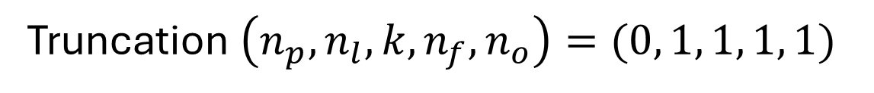

Non-Abelian String-Breaking at Large $N_{c}$
Truncation $\left(n_{p},n_{l},k,n_{f},n_{o}\right)=(0, 1, 1, 1, 1)$
Resonance:
$g=\sqrt{\frac{8mN_{c}}{N_{c}^{2}−1}}$
$g=\sqrt{\frac{8mN_{c}}{\left(N_{c}^{2}−1\right)ℓ_{d}}}$
$$E=\frac{g^{2}}{2}⋅\frac{N_{c}^{2}−1}{2N_{c}}$$
$$E=2m$$
Satisfied on resonance!
Wisdom from ‘t Hooft:
Hold $λ=g^{2}N_{c}$ fixed
As $N_{c}→∞$, string-breaking suppressed

Slide 18
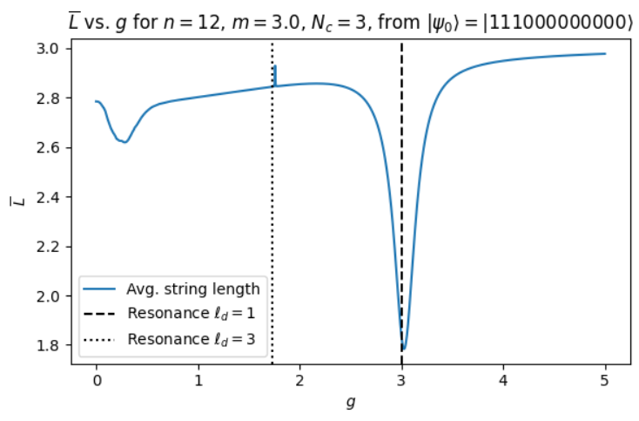
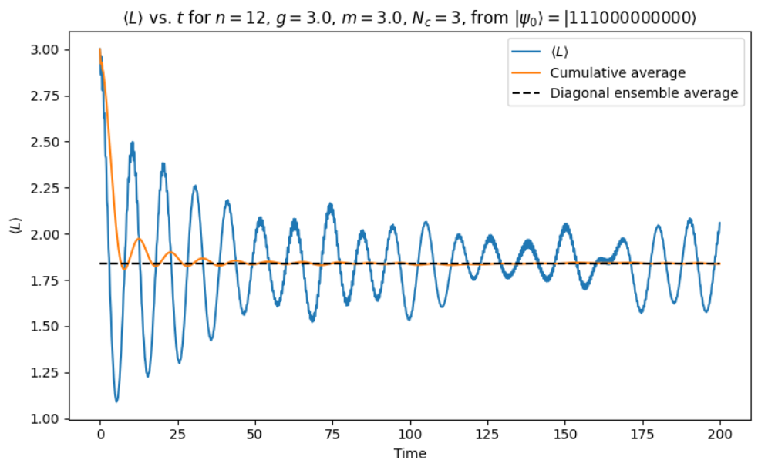

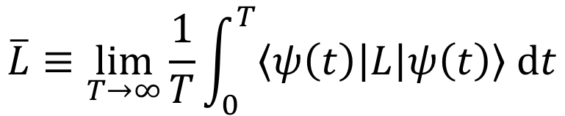
Non-Abelian String-Breaking at Large $N_{c}$
$$\overline{L}≡\lim_{T→∞}{\frac{1}{T}\int_{0}^{T}{\left\langle ψ\left(t\right)\left|L\right|ψ\left(t\right)\right\rangle dt}}$$
Probe resonance:

Slide 19
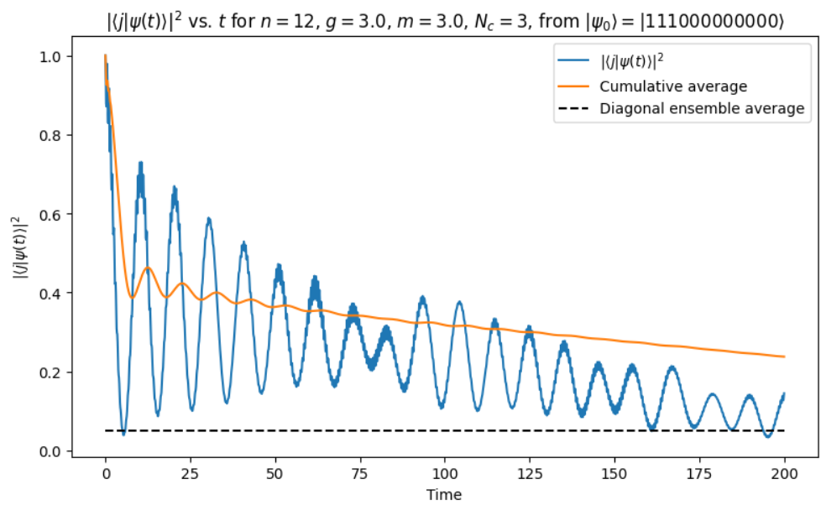
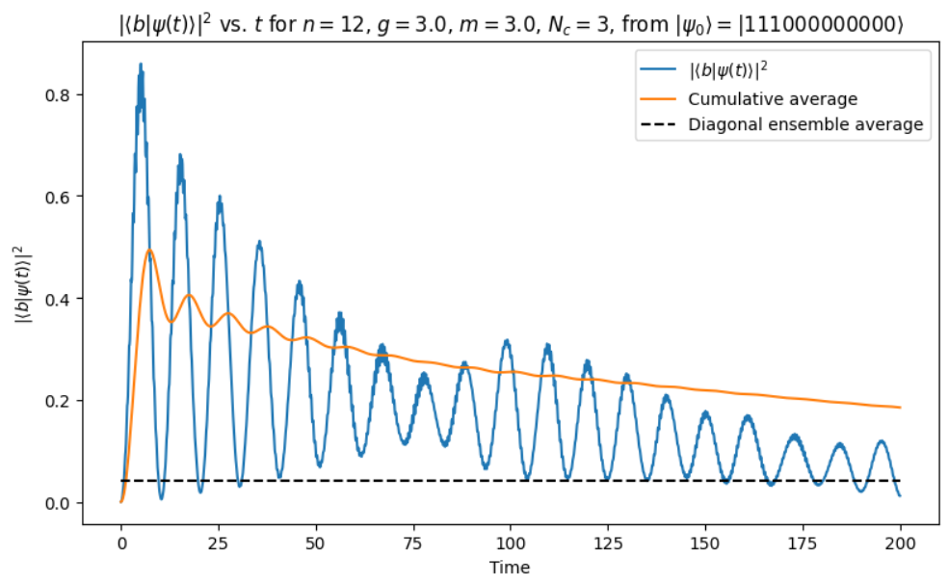
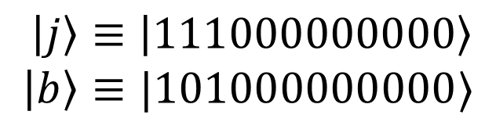
Non-Abelian String-Breaking at Large $N_{c}$
$\left|j\right\rangle ≡\left|111000000000\right\rangle$
$$\left|b\right\rangle ≡|101000000000⟩$$
Define:

Slide 20
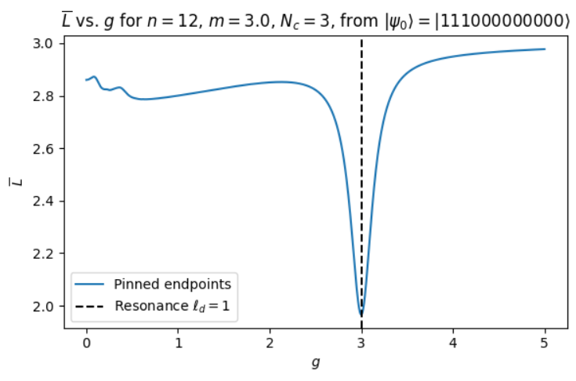
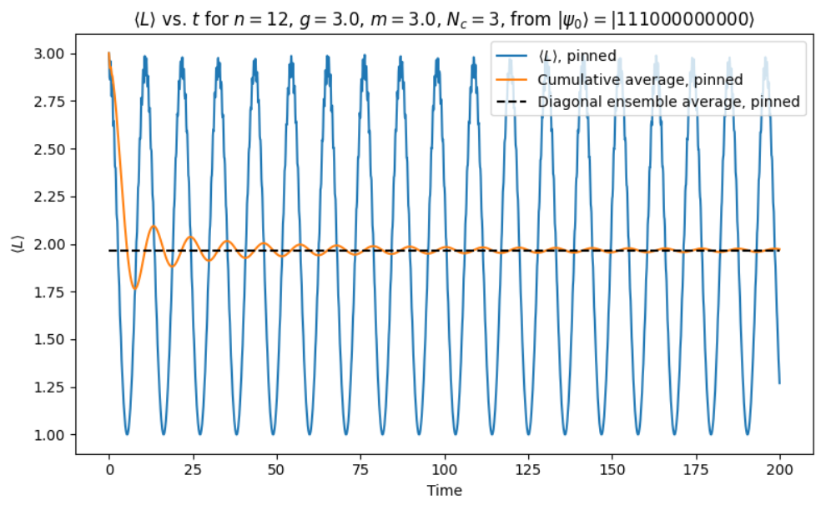
Non-Abelian String-Breaking at Large $N_{c}$
$\left|j\right\rangle ≡\left|111000000000\right\rangle$
$$\left|b\right\rangle ≡|101000000000⟩$$
Define:
Now pin the charges at the endpoints of the string.

Slide 21
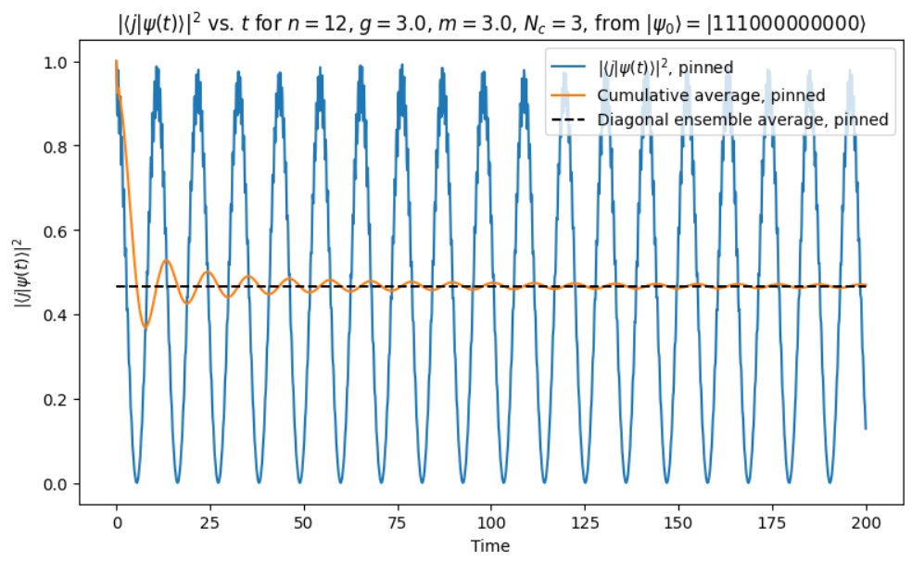
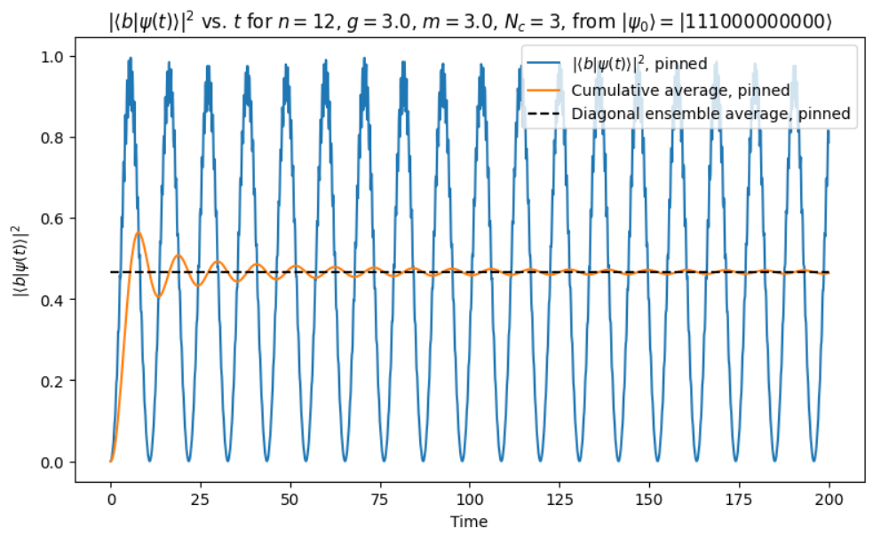
Non-Abelian String-Breaking at Large $N_{c}$
$\left|j\right\rangle ≡\left|111000000000\right\rangle$
$$\left|b\right\rangle ≡|101000000000⟩$$
Define:
Now pin the charges at the endpoints of the string.

Slide 22

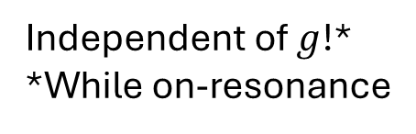
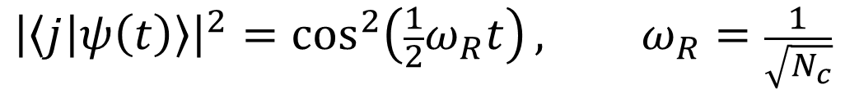
Non-Abelian String-Breaking at Large $N_{c}$
Rabi-type oscillations:
$$ℋ_{eff}=span(|b⟩,|j⟩)$$
$$H_{eff}≈8m\left(|b⟩⟨b|+|j⟩⟨j|\right)+\frac{1}{2\sqrt{N_{c}}}\left(\left|b\right\rangle \left\langle j\right|+\left|j\right\rangle \left\langle b\right|\right)$$
$${\left|\left\langle j | ψ\left(t\right)\right\rangle \right|}^{2}=\cos^{2}\left(\frac{1}{2}ω_{R}t\right), ω_{R}=\frac{1}{\sqrt{N_{c}}}$$
Independent of $g$!*
*While on-resonance

Slide 23
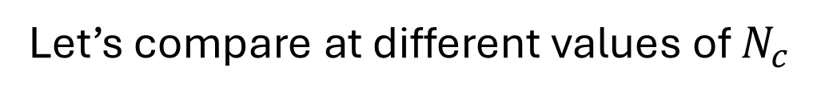
Non-Abelian String-Breaking at Large $N_{c}$
Let’s compare at different values of $N_{c}$

Slide 24
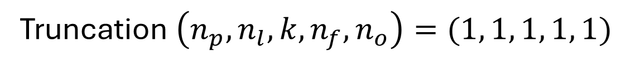
Non-Abelian String-Breaking at Large $N_{c}$
Truncation $\left(n_{p},n_{l},k,n_{f},n_{o}\right)=(1, 1, 1, 1, 1)$

Slide 25
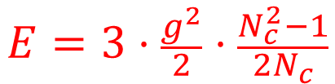
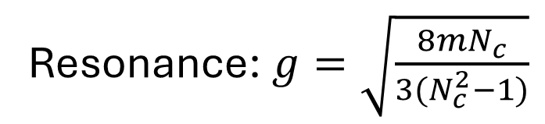

Non-Abelian String-Breaking at Large $N_{c}$
$$E=3⋅\frac{g^{2}}{2}⋅\frac{N_{c}^{2}−1}{2N_{c}}$$
$$E=2m$$
Resonance: $g=\sqrt{\frac{8mN_{c}}{3(N_{c}^{2}−1)}}$

Slide 26
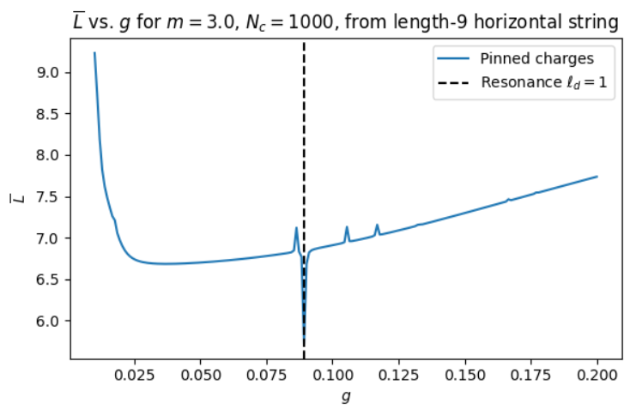
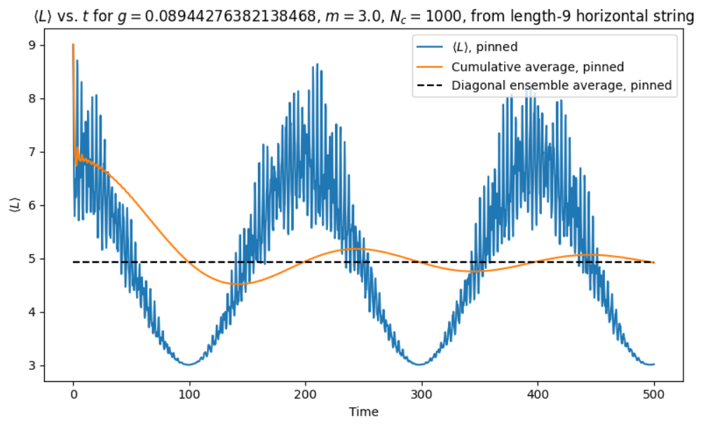
Non-Abelian String-Breaking at Large $N_{c}$

Slide 27
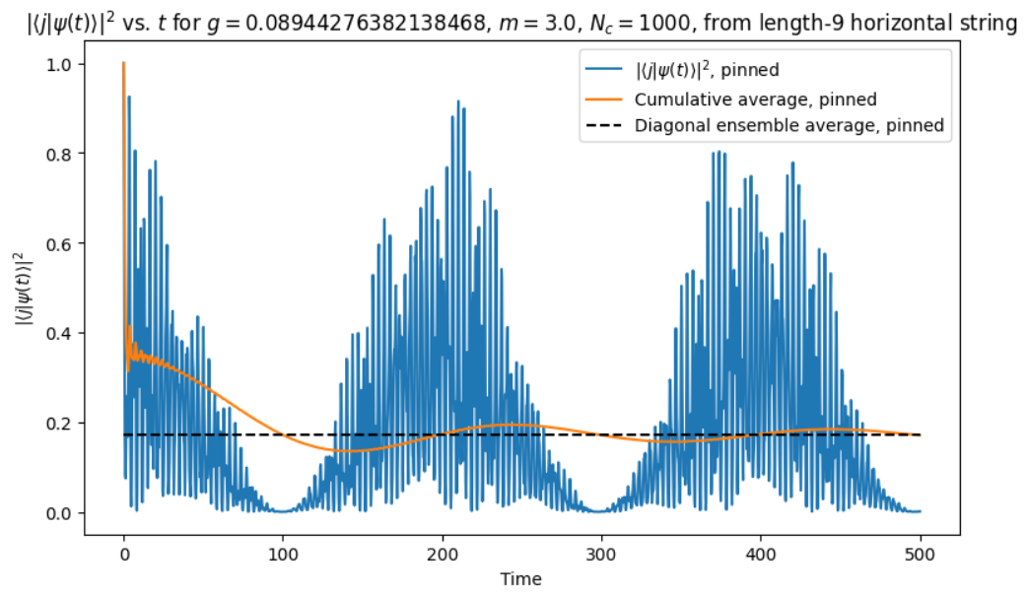
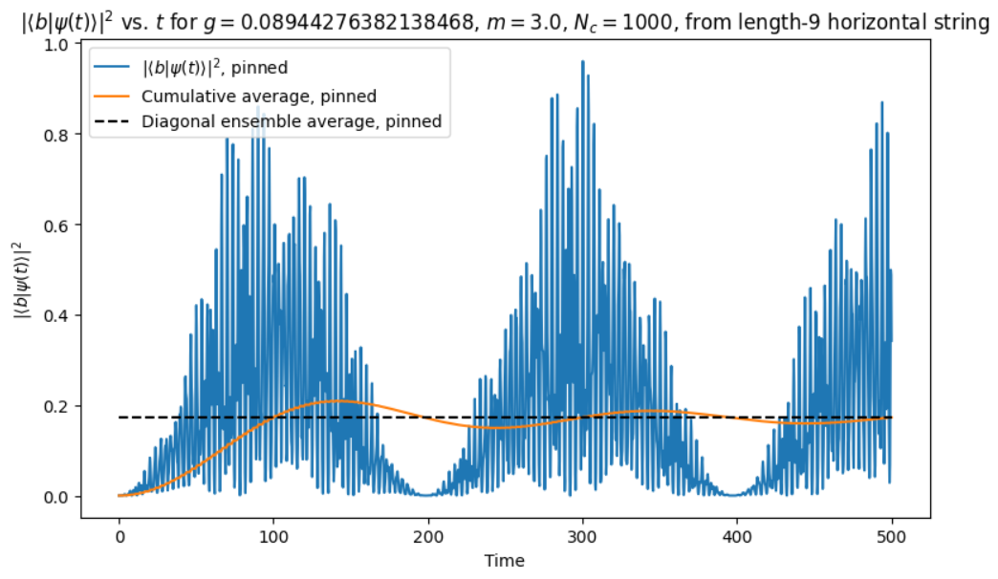
Non-Abelian String-Breaking at Large $N_{c}$

Slide 28
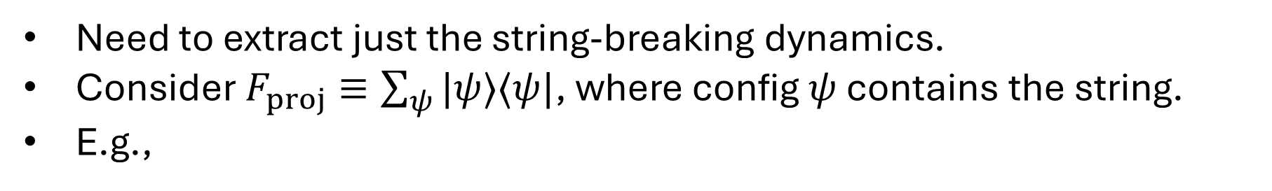
Non-Abelian String-Breaking at Large $N_{c}$
Need to extract just the string-breaking dynamics.
Consider $F_{proj}≡\sum_{ψ}{|ψ⟩⟨ψ|}$, where config $ψ$ contains the string.
E.g.,

Slide 29
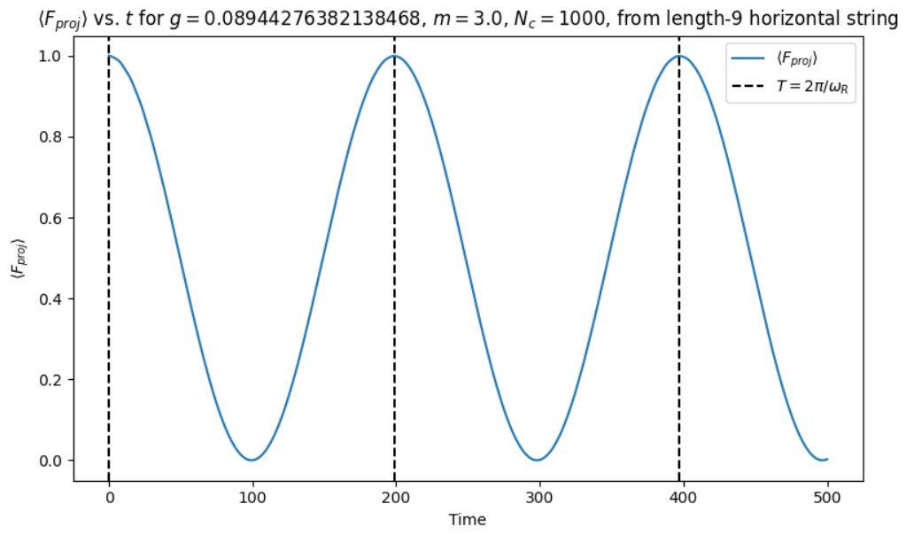
Non-Abelian String-Breaking at Large $N_{c}$

Slide 30
Thank you!

