Slide 1
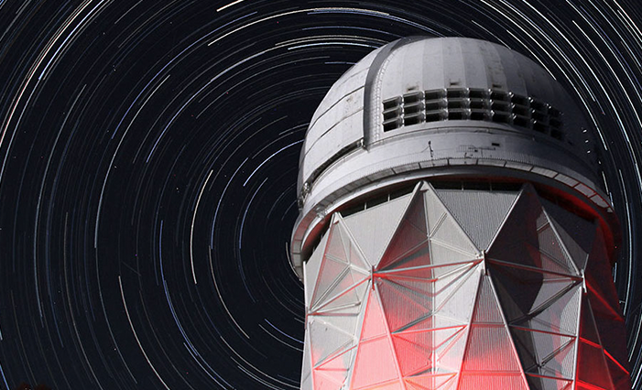

LBNL Cosmology Program
John Groh
Lawrence Berkeley National Lab
(john.groh@lbl.gov)
Physics Grad Open House
March 14, 2025

Slide 2
The cosmology group at LBNL
Over 20 Senior Members. Lots of possible projects and research supervisors.
Very broad program: instrumentation → simulation → analysis → theory
Very close connection to UC Berkeley, BCCP (joint seminars, meetings, weekly pizza, speaker dinners, etc.)
Campus + LBNL → one of the largest and broadest cosmology groups
+

Slide 3
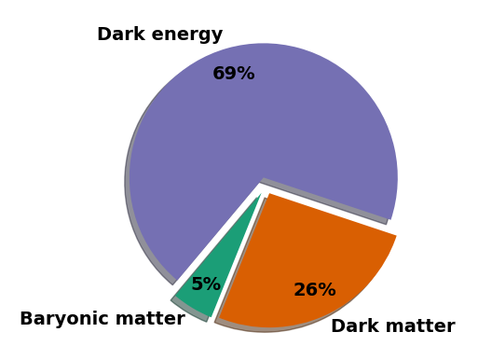
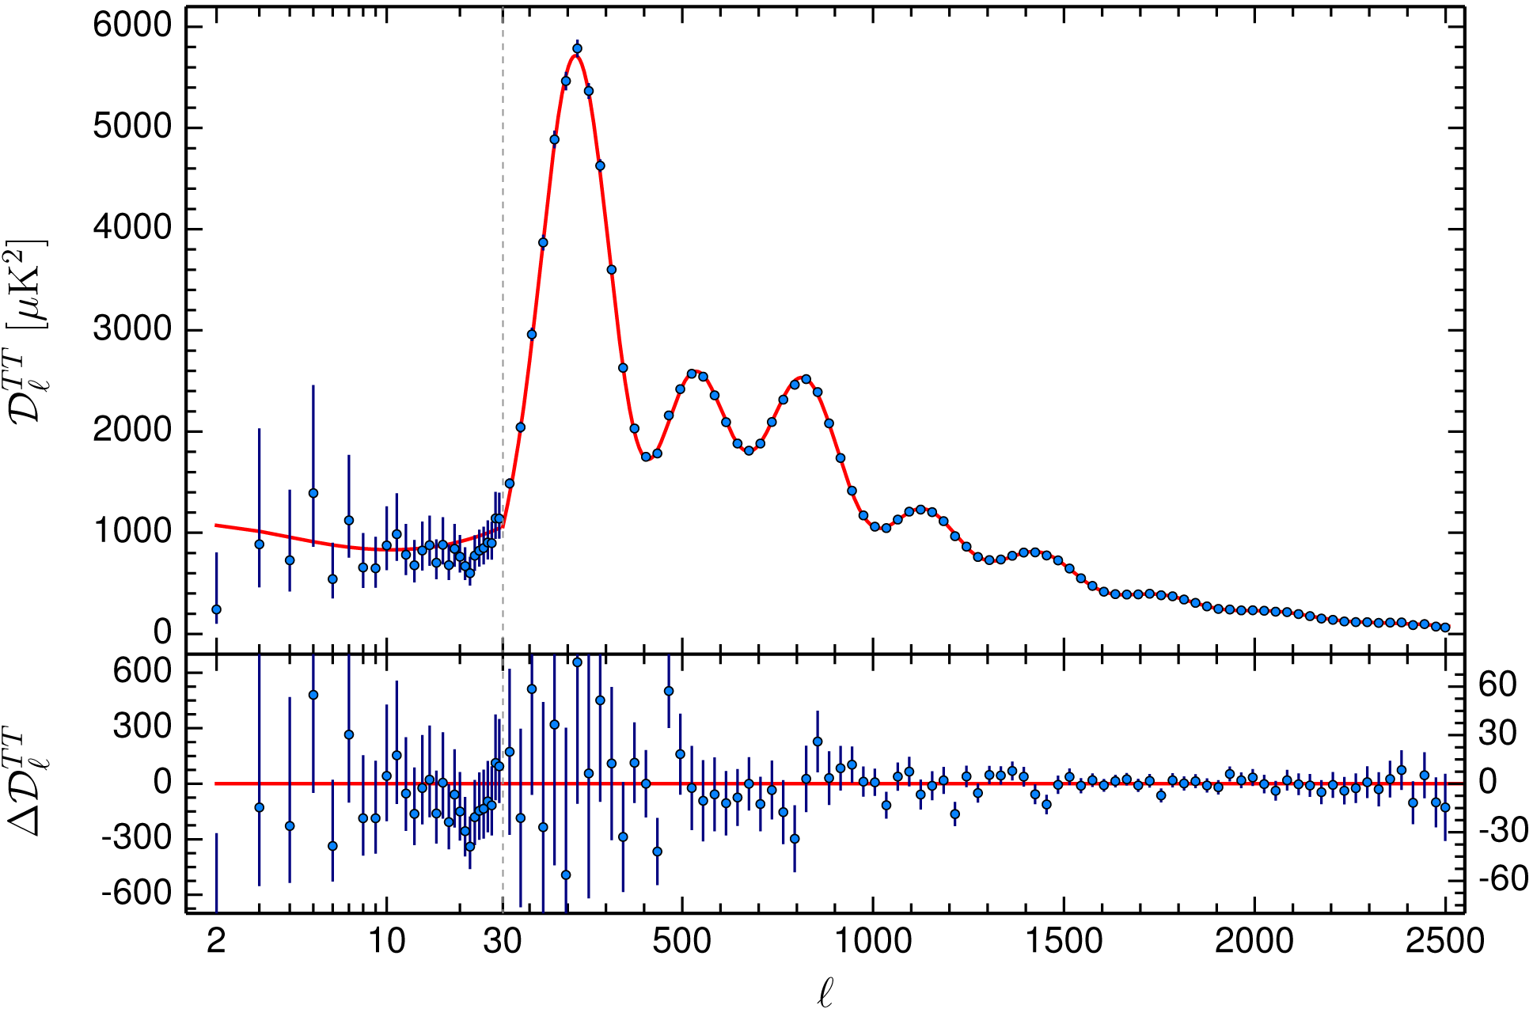
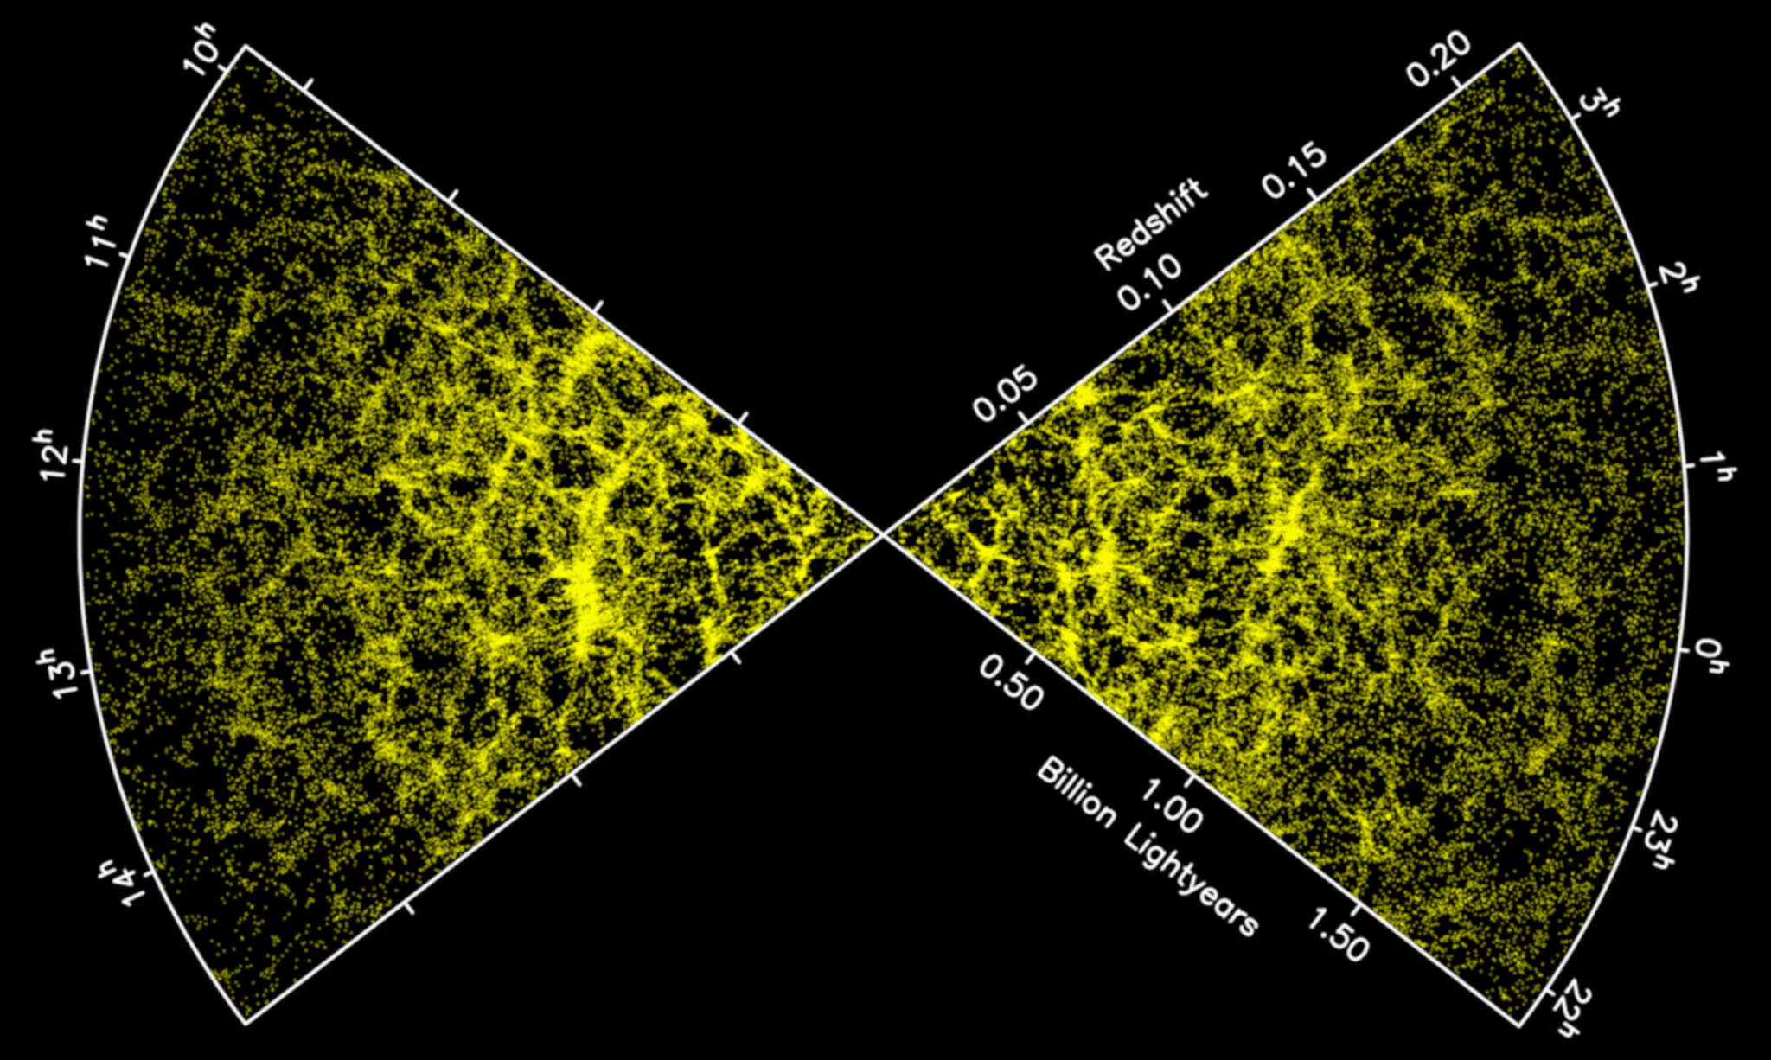
A simple yet strange Universe
But the model is based on…
Dark Matter (?)
Dark Energy (?)
Inflation (?)
Neutrinos and other light particles (?)
The primary goal of the Cosmology Group program is to understand these “ingredients”!
Planck, BOSS
Notes:
Say that I will talk about inflation

Slide 4
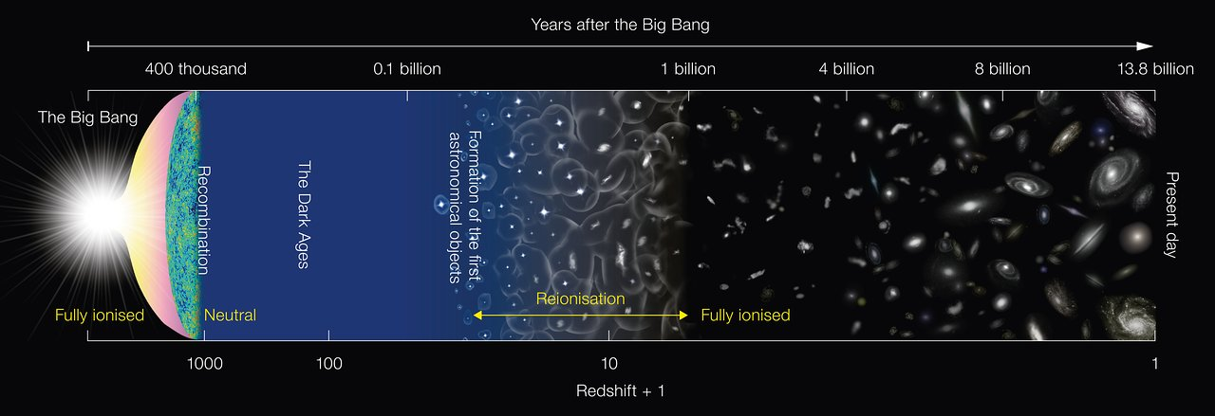
Our program combines a wide range of probes across cosmic history
CMB-S4
Simons Observatory
BICEP/Keck
DESI, DESI-2, Spec-S5
Supernova program
CMB secondary anisotropies
LuSEE-night
Credit: ESA

Slide 5
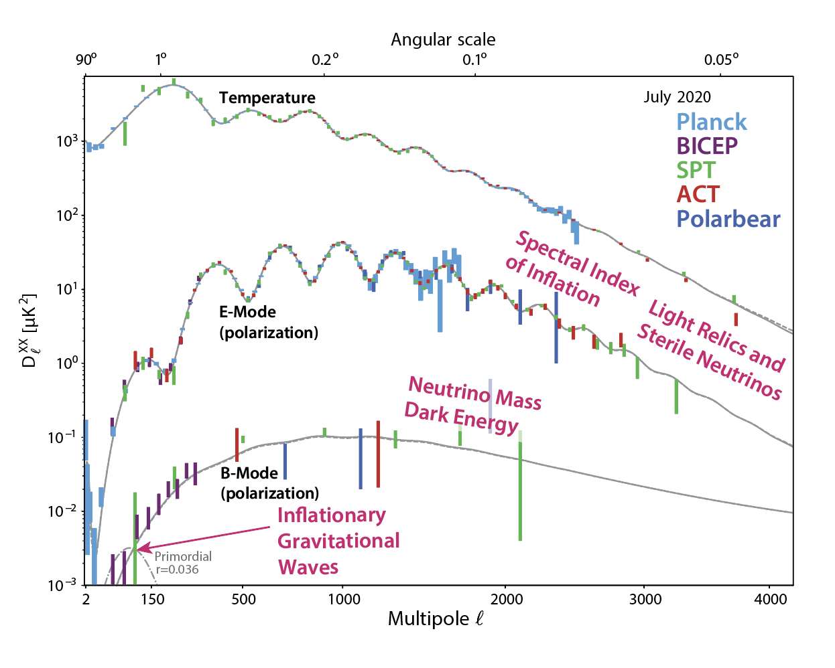
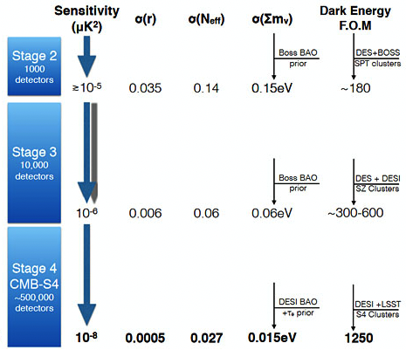
CMB science over the next 2 decades
A wide range of high-energy physics phenomena can be probed by CMB measurements!
(+ many not shown here)

Slide 6
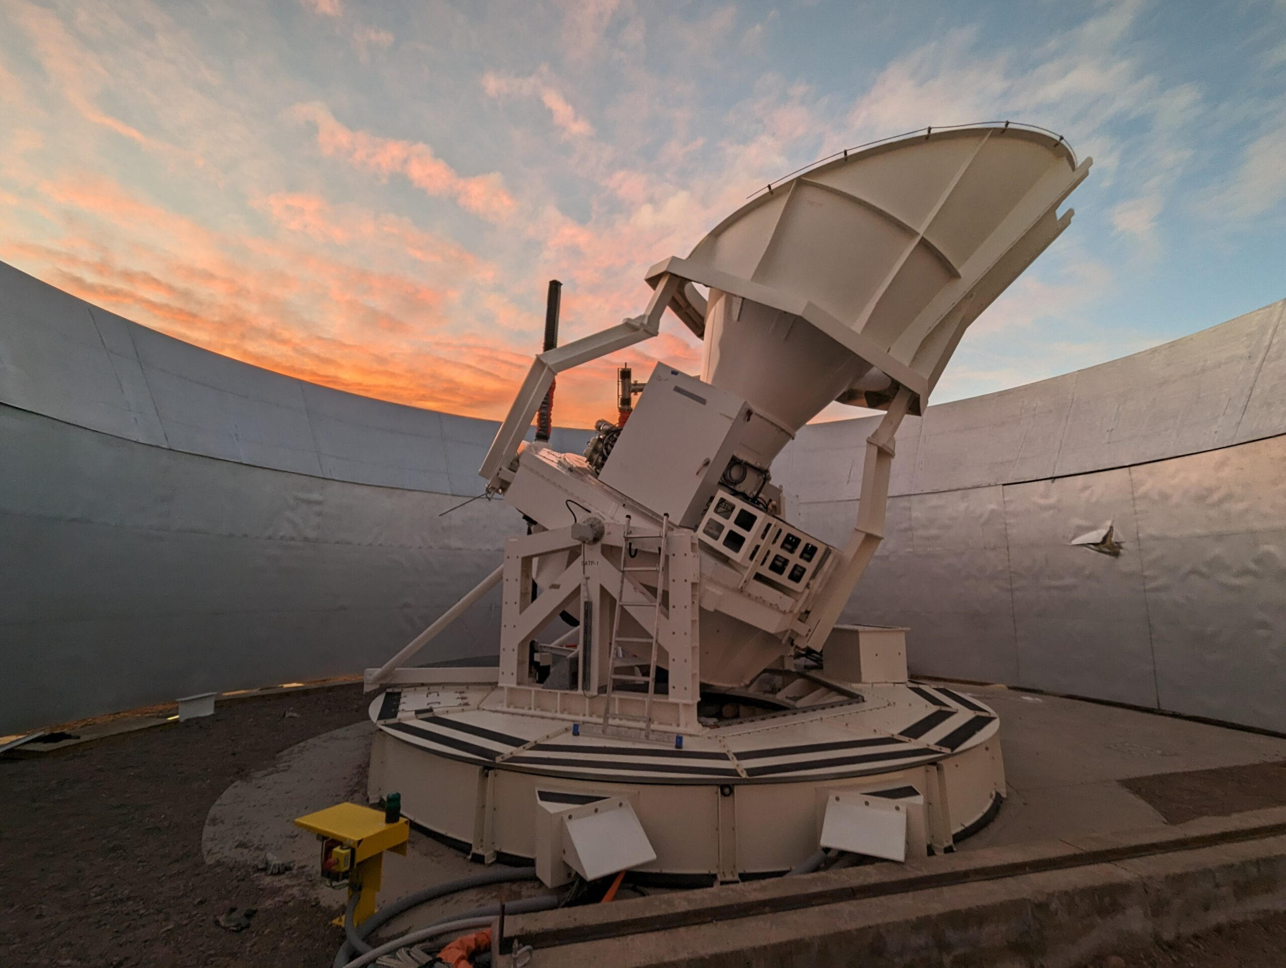
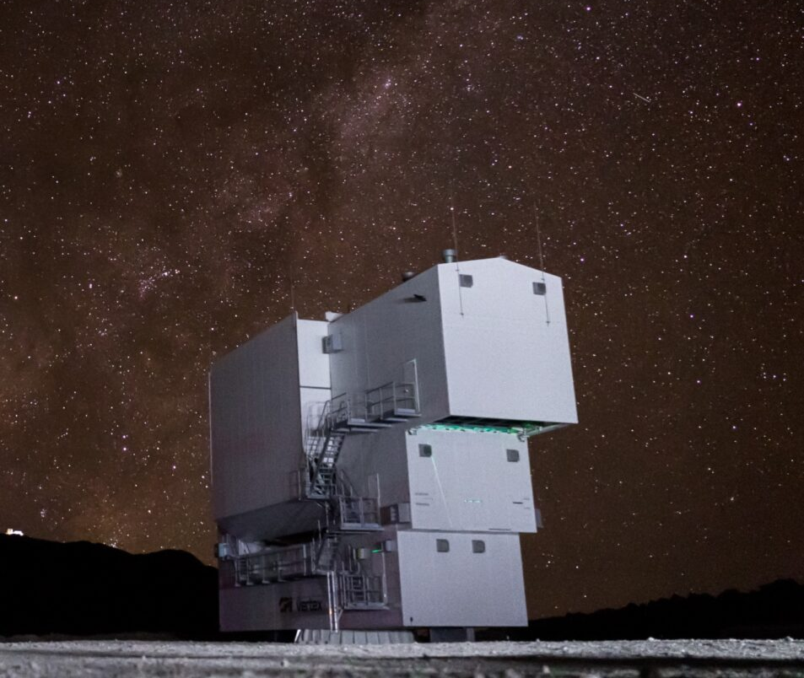
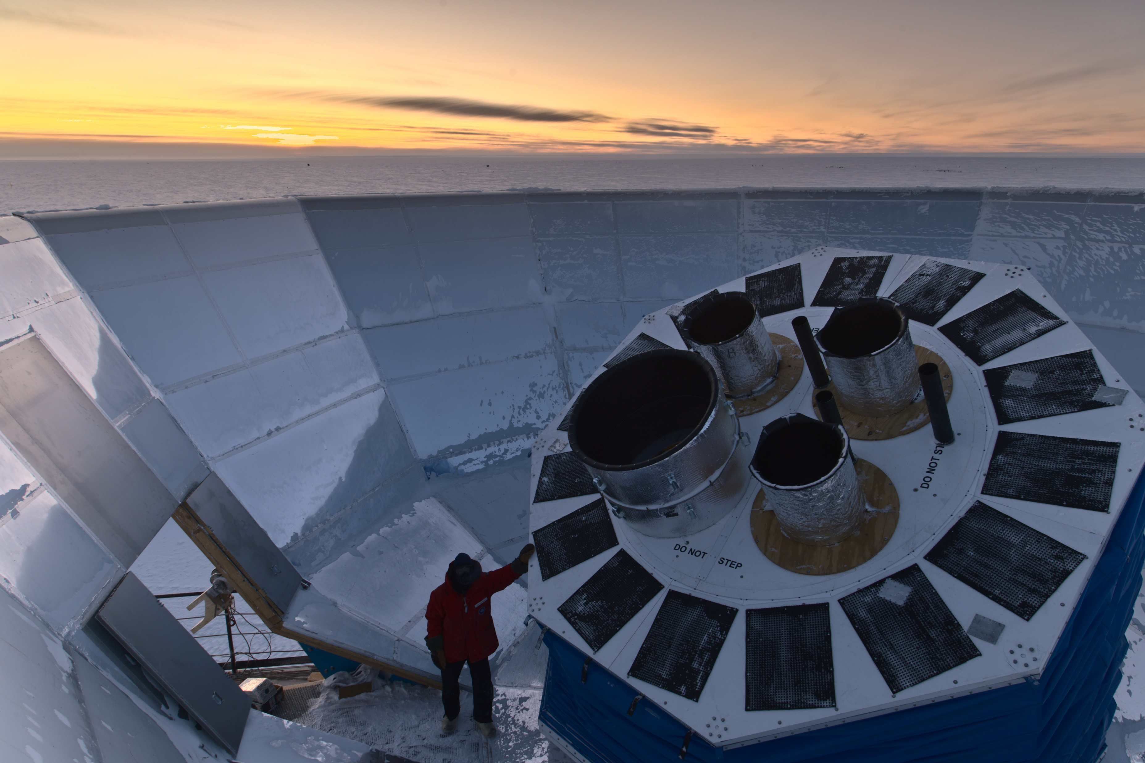
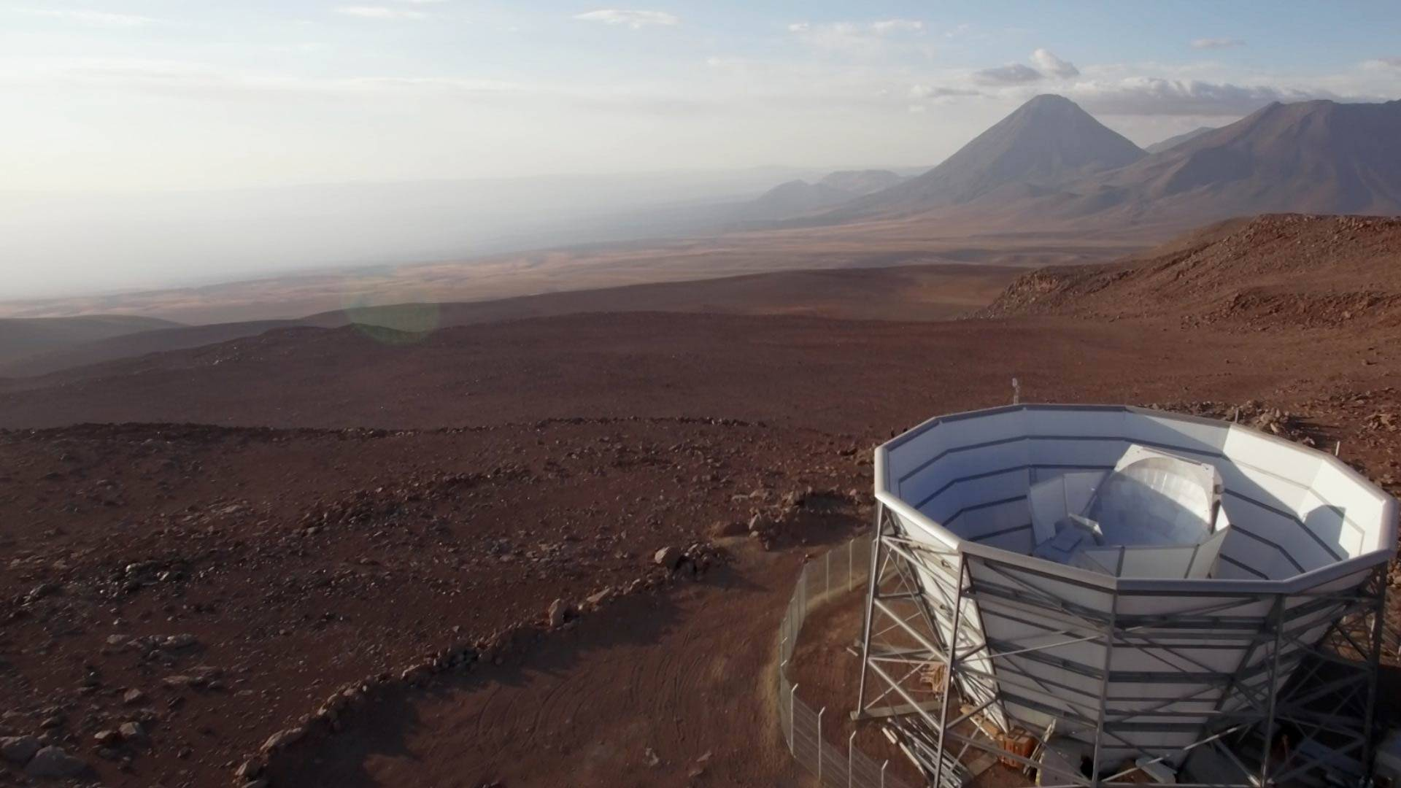
We have a rich science program with current observatories
x6
The Simons Observatory: achieved first light in 2024!
Wide variety of science from inflation to neutrinos
BICEP Array
Inflation science
Atacama Cosmology Telescope
Secondary anisotropies
Cross-correlation w/ LSS

Slide 7
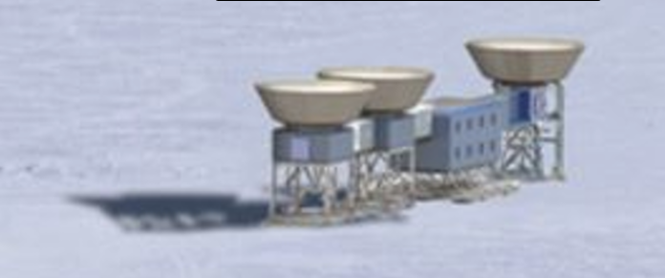
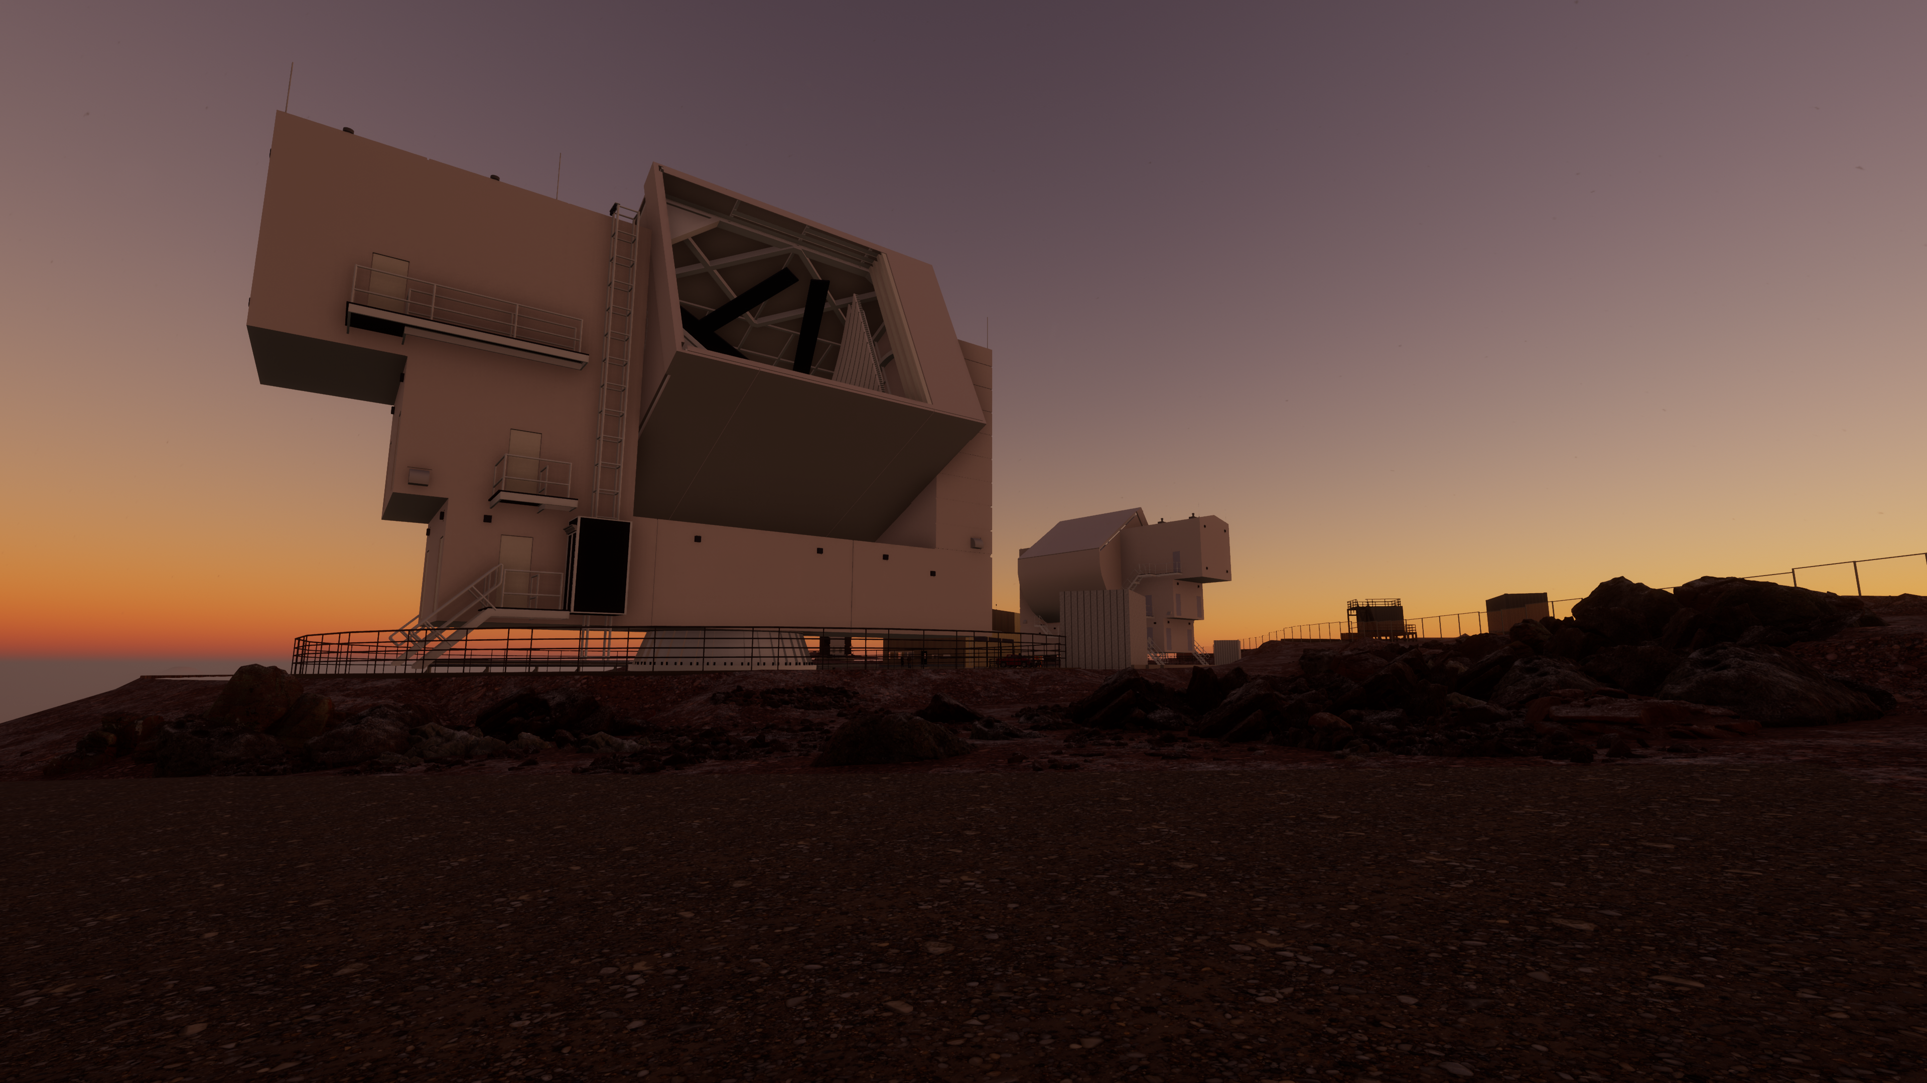
LBNL is the Lead Laboratory for CMB-S4
~10x 0.5-meter aperture telescopes for a deep inflation survey on 3% of the sky
~3x 6-meter aperture telescopes for delensing and a wide survey of 60% of the sky
We are leading many key project areas, from detectors to data management to SATs to analysis
10 year survey, starting in the early 2030s

Slide 8
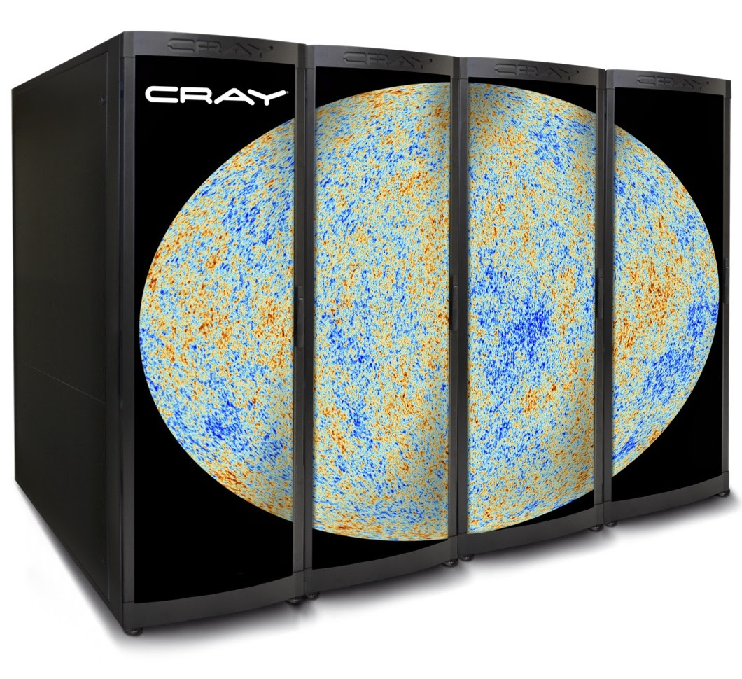
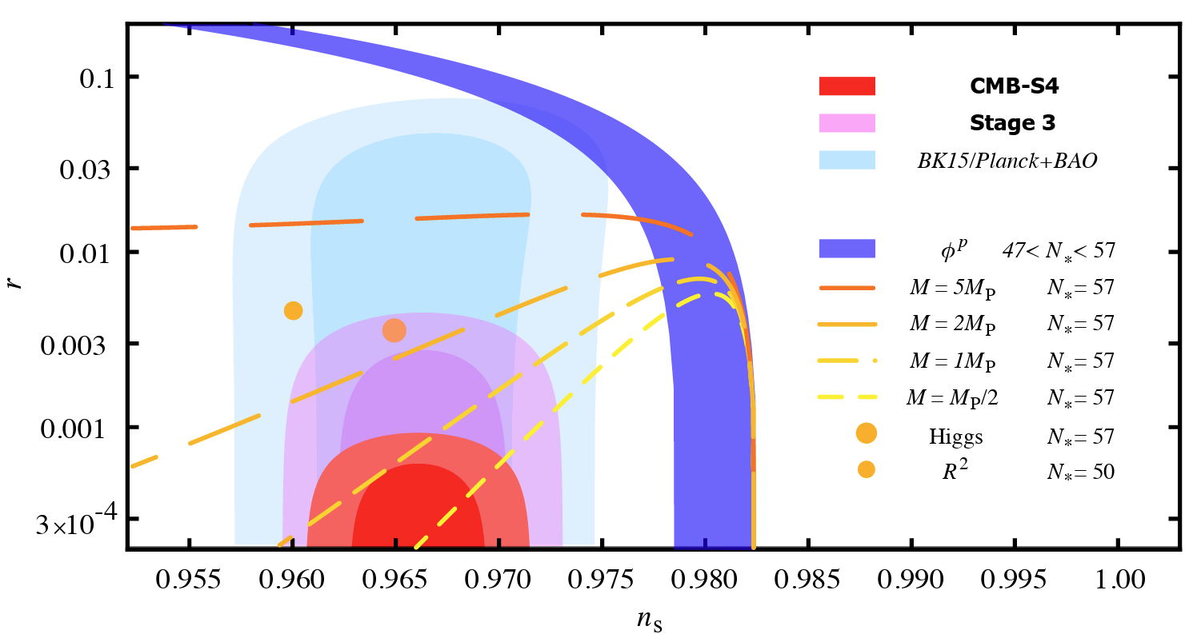
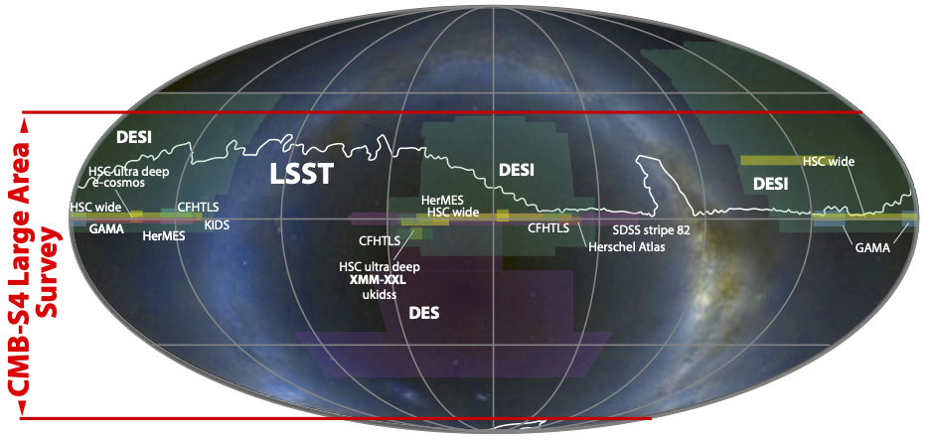
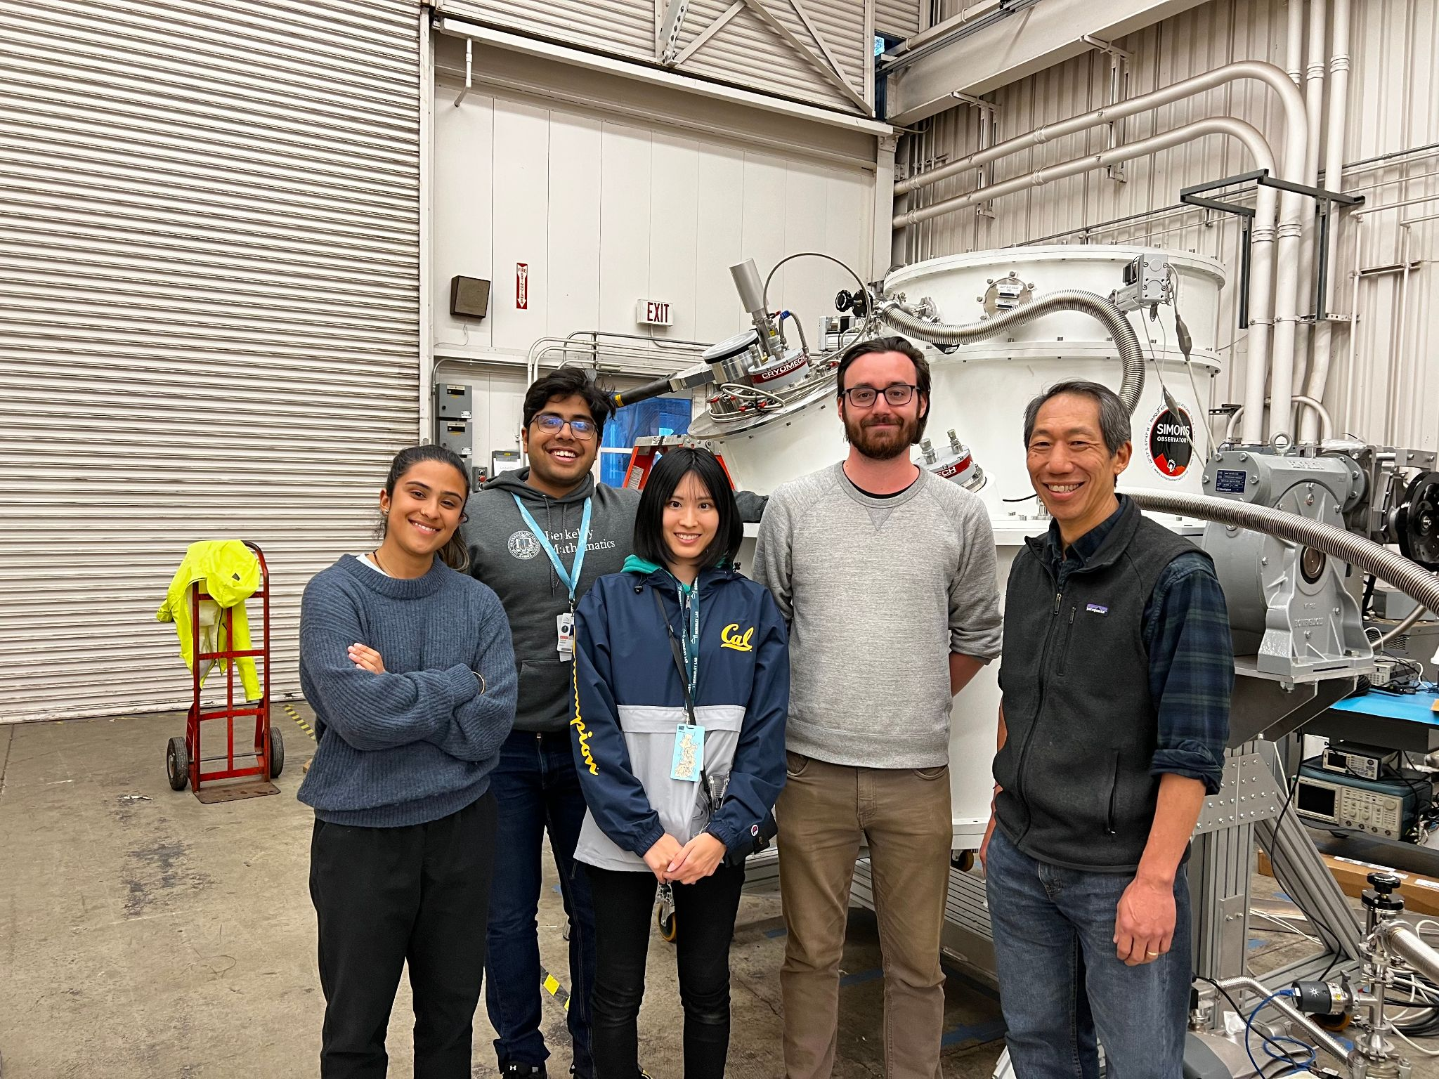
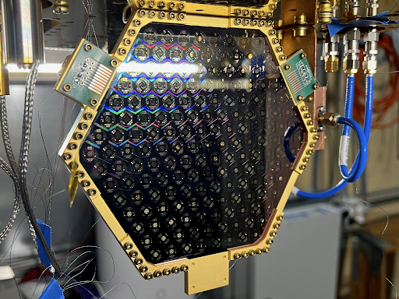
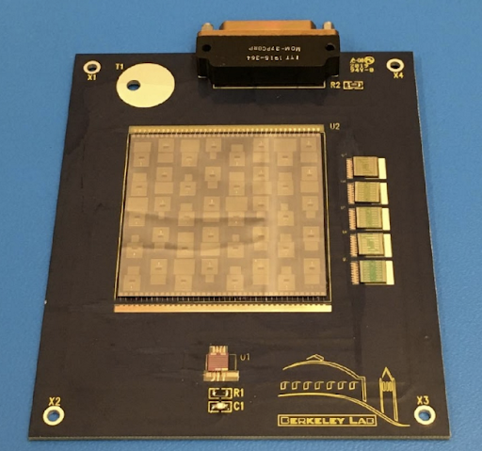
Other Active CMB Research Areas
Time-ordered data analysis and simulation
Inflation science
Secondary anisotropies and CMBxLSS
Small Aperture Telescopes
Superconducting Detectors
Cryogenic Readout

Slide 9
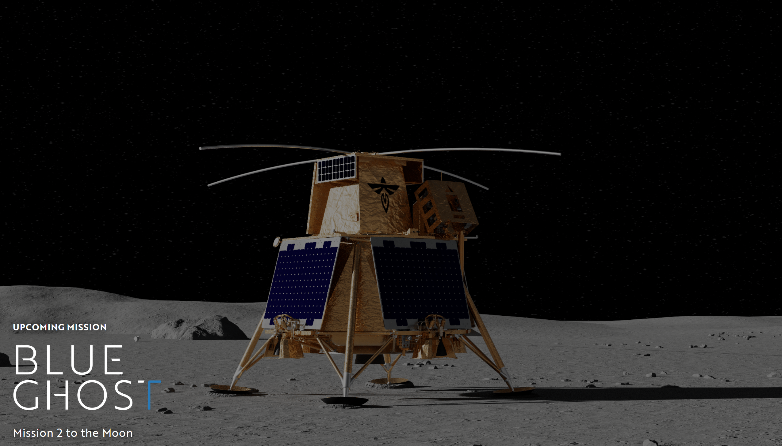
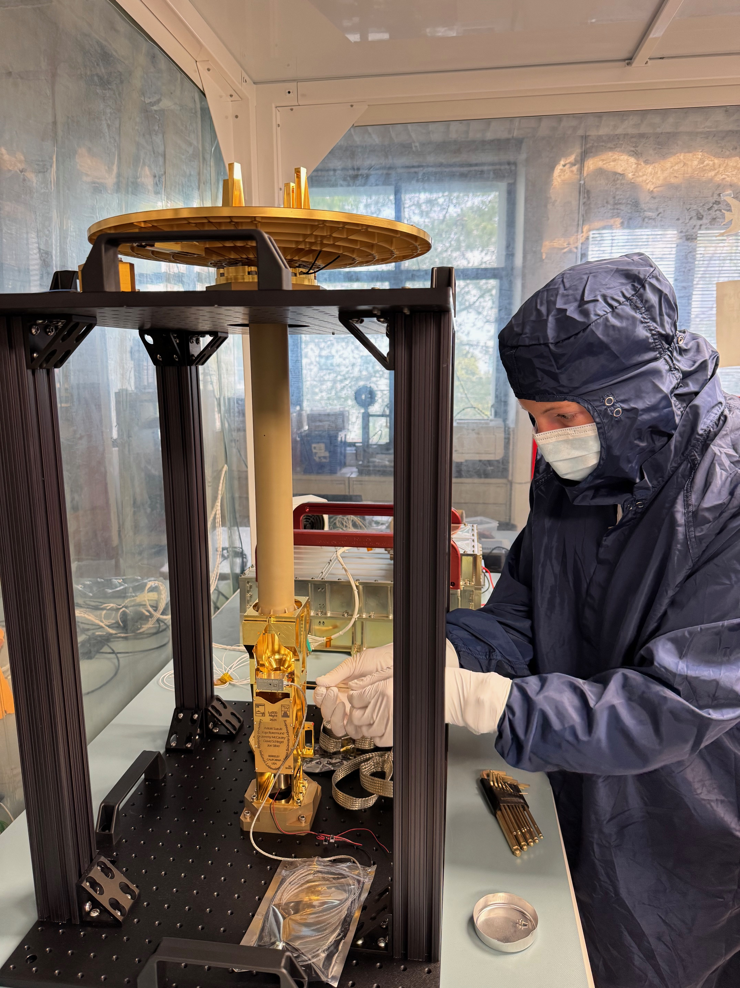


LuSEE-Night
21 cm Astrophysics from far side of the Moon
Dark Ages, unexplored time of the universe
21 cm signal → early universe, CMB to the 1st star
Polarized MHz signal → Dark matter (axion) search
LuSEE-Night: NASA+DOE project
0.5 MHz ~ 50 MHz observation from far side of the moon
Launch December 2025
LBNL’s role: Antenna Subsystem & Data analysis
Assembly of Flight Module at
Space Science Lab (UC Berkeley)

Slide 10
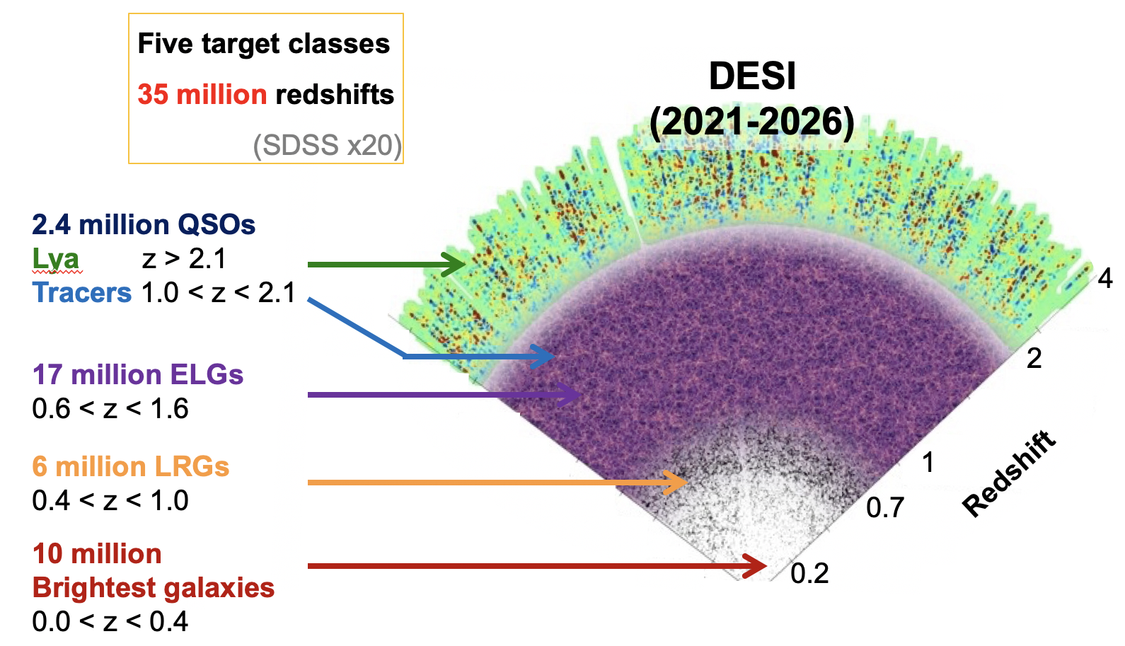
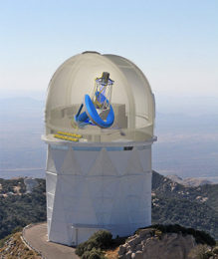
Dark Energy Spectroscopic Instrument (DESI): Massively multiplexed spectroscopic survey with 5000 robotic fibers, over ~14,000 sq. deg
40
Mayall Telescope
Kitt Peak, Arizona
LBNL is the Lead Laboratory for DESI
Major LBNL contributions in almost all aspects
Great alignment with campus/BCCP interests

Slide 11
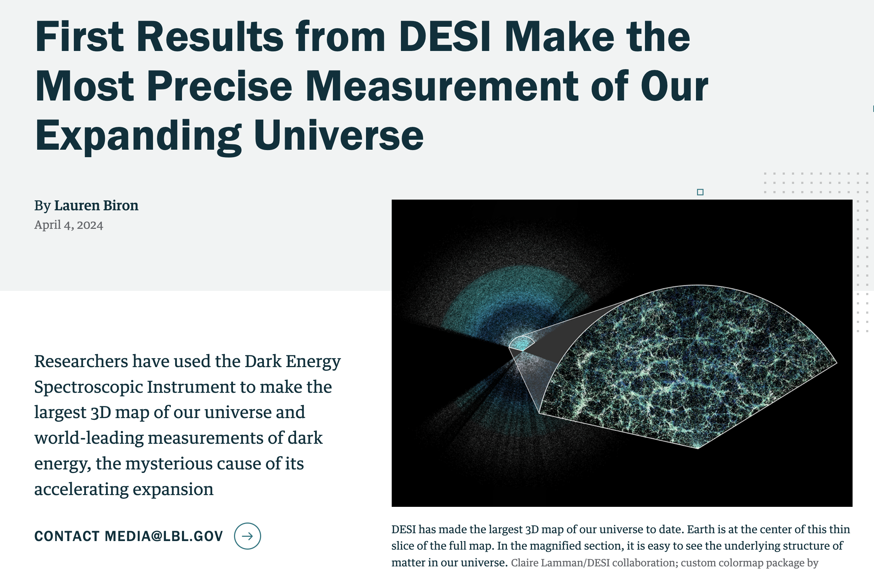
With just first year of data, DESI surpasses all previous 3D maps of the universe combined
Expansion history measured before Dark Energy domination (8-11 billion years ago) with a precision of better than 1%
Confirms the basics of our best model of the universe – with some tantalizing differences

Slide 12
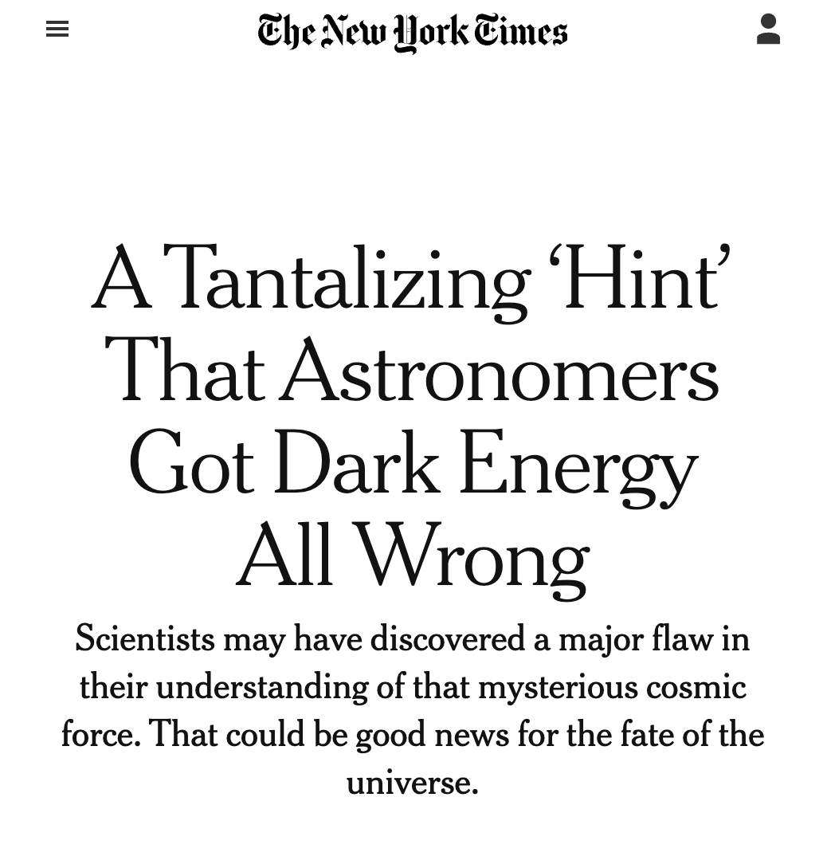
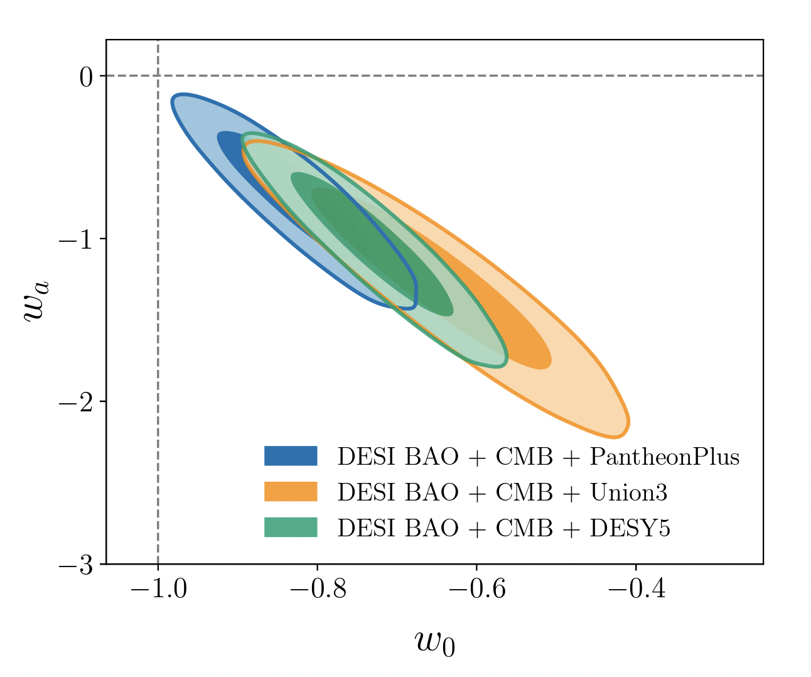
April 4, 2024
DESI Collaboration
Adame et al 2024
ΛCDM
1σ
2σ
BAO + CMB + Supernova ( Pantheon+)
BAO + CMB + Supernova (Union3)
BAO + CMB + Supernova (DESY5)
Supernova Cosmology Project Collaboration
Rubin et al 2024
2.5 – 3.9σ tension with ΛCDM

Slide 13
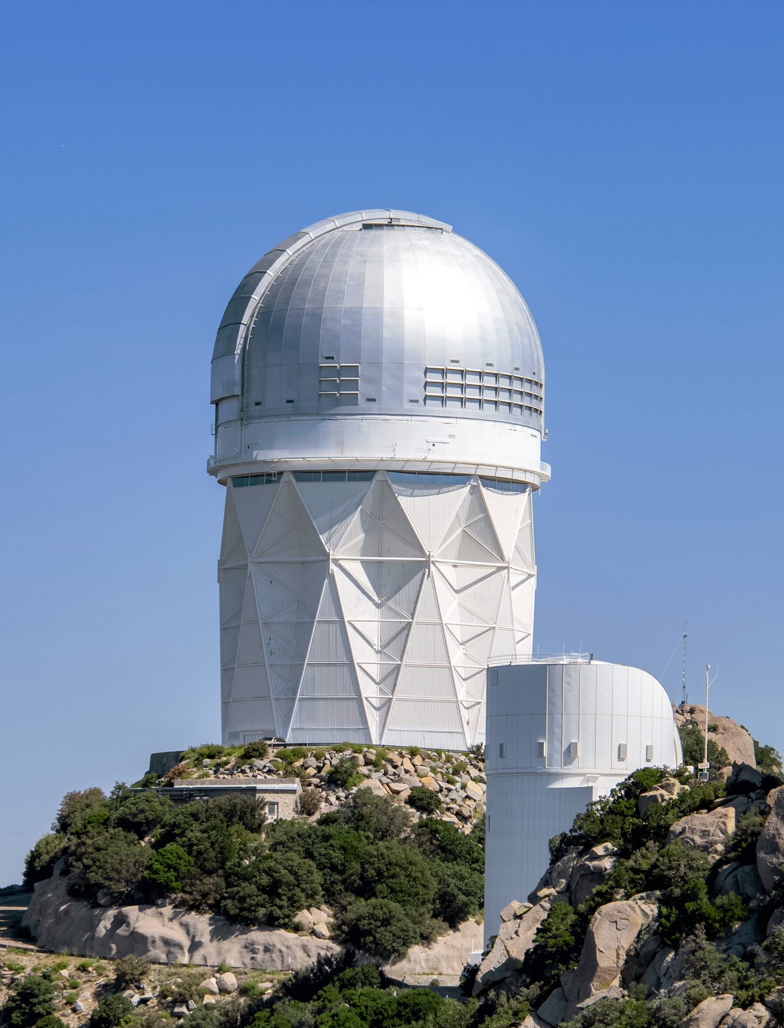
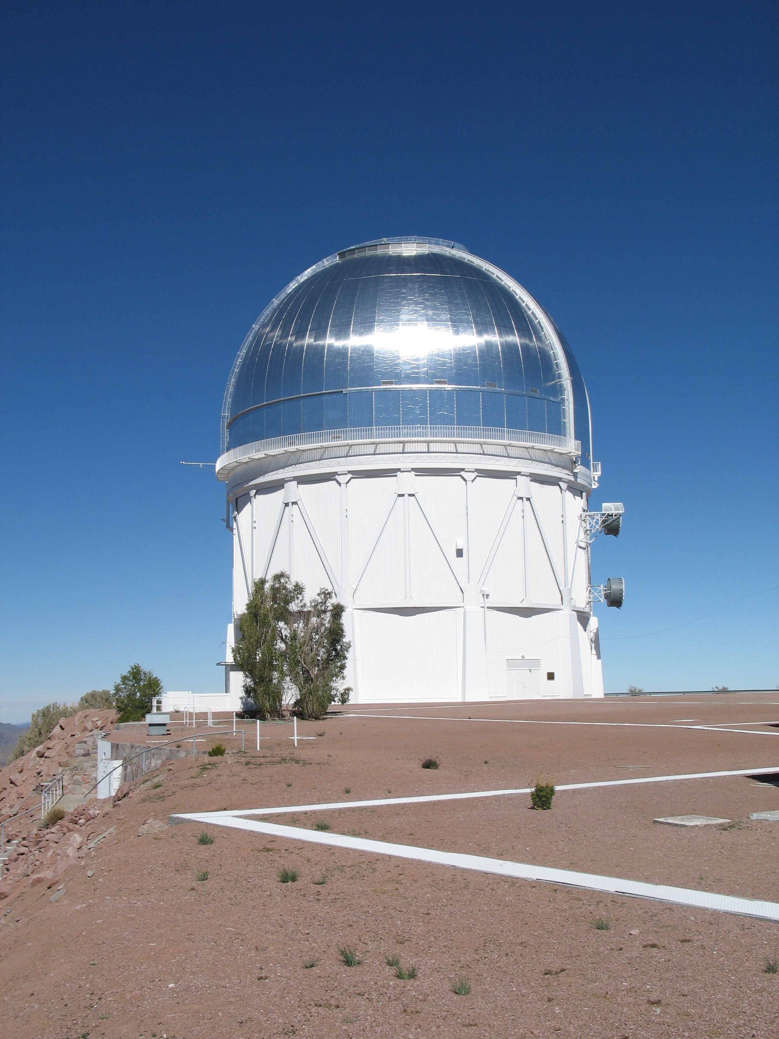
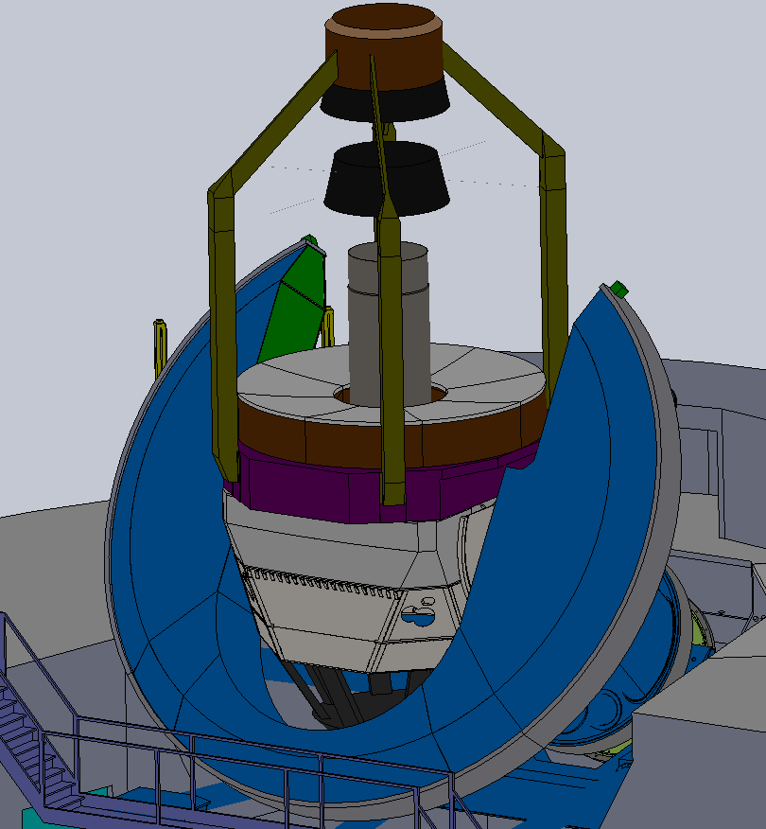
DESI is so successful that we are proposing DESI x 10 (Stage-5 spectroscopy!)
Two 6-meter telescopes and 26,000 fibers
Active R&D efforts in:
CCDs
Positioners
Spectrographs

Slide 14
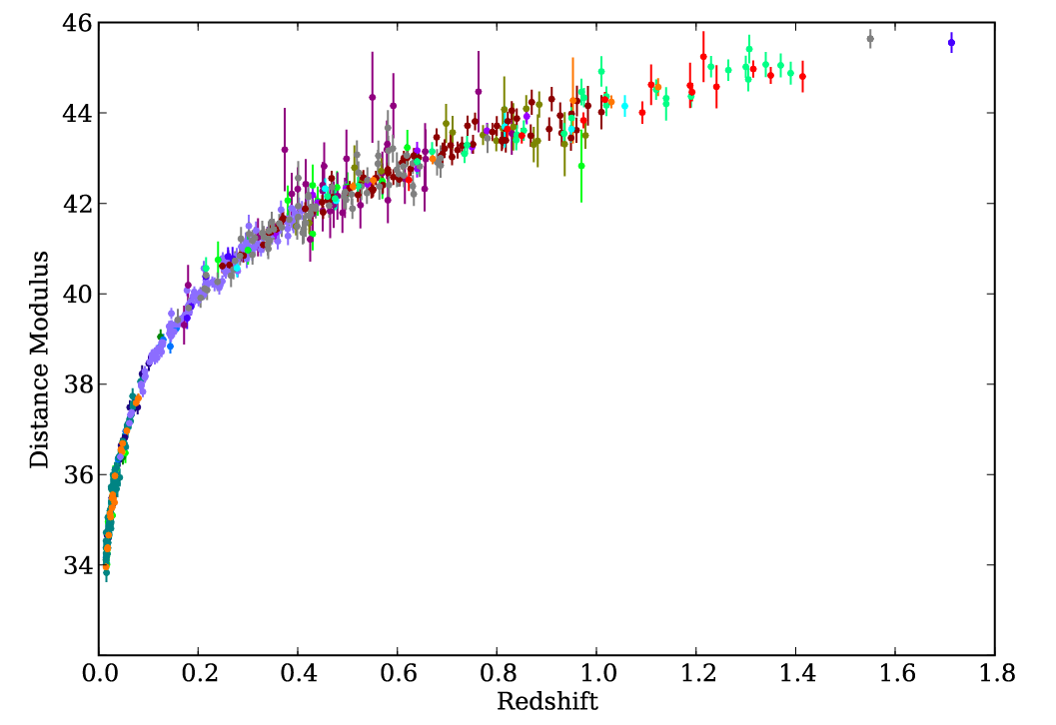
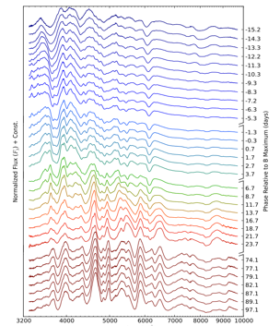
Studying Dark Energy & Gravity with Supernovae
Saul Perlmutter, Greg Aldering, Alex Kim + Peter Nugent, Rob Knop in C³
DESI is making the definitive measurement of the nearby galaxy density field. We are using this and nearby supernovae to measure the growth of structure, and thereby measure how gravity behaves on cosmological scales.
Low-z
At low redshifts, we are using Machine Learning with the comprehensive observations of 300 SNe from our Nearby SN Factory to make possible the next generation of Dark Energy measurements.

Slide 15
Studying Dark Energy & Gravity with Supernovae
Saul Perlmutter, Greg Aldering, Alex Kim + Peter Nugent, Rob Knop in C³
High-z
Mid-z
At mid-to-high z, we are designing and building the instruments and software pipelines to follow the triggers from LSST (in Chile) and Roman Space Telescope (in space).

Slide 16
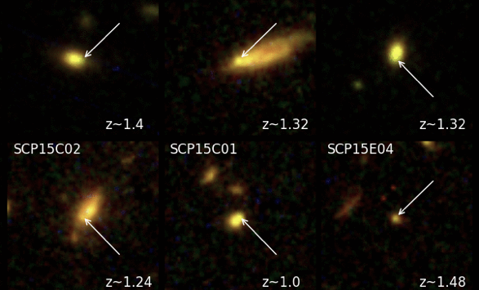
Studying Dark Energy & Gravity with Supernovae
Saul Perlmutter, Greg Aldering, Alex Kim + Peter Nugent, Rob Knop in C³
High-z
At high z, we are currently measuring time-variability of Dark Energy using HST supernova searches and follow-up. We are also developing spectral reduction techniques for the Roman Space Telescope instruments, and propose an ambitious new space telescope to follow SNe and LIGO gravitational wave triggers.

Slide 17
Studying Dark Energy & Gravity with Supernovae
Saul Perlmutter, Greg Aldering, Alex Kim + Peter Nugent, Rob Knop in C³
High-z
Mid-z
We are determining SI-traceable flux calibration to tie together SNe at all redshifts.
Low-z

Slide 19
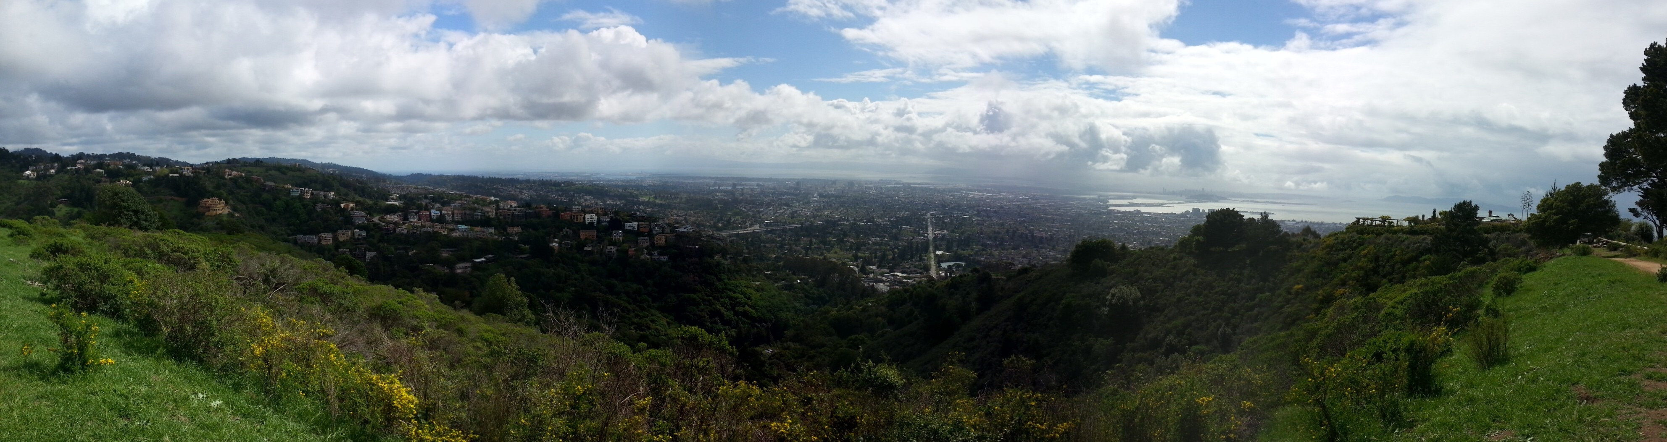
Thank you!
View of the Berkeley area from just South of LBNL during the grad visit day 11 years ago - it’s usually not this dreary!

