Slide 1
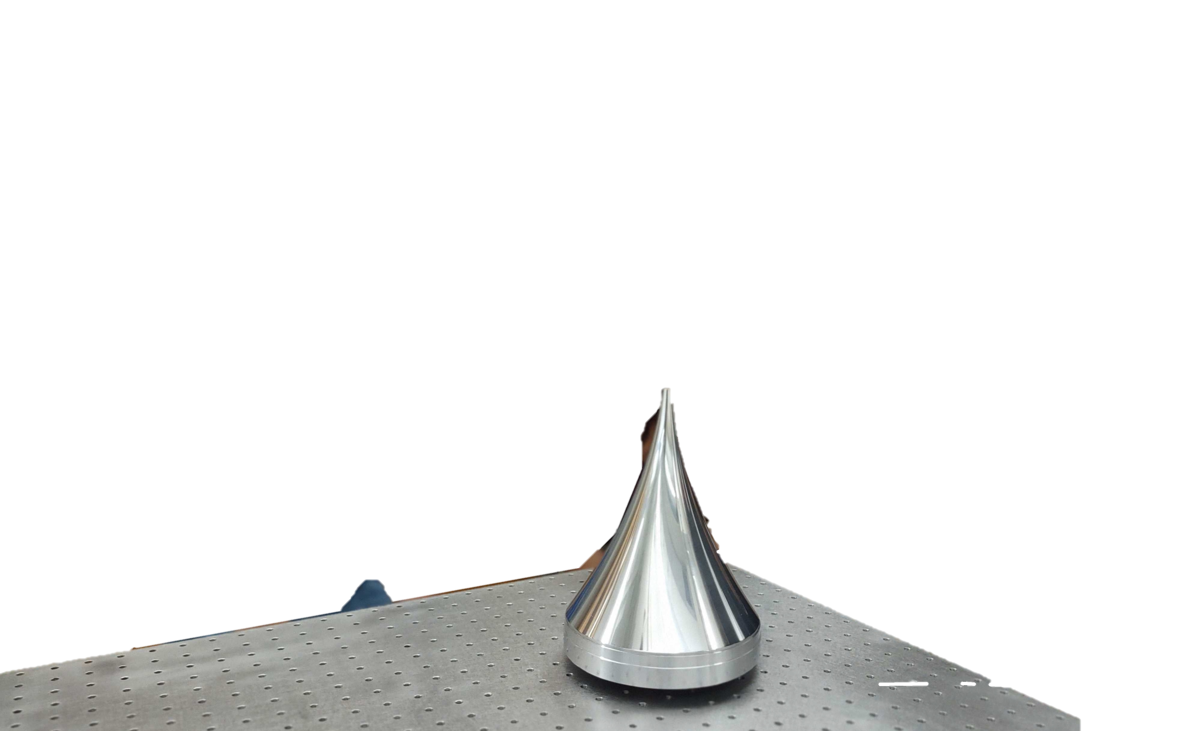
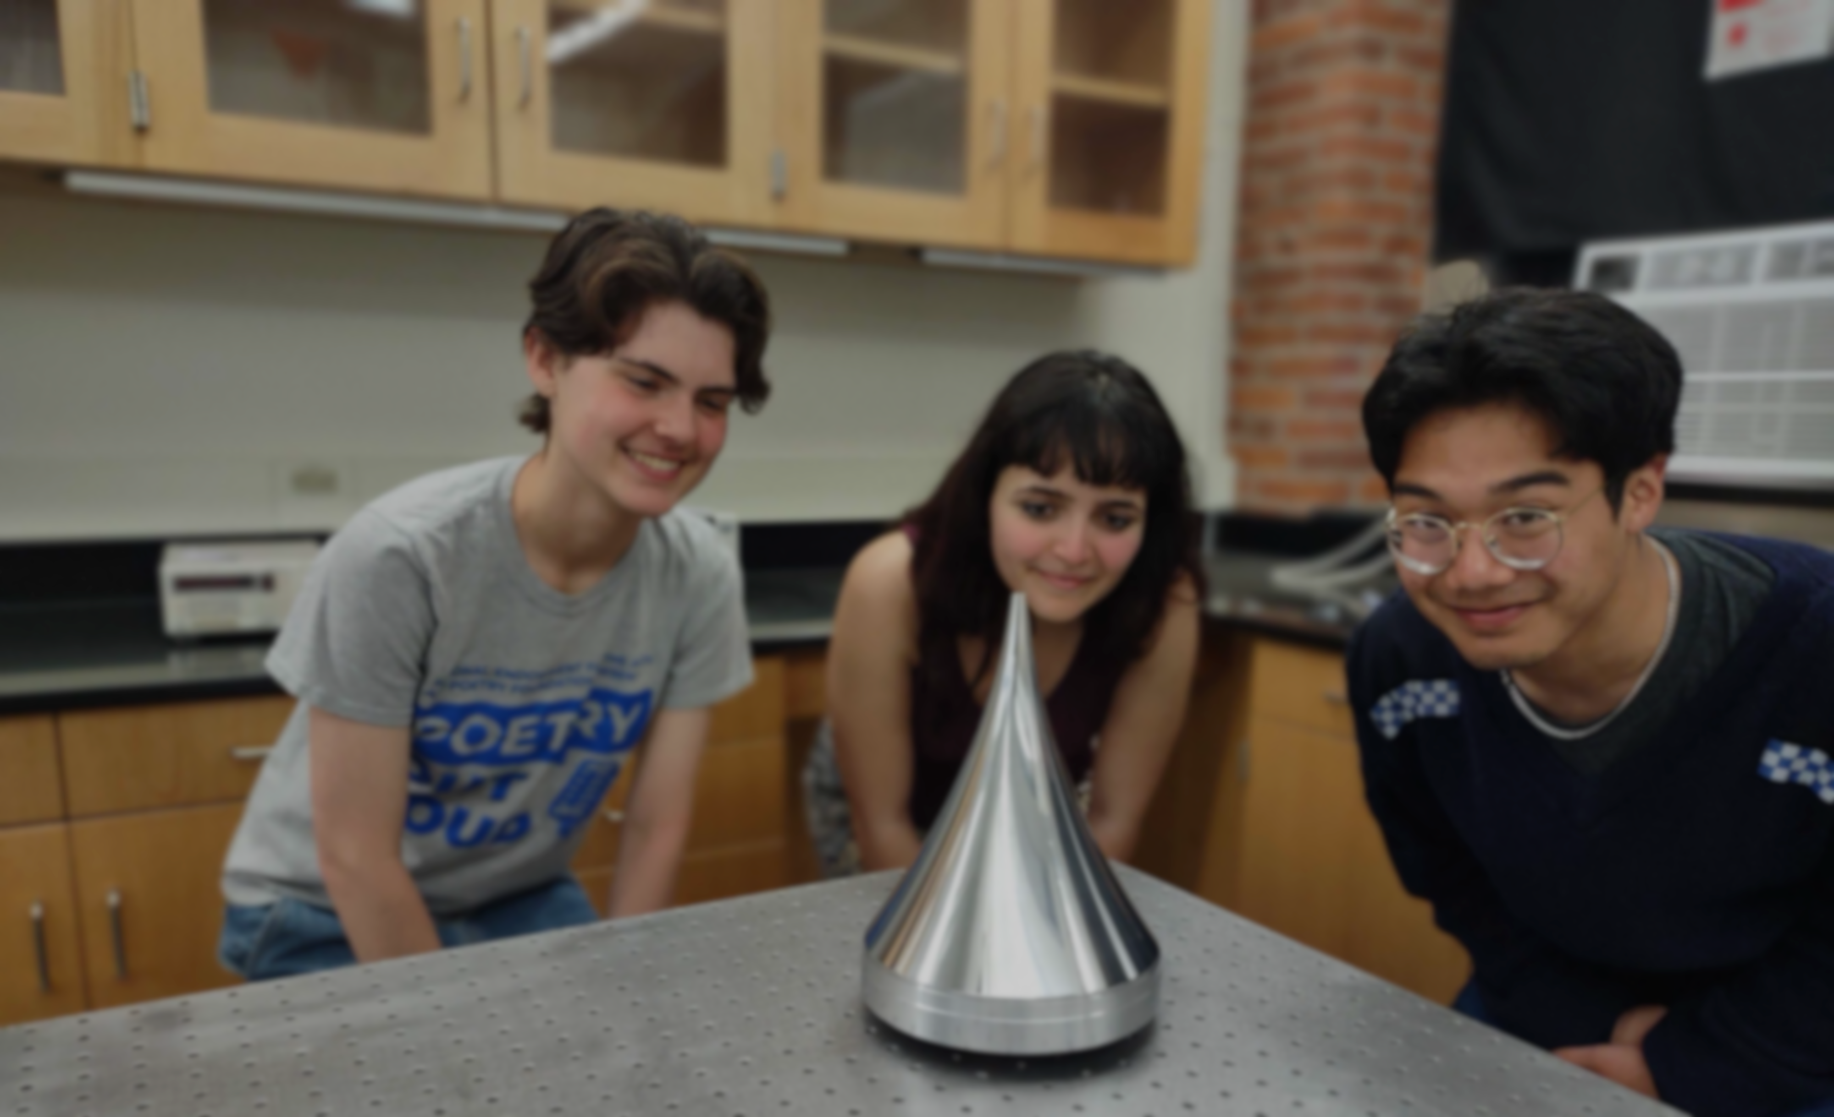


BREAD
Broadband Reflector Experiment for
Axion Detection
Stefan Knirck
Harvard University, Department of Physics
for the BREAD collaboration

Slide 2
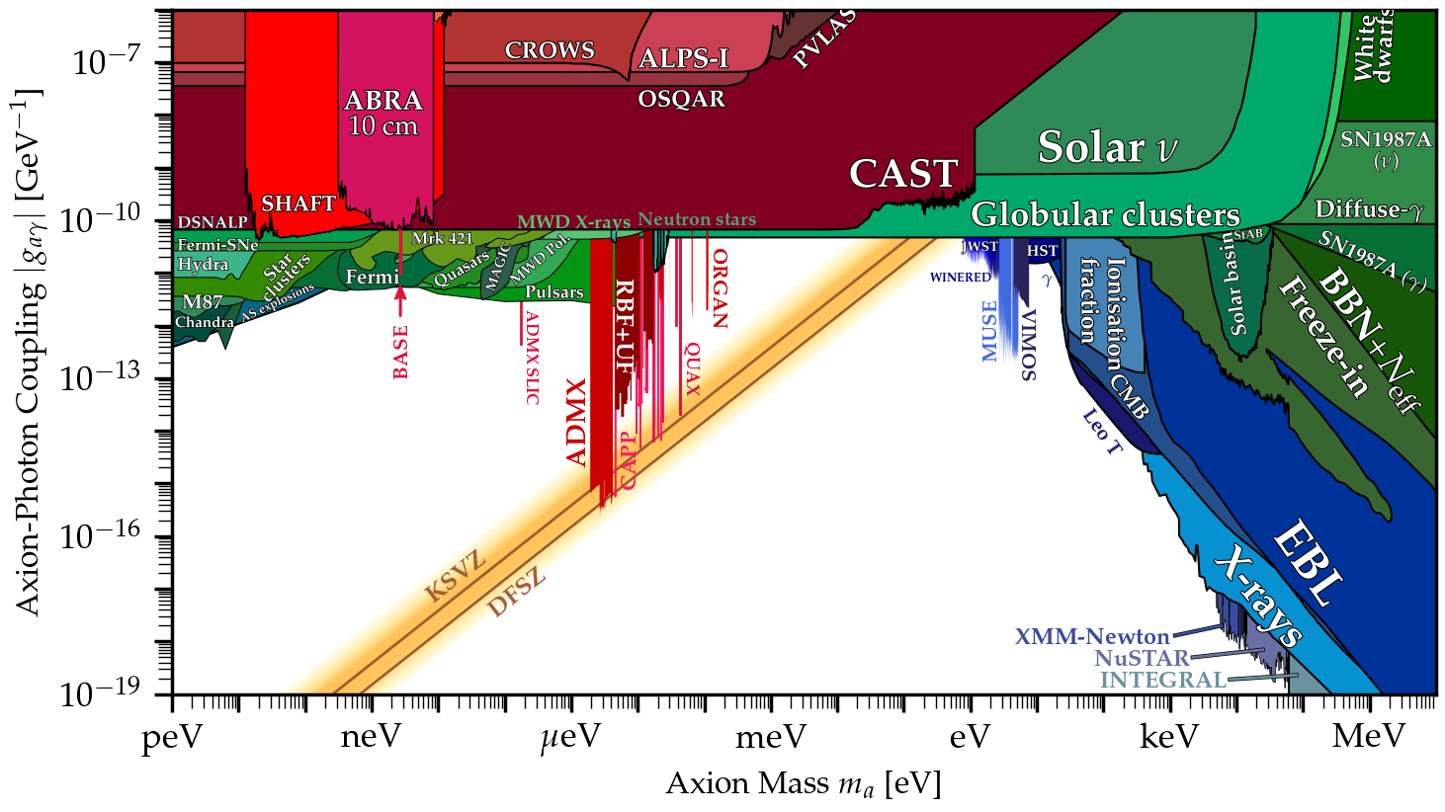
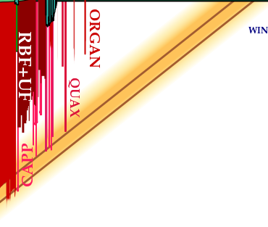

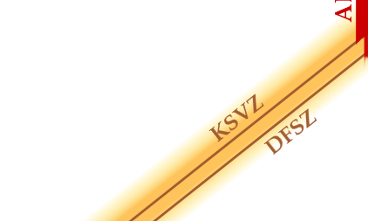
Where to look for axions?
Introduction
First Results
Outlook
Conclusion
[adapted from
cajohare.github.io/axionlimits]
Post-Inflationary
Symmetry Breaking
Benchmark Models

Slide 3

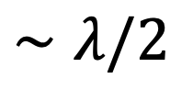

The Resonant Cavity – Higher Masses
Introduction
First Results
Outlook
Conclusion
✔ high-Q resonator
FFT
$$E$$
✔ low-noise
receiver
$$m_{a}$$
$$∼λ/2$$
✔ high B-field
$$P_{sig}=2⋅{10}^{−23} W⋅{\left(\frac{B}{7.6 T}\right)}^{2}\left(\frac{V}{136 ℓ}\right)\left(\frac{C}{0.4}\right)\left(\frac{Q}{30,000}\right){\left(\frac{g_{γ}}{0.36}\right)}^{2}\left(\frac{m_{a}}{3 μeV}\right)\left(\frac{ρ_{DM}}{0.45 GeV cm^{−3}}\right)$$

Slide 4

The Resonant Cavity – Higher Masses
Introduction
First Results
Outlook
Conclusion
✔ high-Q resonator
FFT
$$E$$
✔ low-noise
receiver
$$m_{a}$$
✔ high B-field
$$P_{sig}=2⋅{10}^{−23} W⋅{\left(\frac{B}{7.6 T}\right)}^{2}\left(\frac{V}{136 ℓ}\right)\left(\frac{C}{0.4}\right)\left(\frac{Q}{30,000}\right){\left(\frac{g_{γ}}{0.36}\right)}^{2}\left(\frac{m_{a}}{3 μeV}\right)\left(\frac{ρ_{DM}}{0.45 GeV cm^{−3}}\right)$$

Slide 5

The Resonant Cavity – Higher Masses
Introduction
First Results
Outlook
Conclusion
✔ high-Q resonators
FFT
combiner
✔ low-noise
receiver
$$E$$
$$m_{a}$$
✔ high B-field
$$P_{sig}=2⋅{10}^{−23} W⋅{\left(\frac{B}{7.6 T}\right)}^{2}\left(\frac{V}{136 ℓ}\right)\left(\frac{C}{0.4}\right)\left(\frac{Q}{30,000}\right){\left(\frac{g_{γ}}{0.36}\right)}^{2}\left(\frac{m_{a}}{3 μeV}\right)\left(\frac{ρ_{DM}}{0.45 GeV cm^{−3}}\right)$$

Slide 6

The Resonant Cavity
Introduction
First Results
Outlook
Conclusion
✔ high-Q resonators
FFT
✔ low-noise
receiver
😬
Complexity
Hard to Tune
$$m_{a}$$
✔ high B-field

Slide 7

BREAD Concept
Introduction
First Results
Outlook
Conclusion
✔ “dish antenna”
[Horns et al, arXiv:1212.2970]
$$P_{sig}=1.2⋅{10}^{−25} W⋅\left(\frac{A}{10{ m}^{2}}\right){\left(\frac{B_{∥}}{10 T}\right)}^{2}$$
$$×\left(\frac{ρ_{DM}}{0.45 GeV cm^{−3}}\right){\left(\frac{g_{aγγ}}{3.9⋅{10}^{−16} GeV^{−1}}\right)}^{2}{\left(\frac{1 μeV}{m_{a}}\right)}^{2}$$
axion
FFT
$$B$$
✔ low-noise
receiver
$
$$m_{a}$$
✔ high B-field
a scalable a broadband

Slide 8

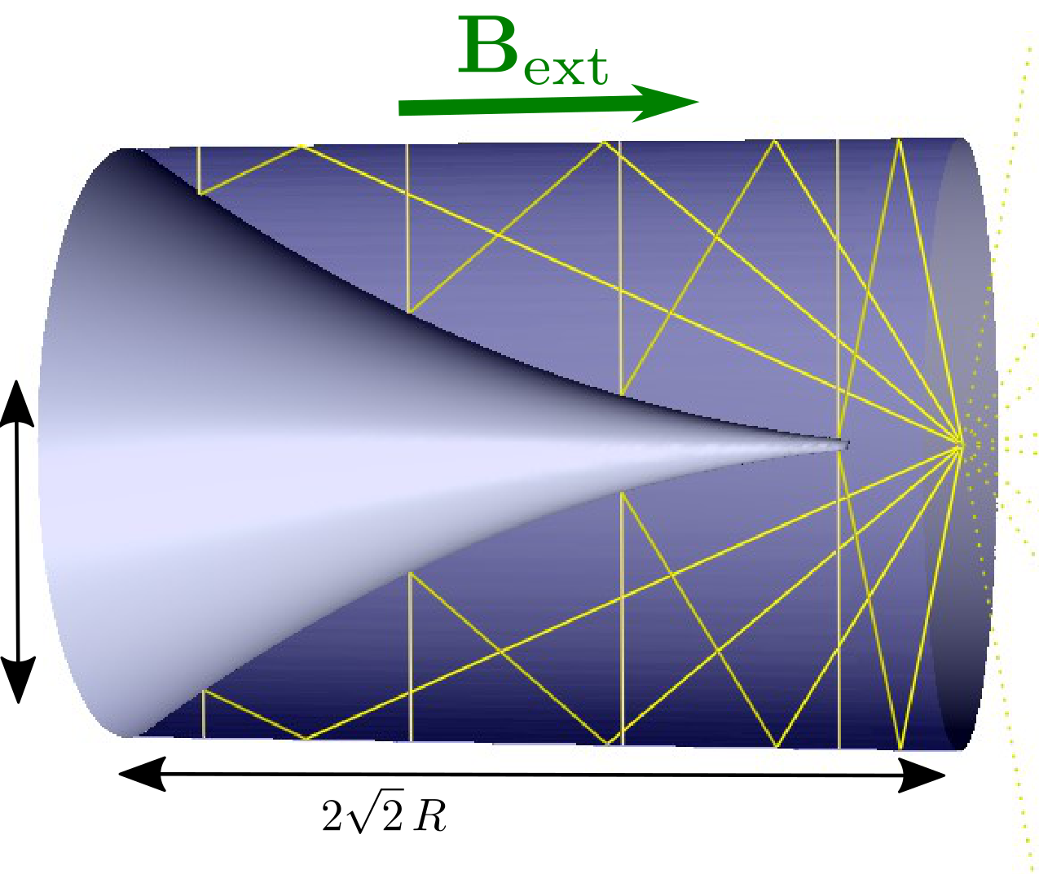

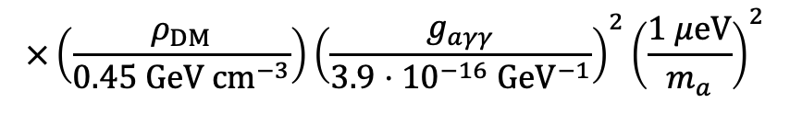

BREAD (Broadband Reflector Experiment for Axion Detection)
Introduction
First Results
Outlook
Conclusion
✔ “coaxial dish antenna”
$$P_{sig}=1.2⋅{10}^{−25} W⋅\left(\frac{A}{10{ m}^{2}}\right){\left(\frac{B_{∥}}{10 T}\right)}^{2}$$
$$×\left(\frac{ρ_{DM}}{0.45 GeV cm^{−3}}\right){\left(\frac{g_{aγγ}}{3.9⋅{10}^{−16} GeV^{−1}}\right)}^{2}{\left(\frac{1 μeV}{m_{a}}\right)}^{2}$$
FFT
✔ low-noise
receiver
$$m_{a}$$
a use solenoid magnet, e.g., MRI

Slide 9
Sensitivity
Introduction
First Results
Outlook
Conclusion
[Liu et al (BREAD).,
arXiv:2111.12103, PRL 128 (2022) 131801]

Slide 10
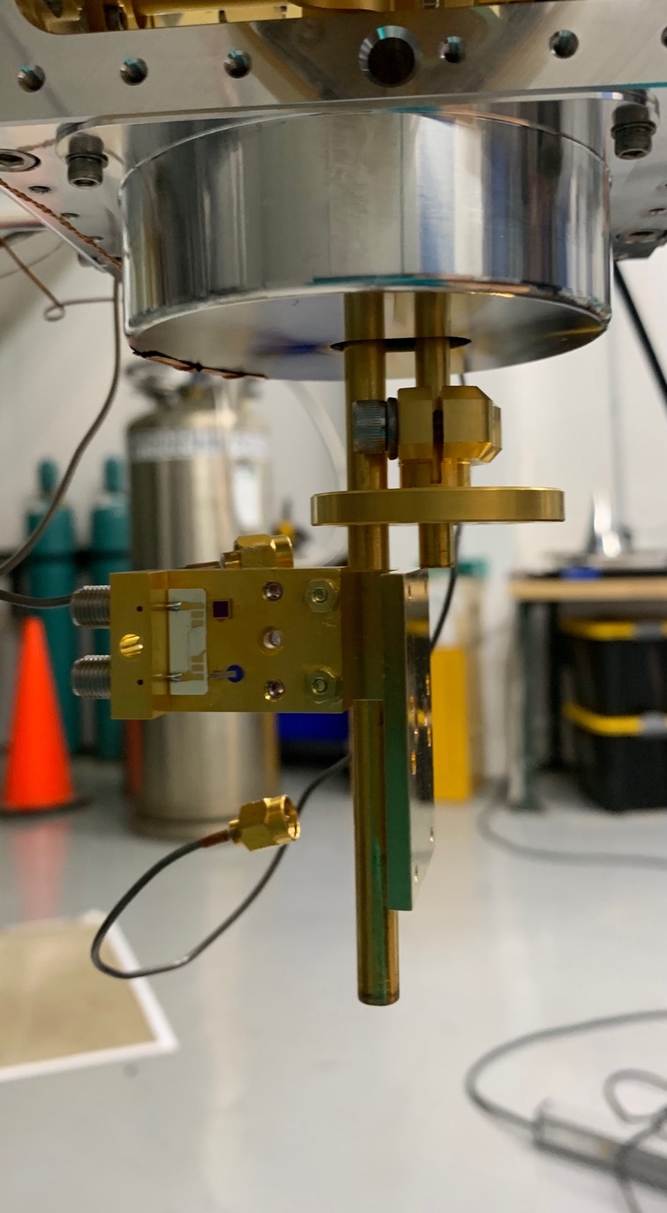
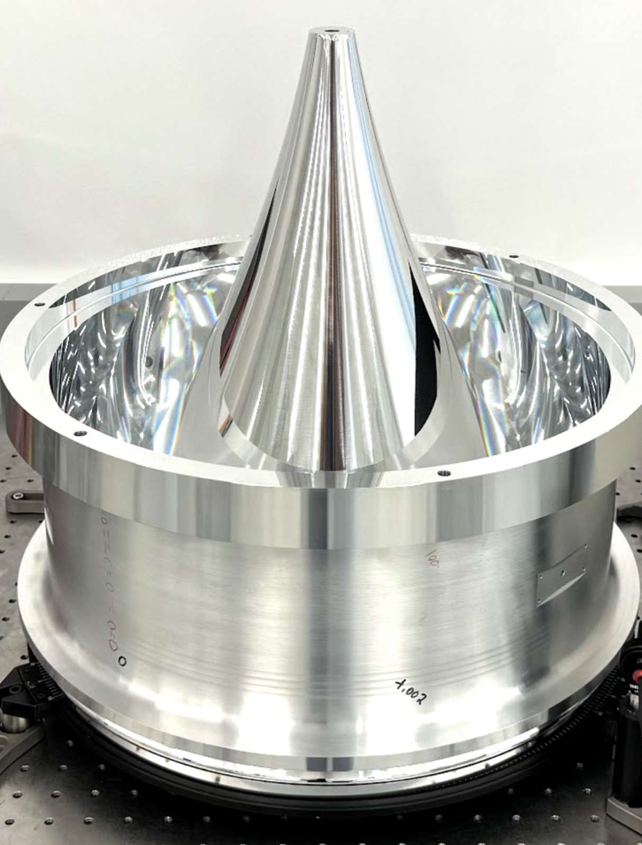
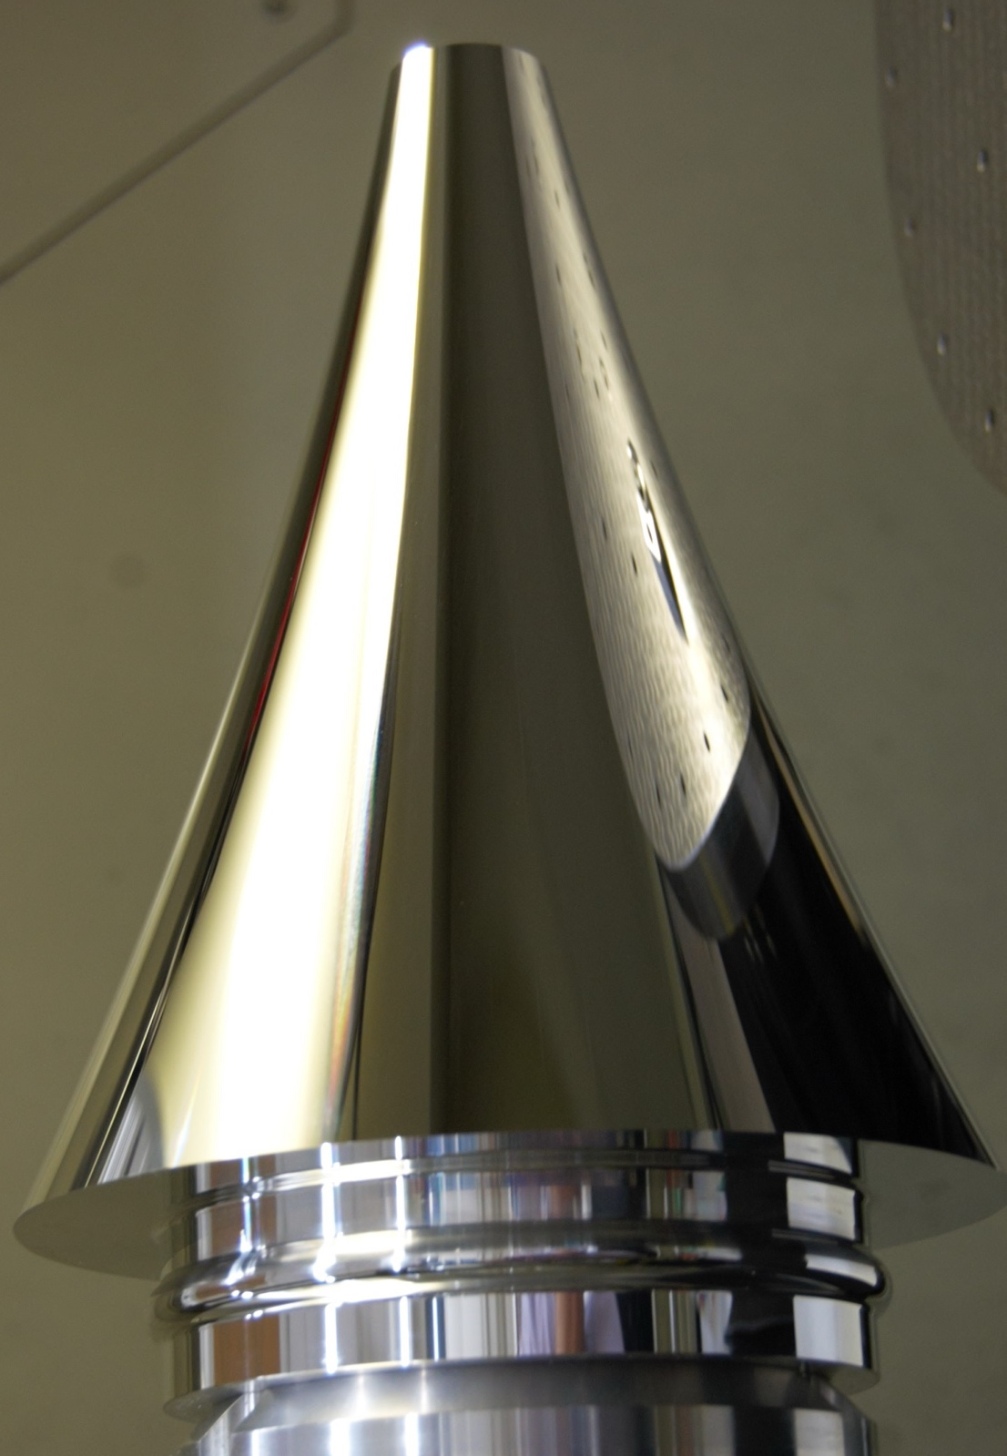
InfraBREAD
Introduction
First Results
Outlook
Conclusion
Superconducting Nanowire Single Photon Detector (SNSPD)
from JPL
100nm wide nanowires
in 15x15µm SNSPD
from MIT
Optical Grade Reflector from LLNL
→ goal: cryogenic dark photon search at infrared (eV)

Slide 11
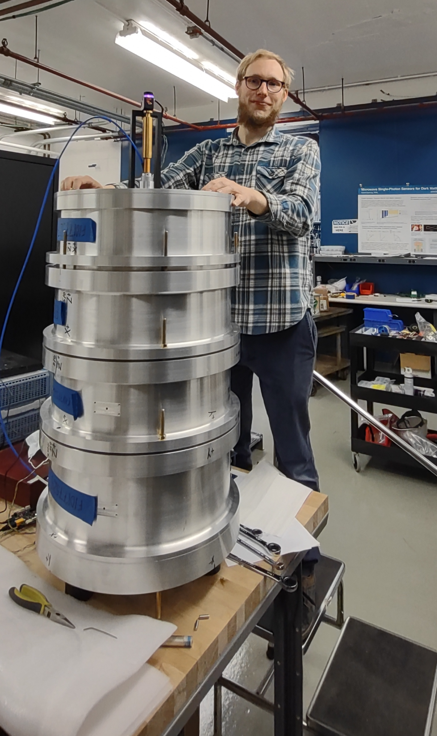
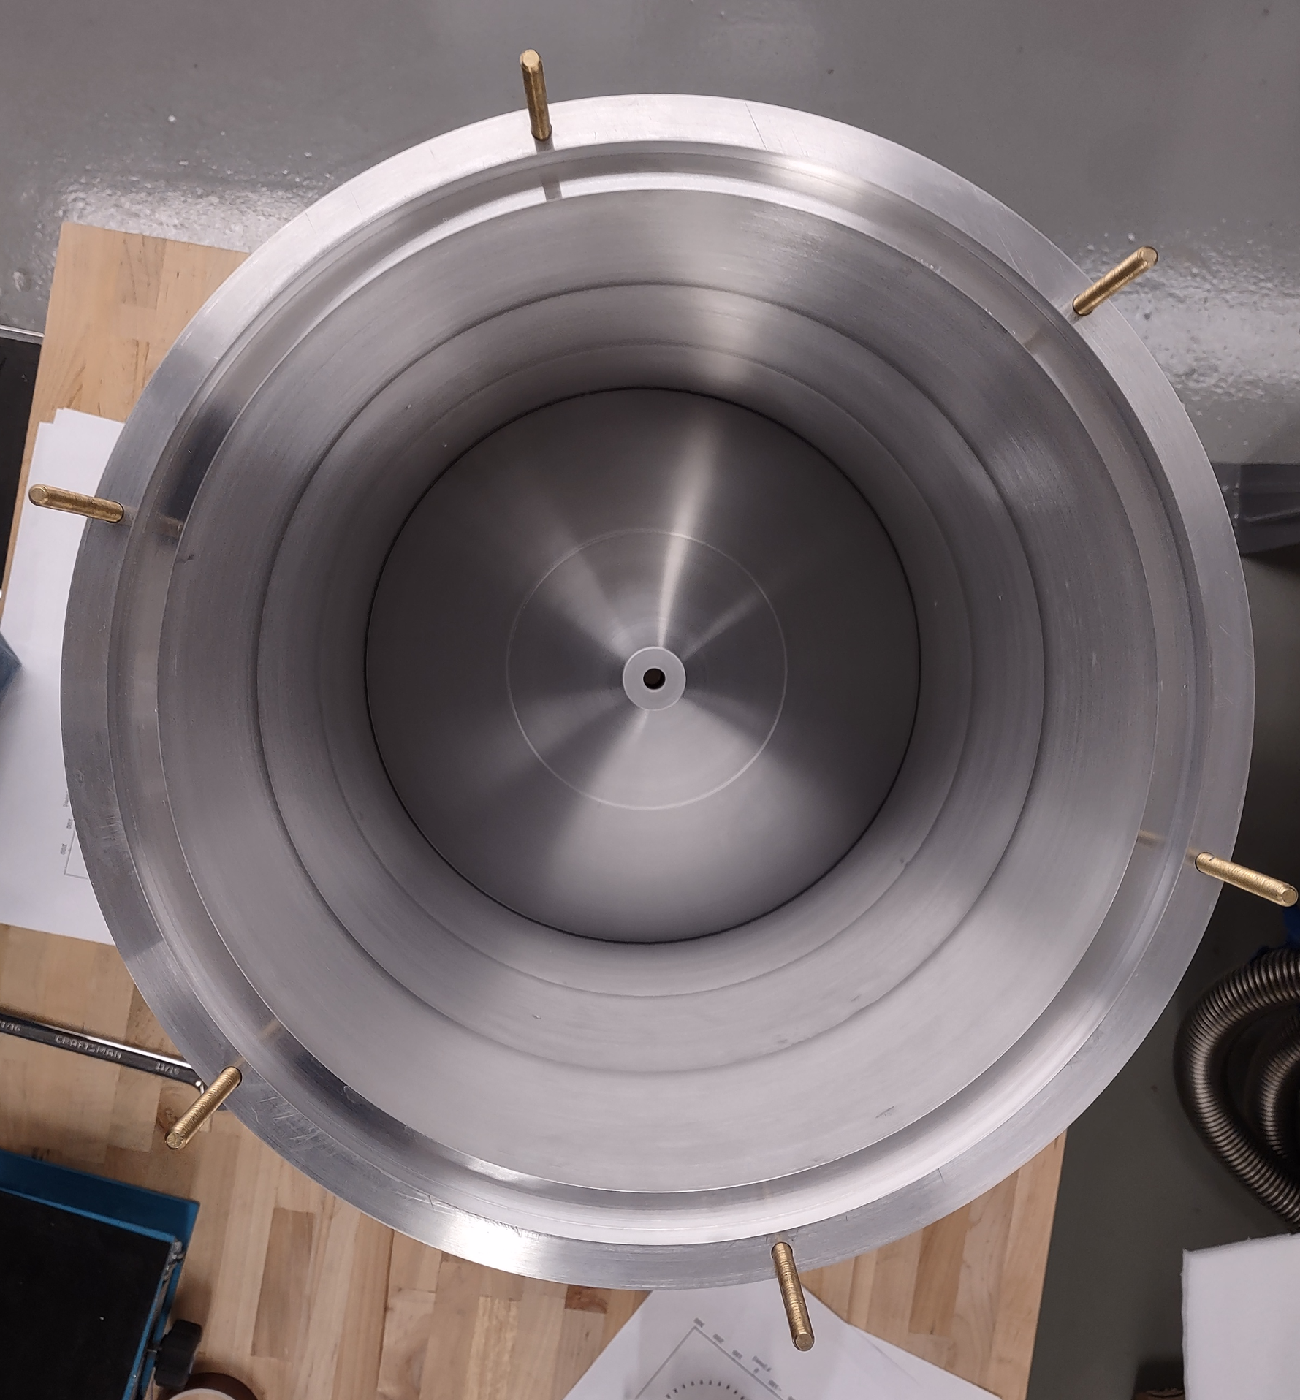
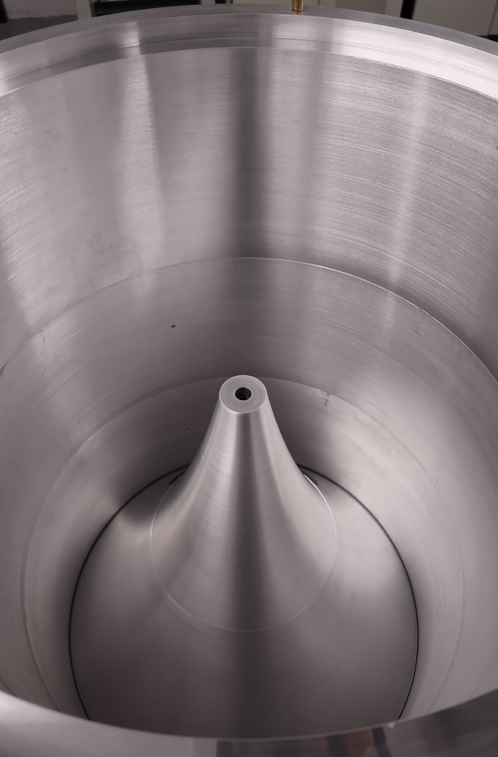
GigaBREAD: First 10-14 GHz (50µeV) BREAD pilot
Introduction
First Results
Outlook
Conclusion

Slide 12

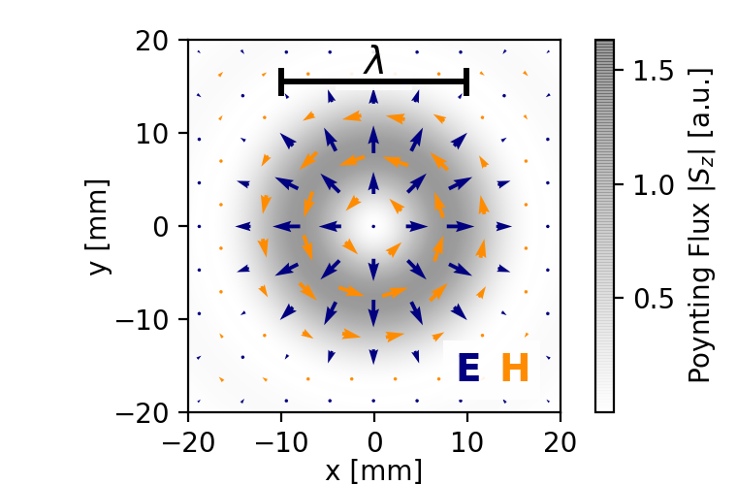
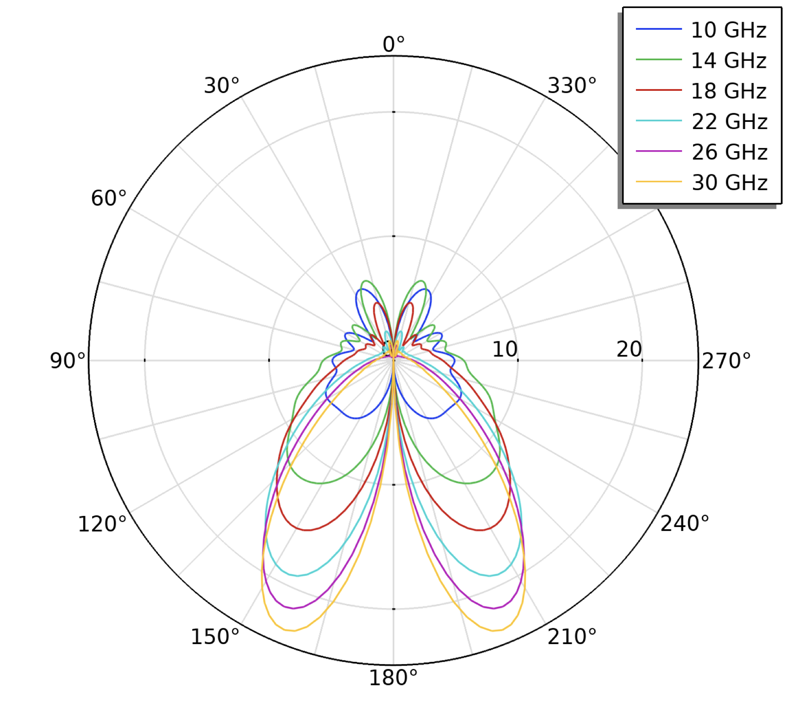

Coaxial Horn Antenna
Introduction
First Results
Outlook
Conclusion
coaxial horn antenna
$$B$$
e.g. [Bykov et al,
DOI:10.1134/S0020441208050126]
[Barros et al,
DOI:10.1109/IMOC.2013.6646569]

Slide 13
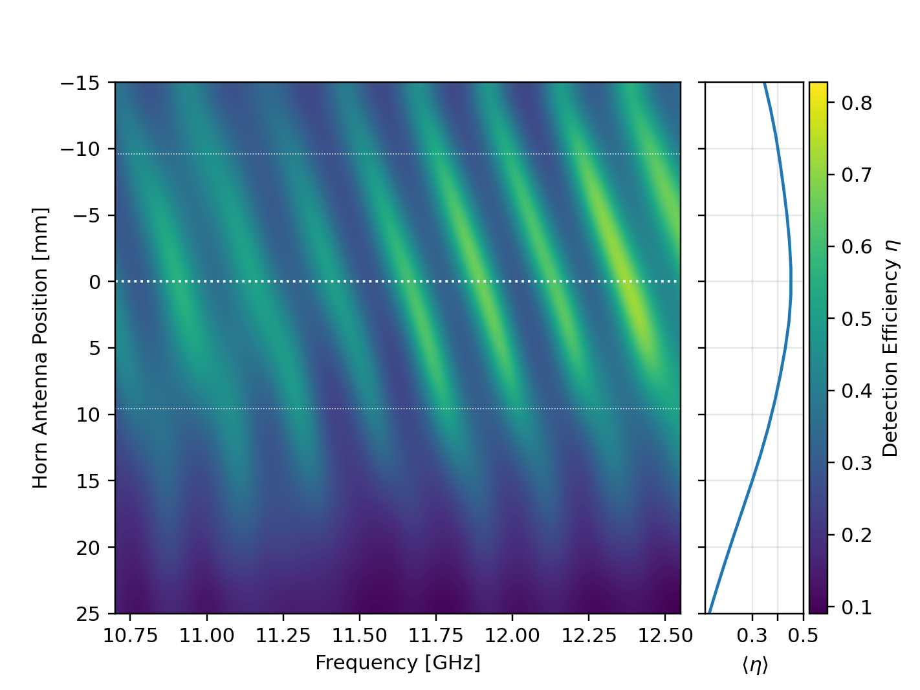
RF Simulation
Introduction
First Results
Outlook
Conclusion
Signal vs. Antenna Position
on focus
off focus
signal suppressed away from focus

Slide 14
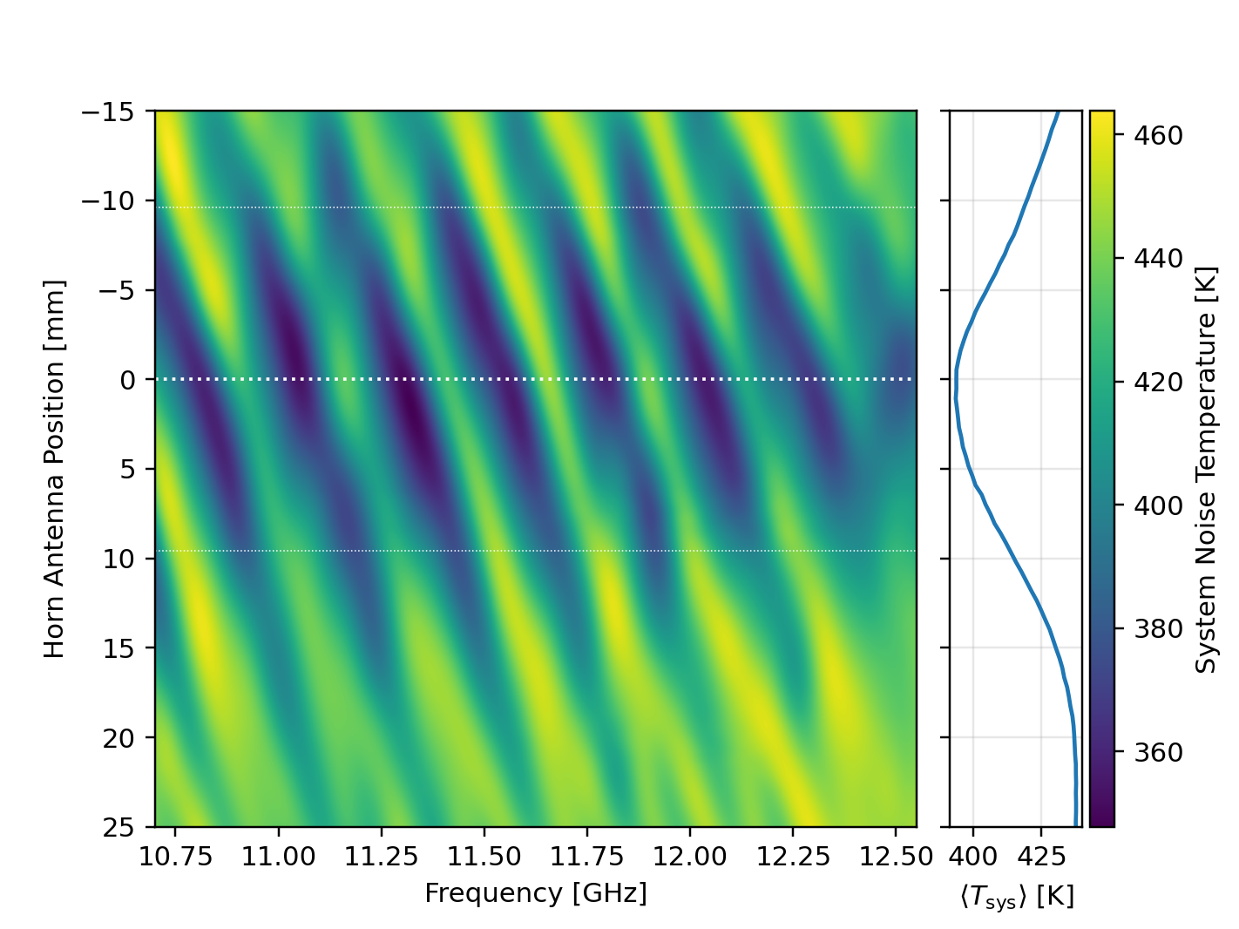
Reflector Characterization Measurement
Introduction
First Results
Outlook
Conclusion
Measured Thermal Noise
on focus
off focus
see focus & resonances

Slide 15
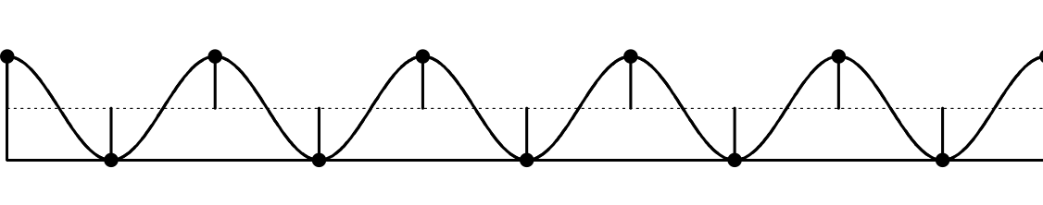
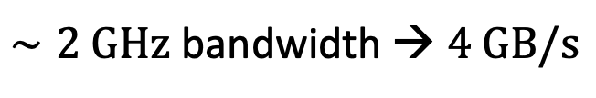

Broadband DAQ
Introduction
First Results
Outlook
Conclusion
FFT
RF
IF
~
LO
Nyquist: Min. Sample Rate = 2 $×$ Bandwidth
[https://commons.wikimedia.org/wiki/File:Nyquist_Aliasing.svg]
$∼2 GHz$ bandwidth → $4 GB/s$
signal bandwidth
(10.7 - 12.5) GHz
Challenge: Real-Time Data Reduction

Slide 16

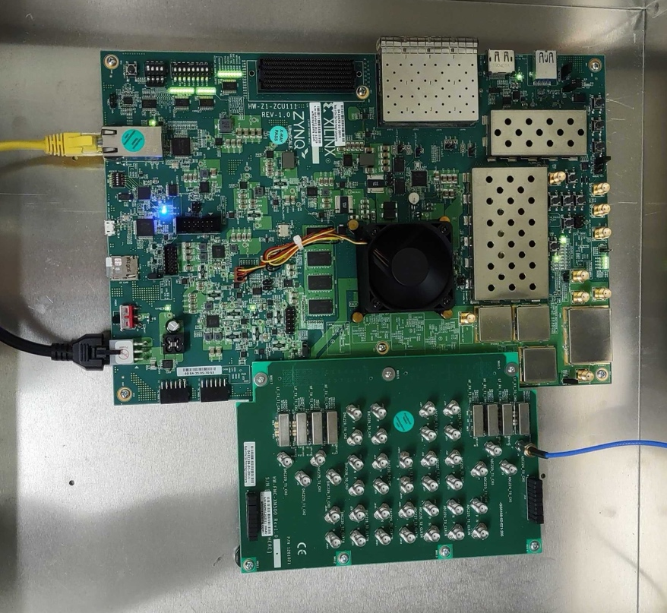

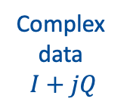
Broadband DAQ
Introduction
First Results
Outlook
Conclusion
based on QICK platform:
FFT & Averaging
on FPGA
RF
IF
~
LO
Polyphase filter bank
(PFB)
deMUX
and FDM to TDM
IF I
ADC
…
FFT
FFT
Zynq (OS, Python)
FFT
Averager
(>1s)
IF Q
16x ~500MHz BW overlapping spectra, 8kHz resolution
ADC
Complex
data
$$I+jQ$$
$$∑$$
signal bandwidth
(10.7 - 12.5) GHz
Xilinx ZCU111 board (ZU28DR RFSoC)
Negligible Dead Time after >1s on-board averaging

Slide 17
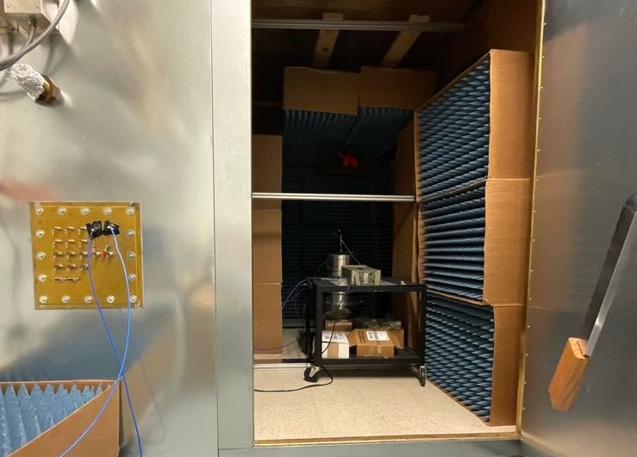
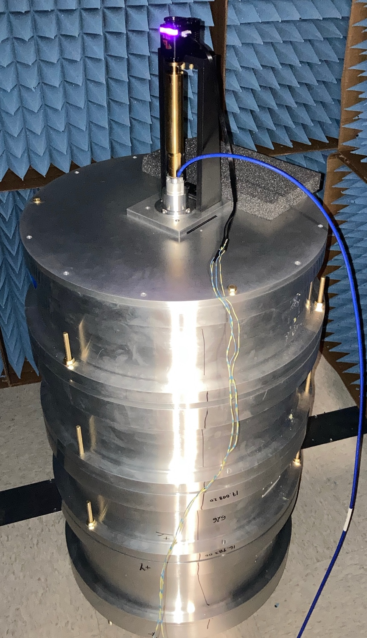
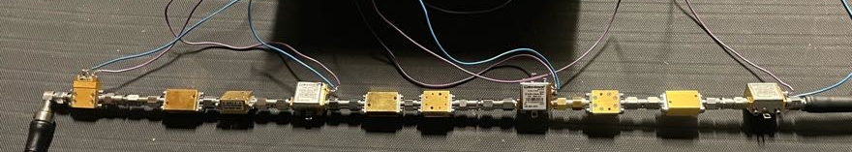
First Data Taking Run
Introduction
First Results
Outlook
Conclusion
RF Shielded Room
24 days science data,
June 16 – July 17, 2023
University of Chicago
41° 47' 31.6098",
-87° 36' 6.141”
sensitive to vertical dark photon polarization
horn antenna focal spot sweep over every ~ 4hrs
RFI shielded Faraday cage:
dish, all RF amplifiers
in basement:
down-conversion, DAQ,
slow control
Horn Movement
Dish
← to DAQ
← to feedthrough
~100K Amplifier Chain

Slide 18
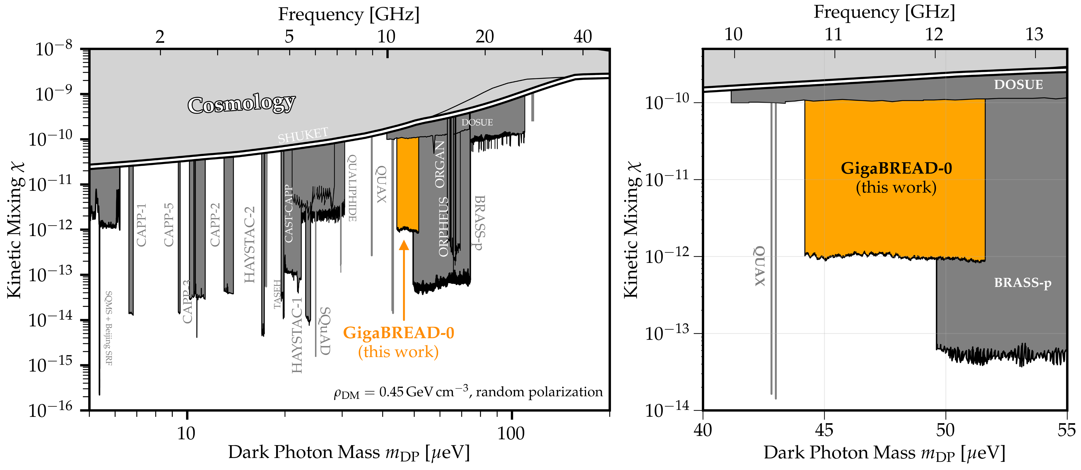
Result – Exclusion Limits
Introduction
First Results
Outlook
Conclusion
[SK et al. (GigaBREAD), arXiv:2310.13891, PRL 132, 131004 (2024)]
sensitivity estimate
PATRAS 2021
[limit plot adapted from cajohare.github.io/axionlimits]

Slide 19
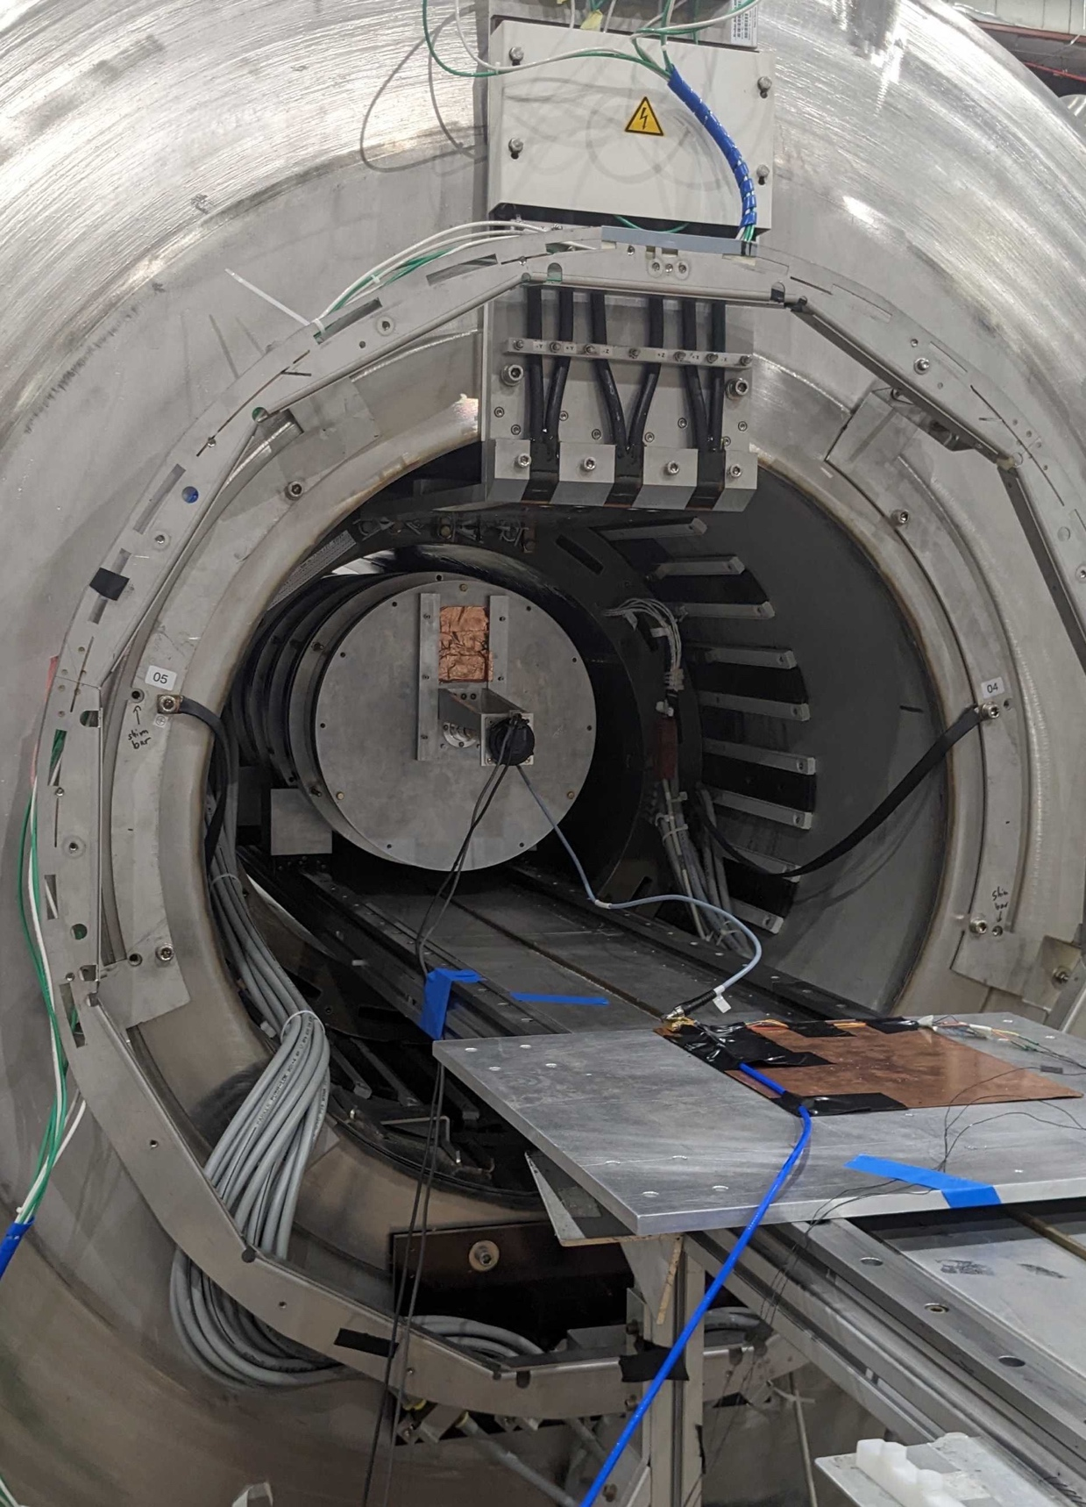
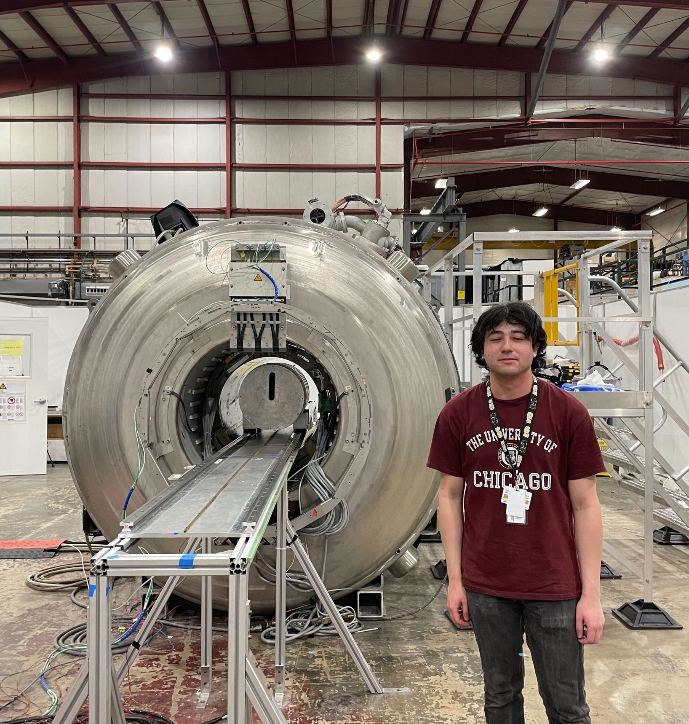
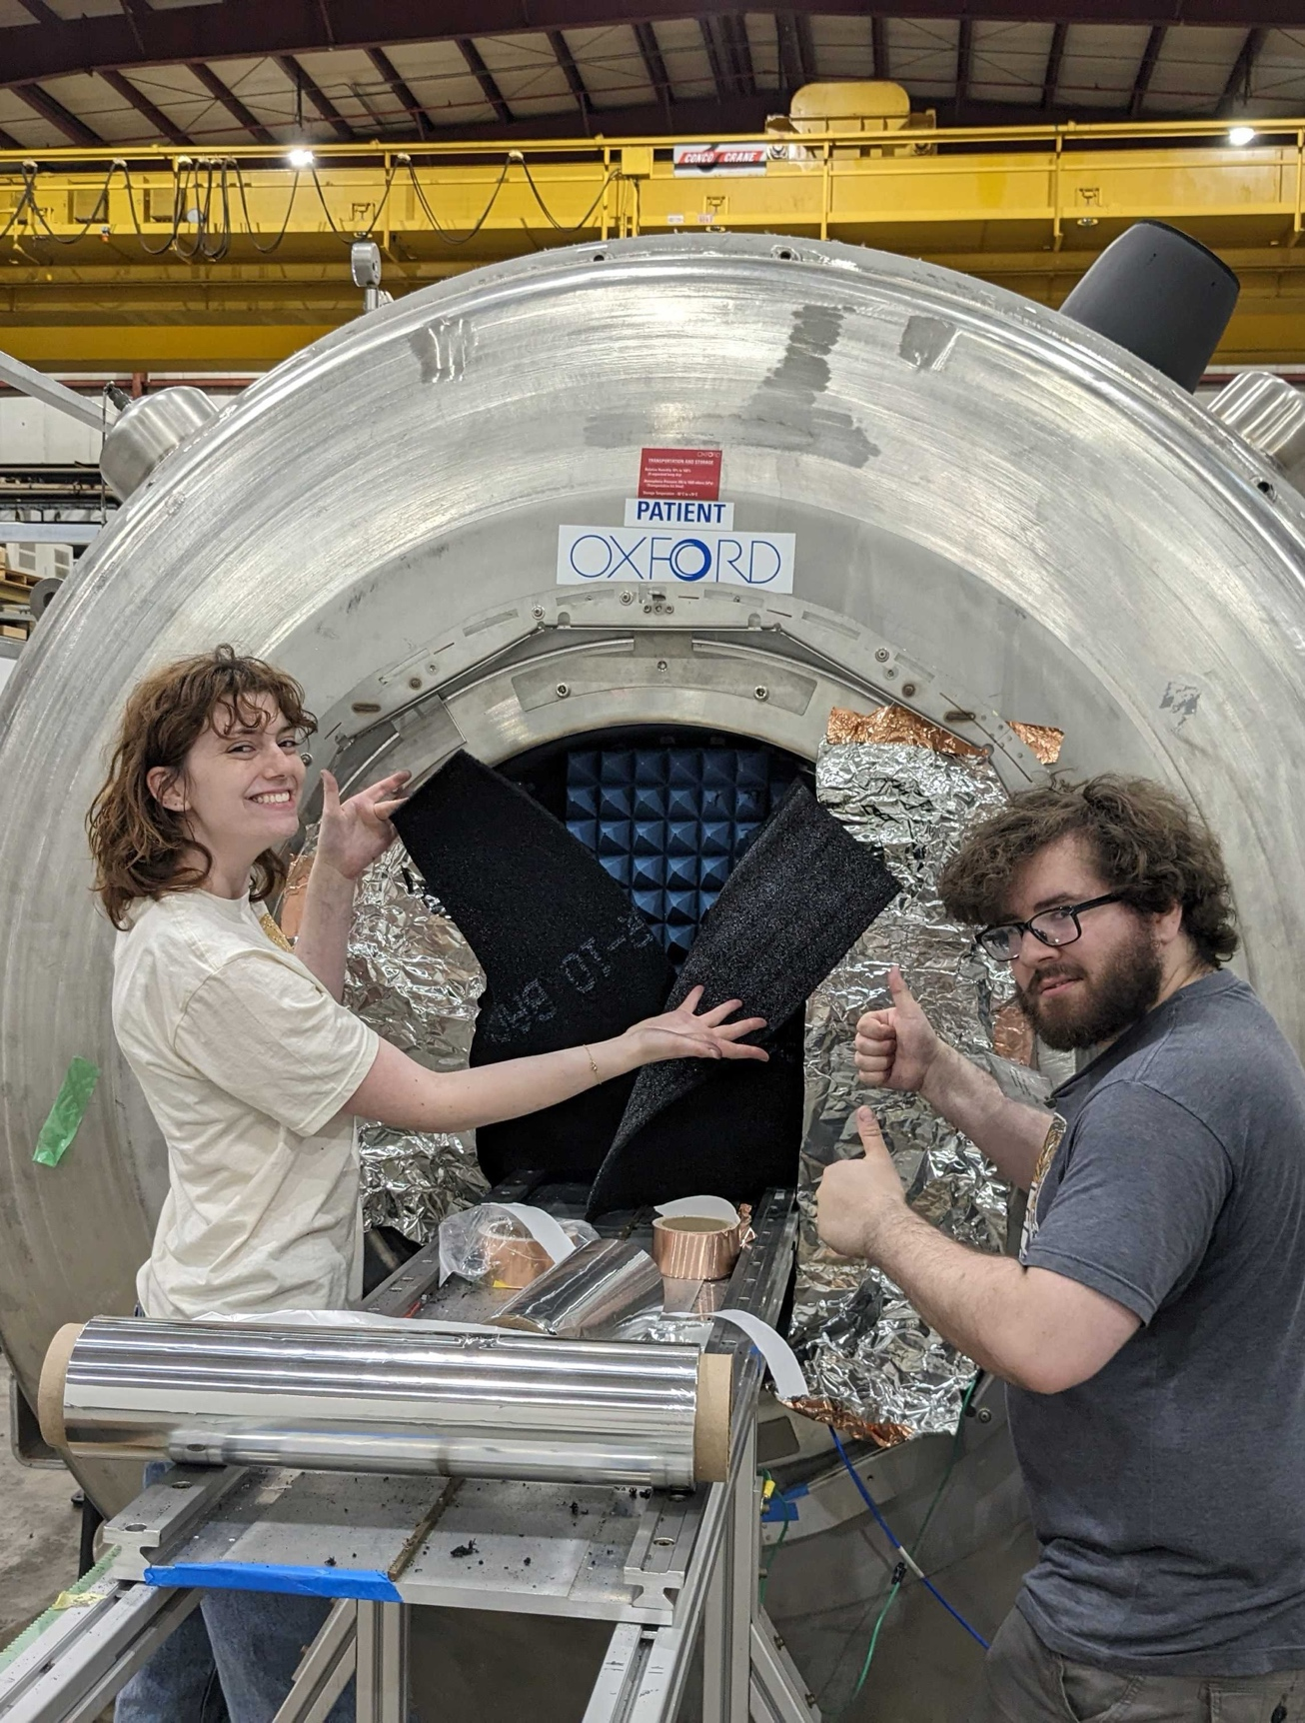
4T MRI Magnet @ Argonne National Lab
Introduction
First Results
Outlook
Conclusion
ALPs science run: summer 2024, one month data
Pictured: Gabe Hoshino, Mira Littmann, Alex Lapuente

Slide 20
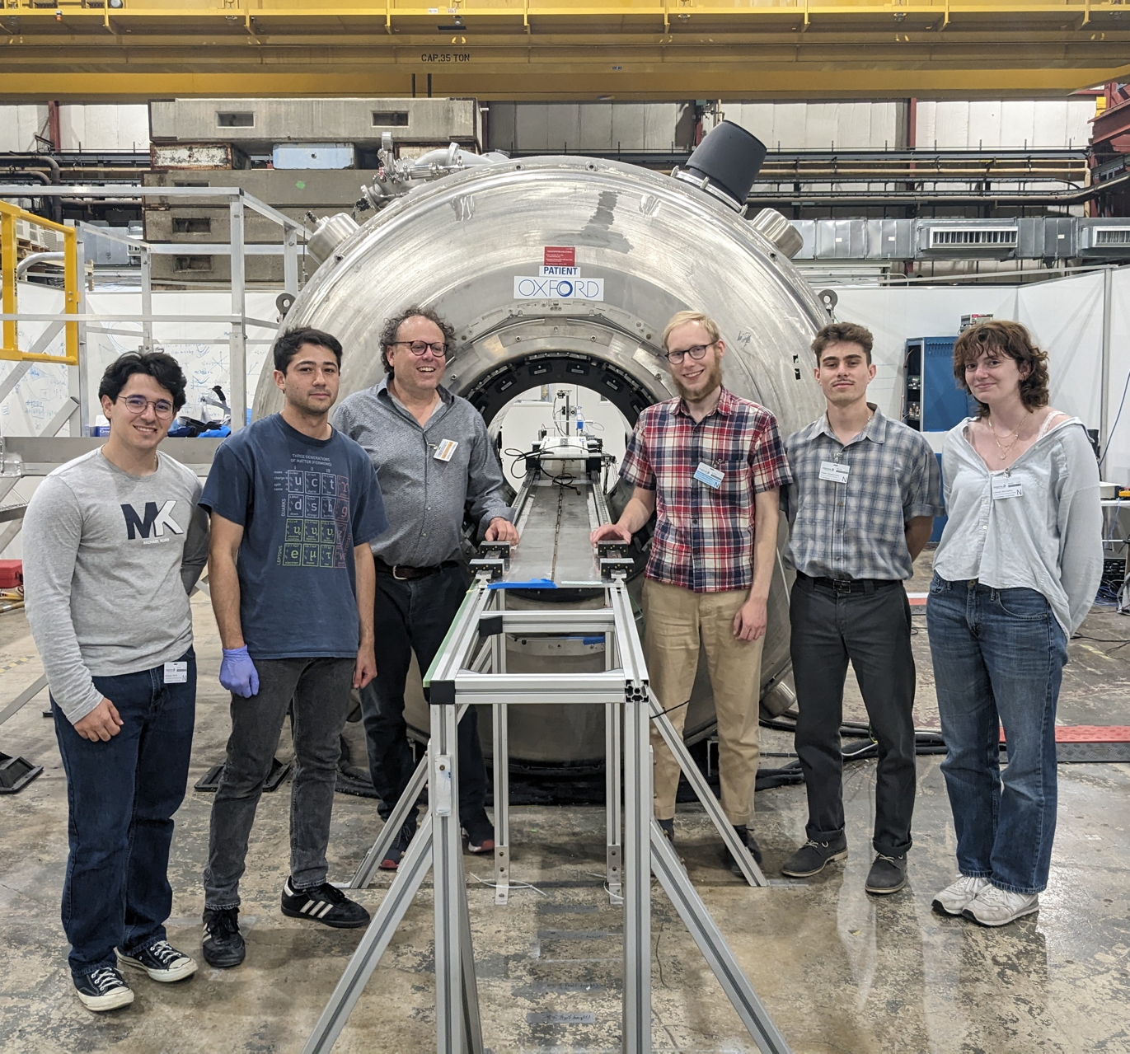
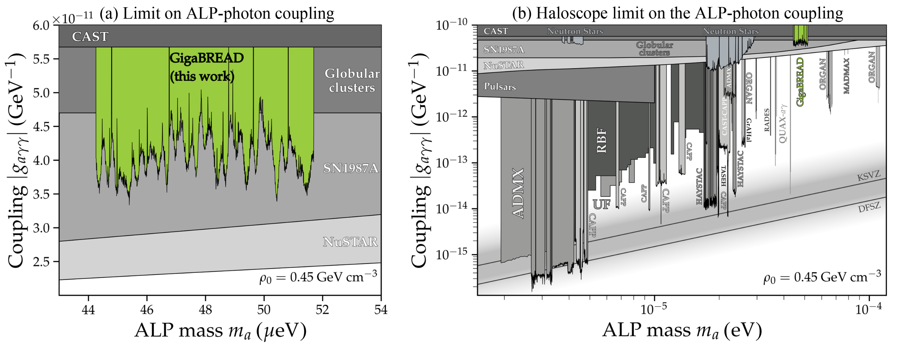
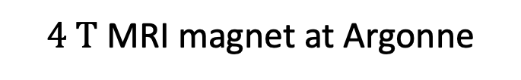
Axion-Like Particles – First Result
Introduction
First Results
Outlook
Conclusion
[G. Hoshino, SK, et al (GigaBREAD),
PRL 134, 171002 (2025)]
$4 T$ MRI magnet at Argonne
[limit plot adapted
from cajohare.github.io/axionlimits]
world’s first dish antenna ALP result!

Slide 21
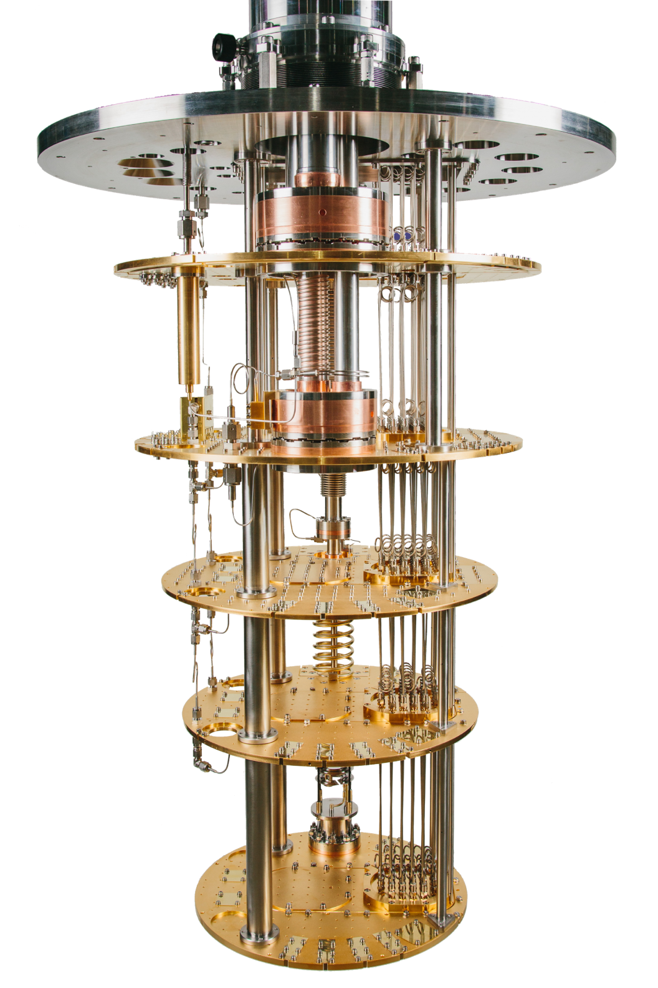
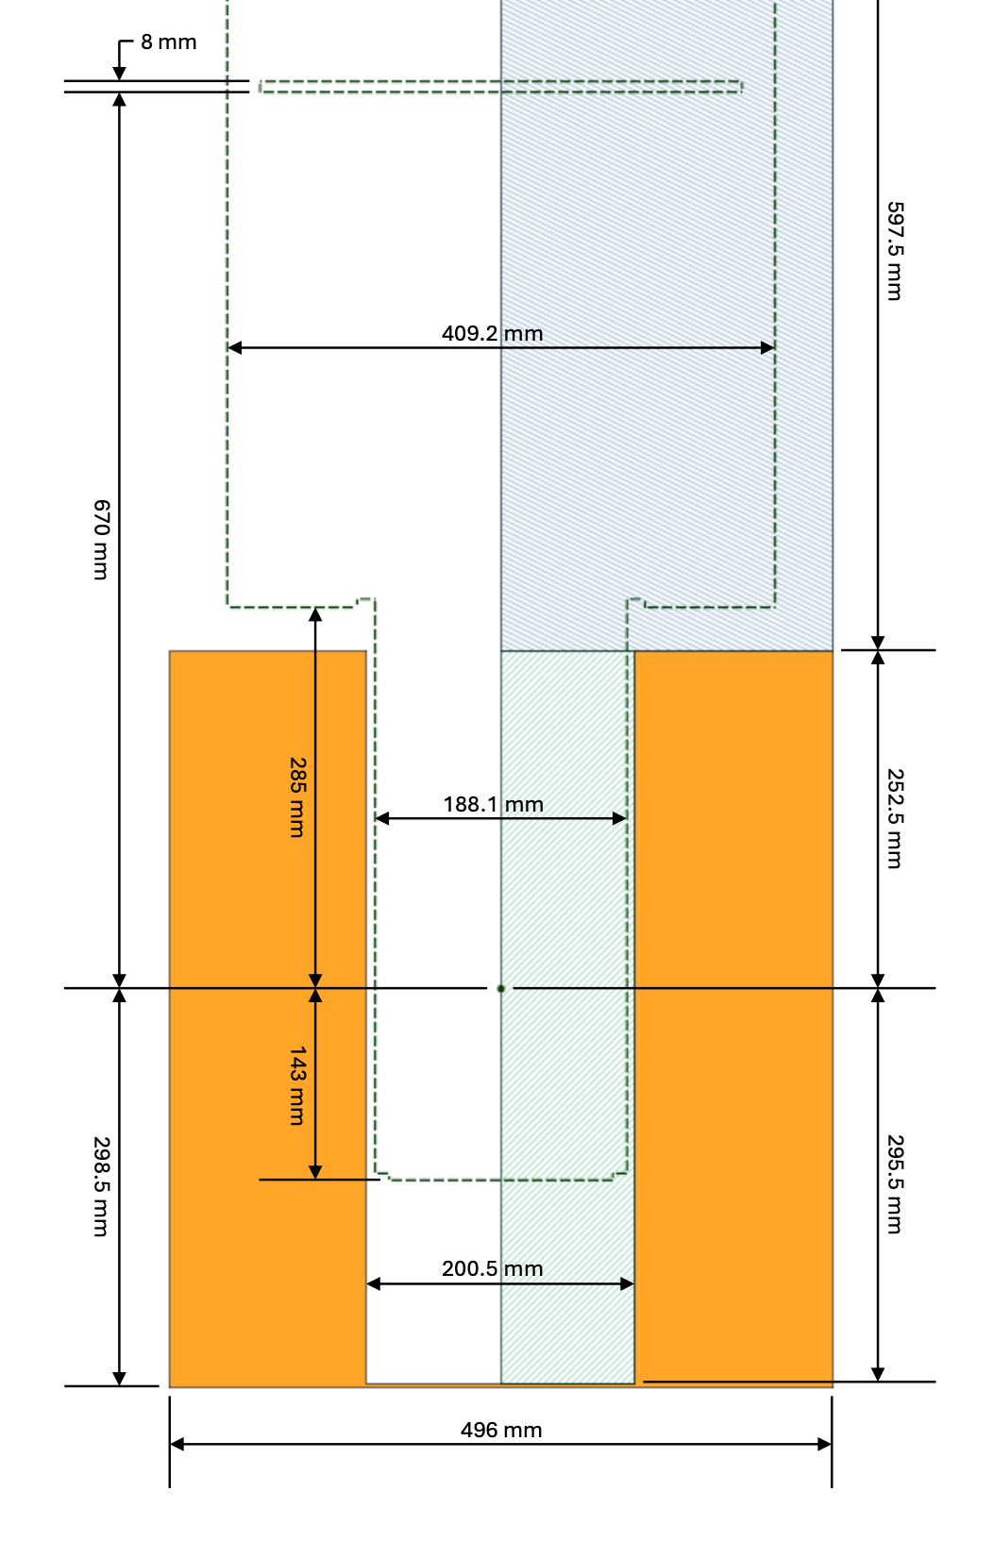
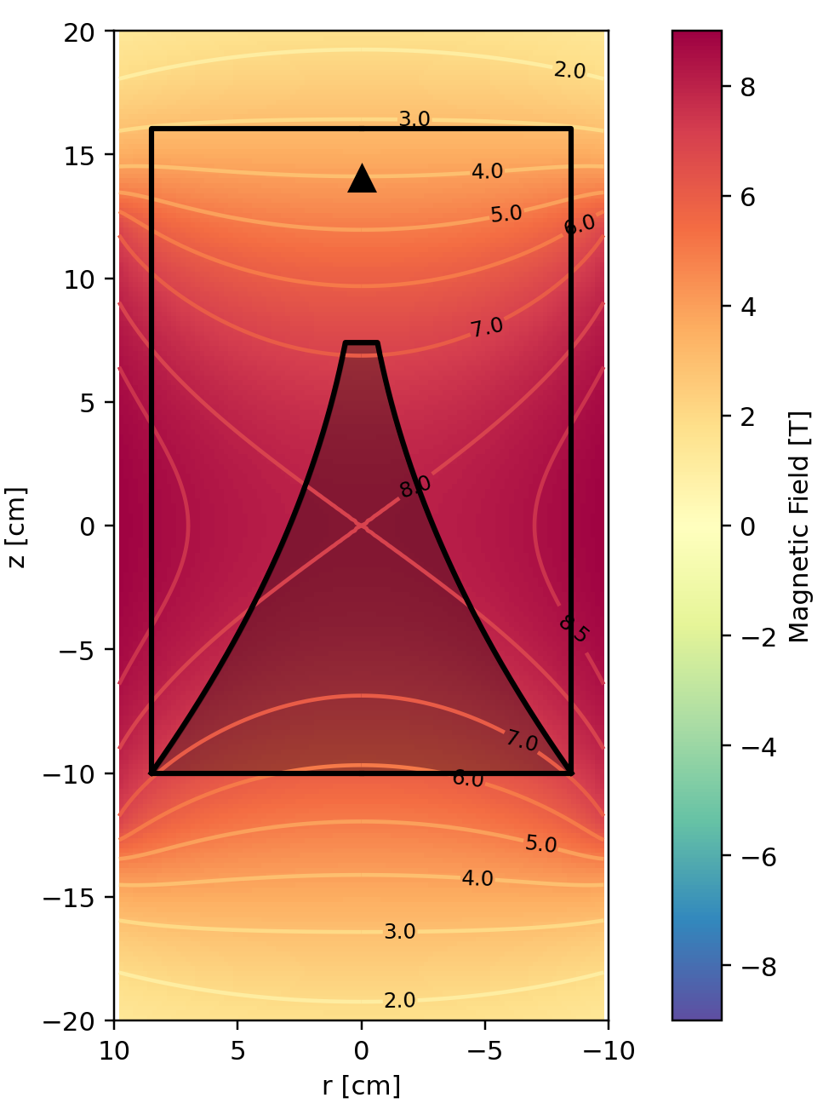
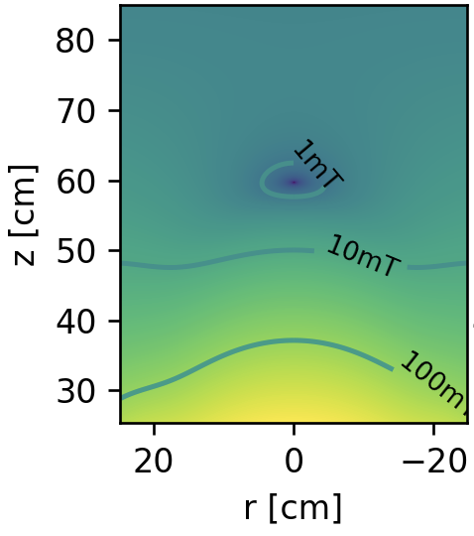
Dil. Fridge + 8T Magnet
Introduction
First Results
Outlook
Conclusion
High Field Region for Axion Conversion
Low Field Region for Detectors
compensated
arrives winter 25/26
will enable axion searches at Harvard
ProteoxMX from Oxford Instruments

Slide 22
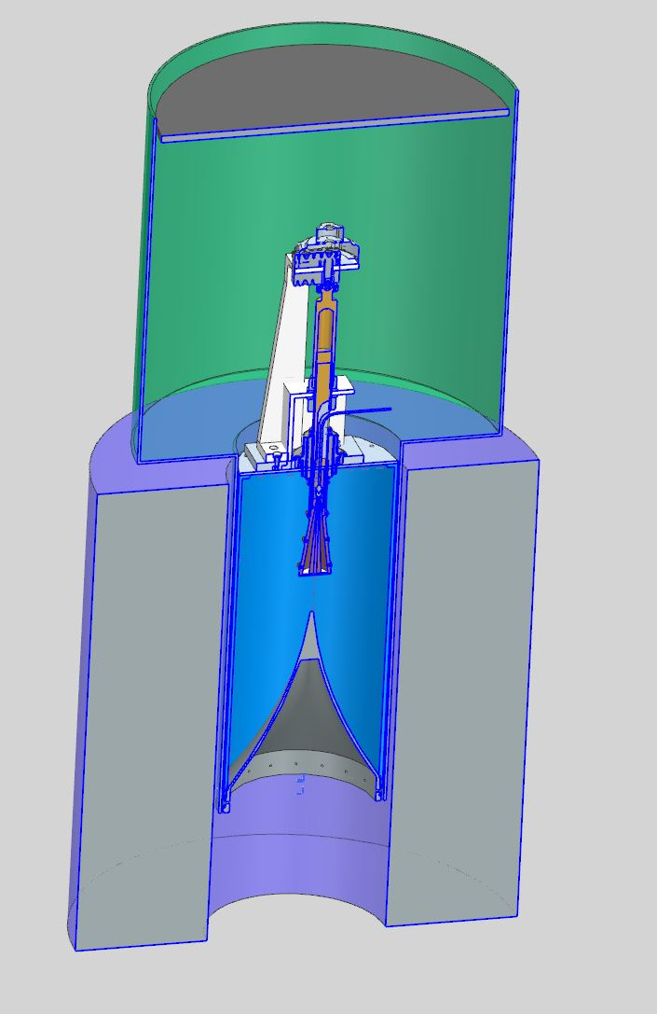
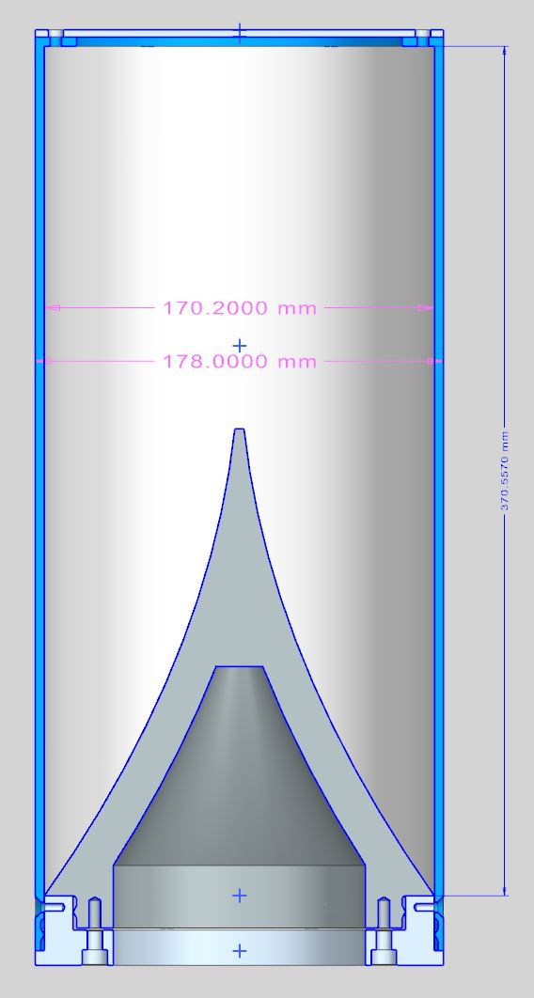
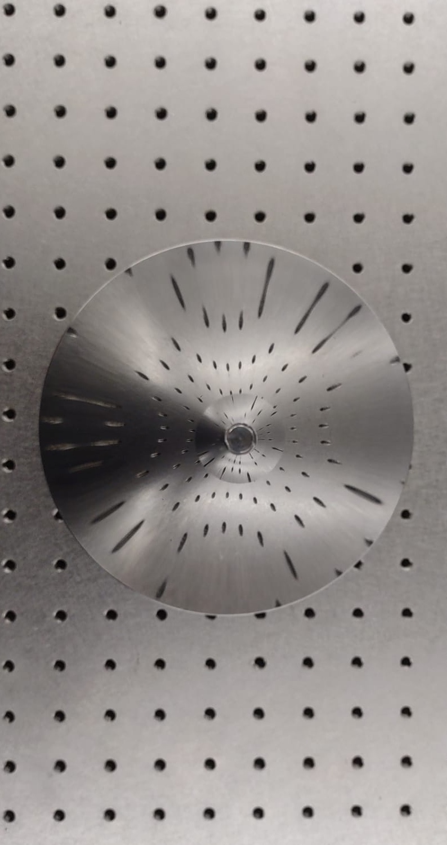
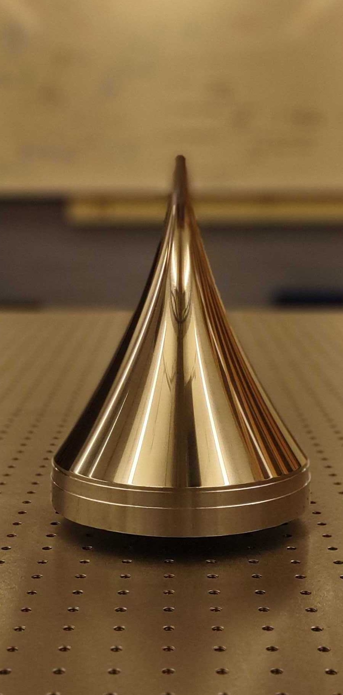
Small BREAD Reflector
Introduction
First Results
Outlook
Conclusion
Mixing Plate
Magnet

Slide 23
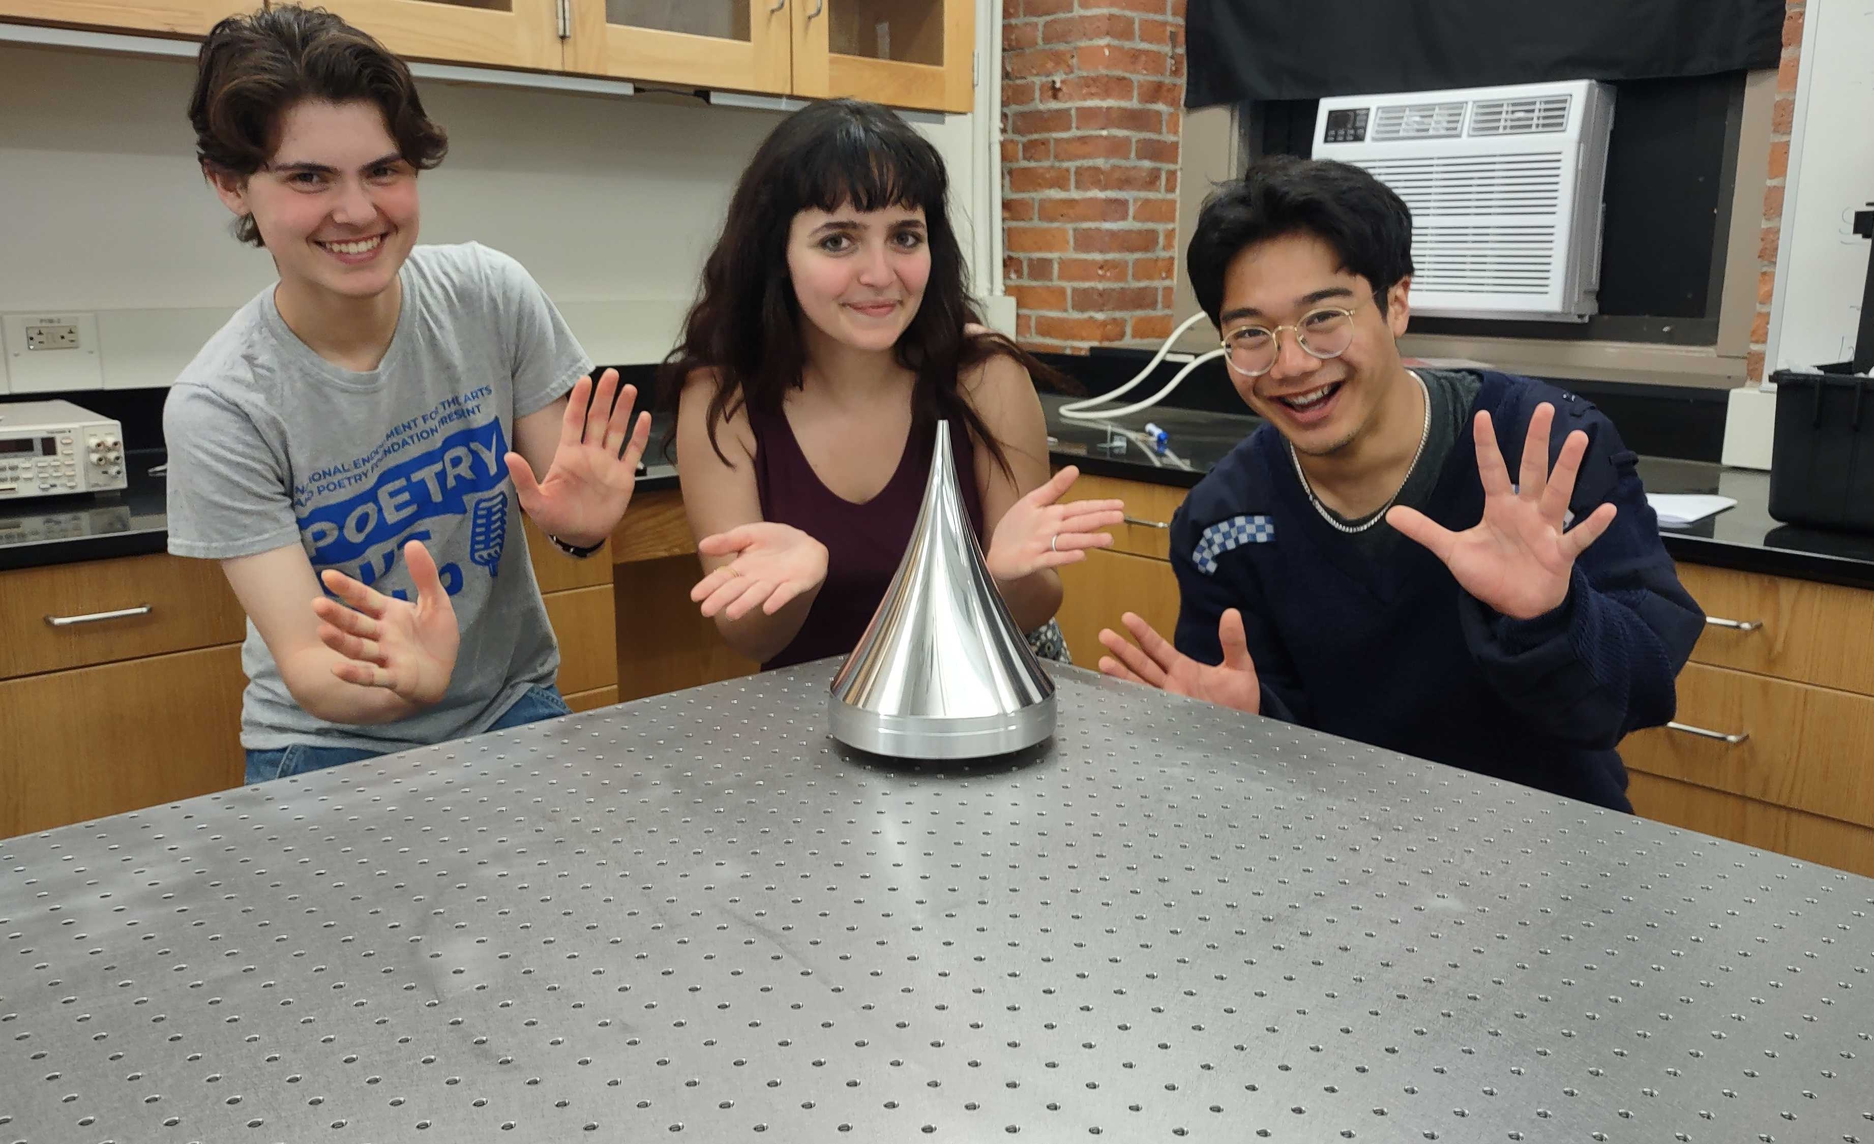
Small BREAD Reflector
Introduction
First Results
Outlook
Conclusion
Mixing Plate
Magnet

Slide 24

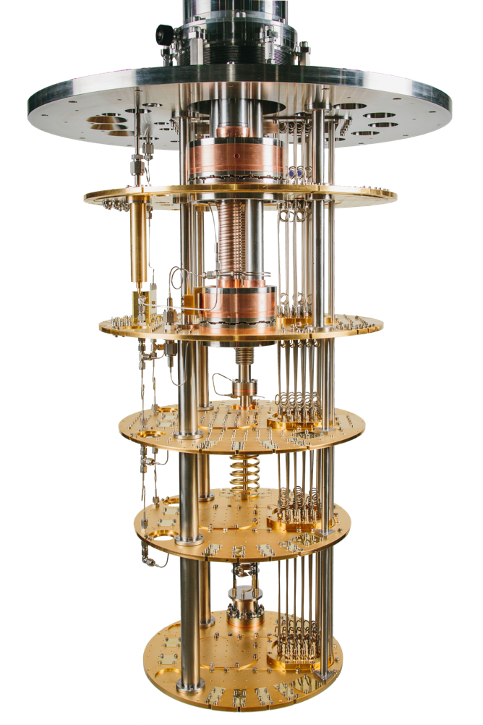
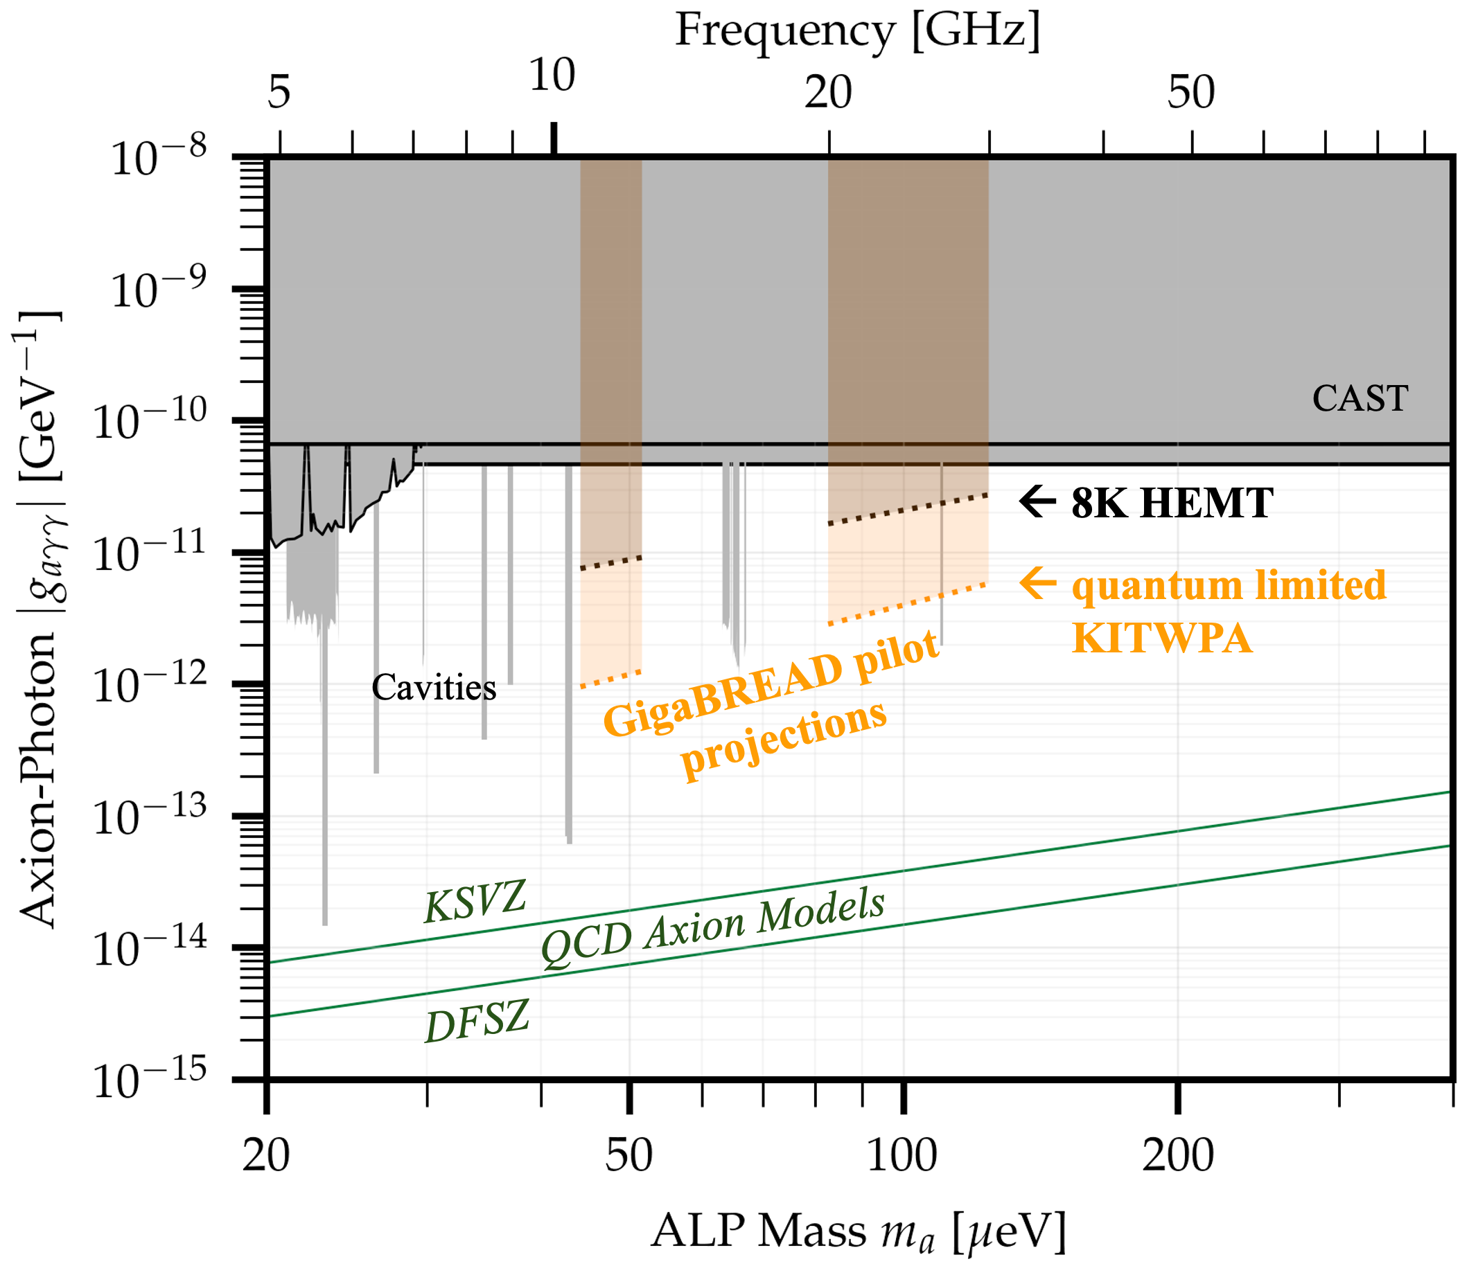
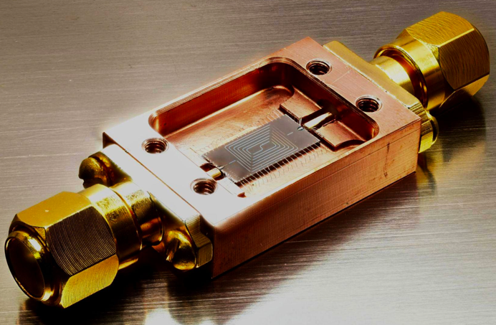

Quantum Limited GigaBREAD
from
+ DOE QuantiSED 2.0 funding
Introduction
First Results
Outlook
Conclusion
Quantum-Limited Readout
w/ KI-TWPA
Current
Result
CU Bolder/ NIST
+
Harvard
Magnet
[limit plot adapted from cajohare.github.io/axionlimits]

Slide 25
Sensitivity
Introduction
First Results
Outlook
Conclusion
[Liu et al (BREAD).,
arXiv:2111.12103, PRL 128 (2022) 131801]

Slide 26
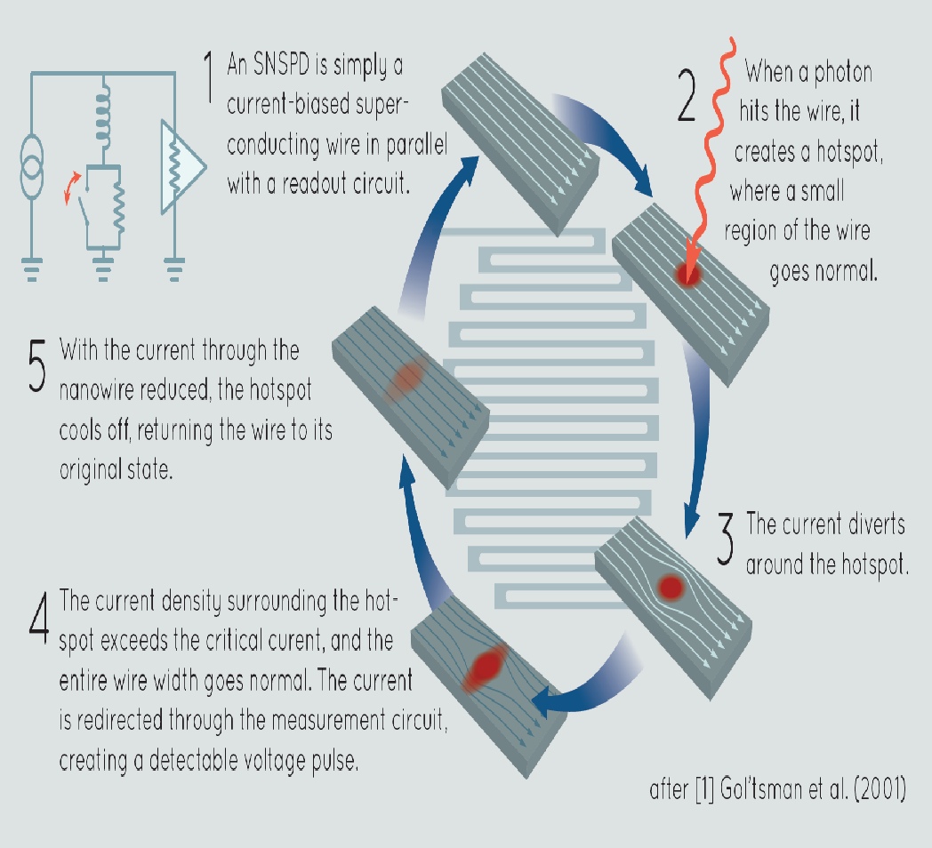
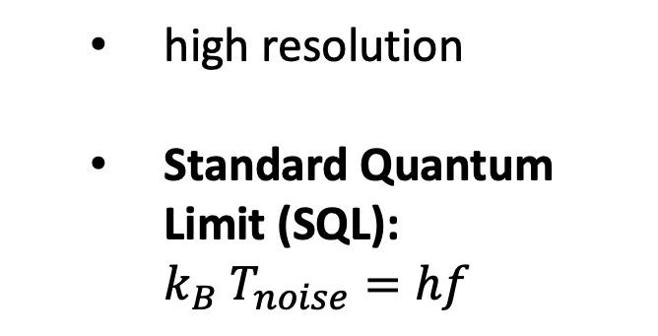
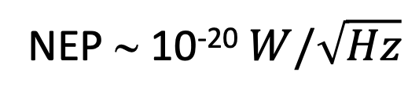
Lower Noise: Sensors
Introduction
First Results
Outlook
Conclusion
Heterodyne
Bolometer
Single Photon Counting
Power
P
~
Resistive
LO
Thermometer
absorber
FFT
[https://en.wikipedia.org/wiki/Bolometer]
Fig.: Sae Woo Nam (NIST)
RF
IF
Thermal Mass
Heat Capacity
C
  high resolution
  Standard Quantum Limit (SQL): ${k_{B} T}_{noise}=hf$
Temparature
T
Thermal
e.g., nanowire detectors
Conductance
G
down to ~ 1 photon/day
Thermal Reservoir
NEP ∼ 10⁻²⁰ $W/\sqrt{Hz}$

Slide 27


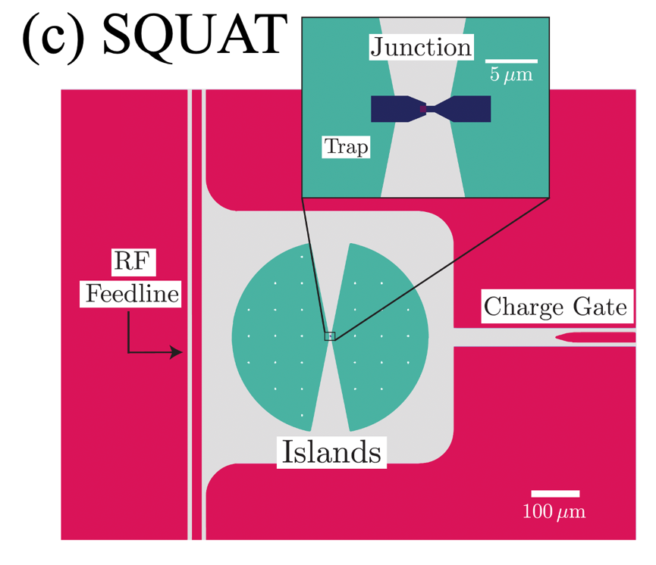
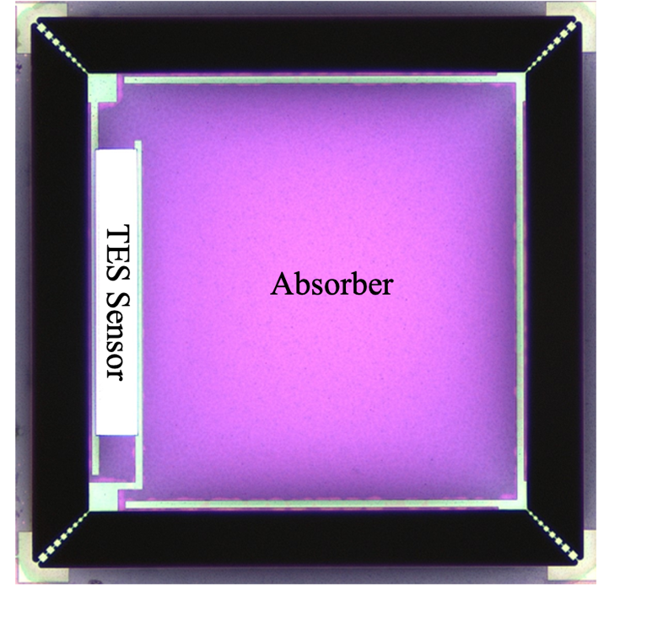
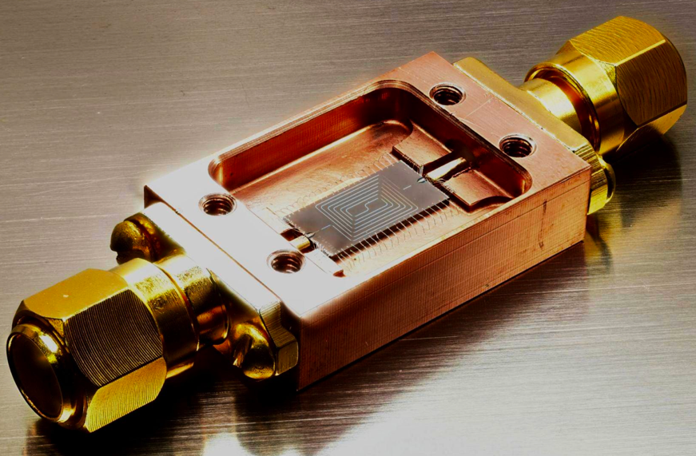







Lower Noise: Sensors (Examples)
Introduction
First Results
Outlook
Conclusion
Heterodyne
Bolometer
Single Photon Counting
TWPA
TES
SQUAT (qbit)
SIS
MKID
WIXARD (Graphene)
& more!

Slide 28


Increase Signal: Fabry–Pérot + BREAD
Introduction
First Results
Outlook
Conclusion
Focus Mirror
Proof-of-Concept Simulation
Electric Field log10 |$E|/E_{0}$
Outer Cylindrical Reflector
Inner Parabolic
Reflector
broadband comb of resonances
being built at FNAL

Slide 29






Increase Signal: Dielectrics
Introduction
First Results
Outlook
Conclusion
[A. Caldwell et al., PRL 118, 091801 (2017))]
[A. J. Millar et al., JCAP, 061 (2017)]
$$∼λ/2$$
Mirror
Receiver
$$P_{sig}={β^{2} × P}_{dish}$$

Slide 30

Increase Signal: Dielectrics
Introduction
First Results
Outlook
Conclusion
[A. Caldwell et al., PRL 118, 091801 (2017))]
[J. Egge et al. (MADMAX), arXiv:2408.02368, PRL 134, 151004 (2025)]
$$∼λ/2$$
Mirror
Dielectric Layers
Receiver
$$P_{sig}={β^{2} × P}_{dish}$$

Slide 31



Increase Signal: Dielectrics
Introduction
First Results
Outlook
Conclusion
[A. Caldwell et al., PRL 118, 091801 (2017))]
[J. Egge et al. (MADMAX), arXiv:2408.02368, PRL 134, 151004 (2025)]
$$∼λ/2$$
Mirror
Dielectric Layers
Receiver
prototype
(MAgnetized Disk and Mirror
Axion eXperiment)
$$P_{sig}={β^{2} × P}_{dish}$$

Slide 32






Increase Signal: Dielectrics
Introduction
First Results
Outlook
Conclusion
[A. Caldwell et al., PRL 118, 091801 (2017))]
20 cm
Sliced BREAD (Concepts)
1
2
$$∼λ/2$$
up →
20mK
sensor in low magnetic field
horn
antenna
8T solenoid magnet
Mirror
Dielectric Layers
Receiver
stack →
$$P_{sig}={β^{2} × P}_{dish}$$

Slide 33



Scale Up: Long Term Prospects
Introduction
First Results
Outlook
Conclusion
TeraBREAD Phase I
e.g., QualityBREAD
Astrophysical
TeraBREAD Phase II
$A=2m^{2}, B=9.4T$,
$$β^{2}∼100$$
off-the-shelf amplifiers
Other
Cavities
Full-Scale MADMAX
ADMX
ADMX
TeraBREAD Phase III
$A=7m^{2}, B=20T$,
$$β^{2}∼1,000$$
quantum limited amplifier
→ need large-scale facility

Slide 34











Scale Up: Large-Scale Facility
Introduction
First Results
Outlook
Conclusion

Slide 35


Introduction
First Results
Outlook
Conclusion
Broadband Reflector Experiment for Axion Detection (BREAD)
Pete Barry, Clarence Chang, Juliang Li, Argonne National Laboratory
Chiara Salemi, UC Berkeley
Christina Wang, Caltech
Jesse Liu, University of Cambridge
Kristin Dona, Gabe Hoshino, Alex Lapuente, David Miller, Max Olberding, University of Chicago
Daniel Bowring, Gustavo I Cancelo, Claudio Chavez, Aaron Chou, Mohamed Hassan, Samantha Lewis, Matthew Malaker, Cristian Pena, Andrew Sonnenschein, Leonardo Stefanazzi, Kevin Zvonarek, Fermilab
Rakshya Khatiwada, Fermilab and Illinois Institute of Technology
Stefan Knirck, Jasmine Palma, Steven Su, Jian Wang-Munoz, Harvard University
Gianpaolo Carosi, Lawrence Livermore National Laboratory
Karl Berggren, Dip Joti Paul, Tony (Xu) Zhou, Massachusetts Institute of Technology
Omid Noroozian, NASA Goddard Space Flight Center
Sae Woo Nam, National Institute of Standards and Technology
Noah Kurinsky,, SLAC
Special Thanks to: Peter Winter, Simon Corrodi, Argonne National Laboratory, Muon g-2
This work was supported by the Fermi Research Alliance, LLC under Contract No. DE-AC02-07CH11359 with the U.S. Department of Energy, Office of Science, Office of High Energy Physics.

Slide 36




Conclusion
Introduction
First Results
Outlook
Conclusion
Thank you very much!

