Slide 1
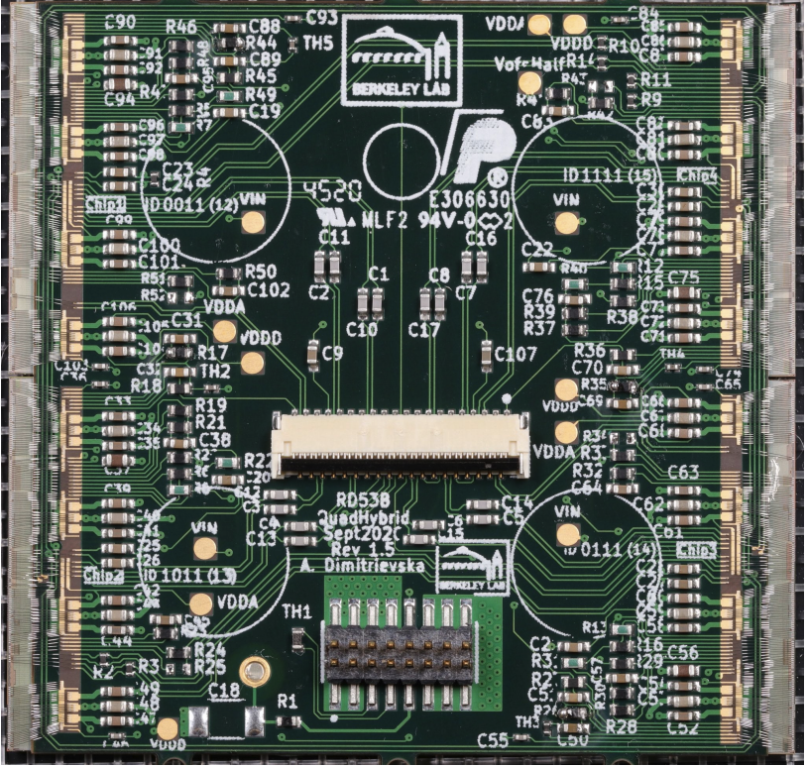
Week 3: Detector readout chips
Undergraduate reading group
Luc Le Pottier, Maria Mironova
February 11th, 2025

Slide 2
Introduction
What do you already know about “readout chips”?
What do you want to know?
…

Slide 3
What do you want to know?
As always, fill out this form: https://tinyurl.com/lblatlasrg
Also linked on the Indico!

